Slide 1
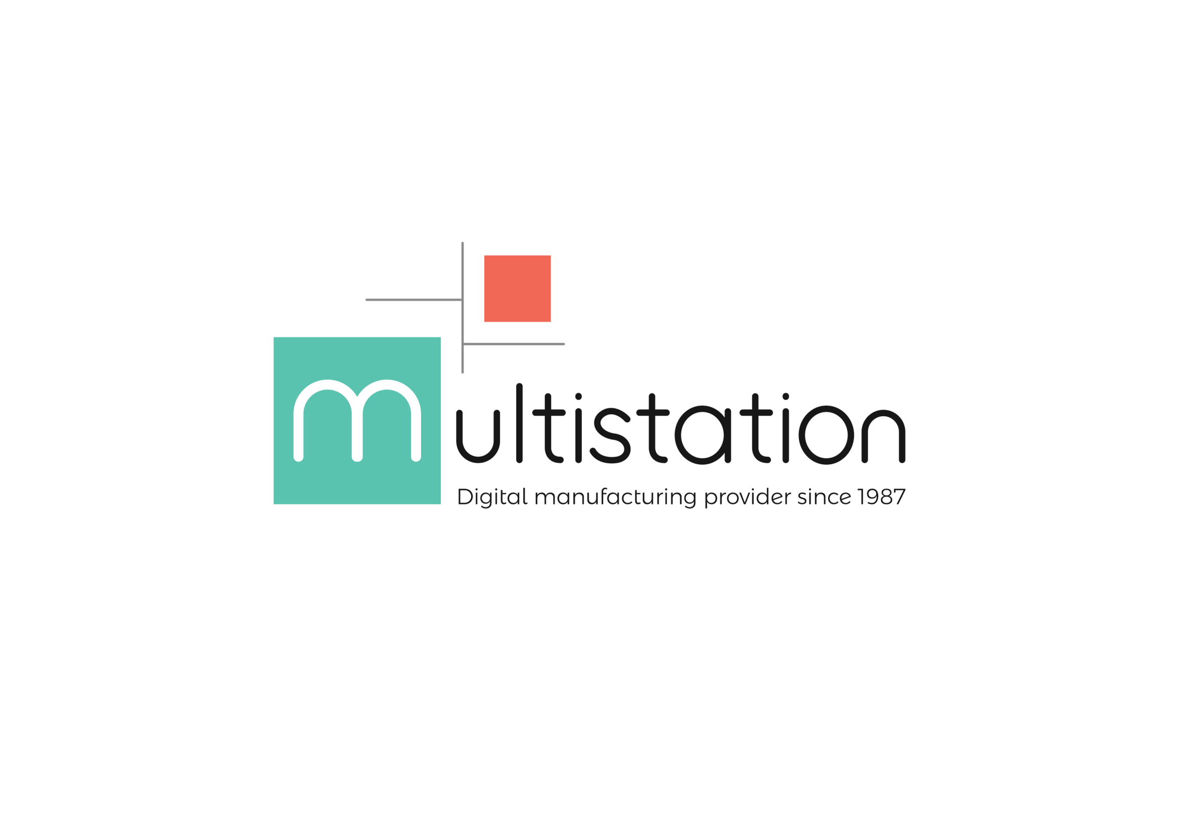
Independent provider of disruptive
and advance digital manufacturing
services and devices since 1987
Company Overview
Colloque fabrication additive Physique des deux infinis – 13 Décembre 2018

Slide 2
Introduction
Multistation, founded in 1987, provides its customers with expertise in digital and additive manufacturing. We provide them with software, material, machines and engineering services
Multistation assists its customers during the integration of digital manufacturing technologies
Colloque fabrication additive Physique des deux infinis – 13 Décembre 2018
Digital. Manufacturing. Solutions.

Slide 3
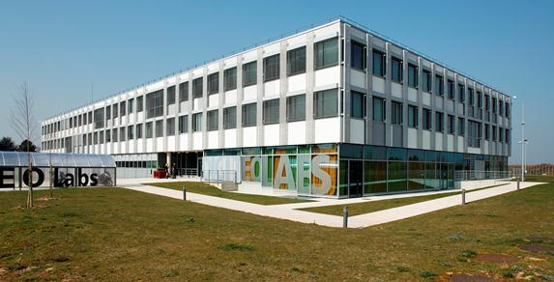
Organization
Multistation is organised in 4 divisions:
Digital manufacturing : complex machine tools and heavy machines
Additive Manufacturing: metal, ceramic and polymers
Additive Consulting & Services
Multistation Second Life, a marketplace for « certified pre-owned machines »
We have offices in France in the cities of Paris, Dinard and Saclay
Colloque fabrication additive Physique des deux infinis – 13 Décembre 2018
Digital. Manufacturing. Solutions.

Slide 4
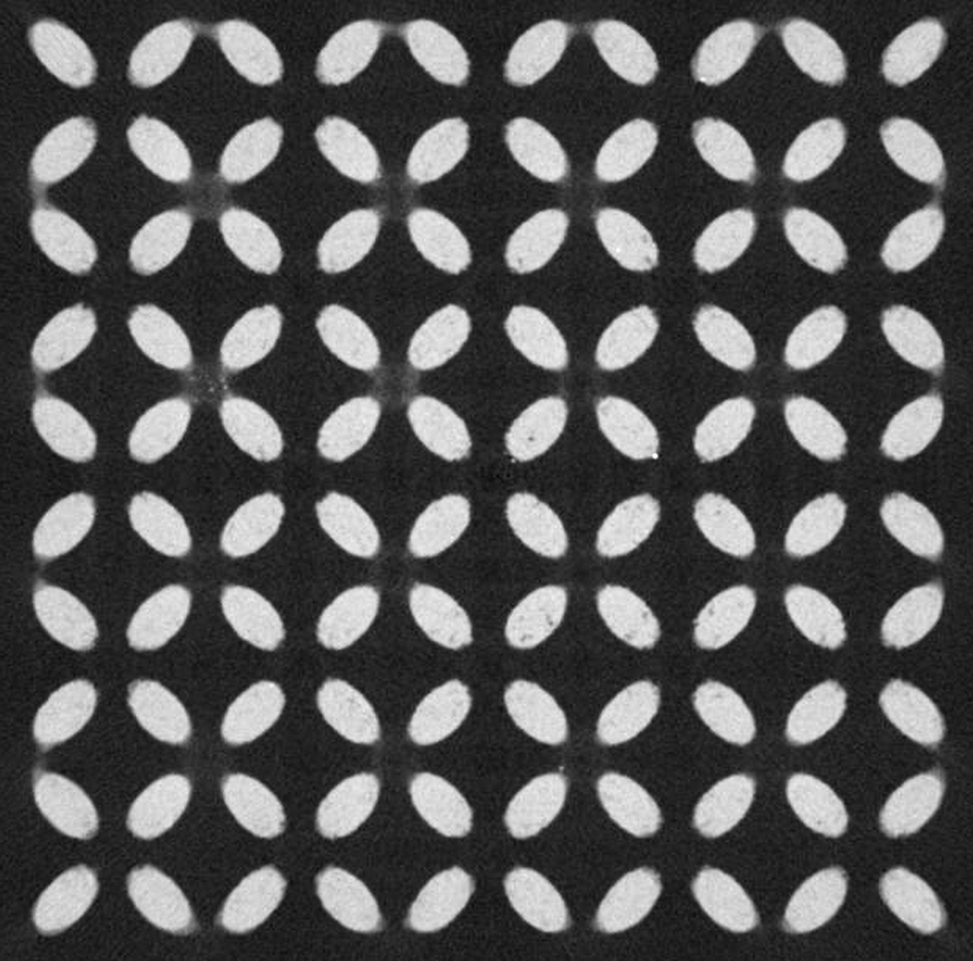
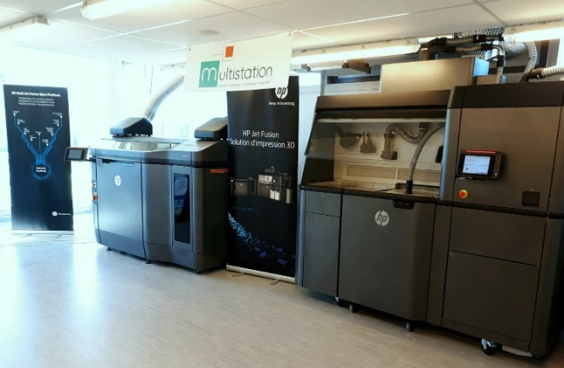
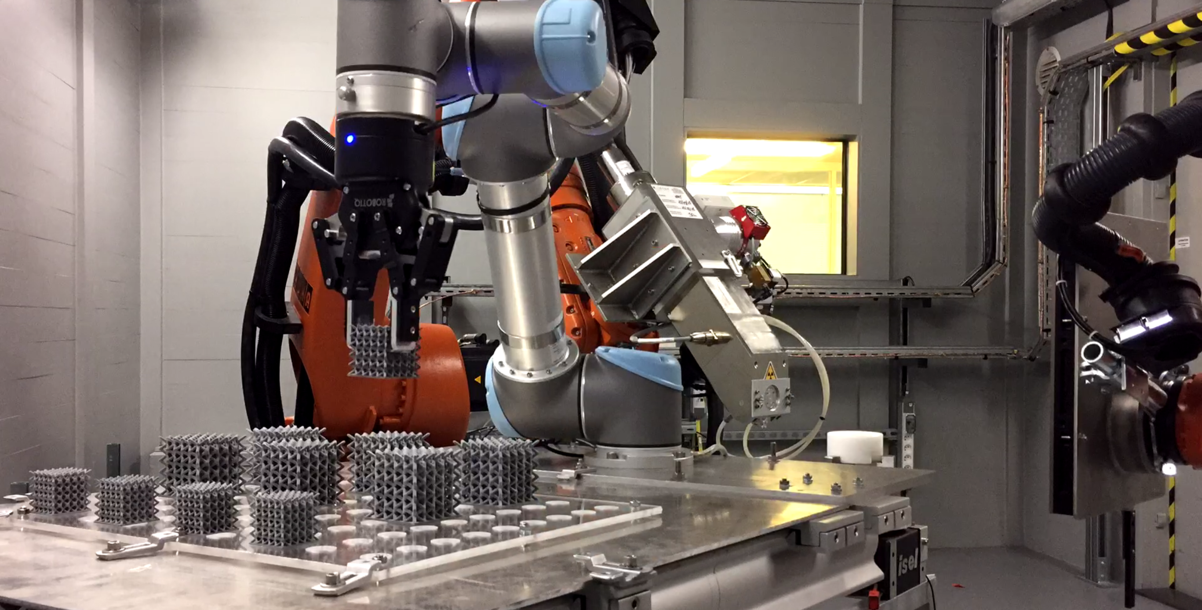
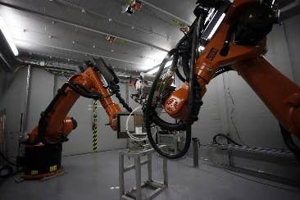
We are partners with CEA TECH in the heart of the Additive Factory Hub
Our facilities in Paris Saclay:
A demonstration centre for AM technologies
Procurement of engineering services (DFAM, 3D Scanning…)
Collaboration on R&D projects, such as tomography automatization on lattice structures
Colloque fabrication additive Physique des deux infinis – 13 Décembre 2018
Digital. Manufacturing. Solutions.

Slide 5
Our customers
Our customers base includes companies renowned worldwide
Colloque fabrication additive Physique des deux infinis – 13 Décembre 2018
Digital. Manufacturing. Solutions.

Slide 6
Additive Manufacturing
ADDITIVE MANUFACTURING
We provide our customers with various state of the art 3D printing technologies
Colloque fabrication additive Physique des deux infinis – 13 Décembre 2018
Digital. Manufacturing. Solutions.

Slide 7
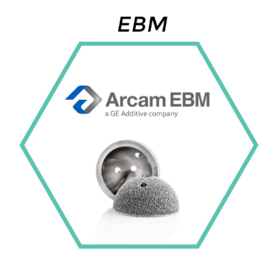
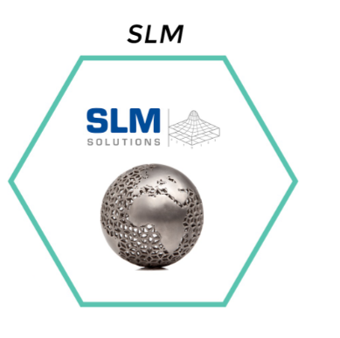
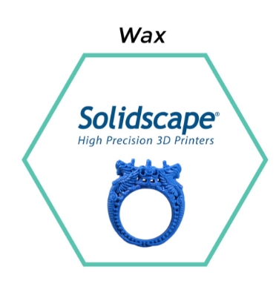
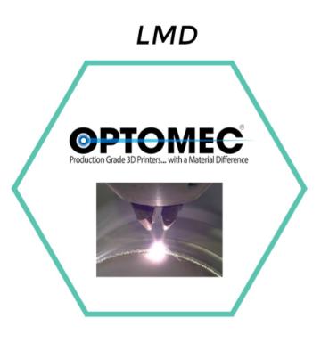
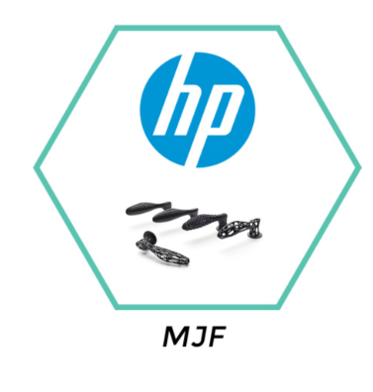
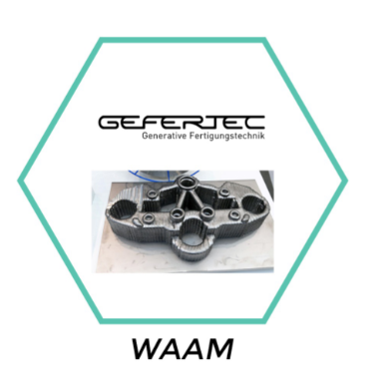
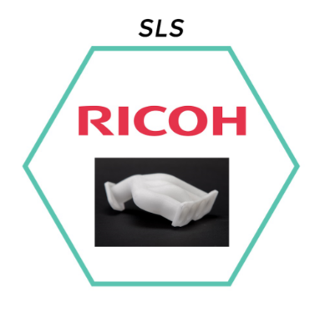
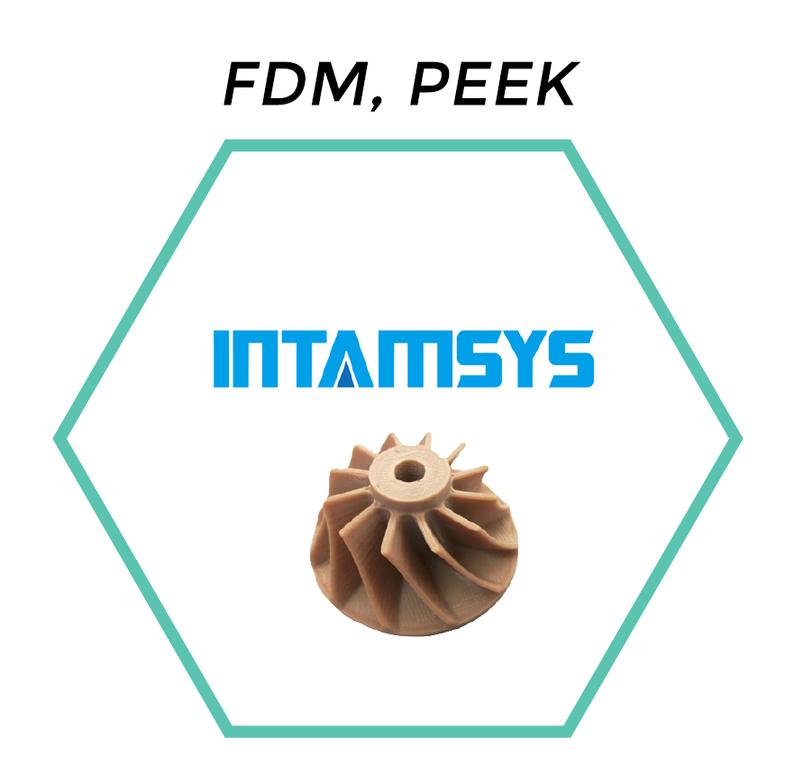
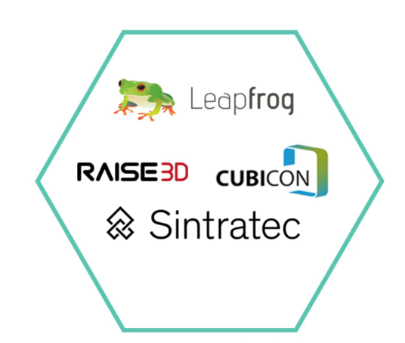
Additive Manufacturing, Partners of Excellence
Metal A.M. vs Machine Tools
Polymer A.M. vs Injection molding or CNC or Hand Prototyping
Fablab vs Handcrafting
Colloque fabrication additive Physique des deux infinis – 13 Décembre 2018
HP Meeting – 10/07/2018

Slide 8
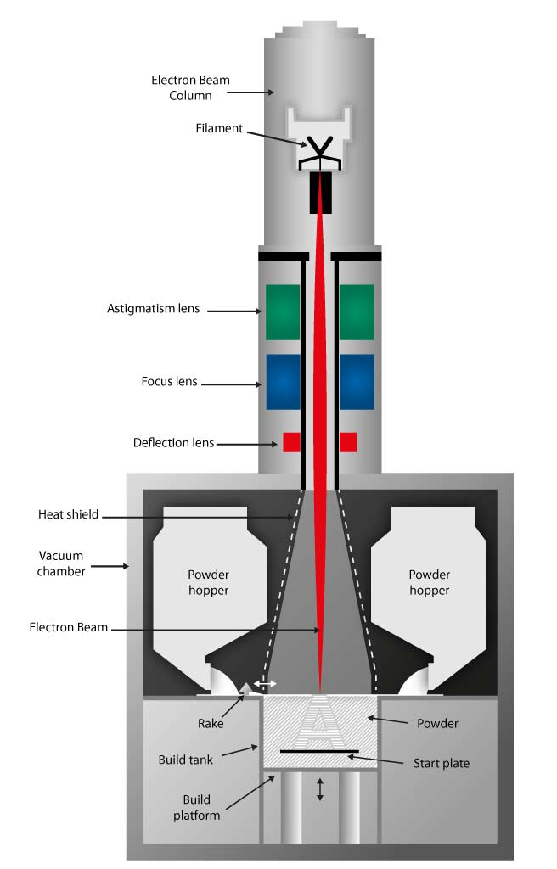
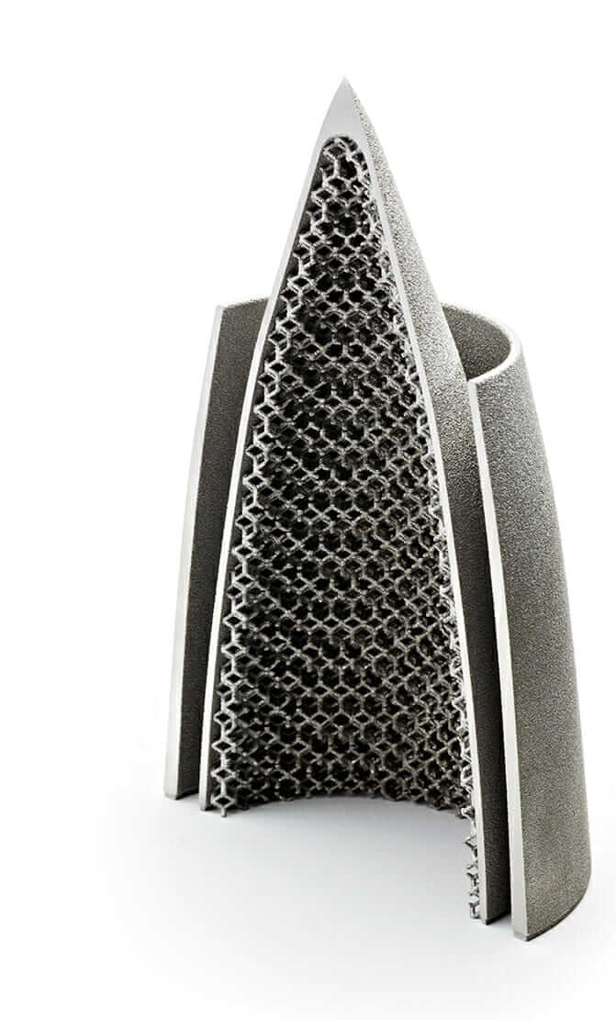
Electron Beam Melting (EBM)
Selective electron beam fusion on powder bed
Materials:
Ti6Al4V / Ti6Al4V ELI / Ti grade 2
IN718
CoCr
Application:
Production of small / medium size parts and for prototyping or small series
Complex forms (topology optimization, lattices structures, cooling channels)
Colloque fabrication additive Physique des deux infinis – 13 Décembre 2018

Slide 9
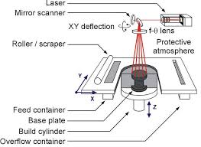
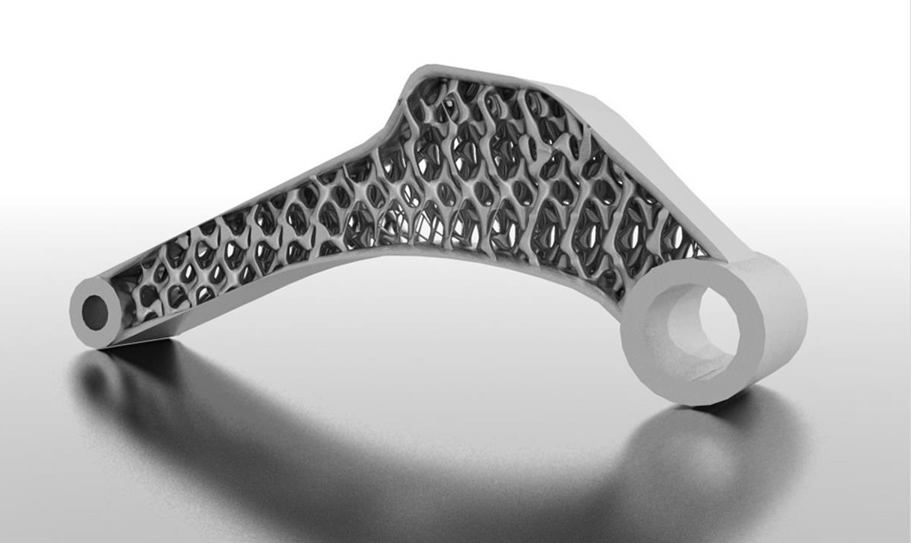
Selective Laser Melting (SLM)
Selective laser beam fusion on powder bed
Materials:
AlSi10Mg / AlSi7Mg
17-4 PH / 316L
IN718
TI6Al4V
CoCr
Application:
Production of small / medium size parts and for prototyping or small series
Complex forms (topology optimization, lattices structures, cooling channels)
Colloque fabrication additive Physique des deux infinis – 13 Décembre 2018

Slide 10
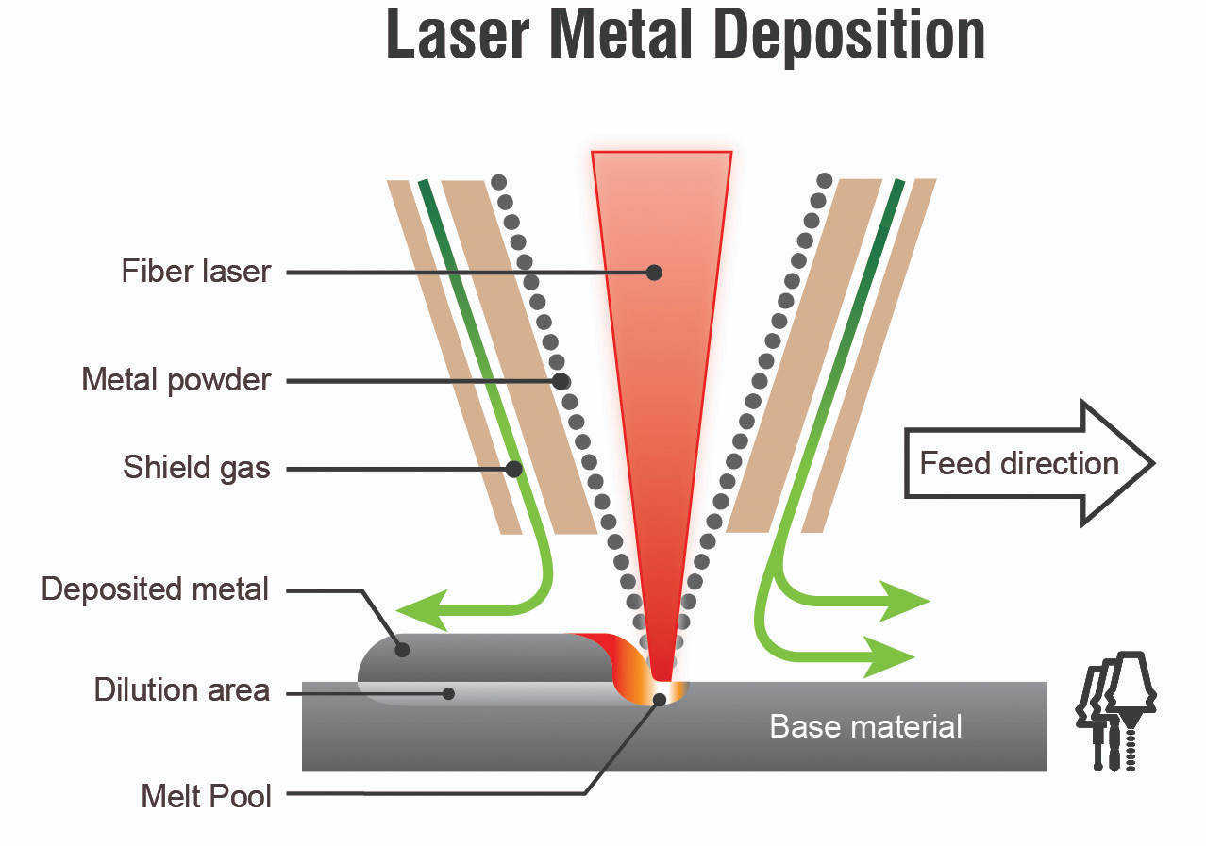
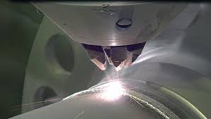
Laser Metal Deposition (LMD)
Recharging by powder projection melted by laser beam
Materials:
AlSi10Mg / AlSi7Mg
17-4 PH / 316L
IN718
TI6Al4V
CoCr
Application:
Part reparation
Coating
Multi material part
Colloque fabrication additive Physique des deux infinis – 13 Décembre 2018

Slide 11
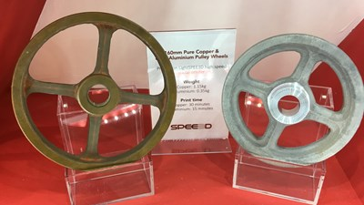
Cold Spray
High velocity powder projection
Materials:
Aluminium
Stainless steel
Nickel
Titanium
Copper
Application:
Coating
Part reparation
Pure copper parts
Adding functionality
Multi material part
Colloque fabrication additive Physique des deux infinis – 13 Décembre 2018

Slide 12
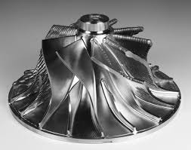
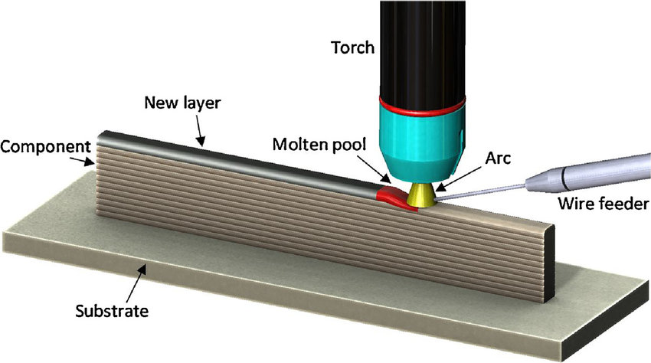
Wire Arc Additive Manufacturing (WAAM)
Additive manufacturing by deposition of metallic wire melted by electric arc
Materials:
IN718
AL99,5 Ti
Ti6Al4V
1.2343 (tool steel)
2.0921 (cupper basis)
Application:
Preform for high dimensions parts
Adding functionality
Multi material part
Colloque fabrication additive Physique des deux infinis – 13 Décembre 2018

Slide 13
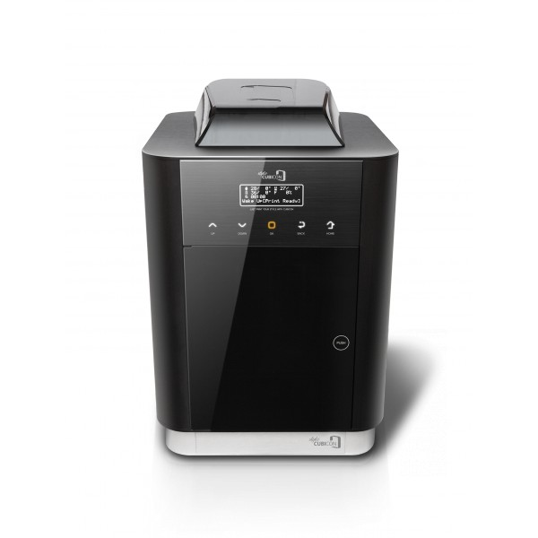
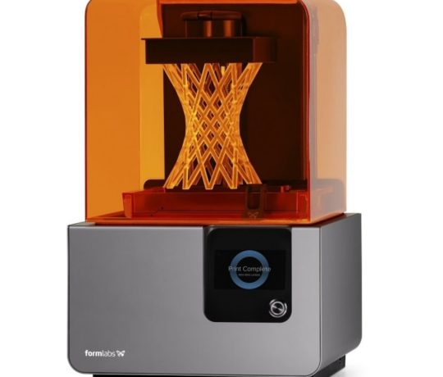
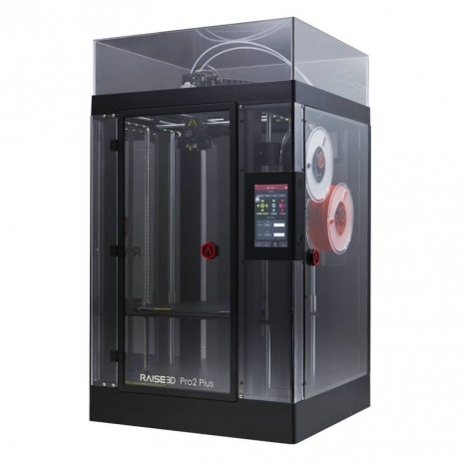
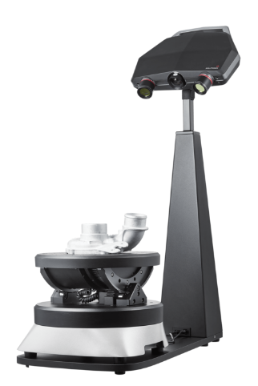
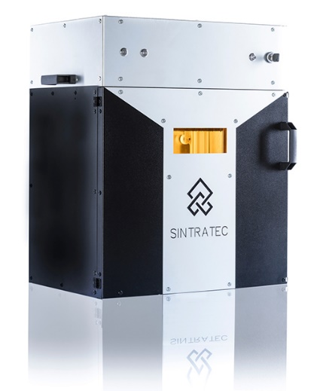
Additive Manufacturing, Microfactories
3D equipment for education, fablabs and designers
3D printing processes: FDM,SLA, SLS
3D Scanners
Laser cutting machines
Table milling
Vacuum casting
Thermoforming
…
Multistation provides proven equipment for rapid prototyping
Colloque fabrication additive Physique des deux infinis – 13 Décembre 2018
Digital. Manufacturing. Solutions.

Slide 14
Additive Consulting and Services
ADDITIVE CONSULTING
AND SERVICES
Colloque fabrication additive Physique des deux infinis – 13 Décembre 2018
Digital. Manufacturing. Solutions.

Slide 15
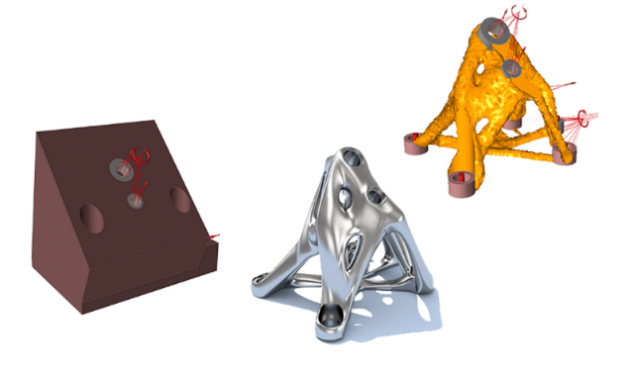
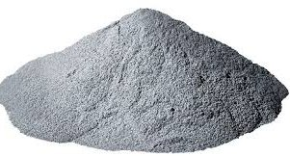
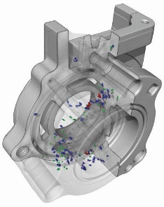
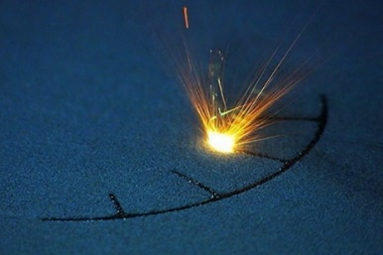
Additive Consulting and Services
The Multistation expertise covers the whole additive manufacturing value chain:
Design for Additive Manufacturing and Digital Chain
Metal powders
Manufacturing
Post treatments
Quality control
ERP
Colloque fabrication additive Physique des deux infinis – 13 Décembre 2018
Digital. Manufacturing. Solutions.

Slide 16
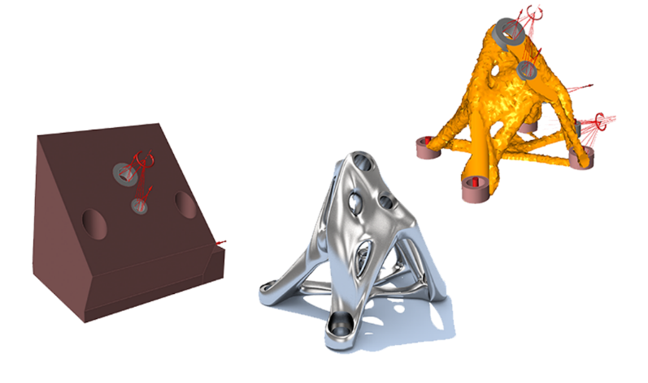
Design for Additive Manufacturing
Definition of the digital chain
Design rules
Process simulation
3D scan, reverse engineering
Topological optimization, lattices structures
Multistation established partnerships with Materialise, Ansys, Altair, Siemens NX…
Colloque fabrication additive Physique des deux infinis – 13 Décembre 2018
Digital. Manufacturing. Solutions.

Slide 17
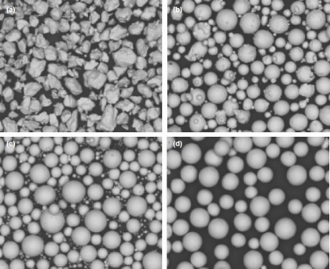
Metal powders
Powder characterisation
Qualification
Parameters development
Health, Safety and Environnement
We select and qualify the best metal powders
Colloque fabrication additive Physique des deux infinis – 13 Décembre 2018
Digital. Manufacturing. Solutions.

Slide 18
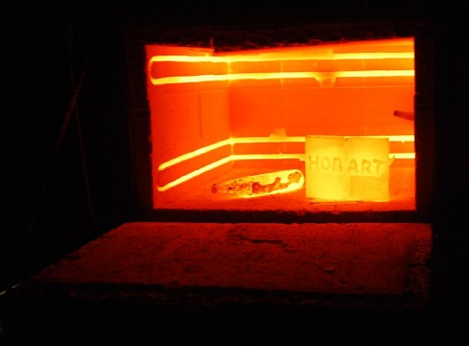
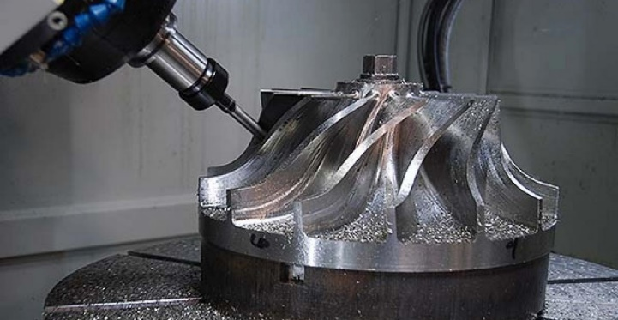
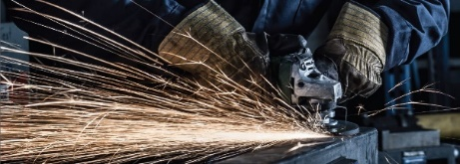
Post treatments
Machining
HIP treatments
Grinding, laser polishing
Stress release
We select the most appropriate post-treatments depending on the part criticity
Colloque fabrication additive Physique des deux infinis – 13 Décembre 2018
Digital. Manufacturing. Solutions.

Slide 19
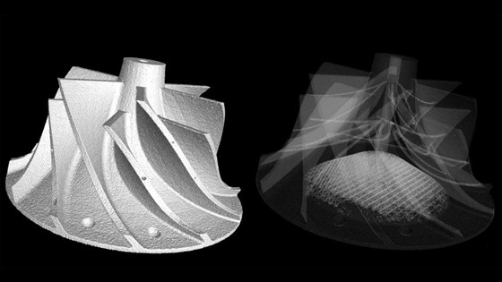
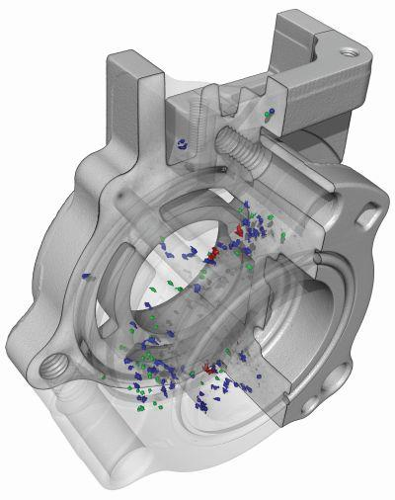
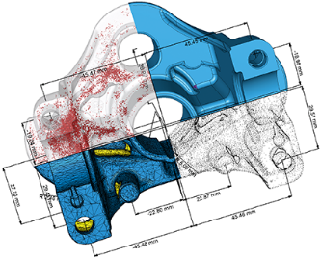
Control – Non Destructive Testing
Control definition
Tomography
Dimensional control
Porosities and internal defects
We ensure that the parts are free of porosities or defects
Colloque fabrication additive Physique des deux infinis – 13 Décembre 2018
Digital. Manufacturing. Solutions.

Slide 20
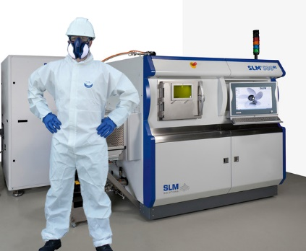
Health, Safety and Environnement
Standards and best practices
Audits, aerological measurements
Personnel training
Multistation protects the workforce against new HSE threats
Colloque fabrication additive Physique des deux infinis – 13 Décembre 2018
Digital. Manufacturing. Solutions.

Slide 21
Additive Explorative Partnership
Project definition:
Part screening, use case identification
Proof of concept realisation
A customized support for a successful implementation:
Machine leasing, delivery and installation
Users training and support
Functional guarantee
Explore, engage, evolve and succeed
ADDITIVE EXPLORATIVE PARTNERSHIP
Flexible pre-buy experience
Initial modular full service rental
Flexible machine rental:
Flexible rental with decreasing rate
No commitment of duration
Support from our application engineers and technicians included:
Design for additive manufacturing (DFAM)
Topological optimization, generation of lattices, process simulation…
3D scan, reverse engineering, dimensional control
Characterisation, qualification, storage and handling of powders
Computed tomography (CT)
Health, Safety and Environment (HSE)
…
Valid for any machine, for any price range (5k to 500k+)
The machine is not an asset but a commodity
Colloque fabrication additive Physique des deux infinis – 13 Décembre 2018
Digital. Manufacturing. Solutions.

Slide 22
ADDRESS
We support the implementation of additive manufacturing technologies
We realize or manufacture for you, in our facilities or with our network of partners
We train your personnel and give you the keys to success
66 boulevard Pasteur,
75015 Paris
PHONE
+33 2 99 16 35 35
E-MAIL
julien.ballesta@multistation.com
WEB SITE
www.multistation.com
Colloque fabrication additive Physique des deux infinis – 13 Décembre 2018
Digital. Manufacturing. Solutions.

