Slide 1

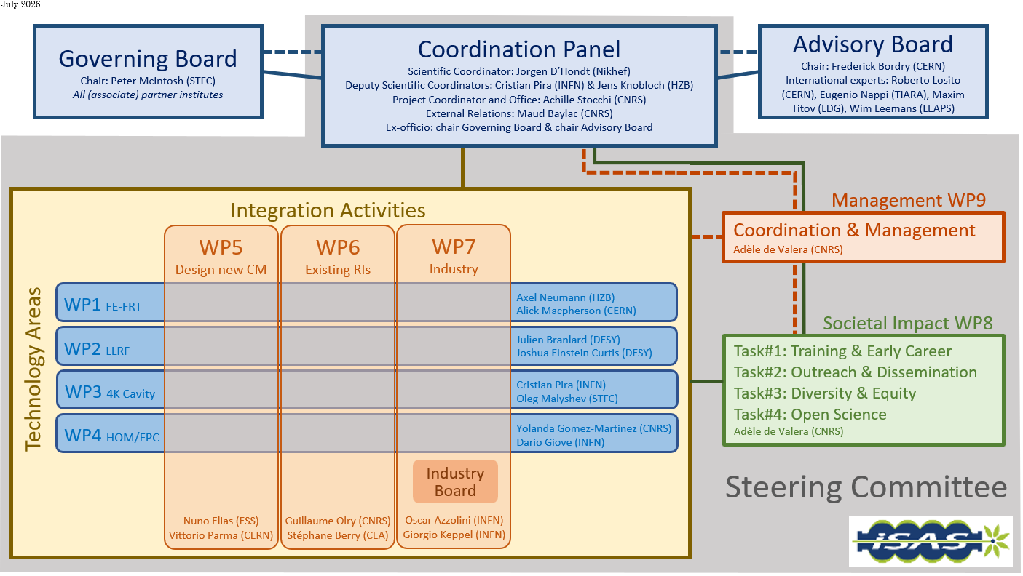

Instances (as formalised in the CA)
  Governing Board & Advisory Board Chairs ex-officio members of Coordination panel to better the communication between instances
  Advisory Board reports back to the Coordination panel for yearly project meetings and upon ad hoc request as counsel
  Coordination panel becomes Steering Committee every other meeting to allow for scientific cross-coordination between Coordination & WP Leaders as well as between WPs
  Industry Board including WP Leaders to enable co-development

Slide 2
Governing Board
Mandated: Peter McIntosh (Chairperson)
Jorgen D'Hondt (Ex-officio)
Adèle de Valera (Ex-officio)
Beneficiaries: Jérôme Schwindling (CEA)
Vittorio Parma (CERN)
Achille Stocchi (CNRS)
Hans Weise (DESY)
Nuno Elias (ESS)
Jens Knobloch (HZB)
Attilio Sequi (INFN)
Michael Tytgat (VUB)
Associated partners: Mike Seidel (EPFL)
Oleg Malyshev (UKRI)
Graeme Burt (University of Lancaster)
Tomas Junquera (ACS)
Alexei Kanareykin (Euclid Techlabs)
Alexander Navitski (Research Instruments)
Ambra Gresele (Zanon)
Coordination panel
Mandated: Achille Stocchi (Chairperson)
Jorgen D'Hondt (Scientific Coordinator)
Cristian Pira (Deputy Scientific Coordinator)
Jens Knobloch (Deputy Scientific Coordinator)
Maud Baylac (External Relations)
Peter McIntosh (Ex-officio)
Frederick Bordry (Ex-officio)
Adèle de Valera (Ex-officio)
Steering committee
Mandated: Coordination panel (Ex-officio)
Work packages: Axel Neumann & Alick MacPherson (WP1)
Julien Branlard & Joshua Einstein Curtis (WP2)
Cristian Pira & Oleg Malyshev (WP3)
Yolanda Gomez-Martinez & Dario Giove (WP4)
Nuno Elias & Vittorio Parma (WP5)
Guillaume Olry & Stéphane Berry (WP6)
Oscar Azzolini & Giorgio Keppel (WP7)
Adèle de Valera (WP8 & WP9)
Advisory Board
Mandated: Frederick Bordry (Chairperson)
Eugenio Nappi (TIARA)
Maxim Titov (LDG)
Roberto Losito (CERN)
Wim Leemans (LEAPS)

Slide 3
Industry Board
Led by WP7
Mandated: Oscar Azzolini (Chairperson)
By academic partners WP Leaders (Ex-officio)
By industrial partners: Arthur Iziquel (Accelerators and Cryogenic Systems)
Alexei Kanareykin (Euclid Techlabs)
Alexander Navitski (Research Instruments)
Ambra Gresele (Zanon Research & Innovation)

