Slide 1
ISAS task summary WP3 - CEA
Task 3.5:
Develop adaptive layers by Atomic layer deposition on Cu that are stable up to 650 °C.
Compare study of Nb₃Sn on Cu with and without adaptive layers on planar samples and QPR.
Milestones:
Developing high T adaptive layer on Cu. Milestone M3.5. Month 18
Comparative study of Nb3Sn on Cu with and without adaptive layer on planar samples and QPR. Deliverable D3.5. Month 38 – STFC
Preliminary results:
Layers stable up to 650°C have been developed on Nb, Si, Sapphire substrates
Layers stable up to 450°C (not tested at higher temperature) on a 1.3 GHz copper cavity.
A 1.3 GHz cavity dedicated ALD apparatus have been built and is operational for this project.

Slide 2
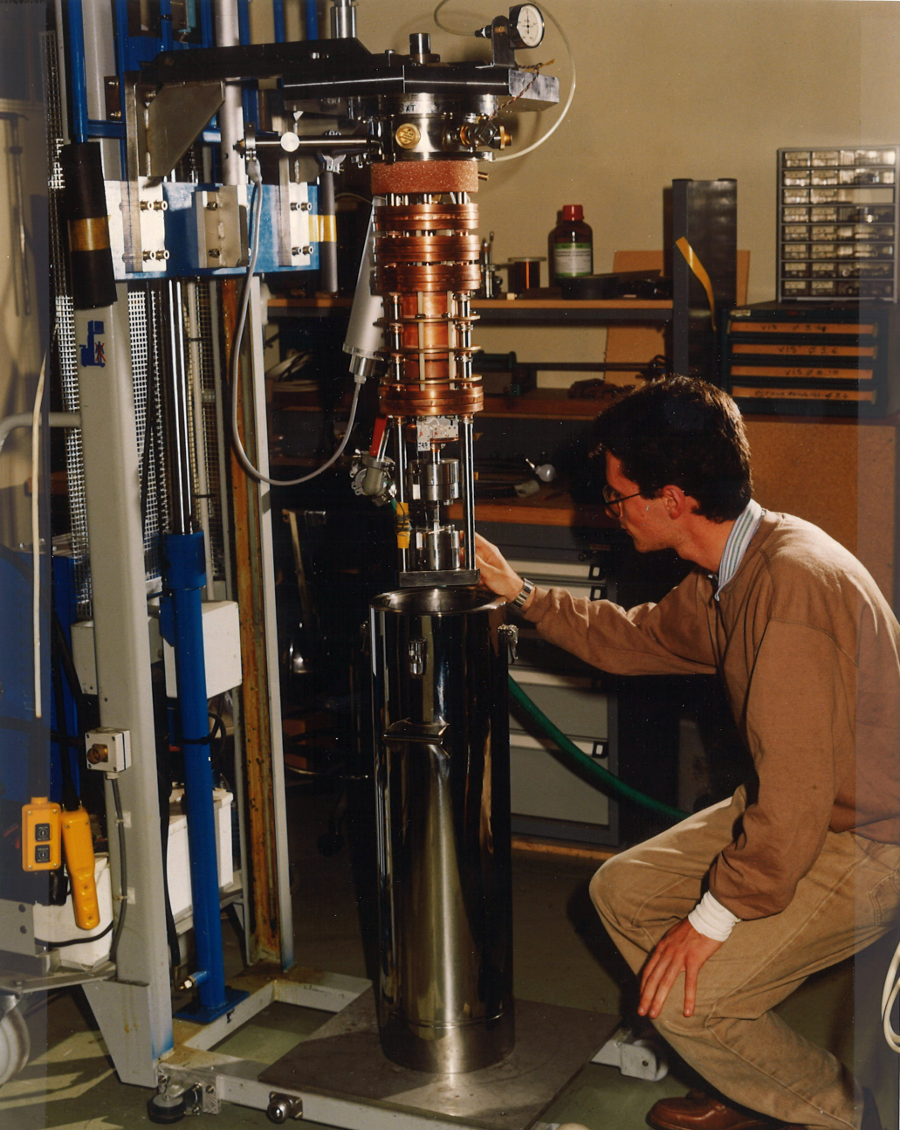
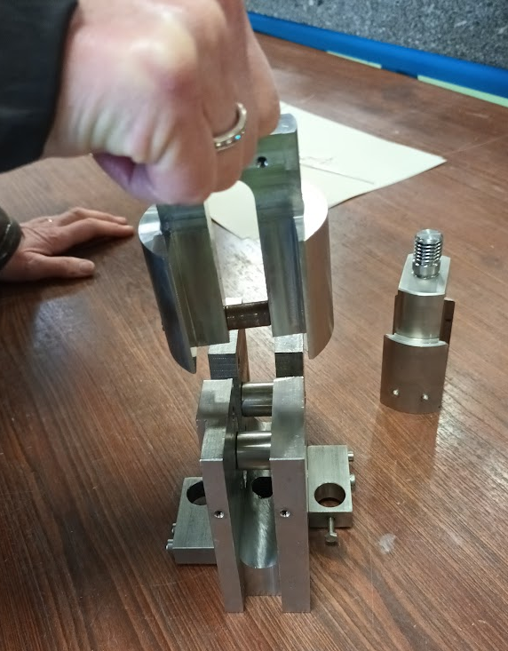
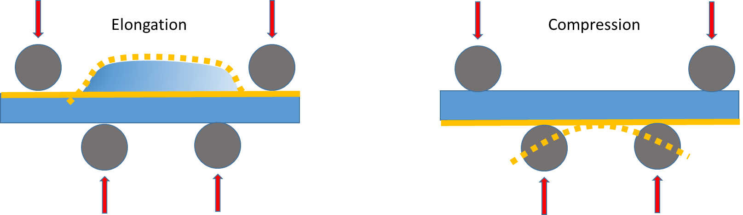
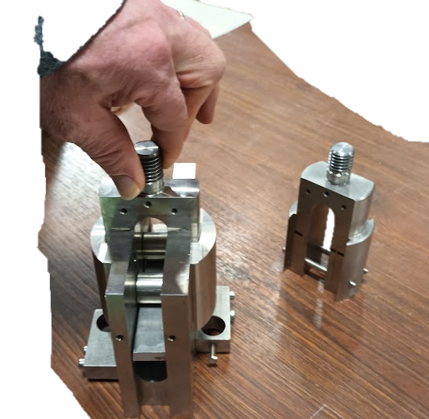
Flexture tests (in Task 3.3)
CEA can provide mechanical tests at room temperature or cryogenic temperature: 77 K (liquid nitrogen) and 4.2 K (liquid helium).
Among those tests, flexture tests are well adapted to study thin film behavior
An Instron electromechanical machine can be fitted with a cryostat with a traction and flexion capacity of 45 kN,
2 kinds of experiments are foreseen
Complete deformation to evaluate adhesion and mechanical resistance of the films
Progressive small deformations comparable to tuning deformation amplitudes to predict tunability limits
M3.3: Report on mechanical strength test of SC coatings (M30)

