Slide 1
HZB sample test cavity for investigating SRF materials
Felix Kramer
IFAST/ISAS Meeting
Berlin, 02 – 03 December 2024
RaSTA
Rapid Sample Test Apparatus

Slide 2
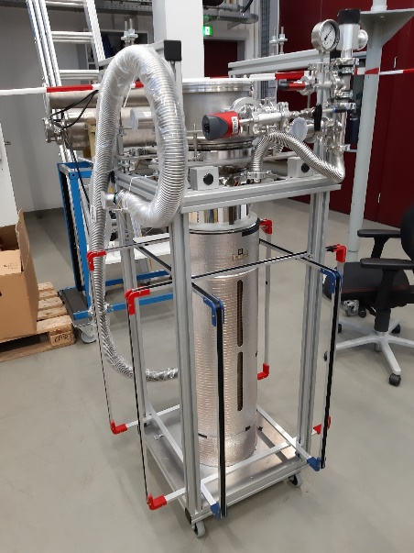
RaSTA: Pre-testing in less time
RastA
Quadrupole Resonator (QPR)
High quality measurements, but ≥ 2 weeks turnaround time
Turnaround time mostly set by infrastructure
Cleanroom work for sample preparation, pre-assembly and mounting
Vertical LHe cryostat, radiation protection measures
Wishlist for a new sample test cavity
Use QPR samples (comparability, calorimetric measurement)
Direct measurement of R_{BCS} and R_{res}
≥ 1 sample per week
Operation without radiation protection measures
Low RF field level only
Fit in “small” cryostat
Compact cavity
Increased frequency (compared to QPR)
→ RaSTA: Rapid Sample Test Apparatus

Slide 3
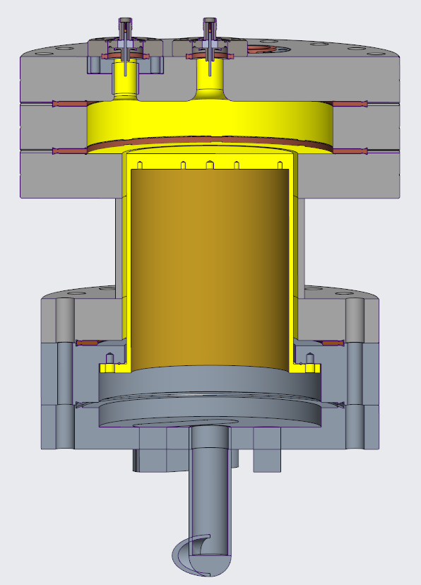
RaSTA: RF parameters
RaSTA
Pillbox-like cavity design
RF mode: TM₀₂₀ at 4.8 GHz
H-field: zero-crossing at coaxial gap
Direct measurement of R_{res} possible
Operation without radiation protection → Limit: 5 kV
B_{sample} = 8.5 mT
P_{sample} = 0.4 W
P_{total} = 35 W
German patent 10 2021 123 261
Temperature | Nb R_{BCS} | Nb₃Sn R_{BCS}
4.2 K | 7300 nΩ | ≈ 100 nΩ
1.8 K | 62 nΩ | << 1 nΩ
1.5 K | 10 nΩ | << 1 nΩ

Slide 4
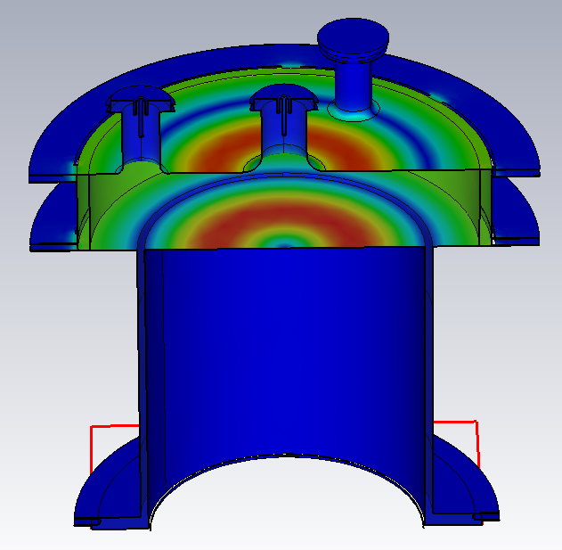
RaSTA: RF parameters
RaSTA
Pillbox-like cavity design
RF mode: TM₀₂₀ at 4.8 GHz
H-field: zero-crossing at coaxial gap
Direct measurement of R_{res} possible
Operation without rad. protection → Limit: 5 kV
B_{sample} = 8.5 mT
P_{sample} = 0.4 W
P_{total} = 35 W
German patent 10 2021 123 261
H
Temperature | Nb R_{BCS} | Nb₃Sn R_{BCS}
4.2 K | 7300 nΩ | ≈ 100 nΩ
1.8 K | 62 nΩ | << 1 nΩ
1.5 K | 10 nΩ | << 1 nΩ

Slide 5
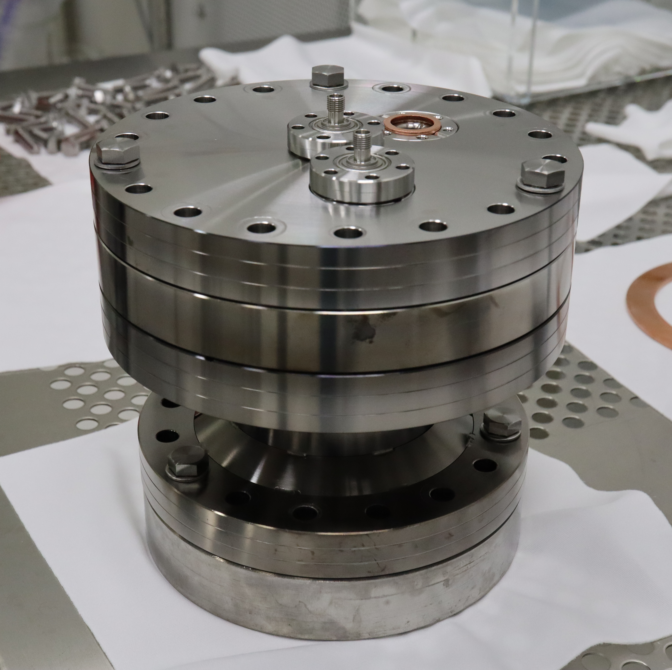
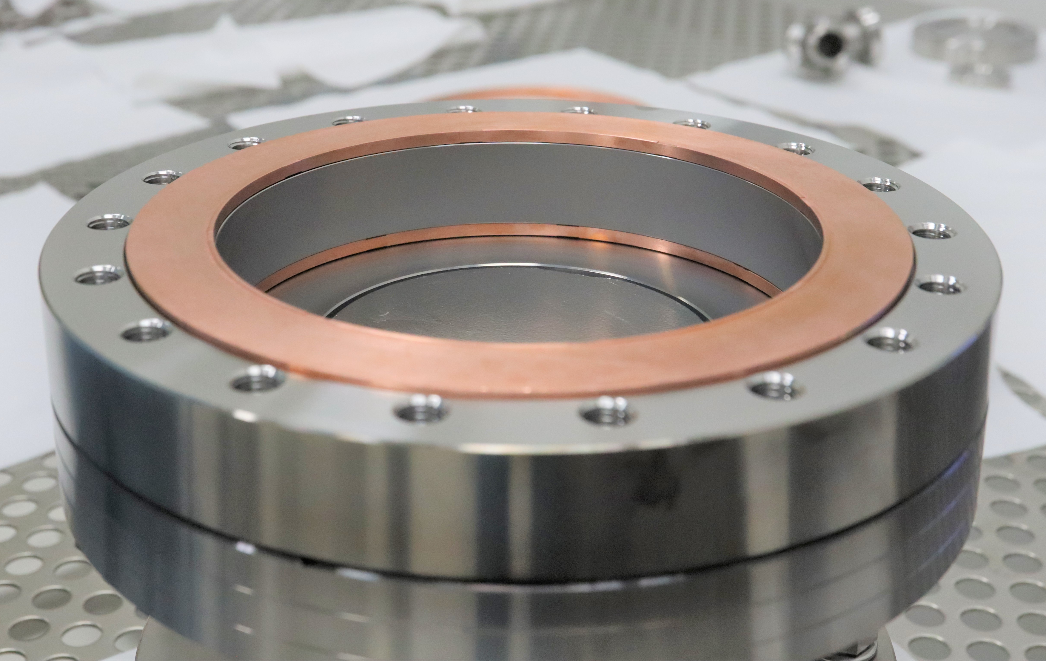
RaSTA: First prototype
RaSTA 1.0
In-house modification of standard components
Niobium coating at University of Siegen
SRF cavity with copper gaskets
Thermal decoupling of cavity and sample

Slide 6
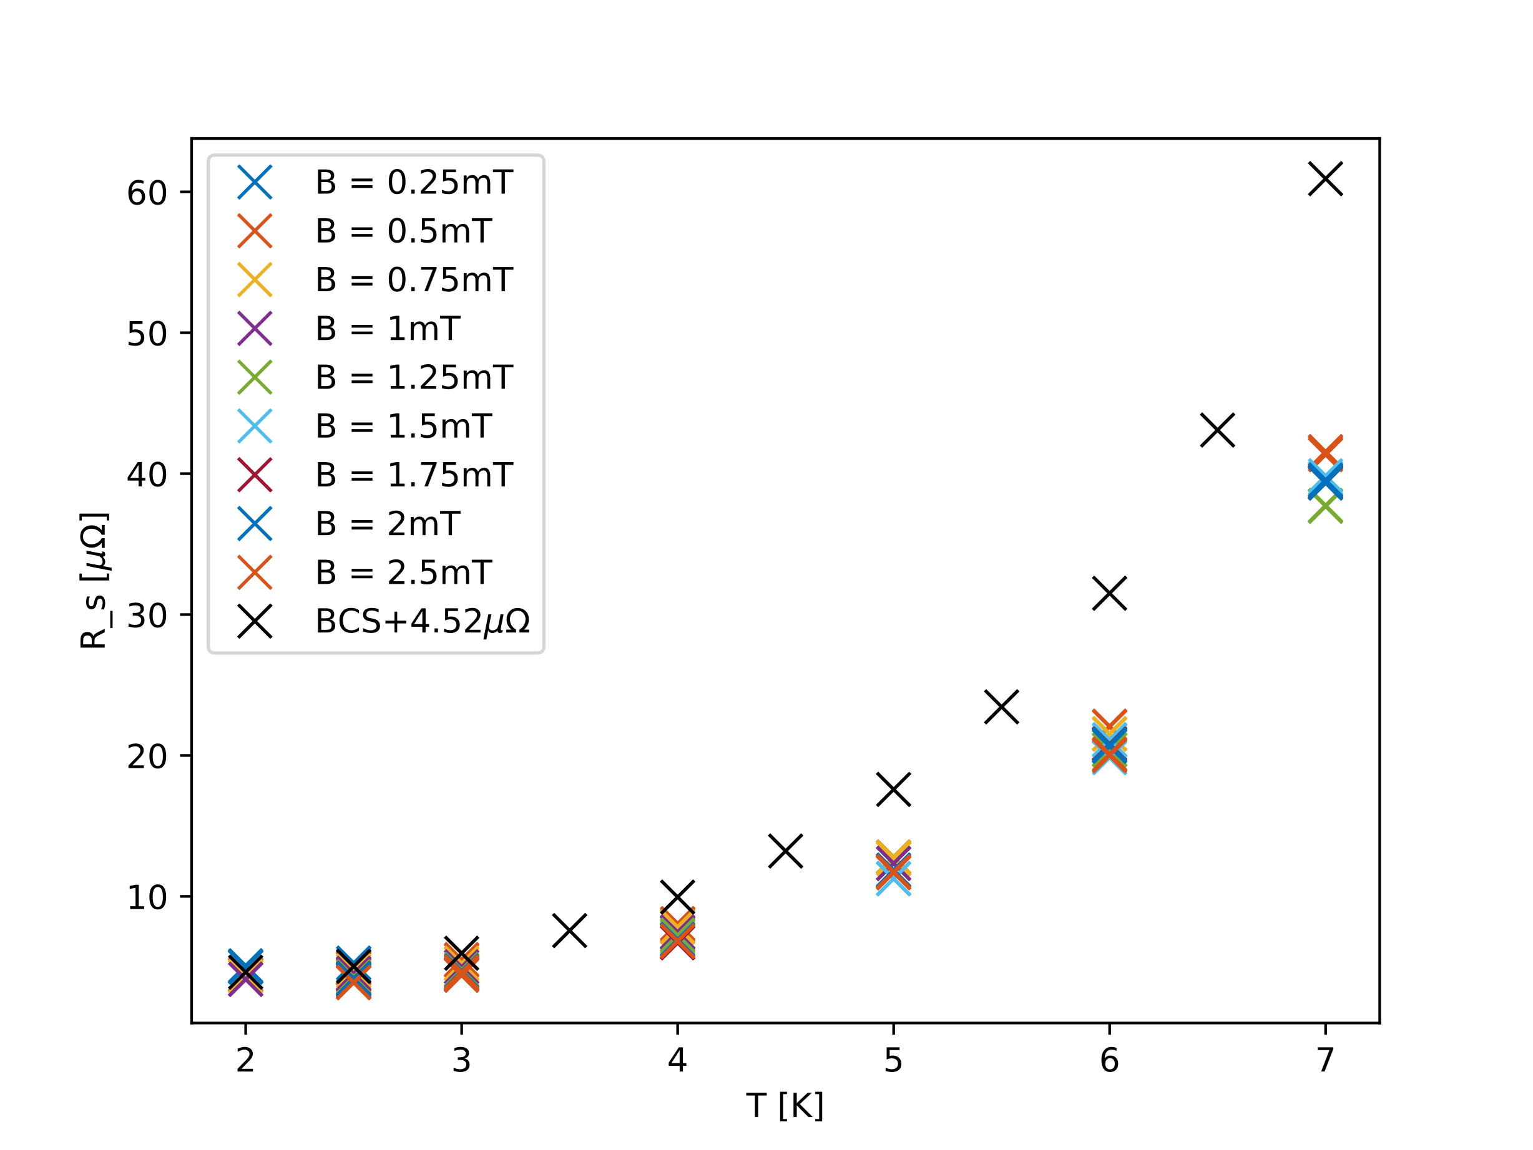
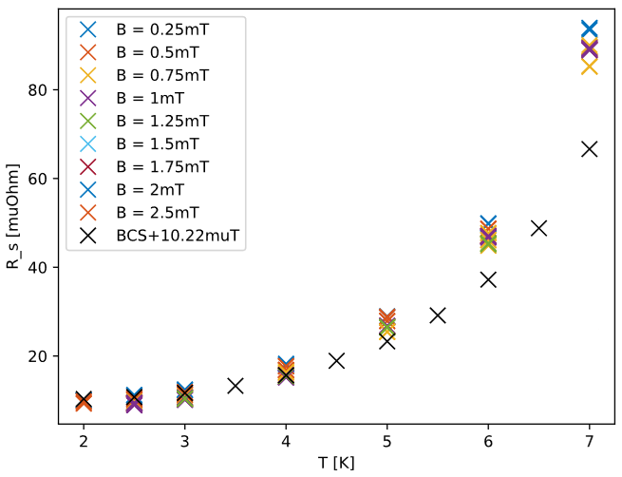
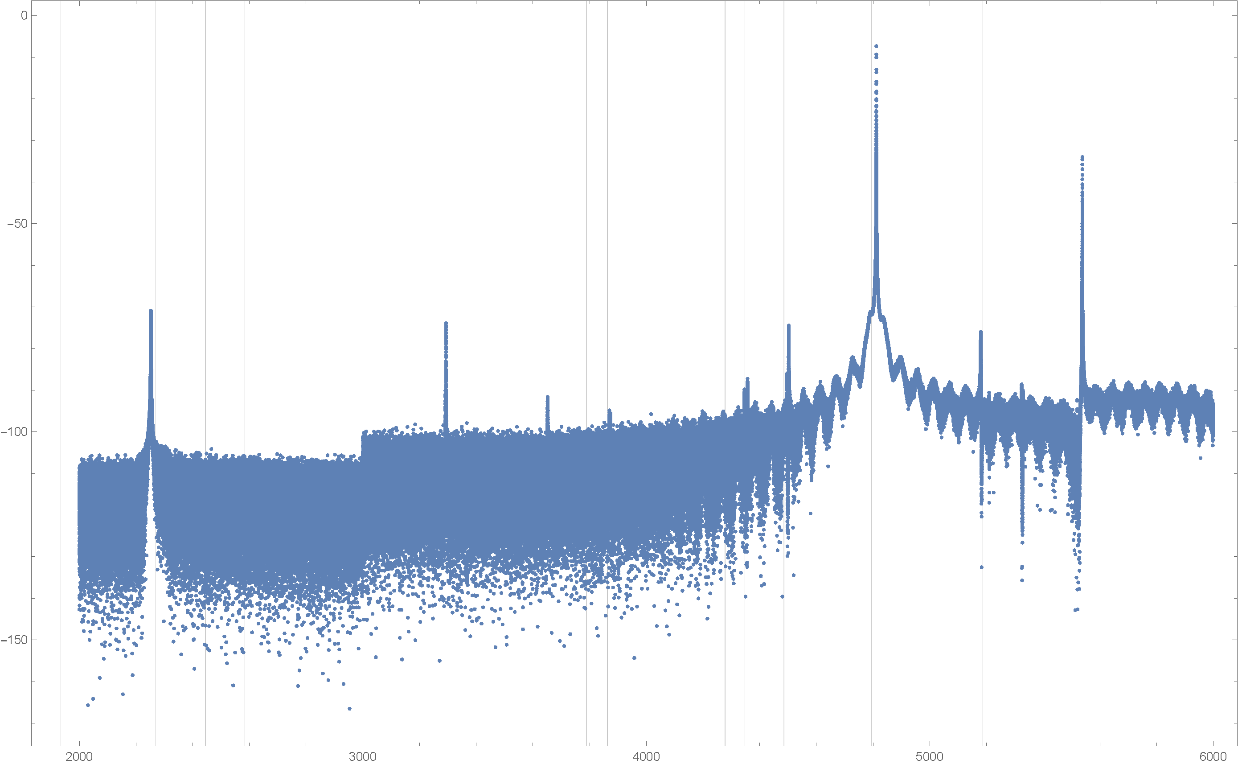
First results from a niobium sample
RaSTA 1.0
RF spectrum looks good, modes are well separated
Calorimetric measurement successful
Open issues
Adjust antennas and coupling
Identify systematic error sources
Deal with high surface resistance (parasitic losses?)
Small cavity → prototyping is possible !

Slide 7
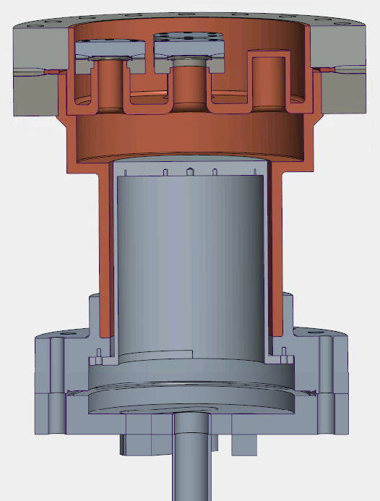
RaSTA 2.0
Rasta 2.0
Dummy RF ports
Less higher mode components, less parasitic losses
Improved cooling of RF surfaces
Copper as base material for all parts with RF fields
Reduced material thickness
Higher RF fields possible
Thermally more stable
Proper coupling measurements
Reduced cold mass (= stainless steel)
Cavity: Only two ring-shaped flanges
No sample adapter flange
Less LHe needed for cooldown
Redesign of sample attachment
No sample adapter flange, direct mounting to host cavity
No cleanroom pre-assembly → improved turnaround time
Longer coaxial line → less parasitic losses

Slide 8
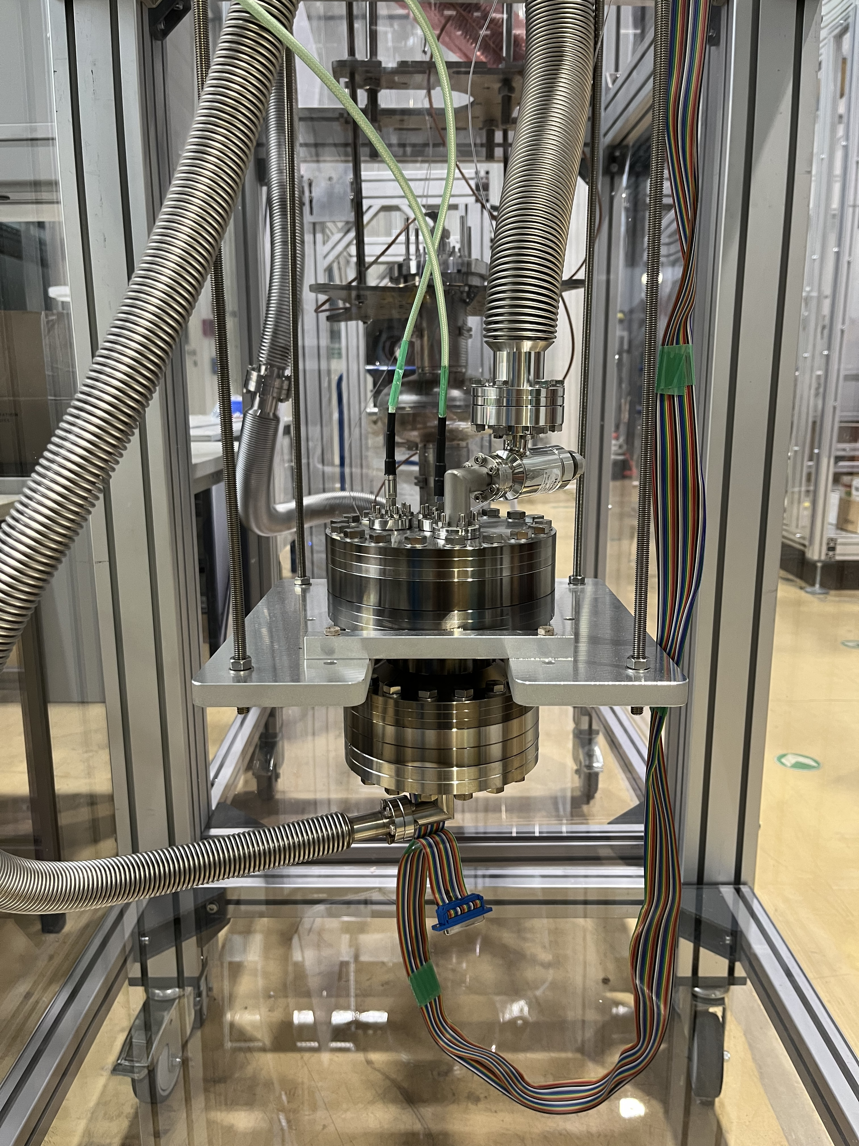
RaSTA
Summary
Based on QPR experience
Complementary tool, enables interative testing
Promising prototype results → optimized version in production

Slide 9

Prototype cavity performance
Rasta 1.0
Cooldown: Monitoring of cavity resonance
Quality factor Q₀ vs. temperature
Separate sc transitions visible, cavity turns sc first
Estimate RRR of niobium coating
$RRR={\left(\frac{Q_{cold, T>T_{c}}}{Q_{room temperature}}\right)}^{2}=\frac{{26630}^{2}}{{6030}^{2}}=19.5$
Cavity nc
Cavity turns sc
Time

Slide 10
Prototype cavity performance
Rasta 1.0
Cooldown: Monitoring of cavity resonance
Quality factor Q₀ vs. temperature
Separate sc transitions visible, cavity turns sc first
Estimate RRR of niobium coating
Sample turns sc
$RRR={\left(\frac{Q_{cold, T>T_{c}}}{Q_{room temperature}}\right)}^{2}=\frac{{26630}^{2}}{{6030}^{2}}=19.5$
Cavity nc
Cavity turns sc
Time

Slide 11
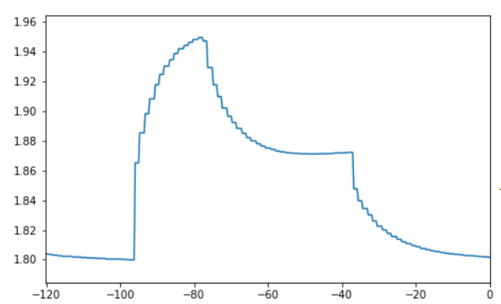
Prototype cavity performance
Rasta 1.0
Cooldown: Monitoring of cavity resonance
Quality factor Q₀ vs. temperature
Separate sc transitions visible, cavity turns sc first
Estimate RRR of niobium coating
Bulky stainless steel parts limit heat transport
CW quench limit: ≈ 5 mT
Quench
$RRR={\left(\frac{Q_{cold, T>T_{c}}}{Q_{room temperature}}\right)}^{2}=\frac{{26630}^{2}}{{6030}^{2}}=19.5$
RF Off
Sample Temperature [K]
Time [s]

Slide 12
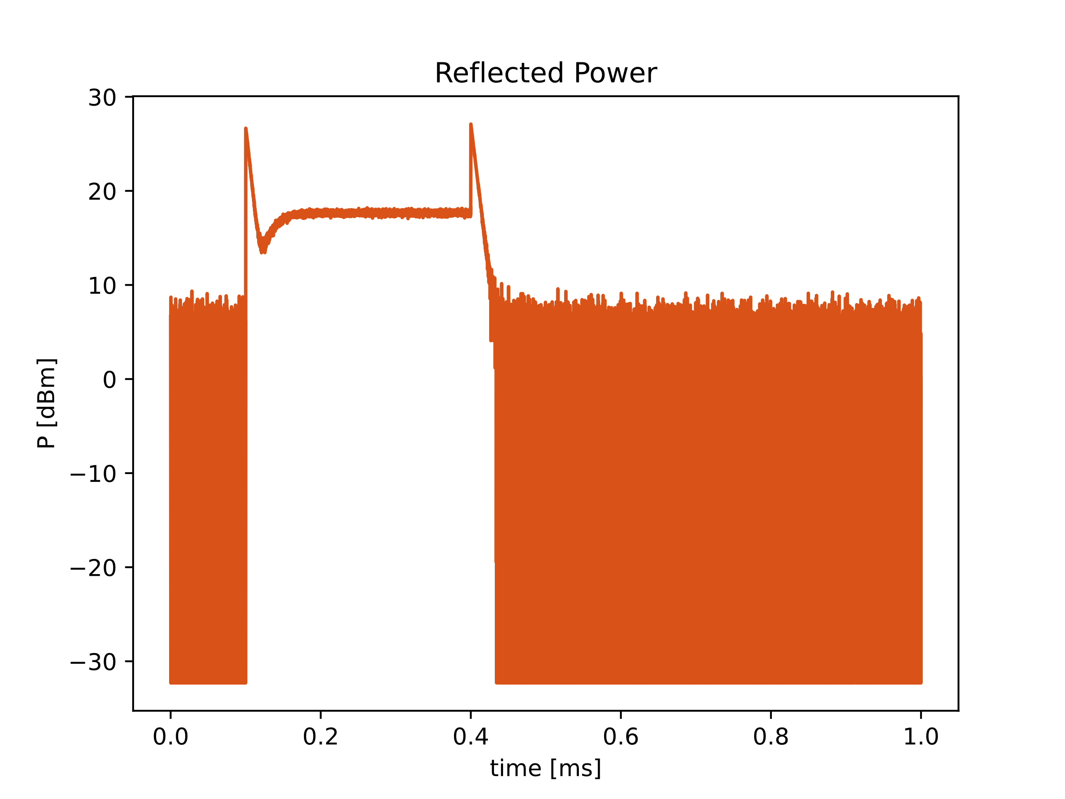
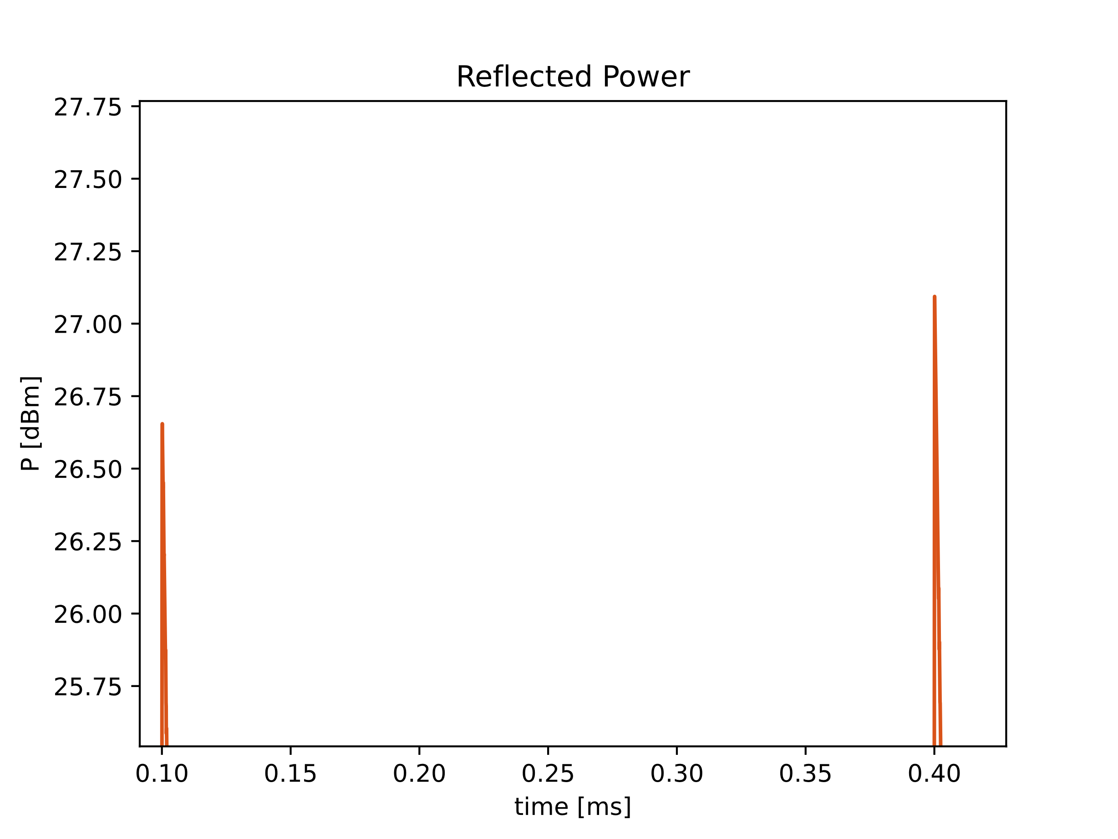
Reflected Pulse Shapes
Current Test
B_peak = 0.5 mT
Clearly over coupled

Slide 13
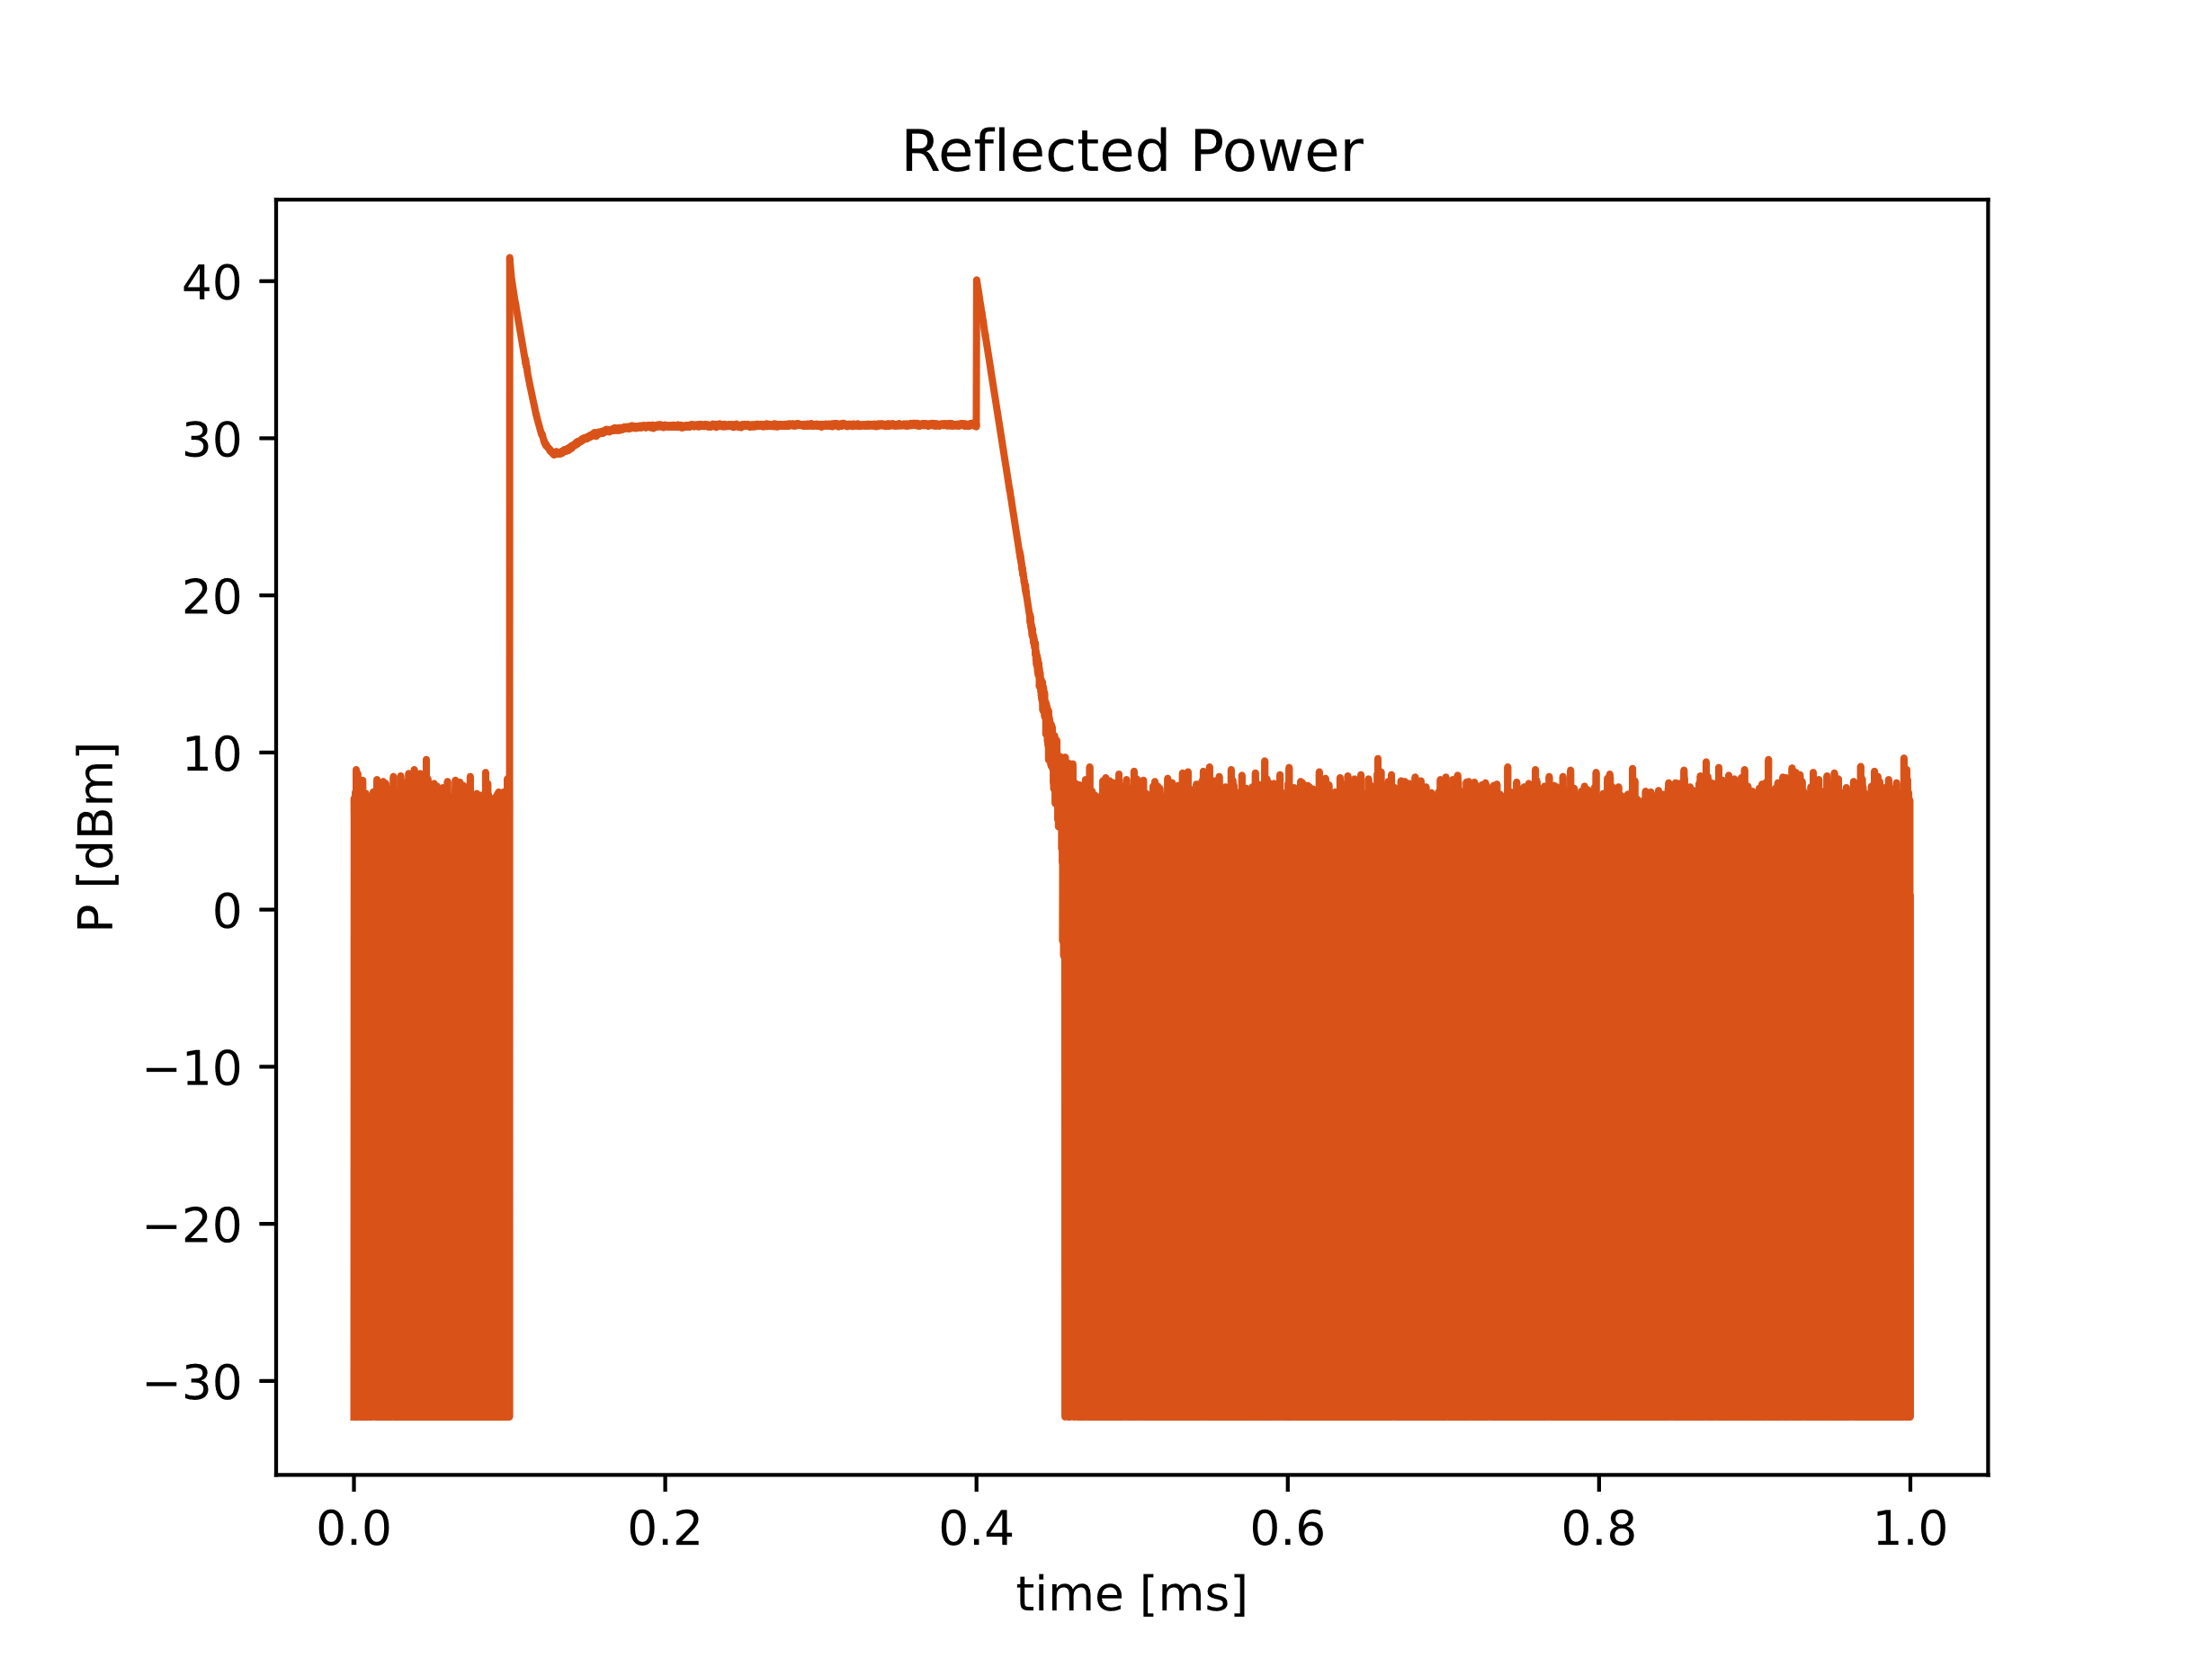
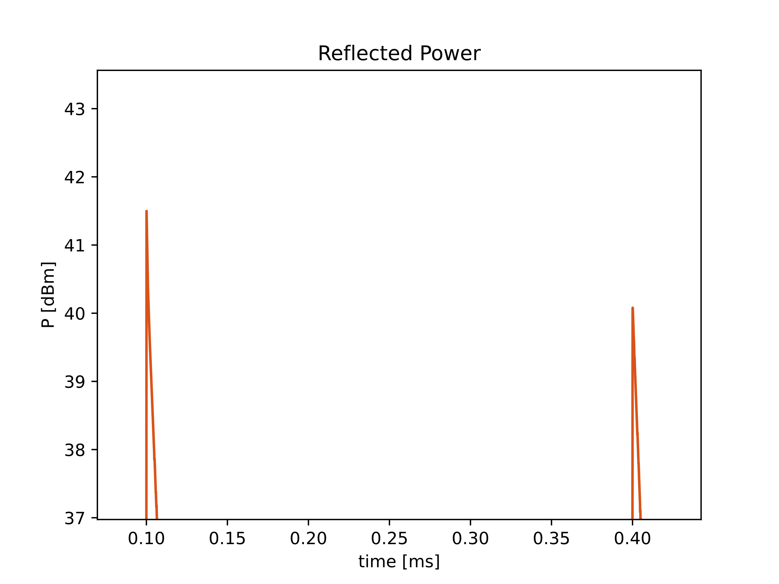
Reflected Pulse Shapes
Current Test
B_peak = 2.5mT
Under coupled?
Dip in power from zero crossing of voltage
But second peak is lower than first peak
Hypothesis: local thermal runaway on niobium film

