Slide 1
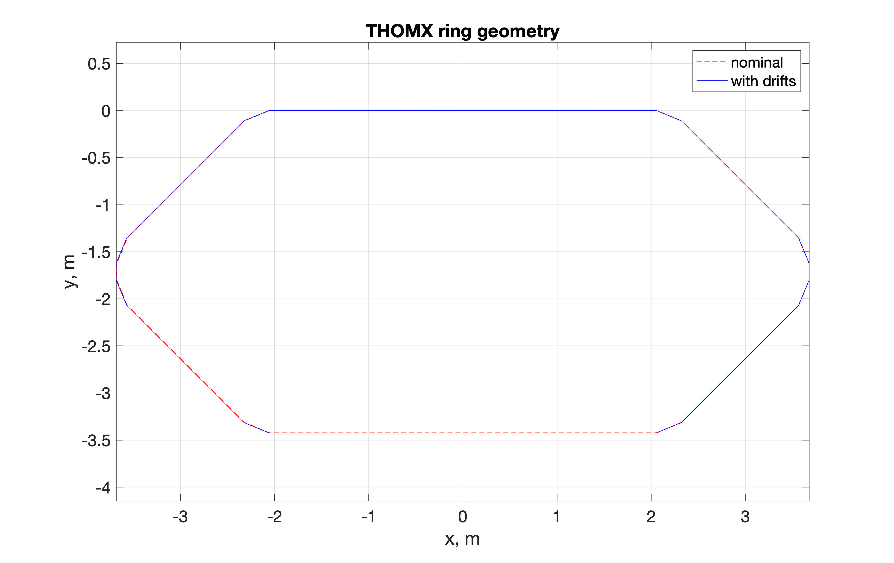
+6mm drifts
Problem: correct simulation of dipoles in AT

Slide 2
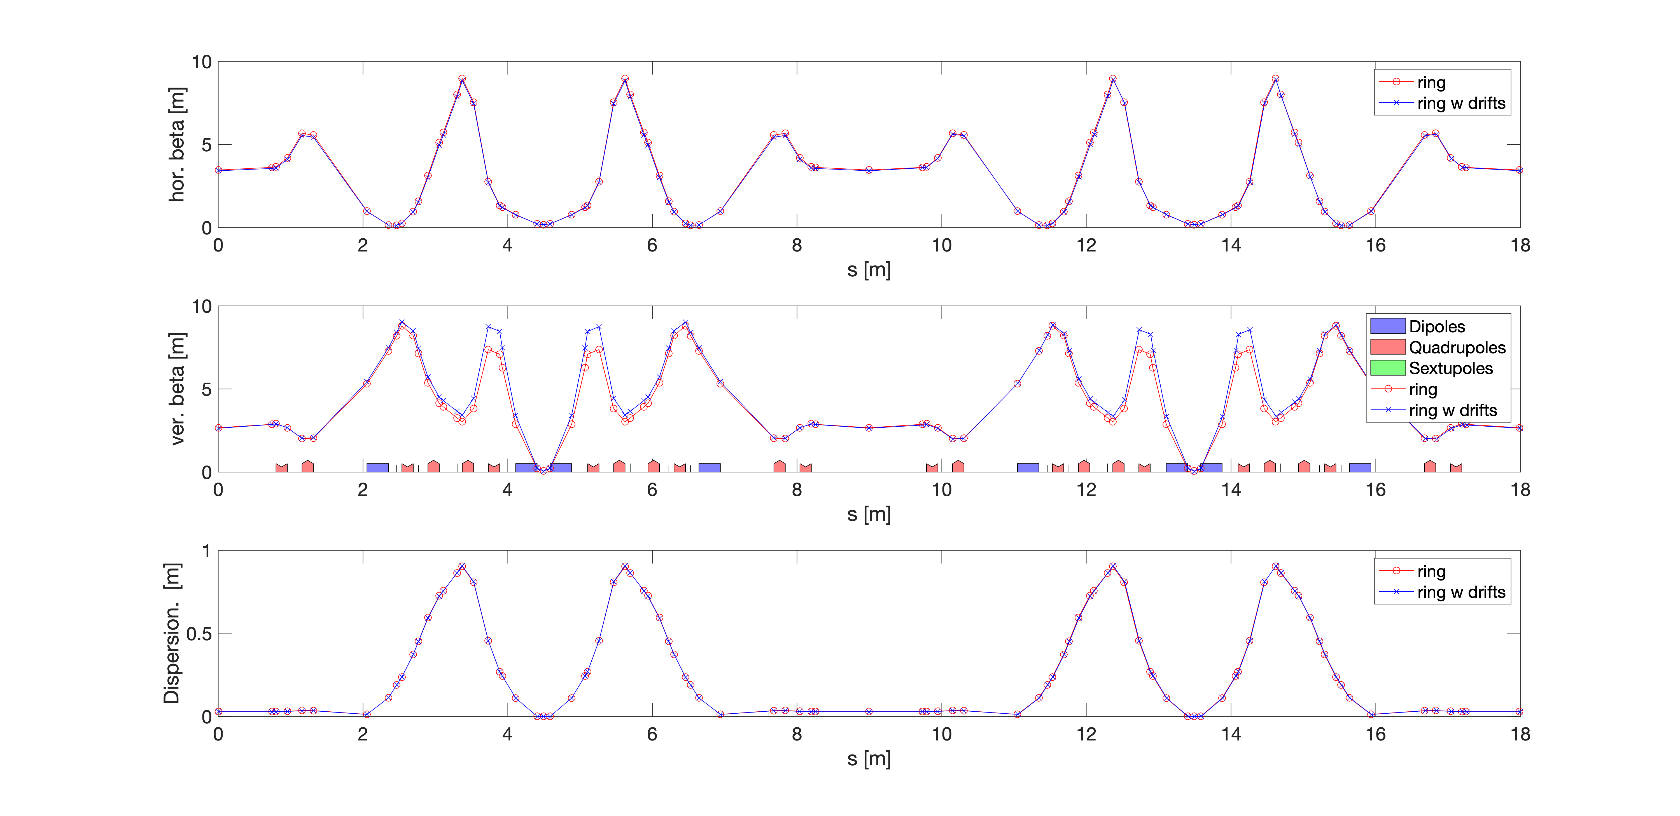
Refitted optics. Matching

Slide 3
NOMINAL
WITH DRIFTs
atsummary(ring)
************* Summary for '' ************
Energy: 0.05000 [GeV]
Gamma: 97.84756
Circumference: 17.98672 [m]
Revolution time: 59.99723 [ns] (16.66744 [MHz])
Betatron tune H: 0.16998 (2833.12609 [kHz])
V: 0.64018 (10670.09816 [kHz])
Momentum Compaction Factor: 1.43393e-02
Chromaticity H: -0.00000
V: -0.00000
atsummary(r_optic)
************* Summary for '' ************
Energy: 0.05000 [GeV]
Gamma: 97.84756
Circumference: 17.99848 [m]
Revolution time: 60.03646 [ns] (16.65654 [MHz])
Betatron tune H: 0.17309 (2883.07420 [kHz])
V: 0.63365 (10554.45082 [kHz])
Momentum Compaction Factor: 1.42541e-02
Chromaticity H: +0.07212
V: -1.34426
Name field before after variation
QP1 PolynomB -4.86169 -4.80669 0.0549962
QP2 PolynomB 9.44146 9.40109 -0.0403643
QP3 PolynomB -18.5428 -18.7781 -0.235302
QP4 PolynomB 16.4601 16.6294 0.169288
QP31 PolynomB -8.90015 -8.5712 0.328949
QP41 PolynomB 5.10745 4.8107 -0.296743

Slide 4
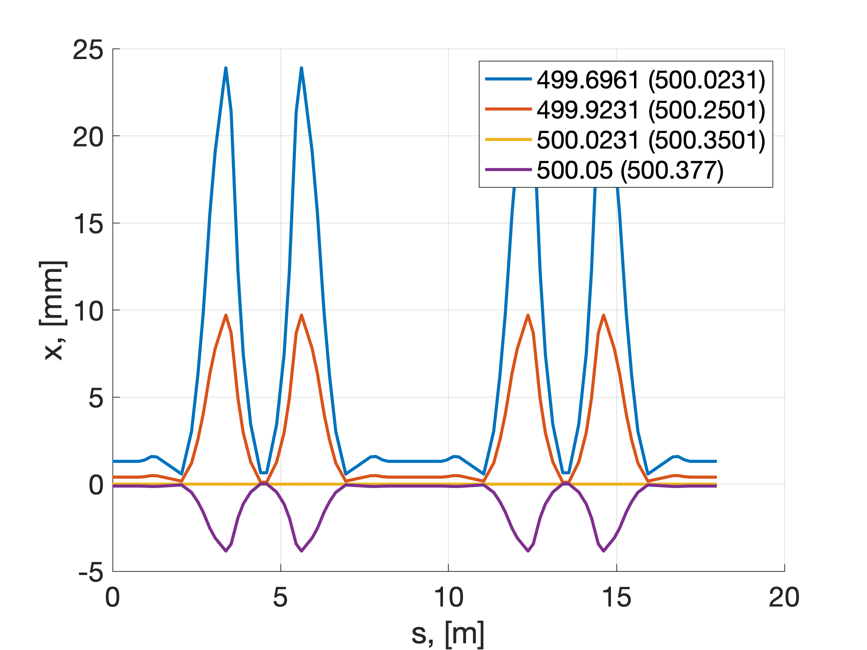
Frequency offset in modelling and in the experiment.
Exp [500.02 ; 500.25 ; 500.35 ; 500.38]
Model [499.69; 499.92; 500.02; 500.05]

Slide 5
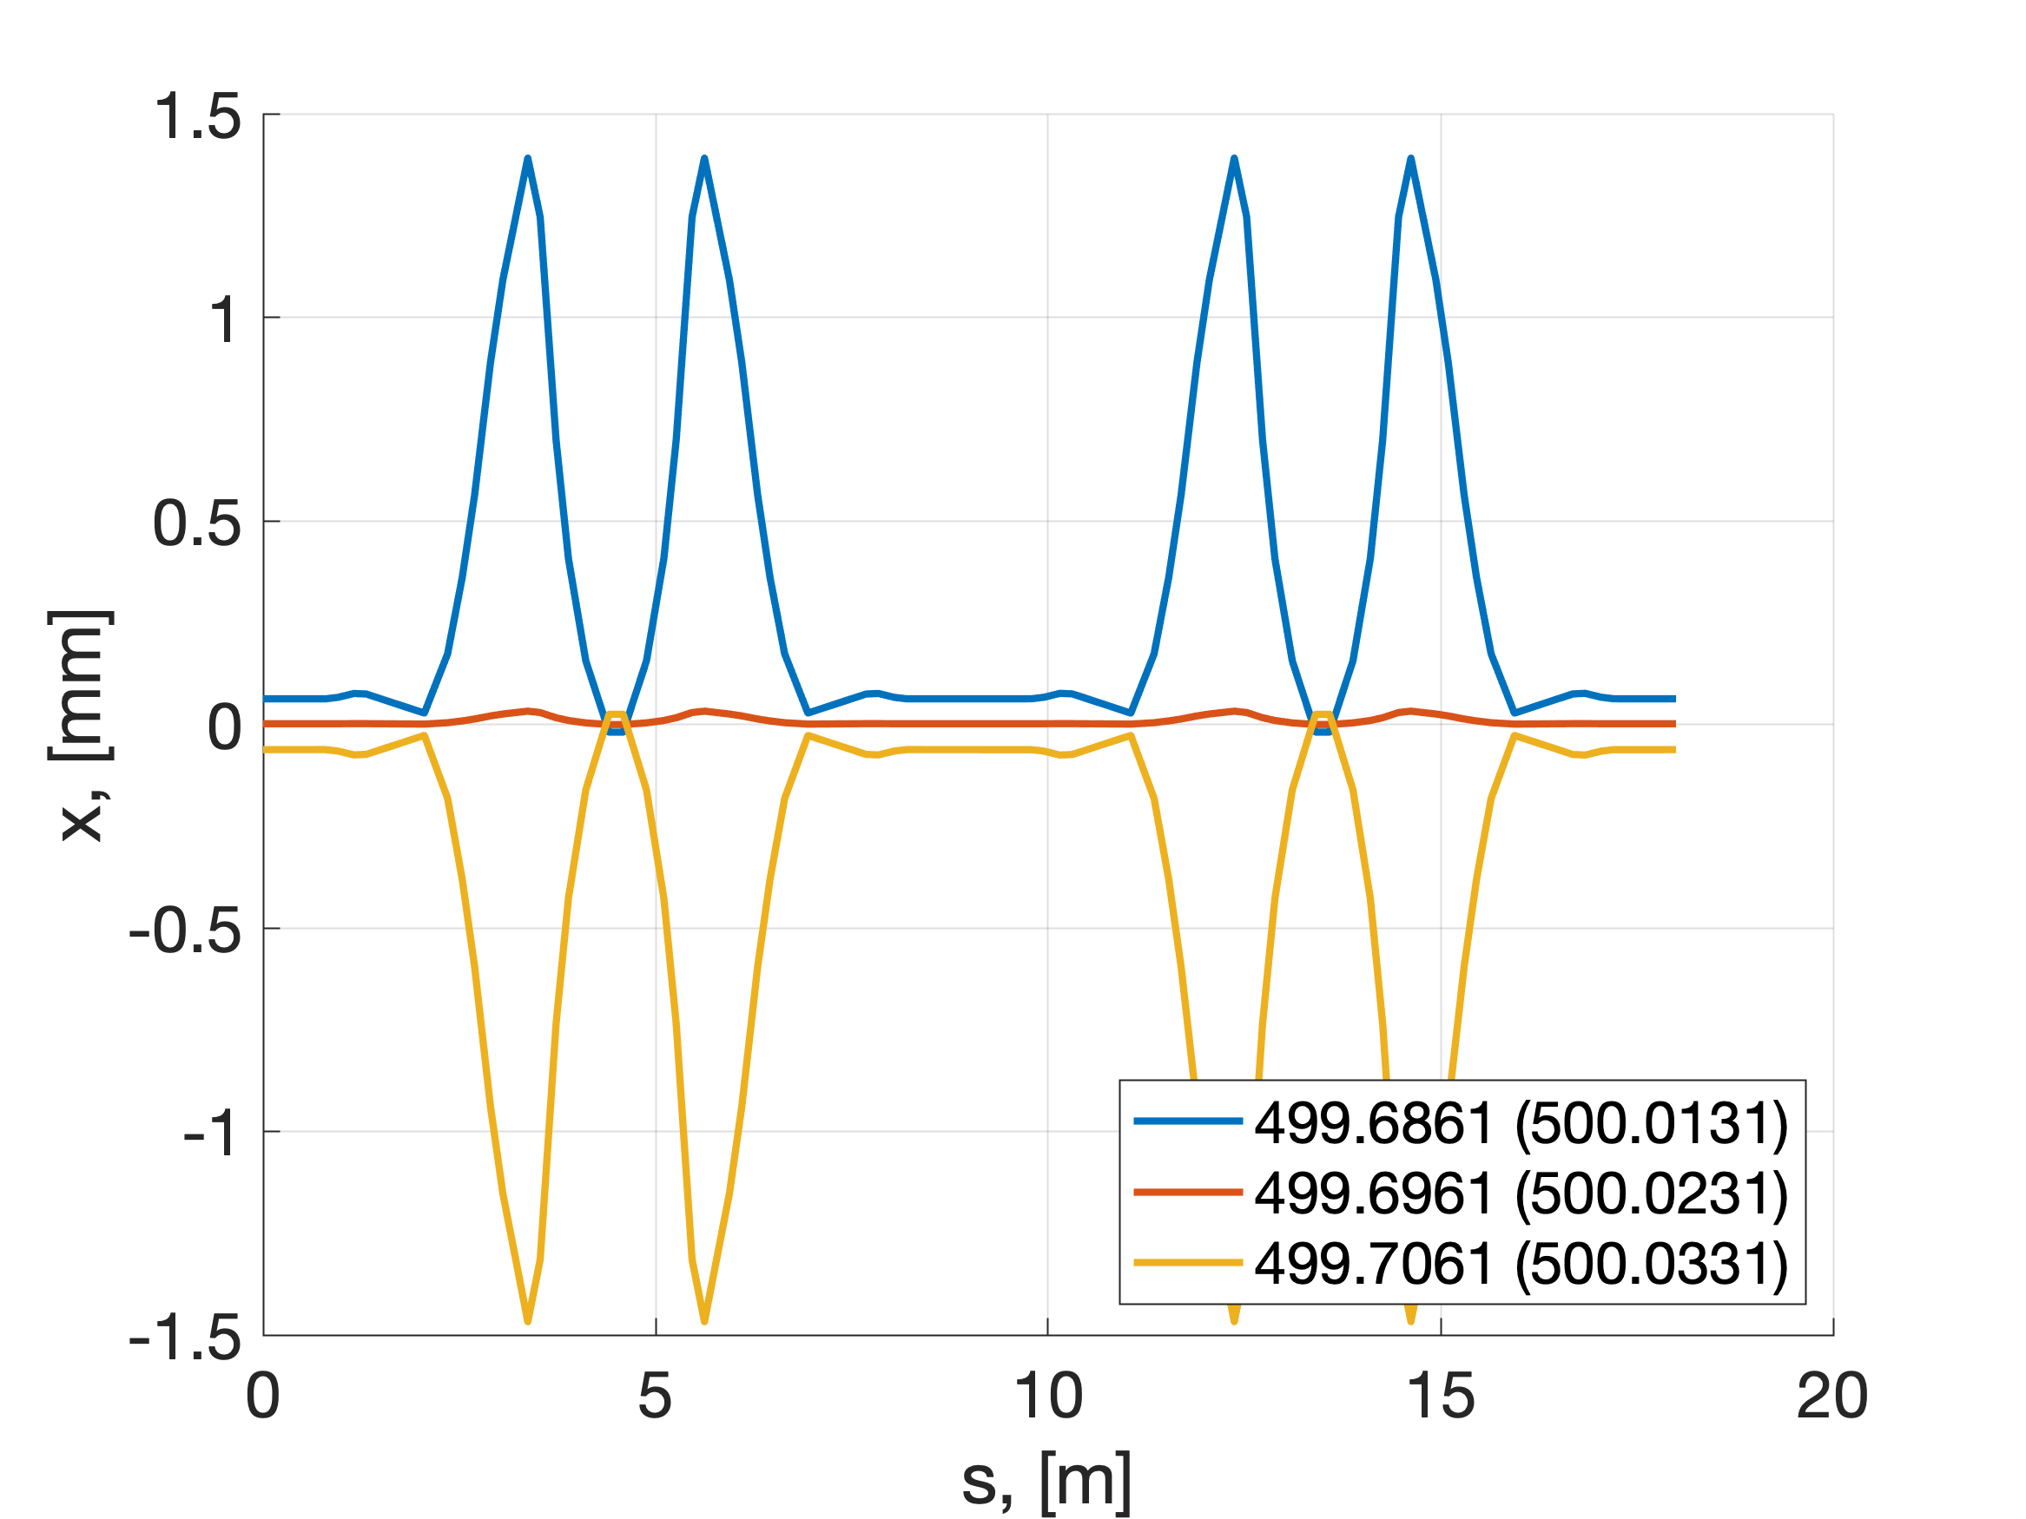
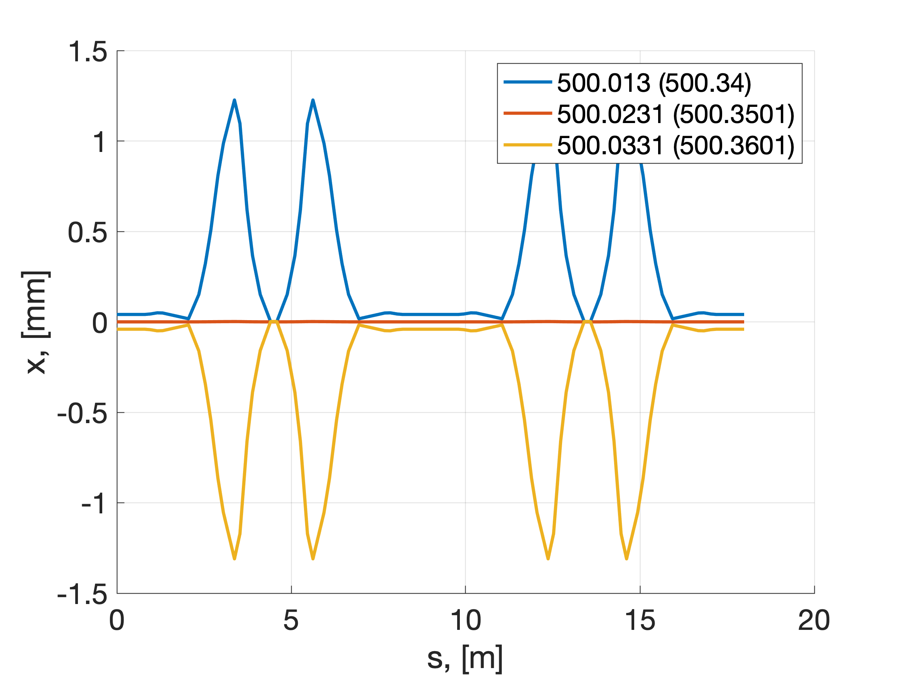
6D Closed orbits+-10 kHz. Horizontal orbit
Current (nominal)
With drifts

