Slide 1
The nuclear shell model in the intrinsic frame
Tomás R. Rodríguez
Fifth GOGNY Conference
Paris
December 10th, 2024
coming soon…

Slide 2
Acknowledgments
Benjamin Bally (CEA-Saclay)
Adrián Sánchez-Fernández (ULB-Brussels)
Jaime Martínez-Larraz (UAM-Madrid)
Vimal Vijayan (GSI-Darmstadt)
Kamila Sieja (Strasbourg)

Slide 3
Outline
1. Introduction
2. Projected Generator Coordinate Method (PGCM)
3. Benchmarking PGCM against shell model with TAURUS
4. Summary and Outlook

Slide 4
Outline
1. Introduction
2. Projected Generator Coordinate Method (PGCM)
3. Benchmarking PGCM against shell model with TAURUS
4. Summary and Outlook

Slide 5
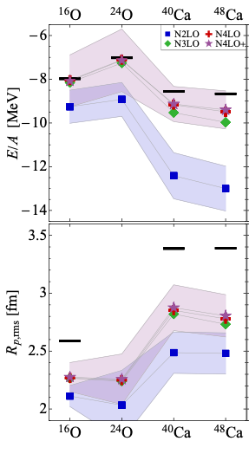
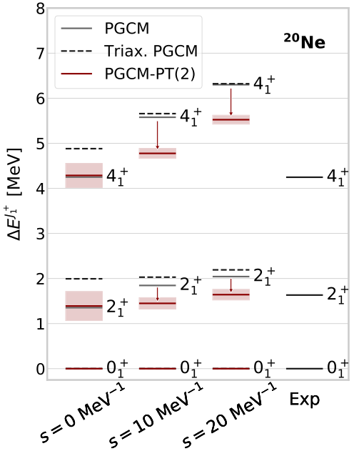
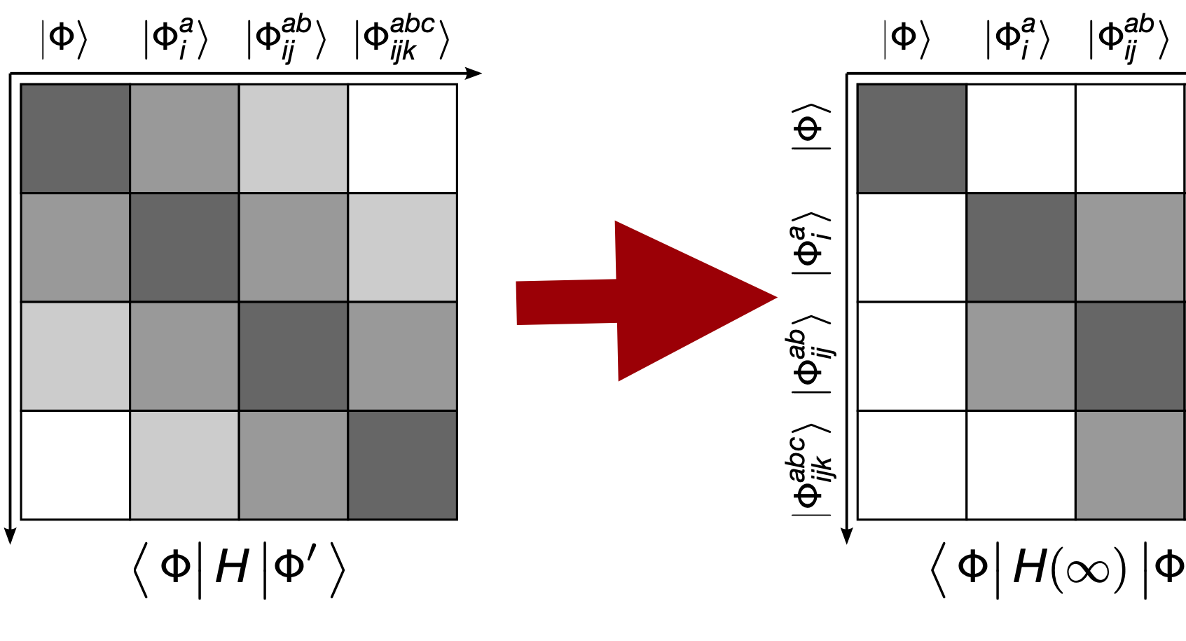
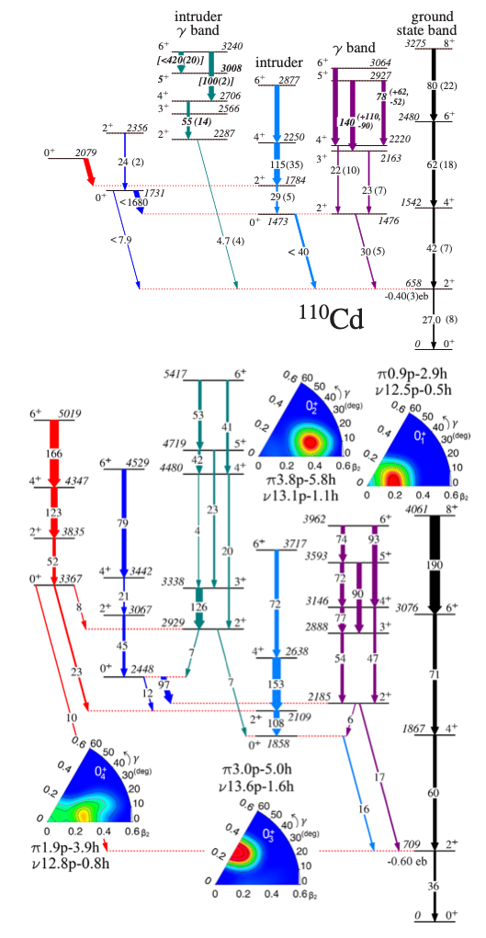
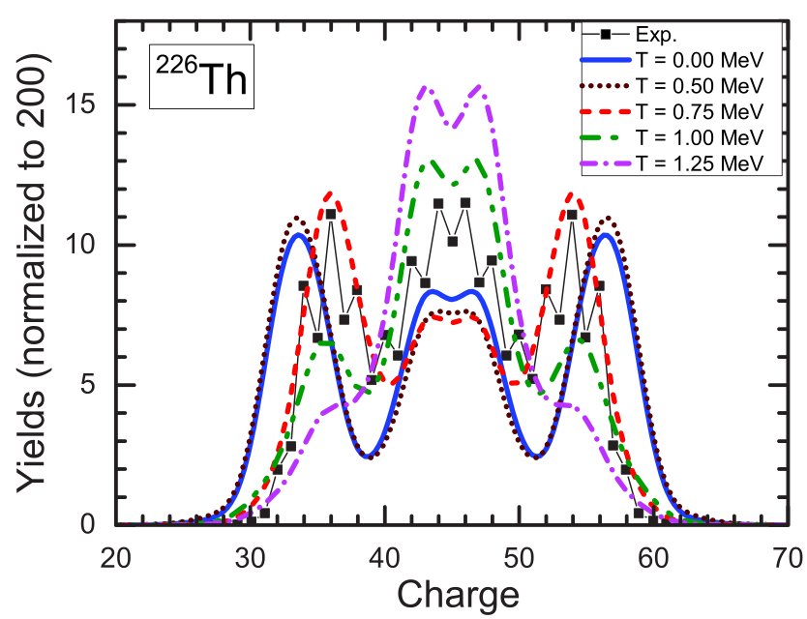
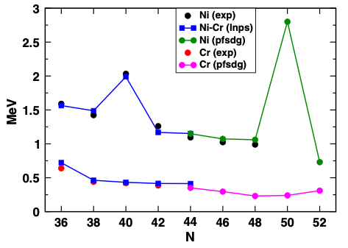
Nuclear many-body problem(s)
Nuclear structure theory rationale
EPJA 58, 63 (2022)
PRC 106, 064002 (2022)
Many-body methods
PRC 99, 014618 (2019)
PRL 123, 142502 (2019)
effective interactions
PRL 117, 272501 (2016)
Results

Slide 6
Nuclear many-body problem(s)
Nuclear methods must provide a wide catalog of physical quantities that can be reliably compared with experimental data
Nuclear structure theory:
- Kind of nuclei
even-even nuclei
even-odd/odd-even nuclei
odd-odd nuclei
- Observables and physical quantities
Bulk properties: masses, radii, nuclear densities.
Excitation energies
electromagnetic transition probabilities
CATALOG OF SERVICES
Beta-decay rates
Double-beta decay matrix elements
Electromagnetic responses
Fission properties
Reaction properties

Slide 7
Nuclear many-body problem(s)
Let us assume that we know the nuclear interaction.
??
Solving the quantum many-body exactly is (in general)
impossible
Most widely used solutions to attack this problem:
Valence-space or no-core (Shell Model) calculations
Variational approximate methods (mean-field and beyond-mean-field).
Expansion techniques (e.g., many-body perturbation theory, Coupled-cluster)

Slide 8
Interacting Shell Model (in a nutshell)
Full diagonalization of an adapted Hamiltonian within a valence space
Nuclear wave functions are linear combinations of Slater determinants written in terms of occupations of spherical orbits
Limited by the combinatorial increase of the number of configurations
Wave functions are defined in the LABORATORY SYSTEM
⇒ SHAPES?!?!
??

Slide 9
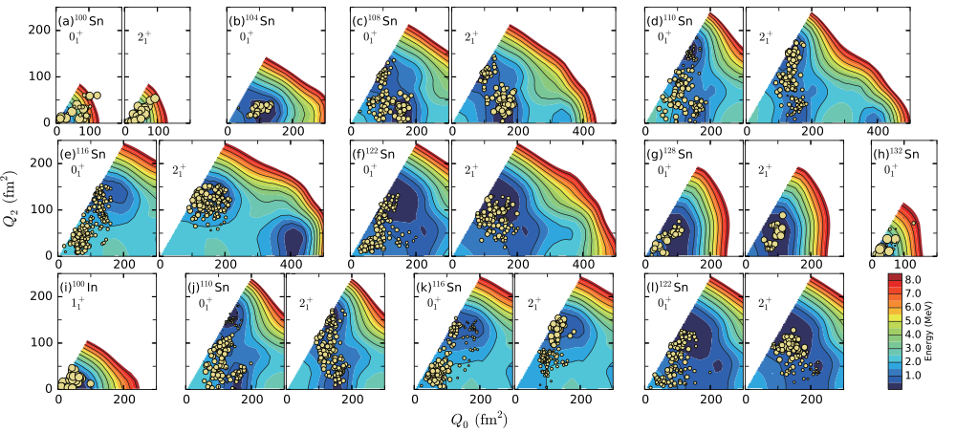
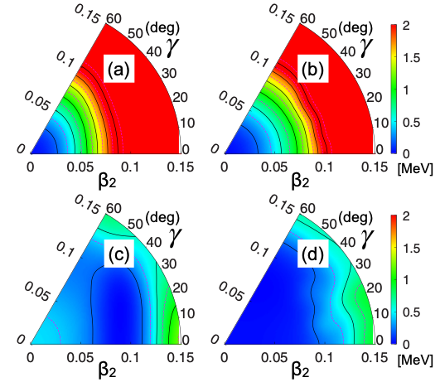
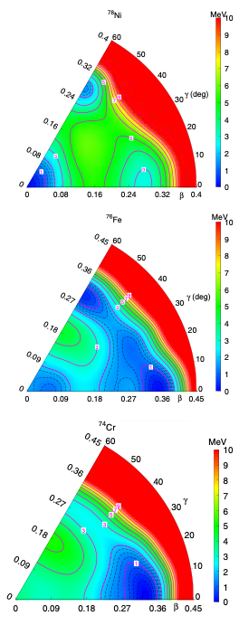
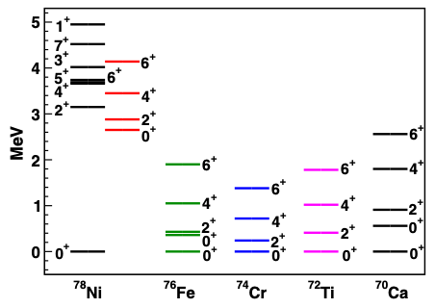
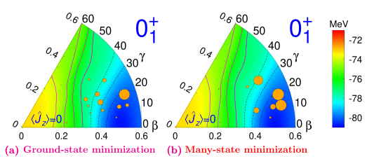
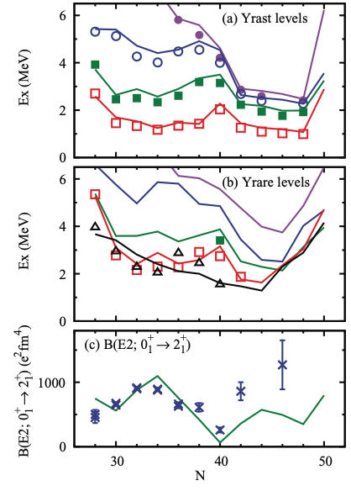
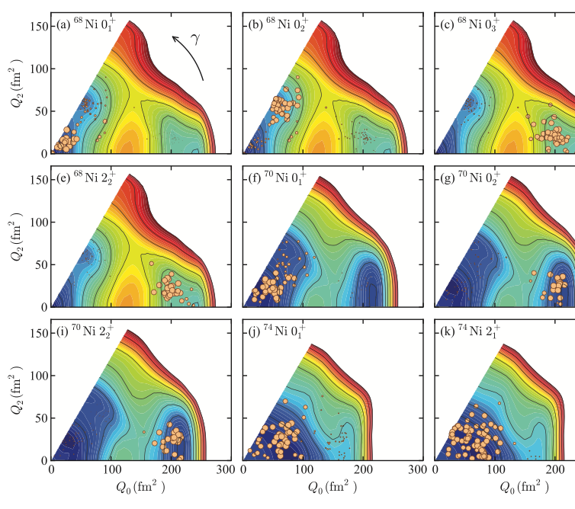
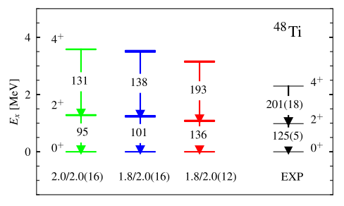
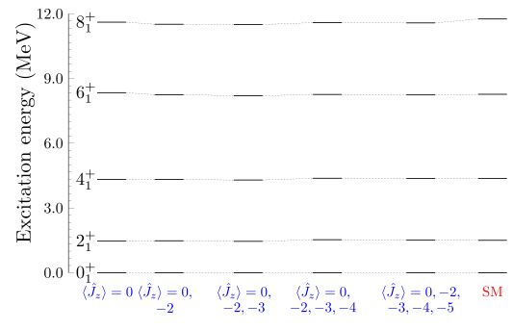
Variational methods in SM spaces
- Extend the range of applicability of shell model calculations
- Provide an interpretation of the SM states in terms of intrinsic collective shapes
Monte Carlo Shell Model
MCSM
Projected Generator Coordinate Method PGCM
Discrete Non-orthogonal Shell Model
DNO-SM
shapes / collective motion
shell structure / particle-hole excitations
Y. Tsunoda et al., PRC 89, 031301(R) (2014), Y. Utsuno et al., PRL 114, 032501 (2015), …
C. F. Jiao et al, PRC 96, 054310, B. Bally et al., PRC 100, 044308 (2019), PRC 104, 054306 (2021), …
B. Bounthong, D. D. Dao and F. Nowacki, PRL 117, 272501 (2016), PRC 105 054314 (2022, …
other approaches: VAMPIR, PSM, …

Slide 10
Outline
1. Introduction
2. Projected Generator Coordinate Method (PGCM)
3. Benchmarking PGCM against shell model with TAURUS
4. Summary and Outlook

Slide 11
Projected GCM
Nuclear wave functions: Generator Coordinate Method (GCM) ansatz
linear combination
coefficients of the linear combination
“basis” states

Slide 12
Projected GCM
Nuclear wave functions: Generator Coordinate Method (GCM) ansatz
variational!
variational!

Slide 13
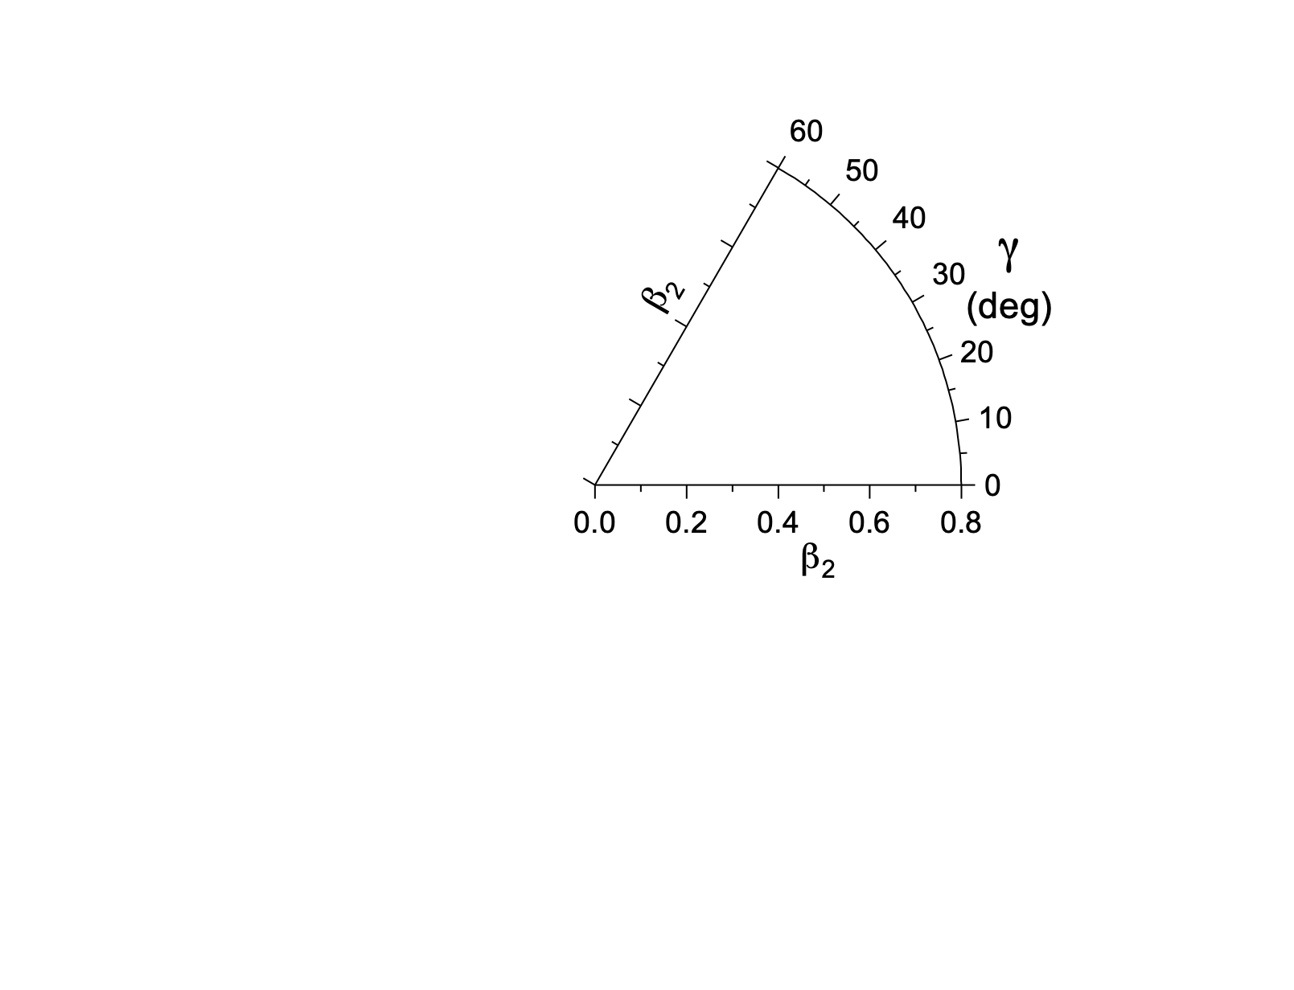
Projected GCM
Nuclear wave functions: Generator Coordinate Method (GCM) ansatz
“basis” states
Intrinsic (HFB-like, Bogoliubov quasiparticle vacuum) state
- First classification of the collective behavior of the nucleus based on the total energy surfaces (TESs)
(our spherical-cow approach)
credits: M. Salgado

Slide 14
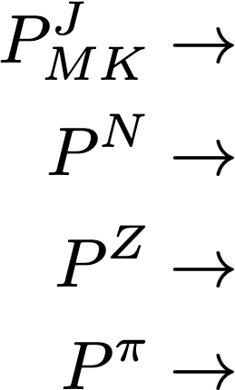
Projected GCM
Nuclear wave functions: Generator Coordinate Method (GCM) ansatz
“basis” states
Symmetry restoration
laboratory frame
z
angular momentum projector
M
fixed-body frame
3
neutron number projector
J
K
proton number projector
spatial parity projector

Slide 15
Projected GCM
Nuclear wave functions: Generator Coordinate Method (GCM) ansatz
coefficients of the linear combination
The coefficients are obtained by minimizing the expectation value of the Hamiltonian (energy) with those coefficients as the variational parameters:
Hill-Wheeler-Griffin (HWG) equation
Hamiltonian and norm kernels

Slide 16
Outline
1. Introduction
2. Projected Generator Coordinate Method (PGCM)
3. Benchmarking PGCM against shell model with TAURUS
4. Summary and Outlook

Slide 17
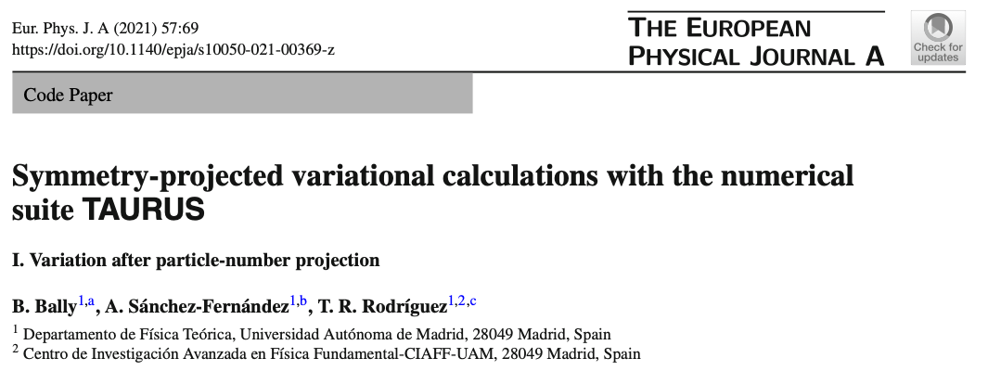
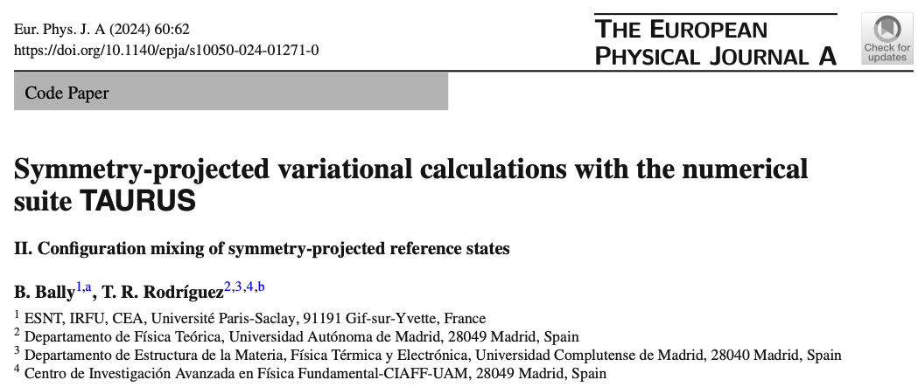
ISM / PGCM
Comparison between Interacting Shell Model calculations and variational approaches
TAURUS
- Benchmark of the PGCM method against exact results.
- Same effective Hamiltonian defined in the same valence space
- Exact SM calculations performed with ANTOINE
Theory for A Unified descRiption of nUclear Structure
- PGCM performed with TAURUS
B. Bally, A. Sánchez, T. R. R., EPJA 57, 69 (2021)
B. Bally, T. R. R., EPJA 60, 62 (2024)

Slide 18
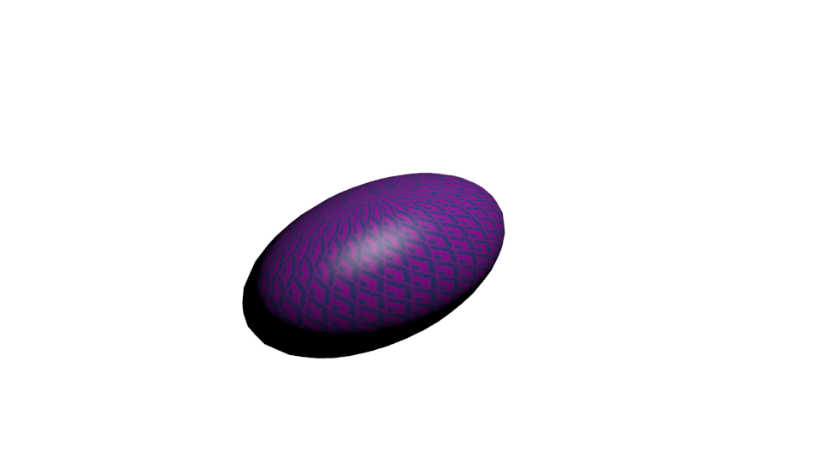
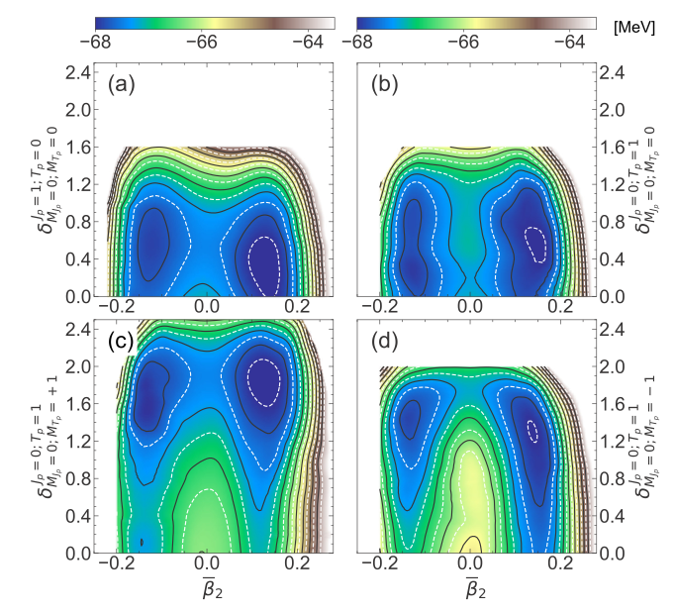
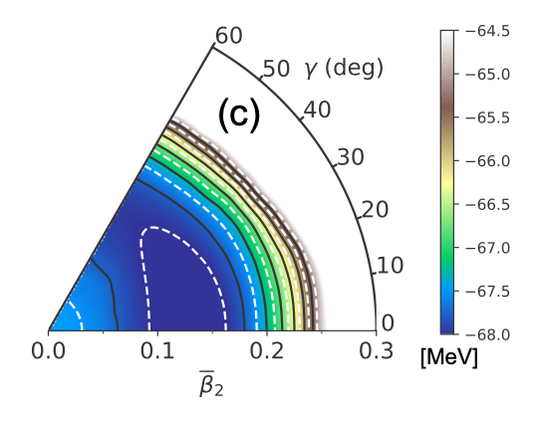
ISM vs PGCM
TAURUS special features (with respect to traditional BMF solvers):
- even-even, even-odd/odd-even and odd-odd nuclei treated on the same footing
- general HFB (real) transformation allows the inclusion of proton-neutron pairing
- particle-number (pairing), parity and rotational symmetries can be simultaneously broken (and restored subsequently)
- degrees of freedom explored explicitly:
Jcrank=0
isoscalar pn
isovector pn
Jcrank≠0
nn
pp
pairing fluctuations
multipole deformations
intrinsic rotations (cranking)

Slide 19
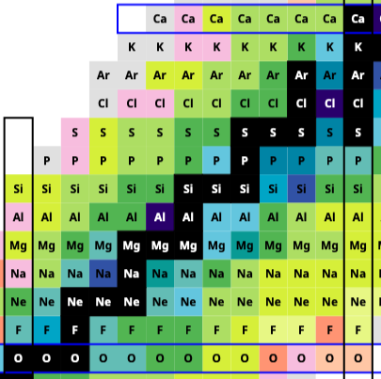
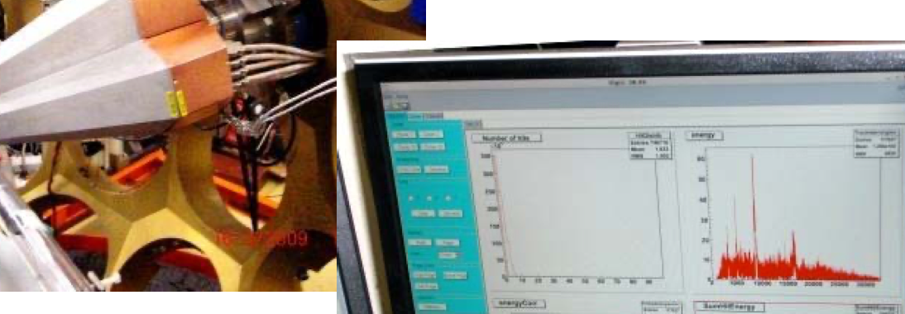
ISM vs PGCM
Nuclear wave functions: Generator Coordinate Method (GCM) ansatz
USD interaction
- Ground and excited state energies
- Gamow-Teller distributions
- Magnetic dipole responses
Commissioning TAURUS
AGATA commissioning 2009

Slide 20
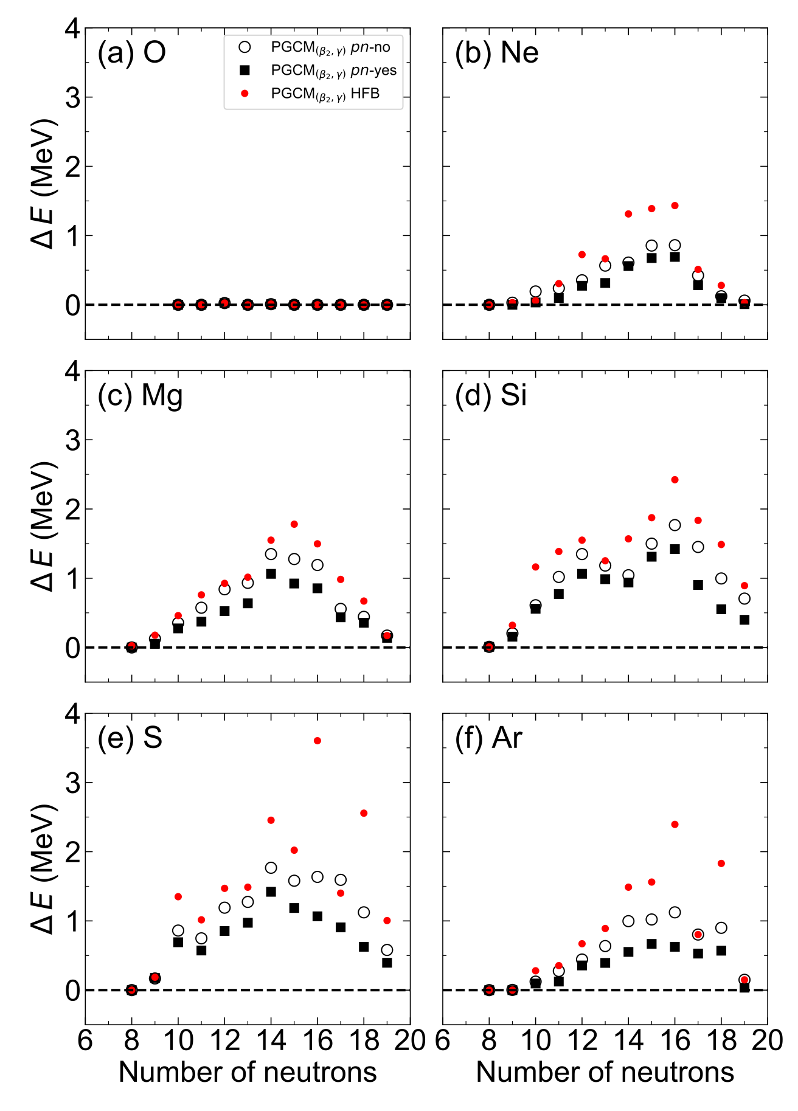
Ground state energies e-e / e-o
Global performance of the PGCM method in the sd-shell
- We compare different choices of PGCM depending on the type of intrinsic wave function
- Best approach to the exact ground state energy is provided by the PNVAP minimization that allows proton-neutron mixing
- Largest difference are obtained in mid-shell nuclei
- Angular momentum of the g.s. of e-o systems is well-reproduced with PNVAP pn-mixing
A. Sánchez, B. Bally, T. R. R., PRC 104, 054306 (2021)

Slide 21
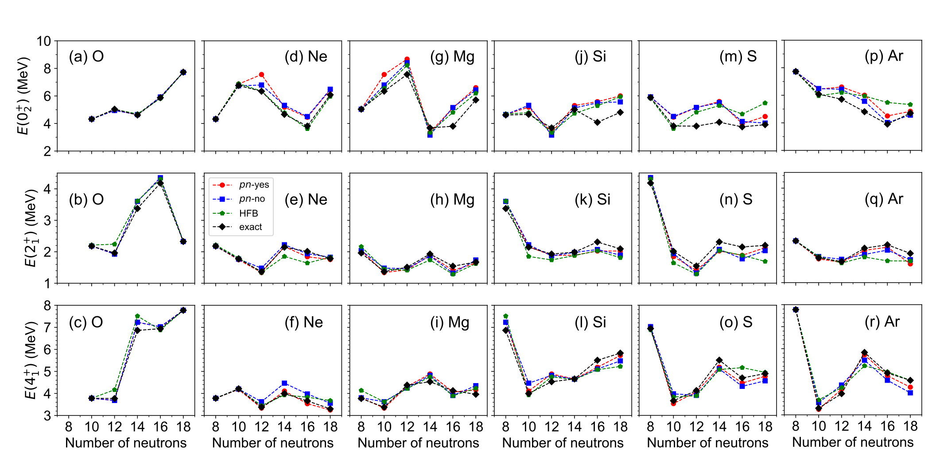
Excited states e-e
Global performance of the PGCM method in the sd-shell
Excited states in even-even nuclei
A. Sánchez, B. Bally, T. R. R., PRC 104, 054306 (2021)

Slide 22
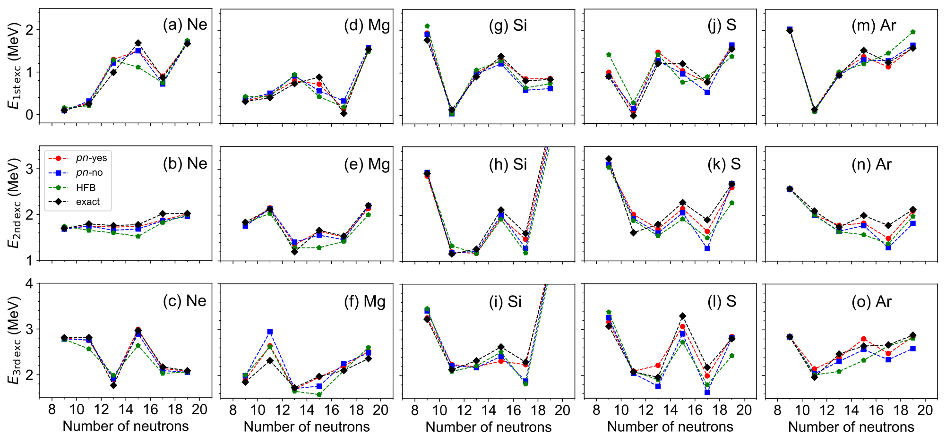
Excited states e-o
Global performance of the PGCM method in the sd-shell
Excited states in even-odd nuclei
A. Sánchez, B. Bally, T. R. R., PRC 104, 054306 (2021)

Slide 23
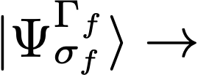
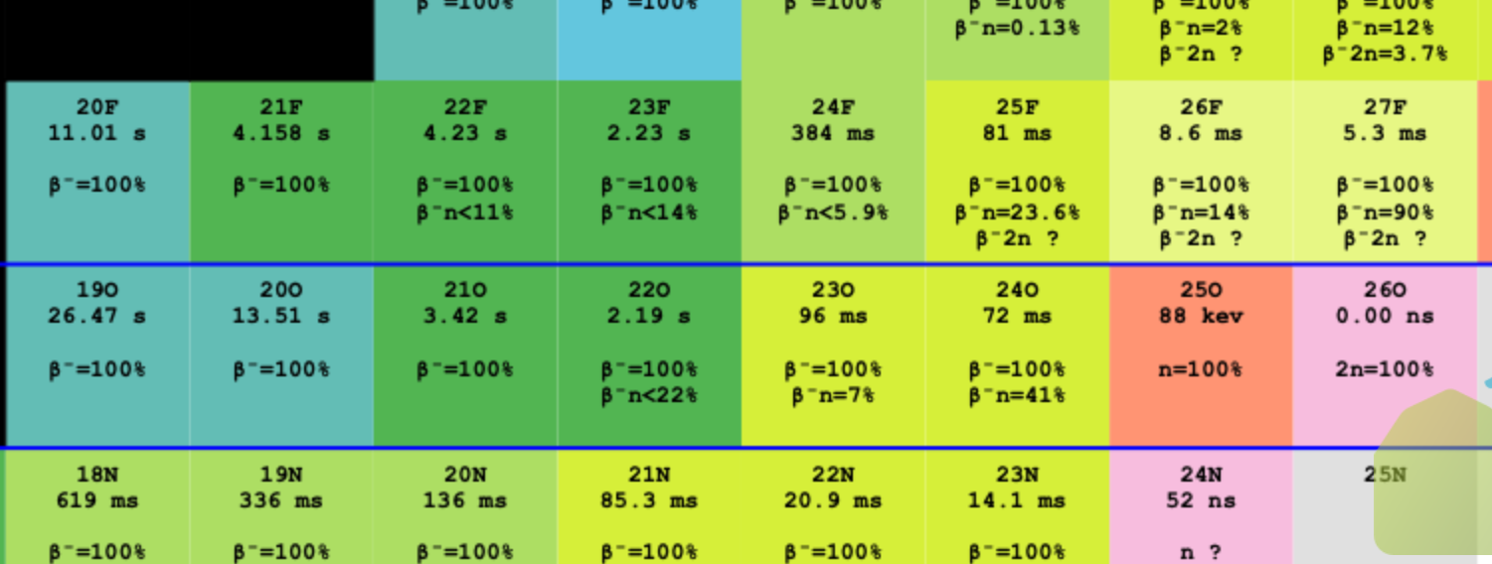
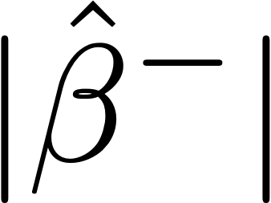
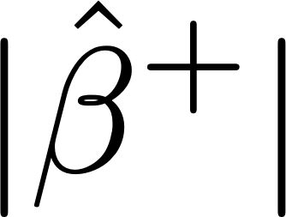
Beta-decay properties
Transition matrix elements
initial state
final state
p
n

Slide 24
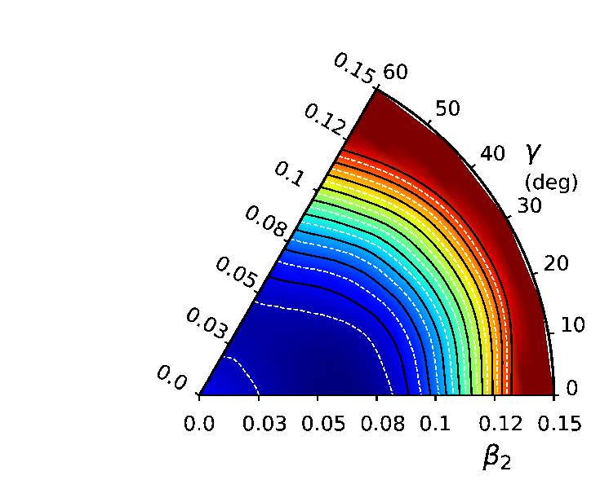
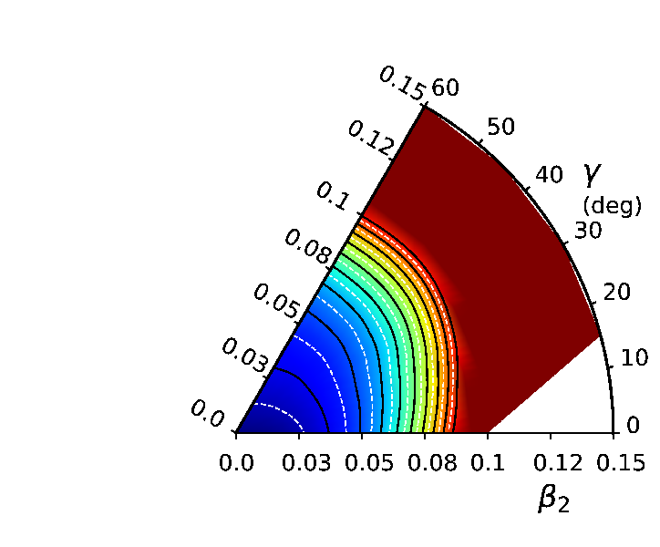
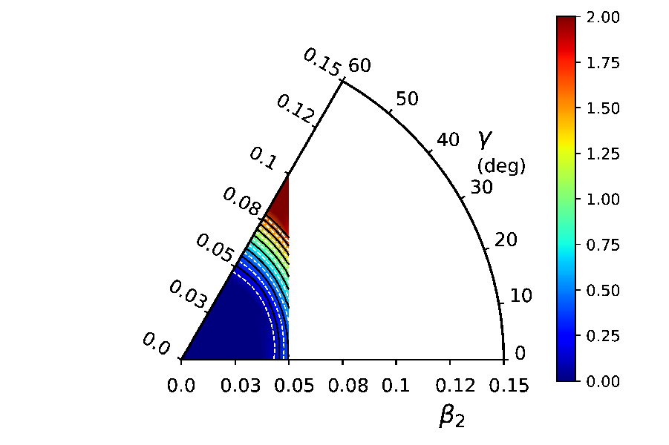
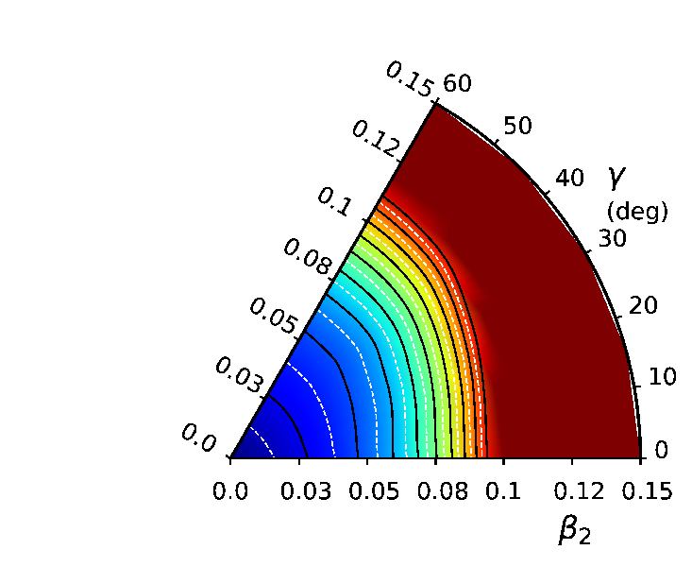
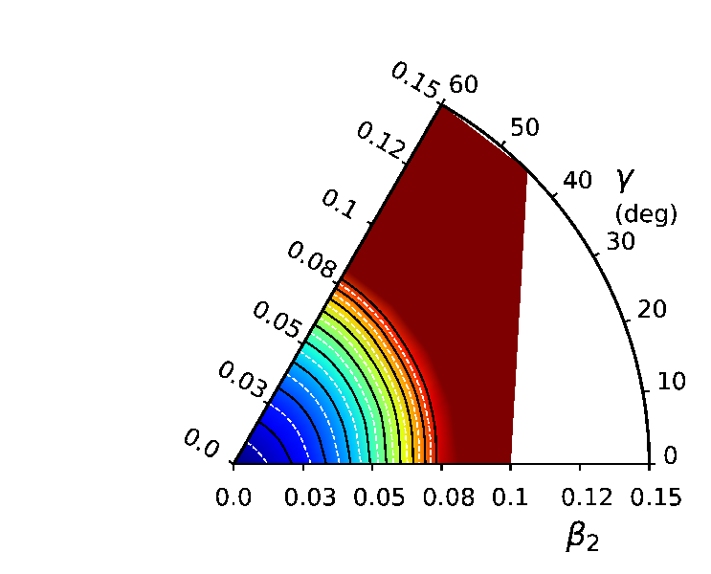
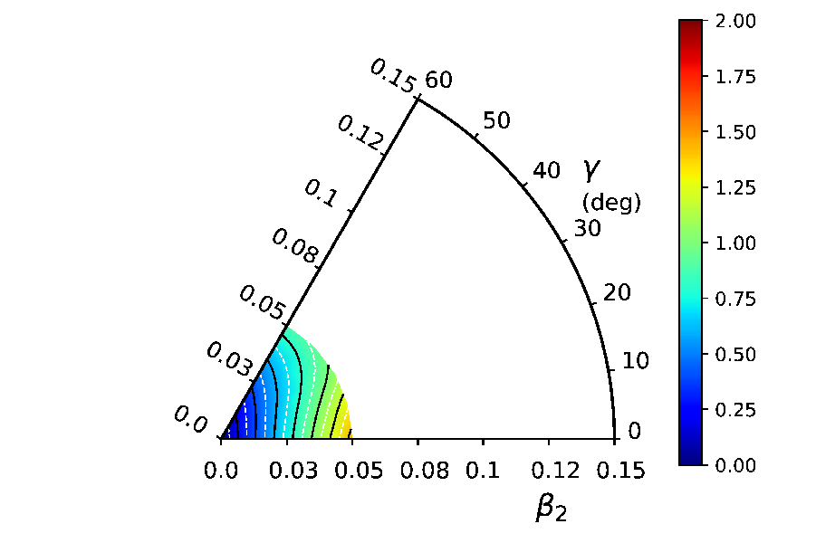
Beta-decay properties
- Oxygen isotopes: no protons in the sd-shell, only neutrons contribute (no pn channel)
PNVAP energy surfaces
[MeV]
²¹O
²³O
²⁵O
²²O
²⁴O
²⁶O

Slide 25
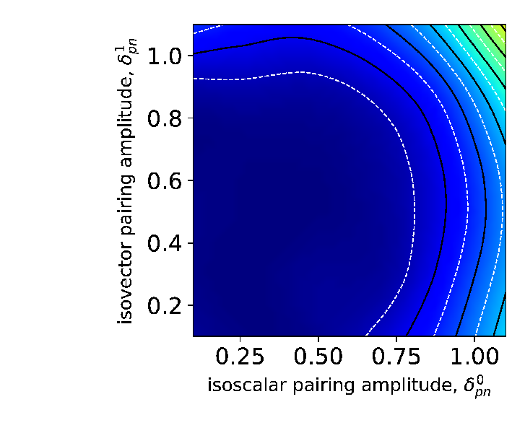
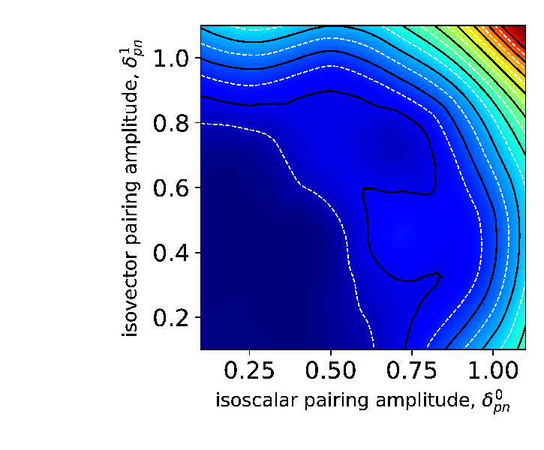
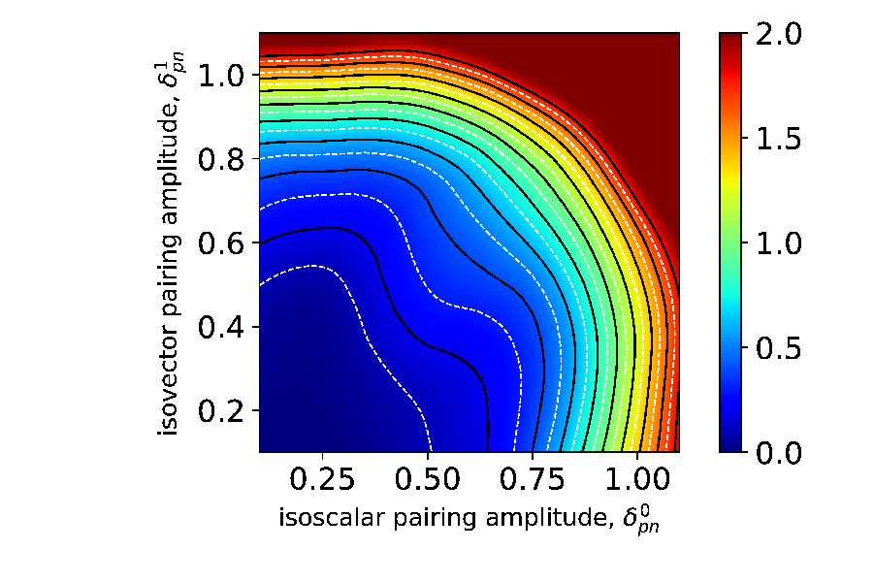
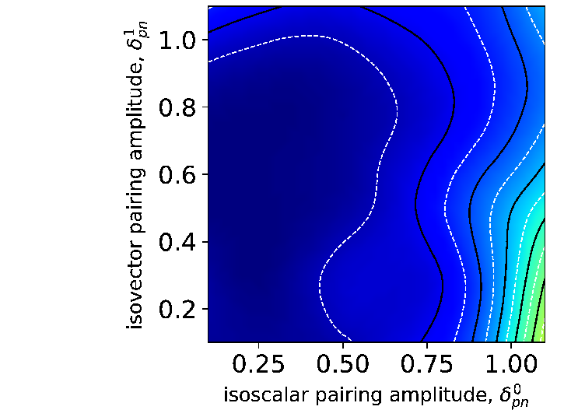
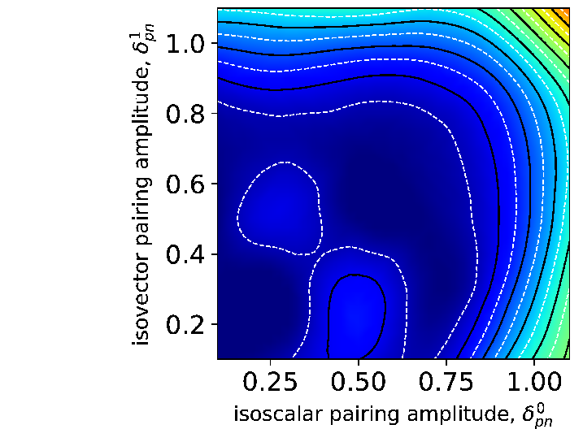
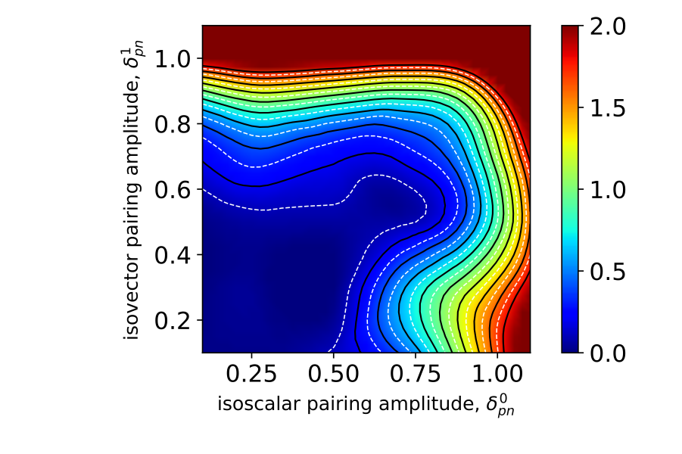
Beta-decay properties
- Fluorine isotopes
PNVAP energy surfaces
[MeV]
²¹F
²³F
²⁵F
[MeV]
²²F
²⁴F
²⁶F

Slide 26
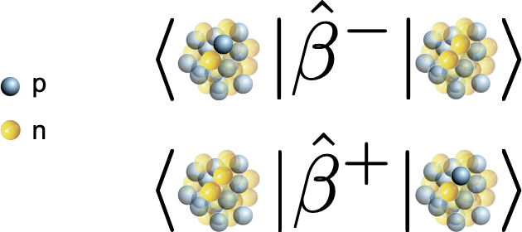
Beta-decay properties
Benchmark of the PGCM method against exact results.
mother nuclei
daughter nuclei
V. Vijayan et al., in preparation

Slide 27
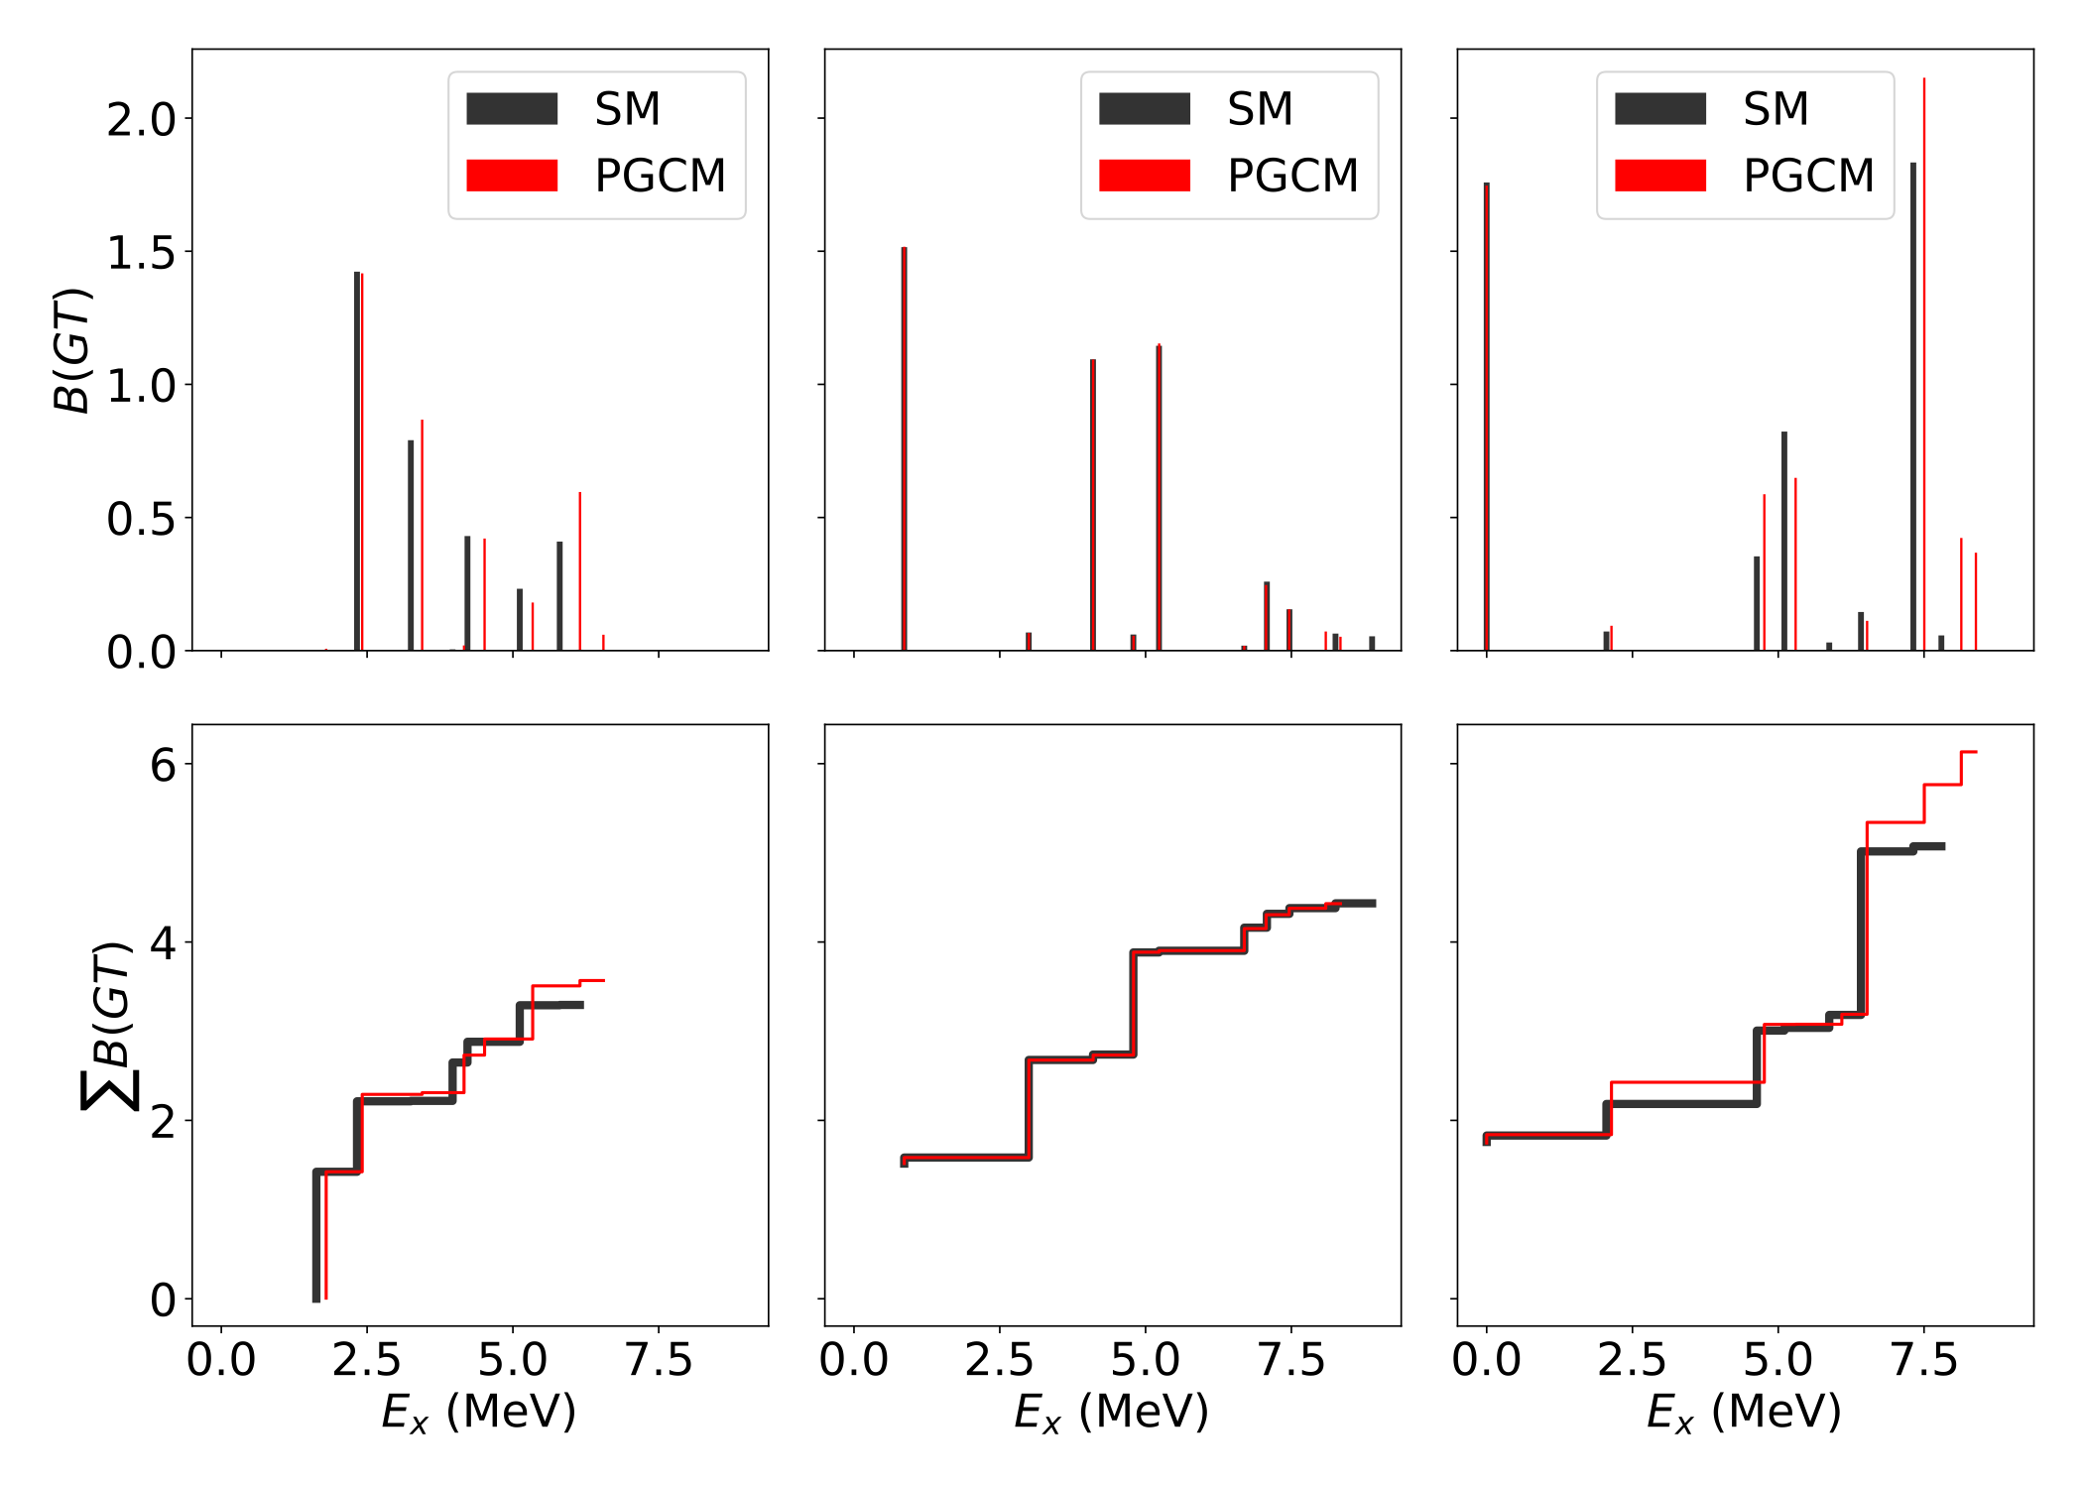
Beta-decay properties
Benchmark of the PGCM method against exact results.
*B. H. Wildenthal, M. S. Curtis, B. A. Brown, PRC 28, 1343 (1983)
 |  | B(GT)SM* | B(GT)PGCM | B.R.
²¹O (5/2⁺) → | ²¹F
 | (3/2⁺)1 | 0.040 | 0.042 | 34 %
 | (5/2⁺)2 | 0.151 | 0.151 | 29 %
²²O (0⁺) → | ²²F
 | (1⁺)2 | 1.423 | 1.417 | 82 %
 | (1⁺)3 | 0.790 | 0.867 | 15 %
²³O (1/2⁺) → | ²³F
 | (1/2⁺)1 | 0.287 | 0.249 | 55 %
 | (3/2⁺)1 | 0.267 | 0.250 | 20 %
²⁴O (0⁺) → | ²⁴F
 | (1⁺)1 | 1.515 | 1.517 | 83 %
 | (1⁺)2 | 1.094 | 1.093 | 10 %
²⁵O (3/2⁺) → | ²⁵F
 | (5/2⁺)1 | 0.638 | 0.648 | 75 %
²⁶O (0⁺) → | ²⁶F
 | (1⁺)1 | 1.758 | 1.746 | 83 %
 | (1⁺)4 | 0.822 | 0.648 | 6 %
B(GT) distributions
²²O → ²²F
²⁴O → ²⁴F
²⁶O → ²⁶F
V. Vijayan et al., in preparation

Slide 28
B(M1) strength functions in e-e nuclei
Magnetic transitions
B(M1)
😥
ground state
set of excited states
(level densities)
challenging!

Slide 29
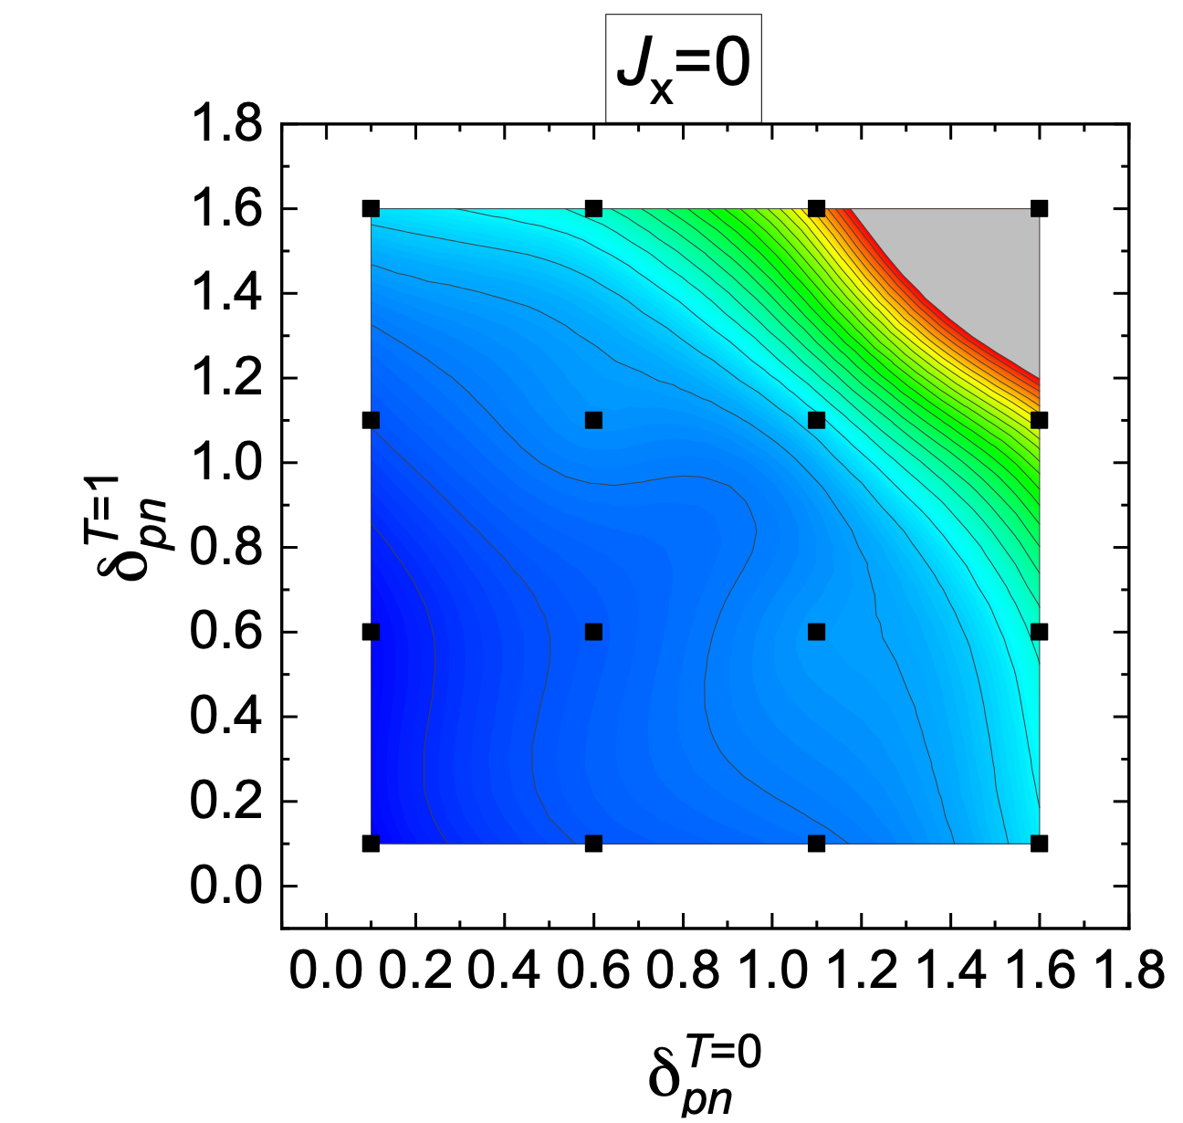
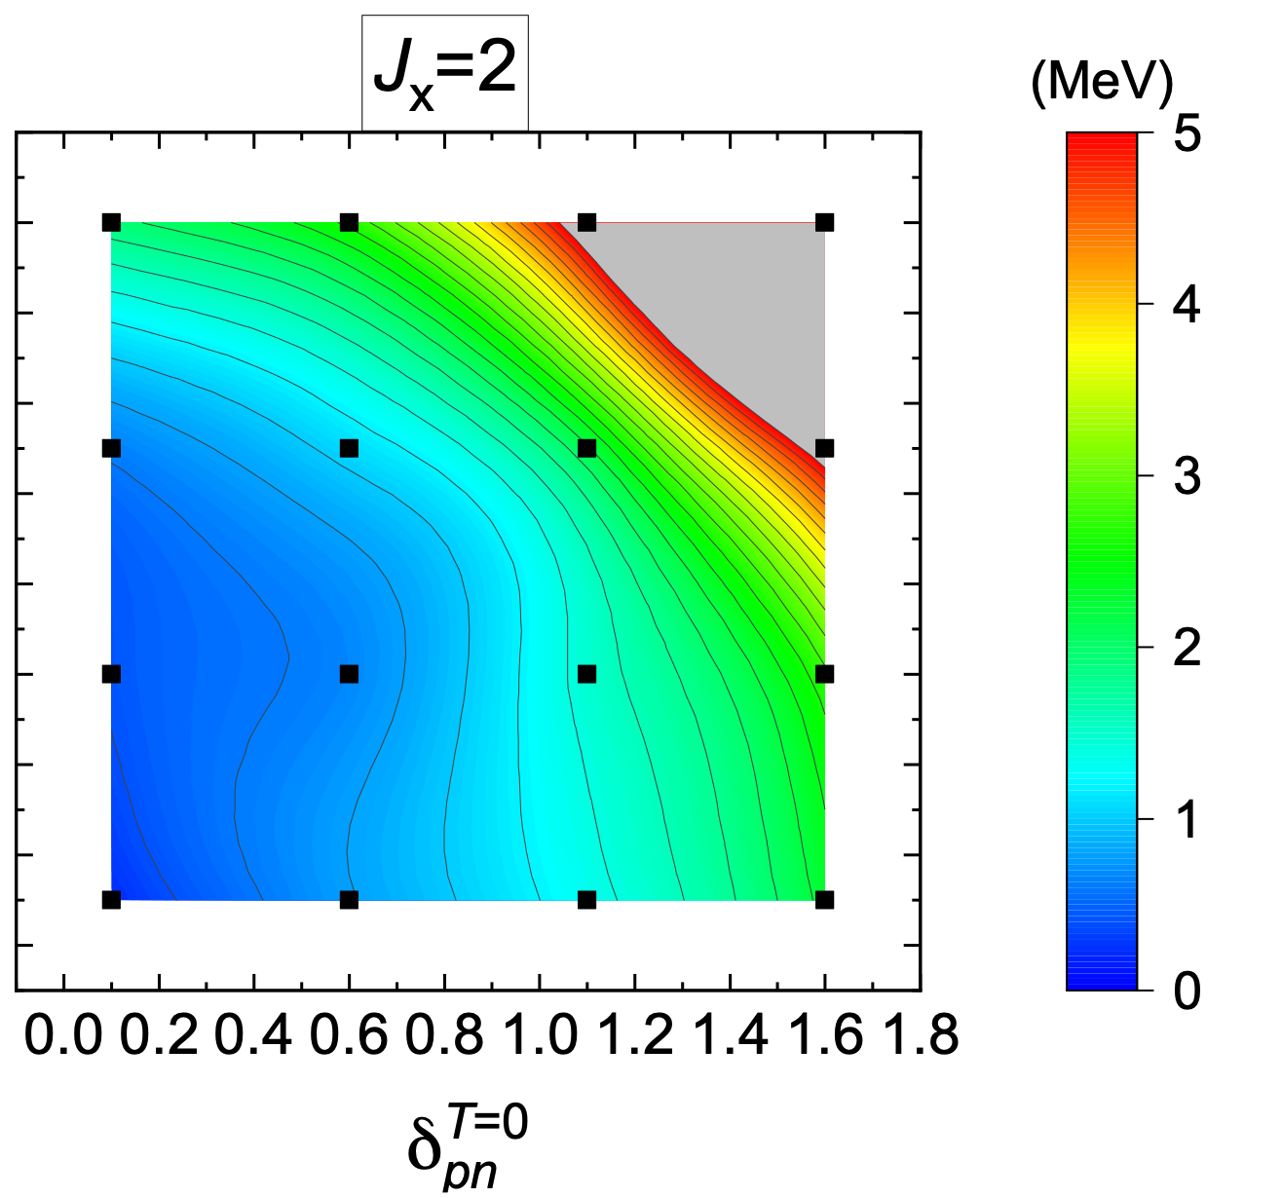
B(M1) strength functions in e-e nuclei
Exploring cranking, pn-pairing (isoscalar and isovector)
Particle-number-projected energy surfaces
- Small pn-pairing configurations are favored in this case
- Pairing is less favored with increasing cranking

Slide 30
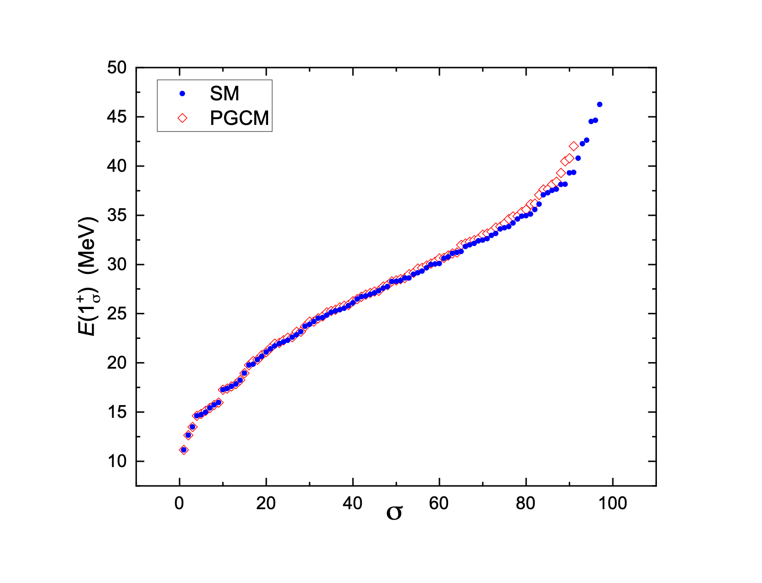
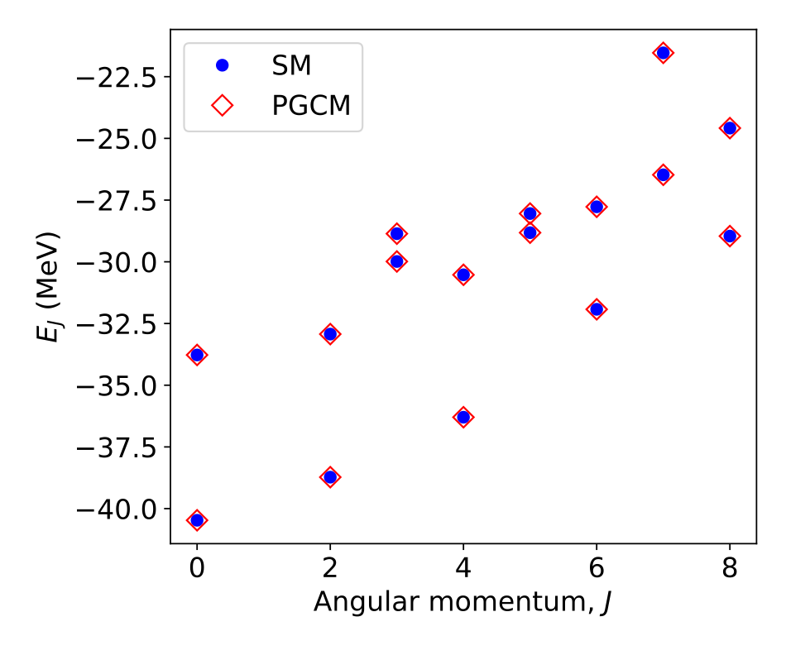
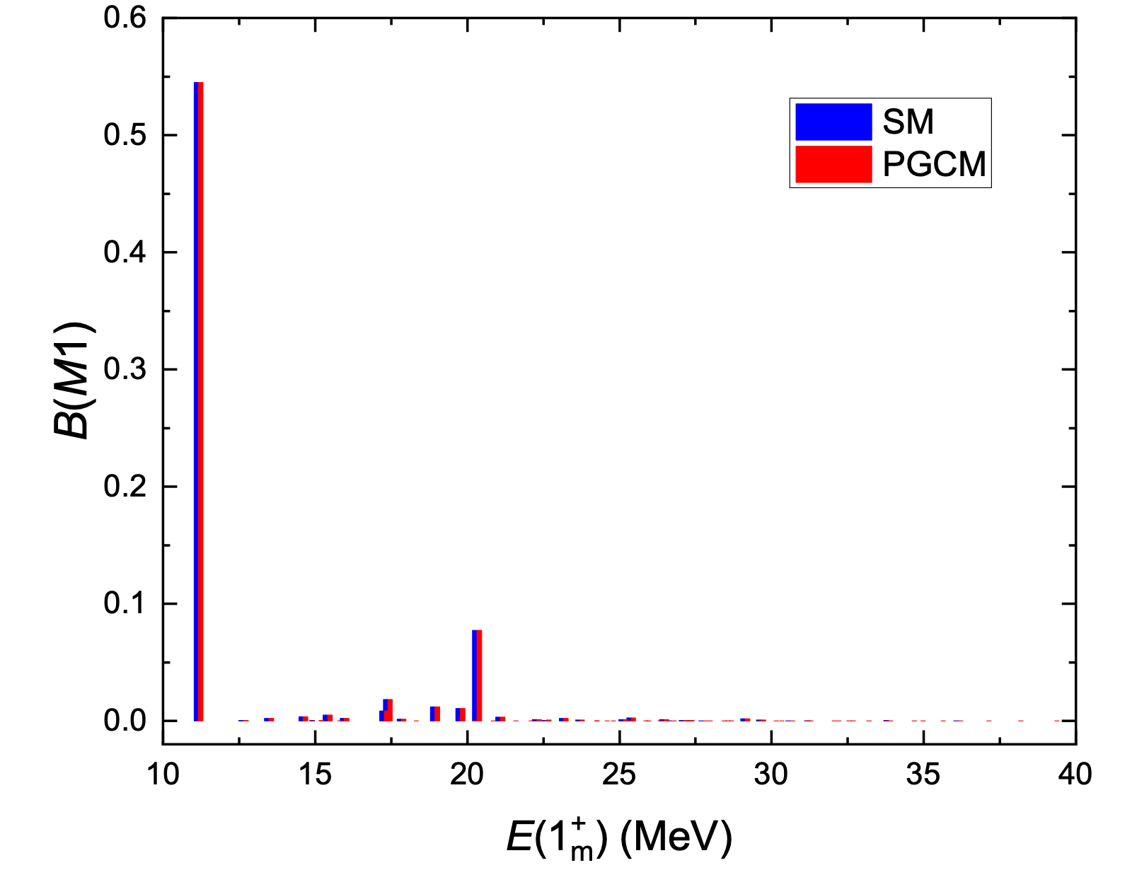
B(M1) strength functions in e-e nuclei
Exploring cranking, pn-pairing (isoscalar and isovector)
²⁰Ne
²⁰Ne
exact ground state energy
exact description of low-lying excited energies
Excellent description of the lowest excited 1⁺ states
S. Bofos, J. Martínez-Larraz et al., in preparation

Slide 31
Shape coexistence in ⁶⁶Se
Shape coexistence in ⁶⁶Se:
We can interpret the exact SM results in terms of collective coordinates (deformations)
JUN45 interaction
0g9/2
1p1/2
0f5/2
1p3/2
Z. Elekes et al., PLB 844, 138072 (2023)

Slide 32
Outline
1. Introduction
2. Projected Generator Coordinate Method (PGCM)
3. Benchmarking PGCM against shell model with TAURUS
4. Summary and Outlook

Slide 33
Summary and Outlook
SUMMARY
PGCM / ISM are complementary methods to provide a reliable description of nuclear structure observables.
PGCM is a very flexible method to approach exact solutions.
ISM states can be studied in terms of intrinsic shapes in the valence space.
OUTLOOK
Extend the calculations to many-shell (no-core) PGCM with realistic interactions.
Interpret ISM states in terms of collective variables (shapes)
Include explicitly quasiparticle excitations into the PGCM wave functions (single-particle excitations).

Slide 34
Acknowledgments
Benjamin Bally (CEA-Saclay)
Adrián Sánchez-Fernández (U. York)
Jaime Martínez-Larraz (UAM-Madrid)
Vimal Vijayan (GSI-Darmstadt)
Kamila Sieja (Strasbourg)
Thank you!

