Slide 1
Modeling Low-Density Nuclear Matter with Neural Quantum States
erhtjhtyhy
$$x_{1}$$
$$Ψ(X;ω)$$
$$x_{2}$$
$$x_{N}$$
Bryce Fore
Fifth Gogny Conference
Paris, France
December 12th 2024
Notes:
Thank you for introduction
Bryce Fore
Currently Postdoc at Argonne national lab
Discussing neural quantum states specifically in the context of solving the nuclear many body problem (even though this method is widely applicable) and even more specifically for investigations of low density nuclear matter relevant to neutron stars

Slide 2
Quantum Many-Body Methods
Notes:
To begin, just an overview of what quantum many body problems are, mention a couple methods currently used, and give a detailed description of the NQS method.

Slide 3
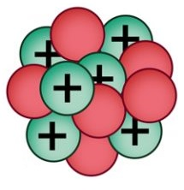
The nuclear many-body problem
Many-body Schrödinger equation
$$\left(−\sum_{i}{\frac{∇_{i}^{2}}{2m_{N}}}+V\right)\left.\left|Ψ_{0}\right.\right\rangle =E_{0}\left.\left|Ψ_{0}\right.\right\rangle$$
Nuclei
Neutron stars
Notes:
At low energy, the relevant degrees of freedom are protons, neutrons, and pions.
In this regime, when I say “solving the nuclear many body problem” I mean finding methods to solve the non-relativistic many body Schrodenger equation.
Of course there are many applications beyond ground state calculations, but
For the purpose of the results in this talk, I will only discuss time independent ground states.
In particular, I will have some discussion of NQS results in nuclei, but mainly show results for low density nuclear matter calculations.

Slide 4
The nuclear many body methods
Configuration-interaction
Quantum Monte Carlo
$$\left.\left|Ψ_{0}\right.\right\rangle =\sum_{h_{1},…,p_{1},…}{c_{h_{1}…}^{p_{1}…}\left.\left|Φ_{h_{1}…}^{p_{1}…}\right.\right\rangle }$$
$$\left.\left|Ψ_{V}\right.\right\rangle =\sum_{n}{c_{n}\left.\left|Ψ_{n}\right.\right\rangle }$$
$$\left.\left|Φ_{h_{1}…}^{p_{1}…}\right.\right\rangle =a_{p_{1}}^{†}…a_{h_{1}}…\left.\left|Φ_{0}\right.\right\rangle$$
$$\left.H\left|Ψ_{n}\right.\right\rangle =E_{n}\left.\left|Ψ_{n}\right.\right\rangle$$
$$\left.\lim_{τ→∞}{e^{−\left(H−E_{0}\right)τ}}\left|Ψ_{V}\right.\right\rangle =c_{o}\left.\left|Ψ_{0}\right.\right\rangle$$
$$\left.\left|Φ_{0}\right.\right\rangle$$
$$\left.\left|Φ_{h_{2}}^{p_{1}}\right.\right\rangle$$
Notes:
There are many methods of solving these ground state calculations which have been developed for many decades, which I won’t go into detail on here.
In particular, I’m interested in methods which don’t require any assumptions on nuclear structure.
A couple of examples include Configuration-Interaction methods and Quantum Monte Carlo methods.

Slide 5
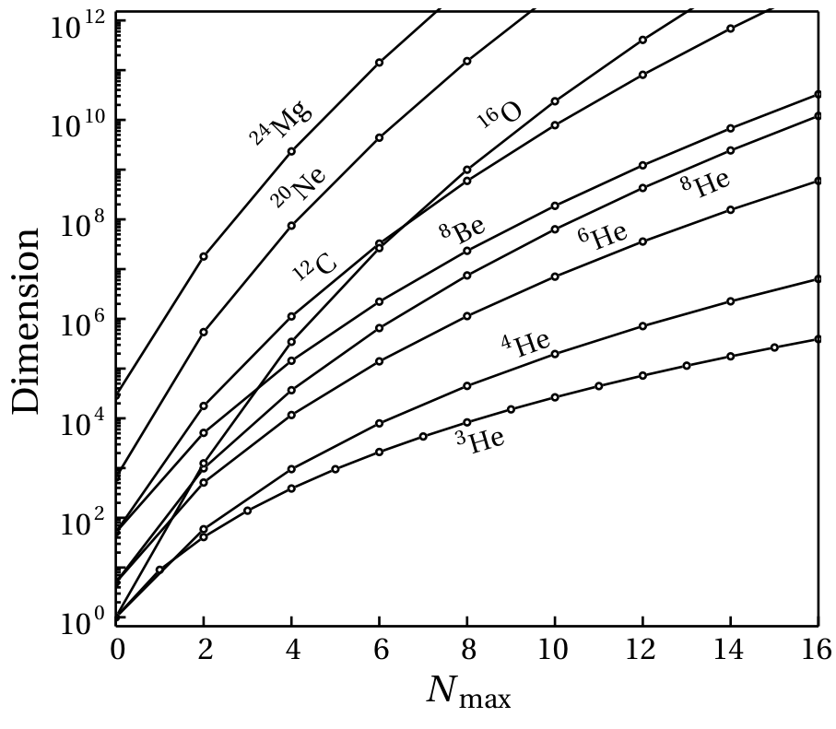
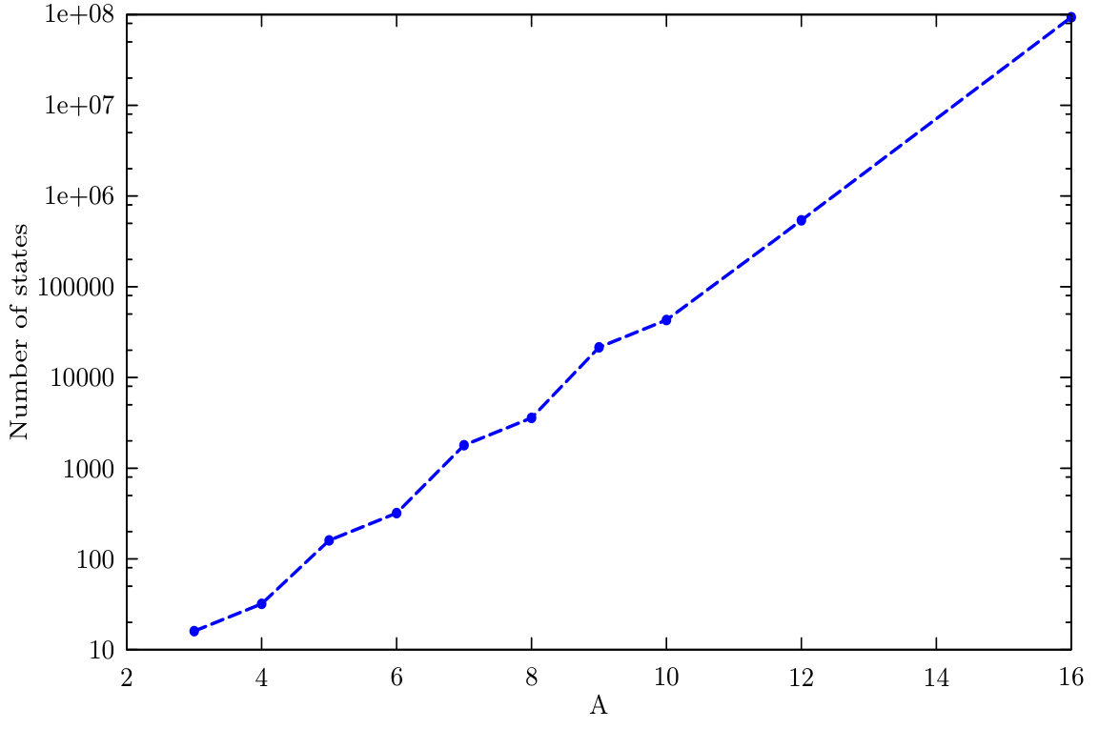
Curse of dimensionality
Configuration-interaction
Green’s function Monte Carlo
$$\left({N \atop A}\right)=\frac{N!}{\left(N−A\right)!A!}$$
$$\lim_{τ→∞}{e^{−\left(H−E_{0}\right)τ}}\left.\left|Ψ_{V}\right.\right\rangle =c_{o}\left.\left|Ψ_{0}\right.\right\rangle$$
Credit: Patrick Fasano
Credit: Alessandro Lovato
Notes:
Each of these methods has issues which drastically increase the dimensionality of the problem beyond small nuclei.
For the configuration-interaction method, the occupation-number representation quickly leads to an explosion in the dimentionality of our state’s representation
Where as for greens function monte carlo the dimensionality of the integral scales quickly with the number of particles
Other quantum monte carlo methods come with similar downsides that result in exponential computation time for accurate calculations.
This means that very accurate calculations of systems beyond 16 or so particles quickly become infeasible for these methods.

Slide 6
Neural network quantum states
Artificial neural networks compactly represent complex high-dimensional functions
Most quantum states of interest have distinctive features and intrinsic structures
$$x_{1}$$
Hilbert Space
$$Ψ(X;ω)$$
$$x_{2}$$
Physical States
$$x_{N}$$
Mean-field
Credit: Giuseppe Carleo
Notes:
Due to the spin dependent correlations in fermionic systems the space to explore is huge
While the actual space occupied by physical states can often be characterized by a much lower amount of information,
thanks to intrinsic structures in the state.
We can take advantage of this in the NQS method.
The short description of the Neural Quantum State method is that it represents the wavefunction, psi, by a neural network architecture with position and spin input, x, for every particle, and neural network parameters omega.
Because Neural networks are very good at compactly representing high-dimensional functions they work extremely well as wavefunction ansatz. This prevents the exponential scaling required by the other methods I mentioned, with the only requirement being that we build in fermion antisymmetry directly into the network.

Slide 7
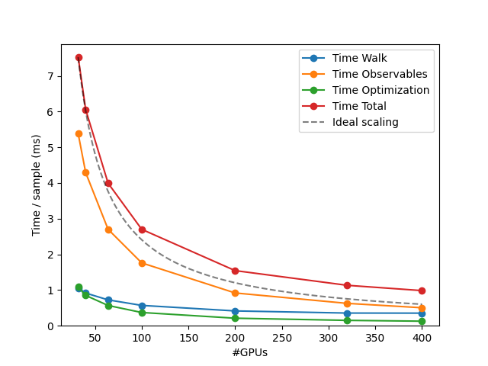
Scaling and computational performance
Scaling with resources
Scaling with system size
Conventional QMC:
$$O(2^{A})$$
Neural quantum states:
$$O(A^{5})$$
A = Number of particles in system
Notes:
Giving the interesting part first, the worst case scaling for NQS goes like A to the 5th compared to the exponential scaling of conventional QMC.
The empirical scaling of NQS should be closer to something between A^2 or A^3 in our current implementation.
To put it in terms of numbers of nucleons, conventional QMC calculations are stuck at somewhere from 12 to 16 nucleons,
while we’ve done accurate calculations with up to 40 nucleons using NQS. With 100s of nucleons being possible based on these initial calculations.
This means that with an accurate nuclear Hamiltonian, ab initio calculations of nuclei can be extended much farther than is feasible with conventional QMC.
Additionally relevant to increasingly large simulations is the scaling of the algorithm. The scaling plot on the right shows the total time per sample in red and the various sections of the algorithm in other colors.
We can see that the scaling is nearly ideal with increasing numbers of GPUs, including in the observables portion of the algorithm which is where the A to the 5th scaling comes from.

Slide 8
Variational Monte carlo with NQS
Create the NQS wavefunction
Compute its energy (Metropolis-Hastings algorithm)
Minimize the energy w.r.t parameters, $ω$, to reach the ground state
$$Ψ_{V}(R,S;ω)=e^{U\left(R,S;ω\right)}Φ(R,S;ω)$$
$$\frac{\left\langle Ψ_{V}\left|O\right|Ψ_{V}\right\rangle }{\left\langle Ψ_{V}|Ψ_{V}\right\rangle }≈\frac{1}{N_{conf}}\sum_{\{R, S\}}{O_{L}(R, S)}$$
$$E_{0}≤E_{V}=\frac{\left\langle Ψ_{V} | \hat{H} | Ψ_{V}\right\rangle }{\left\langle Ψ_{V} | Ψ_{V}\right\rangle }$$
Notes:
I’m going to give a quick overview of what a calculation with NQS looks like before getting to any results.
Ultimately the main algorithm loop is essentially VMC. Define some parameterized wavefunction, sample it with Monte Carlo sampling, minimize the energy.
The only fundamental difference comes from defining our wavefunction ansatz with neural networks to increase its flexibility.
The sampling is essentially what you would expect from many monte carlo algorithms, so I will just say that we can quickly get configurations which sample our current wavefunction.
Since this is a VMC algorithm we are only sampling the wavefunction squared. So the usual issues with Diffusion monte carlo don’t appear.
This process doesn’t change the wavefunction or its parameters in any way. It only provides position and spin values that sample it.
From these samples we can evaluate various observables.
Importantly, we can use these samples to evaluate the energy of our current wavefunction given the systems Hamiltonian.
Finally, in defining our wavefunction ansatz we ensure it always satisfies fermion antisymmetry by construction.
This is necessary in one sense so on optimizing we don’t end up with a bosonic ground state.
Additionally, because we enforce antisymmetry, the variational principal ensures our wavefunctions energy will always be greater than the real ground state.
I will also not go into detail on the optimization method in favor of spending more time on the NQS architecture.
There are some important points on making sure this optimization is stable, however for the purposes of this talk its sufficient to understand that we are just minimizing the energy with respect to the NN parameters.
Because our energy is greater than that of the true ground state we can only get closer to it in this optimization.

Slide 9
Fermionic wavefunctions
$$Ψ_{V}(X)=e^{U\left(X\right)}Φ(X)$$
Build in fermion antisymmetry for network compactness
Permutation-invariant Jastrow function improves ansatz flexibility
Build U and $Φ$ functions from fully connected, deep neural networks
$$Ψ\left(…{,x}_{i}, …x_{j}…\right)=−Ψ(…,x_{j},…x_{i}…)$$
$$U\left(…{,x}_{i}, …x_{j}…\right)= U(…,x_{j},…x_{i}…)$$
$$Φ\left(…{,x}_{i}, …x_{j}…\right)=−Φ(…,x_{j},…x_{i}…)$$
Notes:
As I mentioned, we have to build in fermion antisymmetry directly into our NQS structure.
For now, lets just assume I have some parameterized function, phi, which is antisymmetric on exchange of any two particles.
Additionally, I have some family of functions, U, which are symmetric when exchanging particles.
I will go into the specifics of how we construct these on the next slides, but the general idea is that each of these is built from neural networks to make them as general as possible.
Thus allowing us to reach a state as close to the ground state as possible.
The function phi directly encodes our fermion antisymmetry, but its possible this isn’t flexible enough.
We can include the symmetric function, U, to provide additional flexibility to the ansatz. And I usually call this a Jastrow function

Slide 10
Deep set architecture
Generic permutation invariant function
$$U\left(X\right)=ρ\left(\sum_{i}{\vec{φ}}(x_{i})\right)$$
$$\vec{φ}:ℝ^{5}→ℝ^{N}$$
$$ρ:ℝ^{N}→ℝ$$
Wagstaff et al., arXiv:1901.09006 (2019)
Zaheer et al., arXiv:1703.06114 (2017)
Notes:
The Jastrow function part of the state is fairly straight-forward. We require a function that is independent of the ordering of our particles in order to not change the overall antisymmetry provided by the antisymmetric function.
A method called a Deep Set Architecture provides a simple, but expressive, solution to this issue. The method is fairly simple. We start with a single function, which I’ll call phi, that takes the position and spin information of a particle to some latent space.
These results are summed over all particles so that there is no longer any information on the ordering of the particles.
We can then apply another function, called rho, to the result to map back to the real numbers.
The functions phi and rho can easily be represented by feed forward neural networks which just provide additional parameters to be optimized over.
The layering of these functions around the summation step allows our final Jastrow function to be as expressive as possible.

Slide 11
Neural Slater-Jastrow Ansatz
Slater determinants used in other methods to represent many-body states
Slater determinant to enforce antisymmetry
Single particle wavefunctions represented by neural networks
$$Ψ_{V}(X)=e^{U\left(X\right)}Φ(X)$$
$$Φ(X)=\left|\begin{matrix}φ_{1}\left(x_{1}\right) & φ_{1}\left(x_{2}\right) & … & φ_{1}\left(x_{N}\right) \\ φ_{2}\left(x_{1}\right) & & & ⋮ \\ ⋮ & & & \\ φ_{n}\left(x_{1}\right) & … & & φ_{n}\left(x_{N}\right)\end{matrix}\right|$$
Notes:
Here I describe the first NQS ansatz we used.
Called the neural slater-Jastrow ansatz because it is very similar to a slater-Jastrow wavefunction.
Essentially the Jastrow function I just described is multiplied by a slater determinant,
however, the single particle states, 1 through n, here are simple fully connected neural networks.
We don’t include any information about realistic states here, only allowing the NQS to fully learn what the systems ground state looks like.
In case anyone isn’t familiar with a slater determinant, the basic idea is that each particle coordinates, 1 to n, appear in an column of the determinant.
In this way swapping any of them swaps two columns in the determinant resulting in an overall minus sign.
As mentioned before, we’ve constructed our NQS entirely from NN.
The only physics input that has gone into this process so far is enforcing fermion antisymmetry.
With all the other physics coming from the Hamiltonian in the training process.

Slide 12
Neural Pfaffian Ansatz
Slater determinant → Pfaffian
Build in antisymmetry through a single pairing network rather than determinant of single-particle states
$$det(M)=pf{\left(M\right)}^{2}$$
$$φ(x_{i},x_{j})=η\left(x_{i},x_{j}\right)−η(x_{j},x_{i})$$
$$Φ\left(X\right)=pf\left[\begin{matrix}\begin{matrix}0 & φ(x_{1}, x_{2}) \\ φ(x_{2}, x_{1}) & 0\end{matrix} & \begin{matrix}⋯ & φ(x_{1}, x_{N}) \\ ⋯ & φ(x_{2}, x_{N})\end{matrix} \\ \begin{matrix}⋮ & ⋮ \\ φ(x_{N}, x_{1}) & φ(x_{N}, x_{2})\end{matrix} & \begin{matrix}⋱ & ⋮ \\ ⋯ & 0\end{matrix}\end{matrix}\right]$$
J. Kim, Commun Phys 7, 148 (2024)
Notes:
Unfortunately, the slater Jastrow ansatz isn’t expressive enough on its own to capture ground states beyond very light nuclei.
We’ve tried a variety of other architectures, the most recent of which I will describe quickly.
In what we call the neural Pfaffian ansatz, we use a Pfaffian instead of the slater determinant to supply the antisymmetry.
Where the slater determinant required a separate neural network to represent each single particle state,
we instead have only one network, eta, for this architecture.
This network is applied to every pair of nucleons.
Its not obvious, but the shown construction of this paring network still results in an overall negative sign on particle exchange.
Because we only have one network, this architecture requires far fewer parameters while also building in pairing correlations directly.
The importance of pairing in nuclear systems means this construction of the wavefunction ansatz functions exceptionally well for nuclei and nuclear matter.
Must be skew symmetric, $A={−A}^{T}$, and square with even size

Slide 13
Message passing neural network
Backflow transformation representable by updates to fully connected graph
$$x_{i}→f(x_{i};{\{x_{j}\}}_{j≠i})$$
$${ x}_{1}$$
Update edge values based on vertices
Update vertex values based on connected edges
Retains ordering information for antisymmetry operation
$${ x}_{6}$$
$${ x}_{2}$$
$${ x}_{5}$$
$${ x}_{3}$$
$${ x}_{4}$$
Notes:
Finally, separate from these antisymmetric ansatz are potential backflow methods which function as preprocessing for the input coordinates. The most successful of these takes advantage of the pairwise nature of the interactions of the nuclear forces by representing the configuration as a fully connected graph
Each vertex and edge gets a value
Update edge values from vertices
And update vertices values from connected edges (the image on the right shows this)
By construction this retains the ordering information so the symmetric and antisymmetric portions of our wavefunction are unchanged.
Additionally, this can be repeated if needed for more complex preprocessing as the output can just be fed back in.
Currently one or two iterations has proven sufficient for the systems I’ve looked at.

Slide 14
NQS Results
Notes:
Finally, I will go into some results I’ve obtained using NQS.

Slide 15
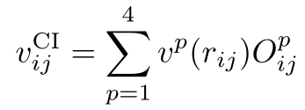
Pionless eft hamiltonian
Pionless-EFT Hamiltonian
NN potential fit to
np scattering lengths
effective radii
deuteron binding energy
Three body potential adjusted to reproduce ³H binding
R. Schiavilla, PRC 103, 054003(2021)
Notes:
Now, before showing the results, I’ll give some information on the Hamiltonian I’m currently using.
It’s also important to mention that the Hamiltonian is really the only input to the neural quantum states method.
We’ve started with a leading order pionless EFT which includes spin and isospin dependence as well as a three body force.
This include charge independent terms in the nuclear potential as well as the coulomb force between protons.
This potential has been shown previously to give accurate energies for nuclei with up to about 20 nucleons.

Slide 16
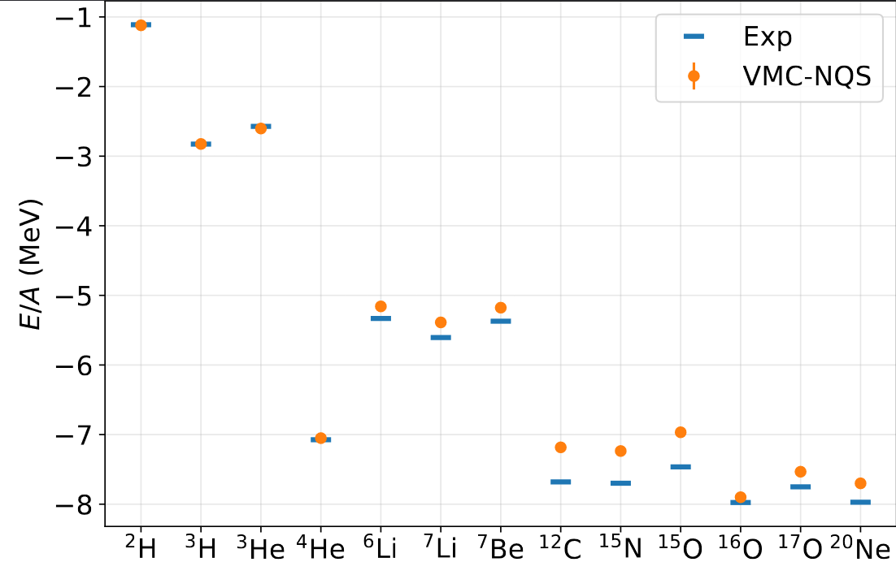
Neural quantum state results in nuclei
A. Gnech, Phys. Rev. Lett. 133, 142501
Notes:
This figure shows energies using the NQS method I just described for a variety of nuclei with up to 20 nucleons compared to experimental values
We can see the results are very good given the simplicity of the Hamiltonian.
The differences from the experimental results mostly come from the Hamiltonian as the NQS outperforms Auxiliary field diffusion monte carlo results in each of these nuclei.

Slide 17
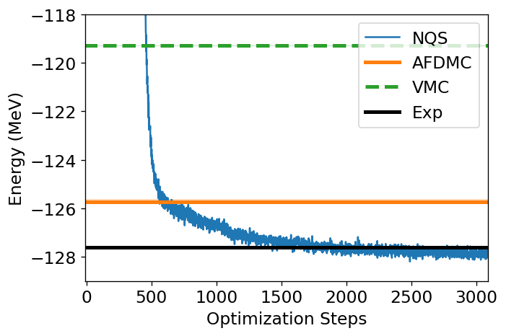
Results in 16O
Notes:
Here I’m specifically showing the training results only for 16O.
The x axis is the number of optimization steps that have passed while the y axis is the energy.
We can see that the NQS results in blue quickly pass the traditional VMC results given by the green dashed line.
The NQS result also improves upon the AFDMC result and ends at an energy very near the experimentally measured ground state energy.

Slide 18
Bulk Nuclear matter setup
Periodic boundary conditions and coordinate system
Potential energy contribution from particle images
Remove Coulomb potential
Notes:
From nuclei, applying this method to bulk matter is straightforward.
Everything about VMC that I have mentioned works just as well for Nuclear matter as it does for Nuclei.
For bulk matter we just need to enforce periodic boundary conditions and coordinate system.
This includes adding potential energy contributions from image particles.
Also, we remove the coulomb potential since we assume it is screened in nuclear matter.

Slide 19
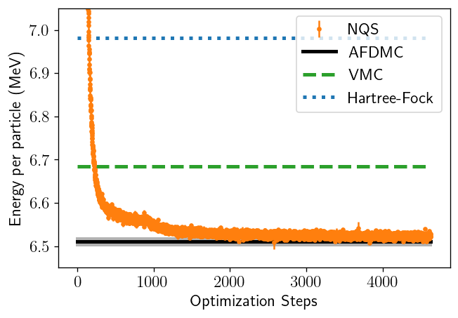
Pure Neutron matter
Neutron Matter (14 particles, 0.04 fm⁻³)
B. Fore, Phys. Rev. Res. 5, 033062(2023)
Notes:
The most straightforward aspect of the inner crust we can model is the pure neutron component.
Here I have a plot of the training of the NQS over many optimization steps.
DESCRIBE AXES
COMPARE TO VMC (green doesn’t use NQS) and DMC
We can see the NQS result agrees with the AFDMC result. As we would expect in a simple system like this.
Important to note here, the unconstrained DMC results I show here require millions of CPU hours to get. While the requirements for the NQS are extremely modest by comparison. Only requiring around a hundred gpu hours.

Slide 20
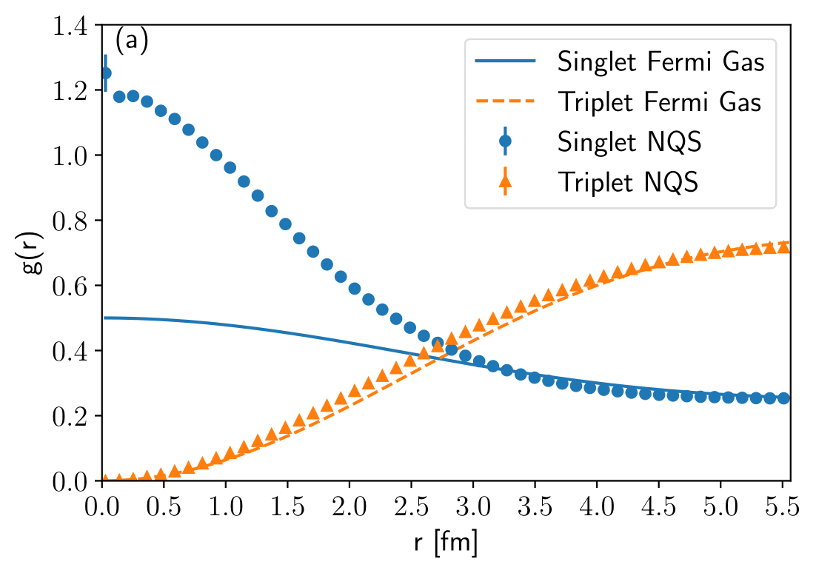
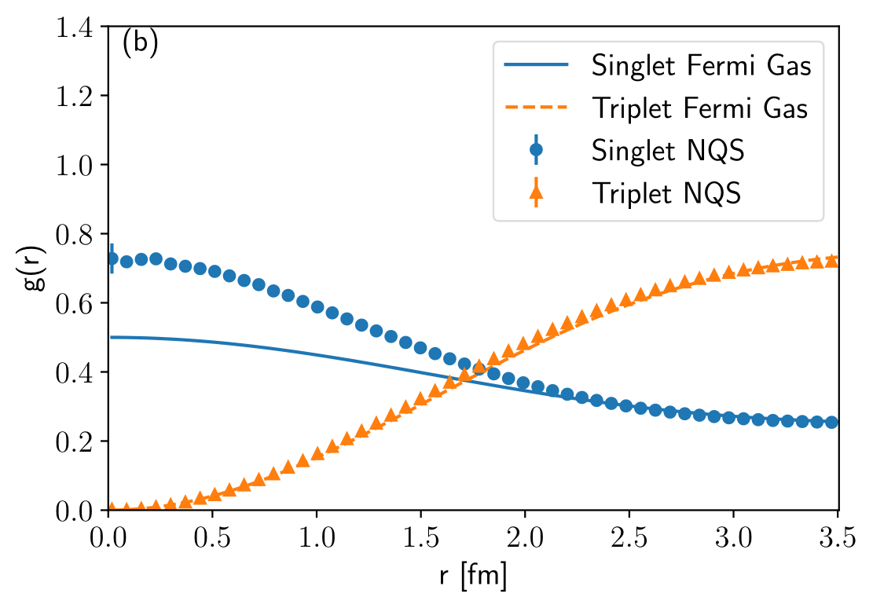
Two-body pair distributions
0.01 fm⁻³
0.04 fm⁻³
B. Fore, Phys. Rev. Res. 5, 033062(2023)
Notes:
From the wavefunction we created for pure neutron matter, represented by the NQS, we can investigate the presence of a neutron superfluid.
This analysis is not possible from the DMC result.
These plots show the probability of finding particular types of pairs of neutrons at specific distances.
This is compared to the non-interacting case in the solid and dotted line results.
What we expect to see for a neutron superfluid is an excess of singlet pairs at short distance. And we can see this is exactly what show up in the low density plot on the left.
Additionally, this excess begins to go away at larger densities like on the right. Which we also expect to occur at higher density in neutron matter.
Similar to the cold fermi gas results, we’ve found that the NQS captures the physics of changing phases in a material without needing to input that information externally.
This is obvious very important if you want to learn where the boundaries of different phases of matter occur in a system.

Slide 21
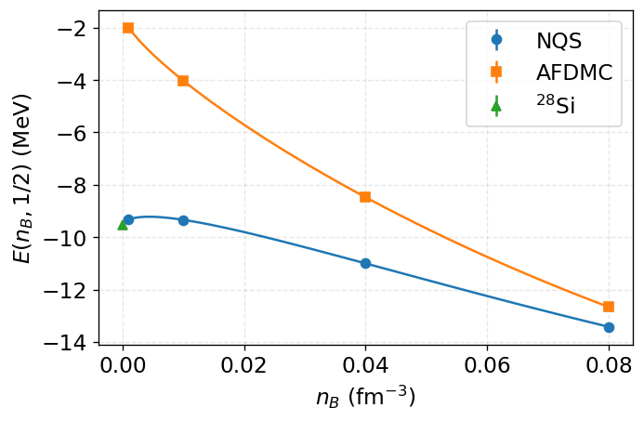
symmetric Nuclear matter
B. Fore, arXiv:2407.21207
Notes:
We can additionally look at the energy of symmetric matter
This plot shows the energy results from our NQS simulations at various densities corresponding to the inner crust. At all densities we’ve modeled the NQS is able to reach lower energies than the DMC result. This is likely because the DMC results are not able to capture clustering at these densities.
At higher densities the clustering effects are less important and we can see this is where the DMC result does much better
Because we expect to recover nuclei at zero density, I’ve added to the plot the energy value for a nuclei with 14 neutrons and 14 protons. So this periodic simulation of 14 neutrons and 14 protons is able to correctly find the lowest energy state at low density.
This gives us confidence in the ability of this method to correctly predict clustering at the densities corresponding to the inner crust of neutron stars

Slide 22
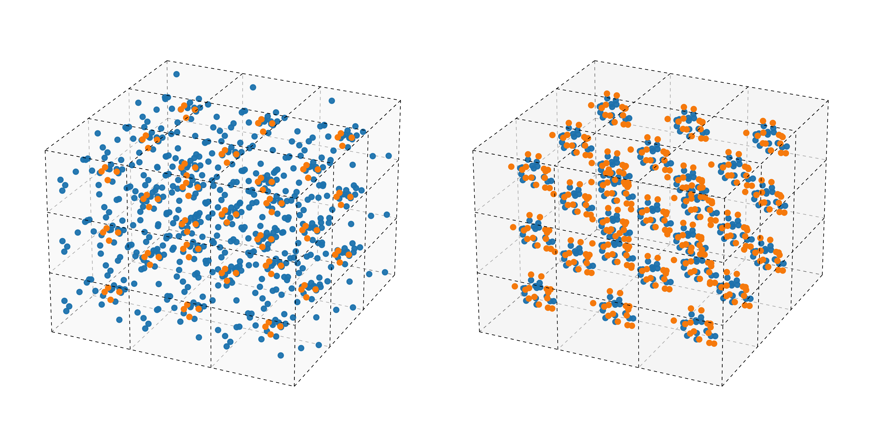
Self emerging Clustering
Density: $0.01$fm⁻³
Proton
Neutron
Fully clustered
(28Si Nucleus)
Proton clusters
Free neutron
component
4 protons; 24 neutrons
14 protons; 14 neutrons
B. Fore, arXiv:2407.21207
Notes:
For a bit more detail on the clustering, I have here some plots showing a random snapshot of the particle locations in our simulations at low density. These particle positions are repeated for every adjacent cell to emphasis the periodic nature of the simulation.
We can see on the right a simulation of symmetric matter with this clustered state very much like 28 silicon.
Additionally, if we attempt to simulate an asymmetric system closer to realistic proton fractions, as expected we are able to see the protons and neutrons forming clusters with a large number of decoupled neutrons.
The size of the systems we analyzed here are too small to be considered accurate even though they are already beyond what is remotely possible with conventional methods. However, we are still able to see the correct structures appearing.

Slide 23
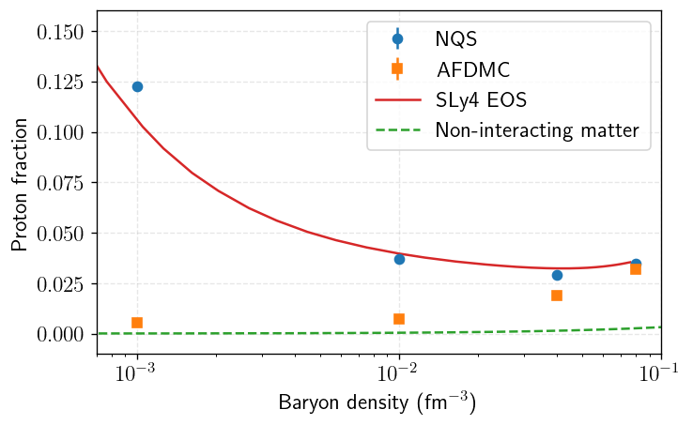
Nuclear matter proton fraction
Assumptions:
Charge neutrality
Beta equilibrium
$$n_{p}=n_{e}$$
$$μ_{e}=μ_{n}−μ_{p}$$
B. Fore, arXiv:2407.21207
Notes:
Utilizing this and a few standard assumptions in neutron star physics allows us to compute the fraction of nuclear matter that is protons at a given density.
The results for NQS in blue are compared to a representative equation of state in red and we can see the NQS results closely follow this within this range of densities.
I’ve additionally plotted the equivalent results for the DMC calculation that I showed previously.
Because this method is not able to properly capture the clustering of symmetric matter it falls well short,
ultimately predicting matter that looks like non-interacting results at low density

Slide 24
Conclusions and Next steps
Conclusions:
Favorable scaling with number of fermions
Universal and accurate approximations for fermion wavefunctions
Scaling to leadership-class computers
NQS can model a variety of phases of nuclear matter material
Next steps:
Improved nuclear potential including tensor term
Expanding to larger nuclei and larger periodic systems to avoid finite size effects
Excited state calculations
Notes:
Finite size effects, (tensor term->overcomplete basis sampling)

Slide 25
Collaborators
A. Lovato, A. Tropiano
J. Kim
M. Hjorth-Jensen
Notes:
I’d like to make sure to thank my collaborators before ending.
Alessandro Lovato introduced me to the method and provided the basis of this code. Anthony Tropiano is helping us to improve our current nuclear potential.
Jane Kim currently at Ohio University, has preformed an enormous amount of work with me improving the code including originally creating and testing the Neural Pfaffian Ansatz, not to mention analyzing several different non-nuclear systems.
And Morten Hjorth-Jensen has provided significant feedback and oversite throughout my own involvement in the project.

Slide 26
Thank you
Notes:
- I didn’t mention it within the talk but because the Pfaffian builds in pairwise correlations directly the Jastrow function may not be necessary for this ansatz. Preliminary investigations with small nuclei have been preformed without a Jastrow function resulting in improved convergence time due to smaller numbers of parameters.
- Pfaffian parameters num constant with increasing particle number. Maybe need to increase size as we go on.

Slide 27
Metropolis-hastings Sampling
Sampling algorithm:
Randomly sample coordinates, R’, and spins, S’
If P is greater than uniform random variable from 0 to 1, accept new values
Observables are estimated by taking averages over sampled configurations
$$P_{R}=\frac{{\left|Ψ_{V}(R′, S)\right|}^{2}}{{\left|Ψ_{V}(R, S)\right|}^{2}}$$
$$P_{S}=\frac{{\left|Ψ_{V}(R, S′)\right|}^{2}}{{\left|Ψ_{V}(R, S)\right|}^{2}}$$
$$\frac{\left\langle Ψ_{V}\left|O\right|Ψ_{V}\right\rangle }{\left\langle Ψ_{V}|Ψ_{V}\right\rangle }=\frac{\sum_{S}{\int{dR {\left|Ψ_{V}\left(R, S\right)\right|}^{2} O_{L}(R, S)}}}{\sum_{S}{\int{dR {\left|Ψ_{V}\left(R, S\right)\right|}^{2}}}}≈\frac{1}{N_{conf}}\sum_{\{R, S\}}{O_{L}(R, S)}$$
$$O_{L}=\frac{\left\langle RS|O|Ψ_{V}\right\rangle }{\left\langle RS|Ψ_{V}\right\rangle }$$
Notes:
First I’d like to give a quick overview of the last two steps. Sampling to get the energy and optimizing the wavefunction.
The basic idea of the Metropolois algorithm is to take some random initial configurations (the positions and spins for the particles in the system) and update them to correctly sample whatever our current state is.
To preform the update, we move the coordinates and spins a bit and check how likely these are to be sampled compared to the old values. These probabilities are the P sub R and P sub S
From here the metropolis algorithm tells us weather we should keep the new values or the old and that by repeating this process we will eventually properly sample our state.
This process doesn’t change the wavefunction at all, which initially starts with some random initialization. It only updates the coordinates to correctly sample the current wavefunction.
Once we do have correctly sampled configurations, we estimate the value of any observable we need through a simple average of the values for each configuration.
In particular, this gives us the energy of the state which we can use in the optimization.

Slide 28
NQS optimization
Improve wavefunction by minimizing energy expectation value
$$E_{0}≤E_{V}=\frac{\left\langle Ψ_{V } | \hat{H} | Ψ_{V}\right\rangle }{\left\langle Ψ_{V} | Ψ_{V}\right\rangle }$$
Gradient of energy ($G_{i}=\frac{dE_{V}}{dω_{i}}$)
$$G_{i}=2\left(\frac{\left\langle {∂_{i}Ψ}_{V} | \hat{H} | Ψ_{V}\right\rangle }{\left\langle Ψ_{V} | Ψ_{V}\right\rangle }−E_{V}\frac{\left\langle {∂_{i}Ψ}_{V} | Ψ_{V}\right\rangle }{\left\langle Ψ_{V} | Ψ_{V}\right\rangle }\right)$$
Parameters at step s are updated as
$$ω^{s+1}=ω^{s}−ηG$$
Notes:
As I mentioned, the symmetries we build into the wavefunction ensures our energy is always greater than or equal to the real ground state energy
So we can just optimize on the energy.
Here I’ve just written out the gradient of the energy with respect to the parameters. Giving us a simple gradient decent update to our parameters with some learning rate eta.
Unfortunately, actually attempting this results in a very unstable update which never reaches the fully converged state.
Using the Adam optimizer improves on this but still never reaches the fully converged state.

Slide 29
Stochastic reconfiguration
Improve wavefunction by minimizing energy expectation value
$$E_{0}≤E_{V}=\frac{\left\langle Ψ_{V } | \hat{H} | Ψ_{V}\right\rangle }{\left\langle Ψ_{V} | Ψ_{V}\right\rangle }$$
Gradient of energy ($G_{i}=\frac{dE_{V}}{dω_{i}}$), supplemented by Quantum Fisher Information $S_{ij}$
$G_{i}=2\left(\frac{\left\langle {∂_{i}Ψ}_{V} | \hat{H} | Ψ_{V}\right\rangle }{\left\langle Ψ_{V} | Ψ_{V}\right\rangle }−E_{V}\frac{\left\langle {∂_{i}Ψ}_{V} | Ψ_{V}\right\rangle }{\left\langle Ψ_{V} | Ψ_{V}\right\rangle }\right)$;
$$S_{ij}=\frac{\left\langle {∂_{i}Ψ}_{V} | ∂_{j}Ψ_{V}\right\rangle }{\left\langle Ψ_{V} | Ψ_{V}\right\rangle }−\frac{\left\langle {∂_{i}Ψ}_{V} | Ψ_{V}\right\rangle \left\langle Ψ_{V} | {∂_{j}Ψ}_{V}\right\rangle }{\left\langle Ψ_{V} | Ψ_{V}\right\rangle \left\langle Ψ_{V} | Ψ_{V}\right\rangle }$$
Parameters at step s are updated as
$$ω^{s+1}=ω^{s}−η{\left(S+Λ\right)}^{−1}G$$
Notes:
This search for better optimization has, so far, lead to an algorithm called stochastic reconfiguration, which is essentially the quantum version of natural gradient decent.
This slide is identical to the previous one except I’ve added in the expression for this quantum fisher information matrix. Which is basically the second derivative of the wavefunction with respect to the parameters.
This comes into the update step as a modification to the gradient decent where lambda is some small constant to stabilize inverting S
The quantum fisher information matrix essentially is informing the update step more on the structure of the wavefunction.
This method accurately and quickly optimizes the wavefunction, and we have made small improvements to this including adding momentum,
But its possible there are more improvements that could be made here.

Slide 30
NQS wavefunction ansatz Overview
Neural Slater-Jastrow
Hidden Fermion
Neural Pfaffian
$$Ψ_{V}=e^{U\left(\right)}φ_{}( )$$
$$Ψ_{V}=det\left(\begin{matrix}φ_{}( ) & φ_{}( ) \\ φ_{}( ) & φ_{}( )\end{matrix}\right)$$
$$φ(x_{i},x_{j})=η\left(x_{i},x_{j}\right)−η(x_{j},x_{i})$$
Notes:
Finally, going back to the first step in the process is the actual architecture of the wavefunction.
The requirements being that the NQS satisfies the correct symmetries and it is sufficiently general without the exponential scaling of other methods.
For the continuous systems I’m interested in, the first architectures we used was called the neural slater Jastrow which takes the simplest structure used in conventional QMC methods and generalizes it with neural networks
From here we began using an expansion on this method which drastically improves the ability of the network at the cost of a larger size, called the hidden fermion architecture.
Finally, we found an architecture which is fundamentally different called the neural Pfaffian.
This network architecture directly builds in pairing correlations by operating on all the pairs of particles in a system instead of single particles.
I will discuss some specifics of these architectures on the next slides.

Slide 31
Hidden fermions
Comparison to
Neural SJ Ansatz
$$Ψ_{V}(X)=e^{U\left(X\right)}Φ(X)$$
$$Ψ_{V}(X)=e^{U\left(X\right)}Φ(X)$$
Visible wavefunctions on visible coordinates
Visible wavefunctions on hidden coordinates
Hidden wavefunctions on visible coordinates
Hidden wavefunctions on hidden coordinates
J. R. Moreno, PNAS 119 (32) e2122059119
Notes:
A more general architecture for fermions, which is an extension of the slater-Jastrow approximation, is called hidden fermions. This method functions by including additional fermionic degrees of freedom which are said to be “hidden” since they are non-physical. This creates a much more general wavefunction ansatz at the cost of additional complexity.
The basic idea behind this architecture is to expand the slater determinant which appeared in the previous slater Jastrow ansatz.
Here the green upper left region is identical to the matrix from the slater determinant of the previous method.
The yellow portion in the upper right section is constructed using the same wavefunctions but new “hidden” coordinates which have been constructed from the real particle coordinates in a way which removes the particle ordering information.
The remaining sections of the matrix are computed with the same coordinates (the real ones for the left blue section and the “hidden” coordinates for the right blue section) but using new single particle wavefunctions (also given by NN).
The entire right half of the matrix is independent of particle ordering, similar to the Jastrow function described previously and is constructed in a similar way using deep sets.
This example is showing the specific case of 4 real or “visible” coordinates which means it describes a system with 4 nucleons. This can easily be expanded the same way slater determinants are expanded to any number of particles.
Additionally, the number of hidden coordinates doesn’t need to match the number of visible coordinates. When including backflow techniques using a single hidden coordinate is often sufficient.

Slide 32
Determinant vs pfaffian
Notes:
Must be skew symmetric, $A={−A}^{T}$, and square with even size

Slide 33
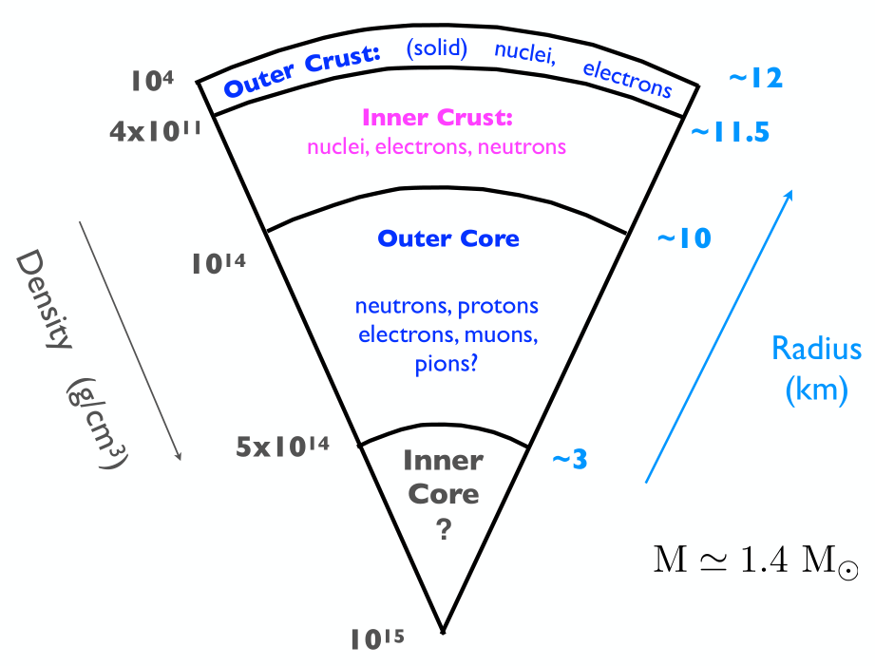
Neutron star Structure
Mostly neutrons but composition varies with density
Nuclei in crust are squeezed into uniform matter in core
Likely neutron superfluid in inner crust and outer core
Calculations currently focus on inner crust
Notes:
Before getting into the results, I’d like to mention a bit of detail on the region of neutron stars I’m attempting to model with these simulations.
The outer crust of neutron stars contains fairly standard nuclei.
Passing into the inner crust we not only have more neutron rich nuclei, but also a free neutron component.
At some density the nuclei are compressed enough to disassociate into neutrons and protons in the Outer Core. The clusters and intermediate phases passed through in the transition within the inner crust are extremely interesting and this is the region I’ve studied thus far with NNQS; up to about half of nuclear density. This region of the inner crust is also compatible with the pionless EFT Hamiltonian we have used for nuclei.
Within the inner crust, some of these interesting aspects I’m attempting to model include a neutron superfluid and the specific structure of the large neutron rich nuclear clusters.
Large clusters in inner crust can’t be modeled yet but only because 1) over simplified Hamiltonian 2) not using enough particles in our system. With the work we have put into our code we can now easily move to much larger systems of particles so more accurate models of this region. Currently simulations with hundreds of nucleons looks possible in the coming years.

Slide 34
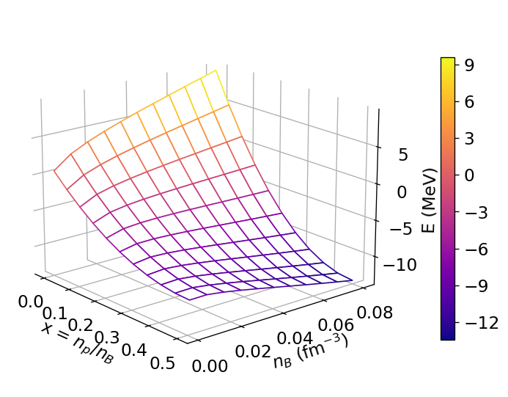
asymmetric matter energy
Fit $E\left(n_{B}, 0\right)$ and $E\left(n_{B}, 1/2\right)$
Model energy by symmetry energy expansion
$$E\left(n_{B}, x\right)=a_{0}+a_{2/3}{\left(\frac{n_{B}}{n_{0}}\right)}^{2/3}+a_{1}\left(\frac{n_{B}}{n_{0}}\right)+a_{2}{\left(\frac{n_{B}}{n_{0}}\right)}^{2}$$
$$S\left(n_{B}\right)=E\left(n_{B}, 0\right)−E(n_{B},1/2)$$
$$E\left(n_{B}, x\right)=E\left(n_{B}, 1/2\right)+{\left(1−2x\right)}^{2}S(n_{B})$$
Notes:
From calculations of pure neutron matter and symmetric matter we are able to interpolate between them to get results for intermediate numbers of protons.
Its not necessary to follow this interpolation
The main point is that we did simulations of pure neutron matter and symmetric nuclear matter at several different densities
which allows us to estimate the ground state energy for the system at all the intermediate densities, and proton fractions as you can see in the plot.

Slide 35
Neural Quantum States
Hilbert Space
Physical States
Mean-field
Credit: Giuseppe Carleo
Notes:
The issue comes down to efficiently exploring the problem space. The Hilbert space is the entire space in which the problem lives
Due to the spin dependent correlations in fermionic systems the space to explore is huge
While the actual space occupied by physical states can often be characterized by a much lower amount of information
This is thanks to the fact that most quantum states of interest have distinctive features and intrinsic structures built in.

Slide 36
Neural Quantum States
Most quantum states of interest have distinctive features and intrinsic structures
Artificial neural networks compactly represent complex high-dimensional functions
Build in symmetries of quantum system to NQS architecture
$$x_{1}$$
$$Ψ(X;ω)$$
$$x_{2}$$
$$x_{N}$$
Notes:
In the Neural quantum state method we can take advantage of these by representing our wavefunction with a neural network.
Because Neural networks are very good at compactly representing high-dimensional functions the complex correlations of fermionic systems don’t correspond to an exponential increase in the size of the network.
Because we still need to build in the antisymmetry of the system into the architecture of the network, its actual structure is more complex than the simple picture here,
But the general idea is still the same. Our network needs to take in positions and spins (given by x) of each particle in the system and give out the wavefunction, what is essentially, the probability of those positions and spins in the system.

Slide 37
Outline
Nuclear many body problem
Many body methods
Curse of dimensionality
Overview of variational Monte Carlo (VMC)
Metropolis-Hastings Sampling
Parameter optimization
Fermionic trial wavefunctions
Results
Nuclei
Notes:
Very quick overview of Monte Carlo Methods

Slide 38
The quantum many-body problem
Many-body Schrödinger equation
$$\left(−\sum_{i}{\frac{∇_{i}^{2}}{2m_{N}}}+V\right)\left.\left|Ψ_{0}\right.\right\rangle =E_{0}\left.\left|Ψ_{0}\right.\right\rangle$$
Fermions have anti-symmetric wavefunction
$$Ψ\left(x_{1},…{,x}_{i}, …,x_{j},…x_{A}\right)=−Ψ(x_{1},…,x_{j},…,x_{i},…x_{A})$$
Notes:
Solving the quantum many body problem implies finding a general method of solving the non-relativistic many-body schrodinger equation. For the results I’ll show this means finding the time independent ground state of the system even though this is not where NQS applications end.
In particular, I’m only discussing fermionic systems but these make up a large number of interesting systems
So while I will focus on nuclear physics in this presentation the methods discussed are relevant to many other important fields including quantum chemistry and condensed matter.
Fermionic systems require an antisymmetric wavefunction so this has to be built into any quantum many body method. This comes with many challenges for most methods.

Slide 39
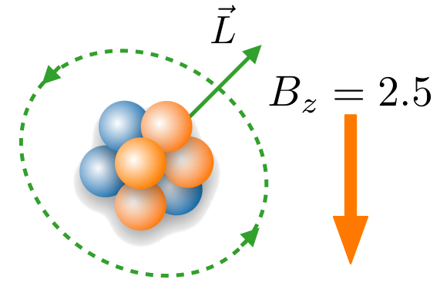
Magnetic moments
Ground state is degenerate in $L_{z}$
Break degeneracy using magnetic field $B_{z}$
$$H→H−B_{z}L_{Z}$$
A. Gnech, B. Fore, Phys. Rev. Lett. 133, 142501
Notes:
Going back to nuclear systems,
its not immediately obvious that we can compute any potentially interesting observable for a given quantum system.
In the ground state of a system, some of the observables are degenerate, so they are essentially compatible with multiple possible values of that observable.
In the case of magnetic moments this happens because of a lack of well-defined angular momentum in our Hamiltonian.
In this PRL WE published a method of extracting the correct magnetic moment of a nuclei even though it is degenerate in the ground state.
To do this we Apply a magnetic field to the potential during the optimization of the NQS.
(start going) this magnetic field breaks the degeneracy giving us a particular value of the magnetic moment.

Slide 40
Magnetic moments
Ground state is degenerate in $L_{z}$
Break degeneracy using magnetic field $B_{z}$
$$H→H−B_{z}L_{Z}$$
A. Gnech, B. Fore, Phys. Rev. Lett. 133, 142501

Slide 41
Magnetic moments
Ground state is degenerate in $L_{z}$
Break degeneracy using magnetic field $B_{z}$
$$H→H−B_{z}L_{Z}$$
A. Gnech, B. Fore, Phys. Rev. Lett. 133, 142501

Slide 42
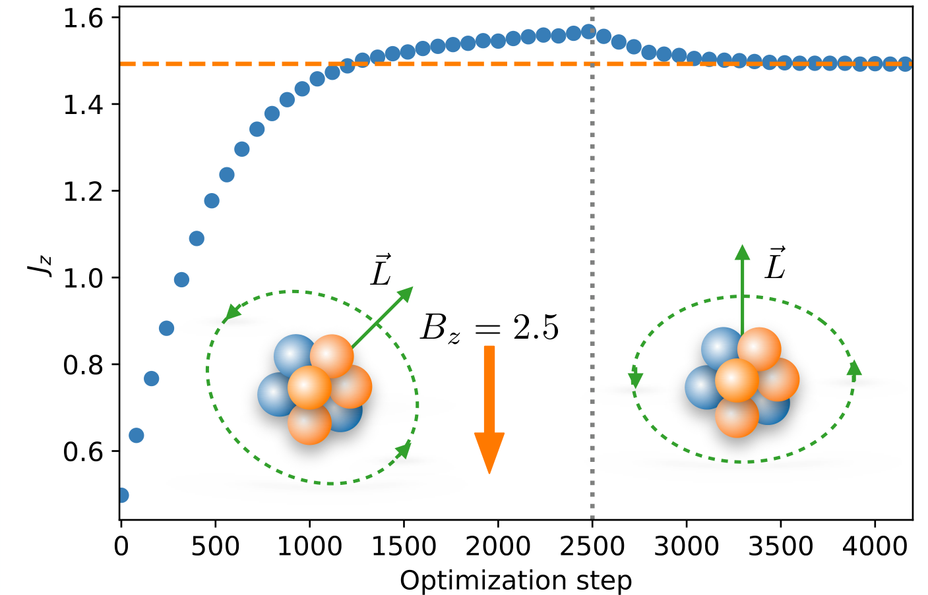
Magnetic moments
A. Gnech, B. Fore, Phys. Rev. Lett. 133, 142501
Notes:
Here is a view of the NQS training for this process.
Before step 2500 (indicated by the vertical line) we have applied a magnetic field during the training which resolves the degeneracy, choosing the larger of the possible angular momentum values.
After 2500 steps the external field is removed and we continue training to remove excitations that are introduced by the magnetic field.
The final state reached has the desired value of total angular momentum so we can compute the corresponding magnetic moment.

Slide 43
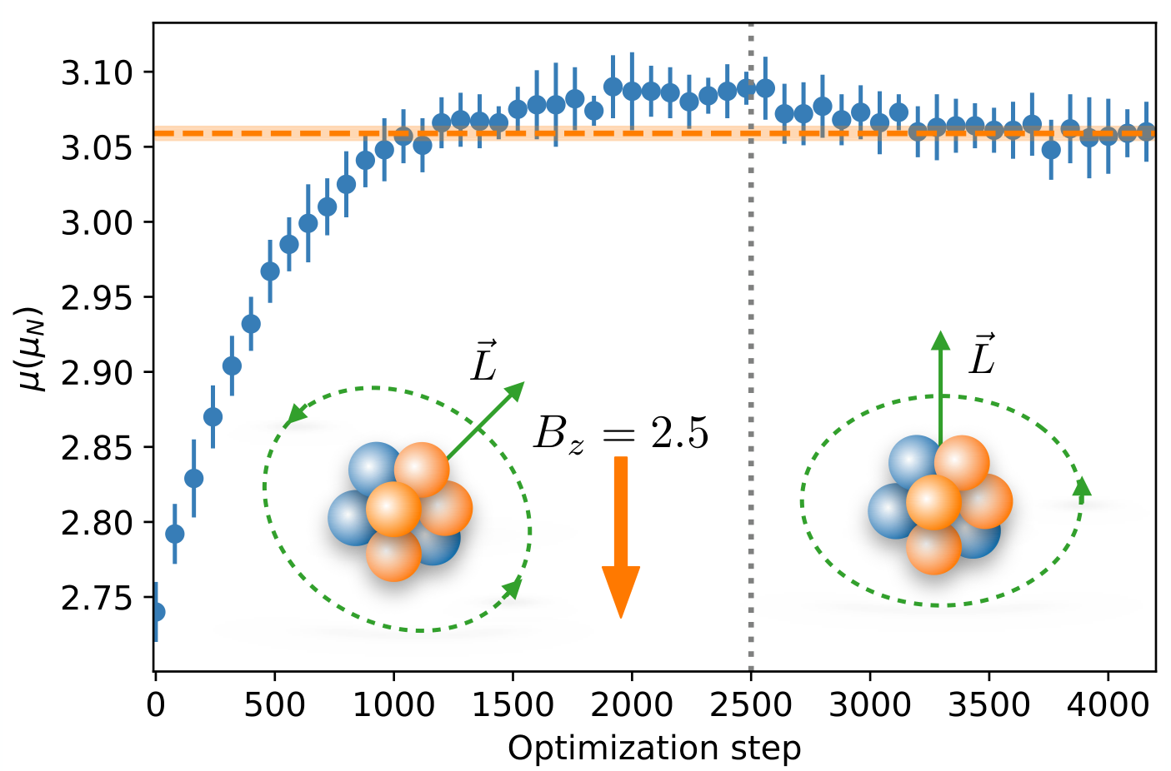
Magnetic moments
A. Gnech, B. Fore, Phys. Rev. Lett. 133, 142501
Notes:
This result is useful in that it shows simple changes to the algorithm can give us the ability to compute quantities which are not obviously accessible otherwise.

Slide 44
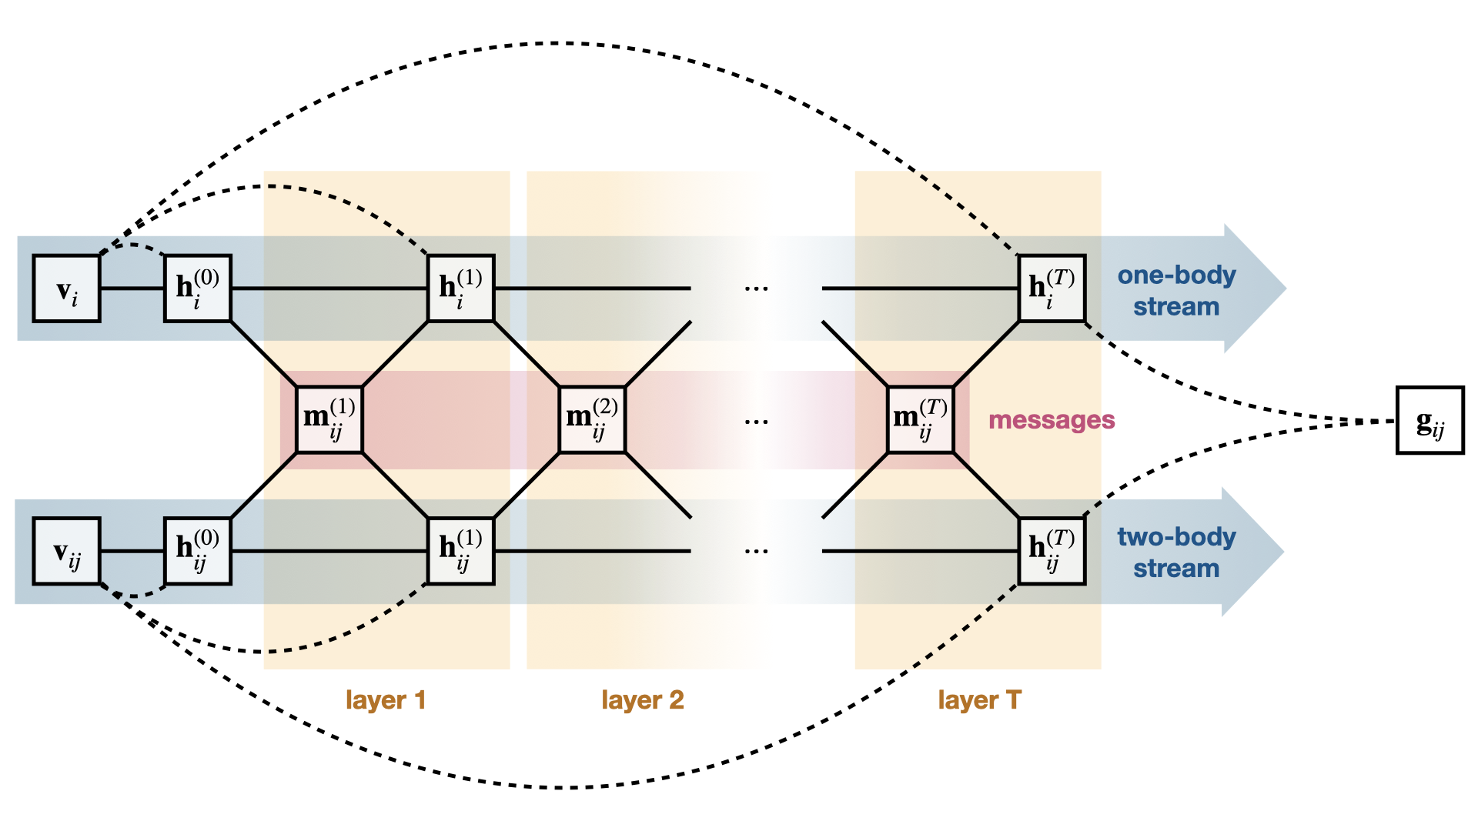
Message passing neural network
Notes:
Before showing some preliminary results using this new ansatz I want to describe(remind you of) the structure of our version of the message passing neural network
Input v_i is the information on single particles, in my case we are constructing the net to be translation invariant so this just ends up being the spins of the particles.
The paired input v_ij is information on each pair of particles, which means pairs of spins as well as the displacement between the pair. Because we are considering periodic matter we also need to look at a periodic version of the displacement which just means using the sine and cosine of the value instead.
Solid lines represent transformations by multi layer perceptrons
Dotted lines are concatinations so (work through one side)

Slide 45
Message passing neural network
$$m_{ij}^{t}=M_{t}(h_{i}^{t−1}, h_{j}^{t−1},h_{ij}^{t−1})$$
$$h_{i}^{t}=(v_{i}, F_{t}(h_{i}^{t−1},m_{i}^{t}))$$
$$h_{i}^{0}=(v_{i}, A\left(v_{i}\right))$$
$$m_{i}^{t}=Pool_{j} (m_{ij}^{t})$$
$$h_{ij}^{t}=(v_{ij}, G_{t}(h_{ij}^{t−1},m_{ij}^{t}))$$
$$h_{ij}^{0}=(v_{ij}, B\left(v_{ij}\right))$$

Slide 46
Neutron star Structure
Mostly neutrons but composition varies with density
Nuclei in crust are squeezed into uniform matter in core
Likely neutron superfluid in inner crust and outer core
Calculations currently focus on inner crust
Notes:
“Basic information on neutron star structure”
Specifically, only talking about cold neutron stars here. (less than 1 MeV temperatures)
The superfluidity of

Slide 47
Neutron star interest
Unique system for accessing nuclear EOS info
High densities
High isospin asymmetries
Mergers result in creation of very heavy elements
Relation between mass and radius controlled by nuclear EOS
Notes:
“Exact nuclear equation of state is unknown since we cannot easily solve QCD exactly. We can access information on it through nuclei and collider experiments but these are limited in some ways. Neutron stars are another, very different, system which give us access to the nuclear equation of state.”
“For example, the high densities and high isospin asymmetries, which is just the excess of neutrons over protons, are not possible to access in terrestrial experiments.”
How to access this information
“Measuring masses with radii of NS we can narrow down what the exact nuclear EOS looks like.”
Additionally, mergers of neutron stars are in a way an enormous collider experiment that probe both high energies and densities. Heavy elements

Slide 48
Neutron star Observation
Gravitational waves
Kilonova light curves
Pulsars
Pulsar glitches
Frequency
Time
GW170817 signal
Notes:
“How would we access the information on nuclear physics through neutron stars?”
“not exhaustive”
We can get more info on nuclear interactions by studying these systems through gravitational waves and observations of kilonova from mergers. Gravitational waves in particular have the potential to show us information about the interior regions in great detail with some non-insignificant improvements to gravitational wave detection. (mass-radius information but also compressibility accessible by improved GW detectors)
pulsars
Additionally, cooling of neutrons stars soon after their creation is affected by matter in the core and inner crust of the star. Since they cool almost exclusively through neutrino emission the propagation of neutrinos through the matter directly affects it. Specifically neutron pairing can change neutrino interactions.
How pairing affects these to set that up?
- How machine learning helps: Calculating neutron star observables directly from equations of state gives us another way to access the accuracy of that equation of state.

Slide 49
Continuous periodic systems
Requirements for periodic systems
Uniform position initialization over simulation box
Periodic coordinate system:
Potential energy from particle images
Filled shells used for comparison to single determinant results
First closed shell of neutron matter will have 14 particles since there are 7 momentum states and 2 spin states
Notes:
A few notes on continuous periodic systems in general (these points are also applicable to jane’s talk)
We only want to track a few particles rather than an enormous number so we use periodic boundary conditions.
This means we will make sure the particles we’re tracking stay inside of a box near the origin, of size determined by the density we are interested in, as well as using a coordinate system which is smooth near the edges of the box rather than have the input to the net be discontinuous at the edge.
In addition to this, we need to take into account the potential contribution from the images of our particles outside of our box at the origin. One simple way to do this which works well for short range interactions is called the minimum image convention. This method only considers the distance to the closest image for each pair of particles in our box at the origin. This way one takes into account the most relevant potential contribution to the infinite system for each pair.
However, the results I will show today take into account contributions to the potential from all the image particles in the closest boxes. So in 3 dimensions that is 27 total contributions for each pair.
Finally, we need to make sure we are including all the particles in a filled momentum shell for our system to really approximate the degenerate case of the full system. The first closed shell we might be interested in has 7 momentum states, with the 2 spin states allowed by the spin ½ fermions we know we need 14 particles in our system to fill all the lowest states.
(From las vegas I think)
A few notes on how we implement the continuous periodic system for the problem.
We only want to track a few particles rather than an enormous number so we use periodic boundary conditions.
This means we will make sure the particles we’re tracking stay inside of a box near the origin, of size determined by the density we are interested in, as well as using a coordinate system which is smooth near the edges of the box rather than have the input to the net be discontinuous at the edge. So using sines and cosigns rather than the direct coordinates is natural.
In addition to this, we need to take into account the potential contribution from the images of our particles outside of our box at the origin.
Including the effects of all particle pairs from the closest boxes within three dimensions amounts to 27 total contributions for each pair of particles.
Finally, we need to make sure we are including all the particles in a filled momentum shell for our system to really approximate the degenerate case of the full system. The first closed shell we might be interested in has 7 momentum states, with the 2 spin states allowed by the spin ½ fermions we know we need 14 particles in our system to fill all the lowest states.

Slide 50
Two body density
Central and spin two body densities
Spin singlet and triplet channel two body densities
Notes:
Once trained on the systems’ energy, the NQS can be used to evaluate various quantum-mechanical observables, two interesting such observables are the spin-singlet and triplet two-body distribution functions, g zero and g one, which give us information about the distance between pairs in the system and relate to particle pairing and superfluidity.
(time)
- The expressions for the central and spin two body distributions are given by g c and g sigma respectively. Where these can be simply evaluated within the simulation as histograms over walkers distances from one another, with g sigma weighted by the walkers' spins.
- These quantities can be combined to give the spin singlet and spin triplet two body distributions g zero and g one.
- In dense neutron systems, like neutron stars, the conditions for superfluidity are present, a strong Fermi degeneracy as well as an attractive interaction between pairs. Specifically, this attractive interaction is in the singlet S wave channel and so we would expect to find singlet pairs in conditions where neutron superfluidity occurs.

Slide 51
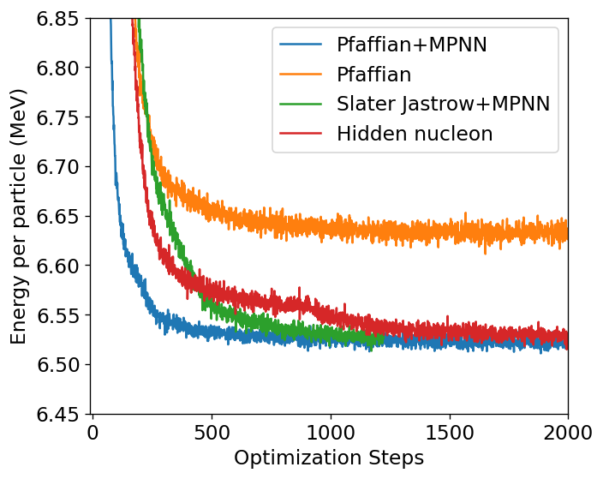
Ansatz comparisons
Neutron Matter (14 particles, 0.04 fm⁻³)
Optimization step time (4 A100 GPUs, 32000 samples)
Pfaffian+MPNN | ~42 (s)
Pfaffian | ~21 (s)
Slater Jastrow+MPNN | ~35 (s)
Hidden fermion | ~46 (s)
Notes:
“comparing this to our previous neutron matter results”
Emphasize that I’m just showing how much faster this new net is and how much less computational resources it uses.
Include a table with time per step!!!!

Slide 52
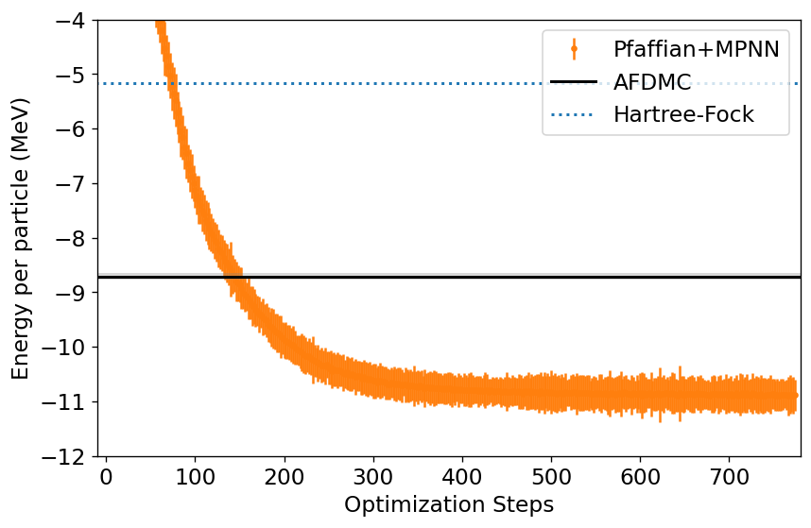
Preliminary 14 neutrons + 14 protons
Symmetric Nuclear Matter (28 particles, 0.04 fm⁻³)
Notes:
“comparing this new net at the same density…”
No comparison to the hidden nucleon yet because it is prohibitively time consuming.

Slide 53
Monte carlo
Monte Carlo methods use random sampling to approximate integrals
$$4\frac{\int{\int_{Circle}{dxdy}}}{\int{\int_{Square}{dxdy}}}=π$$
Notes:
In the most general sense monte carlo methods are methods for randomly sampling from a distribution, usually for the purpose of approximating integrals.
Common example is to approximate the value of pi by randomly tossing points into a square. The area of the circle with radius equal to half the squares side length, divided by the area of the square is pi/4.

Slide 54
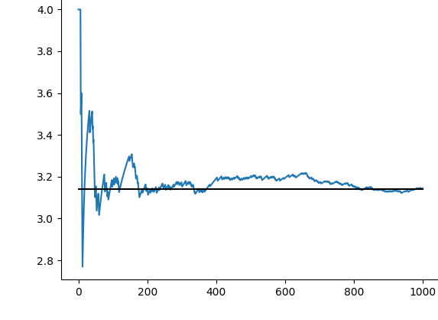
Monte carlo
Monte Carlo methods use random sampling to approximate integrals
$$4\frac{\int{\int_{Circle}{dxdy}}}{\int{\int_{Square}{dxdy}}}=π$$
Notes:
So by randomly choosing points in the square and taking the ratio of the number which land in the circle to the total number, we get an approximation of the ratio of the areas. The plot shows a small example of this multiplied by 4. Using a few thousand random points we can get very close to the value of pi.

Slide 55
Monte carlo
Monte Carlo methods use random sampling to approximate integrals
$$4\frac{\int{\int_{Circle}{dxdy}}}{\int{\int_{Square}{dxdy}}}=π$$
$$O_{T}=\frac{\left\langle Ψ_{T}\left|O\right|Ψ_{T}\right\rangle }{\left\langle Ψ_{T}|Ψ_{T}\right\rangle }≈\frac{1}{N_{conf}}\sum_{\{R, S\}}{O_{L}(R, S)}$$
Notes:
In Quantum monte carlo, this technique is used for the purpose of evaluating expectation values.
Specifically, the energy expectation value. I’ll go into a bit more detail on this in the slide on Metropolis sampling.

Slide 56
Variational Monte Carlo
Update wavefunction parameters, $ω$, via SR algorithm
Initial setup
Sample configurations via Metropolis
Evaluate trial wavefunction energy
$$R, S$$
Results
$$Ψ_{T}(R, S; ω)$$
Notes:
Here I’ve made an oversimplified flow chart for the variational monte carlo algorithm.
The initial setup consists of creating a large number of random configurations (also called walkers), where a single configuration corresponds to the positions and spins of all particles in our system. So if we were considering a system with four particles, for a single configuration we would need to randomly select 4 coordinate positions and 4 spins. And we would want thousands of these configurations.
Additionally in the initial setup we can setup whatever trial wavefunction we are interested in using with some initially random parameters, omega.
The Metropolis algorithm modifies our configurations so they properly sample the probability distribution given by trial wavefunction. Which, again, has initially random parameters so looks nothing like a normal wavefunction.
From our sampled configurations we evaluate their energies (which are called local energies) the average of which gives the energy of our trial wavefunction.
From this evaluation of the energy, we can improve the parameters of our trial wavefunction. We do this using an algorithm called stochastic reconfiguration, which for the moment you are welcome to think of as an improved gradient decent.
After this we loop back and use our improved trial wavefunction to generate new configurations which properly sample the new state and so on.
This process can repeat until our trial wavefunction is no longer improving. At which point we can use it to compute expectation values of other observable quantities.

Slide 57
$$V_{ijk}=c_{E}\frac{f_{π}^{4}}{Λ_{χ}}\frac{{\left(ℏc\right)}^{6}}{π^{3}R_{3}^{6}}\sum_{cyclic ijk}{e^{−(r_{ij}^{2}+r_{jk}^{2})/R_{3}^{2}}}$$

