Slide 1
Ring circumference
I. Chaikovska, V. Kubytskyi, V. Mytrochenko
A. Loulergue

Slide 2
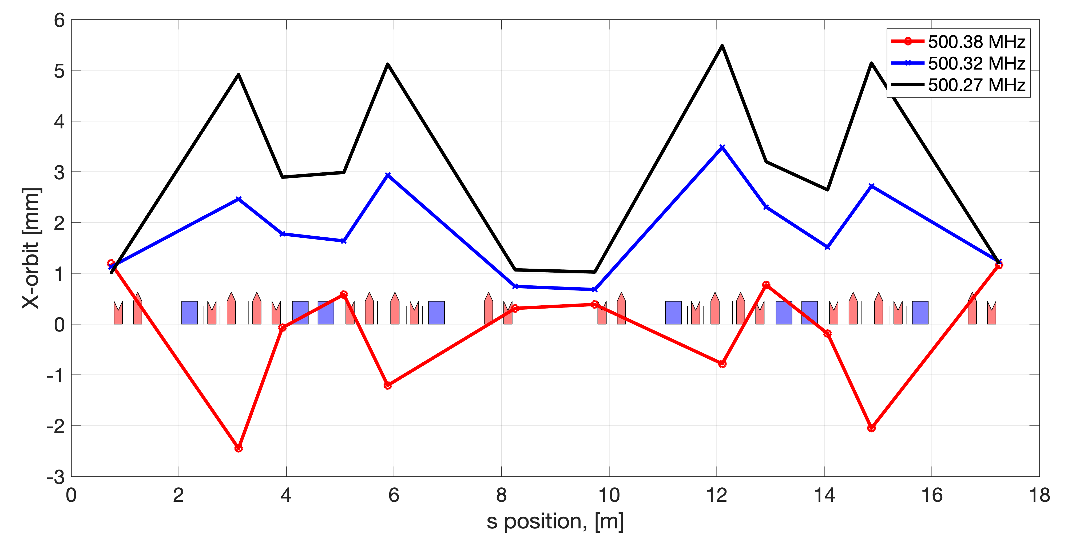
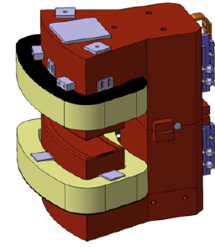
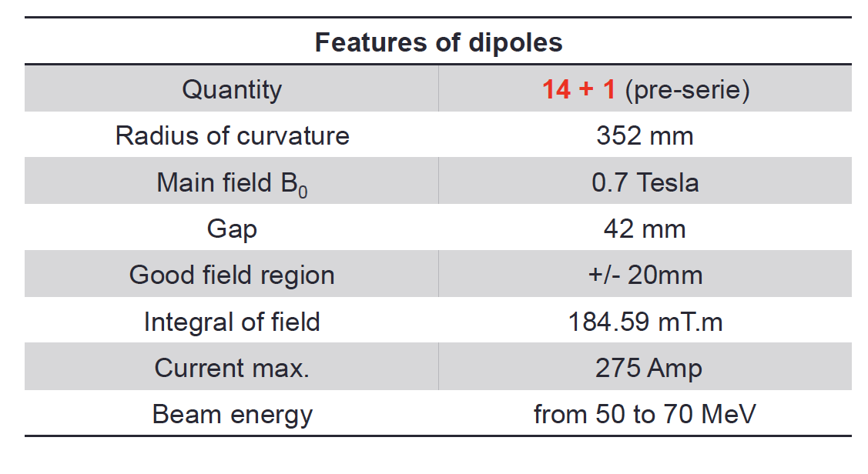
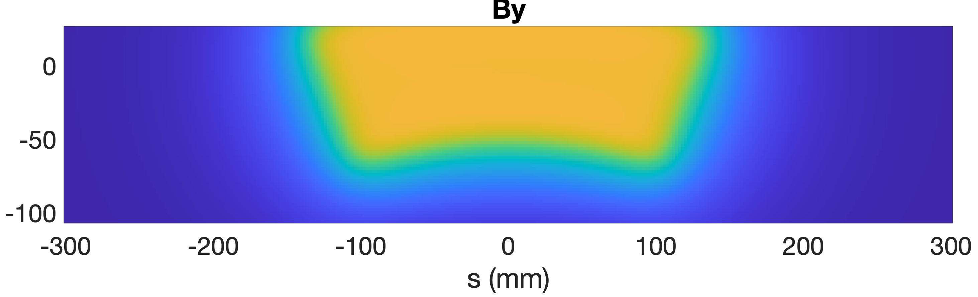
An unexpected find: shorter circumference
Nominal optics MCF 0.014
The RF frequency is found experimentally to be 0.3 - 0.4 MHz higher than the nominal.
What is the reason?
Need explicit simulation!
Measured orbits
Below 500.27 MHz the beam is lost
Short and small-radius dipoles, long fringe fields

Slide 3
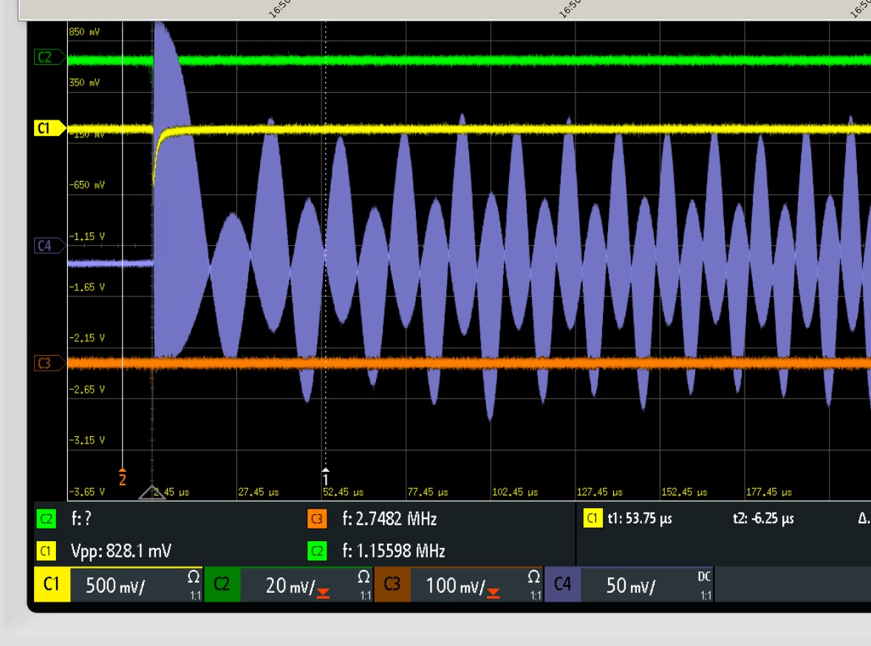
Experimental attempts to measure the ring frequency
Result of screenshot processing.
Bunch circulating frequency vs time.
Screenshot from 02/08/2023 16:50:56.
Beating frequency between F_{LO} =500.32 MHz and turning frequency of the bunch freely circulating around the ring.

Slide 4
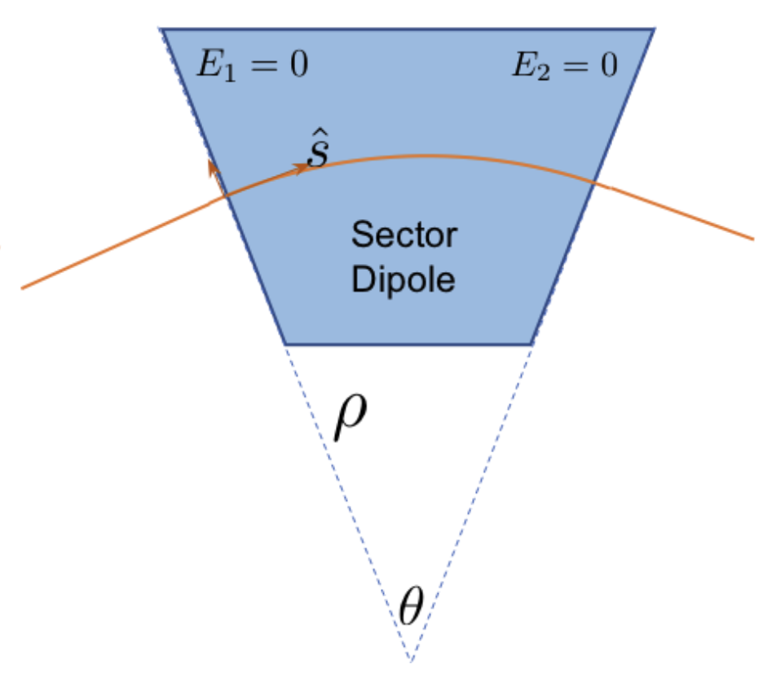
Part 1: Tracking in real field
Simplified dipole model in tracking codes: BEND/ SBEND (including the fringe field modeling)
Works for majority of the studies but fails in the circumference/frequency evaluation.
Tracking in realistic 3D fieldmaps is needed.

Slide 5
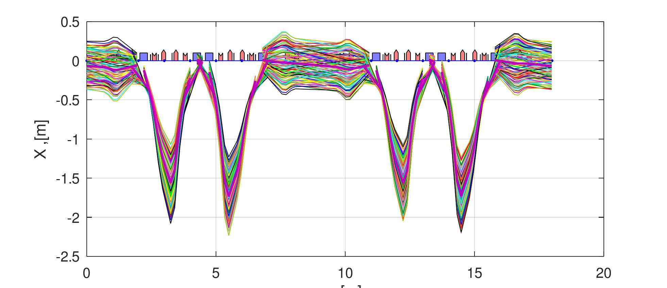
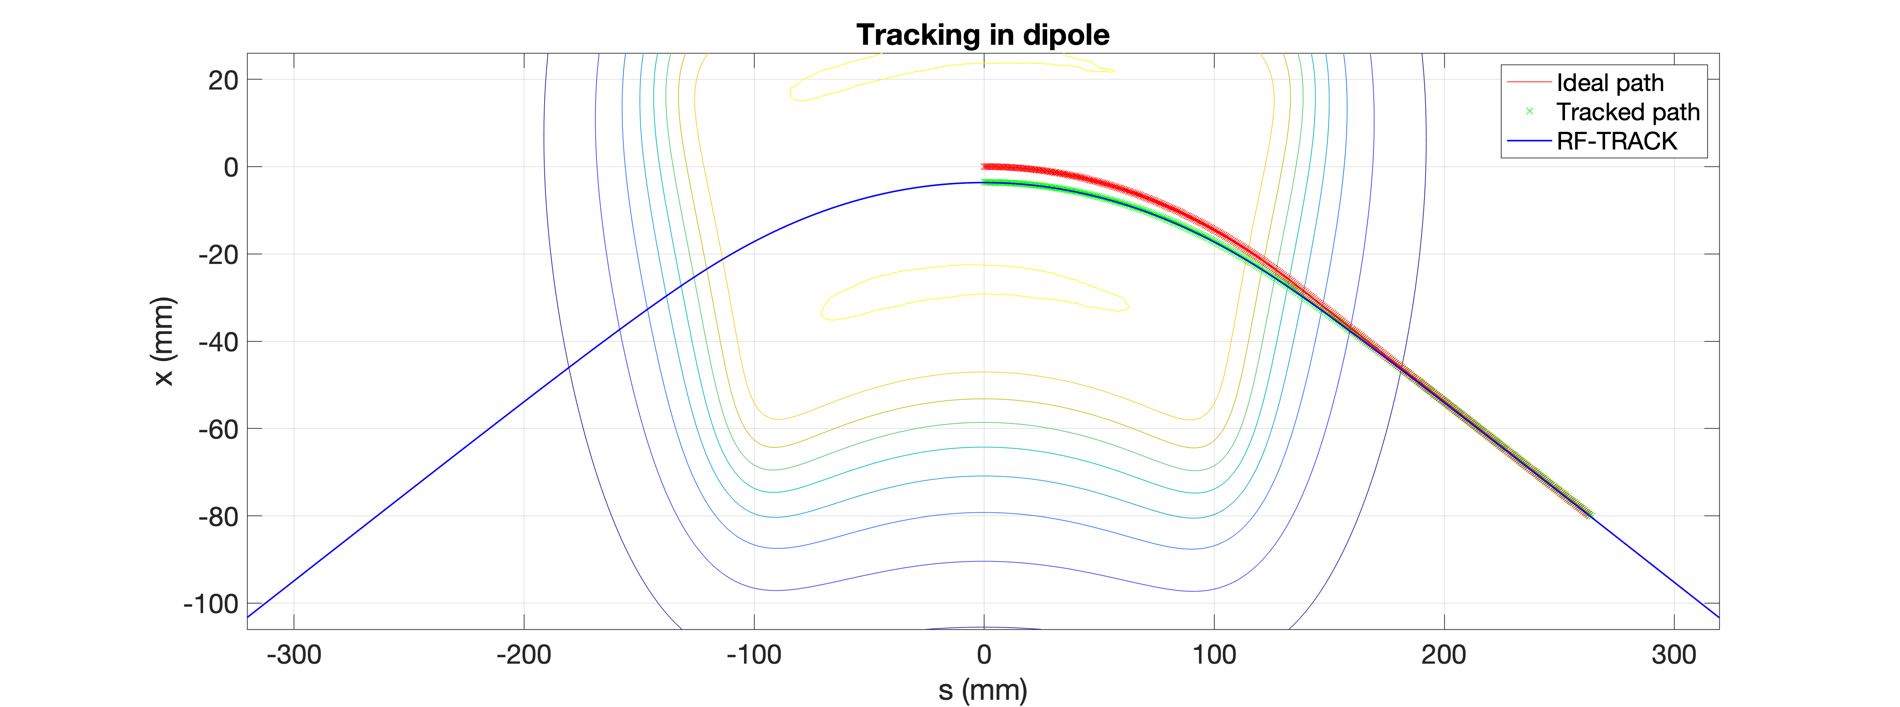

“Experiment on the table” with RF-track (Method 1)
First study to measure ring frequency :
Lattice with dipoles represented by SBEND (usual way) : F = 500.02 MHz
Lattice with dipoles represented by VOLUME with realistic magnetic field : F =500.38 MHz, dispersive orbit. The same effect as in the experiment!
100 turns with realistic dipoles
Big step in understanding of the problem
  It was found that the beam trajectory in the dipoles is shorter wrt. to the ideal path => shorter pathlength and so smaller total circumference

Slide 6
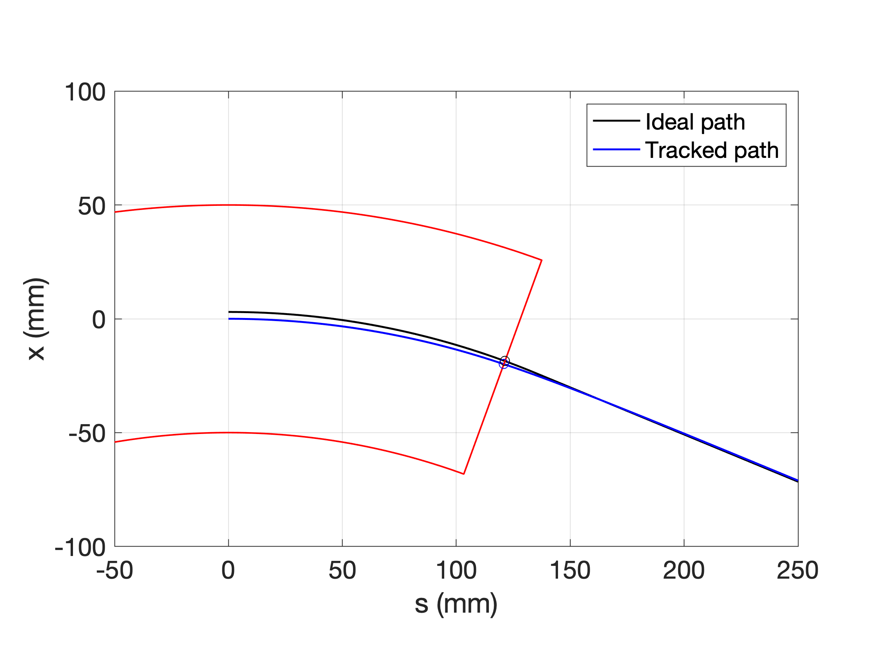
Measure track length in the dipole (Method 2)
Integration of equation of motion in magnetic field.
Compare with ideal orbit length.
Geometrical:
delta in half magnet -0.836117 ;
delta total 1.672234 mm ;
ring circumference delta (x8) -13.377869 mm
Comparing field integrals BL:
  ideal -66.934421 ; real -66.553028;
  ratio 0.994302;
  delta_l 1.688603 mm

Slide 7
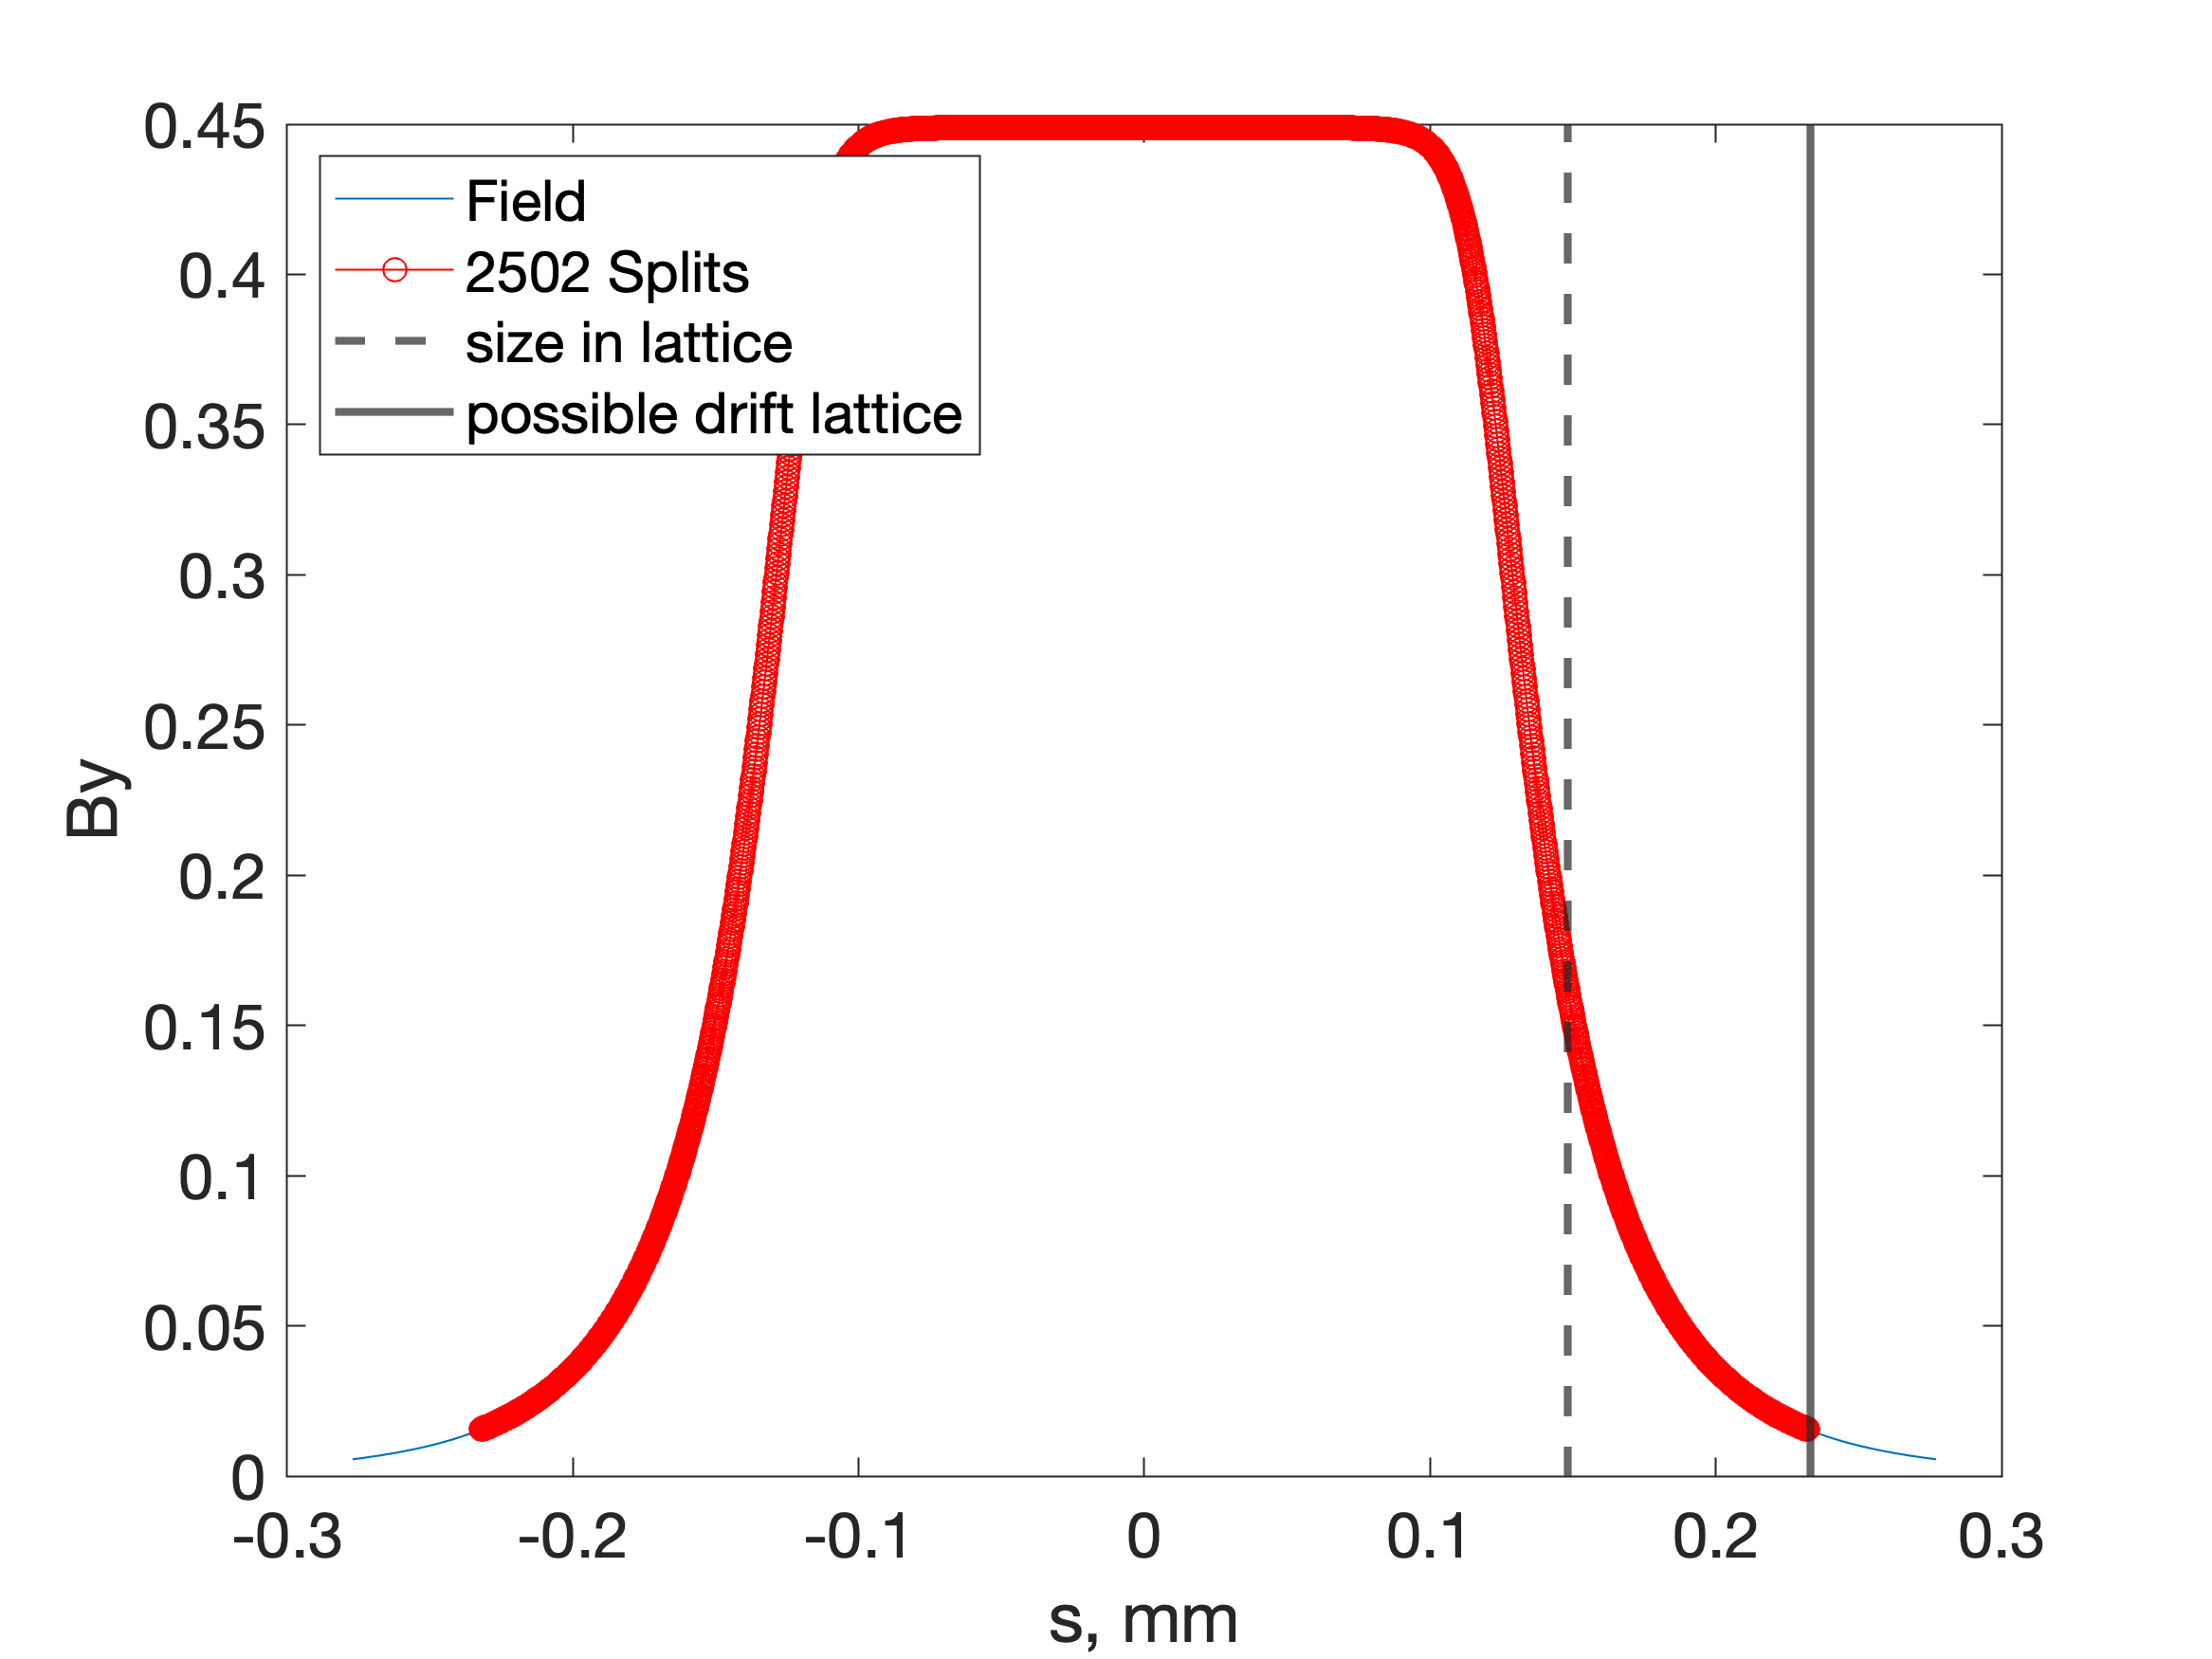
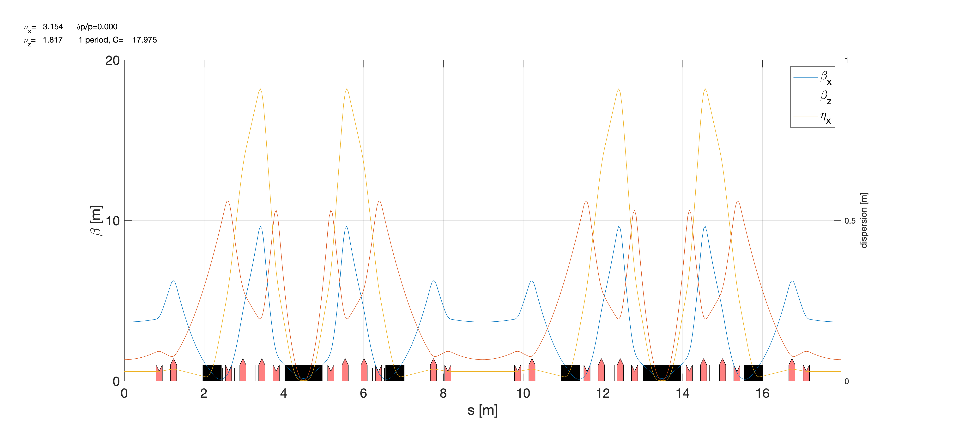
Dipoles slicing and insert in the ring
Goal: develop the realistic model of the dipoles to be used in the tracking code (AT or MADX) to perform the tracking
Solution: perform the magnet slicing to fit the real magnetic field
20165 elements vs 157 elements
Need to adjust element length according to track length.
Slow for matching;
Negative drifts - huge tunes. Cut fields and rescale.
Work done in AT and MADX in parallel for better understanding

Slide 8
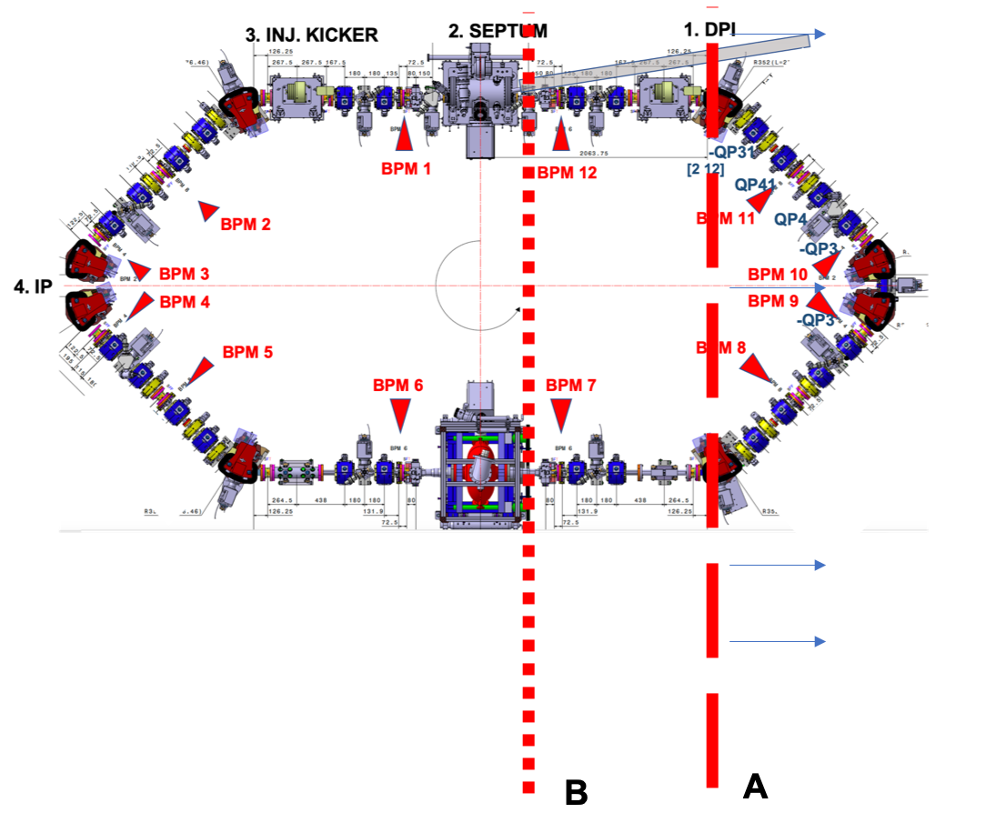
Part 2: AT simulation. Add Drifts
The realistic dipole modelling and electron tracking is understood and studied
Goal: study the solution to bring the ring to the nominal (or suitable for timing and FPC systems) RF frequency

Slide 9
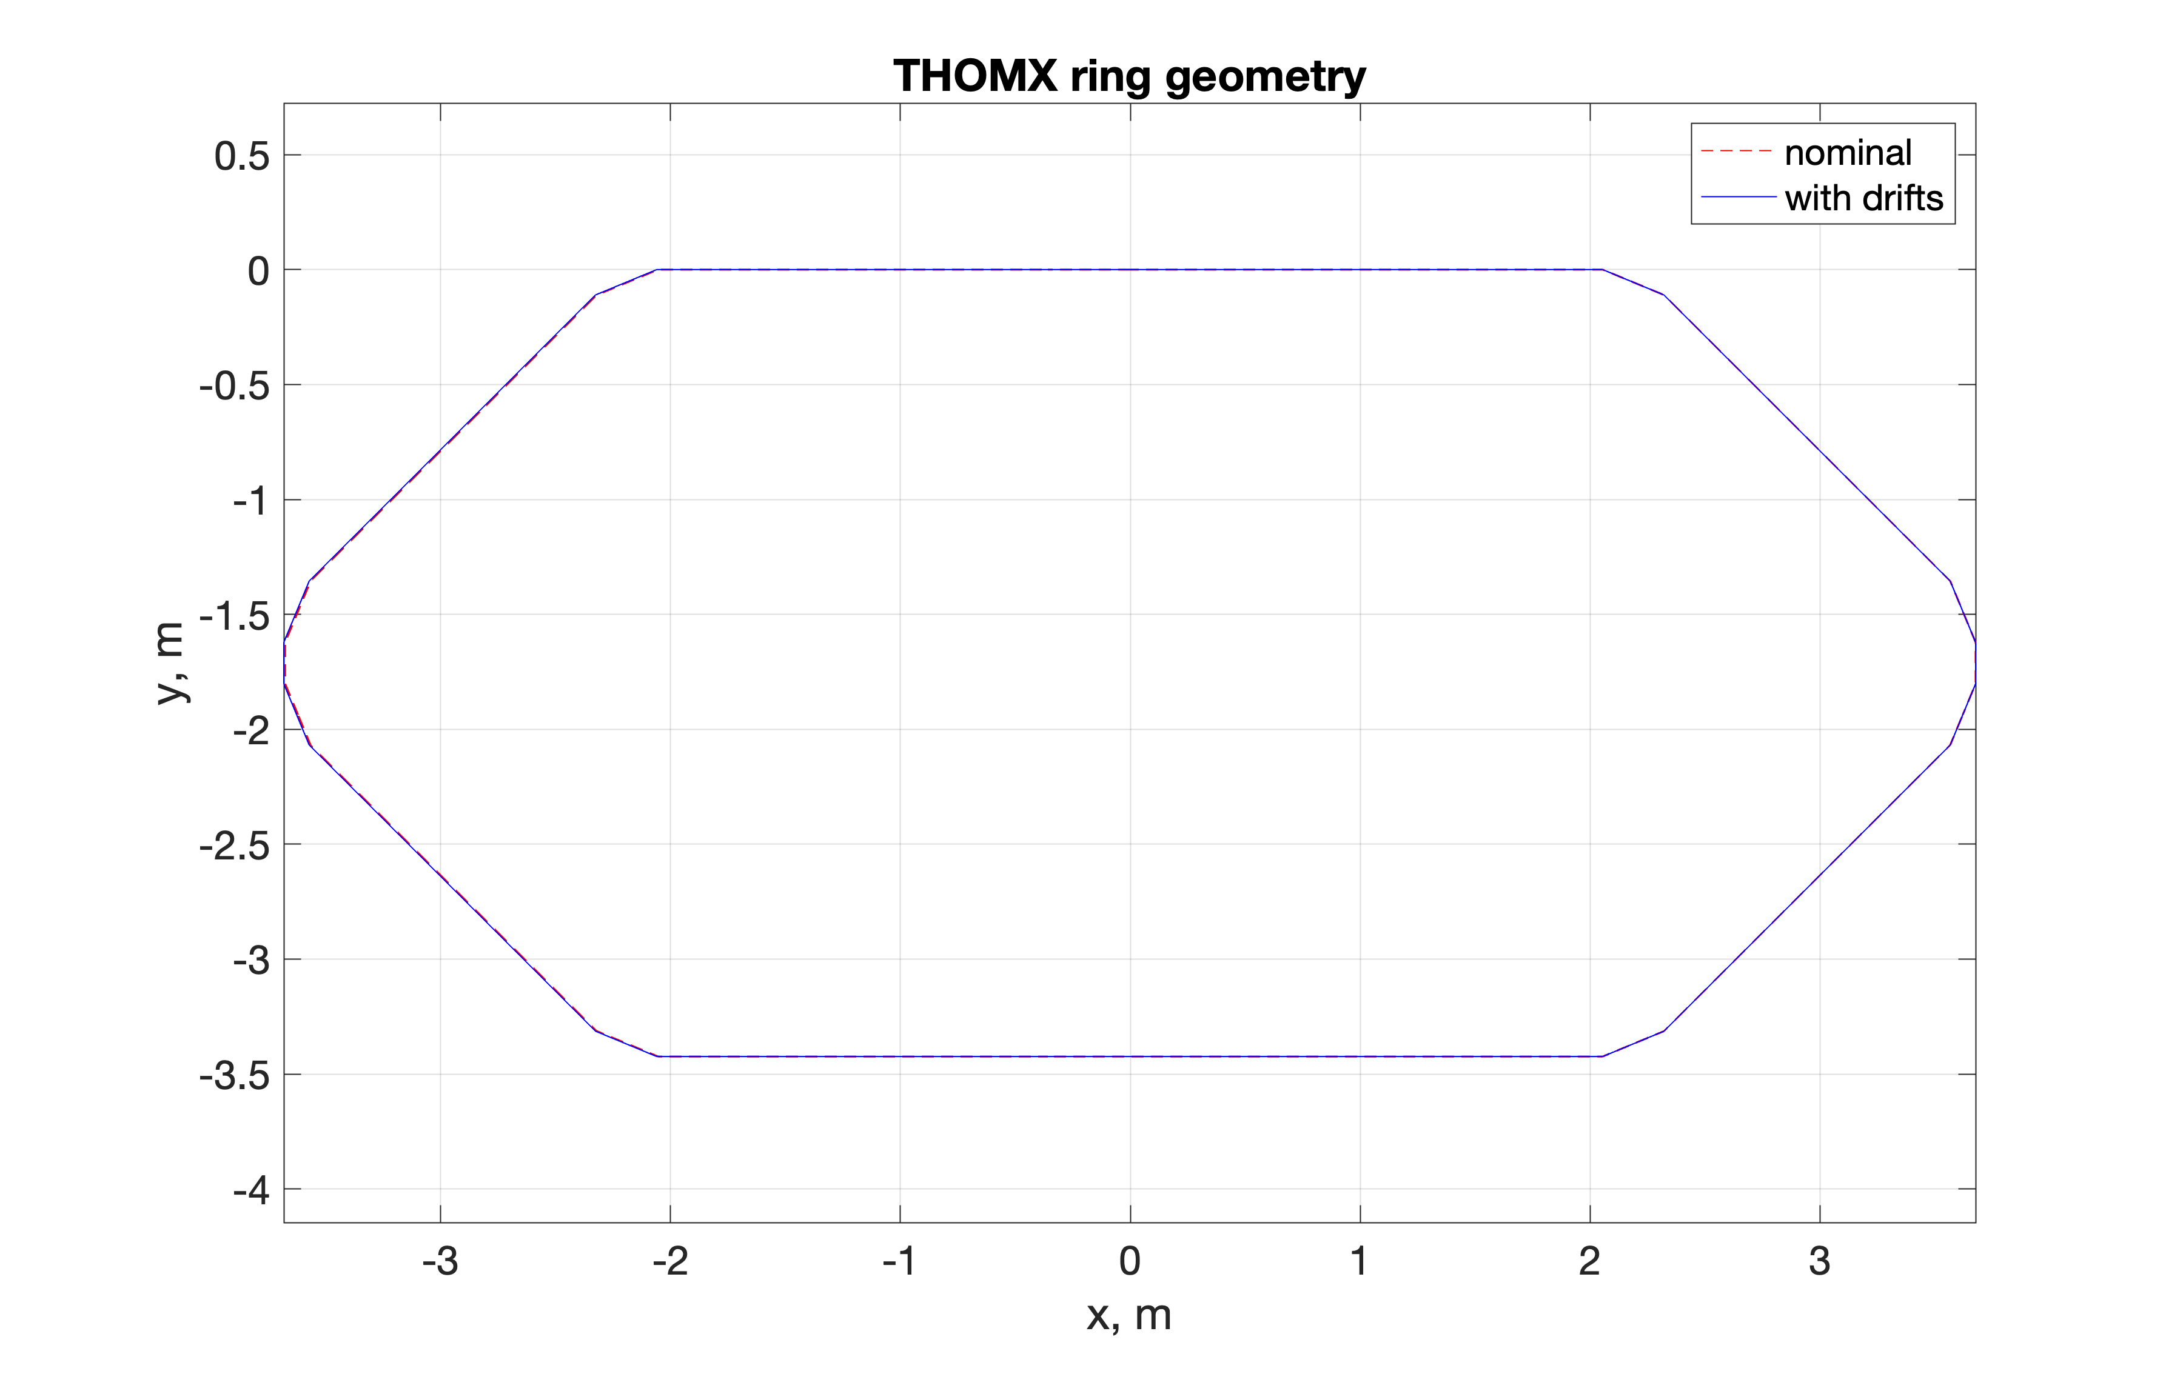
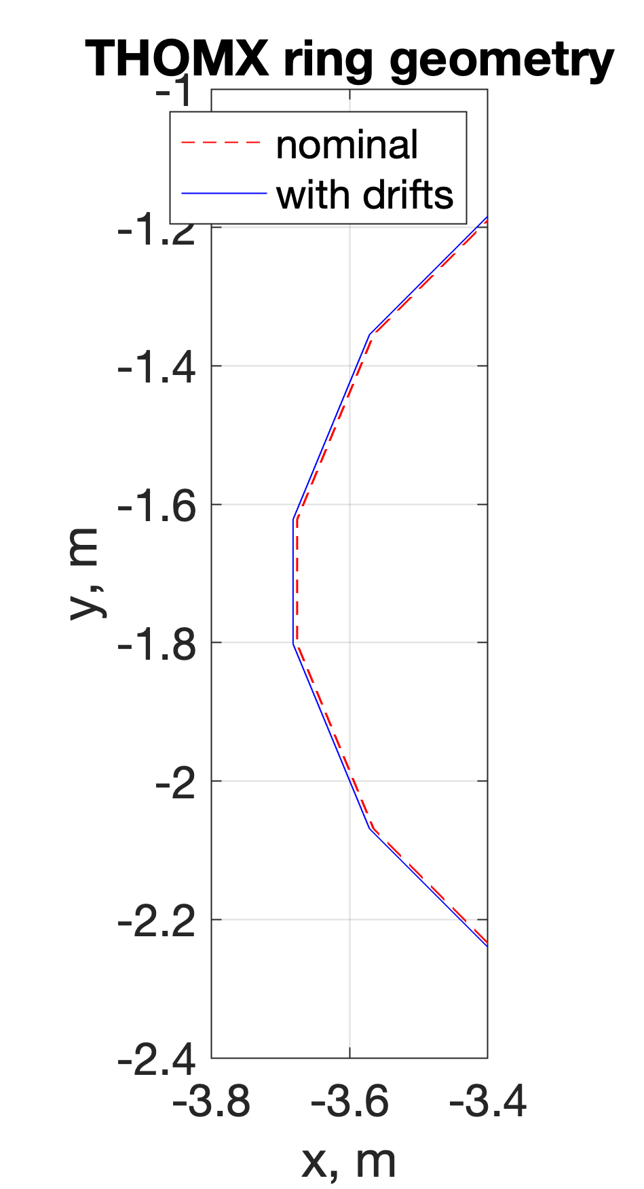
+6mm drifts
+6mm drifts
The exact drift length to be adjusted
Problem: absence of the correct dipole simulation in AT
BEND model in AT (constant bending radius), which is not correct for the ThomX dipole

Slide 10
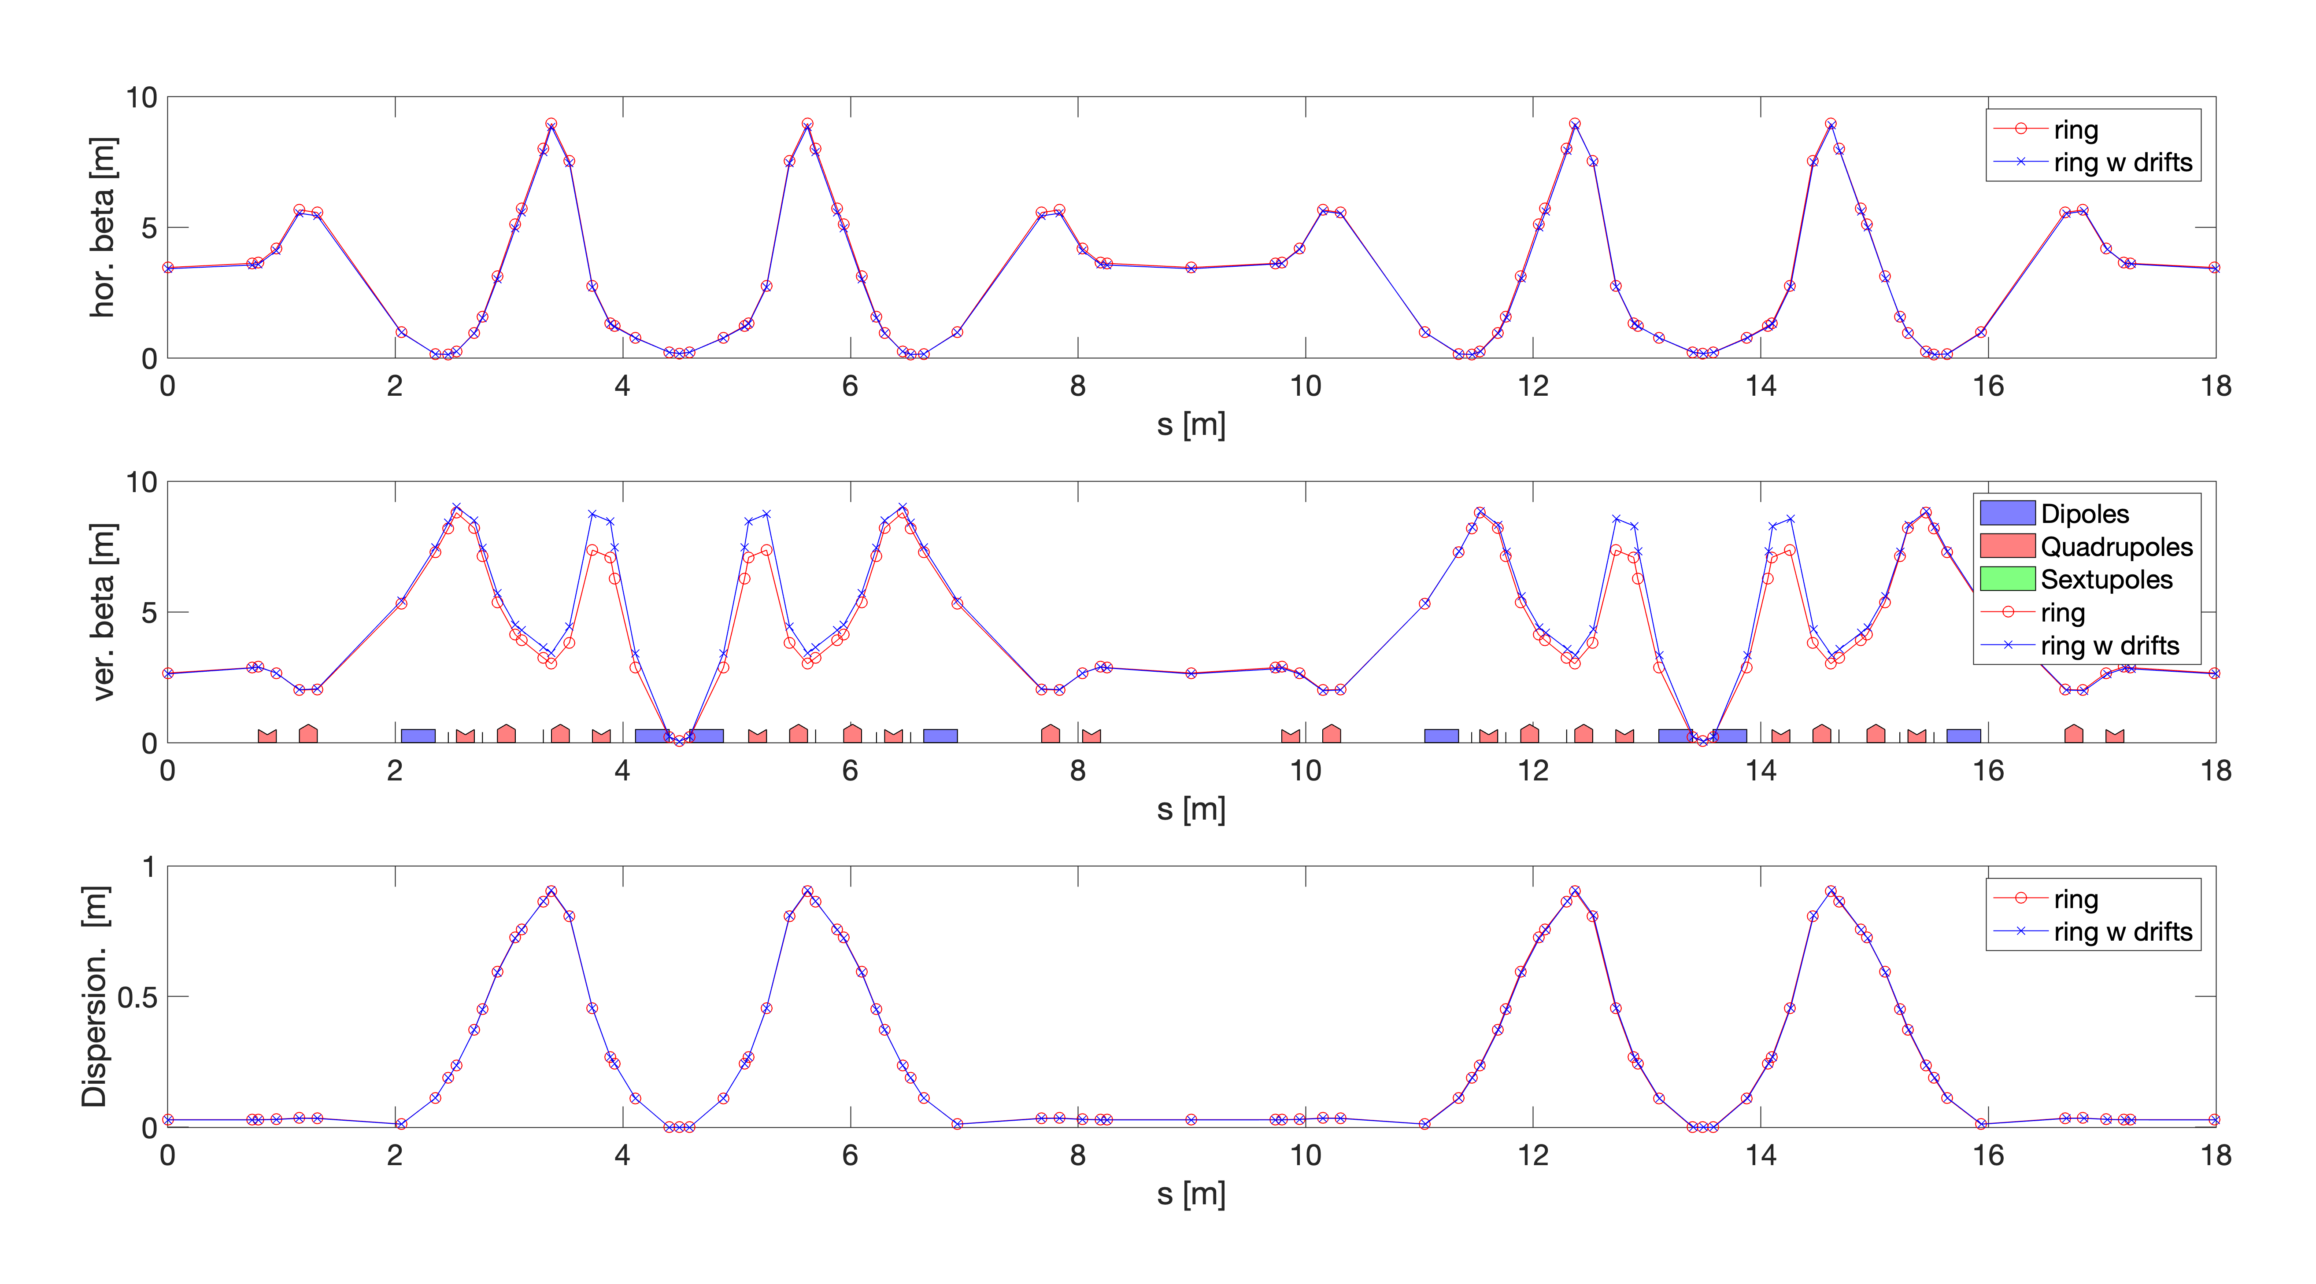
Refitted optics for the ring with the bigger circumference (optics matching)

Slide 11
Simulation/matching results
NOMINAL OPTICS
OPTICS WITH INSERTED DRIFTS
atsummary(ring)
************* Summary for '' ************
Energy: 0.05000 [GeV]
Gamma: 97.84756
Circumference: 17.98672 [m]
Revolution time: 59.99723 [ns] (16.66744 [MHz])
Betatron tune H: 0.16998 (2833.12609 [kHz])
V: 0.64018 (10670.09816 [kHz])
Momentum Compaction Factor: 1.43393e-02
Chromaticity H: -0.00000
V: -0.00000
atsummary(r_optic)
************* Summary for '' ************
Energy: 0.05000 [GeV]
Gamma: 97.84756
Circumference: 17.99848 [m]
Revolution time: 60.03646 [ns] (16.65654 [MHz])
Betatron tune H: 0.17309 (2883.07420 [kHz])
V: 0.63365 (10554.45082 [kHz])
Momentum Compaction Factor: 1.42541e-02
Chromaticity H: +0.07212
V: -1.34426
L_{nom} + 11.8 mm
WITHOUT using QP1,QP2 (injection/extraction):
Name field before after variation
QP1 PolynomB -4.86169 -4.80669 0.0549962
QP2 PolynomB 9.44146 9.40109 -0.0403643
QP3 PolynomB -18.5428 -18.7781 -0.235302
QP4 PolynomB 16.4601 16.6294 0.169288
QP31 PolynomB -8.90015 -8.5712 0.328949
QP41 PolynomB 5.10745 4.8107 -0.296743
From RF-track (optics w/o matching)
Freq = 500.0689 with a drift of 0.0058813 m
Consistent results
Name field before after variation
QP3 PolynomB -18.5428 -18.7993 -0.256462
QP4 PolynomB 16.4601 16.5988 0.1387
QP31 PolynomB -8.90015 -8.57761 0.322532
QP41 PolynomB 5.10745 4.88248 -0.224968

Slide 12
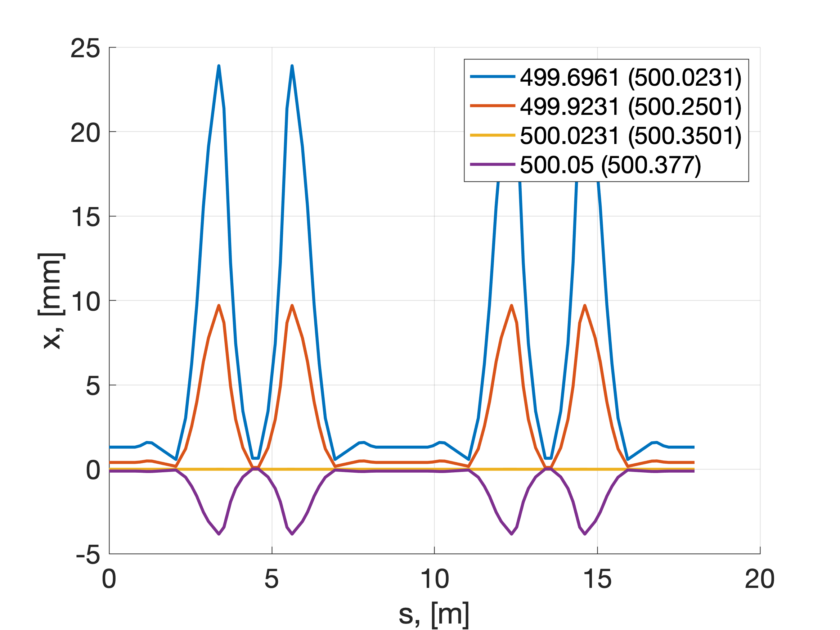
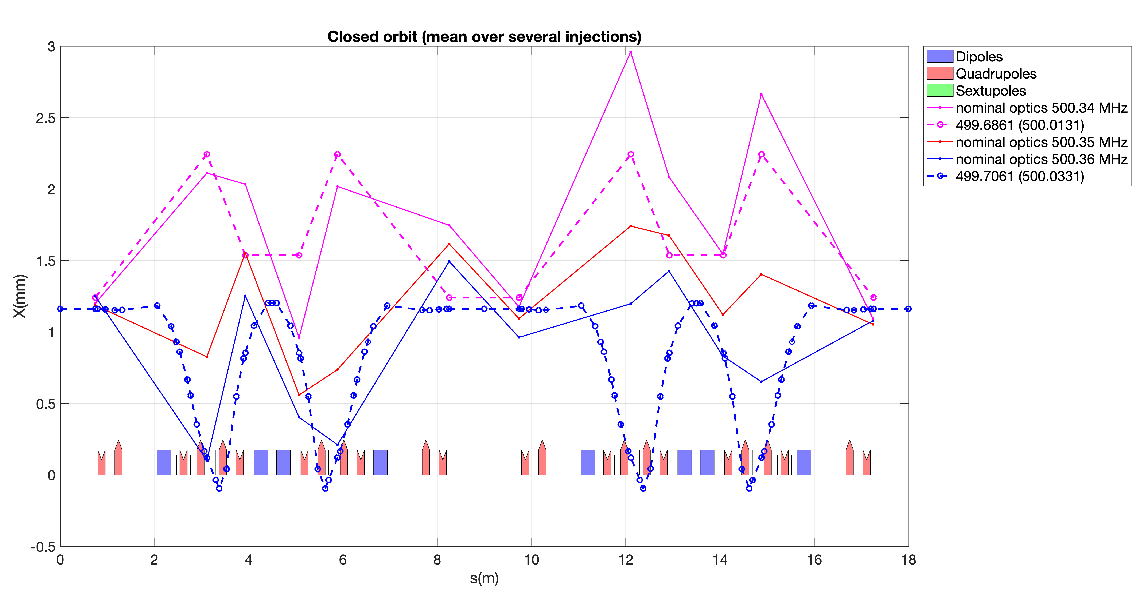
Frequency offset in modelling and experiment
Nominal optics
In the current context, the experimental studies are in good agreement
Exp [500.02 ; 500.25 ; 500.35 ; 500.38]
Model [499.69; 499.92; 500.02; 500.05]

Slide 13
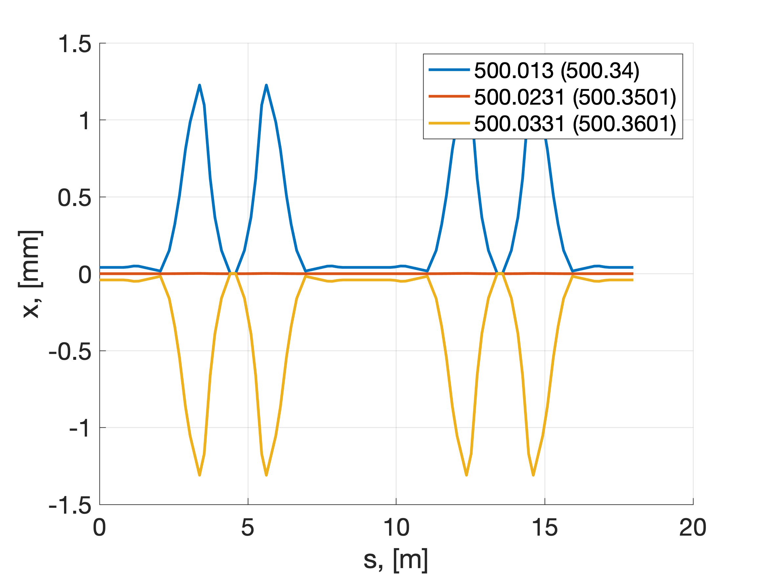
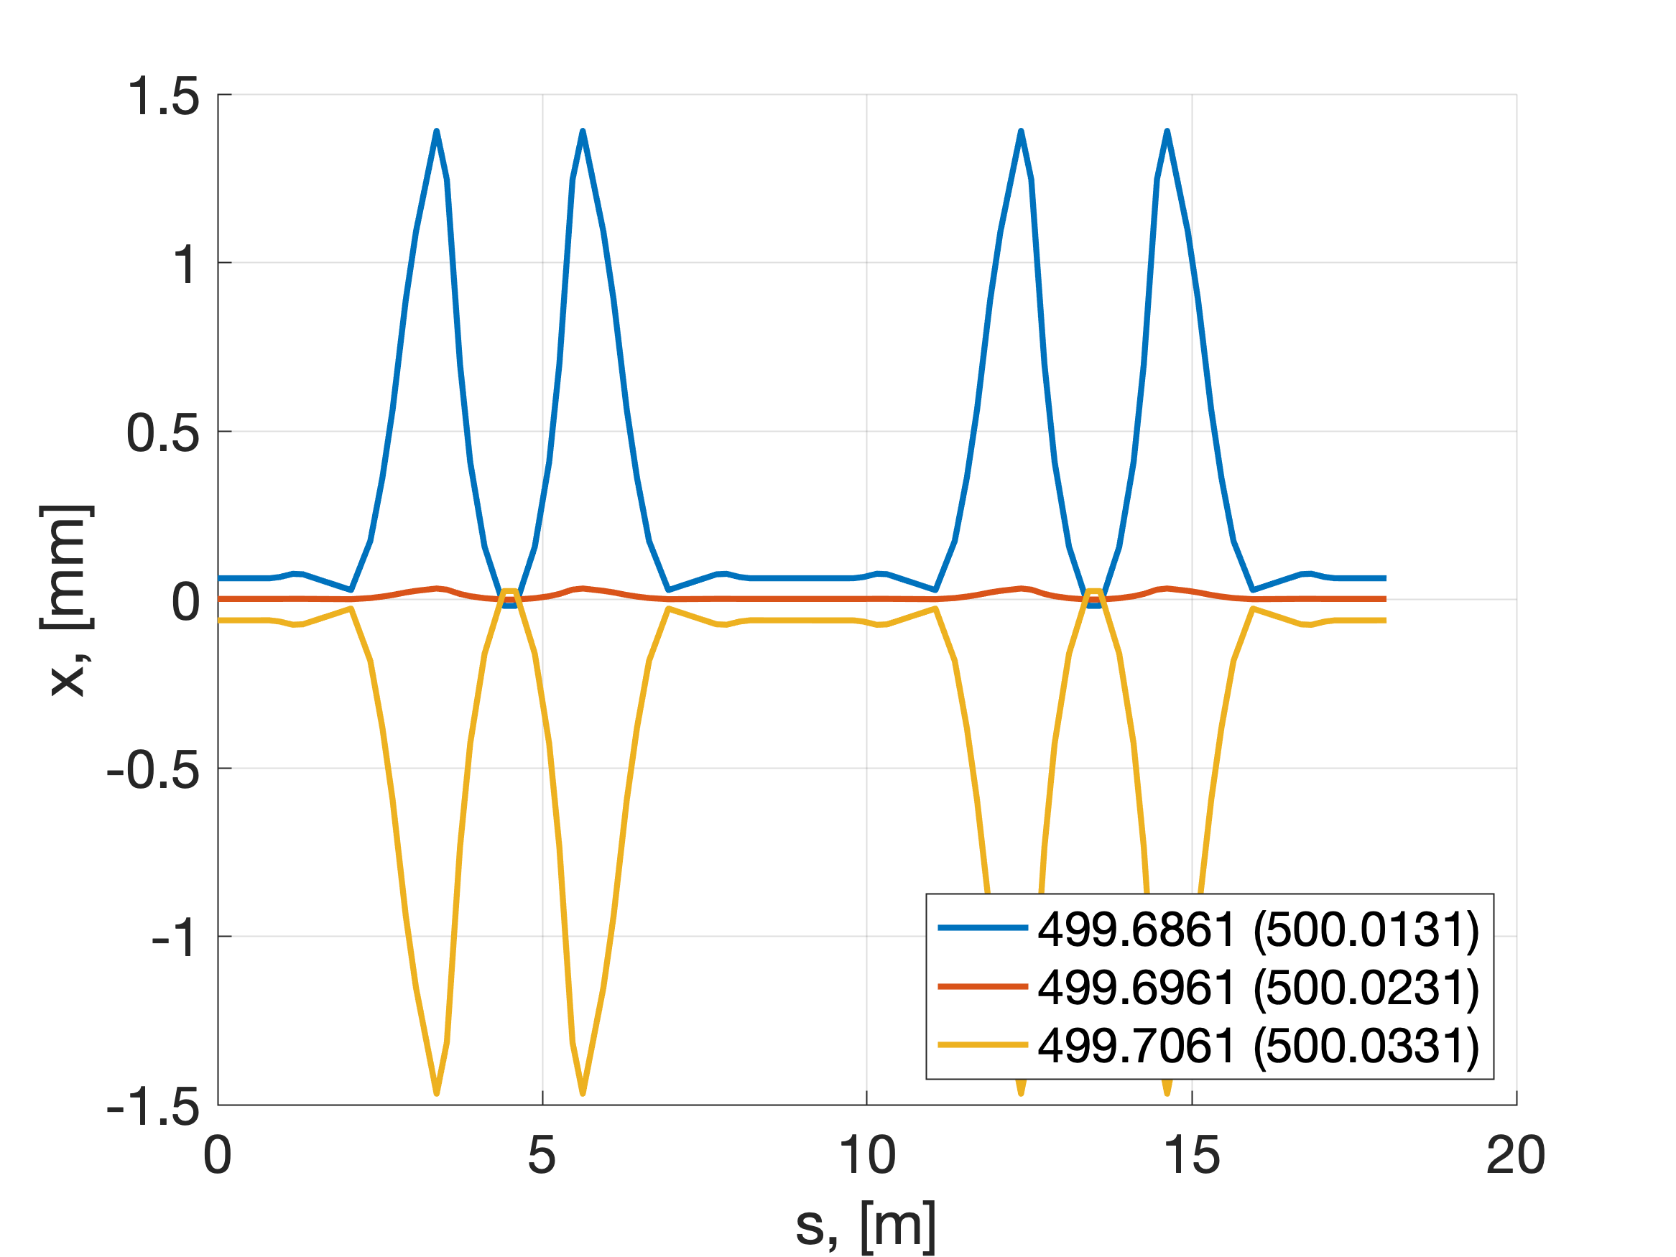
Comparizon of two optics
6D closed orbits @ ±10 kHz
Current optics (nominal)
New optics with the inserted drifts

Slide 14
Simple scaling to be used for estimations
Simple scaling rule, suppose current nominal frequency is 500.35 MHz:
deltaF = 0.327e6;
circumference = 17.98672;
delta_L_theory = 1./2.*circumference*deltaF./500.023e+06;
Very approximately: 1 mm offset on each side of the ring corresponds to 50 kHz offset in frequency

Slide 15
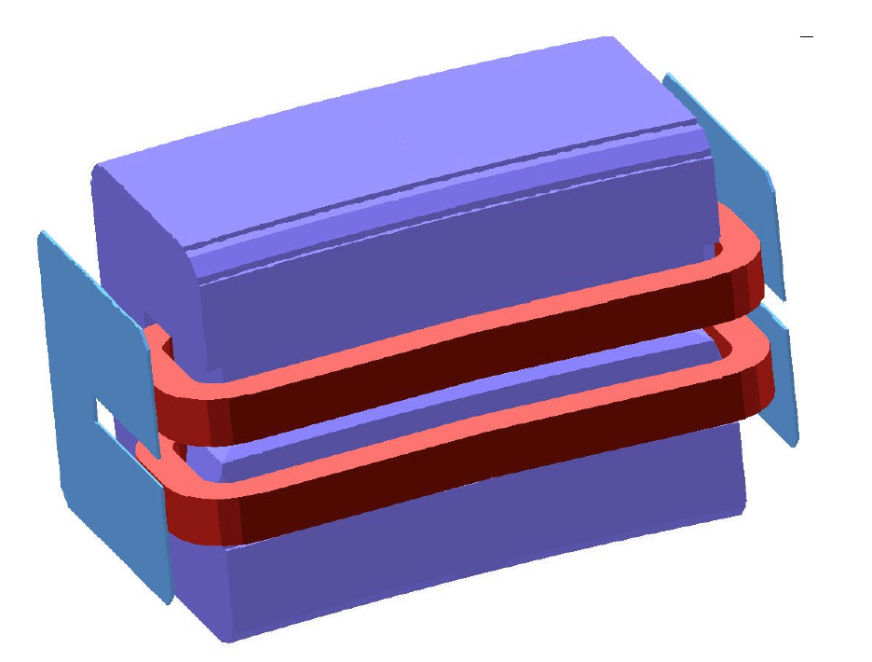
Part 3: Surround dipole with metallic plates
Goal: install the metallic plates for each of the dipole in the ring
Limitation of the fringe field will allow to increase the pathlength in the dipole.
Example: le dipole de l’anneau de soleil.
Etude magnetostatique 3d
n/ref. : dsm/dapnia/sacm/soleil-2002

Slide 16
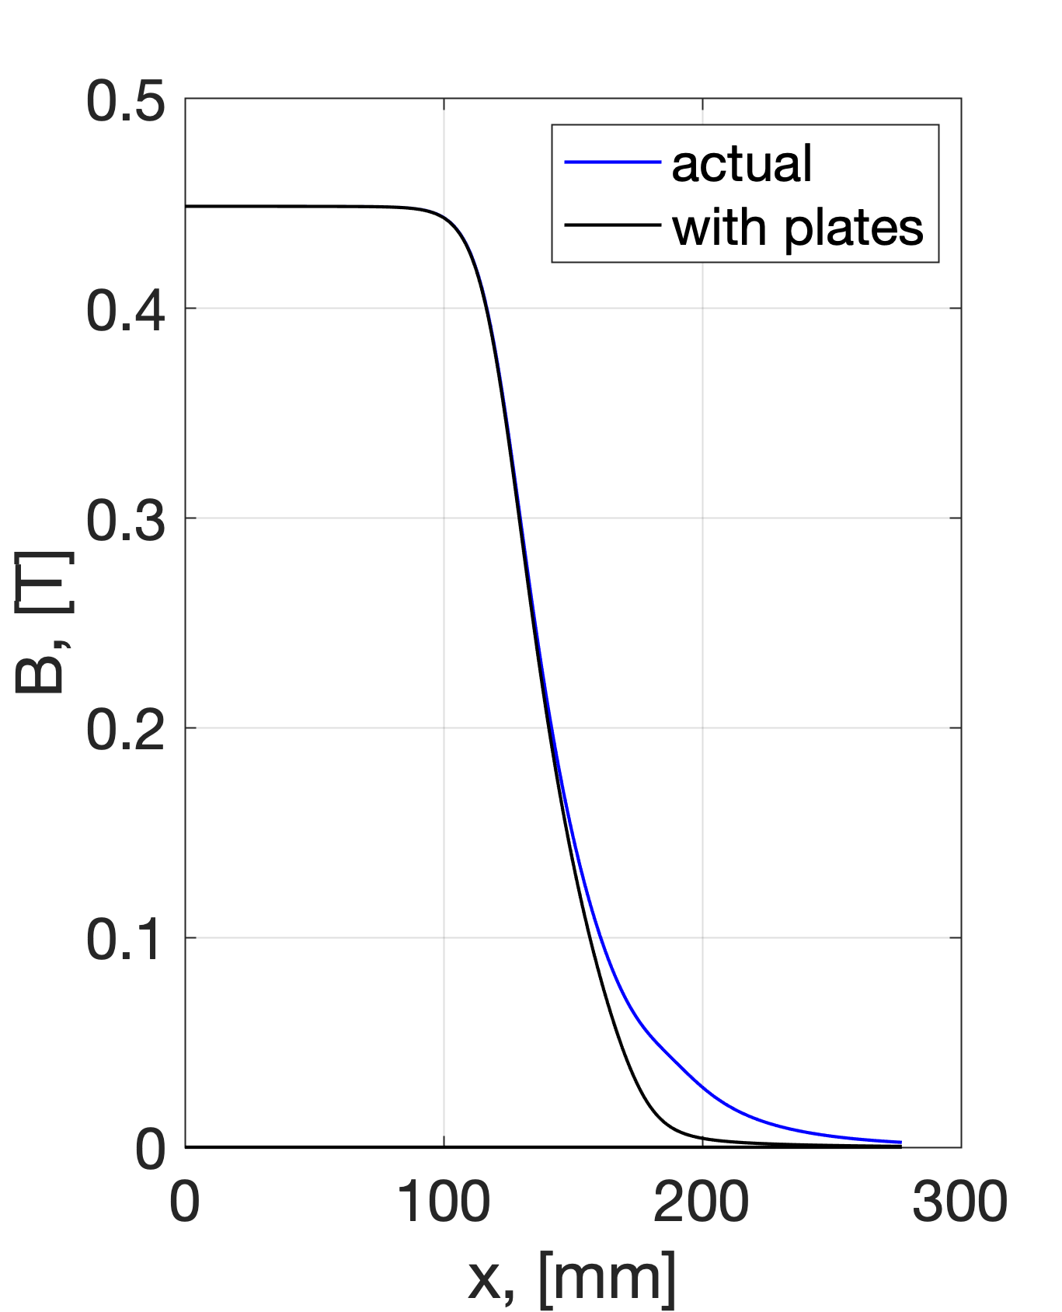
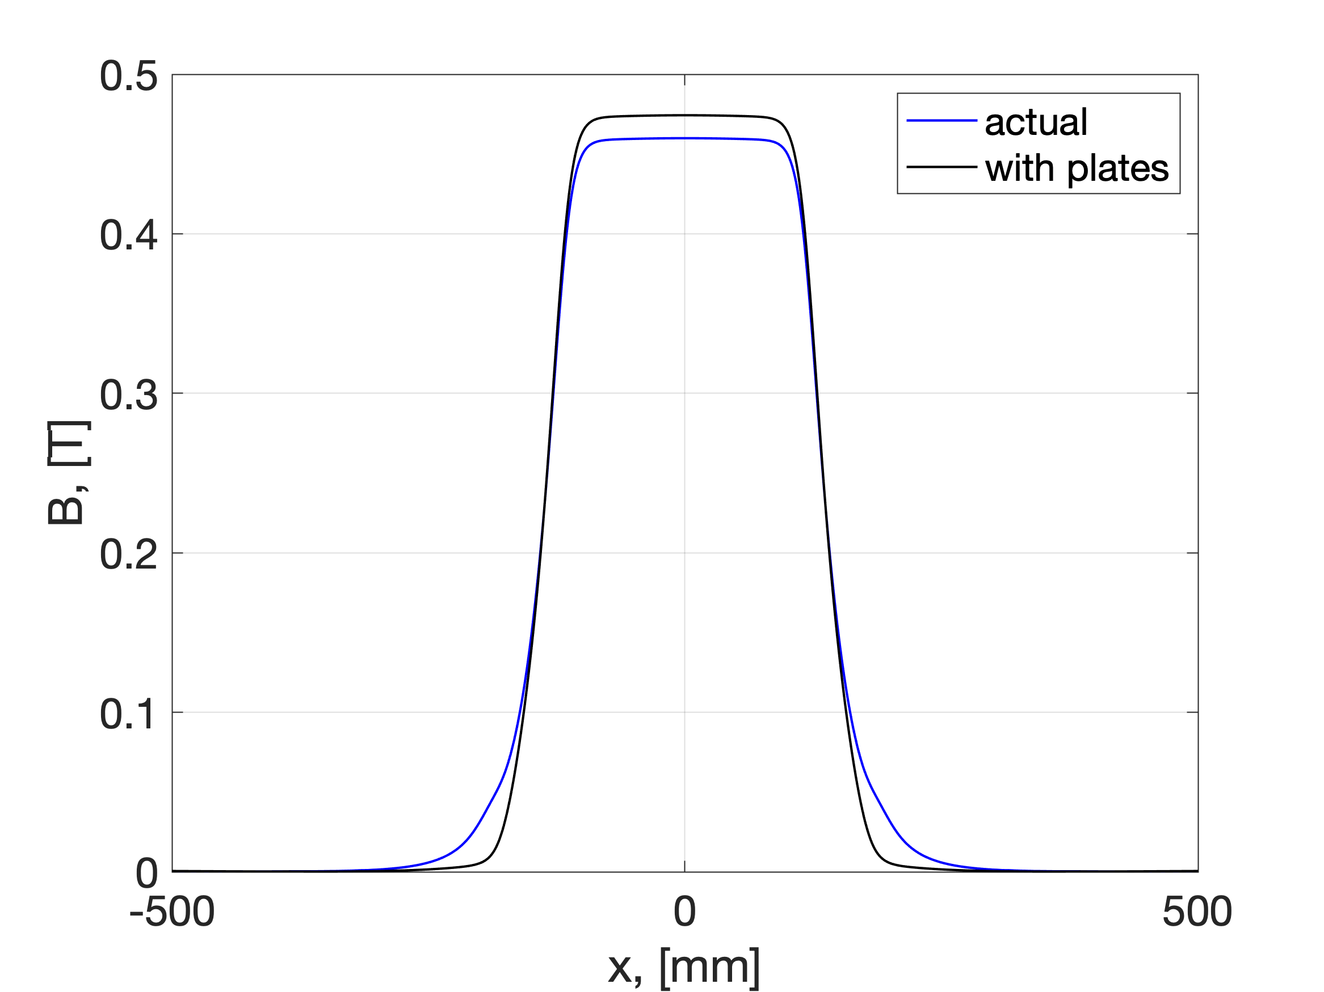
“Experiment on the table” with RF-track
Fieldmaps are provided by Fabrice (SOLEIL)
RF track simulations have been performed with the measured (ALBA) and OPERA dipole field. Difference in fieldmaps => difference: ~ 0.1 MHz
Correct scaling of magnetic field for the magnet with plates allows to reduce the ring RF frequency by ~200 kHz
More realistic design of the plates should be implemented.
OPERA
OPERA
Scaled fieldmap for dipoles with MP

Slide 17
Summary
We developed the method to simulate the ThomX ring in AT.
We investigated the frequency/circumference difference and solution to elongate the ring.
With the inserted drifts up to 6 mm each, the rematched optics is close to nominal. Detailed studies in progress.
  The minimum possible drift value: avec des joints plus large le mini est 0,1mm. Si on met des pièces en plus le mini est 3 mm (info from Rodolphe).
The solution with the metallic plates seems very promising. Allowed spacing and realistic geometry studies in progress. Solution could be more difficult to implement.
Ideally: for model/real accelerator studies, it is important to have the correct dipole simulation in the tracking code. Solution: bring the dipole field as much as possible to the theoretical model of the dipole.
After the input from timing group, fix and validate the frequency change.

Slide 18
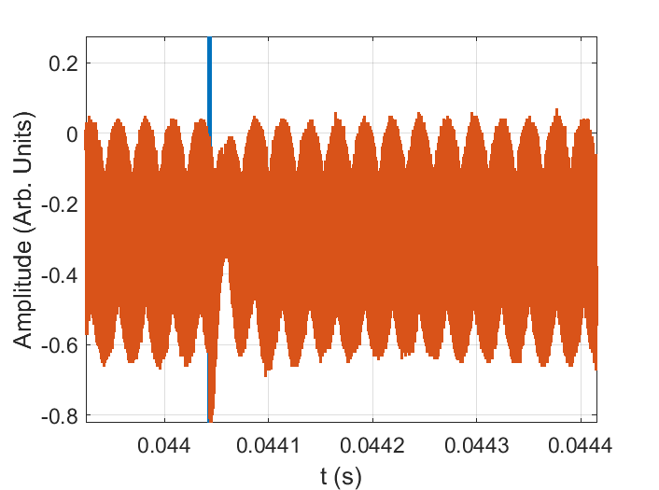
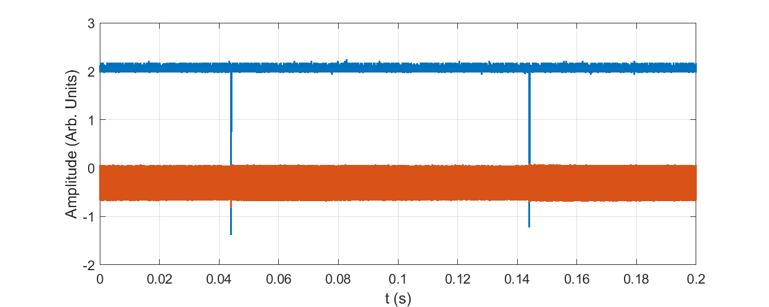
Beam storage in the beginning of the summer
Example of beam storage.
Processing of oscilloscope data
RefCurve_2023-06-13_3_152443.Wfm.csv

Slide 19
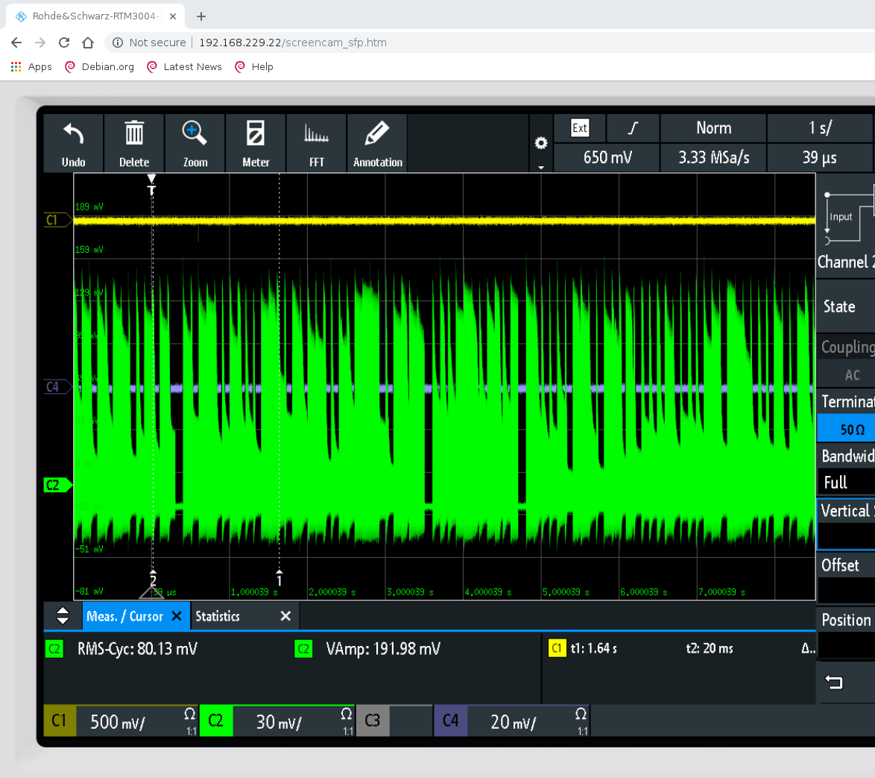
Data from 16/11/2023

Slide 20
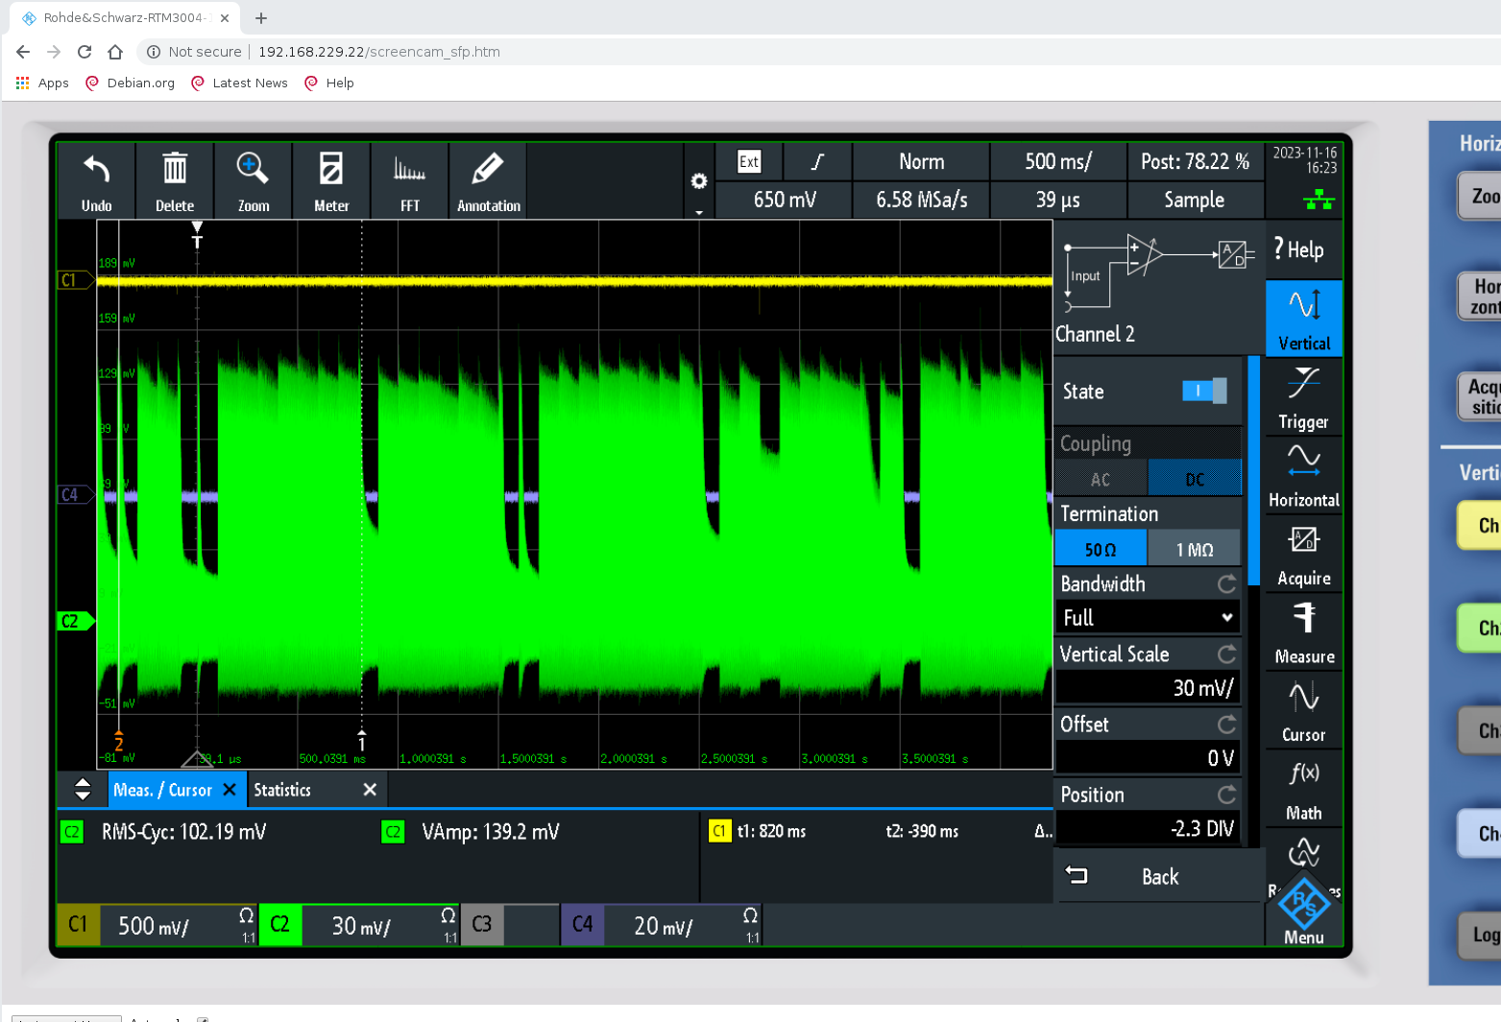
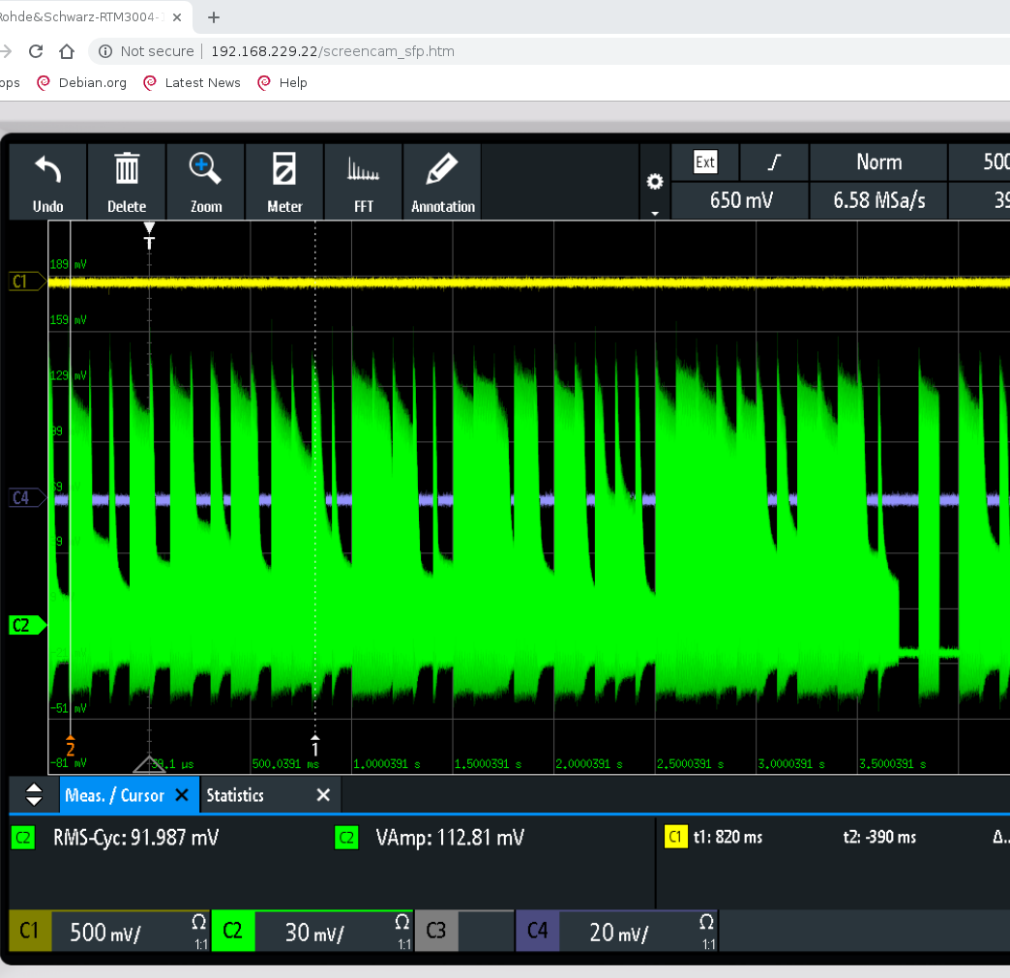
Data from 16/11/2023

Slide 21
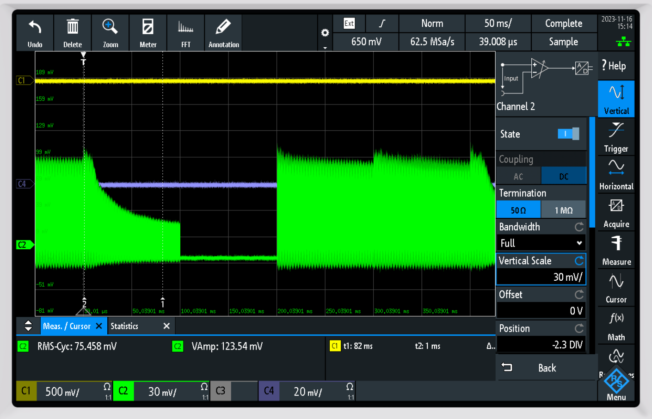
Data from 16/11/2023

