Slide 1
WELCOME
Bienvenu(e)s
A new European Laboratory.
Formed on 2020 by the merging of 5 Laboratories in Orsay-France
CSNSM Centre de Sciences Nucléaires et de Sciences de la Matière
IPN Institut de Physique Nucléaire
IMNC Imagerie et Modélisation en Neurobiologie et Cancérologie
LAL Laboratoire de l’Accélérateur Linéaire
LPT Laboratoire de Physique Théorique

Slide 2
IJCLab : Located in Orsay Campus, 30 Km South-Paris, Campus Paris-Saclay
IJCLab is occupying a large part of the Orsay Campus (~50000m²)
IRFU/CEA in the same Campus
Financial plan (CPER) for renewing buildings and research infrastructures
20,6M€ 2016-2021
9,1M€ 2022-2027

Slide 3
IJCLab staff and guardianships
CNRS (Centre National de la Recherche Scientifique)
~17000 researchers + 16000 technical staff
10 institutes among them IN2P3 (Institut national de physique nucléaire et de physique des particules)
IN2P3 composed by ~20 large-scale laboratories
IJCLab is a IN2P3 laboratory
IJCLab (~700 people) ~1/4 of HR of the IN2P3.
University Paris-Saclay
275 laboratories : 9000 researchers, 11000 IT (University and research organism altogether, comprising CNRS and CEA)
13th Shanghai ranking (Physics : 9th World, 1st Europe)
48000 students (with 9000 Master, 4000 PHD)
University de Paris
Specific links with IJCLab in Health Physics
IJCLab :
Personnel Status
(including non permanent)
712 people
+ 120 Internships
+ 6 trainees (« Apprentis”)
+ 6 Long term visitors
All in all >800 people present at the laboratory

Slide 4
…et voilà IJClab !
7 Research Poles
31 research teams and 2 Departments
1 Engineering pole
4 Departments with 10 Services
1 Administration Pole
3 Divisions + 1 Service
6 support Services
5 Platforms
(with external users)
+ several technical platforms
712 membres (530 permanents)
L'un des plus grands laboratoires du
CNRS / Paris-Saclay / Université de Paris
Dans le réseau des grands laboratoires européens (LDG)
Instances
members
One of the largest laboratories of the CNRS and Paris Saclay
In the network of 8 major European laboratories
CL
CPL
CSS
CLHSCTE
CAT
ASTech
COMUTI
New and different organization compared to the former laboratories + new “instances”

Slide 5
IJCLab : Organisation sur une 1 page !
6 GROUPES TRANSVERSES
Saveurs: Quarks et Leptons
Yasmine Amhis(PHE), Thibaut Louis (A2C), Olcyr Sumensari(TH)
QCD
Jean-Philippe Lansberg(TH), Laure Massacrier(PHE).
Fabrication Additive Technologies Innovantes (FATI)
Stéphane Jenzer(PI-Mécanique), Nicolas Delerue (PA)
Calculs et Données
David Chamont(PI-Informatique), David Rousseau (PHE)
Cosmologie et Physique des Hautes Energies (COSPT)
Eugeny Babichev(TH), Thibaut Louis (A2C), Dirk Zerwas(PHE)
Physique nucléaire dans le cosmos
Nicolas Leroy (A2C),Nicolas de Séréville(PN), Michael Urban(TH)
ARCO (Accelerator Research Center Orsay) pour animer la recherche et le développement en Accélérateurs
Dernière MAJ :

Slide 6
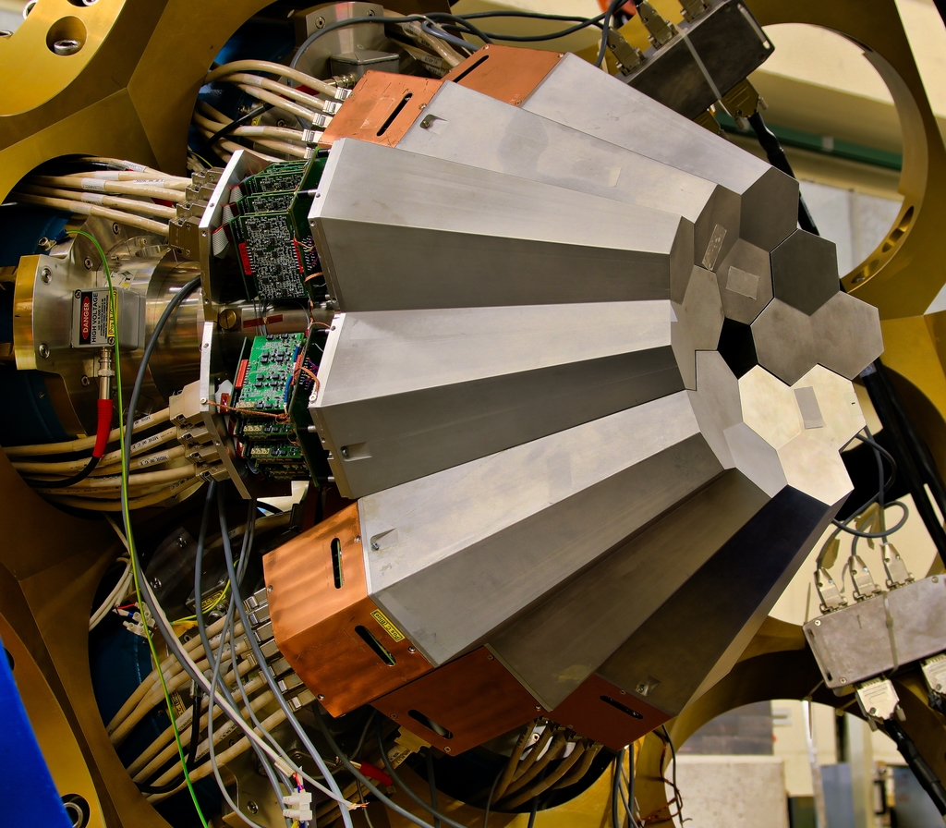
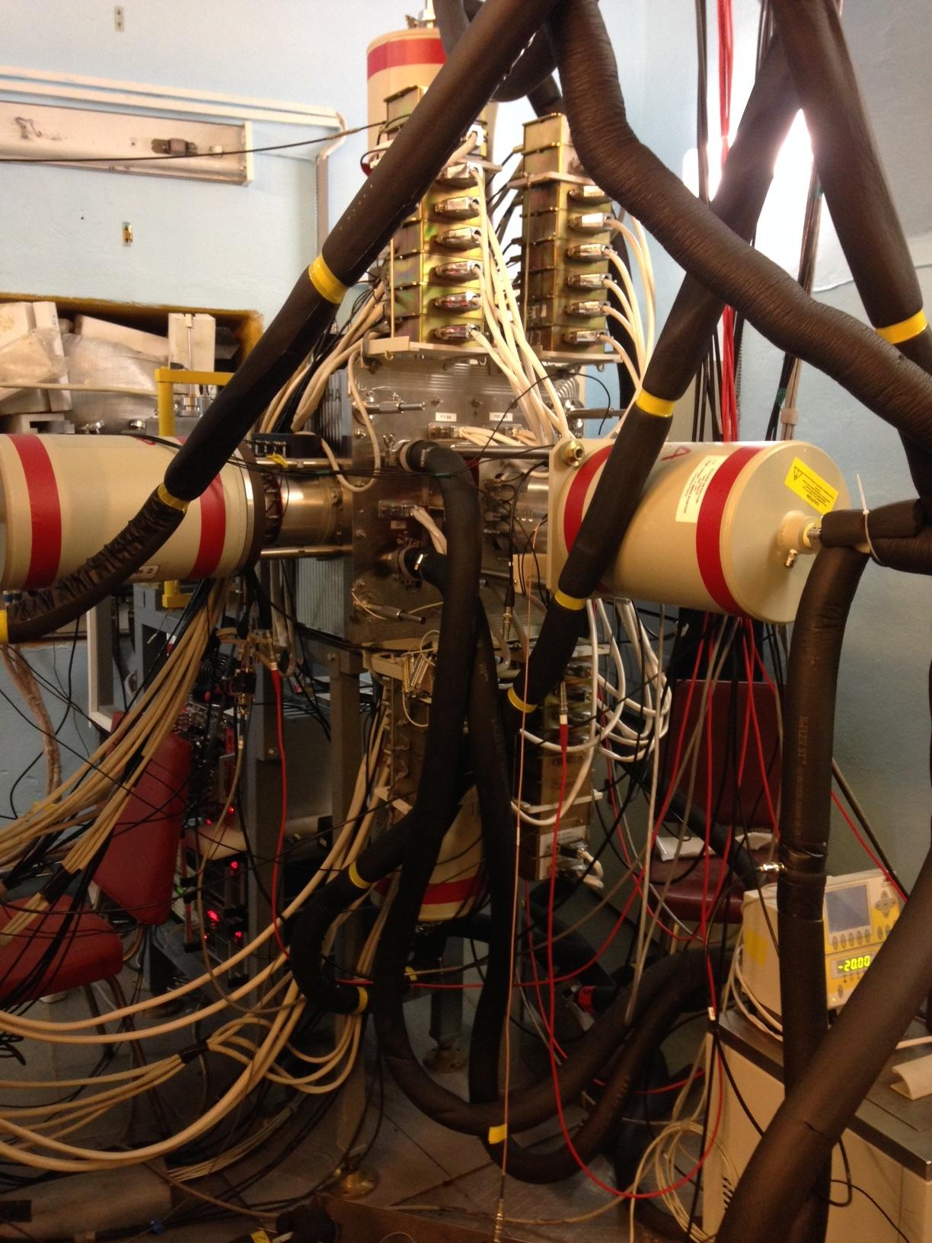
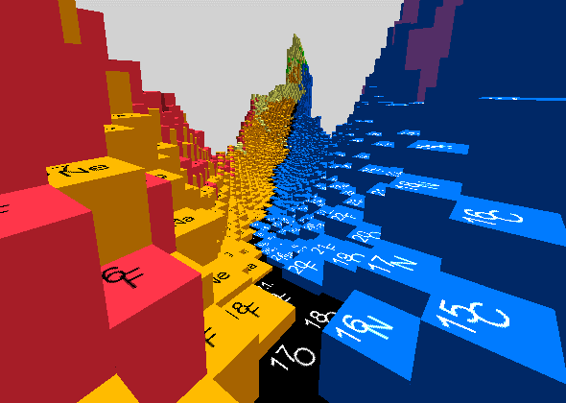
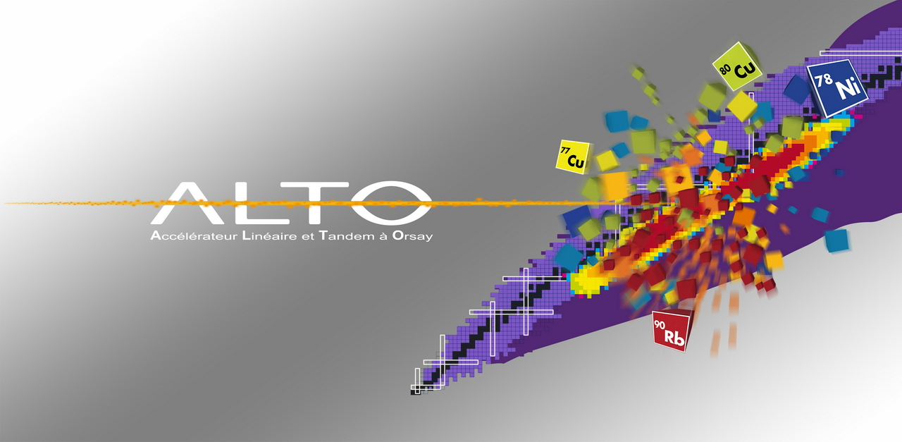
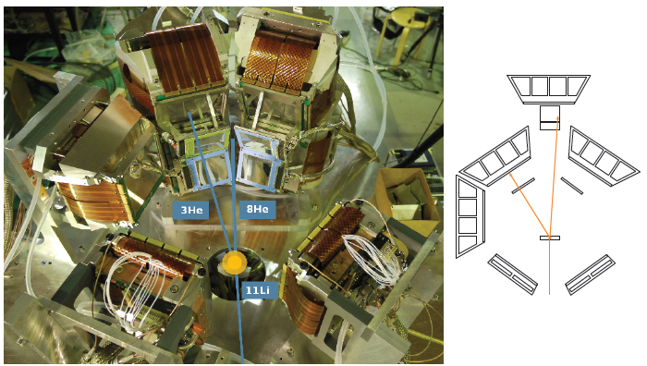
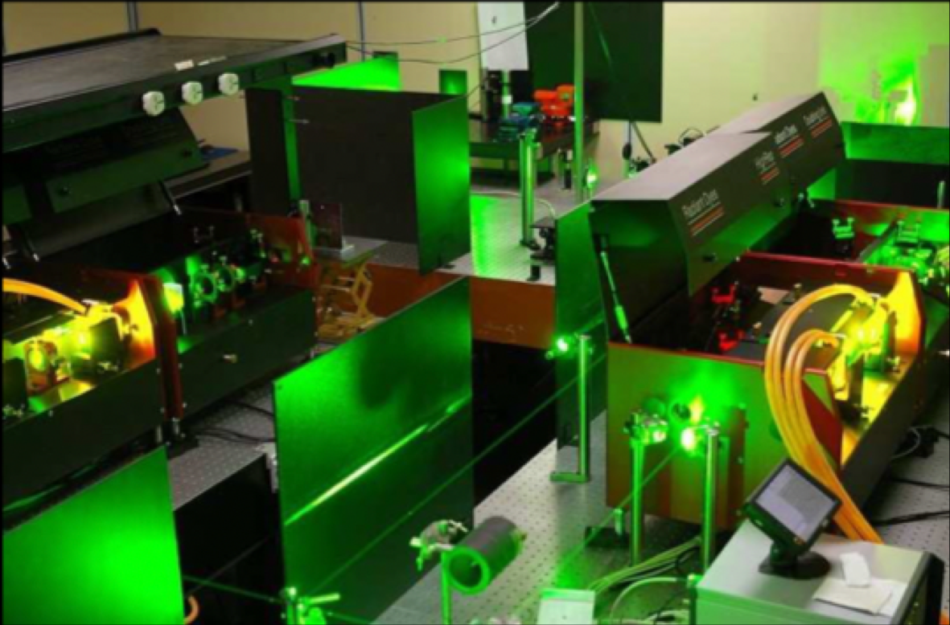
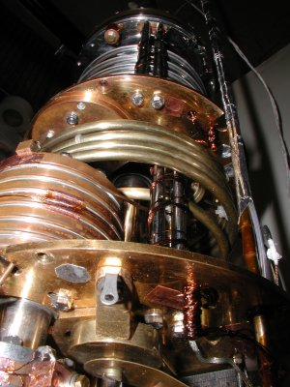
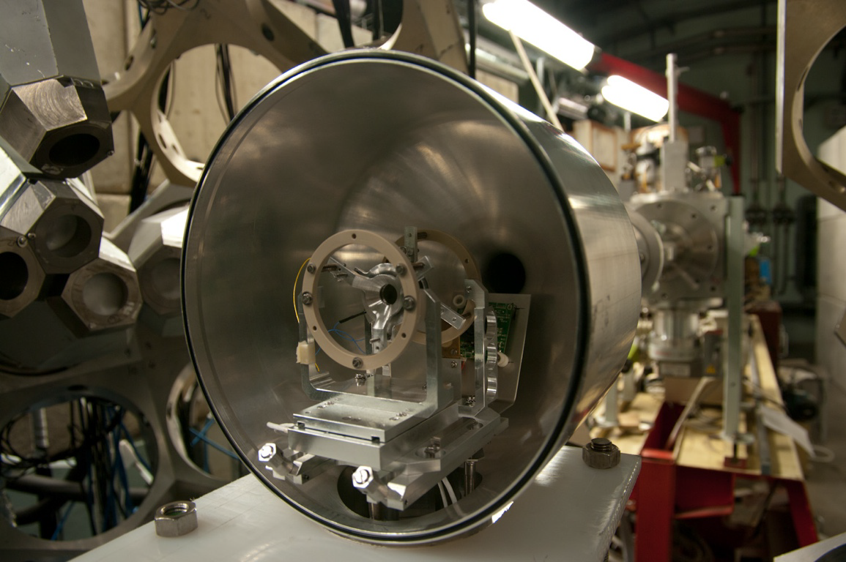
IJClab in a nutshell
All the themes of the "physics of the two infinities" with the presence of strong historical/existing poles, emerging poles and activities at the interfaces.
~ 87
~ 58
~ 61
Including RF and cryogenic services
Theory
~ 72
Energy and Environnement
~ 106
~ 34
Health Physics
~ 25
~ 107
~ 110 PhD

Slide 7
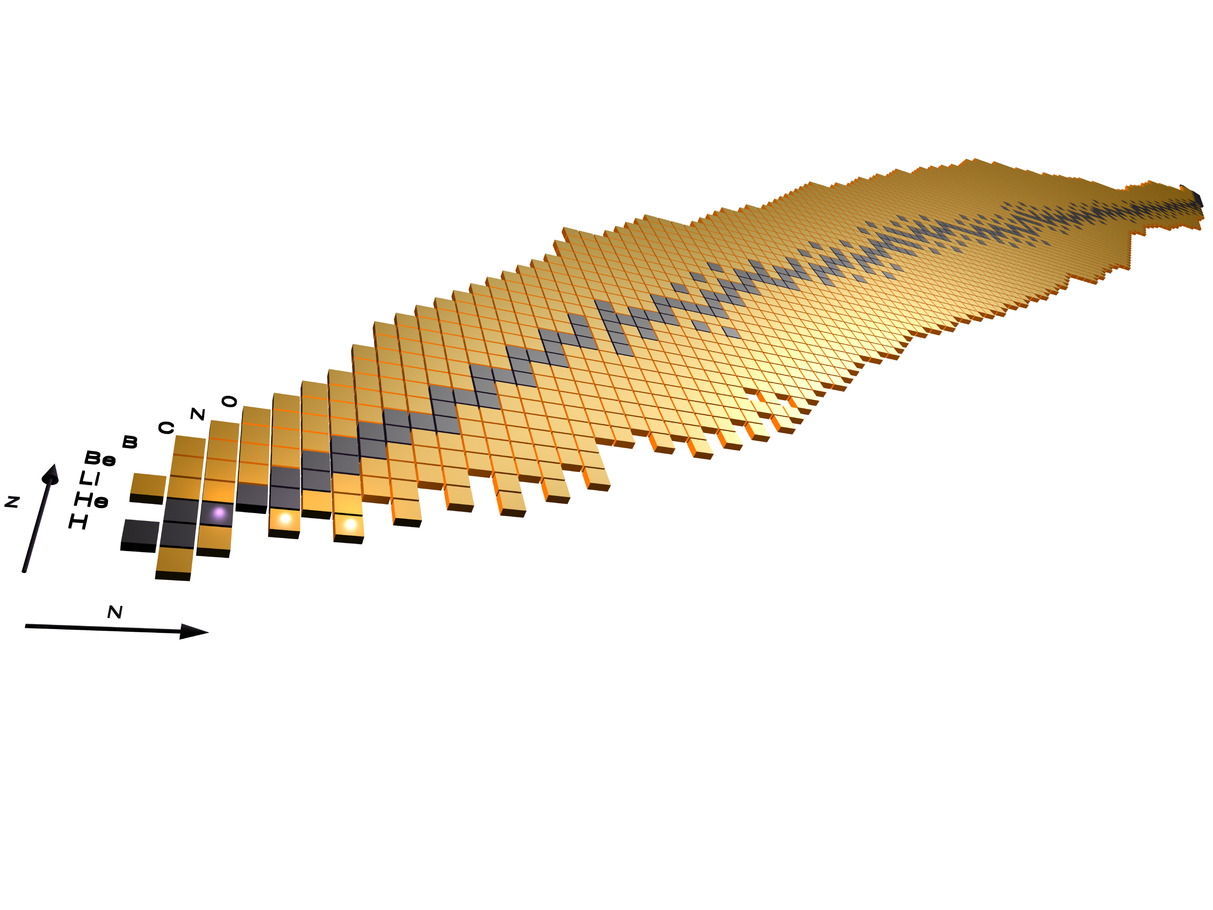
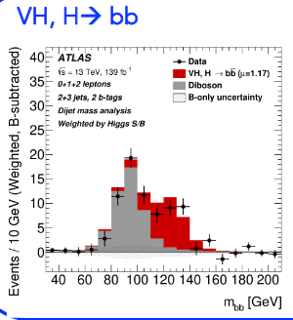
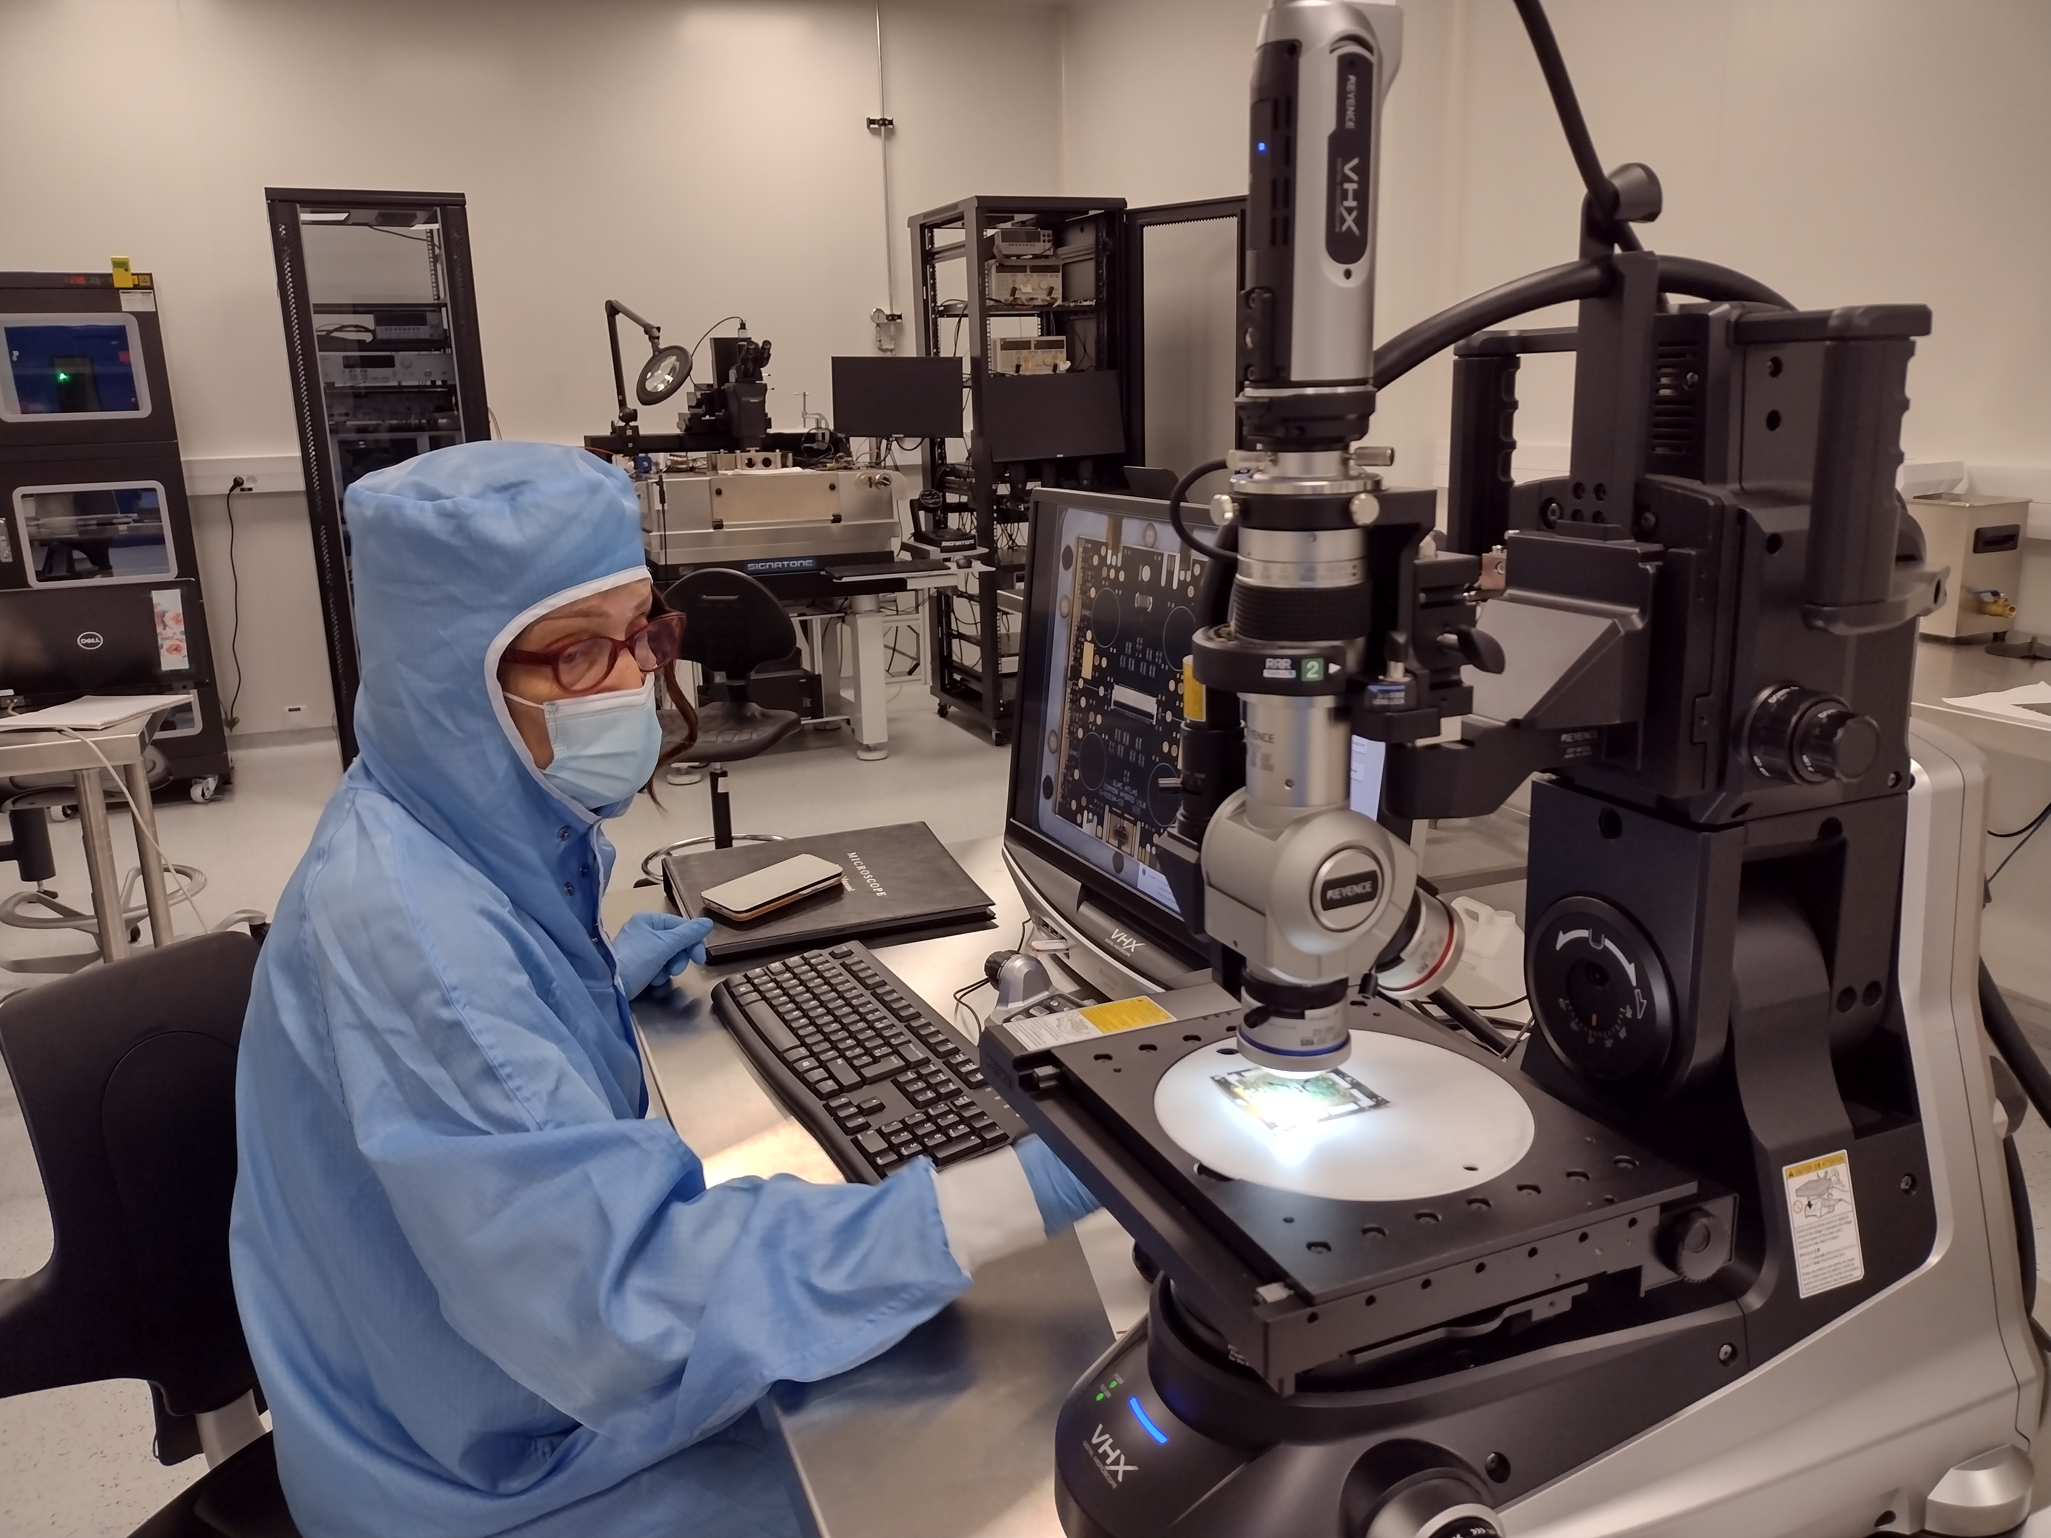
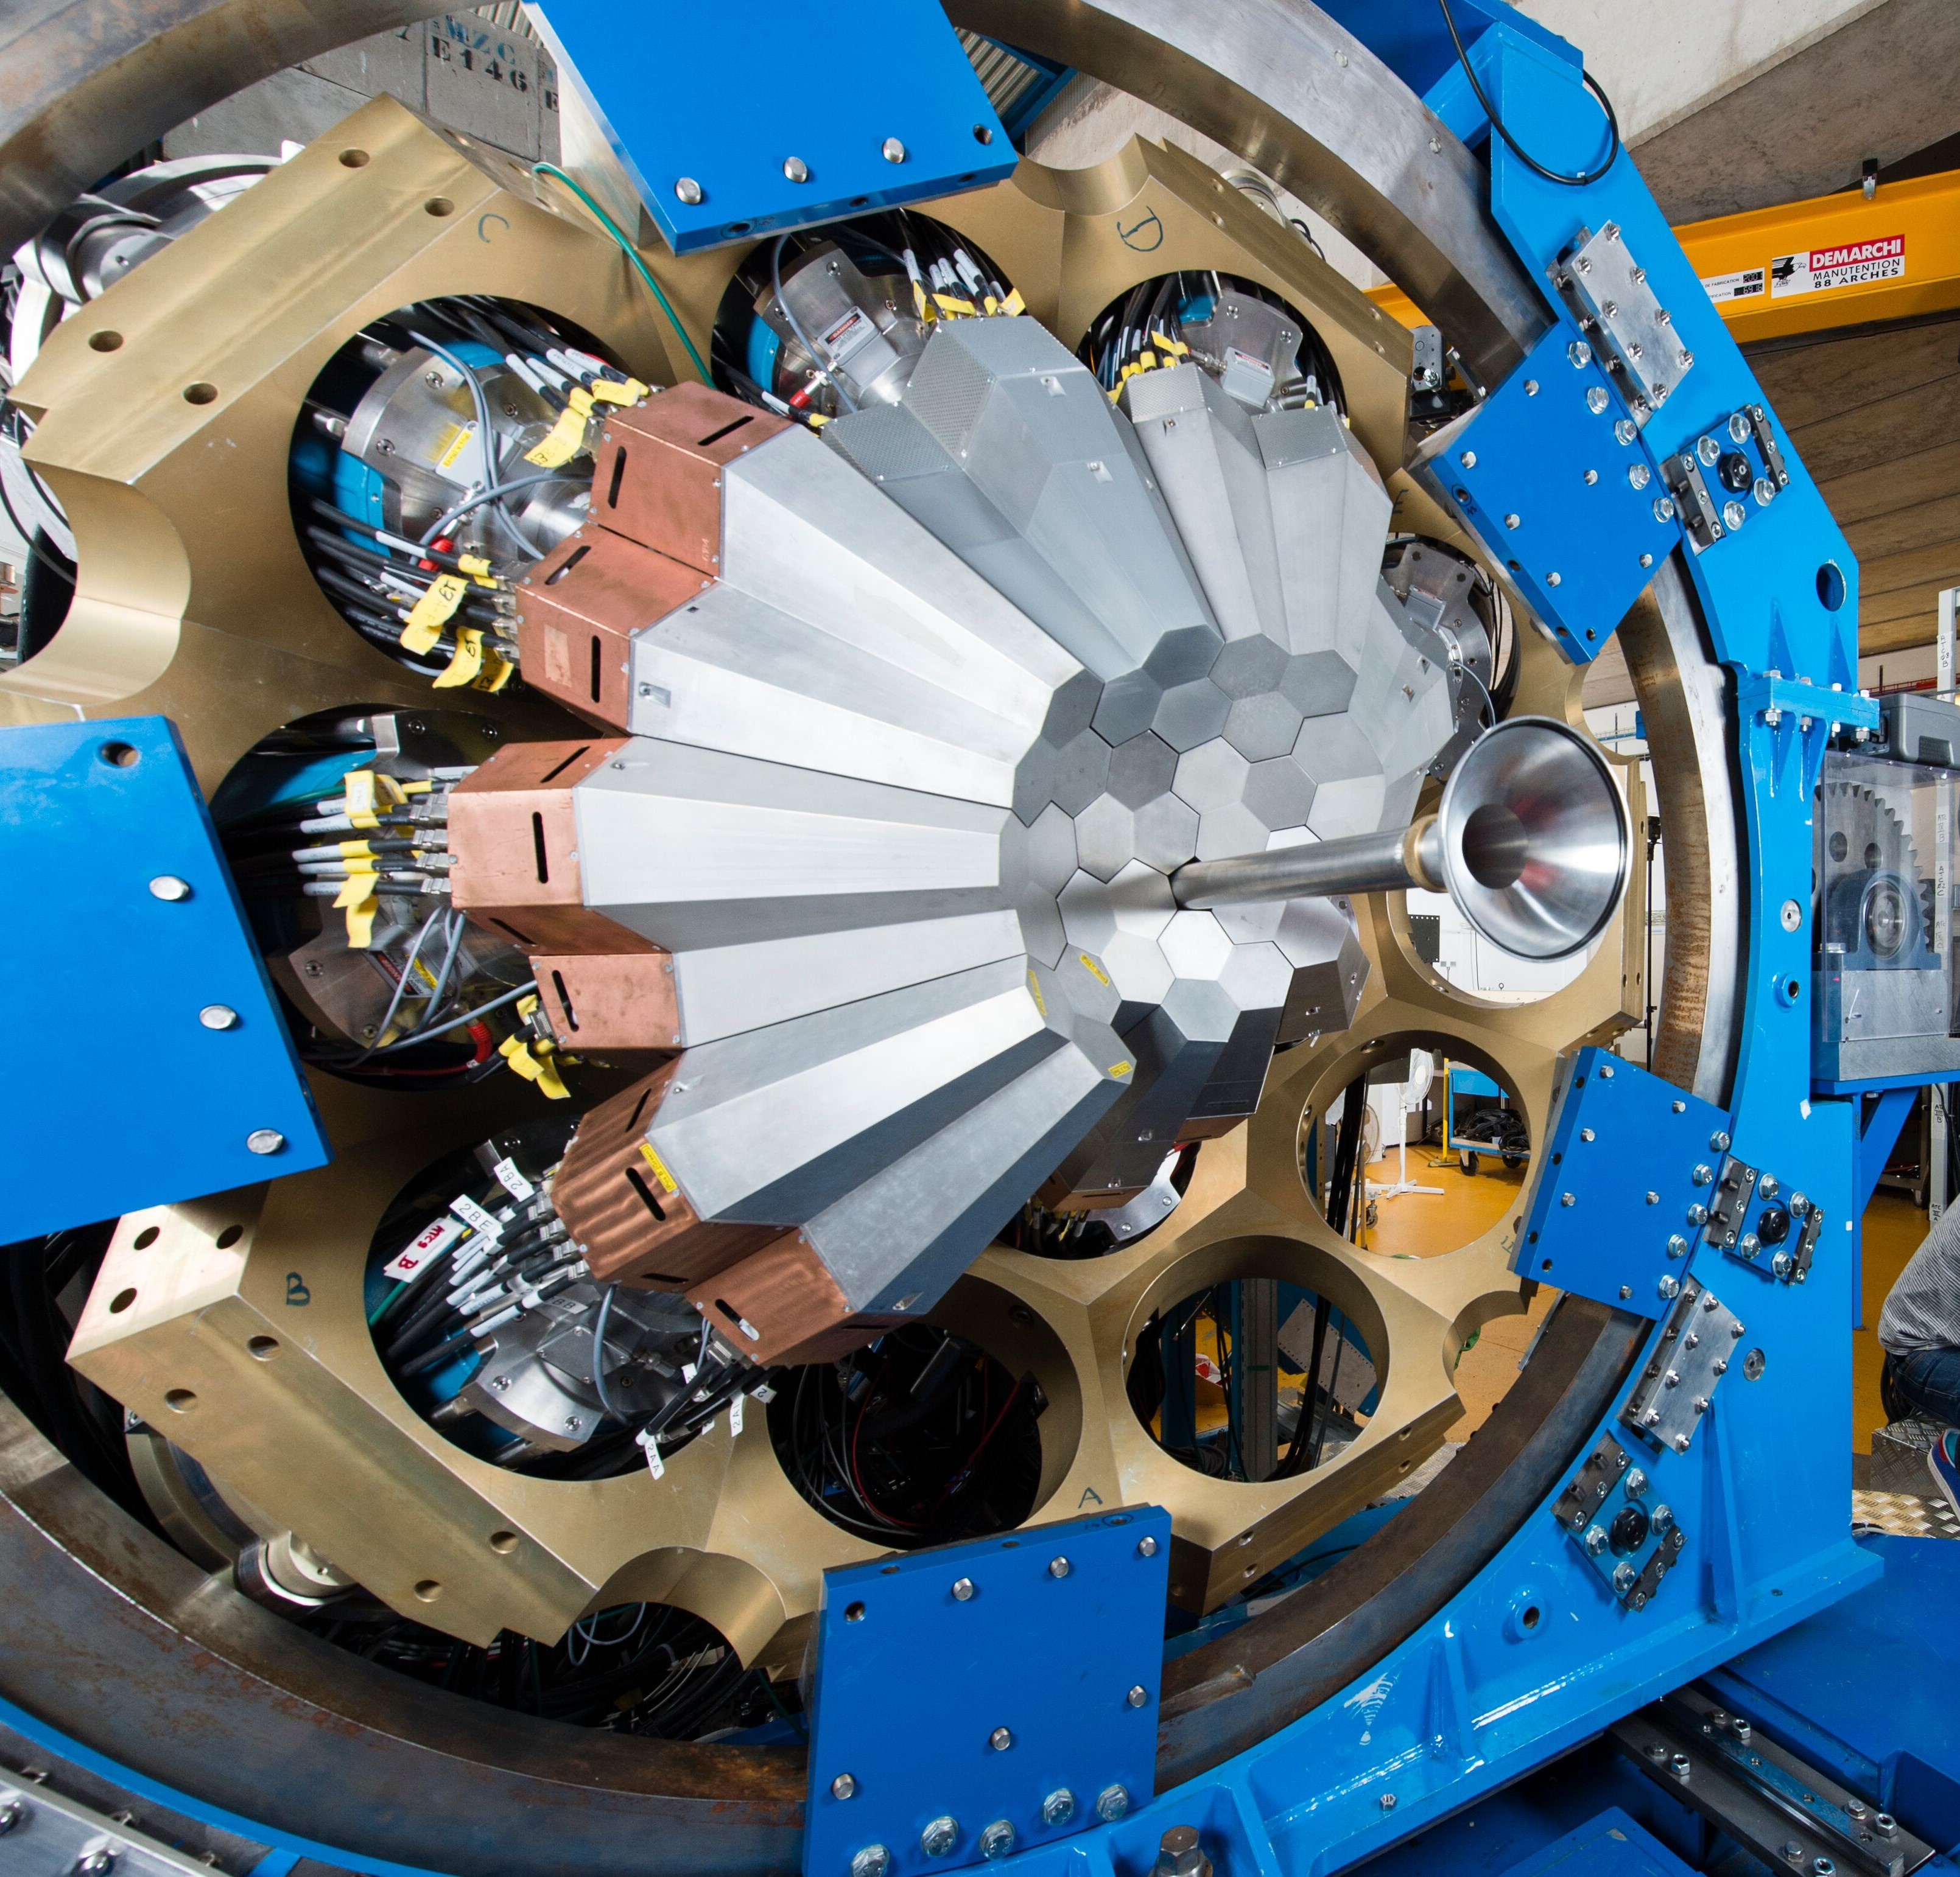
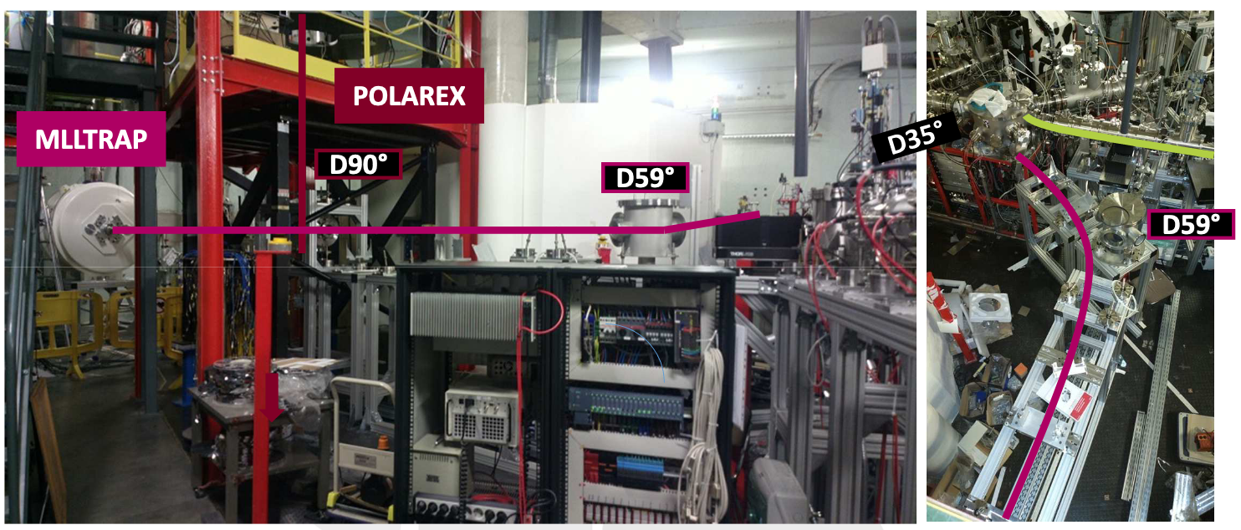
IJCLab : The Research Themes
Probing matter at small distances/high energy E=hc/λ, discover new particles E=mc²
emergent properties of an effective interaction
Extreme en spin
The standard model and the discovery of the Higgs boson!
The missing piece of the standard model
Extreme en mass
Extreme en isospin
Nuclear Physics
Particle/Hadronic
Understand the constituent elements of matter, their interactions
and how the properties of matter are derived from them

Slide 8
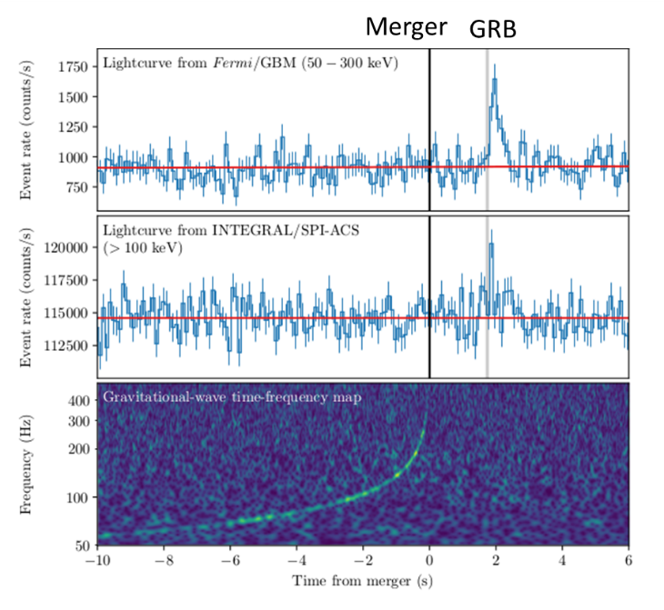
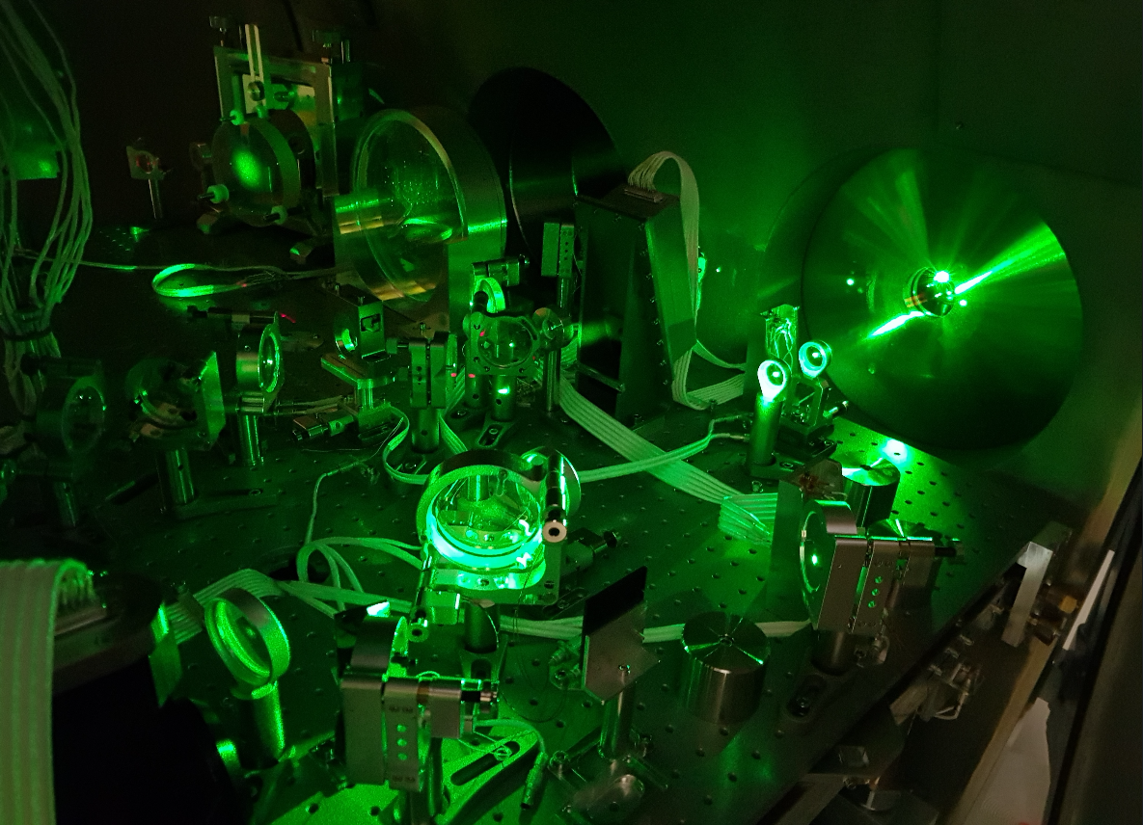
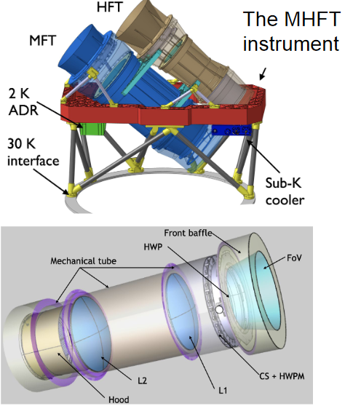
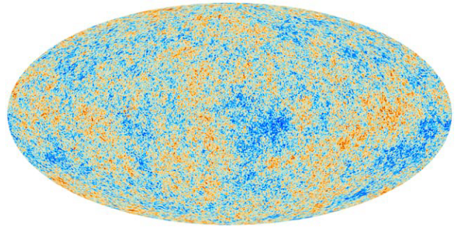
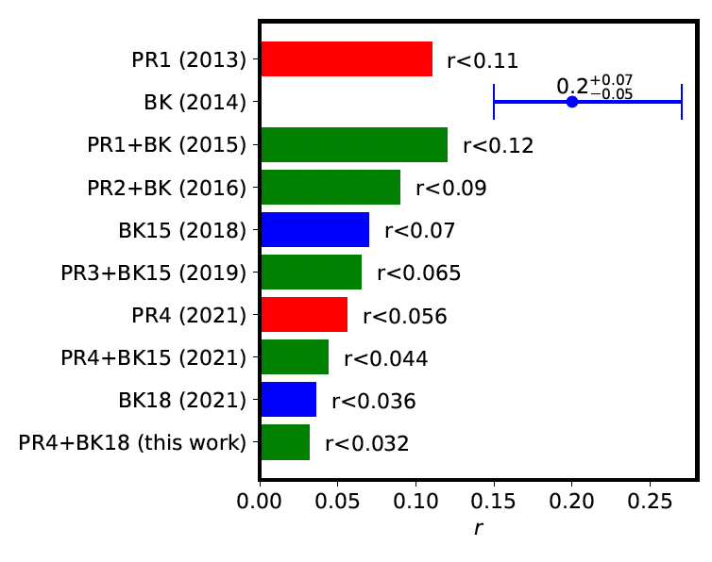
IJCLab : The Research Themes
To understand the evolution of the Universe and to study the violent phenomena that occur in it, in connection with high energy physics
The observation of gravitational waves LIGO/VIRGO
Space-time waves, direct observation of black holes / other compact objects
The early universe seen by the CMB!
The first picture of the universe
ASTROPARTICLES
Astrophysical events (high energy cosmic rays, black hole fusion, general relativity...)
Cosmology
(evolution of the Universe, inflation, large structures, dark matter and energy)
Liens avec le

Slide 9
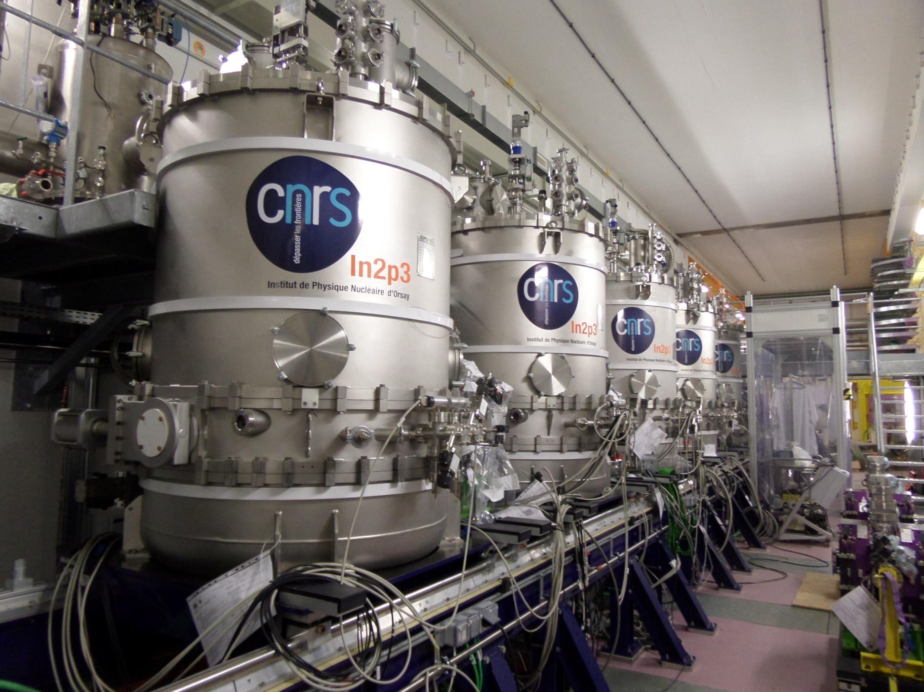
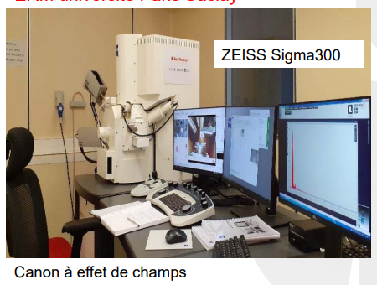
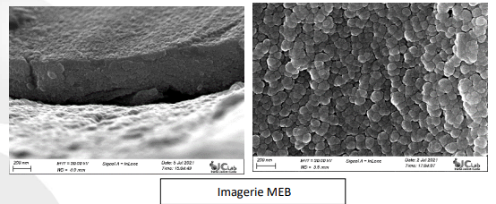
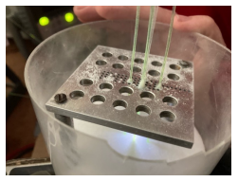
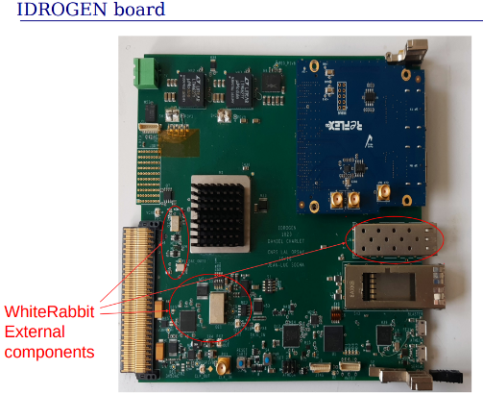
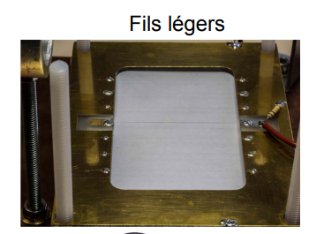
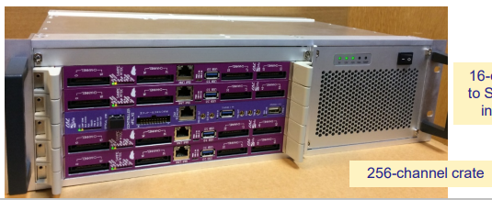
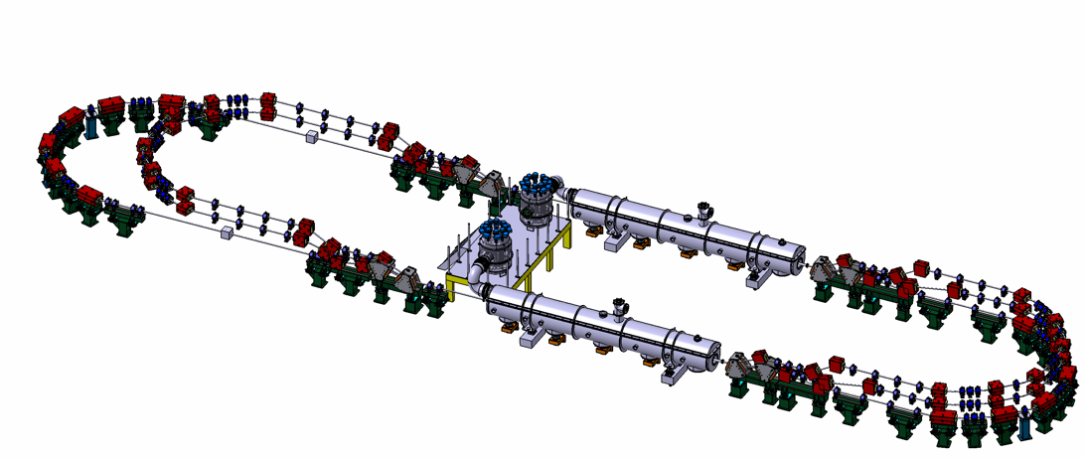
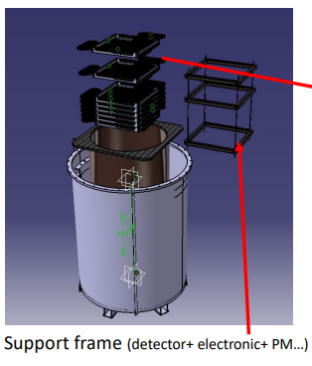
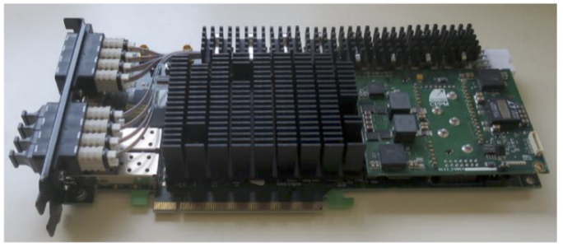
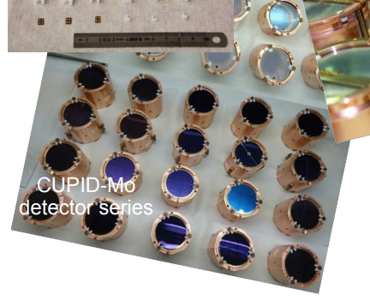
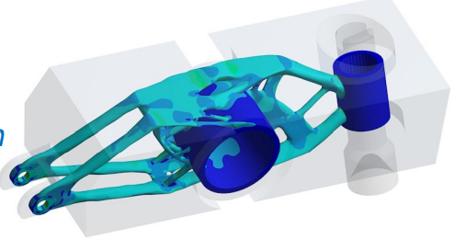
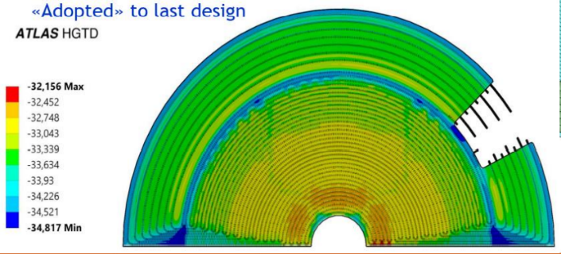
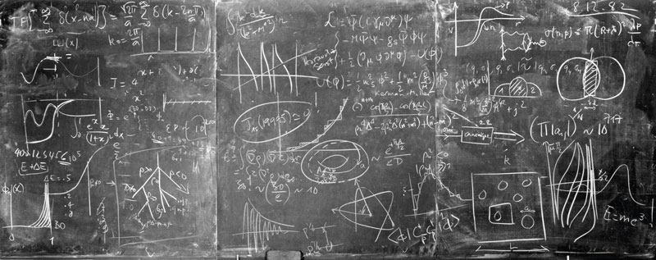
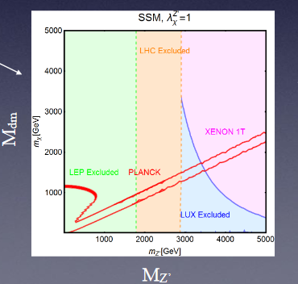
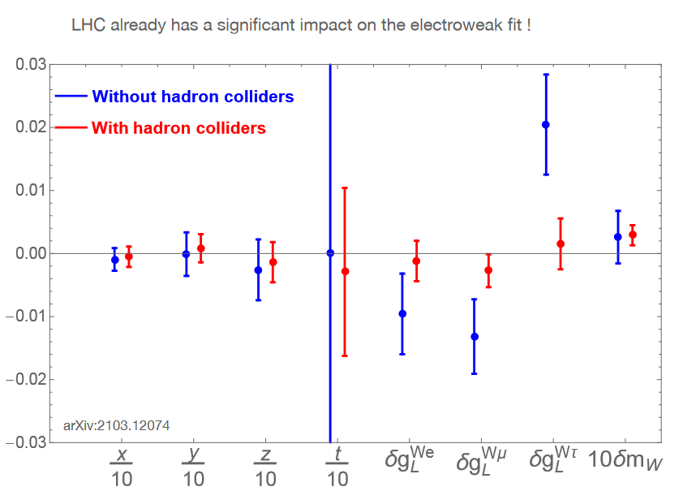
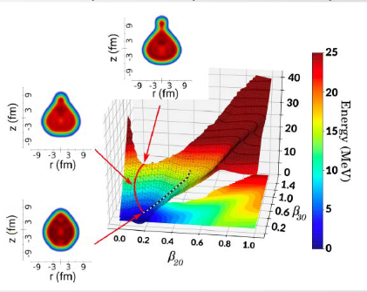
IJCLab : The Research Themes
Design, develop and build tools to carry out this research
Accélérators
Detectors/Instrumentation
Theory

Slide 10
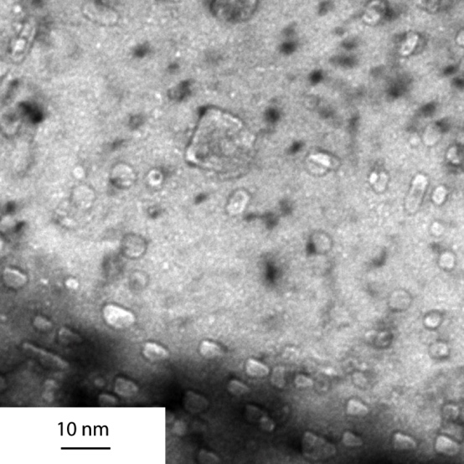
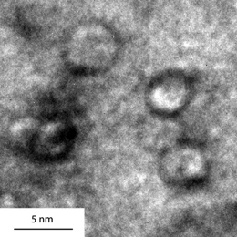
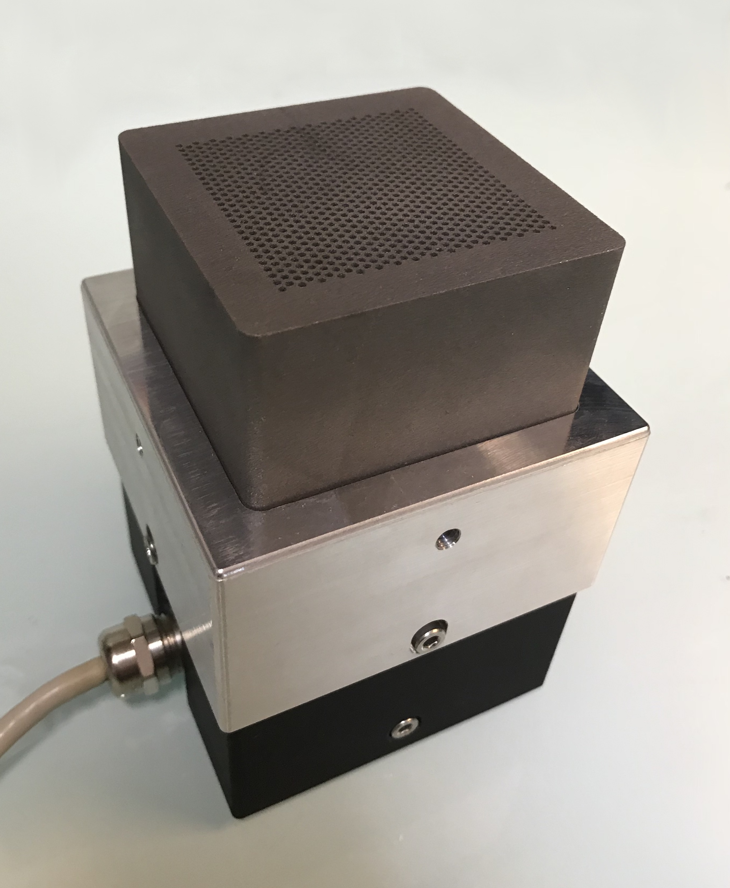
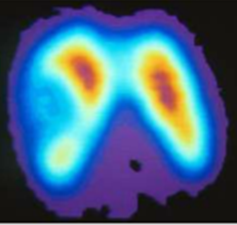
IJCLab : The Research Themes
Tools and concepts applied in areas that have an impact on society
Energy and environment: nuclear energy, radiochemistry and materials
Health physics:
Imaging, radiation therapy, life modeling

Slide 11
IJClab in a nutshell – III : Technical Skills
Services in accelerator Pole
RF
Cryogenics
~30 staff members
~180 staff members
4 Departments :
Electronics / Computing
Instrumentation / Mechanics
with 10 Services
Technical staff with technical skills/expertise
essential pillars for the laboratory to design, draw and build instruments.
Technical services are fuelled by the challenges of research (R&D and projects)
The proximity of technical and research teams (integrated teams)
The ability to combine and make coexist versatility and specialization
Micro-electronics
Front-End electronics
Mechanics
Exploitation
Real Time/
Slow Control
System
CAO – Cabling
Electronics
Developpement Software
Data Acquisition
Computing
Detectors/
Instrumentation
Electrotech./RF
Biology
Mecanical Conception
Cryogenics
Detectors
Laser
Mecanical Worskhops
Vacuum techniques
Accelerators and others specialties
Biology
Materials

Slide 12
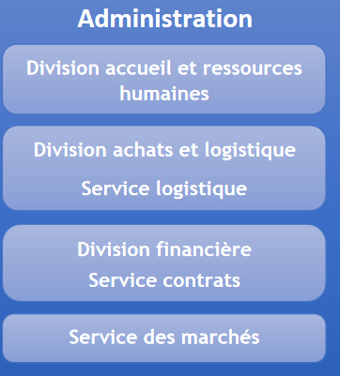
IJCLab in a nutshell: Support Services Support
The Support Services are essential to support all scientific and technical activities of the laboratory
38 members
Management of libraries, common digital library, simplified access to all documentary resources and laboratory productions.
National/international visibility of the IJCLab: external and internal communication, organization of events, heritage activities...).
Support to teaching activities: make the IJCLab a meeting place for students.
Essential for a "laboratory builder". for the success of the new implementation of IJCLab.
Key role, given the specificity of our research activities and all the facilities involved.
International cooperation and links with companies: two pillars of IJCLab
47 members
A strong and newly structured administrative department
3 divisions
2 departments
3
Project Management Unit. Accompanies and supports project leaders, provides input and advises IJCLab management.

Slide 13
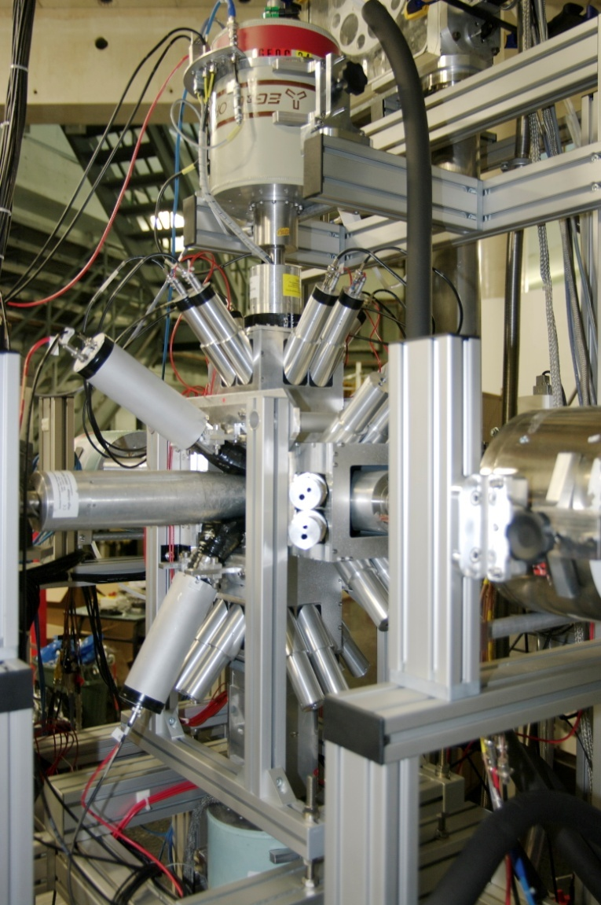
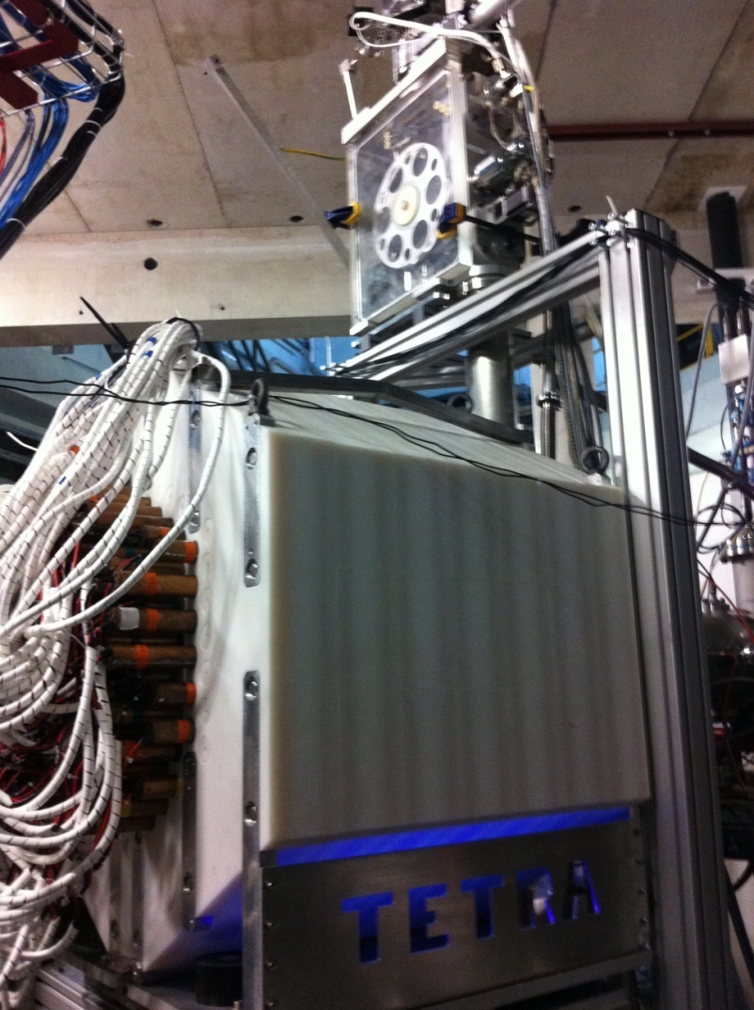
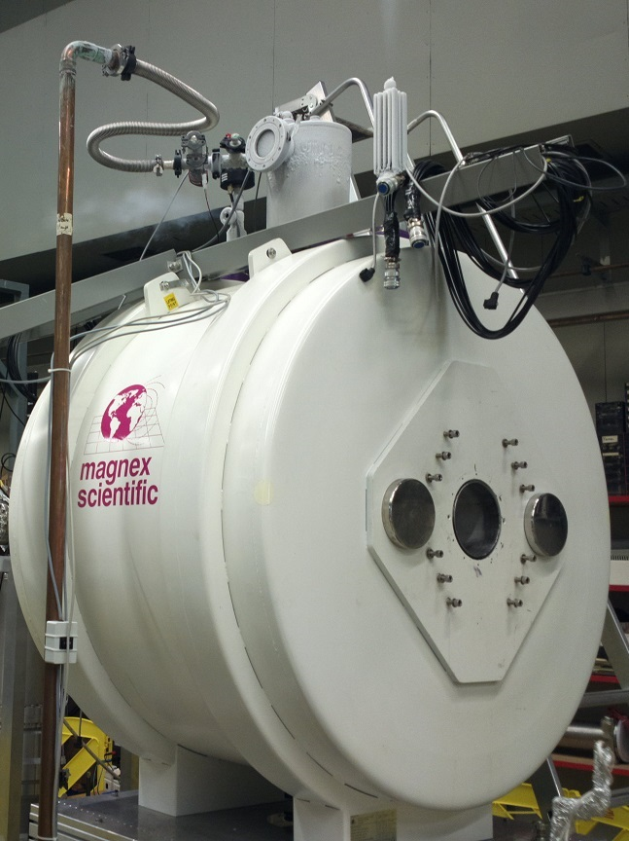
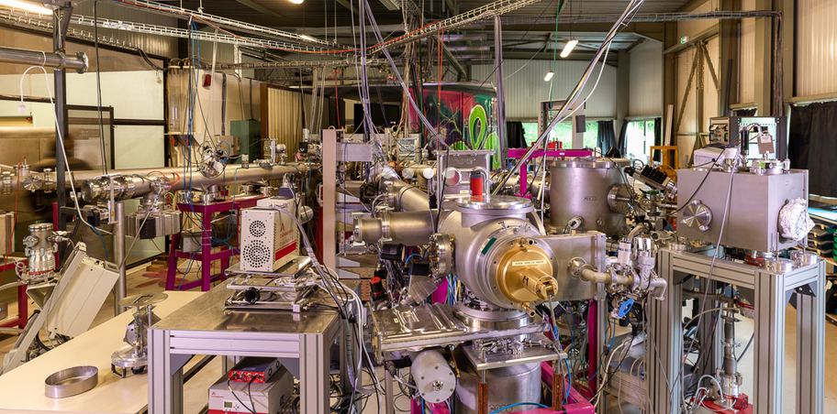
IJClab in a nutshell – IV : The Platforms
15 MV Tandem (from proton to aggregates)
electron linac -> radioactive beams by photofission
Nuclear, Health physics, Irradiation
Opened to external users
Several MeV protons, multicharged atomic ions, gold molecules and nanoparticles
Nuclear/A2C, Health physics, Irradiation
Opened to external users
Ion irradiation / implantation and in situ characterization techniques (TEM, IBA)
Energy, nuclear materials, Health physics, Irradiation physics and chemistry
Opened to external users

Slide 14
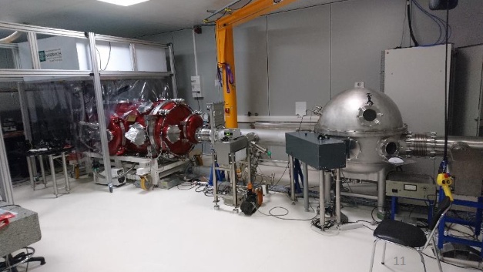
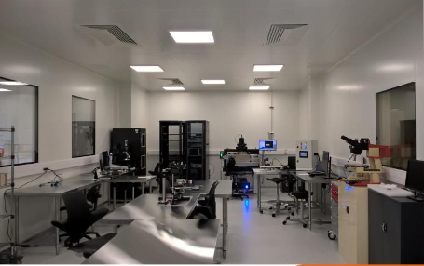
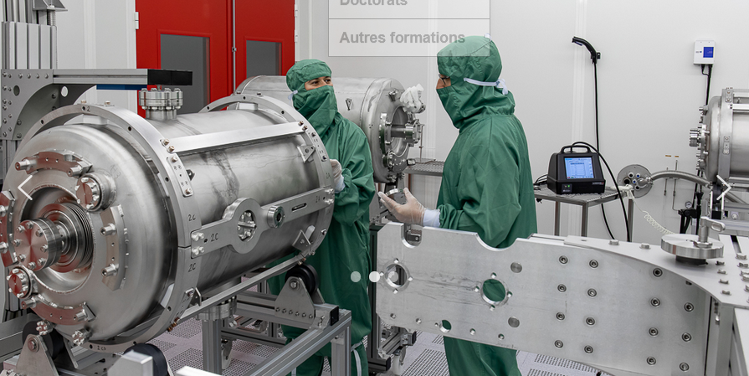
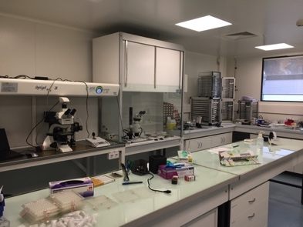
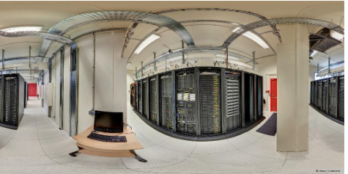
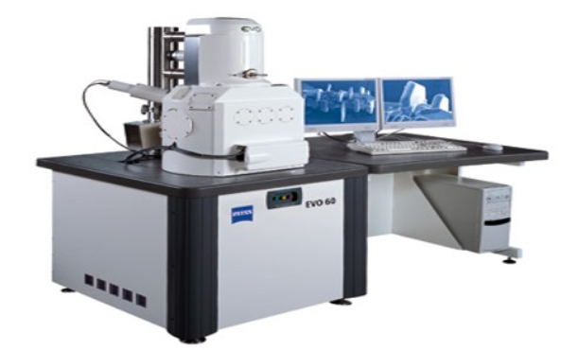
IJClab in a nutshell – V : The Platforms
Semiconductor Platform : Silicon Detector Characterisation/Production
A2C Research themes
CALVA
Accelerators research themes/technologies
Opening to Materials, atomic physics, detectors
SUPRATECH
R&D on the superconducting cavities (prepare, package, assemble & testof the superconducting RF cavities).
Cavities for the Lock of Adv. Virgo / Squeezing
Cavity locking/Squeezing for VIRGO and ET
VIRTUAL DATA
Advanced computing resources infrastructure
Grid / Cloud
Micrometeorite Preparation/analysis
Myrtho
LaseriX
coherent, intense, brief (50fs to 10 ps) sources in near-infrared (800nm) and EUV (30 to 90 eV)
γ Detectors development / characterization
Radiochemistry laboratory
Actinides - Bat 107
Vide et Surfaces
In construction
Health research themes
non linear optical biphotonique imaging

Slide 15
Large Project at IJCLab on PHE, Nuclear, A2C, Accelerator Physics
Implications of IJCLab in the largest projects (most with increasing forces)
In the majority of the projects there is a strong technical implications
Some comments/example
AGATA -National Technical Leader
ALTO -National Platforms/leaders most exp.
Belle II -New Spokesperson of IJCLab
CALICE -IJCLab Spokeperson
DUNE -National Technical Leader
ESS -National responsibility with IRFU
JLab -CLAS12 Spokesperson
LiquidO -Spokesperson
LHCb -New Physics Coordinator
MyRRHA -National responsibility with IRFU
PERLE -International Technical coordination
AstroGam - CoPI M7 Call
Reserchers
Technical Staff
Platform Staff

Slide 16
Major laboratoires with facilities or facilities in the world where IJCLab is involved
Europe
SCK-CEN-Belgium
CERN
CTA-Spain
DESY-Germany
Dubna-Russia
EGO/VIRGO-Italy
ESS-Sweden
GANIL-France
GSI-Germany
Jyväskylä -Finland
LNCA-France
LNGS-Italy
LNL-Italy
LSM-France
Each year, several bilateral international collaborations are signed with research centers and universities.
Recent example given below
19/11/2021
World
Auger-Argentina
LBNL/SLAC-US
Fermilab-US
JLab-US
KEK-Japan
LSST-Chili
Riken-Japan

Slide 17
Some significant figures on "students" / young people
Stages
 | 2020 | 2021 | 2022 | 2023
Nombre de stagiaires | 151 | 210 | 148 | 169
Nombre de mois | 530 | 664 | 436 | 505
% L | 25% | 32% | 24% | 43%
% M1 | 28% | 36% | 32% | 30%
% M2 | 47% | 32% | 34% | 27%
Une augmentation timide des PostDocs, à confirmer avec le succès croissant des différents appels nationaux/européens.
~30 doctorants entrants/an
~30 soutenances de doctorats/an
Stages - Stratégie visible du laboratoire

Slide 18
IJCLab : “A Year budget”
Assigned by governing bodies | Laboratory operation | ~4,0M€
 | Specific programs | ~4,0M€
Contracts : ANR/Europe/industry/Region… |  | ~6,0M€
Own Resources (overheads, services, ..) |  | ~2.0M€
TOTAL RESOURCES |  | ~16M€
Salary of permanent staff | ~40.5M€
Salary of non permanant | ~2.5M€
The salaries of the permanent staff are not in the laboratory budget : directly payed by the employers (CNRS/Universities)

Slide 19
Rénovation et nouvel urbanisme de la Vallée d’Orsay
La transformation de la vallée d'Orsay a accompagné la création d'IJCLab.
Aujourd'hui elle a pris un nouvel élan après la création d'IJCLab.
Restructuration du Hall D1-D2, de l’IGLOO, bat 201

Slide 20
Rénovation et nouvel urbanisme de la Vallée d’Orsay
Operations CPER 2015-2022.
9.1M€ CPER 2022-2027.
Ce projet est actuellement en cours de programmation afin de déterminer les opérations spécifiques à mettre en œuvre.
Deux axes :
Rénovation/restructuration ciblée de certains bâtiments de l'IJCLab pour améliorer l'environnement et la qualité du travail.
Mise à niveau des bâtiments techniques en vue de la construction de PERLE.
Operation | Budget used | Budget still available[M€] | End date
IGLEX (D1-D2) | 3.6 |  | May-21
Renovation Bat. 104 | 1.9 | 2.4 | Apr-23
Virtual DATA (Bat 206) | 2.2 |  | Aug-20
Workshop “Vacuum & Surface” (D3-D4) | 1.2 |  | Apr-22
Ateliers Mechaniques (Bat 100, 200) | 2.4 |  | Apr-22
Extension SCALP-JANNuS (Bat 108) | 1.5 |  | Apr-22
Construction Platforme PSI (Bat 200) | 0.4 |  | Jul-19
Renovation Bat 100, 102, 103, 200, 208 | 1.6 |  | Dec-21
Zone Laser area bat 200 | 1.4 |  | Feb-21
Renovation “Theorie” bat 100 |  | 0.5 | Sep-23
Renovation Construction Hall bat 106 | 0.5 |  | Mar-20
TOTAL | 16.7 | 2.9

Slide 21
In conclusions, our Manifesto
Contributing to projects at all stages: proposal, design, construction, operation, data analysis, theory
Playing a major role in the conception, design and construction of current and future accelerators.
Developing and operating research infrastructures and technological platforms supporting these research areas as well as original research in health physics and energy
Promoting the development of new technologies for science for the benefit of society and thus supporting national and European industrial competitiveness
Welcoming students that the laboratory trains through and for research in the heart of a world-class academic environment.

