Slide 1
Who am I?
ED
O
ARDO
U
Alviani

Slide 2
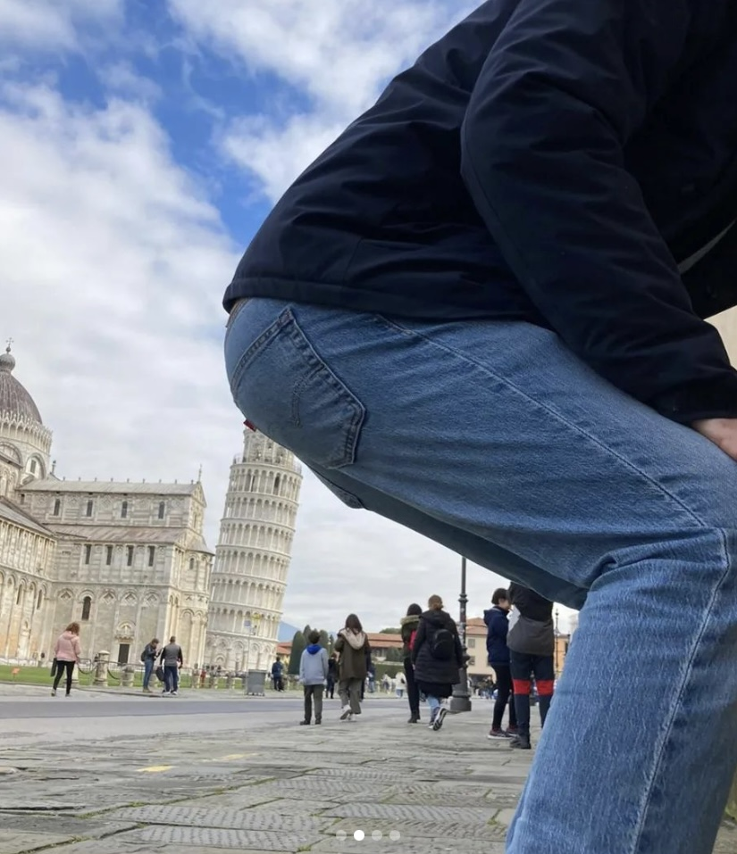
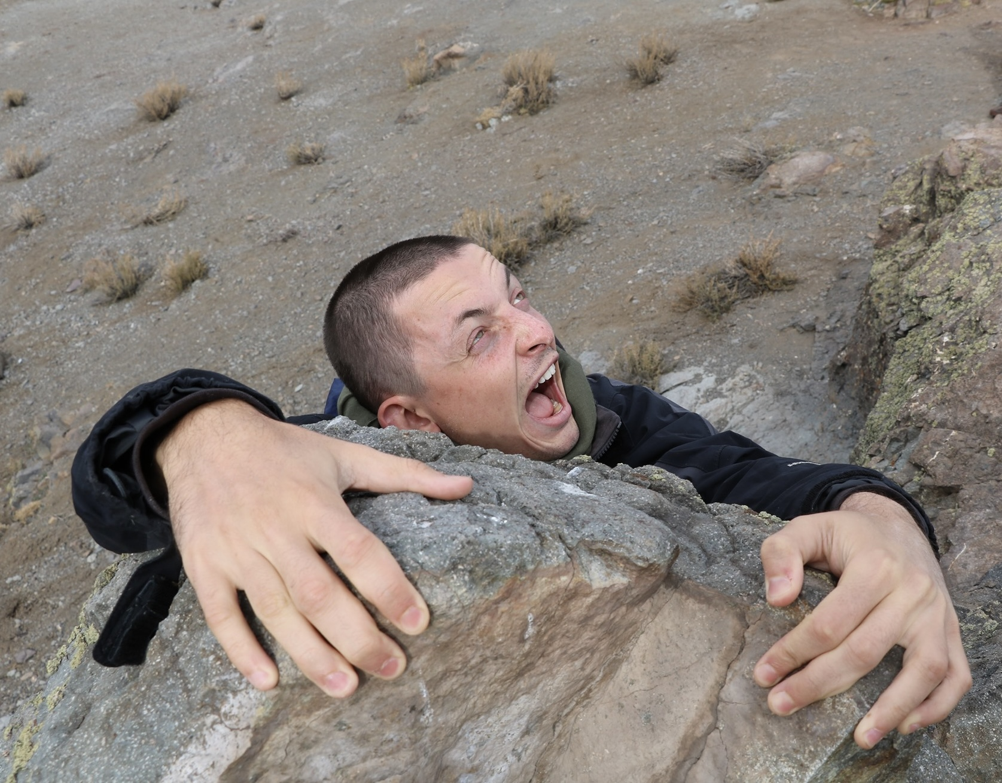
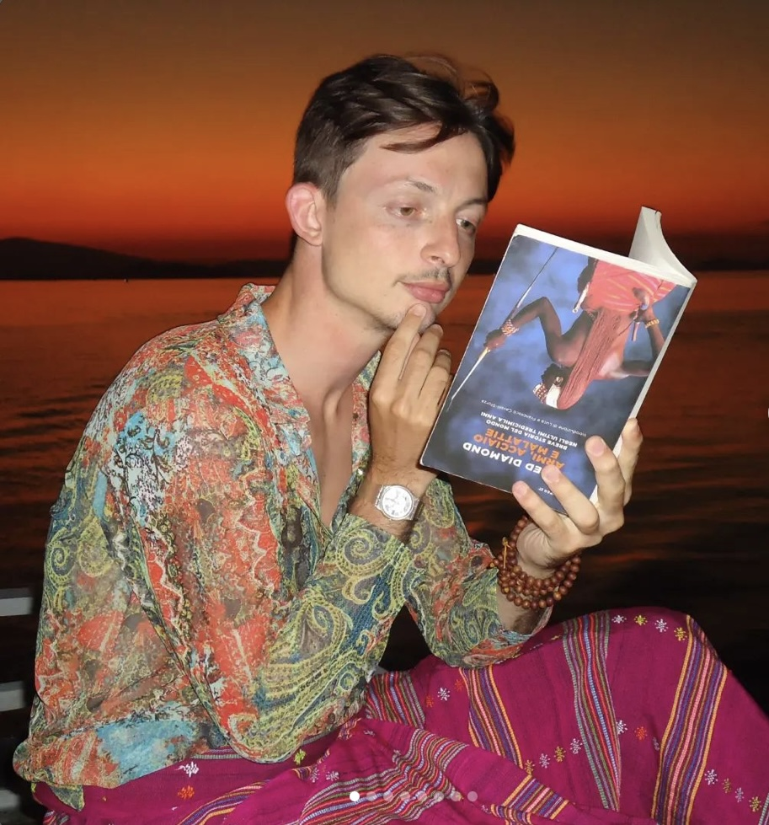
What I love
Indonesia, 2023
Chile, 2019
Pisa, 2021

Slide 3
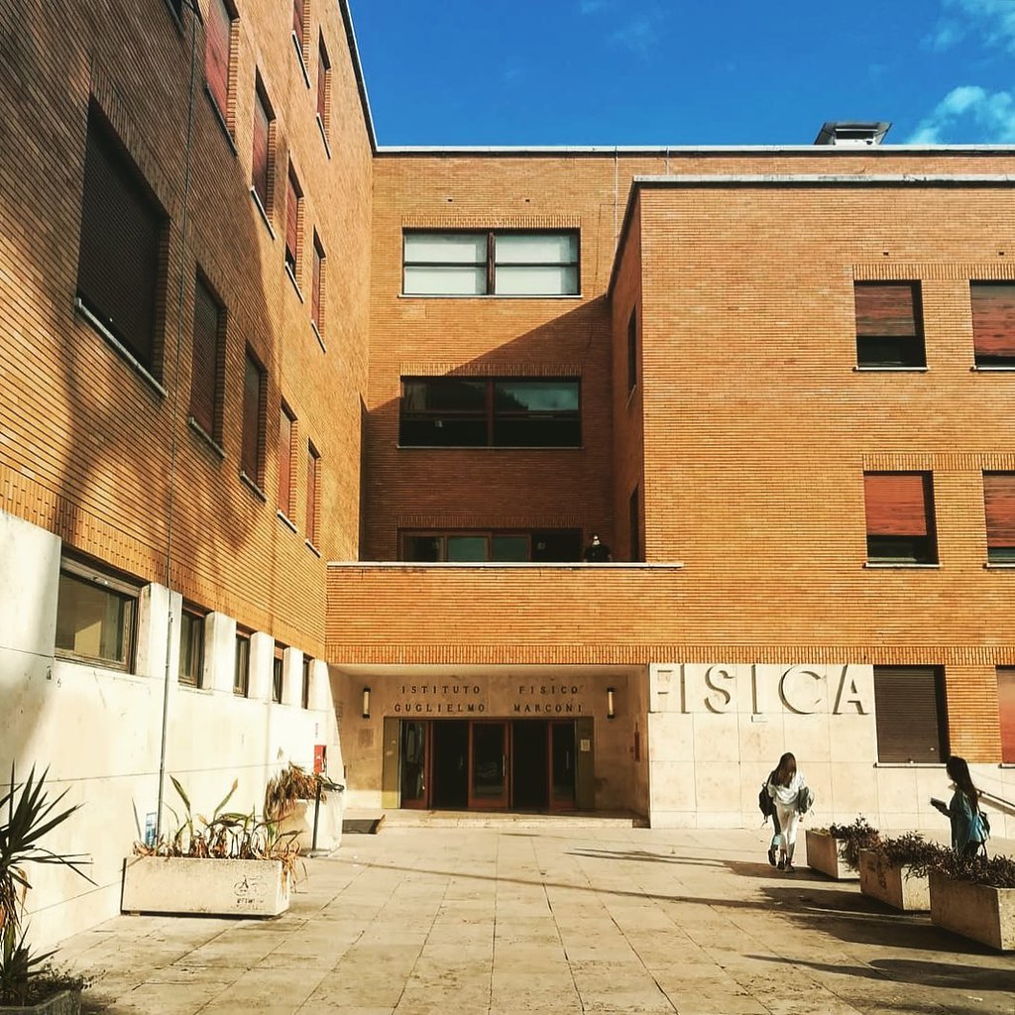
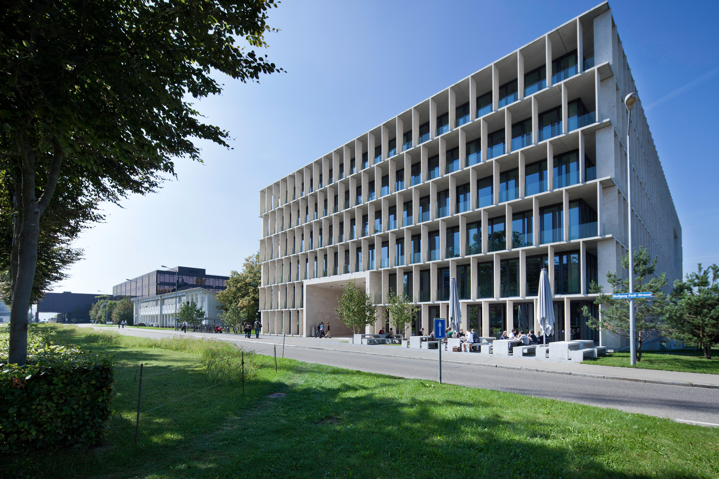
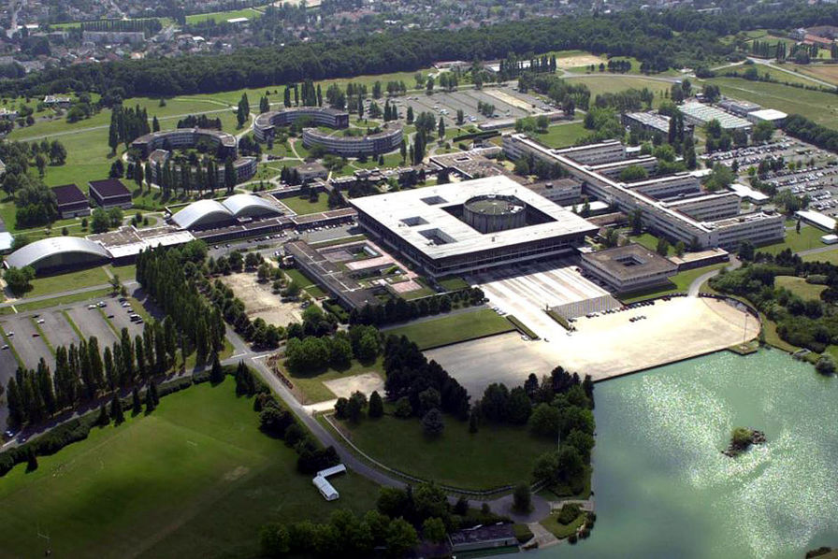
Where I’m from
Sapienza, Roma
ETH, Zurich
École Polytechnique, Paris

Slide 4
My research: Scattering Amplitudes
On-Shell methods, Spinor-Helicity Formalism
&
Unitarity cuts
Effective field theories for gravity
Renormalization group running
Anomalies in quantum field theories
Higher spins, soft theorems, symmetry breaking, causality,…

Slide 5
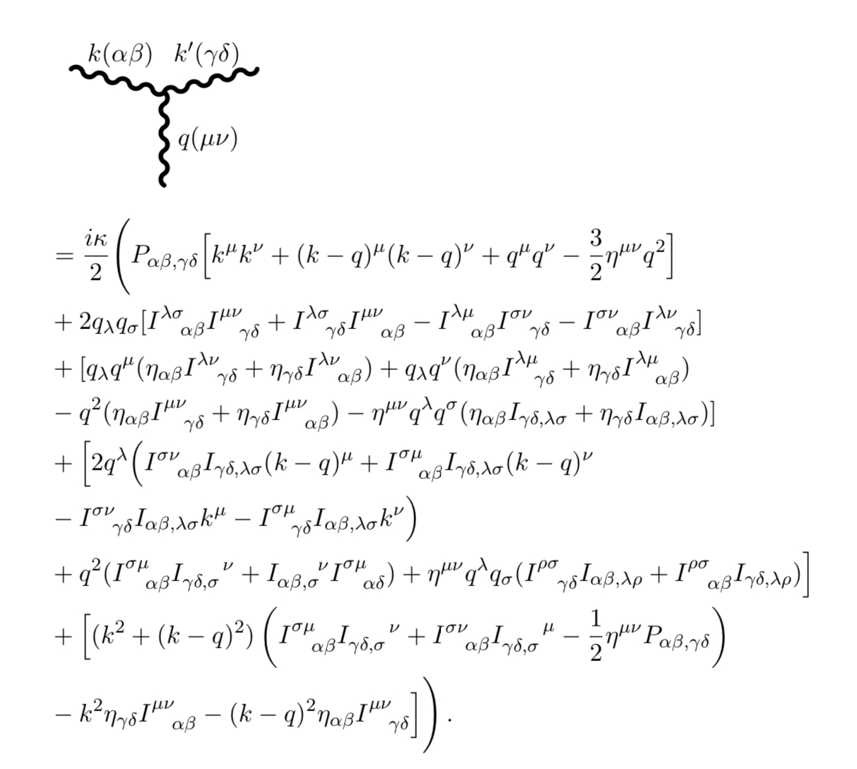
More in detail
RG Running
Anomalies
Wilson coefficients - EFT matching

Slide 6
THE END
?

