Slide 1
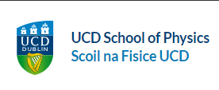
Charm Quarks in the proton
Journée Nouveaux Entrants, IJCLab
27/03/2024
Allencris John Rubesh Rajan
Supervisors
Ronan McNulty
Jean-Philippe Lansberg

Slide 2
Vital Information
Allencris John Rubesh Rajan
J.R.R.

Slide 3
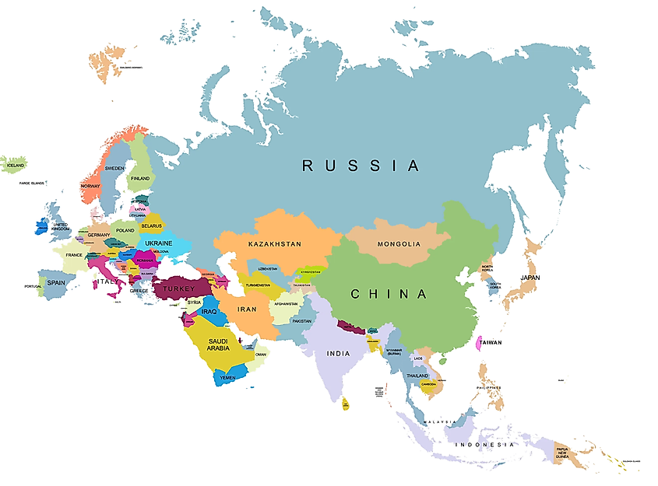
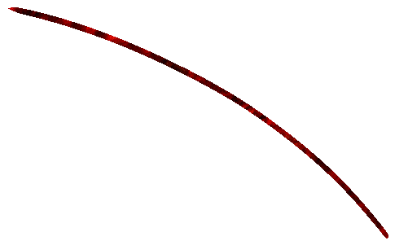
My Journey
Education and Growing up
Current PhD
Born: Tamil Nadu
Stayed until I was 4

Slide 4
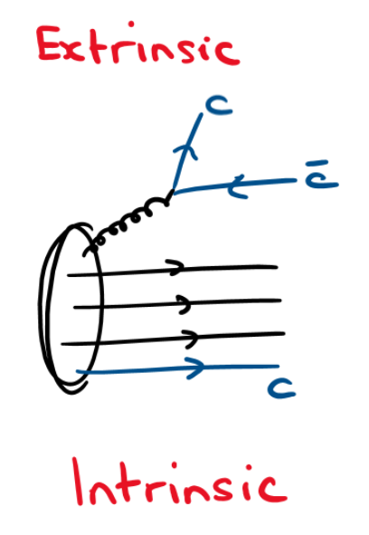
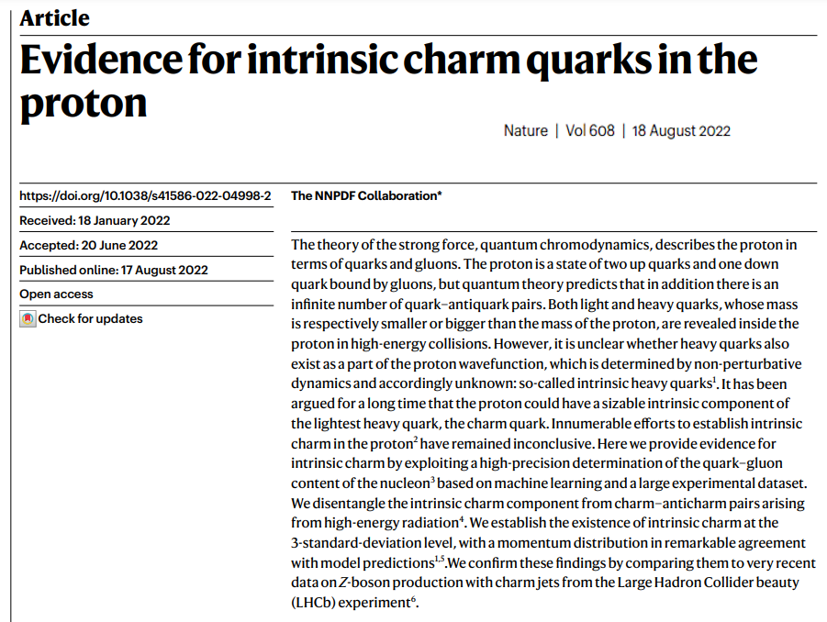
Intrinsic Charm
Well-accepted picture : 3 valence quarks + sea quarks/gluons
Possible non-perturbative (IC) contribution

Slide 5
How?
Compute cross-section for J/ψ + c in proton-proton and UPC in proton-lead
Extend to NLO -> Extension of MadGraph5_aMC@NLO to Quarkonium production
Different models of Quarkonium production
Implement ability to handle massive initial states

