Slide 1
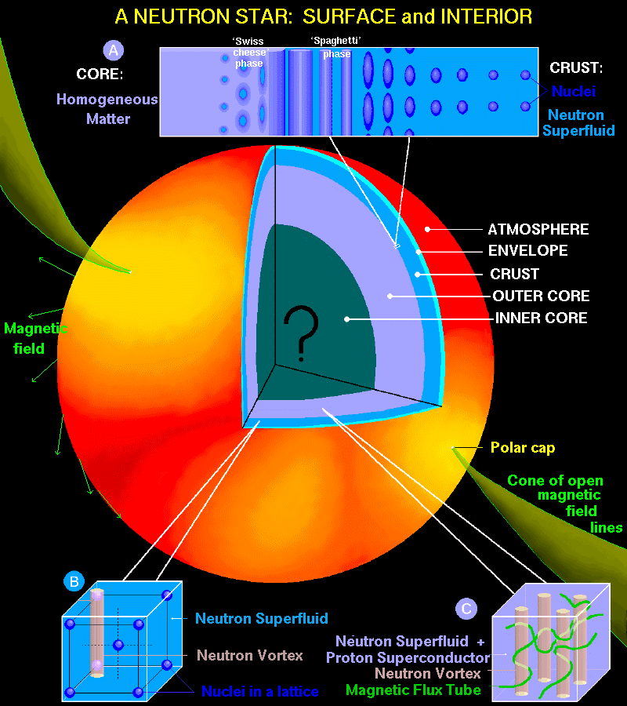
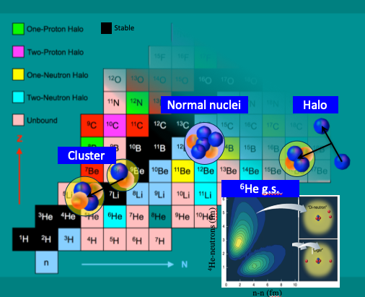
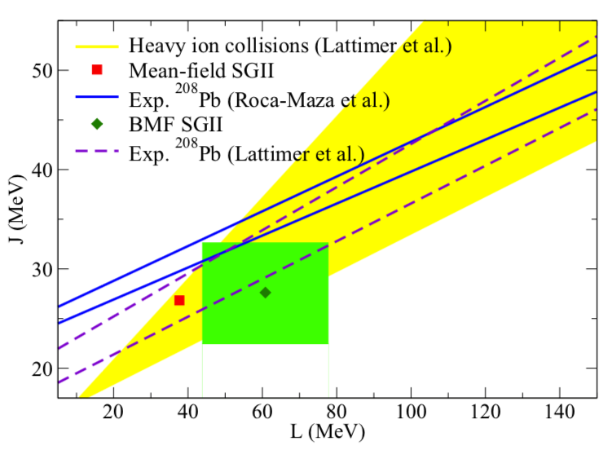
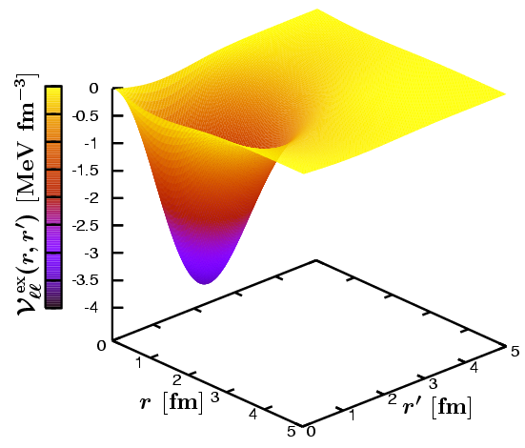
Nuclear Physics Theory team
(Theory Pole)

Slide 2
Nuclear Physics Theory team
Permanent (7+2)
Marcella Grasso (DR)
Guillaume Hupin (CR)
Elias Khan (Pr)
Denis Lacroix (DR)
Paolo Napolitani (CR)
Michael Urban (DR)
Bira van Kolck (DR)
+ Jaume Carbonel (DR)
+ 1 CR in Oct 2024
Phd & Postdocs
ALMIRANTE Giorgio
AYCHET-CLAISSE Samuel
CONTESSI Lorenzo (Pdoc)
DEHGHANI Alireza
DUAN Mingya
HEITZ Louis
PALANIAPPAN Viswanathan
YAGHI Osama
ZHANG Jing

Slide 3
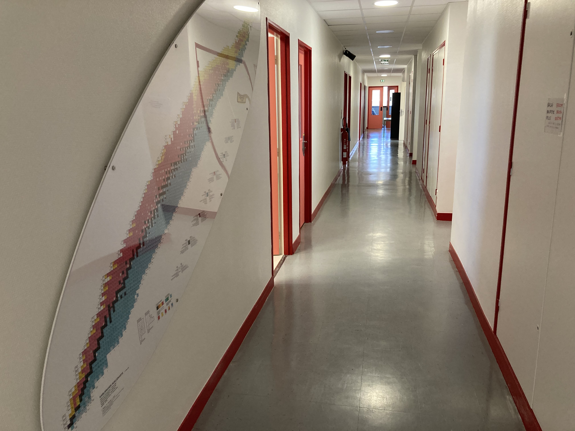
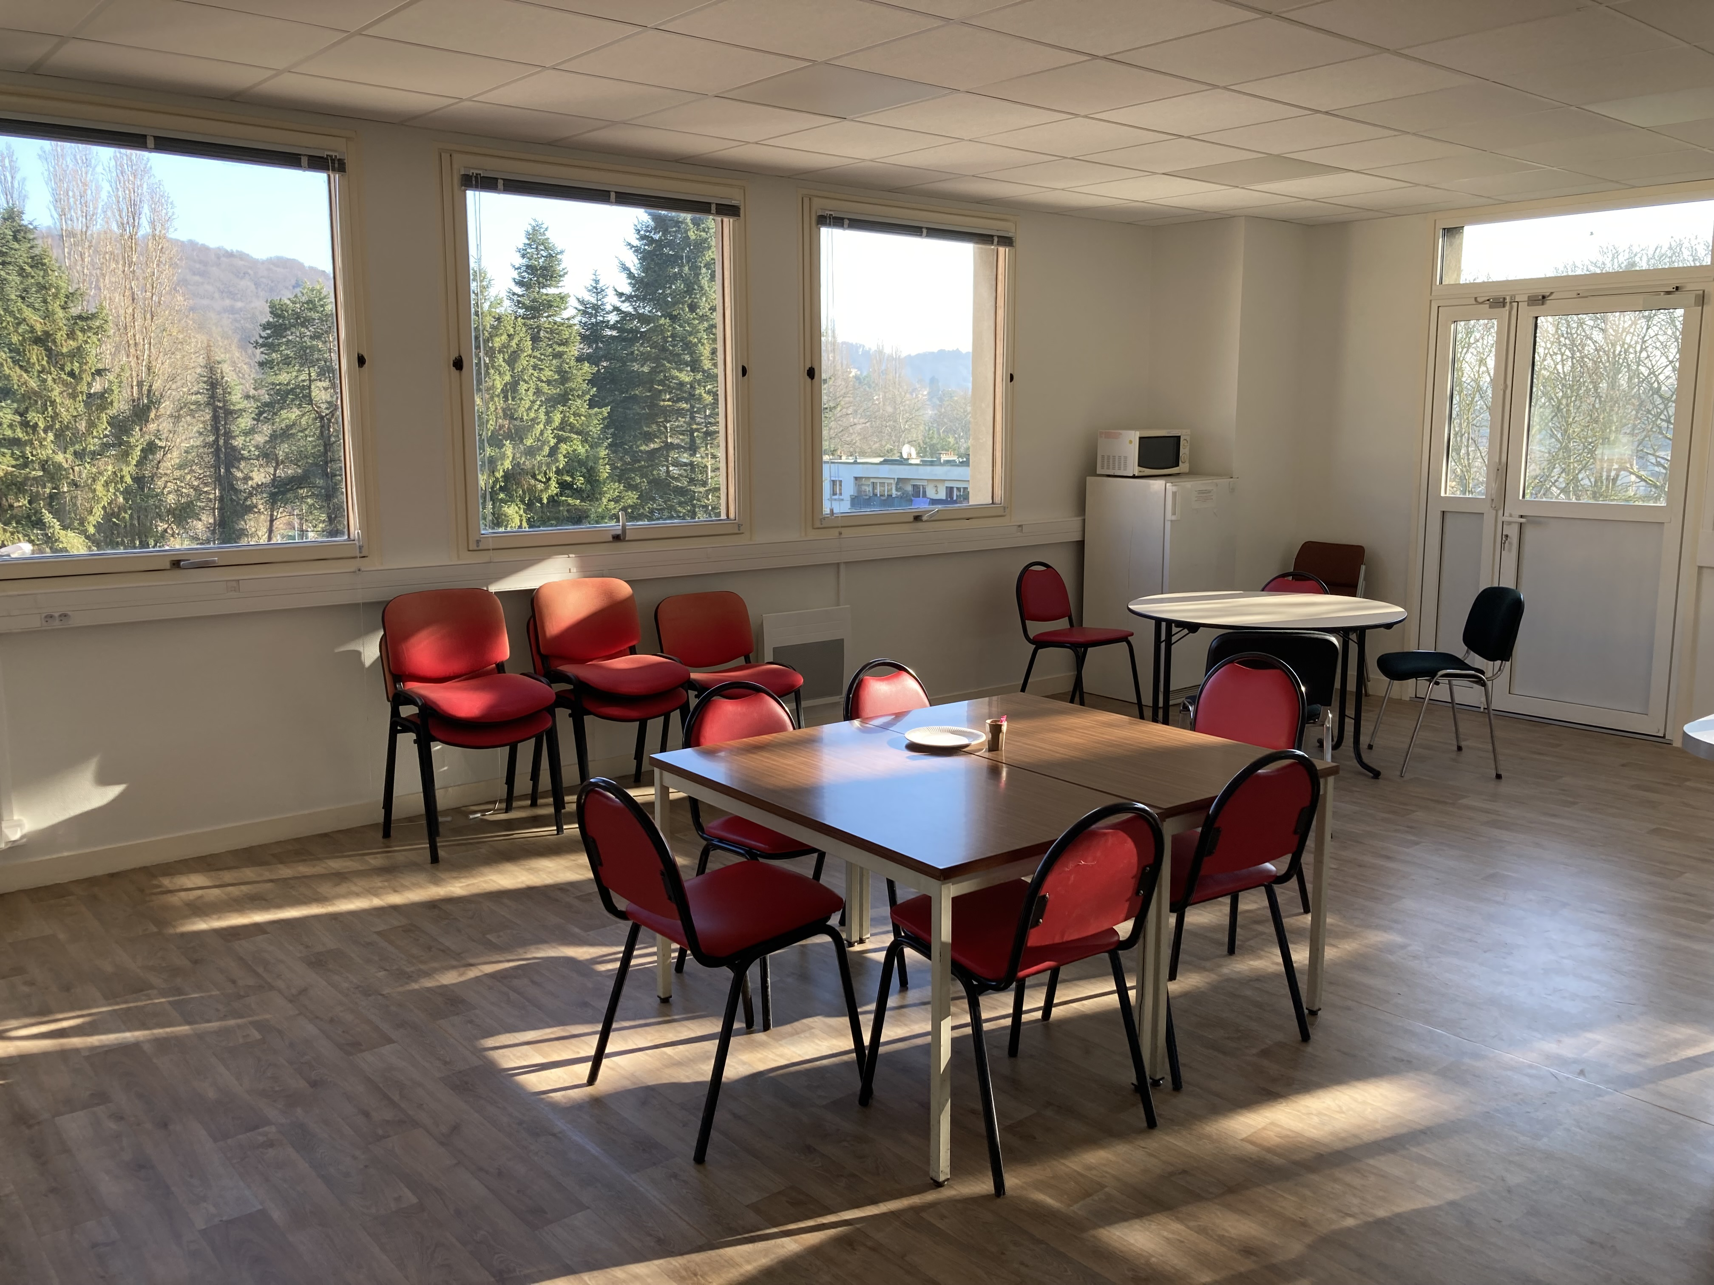
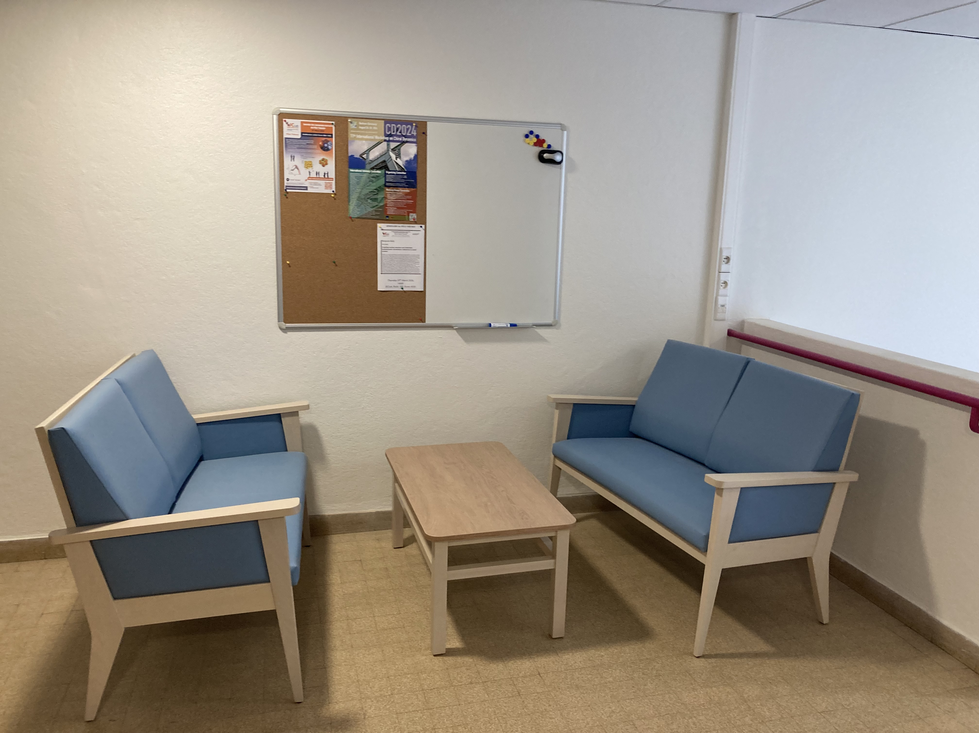
Where are we ?
Bat. 100
2d floor

Slide 4
Topics
Nuclear structure, Ab initio methods and few-body systems
Nuclear dynamics: reactions, transport, excitations, decays
Nuclear astrophysics: neutrons stars, neutrino oscillations
Interdisciplinary research, application and emerging technologies

Slide 5
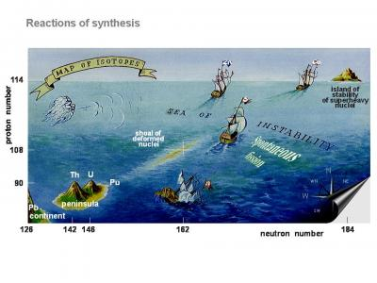
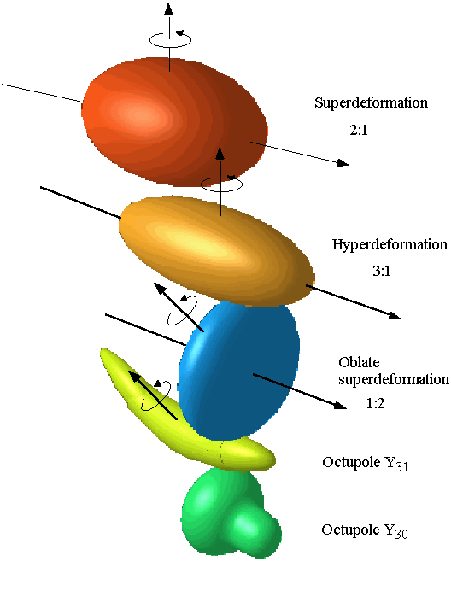
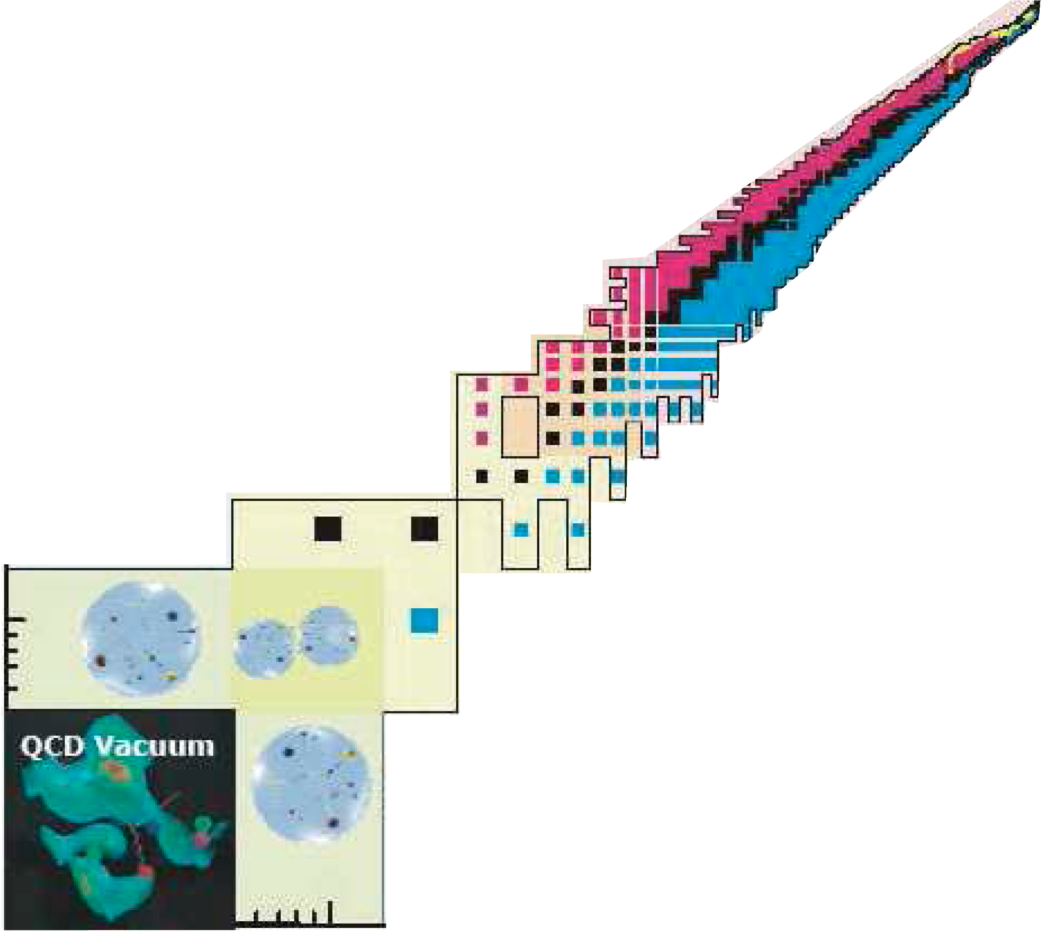
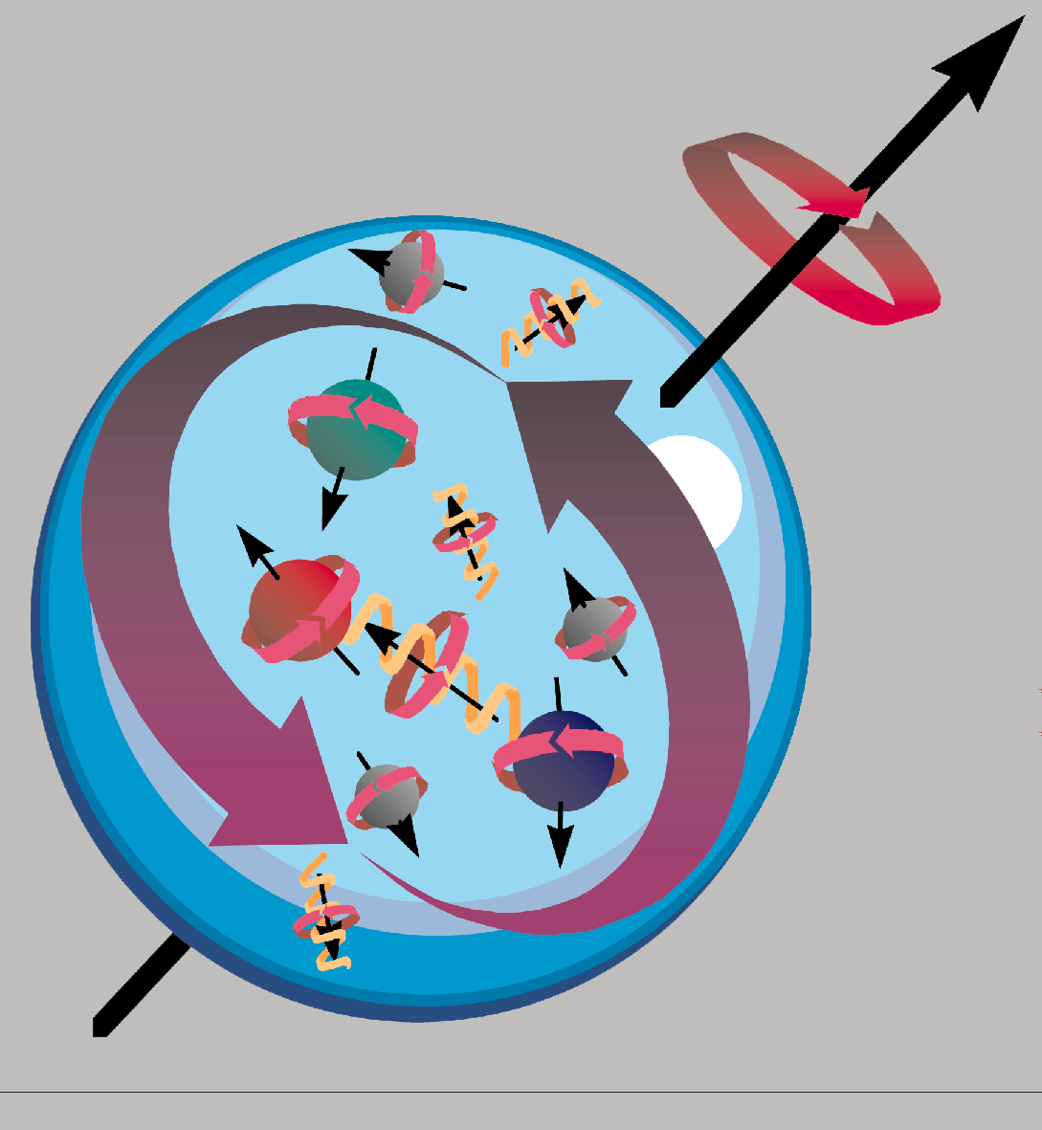
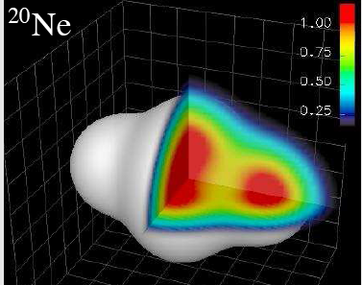
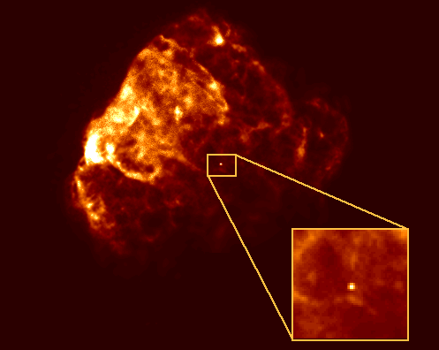
Protons
100
Terra
incognita
10
1
Neutrons
1
10
100
1000

Slide 6
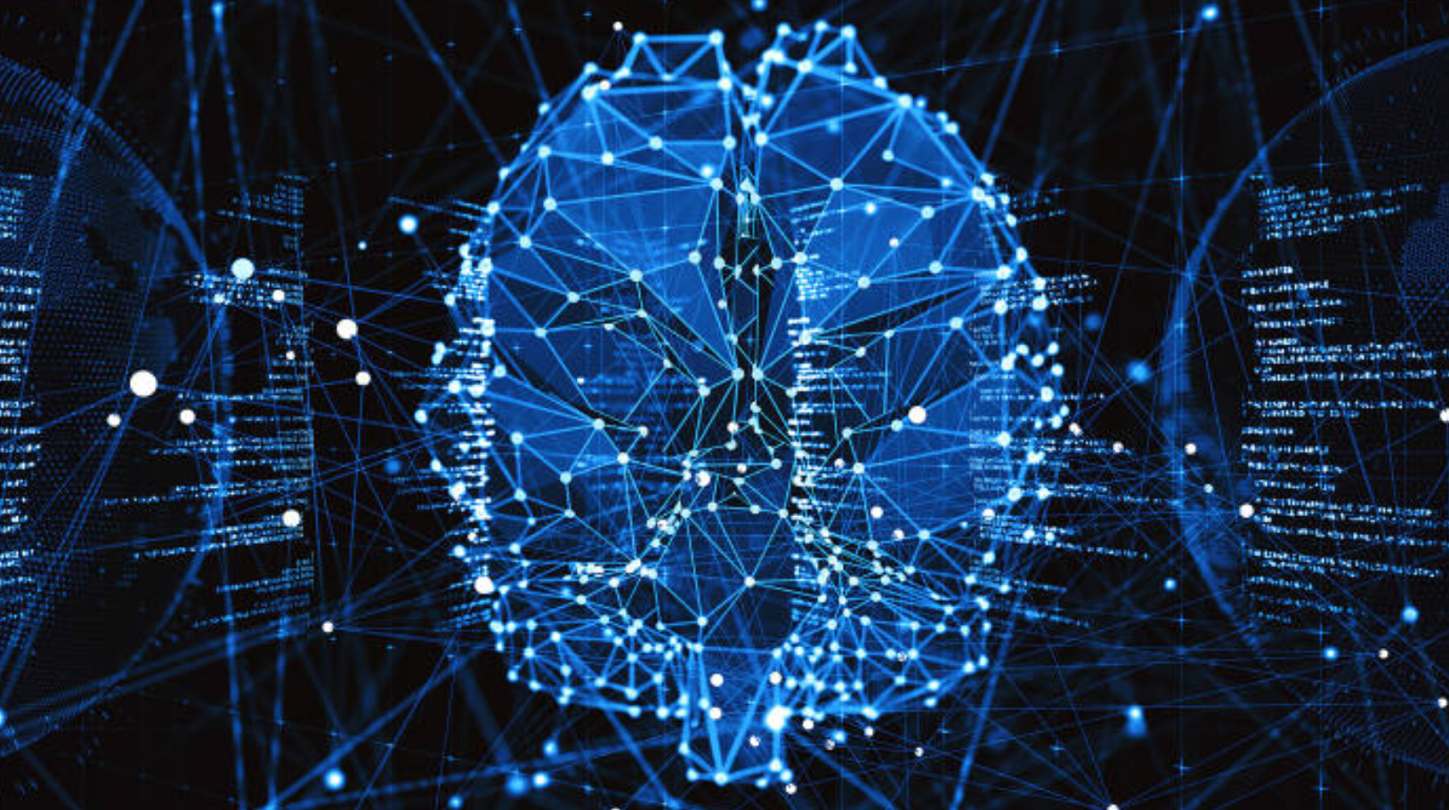
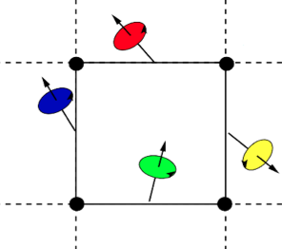
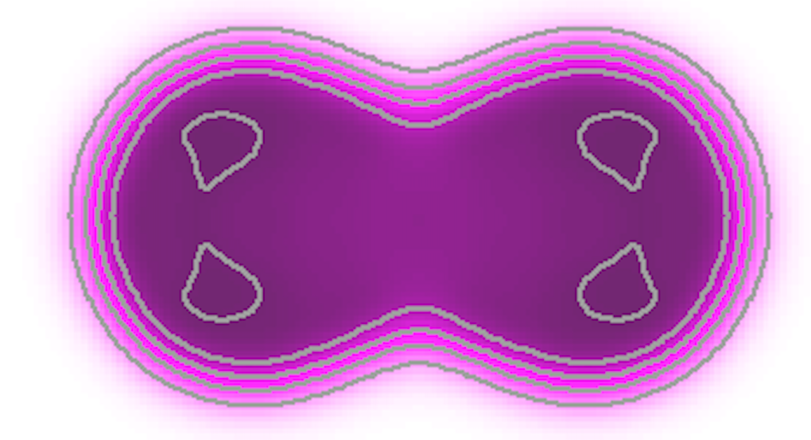
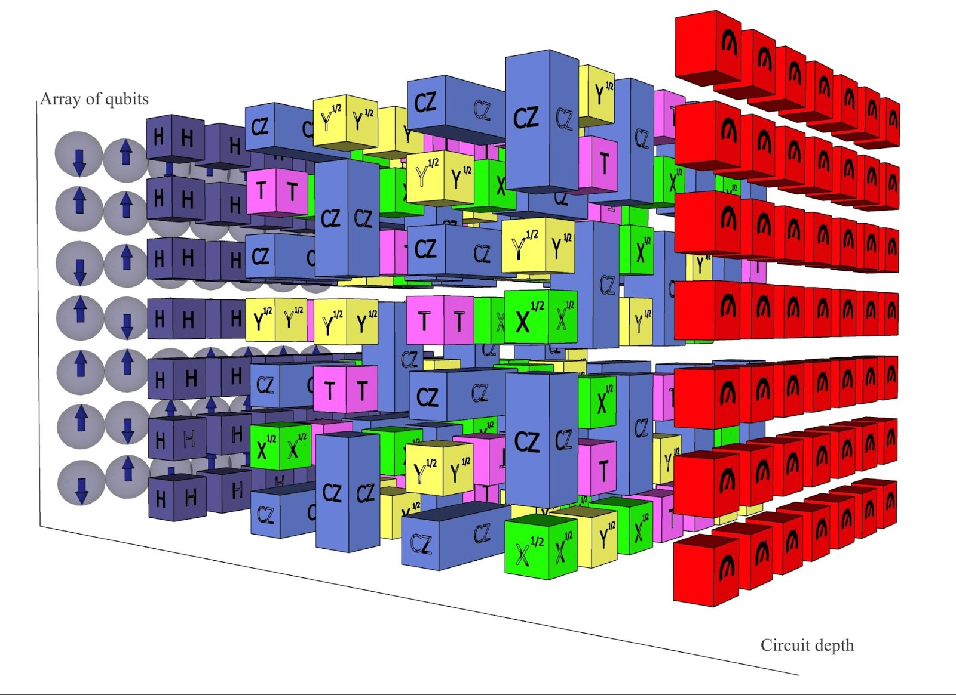
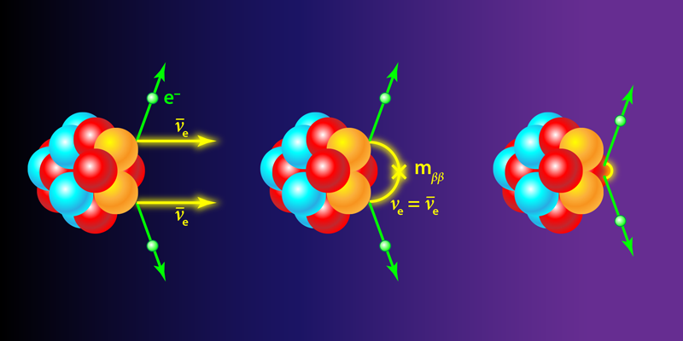
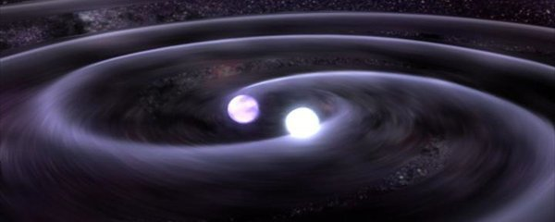
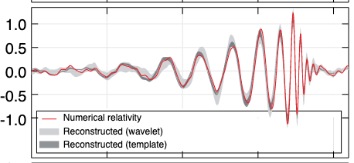
Thematics of the team—Global view
And Emergence of new projects
Nuclear structure
Nuclear excitation
Few-body
and Clustering
Emergent fields
AI, Quantum comp.
Micro theory
Nuclear reactions
Heavy-ions reactions
Fission
Neutino-Less
Double beta
decay
Ab-initio theory
Reactions with
light systems
Nuclear EOS
Nuclear astrophysics
Hyper-nuclei
Link between
Nuclear physics and
Gravitational waves

Slide 7
Research topics developed in the team
(without Marcella)
Nuclear structure, Ab-initio methods and few-body systems
Nuclear effective field theories: excited baryons in Chiral EFT, matching nuclear EFTs to
lattice QCD [Bira]
antinuclear forces and structure [Bira, Guillaume]
nuclear forces and currents from EFT, new probes in few-body systems [Bira, Guillaume]
halo and cluster states with Halo/Cluster EFT, and Cluster phenomenology [Bira, Elias]
Development of energy density functional model for nuclear structure [Elias, Denis]
Generator Coordinate Methods and their extensions [Elias, Denis]
Nuclear dynamics
towards the modeling of complex reactions with ab-initio methods [Guillaume]
development of microscopic models for heavy-ion collisions beyond mean field in the low
(few MeV per nucleon) to intermediate (200 MeV per nucleon) energy range.
Semiclassical approaches (Boltzmann), quantum approaches (TDHF). [Paolo]
Microscopic quantum transport theories including stochastic methods [Denis]
Description of low energy nuclear phenomena: collective excitation, fission, … [Denis, Elias]

Slide 8
Research topics developed in the team
Nuclear astrophysics
cluster formation in heavy-ion collisions as a function of time and density and links with the nuclear equation of state. [Paolo]
Application of nuclear models to nuclear astrophysics [Elias]
Description of neutrons stars [Michael]
Quantum information in neutrino oscillations [Denis]
Interdisciplinary research, applications and emerging technologies
Fermi liquids: dissipation, chaos, large-amplitude fluctuations and bifurcations. [Paolo]
fast heavy-ion-collisions solution for medical applications through deep-learning [Paolo]
Superfluidity and strongly interacting Fermi gas [Michael, Denis]
Machine learning and Quantum Machine Learning [Guillaume, Denis]
Quantum computing applied to many-body systems [Denis, Guillaume]
Nuclear tests of global symmetries (lepton number, baryon number, etc)[Bira]
expansion around unitarity for nucleons and atoms [Bira, Guillaume]

