Slide 1

Improving the Energy Efficiency of Future Accelerators
1st iSAS Workshop, April 15, 2023, IJCLab
Mike Seidel
Paul Scherrer Institute (PSI) and École polytechnique fédérale de Lausanne (EPFL)

Slide 2
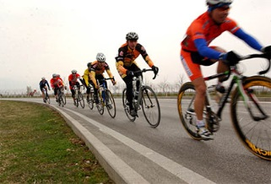
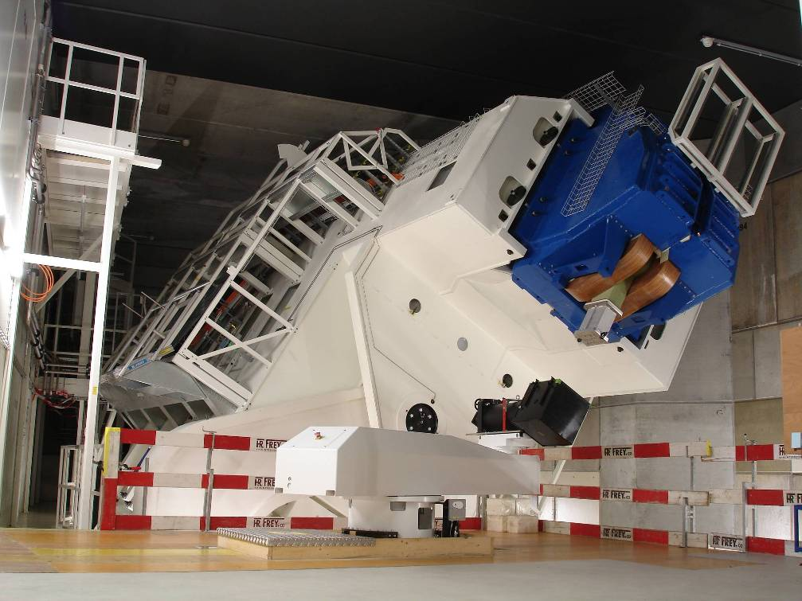
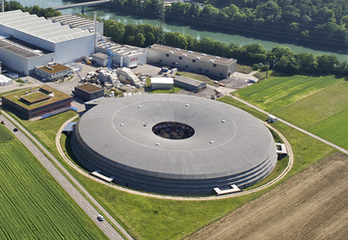
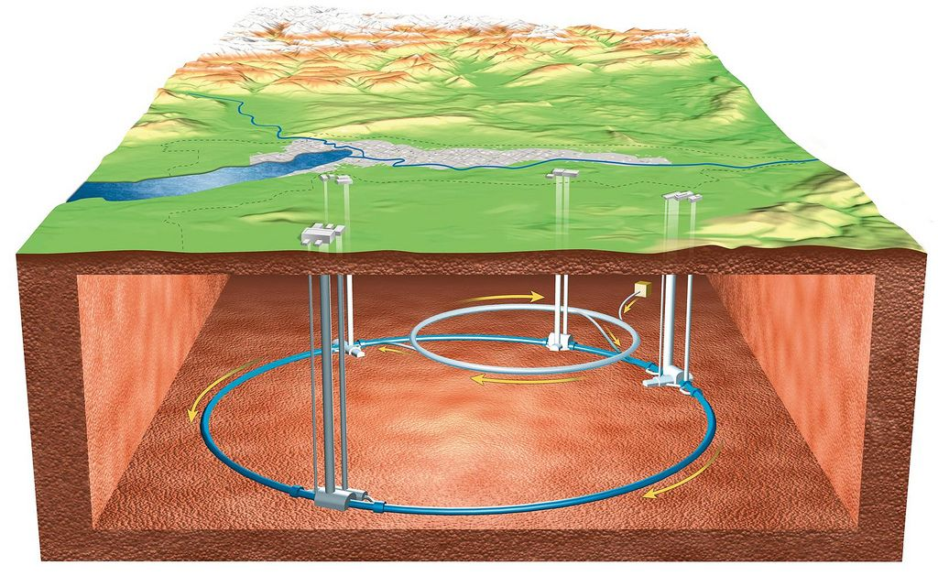
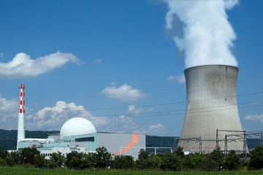
Power – Orders of Magnitude
Cyclist | 0.4 kW
Proton Therapy | 500 kW
Swiss Light Source 2.0 | 2.6 MW
Large Hadron Collider | 120 MW
FCC-ee, @ Higgs Energy | 282 MW
Nuclear Power Station | 1.3 GW
Earth Moon Dissipation | 3.8 TW
Mankind Total (all sources) | 19 TW
proton therapy
cyclist
SLS, 2.6 MW
LHC
nucl. plant 1.3 GW
Tides
Moon
Earth
[Williams, Boggs, 2016: 3.8TW]

Slide 3
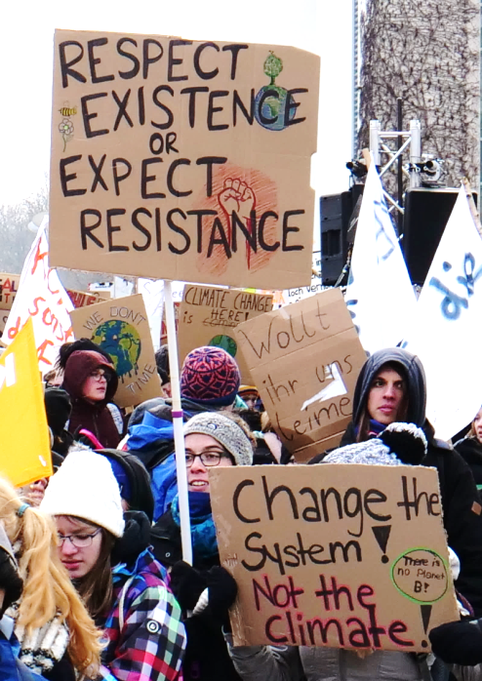
Due to climate change and the overexploitation of many natural resources, sustainability and energy efficiency have become key aspects of all human activity.
This is also important for the next generation of research infrastructures (RI) for these reasons, but also to gain support by politics and society.
Energy efficiency is a key aspect, besides carbon footprint, lifecycle, heat recovery etc.
As a scientific community, we should be at the forefront, leading by example with innovative solutions.
School Strike for Climate
Wikipedia

Slide 4




Community Activities on Sustainability
2014-17: EUCARD-2, WP Energy Efficient Accelerator Technologies
https://www.psi.ch/enefficient
2017–21: ARIES, Work Package Efficient Energy Management
https://www.psi.ch/aries-eem
2021–25: I.FAST, Work Package Sustainable Concepts
https://www.psi.ch/scat
→ consult websites for link collection to workshops and documentation
ICFA panel on sustainable accelerators, chair: Thomas Roser (BNL)
https://icfa.hep.net/icfa-panel-on-sustainable-accelerators-and-colliders/

Slide 5
Accelerator driven Research Infrastructures (RI)
primary beam
grid power
accelerator
conversion target
undulators/magnets
colliding beam insertion
…
radiation to
experiments
auxiliary systems
primary beam production
electrons
protons
ions
conversion to specific secondary radiation
X-rays
neutrons, muons, neutrinos
exotic particles
high level goal:
Science output per grid power, per operating/investment cost.

Slide 6
Accelerator Concepts and Technologies
Proton Drivers with high intensity applications
Synchrotron Light Sources and FELs
Particle Colliders
concepts, RI‘s
Resonators and high Power RF Systems
Accelerator Magnets and Power Supplies
technologies
Cryogenic Systems
Component Cooling, Air Conditioning, Vacuum, Instrumentation … and other aux. systems

Slide 7
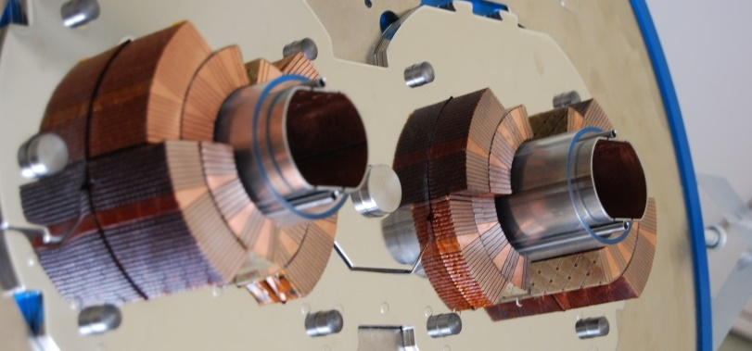
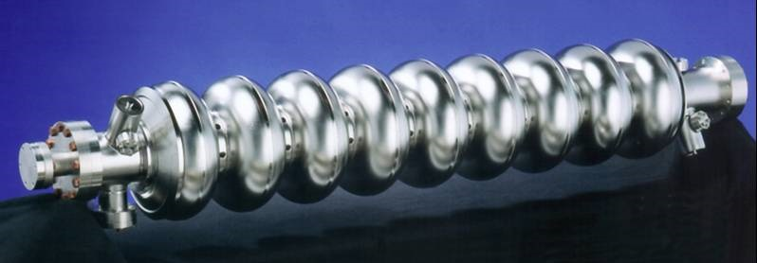
Superconductivity in Accelerators
the main concepts in accelerators: bending of trajectories and energy gain by RF fields, profit from energy efficient superconducting technology
Magnets
RF Resonators
DC field: cooper pairs move frictionless
zero losses
example: MRI magnet with cold switch
RF field: cooper pairs move frictionless, but carry mass that is accelerated back and forth
→ imperfect shielding of RF field in material
→ dissipation from «normal» electrons in RF field
→ very small but non-zero losses

Slide 8
Proton Driver Accelerators
[as example for high intensity applications]

Slide 9
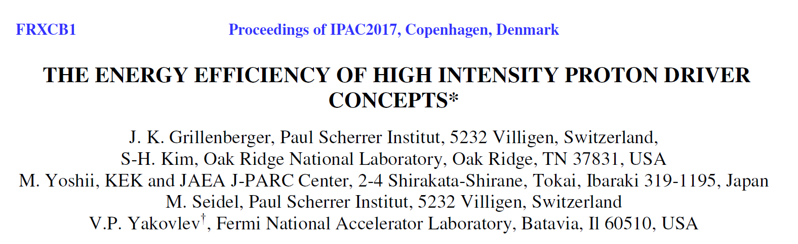
Comparison: Megawatt p-Drivers
Workshop: Efficiency of Proton Driver Accelerators, 2016, PSI
https://indico.psi.ch/event/3848/
Yakovlev, FNAL, invited talk, IPAC 2017
590 MeV, 1.4 MW
Megawatt class facilities operating today:
optimized for application, not efficiency
facility | accelerator type | Economy | Energy Reach | Power Reach | operational complexity | grid-to-beam Efficiency
SNS | superconducting linac | -- | ++ | ++ | ++ | 9%
J-PARC | rapid cycling synchrotron | ++ | ++ | - | - | 3%
PSI | isochronous cyclotron | + | -- | + | - | 18%

Slide 10
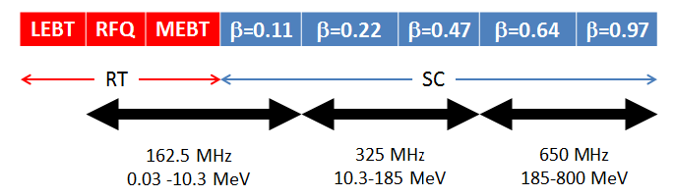
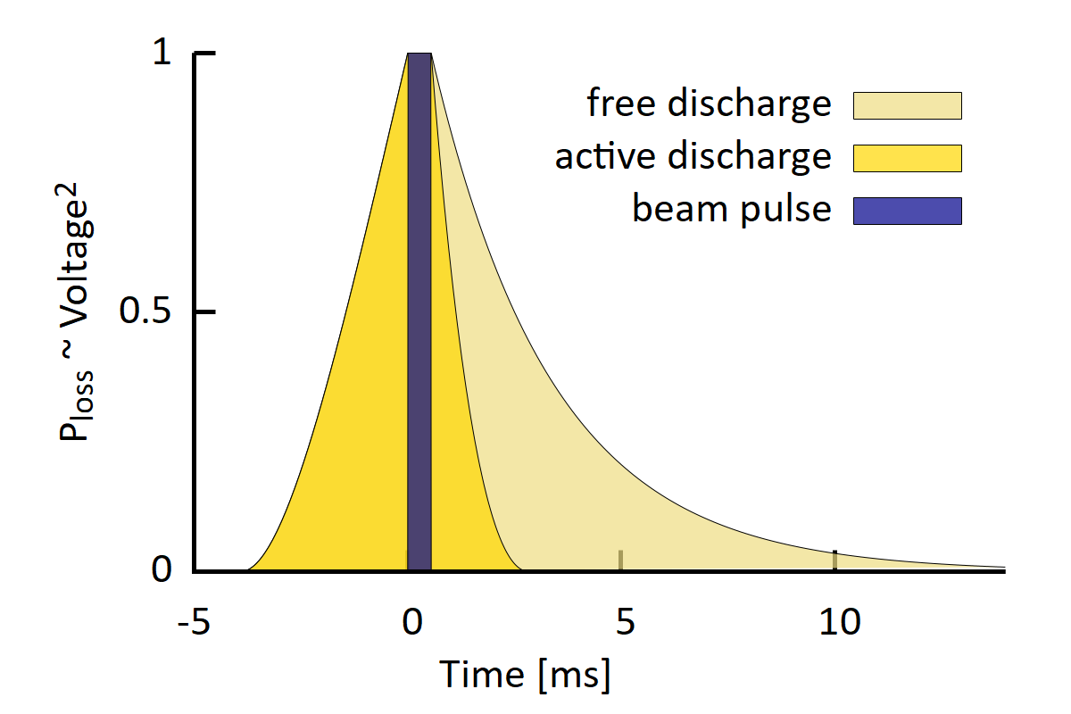
Superconducting Linac : High Efficiency Potential example: PIP-II design of Fermilab
PIP-II base parameters:
H⁻, 800MeV, 2.0mA, part of Fermilab complex
aim: neutrino production (1MW @ 60..120GeV)
CW operation as upgrade path
highest efficiency
not efficient in pulsed operation:
operating regime | avg. RF power | cryogenic power | avg. beam power | grid-to-beam Efficiency
PIP-II pulsed operation | 1.44MW | 1.19MW | 17.6kW | 0.7%
PIP-II CW operation | 9.10MW | 1.83MW | 1.60MW | 15%
[from presentation B.Chase, Y.Yakovlev, 2018]

Slide 11

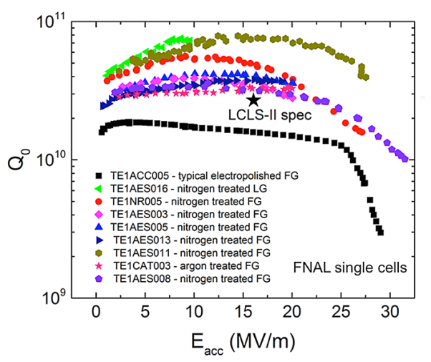
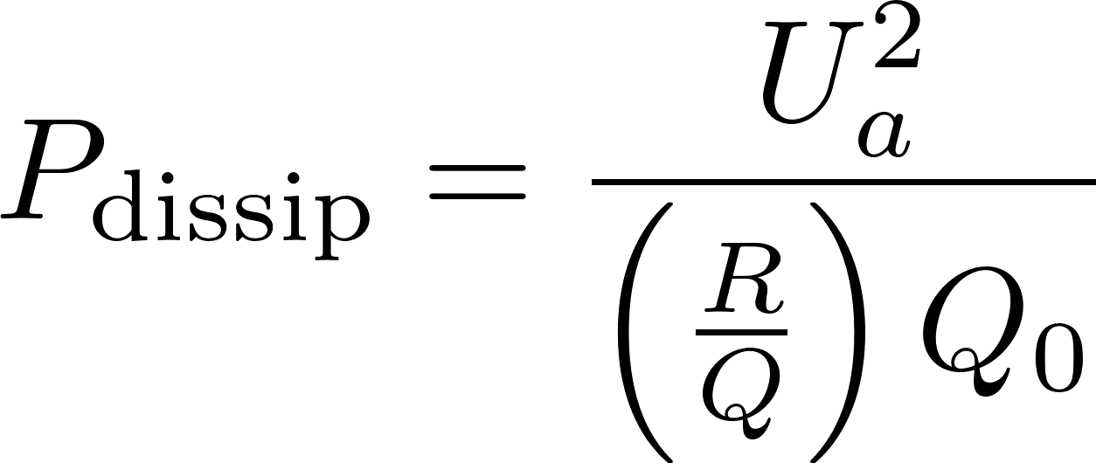
Low Loss Superconducting Resonators
high Q resonators, 1.3GHz, 2K, FNAL
[A.Grassellino, A.Romanenko et al, 2013]
10¹⁰
2×10¹⁰ s.c. resonator
Q₀ = quality factor
→ e-folding decay and resonance width
dissipated power:
10⁵
50‘000 Cu resonator
3‘000 church bell
example:
U_{a} = 20MV, (R/Q) = 609Ω, Q₀ = 2×10¹⁰, I_{b}=2mA
P_{dissip} = 33 W
P_{beam} = 40.000 W
1
but: cryogenic efficiency!

Slide 12
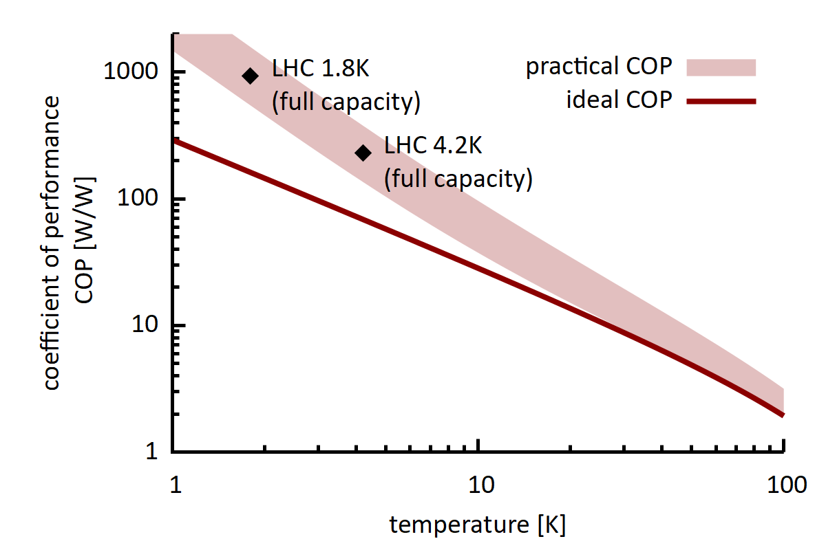
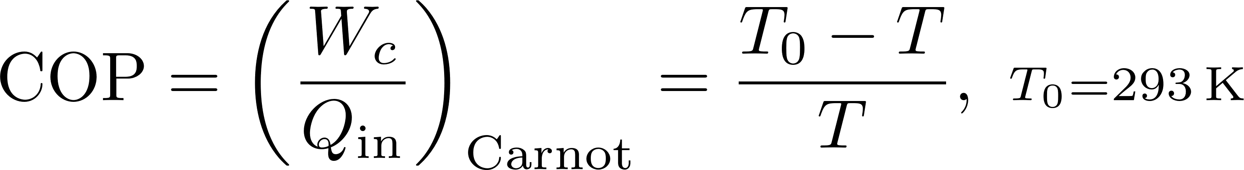

Cryogenic Efficiency
W_{c}
T₀ = 293K
Q_{in}
T = 2K
best possible coefficient of performance (COP):
W_{c} = amount of work required to remove heat Q_{in} at cold temperature T
[S.Claudet et al, CERN 2013]
→ lower COP is better !

Slide 13

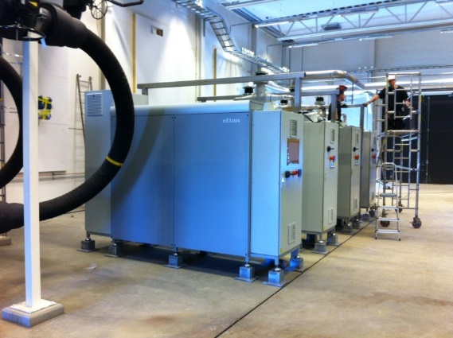
COP Factor: compare heating of houses
W
T = 308K (35°C)
Q_{out}, Q_{in}
T₀ = 273K (0°C)
heat pumps at MAX-4, using waste heat
[Björn Eldvall / E.ON,
Martin Gierow / Kraftringen]
best possible coefficient of performance (COP):
in theory: COP_{Carnot} = 8.8
in practice: COP = 3…5
in this case → higher COP is better !

Slide 14
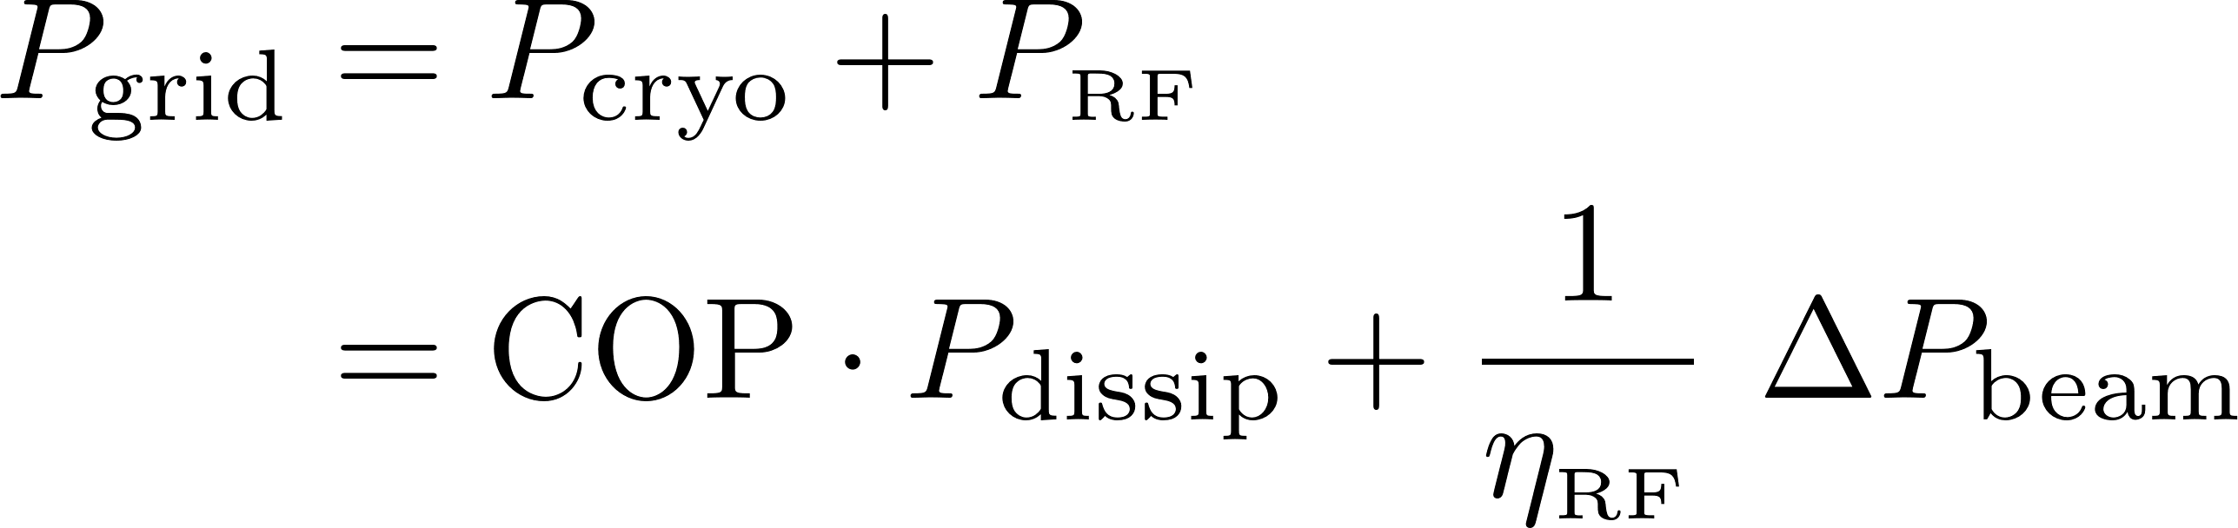

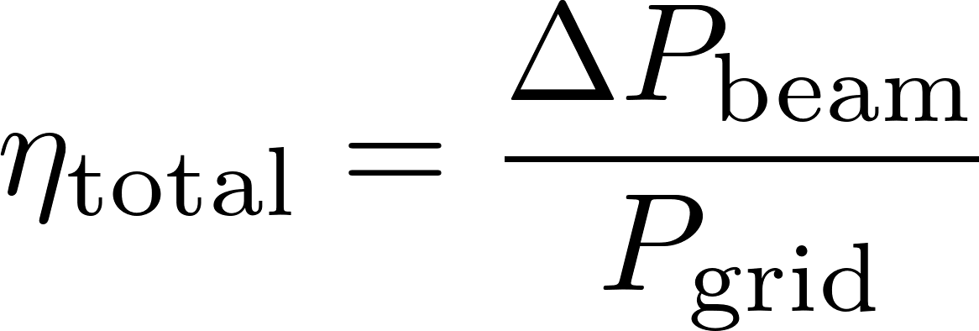
Powerflow s.c. Linac – Minimum System Example for a Single Cavity
power balance:
GRID
AC/DC/RF/guide
η_{RF} ≈ 0.4 .. 0.6
P_{RF}
cryogenics
COP ≈ 1000
P_{dissip}
beam
considered:
one 650MHz cavity
U_{a} = 20MV
l = 1.1m
ignored: cavity detuning, β<1, regulation overhead, aux. systems …
regime | I_{b} [mA] | Q₀ | η_{RF} | ΔP_{beam} [kW] | grid-to-beam Efficiency
TDR, CW | 2.0 | 2⋅10¹⁰ | 0.44 | 40.0 kW | 30%
high Q | 2.0 | 3⋅10¹⁰ | 0.44 | 40.0 kW | 33%
high current | 4.0 | 3⋅10¹⁰ | 0.65 | 80.0 kW | 50%
extrapolation

Slide 15
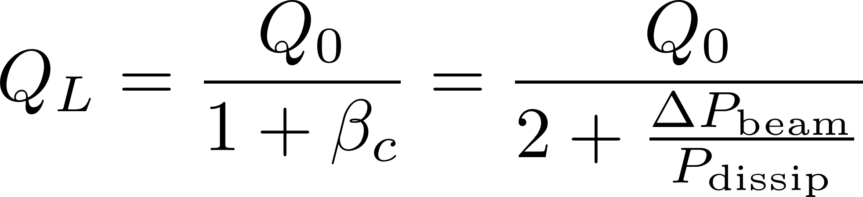
technical challenges of s.c. RF not discussed here:
low DC current requires high Q_{L} for matching → narrow bandwidth → stability/regulation problem
in optimum matched condition:
Lorentz force detuning 1Hz/MV² -> extremely sensitive
high intensity → high power transfer through coupler; excitations of HOMs (damping required), etc.
ERL: deceleration of spent beams → losses from emittance growth

Slide 16
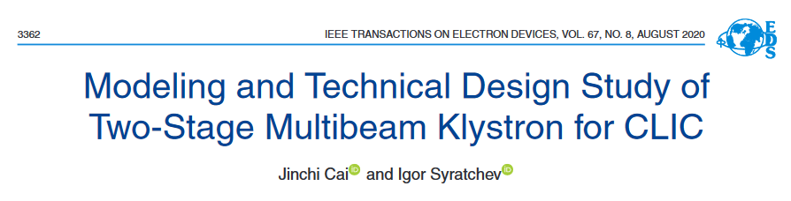
Technology R&D: Efficient RF Power Sources
Klystrons, η>70% within reach
e.g. CLIC two stage multi-beam klystron, J.Cai, I.Syratchev, IEEE Trans, 2020
Example: study 1GHz for CLIC drive beam; 6 cavities, 30 beamlets; 25+140kV; η_{sat}=82%
Magnetron, R&D at various groups, η=60-80% within reach
e.g. Wang et al, J-Lab, IPAC 2019; A.Dexter, Lancaster U., LINAC-2014; B.Chase, Fermilab, JINST-2015
Solid state amplifiers (SSA) at various groups, η=60-90% depending of freq.
Example: SSA for Isotope production Cyclotron, 98.5MHz, 12x1kW units, η_{D}=93% (90% with regulation overhead)
Uppsala group, WP in I.FAST program
I.FAST efficient RF workshop, July 4-6, 2022, Switzerland:
https://indico.cern.ch/event/1138197/

Slide 17
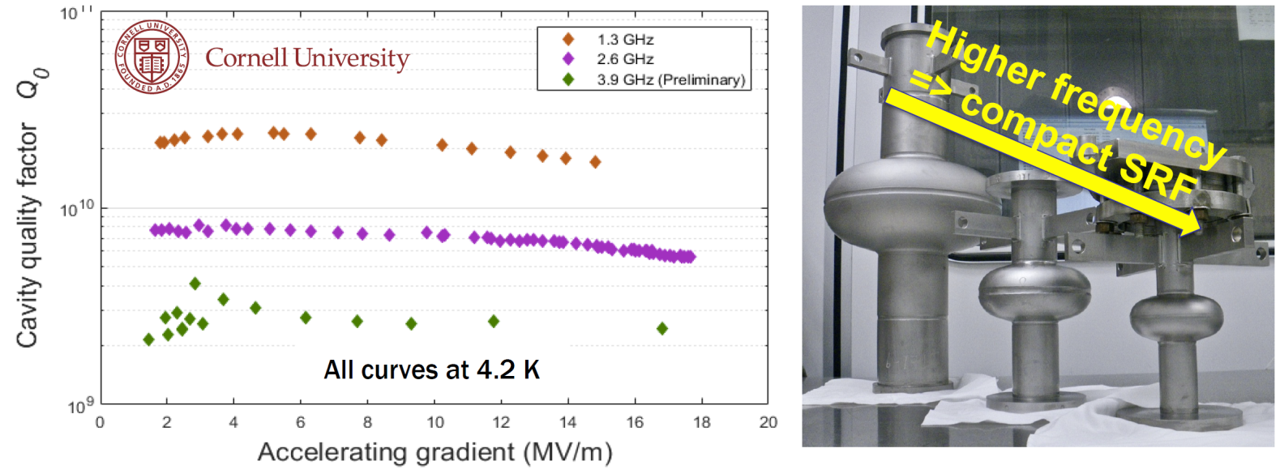
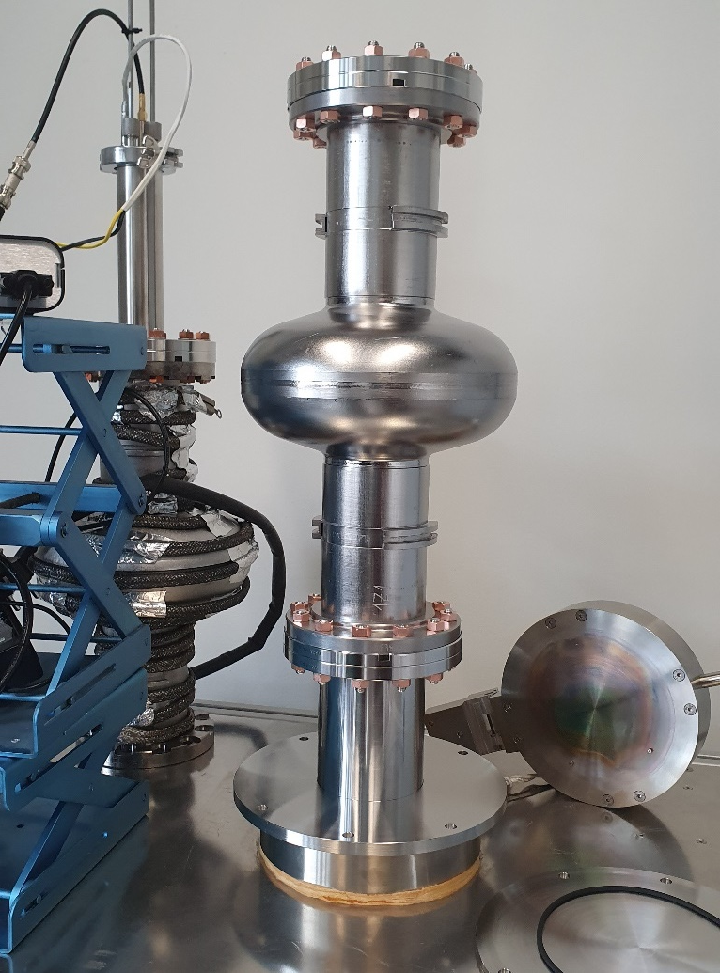
Technology R&D: Superconducting RF at higher temperature
promising R&D: Nb₃Sn coated cavities at Cornell
4.2 vs. 2.0K → efficiency
[M.Liepe, Cornell, IPAC‘19]
Cornell, FERMILAB
→ simplicity, cost, efficiency, smaller size
S Posen et al 2021 Supercond. Sci. Technol. 34 025007
record cw gradient in Nb₃Sn-coated, E_{acc} = 24 MV/m
DESY, Hamburg U.
aim for sustained SRF accelerator technology
10y Goal: >70 MV/m with a Q₀ of 1x10¹⁰ and at 4K
contact: M.Wenskat, DESY
SMART recipe leads to a T_{c} of 15.4 K on Nb-samples coated with 15 / 25 nm of AlN / NbTiN
To be published
Marc Wenskat et al 2023 Supercond. Sci. Technol. 36 015010, DOI 10.1088/1361-6668/aca83f
overview: G.Bisoffi, RF Achievements and Plans
https://agenda.infn.it/event/35579/contributions/201871/

Slide 18
Light Source Example

Slide 19
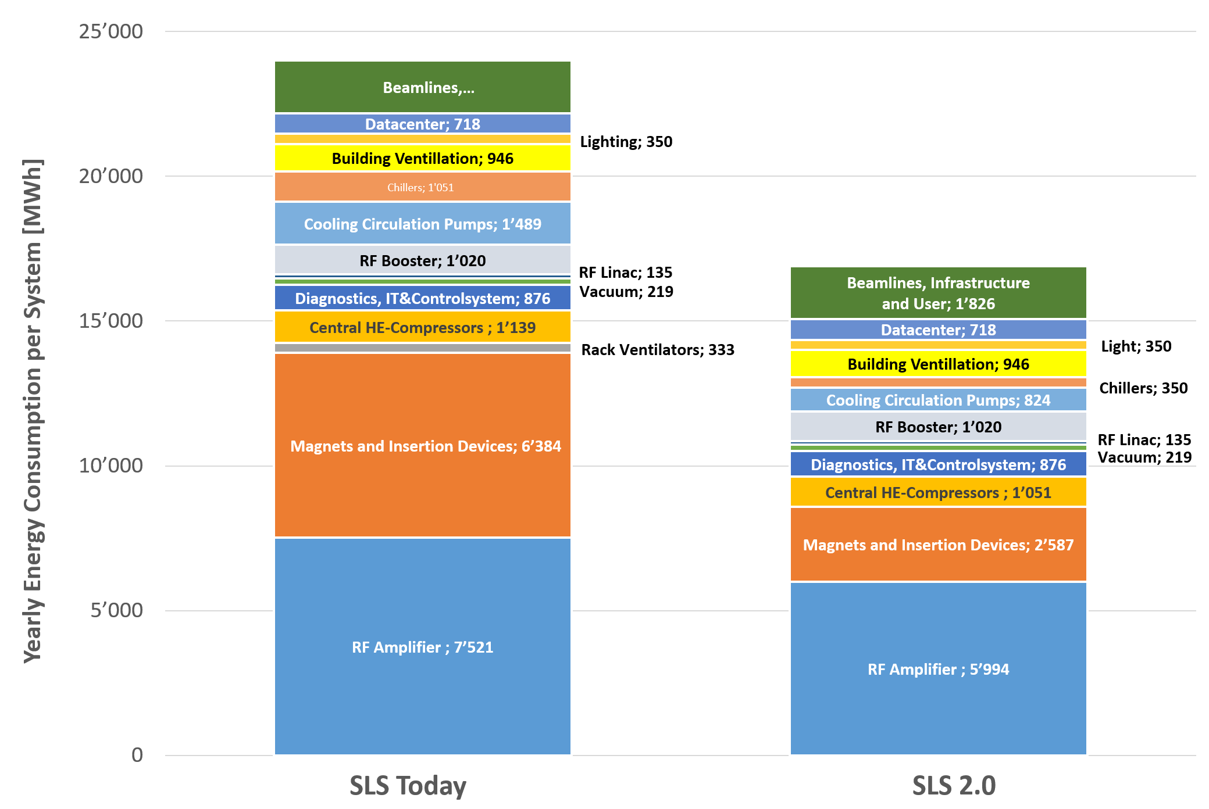
Example Swiss Light Source SLS and its Upgrade @ PSI
≈ 3.3MW
Brilliance x 35 for users
Less electricity consumption
Key savings:
Electromagnets → Permanent magnets
Klystrons → Solid state amplifiers (63%)
standard pumps → modern pumps for cooling
-29 %
SLS2.0: Grid to user X-rays
P_{tot} = 2.4MW
P_{RF} = 0.82MW
P_{γ (undulators)} = 91kW
[M.Jörg, PSI]

Slide 20
Particle Colliders

Slide 21
Colliders - Concepts
Next generation: high Luminosity, high Energy reach needed
Energy Efficiency: Luminosity per Grid Power
m [MeV]
Ring
e⁺/e⁻
1000
p
particle mass impacts synchrotron radiation and beamstrahlung (collision)
→ scaling laws and grid power drivers are quite different for the concepts under discussion
Linear
e⁺/e⁻
100
μ
Ring
p/p
MuonC
μ⁺/μ⁻
10
1
e

Slide 22
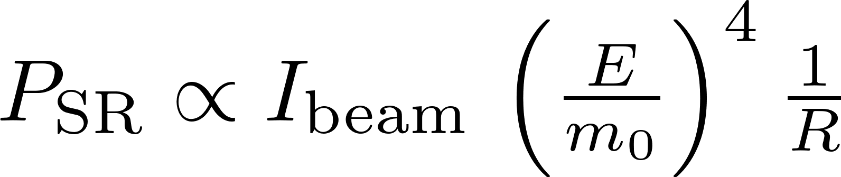


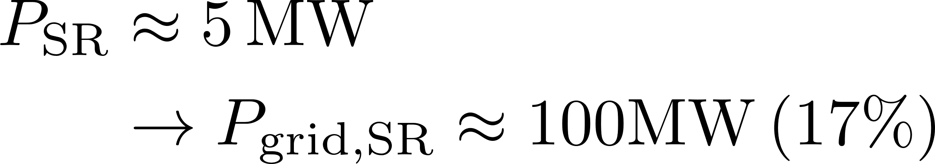
Colliders Types and Power Drivers
Ring
e⁺/e⁻
FCC-ee 240GeV:
P_{grid} = 282MW
+ beam recirculation
- synchrotron radiation
Linear
e⁺/e⁻
CLIC 380GeV (3.0TeV):
P_{grid} = 110MW (589MW)
ILC 250GeV (1TeV):
P_{grid} = 111MW (300MW)
+ no synchrotron radiation
- no recirc., small beam needed
power drivers: cryo (ILC) vs RF (CLIC)
MuonC
μ⁺/μ⁻
MAP 6.0TeV:
P_{grid} = 270MW
+ no Beamstrahlung-Limitation
- inefficient RCS, complexity
Ring
p/p
FCC-hh 100TeV:
P_{grid} = 580MW
+ high energy reach
- SR deposited @50K, cryogenics

Slide 23
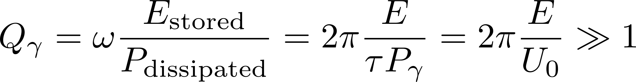
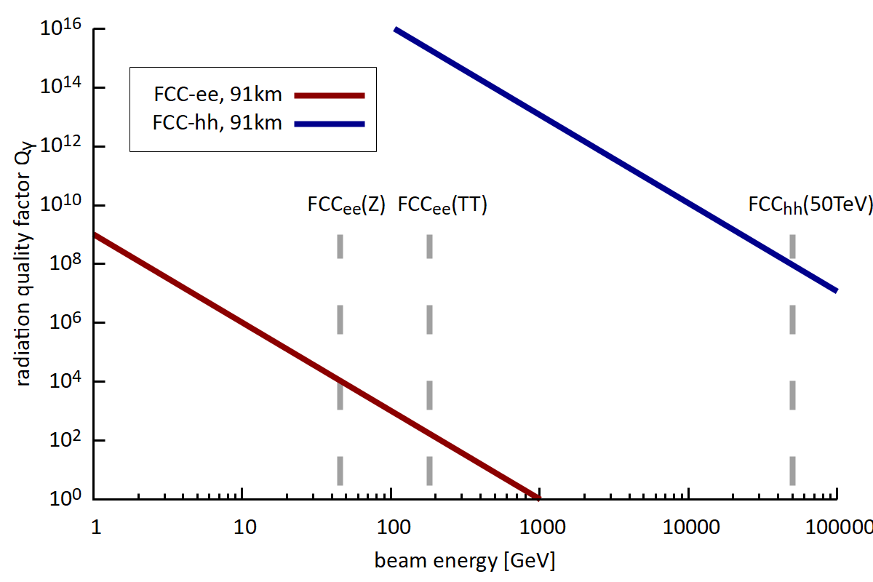
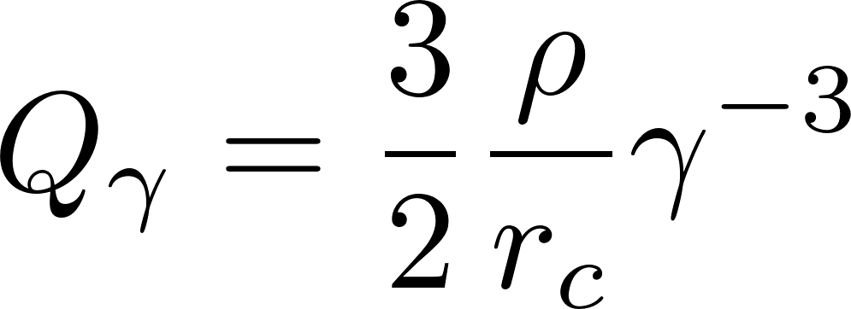
Ring Collider
energy recirculated, thus efficient concept
however, SR losses at higher energies
LHC: burnup dominates beam loss
quality factor storage ring:
= „decay time of beam energy in number of turns due to SR“
bending radius
classical particle radius

Slide 24
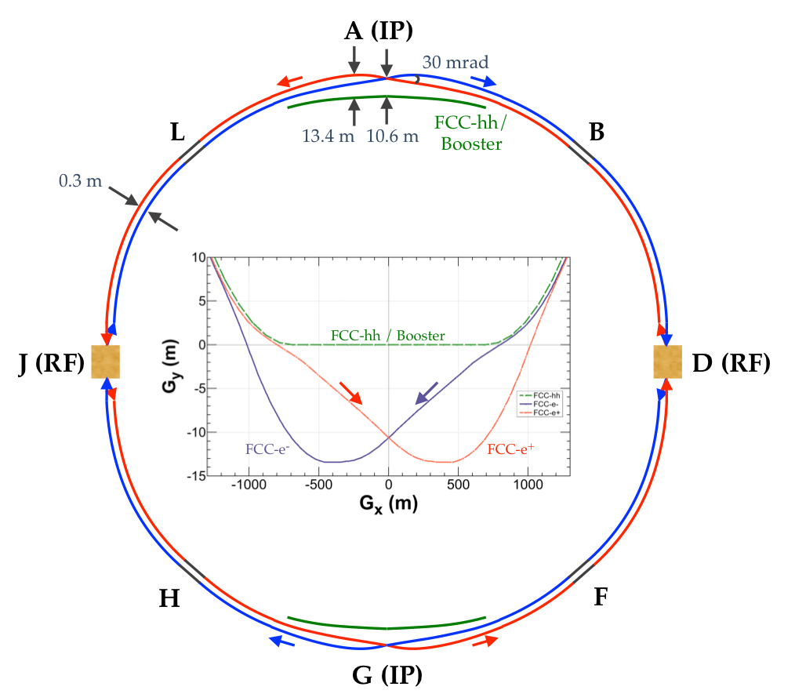
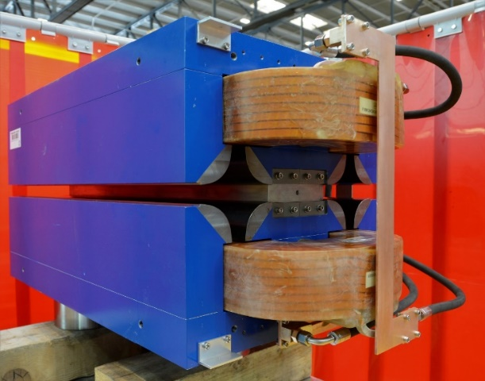
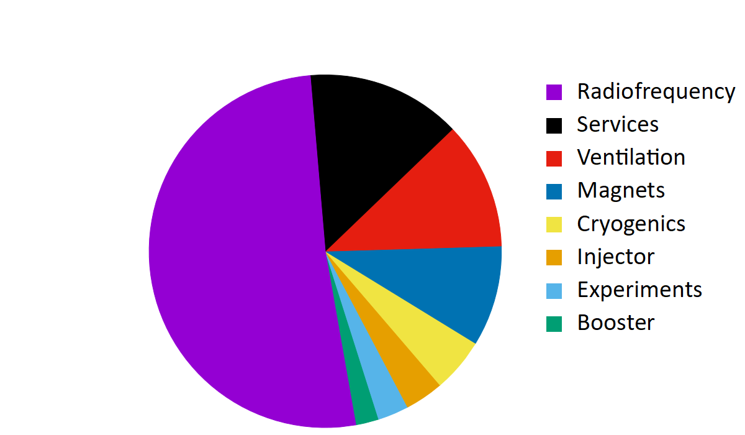
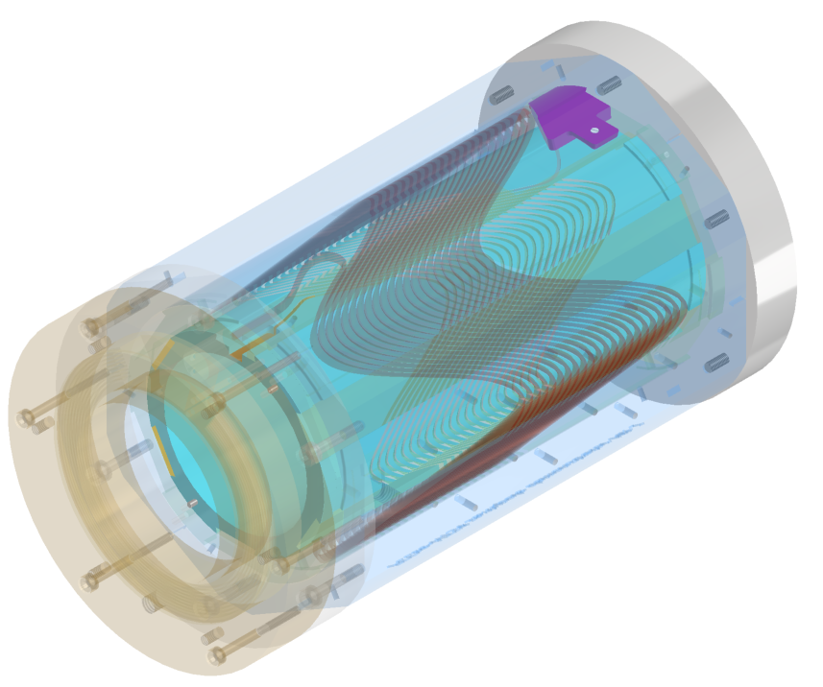
FCC-ee – Optimized Lepton Ring Collider
conceptual measures:
crab waist scheme (specific luminosity)
4 IP‘s instead 2
maximise bending fill factor (combined func. mag.)
technology measures:
high-efficiency klystrons (HEIKA collaboration)
4.5 K s.c. cavities, high Q (400 MHz Nb/Cu)
twin apertue dipoles (50% savings of bends)
HTS quads and sextupoles (M.Koratzinos et al, CHART)
100km
A. Milanese, Efficient twin aperture magnets for the future circular e⁺/e⁻ collider,
Phys. Rev. Accel. Beams 19, 112401 (2016)
K.Oide at al
similar as CERN total today
E_{cm} = 240 GeV (H)
P_{grid} = 282 MW
E_{grid}/y = 1.33 TWh
→ dominated by RF (compensating SR losses)
M.Koratzinos et al, CHART, HTS Sextupole

Slide 25
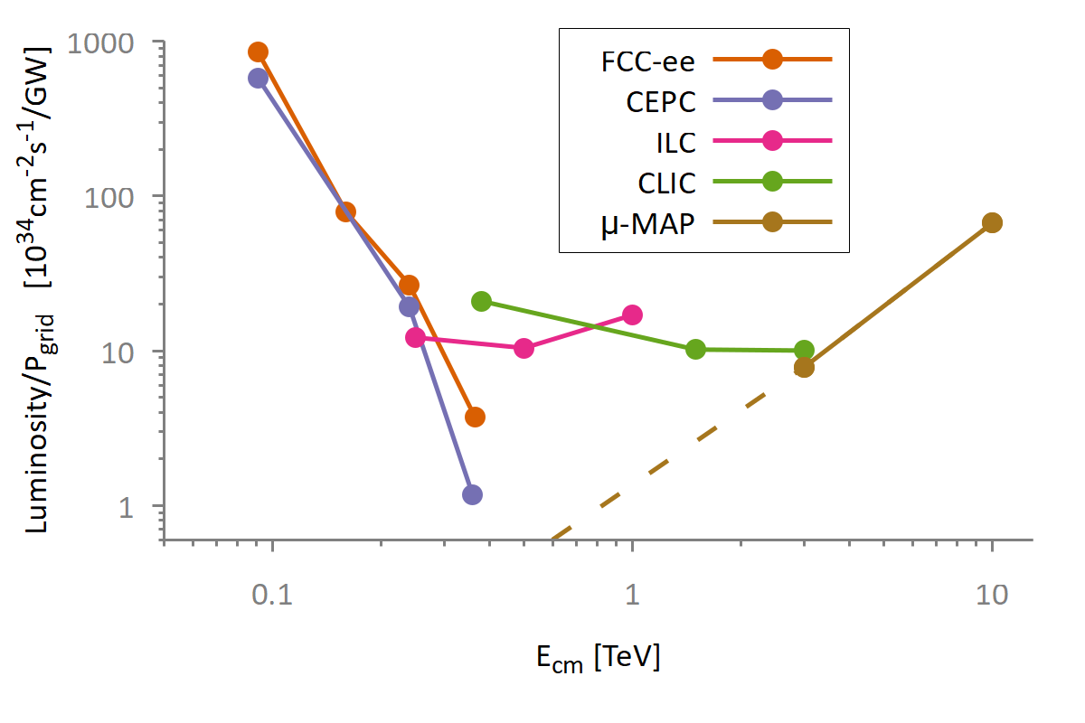
Overview Lepton Proposals
energy specific luminosity production:

Slide 26

Ring vs. Linear Collider
Ring Collider
beams circulate
Linear Collider
beams collide once
 | FCC-ee 365GeV | CLIC 380GeV
σ_{x} [nm] | 38‘000 | 150
σ_{y} [nm] | 68 | 2
σ_{z} [μm] | 2‘500 | 70
N [10⁹] | 230 | 5,2
f_{b} [kHz] | 147 | 17,6
P_{b}[MW] | 988 | 2.8
beam reused
synchrotron radiation dominated
equilibrium beamsize → collision parameters limited
beam used only once
no synchrotron radiation
ambitious collision parameters possible (no ring dynamics)

Slide 27
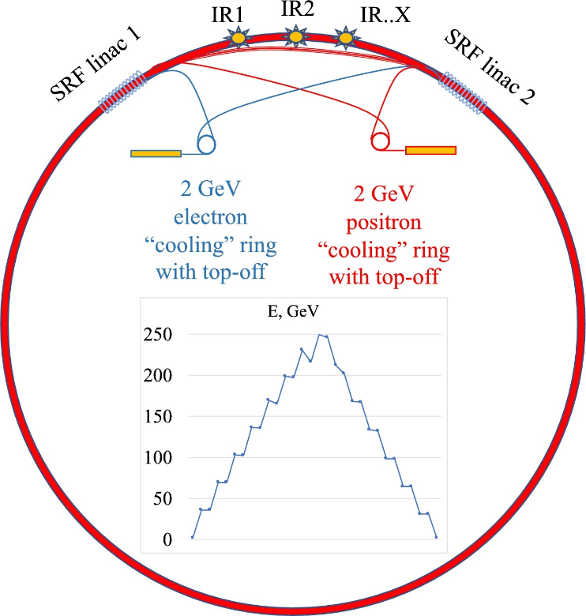
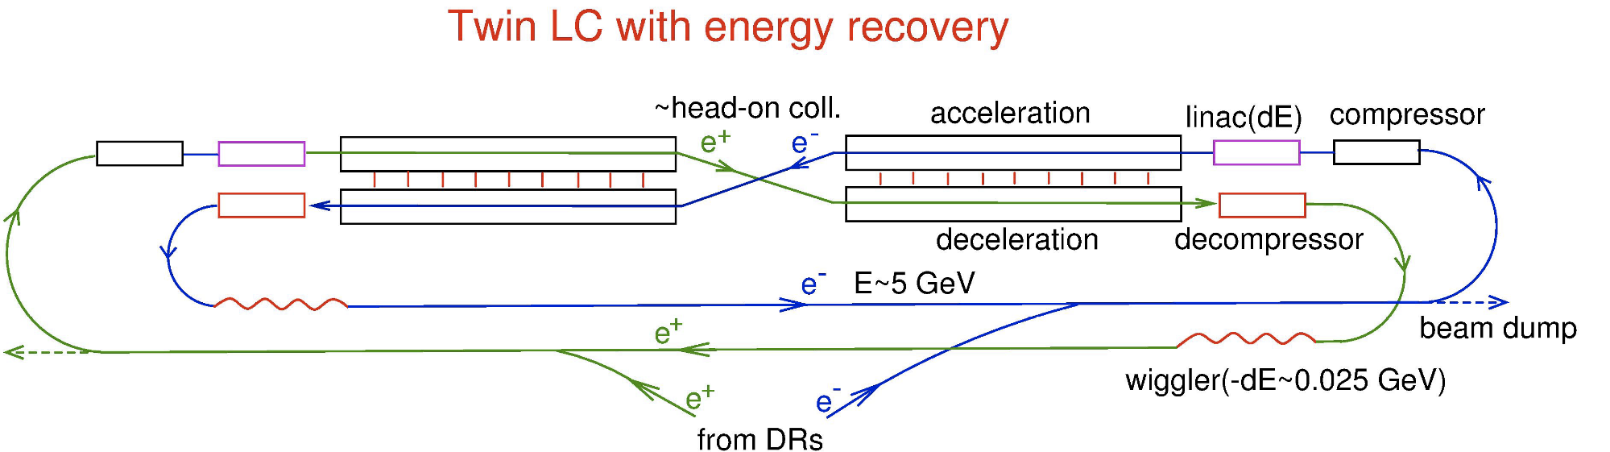
Combining Linear- and Ring-Collider using the ERL Concept
ERL
power circulates
two ERL proposals published:
1) Circular Energy Recovery Collider
V. Litvinenko, T. Roser, M. Llatas, Physics Letter B 804 (2020) 135394
multi turn ERL, modification FCC-ee
acceleration
I
P
P
I
2) Energy Recovery Linear Collider
V.I. Telnov 2021 JINST 16 P12025
twin s.c. linacs, beam recirculation, wiggler damping
deceleration
power recirculated, beam recirc. at low E
benefit from better collision parameters
→ high L per grid power, but higher investments & complexity

Slide 28
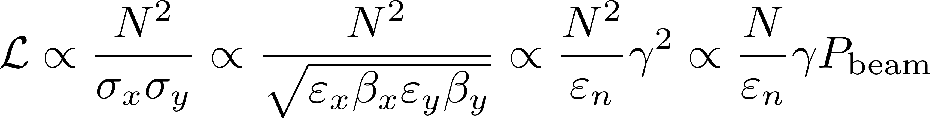


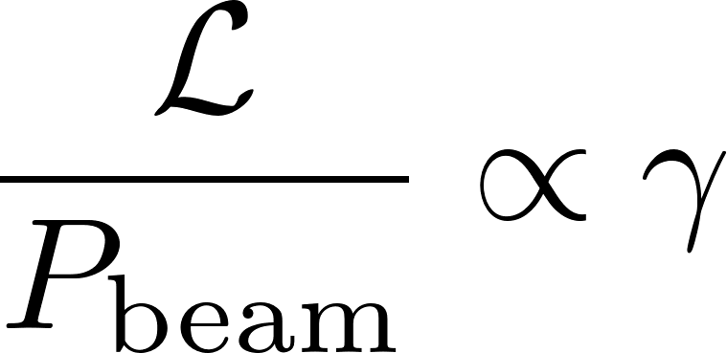

Muon Collider – Efficient at Highest Energies
Muon: E₀ = 106 MeV, τ_{μ} = 2.2 μs
low SR, low beamstrahlung during collisions!
scaling laws for muon collisions at varying E:
thus L/P is increasing with energy:
Beamstrahlung in e+/e- collider:
!

Slide 29
Summary Efficient Particle Accelerators
Grid to Beam
State of the art 20%, up to 50% reachable for s.c. linacs & high beam power; cyclotrons provide solutions for E<1GeV, e.g. ADS systems
Colliders
e+/e- ring collider is a powerful yet simple scheme; advanced efficient schemes include energy recovery collider and muon collider
fluctuating sustainable energy: E management / dynamic operation
Technology
s.c. magnets & high Q cavities are efficient, higher temperature operation (HTS)
efficient RF sources, permanent magnets, heat recovery & photovoltaics
other: water & He consumption, critical materials, managed lifecycle, carbon footprint, energy procurement, advanced energy production

Slide 30
Thank you for your attention.
Many thanks for discussions and input:
V.Yakovlev (Fermilab), V.Ziemann (U.Uppsala), M.Jörg (PSI), H.Schlarb (DESY), D.Schulte, F.Zimmermann (CERN),
M.Bylac (CNRS), P.Williams (STFC).

Slide 31
spare slides on Light Sources, Dynamic Operation

Slide 32
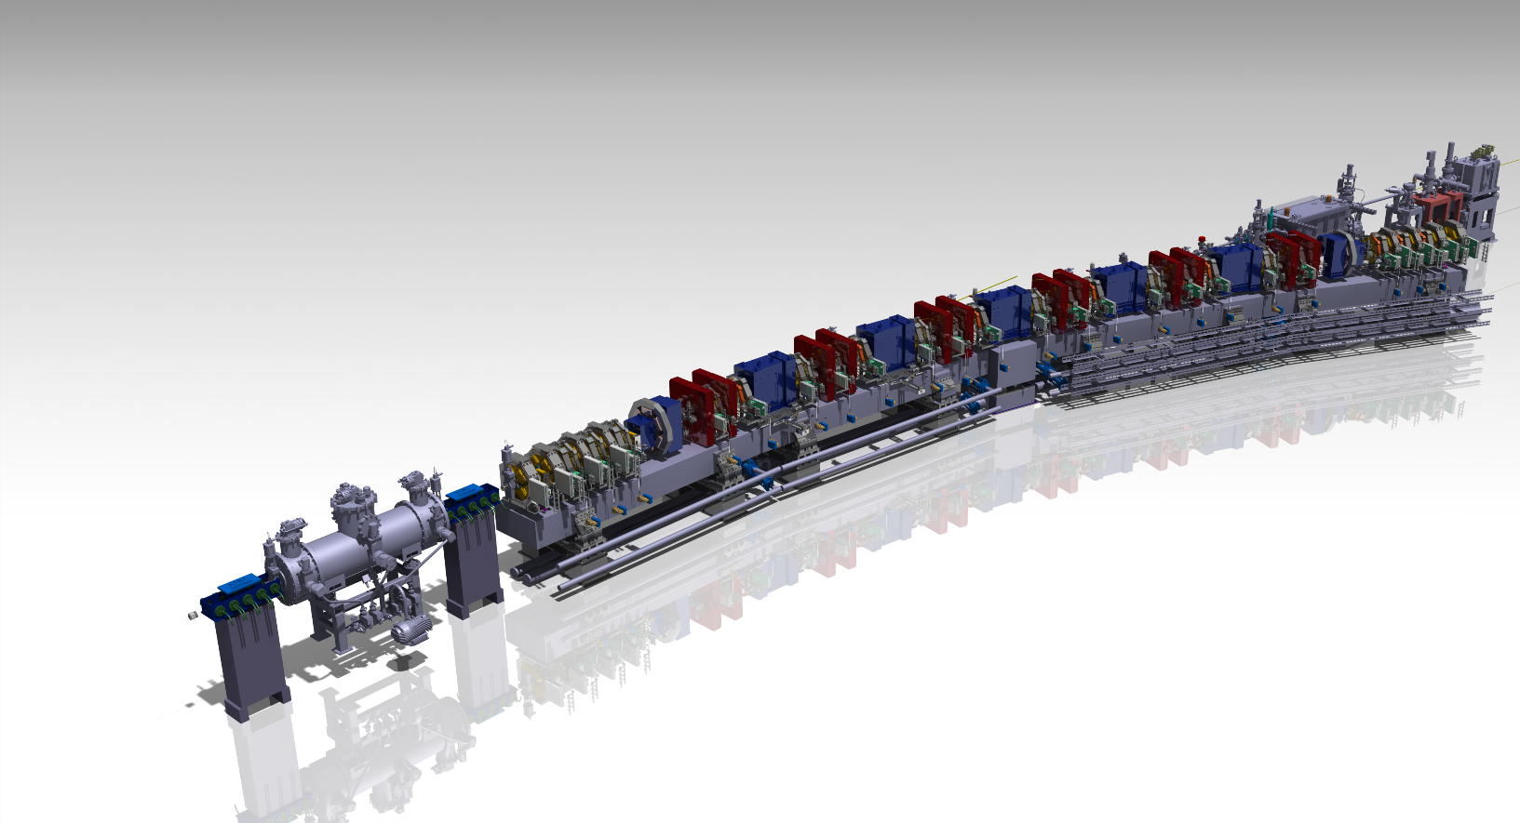
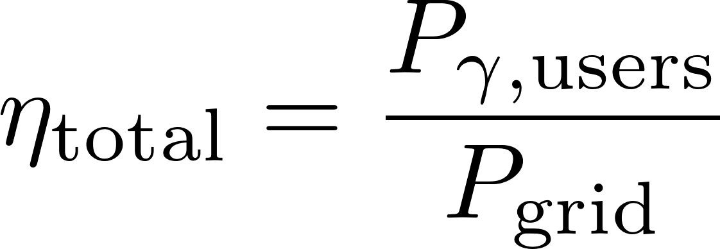
Synchrotron Light Sources and Free Electron Lasers
over the history ring light sources have improved the brilliance by more than 10 orders of magnitude, the last step is made using multi bend achromat lattices and miniaturization using permanent magnets
power consumption of ring light sources is in the range of a few Megawatt and often not a critical factor; however, s.c. FELs might use O(20MW)
the production of tailored radiation – spectral distribution, coherence, ultrashort pulses etc. is in the focus today
SLS2.0 magnet structure
GRID
AC/DC/RF/beam
radiation for users
possible efficiency measure:
unwanted radiation
magnets, AC, aux.systems…

Slide 33



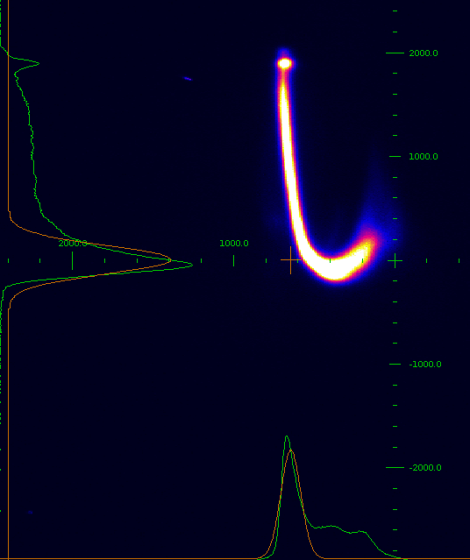
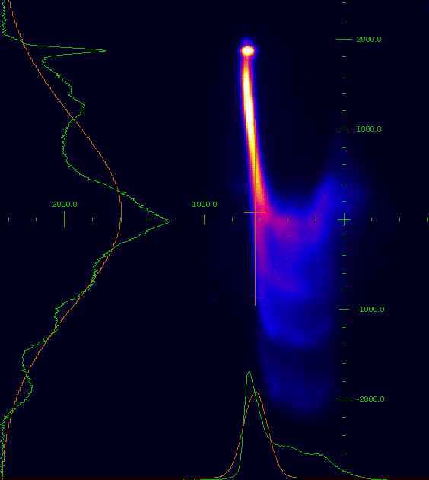
Free Electron Laser
streaked beam, SwissFEL
no lasing lasing
RF, Linac
FEL process
ρ ?
FEL: P_{γ} ∼ N² (coherence length)
energy loss, ΔE/E
best demonstrated energy extraction: ΔE/E = 30%
(E_{k}=65MeV, Laser seeded FEL)
O(10⁻³)
longitudinal, ∝ z², O(30μm)
Facility | Technology | P_{grid} (typ) | P_{beam} (typ) | Photon Power
SwissFEL | n.c., 6 GHz, pulsed | ≈ 3.0 MW | 100 W | up to 0.2 W
EXFEL | s.c., 1.3 GHz, pulsed | ≈ 10 MW | 40‘000 W | up to 40 W
Grid Power Consumption
(order of magnitude)
examples: n.c. / s.c.

Slide 34
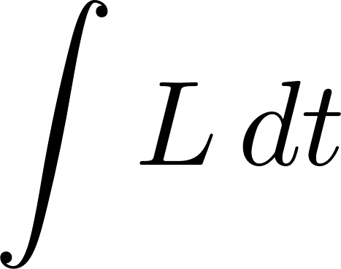
The Future – Fluctuating Energy Sources
simulation: April 2050, sustainable energy system Germany
collider dynamic operation – possible at all?
Collider
production of power
solar, wind
release from storage
variation: x5!
Grid
O(GWh)
low intensity pilot beam (ca . factor 2 grid power reduction needed)
or: standby mode with fast L recovery concepts
or: local energy storage, gas power
use of power
industry, traffic etc
energy storage
residual power
courtesy: FRAUNHOFER-INSTITUT FÜR SOLARE ENERGIESYSTEME ISE, Karlsruhe (2020)

