Slide 1








WP1 – Ferro-Electric Fast Reactive Tuners (FE-FRT)
An overview of the work-package by A. Neumann for the members from CERN, IJCLab, U Lancaster* and HZB
with Euclid TECHLABs as associated partner
*WP6, strong link to WP1
EU HORIZON-INFRA-2023-TECH-01-01

Slide 2
Task#1 Energy Savings from RF power
How do we aim to demonstrate sustainable, thus lower carbon footprint low-RF power operation?
Increase the efficiency of intrinsically efficient RF power source by better integrating them in cavity
LLRF field control and requirements by accelerator/beam settings → WP2
Develop novel fast tuning systems compensating detuning by mechanical vibrations or beam induced
transients, which both are usually compensated by adding a significant power overhead
→ WP1 aka FE-FRT
All this should of course not compromise the stability and reliability of operation, better even improve
it beyond current state of the art.
The savings in RF power should be significant, to justify any required modification to a cavity system
→ retro-fitting to existing systems would be pure gold

Slide 3
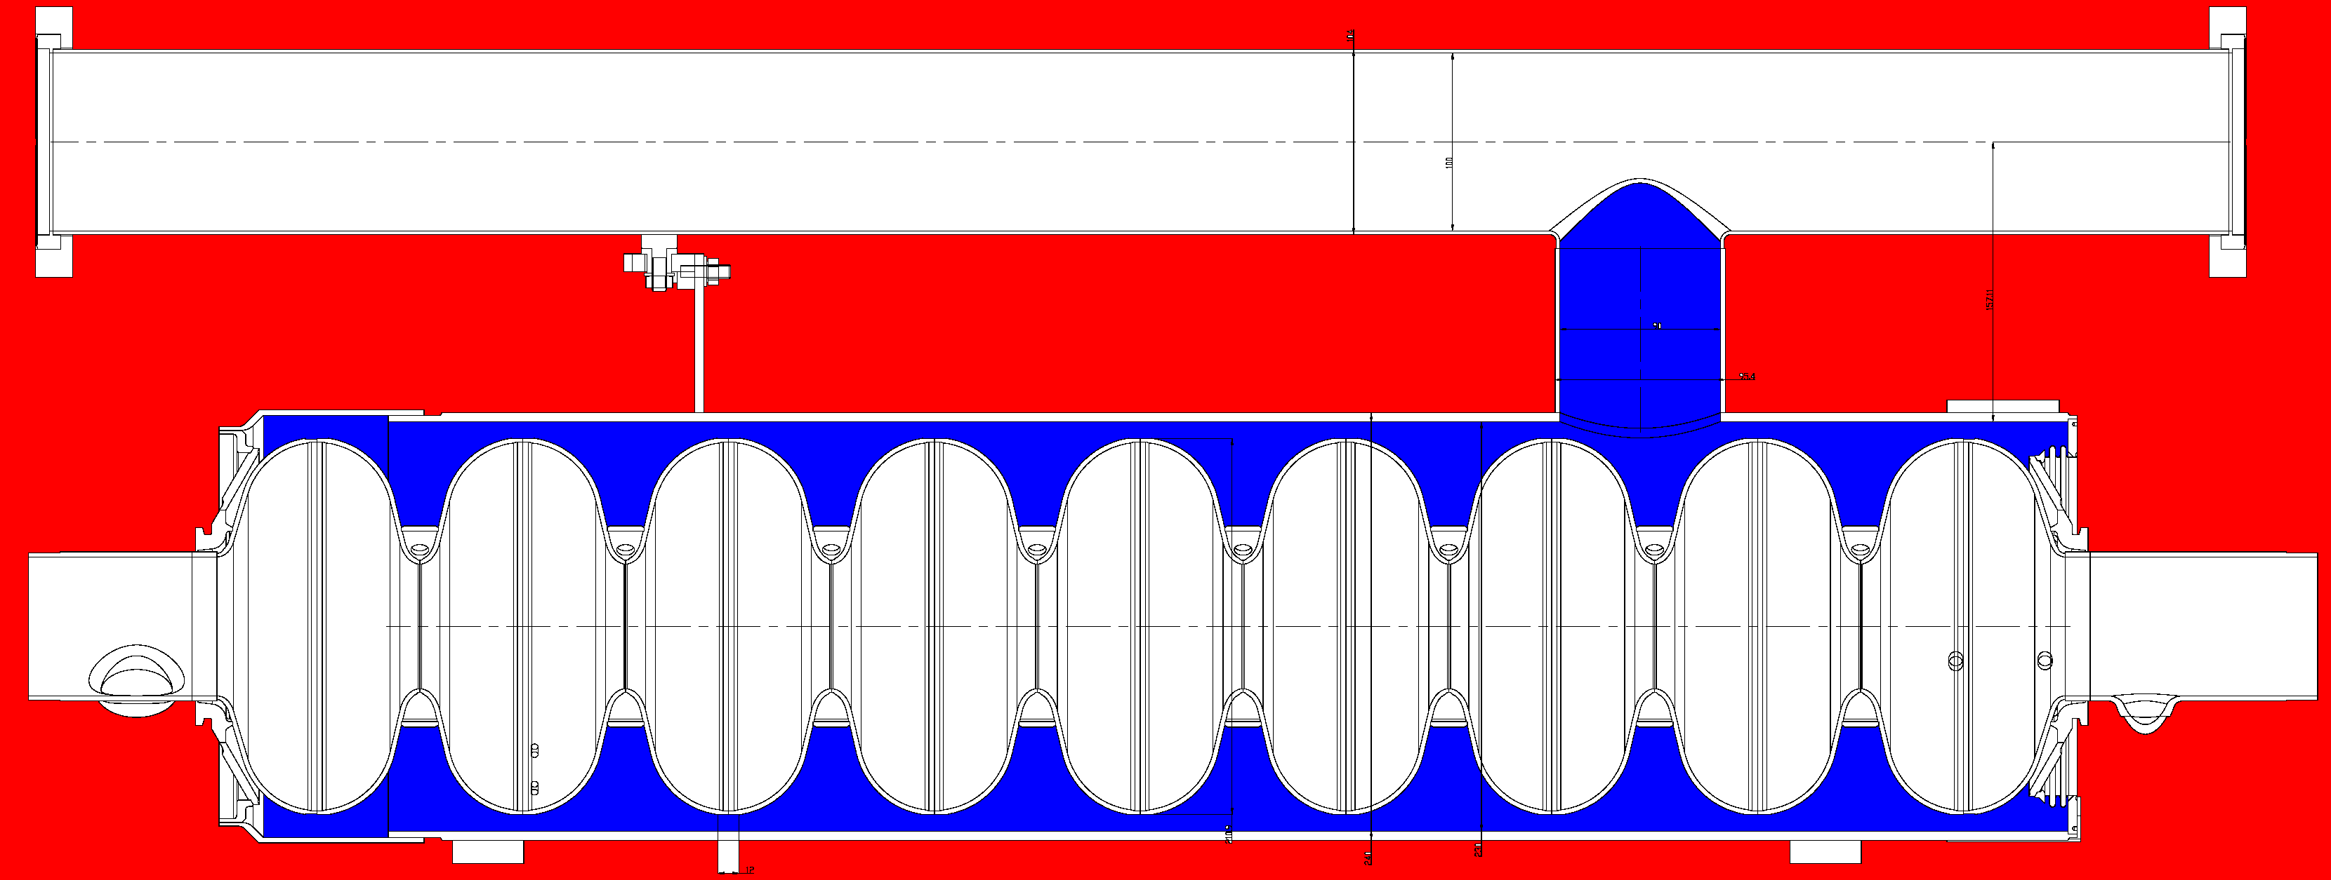
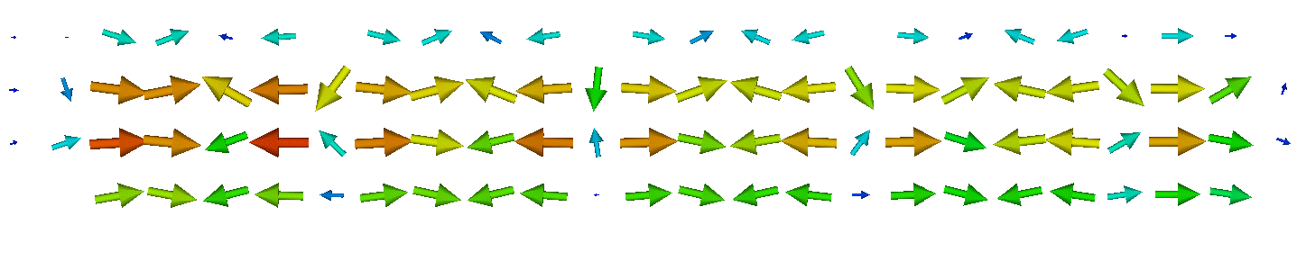
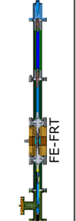
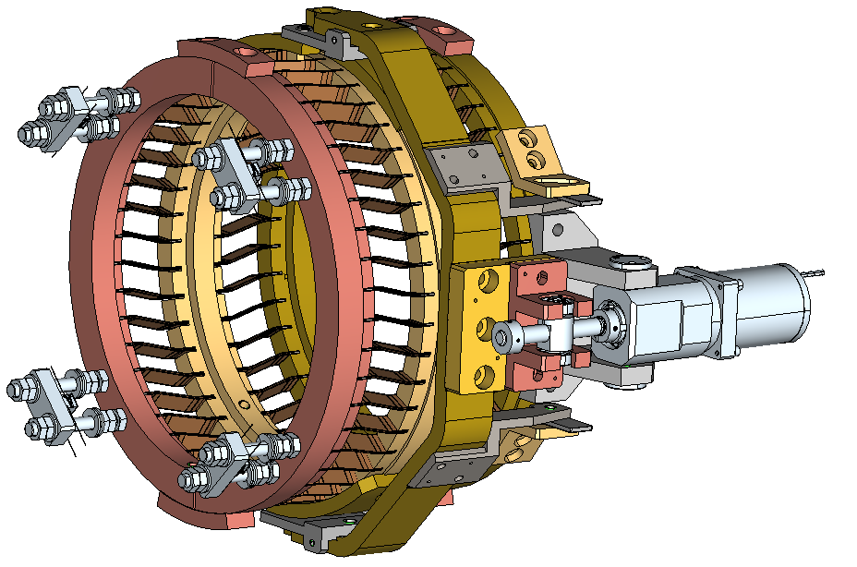
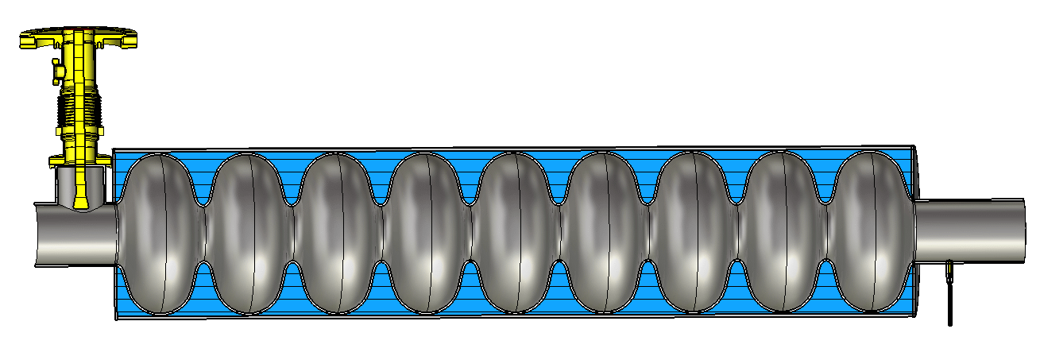
Energy efficient SRF Cavity field control
Accelerating field
Detuning control
Counter-tune
Smart Amplifier control
LLRF control
Detuning/field disturbances:
Field driven Lorentz force detuning
Microphonics detuning
Coupling to mechanical eigenmodes
Helium pressure variations
Beam loading transients
Disturbances
in the acoustic
frequency regime
to MHz
modulate cavity
RF frequency
Reference
Amplifier
RF reflected power
RF Load
Cavity signal
RF input power
Control by detuning
compensation
→ Improve
Control by RF
Power
→ Minimize
Power coupler
FE-FRT
Motor+
piezo tuner
Bunched beam
Applied
methods
Niobium cavity
in helium vessel
Measurement
antenna

Slide 4
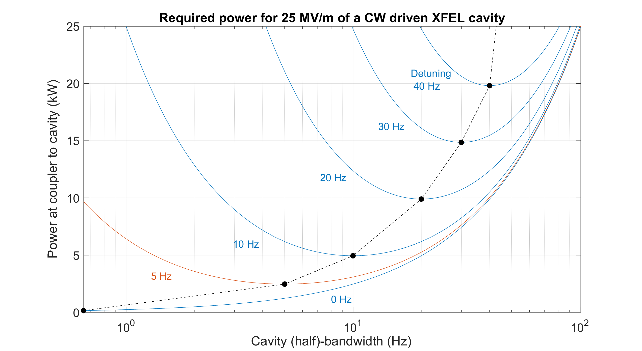
Reduce detuning by FE-FRT or Piezo control
Reduce power
by a factor of
~10
Adjust loaded Q to optimum
Goal
State of the art

Slide 5
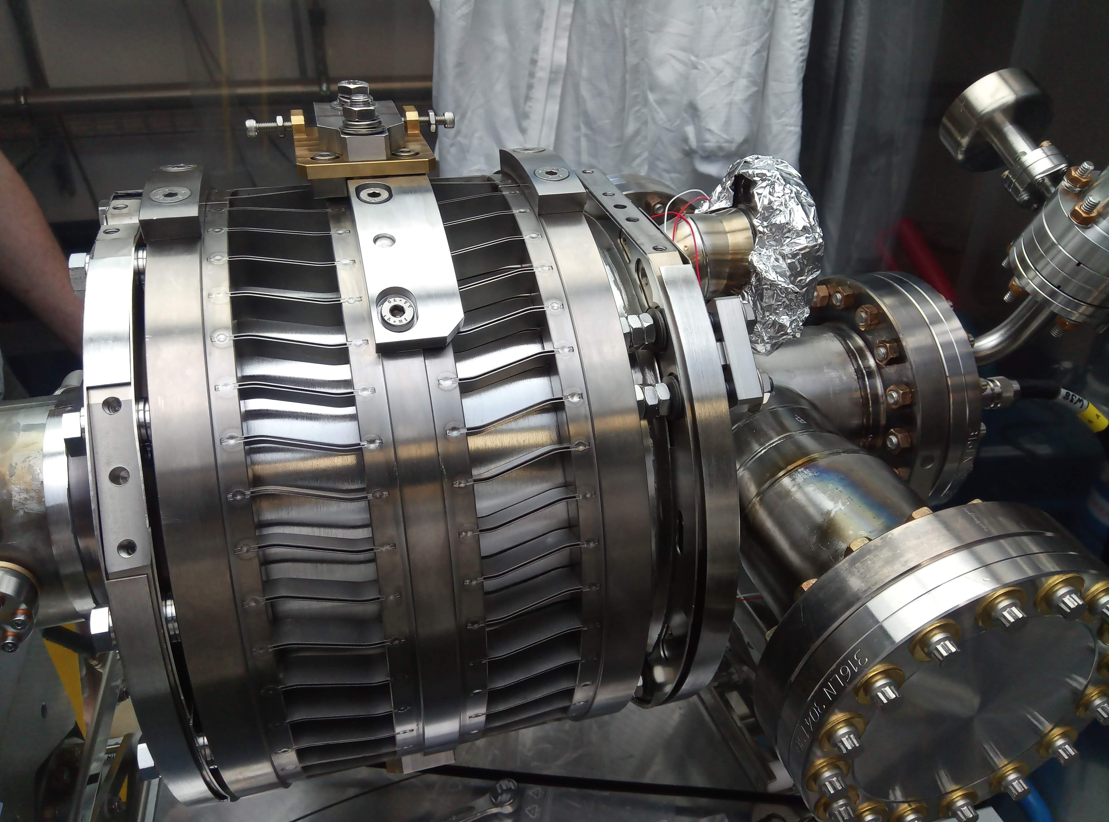
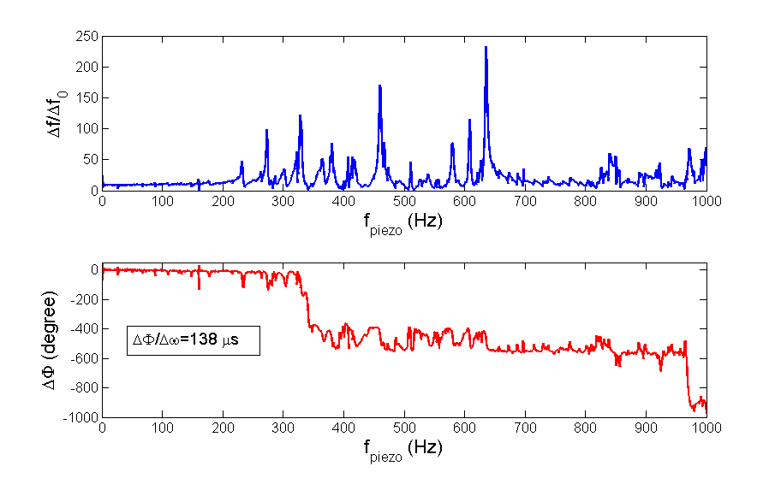
Why FE-FRT?
bERLinPro 2cell booster
with Cornell blade tuner variant
What about mechanical tuner with stepper motor and piezo actuators?
Large tuning range, several 100kHz, some MHz depending on cavity
but very slow
Up to sub-ms response time with piezo, around 1kHz range for piezos
Potentially hysteresis and backlash effects
Limited resolution of both tuner types
A complex detuning response over modulation frequency by
piezos → Complex coupling of mechanical to RF eigenmodes
→ Controls by LMS adaptive feedforward, Active Noise Control techniques,
Kalman filter based state controllers……all complex and not
necessarily robust (WP2 will deal with that)
Can we have a robust tuner, fast and precise for microphonics
to allow operation at highest loaded Q?
Can we even have faster tuning response and orders of magnitude larger
range than piezos for e.g. transient beam-loading?
Piezo modulation to RF detuning transfer function of a TESLA cavity

Slide 6
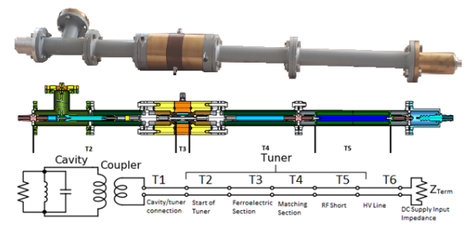
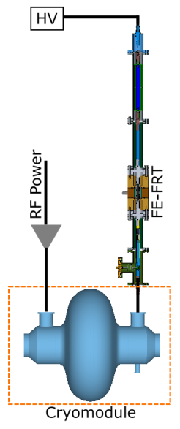
Conceptual design of a high reactive-power ferroelectric fast reactive tuner
Phys. Rev. Accel. Beams
Ilan Ben-Zvi, Graeme Burt, Alejandro Castilla, Alick Macpherson, and Nicholas Shipman
Accepted 12 April 2024
We don’t start from zero. All the following is based on
previous work by CERN, Lancaster, BNL and euclid
Pros and Cons:
Non-mechanical, no complex transfer/
coupling behaviour as with e.g. piezos
Fast tuning response on sub 100 ns
timescale
Tuning range on the order of tens to
hundred (?) of kHz
But, physics is never for free
A suitable coupler port is needed
The material needs to operate at room
temperature, windows, thermal transition
required
Low loss material for a high figure of merit
required
Fast switching HV source for transient
detuning application
HV breakdown of ceramics
Prototype FE-FRT designed and built at Euclid and later sent to CERN
N.C. Shipman et al., “A Ferroelectric Fast Reactive Tuner for Superconducting Cavities”,
in Proc. SRF'19, Dresden, Germany, Jun.-Jul. 2019, pp. 781-788. doi:10.18429
Instead of changing the boundary
conditions via mechanical deformation
for the fundamental mode
→ Couple a tunable device to the resonator
changing the frequency of the coupled system
This can be done, by applying HV to a FE material
such as BST class: BaTiO₃-SrTiO₃
→ Tuneable dielectric constant
Challenges for iSAS

Slide 7
WP1: FE-FRT Team
HZB, CERN, CNRS, Uni.Lancaster
Convener: Axel Neumann (HZB)
Main contacts with other partners: Alick Macpherson (CERN), Walid Kaabi (CNRS),
Graeme Burt (Uni.Lanc.)
Task 2.4 Integrated LLRF control using FE-FRT
Task 3.3 RF tunability, FE-FRT for Nb3SN coated cavities?
Task 1.1: Coordination of R&D on FE-FRT – M1-M48 (HZB)
• General coordination by HZB as described above.
Task 1.2: FE-FRT for Transient Beam Loading – M1-M40 (CERN)
• Design a full FE-FRT-based 400 MHz tuner, applicable to LHC transient detuning scenarios.
• Perform full RF, mechanical and cryogenic evaluation of the FE-FRT-equipped . LHC cryo-module.
• Use design lessons learned to design a tuner for transient detuning of FCC 800 MHz multi-cell cavities.
Task 1.3: FE-FRT for Microphonics – M1-M48 (HZB)
• Establish characteristics and performance of FE-FRT ferroelectric material at frequencies ≥1300 MHz.
• Design, fabricate and validate an FE-FRT for microphonics suppression on a single-cell 1.3 GHz cavity.
• Design, fabricate and validate an FE-FRT for multi-cell cavity at 1300 MHz, in a cryomodule-like setup.
Task 1.4: FE-FRT in Energy-Recovery LINAC (ERL) mode – M1-M48 (CNRS)
• End-group design study for integration into ERL-type cavity, study HOM+BBU properties.
• FE-FRT design study for RF and mechanical integration into upgraded ERL cavity.
Task 6.2: Retrofitting Fast Reactive Tuners into existing cryomodules HL-LHC oriented – M1-M24
Study of frequency domain multiplexor-based HOM coupler
Study the effect of HOMs on FE-FRT operation to define max leakage
Study the heating due to high fundamental power in the coupler
Strong link to
Tasks 1.2-1.4

Slide 8
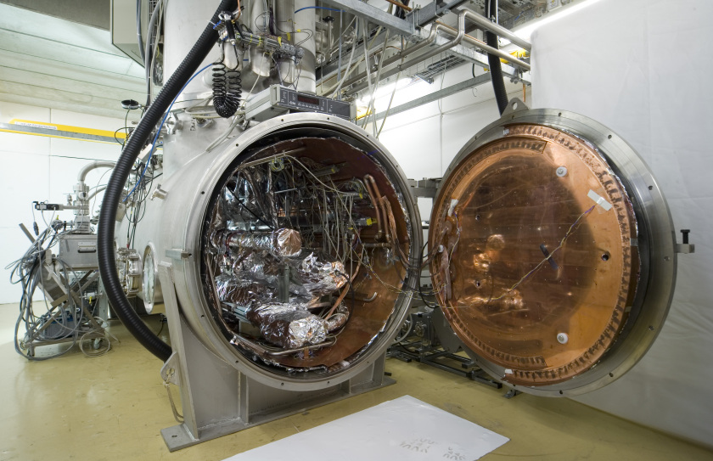
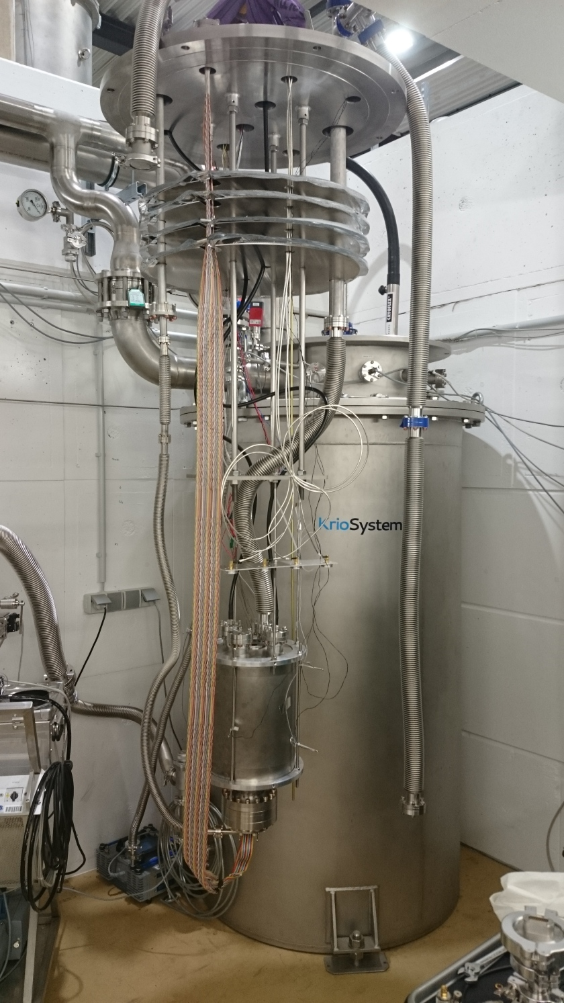
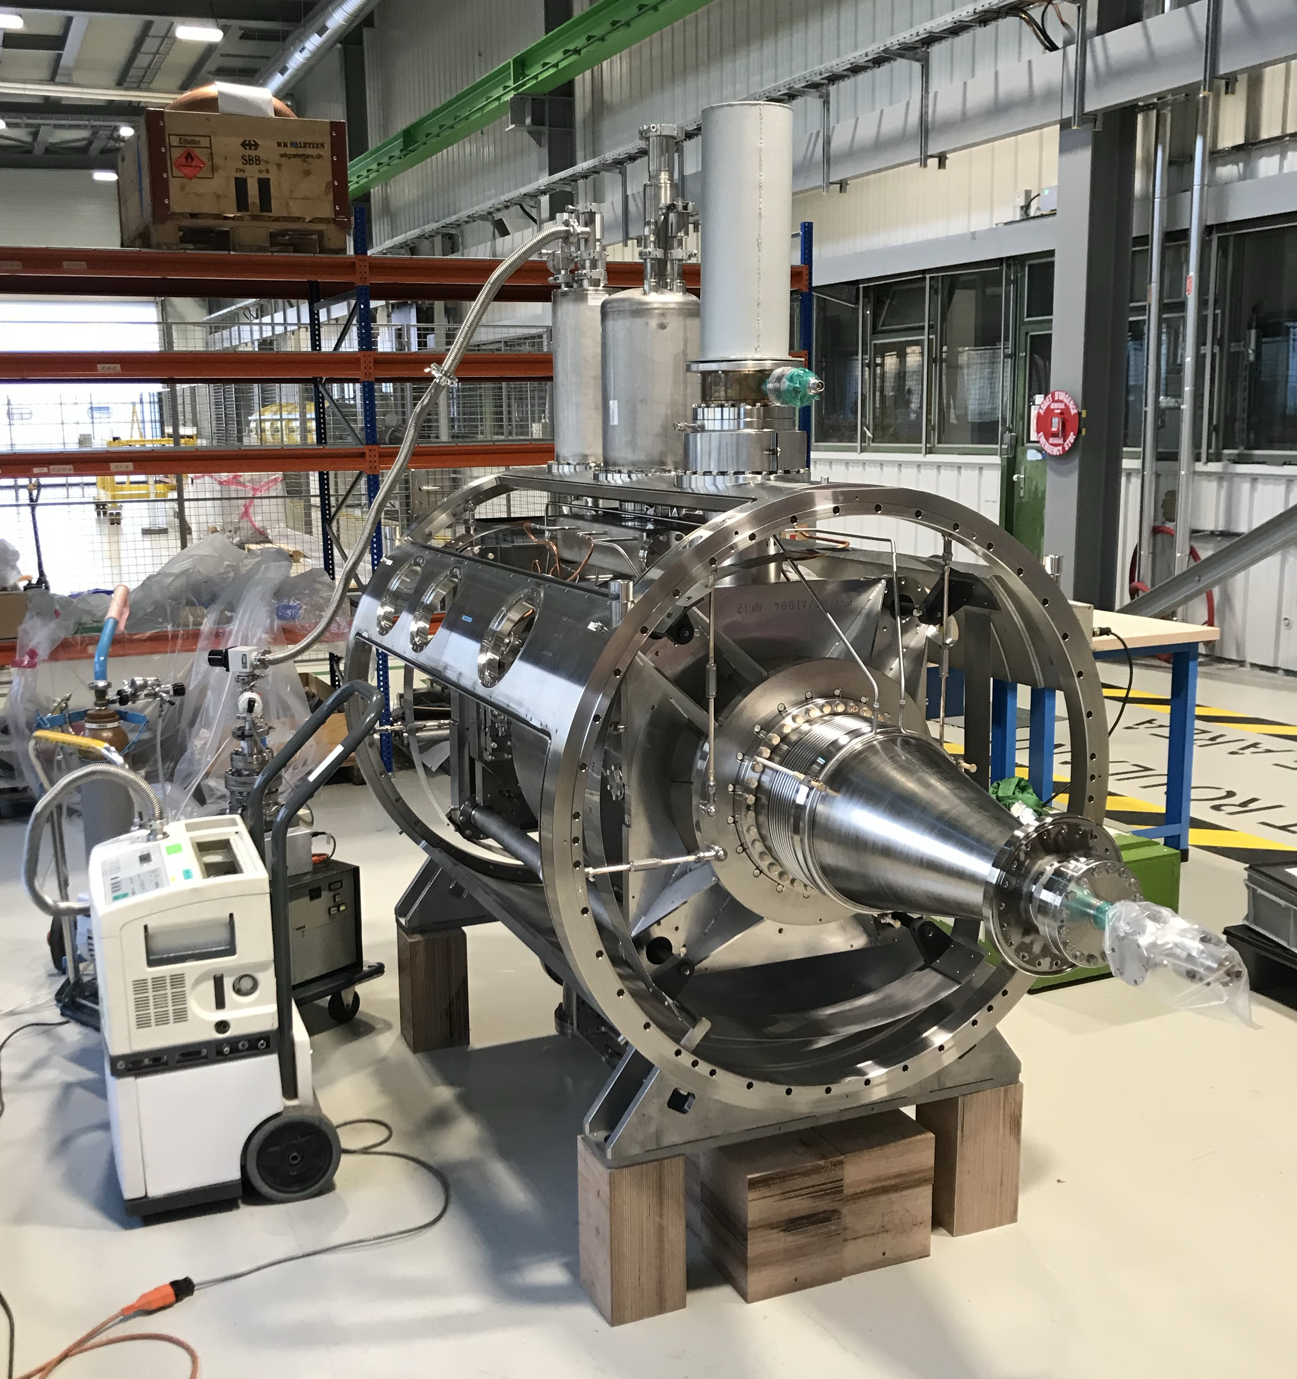
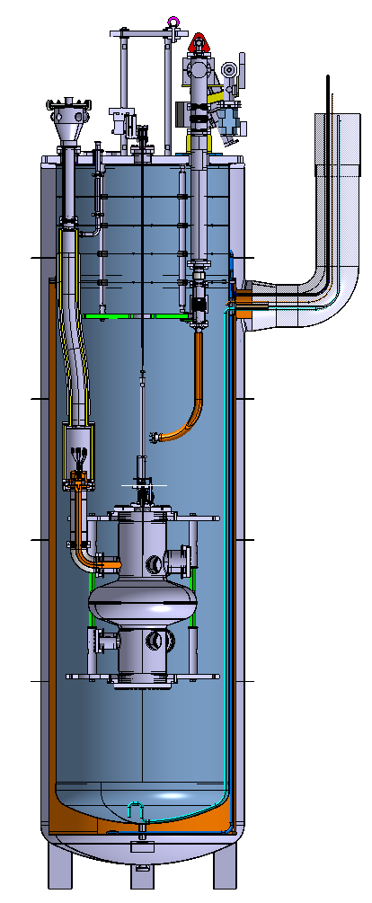
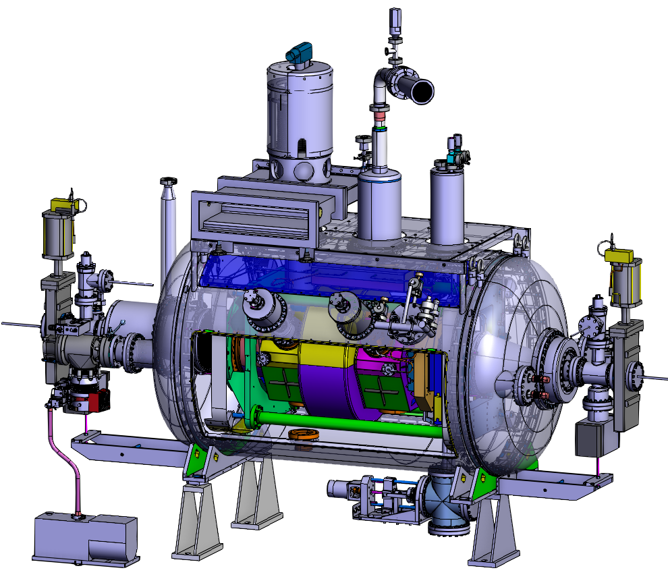
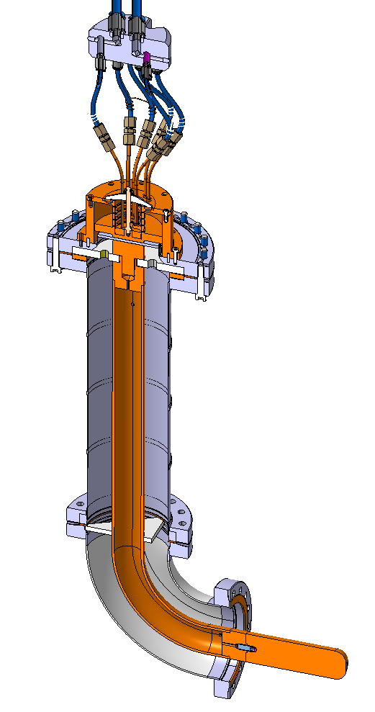
WP1: FE-FRT
HZB, CERN, CNRS, Uni.Lancaster
Convener: Axel Neumann (HZB), Nick Shipman
Main contacts with other partners: Alick Macpherson (CERN), Walid Kaabi (CNRS),
Graeme Burt (Uni.Lanc.)
Infrastructure for testing and cavities for FE-FRT development
LHC ¼ cryo-module
2-cell 1.3 GHz
TDD
V3 SM18 setup
Horizontal cavity teststand
HoBiCaT, small vertical teststand
bERLinPro
2-cell and nine-cell SRF cavities
TDD1
protoytpe
bERLinPro
LHC ¼ cryo-module

Slide 9
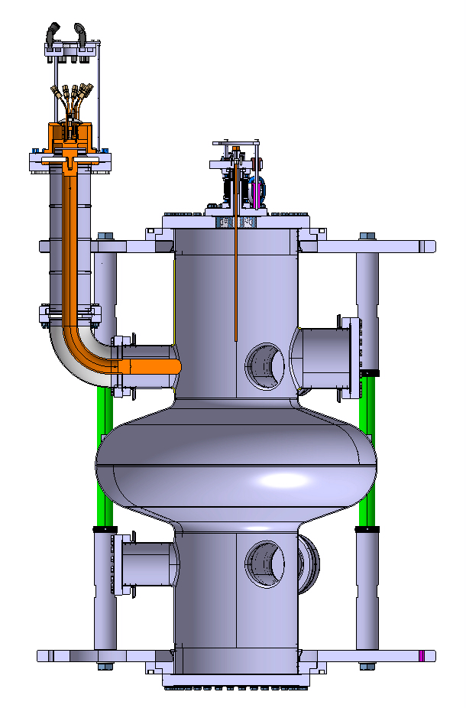
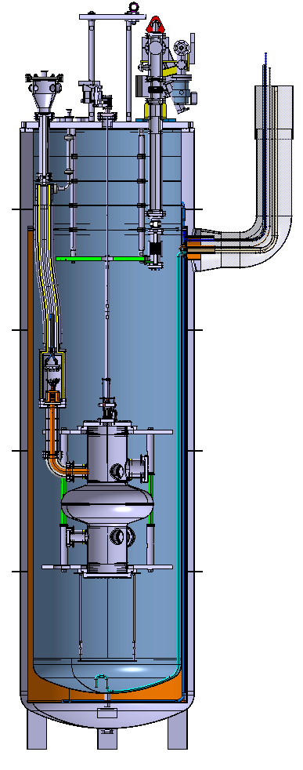
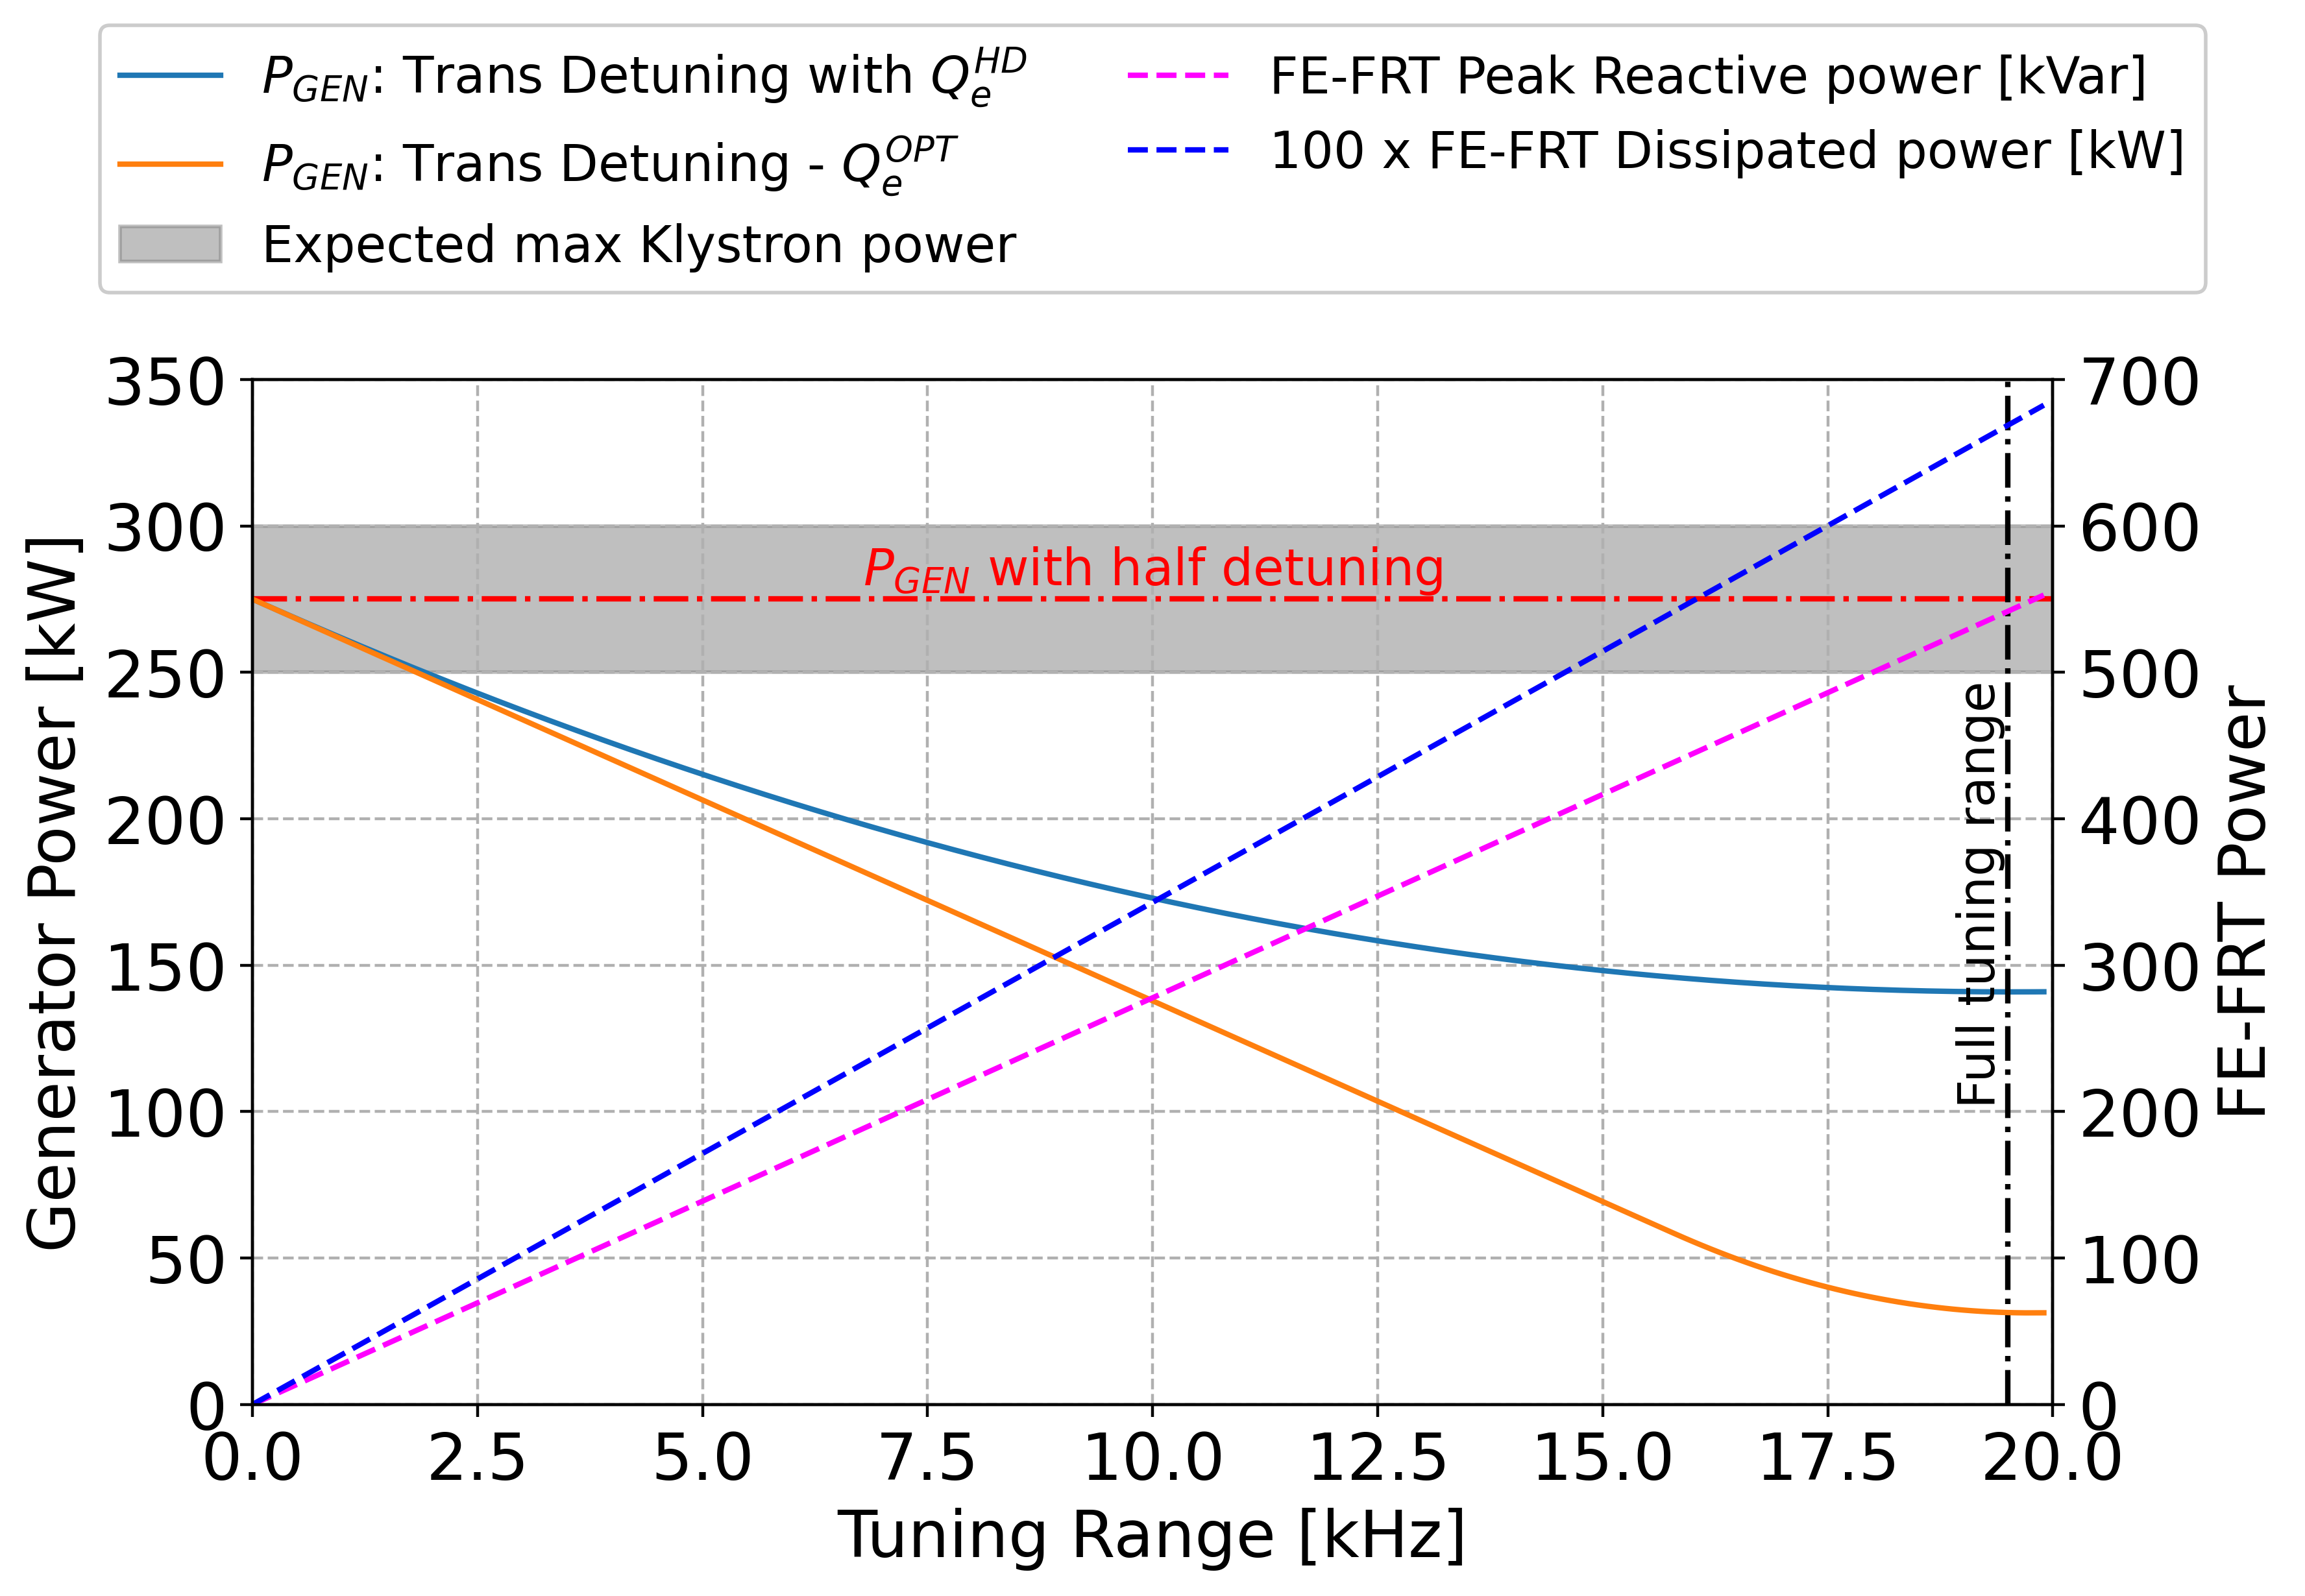
WP1 – FE-FRT: status/evolution of Task 1.2
Motivation for Task 1.2: HL-LHC injection, lack of RF power to capture full beam, FE-FRT as backup solution
to reduce required RF power
Retro-fit FE-FRT into LHC cryo-module (1/4 module) to demonstrate at least partial transient detuning
WP1 will join with existing CERN program, thus iSAS strengthens the push for TD development at CERN
Interim step to validate new stacked design with bare LHC cavity in VTS test
FE-FRT
Available
volume
Validation Configuration:
Bare LHC cavity with tuner

Slide 10
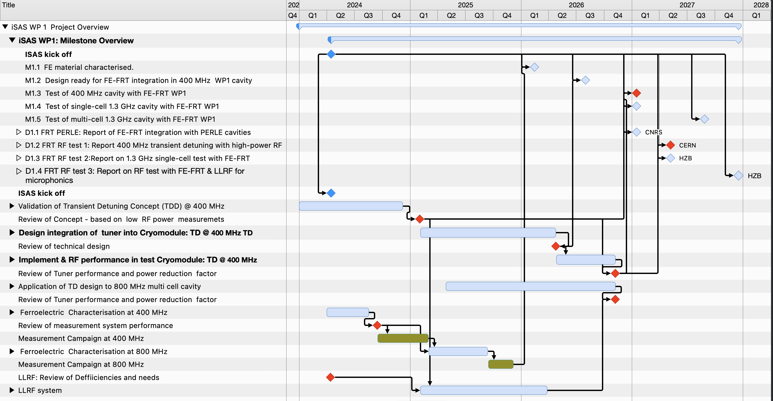
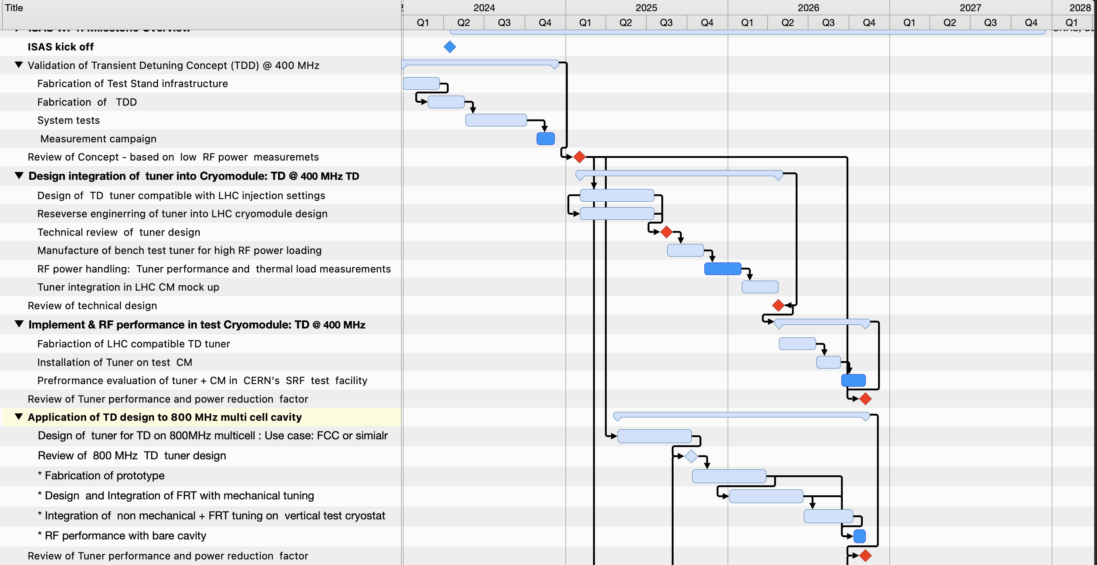
WP1 – FE-FRT: status/evolution of Task 1.2
iSAS milestones
A schedule and workplan has been developed
→ internal milestones beyond iSAS planning
were identified and thus put in place
Task 1.2 has a limited time frame and mainly
spans only the first three years of iSAS
Especially the later work on an 800 MHz
TD design for FCC use case or similar
depends on CERN in-kind infrastructure
and resources availability
1/4 CM - LHC cavity
Internal milestones
= RF Test
Dependent on availability of in-kind infrastructure & resources => TBC

Slide 11
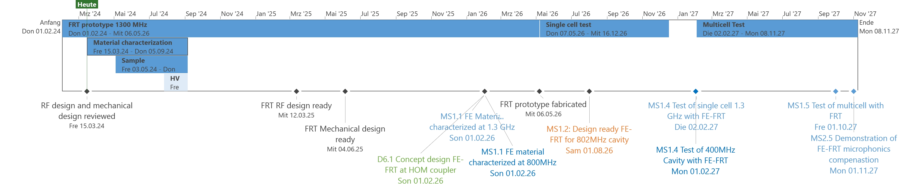
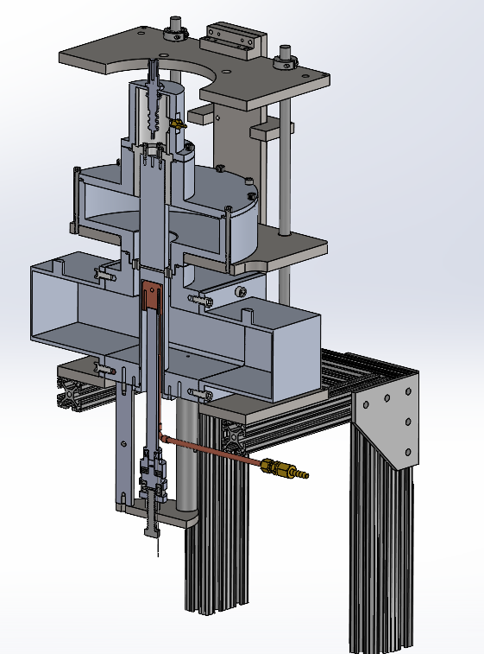
WP1 – FE-FRT: status/evolution of Task 1.3
*
Internal milestones
Testcase: Adapt for simplicity FRT to beamtube port in horizontal
test setup (2-cell and 9-cell 1300 MHz cavities)
Ceramics teststand
Above a summarized timeline for task 1.3. So far no issues are observed and we can stick to the proposed
schedule. The work has been already planned in more detail and new partners identified for some aspects.
HZB (1.3) already started to procure together with Euclid a ceramics characterization teststand for 1.3 GHz and
also has started the RF designs of the FE-FRT vs. microphonics
HZB is also done with hiring personnel for the FE-FRT studies (1 scientist, Nick Shipman)
→ first RF design for microphonics compensation was started together with mechanical integration
HV breakdown tests planned together with task 1.2 at CERN using the infrastructure of W. Wuensch et al.
*I. Profatilova et al., Breakdown localisation in a pulsed DC electrode system,
NIM A, Vol. 953, 2020,163079,

Slide 12
WP1 – FE-FRT: status/evolution of Task 1.4
Task 1.4: FE-FRT in Energy-Recovery LINAC (ERL) mode – M1-M48 (CNRS)
• End-group design study for integration into ERL-type cavity, study HOM+BBU properties.
• FE-FRT design study for RF and mechanical integration into upgraded ERL cavity.
Task 1.4 does not receive any additional funds from iSAS. This task is closely interlinked to WP5 and
by that can also act as a kind of liaison of WP1 within WP5.
Whereas many experimental studies of WP1 can be used to create guidelines for the two given main
topics of task 1.4, task 1.2, 1.3 can both profit from the HOM and BBU studies of implementing another
port with an FE-FRT into a high current cavity design, as for ERLs or future LHC, FCC applications.
The work of task 1.4 can start independently of all the other tasks, but we plan to have strong involvement
and participation of personnel from 1.4 into the work done with the other tasks.

Slide 13
WP1 – FE-FRT: links with Task 6.2
Task 6.2 will study harmonic power generation in FE-FRT which may drive BBU, the effect of HOMs on FE-FRT, develop modelling tools to simulate both, then use this to design an integrated HOM coupler/FE-FRT. Finally a study of heating of this FRT-HOM coupler will be assessed.
Study of harmonic generation within FE-FRT (M3-12)
Study of HOM effects on FE-FRT (M3-12)
Design of a frequency selective splitter to separate HOM and fundamental power and design of a HOM coupler (M13-20)
Study of heating (M20-26)
Advert for researcher will be released in March aiming to start early summer
Application for the HOM coupler has yet to be decided but will certainly be one of the FE-FRT applications being studies in WP1.2 or 1.3.

Slide 14
WP1 – FE-FRT: points of attention
Collaborations with other WPs and new partners
  There is a strong linkage between LLRF WP task 2.4
  WP 6 task 6.2 is a natural collaboration partner for all tasks of WP1, especially task 1.2 based on grown relationship in TD FE-FRT development over the past years
  High gradient RF group of W. Wuensch (CERN) may offer HV breakdown tests for FE ceramics
  JLab, group of A. Castilla in case of receiving funding for FE-FRT+FPC studies is granted
  The exchange with WP5 needs to be evaluated and eventually planning adapted
  A monthly meeting is foreseen between all WP 1 partners and external collabs
Risks:
  So far only one manufacturer of ceramics for FE-FRT (Euclid) identified, but is a project partner
  → Machining of ceramics for final design and assembly might be challenging to achieve
  Availability of SRF teststands, downtimes because of shutdown periods of the hosting laboratory
  Delays by problems with procuring material or equipment, increase of prices by inflation, more worldwide conflicts
New opportunities:
  New FE materials might improve the design and figure of merit and such performance of
  FE-FRTs in the future
  Some milestones of task 1.4 and task 6.2 seem to appear too early taking into account, that results of 1.2 and 1.3 might have impact on designs

Slide 15
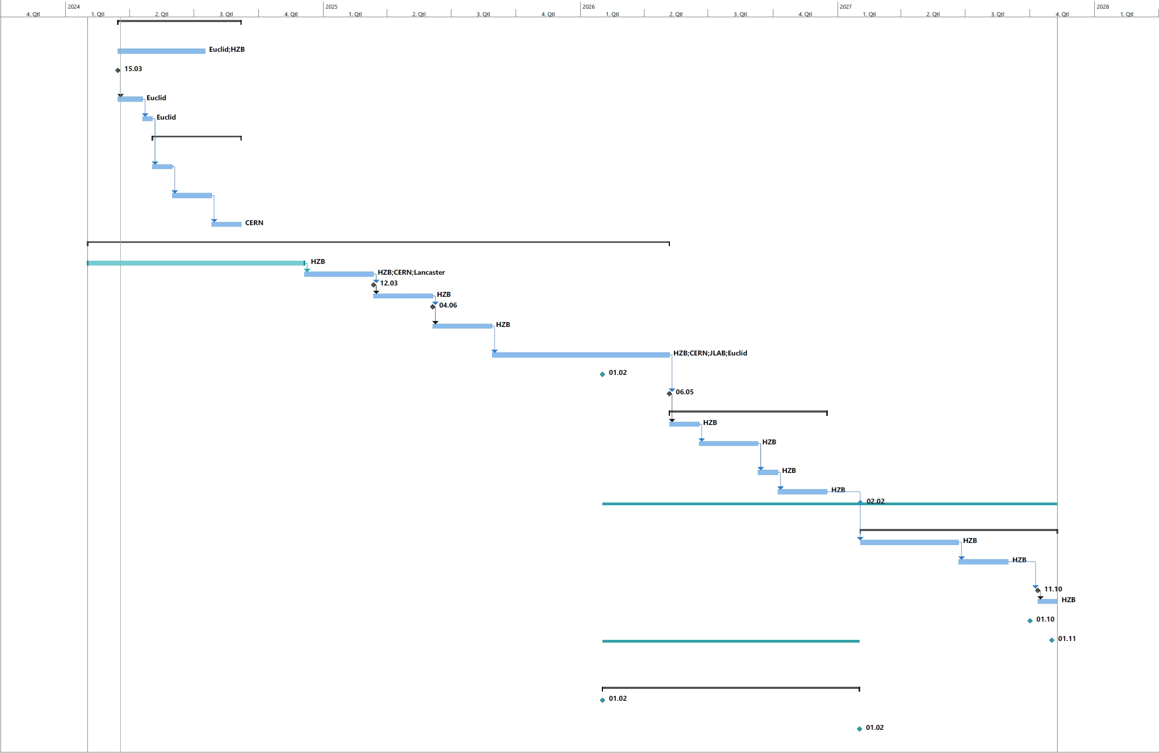
WP1 – FE-FRT: plans to achieve milestones & deliverables
Detailed work plans are being prepared, see e.g. plan for
task 1.2 and 1.3 with interlinkage to task 1.4 and 6.2
Work towards M1.1 has already started due to extra funds
available at HZB
There is a strong wish to interlink the various tasks by personnel
exchange between the labs, especially for attending measurement
campaigns, as e.g. for M1.4 (CERN, HZB)
M1.1 – Feb 26 – CERN – FE material characterised at 800MHz
M1.1 – Feb 26 – HZB – FE material characterised at 1.3GHz
D6.1 – Feb 26 – LU – Concept design of a combined FE-FRT-HOM coupler
M1.2 – Aug 26 – CNRS – Design ready for FE-FRT integration in 802 MHz cavity
M1.4 – Feb 27 – CERN – Test of 400MHz cavity with FE-FRT
M1.4 – Feb 27 – HZB – Test of single-cell 1.3 GHz cavity with FE-FRT
D1.1 – Feb 27 – CNRS – Report of FE-FRT integration with PERLE cavities
D1.3 – Jun 27 – HZB – Report on 1.3 GHz single-cell test with FE-FRT
M1.5 – Oct 27 – HZB – Test of multi-cell 1.3 GHz cavity with FE-FRT
M2.5 – Nov 27 – HZB – Demonstration of FE-FRT microphonics compensation
D1.2 – Feb 28 – CERN – Report 400 MHz high-power RF test (transient detuning)
D1.4 – Feb 28 – HZB – Report on RF test with FE-FRT & LLRF for microphonics
D2.4 – Feb 28 – HZB – Report on integration of FE-FRT in LLRF
Design studies at LU and CNRS
can be performed independently of
the results of task 1.2/1.3, but
discussions should take place to
include latest results into consideration
Results obtained by LU and CNRS
will also support final studies for
FE-FRT integration for a bERLinPro
Linac design and LH-LHC

Slide 16
WP1 – FE-FRT: plans to achieve milestones & deliverables
M5.1 – May 24 – In person WP Kick off meeting at ESS – ESS
M6.1 – Aug 25 – Configure ESS CM to host optimized HOM and FPC – CNRS
M1.1 – Feb 26 – FE material characterised at 800MHz – CERN
M1.1 – Feb 26 – FE material characterised at 1.3GHz – HZB
D5.1 – Feb 26 – Compilation of ESS CM, lessons learned & benchmarks – CERN
D6.1 – Feb 26 – Concept design of a combined FE-FRT-HOM coupler – Lancaster
WP1 within the global
iSAS picture:
WP1 should also be
involved in some of the
design studies performed
within WP5
Eventually CNRS would
be the natural link, as
they participate in WP1
and are present in WP5
M1.2 – Aug 26 – CNRS – Design ready for FE-FRT integration in 802 MHz cavity
M6.2 – Aug 26 – INFN – Validation of all SRF components for adapted CM
M1.4 – Feb 27 – CERN – Test of 400MHz cavity with FE-FRT
M1.4 – Feb 27 – HZB – Test of single-cell 1.3 GHz cavity with FE-FRT
D1.1 – Feb 27 – CNRS – Report of FE-FRT integration with PERLE cavities
D5.2 – Feb 27 – CERN – Roadmap for the CM design
M6.3 – May 27 – CEA – Assembly of adapted CM
D1.3 – Jun 27 – HZB – Report on 1.3 GHz single-cell test with FE-FRT
M1.5 – Oct 27 – HZB – Test of multi-cell 1.3 GHz cavity with FE-FRT
M2.5 – Nov 27 – HZB – Demonstration of FE-FRT microphonics compensation
D1.2 – Feb 28 – CERN – Report 400 MHz high-power RF test (transient detuning)
D1.4 – Feb 28 – HZB – Report on RF test with FE-FRT & LLRF for microphonics
D2.4 – Feb 28 – HZB – Report on integration of FE-FRT in LLRF
D5.3 – Feb 28 – CNRS – Parametric design for a sustainable CM with iSAS techn
D6.2 – Feb 28 – INFN – Report on test of adapted CM

Slide 17
WP1 – FE-FRT: budget plans
Budget related to hired personnel is within plans so far
Two labs are only receiving budget for this WP1: CERN and HZB for tasks 1.2 and 1.3 respectively
Both labs roughly assumed 50% matching budget for personnel (already given personnel at labs involved
with the project) and 50% matching budget for consumables and equipment.
Those plans need to be confirmed with the evolution of the lab’s budgets for the coming years.
Increasing costs and eventually shift of lab’s research focus due to new future budget constraints might
impact this project
HZB could already invest some budget from 2023 (60 k€) into the task 1.3

Slide 18
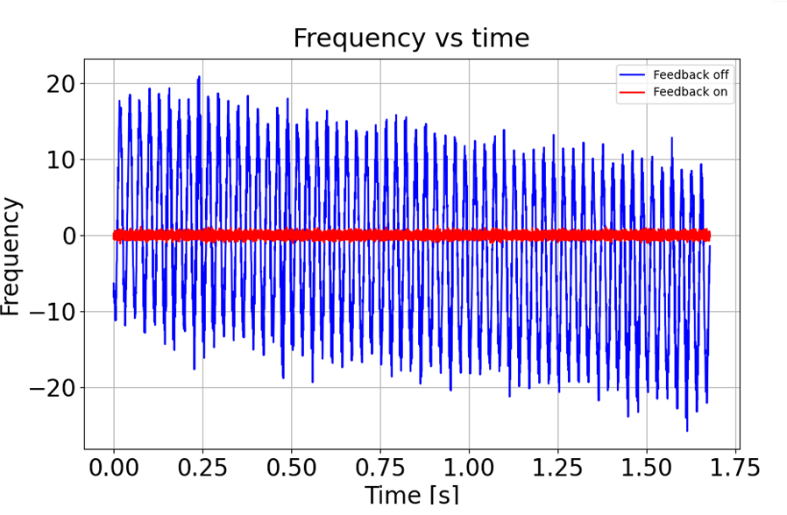
Summary
FE-FRT have the potential of unique auxiliary device allowing lower power consumption
by mitigating microphonics or beam-loading transients by variable beam patterns
In the framework of this work package, at least a prototype will be developed
and tested for both applications in the frequency regimes of 400 and 1300 MHz respectively
→ new potential applications have been identified in the meantime
Work has started already to some level and meetings took already place
A monthly meeting within the WP is envisaged, new partners have been identified
CERN is starting based on previous work and iSAS might help pushing this project more
Thanks to Nick Shipman,
Alick Macpherson and
Graeme Burt for their
contributions
The goal...
Courtesy N. Shipman

