Slide 1
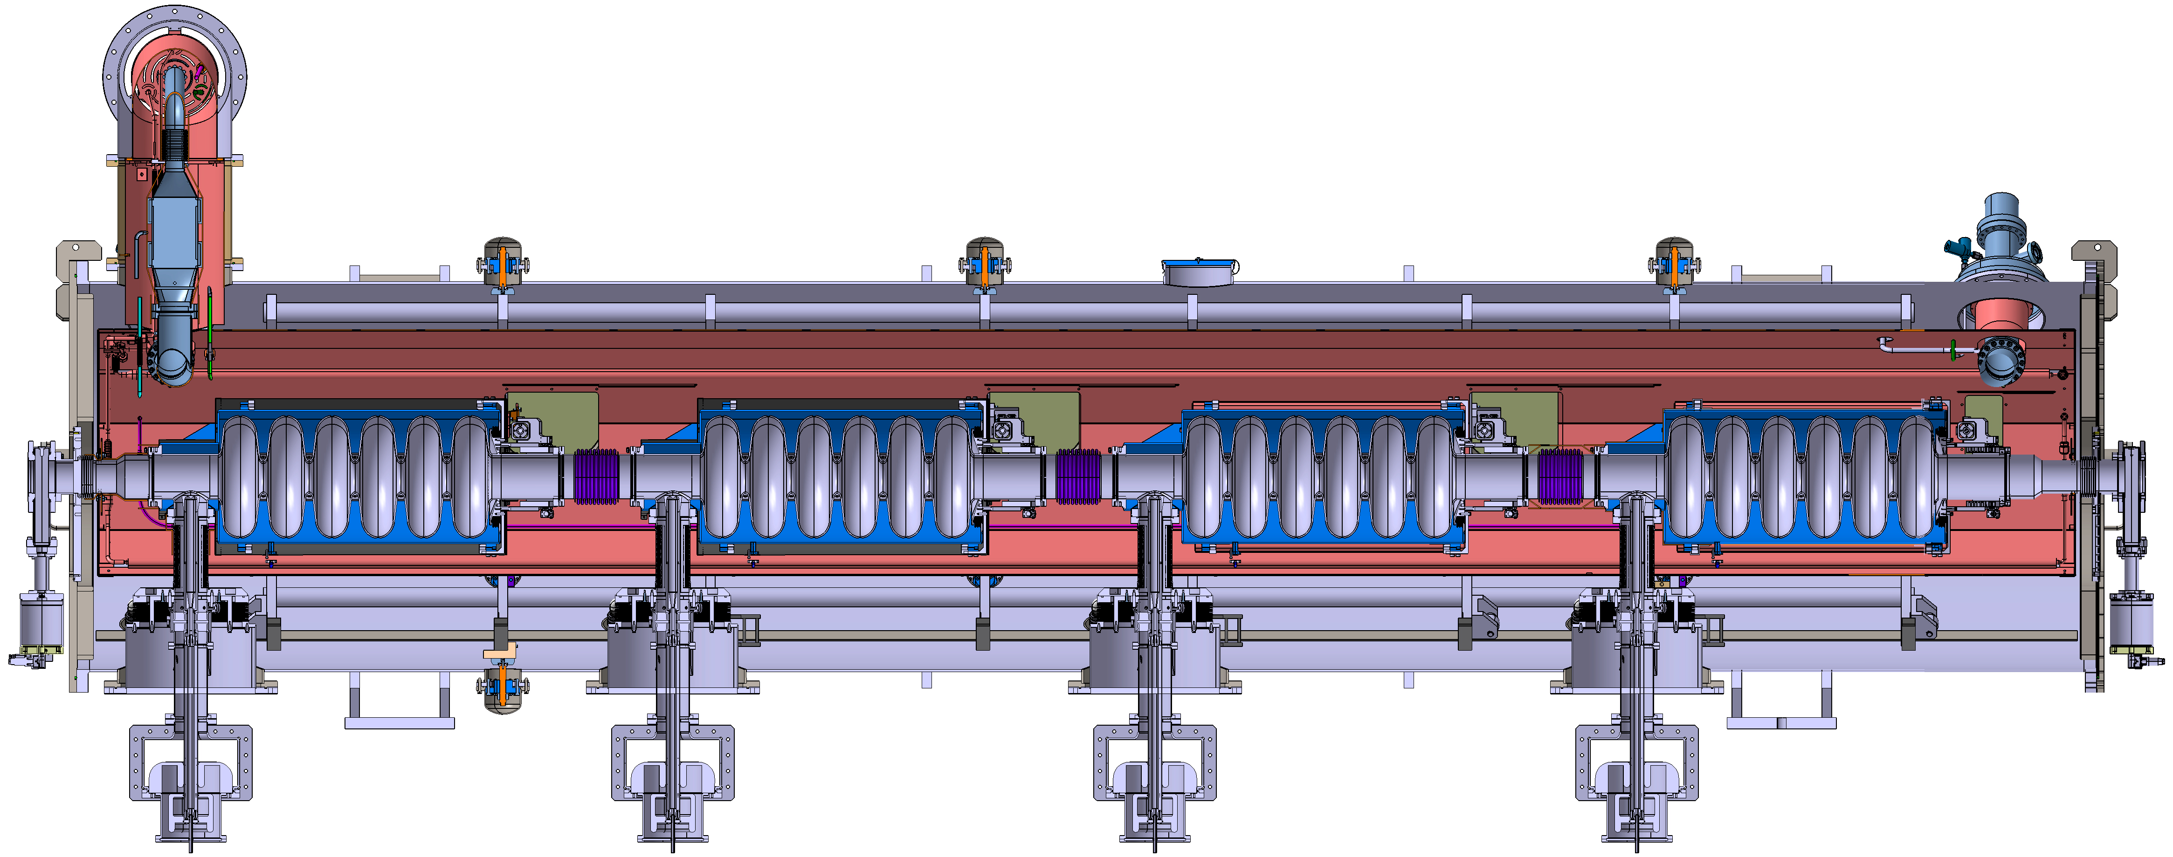
WP4
High-Order Mode dampers and
Fundamental Power couplers
CERN, INFN, CNRS
High Order Mode couplers
Sectional drawing of ESS Cryomodule
Courtesy Gilles Olivier
Fundamental Power couplers
1

Slide 2

WP4 - High-Order Mode (HOM) dampers and
Fundamental Power (FP) couplers
WP4 partners:
    CNRS
    LPSC: Yolanda Gómez Martínez (Convener)
    IJCLab: Patricia Duchesne (Main Contact)
    (Gilles Olivier, Guillaume Olry , Akira Miyazaki, Raphael Roux, Sébastien Blivet)
    CERN: Vittorio Parma (Main Contact),
    (Eric Montesinos, Marco Garlasche, Karin Canderan (6 pm temporary staff))
    INFN: Dario Giove (Main Contact)
    (30 pm temporary staff…)
  Strongly connected with WP6: Guillaume Olry (Main Contact)
  Connected to WP5: Nuno Elias (Main contact)
2

Slide 3
WP4 - High-Order Mode (HOM) dampers and
Fundamental Power (FP) couplers
CNRS, INFN Task 4.1: General coordination of WP4 M1-M48
.
INFN, CNRS, CERN Task 4.2: HOM coupler design M1-M18
CERN, CNRS, INFN Task 4.3: Fabrication of HOM couplers M15- M48** CNRS, INFN Task 4.4: Test of HOM couplers M20-M27
CERN, CNRS Task 4.5: FP coupler design M1-M16
CERN, CNRS Task 4.6: Fabrication of FP couplers M16-M27
CERN, CNRS Task 4.7: Test of FP couplers M24-M33
*including R&D on alternative manufacturing for large productions.
3

Slide 4
WP4 - High-Order Mode (HOM) dampers and
Fundamental Power (FP) couplers
H O M C | Frequency (MHz) | Design Task 4.2 INFN, CERN,CNRS | Manufacturing (qty) Task 4.3 CERN,CNRS,INFN | Test (qty) Task 4.4 CNRS, INFN
 | HOM@800 v1 to WP6 | At CNRS - IJClab | At CERN (4) | At CNRS – IJCLab (4)
 | HOM@800 v2 | At CERN | At CERN (tbd : depend on simulation results) | At CERN (tbd : depend on simulation results)
 | HOM@1300 | At INFN (1) | At CERN (1) | At INFN(1)
F P C | Frequency(MHz) | Design Task 4.5 CERN, CNRS | Manufacturing (qty) Task 4.6 CERN,CNRS | Test (qty) Task 4.7 CERN, CNRS
 | FP@800 MHz to WP6 | At CERN | At CERN (4) | At CERN(4)
4

Slide 5
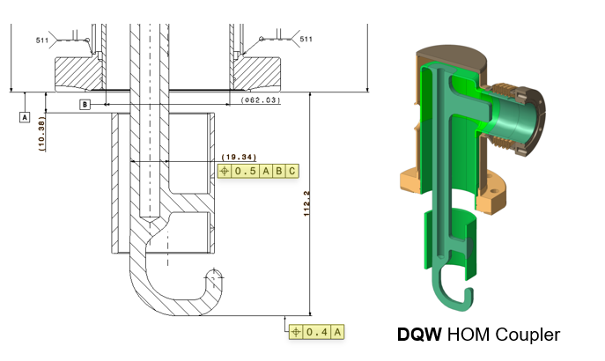
WP4 - HOM and FP couplers:
status/evolution of task 4.2 HOM coupler design
Beam dynamics simulations to determine the limits on HOM loss factors k_{loss}, crucial for evaluating the effect of perturbing modes.
Electromagnetic simulations of the standing wave multicell cavity, to identify the dangerous modes and determine the tolerable beam energy spread induced by HOMs.
Optimize the RF design of DQW, probe and hook models to the needs of high-current accelerators, including ERLs.
Optimization of the cooling scheme to extract the heat deposited due to HOM propagation and to minimize static and dynamic heat loads on the cryogenic circuits of the cryomodule → This study is an input for the WP5 (to the parametric study of the next-generation sustainable cryomodule)
Study of the mechanical integration of HOM couplers into the cryomodule.
→Delivery the 800 MHz HOM design coupler to WP6
HOM Coupler for Hi Lumi Crabs.
Courtesy Vittorio Parma
C.Barbagallo et al, LINAC2022.
First coaxial HOM coupleur prototypes for PERLE
5

Slide 6
WP4 - HOM and FP couplers:
status/evolution of task 4.2 HOM coupler design
Beam dynamics simulations to determine the limits on HOM loss factors k_{loss}, crucial for evaluating the effect of perturbing modes.
Electromagnetic simulations of the standing wave multicell cavity, to identify the dangerous modes and determine the tolerable beam energy spread induced by HOMs.
Optimize the RF design of DQW, probe and hook models to the needs of high-current accelerators, including ERLs.
Optimization of the cooling scheme to extract the heat deposited due to HOM propagation and to minimize static and dynamic heat loads on the cryogenic circuits of the cryomodule → This study is an input for the WP5 (to the parametric study of the next-generation sustainable cryomodule)
Study of the mechanical integration of HOM couplers into the cryomodule.
→Delivery the 800 MHz HOM design coupler to WP6
HOM Coupler for Hi Lumi Crabs provided by Vittorio Parma
No evolution.
Design of 800 MHz HOM coupler to be used in the WP 6 are on going (CNRS – IJCLab).
Not started for the others.
C.Barbagallo et al, LINAC2022.
First coaxial HOM coupleur prototypes for PERLE
6

Slide 7
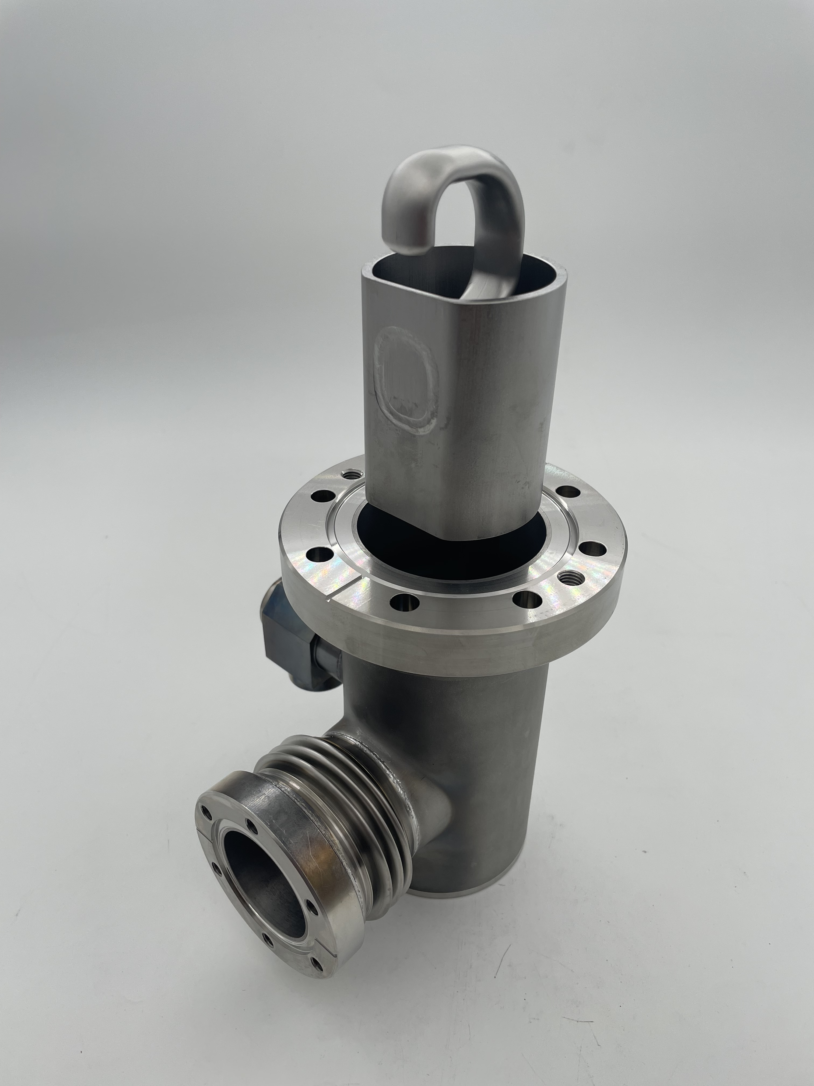
WP4 - HOM and FP couplers:
status/evolution of task 4.3
Fabrication of HOM couplers
At CERN :
  Manufacturing of 4 prototypes at 800 MHz for WP6 and one prototype at 1.3 GHz and to be defined at 800 MHz v2 employing cost and production-time reduction techniques.
  R&D on alternative manufacturing for large productions will be further pursued with for example:
    optimizing design to sustainability and manufacturability,
    exploring through the use of more standardized technologies for manufacturing, as opposed to some of the current fabrication solutions (effective in terms of RF performance, but demanding in terms of material and manufacturing equivalent energy).
    The rationalisation of raw material requirements and the implementation of alternative – more industrial – joining solutions will be key.
HiLumi HOM Coupler provided by the CERN
Probe, Hook and DQW HOM coupleurs for PERLE (from letft to right) C.Barbagallo et al,IPAC2023
7

Slide 8
WP4 - HOM and FP couplers:
status/evolution of task 4.3
Fabrication of HOM couplers
At CERN :
  Manufacturing of 4 prototypes at 800 MHz for WP6 and one prototype at 1.3 GHz and to be defined at 800 MHz v2 employing cost and production-time reduction techniques.
  R&D on alternative manufacturing for large productions will be further pursued with for example:
    optimizing design to sustainability and manufacturability,
    exploring through the use of more standardized technologies for manufacturing, as opposed to some of the current fabrication solutions (effective in terms of RF performance, but demanding in terms of material and manufacturing equivalent energy).
    The rationalisation of raw material requirements and the implementation of alternative – more industrial – joining solutions will be key.
HiLumi HOM Coupler provided by the CERN
No evolution.
Not started.
Probe, Hook and DQW HOM coupleurs for PERLE (from letft to right) C.Barbagallo et al,IPAC2023
7

Slide 9
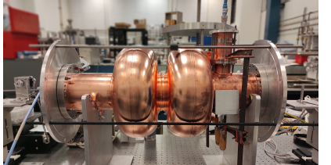
WP4 - HOM and FP couplers:
status/evolution of task 4.4
Test of HOM couplers
IJC Lab (800 MHz) and INFN (1,3 GHz)
  Validation of the design with:
    Low level RF measurements on optimized HOMs prototypes will be performed to evaluate and validate their RF performances.
    RF measurements at room temperature will be performed in dedicated test benches: on mono-cell and multi-cell 800 MHz and 1.3 GHz mock-up cavities. Several configurations of the end-group / HOM coupler combination will be tested to optimize parasitic mode extraction and to define the end group design for the two cavity frequencies being investigated.
  → Delivery of 4 HOM@800 MHz tested to WP6
First RF measurements of coaxial HOM prototypes for PERLE
C.Barbagallo et al,IPAC2023.
9

Slide 10
WP4 - HOM and FP couplers:
status/evolution of task 4.4
Test of HOM couplers
IJC Lab (800 MHz) and INFN (1,3 GHz)
  Validation of the design with:
    Low level RF measurements on optimized HOMs prototypes will be performed to evaluate and validate their RF performances.
    RF measurements at room temperature will be performed in dedicated test benches: on mono-cell and multi-cell 800 MHz and 1.3 GHz mock-up cavities. Several configurations of the end-group / HOM coupler combination will be tested to optimize parasitic mode extraction and to define the end group design for the two cavity frequencies being investigated.
  → Delivery of 4 HOM@800 MHz tested to WP6
First RF measurements of coaxial HOM prototypes for PERLE
C.Barbagallo et al,IPAC2023.
No evolution.
Not started.
10

Slide 11
WP4 - HOM and FP couplers:
status/evolution of task 4.5
FP coupler design
At CERN :
  Optimize the coupler design based on the initial RF design, with the goal to improve both cost and sustainability. → This study is an input for the WP5
  Thermal calculations to optimize cooling circuits and minimize static and dynamic heat loads. → This study is an input for the WP5
  Study of the mechanical integration of these FP Couplers into the prototype cryomodule.→ fully compatible to WP6
11

Slide 12
WP4 - HOM and FP couplers:
status/evolution of task 4.5
FP coupler design
At CERN :
  Optimize the coupler design based on the initial RF design, with the goal to improve both cost and sustainability. → This study is an input for the WP5
  Thermal calculations to optimize cooling circuits and minimize static and dynamic heat loads. → This study is an input for the WP5
  Study of the mechanical integration of these FP Couplers into the prototype cryomodule.→ fully compatible to WP6
No evolution.
Not started.
12

Slide 13
WP4 - HOM and FP couplers:
status/evolution of task 4.6
Fabrication of FP couplers
At CERN:
  Manufacturing 4 FP Couplers prototypes for WP6 while reducing the production costs, fabrication time and failures during the fabrication whenever possible.
  Alternative fabricating technologies will be evaluated such as new joining techniques or additive manufacturing of some complex parts with the possibility to integrate cooling circuits.
  The rescoping of some material requirements will be considered in order to lower the fabrication cost.
13

Slide 14
WP4 - HOM and FP couplers:
status/evolution of task 4.6
Fabrication of FP couplers
At CERN:
  Manufacturing 4 FP Couplers prototypes for WP6 while reducing the production costs, fabrication time and failures during the fabrication whenever possible.
  Alternative fabricating technologies will be evaluated such as new joining techniques or additive manufacturing of some complex parts with the possibility to integrate cooling circuits.
  The rescoping of some material requirements will be considered in order to lower the fabrication cost.
No evolution.
Not started.
14

Slide 15
WP4 - HOM and FP couplers:
status/evolution of task 4.7
Test of the FP couplers
At CERN:
  This task will perform the high-power tests of the 4 FP couplers.
    Preparation (To avoid any contamination and pollution that may cause subsequent dramatic damages up to the breakage during conditioning): Cleaning, ISO4 clean room assembly and baking.
    Validation of the design by RF conditioning test in CW mode.
    → Delivery of 4 MHz FPC to WP6 cryomodule.
15

Slide 16
WP4 - HOM and FP couplers:
status/evolution of task 4.7
Test of the FP couplers
At CERN:
  This task will perform the high-power tests of the 4 FP couplers.
    Preparation (To avoid any contamination and pollution that may cause subsequent dramatic damages up to the breakage during conditioning): Cleaning, ISO4 clean room assembly and baking.
    Validation of the design by RF conditioning test in CW mode.
    → Delivery of 4 HOM and 4 MHz FPC to WP6 cryomodule.
No evolution.
Not started.
16

Slide 17
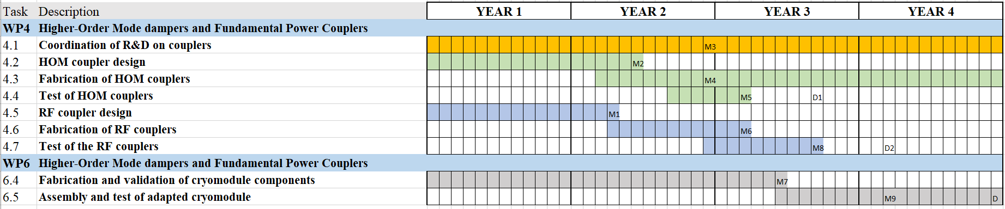
WP4 - HOM and FP couplers:
plans to achieve milestones & deliverables
1/03/2024
800 MHz HOM coupler design delivery to WP6.4
Delivery of 4 HOM dampers and 4 FPC to WP6.5
M1 Design report of FPC
M2 Design report of HOM coupler
M3 Coordination intermediary report
M4 Engineering report of the fabrication of HOM couplers
M5 Test report of HOM couplers
M6 Engineering report of the fabrication of FPCs
M7 Test report of FPC couplers
D1: Report qualification HOM couplers on cavities at 300 K (CNRS)
D2: Report on RF test of 800 MHz FPC at 50 kW (CERN)
17

Slide 18
WP4: HOM and FP couplers:
points of attention
Critical risks
WP4 is connected to the WP5 and most importantly the WP6 activities.
In case of any delay in the WP4‘s HOM 800 MHz or FP coupler may impact WP6.
Cost increase : Major components will be manufactured by iSAS partnes, additional matching funds will be covered by partners of the consortium.
18

Slide 19
Thank-you for your attention
19

