Slide 1

Innovate for Sustainable Accelerating Systems
Kick-off meeting _ 15&16 April 2024
WP6: Integration into Accelerator and Collider RIs
Guillaume Olry (CNRS/IJCLAB) on behalf of WP6 colleagues
guillaume.olry@ijclab.in2p3.fr

Slide 2
Main goal
→ implementation of energy saving technologies (HOM couplers, FE-FRTs, optimized cavities...) in an existing cryomodule to expedite the testing and validation of an integrated, energy-efficient system in an accelerator environment.
ESS prototype cryomodule

Slide 3
Innovate for Sustainable Accelerating Systems
WP6 partners (Main contact):
    CNRS: Guillaume Olry, Gilles Olivier, Sébastien Blivet, Patricia Duchesne, Patxi Duthil, Christophe Joly, Akira Miyazaki, Nicolas Gandolfo
    CEA: Arnaud Madur, ...
    ESS: Nuno Elias, Paolo Pierini, Cecilia Maiano, Henry Przybilski, Marek Skiba, 1 pers
    INFN: Dario Giove, Maria Rosaria Masullo, Luigi Celona, Gino Sorbello, Paolo Spruzzola
    Uni. Lancaster: Graeme Burt,
  Invited partners
    → Link with WP4: Vittorio Parma & Eric Montesinos (CERN) + Yolanda Gomez-Martinez (WP4 convener)
    → Link with WP1: Graeme Burt (UL) + Axel Neumann (WP1 convener)

Slide 4
WP6: Integration into Accelerator and Collider RIs
CNRS/IJCLAB, CEA, ESS, INFN, Lancaster University
Convener: Guillaume Olry (IJCLAB), deputy(ies) : ...
Task 6.1: Coordination – M1-M48
• General coordination by CNRS.
• Coordination with WP4 on HOM and RF couplers implementation into the cryomodule and WP1 on FE-FRT development.
Task 6.2: Retrofitting Fast Reactive Tuners into existing cryomodules – M1-M24
• Study of frequency domain multiplexor-based HOM coupler.
• Study the effect of HOMs on FE-FRT operation to define max leakage.
• Study the heating due to high fundamental power in the coupler.
Task 6.3: Adapt the existing ESS cryomodule – M1-M18
• Modifications of the existing ESS cryomodule based on feedback from assembly experience at CEA and testing experience at ESS.
• Integration of the HOM couplers and FPC (mechanical and cooling circuit interfaces).
• Study of the modifications of the existing tooling needed for the assembly.

Slide 5
WP6: Integration into Accelerator and Collider RIs
CNRS/IJCLAB, CEA, ESS, INFN, Lancaster University
Convener: Guillaume Olry (IJCLAB), deputy(ies) : ...
Task 6.4: Fabrication and validation of cryomodule components – M1-M30
• Fabrication of the critical components (SRF cavity, tuning systems, HOM couplers, ...) adapted to the existing ESS cryomodule.
• SRF cavities preparation and qualification test in a vertical cryostat.
• Preparation and qualification test of the tuning systems.
Task 6.5: Assembly and test of adapted cryomodule – M30-M48
• Clean room assembly of the cavity string and cryostating phase.
• Preparation of the test stand.
• Cryogenic and RF test of the cryomodule.

Slide 6
WP6 – task 6.1 Coordination : status/evolution
General coordination:
First meetings (27 and 29 March)
Set up regular meetings : Monthly (1-hour)
Coordination with WP1 and WP4:
Set up regular joint meetings (→ add a dedicated time slot during one of the WP6 monthly meetings) : 4 joint meetings / year.
Contact persons have been identified.
Main goals: exchange the latest general news, identify the key technical challenges which may impact the cost & planning and define mitigation scenarios

Slide 7
WP6 – task 6.2 Retrofitting FRTs: status/evolution
Status
Study of frequency domain multiplexor-based HOM coupler.
Not started
• Study the effect of HOMs on FE-FRT operation to define max leakage (also look at harmonic generation by the FRT).
Not started
• Study the heating due to high fundamental power in the coupler.
Not started
Evolution
Advert for a reseacher to replace Nick Shipman (not at HZB) is live, have an additional 10 months matching funds (now 24 months split across WP1 and WP6)
First year will be generic studies not for specific application,
After M12, we will decide to focus on either 1.3 GHz or 400 MHz (ERL or LHC)

Slide 8
WP6 – task 6.3 Adapt the existing ESS cryomodule : status/evolution
Status
• Modifications of the existing ESS cryomodule based on feedback from assembly experience at CEA and testing experience at ESS.
Started
1st visit at CEA/Saclay (March 22).
• Integration of the HOM couplers and FPC (mechanical and cooling circuit interfaces).
Started
→ In progress: study of the mechanical integration of some critical components (cavities and HOM couplers → link to WP4)
• Study of the modifications of the existing tooling needed for the assembly.
Not started
Evolution
Integration of beam line absorbers needed into the cryomodule (between cavities). Recent discussion with ACS (last Friday!): PhD student (3 years)on this subject from Oct 1st 2024.

Slide 9
WP6 – Task 6.4: Fabrication and validation of cryomodule components : status/evolution
Status
• Fabrication of the critical components (SRF cavity, tuning systems, HOM couplers, ...) adapted to the existing ESS cryomodule.
Started
In progress: Technical specifications for the Niobium material and the cavities
Not started
Technical specs for HOM couplers and FPC (→linked to WP4), tuning systems.
• SRF cavities preparation and qualification test in a vertical cryostat.
Started
First technical meeting on cavity preparation (heat treatment? Mid-T/low-T baking) with international experts on March 28.
• Preparation and qualification test of the tuning systems.
Not started
Evolution

Slide 10
WP6 – Task 6.5: Assembly and test of adapted cryomodule : status/evolution
Status
• Clean room assembly of the cavity string and cryostating phase.
Not started
• Preparation of the test stand.
Not started
• Cryogenic and RF test of the cryomodule.
Not started
Evolution

Slide 11
WP6: points of attention
Establish and maintain a close collaboration with WP1 and WP4.
  WP1 tasks 1.2 and 1.4
  WP4: all tasks
Need of beam line absorbers into the cryomodule → may impact the task 6.3 (cost and schedule)
Cavity preparation to achieve high performances (Qo3E10 @ 22MV/m): recipe not yet defined. Time needed to validate this recipe: unknown → may impact task 6.4 (cost and schedule)
Cost increase of some key components already observed (Nb and cavity fabrication...). What about more standard components? (HOM couplers fabrication...)

Slide 12
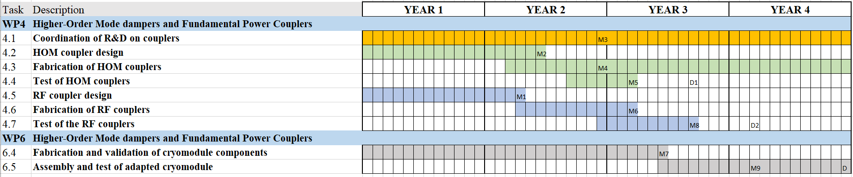
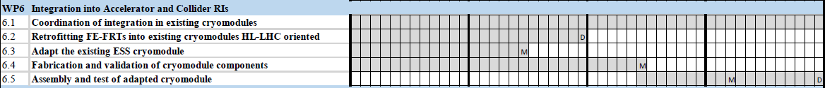
WP6 : plans to achieve milestones & deliverables
Planning
Milestones
Deliverables

Slide 13
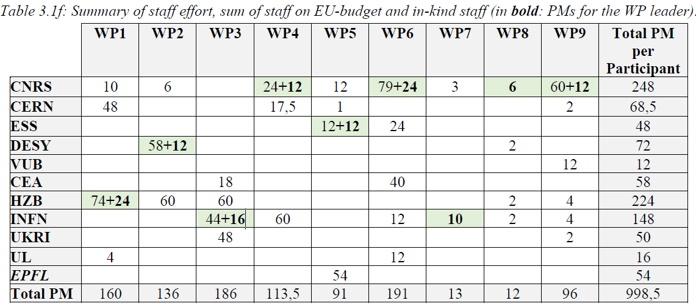
WP6: Staff

Slide 14
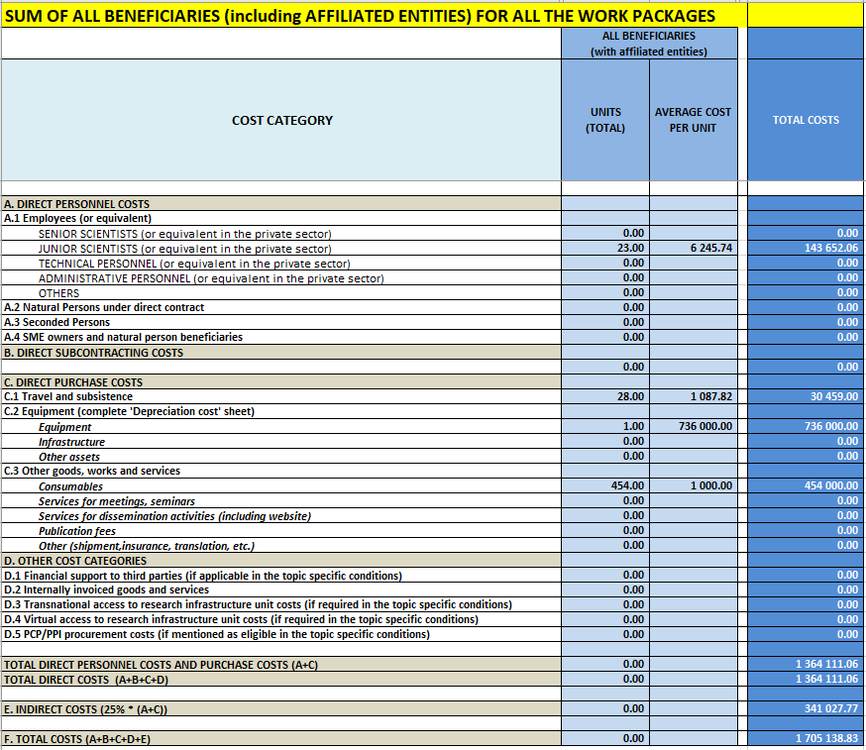
WP6 : budget plans
    CNRS: 736k€ (CM adaptation + cavity string fab) + 2k€ (travels) + 1M€ matching funds (CM adapt. + cavity string fab)
    CEA: 250k€ (CM assembly + tooling) + 2k€ (travels)
    ESS: 100k€ (CM test) + 22k€ (travels) + 75k€ (personnel cost 12 months) + 800k€ matching funds (in-kind : CM vessel)
    INFN: 104k€ (cavity tests) + 2k€ (travels) + matching funds (for cavity tests)
    Uni. Lancaster: 68.6k€ (personnel cost 11 months) + matching funds (for additional 10 months) + 2.5k€ (travels)

