Slide 1
Giorgio Keppel
Oscar Azzolini
innovate for Sustainable Accelerating Systems
WP7
Integration into Industrial Solutions
Kick-off meeting
IJCLab - 15-16 April 2024

Slide 2
Motivation
2021 accelerator market estimated 2.4 B$/y
Range of applications:
particle physics, nuclear physics, light sources
compact FELs for semiconductors photolithography
high-power lasers
accelerators for isotope production, medical sterilization without ⁶⁰Co
compact systems for food industry
wastewater and sludge treatments
40.000 accelerators operating around the world from MeV to TeV
Market growing 10% year

Slide 3
Motivation
Benefit from the high-average power beams of SRF systems
Cost effective and energy efficient
1000-kW beam power (at 10 MeV) for a 5.1M$ compared to 560-kW beam power of commercial IBA RF-based Rhodotron (at 7 MeV) for a 8M$ -> 14.3 M€

Slide 4
Goal of WP7
Objective of iSAS is to plan for concrete co-developments with industry to expedite reaching a TRL sufficiently advanced towards largescale deployment of the new energy-saving solutions at current and future Research Institutions
Main GOAL: develop demonstrators with a higher degree of readiness for industrialization

Slide 5
Goal of WP7
Ambition of iSAS is to develop solutions by research institutions and industry working together collaboratively right from the start
The objective is to optimally match the highest technical energy-saving performance to the manufacturability, including cost and reliability parameters. In addition, the co-developments can unlock new opportunities for European industry

Slide 6
WP7 Objective
Improvements in four key areas of high-power SRF accelerators:
RF power generation
RF power use for cavity operation
Cryogenics
Beam-energy efficiency
Involvement of companies from early stages of the project
Validate the technologies by bringing the state-of-the-art to a TRL 4 to 5 or higher, depending on the iSAS technology
Notes:
TRL 4 (full validation in the laboratory)
TRL 5 (full validation in relevant environment)

Slide 7
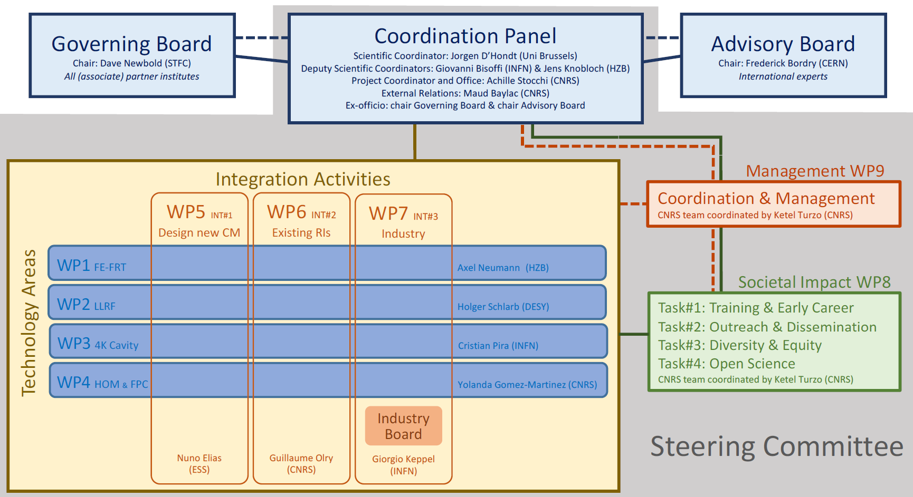
iSAS Organisation

Slide 8
WP7 Structure
Task 7.1: Coordination with industry and Dissemination – M1-M48
Task 7.2: Relations with industries – M1-M48
Task 7.3: Business opportunities – M24-M48

Slide 9
WP7.1 Coordination with industry and Dissemination
General coordination (INFN)
Integrate and update the iSAS website -> section on industrial aspects
Organize iSAS industrial workshops and online meetings with industrial partners
M1-M48

Slide 10
Actions WP7.1
iSAS Industrial section Web site (WP9 interaction)
Database of Industries interacting with iSAS project
Database of the active competences of the iSAS project
Industrial Outreach' section where short videos and presentations produced by individual WPs will be uploaded
Organize 2 industrial workshops linked to iSAS general meetings (12 and 36 months)
M1-M48
Notes:
The aim of the first workshop is to
involve companies in R&D activities from the start, to illustrate the project objectives, to discuss possible difficulties
in industrialisation and to find collaboration partners. The second workshop will be an initiative to communicate and
promote to key stakeholders the technological leap realised by the iSAS project and the industry contributions in iSAS
activities. This activity of the task will be part of the outreach strategy defined in collaboration with WP9.

Slide 11
WP7.2 Relations with industries
Establish and coordinate the activities of the iSAS Industry Board (IB)
Involve companies from the earliest stages of R&D (engagement in low TRL developments)
Promote Knowledge Transfer to industry to stimulate creation of new shared IPs
M1-M48

Slide 12
Actions WP7.2
Goal of IB:
Organize design reviews of specific WPs to optimize the prototype design toward industrialization
Review panel composed by academic and industry experts to facilitate the industrialization of the prototype
Maximize the impact of industrial participation and improving Europe's competitiveness
Stimulate Knowledge and Theology Transfer, encourage new shared IPs. Coordination with the local Knowledge Transfer offices
Report on the activity and actions taken over the year
M1-M48

Slide 13
Actions WP7.2
Industry Board (IB) established in 6 months from now (aprox. 15 people)
WP leaders
representatives of associate companies in key accelerator business
Technology Transfer (TT) offices at RIs. Who believe in the value of the collaboration between industries and Ris
Selected to ensure a balanced representation in term of geography and company size
M1-M48

Slide 14
WP7.3 Business opportunities
Disseminate the developed iSAS technologies
Create an iSAS project repository
Create new business opportunities, spin-offs, etc.
M24-M48

Slide 15
Action WP7.3
Dissemination of iSAS technologies
Newsletter
Workshop
B2B meeting
….
Definition of TRL for each technologies
Production of demonstrator in synergy with industries
Creation of a project repository
M24-M48

Slide 16
WP7 Timeline
D7.1 Industry Website -Website, patent filings, videos, etc WebSite M10 - INFN
D7.2 Report from Industry Board - Report M46 - INFN
D7.3 Report on actions to maximise business opportunities - Report M46 - INFN
IW1 Industrial Workshop 1 y INFN
IW2 Industrial Workshop 3y INFN
today
D7.1
IW1
IW2
D7.2
D7.3
Y0
Y1
Y2
Y3
Y4
2024 | 2025 | 2026 | 2027 | 2028
M | A | M | J | J | A | S | O | N | D | J | F | M | A | M | J | J | A | S | O | N | D | J | F | M | A | M | J | J | A | S | O | N | D | J | F | M | A | M | J | J | A | S | O | N | D | J | F
Task 7.1 – Coordination with industry and Dissemination
Task 7.2 – Relations with industries
Task 7.3 – Business opportunities

Slide 17
WP7 Budget
Cost Category | Total Cost (k€)
Travel and Subsistence | 32
Direct subcontracting cost | 2
Services for dissemination activities (website) | 6

Slide 18
Conclusion
We rely greatly on collaboration given the transversality of WP7
We count on everyone's help to nominate the IB
we hope for a great cooperation of the companies participating in the consortium to foster KT between RIs and companies

Slide 19
Thank you…

