Slide 1
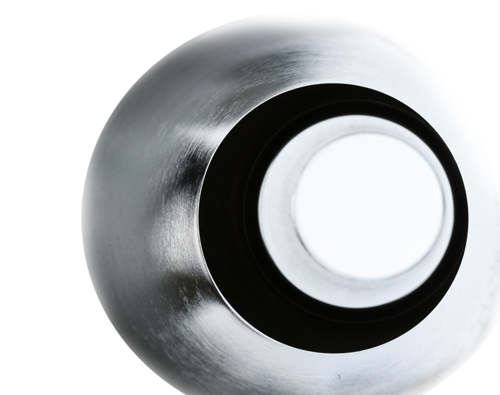
Cristian Pira
innovate for Sustainable Accelerating Systems
WP3
Nb₃Sn on Cu films for 4.2K cavity operation
Remarks from Parallel Meeting
Paris, 16 April 2024
This project has received funding from the European Union’s Horizon-INFRA-2023-TECH-01 under GA No 101131435 - iSAS

Slide 2
WP3 Structure
Task 3.1: Coordination of R&D on SC cavities
Task 3.2: Flux trapping
Task 3.3: RF Tunability
Task 3.4: Adaptative layers
Task 3.5: Working Cavity @4.2 K

Slide 3
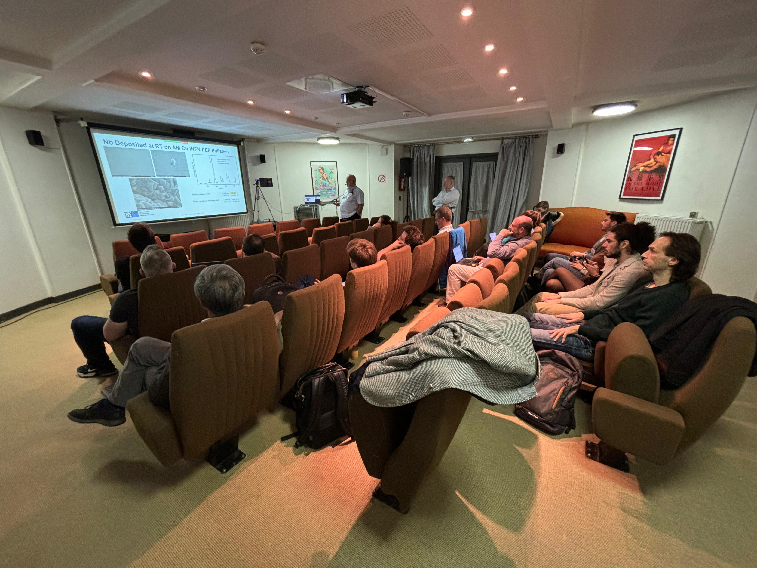
Parallel WP3 Meeting in Sinergy with iFAST WP9 in Paris
20 in presence participants
4 remote participants
90 minutes discussion fully focused on iSAS (1 hour in the opening session + 30 minutes in the afternoon)
Results and discussion on ISAS also during iFAST presentations
The Meeting is still in progress (end at 6 pm)
https://indico.cern.ch/event/1357302/timetable/#20240416.detailed

Slide 4
Status of Technical Tasks
3.2 Status (Flux Trapping):
UKRI and HZB: start to do update their facilities to implementing magnetic flux probes (commissioning phase)
3.3 Status (RF Tunability):
CEA: Preparing protocol for mechanical properties test on Nb3Sn coatings
UKRI and INFN: Coating systems ready for first planar samples deposition
HZB: Design Cavity Tuner System in progress
3.4 Status (Adaptive Layers):
CEA: ALD coating system ready. Waiting Cu substrates from INFN and STFC
UKRI and INFN: Coating systems ready for first planar sample deposition. Substrate polishing in progress
3.5 Status (Working Cavity @4.2 K):
UKRI and INFN: 1.3 GHz Coating systems in the commissioning phase (part of the I.FAST program)

Slide 5
WP3 Timeline
M3.1 Modification of choke cavity for flux trapping study - Engineering report M12
M3.2 Developed ALD adaptive layers on Cu - Engineering report M24
M3.3 Report on mechanical strength test of SC coatings - Test report M30
M3.4 Characterization of Nb₃Sn reference cavity - Test report M34
D3.1 Cavity tuning Report on implementation of cavity Q vs F tuning tool - Report M24 - HZB
D3.2 Flux trapping Report on flux dynamics study in Nb3Sn on Cu samples - Report M30 - HZB
D3.3 Adapt. Layer Report on QPR study of Nb₃Sn on Cu & adaptive layers - Report M38 - CEA
D3.4 4.5-K Cavity Report on 4.5-K Cavity performance & tunability tests - Report M46 - INFN
today
M3.1
M3.2
D3.1
M3.3
D3.2
M3.4
D3.3
D3.4
Y0
Y1
Y2
Y3
Y4
2024 | 2025 | 2026 | 2027 | 2028
M | A | M | J | J | A | S | O | N | D | J | F | M | A | M | J | J | A | S | O | N | D | J | F | M | A | M | J | J | A | S | O | N | D | J | F | M | A | M | J | J | A | S | O | N | D | J | F
Task 3.1 - Coordination
Task 3.2 – Flux Trapping
Task 3.3 – RF Tunability
Task 3.4 – Adaptive Layers
Task 3.5 – Working Cavity @4.2K

Slide 6
Point of attention
Synergy with I.FAST partners at least until 31/12/2025 (I.FAST extension requested)
Nb₃Sn R&D on I.FAST showed the need for an adaptive layer on top of the copper substrate to optimize the lattice parameter of the superconductive Nb₃Sn film that is growing on the substrate in order to maximize the Tc value. Currently, an Nb layer thicker than 30 microns is used for this purpose.
ISAS Task 3.4 gains more importance because, in addition to looking for an adaptive layer via ALD that optimizes the mechanical properties, we will also look for the possibility of replacing the thick Nb layer with an ALD layer that optimizes the lattice parameter of the Nb₃Sn coating and thus maximizes the Tc.
In the grant agreement encountered an error in assigning deliverables (probably occurred during the task numbering change):
Deliverable 3.4 is in charge of CEA and not UKRI

Slide 7
Conclusions
All the partners already start to work on the project
First results on QPR are encouraging
No back stoppers at the moment

Slide 8
cristian.pira@lnl.infn.it
Thank You!
This project has received funding from the European Union’s Horizon-INFRA-2023-TECH-01 under GA No 101131435 - iSAS

