Slide 1
EICROC0 Meeting
06/02/2024
S. CONFORTI DI LORENZO
A. VERPLANCKE
OMEGA microelectronics group
Ecole Polytechnique & CNRS IN2P3
conforti@omega.in2p3.fr
verplancke@omega.in2p3.fr
Notes:
I will talk about SPACIROC asic
SPACIROC stands for Spatial…….

Slide 2
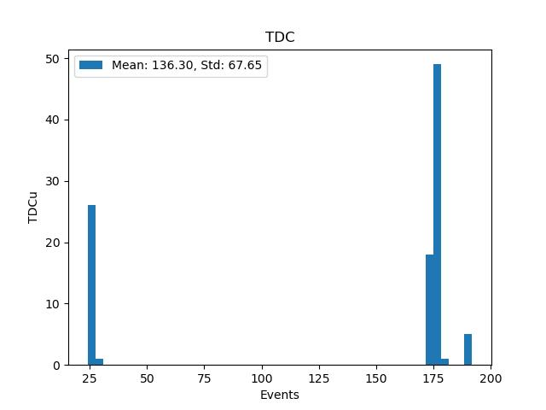
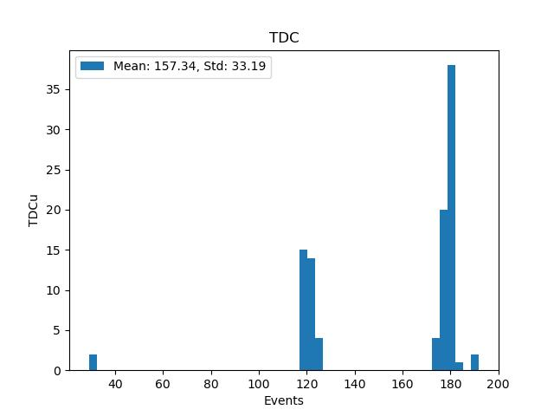
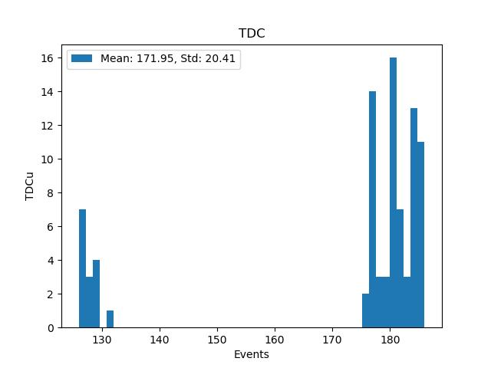
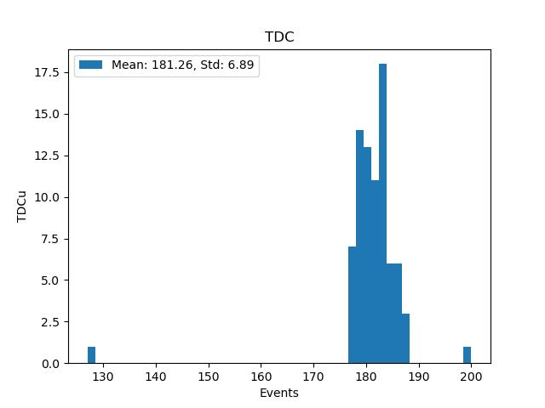
TDC measurements BOARD ASIC alone (3B)
5 fC injected in one pixel: PIXEL 0. Only one pixel ON
Threshold 150
Threshold 160
Threshold 170
Threshold 173
Two distributions observed at low threshold.

Slide 3
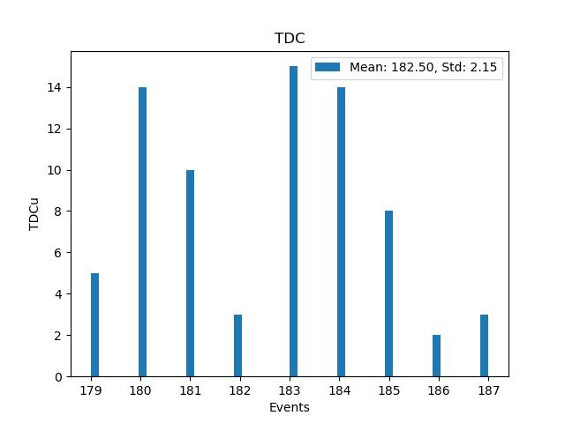
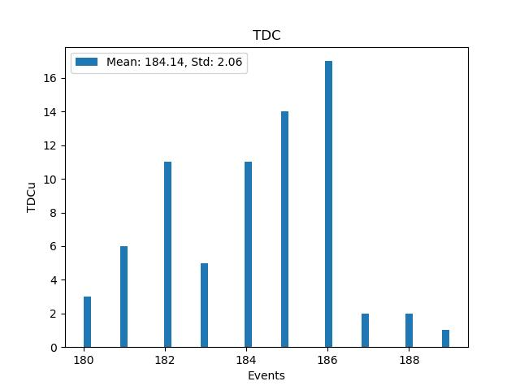
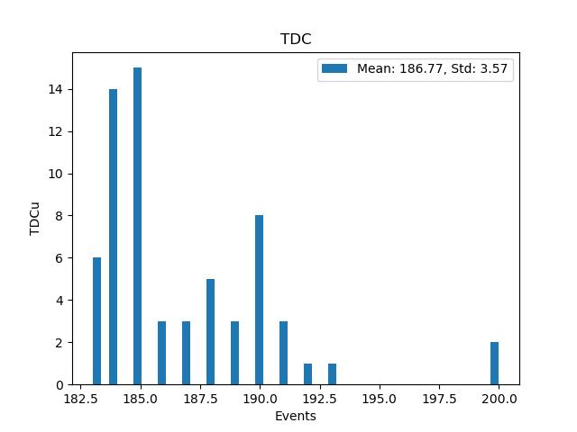
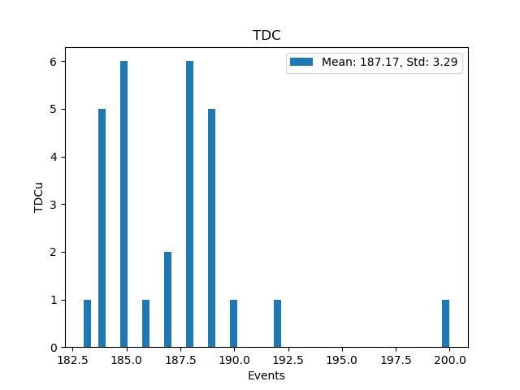
TDC measurements BOARD ASIC alone (3B)
5 fC injected in one pixel. Only one pixel ON
Threshold 175
Mean= 182
Std= 2.15
Threshold 180
Mean= 184
Std= 2.06
Threshold 185
Mean= 186
Std= 3.57
Threshold 190
Mean= 187
Std= 3.29
Under investigation!!!!

Slide 4
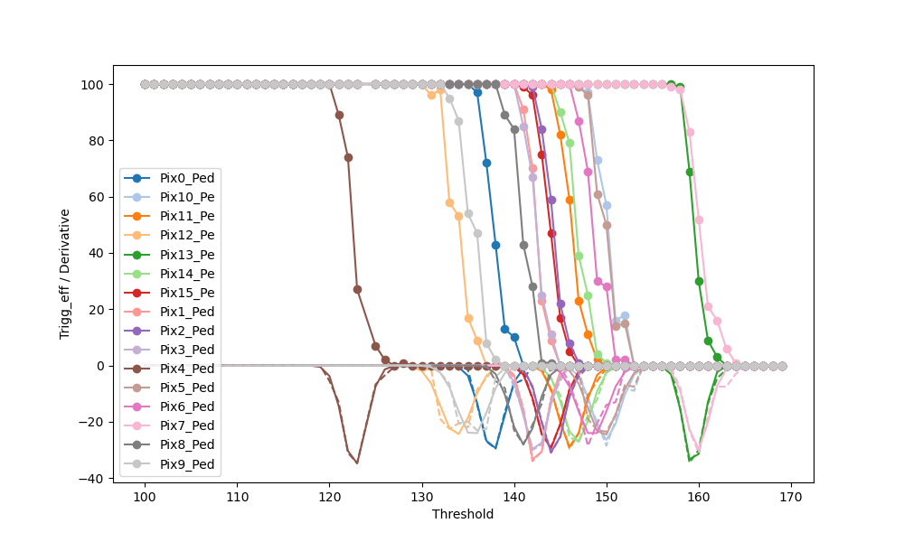
Scurves Pedestal
0,14 fC
Allows to define the Minimum threshold
0,18 fC
0,11 fC / DACu

Slide 5
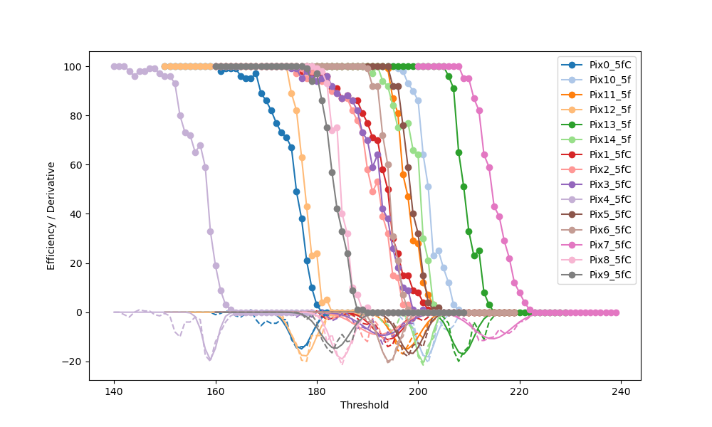
Scurves Charge 5 fC
0,11 fC / DACu
0,275 fC
0,15 fC
0,45 fC

