Slide 1


Heavy Ion Accelerators in the world/ in France
B. Jacquot CNRS,

Slide 2

Overview
Heavy Ions (HI) in the world of particle Accelerators
Technologies and Challenges, specificity
Leading Facilities HI in the world
Medical Applications of HI
French Heavy Ions Facilities
What to do with GdR SCiPAC?

Slide 3
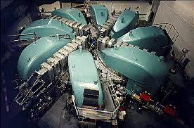
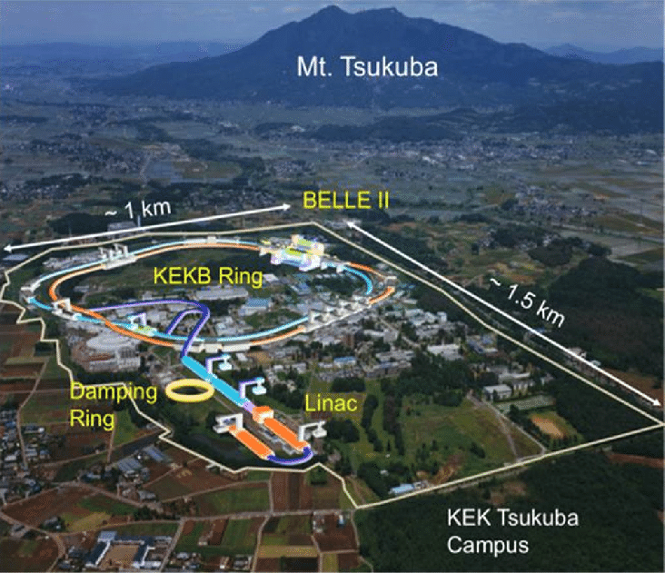
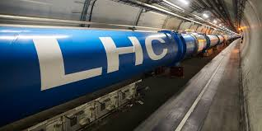
Very Large Accelerators in the world
Very Large accelerator facilities (>0.5 billion Euros)
? Heavy Ion Accelerators Versus p-Accelerators, electrons-Accerators ?
Higher Power:PSI
CERN(Pb-Pb), Fermilab, XFEL, J-PARC /Super KEKB, BNL(RHIC),
SNS, Los Alamos, RIBF, FRIB, PSI, GSI, RAON, HIRFL
+ 70 Synchrotron light sources
Projects : ESS, GSI_FAIR, HIAF, EIC@RHIC, PIPII, MYRRHA
Futur : CERN_FCCee, FCChh, ILC
KEK
The largest
Higher luminonisity
Biggest facility are proton accelerators and electron accelerators
But Heavy Ion accelerators are however well represented

Slide 4
Large Accelerators in the world and science
Large protons accelerators:
  Particle physics, Applications with neutrons, Nuclear physics
    Anti protons, bosons,exotic mesons hadrons, Neutrino(FERMILAB,PSI, J-PARK),
    Hadron structure and dynamics (FAIR, LHC, RHIC)
    Neutrons (SNS,ESS,PSI,CERN, Los Alamos), Acc. Driven System (MYRRHA)
    Muons (FERMILAB,PSI),
Large Heavy Ion accelerators :
Nuclear Physics (…), Atomic physics, Material science, Biophysics,
Nuclear structure with RadioActive Ion Beams (Fragmentation, Fission, Isol )
QG Plasma (LHC_ALICE,RHIC)

Slide 5
Heavy ion Accelerator Technologies
Heavy Ion accelerators ~ protons accelerators : few specifities
Accelerator Types
Linac , Synchrotron => medium/large machine
Cyclotrons => small/ medium machine
Van de Graaf & Tandem=> small machine
Technology
High Voltage (DC) :
Tandem Van de Graff, deflector
Magnet (Normal and Superconducting)
SPECIFIC : ECRIS Source
« Low RF » frequency (10-88 MHz)
High Power solid target :1kW-100kWatts
Heavy Ion Beams
large A/Q, higher Brho, small β <<1, cost~ Q/A,
No Synchrotron radiation
All Time structures : Continuous (electrostatic),
Cw (100% duty cycle linac, cyclotron), Pulsed (synchrotron) SPECIFIC : Charge state, STRIPPING

Slide 6
RIBF (Japan)
2023: 9kW U @ 340MeV/A
2032: >100 kW U beam
FRIB (USA)
2023: 10kW ²⁸Si @ 298MeV/A,…
2028 : U @ 400 MeV/A
400kW for all beams
FAIR (Germany)
U28+ @ 1200 MeV/A, p 29 GeV
Leading facilities with Heavy ions
Spiral2
FRIB
A/Q . < I> _{μA}
RIBF
FRIB
RIBF
Beam energy GeV/u
J. Wei

Slide 7
Rare Isotopes Beam Facility (RIBF Riken)
Leading facilities with Heavy ions : RIBF
150 New isotopes discovered
From 2007 to 2024 : impressive evolution. 2024 : 9 kW ²³⁸U

Slide 8
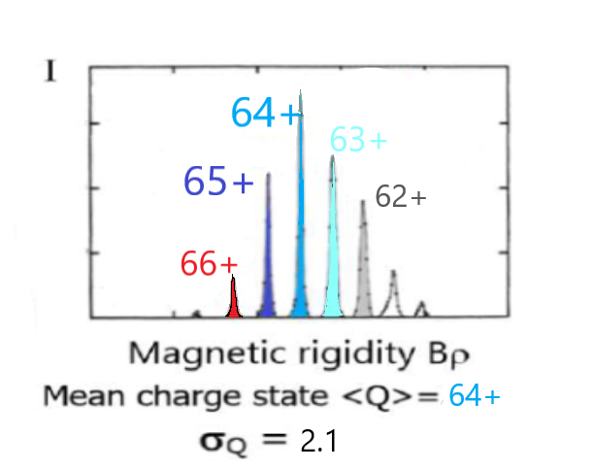
Leading facilities with Heavy ions : RIBF
RIBF, Rare Isotopes Beam Facility (Riken) : U acceleration
²³⁸U 35+/64+/86+ 340 MeV/A
Too high power for C foil
Helium gas stripper
50 cm long : no window
Differential gas pumping system

Slide 9
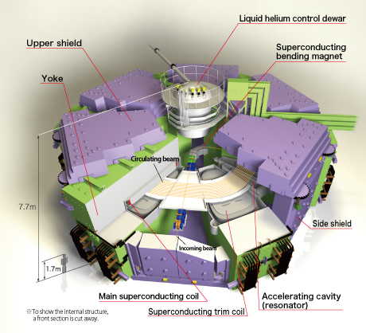
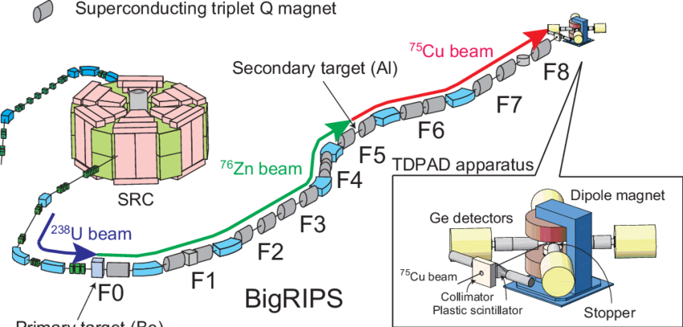
Leading facilities with Heavy Ions : RIBF
Uranium Beam ²³⁸U @ 340 MeV/A
Superconducting Ring Cyclotron (SRC)
8300 tons, Bmax 3.8 T
World Strongest Cyclotron
K factor= 2600 MeV E/A =K (Q/A)²

Slide 10

Leading facilities with Heavy Ions : RIBF
RIBF: optimizing stripping from ε=5% (2024) to 65%
50 m isochronous ring : recirculate unused charge states

Slide 11
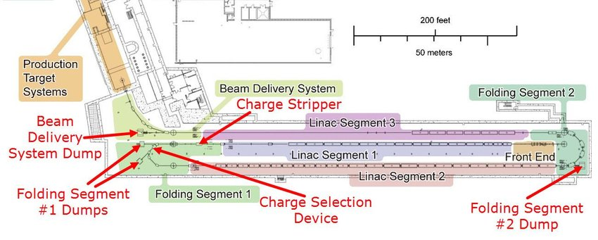
Leading facilities with Heavy ions : FRIB
FRIB : Linac ²³⁸U 200 MeV/A (2022) then 400MeV/A
Linac : 4 cavity families 80.5 MHz ‘QWR) & 322 Mhz (HWR)
Multi charge state operation : increase acceleration efficiency

Slide 12
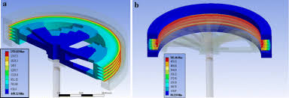
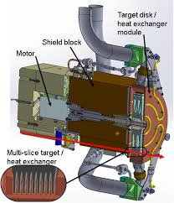
Leading facilities with Heavy Ions : FRIB
FRIB : High power target , C Multi-Slices > 100kWatts
RIB production ~ <Beam Intensity> x Target Thickness
~ < I > x beam Energy ²

Slide 13
Leading facilities with Heavy Ions : FAIR @ GSI
FAIR : Facility Antiprotons and Ion Research ; A very ambitious scientific program
NUSTAR : Nuclear structure , N. Astrophysics
Super FRS
CBM : Compressed baryonic matter
CBM detector
APPA : Atomic, Plasma, Applications, biophysics
SFRS, CRYRING,HITRAP,…
PANDA: p-pbar annhilation (after 2028) Collector ring + H.E. ring+ detector
Facility in construction
Civil engineering
many components constructed
Main synchrotron assembling will start

Slide 14
Leading facilities with Heavy Ions : FAIR project
SiS100 : 110 Superconducting dipole magnets
Circumference ~ 1.1 km
1.5 GeV/u for U²⁸⁺ cycle : 0.5 Hz ions per cycle : ~ 4. 10¹¹
29 GeV for protons : ~ 10¹¹ pps

Slide 15
Heavy Ion Accelerators : What is the best for R.I.B.
For Radioactive Ion Beam production in flight method : « thin Target »
RIB production in flight :
~ σ .<Beam Intensity> x Target Thickness x Separator Transmission
Optimal prod. 30% energy loss in target
dE/dx~ (Ztarget. Zbeam² )/ Ek …
Range~ ∫dx/dE .dE ~ Ek²/ (Ztarget. Zbeam² )
NRIB ~ σ .<Beam Intensity> x beam Energy ² x Transmission
σ Cross section depend on the reaction :
Projectile fragmentation populates the chart close to the primary beam
In flight fission @ E>300MeV/u populate all the nuclear chart on the neutron rich side
σ Fission cross section at RIBF

Slide 16
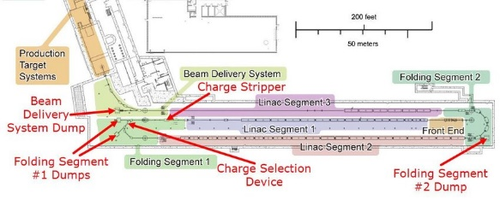
Heavy Ion Accelerators : What is the best for R.I.B.
Exemple of production with in flight method : ⁸⁰Ga*
RIBF-RIKEN : today 238U @ 340 MeV/u production of 80Ga* ?
σ= 5 10⁻²mb target Δx=1000mg/cm2 I=7 10¹¹pps Transmission in separator (~ 5-10% )
(GANIL_LISE x 10000)
FRIB : today 86Kr @ 230 MeV/u
σ= 4 10⁻⁴mb Δx=400mg/cm2 I=3 10¹²pps RIBF/25
  tomorow 238U @ 400 MeV/u 2. 10¹¹pps
σ= 5 10⁻²mb Δx=1200mg/cm2 I= 3. 10¹²pps ??? RIBFx 5
FAIR : after tomorow 238U @ 1500 MeV/u
σ= 5 10⁻²mb Δx=4000mg/cm2 <I>=2 10¹¹pps RIBF /5

Slide 17
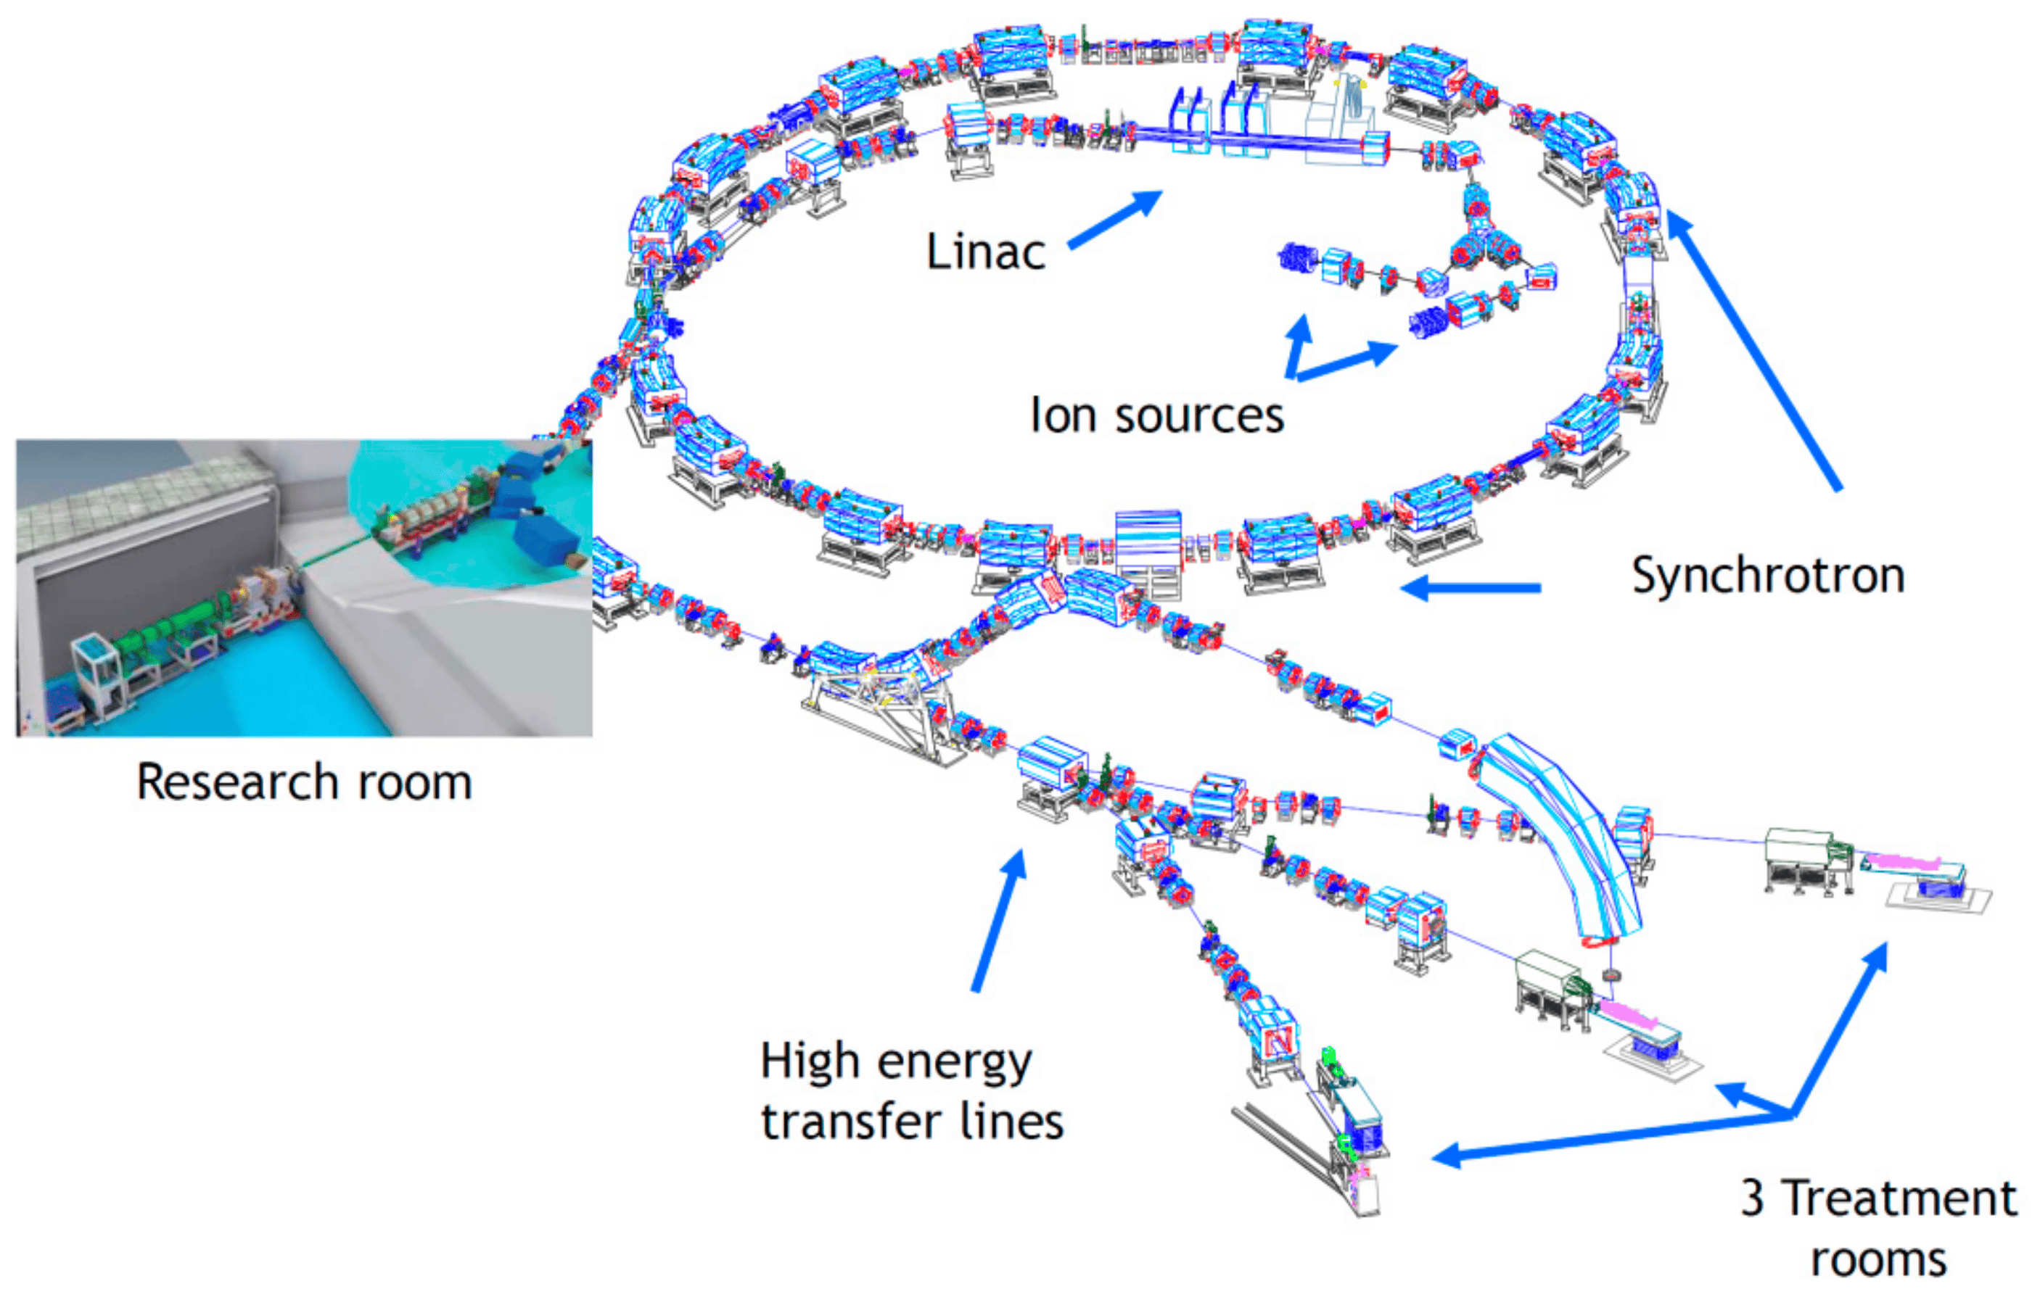
Accelerator for medical applications : Heavy Ion versus e/p
Radio Isotopes production (>700 in the world ):
Mainly Proton /D cyclotrons
Cancer Treatment (>10 000 electron linac // 60 protons facilities // 10 heavy ions )
X ray therapy with 5-25MeV electrons-linac ( 600 in France)
  Proton Isochronous proton cyclotron (PSI,…,), proton synchrotron
  250 MeV proton Synchro-cyclotron (IBA) : … Orsay, Nice,Caen,…
C,Ne,.. 400 MeV/A HI Synchrotrons ( 4 in EU, 0 in Fr )
R&D C400 : cyclotron 400MeV/A ¹²C⁶⁺
Hadron therapy with a very compact machine
CNAO Pavie (It)

Slide 18
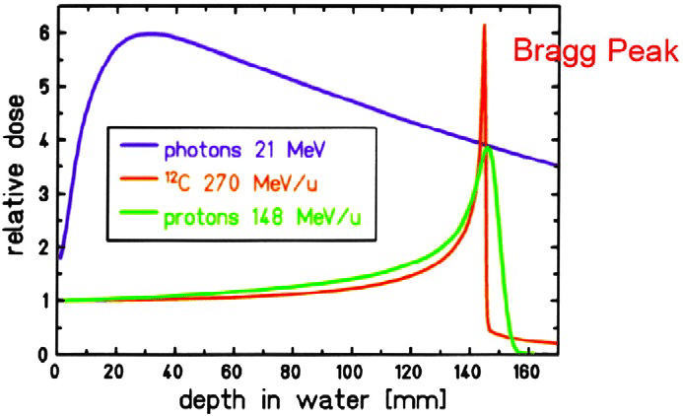
New H.I. Accelerator for medical applications
C400_IBA : 400MeV/A ¹²C⁶⁺ / 250 MeV Proton
Hadron therapy with a very compact machine
Isochronous cyclotron K=1600 MeV; 660 tons
Diameter total 6.9 m; Rextraction: 1.8m
Bfield 4,5 T (Hill) // 2.5 T (Valleys)
RF =75 MHz; Harmonic H=FRF/Frevol.=4
Transmission ~ 0.5%
2024 :
First model C400 being installed in France (Caen , Normandy)

Slide 19
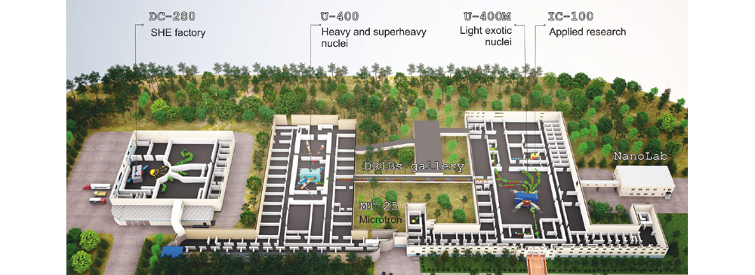
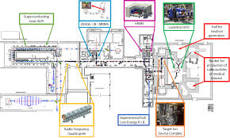
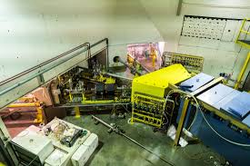

Heavy Ion Accelerators in Europe
CERN : HI LINAC3 +LEIR … for ALICE // Isolde Linac
GSI-Fair (Germany)
Dubna (Russia)
Ganil (Fr), Alto(Fr),…
LNL Legnaro (it),LNS Catania (it)
Warsaw cyclotron facility (Po)
UCL Louvain (Bel.)
RADEEF Jyvaskyla (Fin.)
…etc…

Slide 20

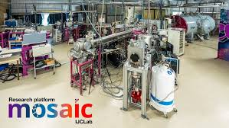
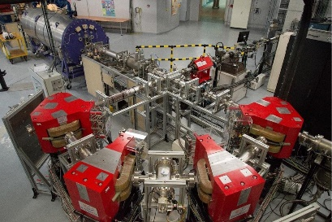
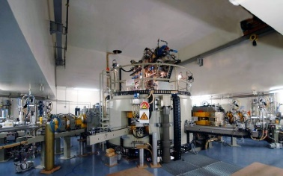
Heavy Ion Accelerators in France
Iba C400

Slide 21
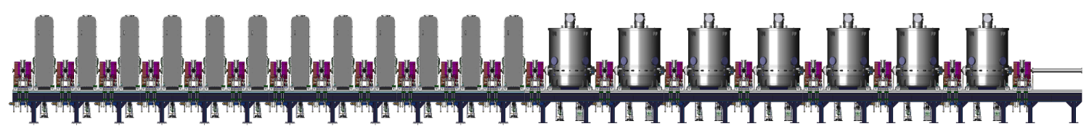
Heavy Ion Accelerator in France
Low energy plateforms :
(2-4MV electrostatics ) ANDROMEDE, ARTEMIS, ASTER, New AGLAE,…
7MVtandem&4MV DAM-Bruyere
ALTO (Tandem-14.5MV)
Ganil_Cyclotrons (C-U up to 95 MeV/A, RIB-ISOL up 20 MeV/u)
Ganil_Spiral2 ( Cw Linac proton 33 MeV, Heavy Ions : 10MeV/A )

Slide 22
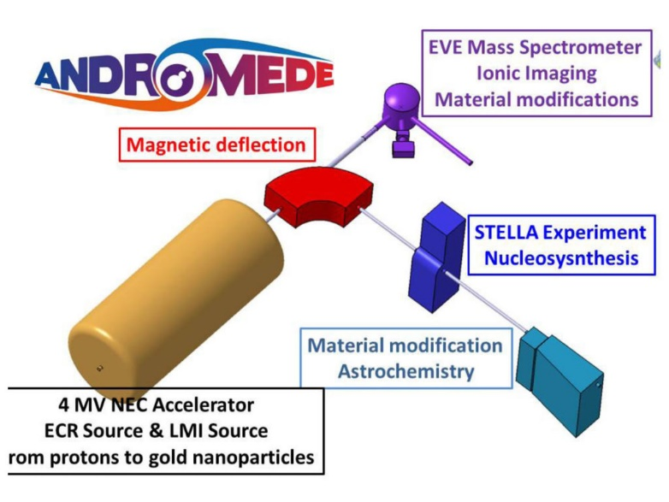
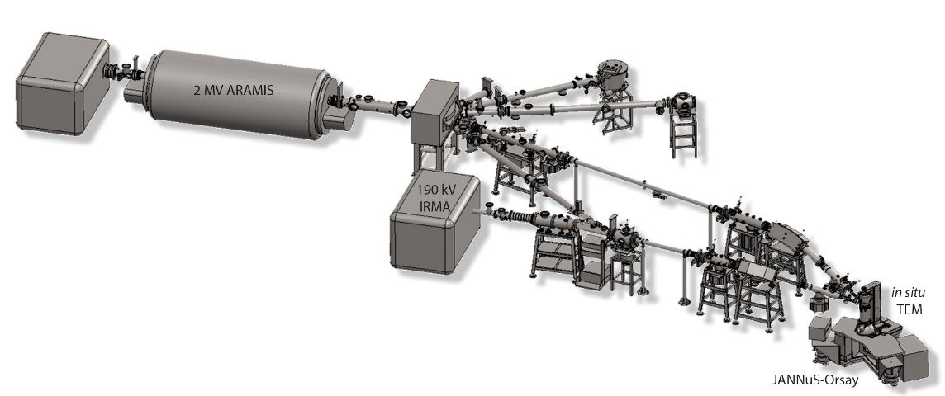
France HI Accelerators : Low energy platforms
Small, Multidisciplinary : ANDROMEDE et ARAMIS @IJCLAB
Beams : 2MVolts HI ARAMIS+ IRMA 190kV
Analysis with ion Beam (RBS, RBS/C, PIXE, PIGE, ERDA,TEM)
solid state physics, Ion implantation, Material science
Beam : from hydrogen to nano-particles (Au₄₀₀⁺⁴) : 4MVolts
Surface analysis, Material science, Secondary Ion Mass Spectrometry (SIMS), Ion Beam Analysis,…

Slide 23
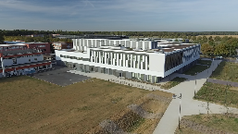
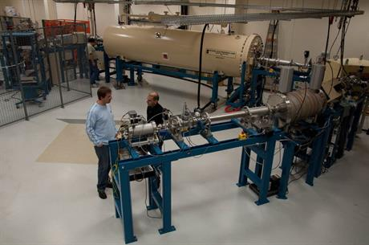
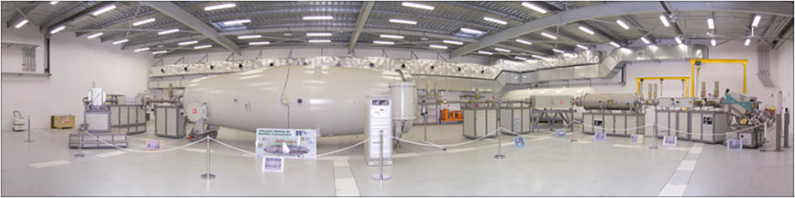
Heavy Ion Accelerator in France: Low energy plateforms
Accelerator Mass Spectrometry (environnement, Datation ¹⁴C,…²⁶Al,³⁶Cl)
ARTEMIS LMC_14@Saclay , ASTER @Aix en provence, ECHoMICADAS MHSN@Paris
ASTERisques 5MV (Accélérateur pour les Sciences de la Terre et les Risques)@ Aix en Provence
ARTEMIS@Saclay : 3MV

Slide 24
Heavy Ion Accelerator in France: GANIL_Spiral2 (Linac)
LINAC proton 33 MeV, H.I. 14 MeV/A
1 RFQ, 26 RF Accelerating cavities
Achievements
1-2 kWatt D beam on NFS for neutron TOF
5mA + bunch selector F~1 MHz
16 kWatt Deutons
Heavy ions tested for S³

Slide 25
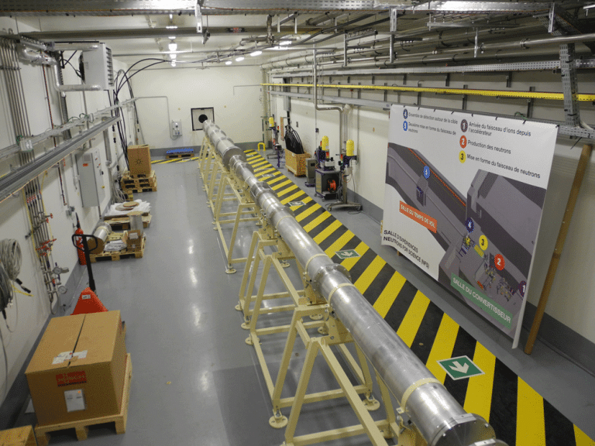
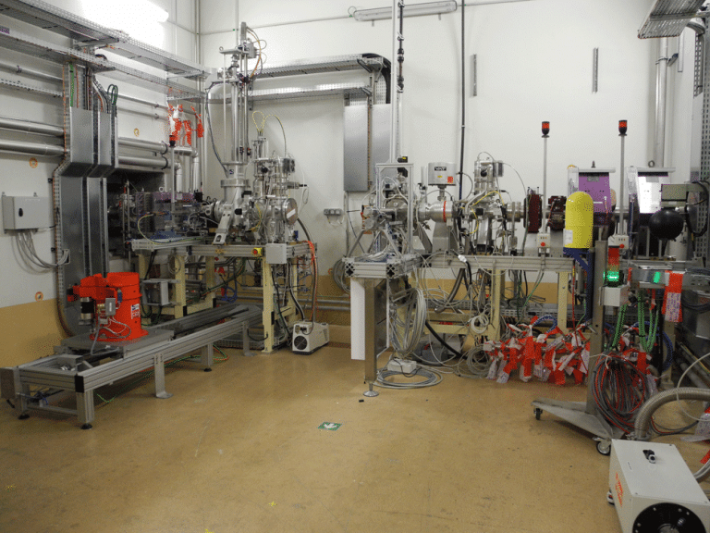
Heavy Ion Accelerator in France: GANIL_Spiral2 (Linac)
Operation : D/H beam for NFS (Neutron TOF facility)
Project New gain: ( New RFQ + New SC ECRIS@28Ghz )
existing Linac A/Q<3: good for light Ions, New RFQ+SC ECRIS good for heavier Ions
New RFQ
Asterics SC ECRIS

Slide 26
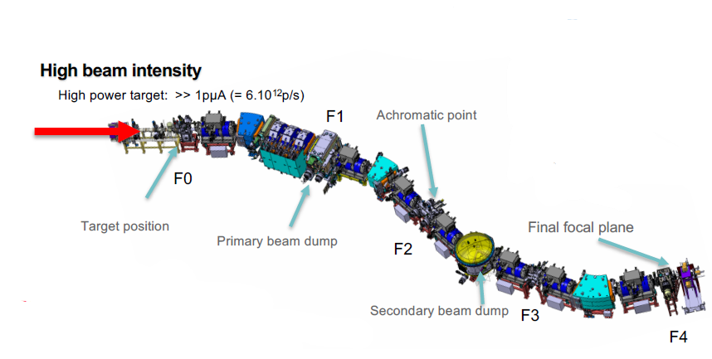

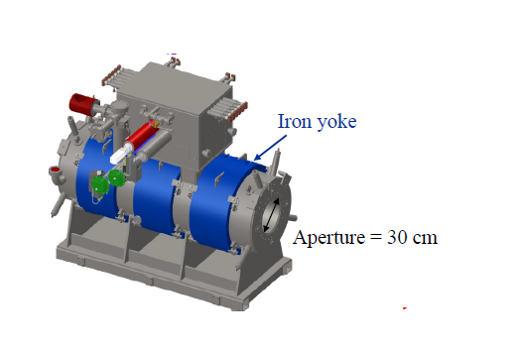
S³ project : CEA+ IN2P3 +….
International collaboration :
7 SC Multipole Triplets

Slide 27


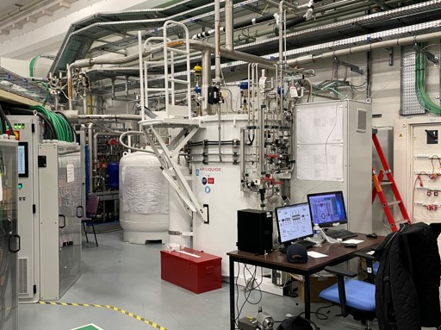


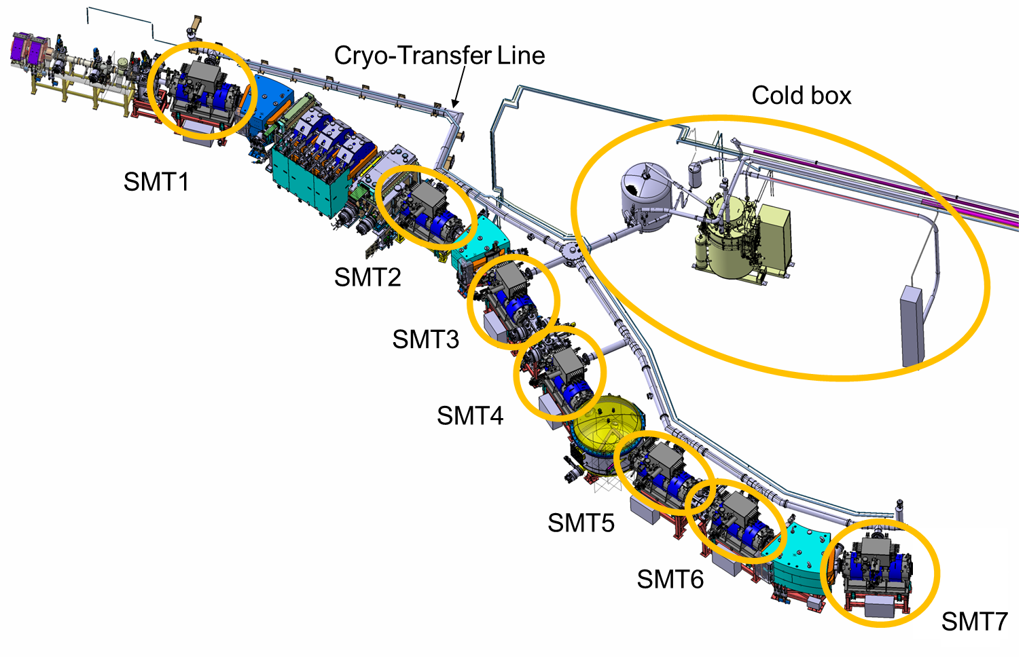

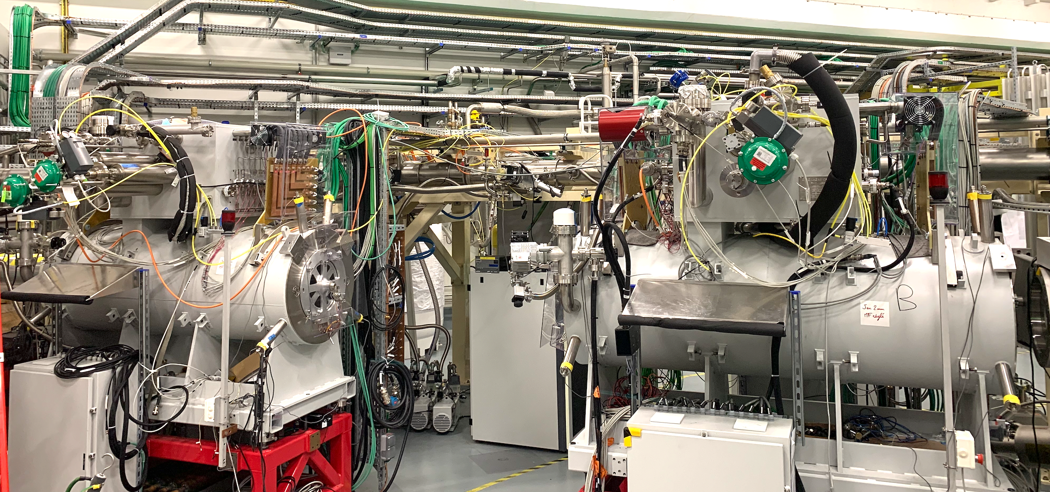
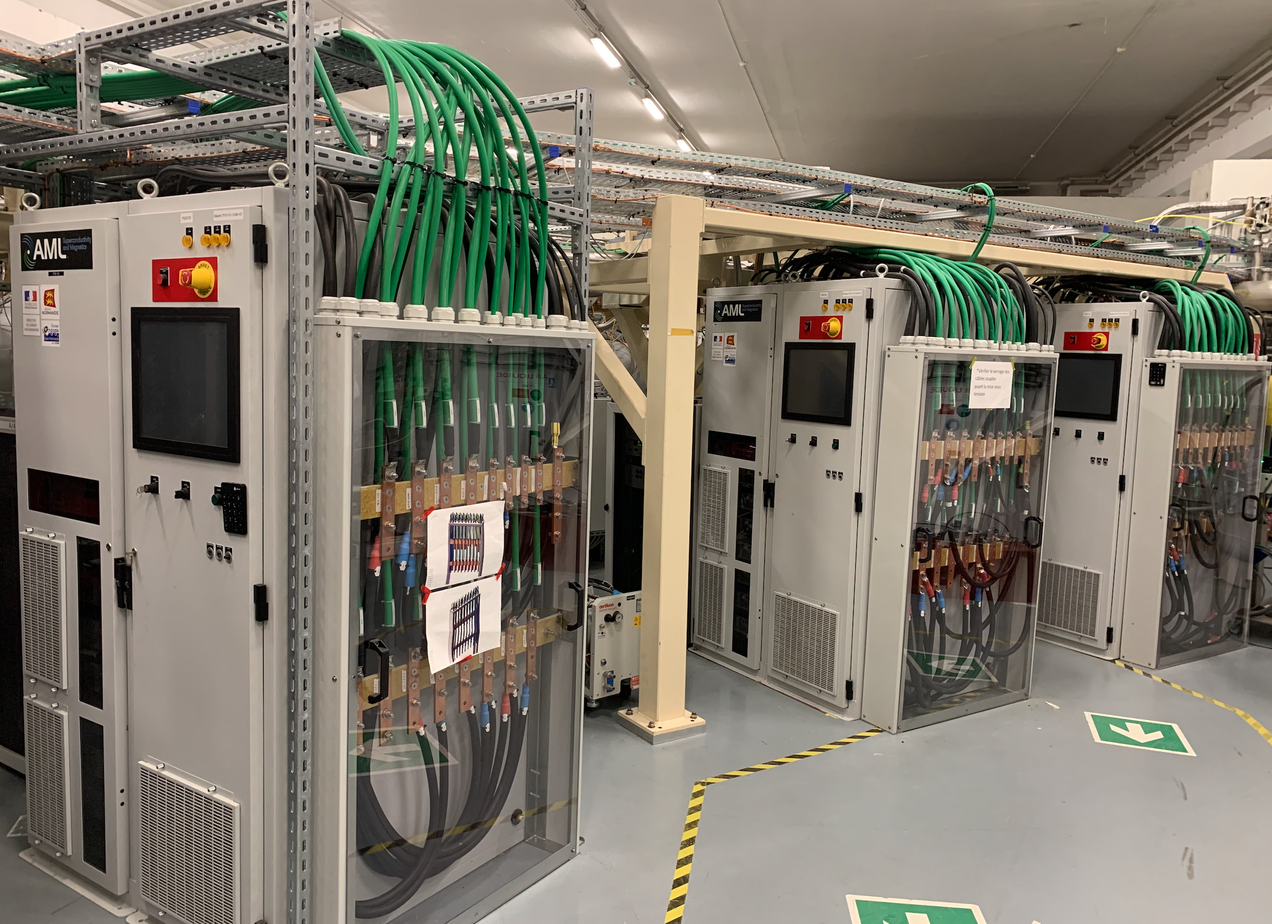


SMT's, PSS and Cryogenics
Cold box in operation
since 2018
Central cryoline
  In use since 2019
West & East cryolines
  Cold tested April 2023
Cold box
2 SMT’s on the central line
PSS connected to SMT
27

Slide 28
S³ project status 2024
Construction ~ done
Installation ~ done
Still many tests to be realised
Cryogenics + SC. Magnets + Deflector (+/-250 kV)
7 SC Multipole Triplets
Serious problems detected :
Cryogenic, LTC, Magnets : HTS, Alignement, quenches
1 magnet to be repaired in US
Expert committee working on the different topics
…Operation very difficult
Quad+Hexa+Octupole+Steerer

Slide 29
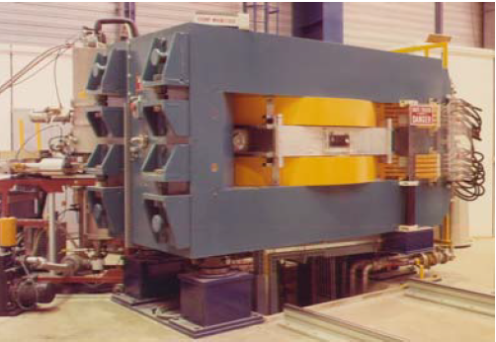
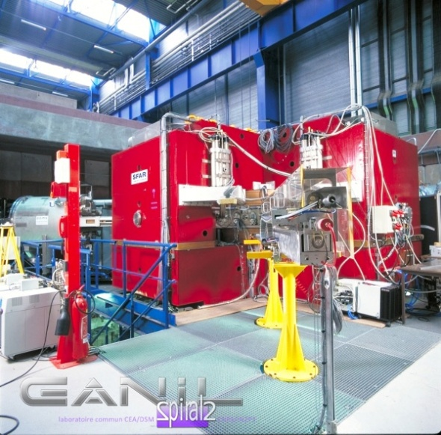
Heavy Ion Accelerator in France: GANIL_Cyclotrons
Operation: experiments 4000h/year
up to 3 experiments in parallele , operating since 1983
(Nuclear Physics, Atomic Physics, Radiobiology, Material physics, Industrial Applications
X2
X2
Projects
with strong support of French community
Project CYREN (renovation)
Project DESIR (Low energy Radioctive Ion Beams)
A New opportinity : The SAGA project try to increase the beam time for SPACE APPLICATION

Slide 30
GdR SCiPAC: What to do ?
Accelerator Science are already structured : Facility/University/Lab CEA+IN2P3
Existing Collaborative projects (New Gain ,Perle , Asterics, S3,Desir…), SFP Roscoff meeting,…
GdR may contribute to transverse topics - Improve collaborations
- Make emerging new ideas ?
Transverse topics for R&D laboratories, Facilities, Universities
Maintain critical skillls :
create/ maintain training program (Master Gd Instrument, option acc., Training period )
Communication
  Help to attract new talents, to get new R&D bugdet, to get new positions
Improve sustainability of our activities
less energy // societal applications (pollution, climate, space industry)
Improve ratio beam time/ Budget (BEAM SHARING)
Develop societal applications (Space applications, Medical,….)
The large accelerators make efforts : MEDICIS@CERN (isotopes), COMET@PSI (treatment), ? SAGA@Ganil?
Nasa Space Radiation Lab(NSRL@BNL) …

Slide 31
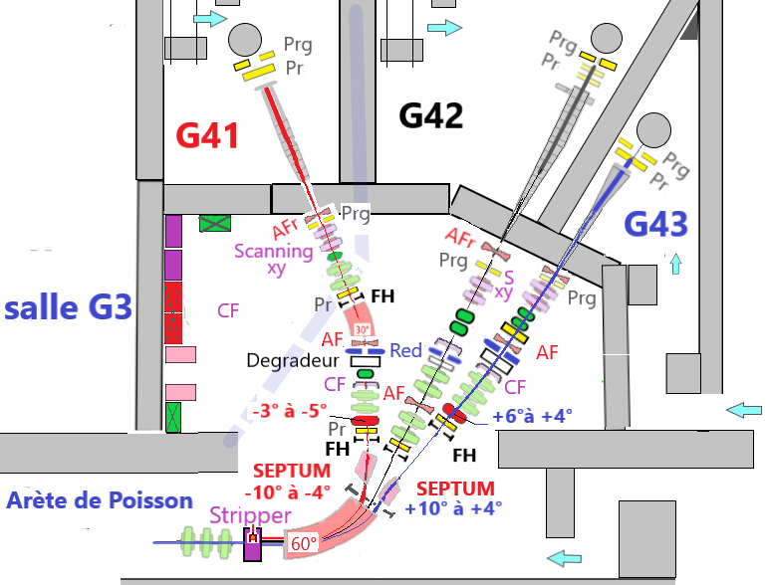
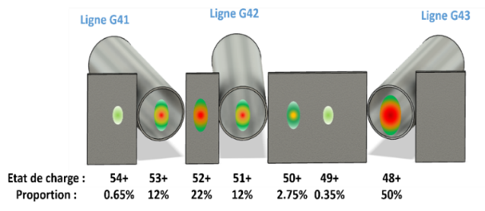
An important topic for GANIL: BEAM SHARING
  Strong demand on Space applications at Ganil , what about ALTO ?
  Need : increase the beam time for industry. New economic model ?? New method ?
SAGA project (E. Dessay) at GANIL : More Beam time for Space Applications at GANIL(€!?)
Project of 3 HI beams at the same time : with beam sharing ( 1 week=3 weeks)
Generates many charge states with a stripper
Many Bρ separated in
a magnet
? Want to join the R&D about beam sharing?
B. Jacquot, M. Lalande,
J.M. Lagniel, M.H. Moscatello

Slide 32
GdR SciPAC
Heavy Ion Accelerators
Additive slides

Slide 33
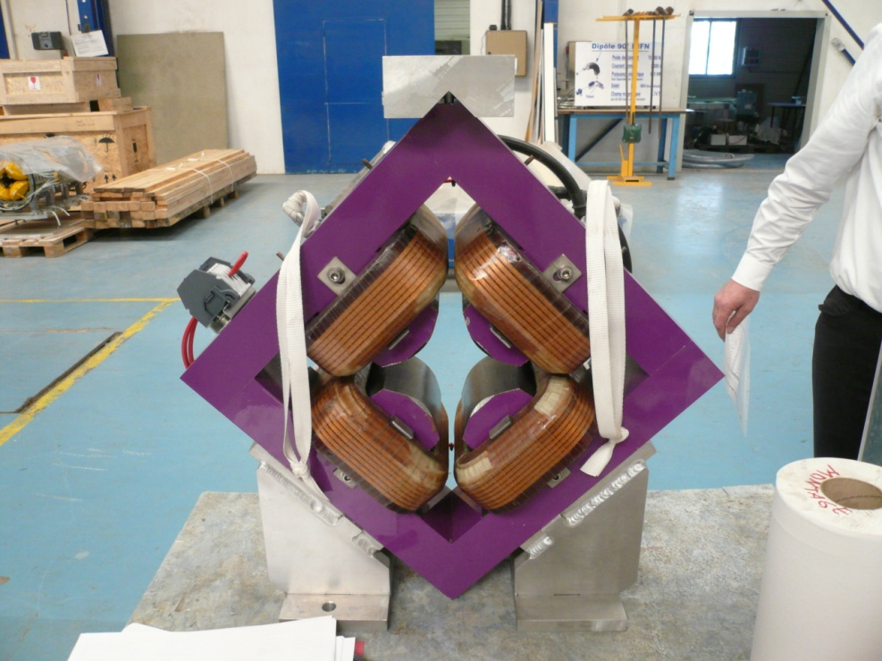
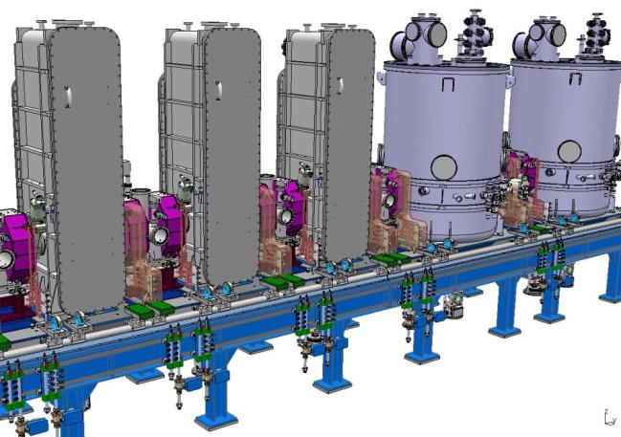
GANIL Linac : rappel de ses constituants
  2 familles, cavités ¼ d’onde. T = 4.5K. E = 6.5 MV/m max (~8 à présent) :
12 Beta = 0.07 (1 cavité / cryomodule)
14 Beta = 0.12 (2 cavités / cryomodule)
Section Beta 0.07
Section Beta 0.12
L~35 m
40 Quadrupôles
Diamètre : 56mm, Champ : 29 T/m
1 BPM par section chaude
1 BEM dans les 5 premières mailles
BEM très précis pour la longueur de paquet mais lent, peu utilisé hors commissioning
maille
1940 mm
maille
1190 mm

Slide 34
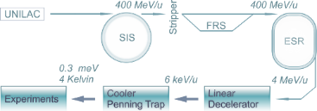
Innovative set-up : HITRAP Deccelerator @GSI
Heavy Ion deccelerator :
Experiments
At rest
HITRAP is a ion trap facility which is designed for capturing and cooling of highly charged ions produced at the GSI. up to uranium U⁹²⁺ , hydrogen-like ions or few-electron systems at low temperatures

Slide 35
GdR Scipac : What to do ?
Status of Ions Accelerators
Accelerators are an enabling technology for basic nuclear physics*/particle physics
but
Accelerator has significant impact on medicine (Radio-isotope & cancer treatment ) *
on industry (space application )*
on environnement, climate study
GdR SCiPAC Heavy Ions/protons Find & develop activities in coherence with the
« french Accelerator strategy » (IN2P3 strategy + CEA)
IN2P3 strategy : 4 axes - support to basic sciences (particle/nuclear) and Applied (medical,ADS)
- support to IN2P3 platforms
- support to project, National/Regional (Equipex,Labex…)
- Increase the R&D > 30% of the activities
CEA strategy : …

Slide 36
Accelerator in France : Accelerator Strategy
Accelerator Road map
RH IN2P3: 2022
*A. lucotte 2022
RH DACM-CEA :
Département des Accélérateurs, de Cryogénie et de Magnétisme ~ ~150 agents

