Slide 1
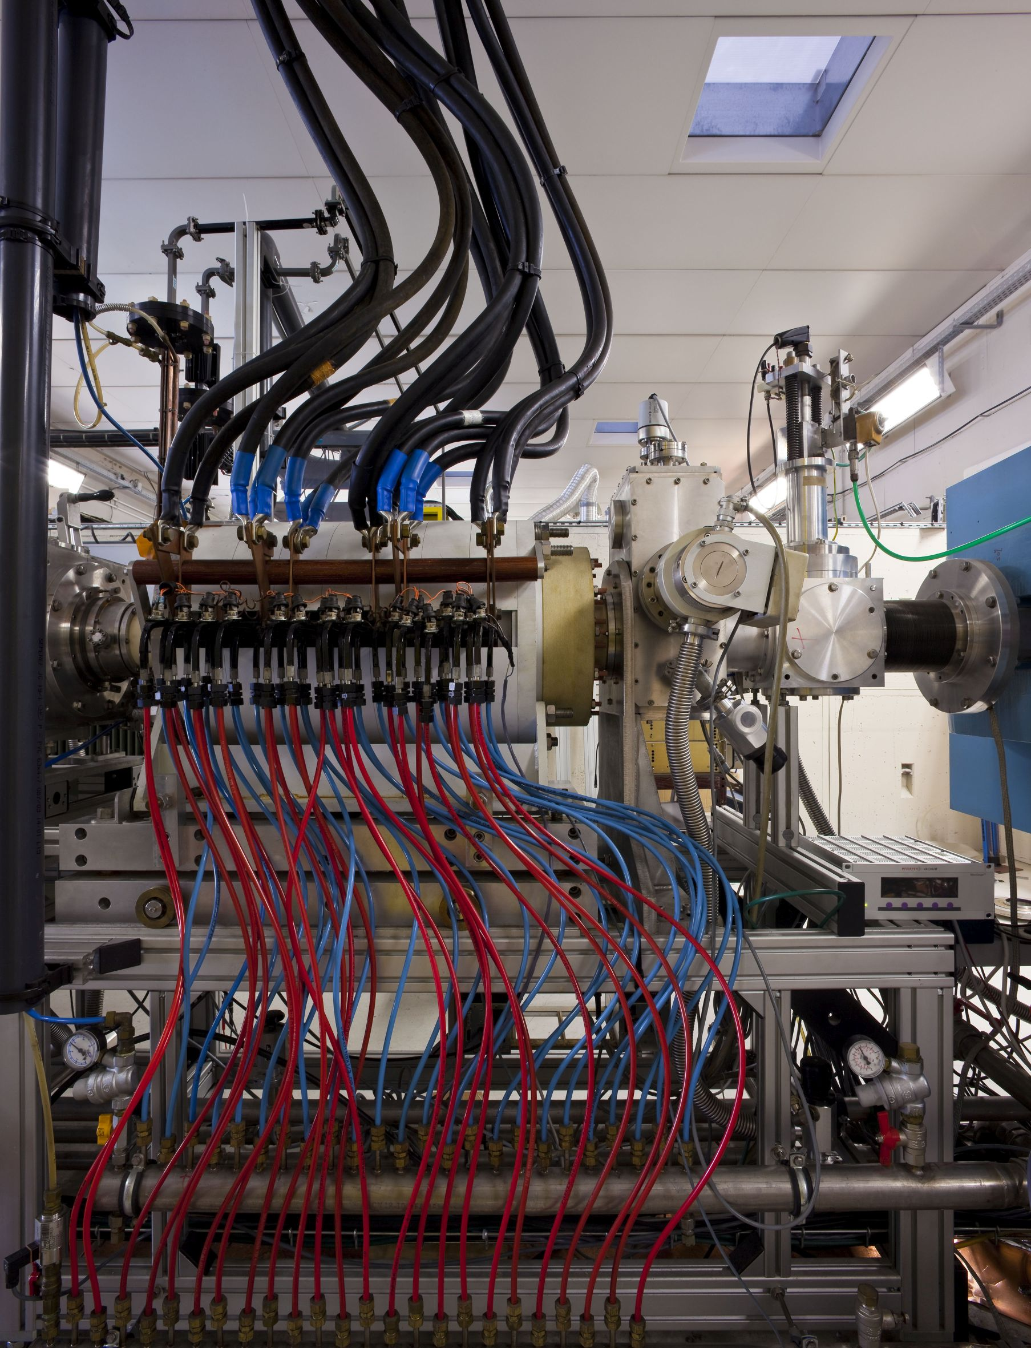
ELECTRON CYCLOTRON RESONANCE
CHARGE BREEDERS
FOR ISOL FACILITIES
J. Angot - LPSC Grenoble
GDR SCIPAC (Axe 1), Production d’ions lourds
Strasbourg – May 27, 2024

Slide 2
Outline
Introduction
ECRIS and EBIS CB technics
R&D on ECRIS CB – European context
Future prospects
Conclusion

Slide 3
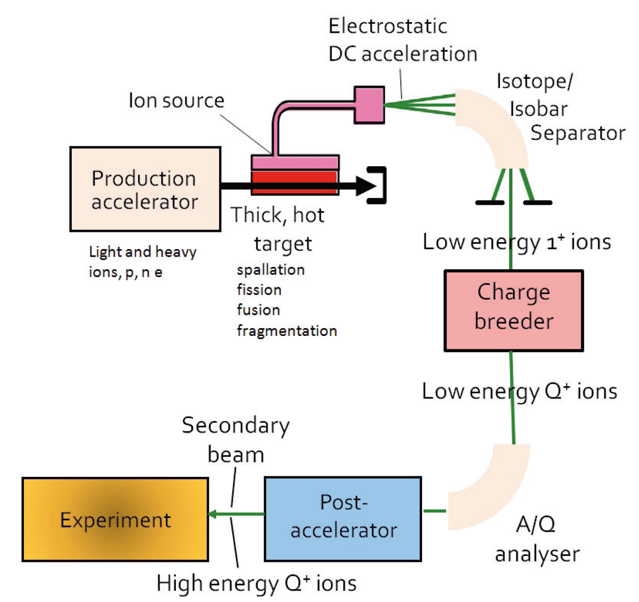
Introduction
Principle of the Isotope Separation On Line method

Slide 4
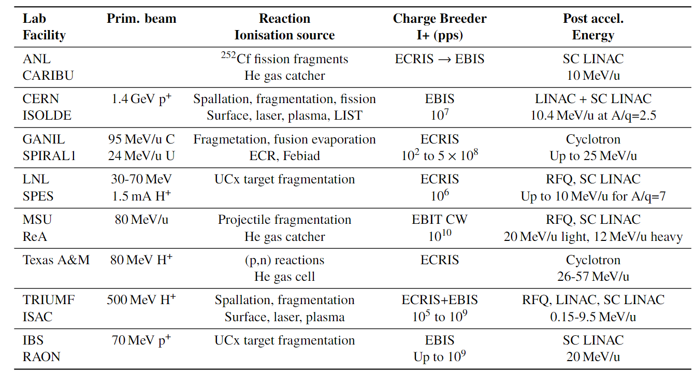

Introduction
ISOL facilities with post acceleration
TRIUMF
Canada
TEXAS A&M
USA
ANL - CARIBU
USA
MSU - ReA
USA
GANIL – SPIRAL1
France
CERN – ISOLDE
Switzeland
VECC
India
LNL – SPES
Italy
IBS – RAON
Korea
KEK - TRIAC
Japan
Great diversity of 1+ ion sources, RI flux, post accelerators, RI species
Constraints on CB device (1+ beam emittance, energy spread….)
Under operation, project, stopped

Slide 5
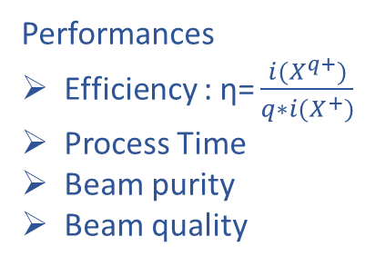
Introduction
X⁷⁺
I (A)
X⁺
I (A)
X¹⁺
A/q
CB
A/q
X⁺
Σ X^{n+}
I X⁺(A)
CB time
I X⁷⁺ (A)
time
time
Performances
Efficiency :$\text{η}\text{=}\frac{i{(X}^{q+})}{q∗i(X^{+})}$
Process Time
Beam purity
Beam quality
Instrument characteristics
Operation mode (CW, pulsed)
Robustness
Cost
Additional instrument necessary ?

Slide 6
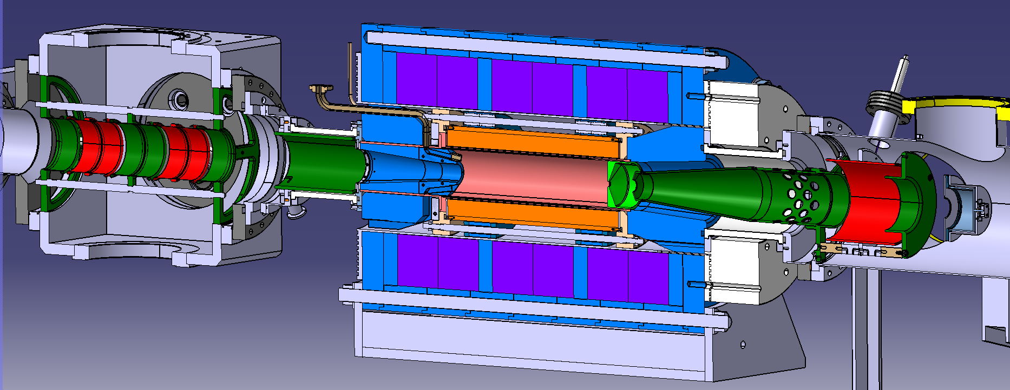
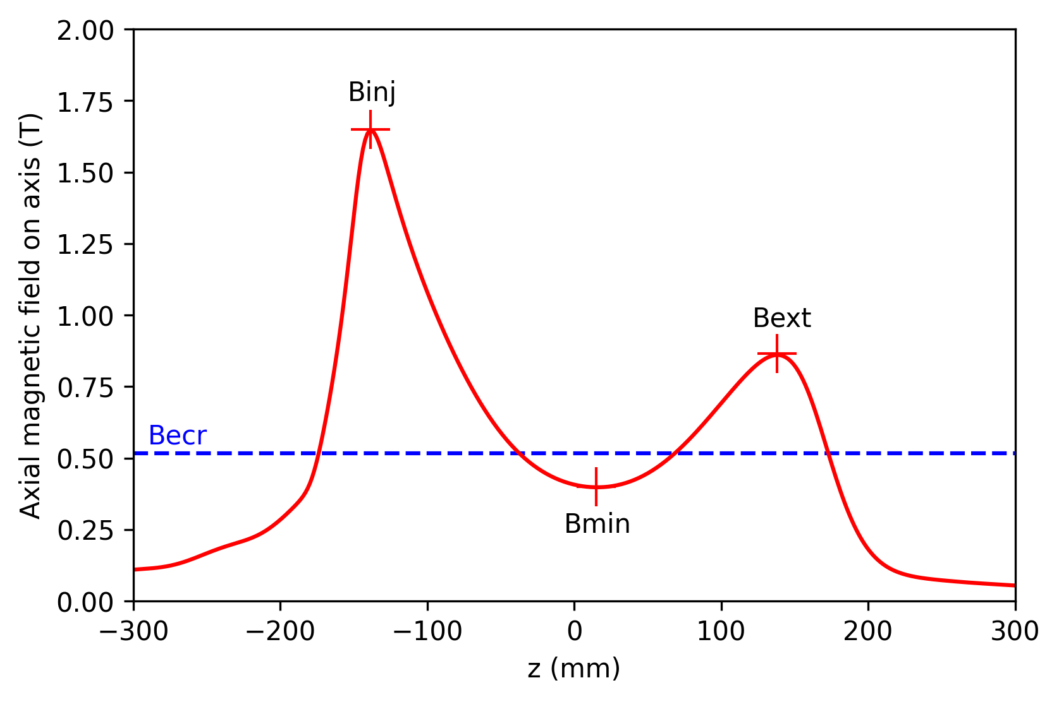
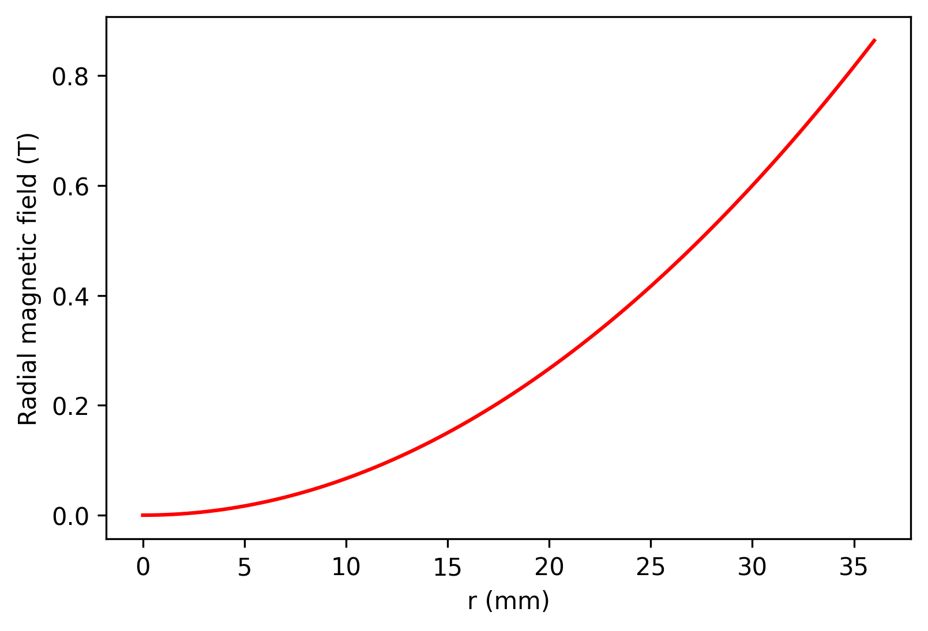
ECRIS CB
14.5 GHz 500W
0.6 m
Extraction optics
Modified min-B ECR ion source
Room temperature coils
Permanent magnet hexapole
B: 0.4 – 1.7T
14.5GHz – 600W
HV: 50kV
n_{e-} ~ 5x10¹¹ cm⁻³
CW or pulse mode
1+ beam, CW
Plasma
Σ N+ beam, CW
Injection optics
3 coils + yoke
Axial B field
Hexapole
Radial B field
Injection
Capture
multi ionisation
extraction

Slide 7
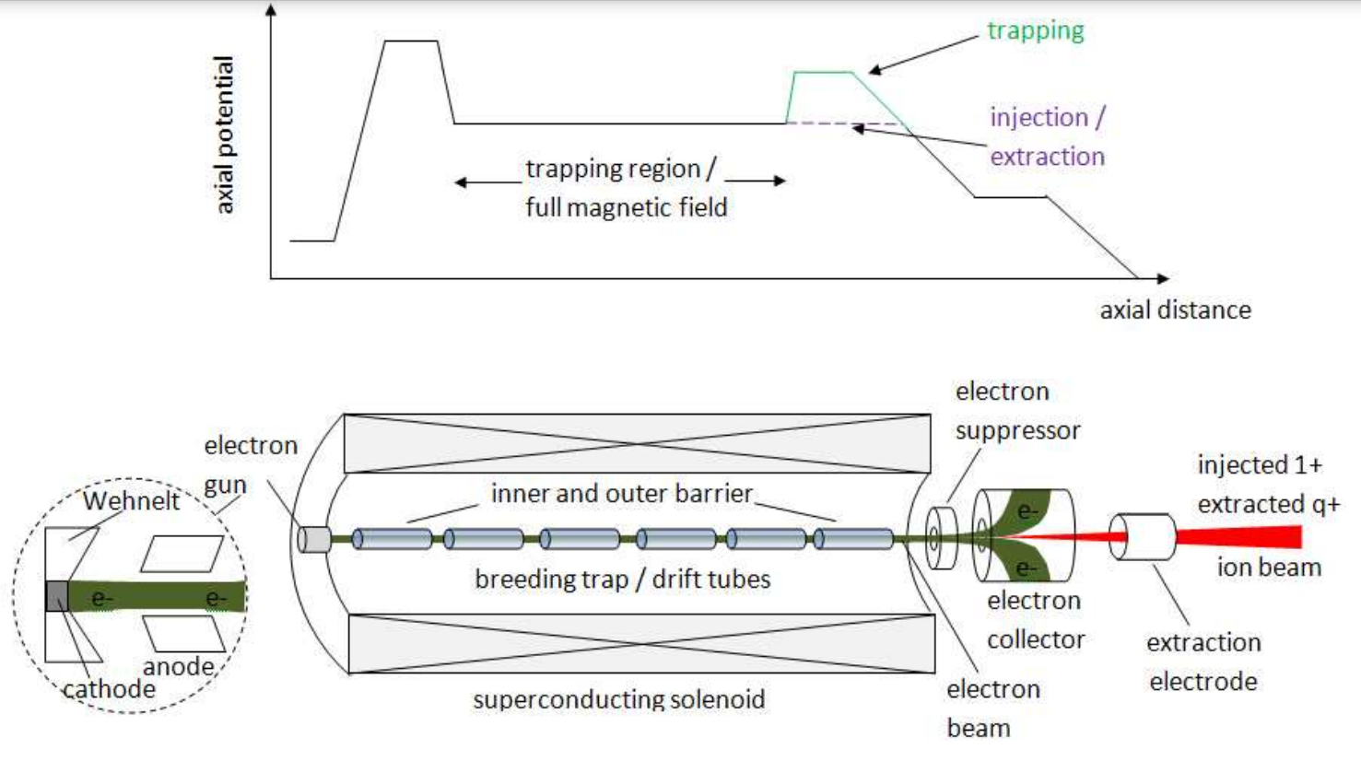
Electron Beam Ion Sources CB
Superconducting solenoid
B: 2-8T
Electrodes for longitudinal trapping
e- beam: 0.2 - 3A , 5 - 30 keV
e- beam radius : < 0.6mm
Pulse mode
0.7 m
Lapierre, Snowmass2021 Ion Source Working Group
Wenander, JINST 5 C10004
Characteristics
A cooler buncher is necessary to prepare the beam (accumulation, bunching, cooling)
Total efficiency of the cooler-buncher + EBIS : 5 to 20% (EBIS alone up to 35%)
CB time of cooler-buncher + EBIS : 10 to 100 ms
A/q : 2 - 3 for light ions, 5 -7 for heavy ions, tunable with breeding time
The charged particules have low interactions with the walls, base vacuum ≈ 10⁻¹¹ mbar ➔ high beam purity
Main limitation
Limited 1+ beam flux (<10¹¹ pps) due to the max. number of charges stored into the cooler buncher or into the EBIS

Slide 8
R&D on ECRIS CB
ECR CB technics developed at LPSC (ISN) in late 1990s for the « PIAFE » project
Different laboratories conceived CB from modified ion sources or new design
PHOENIX CB developed at LPSC since early 2000s
Installed at GANIL – TRIUMF – LNL + 1 R&D model at LPSC on the 1+N+ test bench
LPSC – GANIL collaboration on ECR CB performances in the frame of the« ions radioactifs » IN2P3 master - project
GANIL - LPSC – LNL collaboration for the contaminants reduction (in particular LPSC – LNL research collaboration agreement)
Extended collaboration for ECR plasma and Charge Breeding process studies (GANIL – JYFL – LNL – LPSC – RAL)

Slide 9
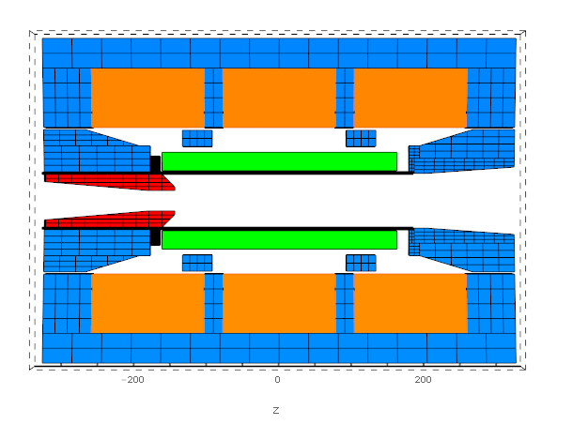
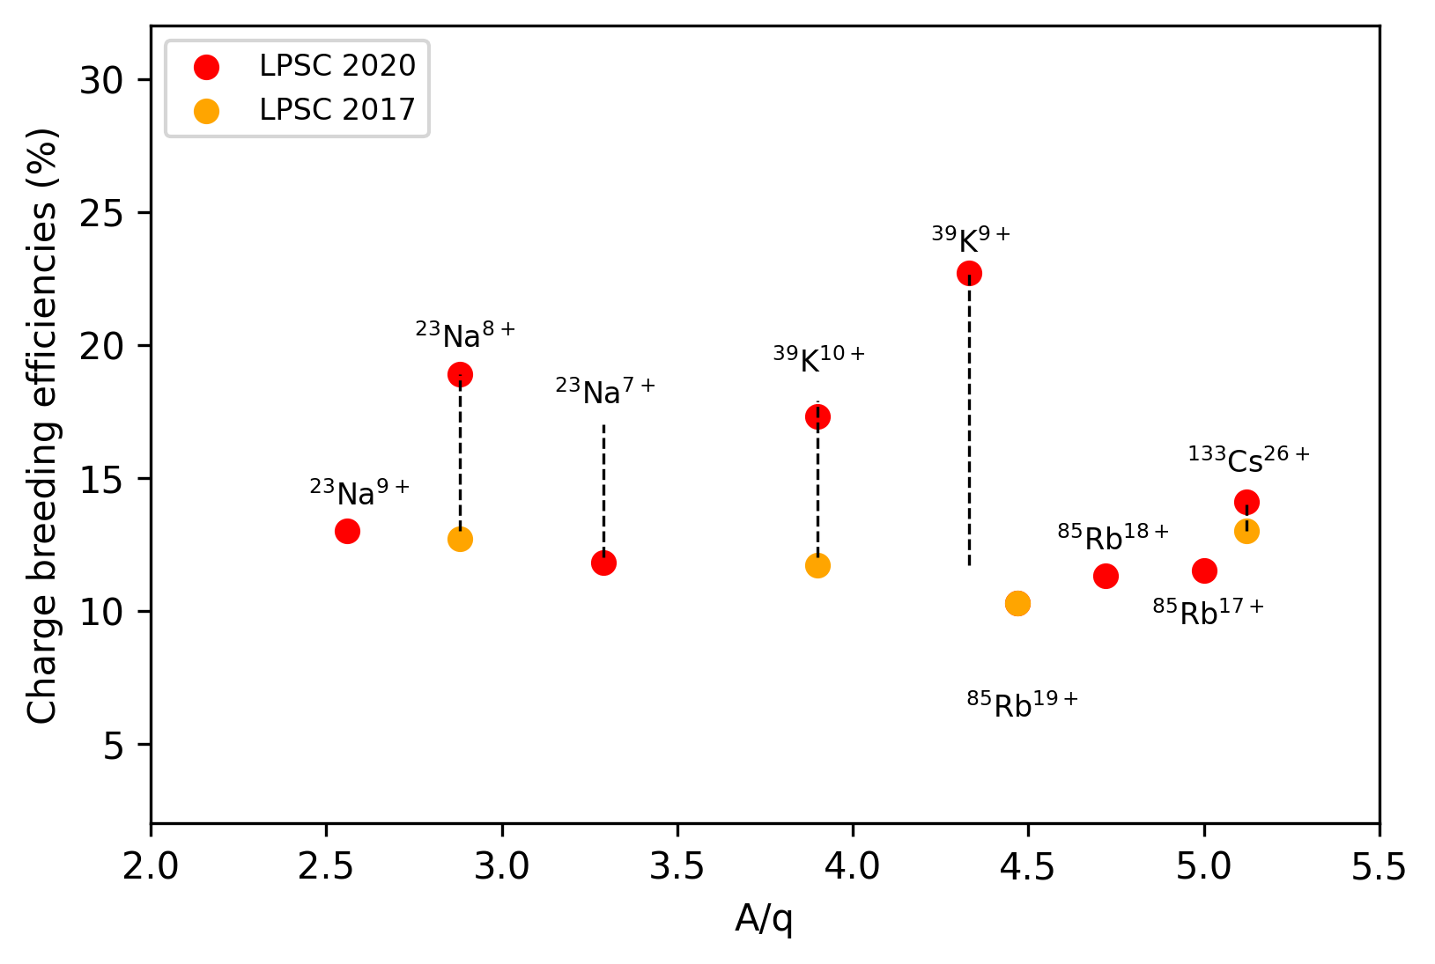
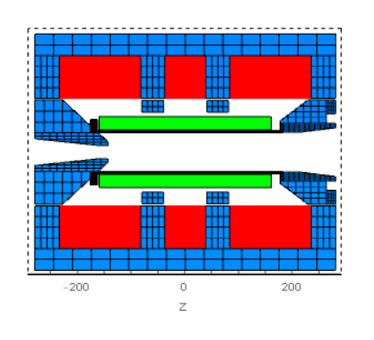
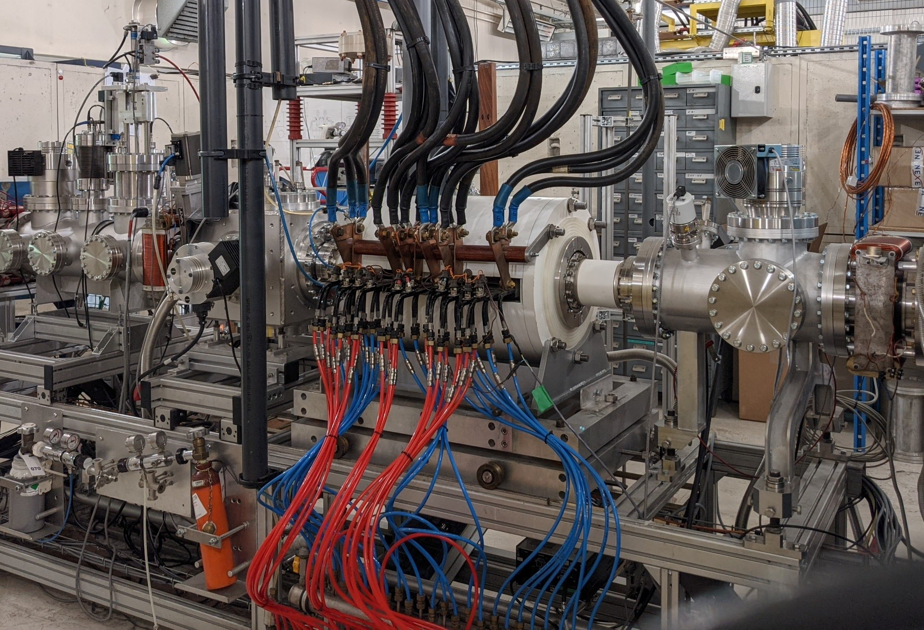
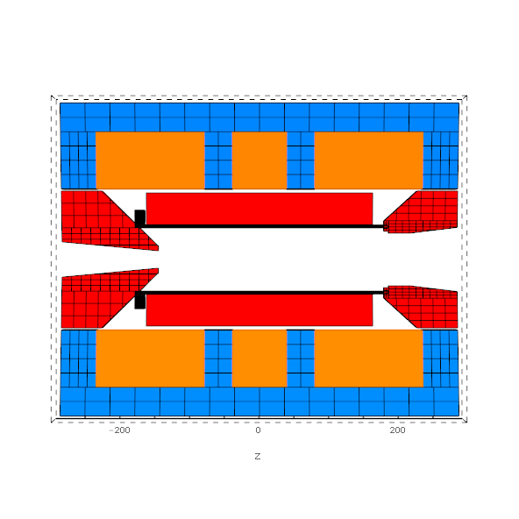
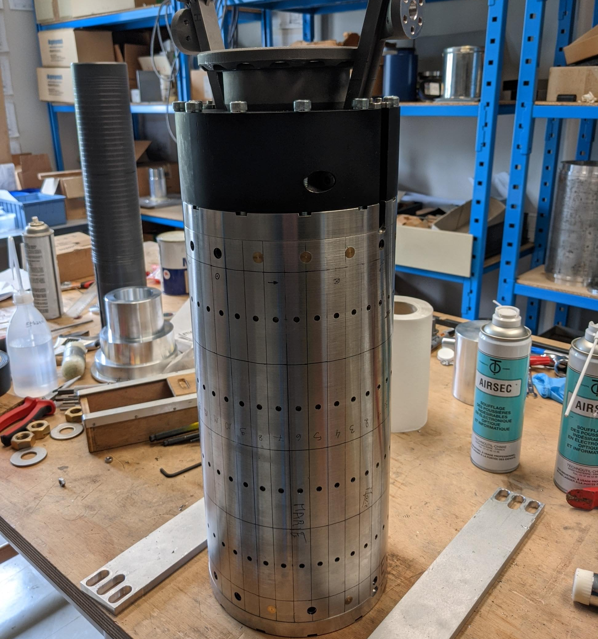
R&D on ECRIS CB
LPSC
Reinforced injection B_{inj} 1.2 → 1.6T:
enhance efficiency
Inprove the plasma confinement
2018-2022
5 coils configuration :
ease the tuning and stabilize the plasma
Improve the axial magnetic field profile
Decrease the cross talk between the coils
Under test
Large diameter configuration 72 → 100mm :
increase high charge state production
decrease the density of contaminants
Increase the plasma volume
sealing exclusively with metal gaskets
18GHz operation, two frequency heating
Assembly phase

Slide 10
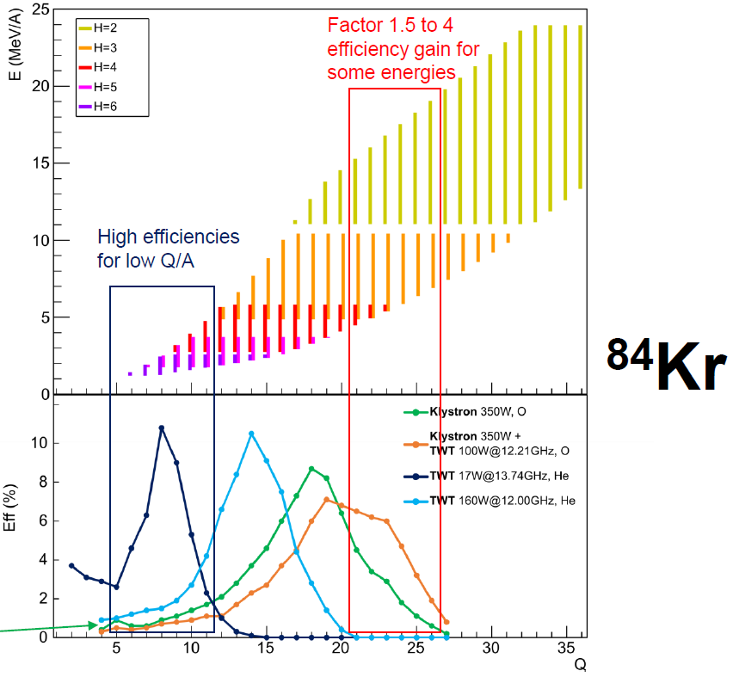
R&D on ECRIS CB
GANIL
Double frequency heating, frequency tuning :
vary the charge state distribution
  Optimize efficiency at a given charge state
  To reach lower and higher beam energies
  To avoid contamination att q/A =1/4, 1/3…
stabilize the plasma
Maunoury, ECRIS2022 talk

Slide 11
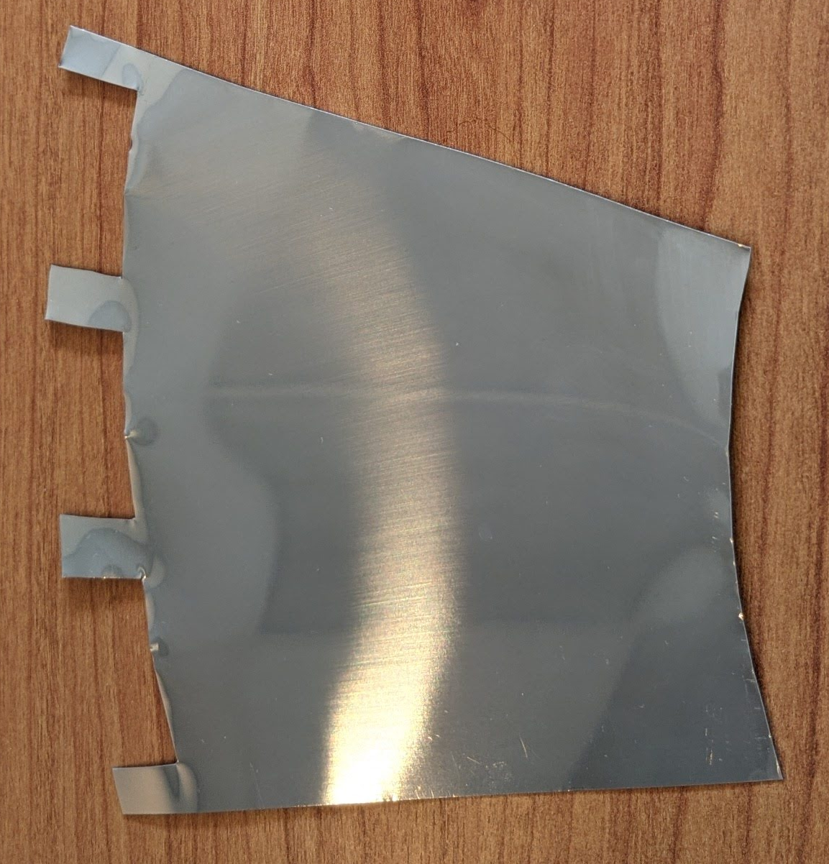
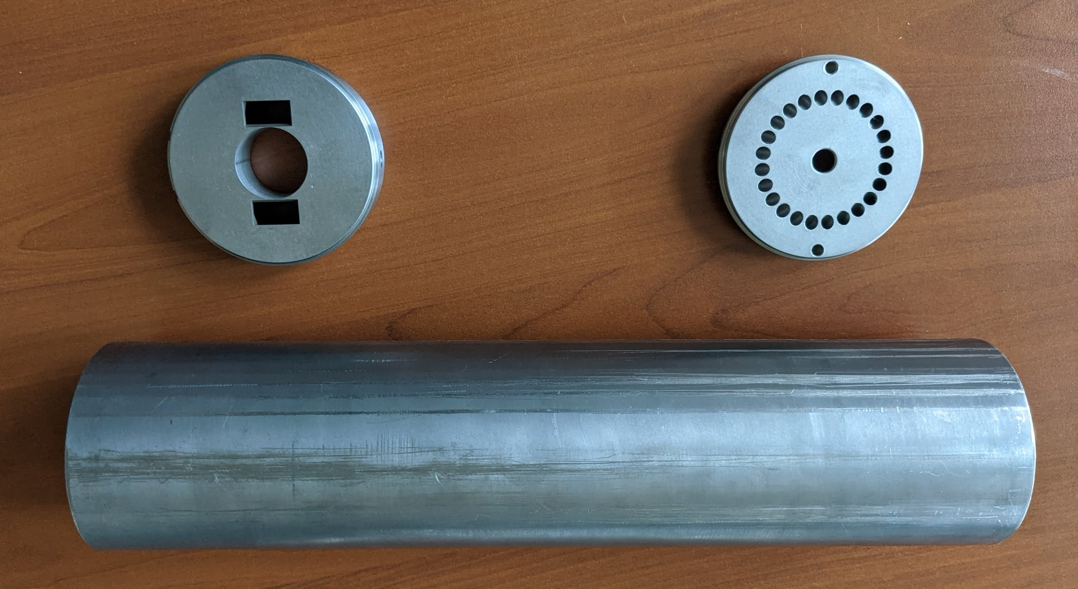
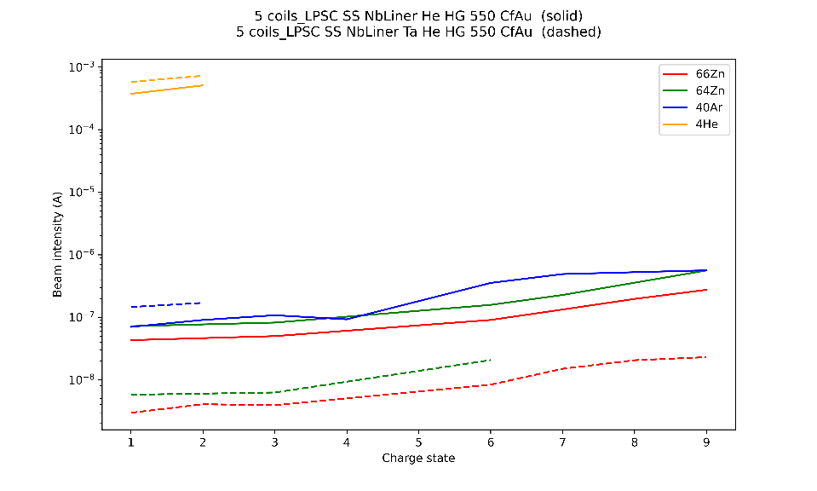
R&D on ECRIS CB
Contaminants reduction
d
Problem for ISOL facilities if :
Production yield is low
Too low downstream resolving power
d
a
b
c
a
b
Double task :
Measure / identify the species
  Development of diagnostics
  Improvement of command - control
  Development of identification code
Reduction :
  Experiments with liners
  Support gas decontamination
  Effect of plasma stability
c
Solid : with
Dashed : with +
a
b
c
a
b
c
d
x0.1

Slide 12
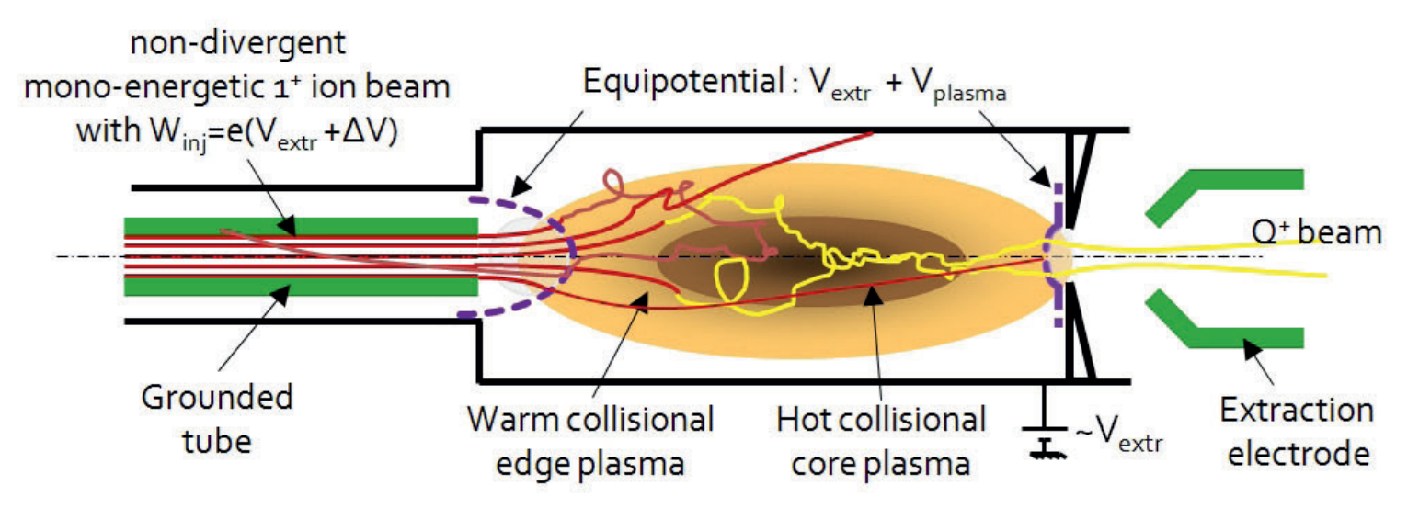
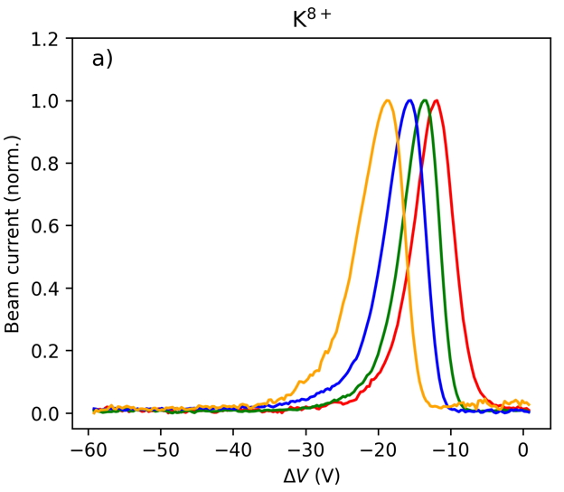
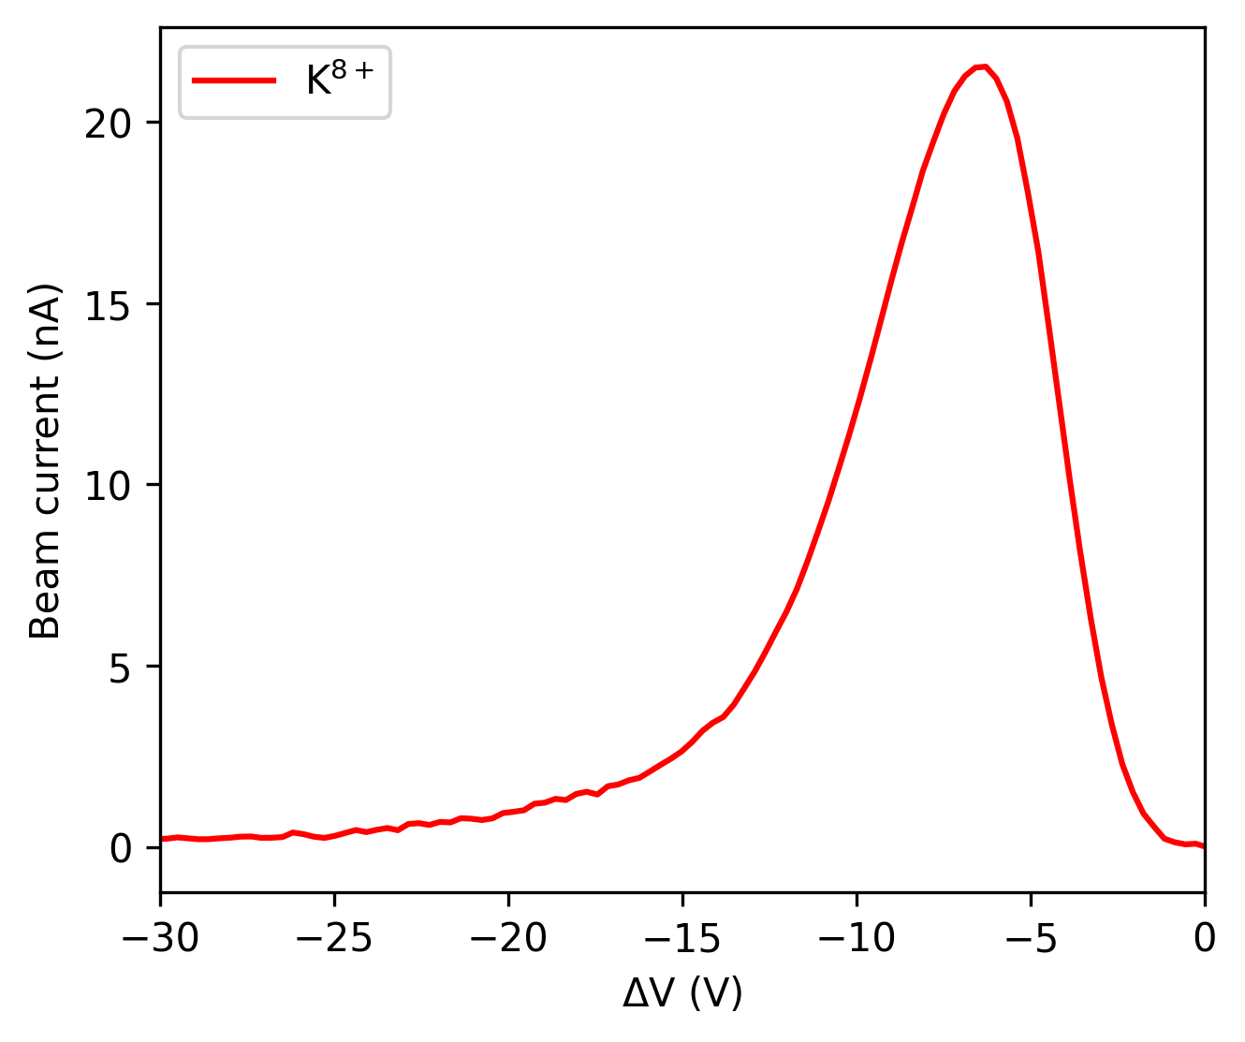
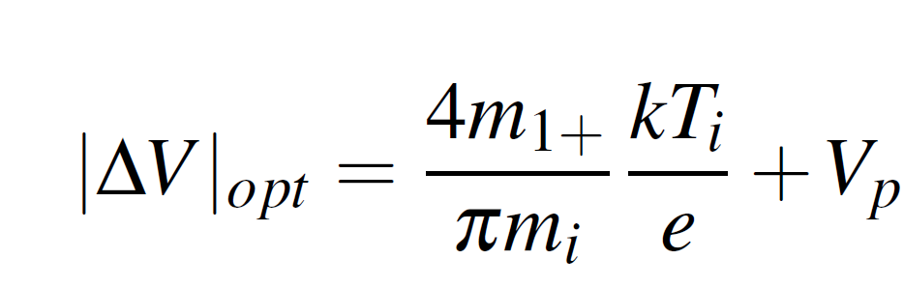
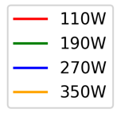
R&D on ECRIS CB
Extended collaboration on charge breeding research : GANIL – JYFL – LNL – LPSC - RAL
Different studies on plasma stability, charge breeding time in pulse mode … at LPSC and GANIL
Recently : the capture of injected ions
Wenander, Charge Breeding of Radioactive Ions
- K⁸⁺
Historically : Capture process theory based on small angle deviations by ion-ion collisions with the buffer gas plasma ions leading to their thermalisation
New model : slowing down of injected ions essentially electrostatically

Slide 13
R&D on ECRIS CB
Technology | EBIS CB | ECRIS CB
Max 1+ RIB intensity (pps) | <10¹¹ | >10¹³
CB time (ms) | 10 - 100 | 100 - 300
Operation mode | Pulsed | CW or pulsed
Robustness | Medium | High
1+N+ conversion efficiency (%) | 5 -20 % | 10 – 20%
RIB total contamination rate extracted (pps) | ∼ 10⁵ | ∼10⁹ - 10¹⁰
Upstream requirement | Ion cooling | None
Maximum A/q : A ∼ 60 Maximum A/q : A ∼ 150 | 2 - 3 6 - 7 | 2 - 3 5 - 6
ECR CB offers high 1+ beam acceptance > 10¹³ pps with a constant contamination yield but higher than EBIS CB
High RIB fluxes are expected in future ISOL facilities like FRIB (10¹²pps in some cases, under commissioning) or EURISOL (10¹² pps)
TRIUMF facility recently equipped with both technologies

Slide 14
R&D on ECRIS CB
New concept of superconducting Charge Breeder
+20% efficiency, -40% CB Time, drastic reduction of contaminants
Flat Field ECR CB @ 14-18 GHz, NbTi@4 K
Thermal screen
and Water cooled
300°Surface
plasma chamber
Pure metal or light
alloy
HV insulator
CRYO
PUMP
CRYO
PUMP
Heater wire to bake
The plasma chamber
Online up to 400°C
Plasma chamber:
Ø200 mm
L~1000 mm
ECR Zone ~500 mm
Thuillier, ECRIS 2018 workshop

Slide 15
Conclusion
ECR Charge Breeders are efficient instruments that accept a very high 1+ beam flux which could be of high interest for future ISOL facilities with high production yield
The beam purity issue can be addressed with high downstream separation and additional R&D must be carried out to reduce the contaminants
ECR Charge Breeding technics can be improved and solutions are identified to enhance the performances through a new generation of source

Slide 16
Thank you for your attention

Slide 17
LPSC 1+N+ test bench

Slide 18
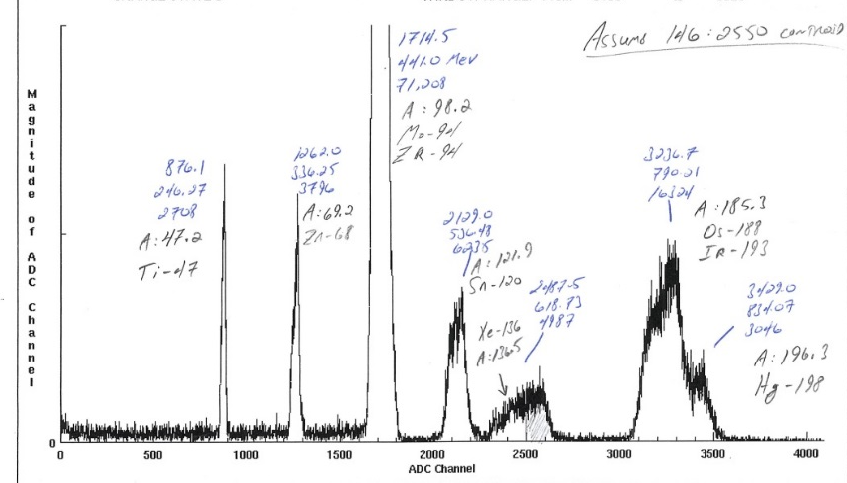

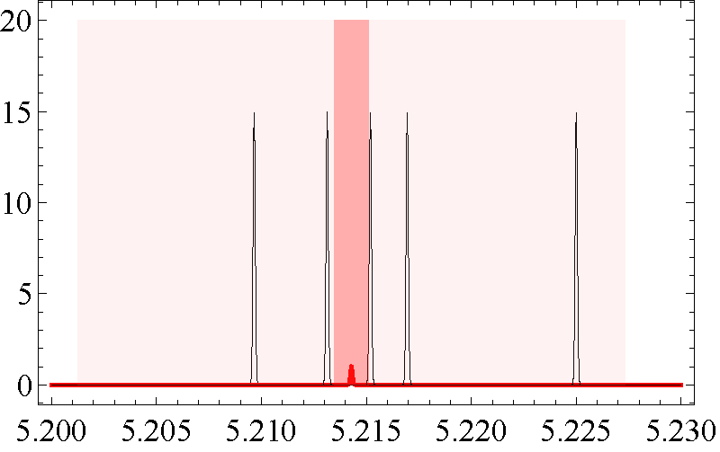
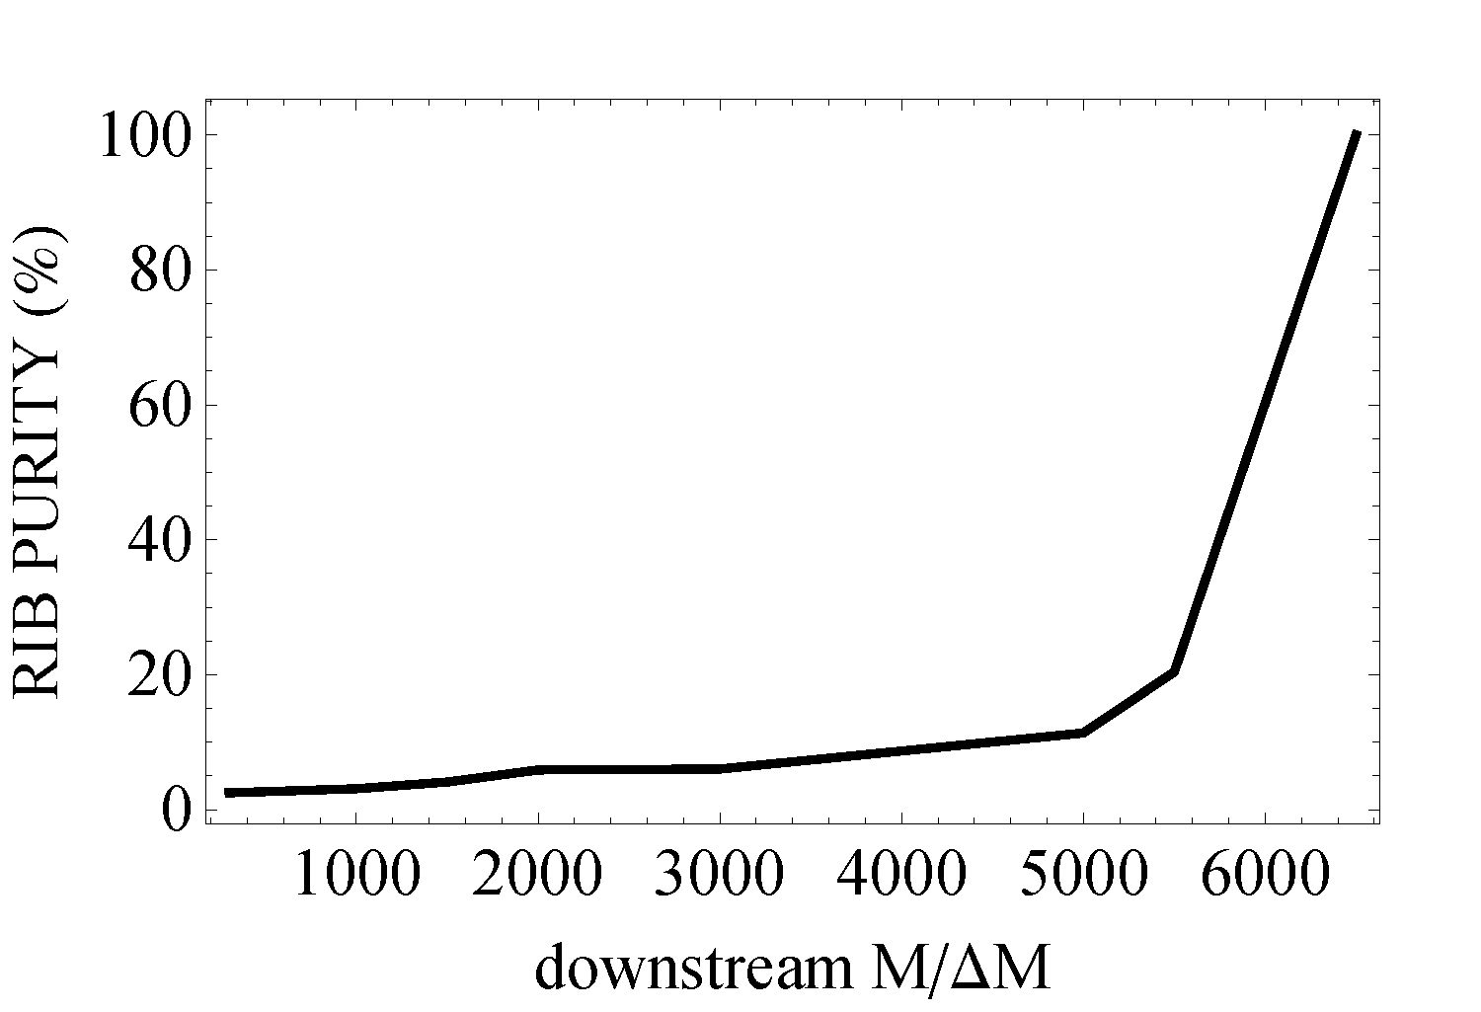



Beam purity issue
  2.7% of RIB content in the beam
  with $\frac{M}{ΔM}\sim 300$
  60% RIB would need $\frac{M}{ΔM}\sim 6000$
~3% of total beam current
⁹⁴Mo¹⁸⁺
⁹⁴Zr¹⁸⁺
⁴⁷Ti⁹⁺
⁶⁸Zn¹³⁺
¹⁹³Ir³⁷⁺
¹²⁰Sn²³⁺
$$\frac{M}{ΔM}\sim 6000$$
$$\frac{M}{ΔM}\sim 300$$
¹³⁶Xe²⁶⁺
¹⁴⁶Ba²⁸⁺
¹⁹⁸Hg³⁸⁺
Ionization chamber signals
¹⁴⁶Ba
case
Thuillier, ECRIS 2018 workshop

Slide 19
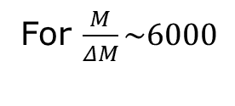
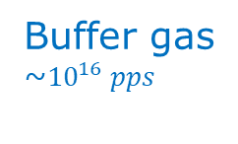
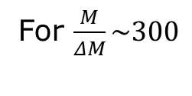
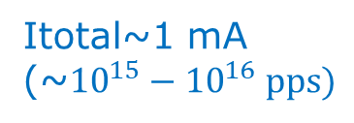
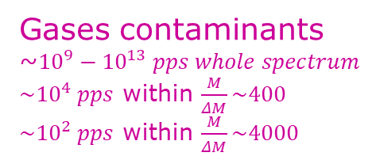
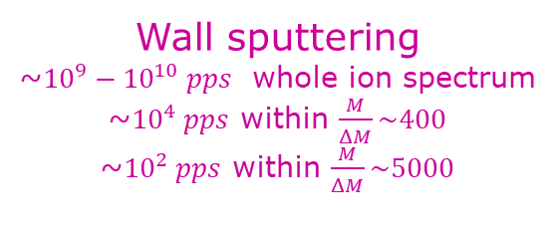

Beam purity issue
Wall sputtering
~${10}^{9}−{10}^{10} pps$ whole ion spectrum
~${10}^{4} pps$ within $\frac{M}{ΔM}\sim 400$
~${10}^{2} pps$ within $\frac{M}{ΔM}\sim 5000$
Buffer gas
~${10}^{16} pps$
Gases contaminants
~$10^{9}−10^{13} pps whole spectrum$
$\sim 10^{4} pps$ within $\frac{M}{ΔM}\sim 400$
$\sim 10^{2} pps$ within $\frac{M}{ΔM}\sim 4000$
14 GHz ECR
contaminants
1+ signal
$$up to 10^{13} pps$$
Itotal~1 mA
(~${10}^{15}−{10}^{16} pps)$
N+ signal
Signal to noise ratio is a key parameter for ECRIS CB at low RIB intensity:
Signal (pps) | 10³ | 10⁴ | 10⁵ | 10⁶ | 10⁷
Signal/Noise | 0.01 | 0.1 | 1 | 10 | 100
N+ RIB fraction | 0.9% | 9% | 50% | 91% | 99%
Signal/Noise | 1 | 10 | 100 | 1000 | 10000
N+ RIB fraction | 50% | 91% | 99% | 99.9% | 99.99%
For $\frac{M}{ΔM}\sim 300$
For $\frac{M}{ΔM}\sim 6000$
ANL
Thuillier, ECRIS 2018 workshop

Slide 20
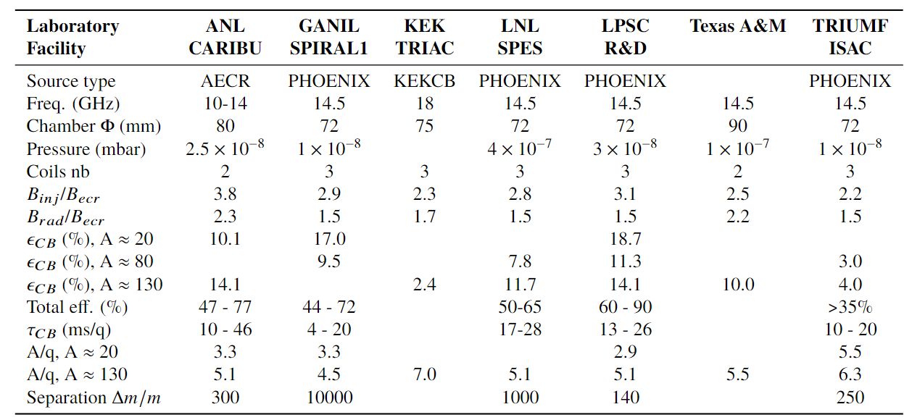
ECR Charge Breeder performances
Different CB configurations
Different facility configurations
Efficiency : 5 to 20%
Total efficiency : 35 to 90%
CB time : 10 – 28 ms/q
ECR CB offer high 1+ beam acceptance > 10¹³ pps with a constant contamination yield
High RIB fluxes are expected in future ISOL facilies like FRIB (>10¹⁰pps in some cases, under commissionning)
or EURISOL (10¹² pps)
At FRIB a High Capacity EBIS is under development, should accept 10¹¹ pps for low mass A≈20 (H.J. Son, NACB 2021)

Slide 21
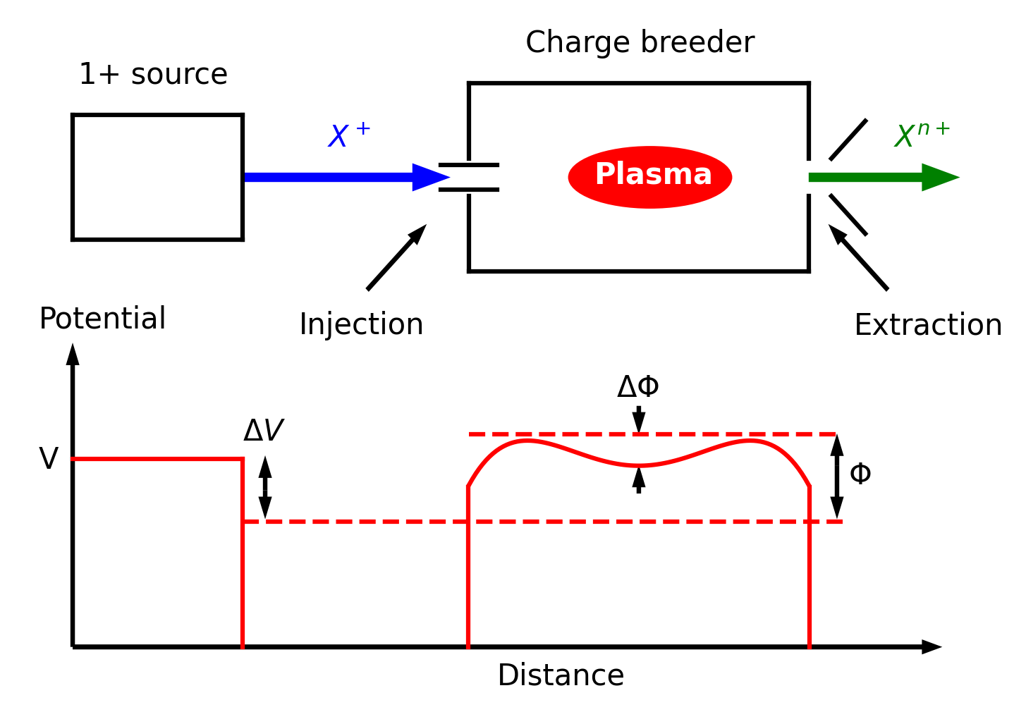
ECRIS CB
14.5 GHz 500W
0.6 m
Extraction optics
Modified min-B ECR ion source
Room temperature coils
Permanent magnet hexapole
B: 0.4 – 1.7T
14.5GHz – 600W
HV: 50kV
CW or pulse mode
1+ beam, CW
Plasma
Σ N+ beam, CW
Injection optics
3 coils + yoke
Axial B field
Hexapole
Radial B field
Injection, capture, multi ionisation, extraction
V
ΔV

