Slide 1




Status of SEASON
SEASON development team
Project Managers
O. Cloué (technic)
M. Vandebrouck (scientific)
Mechanical conception
S. Cazaux, P. Daniel-Thomas
Detection/Acquisition
F. Bouyjou, T. Chaminade
Control & Command
A. Gaget, J. Relland, A. Roger
Electrical engineering
J. Noury, Y. Reinert
Simulations
E. Rey-herme
Damien THISSE
May, 28th 2024

Slide 2
Summary
Quick reminders on SEASON
Main objectives
Description of the detector
Technical specifications
Current status of the development
Focus on detector/acquisition test bench
Schedule for upcoming months
Towards the full assembly of SEASON
Implementation of SEASON at Jyväskylä
1

Slide 3



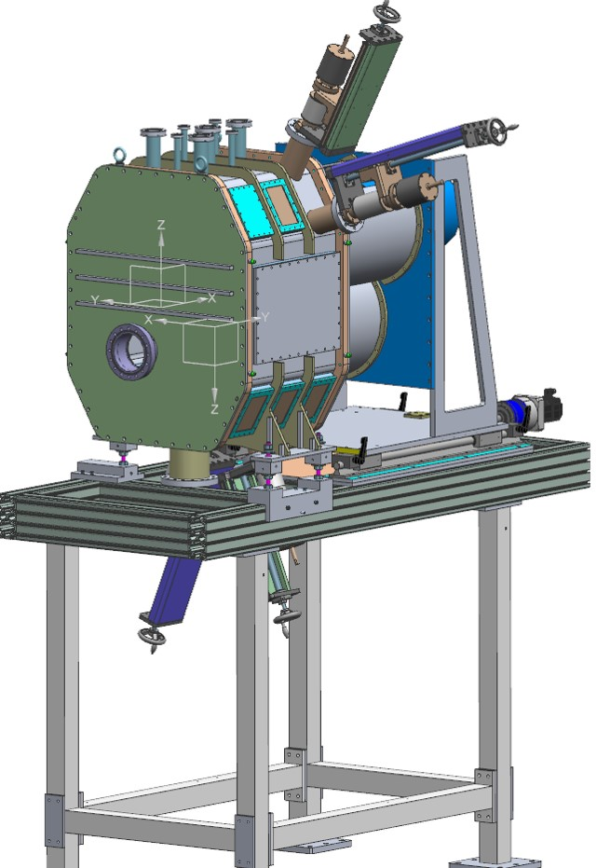


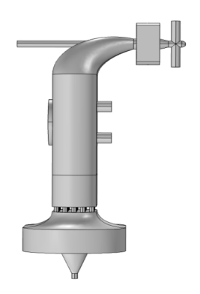


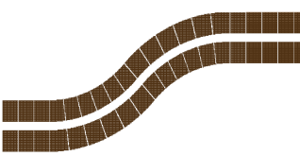

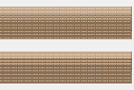


SEASON’s objectives
It has been designed to be set at the end of S³ low energy branch (LEB).
The two main purposes of SEASON@S³-LEB :
Act as a counter for laser spectroscopy.
Perform a detailed α-e─-γ decay spectroscopy.
Coupling of both nuclear and atomic approaches to get a more complete description of the nucleus.
MR ToF MS
(m/Δm ~ 10⁵)
λ₂
λ₁
λ_{1,2}
Bender
Pulse up (~ 3 kV)
SEASON
ERs from S³ (E~0.1 MeV/u)
Gas jet
ERs
Neutralized ERs
Photoions
QMF
(m/Δm ~ 100)
RFQ
buncher
Gas cell
S-shaped RFQ
Diff. pumping mRFQ
2

Slide 4
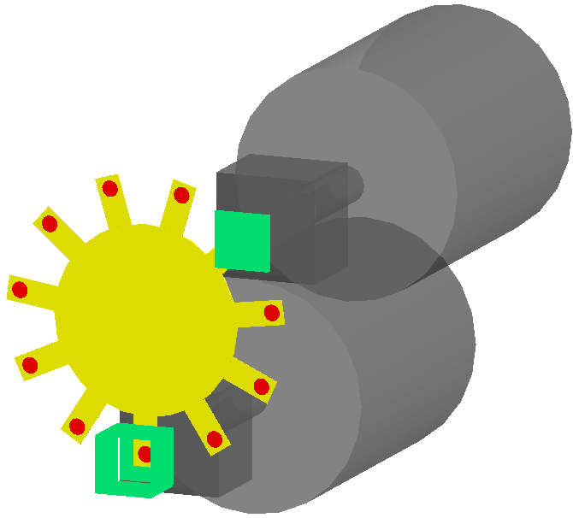
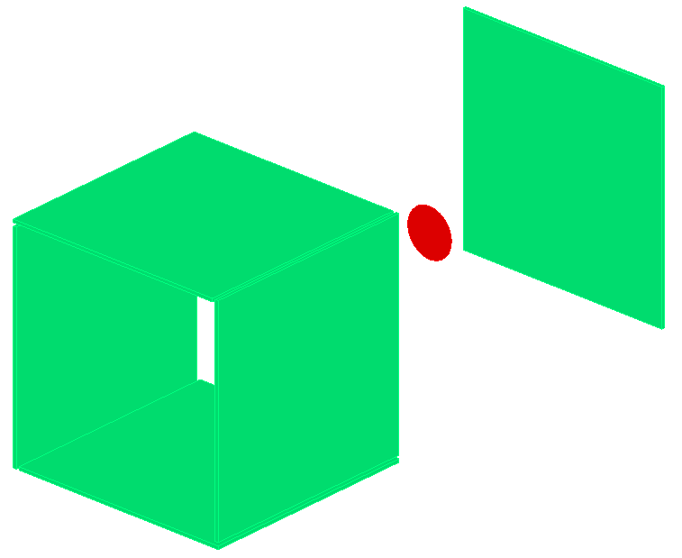
SEASON decay station
View of SEASON in GEANT4
2 DSSD
Deported station
Long T_{1/2}
Carbon foil
~90 nm thickness
Wheel
2 mm thickness
35 cm ⊘
2 HPGe detectors
EXOGAM
Variable
Min. 2 mm
α
Beam
3 - 30 keV
5 DSSD
Main station
e⁻
e⁻
3

Slide 5
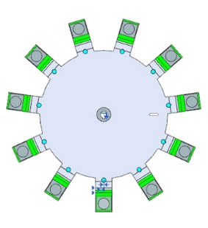
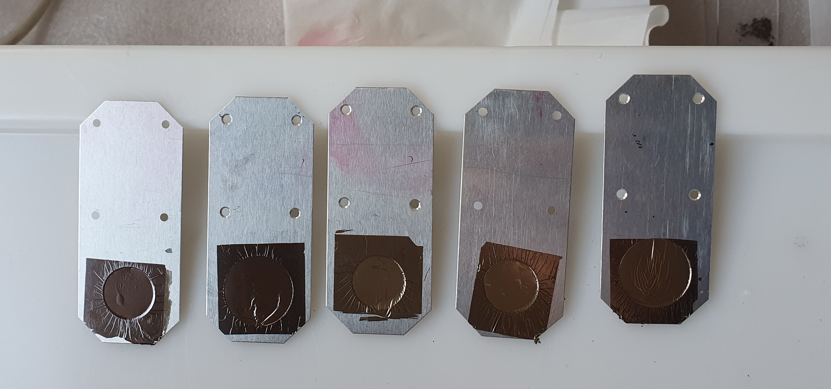
SEASON decay station
Wings must be easy to place
View of SEASON in GEANT4
Clipped
2 DSSD
Deported station
Long T_{1/2}
Carbon foil
~90 nm thickness
Wheel
2 mm thickness
35 cm ⊘
2 HPGe detectors
EXOGAM
Beam
3 - 30 keV
5 DSSD
Main station
3

Slide 6
SEASON decay station
Wings must be easy to place
View of SEASON in GEANT4
Clipped
2 DSSD
Deported station
Long T_{1/2}
Carbon foil
~90 nm thickness
Wheel
2 mm thickness
35 cm ⊘
2 HPGe detectors
EXOGAM
Beam
3 - 30 keV
5 DSSD
Main station
3

Slide 7
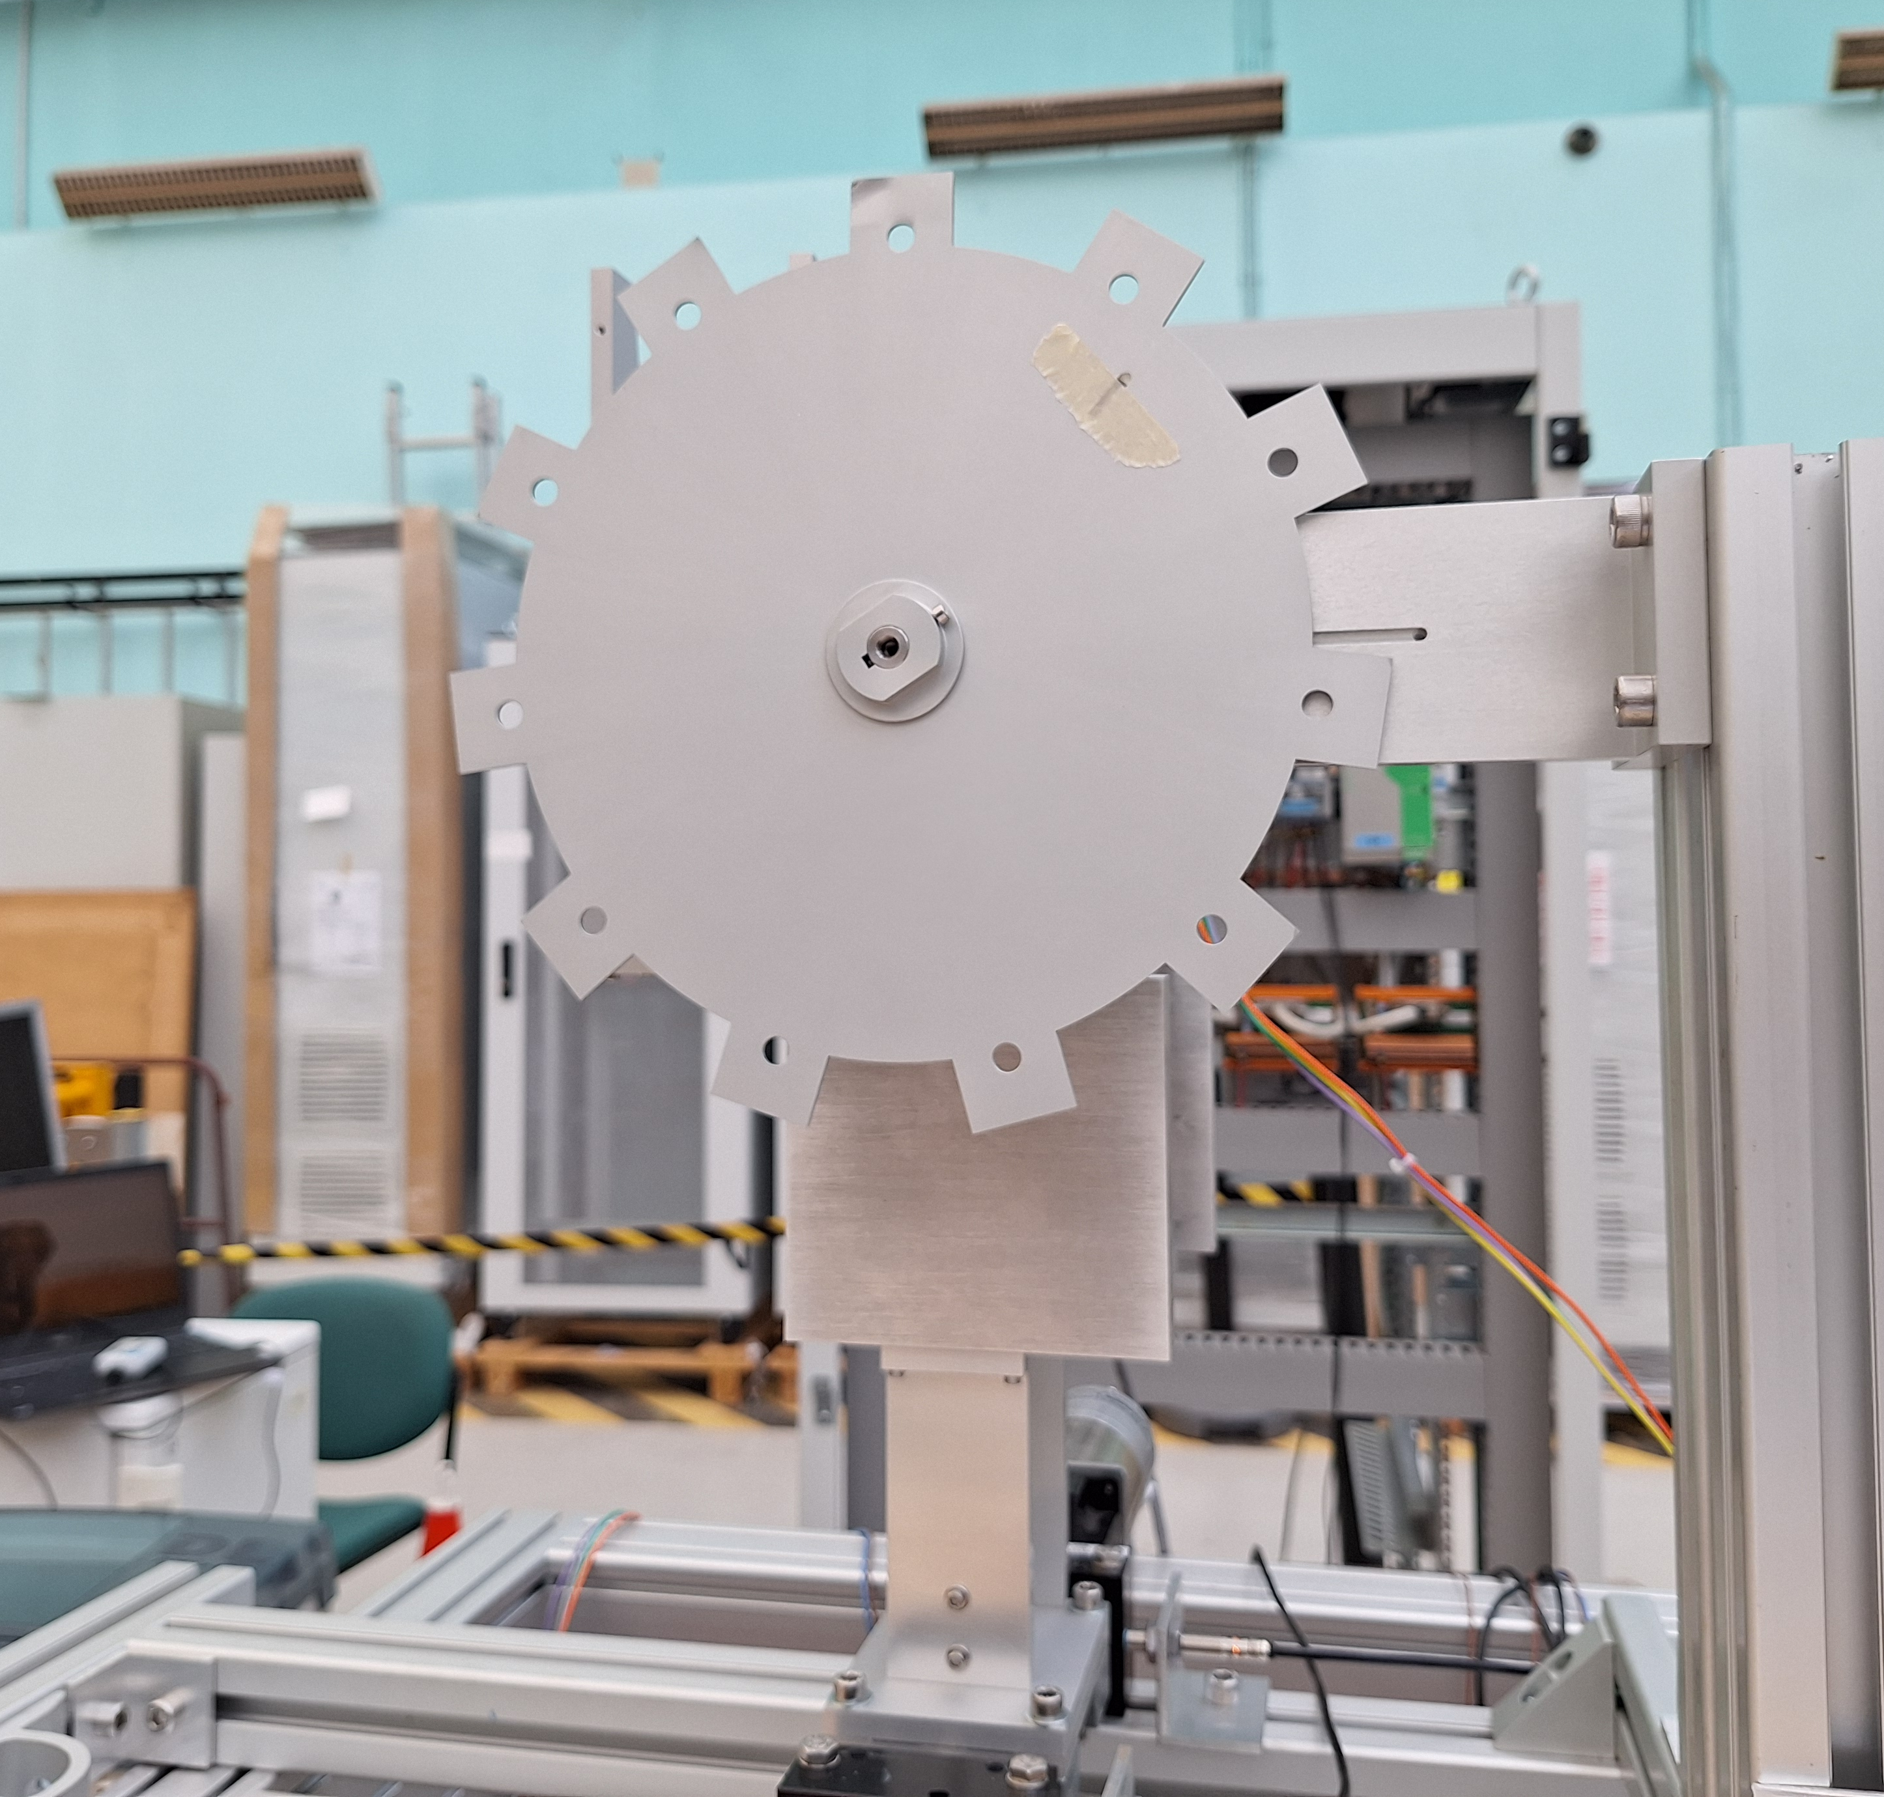
SEASON decay station
View of SEASON in GEANT4
2 DSSD
Deported station
Long T_{1/2}
Carbon foil
~90 nm thickness
Wheel
2 mm thickness
35 cm ⊘
2 HPGe detectors
EXOGAM
Beam
3 - 30 keV
5 DSSD
Main station
3

Slide 8
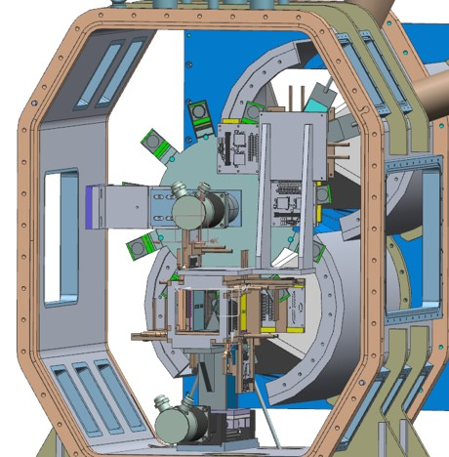
SEASON decay station
CAD of SEASON
View of SEASON in GEANT4
2 DSSD
Deported station
Long T_{1/2}
Carbon foil
~90 nm thickness
Wheel
2 mm thickness
35 cm ⊘
2 HPGe detectors
EXOGAM
Beam
3 - 30 keV
5 DSSD
Main station
S. Cazaux, P. Daniel-Thomas
3

Slide 9
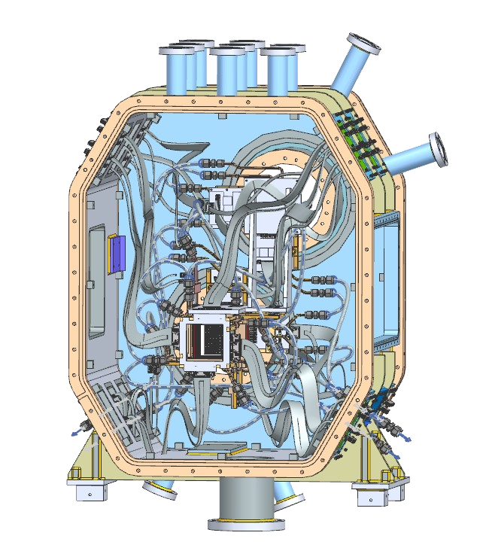
SEASON decay station
Calibration arms
2 pairs (one for each station) holding 3-α and ¹³³Ba sources
Translation/Rotation movement in order to place a calibration source at the position of the implantation foil
S. Cazaux, P. Daniel-Thomas
4

Slide 10
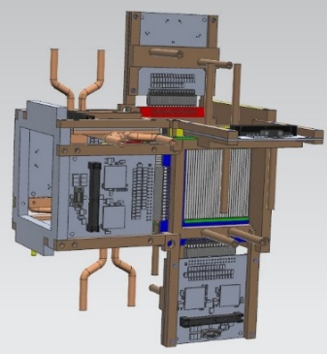
SEASON decay station
S. Cazaux, P. Daniel-Thomas
4

Slide 11
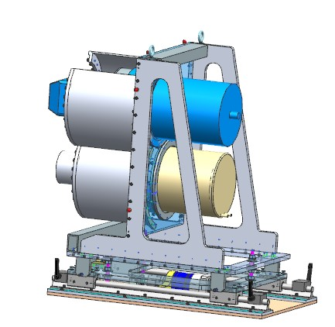
SEASON decay station
S. Cazaux, P. Daniel-Thomas
4

Slide 12
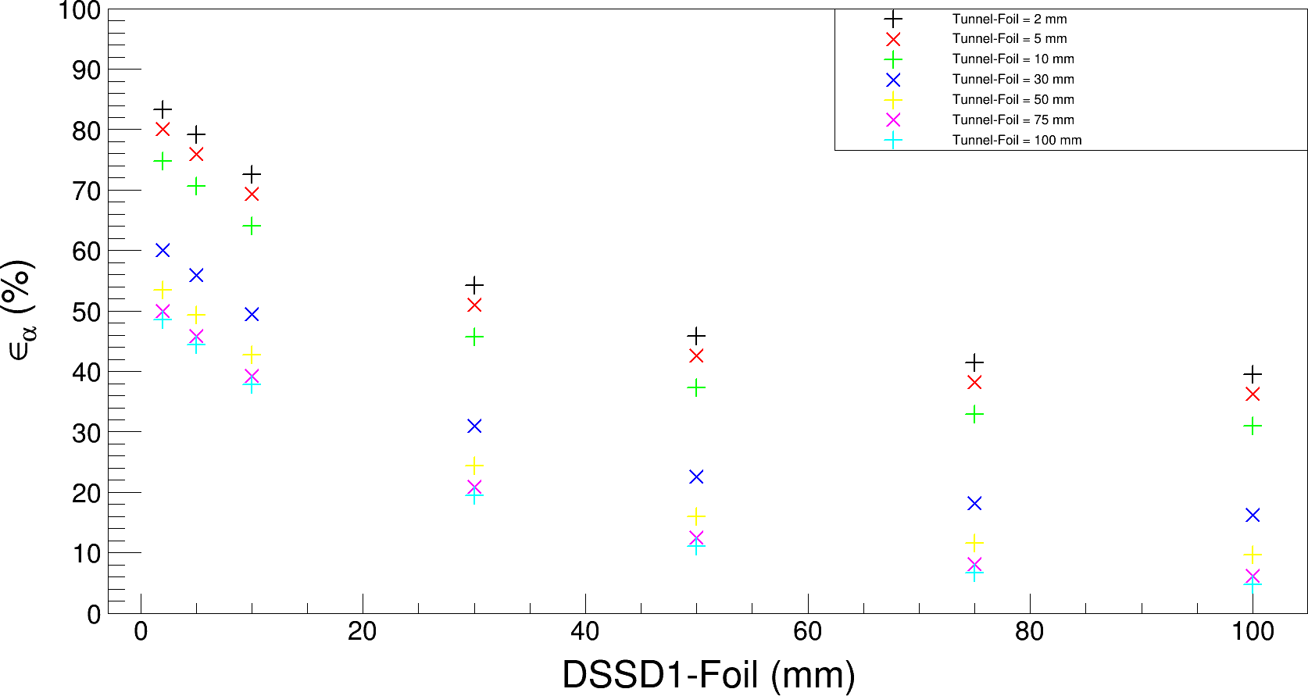
SEASON’s technical specifications
High efficiency for both electron and α-particle
Most compact configuration :
Alpha efficiency = 84 %
E. Rey-herme simulation/analysis
5

Slide 13
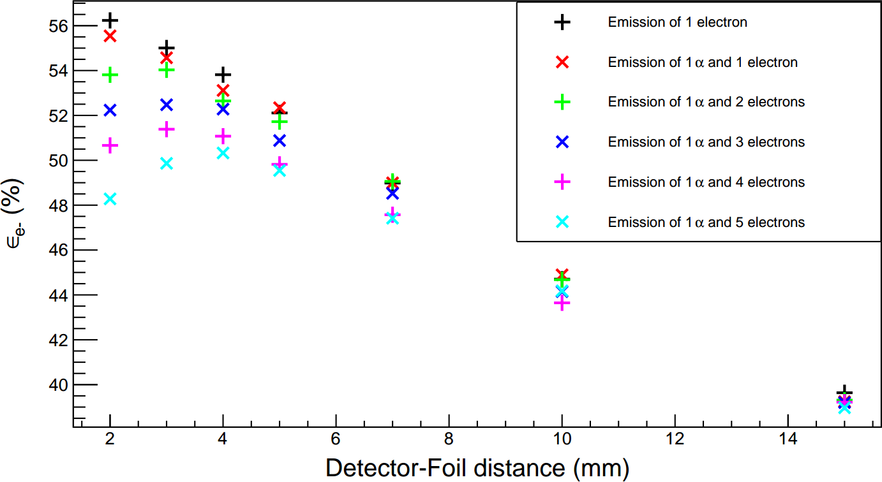
SEASON’s technical specifications
High efficiency for both electron and α-particle
Most compact configuration :
Alpha efficiency = 84 %
Electron efficiency = 56 %
… but impact of the summing effect to be taken into consideration
E. Rey-herme simulation/analysis
6

Slide 14
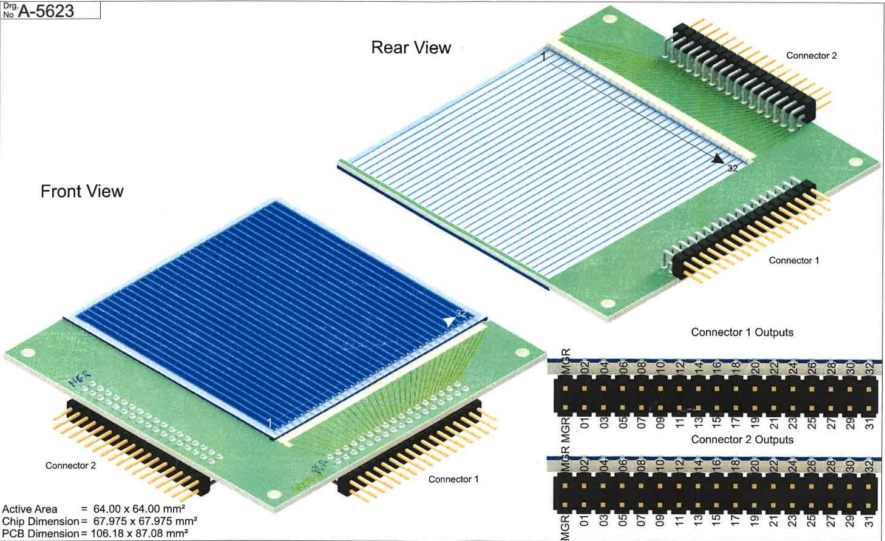
SEASON’s technical specifications
Good energy resolution for both electron and α-particle
BB7 detector from Micron
Some important characteristics :
32 strips on each face
Active area : 6.4 x 6.4 cm²
Dead layer : 50 nm
Thickness: 1037 µm
Ultra high resistivity
Nominal depletion voltage : ~75 V
7

Slide 15
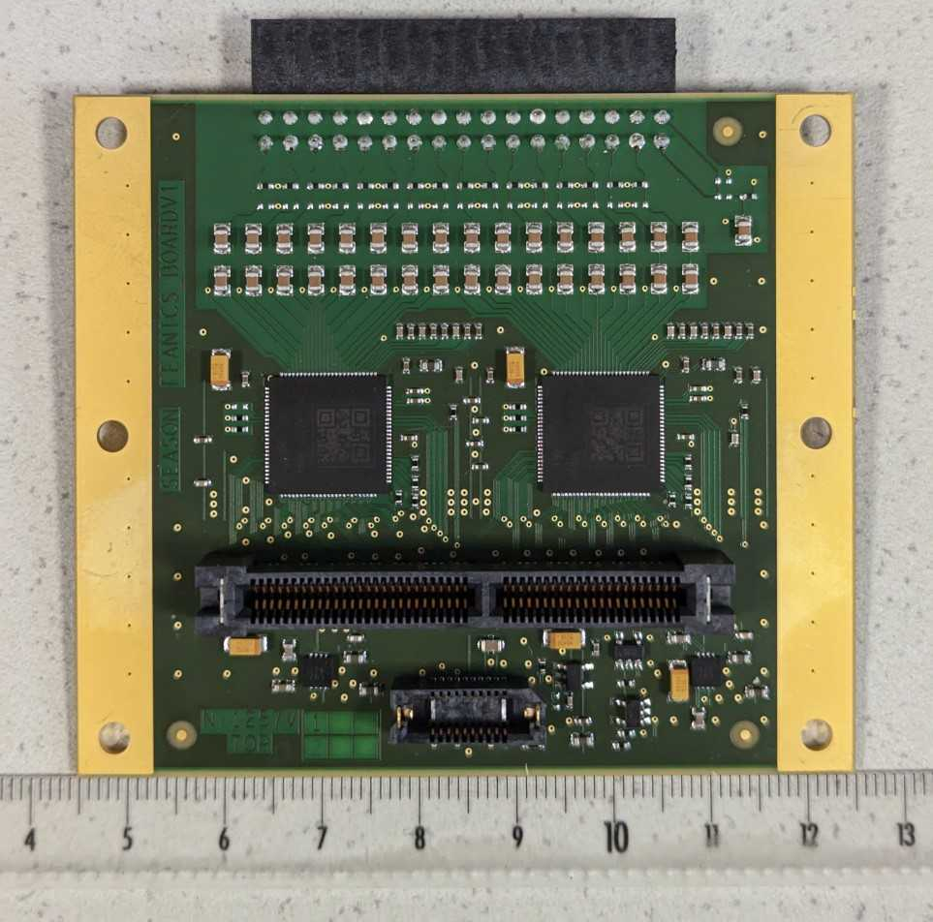

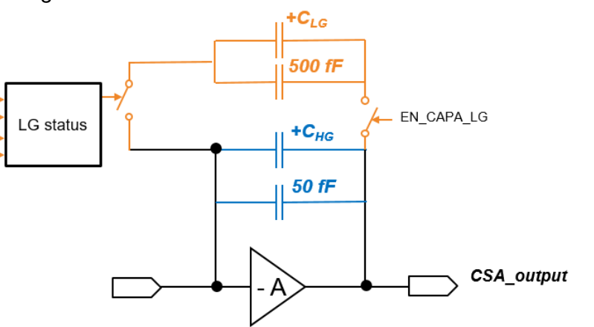
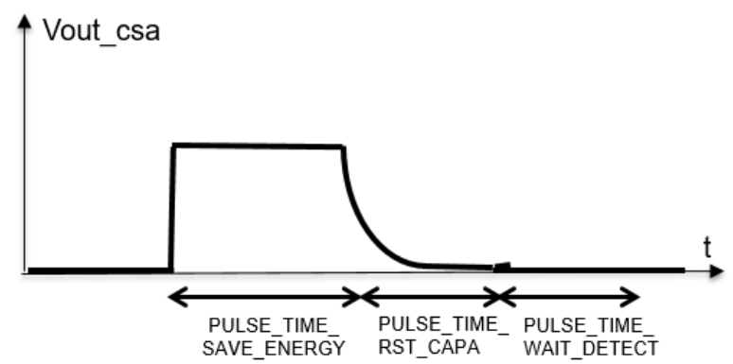
SEASON’s technical specifications
Good energy resolution for both electron and α-particle
Development of a front-end electronics for DSSD signal processing
Double gain preamplifier with automatic gain switch
Shaping
Front-End Adaptive gaiN Integrated CircuitS
CSA floor noise (no detector) : ~2.3 keV
Work of F. Bouyjou and T. Chaminade
8

Slide 16
SEASON’s technical specifications
Good energy resolution for both electron and α-particle
Development of a front-end electronics for DSSD signal processing
Double gain preamplifier with automatic gain switch
New version of the cards :
QFN packaging
New voltage regulator
→ Less noise from alimentation
Duplication of capacitors between the detector and FEANICS
→ Less leakage current
Front-End Adaptive gaiN Integrated CircuitS
CSA floor noise (no detector) : ~2.3 keV
Work of F. Bouyjou and T. Chaminade
8

Slide 17
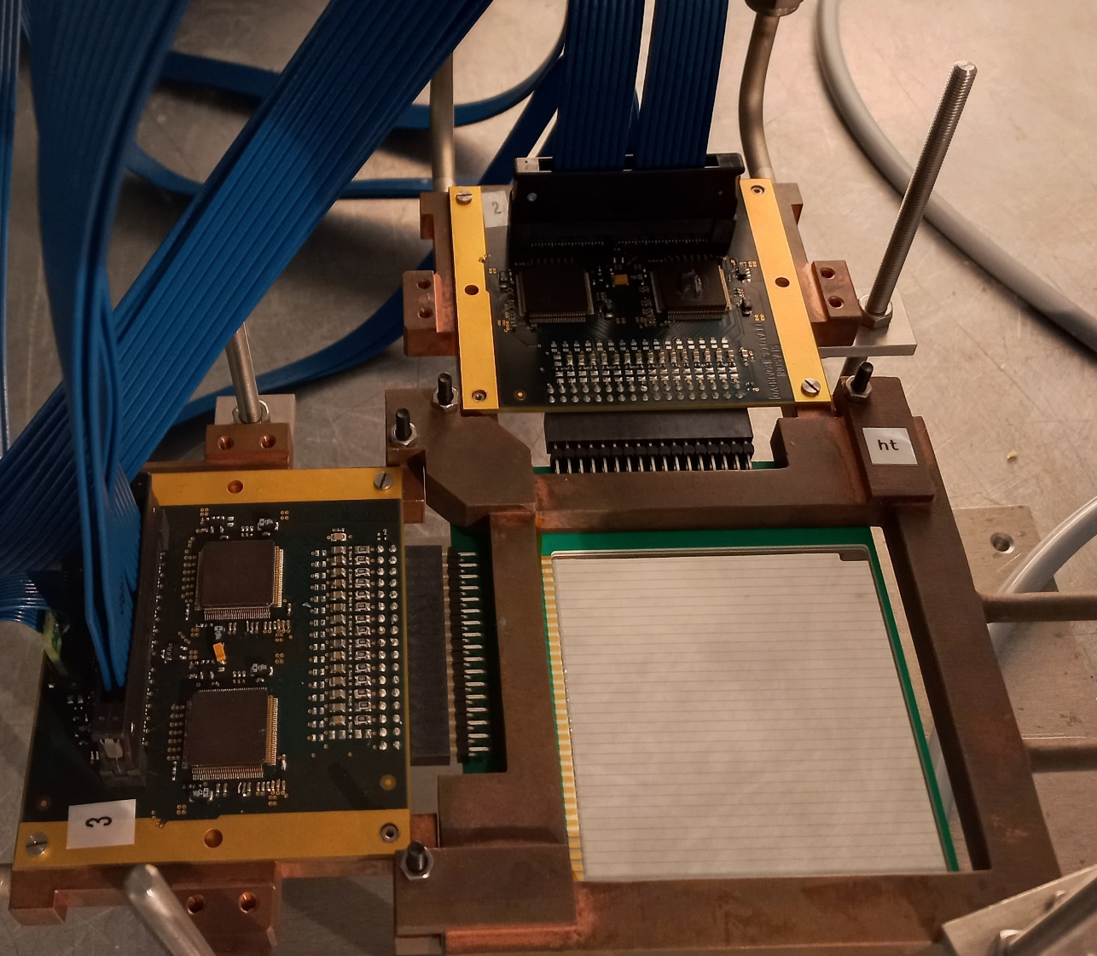
Current status of SEASON’s development
Focus on our DSSD test bench
We’re characterising the full electronic acquisition chain : DSSD → FEANICS → Numexo2
Work of M. Ragot
9

Slide 18
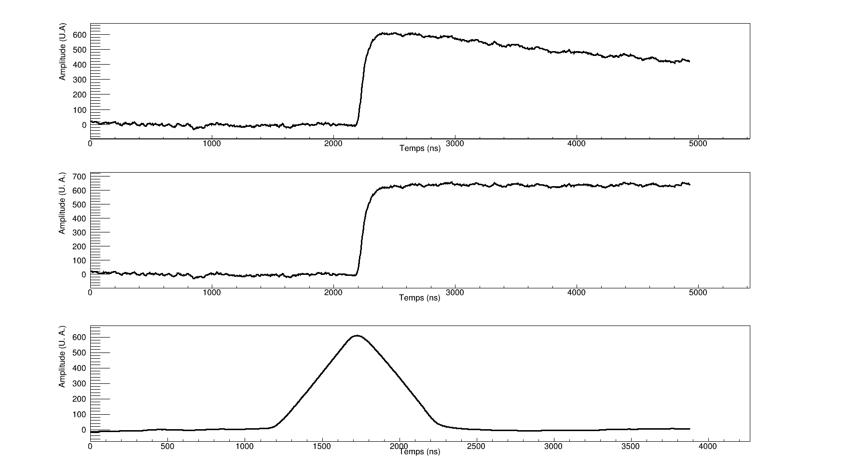
Current status of SEASON’s development
Focus on our DSSD test bench
We’re characterising the full electronic acquisition chain : DSSD → FEANICS → Numexo2
Pole-zero cancellation
Trapezoid filter
Work of M. Ragot
9

Slide 19
Current status of SEASON’s development
Focus on our DSSD test bench
We’re characterising the full electronic acquisition chain : DSSD → FEANICS → Numexo2
Pole-zero cancellation
L
G
L
Trapezoid filter
Work of M. Ragot
9

Slide 20
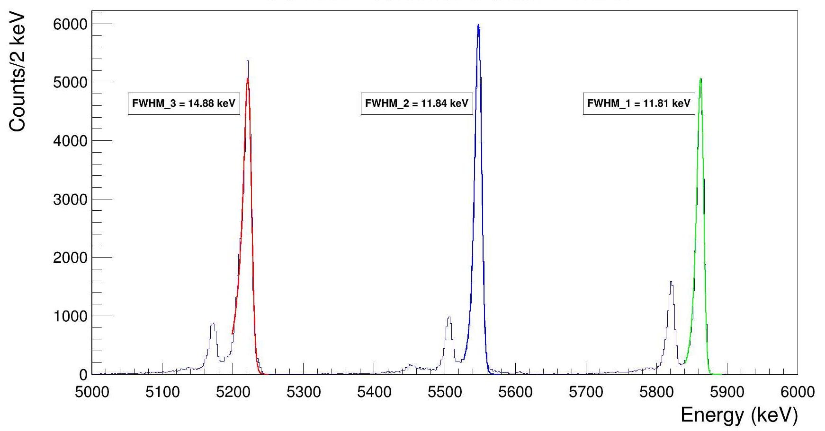
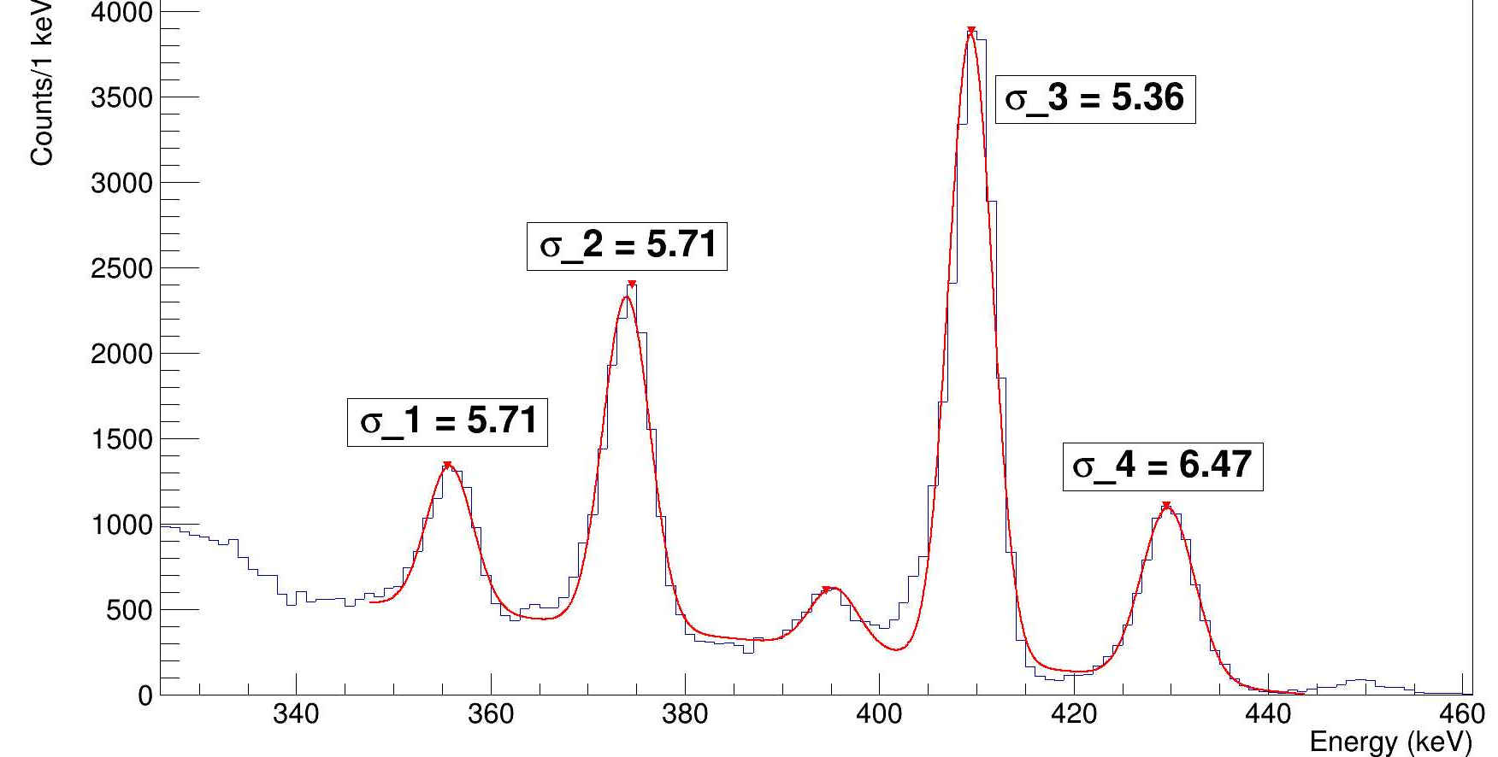
Current status of SEASON’s development
Focus on our DSSD test bench
We’re characterising the full electronic acquisition chain : DSSD → FEANICS → Numexo2
3-α calibration source (²³⁹Pu, ²⁴¹Am, ²⁴⁴Cm)
FWHM @ 5804.77keV : 11.8 keV (was 17 keV!)
Obtained with fixed Gain
Measured on central strips (normal incidence)
Electron source (¹³³Ba)
FWHM @ 320.3 keV : ~6 keV (was 10.2 keV!)
Obtained with fixed Gain
Measured on central strips (normal incidence)
FWHM
FWHM
FWHM
FWHM
Work of M. Ragot
10

Slide 21
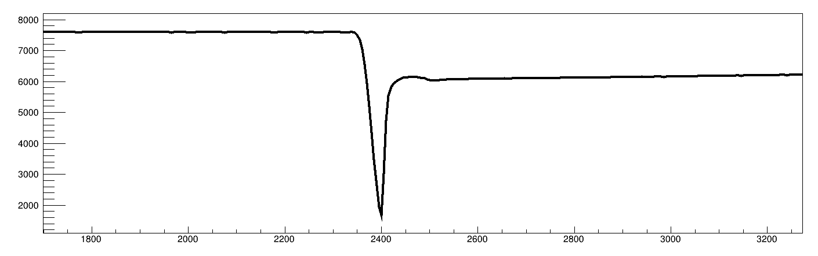
Current status of SEASON’s development
Focus on our DSSD test bench
We’re characterising the full electronic acquisition chain : DSSD → FEANICS → Numexo2
Baseline
Amplitude (A. U)
Development of methods to accurately tackle with the gain switched traces
High Gain regime
Low Gain regime
Gain Switch Threshold
Time (ns)
11

Slide 22
Current schedule for SEASON commissioning
2024
2025
T1
T2
T3
T4
T1
T2
T3
Mechanical mounting at CEA-Saclay
General test of all the electronics
Test of control and commands (wheel, det. position, calibration arms…)
Mounting and alignment of SEASON with and without vacuum
Write/adjust a set-up protocol
12

Slide 23
Current schedule for SEASON commissioning
2024
2025
T1
T2
T3
T4
T1
T2
T3
Mechanical mounting at CEA-Saclay
Complete test of SEASON without beam using GANIL acquisition system
First real-case measurement of SEASON’s characteristics (efficiency, timing properties, ...)
Source commissioning at GANIL
12

Slide 24
Current schedule for SEASON commissioning
2024
2025
T1
T2
T3
T4
T1
T2
T3
...
Experimental campaign
Mechanical mounting at CEA-Saclay
Transport and installation at IGISOL
Complete* test of SEASON with beam using Jyväskylä acquisition system
Source commissioning at GANIL
Commissioning experiment :
²³²Th(p, xn)^{233-x}Pa (accepted)
Online commissioning at Jyväskylä
Considered experiments :
²³²Th(α, xn)^{236-x}U
²³³U(p, xn)^{234-x}Np
²³³U(α, xn)^{237-x}Pu
Coupling with mass measurement (trap)
* without deported station
12

Slide 25
Conclusion on SEASON’s development
Assembly of SEASON at Saclay + Reception and test of the 6 remaining detectors should start in June
The interface and network for the control of SEASON’s elements (wheel, detector positions, …) is under development.
The carbon implantation foils have been tested several times on different real case experiments (VADER@JYFL in Oct. 2022, Musett@ISOLDE in June 2023)
The first DSSD of SEASON is being tested with the new FEANICS card.
Very promising results regarding the energy resolution.
Current schedule :
Assembly and test at Saclay : June – October 2024
Moving to GANIL for offline commissioning : November 2024
Moving to Jyväskylä for online commissioning : Spring 2025
13

Slide 26
Conclusion on SEASON’s development
Assembly of SEASON at Saclay + Reception and test of the 6 remaining detectors should start in June
The interface and network for the control of SEASON’s elements (wheel, detector positions, …) is under development.
The carbon implantation foils have been tested several times on different real case experiments (VADER@JYFL in Oct. 2022, Musett@ISOLDE in June 2023)
The first DSSD of SEASON is being tested with the new FEANICS card.
Very promising results regarding the energy resolution.
Current schedule :
Assembly and test at Saclay : June – October 2024
Moving to GANIL for offline commissioning : November 2024
Moving to Jyväskylä for online commissioning : Spring 2025
Thank you for your attention
13

Slide 27
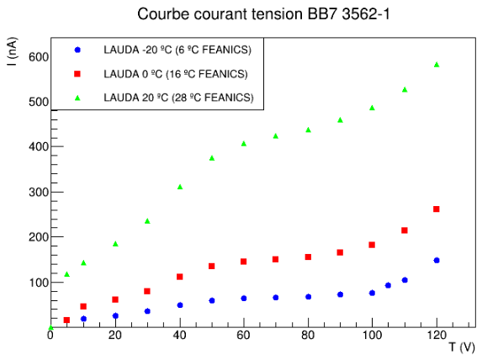
Leakage current comparison
4 times smaller compared to the previous FEANICS card
BU1

Slide 28
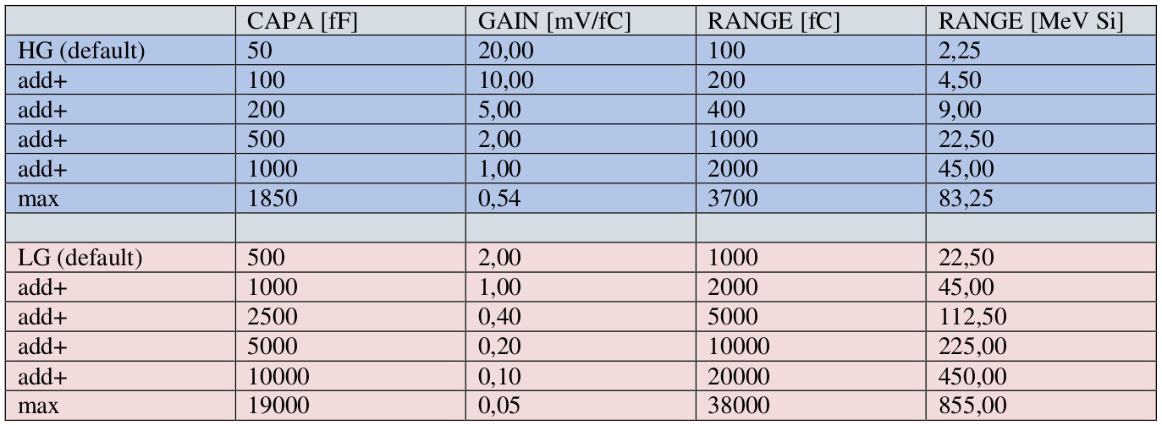
BU2

