Slide 1
HIGH-PRECISION MASS MEASUREMENTS OF ^{68,69,70}Co AT IGISOL/JYFL
M. Flayol, A. de Roubin, P. Ascher, D. Atanasov, B. Blank, L. Canete, Q. Délignac, T. Eronen, Z. Ge, M. Gerbaux, S. Grévy, M. Hukkanen, A. Husson, A. Jaries, A. Kankainen, I. D. Moore, M. Mougeot, M. Stryjczyk, J. Ruotsalainen, V. Virtanen
Pauline Ascher – ISOL-France Meeting – 27-29 May 2024

Slide 2
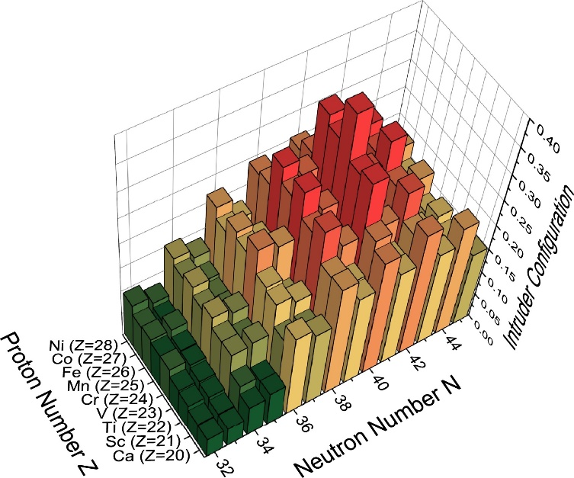
N=40 REGION
N=40
Collective behavior rapidly develops as protons are removed from f_{7/2} orbital
(Sudden drop of E(2⁺) between ⁶⁸Ni and ⁶⁶Fe)
Adding neutrons on g_{9/2} weakens the Z=28 gap
Z=28
Possibilities of ph excitations across both N=40 and Z=28
→ Island of Inversion
f7/2
g9/2
Silwal, R. et al, PLB 833, 137288 (2022)
Pauline Ascher – ISOL-France Meeting – 27-29 May 2024

Slide 3
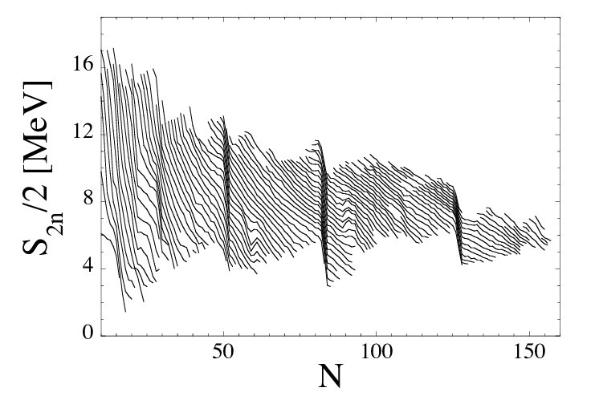
MASSES AND S2N
$$M(Z,N)=Z∙Mp+N∙Mn−BE(Z,N)$$
$$S_{2n}\left(Z,N\right)=BE\left(Z,N\right)−BE(Z,N−2)$$
Shape transitions & shape coexistence
Evolution of shell closures
Isospin symmetry (IMME, Wigner term, …)
Location of drip-lines & search for exotic radioactivities
…
Pauline Ascher – ISOL-France Meeting – 27-29 May 2024

Slide 4
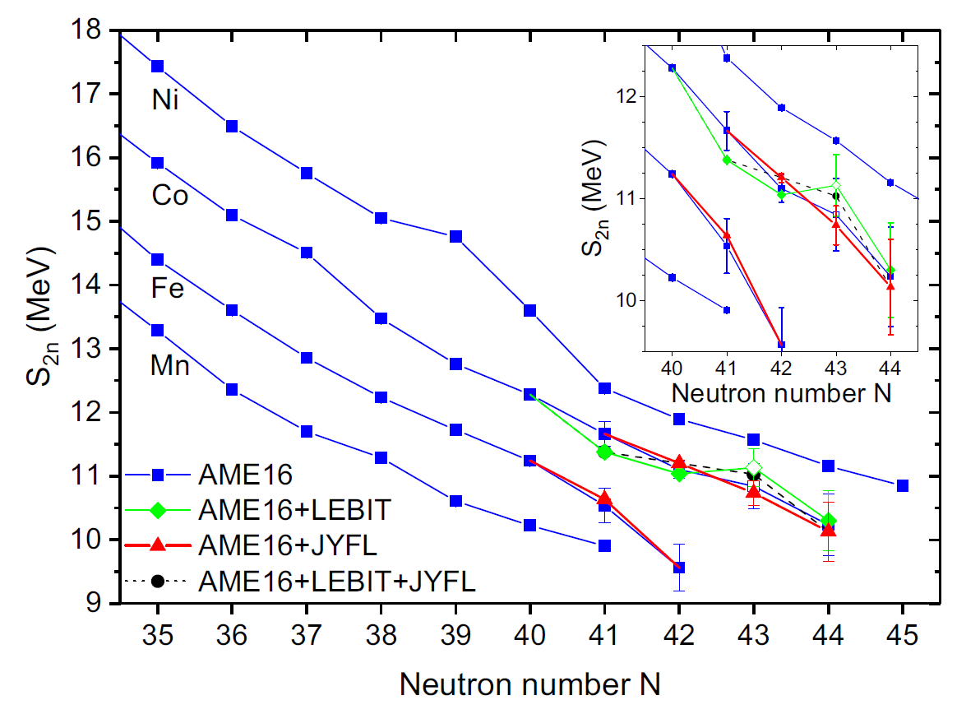
MASSES AND S2N
$$M(Z,N)=Z∙Mp+N∙Mn−BE(Z,N)$$
$$S_{2n}\left(Z,N\right)=BE\left(Z,N\right)−BE(Z,N−2)$$
Shape transitions & shape coexistence
Evolution of shell closures
Isospin symmetry (IMME, Wigner term, …)
Location of drip-lines & search for exotic radioactivities
…
N=40 REGION
Previous PT measurements
LEBIT (Izzo et al.) → ^{68,69}Co
JYFL (Canete et al.) → ^{69,70}Co
Kink at N=43
Isomer in ⁶⁸Co measured ?
L. Canete et al, PRC 101, 041304(R) (2020)
Pauline Ascher – ISOL-France Meeting – 27-29 May 2024

Slide 5
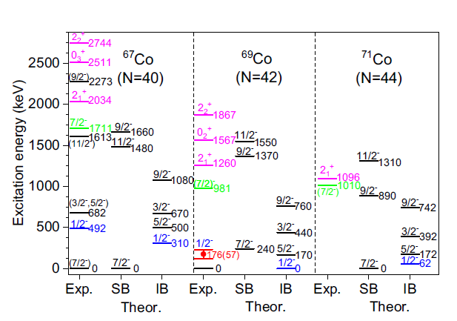
STATE OF THE ART
Odd – even Co: position of the ½- ?
(1/2-)
1p2h proton excitation from f_{7/2} across Z=28
1095.0(2) keV
(1/2-)
491.5(1) keV
1/2-#
170(90) keV
?
(7/2)-
(7/2-)
(7/2-)
(7/2-)
⁶⁵Co
⁶⁷Co
⁶⁹Co
⁷¹Co
1 proton hole in f7/2
Excitation energy in ⁶⁹Co not precise
Intruder state in ⁷¹Co ? and mass precision 500 keV
L. Canete et al, PRC 101, 041304(R) (2020)
Pauline Ascher – ISOL-France Meeting – 27-29 May 2024
Notes:
Pourquoi pour le 69Co c’est une estimation le ½- pas une mesure ?

Slide 6
STATE OF THE ART
Odd – odd Co
(3+)
(2-)
1.6(3) s
(7-)
112(7) ms
175.1(3) keV
E* ?
E* ?
?
?
(1+)
(7-)
200(20) ms
(1+)
508(7) ms
⁶⁶Co
⁶⁸Co
⁷⁰Co
Excitation energy in ⁶⁹Co not precise
Intruder state in ⁷¹Co ?
Ordering of states in ⁶⁸Co and ⁷⁰Co unknown
Excitation energy of isomers unknown for ⁶⁸Co and ⁷⁰Co
Masses of ^{68,70}Co known ?
→ (one of the) goals of the experiment: mass measurements of ^{68,69,70,71}Co (gs +m)
Pauline Ascher – ISOL-France Meeting – 27-29 May 2024

Slide 7
EXPERIMENT AT IGISOL
Spokesperson: A. de Roubin
Pauline Ascher – ISOL-France Meeting – 27-29 May 2024

Slide 8
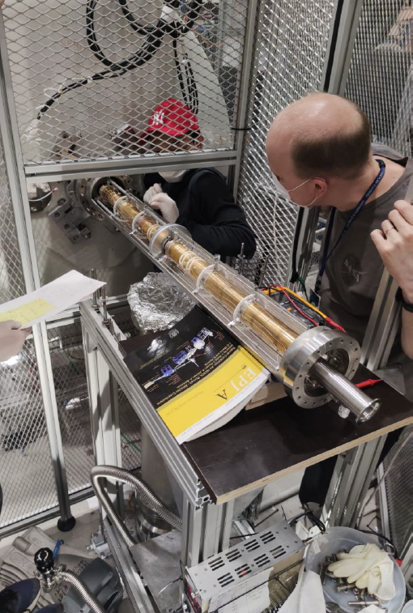
JYFLTRAP
PI-ICR
Mass-selective buffer-gas cooling
ToF-ICR
Pauline Ascher – ISOL-France Meeting – 27-29 May 2024

Slide 9
PI-ICR MASS MEASUREMENT
Reference
Reference
Reference
Reference
Ion of Interest
Ion of Interest
Ion of Interest
0
Time
1h
$$\frac{δB}{Bδt}=2,01\left(25\right).{10}^{−12}min^{−1}$$
$$ν_{c}=\frac{α_{c}+ 2πn}{2πt}$$
$$\text{B}$$
$$=\frac{qB}{2πm}$$
$$α_{c}$$
Precision for our Co cases
$\frac{Δm}{m}∼{10}^{−8}$
Pauline Ascher – ISOL-France Meeting – 27-29 May 2024

Slide 10
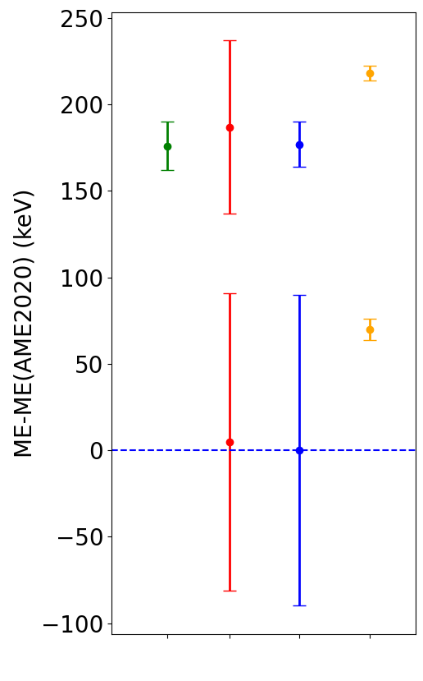
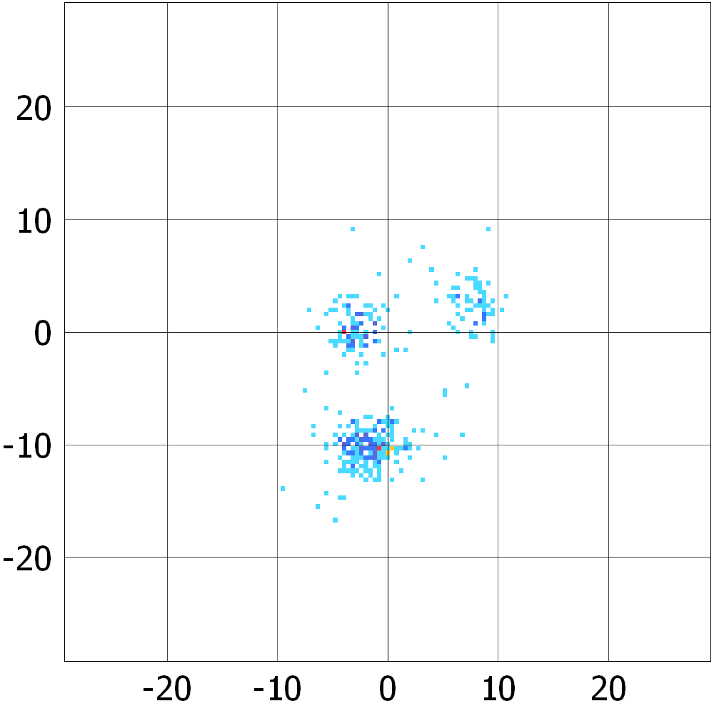
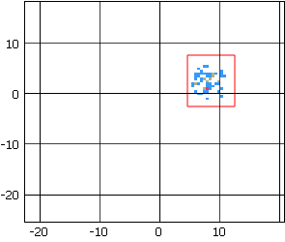
⁶⁹Co MASS EXCESS
⁶⁹Co
m
z
z
⁶⁹Co
T_{acc} = 79 ms
Counts
m
z
m
Counts
z
^{center}
^{m}
Y$(mm)$
Y$(mm)$
Y$(mm)$
g.s.
^{g.s.}
z
g.s.
g.s.
$$X(mm)$$
$$X(mm)$$
E* = 148.3(76) keV
Precision on E* improved by a factor of 12
LEBIT JYFL AME This work
Pauline Ascher – ISOL-France Meeting – 27-29 May 2024

Slide 11
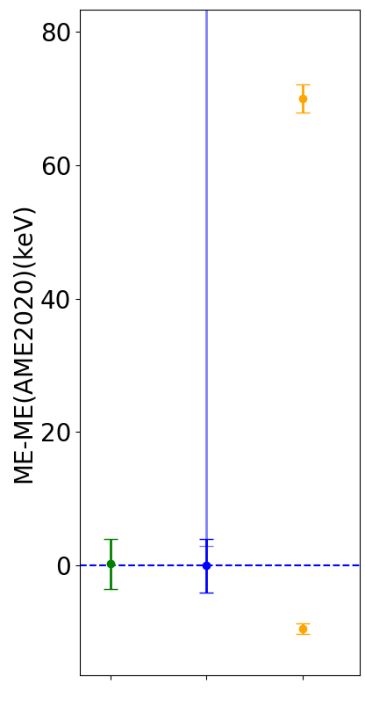
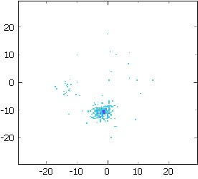
⁶⁸Co AND ⁷⁰Co MASS EXCESSES
⁶⁸Co
^{m}
T_{acc} = 113 ms
Y$(mm)$
^{m}
^{g.s.}
$$X(mm)$$
^{g.s.}
^{g.s.}
^{g.s.}
LEBIT AME This work
Pauline Ascher – ISOL-France Meeting – 27-29 May 2024

Slide 12
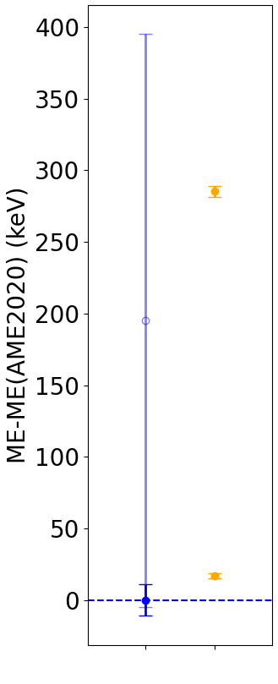
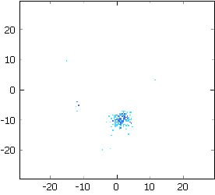
⁶⁸Co AND ⁷⁰Co MASS EXCESSES
⁷⁰Co
⁶⁸Co
^{m}
T_{acc} = 113 ms
m
T_{acc} = 35 ms
m
Y$(mm)$
Y$(mm)$
^{m}
^{m}
^{g.s.}
^{g.s.}
$$X(mm)$$
$$X(mm)$$
^{g.s.}
^{g.s.}
g.s.
^{g.s.}
g.s.
LEBIT AME This work
AME This work
Pauline Ascher – ISOL-France Meeting – 27-29 May 2024

Slide 13
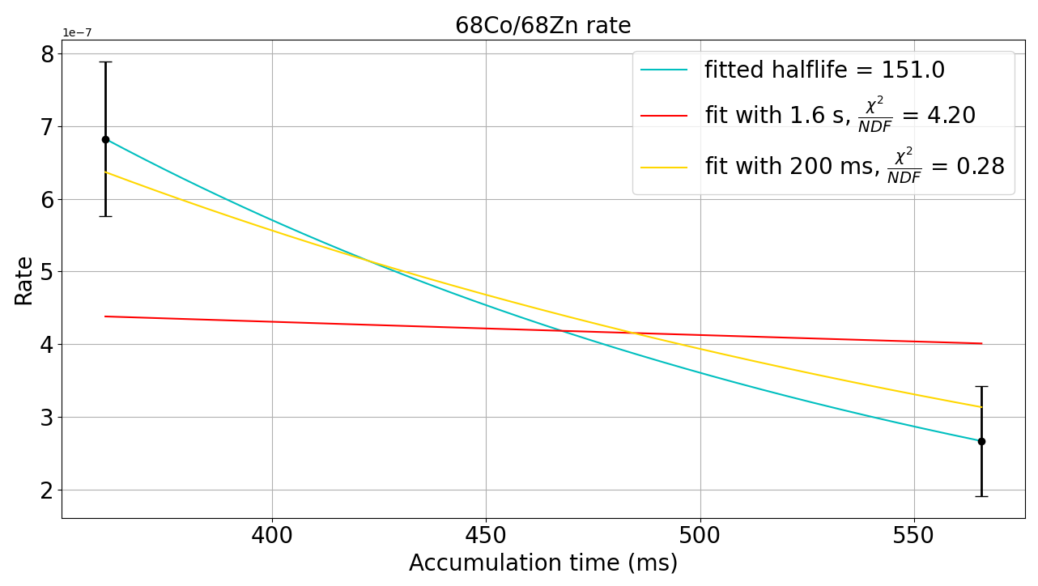
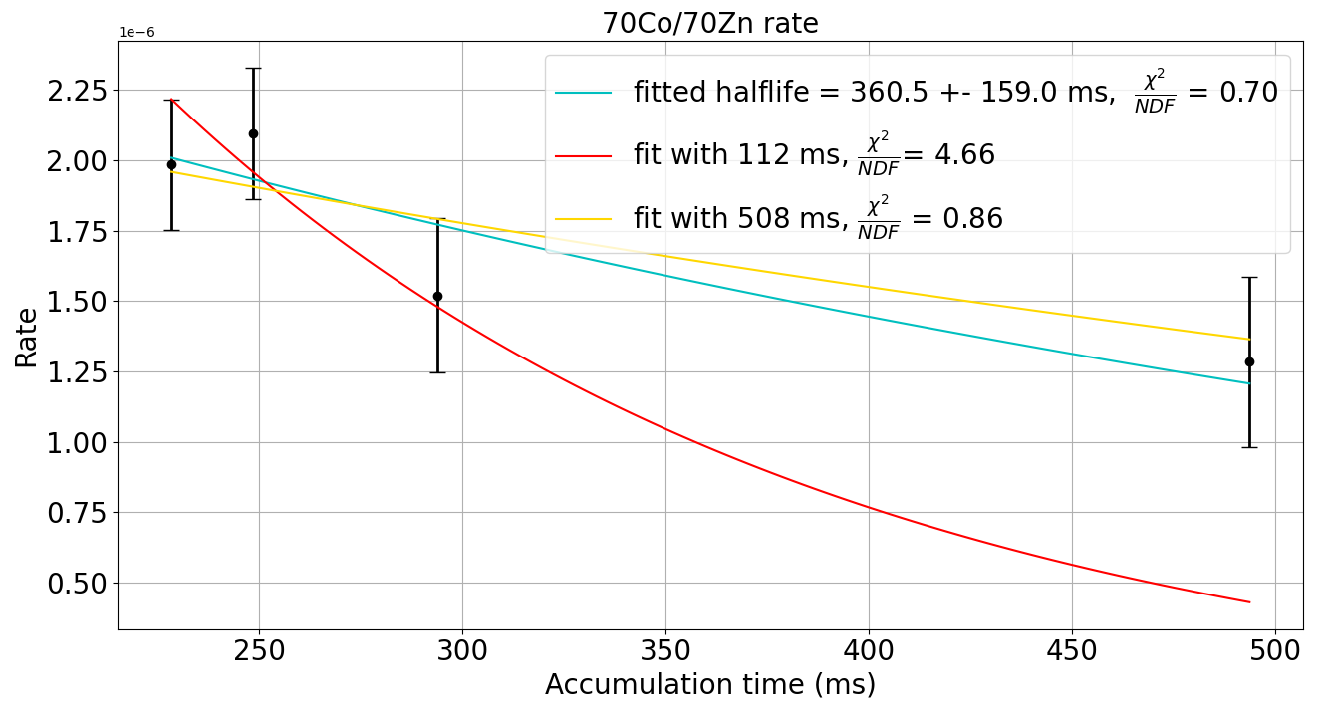
⁶⁸Co AND ⁷⁰Co GROUND-STATE RATES
(2-)
1.6(3) s
E* = 79.5(2) keV
?
(7-)
200(20) ms
⁶⁸Co
SM calculations F. Nowacki and D. Dao
in progress….
(7-)
112(7) ms
E* = 268.4(50) keV
?
(1+)
508(7) ms
⁷⁰Co
Pauline Ascher – ISOL-France Meeting – 27-29 May 2024

Slide 14
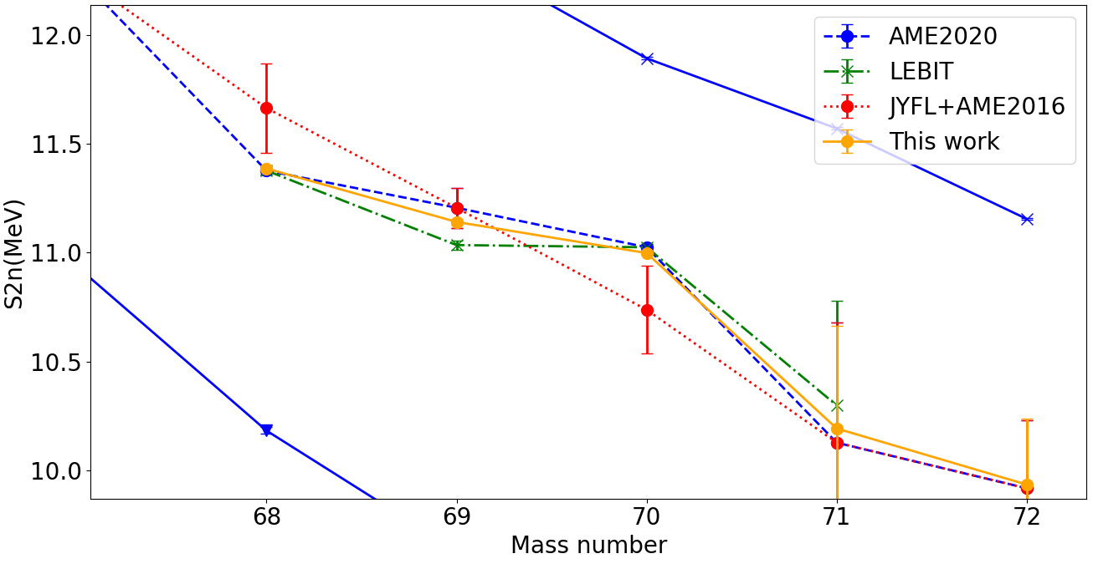
S2N TRENDS
SM calculations F. Nowacki and D. Dao
n progress….
Pauline Ascher – ISOL-France Meeting – 27-29 May 2024

Slide 15
CONCLUSIONS
Excitation energy in ⁶⁹Co not precise
Intruder state in ⁷¹Co ? (contamination of ¹⁴²Ce²⁺)
Ordering of states in ⁶⁸Co and ⁷⁰Co unknown
Excitation energy of isomers unknown for ⁶⁸Co and ⁷⁰Co
Masses of ^{68,70}Co known ?
PI-ICR analysis done by Mathieu Flayol (LP2iB)
+ PI-ICR measurements of ⁷⁹Ge and ⁷³Ni
+ (probable) MR-ToF measurements (first run) of ⁸⁵⁻⁸⁶Ge, ⁸⁸As and ^{90,91}Se → analysed by Ville Virtanen (JYFL)
Pauline Ascher – ISOL-France Meeting – 27-29 May 2024

Slide 16
THANK YOU !
M. Flayol, A. de Roubin, P. Ascher, D. Atanasov, B. Blank, L. Canete, Q. Délignac, T. Eronen, Z. Ge, M. Gerbaux, S. Grévy, M. Hukkanen, A. Husson, A. Jaries, A. Kankainen, I. D. Moore, M. Mougeot, M. Stryjczyk, J. Ruotsalainen, V. Virtanen
Pauline Ascher – ISOL-France Meeting – 27-29 May 2024

Slide 17
PI-ICR
2nd Trap
ν_{c} = ν₊ + ν₋
y_{d}
Measurement of the reference position
$$ν_{−}=\frac{φ_{−}+2πn_{−}}{2πt_{−}}$$
x_{d}
Pauline Ascher – ISOL-France Meeting – 27-29 May 2024

Slide 18
PI-ICR
2nd Trap
ν_{c} = ν₊ + ν₋
y_{d}
Measurement of the magnetron frequency
$$ν_{−}=\frac{φ_{−}+2πn_{−}}{2πt_{−}}$$
$$φ_{−}$$
Total phase accumulation:$2π{×n}_{−}+ φ_{−}$
x_{d}
Pauline Ascher – ISOL-France Meeting – 27-29 May 2024

