Slide 1
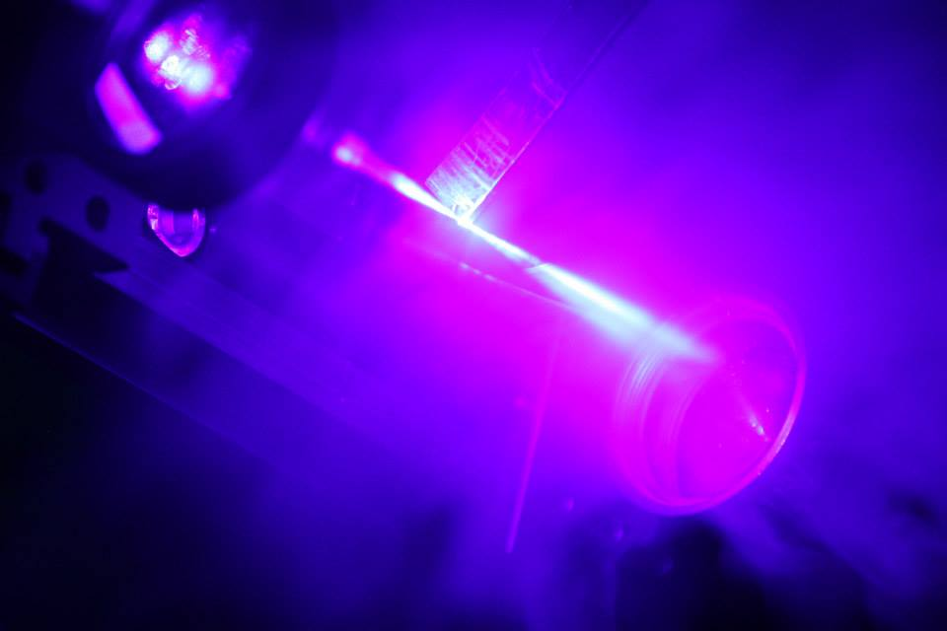
Status of the S³
Low Energy Branch
Sarina Geldhof for the S³-LEB collaboration

Slide 2
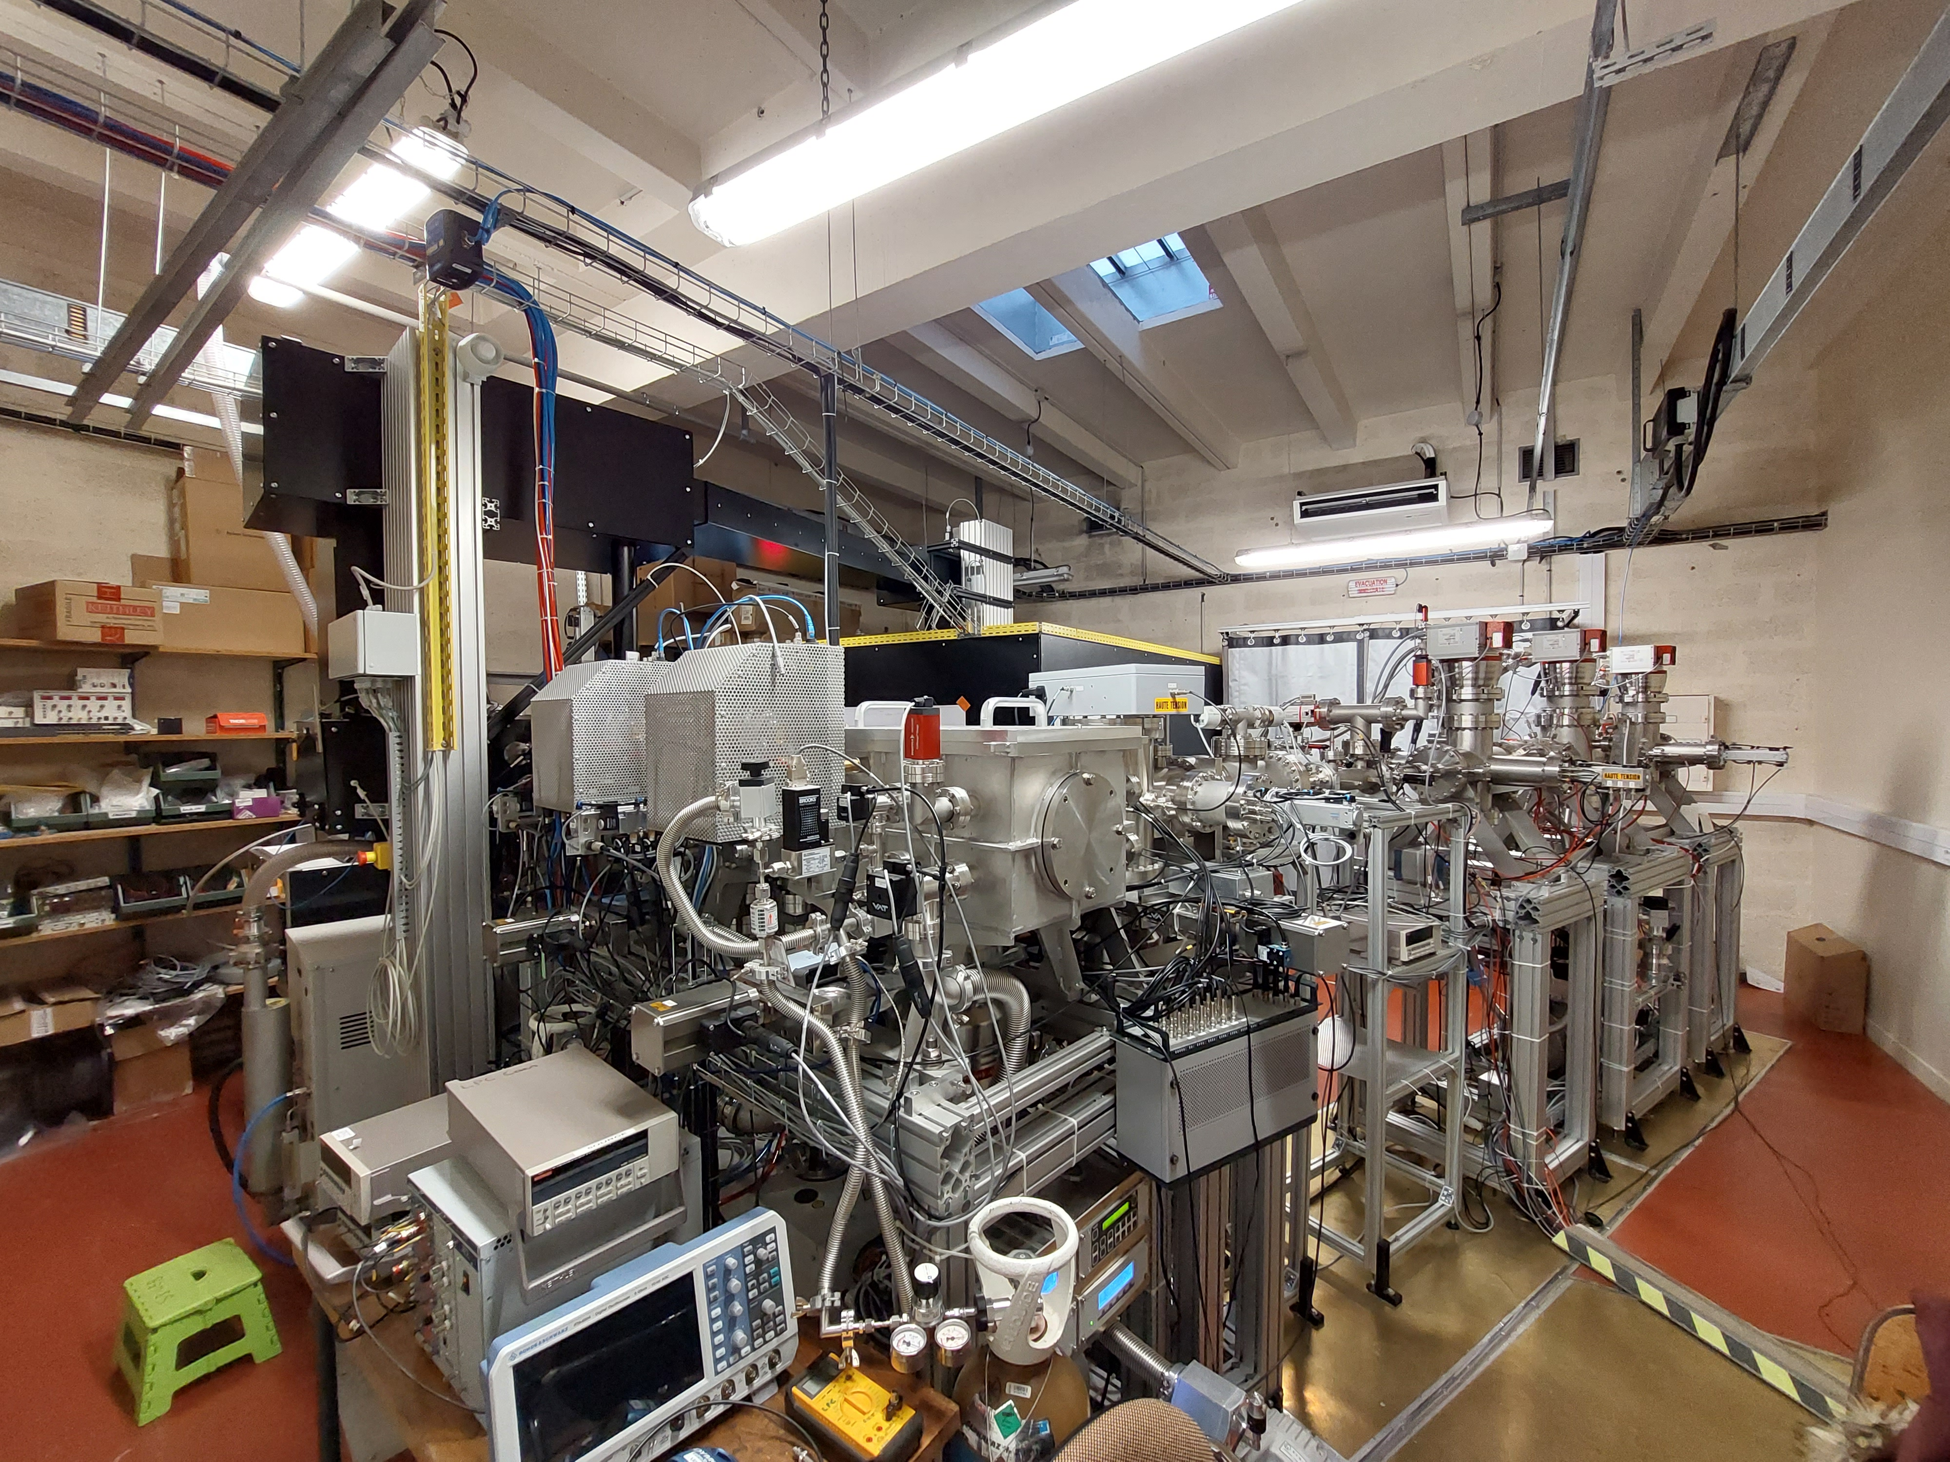
Outline
S³ and S3-LEB
Offline commissioning at LPC
S3-LEB moving
S³ laser lab
GISELE laser lab
Conclusion and outlook

Slide 3
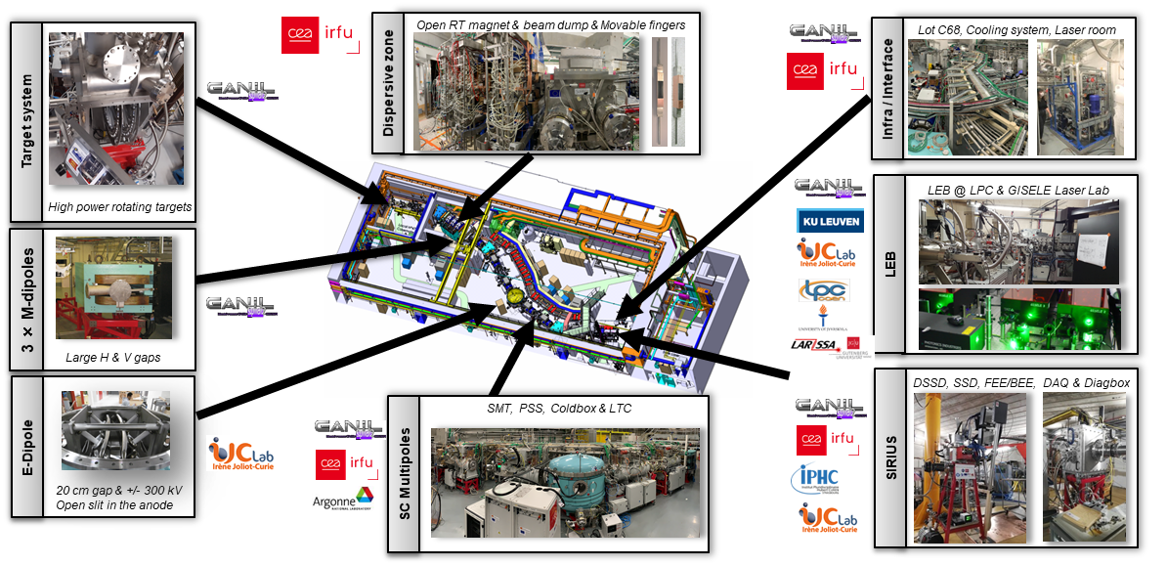
S³ status
Courtesy Hervé Savajols
All functional components of the spectrometer at GANIL
Degree of completion 85%
Main technical challenge: SMTs and associated cryogenic system
Commissioning planned starting end of 2025

Slide 4
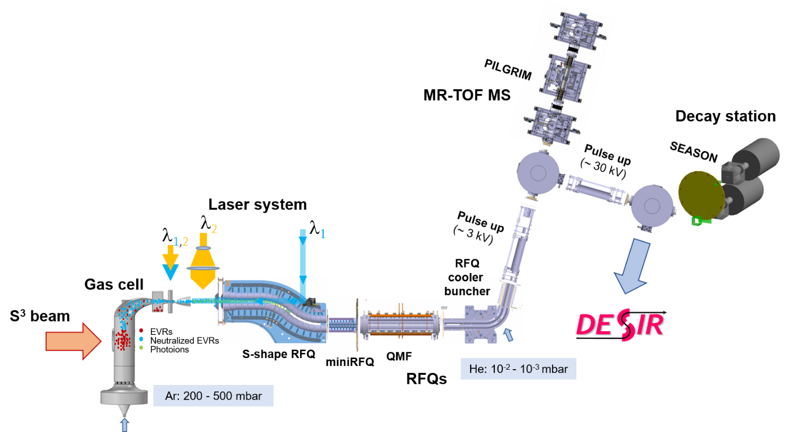
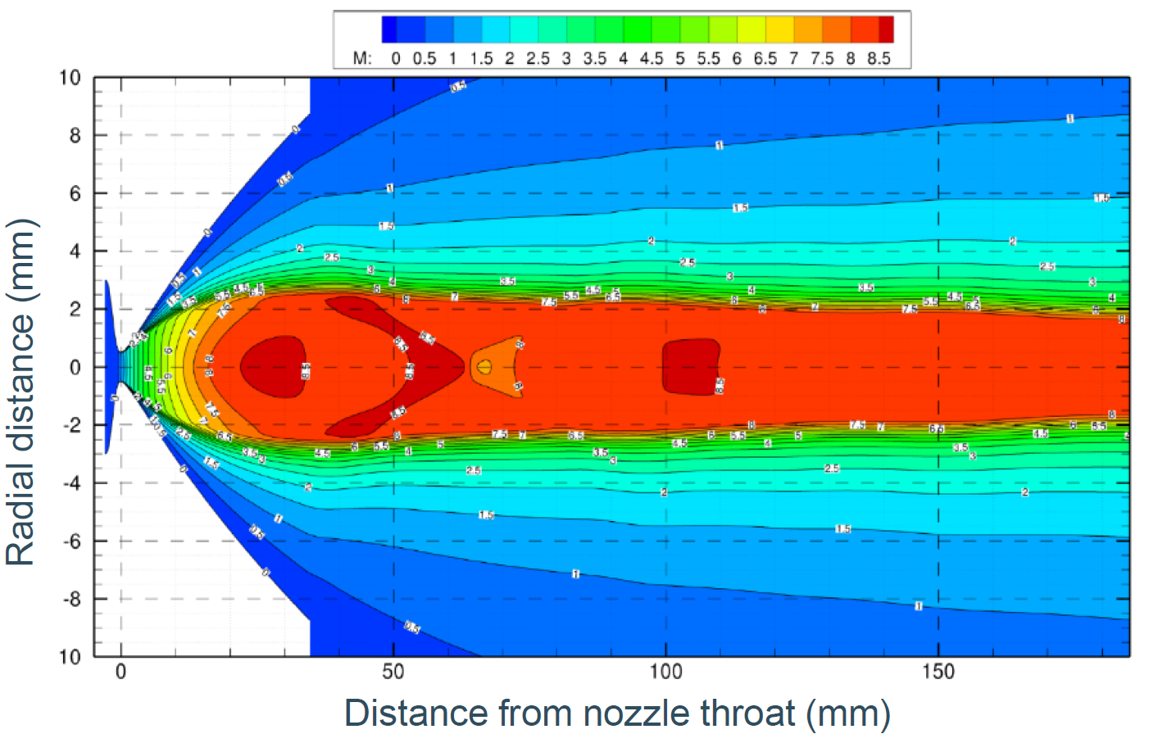
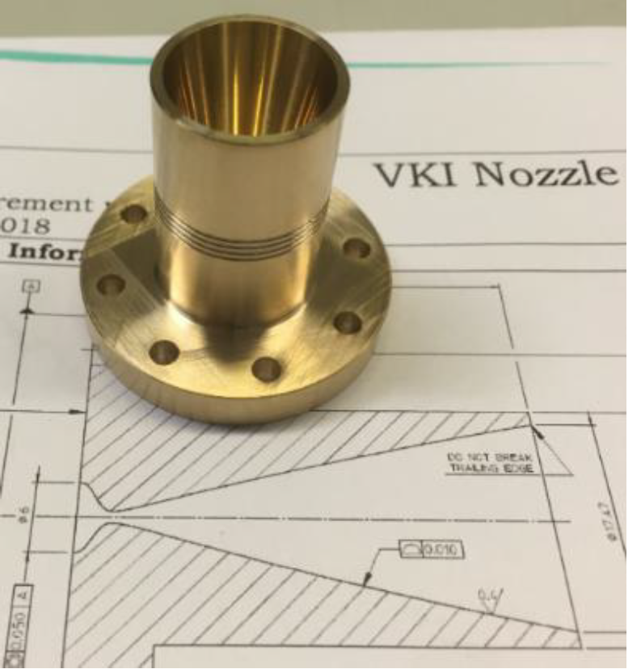
S3-LEB
Laser spectroscopy on S³ products in a supersonic jet at intermediate resolution (200 MHz)
Mass and decay spectroscopy measurements
Low (or no)-background laser spectroscopy due to mass/decay-tagged counting
Low (or no)-background mass spectrometry and decay spectroscopy due to (very) selective ionisation

Slide 5
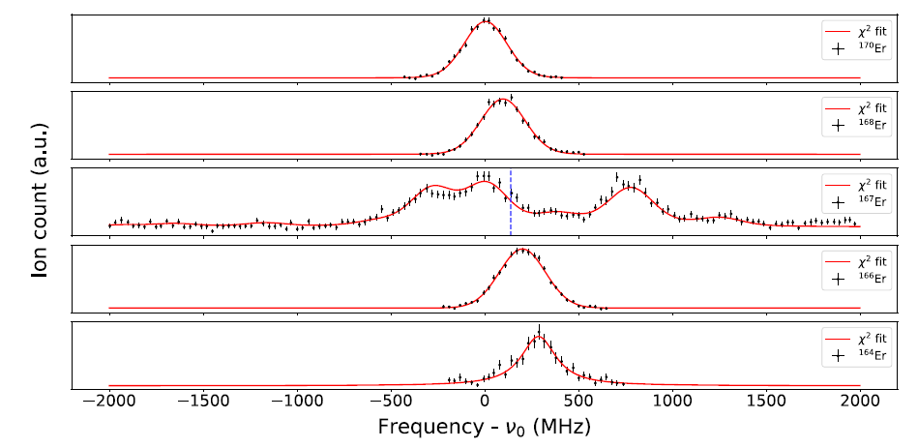
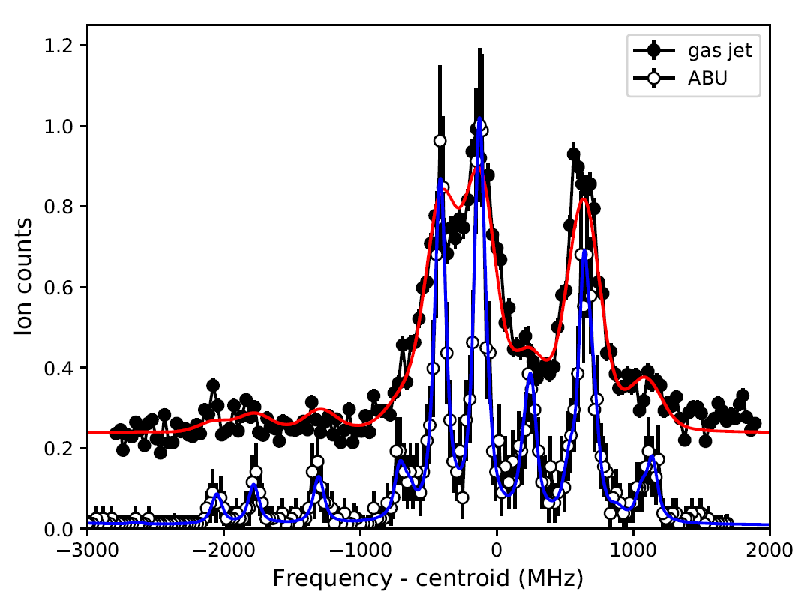
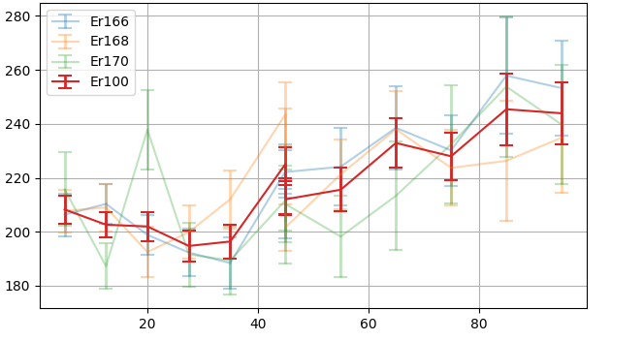
Offline commissioning
First in-gas-jet spectroscopy, resolution of 280 MHz obtained = apparent Mach number 4.5, nozzle made for Mach 8
A.I.
¹⁷⁰Er
¹⁶⁷Er
396.7 nm
¹⁶⁸Er
415.2 nm
¹⁶⁶Er
¹⁶⁴Er
S³-LEB gas jet
Er
GISELE ABU
Good agreement with literature data on determined IS and HFS coefficients
A. Ajayakumar et al., NIMB 539, 102-107 (2023)
Systematic work to improve resolution by studying influence of:
Laser power and alignment
Background pressure
Gas cell position and temperature
Reached Mach 6-6.5 (~200 MHz FWHM), to be continued (e.g. better pressure readout will be installed)
FWHM (MHz)
PhD thesis of F. Ivandikov, KU Leuven
Axial position in jet (mm)

Slide 6
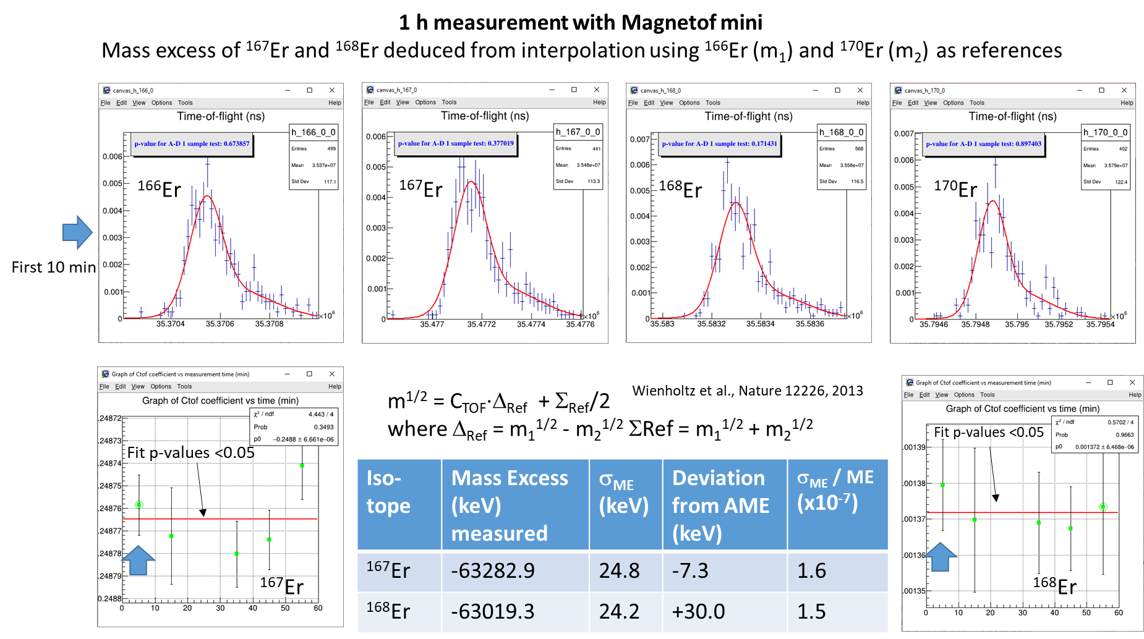
Offline commissioning
Courtesy Pierre Delahaye

Slide 7
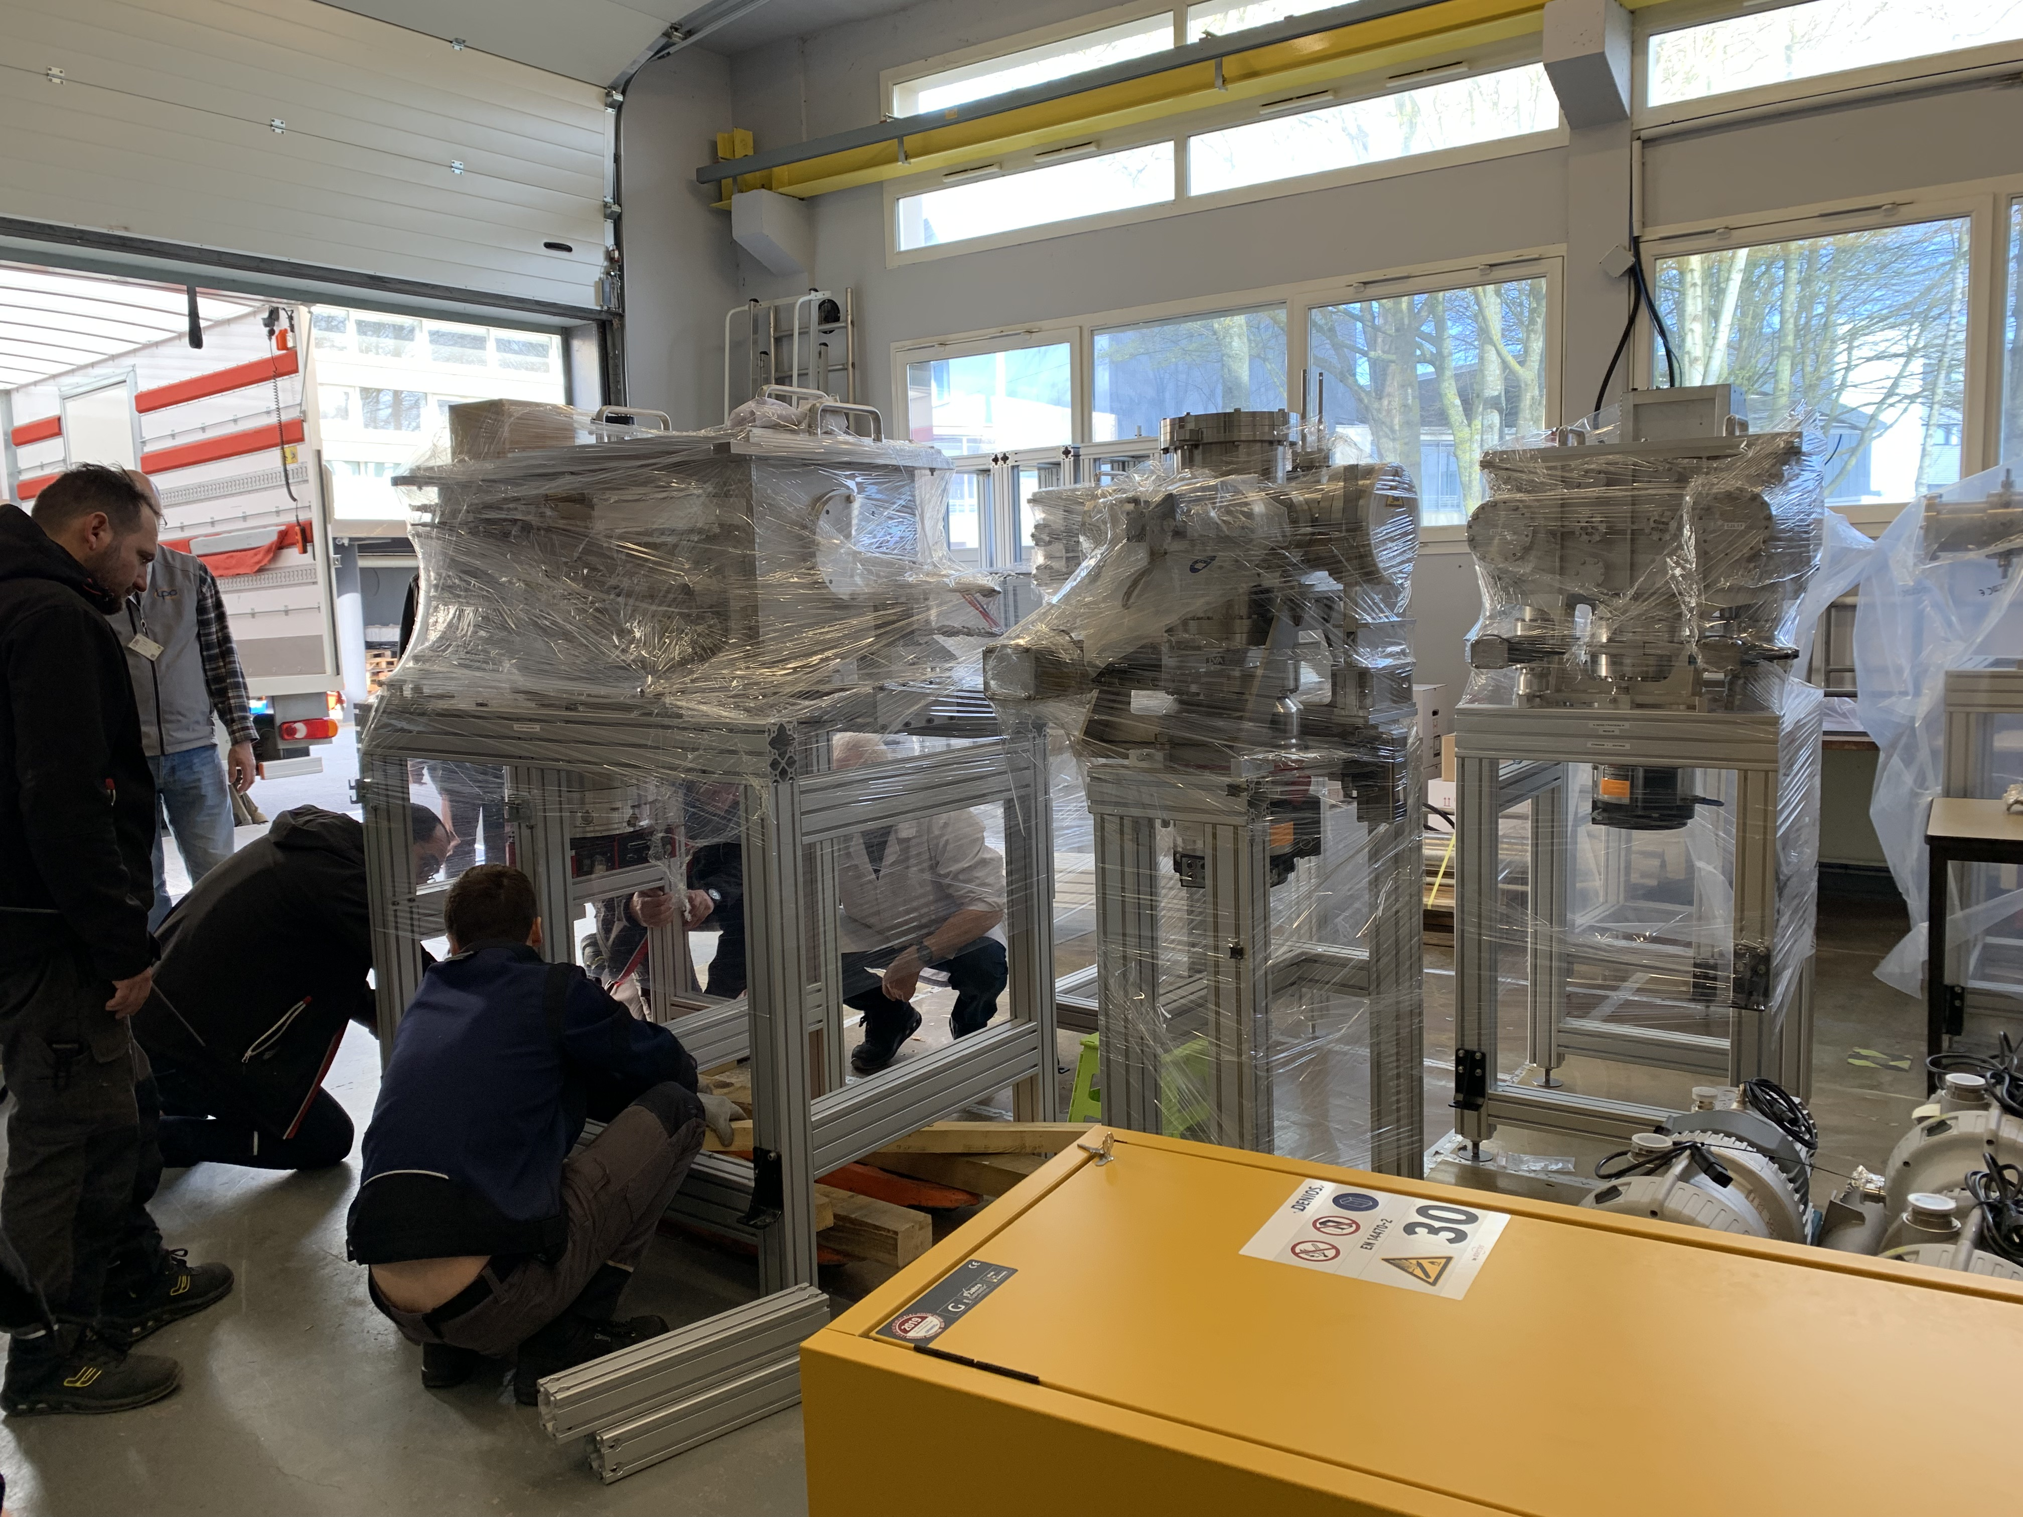
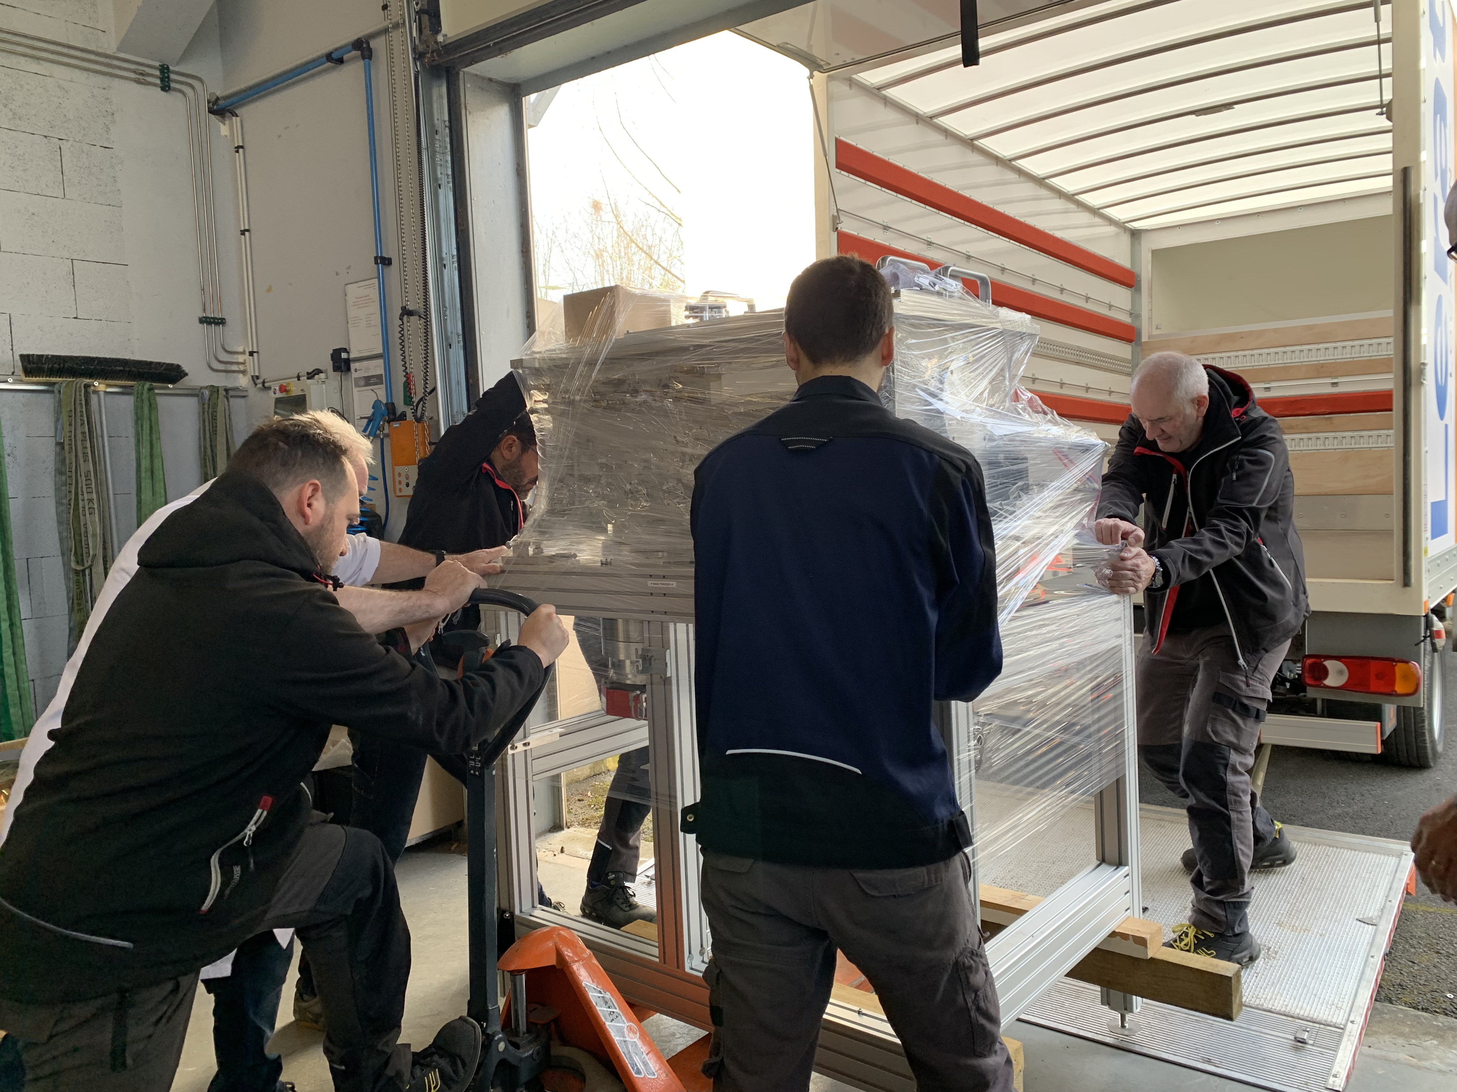
S3-LEB moving
After 10 years of construction, testing and commissioning at LPC Caen, moving of S3-LEB to S³ in March 2024
Around one week to decable, dismount, pack S3-LEB, 2 days to move

Slide 8
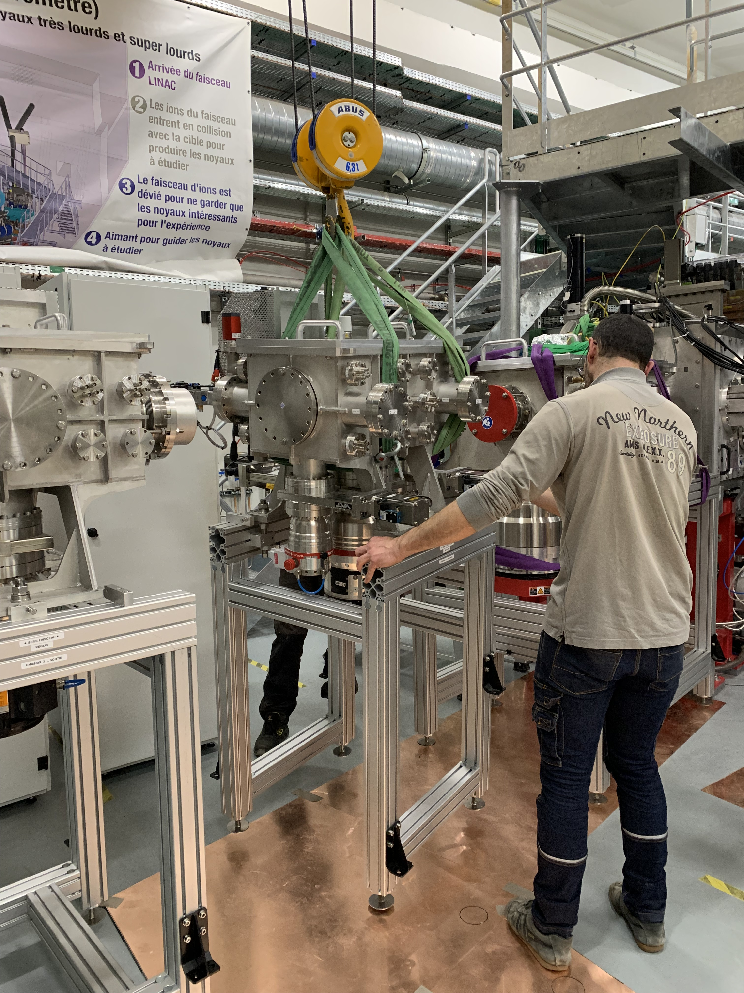
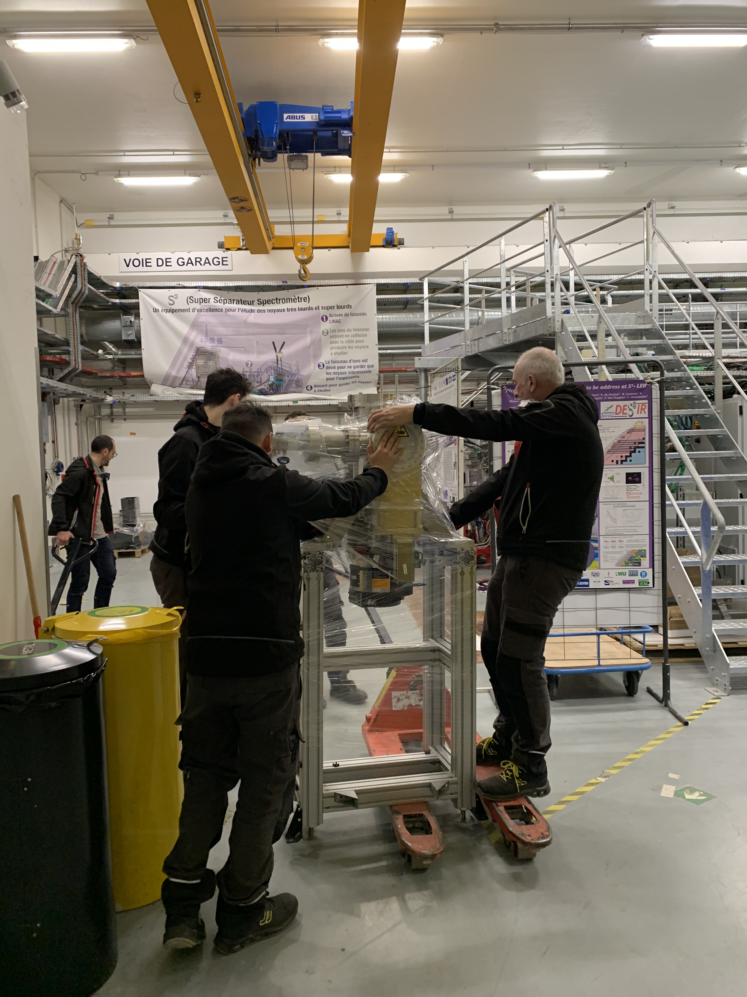
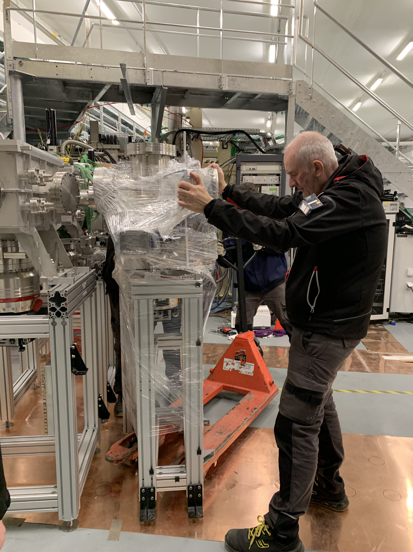
S3-LEB moving

Slide 9
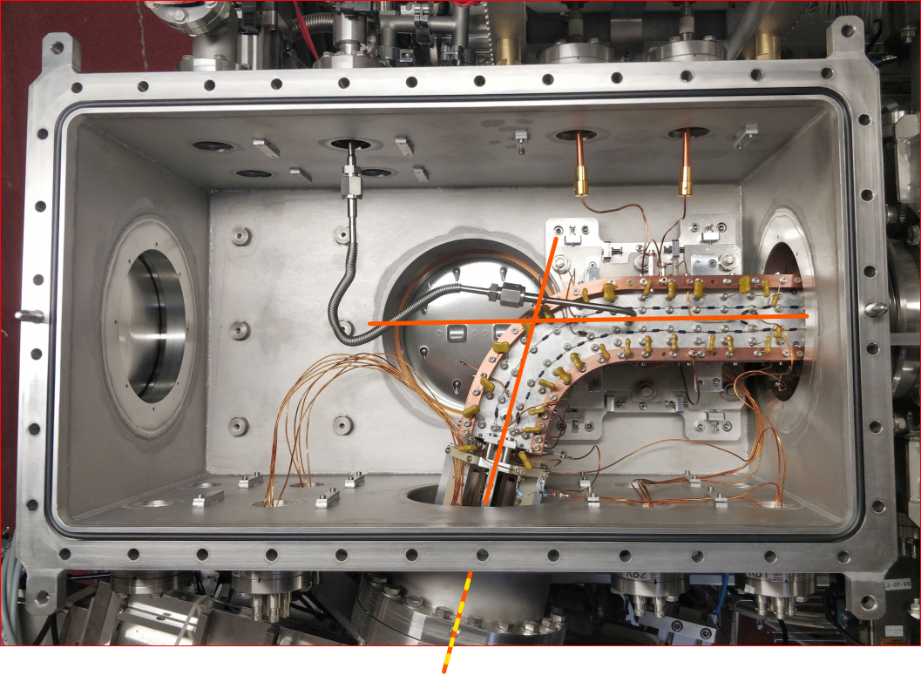
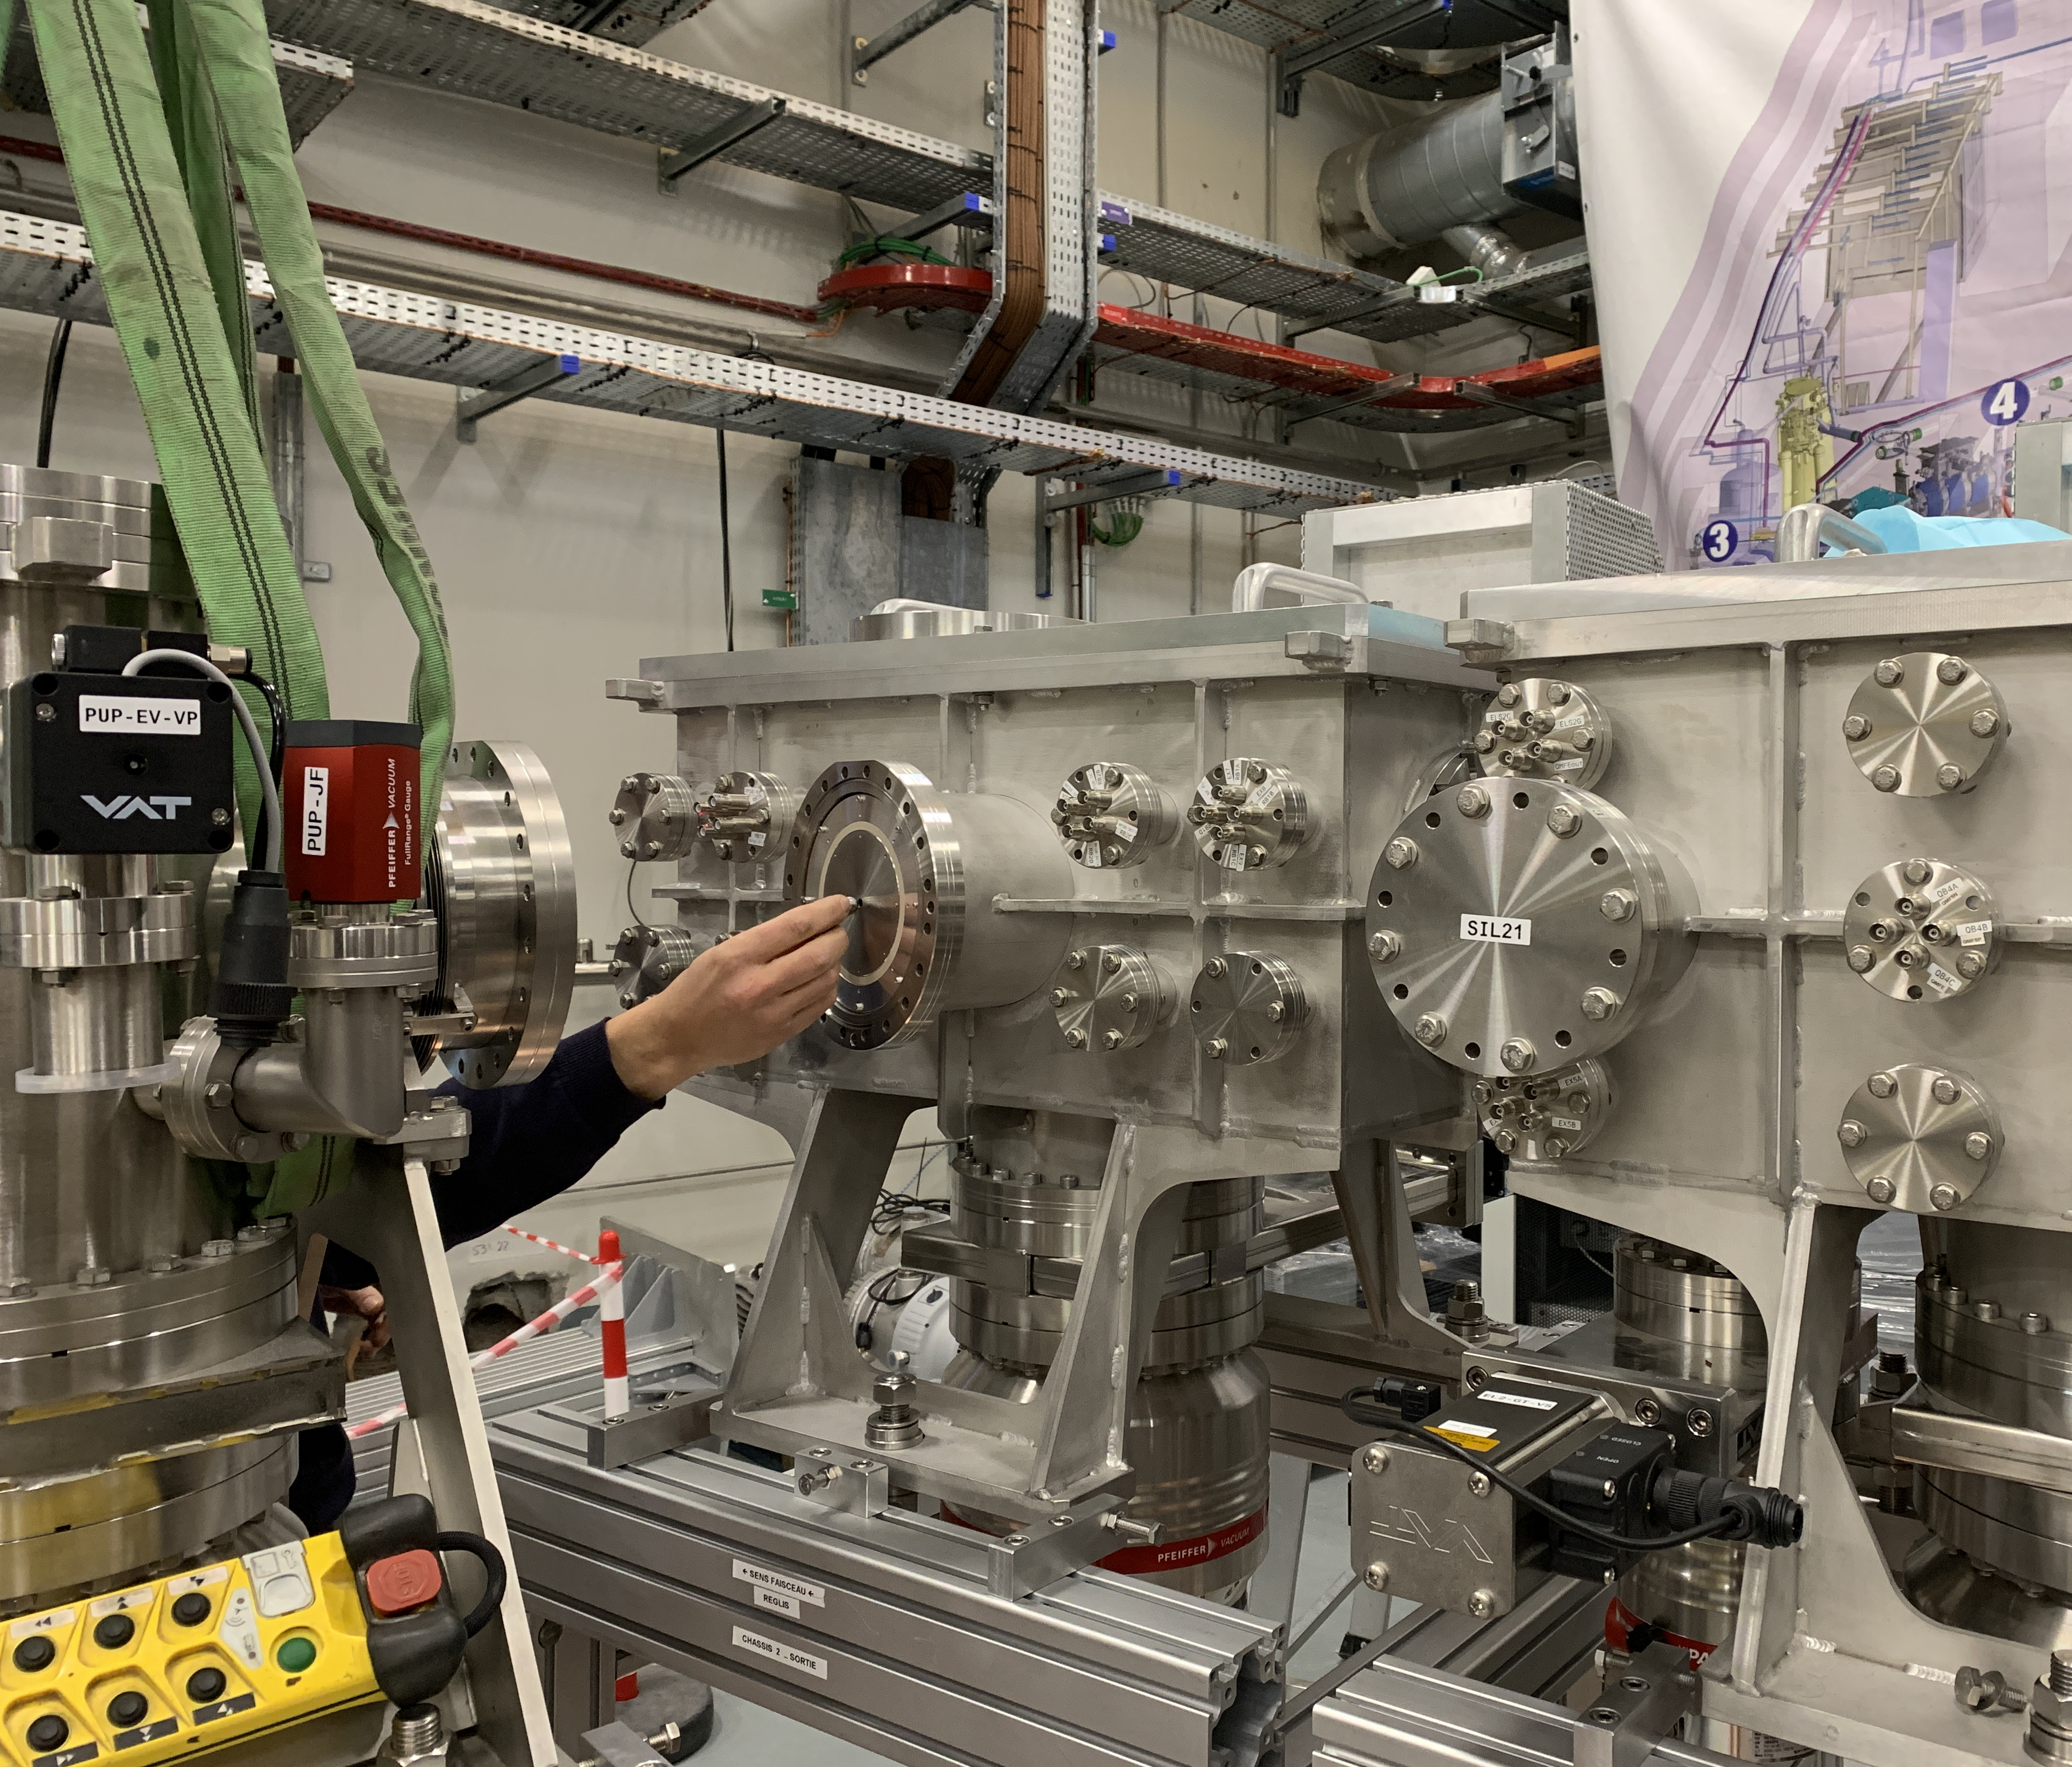
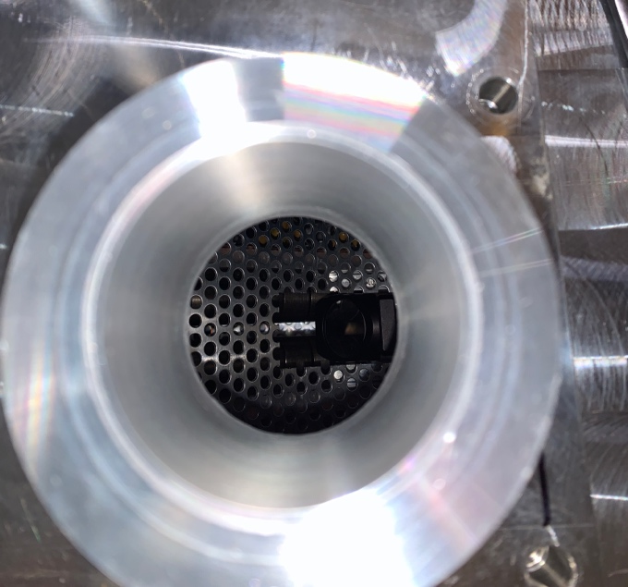
S3-LEB moving
Alignment of first chambers: few small issues (e.g. mismatch of bellows) already resolved, few still to be resolved (anti-collinear beam path, anchoring of gas cell chamber)

Slide 10
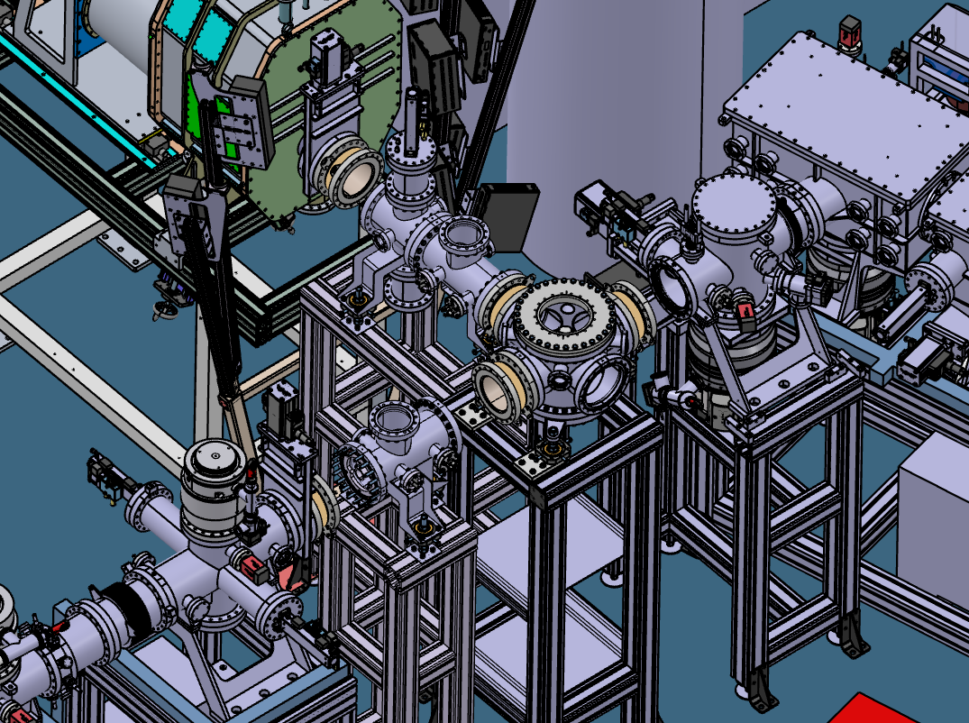
S3-LEB moving
One missing piece still: 90° bender and optics
Design finalised
Bender from IPHC, chamber constructed
Transport optics and chamber to be fabricated
Benjamin Lucarz
Antoine de Roubin

Slide 11
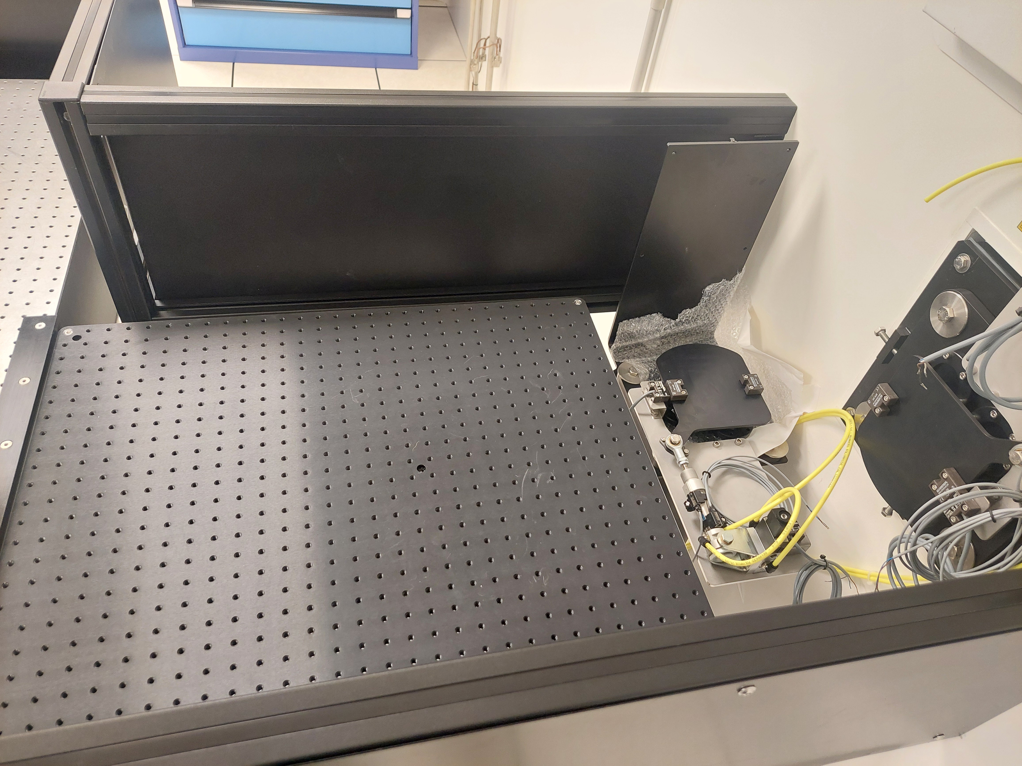
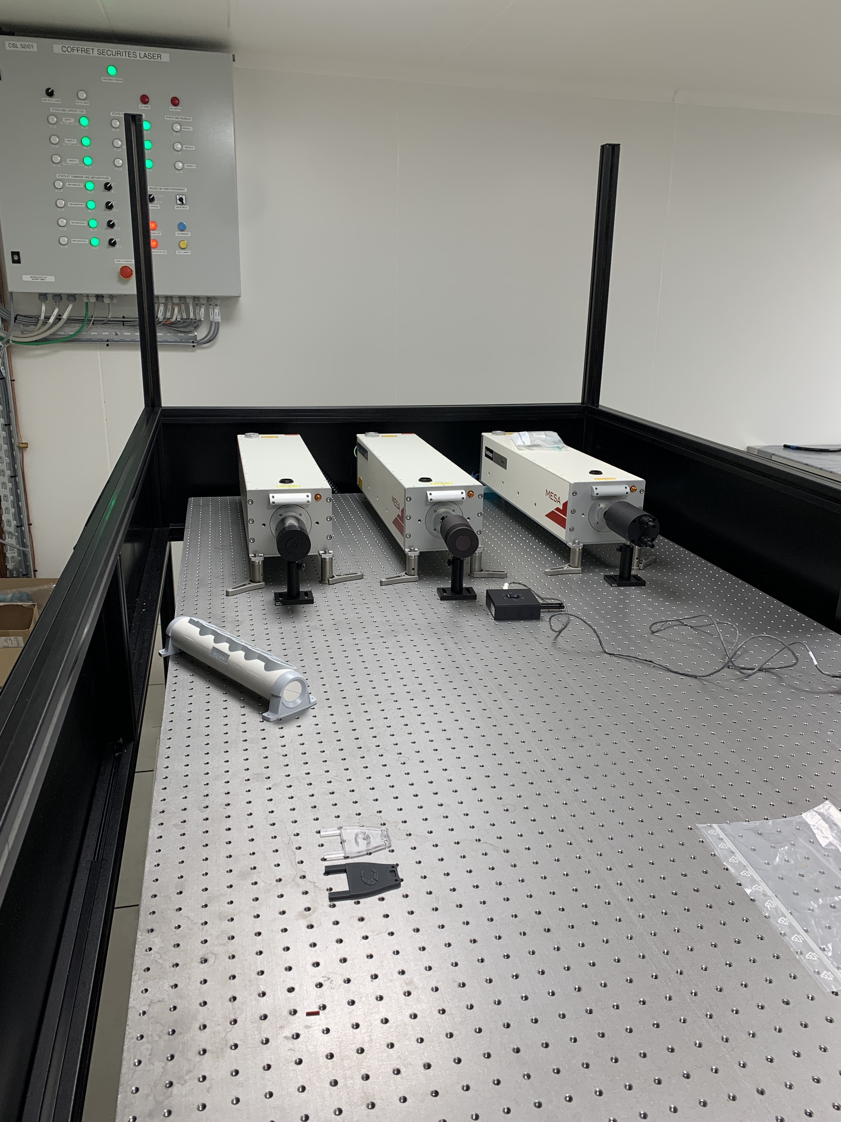
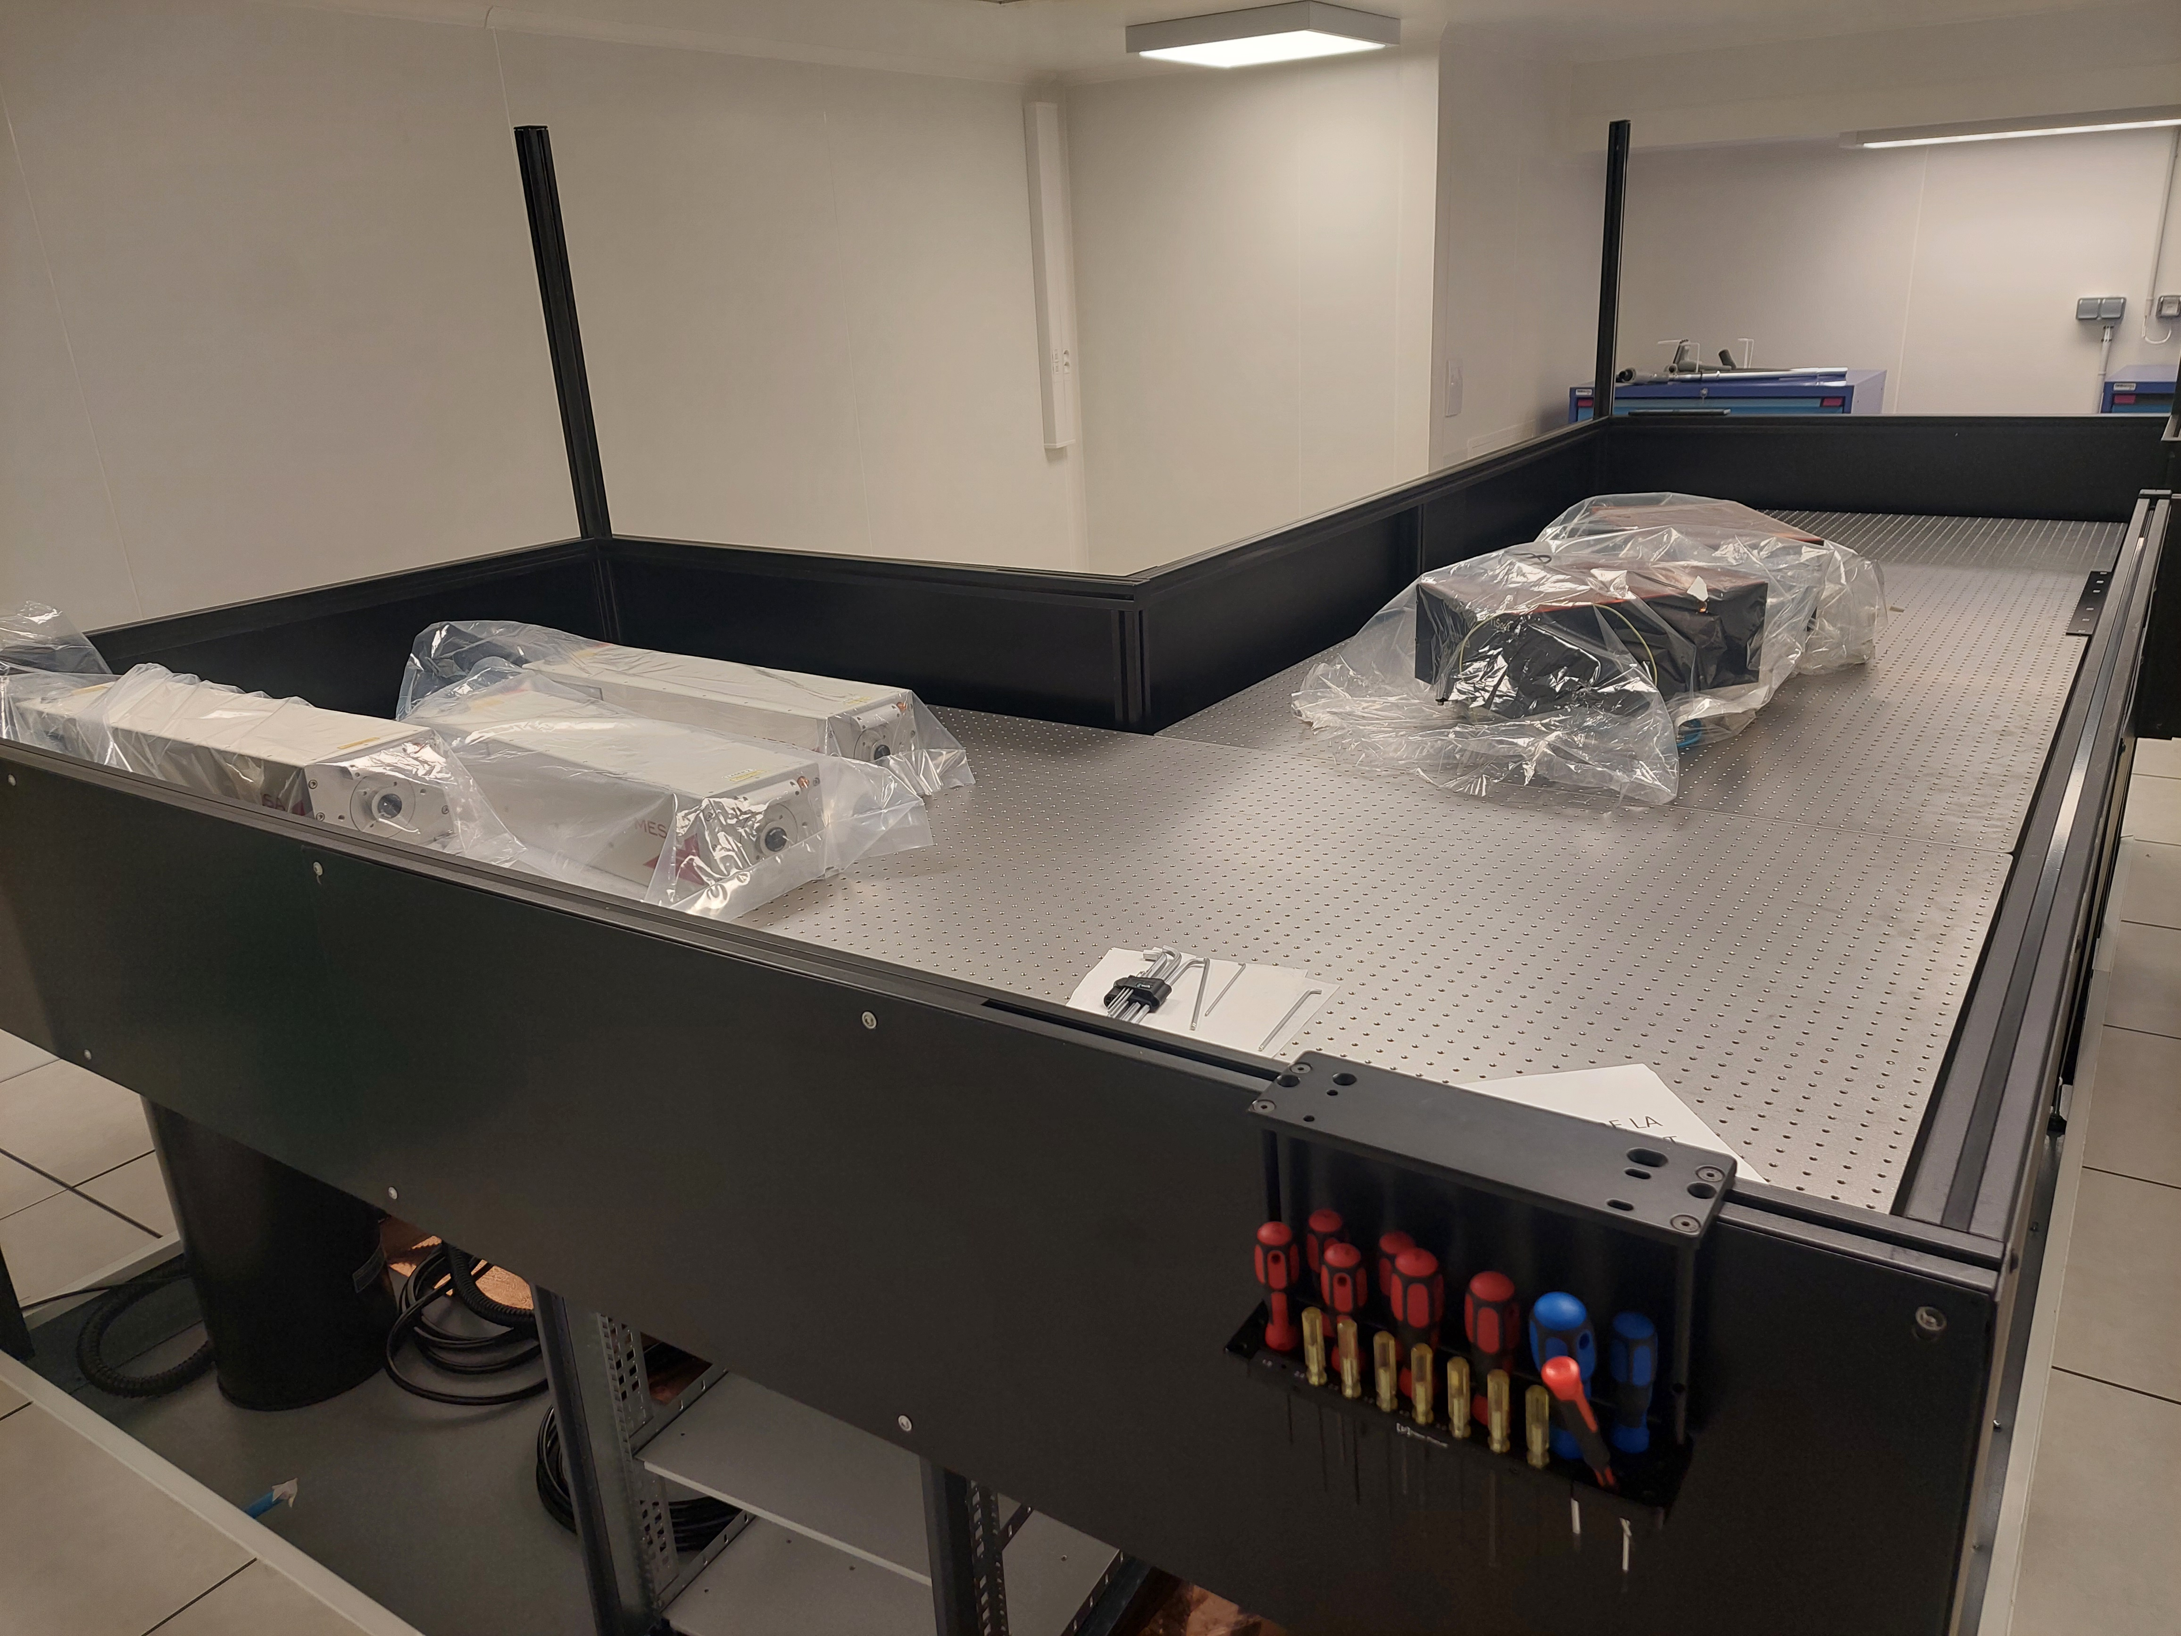
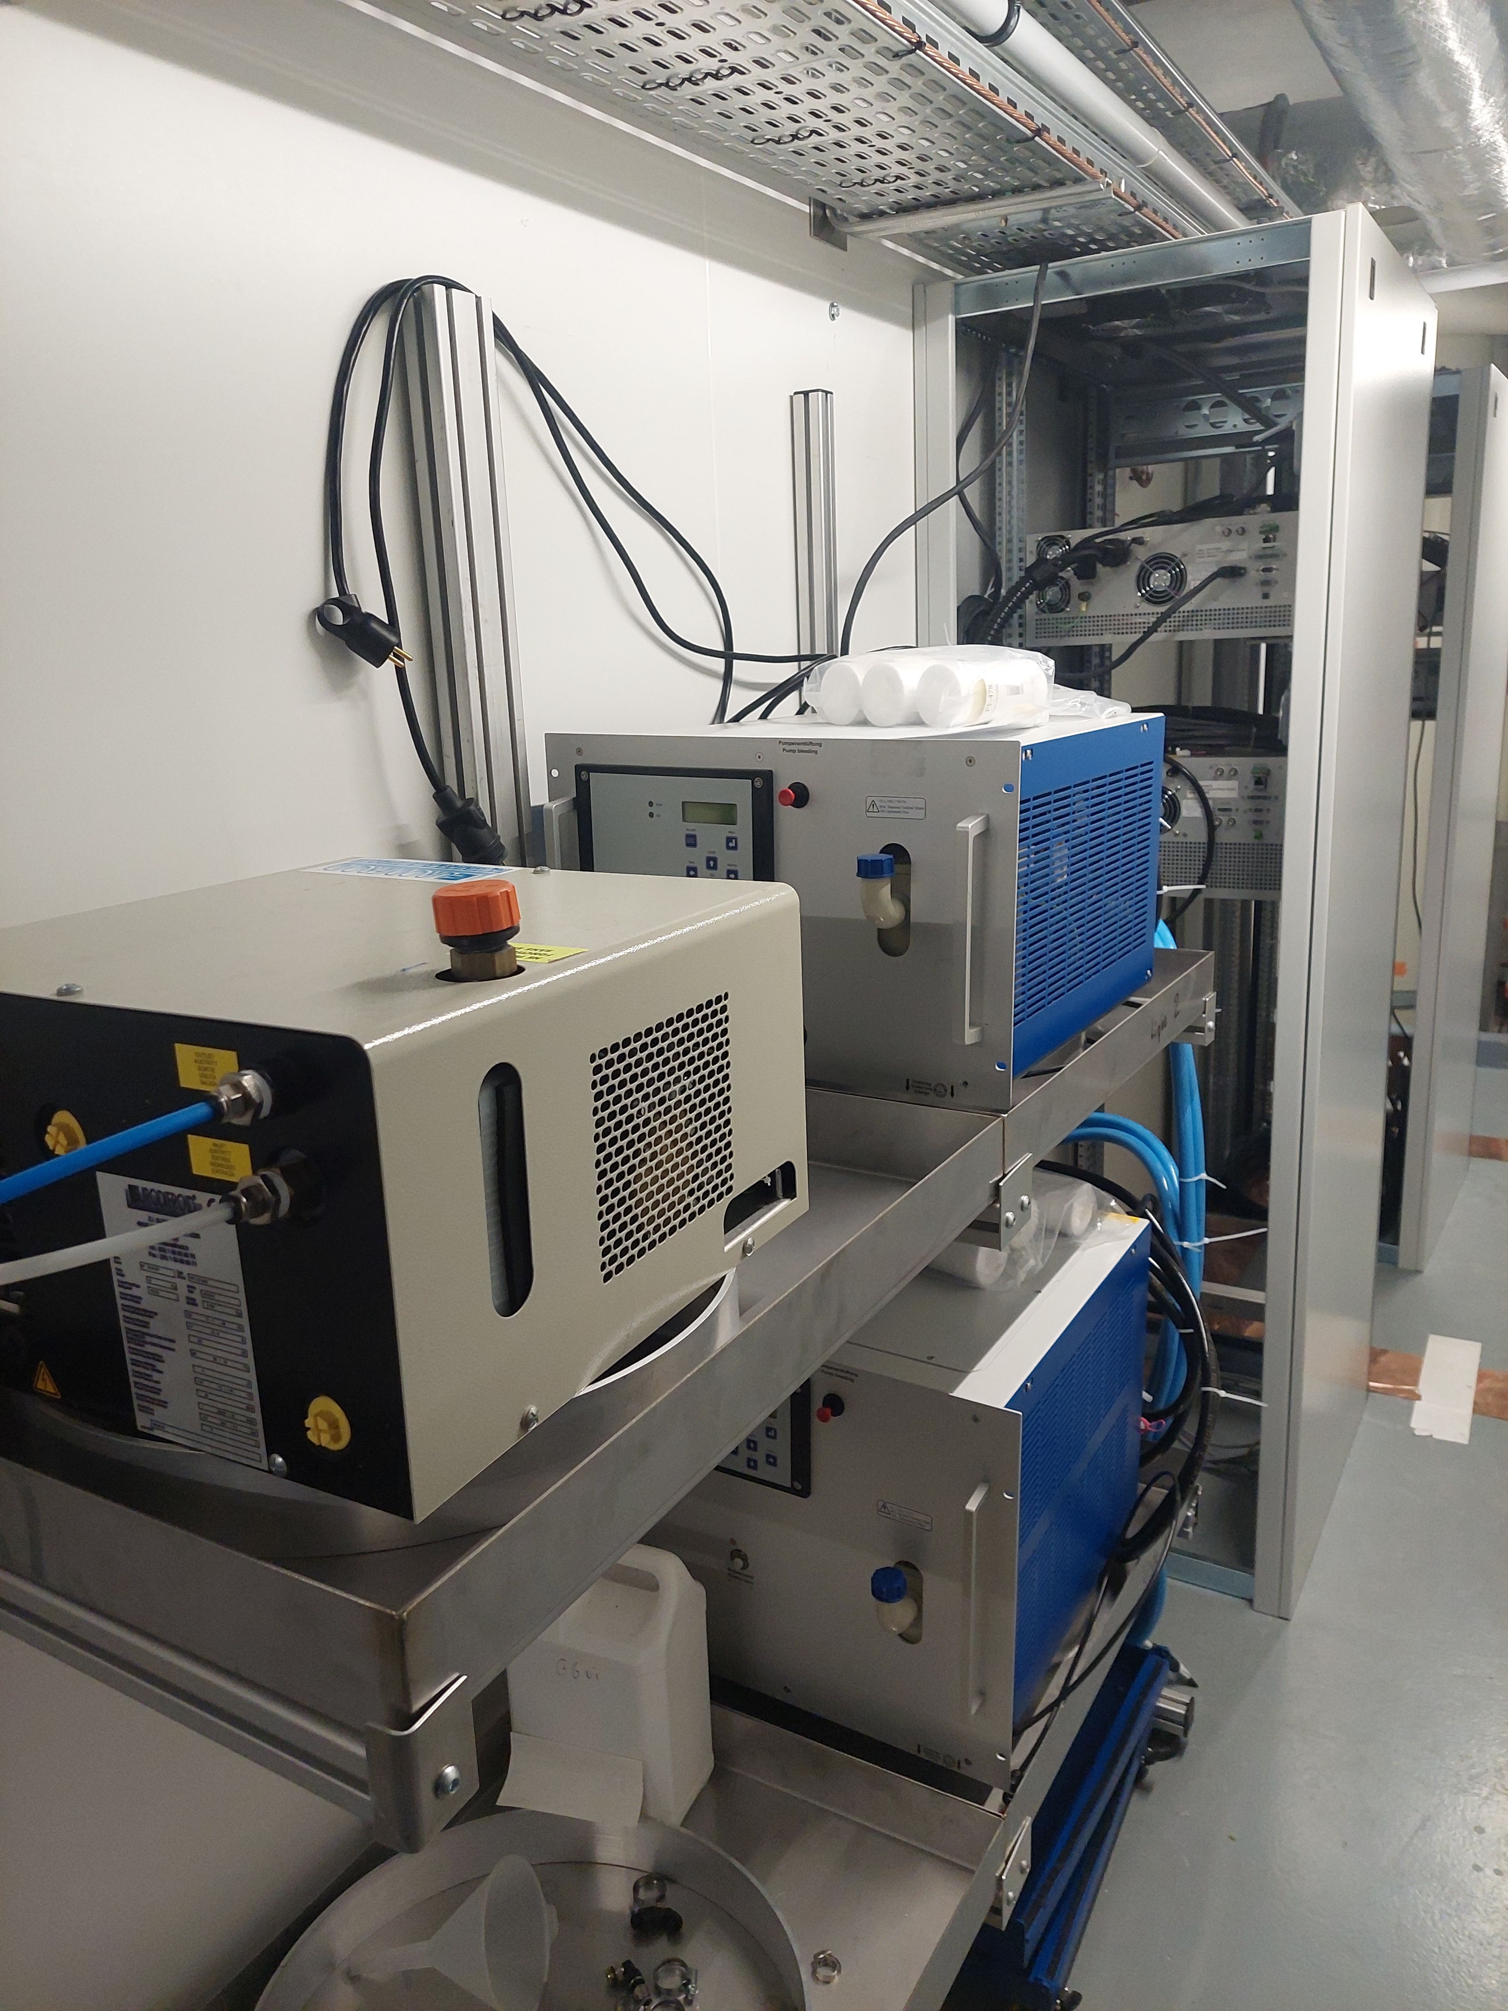
S³ laser lab
Laser safety finished, definition of procedures ongoing (outfits, entry/exit..)
New 2 x 40W dual pump laser commissioned and ‘old’ 60W pump laser reinstalled
Matisse cw Ti:sapphire laser arriving in summer, pulsed Ti:sapphire cavities to be installed
Dye laser room under study, dye laser system operational at KU Leuven

Slide 12
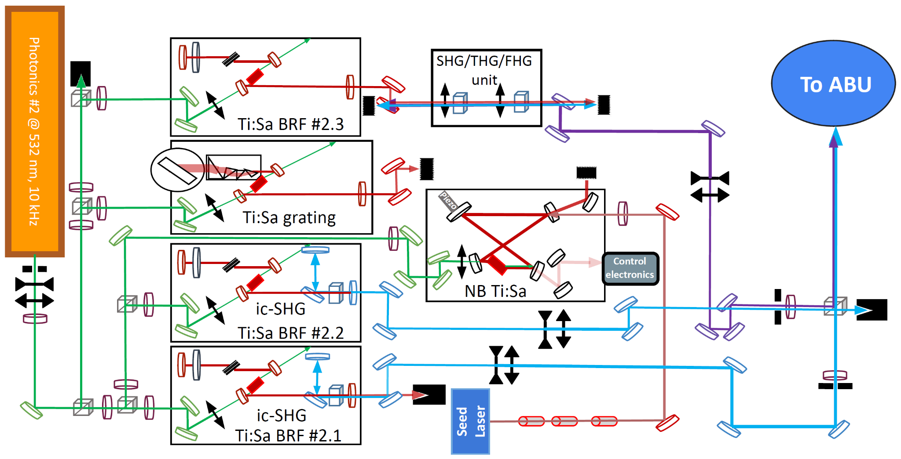
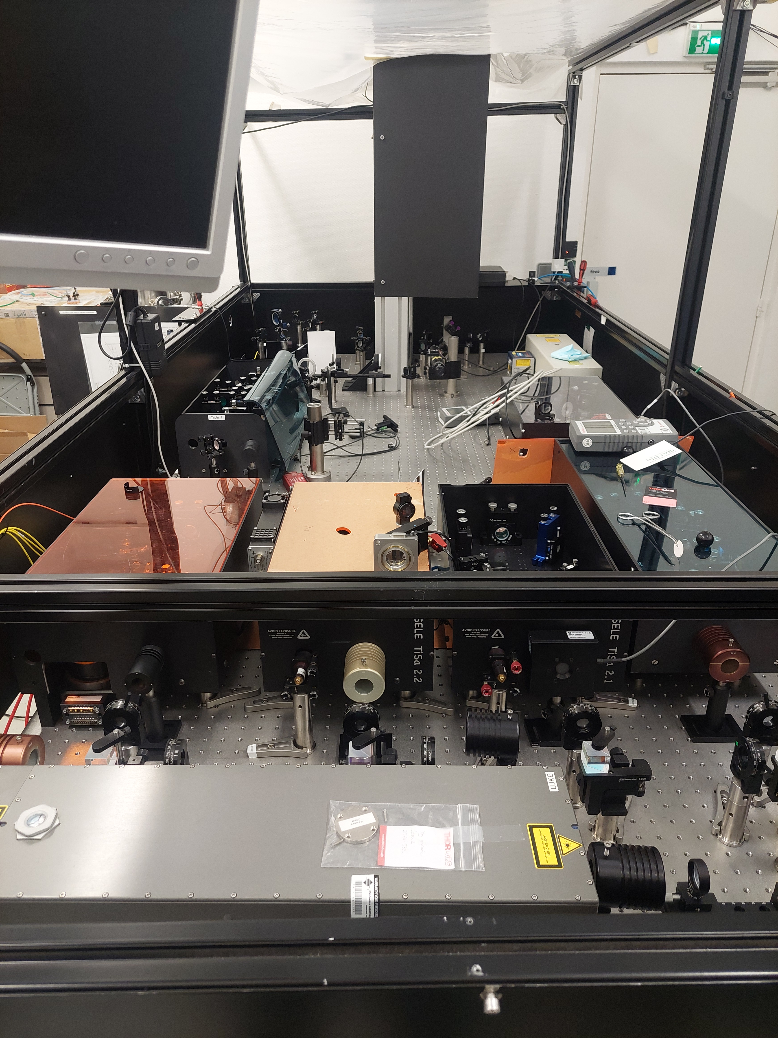
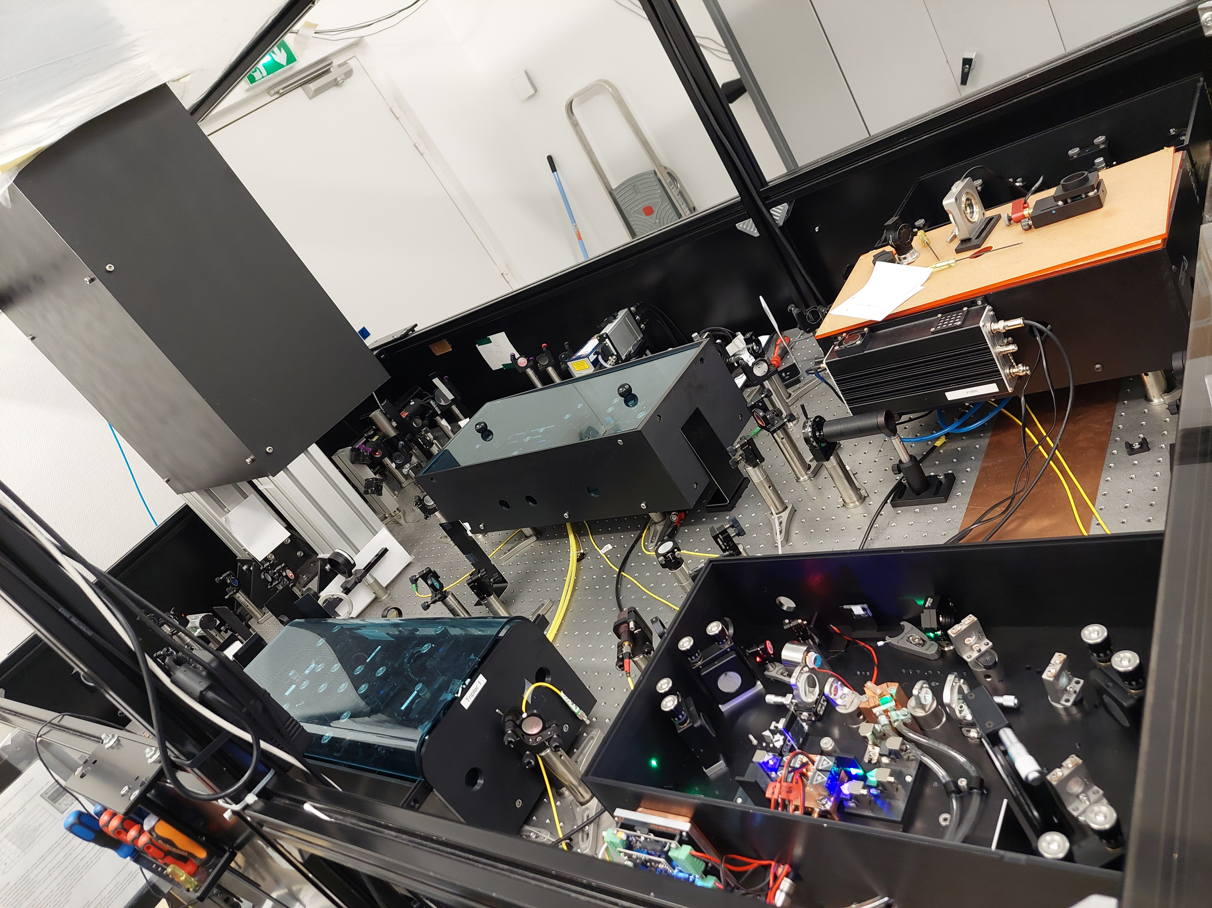
GISELE laser lab
Complete overhaul of laser table to accommodate Millenia laser (on loan) and optimise layout
Ongoing developments and tests:
  Finish construction and characterisation cw cavity
  Test intra-cavity tripling, temperature-controlled ic doubling,…

Slide 13
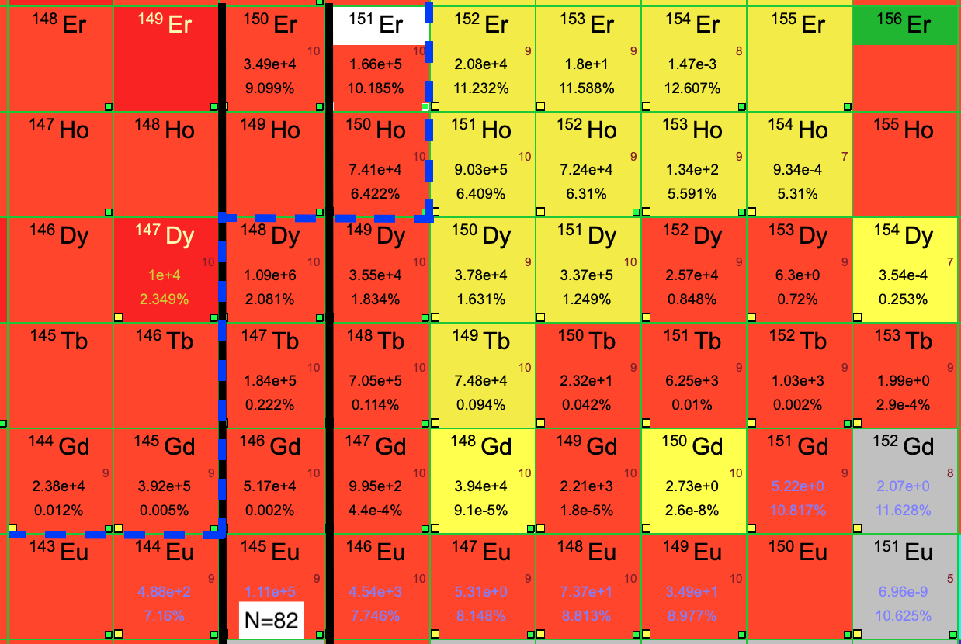
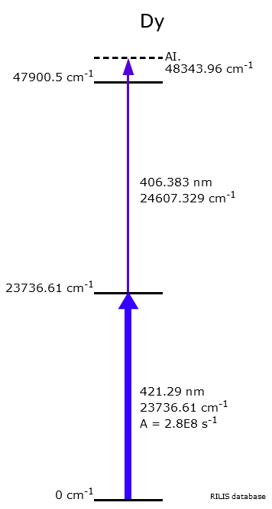
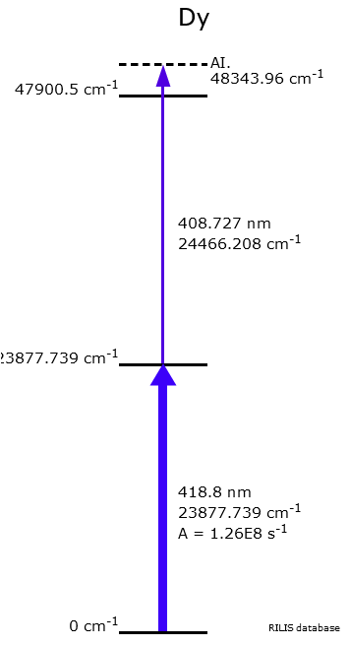
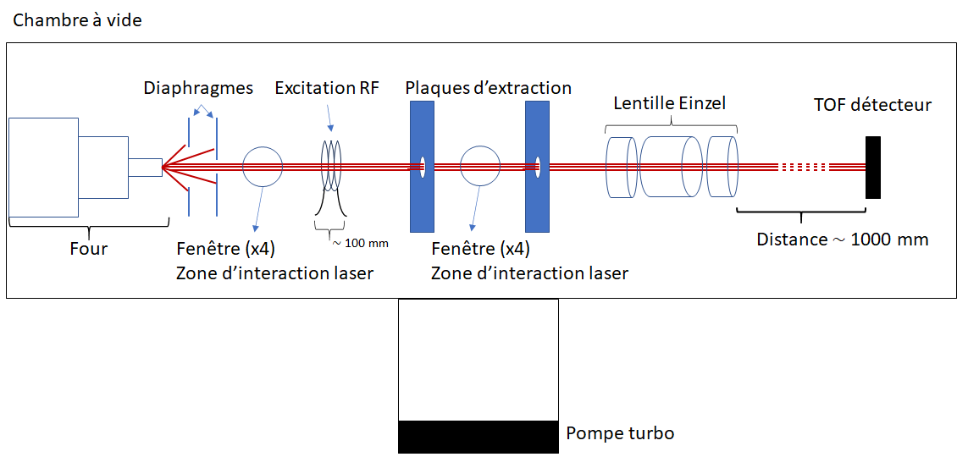
GISELE laser lab
Dy/Ho/Gd… scheme testing/development to be started soon for S3-LEB ‘Day 0’ experiment
Design of new ABU for S³ and GISELE ongoing, implementing possibility for RF spectroscopy
GISELE lasers to be used for the FRIENDS³ test bench which will be installed at GANIL by the end of the year
⁴⁰Ar + ¹¹⁶Sn
Courtesy Antoine de Roubin

Slide 14
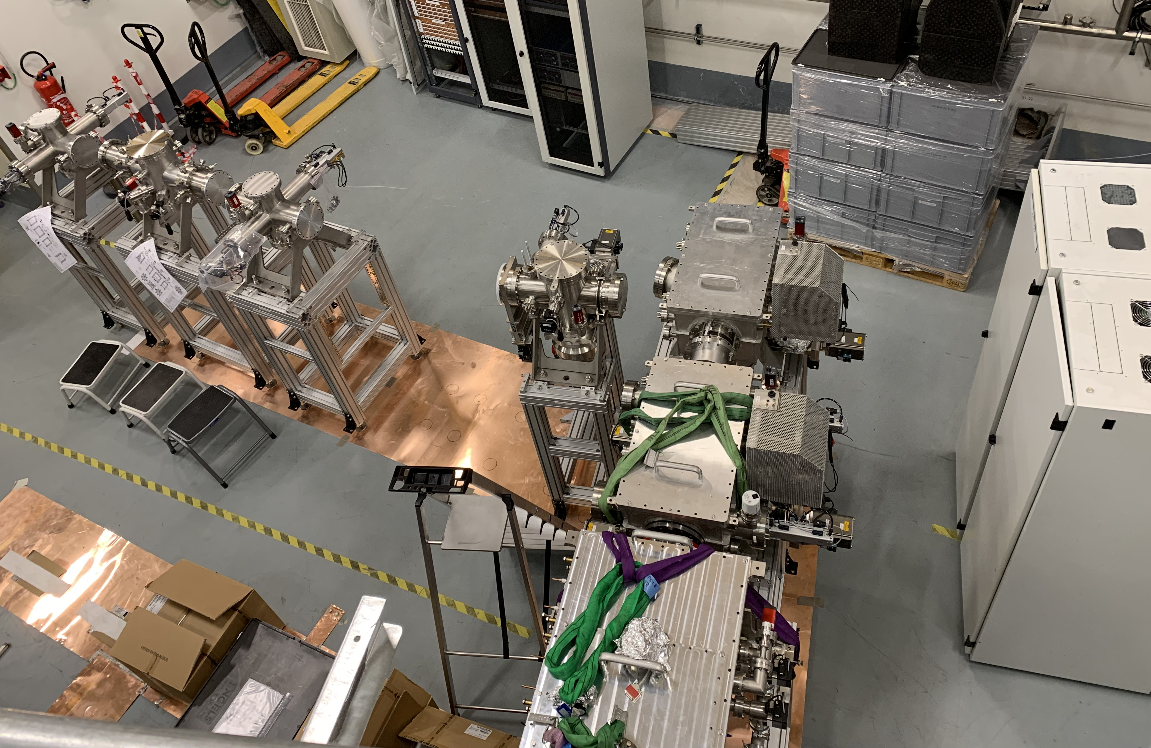
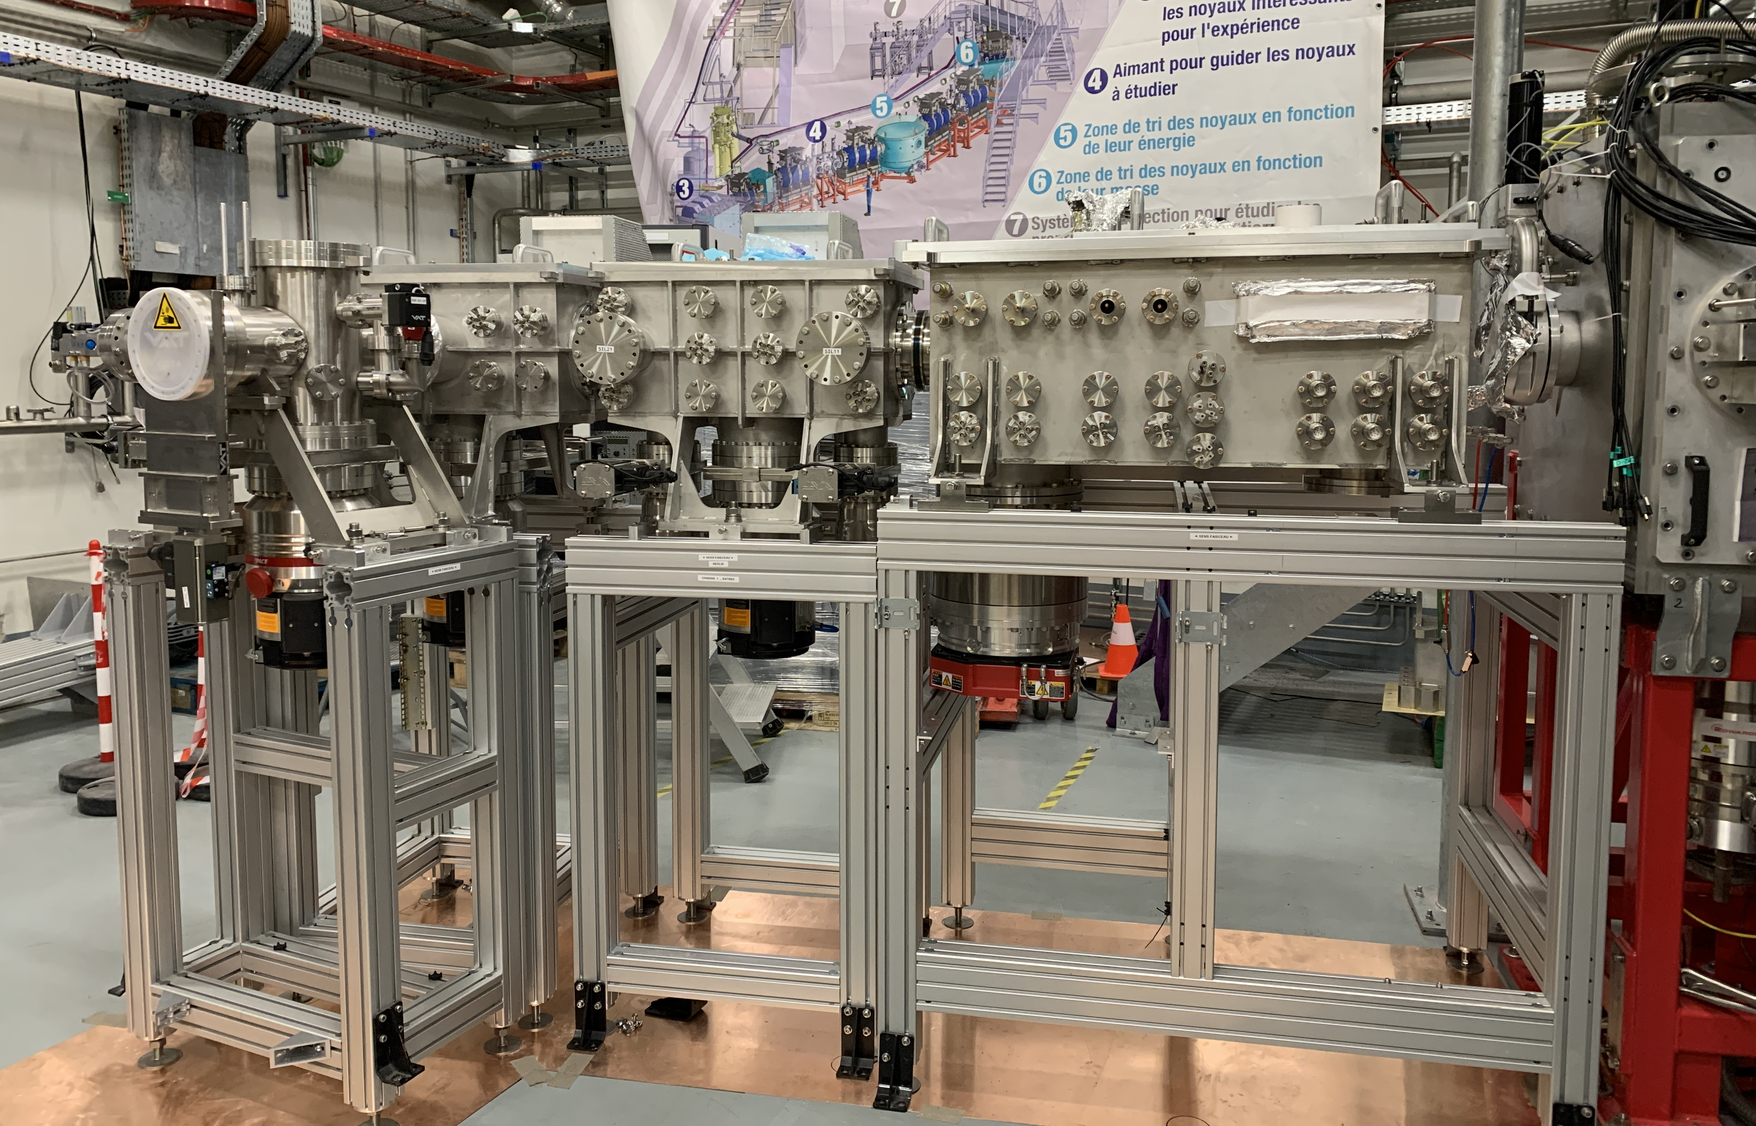
Conclusion and outlook
Offline commissioning completed at LPC
  First in-gas-jet spectroscopy and mass measurements demonstrated
  Characterisation of many aspects of setup performed
Installation at focal plane of S³ ongoing, restart in autumn to prepare for online commissioning
S³ laser room ready for installation of Ti:sapphire cavities and transport optics
GISELE continues as testing/development/training lab for S3-LEB

Slide 15





Thank you for your attention!

