Slide 1

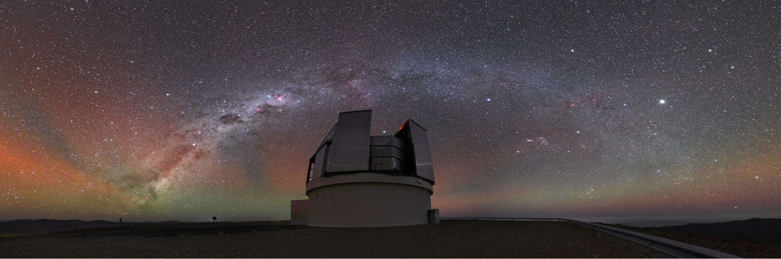
Antoine Rocher (EPFL)
Postdoc –antoine.rocher@epfl.ch
4MOST Cosmology Redshift Survey (CRS)
GDR CoPhy, Lyon, May 22nd 2024
www.4MOST.eu

Slide 2
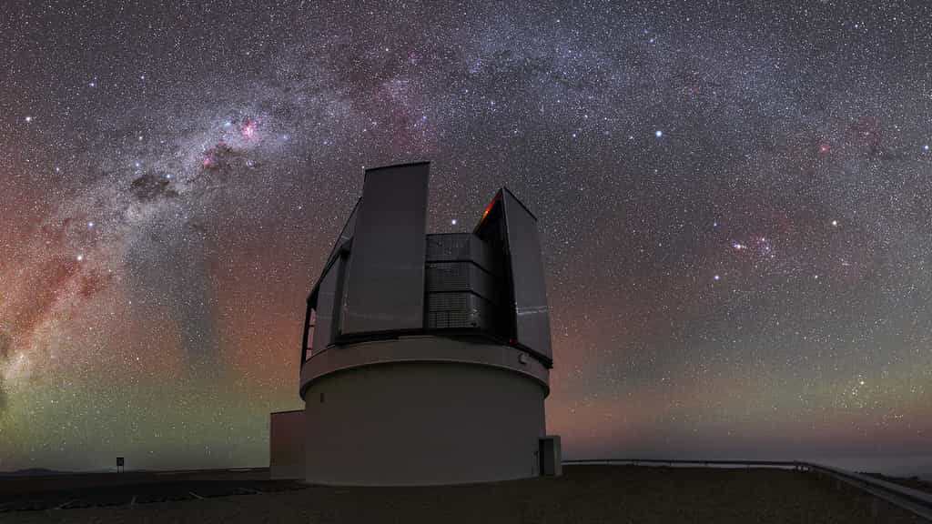
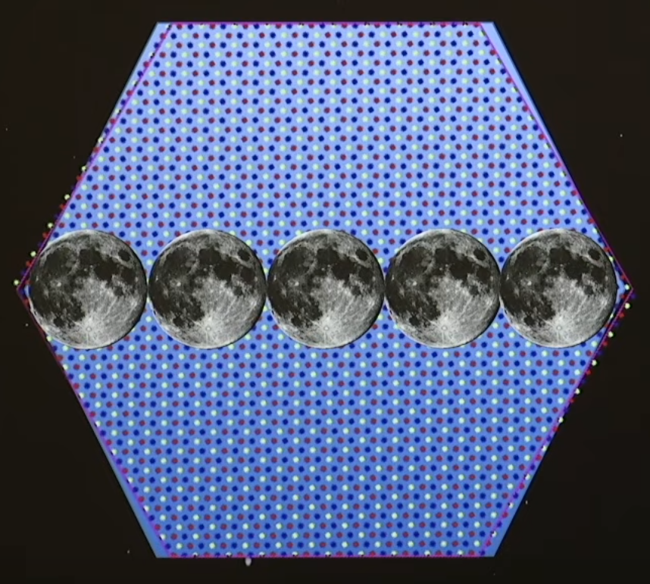
4MOST: Wide-field, high-multiplex optical spectroscopic survey facility for ESO / VISTA
VISTA telescope (4m) at Paranal Observatory, Chile
  Hexagonal field of view ~ 4.2 deg²
Fibre fed spectroscopic instrument - 2436 fibers:
  Reconfiguration time < 2 min (during CDD readout)
5-year survey over most of the Southern sky resulting in more than 20 million spectra
=> Start of operations: spring 2025

Slide 3
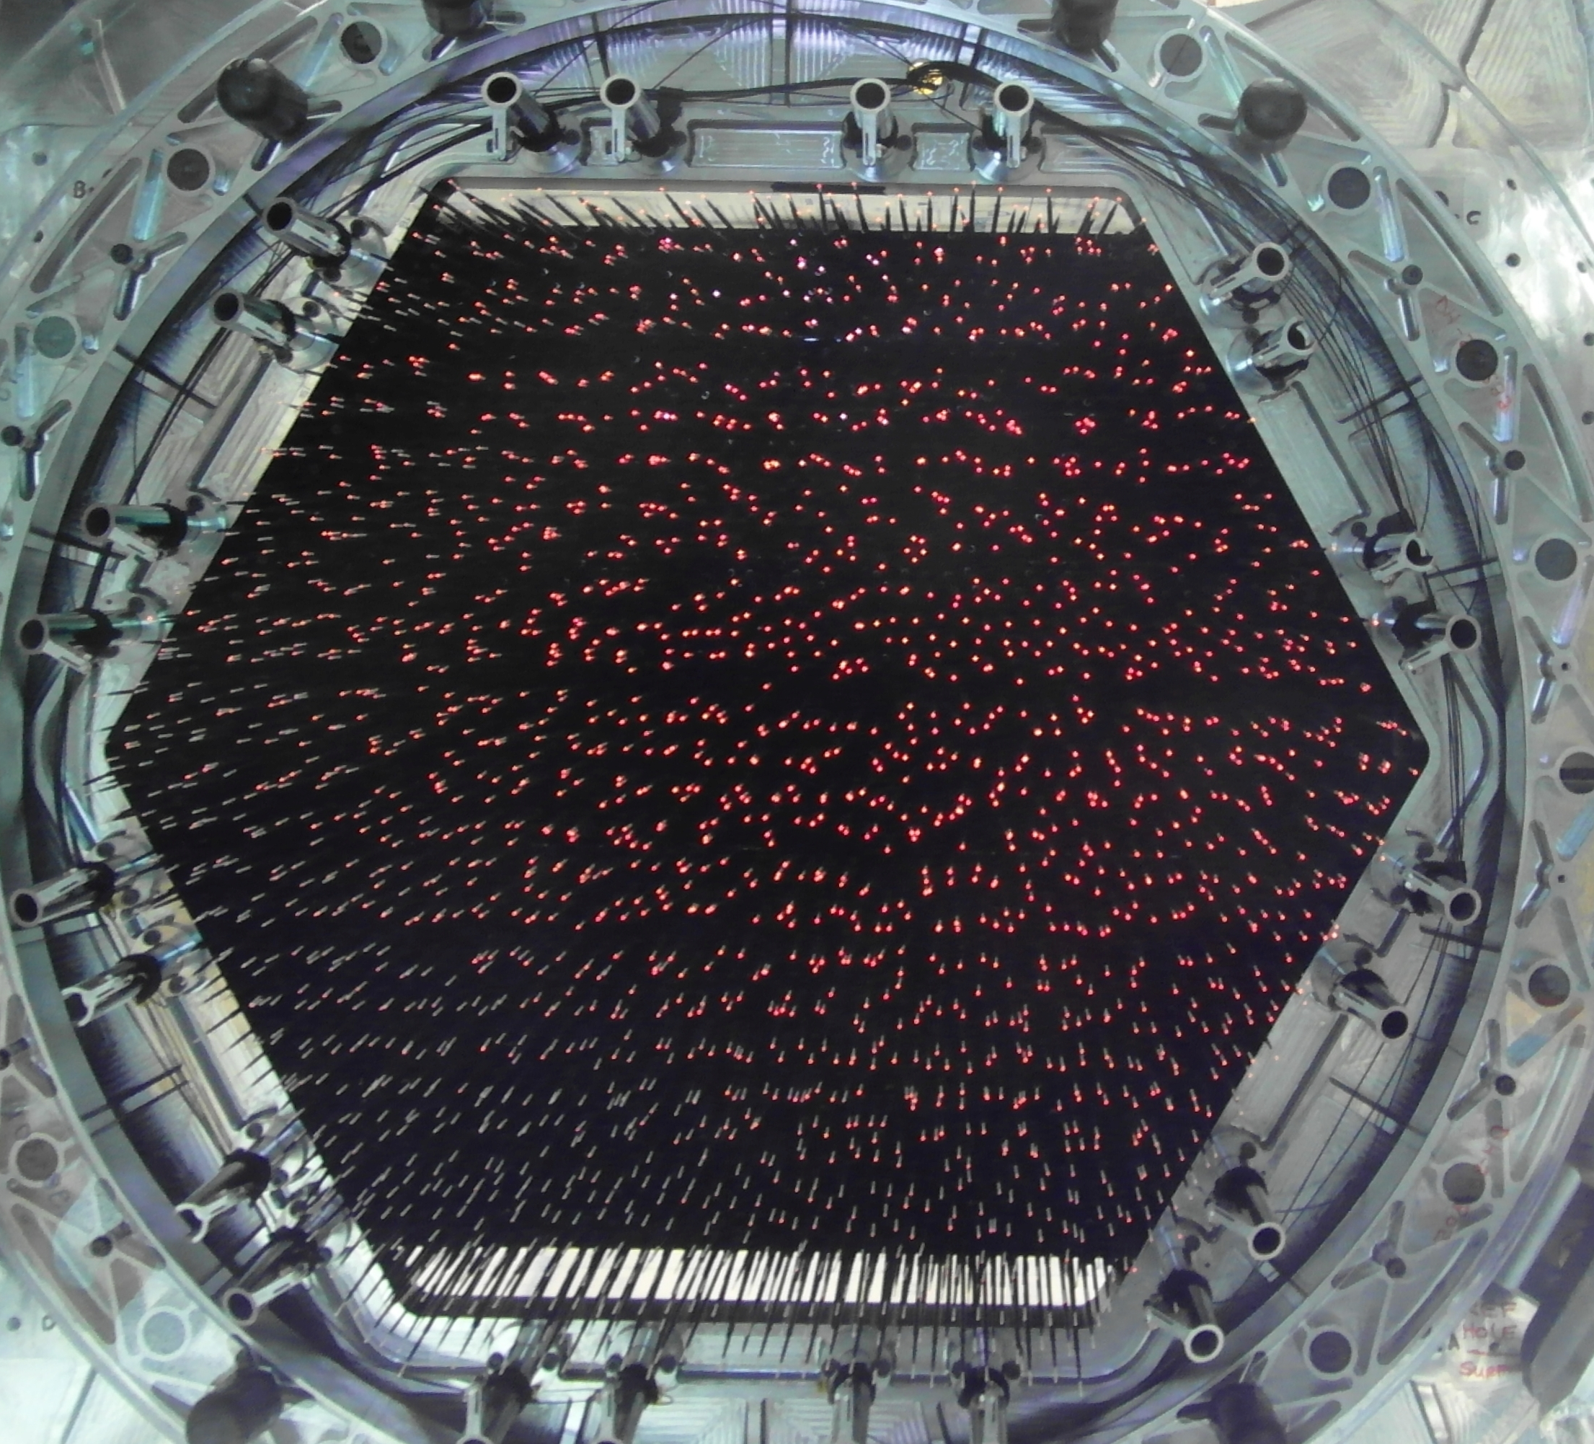
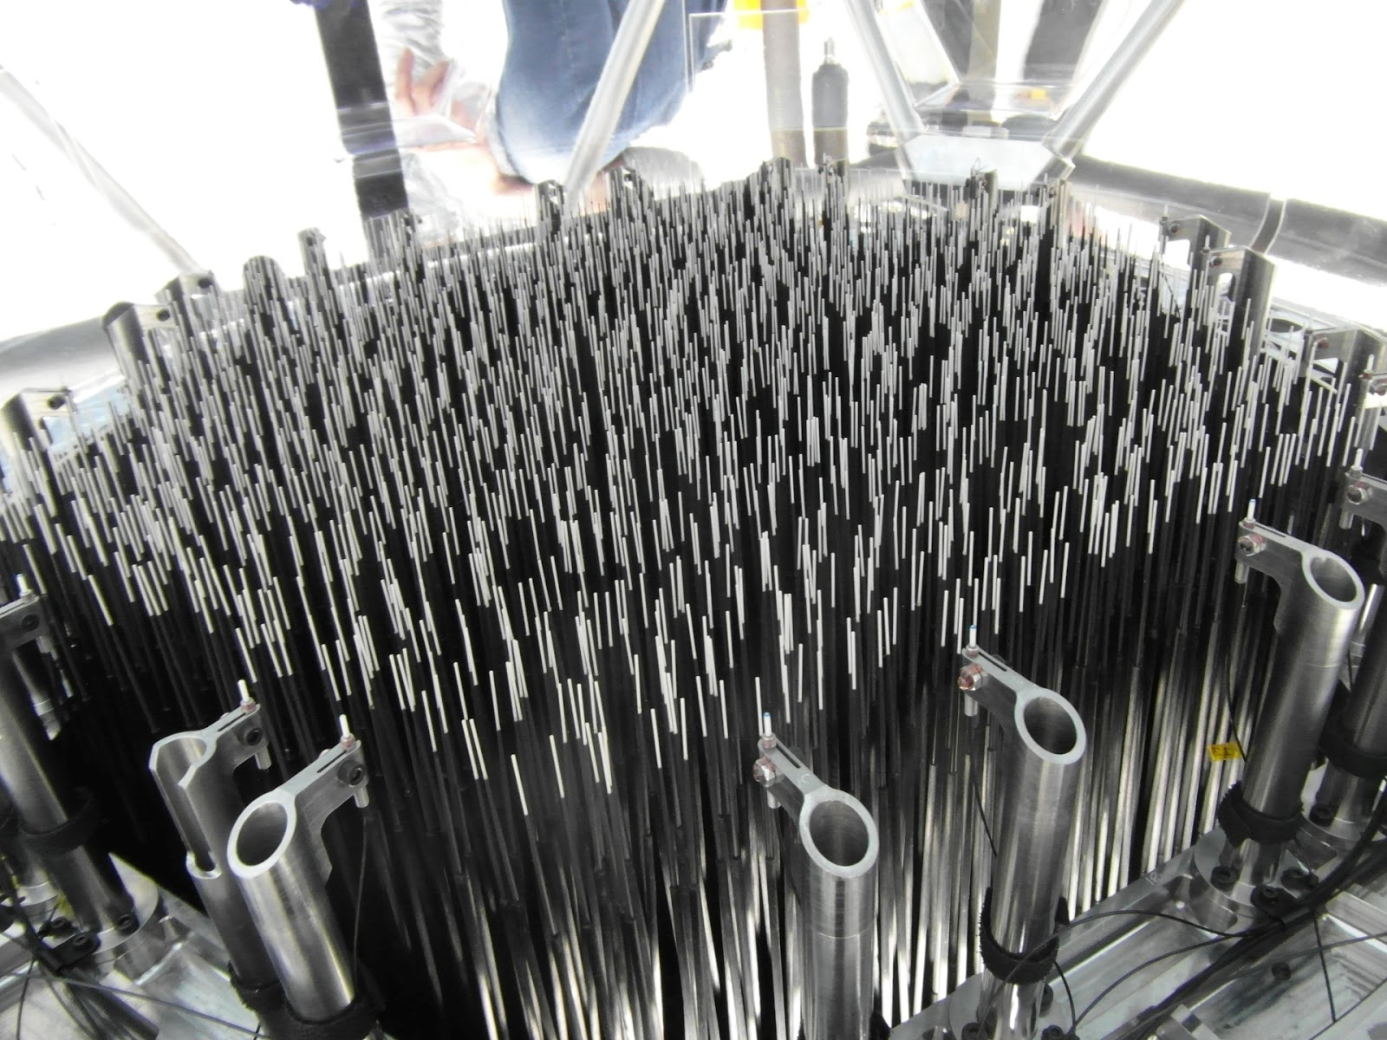
4MOST: Wide-field, high-multiplex optical spectroscopic survey facility for ESO / VISTA
Patrol radius ~ 11.8 mm (~200 arcsec on sky)
Closest separation ~ 15 arcsec
Accuracy of fibre positioning < 0.2 arcsec on sky

Slide 4
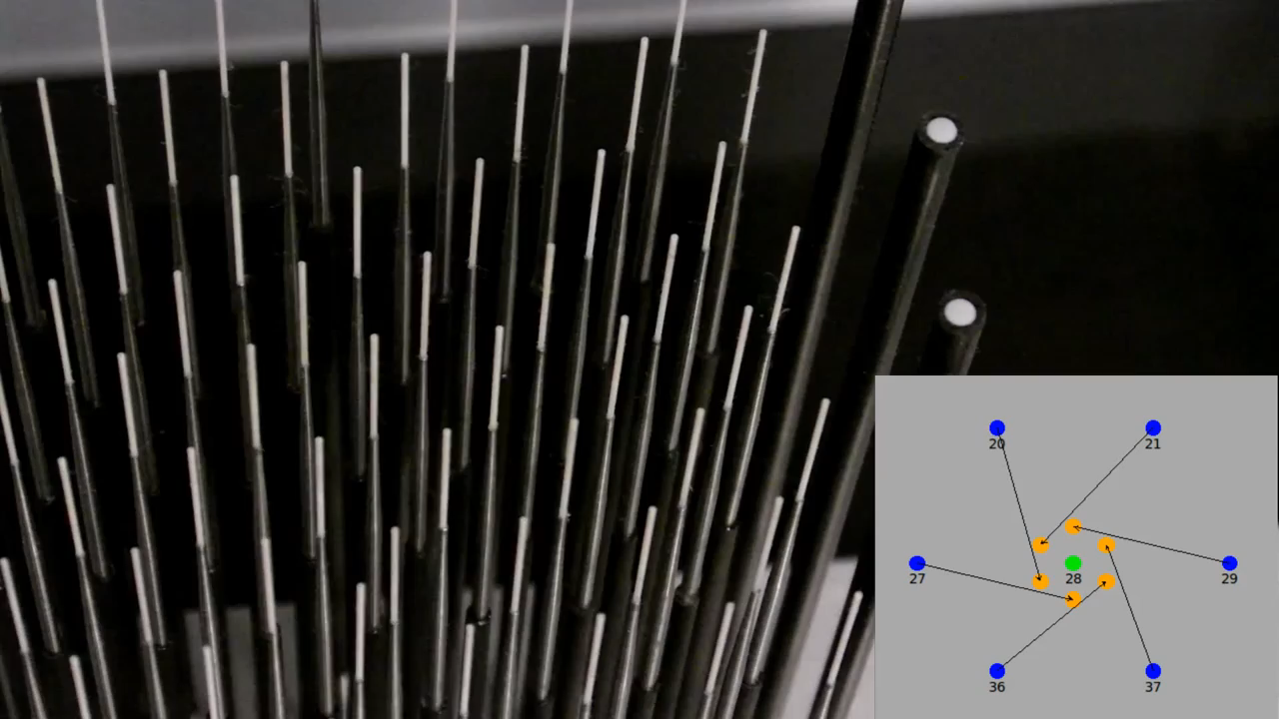
4MOST: Wide-field, high-multiplex optical spectroscopic survey facility for ESO / VISTA
Patro radius ~ 11.8 mm (~200 arcsec on sky)
Closest separation ~15 arcsec
Accuracy of fibre positioning < 0.2 arrsec

Slide 5
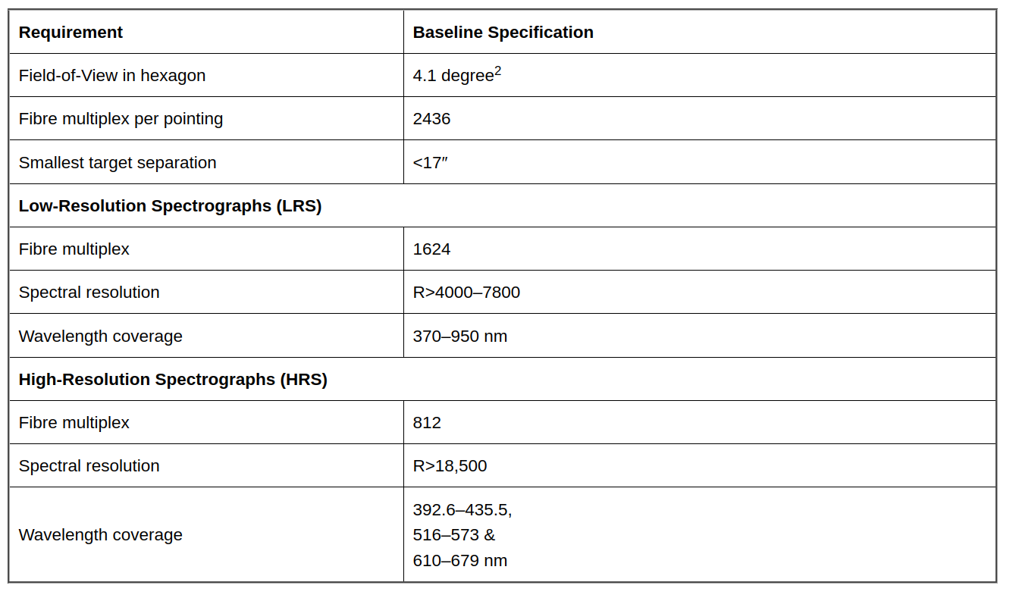
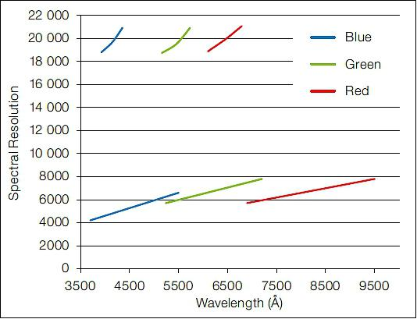

4MOST: Wide-field, high-multiplex optical spectroscopic survey facility for ESO / VISTA
Credit: ESO, 4MOST consortium
3 arms spectrograph - 3 CCDs 6k x 6k - 200 mm beam size
812 science fibers per spectrograph (2 LR + 1 HR)
LR spectrographs were designed and built at CRAL in Lyon.

Slide 6
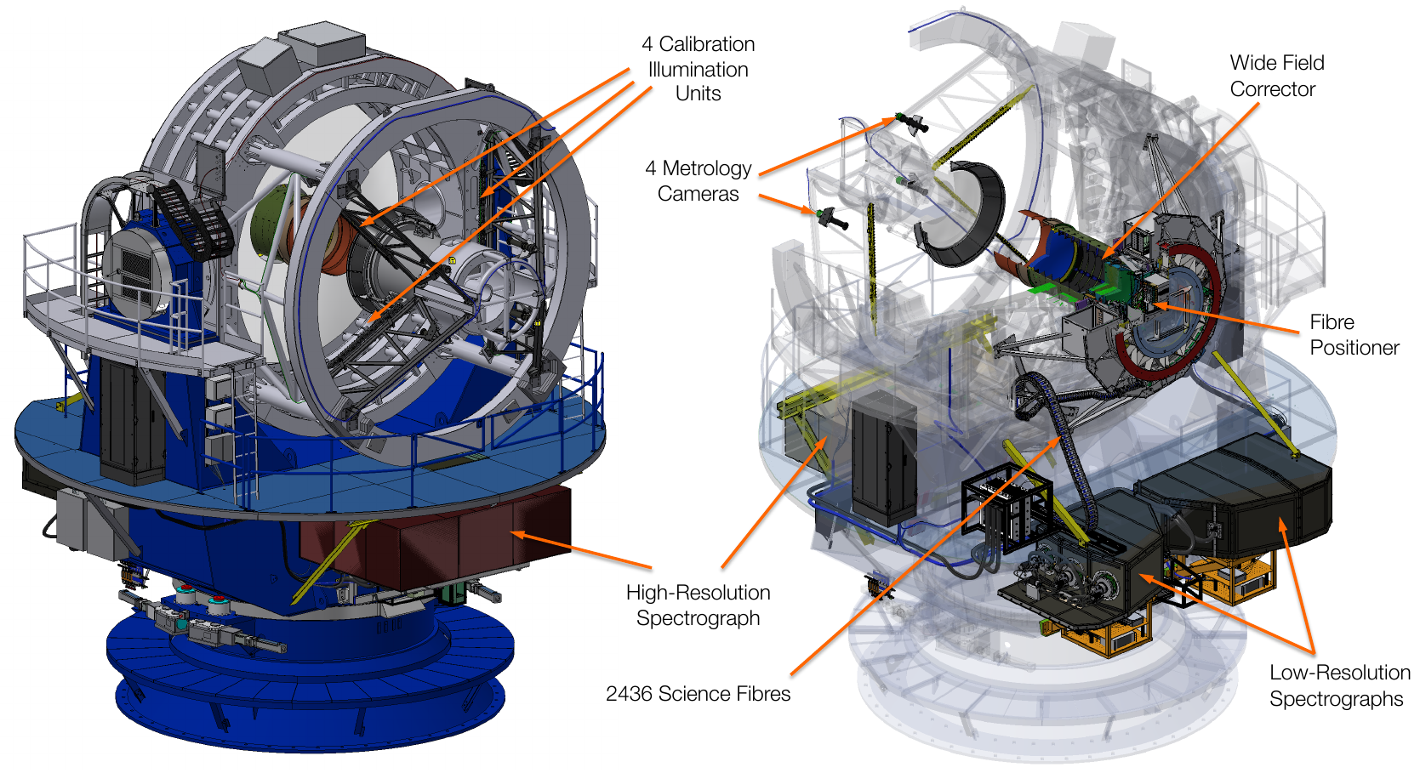
4MOST: Wide-field, high-multiplex optical spectroscopic survey facility for ESO / VISTA

Slide 7
4MOST: Observing strategy
Unique operations model => Suitable for most science cases
4MOST program defined by Public Surveys of 5 years
  Consortium (~70%)
  Community (30%)
All Surveys will run in parallel
  Surveys share fibres per exposure for increased efficiency
Consortium Key Surveys define observing strategy
  Millions of targets all sky
  Fill all fibres

Slide 8
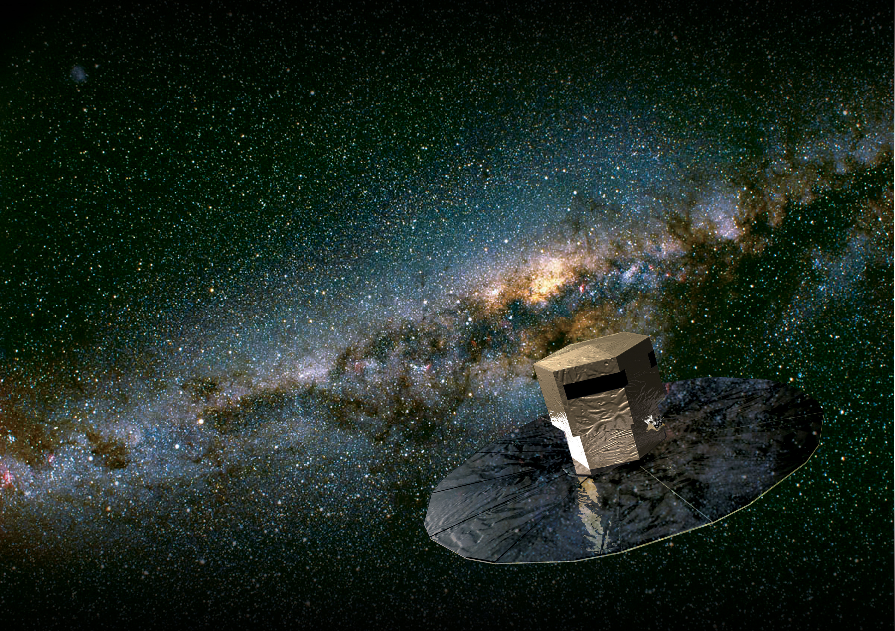
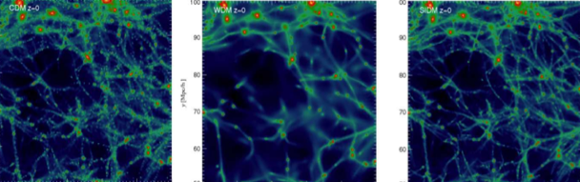
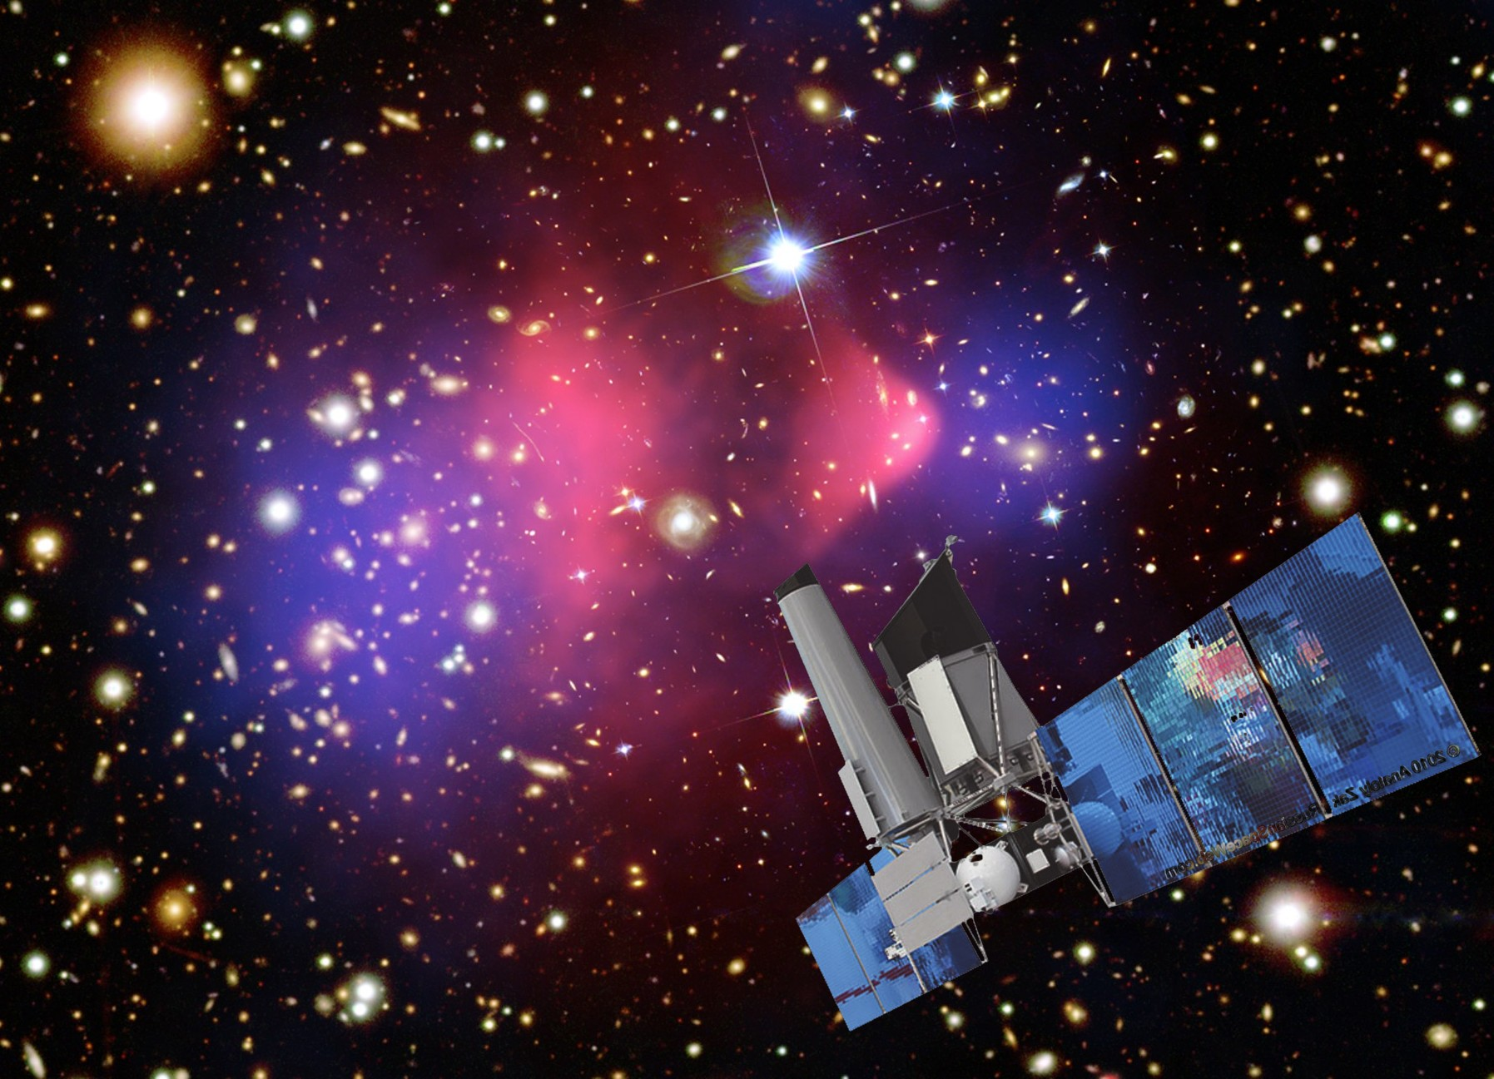
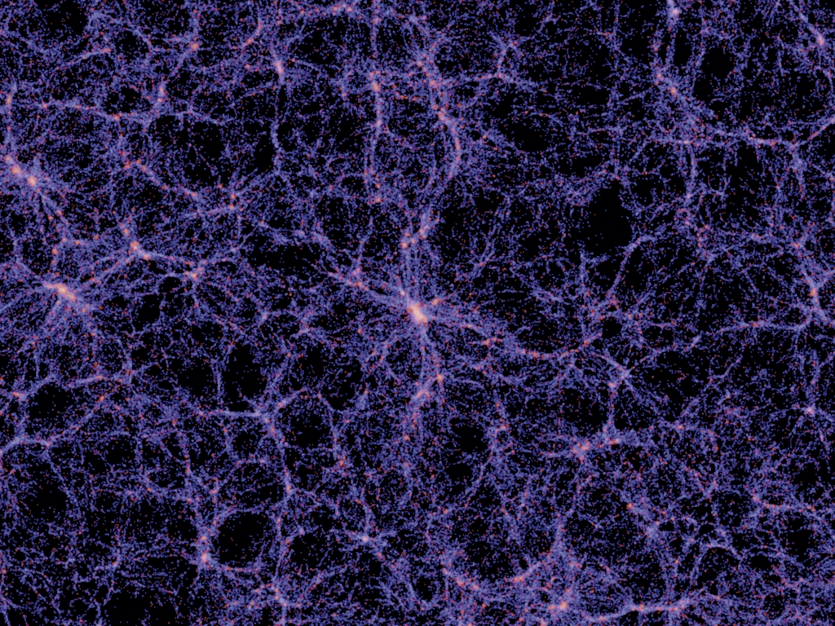
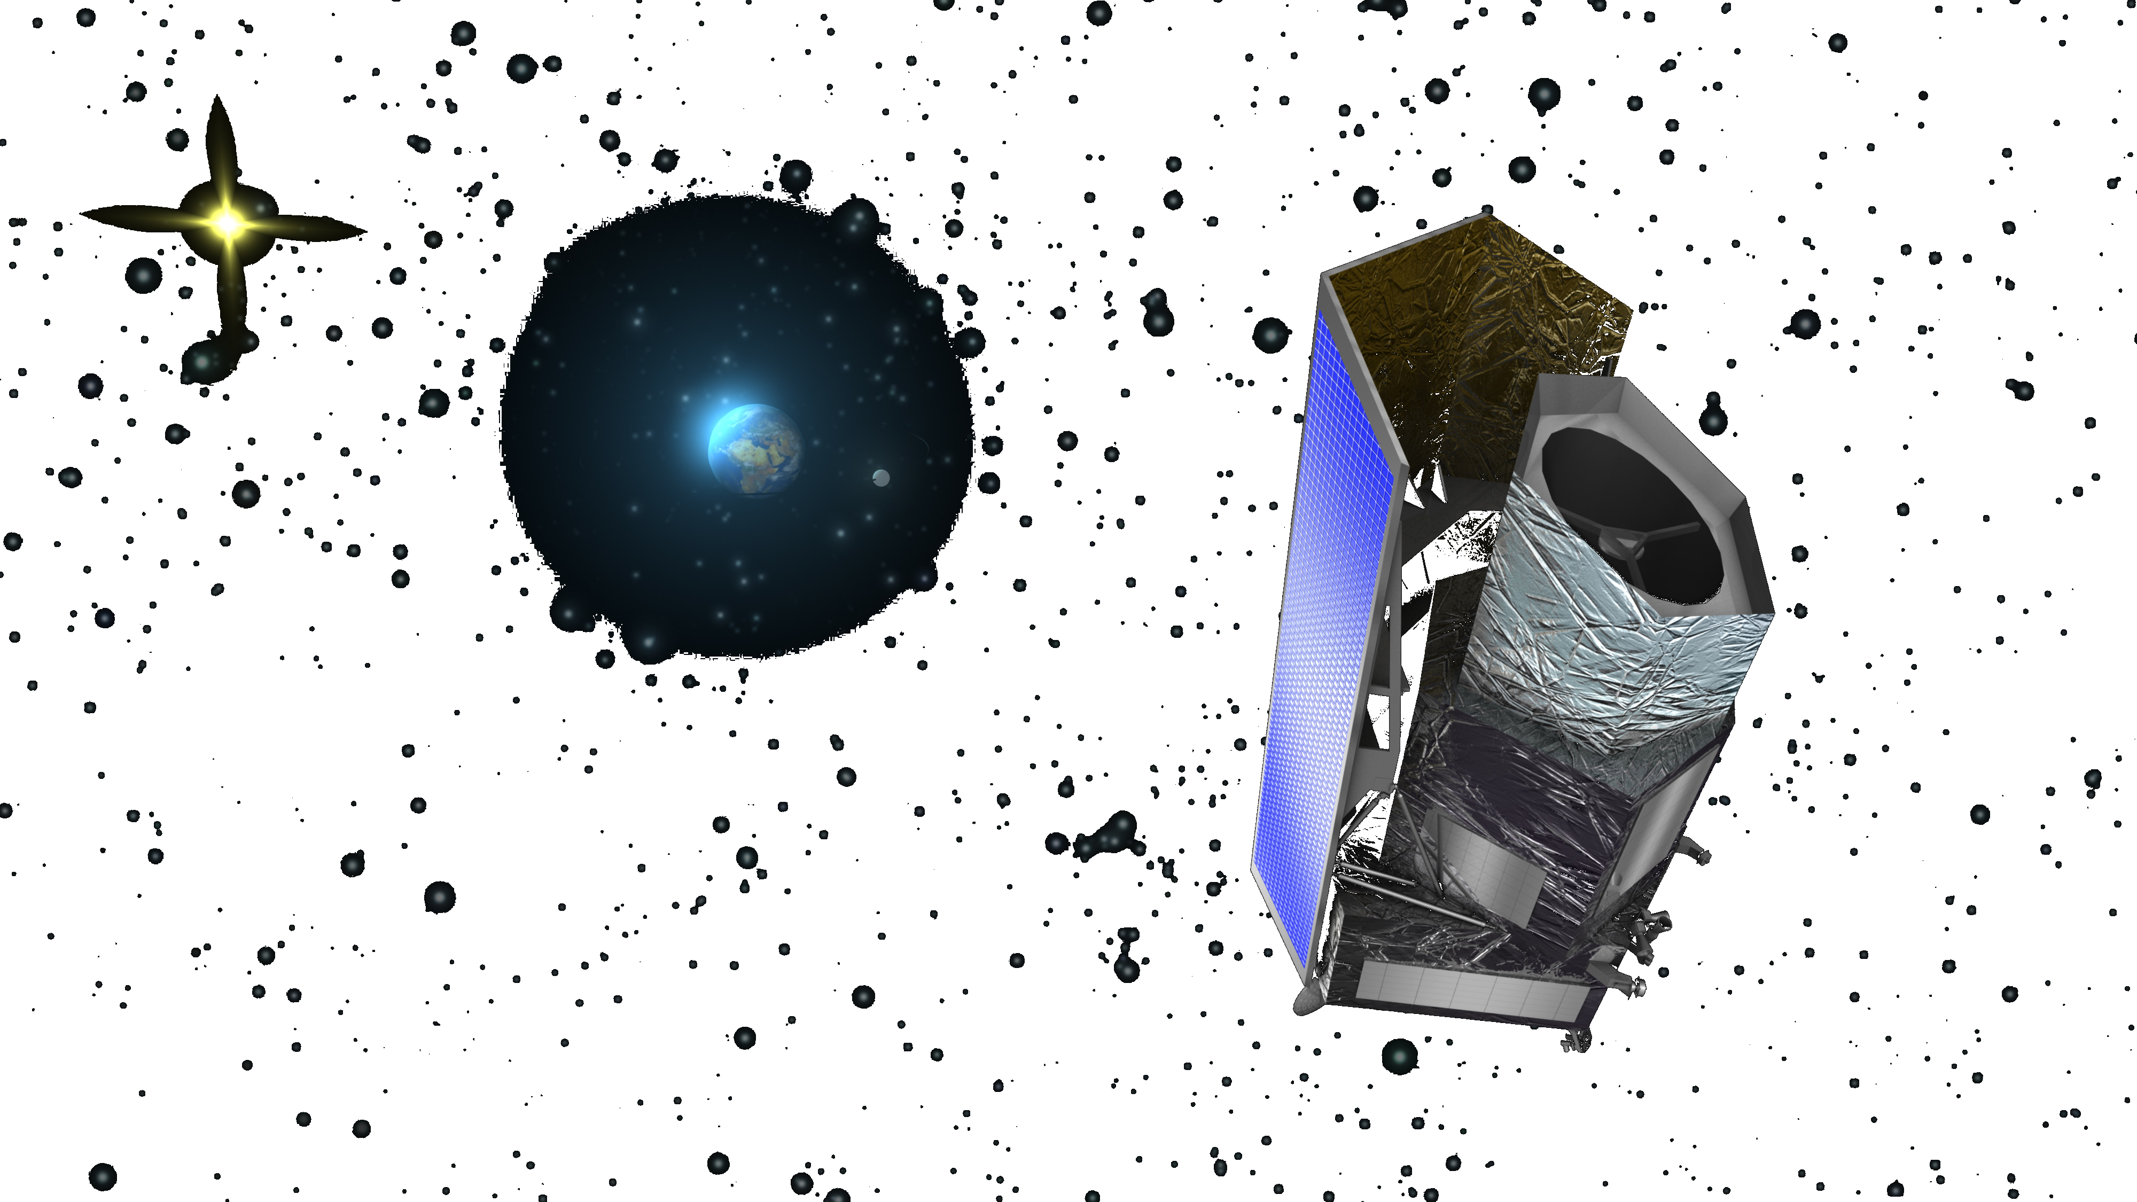
4MOST: Science Themes
Galactic Archeology
  Gaia and PLATO
Main scientific drivers for 4MOST:
Gaia follow-up
eROSITA follow-up: clusters of galaxies and AGN
Weak Lensing surveys (Euclid/LSST)
Cosmology with Baryonic Acoustic Oscillations and Redshift Space Distortion (complementary to DESI)
LSST transients follow-up
Galaxy evolution
  VST/VISTA
High-energy sky
eROSITA
Cosmology
  Euclid/LSST/SKA

Slide 9
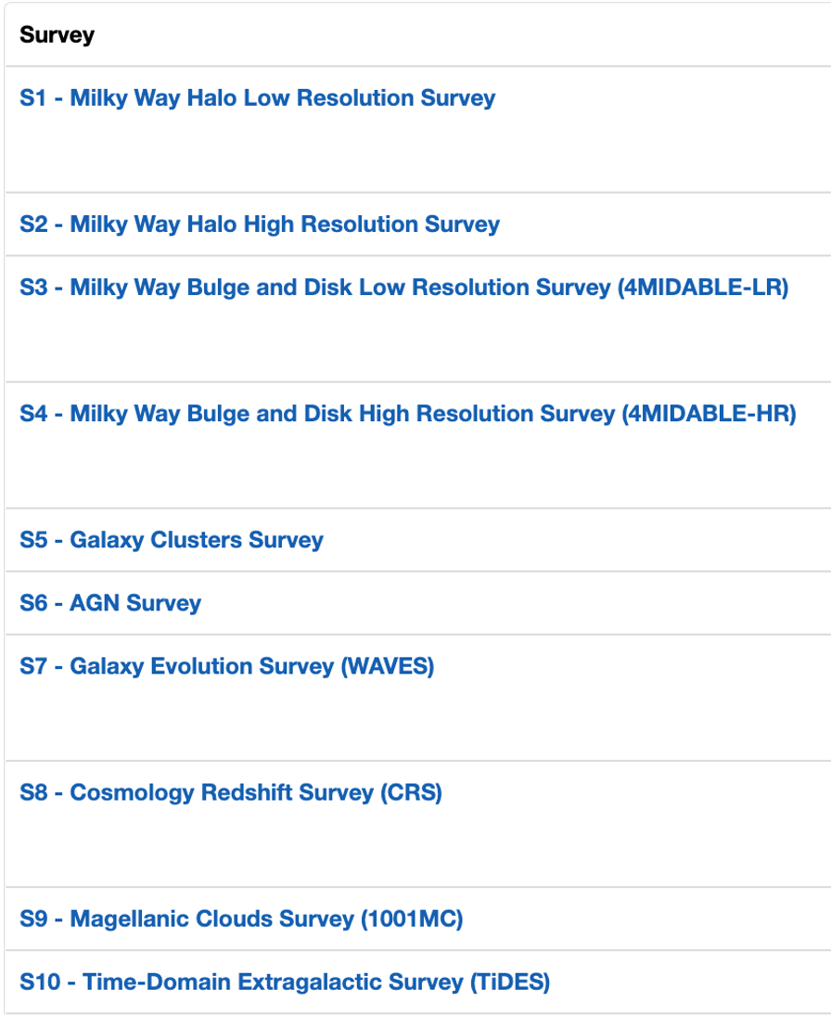
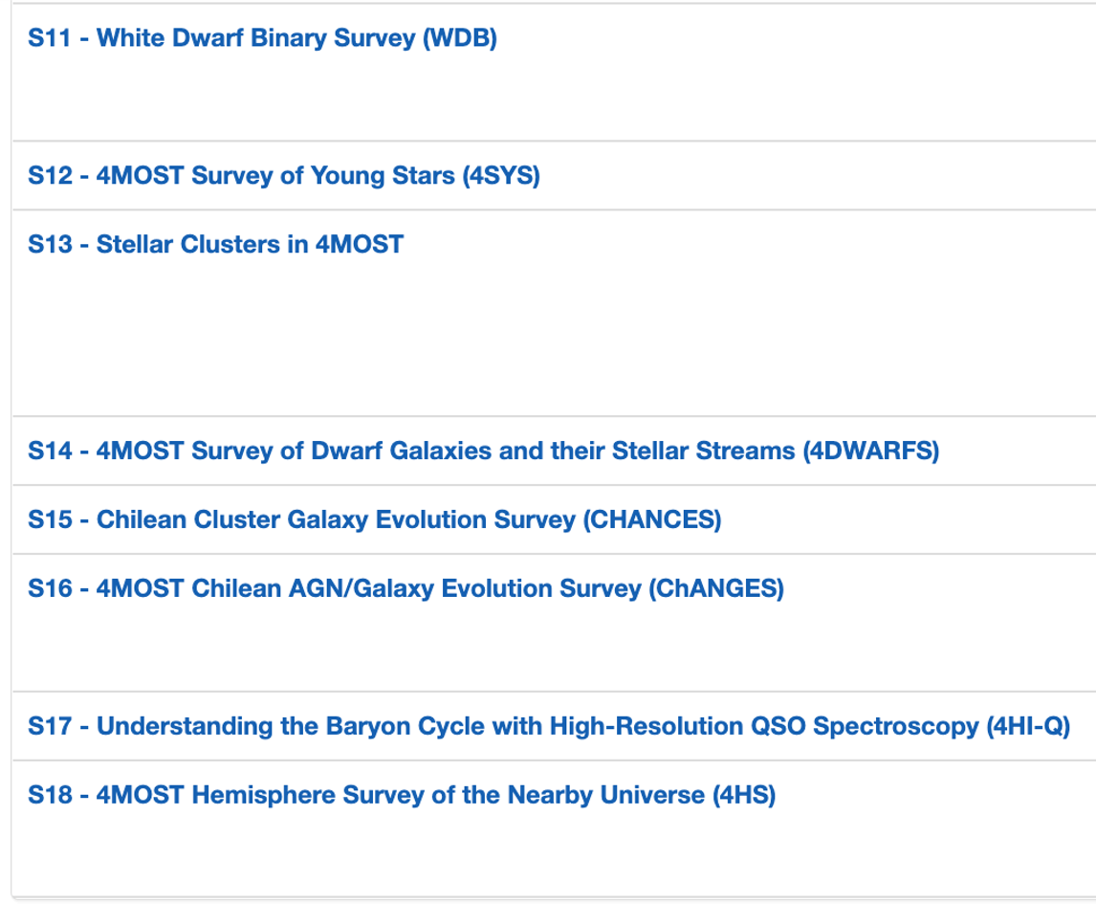
4MOST: 18 different science surveys
10 Consortium
8 Community

Slide 10
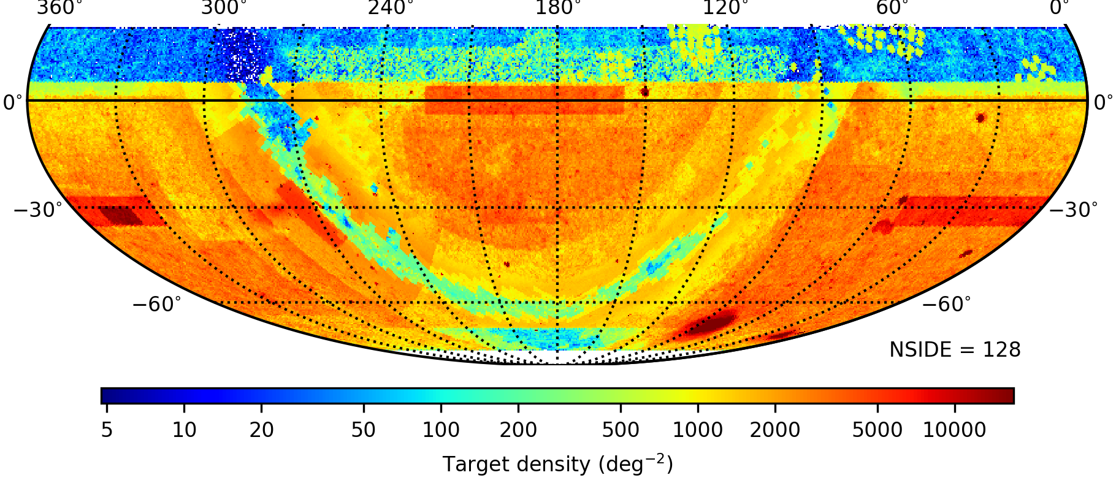
4MOST: Area coverage and target densities for consortium surveys
Low Resolution
Output target density for the 18 surveys
Fibre assignment is computed to optimize the performance of each survey

Slide 11
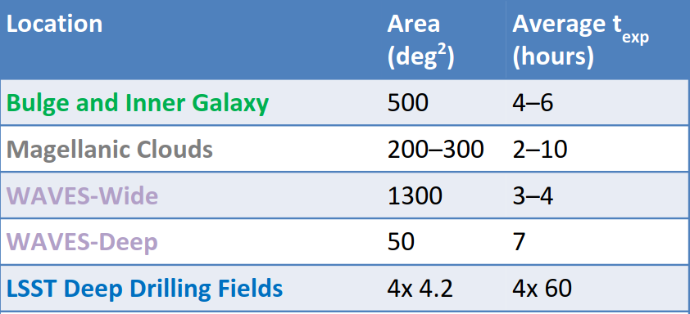
4MOST: Area coverage and target densities for consortium surveys
Low Resolution
Output target density for the 18 surveys
Fibre assignment is computed to optimize the performance of each survey

Slide 12
4MOST: Cosmology
Cosmology
  Euclid/LSST
Main science purposes:
Weak Lensing: Photo-z calibrations and characterize the foreground ​
Galaxy Clusters: Redshifts evolution and velocity dispersions of Galaxy Clusters ​
SNe Ia: DES/LSST live SNe Ia and host galaxies (50k transients/year)​
BAO and RSD: BGs, LRGs, QSOs, Lyα-forest
Synergies with southern facilities:​
cross-correlation with weak-lensing (LSST/Euclid)​
synergies with radio surveys (SKA)​
synergies with CMB surveys (SPT/ACT)
eROSITA Cluster

Slide 13
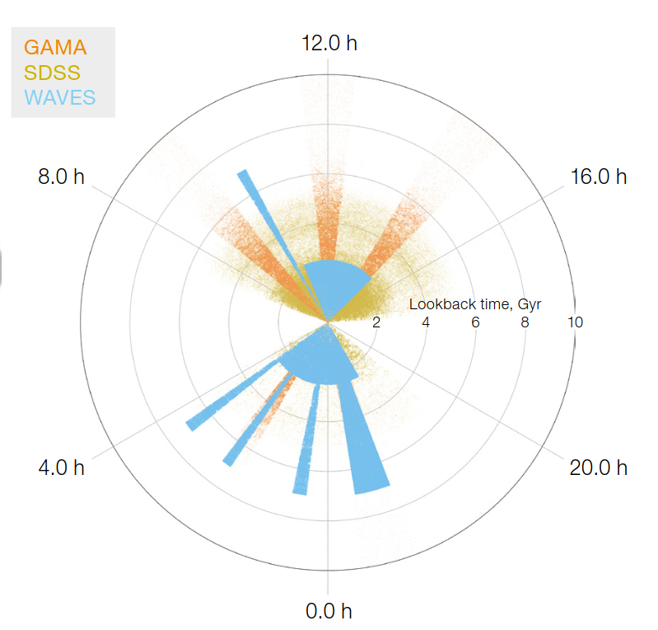
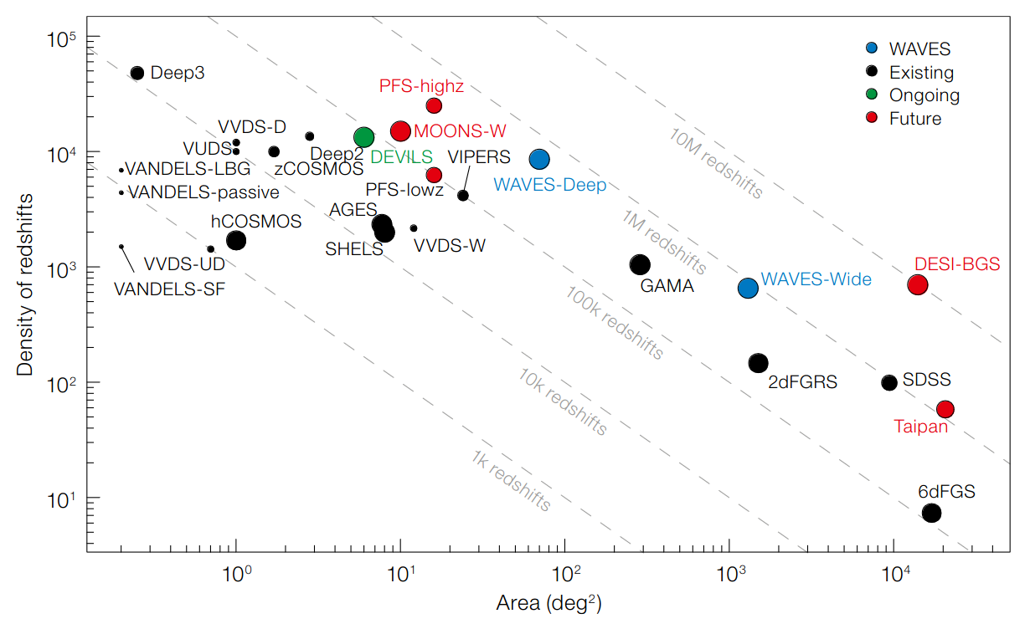

Wide-Area VISTA Extragalactic Survey (WAVES)
Galaxy evolution​
VST/VISTA
PI: S. Driver & J. Liske
2 observation strategies: wide and deep => high redshift completness
Galaxy formation to dwarf satellite scale, halo occupation (nature of DM)
Evolution of mass & energy budget for z<1
Growth of structure on 1kpc-10Mpc scales for z<1
Photometric redshift calibration

Slide 14
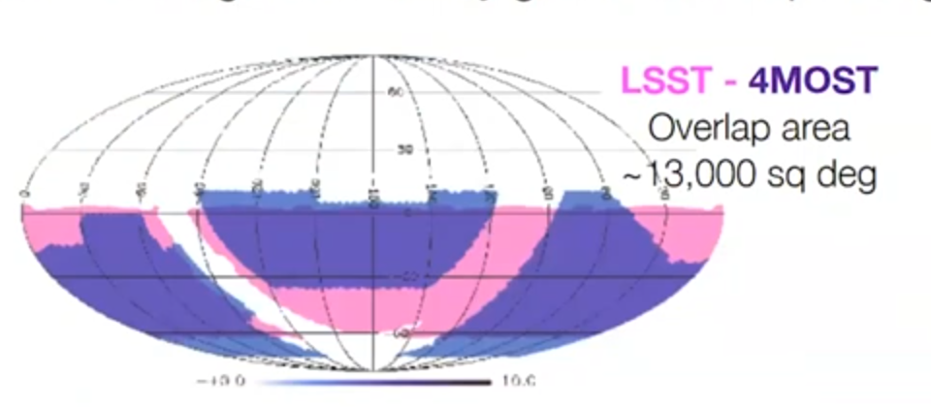
4MOST: Time Domain Extragalactic survey
High-energy sky
eROSITA
PI: Isobel Hook
Spectroscopic follow up of transient+ host
Can target ~10 events in any given 4MOST pointing

Slide 15
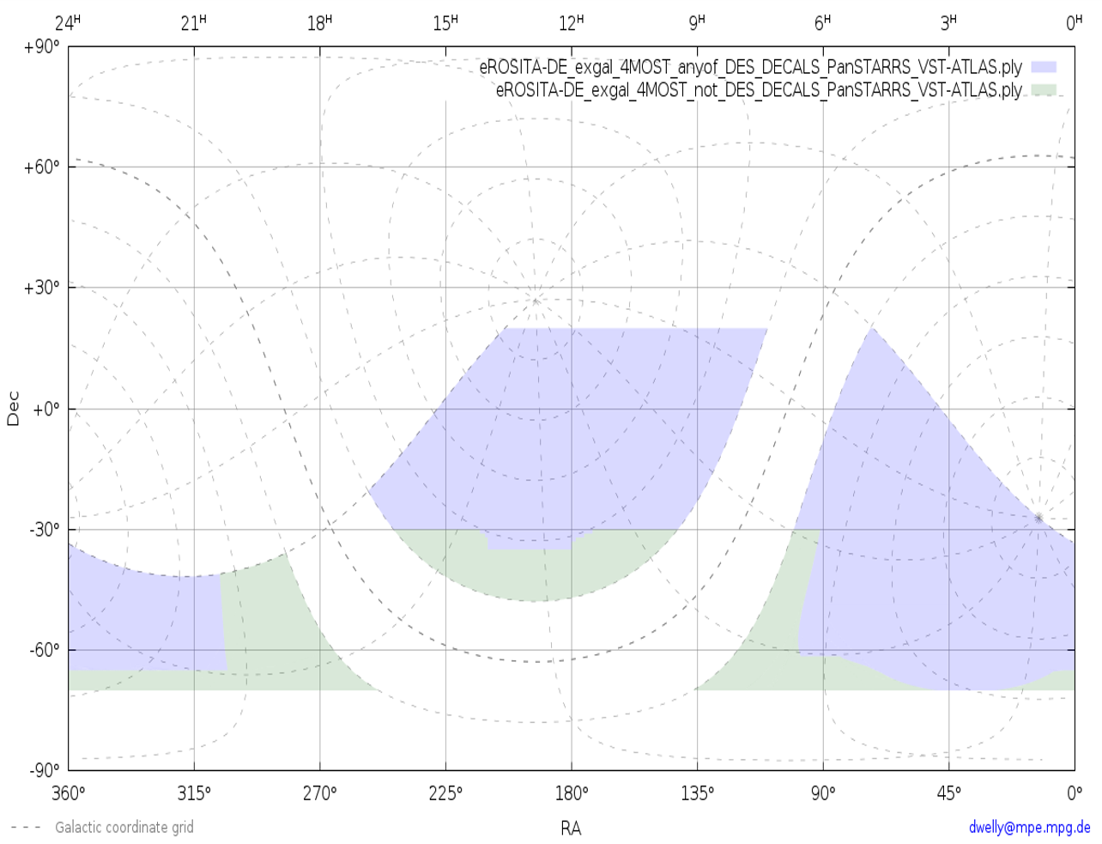
4MOST: eROSITA Galaxy Cluster Redshift Survey
High-energy sky
eROSITA
Spectroscopic follow up of eROSITA cluster
Survey strategy
  13,000 deg²
  200,000 X-ray clusters
  ~2M galaxies
Primary science goals
  Cluster mass function evolution with redshift
  Evolution of the cluster power spectrum
  Galaxy evolution in dense environments
PI: Johan Comparat

Slide 16
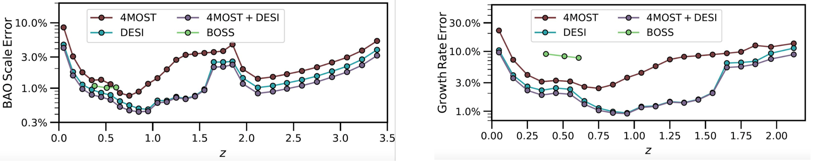
4MOST-Cosmology Redshift Survey : strategy
PI: J. Richard & J-P Kneib
Primary science goal: Constrain Dark Energy and General Relativity by measuring cosmic expansion history and growth of structure using different tracers:
  ~1.5M Bright Galaxies z<0.4
  ~ 3.5M Luminous Red Galaxies 0.4>z>1
  ~1.5 M Quasars (QSO) 0.9<z<2.1+ QSO-Lya 2.2<z<3.5
Hard to be competitive with DESI/Euclid for BAO/RSD measurements in terms of number of targets and timeline of the survey
  => Try to be complementary to DESI:
  + Concentrate on redshifts z<~1 and z>2.4 to complement Euclid

Slide 17
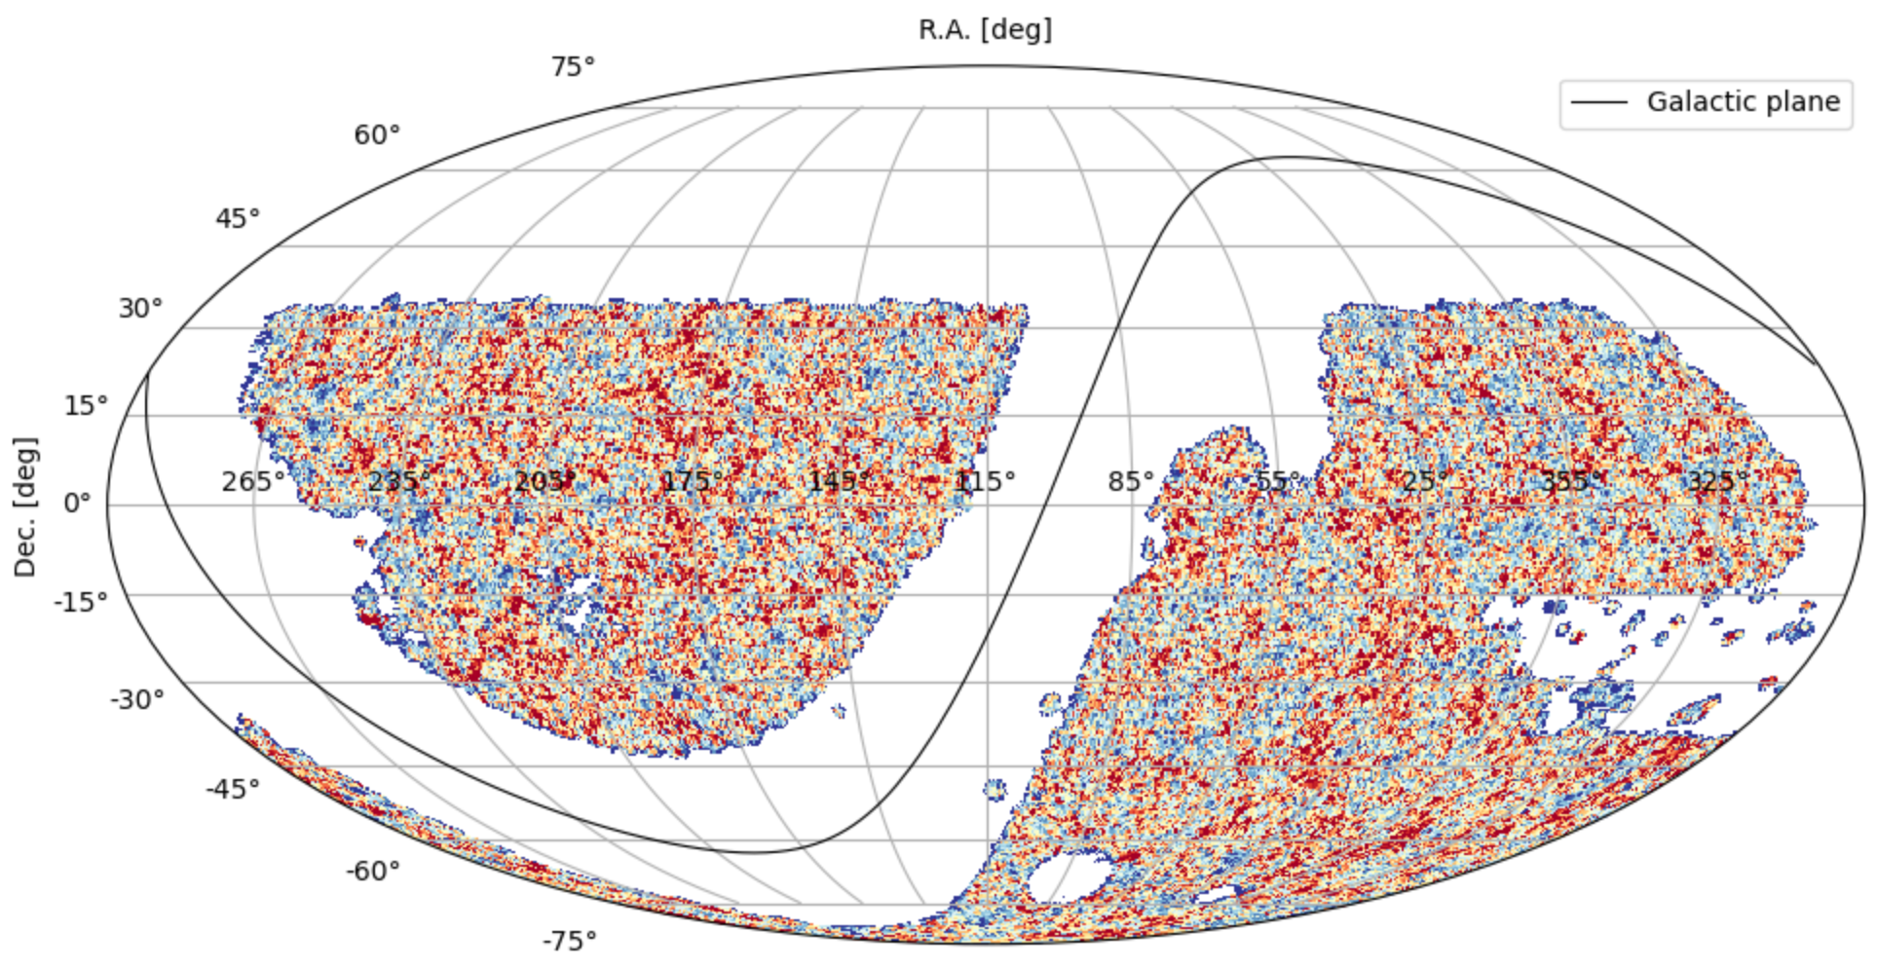
4MOST-CRS: Legacy Survey DR10
new imaging from DECam into the "southern" (Declination ≤ 32.375°) Legacy Surveys footprint
DECAM (Legacy Surveys) provides the best quality of imaging to select targets (until we have access to LSST)​
=> Switch from VHS to Legacy Survey DR10 to refine the target selection​
=> Create galaxy samples similiar to DESI (for BG and LRG)​
=> Take advantage of DESI TS performance

Slide 18
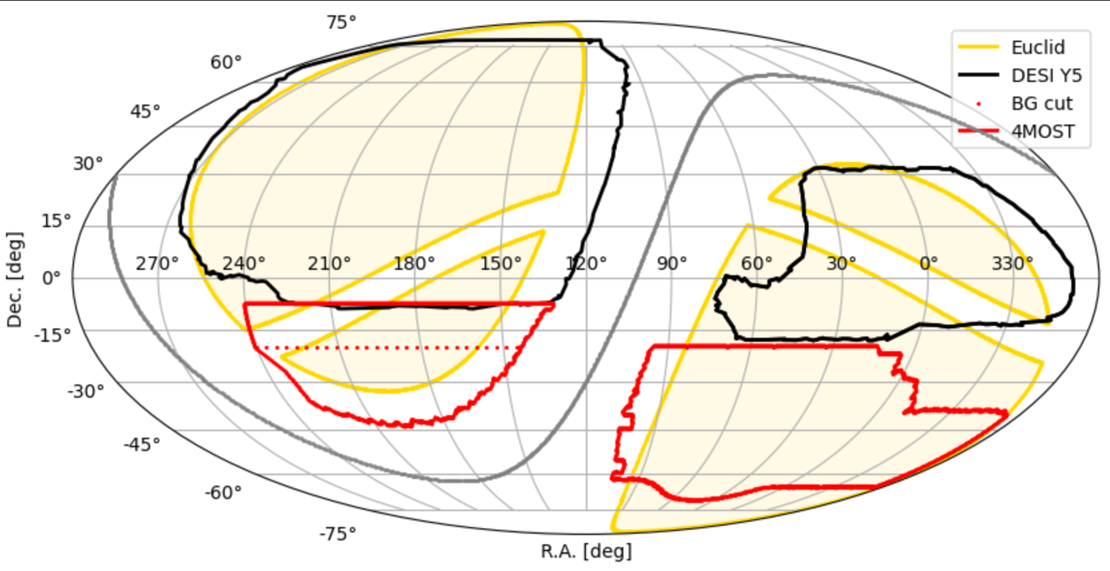
4MOST-CRS:
Bright galaxies & Luminous Red Galaxies
LSST area
Area:
  LRG ~7000deg²
  BG ~ 5600deg²
BGs cut at dec <20°​
=> DESI should go down to dec –20° for BGs

Slide 19
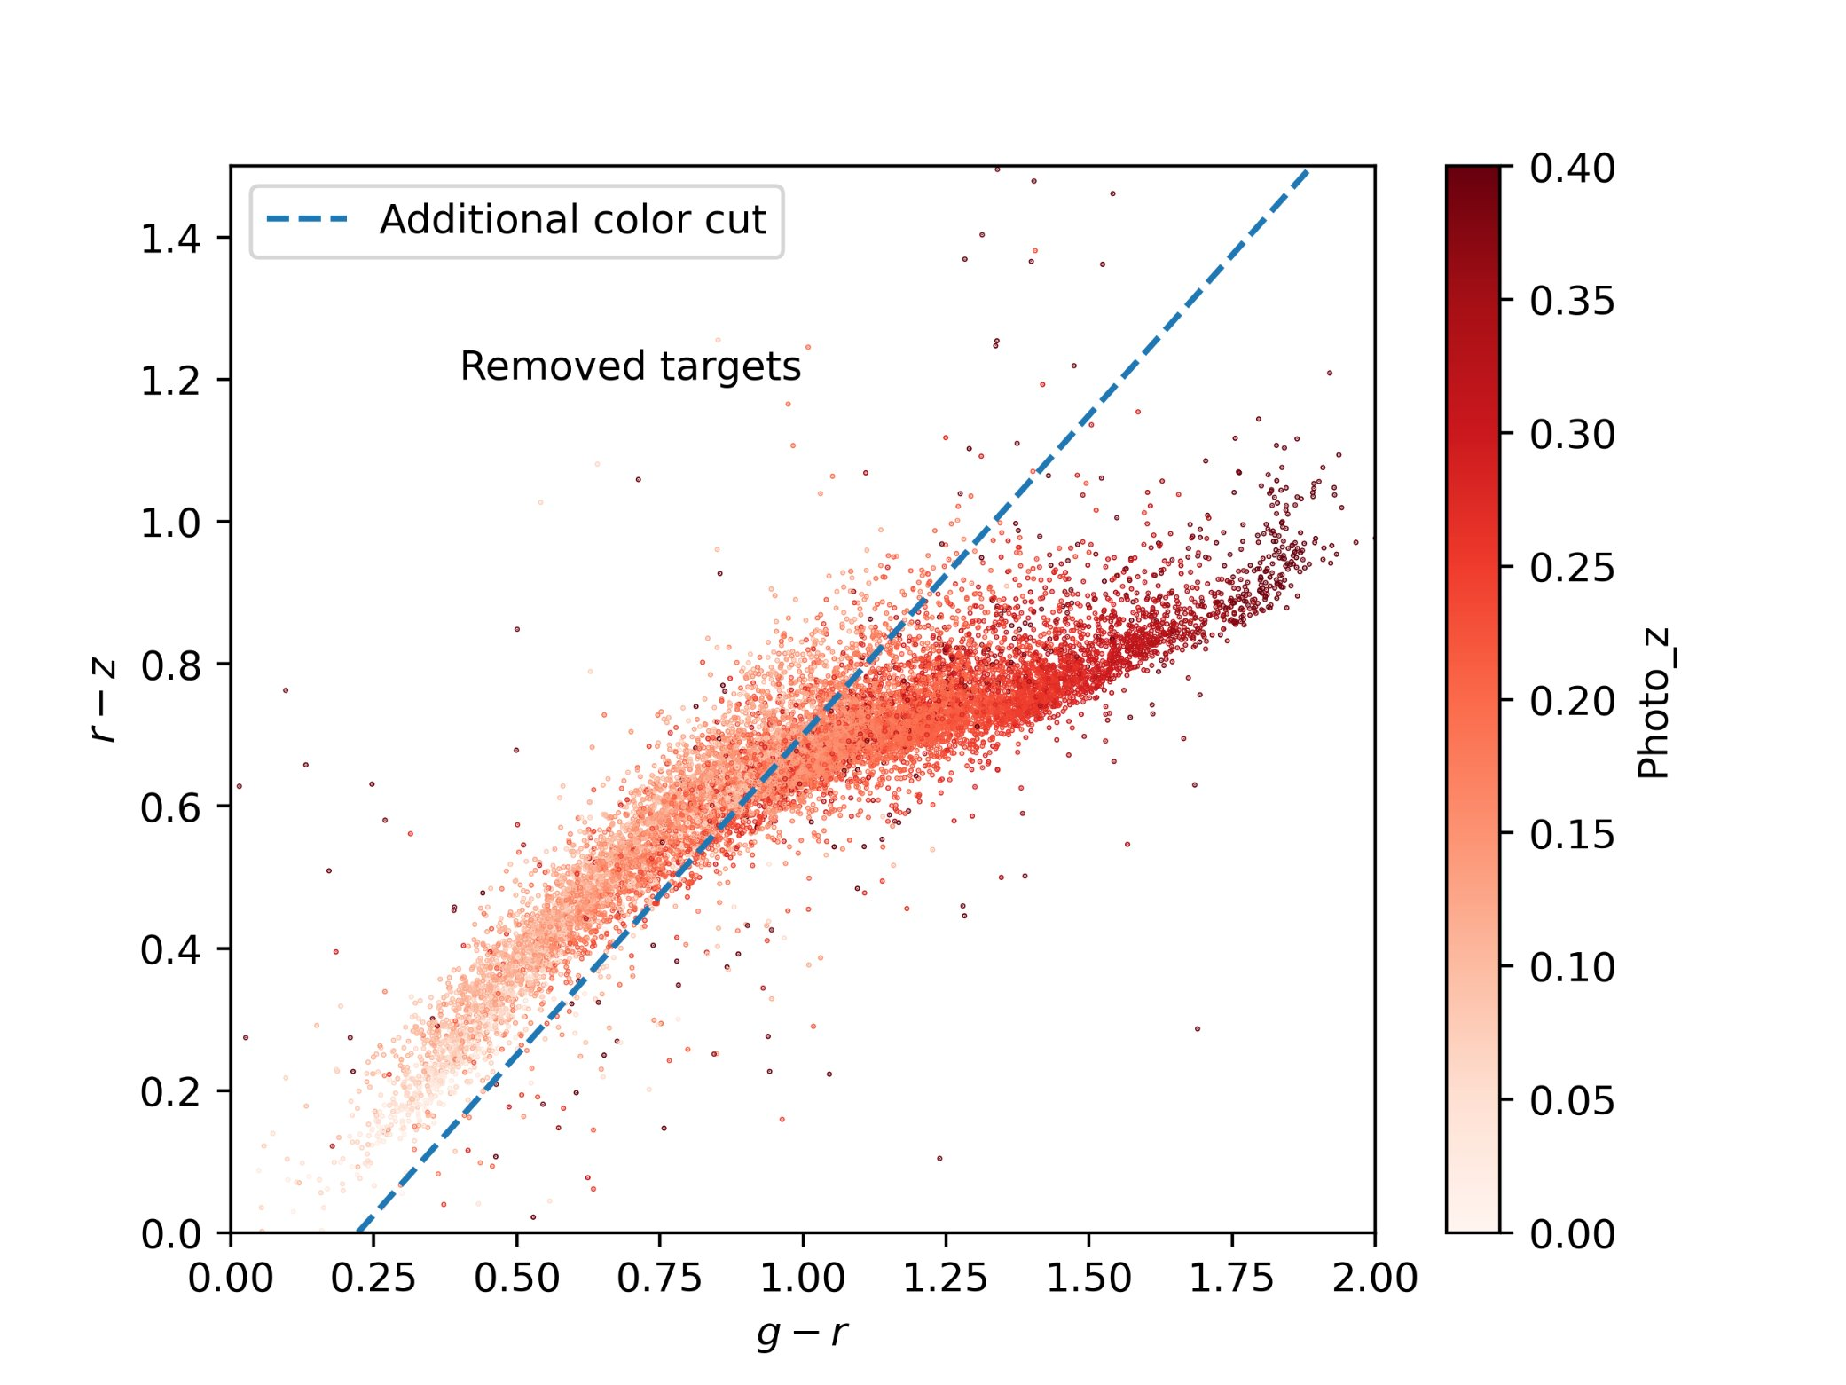
4MOST-CRS: BG & LRG Target selection
Similar to the DESI TS but using Legacy survey DR10
+ Additionnal color cuts to reduce the target density:
BG ~860/deg² (DESI) => ~250/deg²:
  Remove lowest redshift part z<0.1
  r magnitude cut > 19

Slide 20
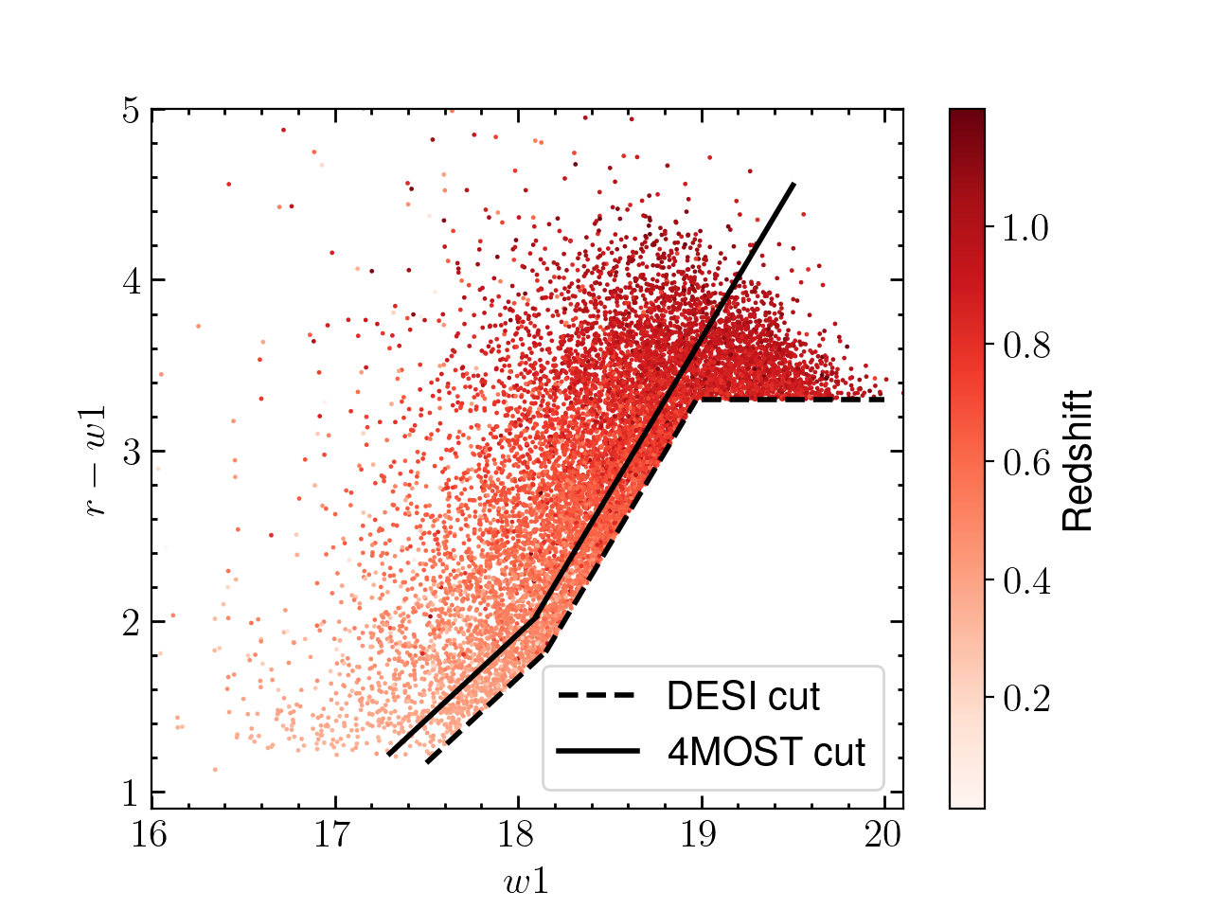
4MOST-CRS: BG & LRG Target selection
Similar to the DESI TS but using Legacy survey DR10
+ Additionnal color cuts to reduce the target density:
BG ~860/deg² (DESI) => ~250/deg²:
  Remove lowest redshift part z<0.1
  r magnitude cut > 19
LRG ~605/deg² (DESI) => ~400/deg²:
  Remove the tail at high redshift z>1
  Shift the color selection in a redshift independent way

Slide 21
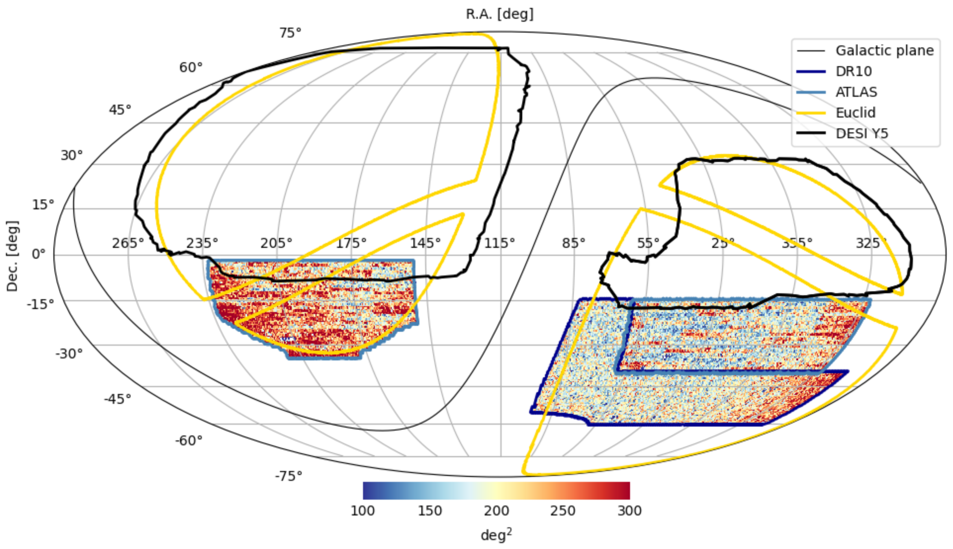
4MOST-CRS: QSOs
LSST area
2 different photometric surveys:
  ATLAS (information from the u-band)
  LS DR10
Area: ~7000 deg²

Slide 22
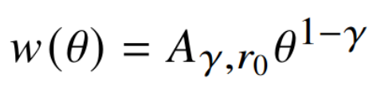
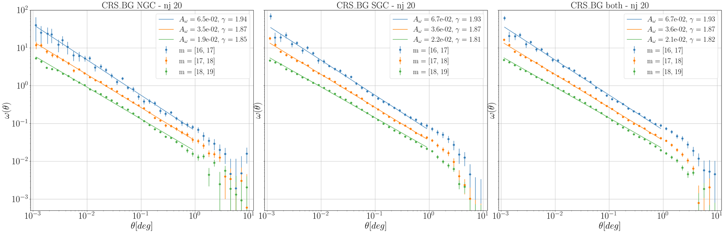
4MOST-CRS:
Angular Clustering and Limber Scaling Test
BG angular clustering in magnitude slices
Preliminary
Behnood Bandi

Slide 23
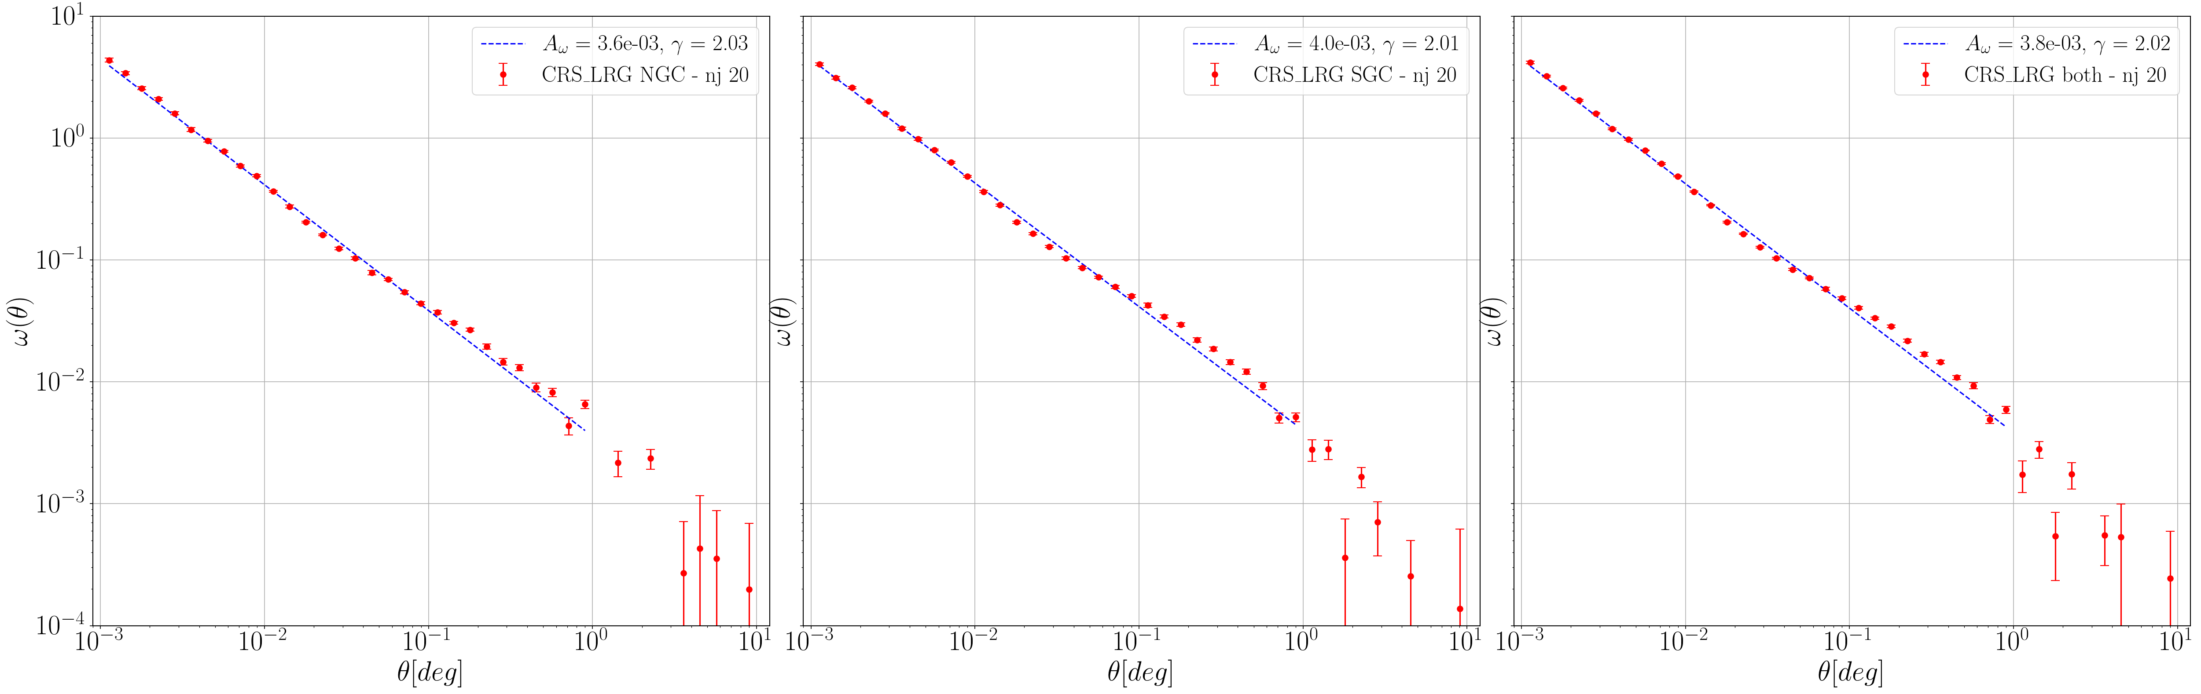
4MOST-CRS:
Angular Clustering and Limber Scaling Test
LRG angular clustering
Preliminary
Behnood Bandi

Slide 24
Next steps
4MOST almost ready:
  waiting for decision to ship from Potsdam to Paranal
Planned start of operations => spring 2025
1st data release (survey validation data) expected 6 months latter (end 2025)
Then ~ 1 data release per year
=> Lots of exciting sciences incoming (not only for cosmology)

Slide 25


























Thank you

Slide 26
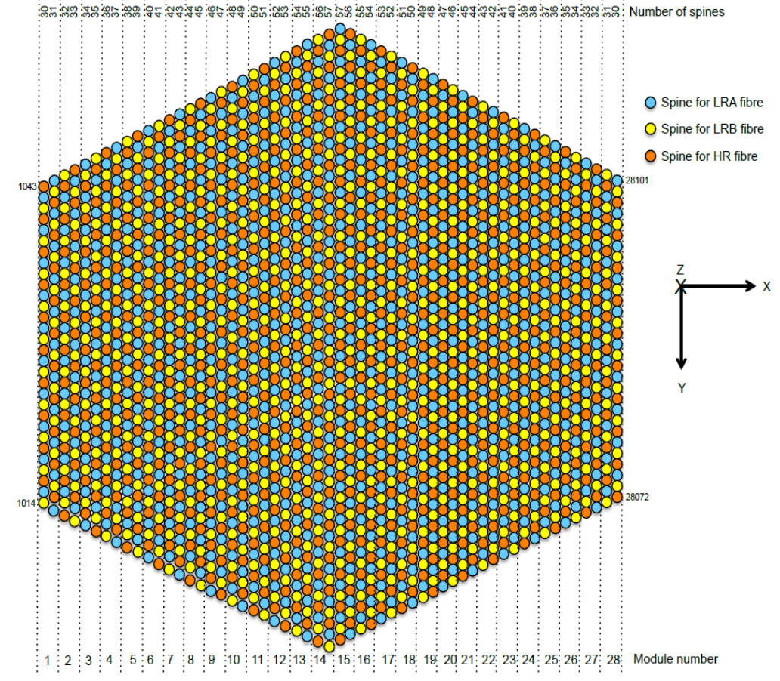
4MOST-CRS:
Bright galaxies & Luminous Red Galaxies

Slide 27
4MOST-Cosmological Redshift Survey (CRS)
Primary science goal: Constrain Dark Energy and General Relativity by measuring cosmic expansion history and growth of structure using different tracers:
target | imaging | redshift range | density
BG | LS DR10 | 0.1<z<0.4 | 250/deg2
LRG | LS DR10 + WISE | 0.4<z<1 | 400/deg2
QSO | LS DR10 +ATLAS+WISE | 0.9<z<2.2 | 190/deg2
QSO-Lya | LS DR10 +ATLAS+WISE | 2.2<z<3.5 | 50/deg2

