Slide 1
EICROC0
Tests followup
S. CONFORTI DI LORENZO
A. VERPLANCKE
OMEGA microelectronics group
Ecole Polytechnique & CNRS IN2P3
conforti@omega.in2p3.fr
verplancke@omega.in2p3.fr
Notes:
I will talk about SPACIROC asic
SPACIROC stands for Spatial…….

Slide 2
Scurve with automatic threshold sweep
BOARD ASIC alone (3B)

Slide 3
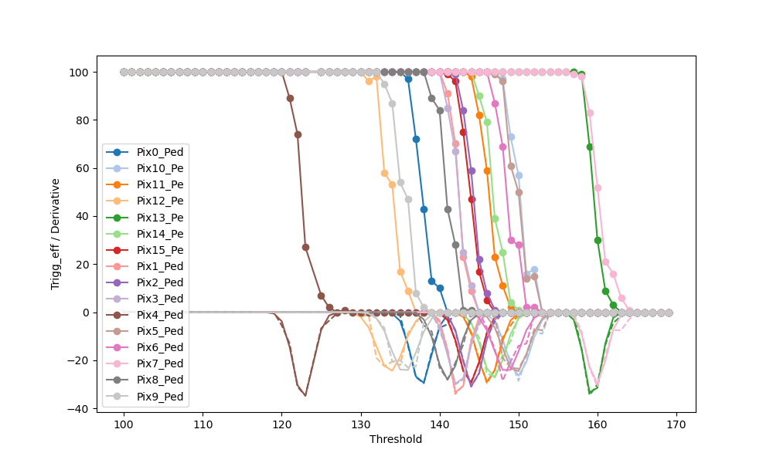
Pedestal vth_correction at 0
Input DAC_pulse 0: No input charge
Vth_correction fixed at 0
0,11 fC / DACu
Threshold DAC_10bits

Slide 4
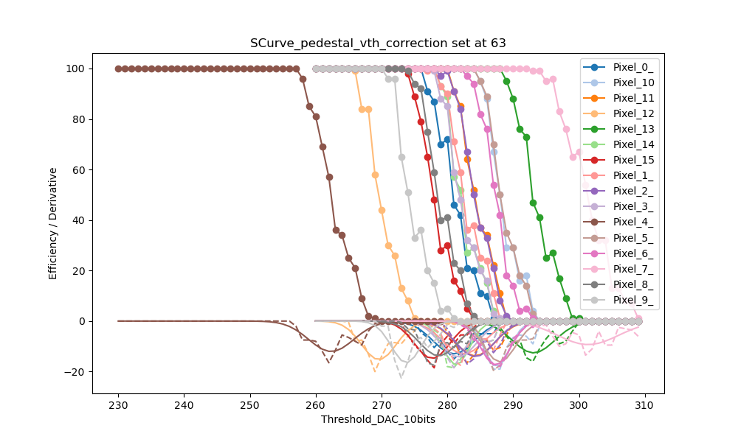
Pedestal vth_correction at 63
Input DAC_pulse 0: No input charge
Vth_correction fixed at 63

Slide 5
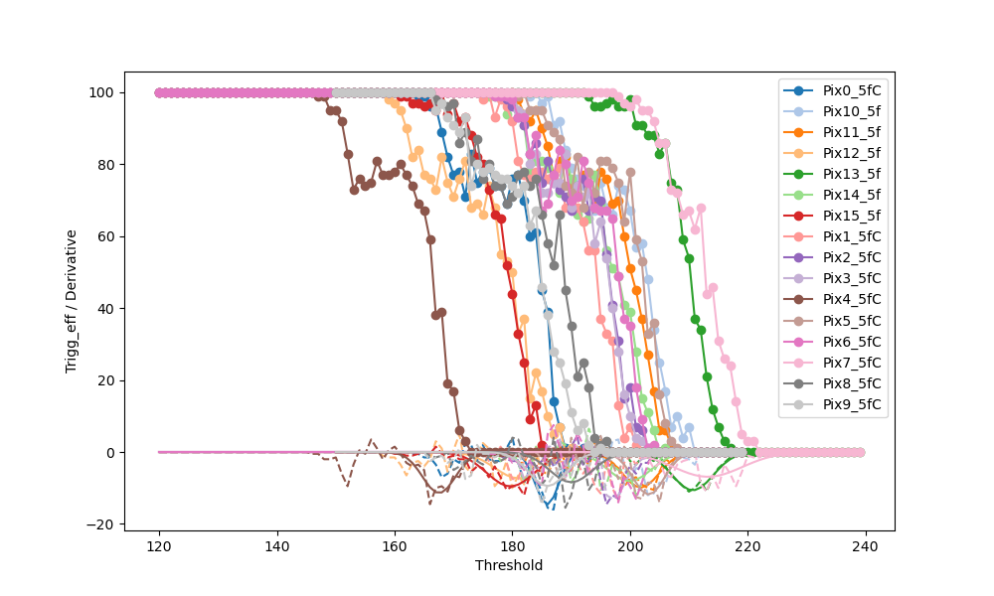
Scurve 1
Input DAC_pulse 11: ~ 5 fC
Vth_correction fixed at 0
Day 1
Threshold DAC_10bits

Slide 6
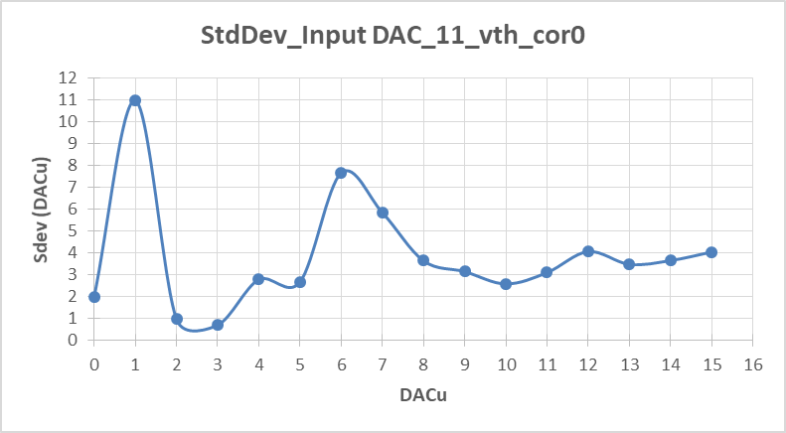
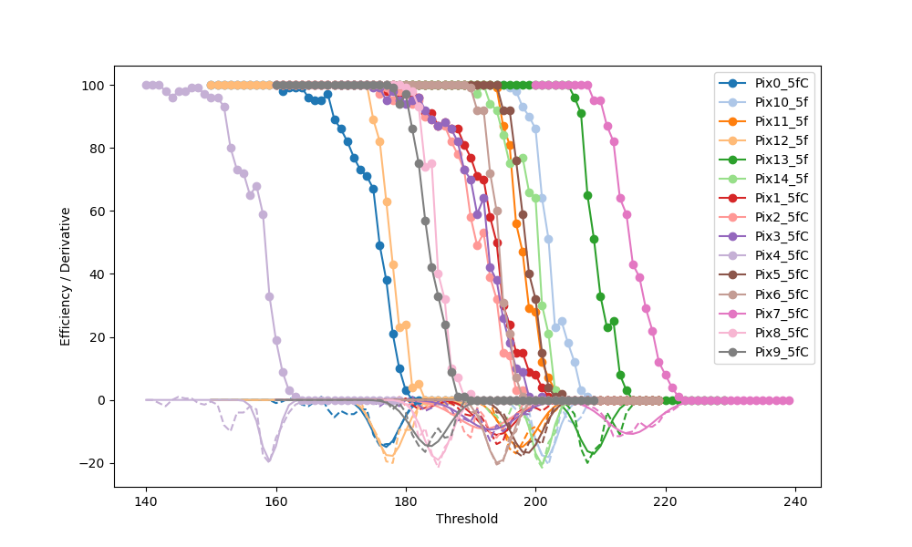
Scurve 1
Day 2…after board rebooting
Input DAC_pulse 11: ~ 5 fC
Vth_correction fixed at 0
0,11 fC / DACu
Threshold DAC_10bits

Slide 7
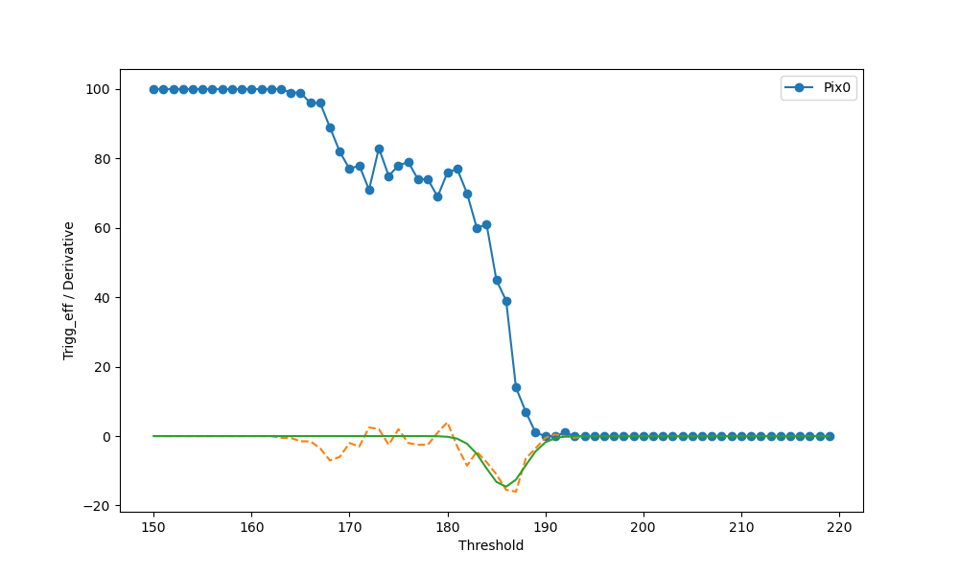
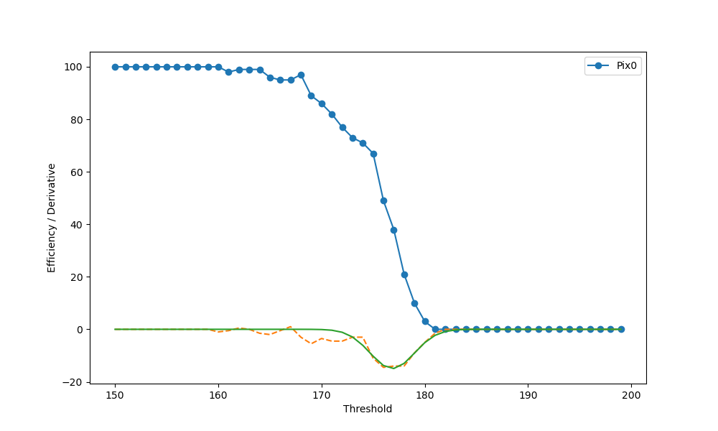
Scurve 1
Zoom only pixel zero

Slide 8
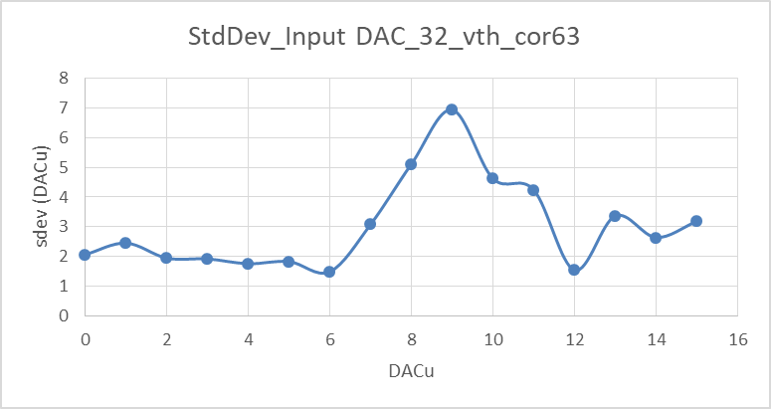
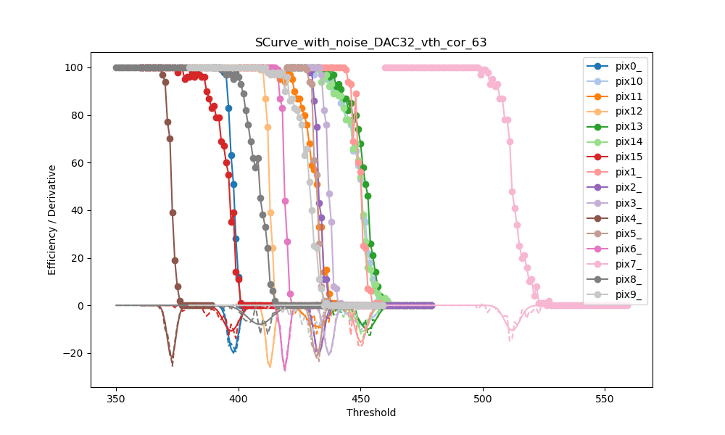
Scurve 2
Input DAC_pulse 32: ~ 14 fC
Vth_correction fixed at 63
0,11 fC / DACu
Threshold DAC_10bits

Slide 9
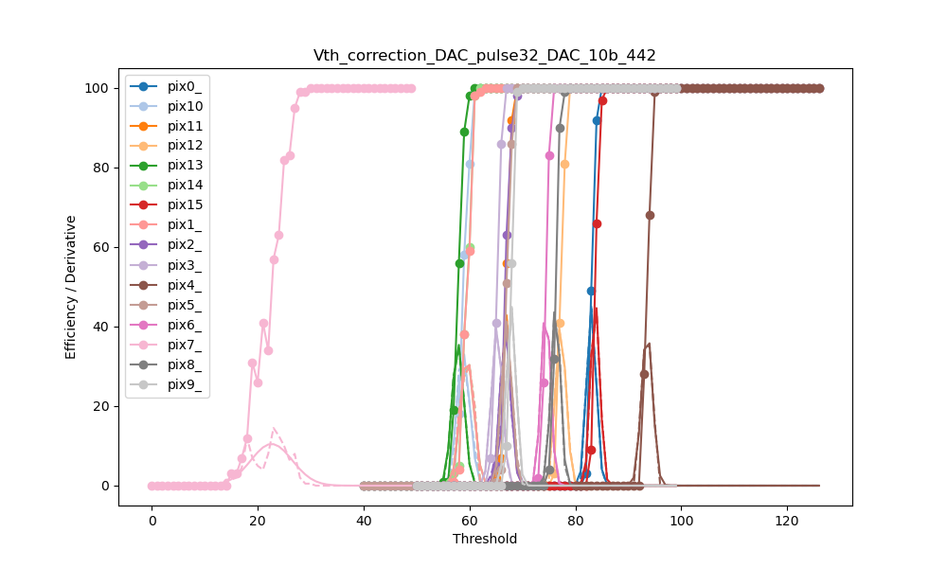
Scurve 3
Input DAC_pulse 32: ~ 14 fC
DAC 10 bits fixed at 442 → Mean value of the thresholds of all the channels
(see previous slide)
Pix | 50% trigger_eff
0 | 83
1 | 60
2 | 67
3 | 65
4 | 94
5 | 67
6 | 74
7 | 23
8 | 76
9 | 68
10 | 59
11 | 67
12 | 77
13 | 58
14 | 60
15 | 84
Threshold vth_corr
We can fix the vth_corr for each channel

Slide 10
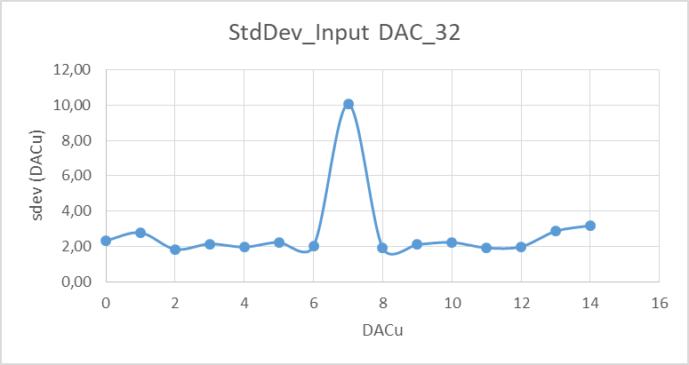
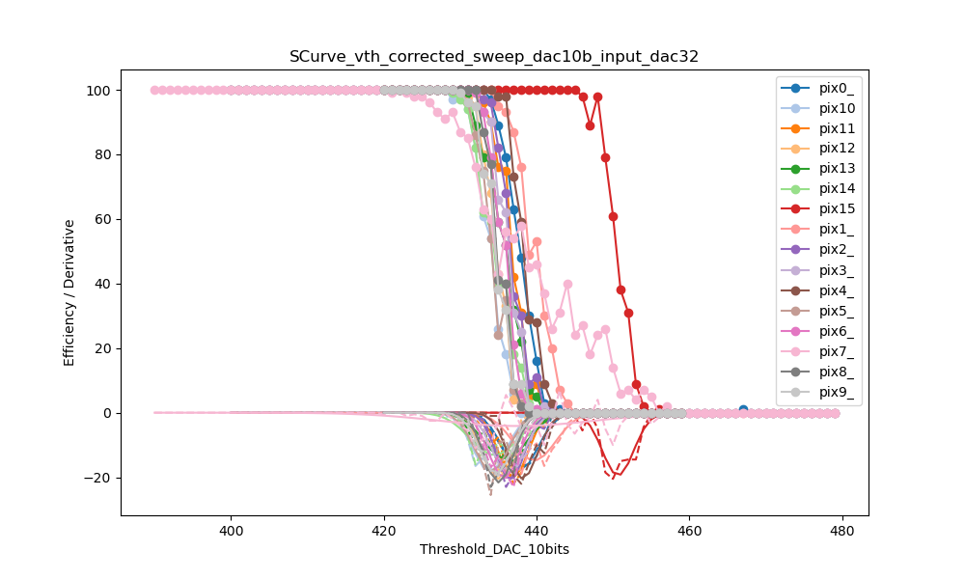
Scurve 4
Input DAC_pulse 32: ~ 14 fC
Vth_correction fixed for each channel at the measured value
0,11 fC / DACu

Slide 11
Scurve with threshold sweep
BOARD with sensor

Slide 12
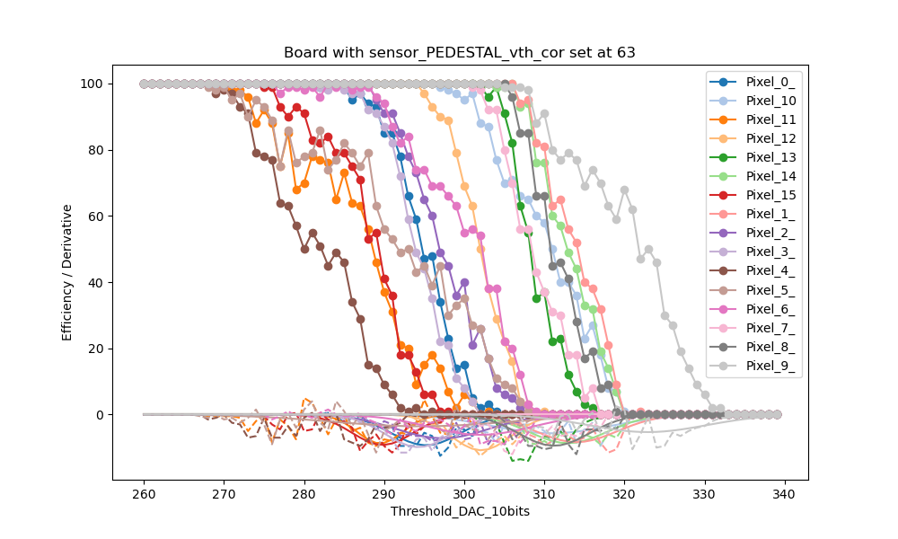
Pedestal vth_correction at 63
Input DAC_pulse 0: 0 fC
Vth_correction fixed at 63
Vth corr to test!!!

Slide 13
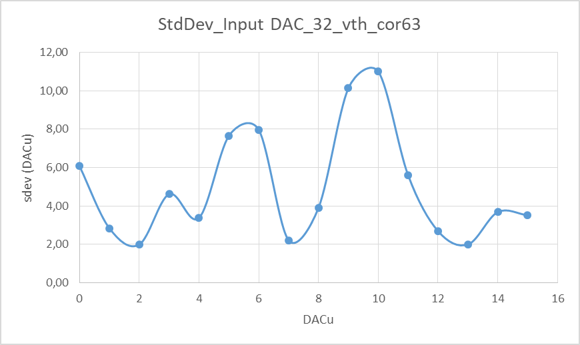
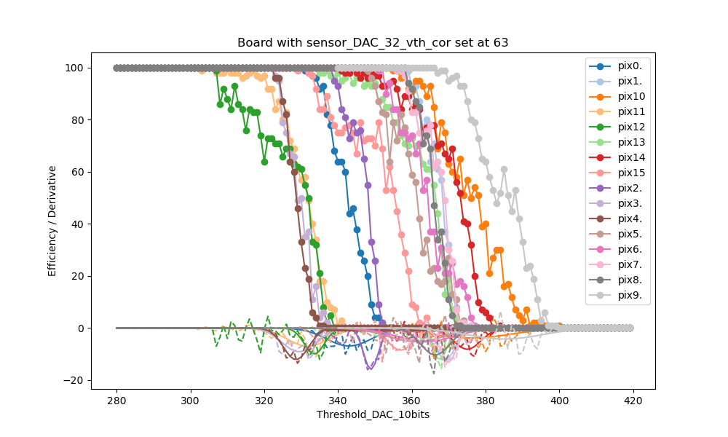
Scurve
Input DAC_pulse 32: ~ 14 fC
Vth_correction fixed at 63
0,11 fC / DACu
Vth corr to test!!!

