Slide 1
PERLE Collaboration Board Meeting
Meeting agenda:
  Welcome and last CB minutes approval – O. Bruening
  Recent Technical Progress - W. Kaabi
  Timeline, site choice at Orsay, obtained and future funds, ongoing discussions with collaborators- A. Stocchi
  Activities in Partner Institutes - All
  PERLE Collaboration, Membership and Publication Policy (M. Klein)
  Plan for the next Collaboration Meeting
  AoB

Slide 2
Recent Technical Progress

Slide 3
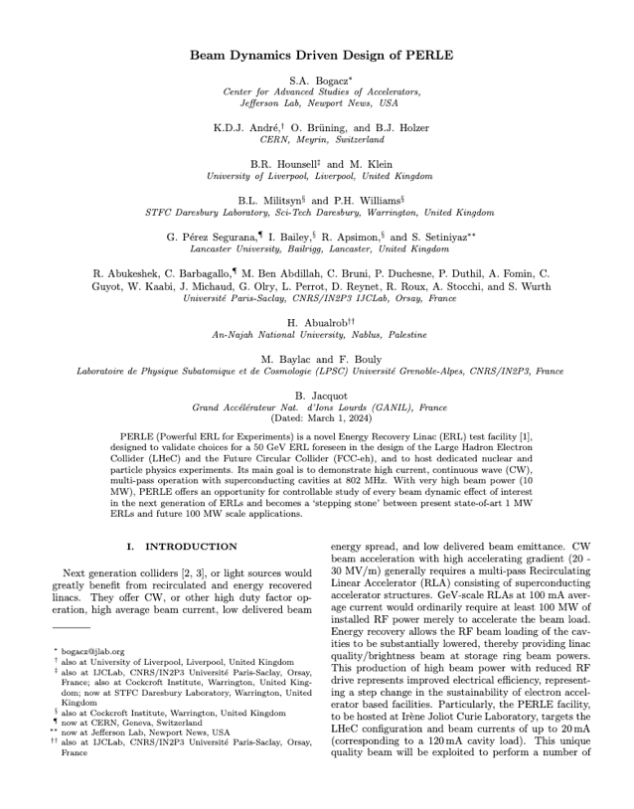
First fruit of the PERLE collaboration!
The first paper on Beam Dynamics and PERLE Design has been accepted for publication as a Regular Article in Physical Review Accelerators and Beams (PRAB). Under production currently.
It was also selected as a « PRAB Editors Suggestion ». Once published, your manuscript will be featured on the Physical Review PRAB homepage alongside other
highlighted articles: https://journals.aps.org/prab
Special thanks to Alex Bogacz for the coordination of this effort!
And many thanks to all the contributors!

Slide 4
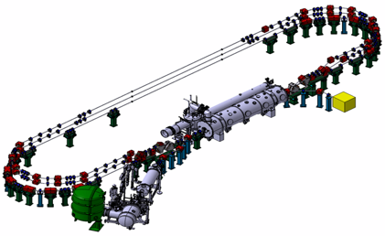
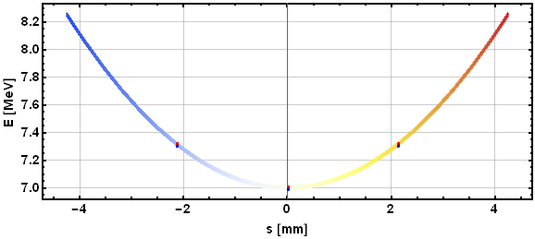
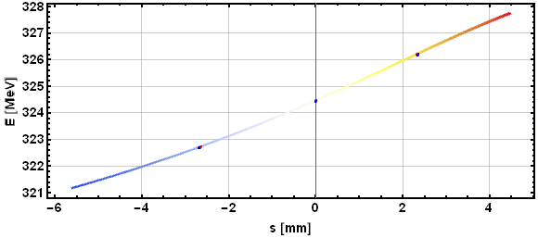
Further design and beam dynamics studies ongoing
The effort is currently focused on the 250 MeV version of PERLE. The following beam dynamics studies are ongoing or to done:
  Matching with collective effects
  Longitudinal phase space tuning and linearization
    Linacs phases
    Arc length correction
    Focal conditions at IRs
  Misalignments and correctors
  Diagnostics
    Non destructive emittance measurement (DMD, MLA)
    Beam losses and halo formation
    6D beam qualification

Slide 5
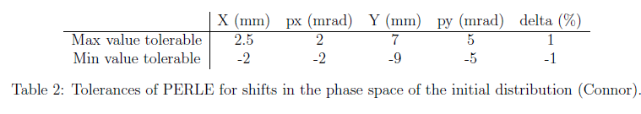

Further design and beam dynamics studies ongoing
Beam Losses study: Vertical $5σ$ beam envelop through PERLE (with space charge and CSR)
Matched injector’s distribution
Unmatched injector’s distribution
Beam pipe of $φ40$ mm should be sufficient

Slide 6
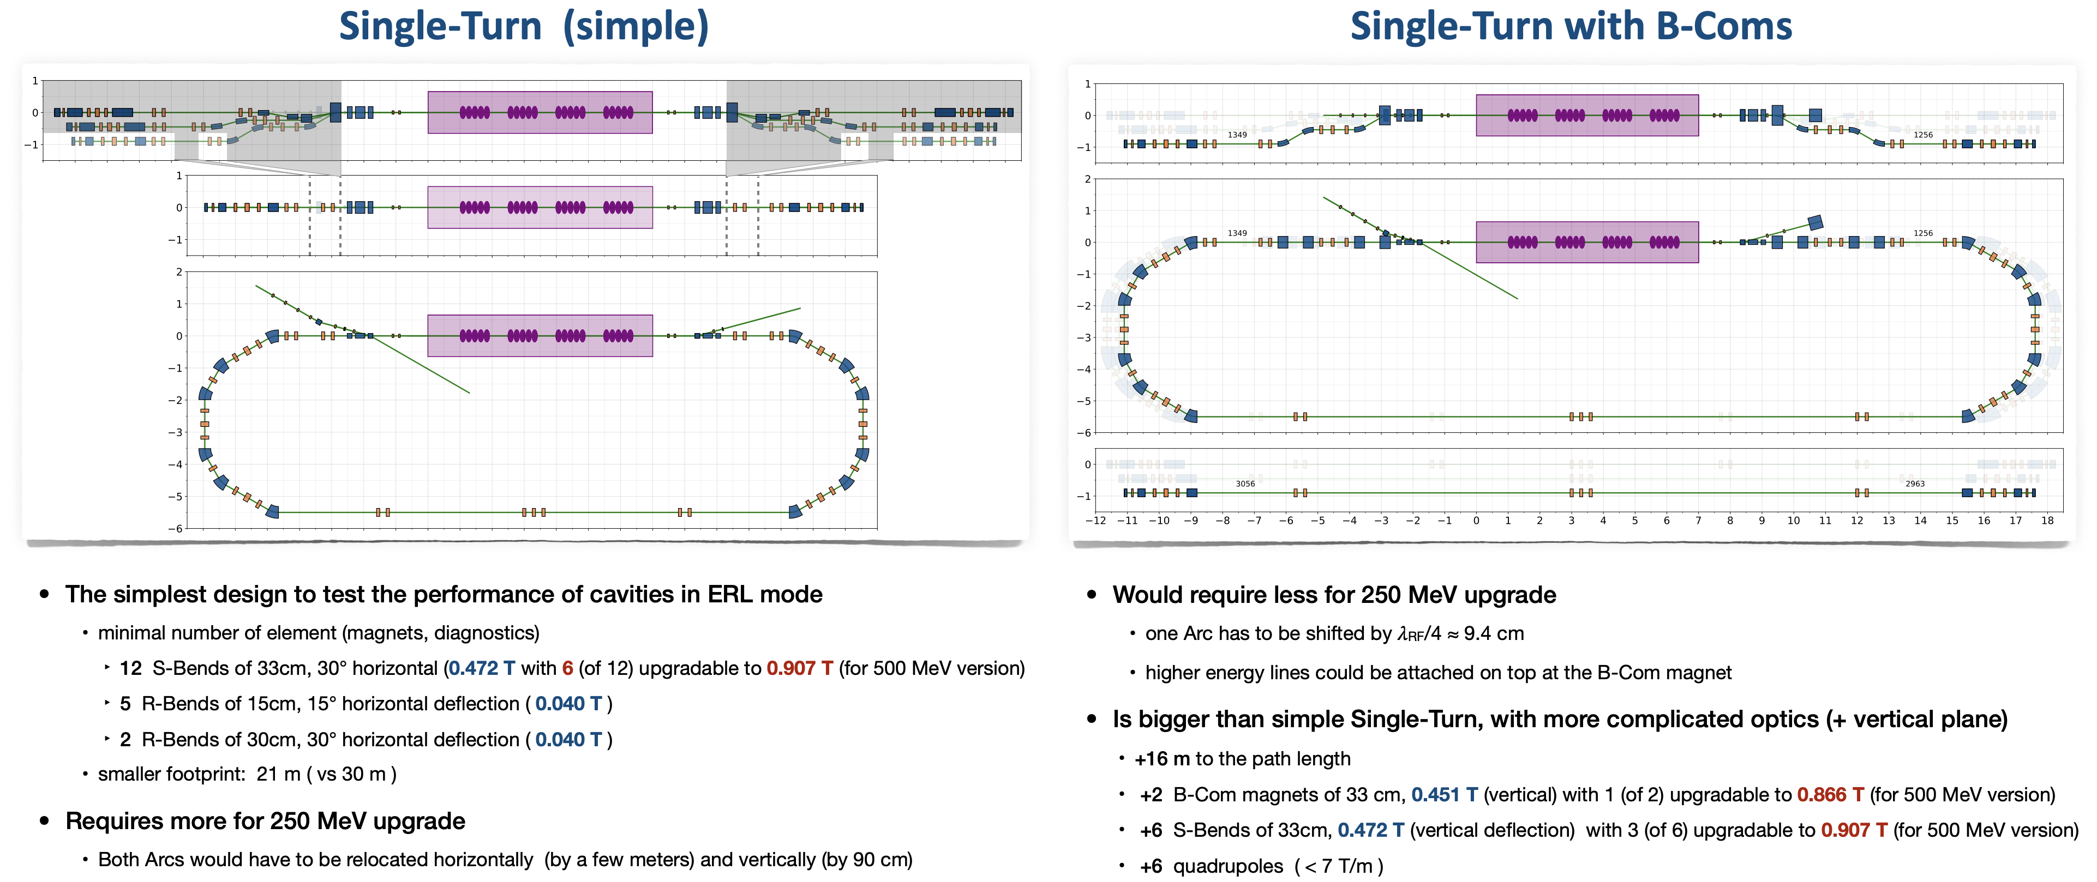
Further design and beam dynamics studies ongoing

Slide 7

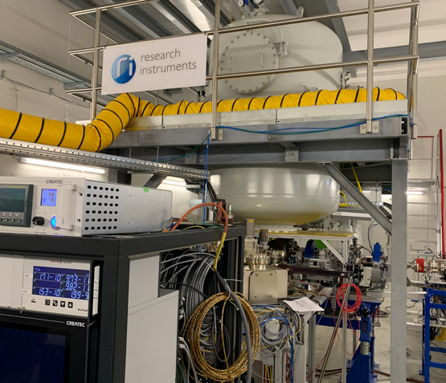
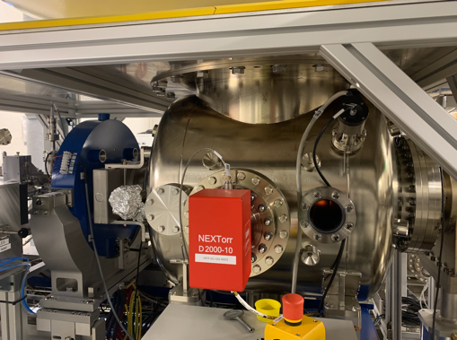
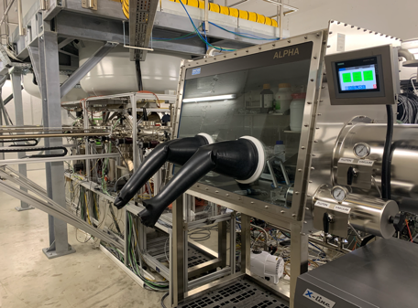
PERLE e- Source
Within a Collaboration Agreement for photoinjector R&D between IJCLab (IN2P3) and Research Instruments GmbH (RI), Hardware of lighthouse project (terminated) transferred to IJCLab for PERLE. The gun was commissioned and tested at high rep rate, at a limited bunch charge. It includes:
A DC Gun, Cornell design (400 pC, 50 MHz demonstrated), fully equipped (all pumps) in load-lock version
A Photocathode Preparation Facility (PPF)
HV power supply suited for high bunch charge (designed for 40 mA, 450 kV)

Slide 8
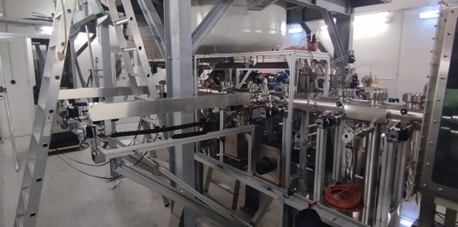
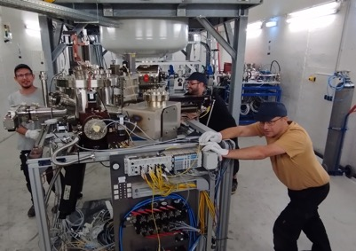
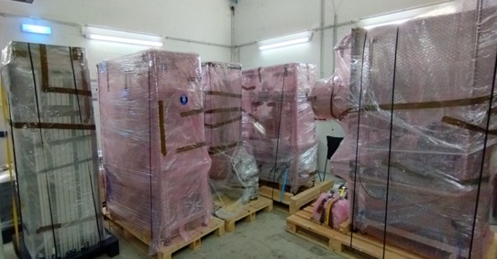
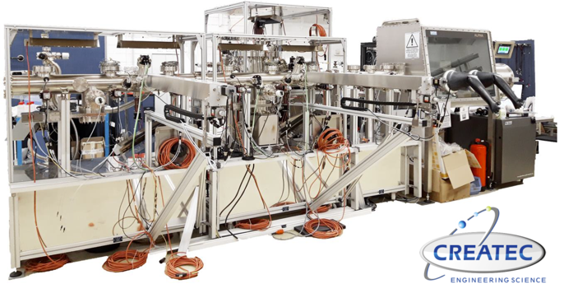
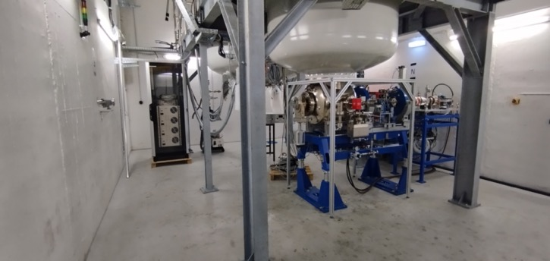
PERLE e- Source
Dismantling of the PPF (September 2023)

Slide 9
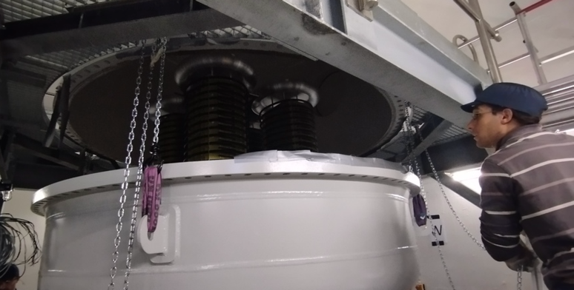
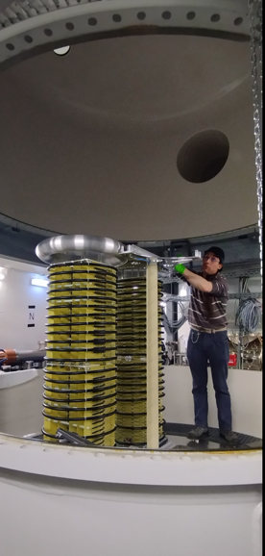
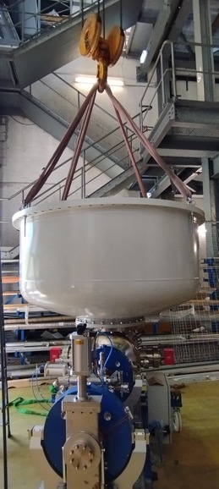
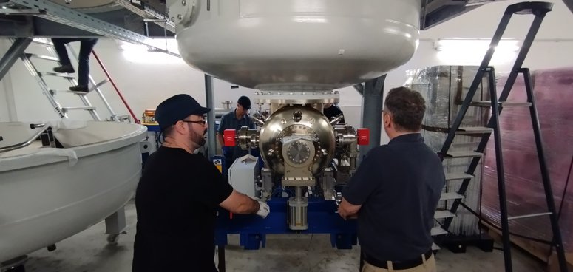
PERLE e- Source
Dismantling of the HV Columns tanks
Dismantling of the platform done by Baumann (November 2023)

Slide 10
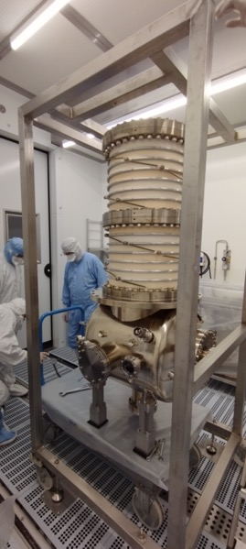
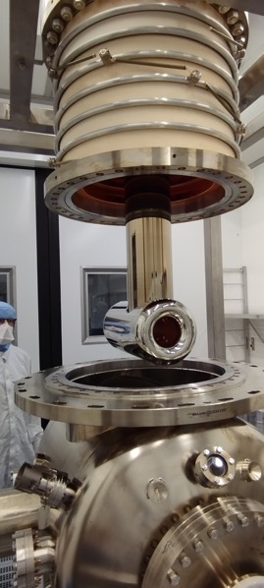
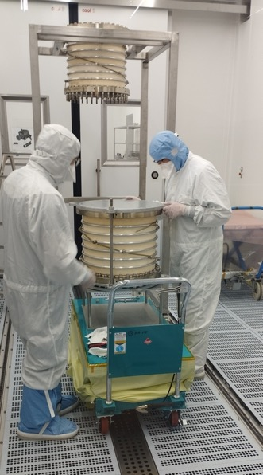
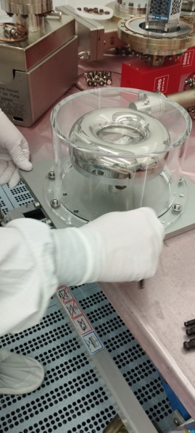
PERLE e- Source
Gun status : dismantling of the gun in clean room (January 2024)

Slide 11
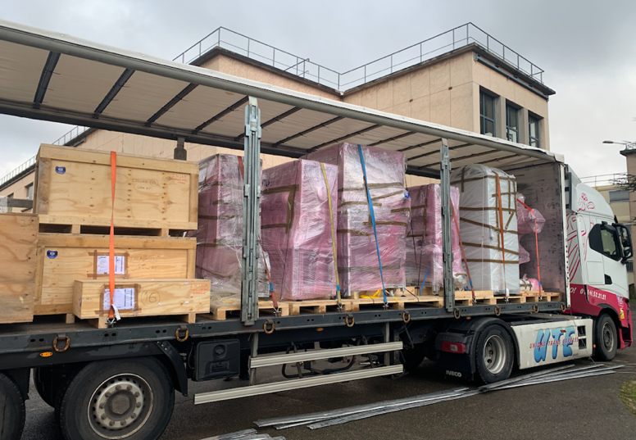
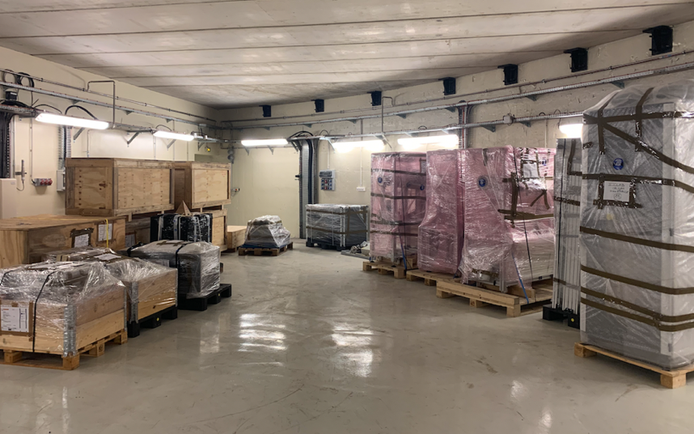
PERLE e- Source
The equipment were received at Orsay in 2 lots, end of December and end of January.

Slide 12
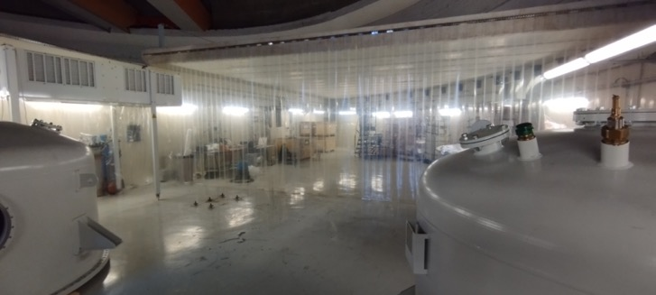
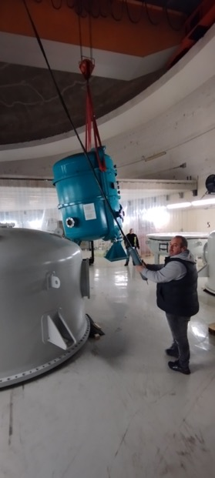
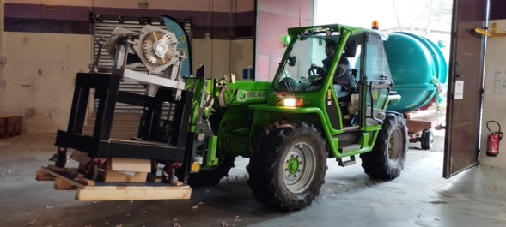
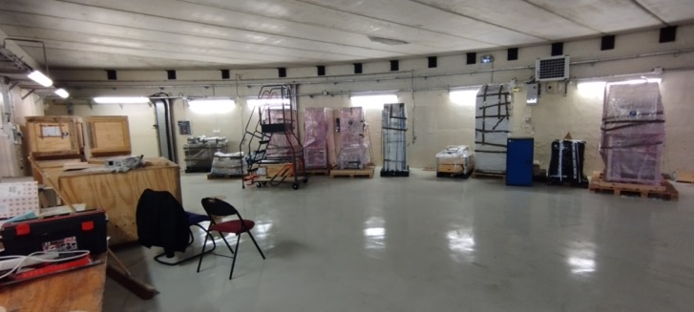
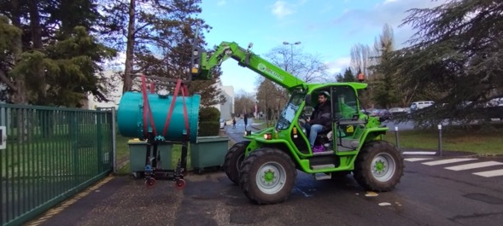
PERLE e- Source
Evacuation of ALICE photogun from igloo bunker

Slide 13
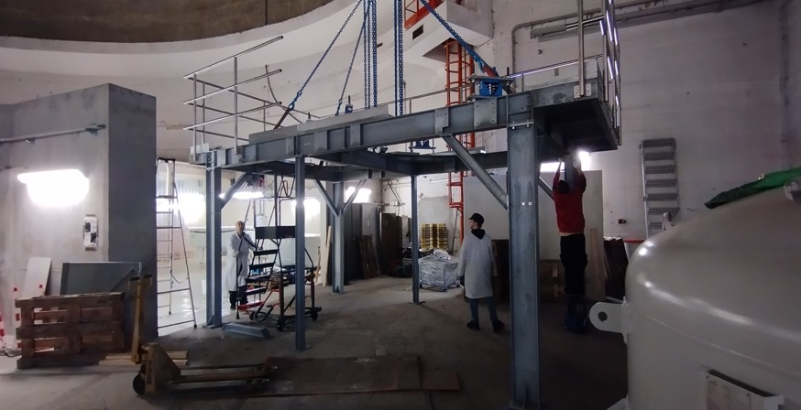
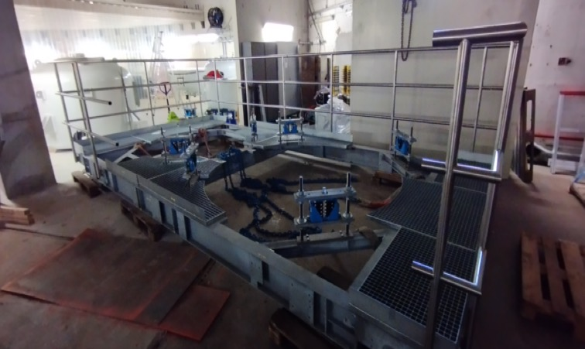
PERLE e- Source
Platform assembly completed and pre-positionned in the igloo

Slide 14
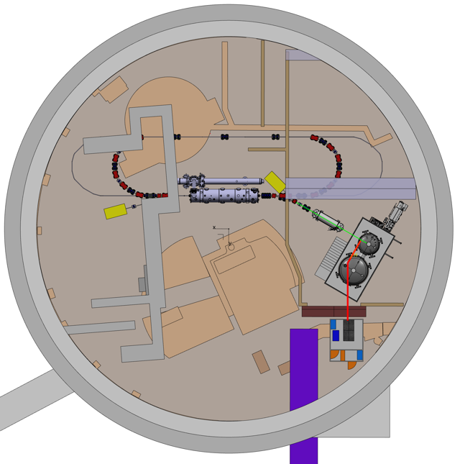
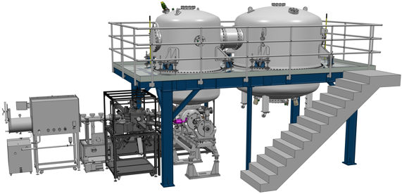
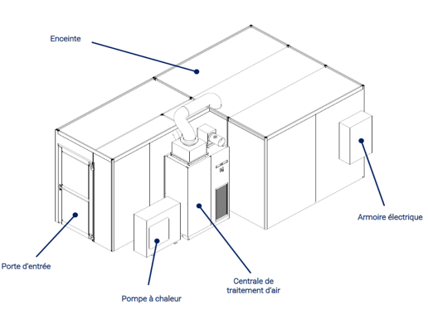

Site choice and first equipment implementation
After site studies of the the two possible locations to host PERLE (Super ACO hall and Igloo):
The IGLOO was the preferred solution. Several scenario of implementation were thus discussed.
Implantation in igloo being finalized
Laser clean room: to be delivered in June 2024

Slide 15
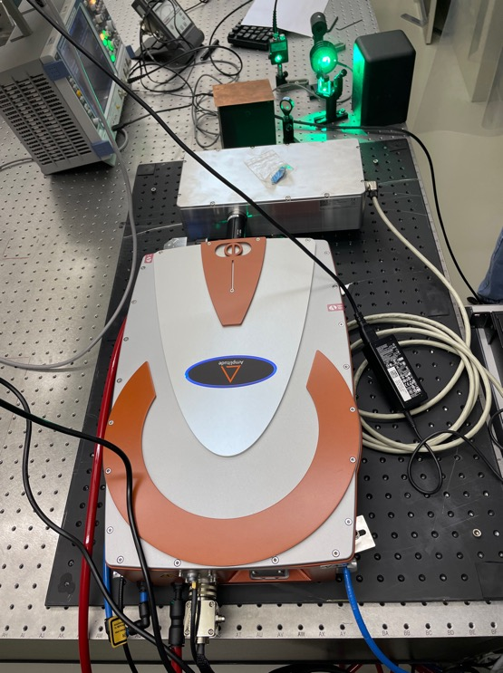
Laser for Photocathode:
The Photocathode Laser was received, tested and accepted end 2023. Further work is ongoing.
A young engineer (Fatumatuj Johara) was hired in November 2023 to work on the PERLE laser implementation.
Installation of the laser in the Igloo is foreseen Fall 2024.

Slide 16
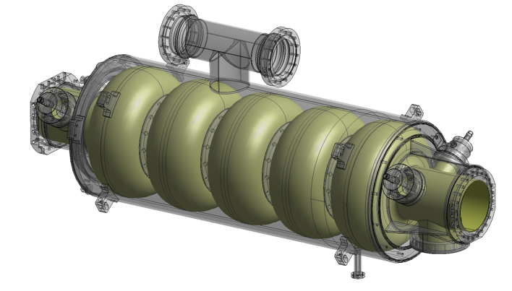
SRF cavity:
Current work:
Specifications of the 5-Cell 800 MHz cavity is under finalisation.
A review meeting on the cavity post-production processes recipes (EP, BCP, Mid-T baking…) is scheduled for March 28 with international experts.
Within iSAS program:
The Nb procurement procedure will be lunched before summer (for single and multi-cell cavities).
It is foreseen to lunch the procurement procedure of 4 cavities also before summer.

Slide 17
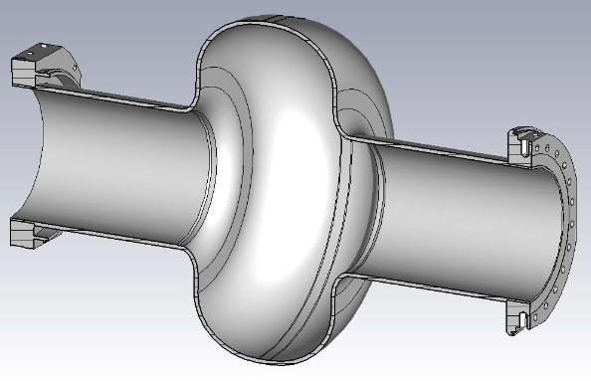
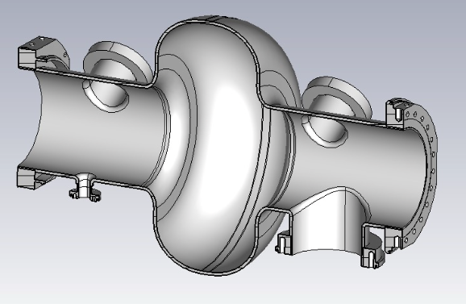
SRF cavity:
Further discussion:
Discussion ongoing with Jlab to pursue the R&D: single-cell cavity fabrication (R&D + prototype for booster), surface treatment, cold test and HOM studies.
Discussion with CERN (synergy with FCCee): R&D on surface treatment and baking for a common single-cell design.
Baseline: mid-T baking test
Option: HOM tests

Slide 18
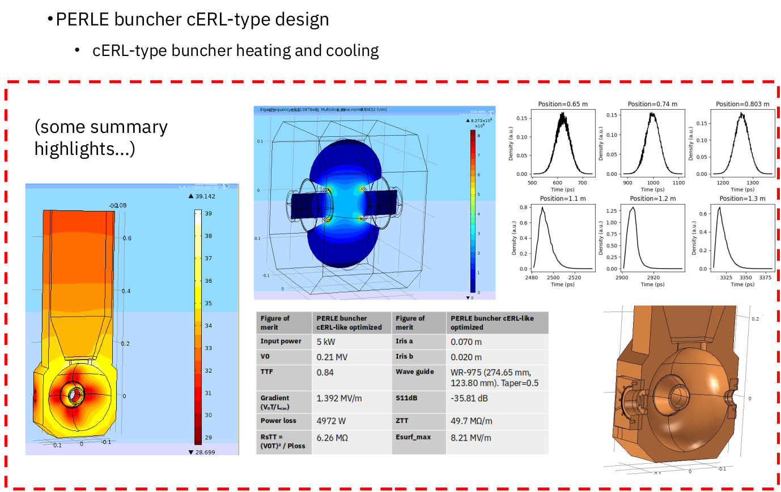
Buncher cavity design:
Impressive piece of work done by our colleague Juan Luis Munoz (ESS-Bilbao) for the RF design, thermal and beam dynamics simulations of a buncher cavity for PERLE.

Slide 19
PERLE Cryoplant:
Advanced discussions ongoing with HZB colleagues to recuperate the Bessy Cryoplant
Technical exchanges bring us to the conclusion that the cooling capacity of the Cryoplant is well sized, at least for PERLE 250 MeV.
Possible transfer to Orsay in summer 2025.
Further administrative discussions foreseen in the coming weeks.

Slide 20
Magnets:
Discussions with Cornell last December to recuperate the magnets (Quadrupoles and multipoles + their power suppliers) of CBETA spreader and re-conbinar of the 3 lines that will be dismounted:
  Air cooled quadrupoles (15x15x15) : 26 units
  Water cooled quadrupoles (15x15x15) : 20 units
  V corr 2 (12x7.5x5) 16 units
  V corr 1 (12x7.5x10) 16 units
With additional 30° and 15° dipoles, this might allow us to construct a single turn of PERLE.

Slide 21
Thank you for your attention!

