Slide 1


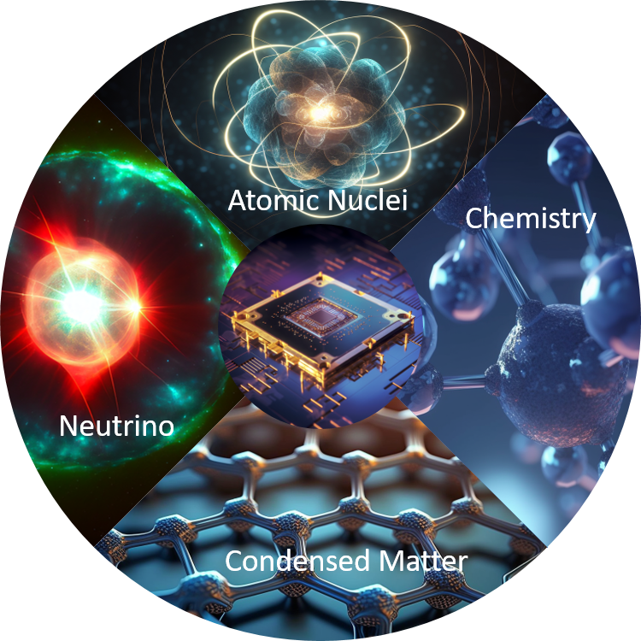
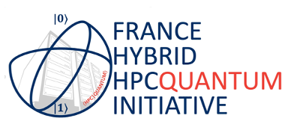

Progress in algorithms and numerical tools for QCD - June 17-18, 2024
Applications of quantum computing:
a focus on Lattice simulations
Denis Lacroix (IJCLab, Orsay, France)
Many-body physics and QC - T. Ayral, P. Besserve, D. Lacroix, and E.A. Ruiz Guzman,
Quantum computing with and for many-body physics, EPJA 59 (2023)
Symmetry and QC – D. Lacroix, A. Ruiz Guzman and P. Siwach,
Symmetry breaking/symmetry preserving circuits and symmetry restoration on quantum computers
EPJA 59 (2023)

Slide 2
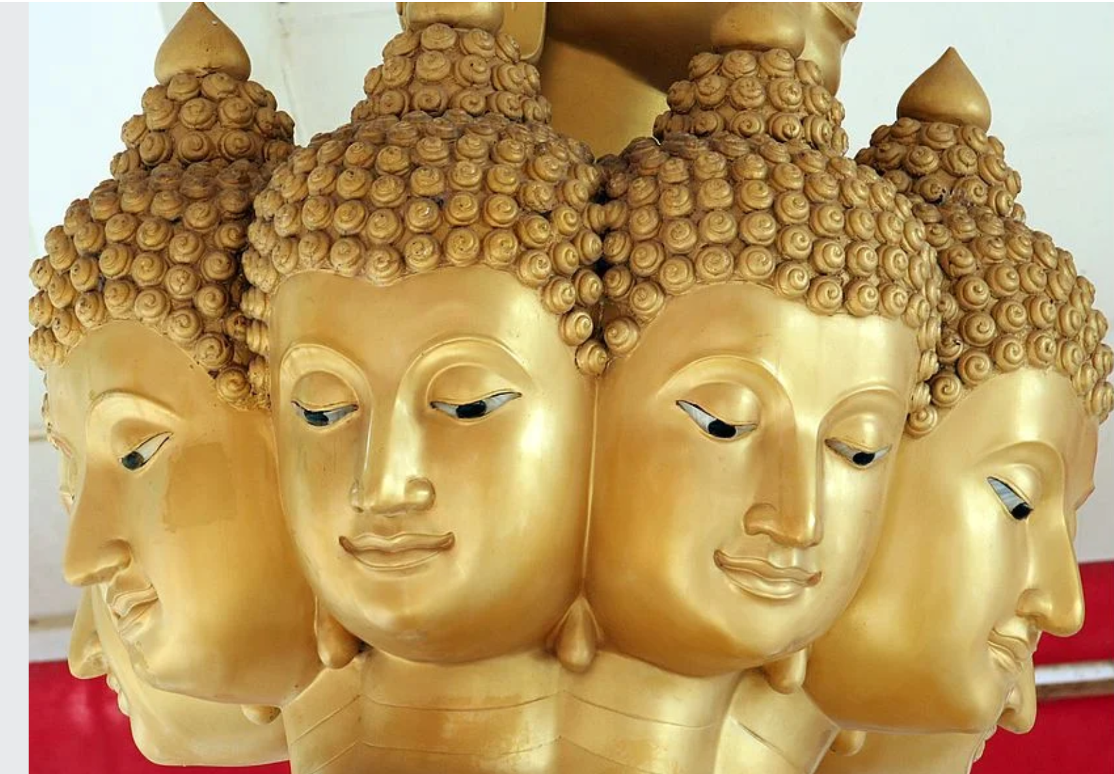
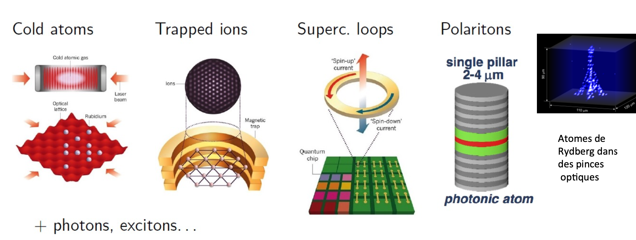
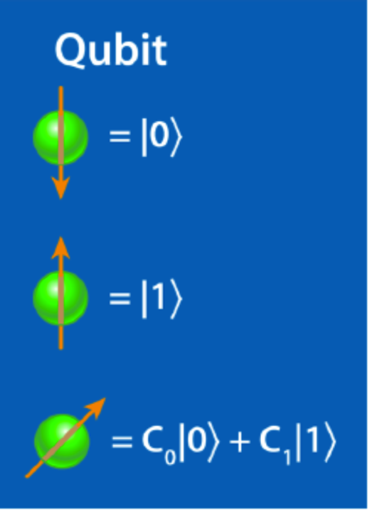
What means quantum devices today
There are many types of quantum computers: analog versus digital quantum computers
There are now many quantum objects one can manipulate
Analog quantum simulator
Digital quantum simulator
Analog
Systems
Physical problem 1
Physical problem 2
Complex problem
that cannot or hardly
be simulated on
classical computers
Analog problem to 1
that could be tested
in laboratory
Non-universal
Universal Quantum simulation

Slide 3
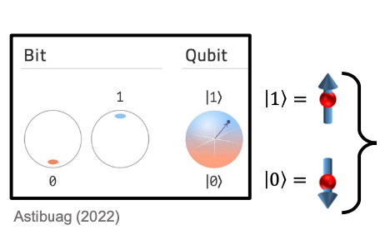
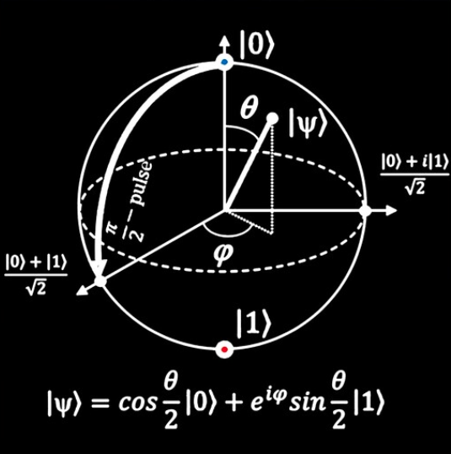
Digital quantum simulations
Where do we expect quantum advantage?
A few examples
Quantum RAM advantage
Storing with
-1 bit: 2 integers 0,1
-2 bits: 4 integers 0,1,2,3
…
Bloch sphere picture
Storing with one qubit
Two-qubits
…
Direct multi-parameters function encoding
Continuous function programming

Slide 4
Advantage in Quantum RAM
Qubit basis/quantum register
1 qubit
2 qubit
3 qubit
q qubit
What does a
perfect quantum
computer?
Computational Basis
=
qubit register
0
1
Unitary
Transfor-mation
0
1
Hilbert space size

Slide 5

Quantum speedup – or how to use entanglement to solve a problem
(generated by DeepAI)

Slide 6
A more precise view of problem complexity and quantum advantage:
Why entanglement is the key?
Complexity of a problem
A fundamental question is how much “computational time” it takes to solve problem – this is linked
to the complexity of the problem (Church-Turing thesis, Problem complexity classification, …)
M.A. Nielsen and I. L. Chuang, “Quantum computation and quantum information”, Cambridge university press.
What could be computed is independent on computers – only speed will change with hardware,
resources progresses
Quantitatively, we are interested in the “speedup” to perform a calculation
Speedup can be:
linear
linear
quadratic
Execution time
Quadratic
speedup
polynomial
But the speed up could not be exponential !
Exponential
speedup
Quantum computers contradict this thesis- some algorithms
Promises exponential speedup for specific calculations
System dimension
A calculation that’s takes 1 year in “linear” case would takes 24 seconds with exponential speedups

Slide 7
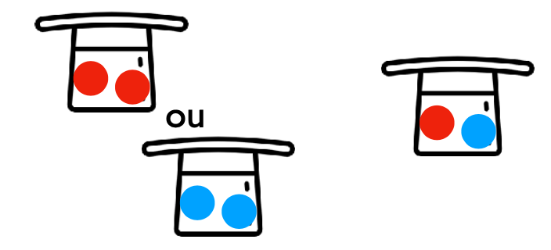



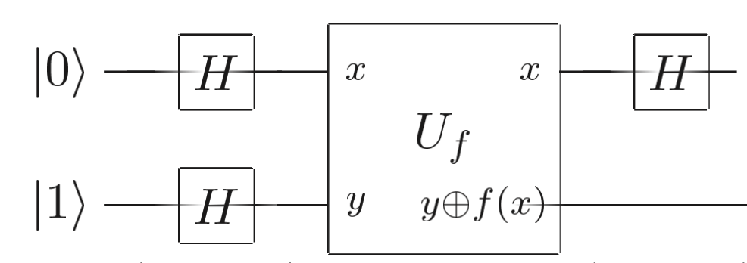

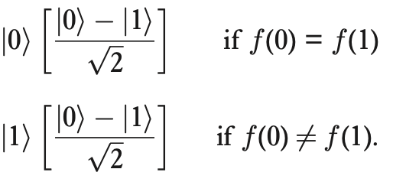

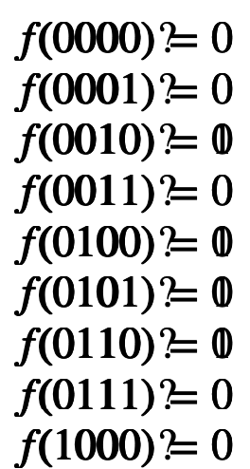
Algorithmic – Some history
Problem complexity and quantum advantage
time
1940
1985
1992
Turing
Deutsch
Deutsch-Josza, Simon, Shor, Bernstein-Varizani, …
Church Turing problem: analysis of a computational problem, complexity…
case 1
case 2
The “simple” Deutsch problem:
(Oracle)
Q: determine if
Classically requires to have 2 answers
Quantum: one can directly ask
Deutsch-Josza problem (92)
Example n=4
Q: Is f constant or an equal mixing of 0 and 1 ?
Classically requires 1+2^{n-1} questions
Quantum: requires only 1 question but n entangled qubits
These problems are rather specific – usefulness?
…

Slide 8

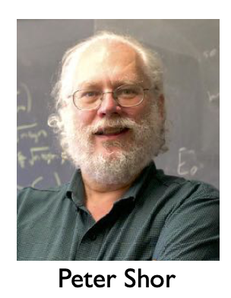

Algorithmic – Some history
Problem complexity and quantum advantage
time
1940
1985
1992
Turing
Deutsch
Deutsch-Josza, Simon, Shor, Bernstein-Varizani, Kitaev …
Tracking applications and progress
Simon (1994): find the period of a function
Classically requires exponential number of questions.
Quantum: linear number of questions
Ingredient: Quantum Fourier transform (QFT) in qubit representation
Shor (1994): find the period of a function
Ingredient: QFT, quantum phase estimation (QPE), no Oracle
Applications: factorization, discrete log (quantum algo can potentially break the RSA
public key encryption technique)
Birth of the post-quantum cryptography
Kitaev 95: Circuits for QPE: eigenvalue problems, linear algebra, …
Grover search algorithm (1997): unsupervised search algorithm, data mining, …

Slide 9
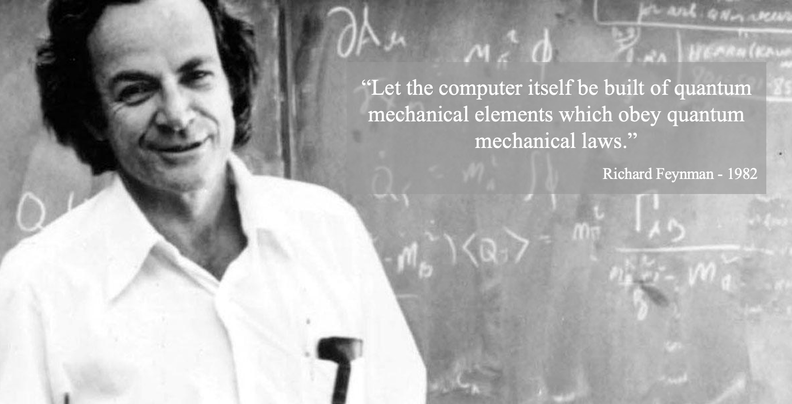
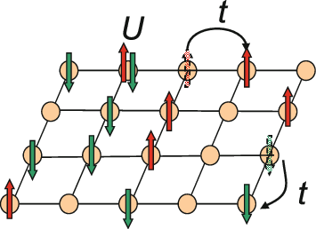
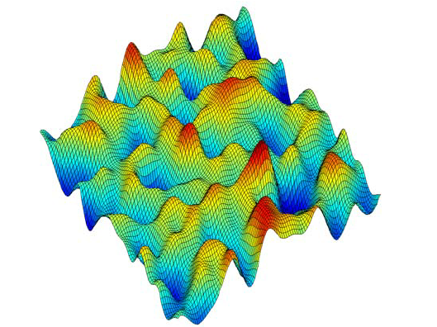
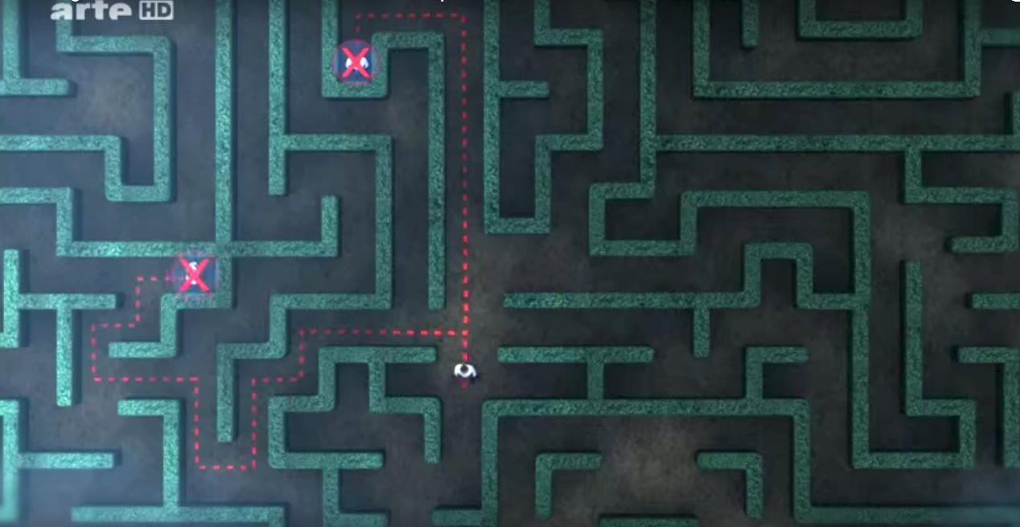
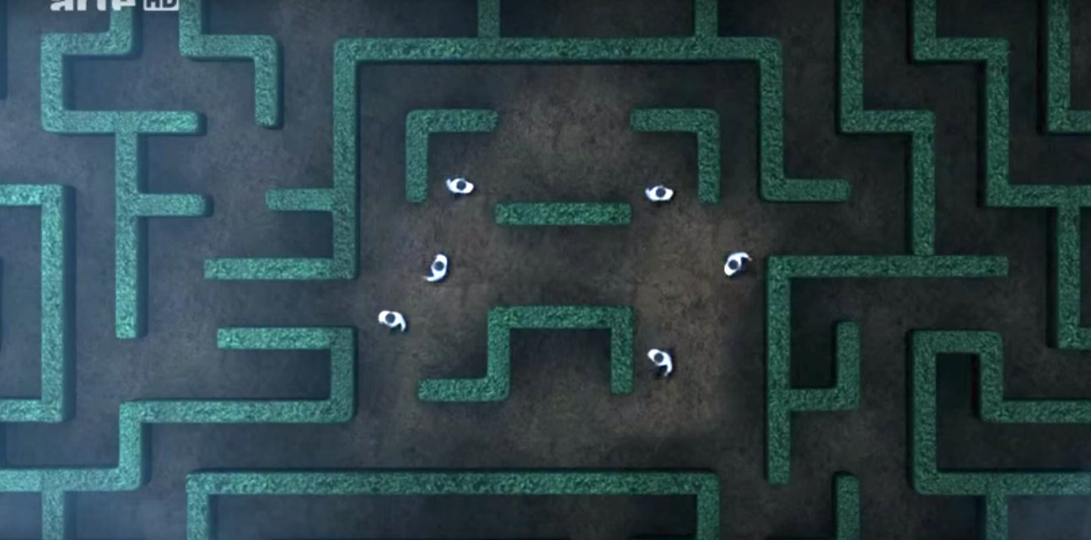



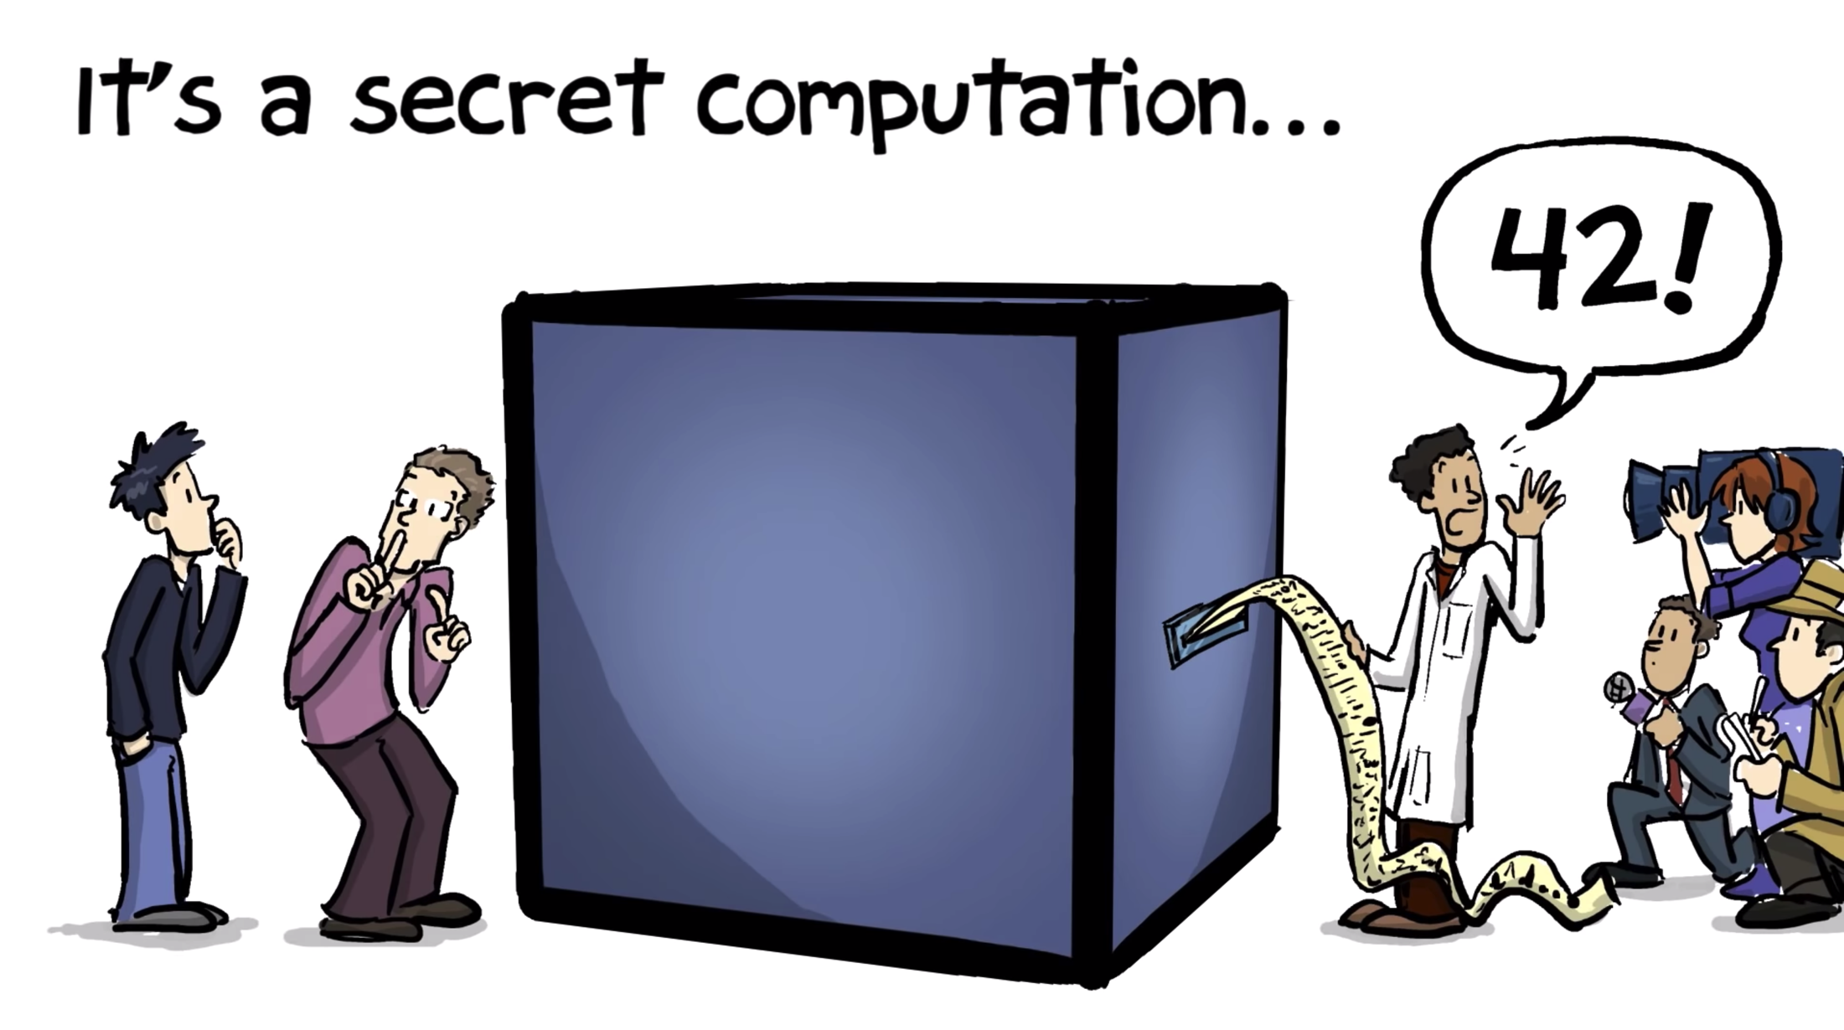
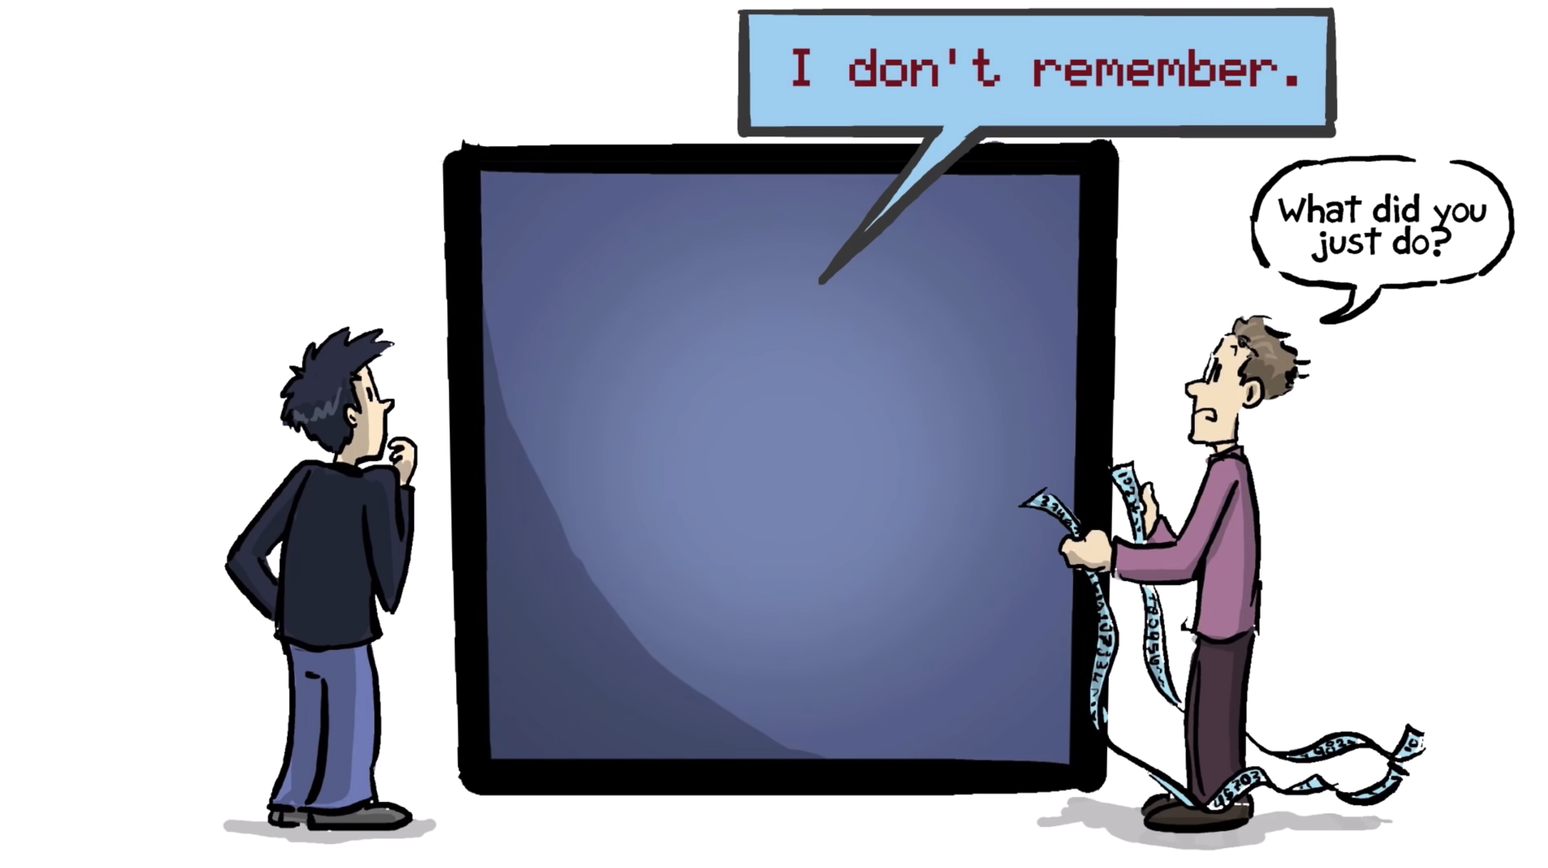
What are the anticipated applications ?
Ex: systems on lattices
Simulation of Quantum complex systems
On classical computers
Can be solved exactly
For max 20 particles.
On quantum computers:
N sites means only N qubits
Quantum versus classical search
Classical
Quantum
vs
Exploring complex landscape:
molecules, classification,
optimization…
Credit: The Fabric of The Cosmos: Quantum Leap
Quantum secrets (cryptography, quantum key, …)
Evesdropper
A
B
Bob
Alice
A
B

Slide 10
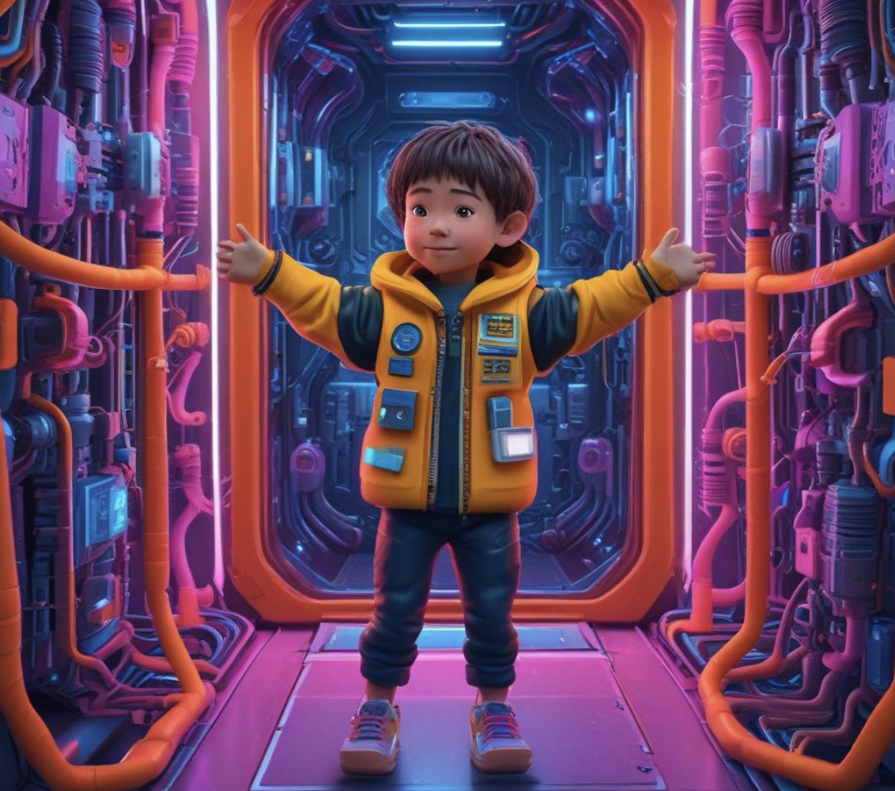
Digital Quantum computing
(very minimal lifejacket)
(generated by DeepAI)

Slide 11
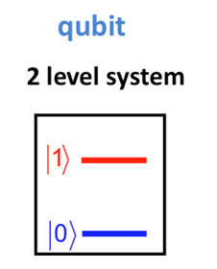
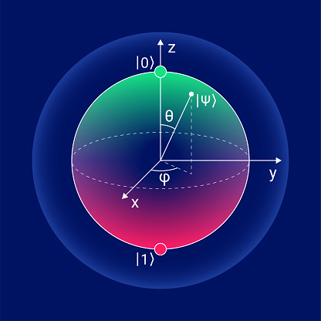
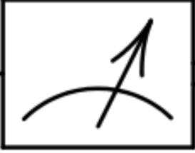
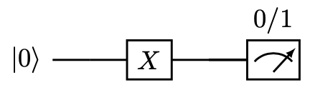
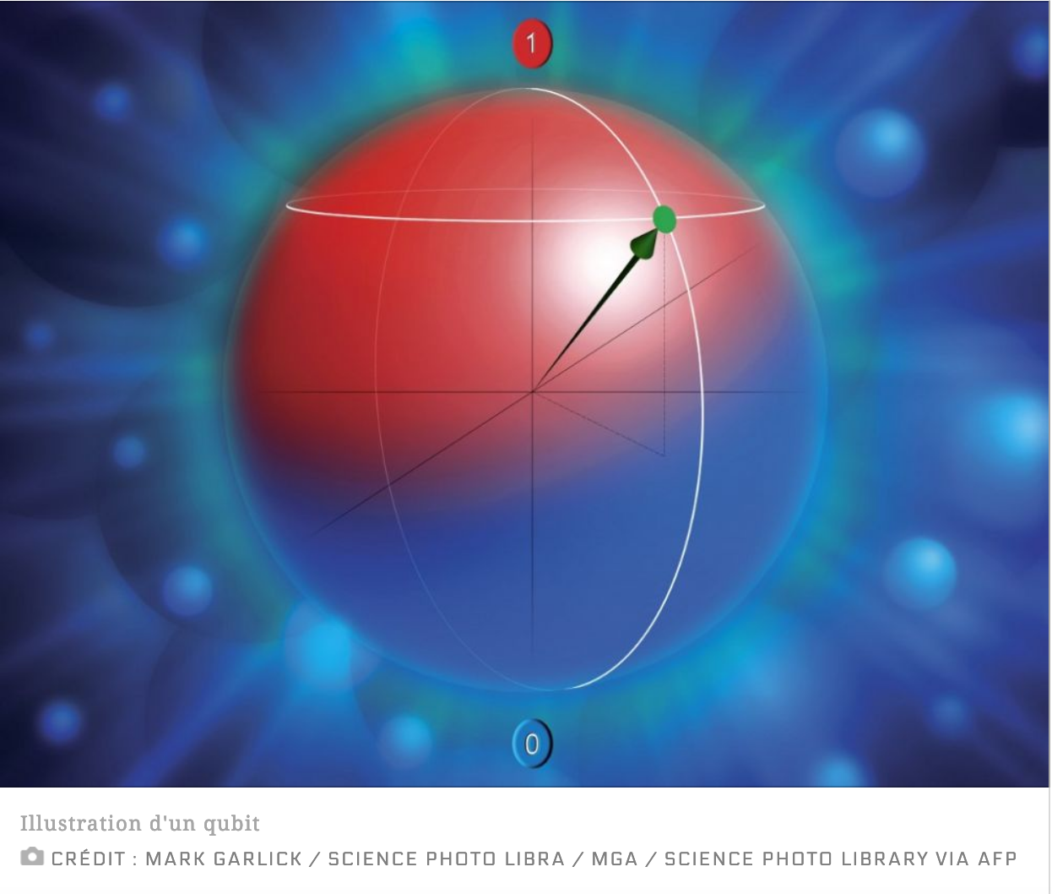
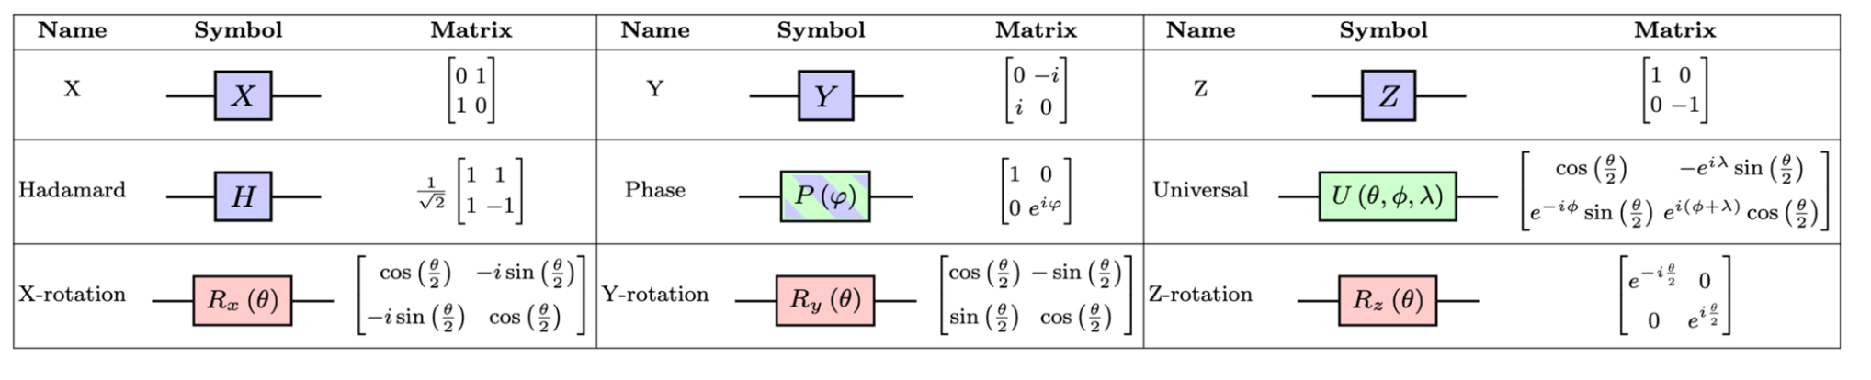
One qubit- some operations and measurement
Manipulate the Qubits (Make rotations)
Initial state
Final state
Measure the state
(“destroy” the state)
Example of simple unary operations (gates)
Elementary operations

Slide 12
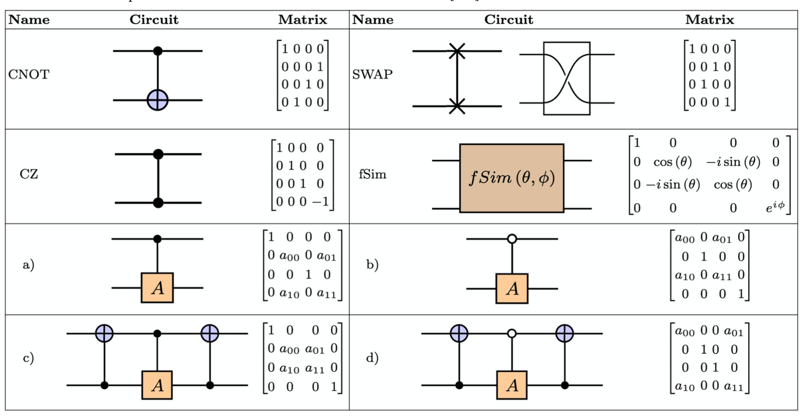
One qubit- some operations and measurement
Manipulate the Qubits (Make rotations)
Initial state
Final state
Measure the state
(“destroy” the state)
Example of simple unary operations (gates)
+ Gates acting on two-qubits
Elementary operations

Slide 13
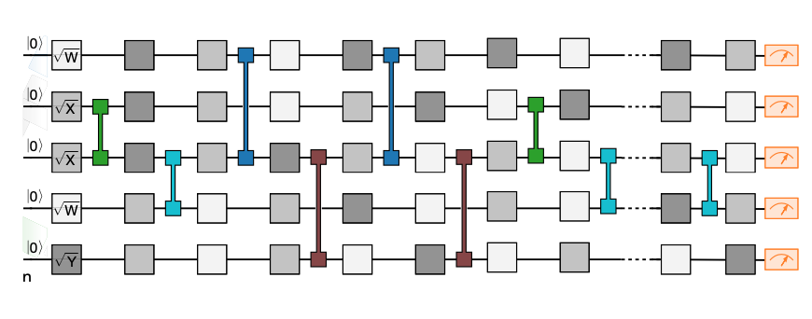
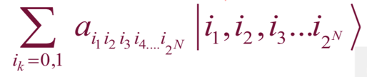
Quantum computing with more than one qubit
Some terminology – general aspects
Quantum circuits with more than one qubit
Binary gates
Unary gates
circuit length
Quantum
measurement
of qubits – leads
to a set of events
In the form of
bitstring
Quantum register:
Define the qubit computational
basis:
Quantum circuits:
circuit depth
Constraint: the circuit makes
Unitary transformation, i.e. no
loss of information
Hilbert space size
Gives the |a|²

Slide 14
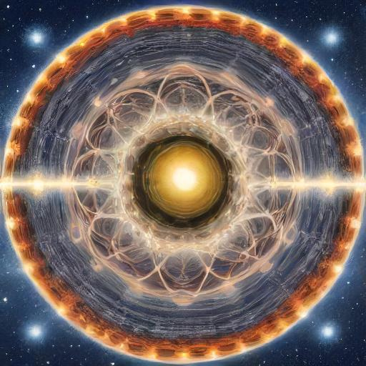
Where it might be helpful to nuclear, neutrino and particle physics
(generated by DeepAI)

Slide 15
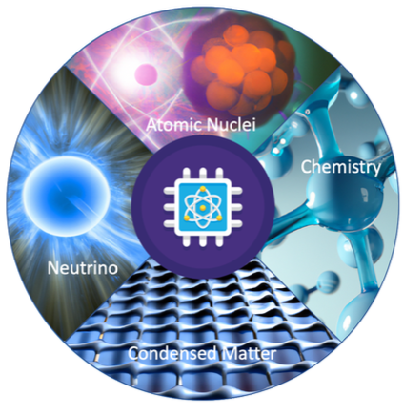
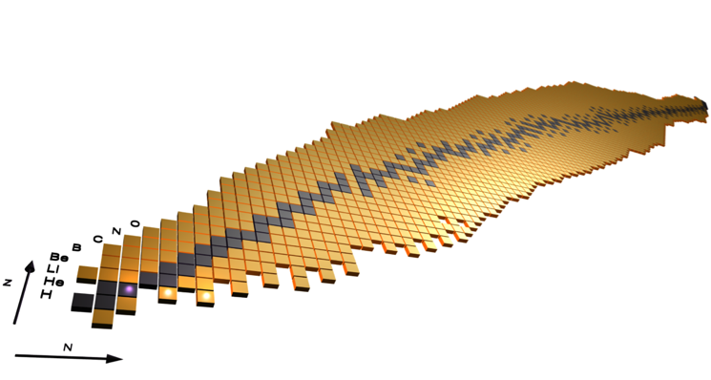
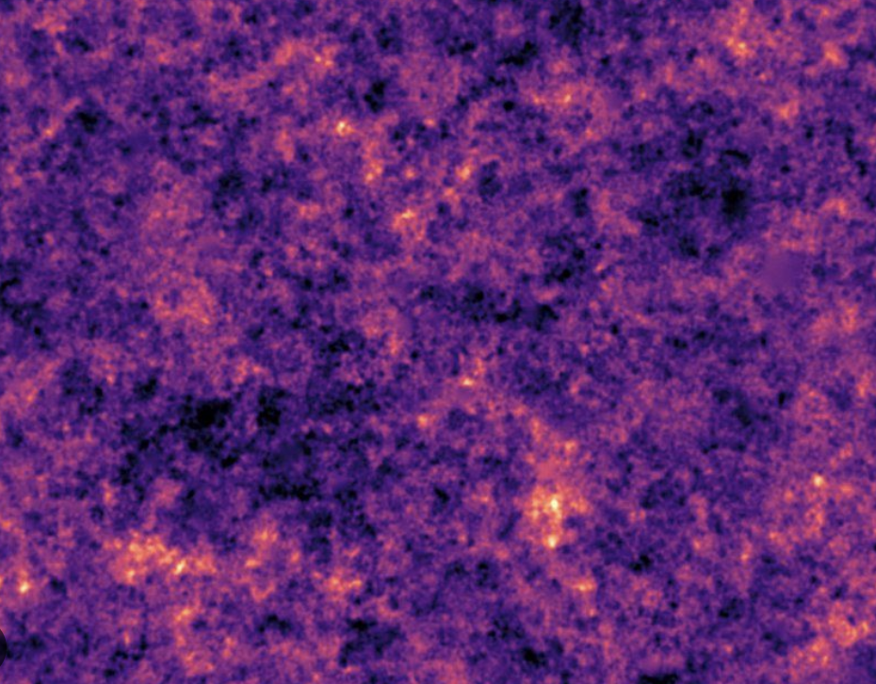
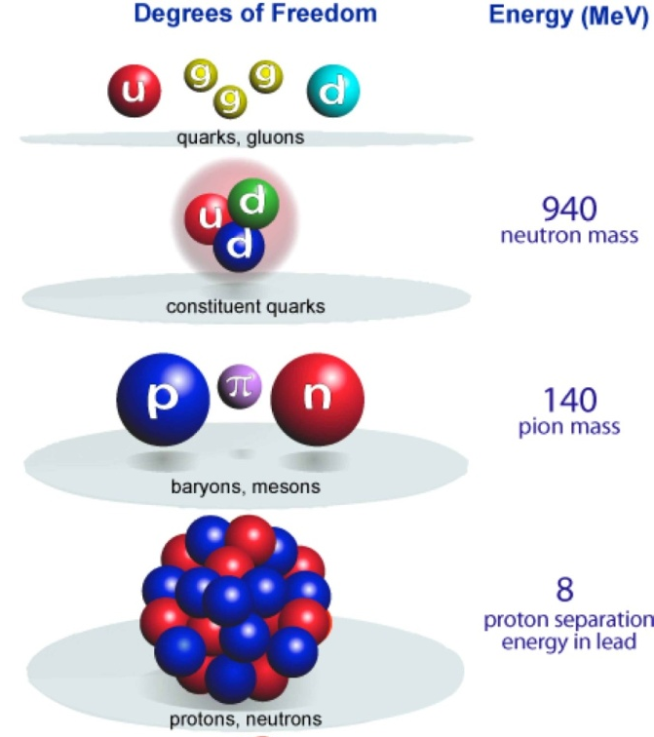
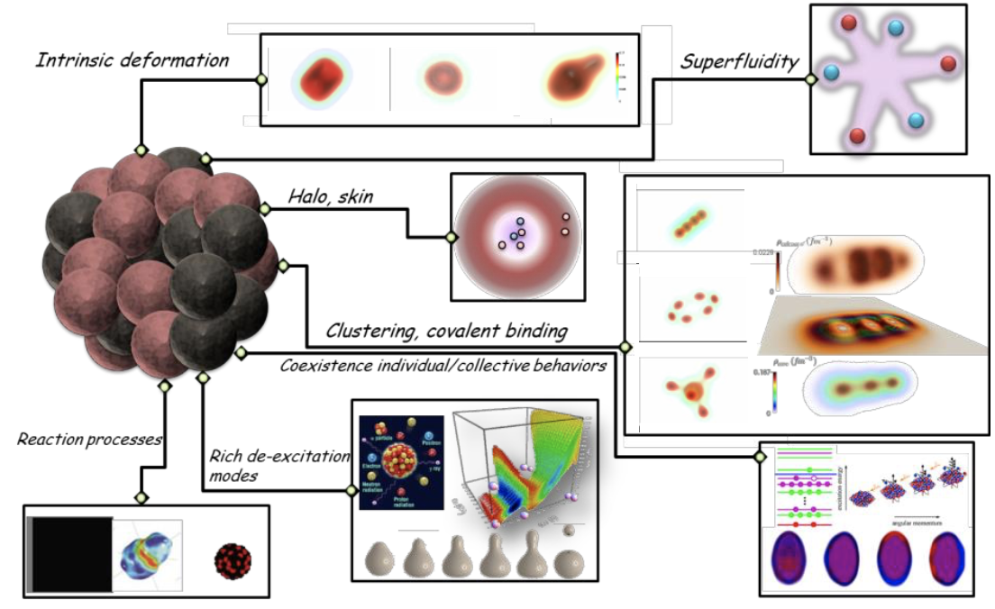
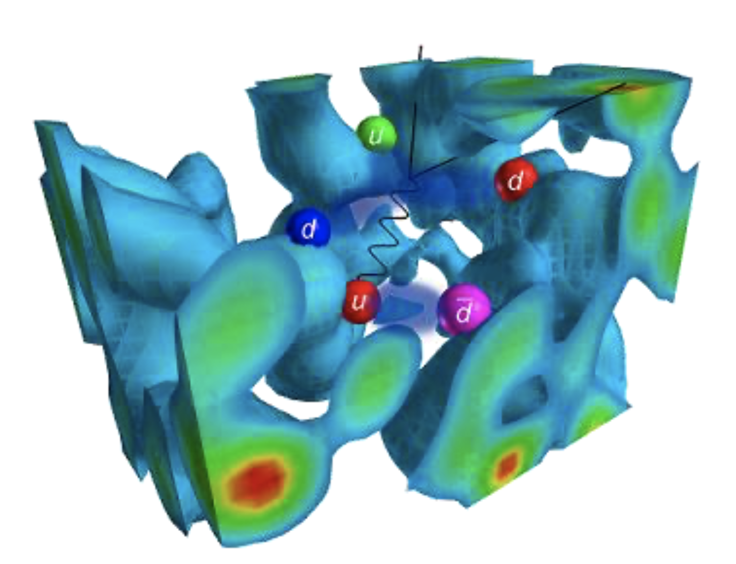
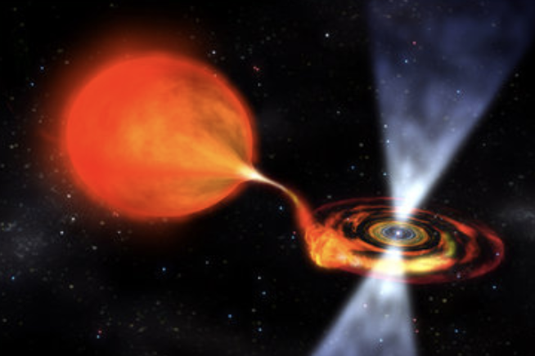
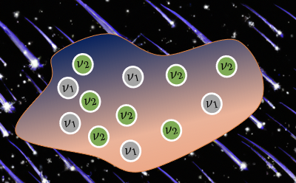
Quantum computers are often themselves many-body interacting systems
Quantum computing for the infinities
to atomic nuclei
to pions
and
nucleons
to stellar
processes
from quark
Courtesy J.P. Ebran

Slide 16


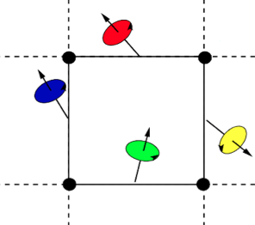

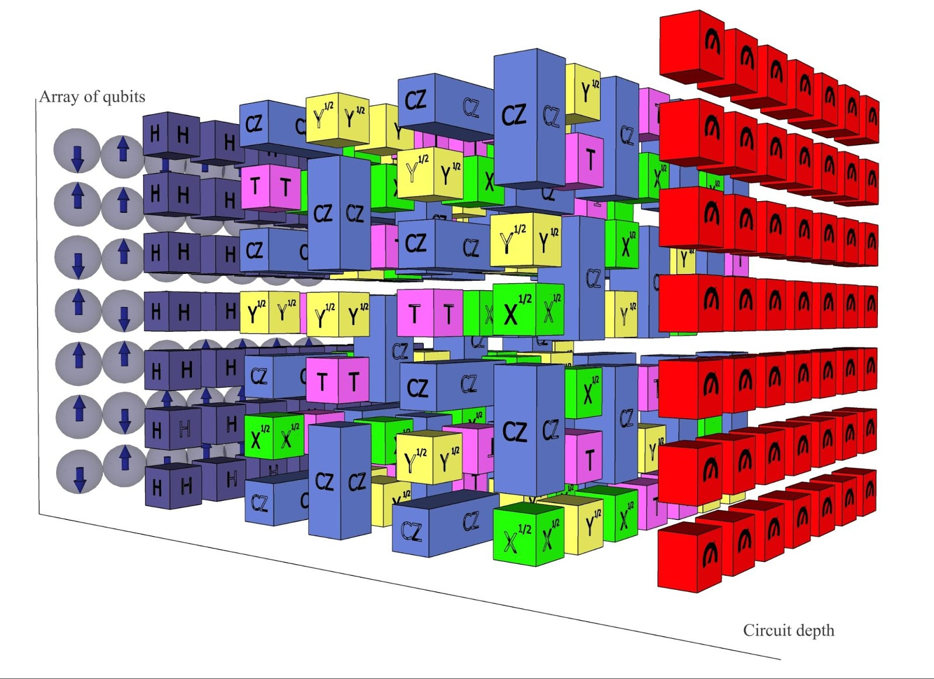




Ongoing projects that are starting now

Slide 17
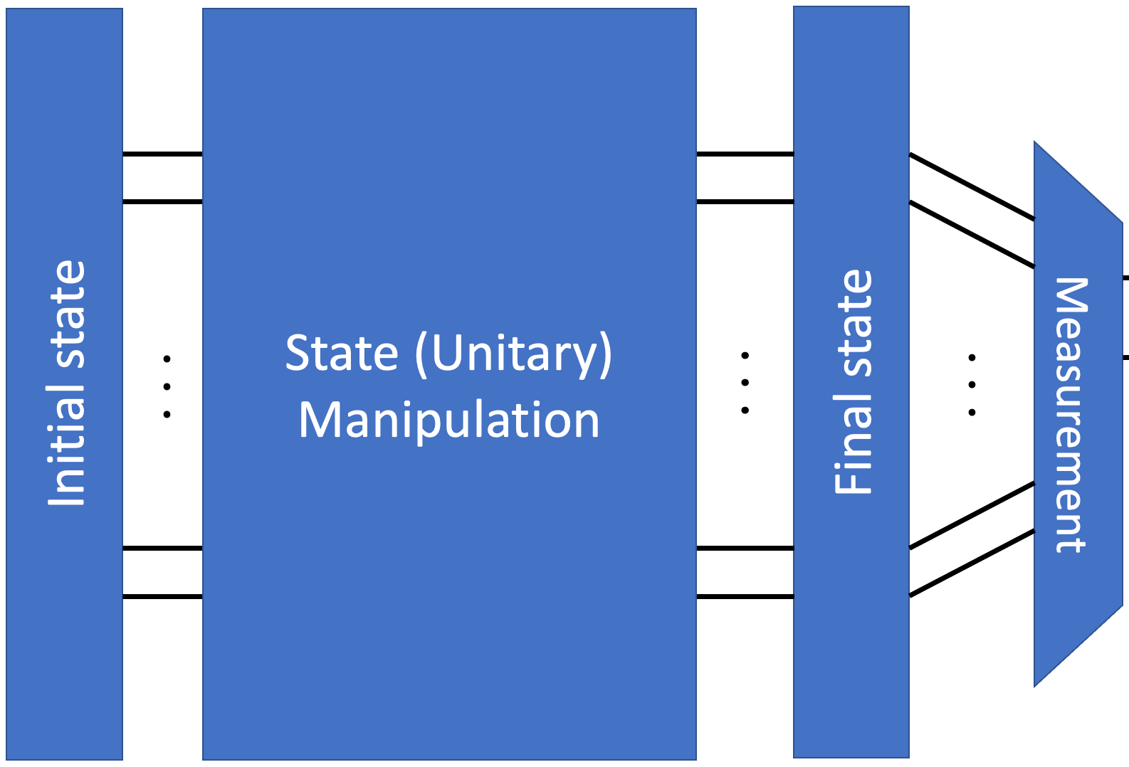



General strategy for quantum computing
Take a problem
(classical or quantum)
QC is particularly suited for fermions
on lattices.
Encode the problem
Onto a set of qubits
There are many ways to encode a
classical problem (phase, amplitude,
time, … )
Schuld and Petruccione,
Supervised learning with
quantum computers (2018)
Make Quantum Computing
Program to solve the problem
For instance
Qiskit, cirq,
myQLM, …
Test on a
QC emulator
Test on a true
QC
…

Slide 18
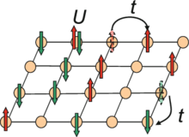
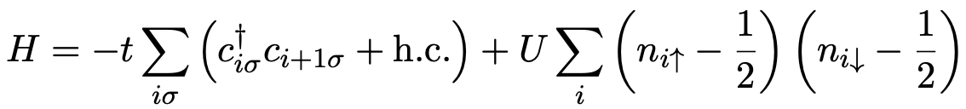
A few examples on lattices
The Hubbard model
Hamiltonian
Fermion to qubits
Fock space
Qubit space
anti-commutation
Problem
One possible solution (Jordan-Wigner transformation -1928)
…
1
Order the index like in a lattice
Define new mapping
k=0
1
2
3
…
j
2

Slide 19
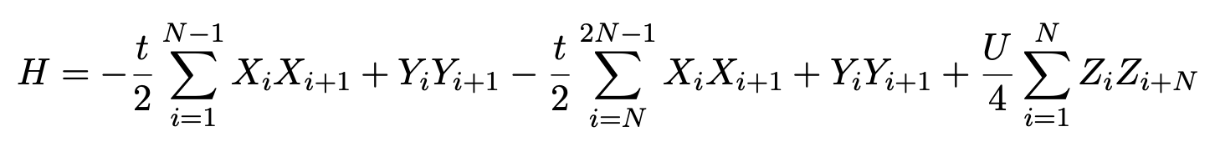
A few examples on lattices
The Hubbard model
Hamiltonian
Fermion to qubits
Jordan-Wigner Transformation
Then, one can a priori do the exact propagation
Formal
solution
This can be a priori computed
Directly on a QC
time
1. Decomposition of H into elementary blocks
2. Use a transformation (Trotter-Suzuki)
(First order Trotter-Suzuki)

Slide 20
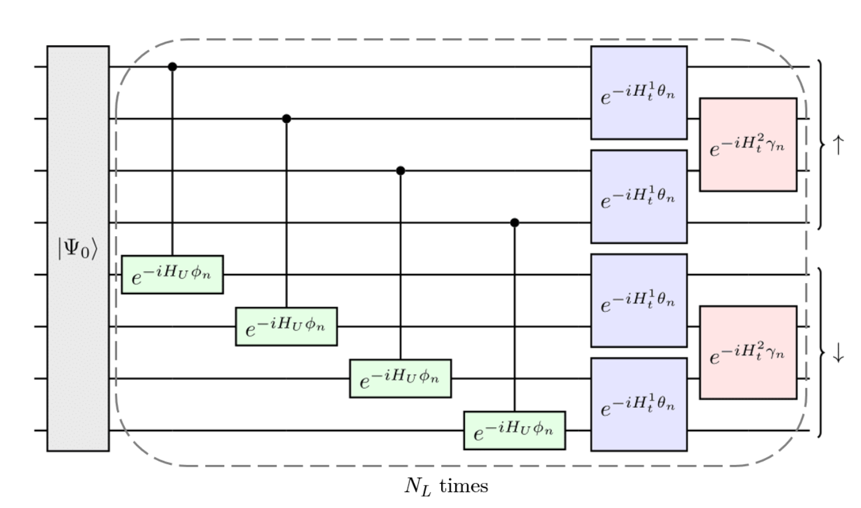
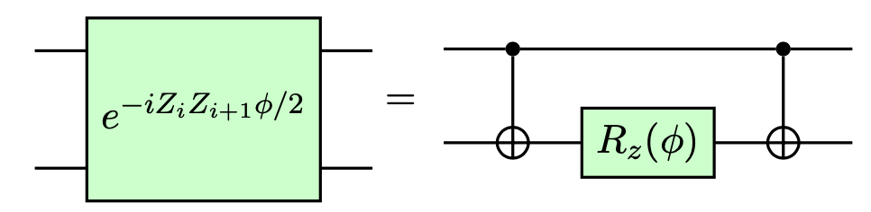
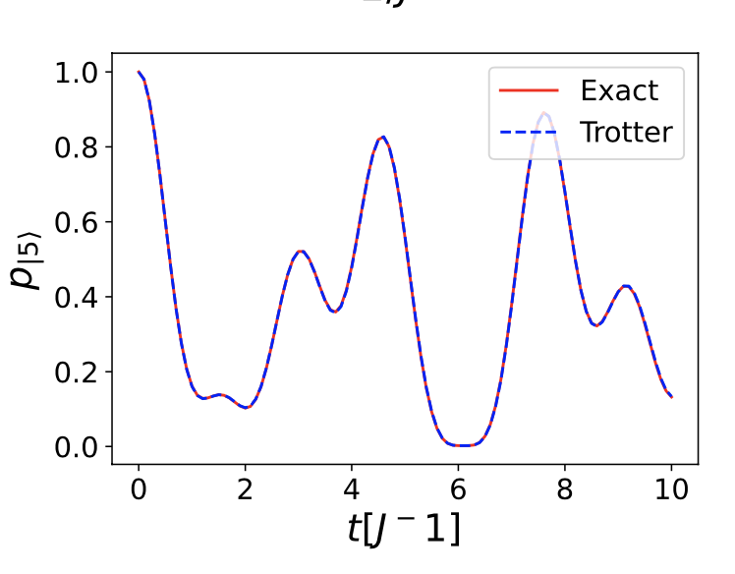
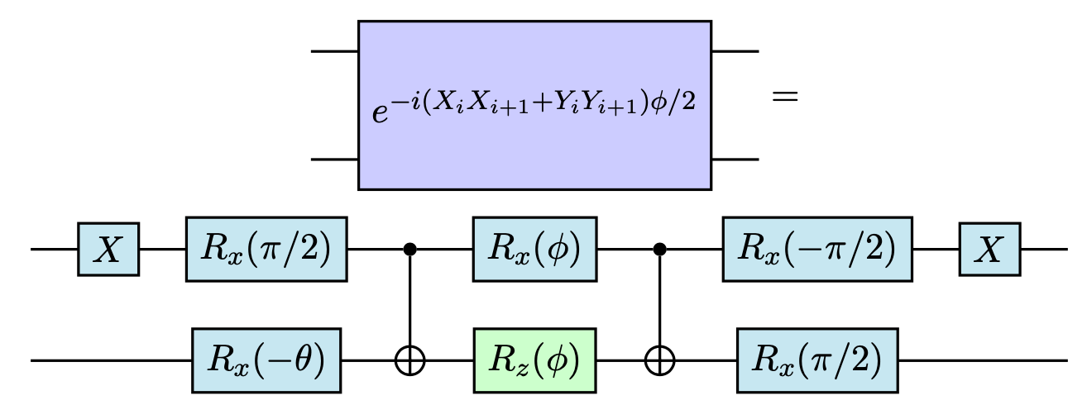
A few examples on lattices
The Hubbard model
Example-1D Hubbard model
1 Layer = 1 time-step
JWT
Circuit
building blocks
Example of evolution
Ruiz Guzman, PhD thesis IJCLab

Slide 21
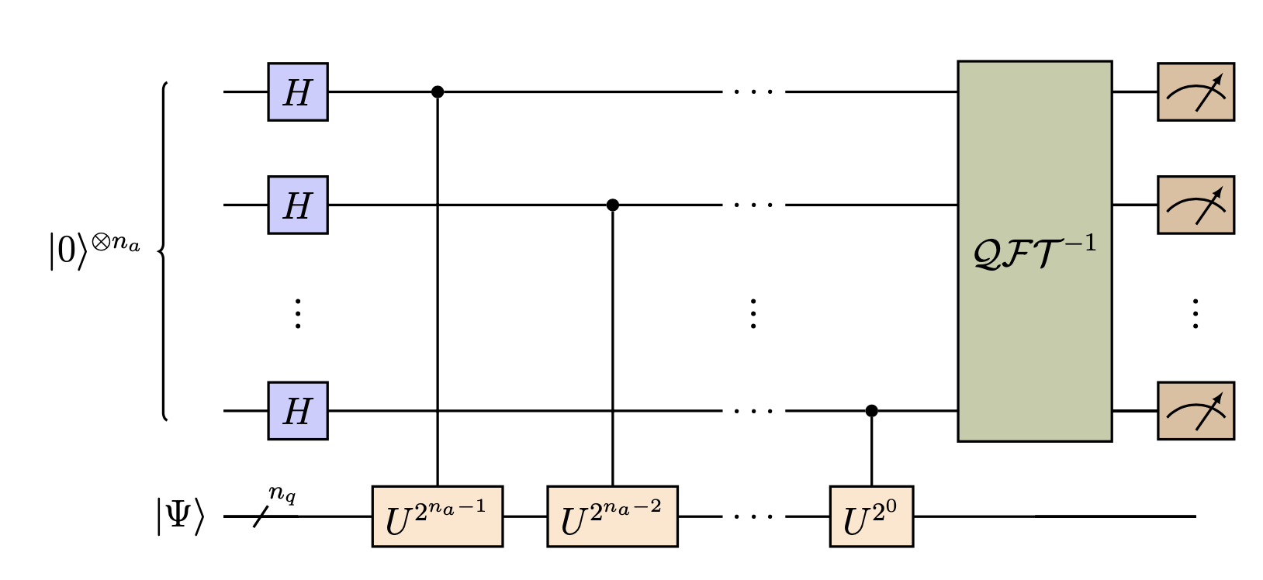
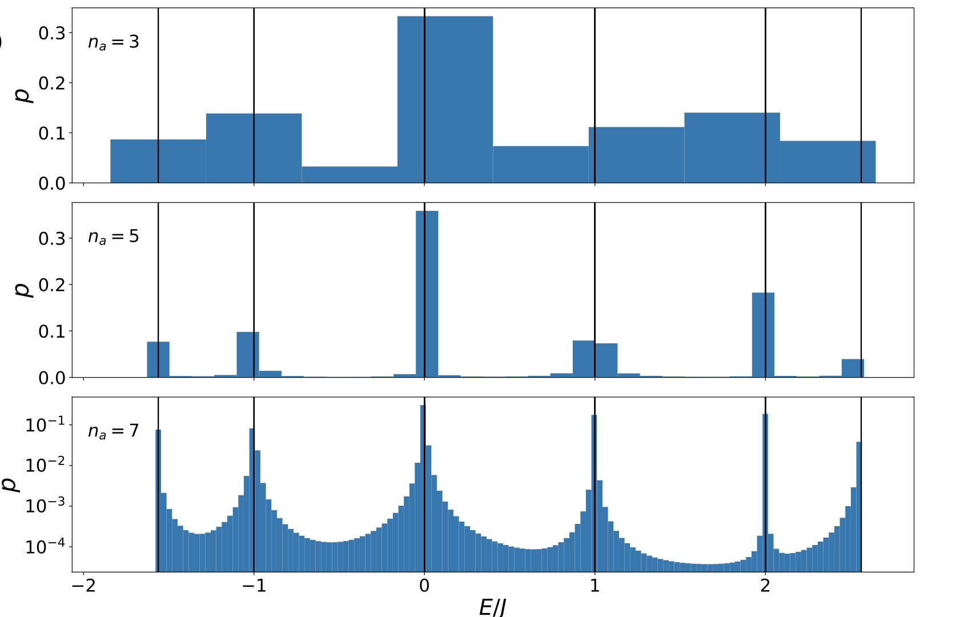
A few examples on lattices
The Hubbard model
Quantum Phase-Estimate / the perfect eigensolver

Slide 22





A few examples on lattices
The (1+1) Schwinger model
arxiv:2311.17388
Step 1: write your favorite Lagrangian
Schwinger model is quantum electrodynamics in 1 + 1 dimensions
Lagrangian in the continuous spacetime
: Dirac field:
: electric field
Minkowski spacetime metric

Slide 23



A few examples on lattices
The (1+1) Schwinger model
Step 2: transform it into an Hamiltonian
arxiv:2311.17388
Fix the Gauge (set A₀ = 0)
Make Legendre transformation
Step 3: transform it as interacting fermions on a Lattice transform
Gauss law: eliminate the degree of freedom of the electric field
Discretize Photon field
Link variable
Conjugate momentum:
Dirac fermions
Staggered fermions

Slide 24



A few examples on lattices
The (1+1) Schwinger model
Step 3: transform it as interacting fermions on a Lattice transform
Link variable
and its conjugate momentum:
Fermions fields:
Step 4: transform fermions to qubits (Jordan-Wigner Transformation)

Slide 25


A few examples on lattices
The (1+1) Schwinger model
For comparison Hubbard :
Selected history/insight
2006 -Byrnes, Yamamoto (PRA 73)
Formulation of SU(N) gauge theory on QC
2014 -Jordan, Lee, Preskill
Scattering in scalar QFT
…
Made on trapped Ca⁺ trapped Ions
2016 Martinez et al (nature letter)
Real time evolution (1+1) on real QC

Slide 26


A few examples on lattices
The (1+1) Schwinger model
For comparison Hubbard :
Selected history/insight
2006 -Byrnes, Yamamoto (PRA 73)
Formulation of SU(N) gauge theory on QC
2014 -Jordan, Lee, Preskill
Scattering in scalar QFT
…
Simulation made on the
IBM QC Cloud
2016 Martinez et al (nature letter)
Real time evolution (1+1) on real QC
2018 Klco et al (PRA 98)
Quantum-Classical calculations (1+1)
on real QC
…

Slide 27




The field is rapidly growing
Many recent reviews, roadmaps, white-papers

Slide 28



Lattice Gauge theory – and related Field theories
Digital Quantum Chromodynamics
Map quarks and gluons on
quantum register
Develop unitary operators for
their evolution
Obtain relevant observables
from measurements
Courtesy M. Savage

Slide 29



Lattice Gauge theory – and related Field theories
Digital Quantum Chromodynamics
Map quarks and gluons on
quantum register
Develop unitary operators for
their evolution
Obtain relevant observables
from measurements
Courtesy M. Savage

Slide 30

Nuclear Physics
Actual tendency : Towards Full configuration-Interaction description ?
Current status

Slide 31







Nuclear Physics
Actual tendency : Towards Full configuration-Interaction description ?
Current status
New algorithms
Systematic strategy

Slide 32










Neutrino oscillations
Nowadays: Increasing
number of applications
2-flavor approx. directly treated as Qubit
Quantum Information
And entanglement
Natural treatment as Qutrits
Neutrino oscillations in beams
…
…

Slide 33


Quantum Machine Learning
and event classification
Some quantum historical algorithms are very fast for pattern recognition.
Deutsch (1985), Simon (1994), …
case 1
case 2
The “simple” Deutsch problem:
(Oracle)
Q: determine if
Classically requires to have 2 answers
Quantum: one can directly ask

Slide 34




Quantum Machine Learning
and event classification
Some quantum historical algorithms are very fast for pattern recognition.
Deutsch (1985), Simon (1994), …
case 1
case 2
The “simple” Deutsch problem:
(Oracle)
Q: determine if
Classically requires to have 2 answers
Quantum: one can directly ask

Slide 35
Some final highlights
Today the main goal is to find pilot applications
Many fields of applications are evolving fast
-High energy physics
-Neutrino Physics
-Nuclear Physics
-Quantum Machine Learning
-Quantum Chemistry
-Condensed Matter
…
Theory is easy compared to today’s
experimental challenges …
And for theory the challenge is to adapt to
Unperfect quantum processor units
Thank you !

Slide 36















Thanks to my Collaborators
T. Ayral
E. Litivinova
A. Roggero
M. Mangin Brinet
E. A. Ruiz Guzman
J. Zhang
Y. Beaujeault-Taudiere
M. O. Hlatshwayo
P. Siwach
(Now in IBM Quantum)
(Now in Alice & Bob)

Slide 37


