Slide 1
Stellar Population Synthesis to improve templates for photometric redshifts estimation
Joseph Chevalier, Sylvie Dagoret-Campagne
PHENIICS Fest, IJClab
May 16, 2024

Slide 2
Outline
A few words on redshift
Estimation from photometry : how can we do?
Template fitting for photometric redshift
How does it work?
What to improve?
Photo-z, Dust and SPS
Conclusion

Slide 3
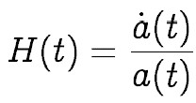
A few words on redshift
Einstein’s field equations of General Relativity :
Friedmann-Lemaître-Robertson-Walker solution for a homogeneous and isotropic Universe :
“Redshift” : analogous to Doppler shift in wavelengths of emitted photons, equivalently defined with the scale factor
Expansion rate ( “Hubble constant” H₀ for t = today) :
Redshift : essentially a measure of time
Expansion of the universe : related to its contents and the redshift.
Dark Energy ↔Acceleration of the expansion : probe contents at various redshifts

Slide 4
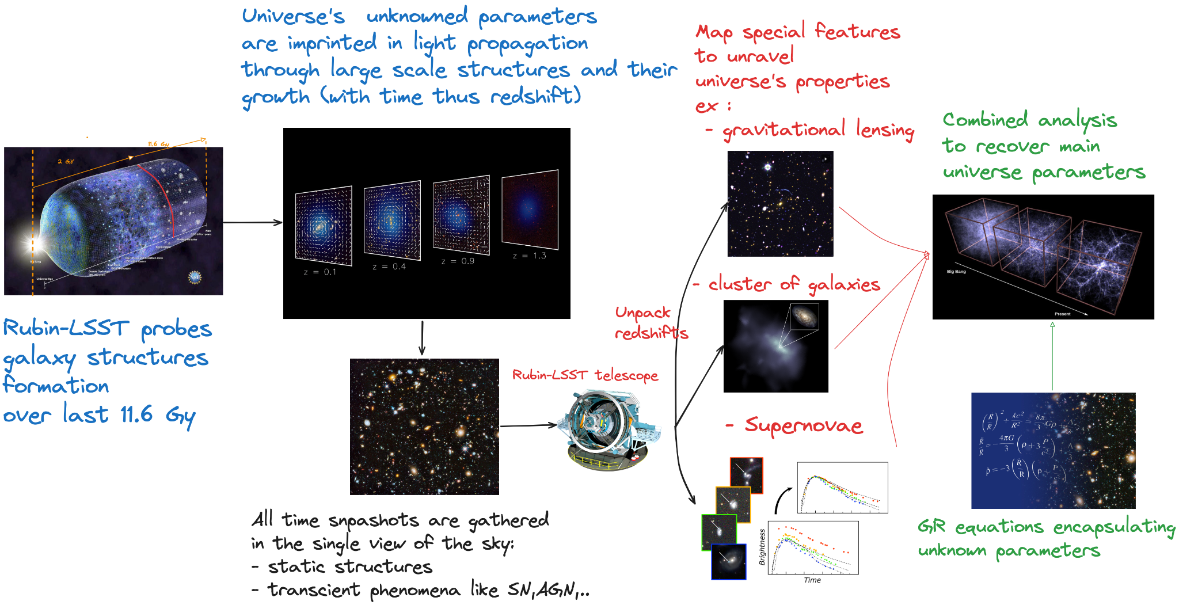
Expansion of the universe : related to its contents and the redshift.
Dark Energy ↔Acceleration of the expansion : probe contents at various redshifts

Slide 5
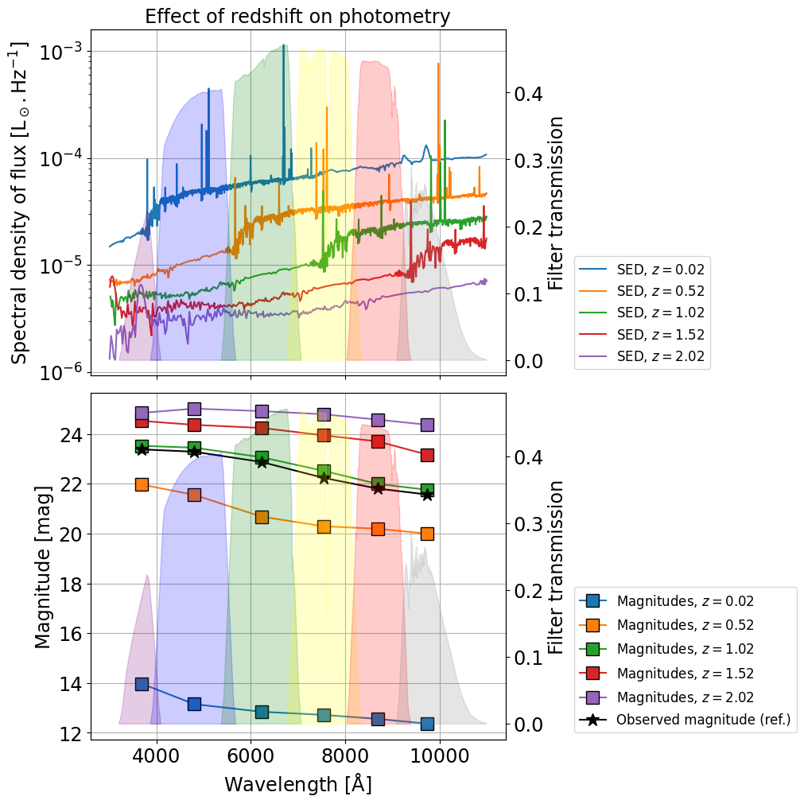
A few words on redshift
Redshift : analogous to Doppler shift in wavelengths of emitted photons.
Usually computed via spectrometry.
Cosmological surveys (like LSST) : too many galaxies
Spectroscopy excluded
Redshift must be estimated from photometry, i.e. measuring light through wide-band filters.
Only 6 filters in visible range for LSST. Other surveys (e.g. Euclid) use other passbands (infrared).
Photometric redshift among the most significant sources of errors in cosmological parameters estimation

Slide 6
Estimation from photometry : how can we do?
Historical method : template fitting (BPZ : Benítez, 2000 ; LEPHARE : Arnouts et al., 1999 & Ilbert et al., 2006) = compare observations to theoretical photometry from a set of well-known templates (SED)
Pros : easy (in theory) ; representative of established physics ; can include the effects of many physical phenomena
Cons : SED templates from local Universe may not match actual galaxies in distant Universe ; degeneracies
Trending : neural networks et al. (FlexZBoost : Izbicki & Lee, 2017) = train the code on a dataset {photometry + redshift} then estimate the redshift of observed {photometry}
Pros : fast once trained ; very accurate ; suited to statistics on large datasets (cosmological surveys)
Cons : training sets not representative of all study cases (too shallow, simulated, different photometry bands, etc.)
Both techniques suffer from representativeness issues, i.e. the availability of template SEDs and training data respectively
My PhD somehow
Future surveys + improved simulations

Slide 7
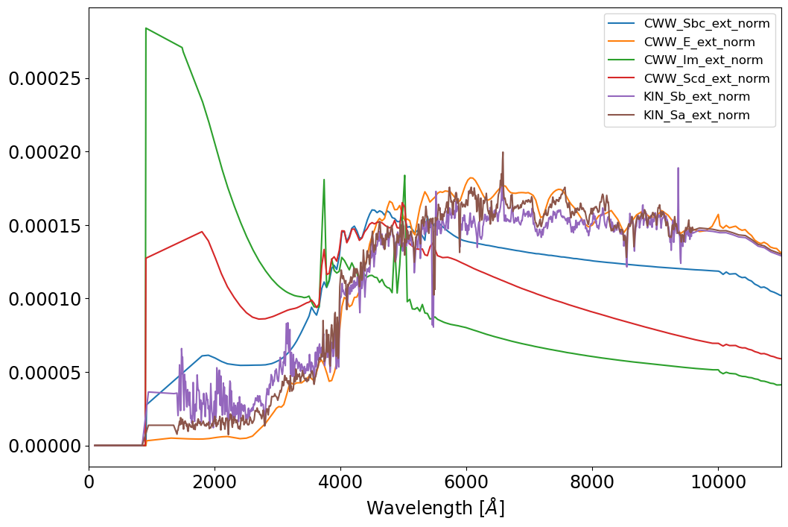
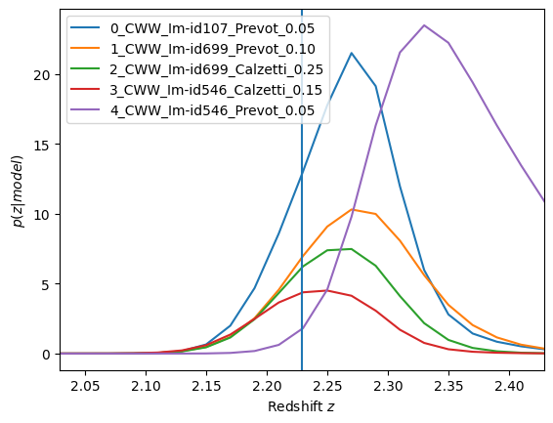
Template fitting : How does it work?
Spectral Energy Distribution (SED) of various galaxy morphologies serve as templates :
Recomputed for many redshift values
Their photometry (fluxes in passbands) is computed
Observations are compared to these references to build probability distributions of redshift values.
The most likely redshift is selected : the “photometric redshift”

Slide 8
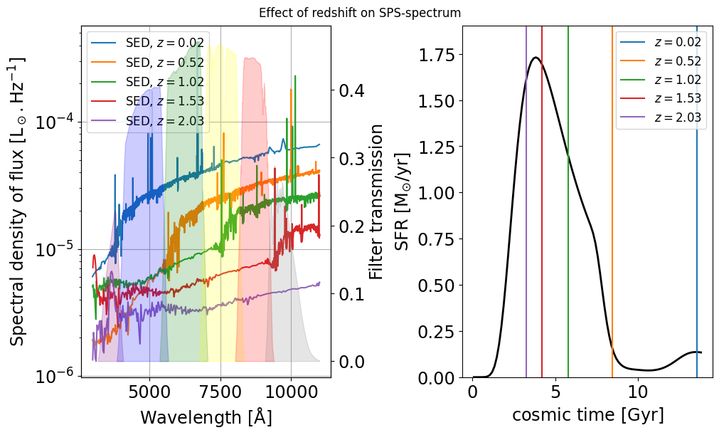
Template fitting : What to improve?
Template spectrum shifted
+ its stellar content adjusted to the epoch of emission.
Aim : better representativeness of templates at higher z
The key : representativeness.
The issue : well-calibrated templates are mostly local, observations will be distant.
The fix : use Stellar Population Synthesis (SPS) and Star Formation History (SFH) to improve SED templates.
The idea : compare the radiation emitted by “young” galaxies to “younger” versions of the templates, as the stellar content evolves with time.
Galaxies = stars + dark matter + other (dust, gas…)
Emit the light we observe (~ black body)
Alter the signal
SPS = fit models of galaxy contents to observations
Use the results as (or instead of) SED templates

Slide 9
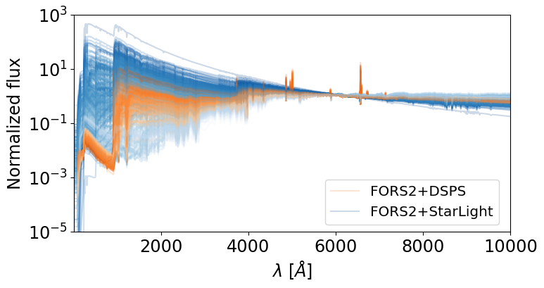
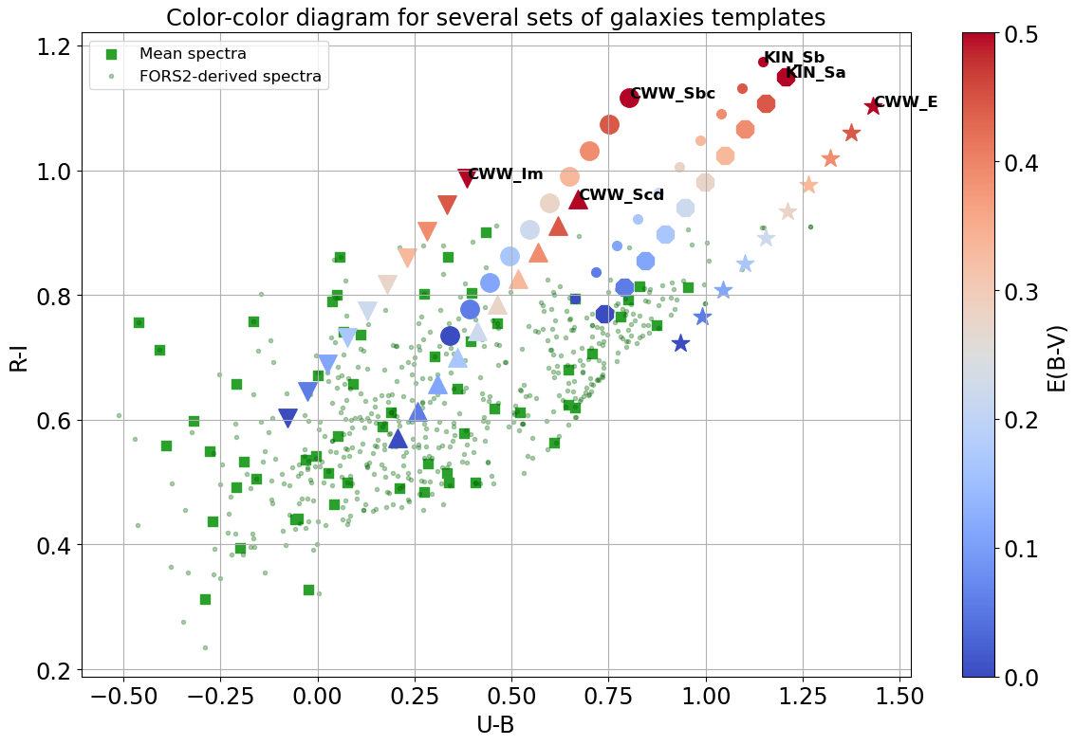
Photo-Z, Dust and SPS
Dust extinction and SFR determine UV radiation, critical for photo-z estimation at higher z
Dust :
necessary for good representativeness
Yields degeneracies with photo-z
Requires careful treatment
UV-light :
Shifted into visible : key to high z
Related to Star-formation
Absorbed by dust
Good photo-z = Star-formation + dust
Notes:
The answer may lie in the understanding of the astrophysics of galaxies, so that Stellar Population Synthesis tools (such as StarLight, that was used to obtain the our spectra, or DSPS, a more recent and readable code that Sylvie will introduce tomorrow) can be used to generate templates that are the best possible for photo-z codes, or could even be tailored (on the basis of observations like FORS2 + prior knowledge) to a sample of galaxies directly at the time of photo-z to ensure the best coverage. One big battle for photo-z is the effect of dust, that strongly affects the UV light, which is shifted towards the visible bands with increasing redshifts. This UV light is linked to the Star formation rate of a galxy, therefore correctly estimating both dust and SFR, though SPS fitting and additional knowledge (IR filters?) could improve the quality of templates and ultimately photo-z results.

Slide 10
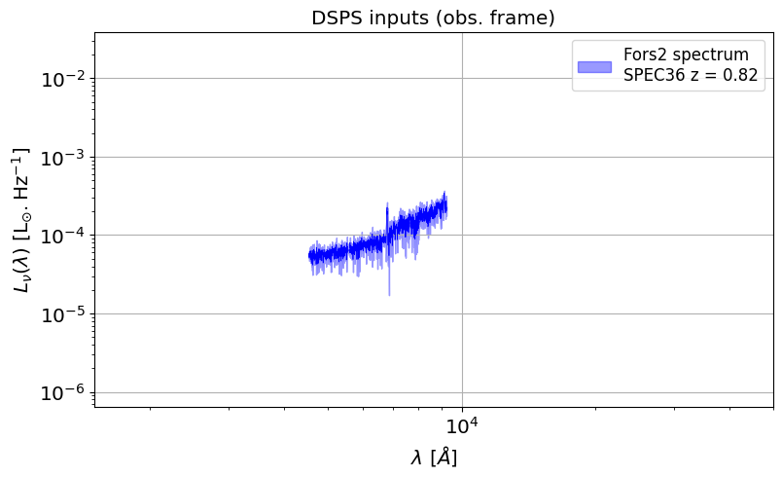
Photo-Z, Dust and SPS
Guideline :
UV in templates is key to good photo-z
Observations in UV can yield SFR and hints to dust,
Observations in infrared can constrain dust (via re-emission),
Spectroscopy (emission lines) can constrain SFR.
Observed spectra from FORS2 at VLT
(Giraud et al., 2011)

Slide 11
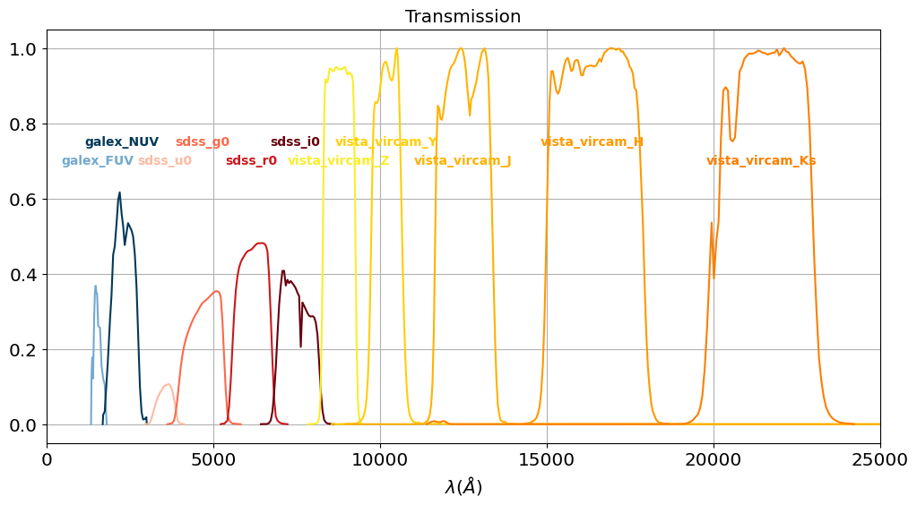
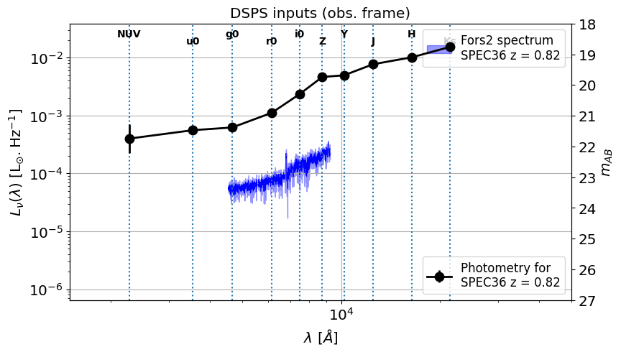
Photo-Z, Dust and SPS
Guideline :
UV in templates is key to good photo-z
Observations in UV can yield SFR and hints to dust,
Observations in infrared can constrain dust (via re-emission),
Spectroscopy (emission lines) can constrain SFR.
Cross-matched with photometry from UV to IR
(Kuijken et al., 2019 ;
Morrissey et al., 2007)

Slide 12
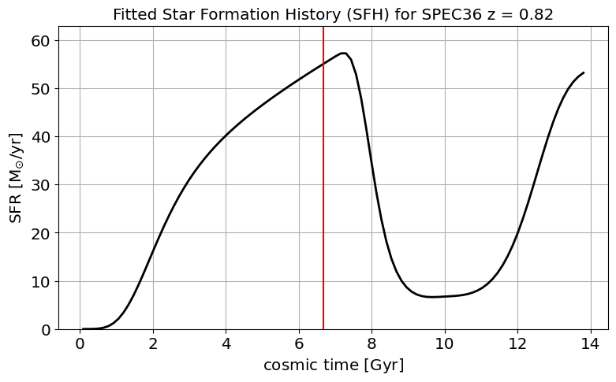
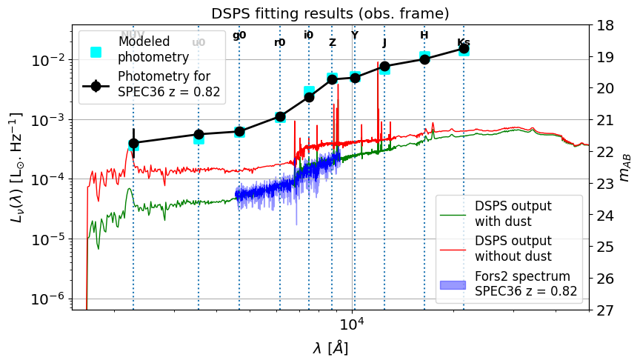
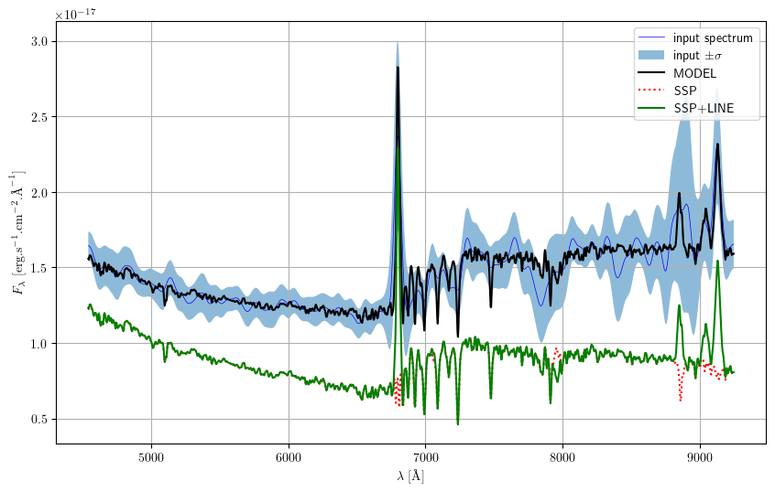
Photo-Z, Dust and SPS
Guideline :
UV in templates is key to good photo-z
Observations in UV can yield SFR and hints to dust,
Observations in infrared can constrain dust (via re-emission),
Spectroscopy (emission lines) can constrain SFR.
Fit with DSPS
(Hearin et al., 2023)
Xmit. lines with GELATO
(Hviding et al., 2022)

Slide 13
Conclusion and Takeaways
Aim : improve existing and/or generate new sets of templates for photo-z
Data : FORS2, COSMOS2020, LSST+Euclid? etc.
Tools : LEPHARE++ or other photo-z, DSPS and CIGALE for stellar population, GELATO for lines detections
Ideas and prospects :
identify spectral / stellar properties of good templates (emphasis on UV)
explore hybrid methods (TF+ML) thanks to numerous spectra + SPS
improve model selection within photo-z codes
What we’re trying to avoid :
PRECISION COSMOLOGY
PHOTOMETRIC REDSHIFTS
LSST
Thank you for your attention

