Slide 1
Three-mirror cavity for quantum noise reduction of future gravitational wave detectors

Slide 2
Outline
Context
Three-mirror cavities optics
Conclusion
2024/05/16
Paul Stevens

Slide 3
Context
2024/05/16
Paul Stevens

Slide 4
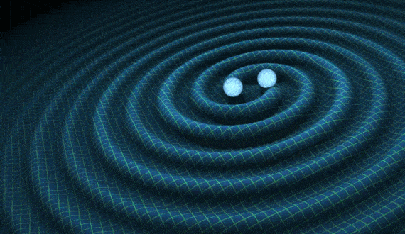
Gravitational waves
Context
Accelerated masses & propagation through space-time
1/12
2024/05/16
Paul Stevens

Slide 5
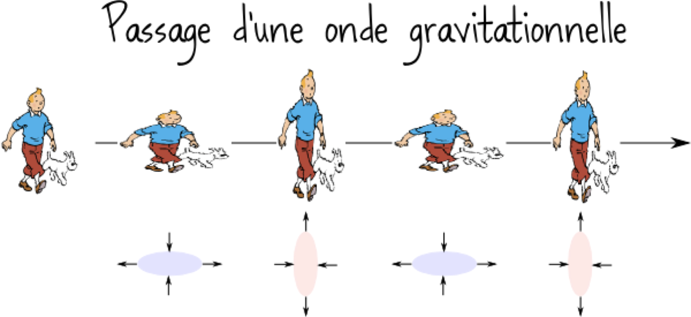
Gravitational waves
Stretch / compress orthogonal directions
Context
Accelerated masses & propagation through space-time
1/12
2024/05/16
Paul Stevens

Slide 6
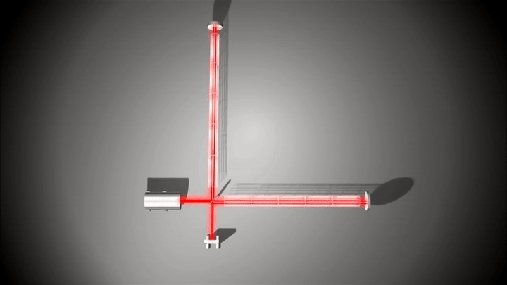
Gravitational waves
Stretch / compress orthogonal directions
Context
Accelerated masses & propagation through space-time
Detection via Michelson interferometer
1/12
2024/05/16
Paul Stevens

Slide 7
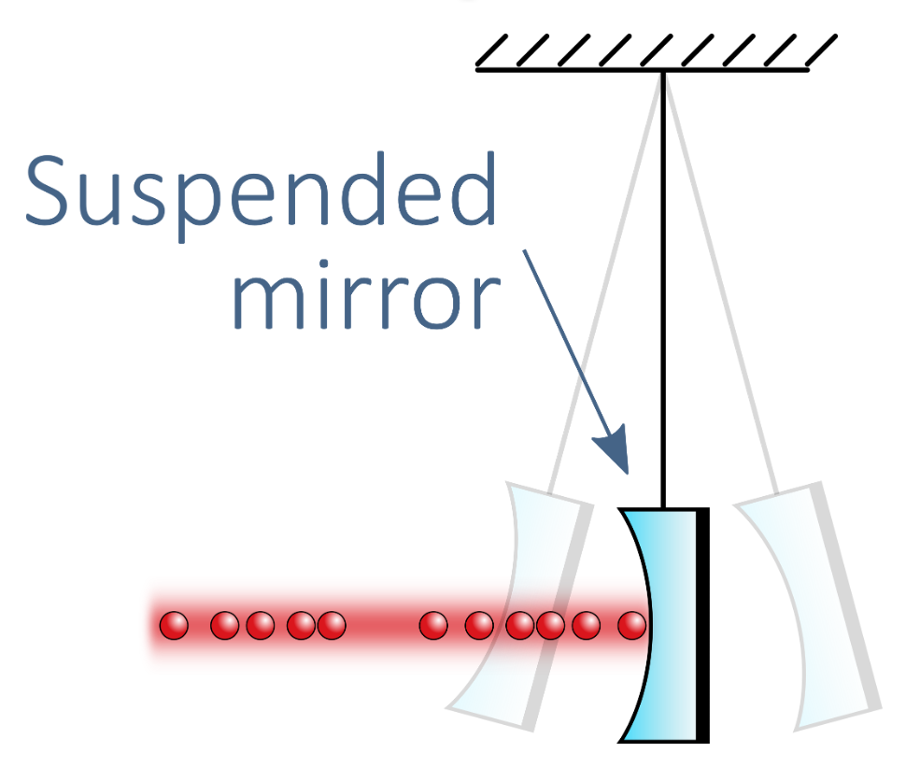
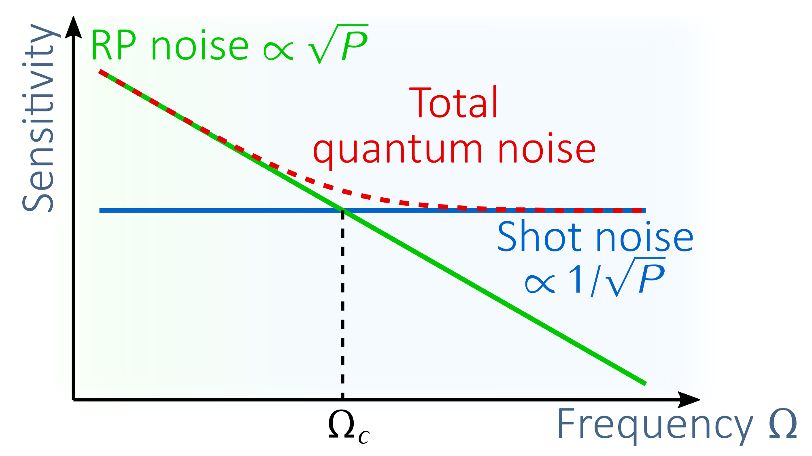
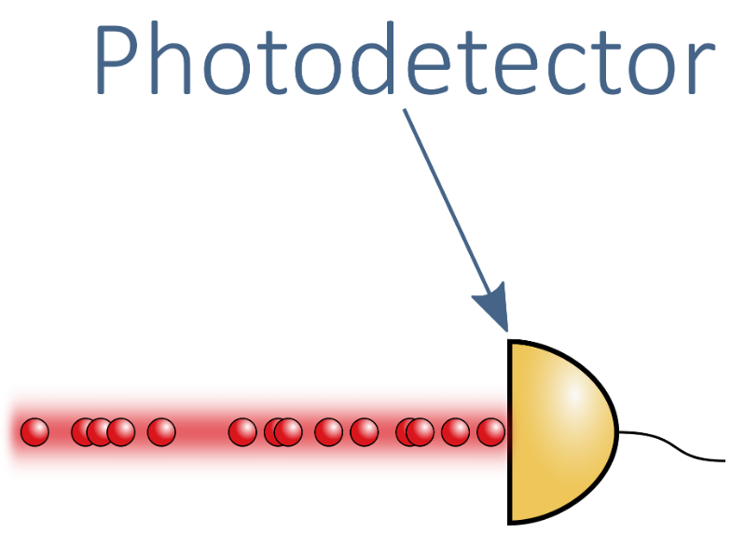
Quantum noise
Total quantum noise : sum of two sources
Radiation pressure (RP) noise
Shot noise
Cross each other at frequency Ω_{c}
Radiation pressure noise
→ Is an amplitude noise
Arises from impact of laser beam on mirrors
Context
Shot noise
→ Is a phase noise
Arises from variation of photon number in the beam (Poisson statistic)
2/12
2024/05/16
Paul Stevens

Slide 8
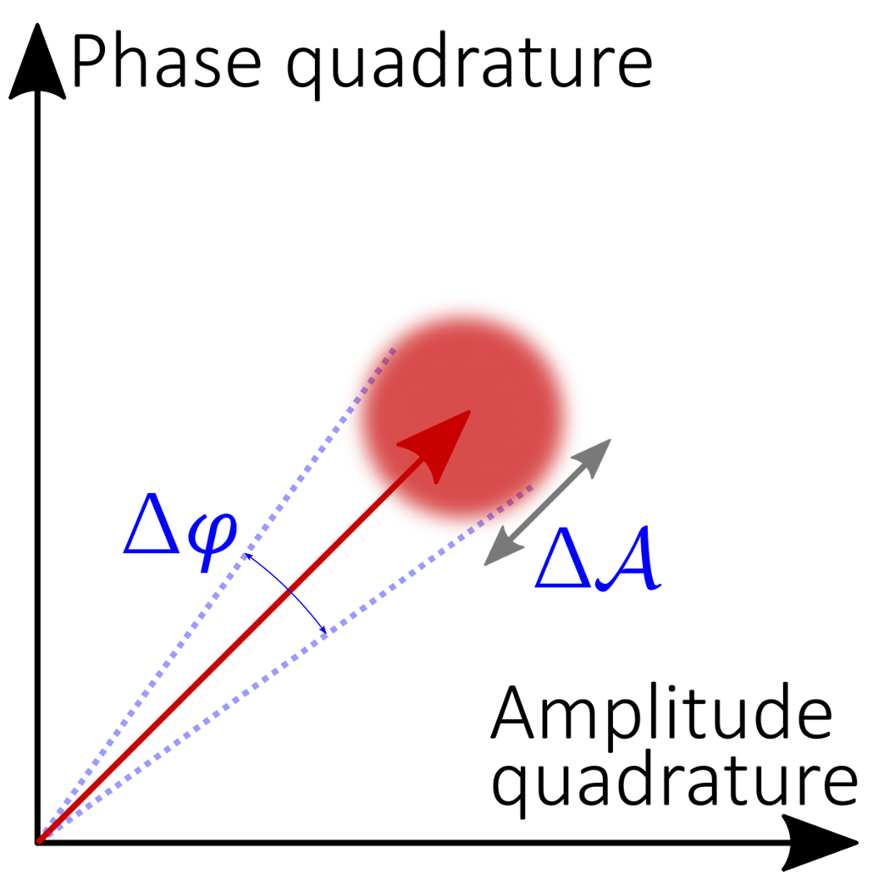
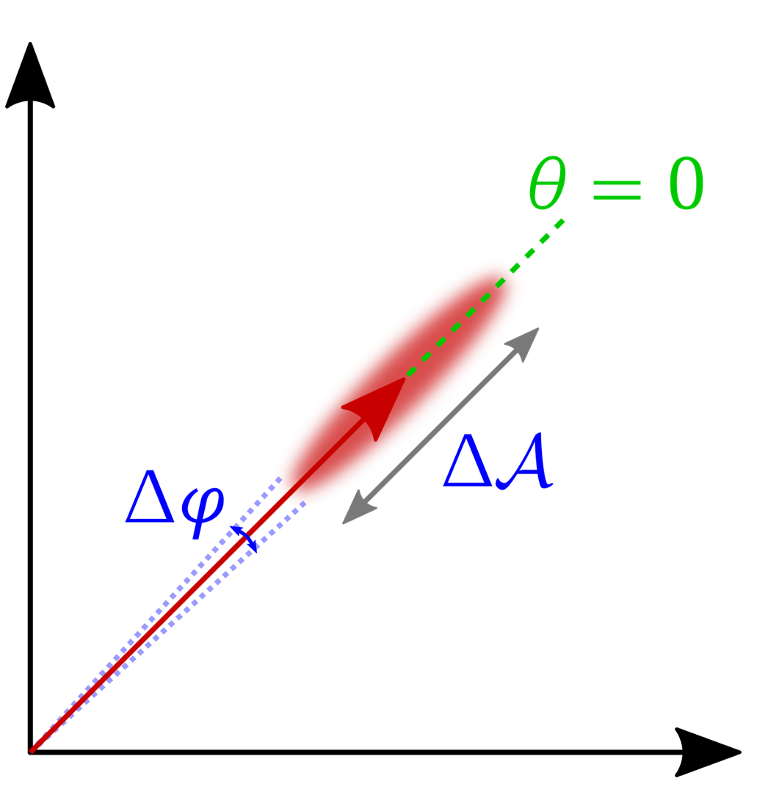
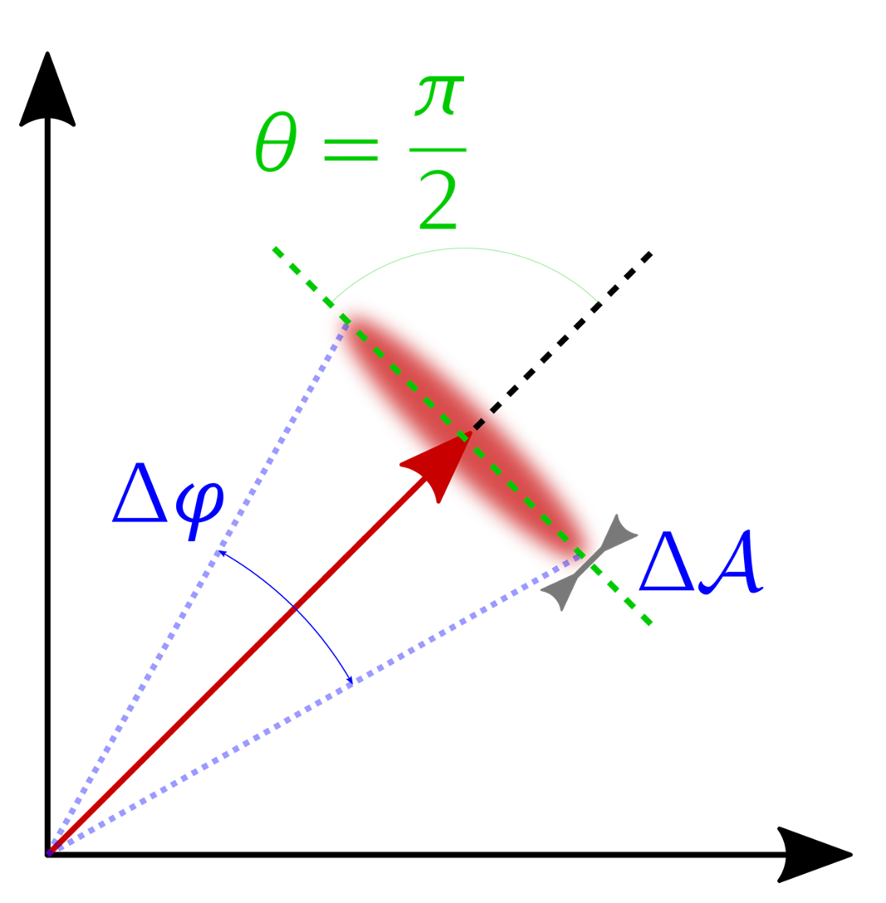
Squeezed states of light
Coherent state
Phase sq. state
Amplitude sq. state
Optical Parametric Oscillator (OPO) “converts” input coherent beam to squeezed beam
Context
Uncertainty disk: Heisenberg principle ΔA Δφ ≥ 1
For both cases, the area of uncertainty region is equal to the uncertainty of initial coherent state
Choose either to reduce phase noise at the prize of increasing amplitude noise or the invert
3/12
2024/05/16
Paul Stevens

Slide 9
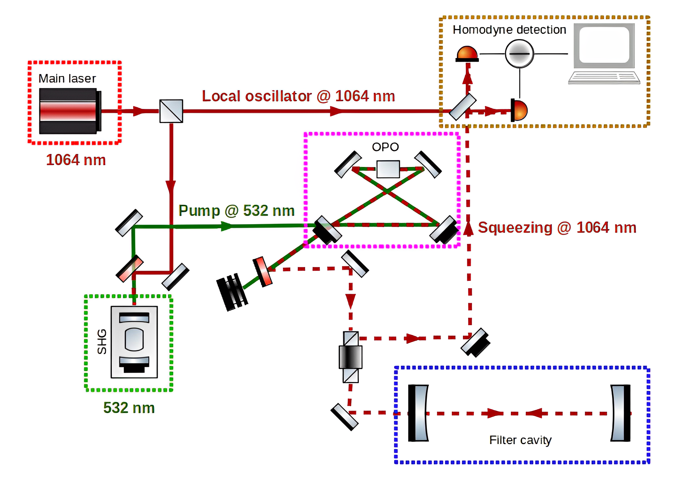
Frequency dependent squeezing & filter cavity (1/2)
The squeezed beam produced in the OPO enters into a « filter cavity »
Context
4/12
2024/05/16
Paul Stevens

Slide 10
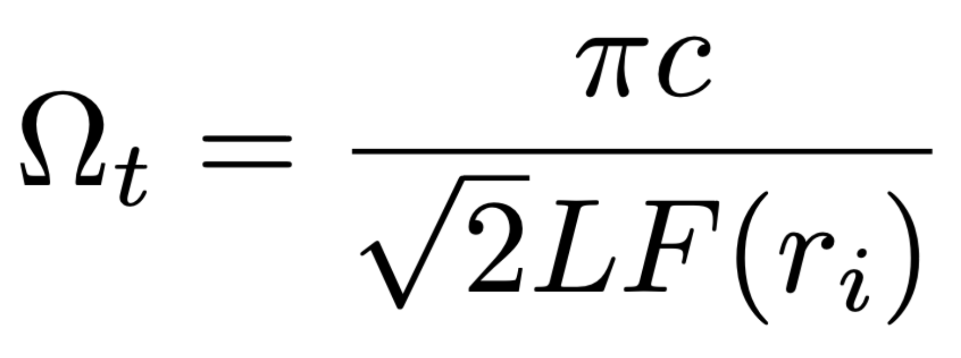
Frequency dependent squeezing & filter cavity (1/2)
The squeezed beam produced in the OPO enters into a « filter cavity »
Context
The configuration of the filter cavity define a frequency Ω_{t} around which a transition of squeezing nature (amplitude / phase) occurs
L: cavity length
F: finesse of the cavity (depends on mirrors reflectivities r_{i})
4/12
2024/05/16
Paul Stevens

Slide 11
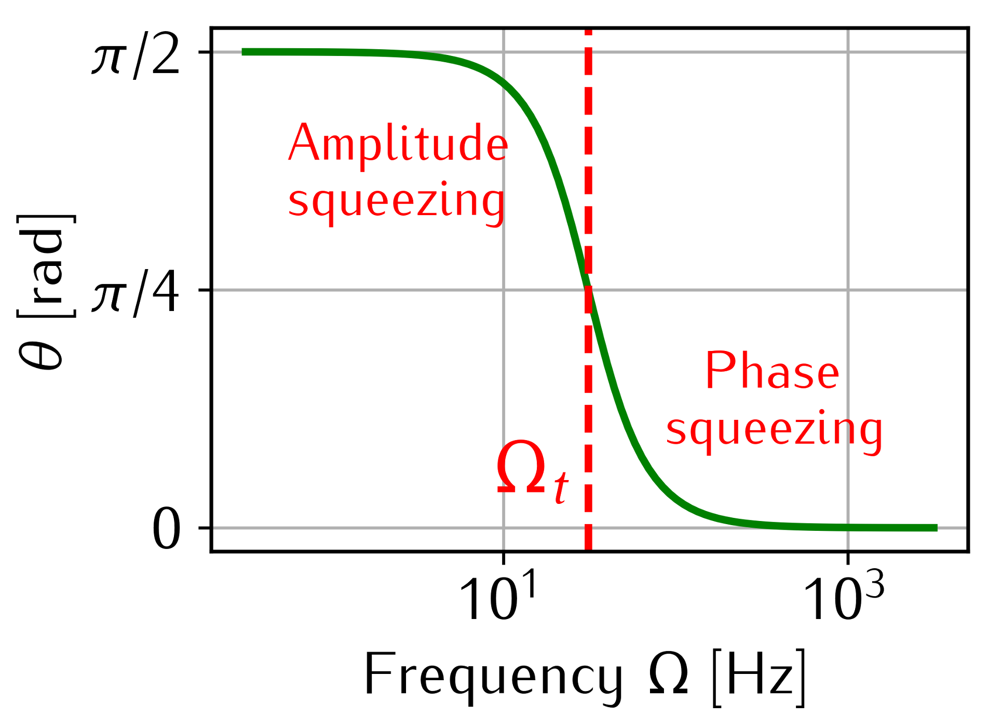
Frequency dependent squeezing & filter cavity (1/2)
The squeezed beam produced in the OPO enters into a « filter cavity »
The squeezing ellipse rotation curve shape is a consequence of filter cavity optical behavior
Choose filter cavity setting so that Ω_{t} = Ω_{c}
Context
The configuration of the filter cavity define a frequency Ω_{t} around which a transition of squeezing nature (amplitude / phase) occurs
L: cavity length
F: finesse of the cavity (depends on mirrors reflectivities r_{i})
4/12
2024/05/16
Paul Stevens

Slide 12
Frequency dependent squeezing & filter cavity (1/2)
The squeezed beam produced in the OPO enters into a « filter cavity »
The squeezing ellipse rotation curve shape is a consequence of filter cavity optical behavior
Choose filter cavity setting so that Ω_{t} = Ω_{c}
Context
Resulting situation: below Ω_{c} the RP noise is decreased while the shot noise is increased, above Ω_{c} the situation is inverted
⇒ QN reduced at all
The configuration of the filter cavity define a frequency Ω_{t} around which a transition of squeezing nature (amplitude / phase) occurs
L: cavity length
F: finesse of the cavity (depends on mirrors reflectivities r_{i})
4/12
2024/05/16
Paul Stevens

Slide 13
Frequency dependent squeezing & filter cavity (1/2)
The squeezed beam produced in the OPO enters into a « filter cavity »
The squeezing ellipse rotation curve shape is a consequence of filter cavity optical behavior
Choose filter cavity setting so that Ω_{t} = Ω_{c}
Context
Resulting situation: below Ω_{c} the RP noise is decreased while the shot noise is increased, above Ω_{c} the situation is inverted
⇒ QN reduced at all
The configuration of the filter cavity define a frequency Ω_{t} around which a transition of squeezing nature (amplitude / phase) occurs
L: cavity length
F: finesse of the cavity (depends on mirrors reflectivities r_{i})
4/12
2024/05/16
Paul Stevens

Slide 14
Frequency dependent squeezing & filter cavity (1/2)
The squeezed beam produced in the OPO enters into a « filter cavity »
The squeezing ellipse rotation curve shape is a consequence of filter cavity optical behavior
Choose filter cavity setting so that Ω_{t} = Ω_{c}
Context
Resulting situation: below Ω_{c} the RP noise is decreased while the shot noise is increased, above Ω_{c} the situation is inverted
⇒ QN reduced at all frequencies
The configuration of the filter cavity define a frequency Ω_{t} around which a transition of squeezing nature (amplitude / phase) occurs
L: cavity length
F: finesse of the cavity (depends on mirrors reflectivities r_{i})
4/12
2024/05/16
Paul Stevens

Slide 15
Frequency dependent squeezing & three-mirror cavity
Context
Fabry-Perot
cavity
Impact on squeezing properties ?
Three-mirror
cavity
5/12
2024/05/16
Paul Stevens

Slide 16
Frequency dependent squeezing & three-mirror cavity
To understand the squeezing behavior in a three-mirror cavity, we need first to understand its optical behavior.
Context
Fabry-Perot
cavity
Impact on squeezing properties ?
Three-mirror
cavity
5/12
2024/05/16
Paul Stevens

Slide 17
Three-mirror cavities optics
2024/05/16
Paul Stevens

Slide 18
Three-mirror cavity
Simple Fabry-Perot cavity + third, “middle” mirror (two “sub” cavities)
Three optical resonators
Despite simple configuration, non-trivial behavior
Three-mirror cavities optics
Fabry-Perot cavity
Third, middle mirror
6/12
2024/05/16
Paul Stevens

Slide 19
Modelisation and simulation setup
To characterize the system: how the global transmissivity and reflectivity of a three-mirror cavity change when we modify the configuration ?
1 - Modelisation
2 - Simulations
Three-mirror cavities optics
7/12
2024/05/16
Paul Stevens

Slide 20
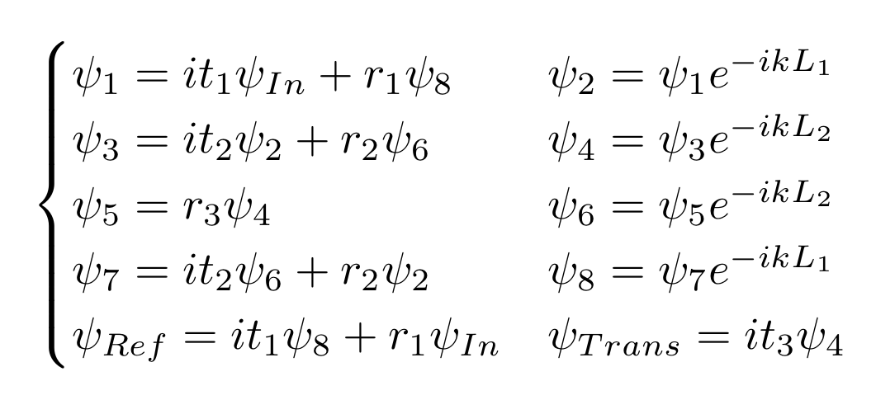
Modelisation and simulation setup
To characterize the system: how the global transmissivity and reflectivity of a three-mirror cavity change when we modify the configuration ?
1 - Modelisation
2 - Simulations
A - Fields propagation through the system:
k: wave-vector; r_{i} and t_{i}: reflection and transmission coefficients of mirror “i”
B - Global reflection and transmission coefficients:
C - Cavity behavior depend on a complex combination of configuration parameters → simulations
Three-mirror cavities optics
7/12
2024/05/16
Paul Stevens

Slide 21
Modelisation and simulation setup
To characterize the system: how the global transmissivity and reflectivity of a three-mirror cavity change when we modify the configuration ?
1 - Modelisation
2 - Simulations
A - Fields propagation through the system:
k: wave-vector; r_{i} and t_{i}: reflection and transmission coefficients of mirror “i”
B - Global reflection and transmission coefficients:
C - Cavity behavior depend on a complex combination of configuration parameters → simulations
Three-mirror cavities optics
7/12
2024/05/16
Paul Stevens

Slide 22
Modelisation and simulation setup
To characterize the system: how the global transmissivity and reflectivity of a three-mirror cavity change when we modify the configuration ?
1 - Modelisation
2 - Simulations
A - Fields propagation through the system:
k: wave-vector; r_{i} and t_{i}: reflection and transmission coefficients of mirror “i”
B - Global reflection and transmission coefficients:
C - Cavity behavior: complex combination of configuration parameters → simulations
Three-mirror cavities optics
7/12
2024/05/16
Paul Stevens

Slide 23
Modelisation and simulation setup
To characterize the system: how the global transmissivity and reflectivity of a three-mirror cavity change when we modify the configuration ?
1 - Modelisation
2 - Simulations
A - Fields propagation through the system:
k: wave-vector; r_{i} and t_{i}: reflection and transmission coefficients of mirror “i”
B - Global reflection and transmission coefficients:
C - Cavity behavior: complex combination of configuration parameters → simulations
Implement global reflection and transmission coefficients in a code
Parameters to change:
Laser wavelength (wave-vector)
First, second and third mirrors coefficients
L₁ and L₂ distances
Three-mirror cavities optics
7/12
2024/05/16
Paul Stevens

Slide 24
Modelisation and simulation setup
To characterize the system: how the global transmissivity and reflectivity of a three-mirror cavity change when we modify the configuration ?
1 - Modelisation
2 - Simulations
A - Fields propagation through the system:
k: wave-vector; r_{i} and t_{i}: reflection and transmission coefficients of mirror “i”
B - Global reflection and transmission coefficients:
C - Cavity behavior: complex combination of configuration parameters → simulations
Implement global reflection and transmission coefficients in a code
Parameters to change:
Laser wavelength (wave-vector)
First, second and third mirrors transmission coefficients
L₁ and L₂ distances
Three-mirror cavities optics
7/12
2024/05/16
Paul Stevens

Slide 25
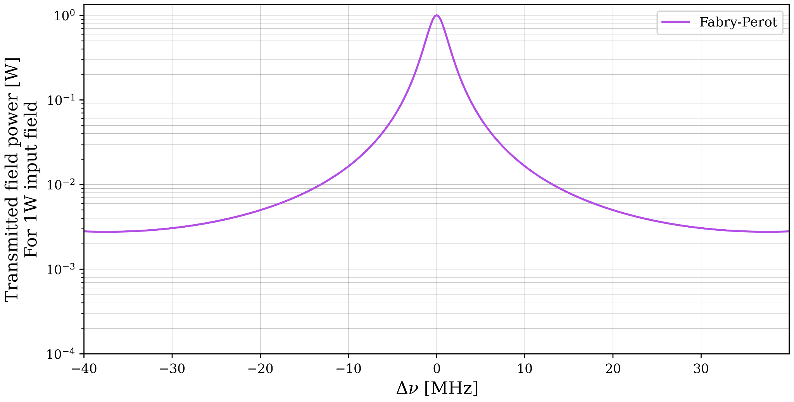
The doubling of transmission peak
For Fabry-Perot cavity: transmission peak for each resonance condition (cavity length = integer number of half-wavelength)
Scan the input field detuning
Three-mirror cavities optics
8/12
2024/05/16
Paul Stevens

Slide 26
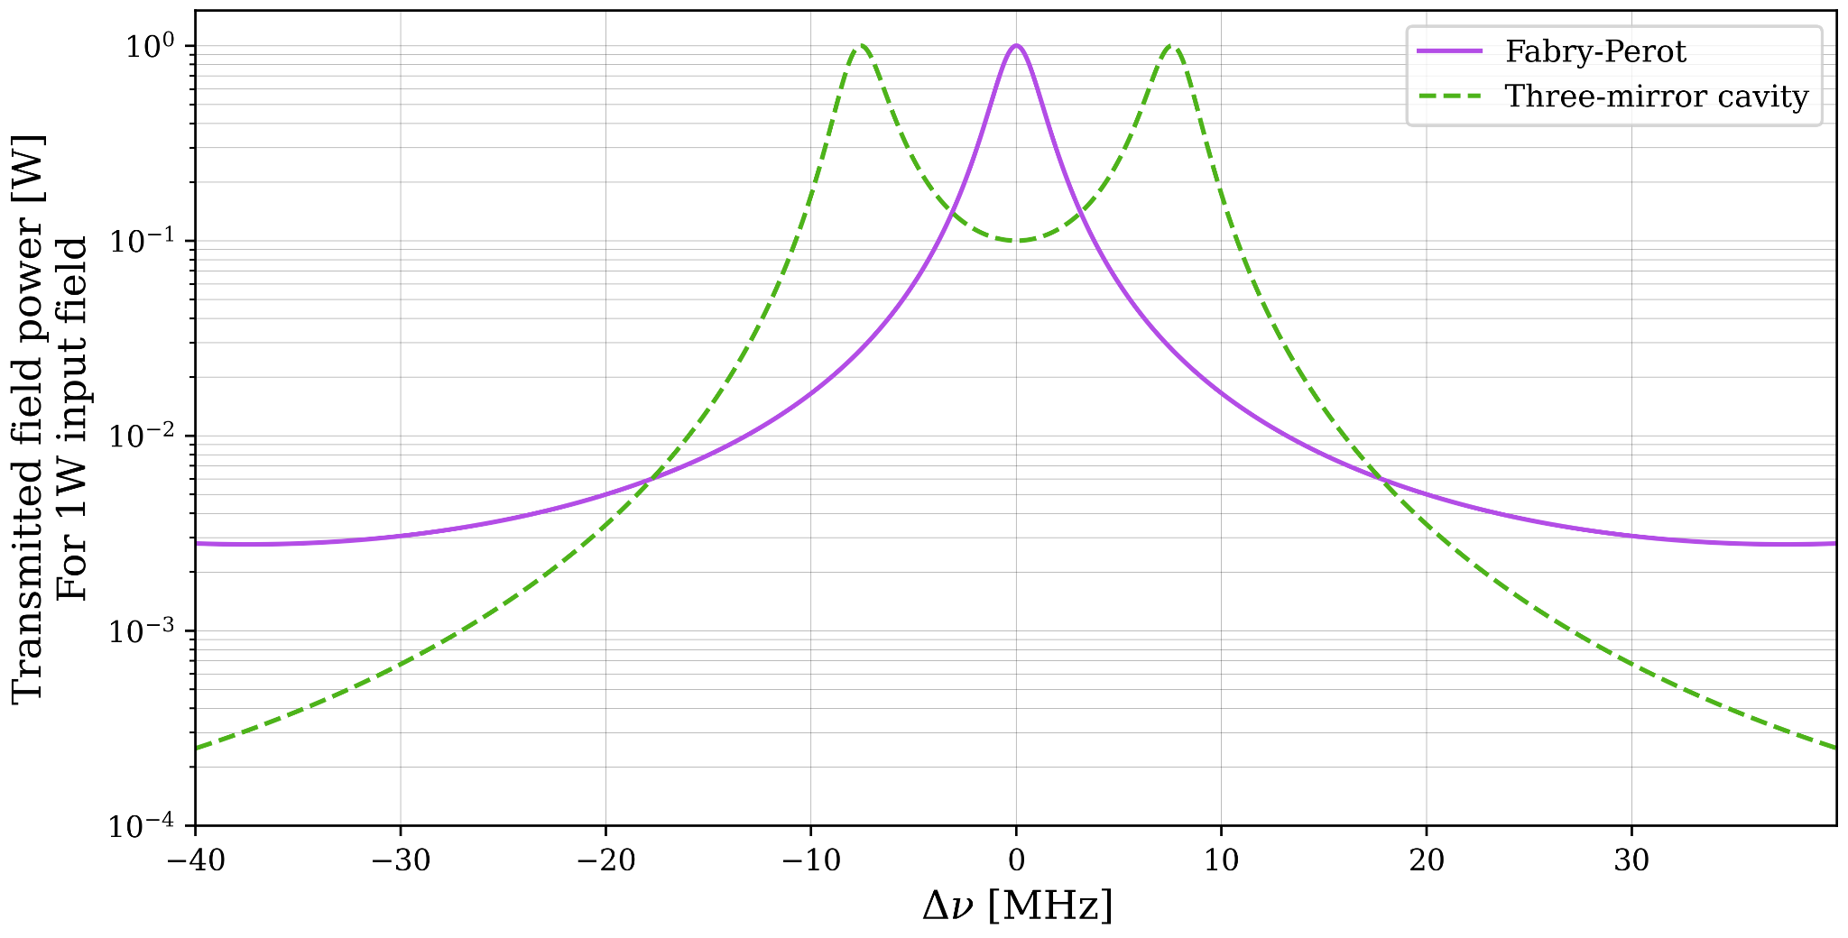
The doubling of transmission peak
For Fabry-Perot cavity: transmission peak for each resonance condition (cavity length = integer number of half-wavelength)
Scan the input field detuning
Three-mirror cavities optics
A three-mirror cavity can show off a doubling of the transmission peak
8/12
2024/05/16
Paul Stevens

Slide 27
The doubling of transmission peak
For Fabry-Perot cavity: transmission peak for each resonance condition (cavity length = integer number of half-wavelength)
Scan the cavity length/input field detuning
Variation of “double-peak” shape as function of cavity parameters ?
Three-mirror cavities optics
A three-mirror cavity can show off a doubling of the transmission peak
8/12
2024/05/16
Paul Stevens

Slide 28
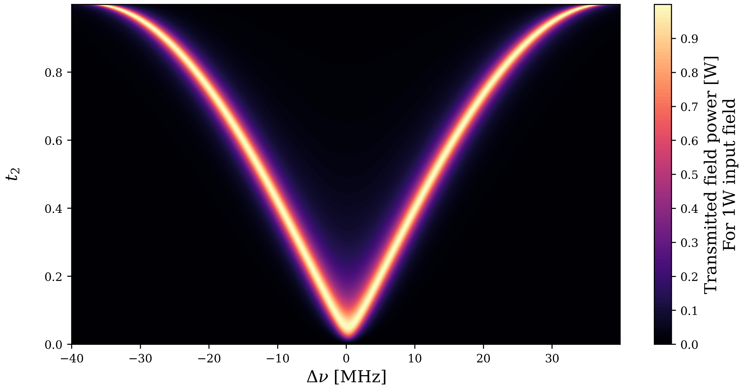
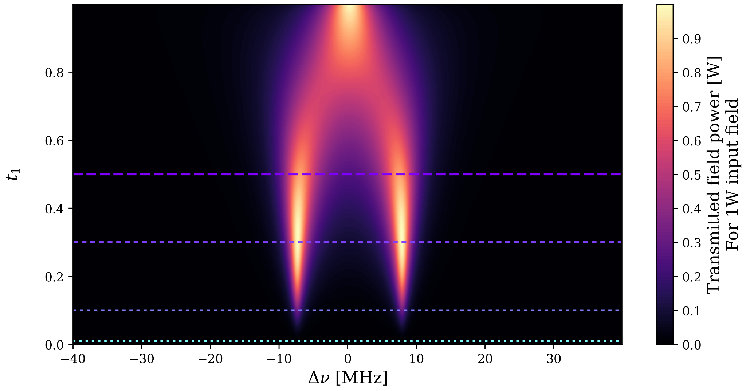
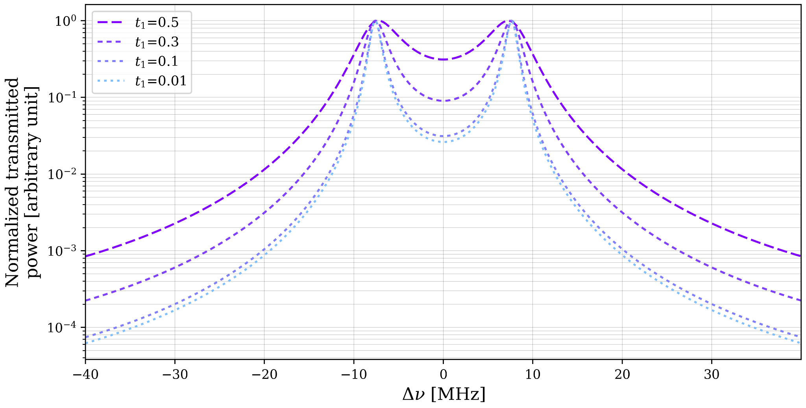
Mirrors transmissivity
Second mirror transmissivity → symmetrical variation of space between maxima
First (or third) mirror transmissivity → sharpen each maxima
Three-mirror cavities optics
Fixed parameters: L₁ = L₂= 1m, R₂ = 0.9
9/12
2024/05/16
Paul Stevens

Slide 29
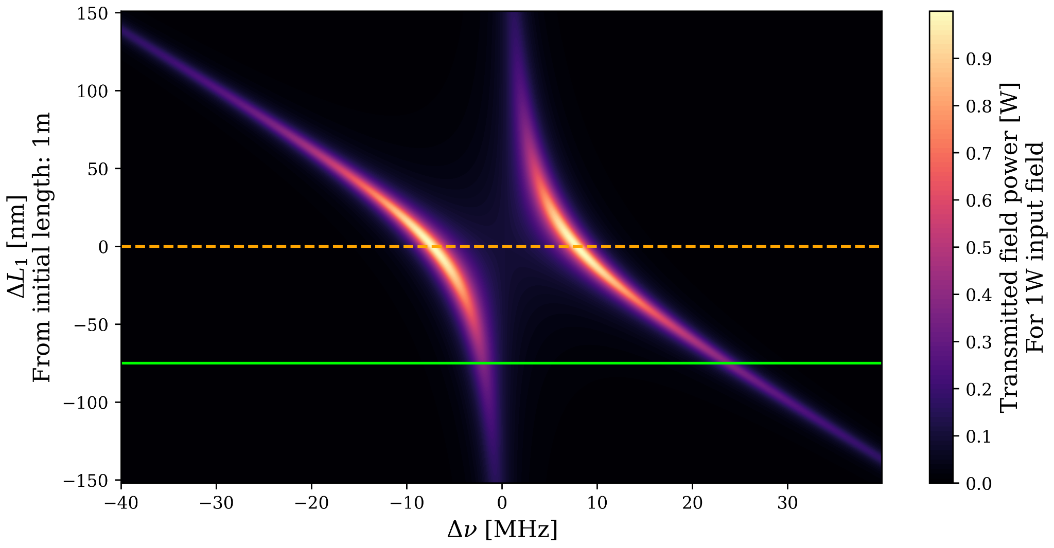
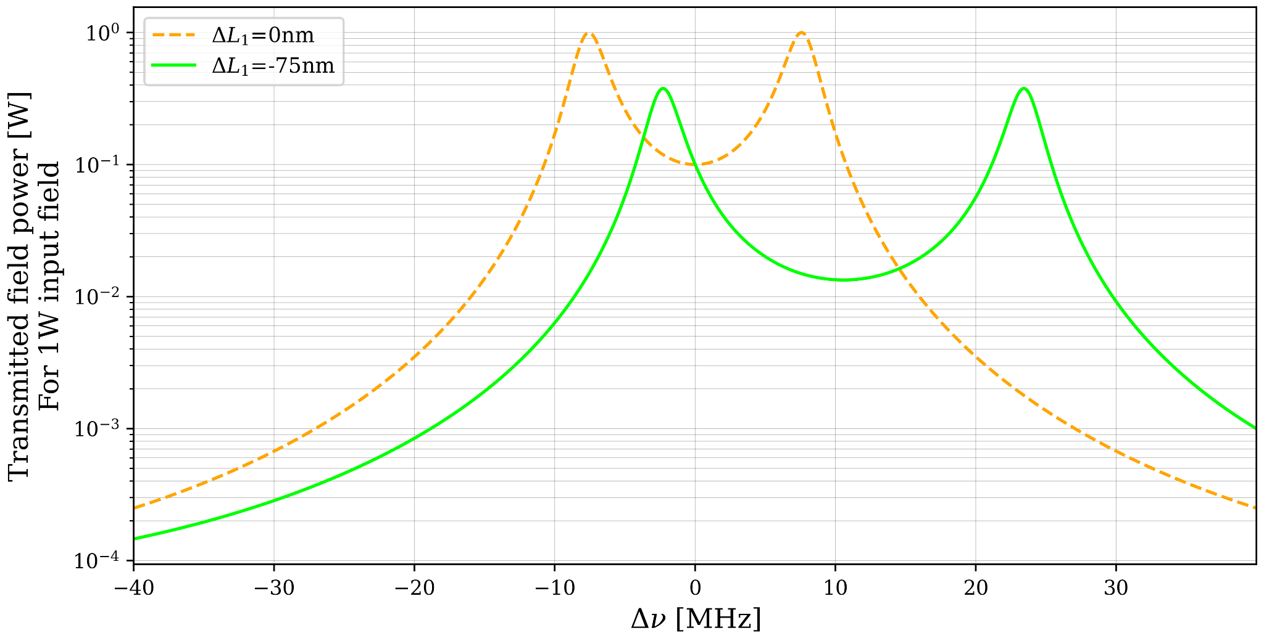
Microscopic mirrors spacing
Three-mirror cavities optics
Asymmetrical variation of maxima spacing (same power in each maxima)
Fixed parameters: L₂ = 1m, R₁ = R₂= R₃ = 0.9
10/12
2024/05/16
Paul Stevens

Slide 30
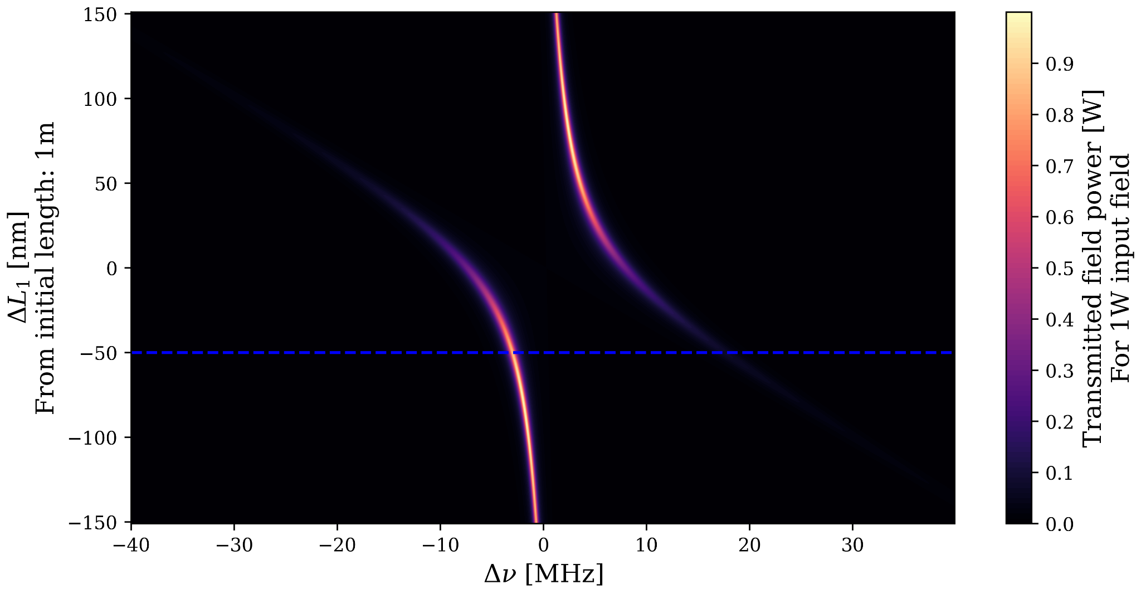
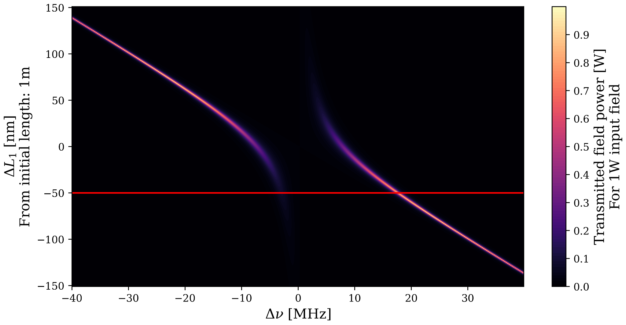
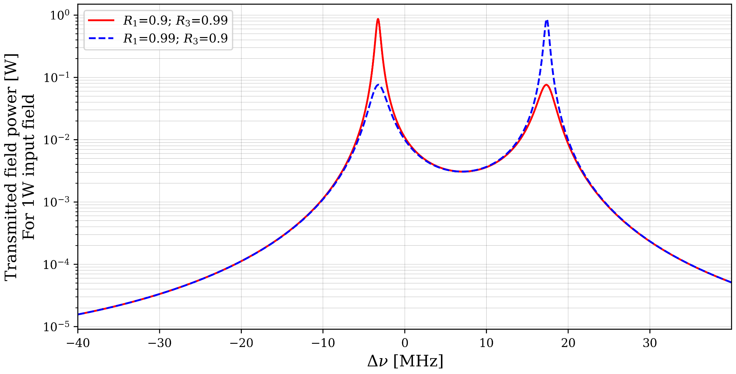
Mirrors transmissivity (again)
Variation of power along resonance lines
Fixed parameters: L₂ = 1m, R₂ = 0.9
Three-mirror cavities optics
11/12
2024/05/16
Paul Stevens

Slide 31
Conclusion
2024/05/16
Paul Stevens

Slide 32
Conclusion
Simulations of three-mirror cavity optics: ✅
Doubling of resonance peak
Position, height and sharpness of “double-peak” maxima almost completely modulable by changing the cavity configuration
⇒ Quantum noise reduction for next GW detectors!
Need to pay attention to cavity stability (not presented here)
Currently: implementation of a meter-scale prototype on CALVA platform, IJCLab
Next step: simulations of squeezing properties in a three-mirror cavity
12/12
2024/05/16
Paul Stevens

Slide 33
Thank you !
2024/05/16
Paul Stevens

Slide 34
Backup slides
2024/05/16
Paul Stevens

Slide 35
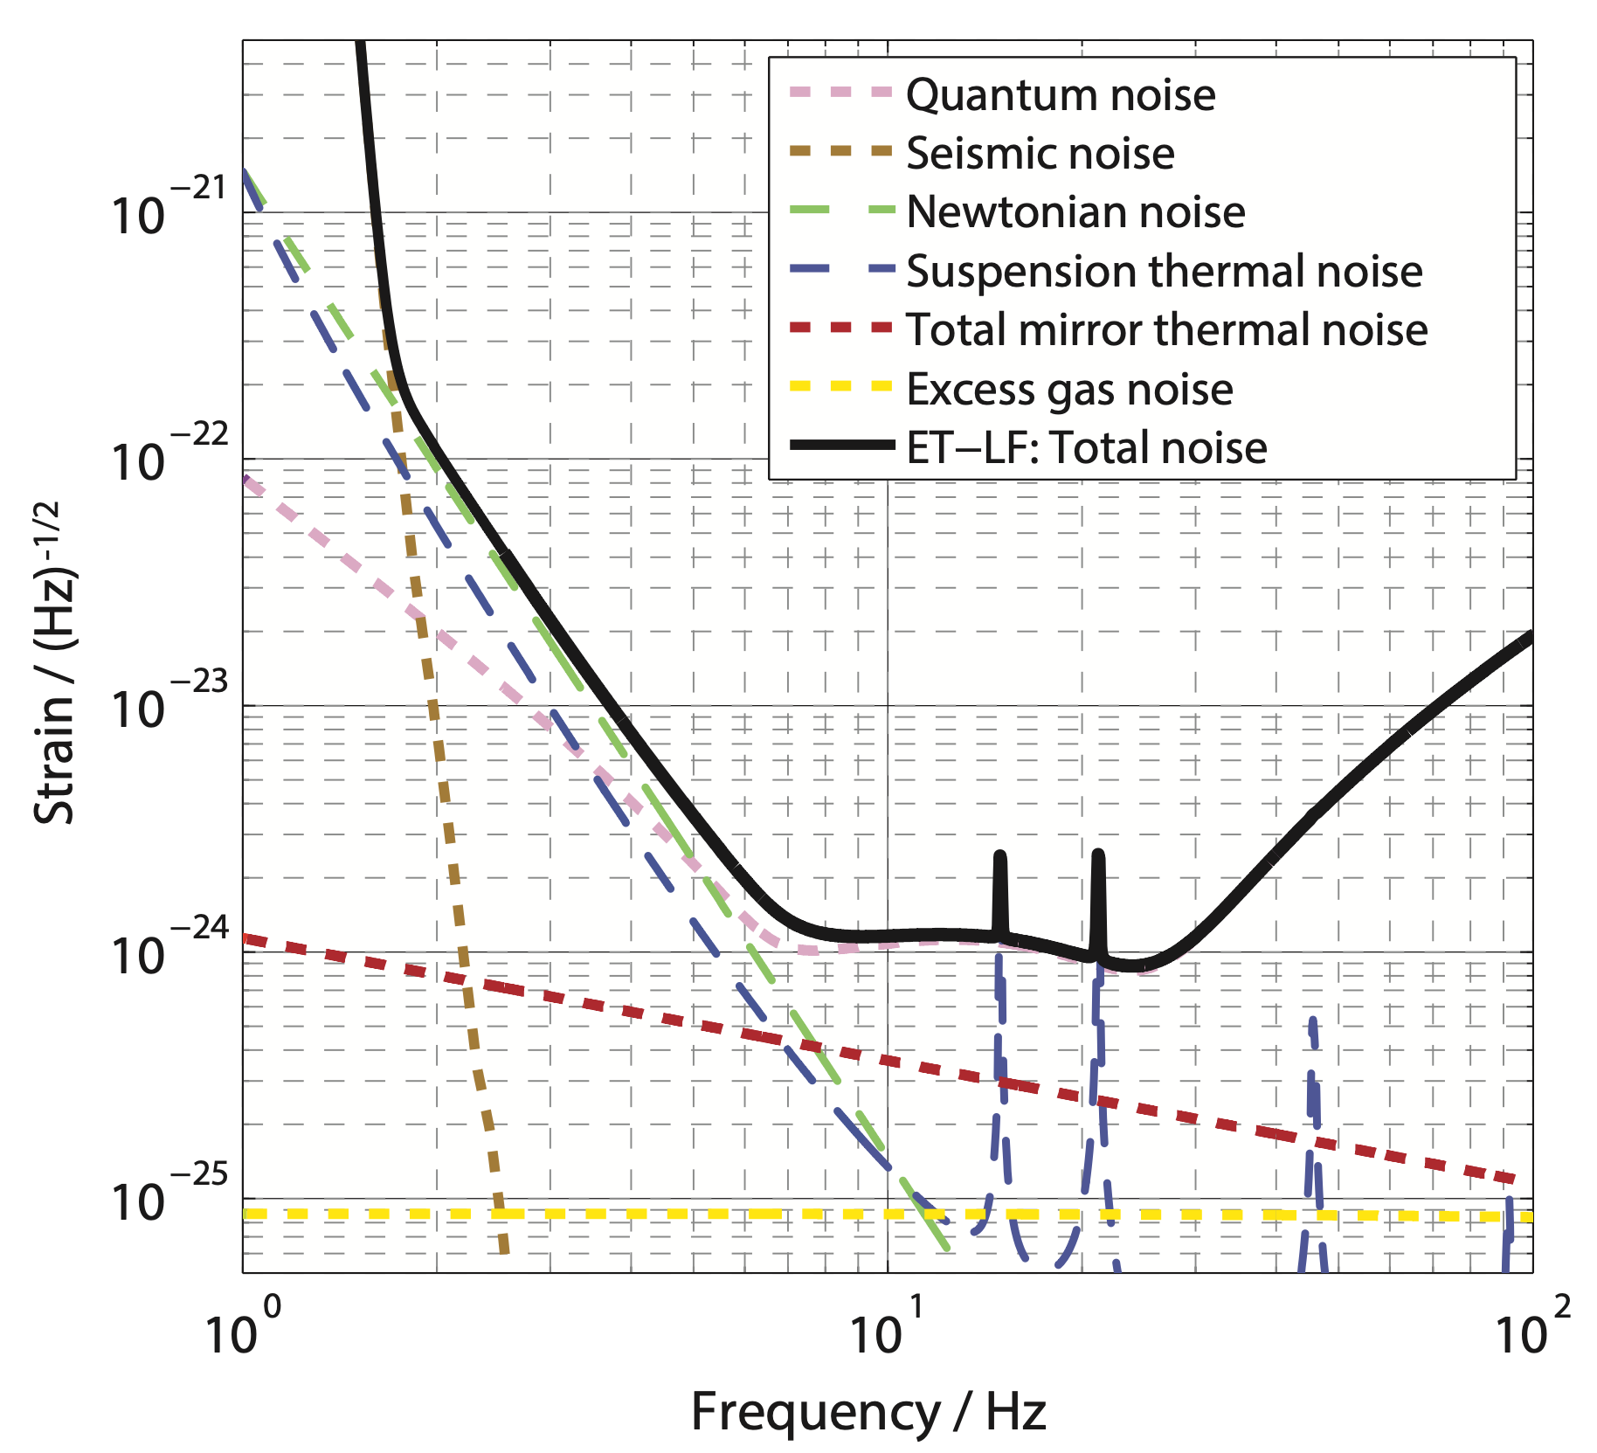
Frequency dependant squeezing for next generation of GW detectors
Frequency dependant squeezing in current detectors:
⇒ Squeezed beam filtered with a “simple” Fabry-Perot cavity → allow to reduce QN at all frequencies
Future detectors:
⇒ Is it possible to develop a system for more complex QN shape, Einstein Telescope - Low Frequency (ET-LF) ?
⇒ Current proposition: two Fabry-Perot cavities in series
Problematic:
⇒ Replace the two Fabry-Perot cavities with a three-mirror cavity ?
To understand the squeezing behavior in a three-mirror cavity, we need first to understand its optical behavior.
Context
Backup slides - 1/3
2024/05/16
Paul Stevens

Slide 36
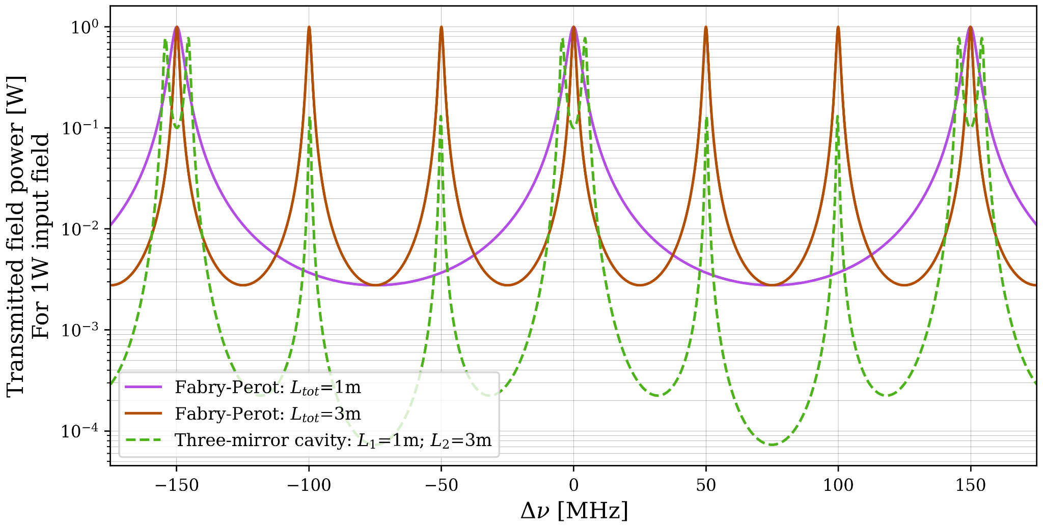
Condition for doubling of transmission peak
Each sub-cavity have to be resonant
Three-mirror cavities optics
Backup slides - 2/3
2024/05/16
Paul Stevens

Slide 37
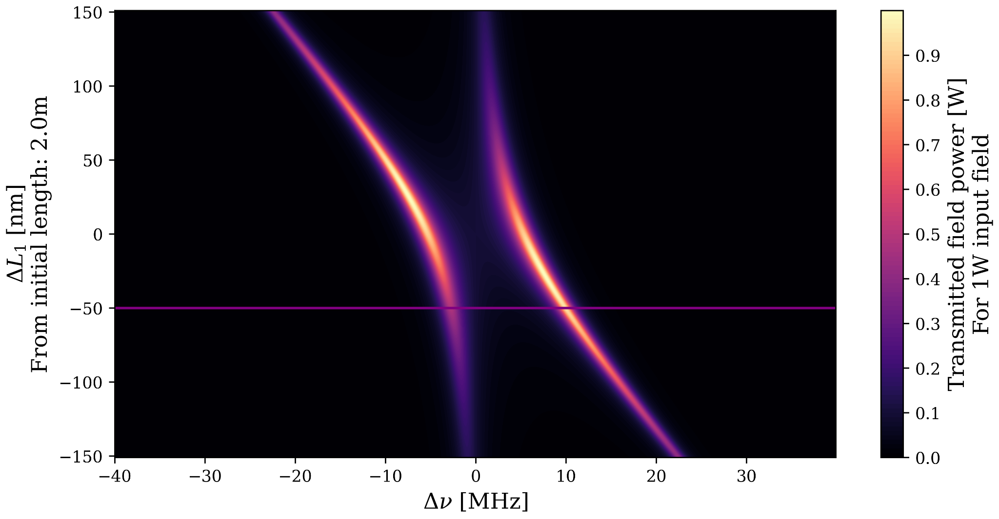
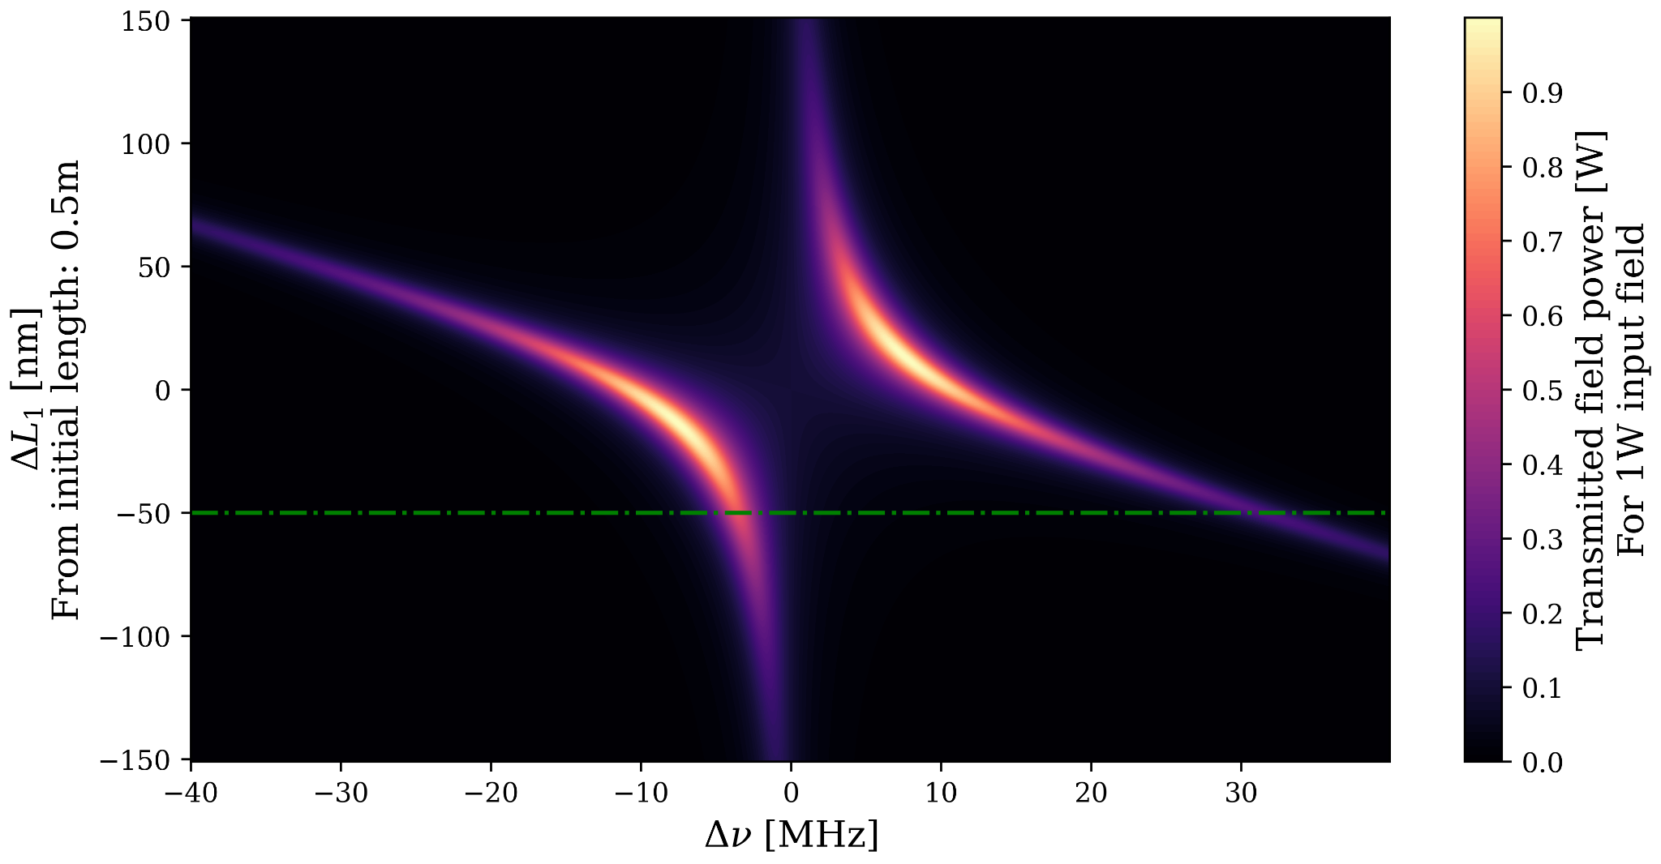
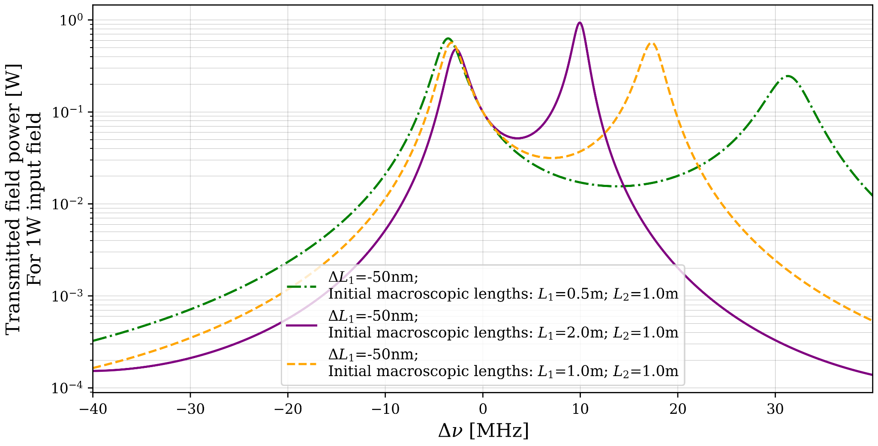
Macroscopic mirrors spacing
Asymmetrical variation of maxima spacing and power ratio
Fixed parameters: L₂ = 1m, R₁ = R₂= R₃ = 0.9
Three-mirror cavities optics
Backup slides - 3/3
2024/05/16
Paul Stevens

