Slide 1





New paths for the study of heavy nuclei
Jonathan Bequet

Slide 2
New paths for the study of heavy nuclei
Introduction to Multi-Nucleon Transfer (MNT) and motivations
The ¹³⁶Xe+²³⁸U MNT experiment @ANL
Conclusion and outlooks

Slide 3
Introduction to MNT and motivations
1

Slide 4
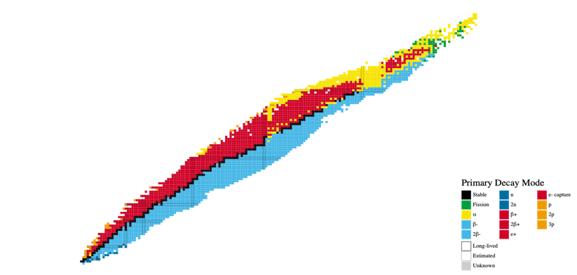
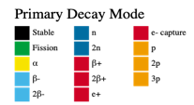
Physics motivation for the study of MNT: The island of stability
Z
N

Slide 5
Physics motivation for the study of MNT: The island of stability
Magic number: the nucleus has an enhanced stability compared to its close neighbours
Z
82
50
28
20
8
2
2
8
28
50
20
82
126
N

Slide 6
Physics motivation for the study of MNT: The island of stability
Magic number: the nucleus has an enhanced stability compared to its close neighbours
Z
Island of stability: Next magic numbers according to theoretical predictions
114, 120 or 126?
82
50
28
20
8
2
2
8
28
50
20
82
126
184?
N

Slide 7
Tow ards heavier nuclei : fusion-evaporation
Z
82
126
N

Slide 8
Tow ards heavier nuclei : fusion-evaporation
Z
Fusion-Evaporation
82
126
N

Slide 9
Tow ards heavier nuclei : fusion-evaporation
Beam
Target

Slide 10
Tow ards heavier nuclei : fusion-evaporation
Beam
Target
Nuclear molecule

Slide 11
Tow ards heavier nuclei : fusion-evaporation
Beam
Target
Nuclear molecule
Compound nucleus

Slide 12
Tow ards heavier nuclei : fusion-evaporation
Beam
Target
Nuclear molecule
Ɣ
n
Ɣ
n
Fusion-évaporation
Compound nucleus

Slide 13
Tow ards heavier nuclei : fusion-evaporation
Beam
Target
Nuclear molecule
Ɣ
n
Ɣ
n
Fusion-évaporation
Compound nucleus
Fusion-fission

Slide 14
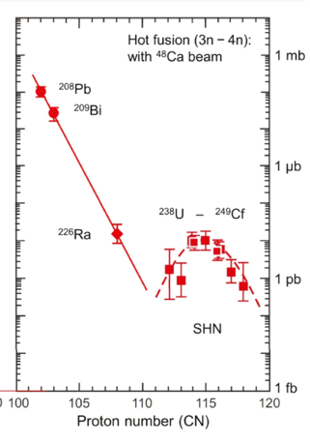
Tow ards heavier nuclei : fusion-evaporation
Beam
The Beam/Target combinations are limited due to experimental constraints
Low cross-sections for the heaviest produced nuclei
Problem: Produced nuclei are only neutron deficient
Target
Nuclear molecule
Ɣ
n
Cross-section (pb)
Ɣ
n
Fusion-évaporation
Compound nucleus
Fusion-fission

Slide 15
MNT: a complementary mechanism
Z
Fusion-Evaporation
MNT
82
126
N

Slide 16
MNT: a complementary mechanism
Beam
Target

Slide 17
MNT: a complementary mechanism
Beam
Target
Nuclear molecule

Slide 18
MNT: a complementary mechanism
Beam
Target
Nuclear molecule
Compound nucleus

Slide 19
MNT: a complementary mechanism
Beam
Target
Nuclear molecule
MNT
Compound nucleus

Slide 20
MNT: a complementary mechanism
Beam
Complementary to fusion-evaporation regarding the produced nuclei
Neutron rich nuclei are accessible
Target
Nuclear molecule
MNT
Compound nucleus

Slide 21
The ¹³⁶Xe+²³⁸U MNT experiment @ANL
2

Slide 22
MNT using ²³⁸U
Z
U-like
82
126
N

Slide 23
The experimental setup: ¹³⁶Xe+²³⁸U
- Beam: ¹³⁶Xe at 700 and 800 MeV
¹³⁶Xe beam produced by ATLAS

Slide 24
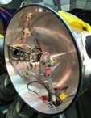

The experimental setup: ¹³⁶Xe+²³⁸U
Beam: ¹³⁶Xe at 700 and 800 MeV
Target: ²³⁸U (U 350 µg/cm² + C 45 µg/cm²)
¹³⁶Xe beam produced by ATLAS
²³⁸U
Target
Target chamber
Target wheel

Slide 25
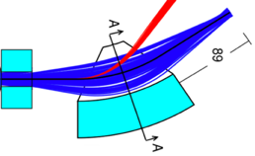
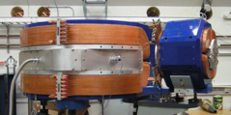
The experimental setup: ¹³⁶Xe+²³⁸U
Beam: ¹³⁶Xe at 700 and 800 MeV
Target: ²³⁸U (U 350 µg/cm² + C 45 µg/cm²)
Scaterred
beam
¹³⁶Xe beam produced by ATLAS
MNT products
²³⁸U
Target
Focal plane
Q_{v}
D_{m}
Target chamber
Q_{v}
D_{m}
Target wheel
Gas-filled separator AGFA

Slide 26
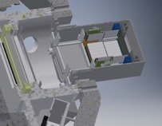
The experimental setup: ¹³⁶Xe+²³⁸U
Beam: ¹³⁶Xe at 700 and 800 MeV
Target: ²³⁸U (U 350 µg/cm² + C 45 µg/cm²)
Quasi-target indentification
(coïncidences)
Scaterred
beam
¹³⁶Xe beam produced by ATLAS
MNT products
²³⁸U
Target
Focal plane
Q_{v}
DSSD
D_{m}
Target chamber
PPAC
Q_{v}
D_{m}
Target wheel
Focal plane
Gas-filled separator AGFA

Slide 27

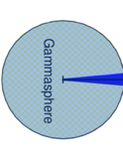
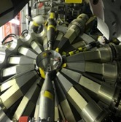

The experimental setup: ¹³⁶Xe+²³⁸U
Beam: ¹³⁶Xe at 700 and 800 MeV
Target: ²³⁸U (U 350 µg/cm² + C 45 µg/cm²)
Quasi-target indentification
(coïncidences)
Scaterred
beam
¹³⁶Xe beam produced by ATLAS
$γ$, X-rays
MNT products
²³⁸U
Target
Focal plane
Q_{v}
DSSD
D_{m}
Target chamber
PPAC
Q_{v}
D_{m}
Target wheel
Focal plane
Prompt spectroscopy
Gas-filled separator AGFA

Slide 28
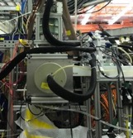

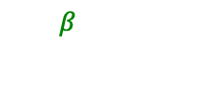
The experimental setup: ¹³⁶Xe+²³⁸U
CloverD
Decay spectroscopy
Beam: ¹³⁶Xe at 700 and 800 MeV
Target: ²³⁸U (U 350 µg/cm² + C 45 µg/cm²)
Quasi-target indentification
(coïncidences)
$$γ$$
CloverA
Scaterred
beam
CloverE
XArray
$β$
¹³⁶Xe beam produced by ATLAS
$γ$, X-rays
MNT products
CloverC
Xarray
²³⁸U
Target
Focal plane
Q_{v}
DSSD
D_{m}
Target chamber
PPAC
Si Tunnels
Q_{v}
D_{m}
Target wheel
Focal plane
Prompt spectroscopy
Gas-filled separator AGFA

Slide 29
Observables for the analysis
6 chosen Observables for this study:
Implantation energy in the DSSD
E_{dssd}
MNT product
DSSD

Slide 30
Observables for the analysis
6 chosen Observables for this study:
Implantation energy in the DSSD
Energy loss in the PPAC
E_{dssd}
MNT product
ΔE
PPAC
DSSD

Slide 31
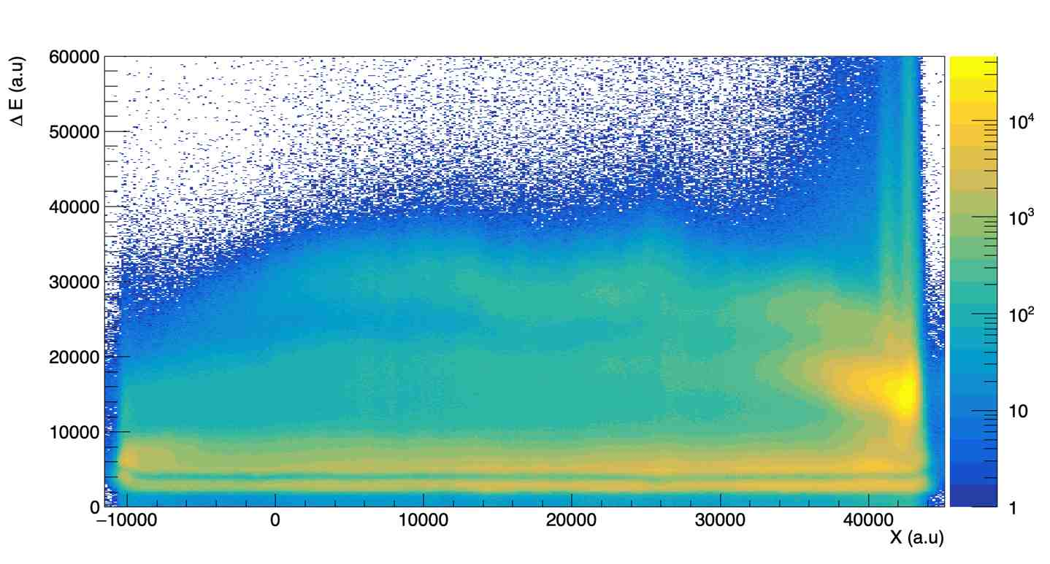
Observables for the analysis
6 chosen Observables for this study:
Implantation energy in the DSSD
Energy loss in the PPAC
Position of nuclei in the PPAC
E_{dssd}
MNT product
X
ΔE
PPAC
DSSD

Slide 32
Observables for the analysis
6 chosen observables for this study:
Implantation energy in the DSSD
Energy loss in the PPAC
Position of nuclei in the PPAC
Time of flight (ToF) between nuclei entering the PPAC and the Ɣ they emitted in Gammasphere
Ɣ energies in Gammasphere
HPGe (Gammasphere)
E_{Ɣ}
E_{dssd}
Ɣ
MNT product
X
ΔE
Time of Flight
PPAC
DSSD

Slide 33
Recoil correlated spectrum
8⁺ → 6⁺
The most intense peaks come from Coulex
→ Background to be supressed
→ Ɣ-Ɣ correlations
10⁺ → 8⁺
Rotational band of ²³⁸U
6⁺ → 4⁺
12⁺ → 10⁺
14⁺ → 12⁺
16⁺ → 14⁺
4⁺ → 2⁺
18⁺ → 16⁺
20⁺ → 18⁺
22⁺ → 20⁺
24⁺ → 22⁺

Slide 34
Ɣ-Ɣ Correlations
(12⁺)
1100.5
307.6
(10⁺)
792.9
²⁴⁰U*
264.1
(8⁺)
528.69
215.5
(6⁺)
313.19
162.6
(4⁺)
150.60
105.6
(2⁺)
45
0⁺
45
0

Slide 35
Ɣ-Ɣ Correlations
(12⁺)
1100.5
307.6
(10⁺)
792.9
Ɣ
²⁴⁰U*
264.1
(8⁺)
528.69
215.5
(6⁺)
313.19
162.6
(4⁺)
150.60
105.6
(2⁺)
45
0⁺
45
0

Slide 36
Ɣ-Ɣ Correlations
(12⁺)
1100.5
307.6
(10⁺)
792.9
Ɣ
Ɣ
²⁴⁰U*
264.1
(8⁺)
528.69
215.5
(6⁺)
313.19
162.6
(4⁺)
150.60
105.6
(2⁺)
45
0⁺
45
0

Slide 37
Ɣ-Ɣ Correlations
(12⁺)
1100.5
307.6
(10⁺)
792.9
Ɣ
Ɣ
²⁴⁰U*
264.1
(8⁺)
528.69
215.5
Ɣ
(6⁺)
313.19
162.6
(4⁺)
150.60
105.6
(2⁺)
45
0⁺
45
0

Slide 38
Ɣ-Ɣ Correlations
(12⁺)
1100.5
307.6
(10⁺)
792.9
Ɣ
Ɣ
²⁴⁰U*
264.1
(8⁺)
528.69
Ɣ
215.5
Ɣ
(6⁺)
313.19
162.6
(4⁺)
150.60
105.6
(2⁺)
45
0⁺
45
0

Slide 39
Ɣ-Ɣ Correlations
(12⁺)
1100.5
307.6
Ɣ
(10⁺)
792.9
Ɣ
Ɣ
²⁴⁰U*
264.1
(8⁺)
528.69
Ɣ
215.5
Ɣ
(6⁺)
313.19
162.6
(4⁺)
150.60
105.6
(2⁺)
45
0⁺
45
0

Slide 40
Ɣ-Ɣ Correlations
(12⁺)
1100.5
307.6
All these Ɣ are emitted at a sub-nanosecond scale
→ They are detected ∼ at the same time
→ Correlate them and look at the pairs (E₁ , E₂) we created
Ɣ
(10⁺)
792.9
Ɣ
Ɣ
²⁴⁰U
264.1
(8⁺)
528.69
Ɣ
Ɣ
215.5
Ɣ
(6⁺)
313.19
162.6
(4⁺)
150.60
105.6
(2⁺)
45
0⁺
45
0

Slide 41
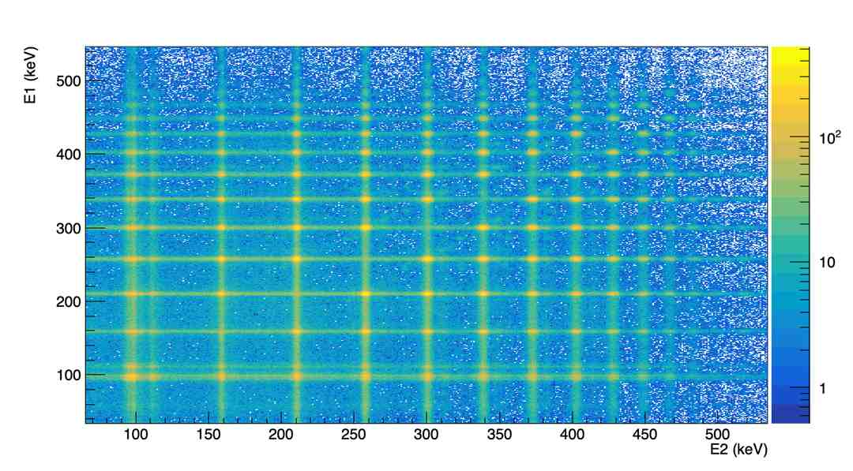
Ɣ-Ɣ Matrix
Select MNT by gating on E1 to look at E2

Slide 42
²⁴⁰U identification
²⁴⁰U: 16⁺->14⁺
²⁴⁰U: 20⁺->18⁺
PRELIMINARY
²⁴⁰U: 18⁺->16⁺

Slide 43
²⁴⁰U identification
²⁴⁰U: 12⁺->10⁺
²⁴⁰U: 16⁺->14⁺
PRELIMINARY
²⁴⁰U: 14⁺->12⁺

Slide 44
²⁴⁰U identification
²⁴⁰U: 10⁺->8⁺
²⁴⁰U: 14⁺->12⁺
PRELIMINARY
²⁴⁰U: 12⁺->10⁺

Slide 45
Conclusion and outlooks
3

Slide 46
Conclusion and outlooks
MNT reactions imply transfer of nucleons between reaction partners.
It could be a complementary mechanism to fusion-evaporation to produce new neutron-rich heavy and superheavy nuclei.
An experiment was performed last October to study MNT products from the ¹³⁶Xe+²³⁸U reaction.
First preliminary result: hints for the production of ²⁴⁰U with this reaction.
This reaction was a first step towards the production of heavier neutron-rich isotopes using different beam/target combinations.

Slide 47
Thank you for your attention
CEA SACLAY
91191 Gif-sur-Yvette Cedex
France
jonathan.bequet@cea.fr

Slide 48
Backup
4

Slide 49
Selecting relevant events
E_{dssd} > 110 MeV
-128 < ToF < -116

Slide 50
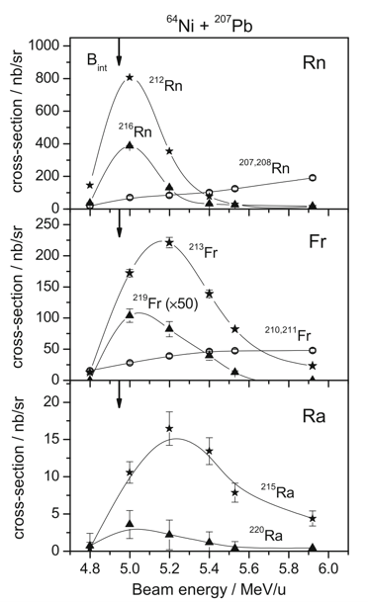
Best energy for MNT reactions
Coulomb barrier
MNT experiments using SHIP@GSI
Many beam energies tested near the Coulomb barrier
Seems to confirm the cross-section enhancement near 1.1 Vc
Necessity to be very carrefull when choosing the beam energy
V. F. Comas, S. Heinz; EPJA i2013-13112-x (2013)

Slide 51
Coulombian barrier of the ¹³⁶Xe+²³⁸U reaction
Coulombian Barrier computed with different formulas
Should use the Bass one according to literature
With E_{beam} = 750 MeV (or more) we should find better cross-sections

Slide 52
Cross-sections for ¹³⁶Xe+²³⁸U at forward angles
Cross sections distribution at forward angles for Quasi-Target products using ¹³⁶Xe+²³⁸U with E_{beam} ≈ 800 MeV
Calculations are done using the Langevin’s model first developped by Zagrebaev and Greiner
Theoretical predictions (Karpov, private communication)

Slide 53
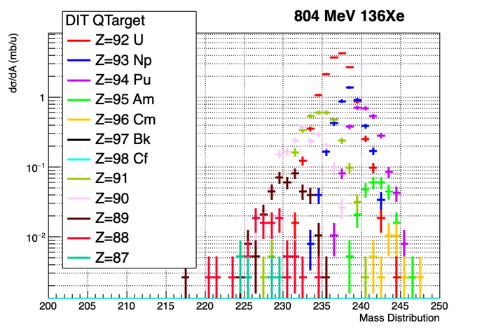
Cross-sections for ¹³⁶Xe+²³⁸U at forward angles
Cross sections distribution at forward angles for Quasi-Target products using ¹³⁶Xe+²³⁸U with E_{beam} = 804 MeV
Calculations are done using the semi-classical simulation code DIT (special thanks to Iulian Stefan from IJCLab)
DIT code (my work)

Slide 54
Cross-sections for ¹³⁶Xe+²³⁸U at forward angles
Theoretical predictions (Karpov, private communication)
DIT code (my work)
Our semi-classical code is consistent with theoretical predictions: same trend for the cross-section distribution with 1 order of magnitude of difference overall

Slide 55
Reaction kinematic
We can predict the (large) Energy range for both reaction partners
At a given angle the minimum corresponds to TKE = B_{c} for the di-nuclear system
The maximum come from an elastic reaction

Slide 56
Magnetic rigidity for reaction products and unreacted beam
¹³⁶Xe
²³⁸U
Compilation of most of the models available for B⍴ in Gas-filled separators
At our energies, B⍴ can be very different depending on the model used
Most of the experimental data used to fit such models have far lower kinetic energies than for this experiment

Slide 57
Magnetic rigidity for reaction products and unreacted beam
¹³⁶Xe
²³⁸U
Here are only selected the models that could be compatible with this experiment

Slide 58
Yields at different energies
Comparison of the yields for Uranium isotopes from DIT at 800 and 900 MeV
DIT predicts better yields around 800 MeV which should also be the best one according to Zagrebaev’s theory

Slide 59
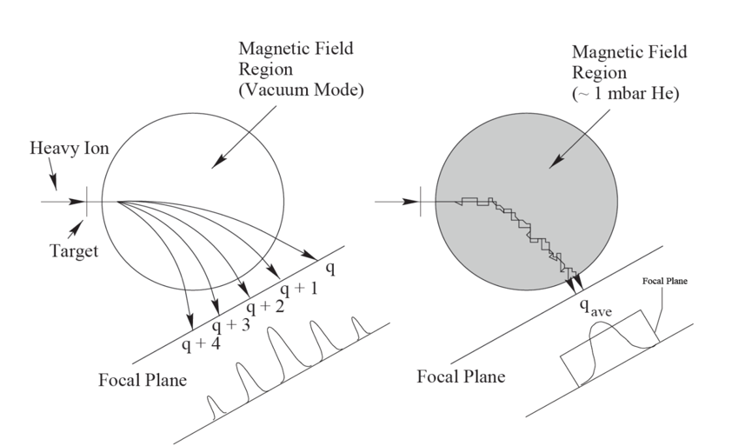
Gas filled separator
Greenlees, P. Identication of Excited States and Evidence for Octupole
Deformation in 226U. PhD thesis (University of Liverpool, 1999).

Slide 60
GRAZING ANGLE AND ANGULAR DISTRIBUTION
beam
For an high enough impact parameter the nuclei won’t be scattered
impact parameter
target
Notes:
Cliquez sur Insertion puis En-tête/Pied pour saisir les champs « Evènement – Date » et « Service » ; puis cliquer sur Appliquer partout.

Slide 61
GRAZING ANGLE AND ANGULAR DISTRIBUTION
The lower the impact parameter is, the higher the scattering angle will be.
beam
θ
impact parameter
target
Notes:
Cliquez sur Insertion puis En-tête/Pied pour saisir les champs « Evènement – Date » et « Service » ; puis cliquer sur Appliquer partout.

Slide 62
GRAZING ANGLE AND ANGULAR DISTRIBUTION
The grazing angle is the value for which the Rutherford scattering cross-section goes down to ¼ of its maximum value
beam
θ_{GRAZING}
Impact parameter
≃ 1 fm
target
Notes:
Cliquez sur Insertion puis En-tête/Pied pour saisir les champs « Evènement – Date » et « Service » ; puis cliquer sur Appliquer partout.

Slide 63
GRAZING ANGLE AND ANGULAR DISTRIBUTION
beam
θ_{GRAZING}
Impact parameter
target
Notes:
Cliquez sur Insertion puis En-tête/Pied pour saisir les champs « Evènement – Date » et « Service » ; puis cliquer sur Appliquer partout.

Slide 64
GRAZING ANGLE AND ANGULAR DISTRIBUTION
beam
Impact parameter
≃ 1 fm
θ
target
Notes:
Cliquez sur Insertion puis En-tête/Pied pour saisir les champs « Evènement – Date » et « Service » ; puis cliquer sur Appliquer partout.

Slide 65

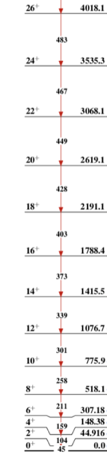

Level schemes
²³⁶U
²³⁸U
²⁴⁰U

Slide 66
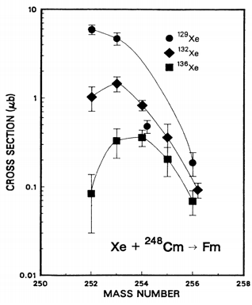
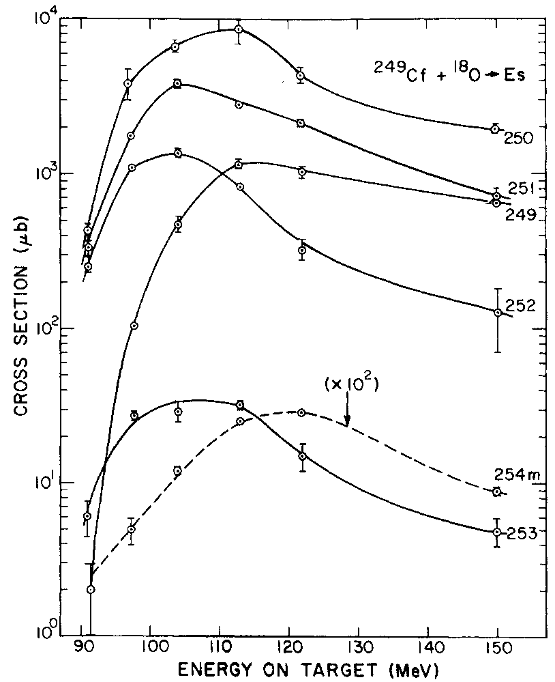
Brief history of MNT: radiochemistry
→Chemical separation methods
→isotope identification via radioactive decay
→timescale of the fastest radiochemical separation techniques long lived isotope ≈ 10 s
→Nuclei produced: Z=101, N=157
B. Welch et al. Phys. Rev. C Vol 35 (1987)
D. Lee et al. PRC 25 (1982) 286 : ¹⁶O, ¹⁸O, ²⁰Ne, ²²Ne + ²⁴⁸Cm
D. Lee et al. PRC 27 (1983) 2656 : ¹⁸O + ²⁴⁸Cm, ²⁴⁹Cf
K.J. Moody et al. PRC 33 (1986) 1315 : ¹⁸O, ⁸⁶Kr, ¹³⁶Xe + ²⁴⁸Cm
M. Schädel et al. Phys. Rev. Lett. 48, 852 (1982): ²³⁸U+ ²⁴⁸Cm
Türler et al. PRC 46 (1992) 1364 :^{40,44,48}Ca + ²⁴⁸Cm
...

Slide 67
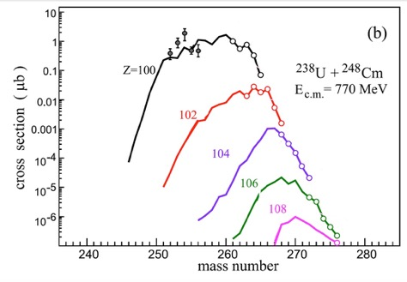
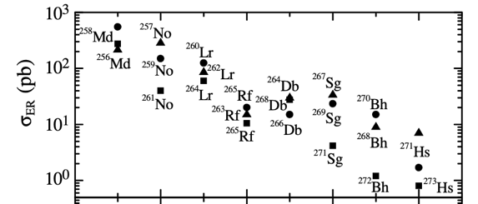
Brief history of MNT: a renewed interest
Zagrebaev and Greiner developed a model using multidimensional langevin equations to describe the dynamics of MNT at low energy
They theorized that if MNT reactions were run near the barrier [∼1.1Vb] shell effects would be preserved and large transfers would occur at forward angles.
Adamian et al. describe such reactions as the evolution of a dinuclear system.
Contrary to Langevin model, lighter beams are favored
Different models predict reasonable cross-sections for the production of superheavy nuclei
V. Zagrebaev,W. Greiner, Nulc. Phys. A 944 (2015)
⁴⁸Ca+^{244,246,248}Cm (E_{c.m.} ≈ 205 MeV)
G. G. Adamian , PHYSICAL REVIEW C 71, 034603 (2005)
102
104
106
108
Z

Slide 68
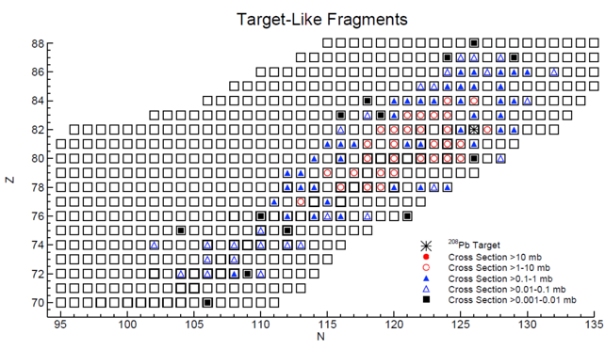
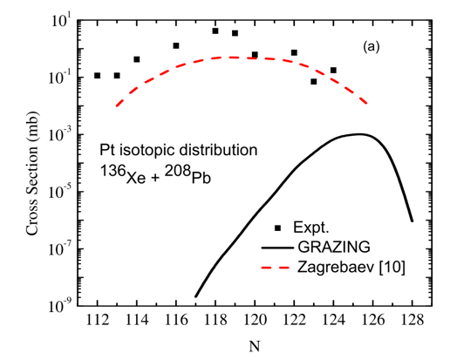
Test of models of MNT reaction: ¹³⁶Xe+²⁰⁸Pb
¹³⁶Xe+²⁰⁸Pb (E_{beam}= 785 meV) @ Gammasphere: the beam was stopped in a thick target;
J.S. Barrett et al. Phys. Rev. C 91, 064615 (2015)
117 target like produced from Yb (Z=70) to Ra (Z=88).
The cross section follow the trend predicted by Zagrebaev for the target like products
V. Zagrebaev, and W. Greiner, Physical Review C 83, 044618 (2011).

Slide 69
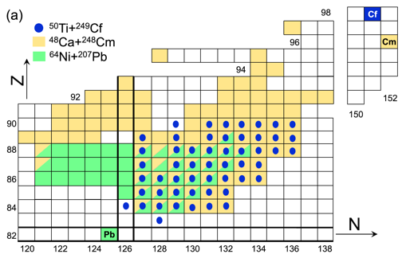
Examples of successful MNT experiments for heavy elements @ 0°
48Ca+248Cm @ (5.3 MeV/n) At SHIP (GSI)
⁵⁰Ti+²⁴⁹Cf @ (6.1 MeV/n) At TASCA (GSI)
S. Heinz, et al. Eur. Phys. J. A (2016) 52: 278
TASCA
Gas-filled separator – short lenght
Mass identification via alpha decay correlations.
SHIP
Mass identification via alpha decay correlation
Max corr. Time 1s; Small angular acceptance 0.3%
→only central collision with small angular momenta
¹A. Di Nitto, et al. PLB 784 (2018)199–205

