Slide 1
PHENIICS Doctoral School
PHENIICS Fest 2024

Slide 2
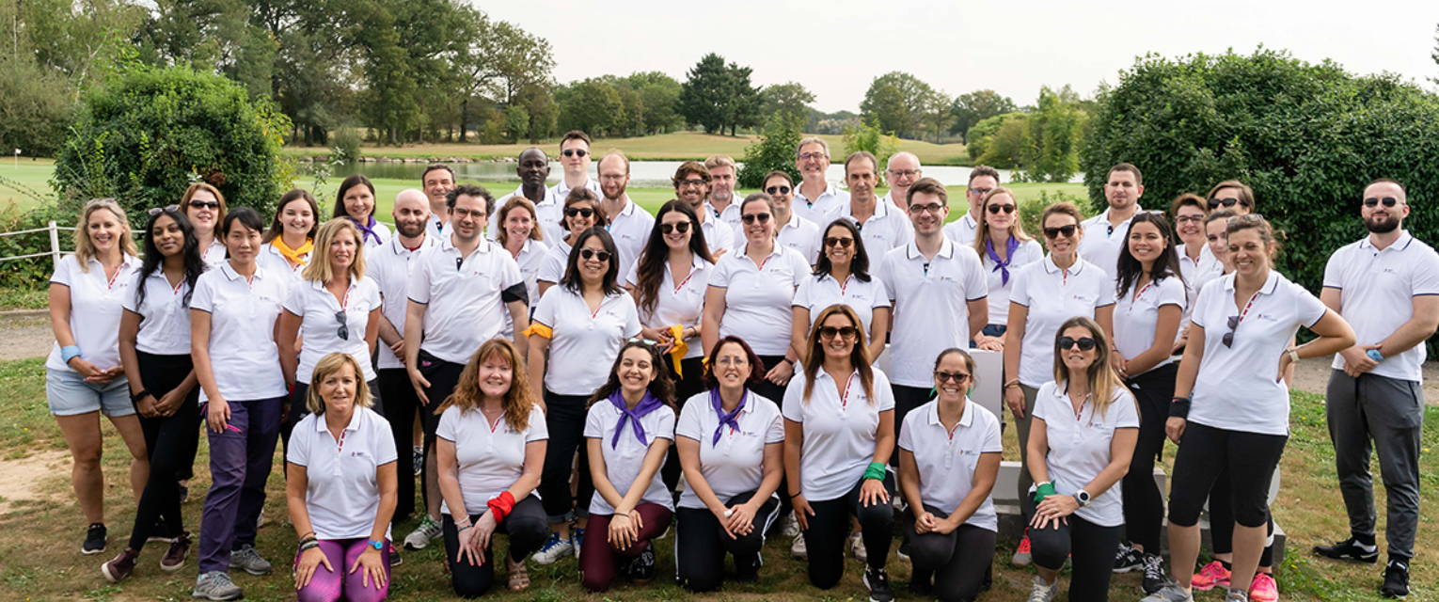
SATT PARIS-SACLAY: in short
#Consultancy Services
#Technologic Transfer
#Start-up
Created in 2014 and stemming from the “Investissements d’Avenir” (“Investing in the Future”) Program, SATT Paris-Saclay is the Technology Transfer Accelerator Office of the Paris-Saclay Cluster.
SATT has an investment capacity of € 79 million over 11 years to fund and support the development of research work carried out in the territory and ensure the transfer of technologies to the market.
Creation | July 2014
Location | Orsay
Headcount | +50 employees
Investment executed | € 46 M
Investment capacity | € 79 M
Quality certification | ISO 9001: 2015
Shareholders

Slide 3
Paris-saclay: a cluster dedicated to innovation
SATT Paris-Saclay, a common actor for technology transfer
PARIS-SACLAY
French national
research organizations

Slide 4
After your PHd: What’s next?
Research
Postdoc
Valorisation
Teaching
Company

Slide 5
Research valorisation: A schematic model
€€€
Academic
world
Universities
Grandes Écoles
Research labs
Socioeconomic world
Companies
Clients
Markets
Knowledge

Slide 6
Research valorisation: A schematic model
Partnerships (collab, presta, CIFRE, …)
Academic
world
Universities
Grandes Écoles
Research labs
Socioeconomic world
Companies
Clients
Markets
Technology transfer
Intellectual property

Slide 7
From idea to market: AN accompaniment continuum on PARIS-SACLAY
INVENT
PROTECT
ANALYSE
POSITION
MATURE
FUND & DEVELOP
START-UP
and more…
Lab research
Prematuration
Maturation
50 – 100 k€
100 - 500 k€
EXISTING COMPANY
Description of technical principles
Formulation of a concept for application
Invention disclosure
Proof of concept
Market analysis
Technical and economic analysis
IP creation
Demonstration of a prototype in operational conditions
Consolidation of prematuration results
Validation the transfer strategy

Slide 8
Key point: protecting your knowledge
Your technology must be protected in order to be transferred

Slide 9
From idea to market: AN accompaniment continuum on PARIS-SACLAY
INVENT
PROTECT
ANALYSE
POSITION
MATURE
FUND & DEVELOP
START-UP
and more…
Lab research
Prematuration
Maturation
50 – 100 k€
100 - 500 k€
INDUSTRIEL EXISTANT
Description of technical principles
Formulation of a concept for application
Invention disclosure
Proof of concept
Market analysis
Technicoal and economical analysis
IP creation
Demonstration of a prototype in operational conditions
Consolidation of prematuration results
Validation the transfer strategy
Disclosures (publications, conferences, …)

Slide 10
Key point: protecting your knowledge
Protection and publication do not exclude each other.
Protection must occur before publishing.
If you need advice, you may contact you valorisation department or the SATT.

Slide 11
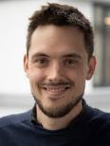
PhD Transfer : A program for young PhDs
2018
Lauréat
2020-2022
Grand prix
100 k€
565 k€
600 k€
Fundraising 2023
4 M€

Slide 12
SATT ProjeCt in progress : mita-opalis
Darine Abi Haidar

Slide 13
Satt Project in progress : mita-opalis
Darine Abi Haidar

Slide 14
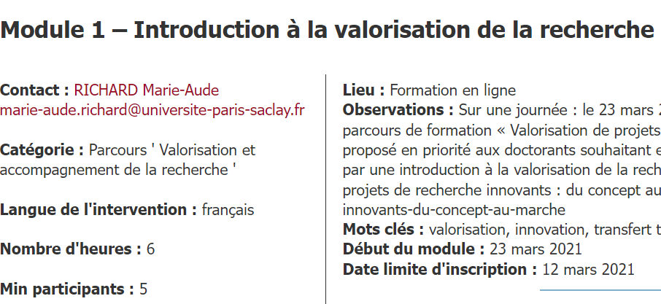
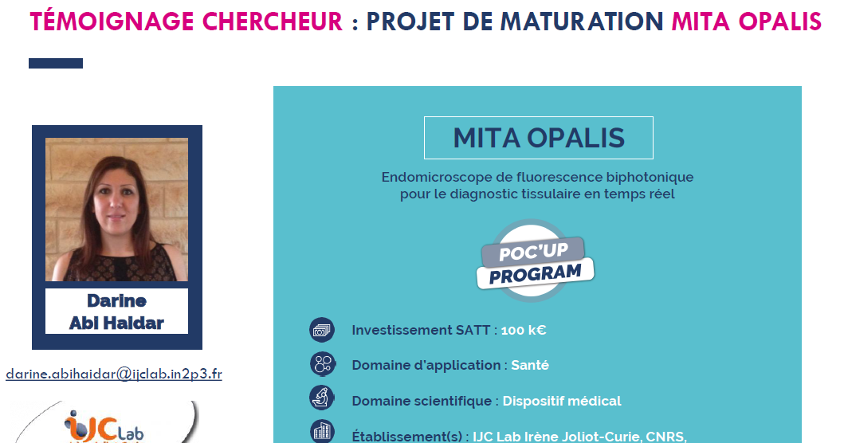
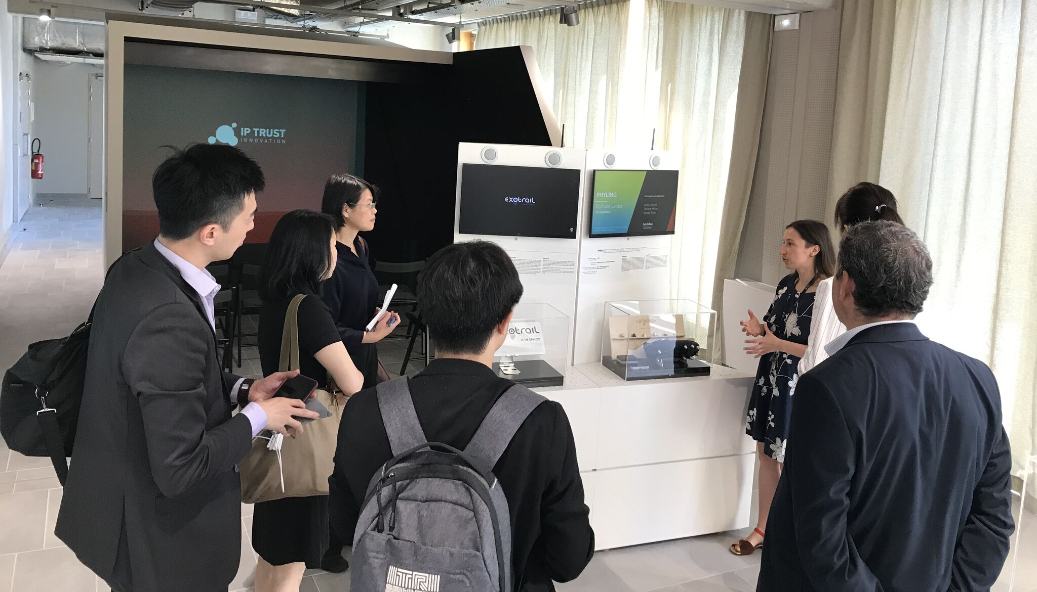
More info about deeptech or valorisation ?
Wish to know more about Valorisation or Deeptech Entrepreneurship ?
Wish to hear more about Deeptech Entrepreneurship ?
Wish to see more about Deeptech Entrepreneurship ?
Watch some of our SATT webinars ! We have, each time, a researcher testimony about her/his experience !
You can have a tour around our technological showroom at « PlayGround Paris-Saclay » !
Search for ADUM courses about it !
Subscribe to our newsletter and follow us on LinkedIn to not miss anything.

Slide 15
Do not hesitate to contact us!
We remain available should you have any questions.
CONTACT
Yacine BENTALEB | Chef de projet Catalyseur | Pôle Ingénierie et Numérique | SATT Paris-Saclay
Denis KUZZAY | Chef de projet Catalyseur | Pôle Ingénierie et Numérique | SATT Paris-Saclay
maturation@satt-paris-saclay.fr
+ d’infos
www.satt-paris-saclay.fr

