Slide 1
Unmixing Spectrum Analysis for Noble Gas Detection Charles-Philippe Mano - CEA/DAM/DIF charlesphilippe.mano@cea.fr
Thesis supervisors : - Frédérick Carrel (CEA/DRT)
- Hugues Paradis (CEA/DAM/DIF) - Luc Patryl (CEA/DAM/DIF)

Slide 2
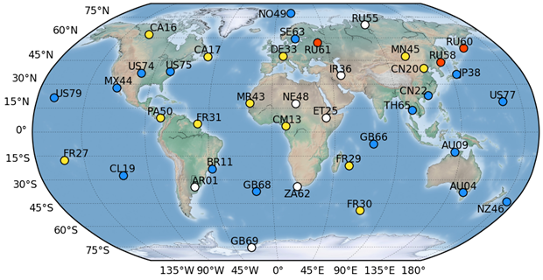
CTBT Context
The Comprehensive Nuclear-Test-Ban Treaty (CTBT) :
International Monitoring System (IMS)
Seismic
Acoustic
Hydroacoustic
Radiological (particulates fission product : 80 stations gazeous fission products : 40 stations)
Stations Map for Radioxenons Measurement
ARIX ; SAUNA ; SPALAX ; Not yet installed stations (white).

Slide 3
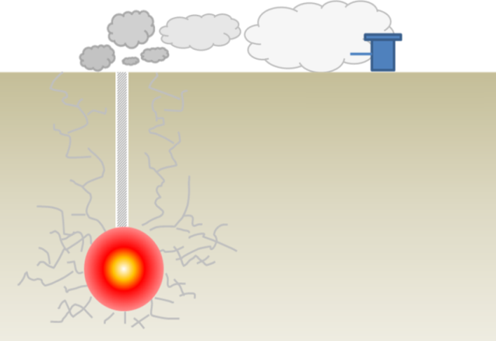
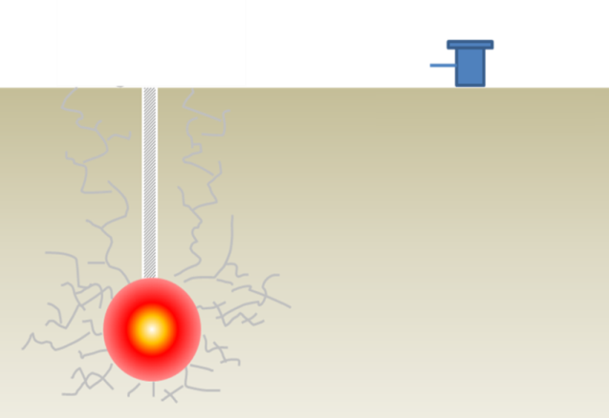
Radionuclide rejections during a nuclear test
Even when the nuclear test is underground, some radioactive fission products can escape.
Atmospheric
Transport
~10⁻² Bq/m³
~10⁻³ Bq/m³
10¹³ Bq, 10¹⁴ Bq
4 fission products of interest : ^{131m}Xe , ^{133m}Xe, ¹³³Xe, ¹³⁵Xe.
¹³³Xe , ¹³⁵Xe
Rejection
Detection
Migration
Hundreds of m
Thousands of km
dilution in the atmosphere
very low activity to measure
Cavity
(1 kt)
∼12000 m³/kt water steam
∼3000 m³/kt gaz (H₂, CO₂, CO…Xe)
∼ 50 g/kt fission products (10¹⁹ Bq/kt)
¹³³Xe ∼ 10¹⁶ Bq, ¹³⁵Xe ∼ 10¹⁷ Bq

Slide 4
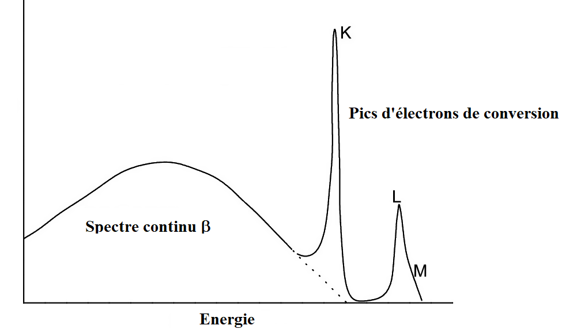
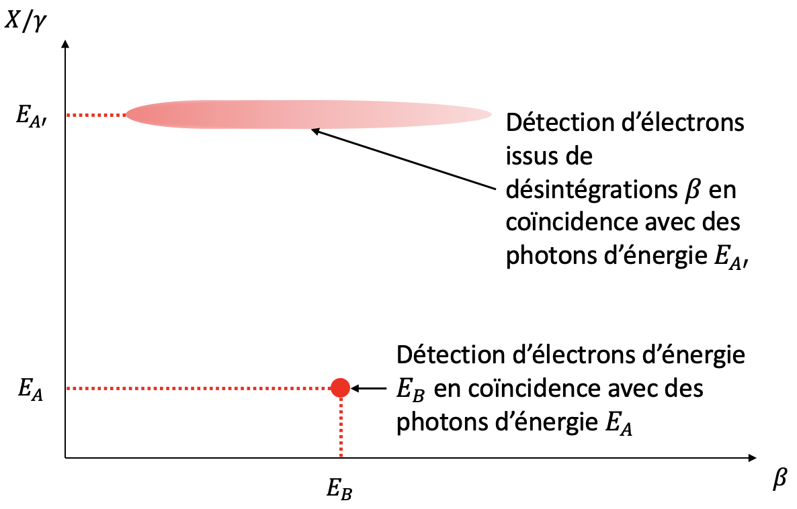
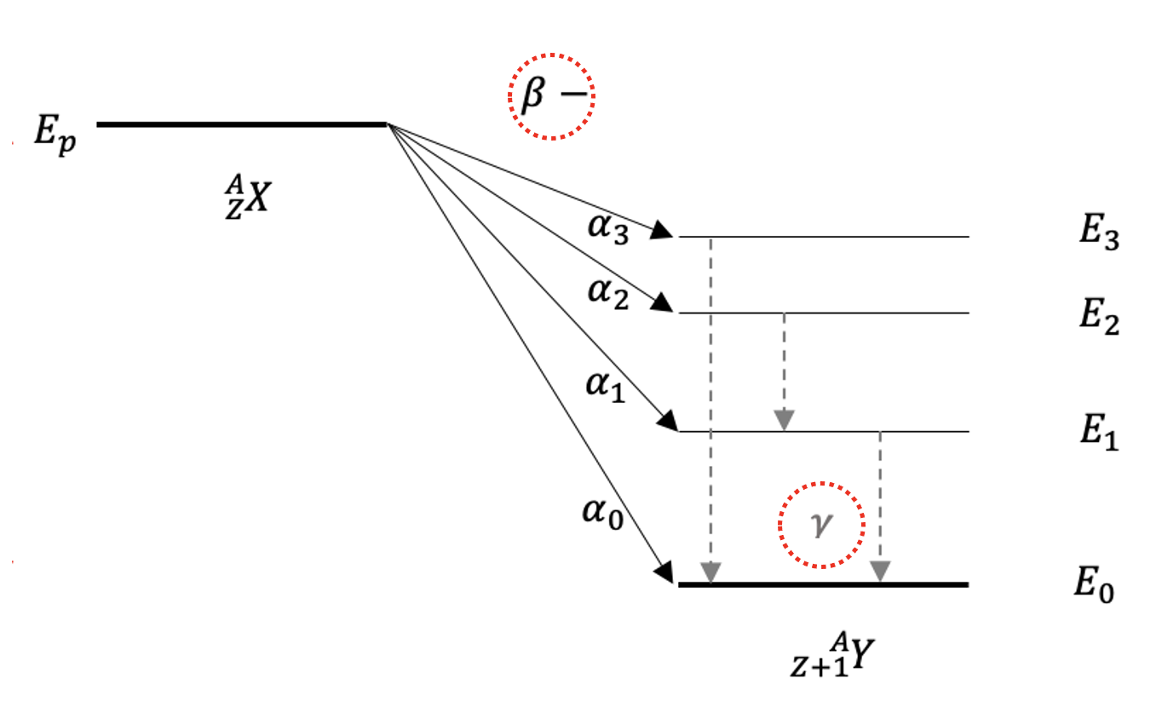
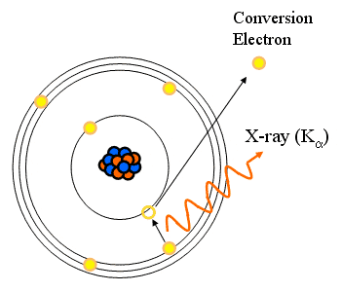
The radioxenon measurements method
β and e⁻ spectrum
Radionuclides of interest : important fission products from a nuclear explosion
Coincidence spectrometry to improve sensitivity
Simultaneous detection of two events
4 physical properties :
Decay : β⁻ and internal transition
Desexcitation γ, electron conversion and X-rays
Drawing of a coincidence 2D matrix
$$γ$$
Detection of a β in coincidence with a photon (E_{A’})
$β$⁻ decay scheme
Detection of conversion an electron (E_{B}) in coincidence with a photon (E_{A})
$$X−K_{α}$$
Improvement of Signal-to-Noise ratio
Specific fingerprints for each radionuclide
Internal conversion drawing

Slide 5
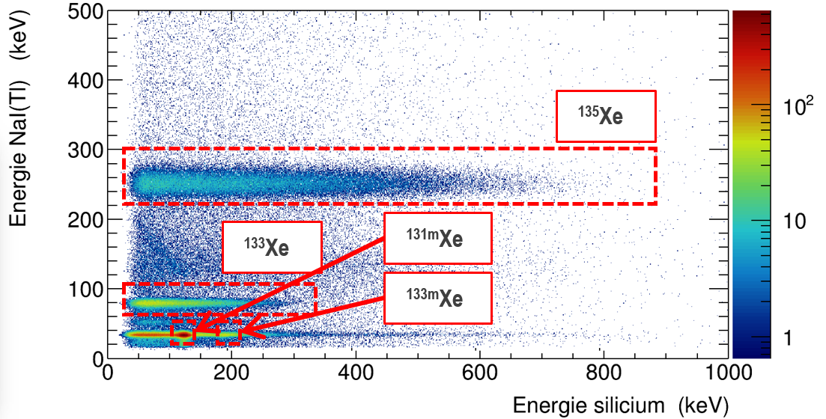
Set-up at the laboratory to test a new method
Development of a laboratory system (based on low resolution technology for photon measurements – NaI)
System description
Photons γ and X : NaI(Tl)
Electrons and β : Silicon
Electronic : Pixie-Net ➔ 4 synchronized channels
Data : 2D matrix
Coincidence matrix with the 4 radioxenons
Picture of the system

Slide 6
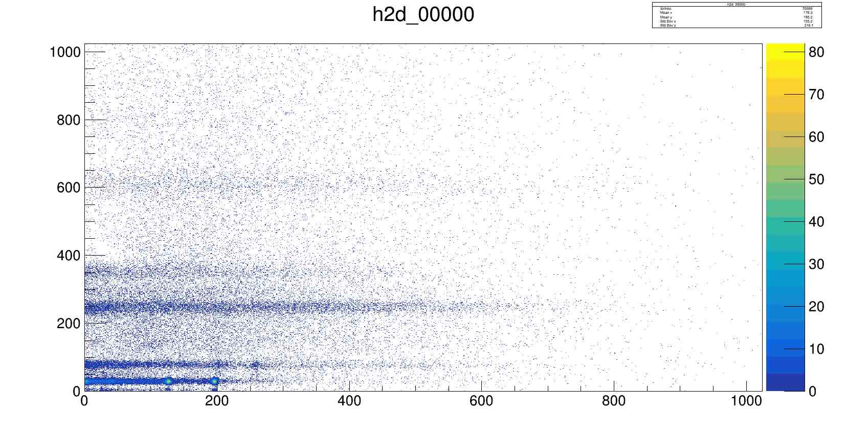
Current analysis for matrix coincidences : Regions of Interest (ROI)
Method for high resolution systems at NDC
One ROI for each radioxenons
4 radioxenons
Radon daughters (²¹⁴Bi + ²¹⁴Pb)
Subtraction of interferences of each radionuclide
Energy $γ [keV$]
²¹⁴Bi
$C_{net} = C_{brut} −B −{R∗C}_{net}$
²¹⁴Pb
¹³⁵Xe
C_{net} : net count in the ROI (matrix 6x1)
C_{brut} : gross count in the ROI (matrix 6x1)
B : background in the ROI (matrix 6x1)
R : interference matrix (matrix 6x6)
¹³³Xe
^{131m}Xe ^{133m}Xe
Energy $β [keV]$

Slide 7
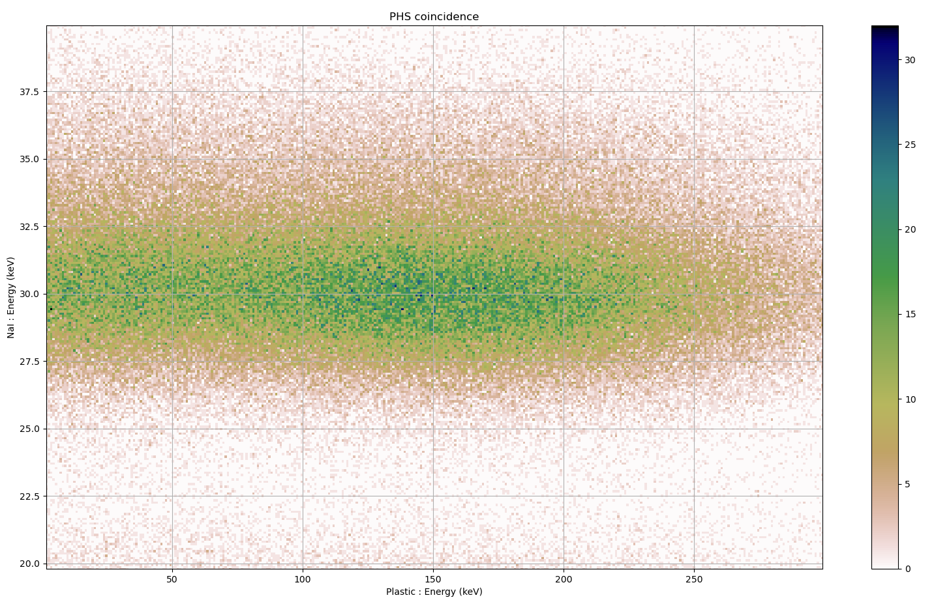
The overlap problem
¹³³Xe
^{131m}Xe
^{133m}Xe
Low activity + overlap ➔ Complex to analyse
➔ Research of a new method
7 / 17

Slide 8
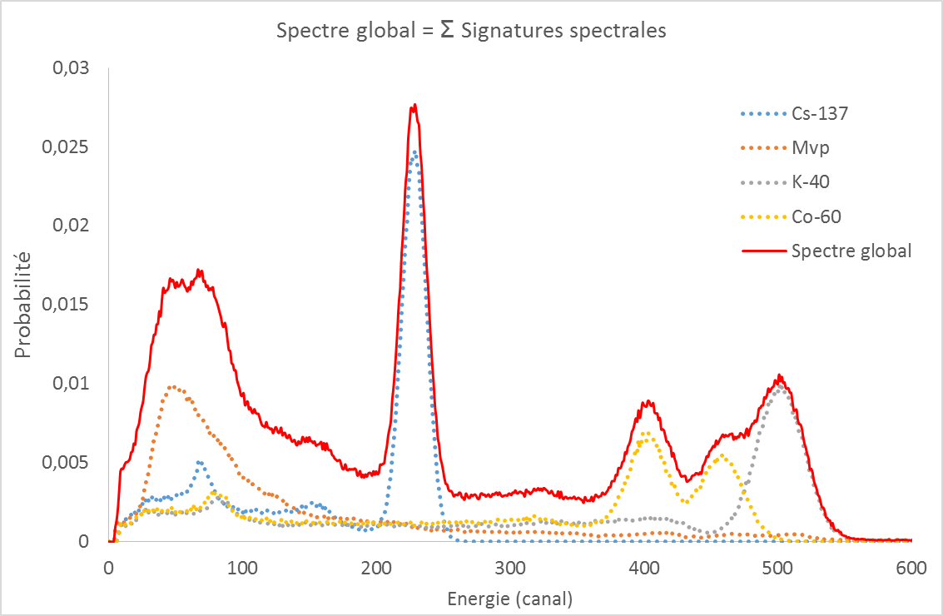
New method « Spectral unmixing » (1/3)
Hypothesis : multi-γ spectrum ⬄ linear combination of individual spectra*
Spectral unmixing : calculation of individual abundances in the spectrum
Data library of reference spectra : reference spectra depend of the detector, the radionuclide and the environment
No ROI analysis, no peak search ➔ global analysis of the spectrum
background used as a reference spectrum and add in the data library.
Global spectrum = Σ individual spectra
¹³⁷Cs
^{Background}
⁴⁰K
⁶⁰Co
^{Global spectrum}
Probability
Energy (chanel)
* Paradis H. et al. Spectral unmixing applied to fast identification of gamma-emitting radionuclides using NaI(Tl) detectors, Applied Radiation and Isotopes, 158 (2020) 109068.

Slide 9
New method « Spectral unmixing » (2/3)
The problem can be seen as an inverse problem : « We need to find the causes from the effects »
Radionuclide signature, i.e. corresponding spectrum of a single radionuclide in the sample
$$s= \sum_{\begin{aligned}all the \\ radionuclides i\end{aligned}}{ai ×\text{Φ}i}$$
Global spectrum
Abundance of a certain radionuclide in the measured sample
Global spectrum = Σ individual spectra
¹³⁷Cs
^{Background}
⁴⁰K
⁶⁰Co
^{Global spectrum}
Indice i | $$\text{Φ}i$$ | $$ai$$
1 | Spectral signature of Mvp | Abundance of Mvp
2 | Spectral signature of ¹³⁷Cs | Abundance of ¹³⁷Cs
3 | Spectral signature of ⁴⁰K | Abundance of ⁴⁰K
4 | Spectral signature of ⁶⁰Co | Abundance of ⁶⁰Co
Probability

Slide 10
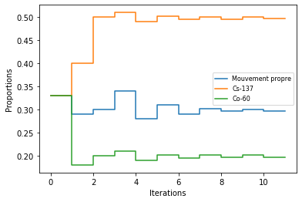
New method « Spectral unmixing » (3/3)
We want to determine abundances of radionuclides behind the observed spectrum s
We want to find the a_{i} with respect to :
$$s= \sum_{\begin{aligned}all the radionuclides \\ i\end{aligned}}{ai × \text{Φ}i}$$
Background
¹³⁷Cs
⁶⁰Co
We need an estimation of the $ai$
Likelihood function :
$$ℒ\text{(}\text{a}\text{)}\text{ =}\sum_{\begin{aligned}all the \\ chanels m\end{aligned}}{ \sum_{\begin{aligned}all the \\ radionuclides i\end{aligned}}{ [ai \text{Φ}im} }−sm log⁡(ai \text{Φ}im)]$$
Example of a spectrum composed of background, ¹³⁷Cs and ⁶⁰Co
We can deduce from the likelihood an estimator than can be computed according to :
$$\hat{a}=argmin 𝓛\text{(}\text{a}\text{)}$$
10 / 17

Slide 11
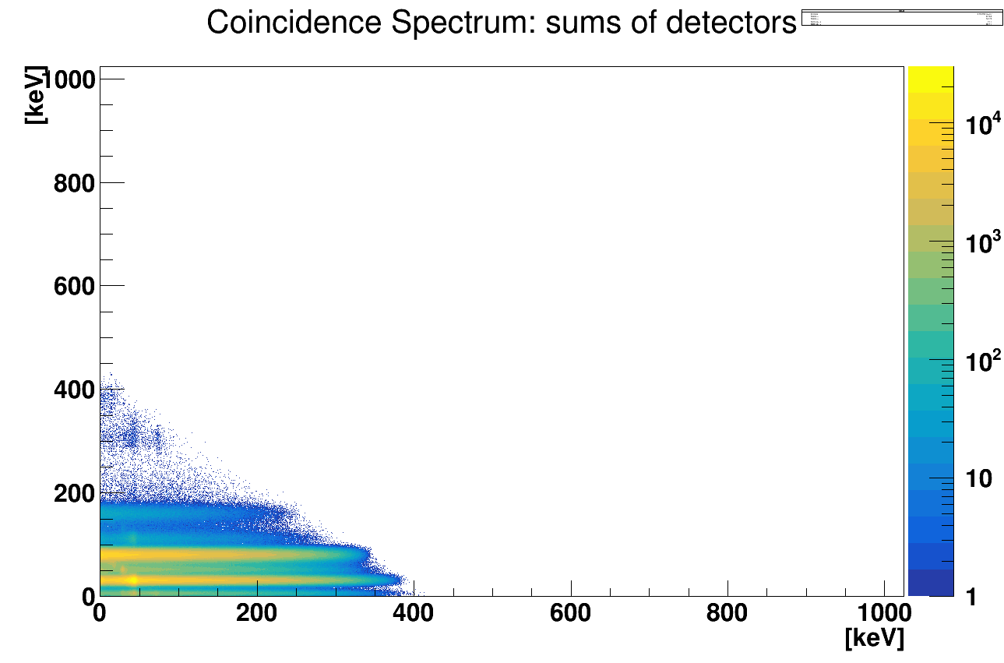
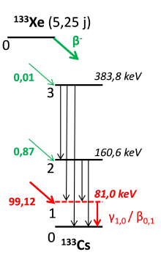
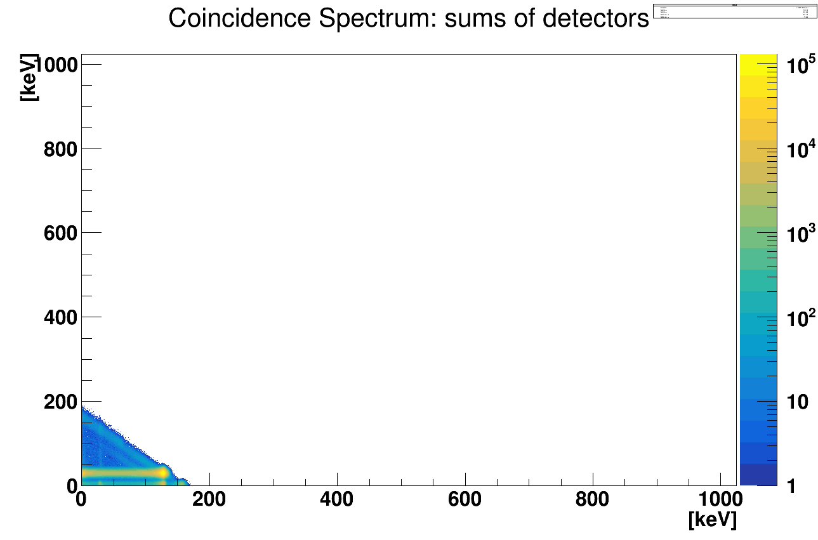
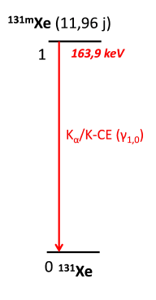
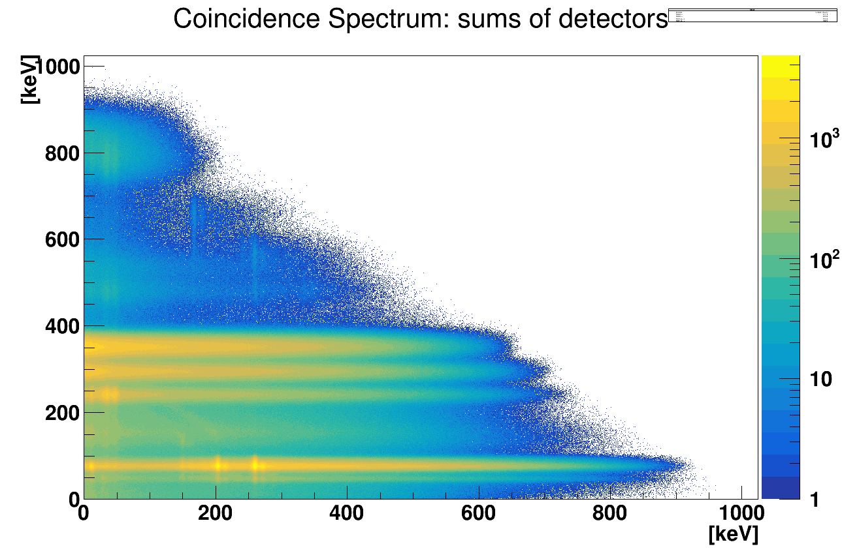
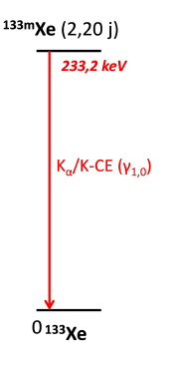
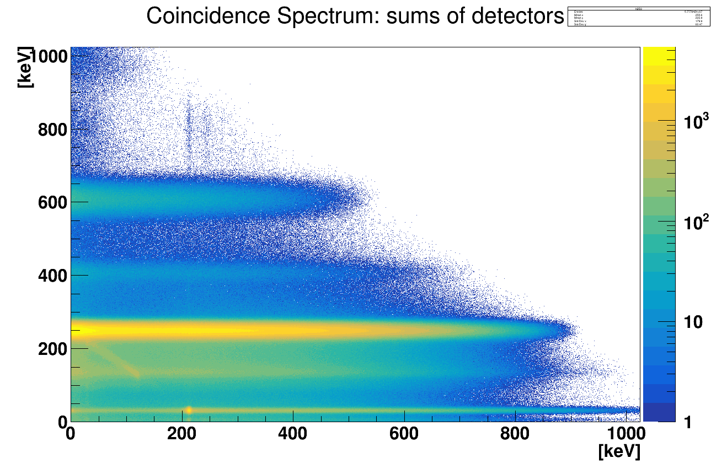
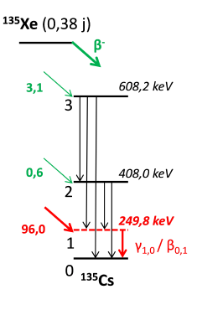
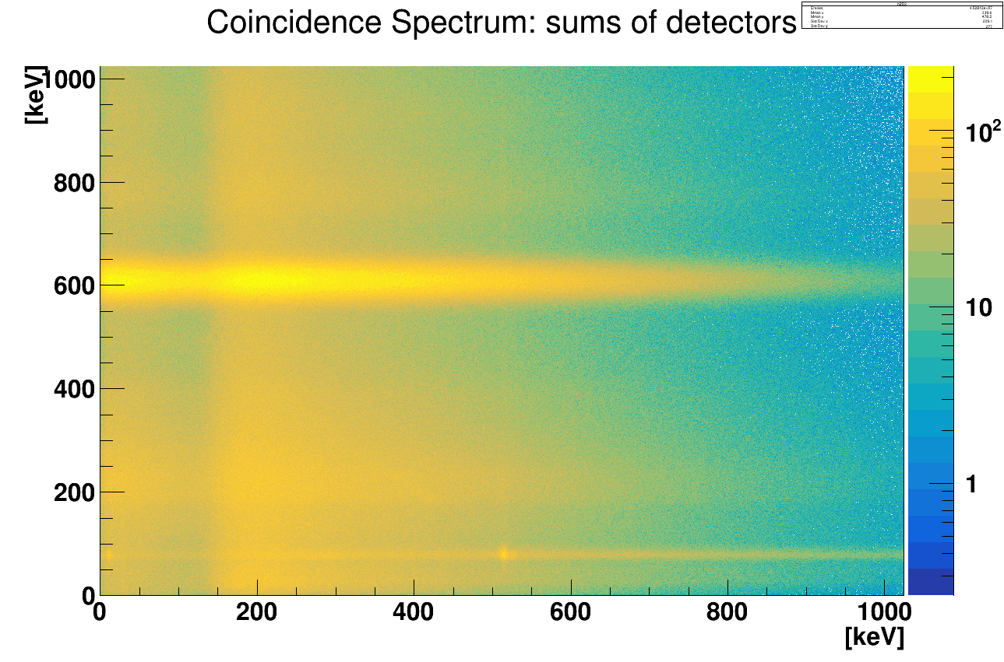
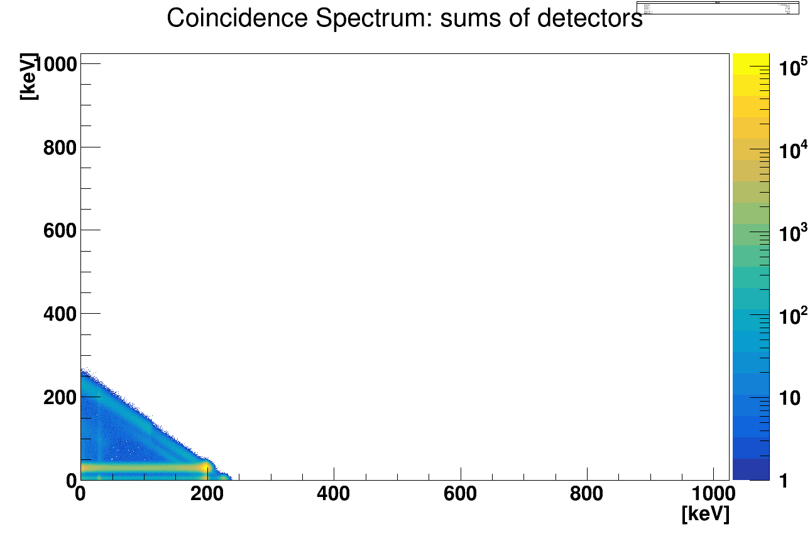
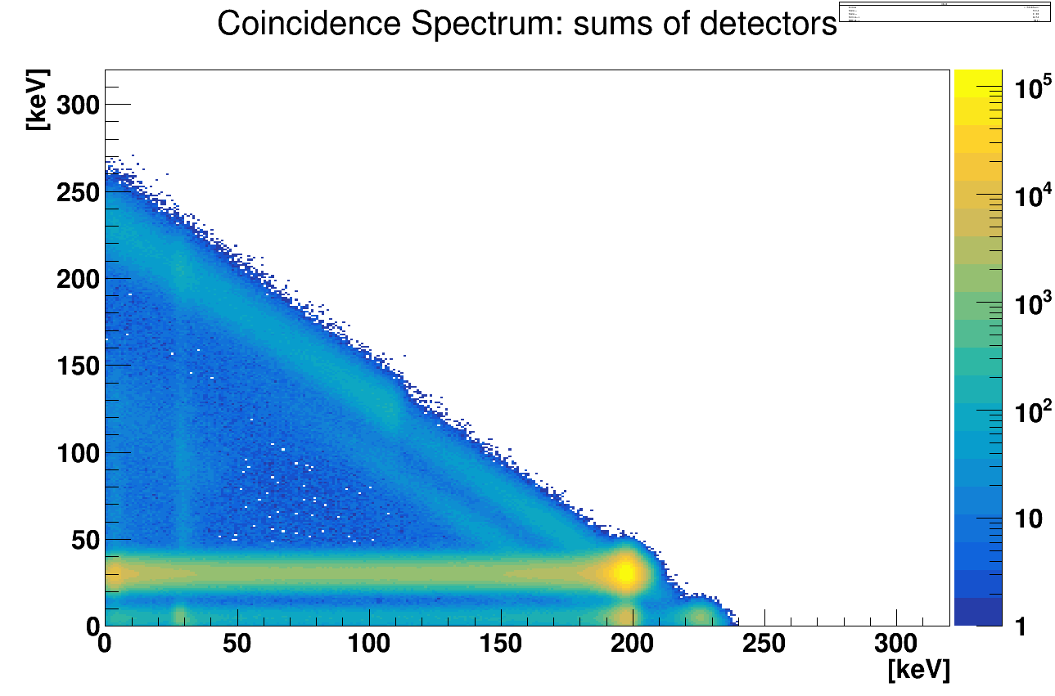
Building the data library to apply the spetral unmixing spectra
Reference spectra for each radionuclide
¹³³Xe
^{131m}Xe
²¹⁴Pb
Energy $γ$
Energy $γ$
Energy $γ$
+
Energy $β$
Energy $β$
Energy $β$
^{133m}Xe
¹³⁵Xe
²¹⁴Bi
Energy $γ$
Energy $γ$
Energy $γ$
Energy $β$
Energy $β$
Energy $β$

Slide 12
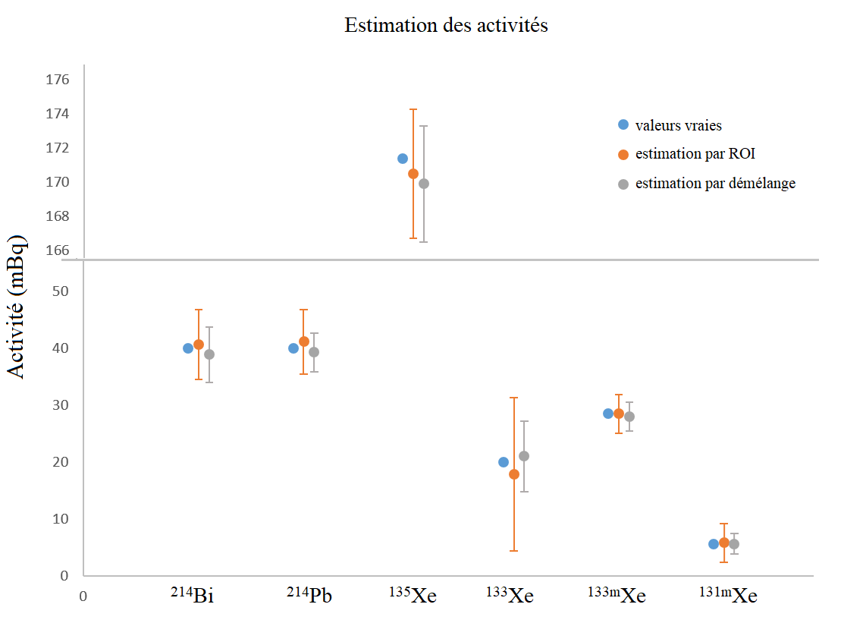
Results (1/4) : accuracy
Simulation of a mix of radionuclides by Monte-Carlo simulations
1000 simulations ➔ uncertainties : standard deviation
Good agreement between activities obtained with the reference method and with unmixing method
Uncertainties improved
Activities estimated
RN | A simulated (mBq) | A_{ROI} (mBq) | A_{unmix} (mBq)
²¹⁴Bi | 40,0 | 40,7 ± 6,2 | 38,9 ± 4,9
²¹⁴Pb | 40,0 | 41,2 ± 5,7 | 39,3 ± 3,4
¹³⁵Xe | 171,6 | 170,5 ± 3,8 | 169,9 ± 3,4
¹³³Xe | 20,0 | 17,9 ± 13,5 | 21,0 ± 6,2
^{133m}Xe | 28,4 | 28,5 ± 3,4 | 28,0 ± 2,5
^{131m}Xe | 5,6 | 5,8 ± 3,4 | 5,6 ± 1,9
True values
ROI activites
Unmixing values
Activity (mBq)
Example of a mix representative of a nuclear test

Slide 13
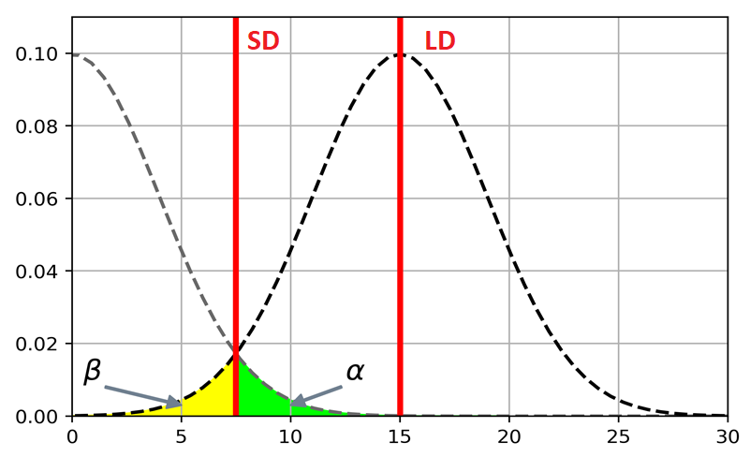
Results (2/4) : sensitivity
CL
DL
Critical level (CL) and detection limit (DL) with risks
α and β equal to 5%
Currie formula for ROI analysis :
$$CL={ k}_{1−α } ∗ \sqrt{2∗b}$$
$$DL={k_{1−α}}^{2}+2∗SD$$
Monte-Carlo simulations for unmixing
Background analysis (300 counts in the matrix ⬄ 8h measurement) :
RN | CL_{ROI} (mBq) | CL_{unmix} (mBq)
¹³⁵Xe | 1,2 | 0,8
¹³³Xe | 10,4 | 0,2
^{133m}Xe | 1,6 | 0,3
^{131m}Xe | 1,6 | 0,4
RN | DL_{ROI} (mBq) | DL_{unmix} (mBq)
¹³⁵Xe | 2,7 | 1,8
¹³³Xe | 23,0 | 1,1
^{133m}Xe | 4,6 | 1,3
^{131m}Xe | 4,6 | 1,4
Improvement of the sensitivity

Slide 14
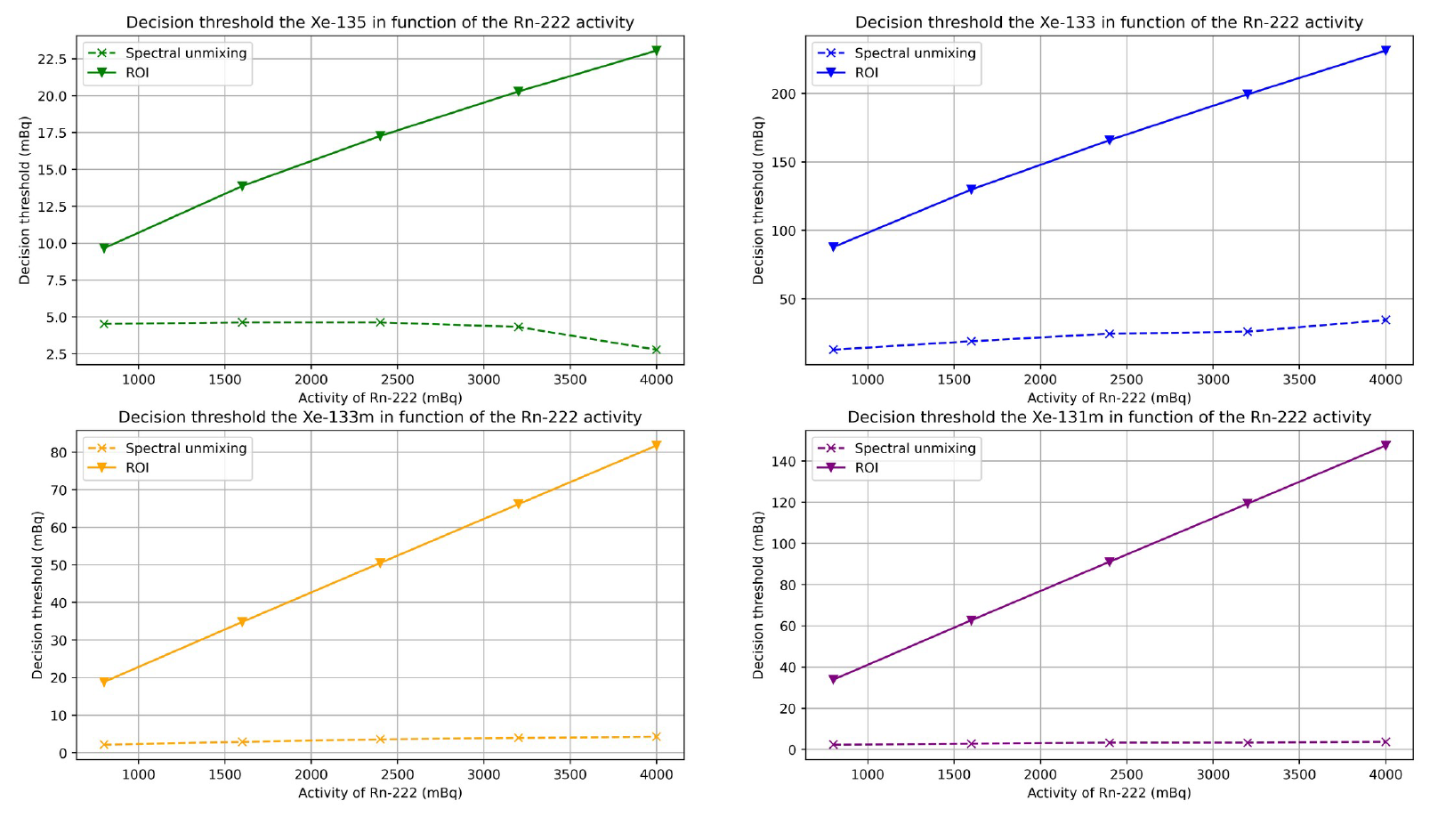
Results (3/4) : radon contamination
CL with α equal to 5%
Variation of proportion of radon daughters
CL ↘⬄ reliability
¹³⁵Xe
¹³³Xe
> 10
> 10
Critical level (counts)
1000 2000 3000 4000
1000 2000 3000 4000
^{133m}Xe
^{131m}Xe
> 10
> 10
1000 2000 3000 4000
1000 2000 3000 4000
Concentration of Rn daughters

Slide 15
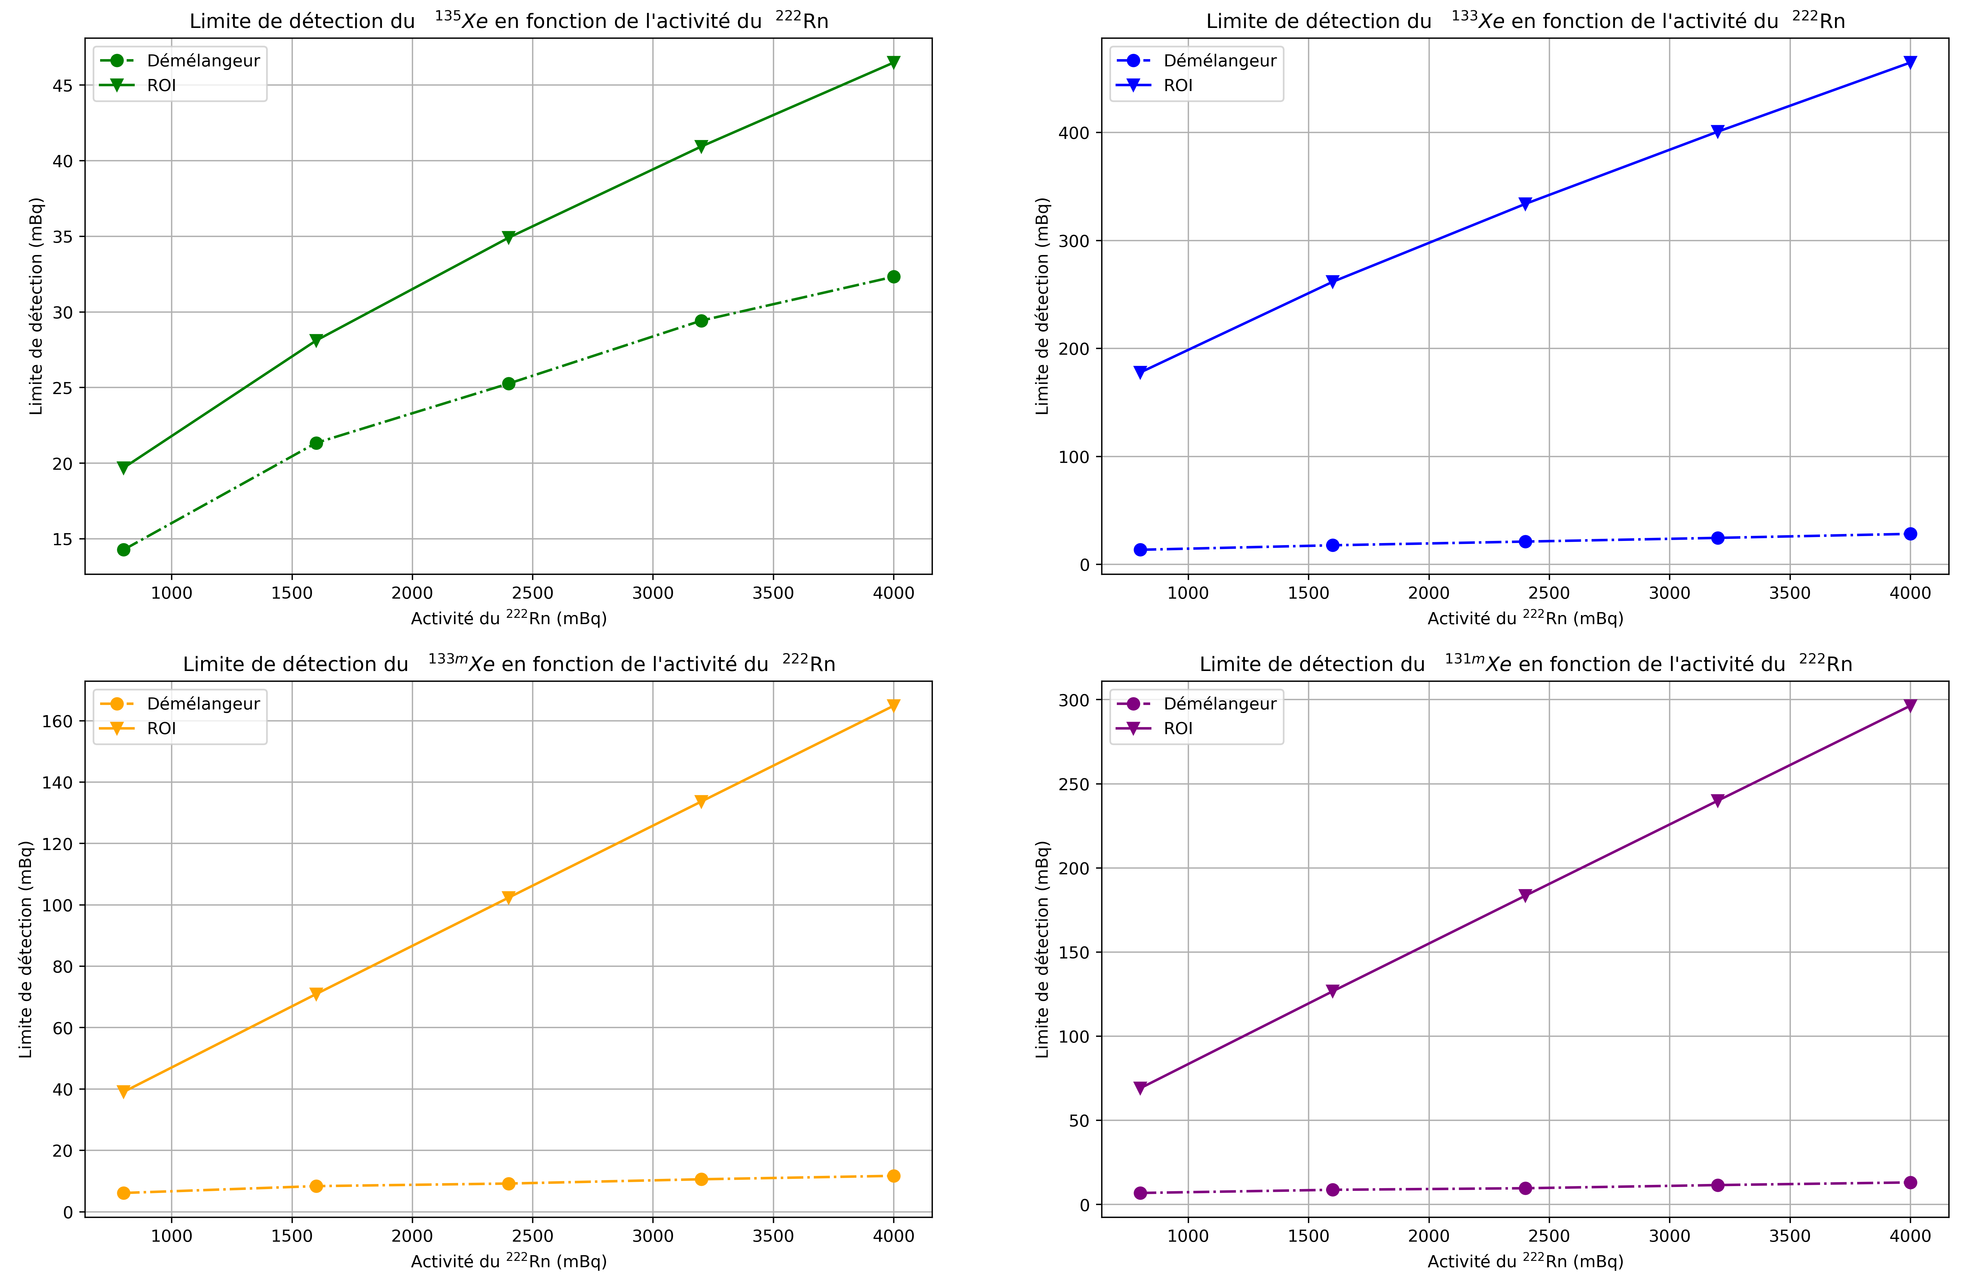
Results (4/4) : radon contamination
DL with β = 5%
Variation of proportion of radon daughters
DL ↘ ⬄ Sensitivity improved
DL less damaged by the presence of Pb/Bi-214 ➔ more robust if Rn is present in the sample.
¹³⁵Xe
¹³³Xe
1000 2000 3000 4000
1000 2000 3000 4000
Detection limits (counts)
^{133m}Xe
^{131m}Xe
1000 2000 3000 4000
1000 2000 3000 4000
Concentration of Rn daughters

Slide 16
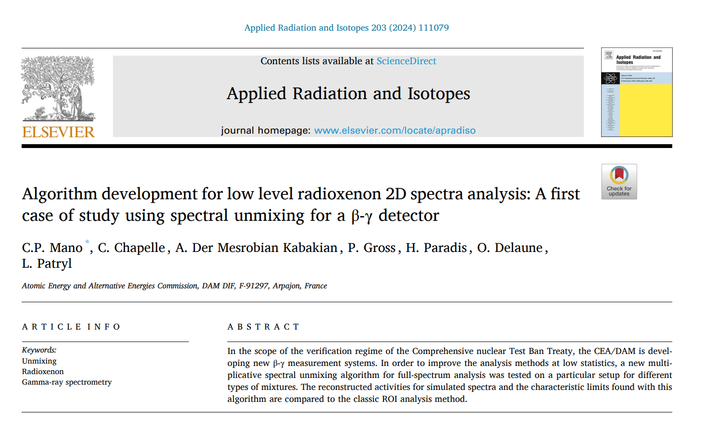
Conclusion
Adaptation of a new global method on two dimension spectra
Use of a maximum of information
Possibility to perform automatic analysis
Improvement of the sensitivity for radioxenon measurements
CL improved of a factor of 10
DL improved
Method more robust with Rn daughter presence
Improve the reliability of RXe detections in case of nuclear test
**
** Mano CP. et al. Algorithm development for low-level radioxenon 2D spectra analysis : a first case of study with spectral unmixing using a β-γ detector, Applied Radiation and Isotopes (2023)

Slide 17
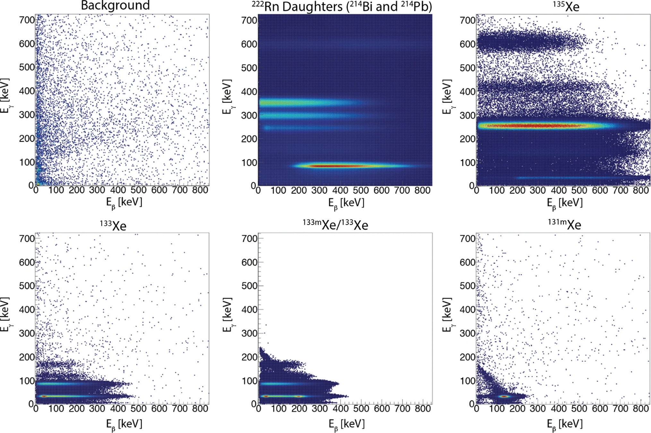
Outlook
Comparison to be done with tools developed by CTBTO tools
Addition of sparsity constraints to improve the false positive responses
➔ Variation of the data library to keep just RN present
Automatic analysis of matrices from low-resolution system
Comparison with officials CTBTO tools
➔ Maximizing network utilization
Thank you
Coincidence matrices for each radionuclide of interest from low resolution system
charlesphilippe.mano@cea.fr

