Slide 1
Radiative deexcitation of ¹⁷⁷Lu
Mathilde POTTIER (2nd-year PhD)
Olivier ROIG, Laurent GAUDEFROY, Vincent MEOT
CEA/LMCE
PHENIICS Fest
May 2024

Slide 2
Introduction
Improve the evaluation of radiative neutron capture cross-sections in neutron-rich nuclei
Constraining models by determining two essential ingredients:
$γ$-strength function
Nuclear levels density
S_{n}
Target nucleus: ¹⁷⁶Lu
Radiative capture (n,$γ$)
¹⁷⁵Lu
97.41 %
¹⁷⁶Lu
2.59 %
¹⁷⁷Lu
3.68 h
3.8 10¹⁰ y
160.1 d
6.71 d
Notes:
These ingredients manage the gamma cascade and are key elements to predict reaction cross sections
γ -ray strength function (γ SF) and nuclear level density (NLD) describe the nuclear structure in the region of the quasicontinuum
The strength of transitions for γ rays of certain energies is directly related to the transition probability and is expressed in a function called the γ ray strength function.
the γSF characterizes the average electromagnetic properties and is related to radiative decay and photoabsorption processes

Slide 3
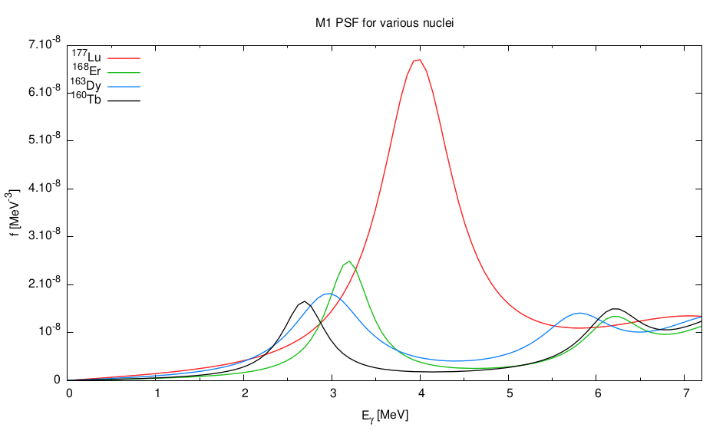
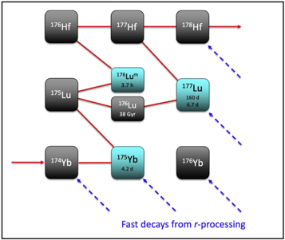
Motivations
M1 $γ$SF for various nuclei [2]
¹⁷⁷Lu
¹⁶⁸Er
¹⁶³Dy
¹⁶⁰Tb
Why ¹⁷⁶Lu(n,$γ$)¹⁷⁷Lu reaction?
Nuclear structure
¹⁷⁶Lu target is one of the heaviest naturally odd-even nucleus (Z=71, N=105)
Multiple configuration possible, high level density
High spins reached (¹⁷⁷Lu, $J^{π}=13/2$, $15/2^{−}$) from one of highest spin of the ground state (¹⁷⁶Lu, $J^{π}=7^{−}$)
Special decay scheme, presence of isomers
Among the most deformed nuclei ($β=0.3$^{[1]})
Collective excitation expected, NLD and $γ$SF affected^{[2][3]} (M1 scissor mode, …)
Nuclear reaction
¹⁷⁶Lu(n,$γ$) is an important reaction for applications in astrophysics with nucleosynthesis
Associated to ¹⁷⁶Hf, one of the powerful tool to measure the temperature of stars/sites as cosmothermometer^{[4]} or the age of astrophysical events as cosmochronometer^{[5]}
s-process
[1] www-phynu.cea.fr
[2] S. Valenta, Dipl. thesis, Charles Univ., Prague (2010).
[3] D. Denis-Petit et al., Phys. Rev. C 94, 054612 (2016).
[4] M. Heil et al., ApJ, 673, 434 (2008).
[5] M. Busso et al, ApJ, 908, 55 (2021).
fast decays from r-process

Slide 4
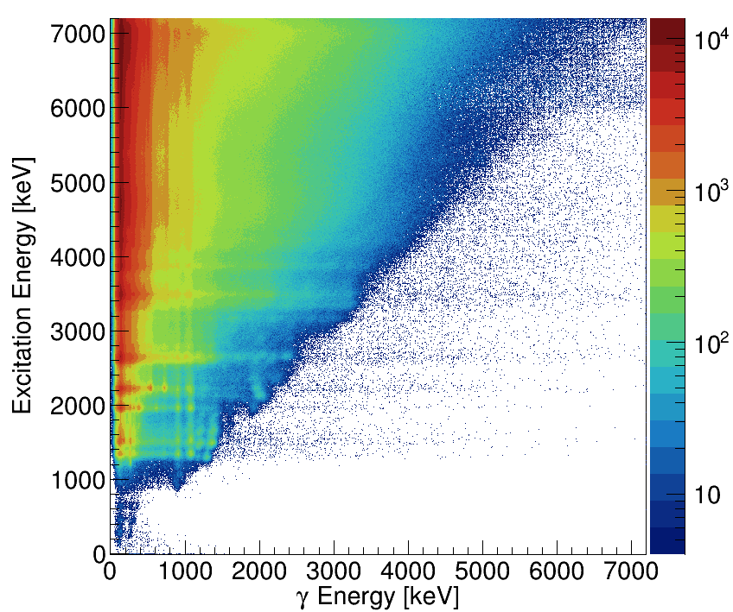
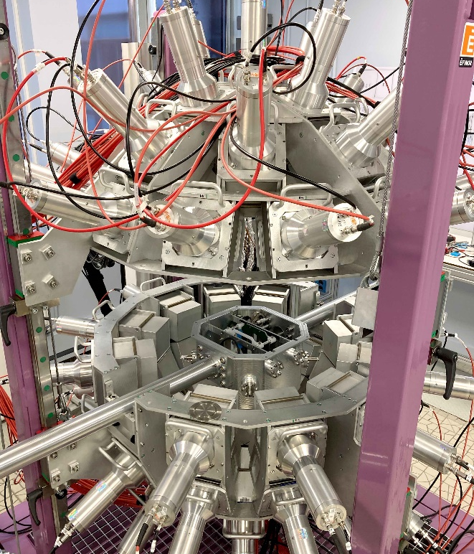
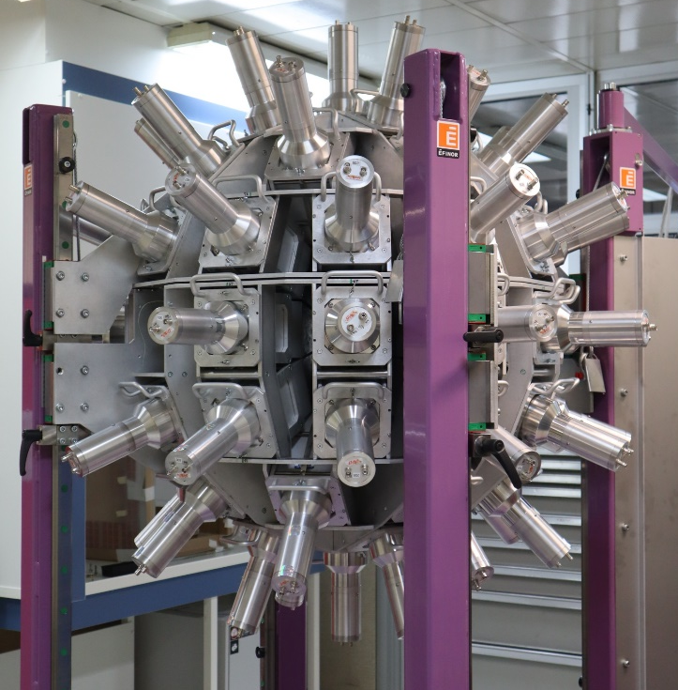
Transfer reaction: ¹⁷⁶Lu(d,p)¹⁷⁷Lu*
$[E_{ex},E_{γ}]$ matrix
Experiment principle: populate ¹⁷⁷Lu with a known excitation energy, under neutron emission, and measure the corresponding $γ$ de-excitation.
E
$$γ$$
ΔE
E*
¹⁷⁶Lu(d,p)¹⁷⁷Lu*
$$γ$$
Experiment using SF$γ$NCS detector:
Detection of emitted protons (energy, emission angle) to compute excitation energy (2 segmented Si detectors in telescope configuration)
Detection of $γ$ cascade in coincidence with protons (sphere of 60 NaI(Tl) detectors)
E
NaI detector
Resolution:
$E_{ex}$ : $σ$ = 35 keV
$E_{γ}$ : $σ$ = 24 keV (at 870 keV)
$T_{NaI}$ : $σ$ = 2 ns
Notes:
Gamma spectra only depends on the gsf and the level density

Slide 5
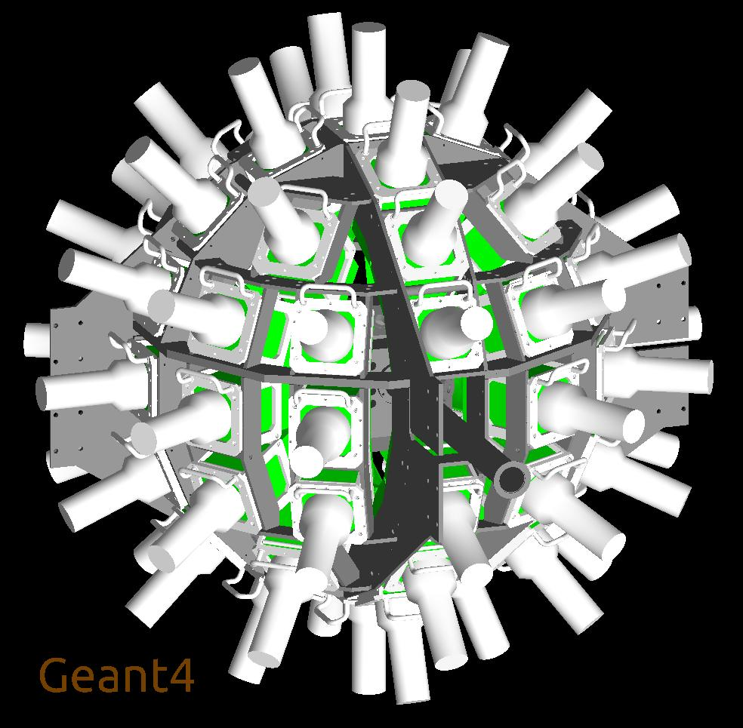
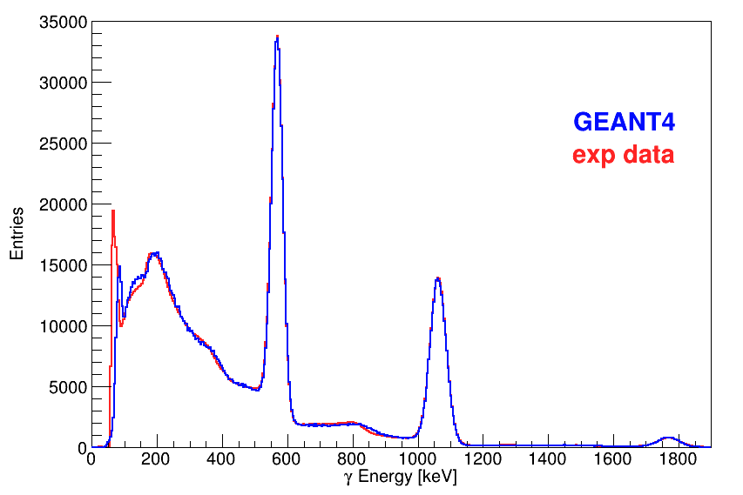
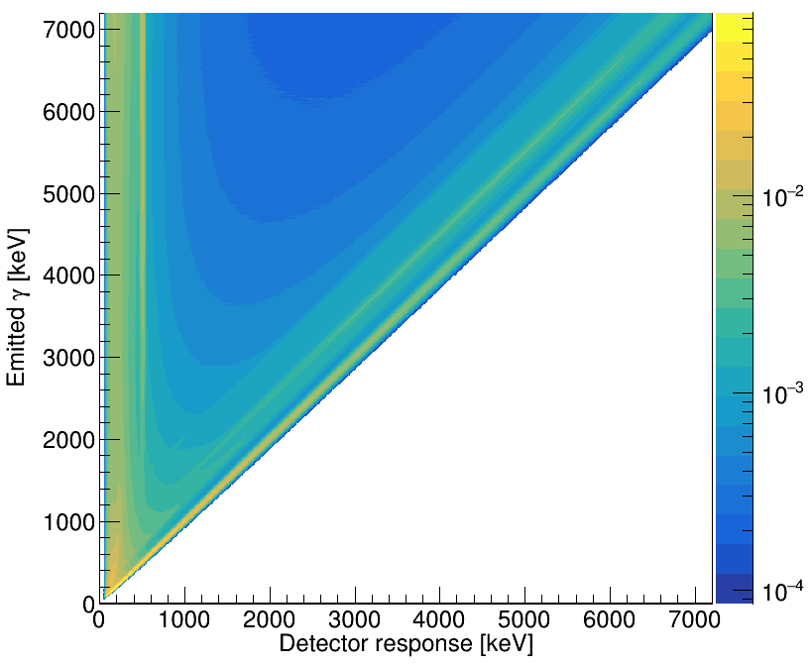
Simulations with GEANT4
Determining the detector response matrix.
Source and background measurements to adjust simulation on experiment.
Simulated SF$γ$NCS detector
²⁰⁷Bi source
Response matrix
Notes:
Threshold issues at low energy

Slide 6
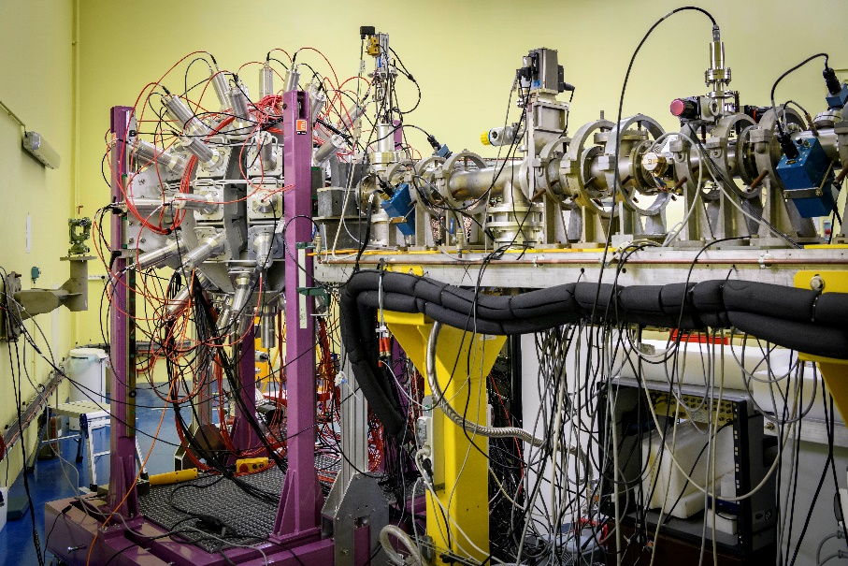
Target and beam
Experiment in June 2023
Deuteron beam with an intensity of a few nA and 12 MeV energy with NENUPHAR accelerator at CEA
¹⁷⁶Lu target
Target made at SIDONIE isotopes separator in Orsay
Isotopic enrichment from natural (2.59 %) to 99.9 % of ¹⁷⁶Lu.
Details:
243 µg/cm²
Carbon backing, 100 µg/cm²
Total width: 691 nm
diameter: 12 mm
SF$γ$NCS detector on beamline

Slide 7
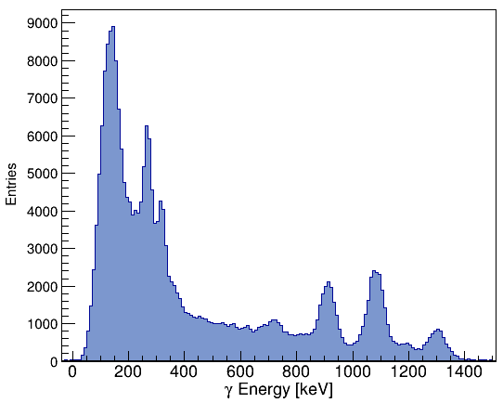
Excitation energy - $γ$ energy matrix
$γ$ spectrum available for each excitation energy range.
¹⁷⁷Lu, matrix with background substraction
$γ$ spectrum projection for excitation energy between 1290 keV and 1390 keV
Notes:
Triangular matrix

Slide 8
Analysis
Unfolding using GEANT4 simulations
Primary $γ$ matrix extraction
NLD and $γ$SF extraction with Oslo method

Slide 9
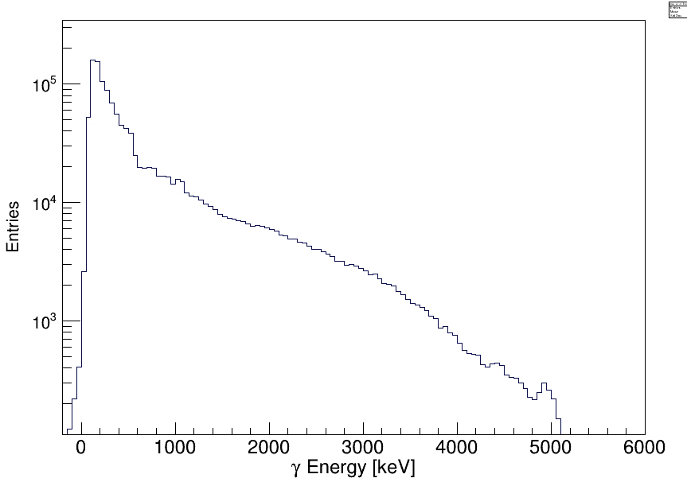
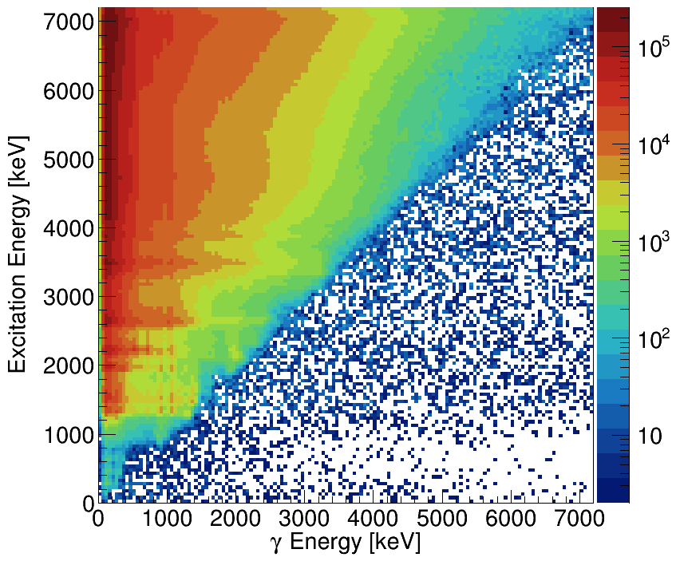
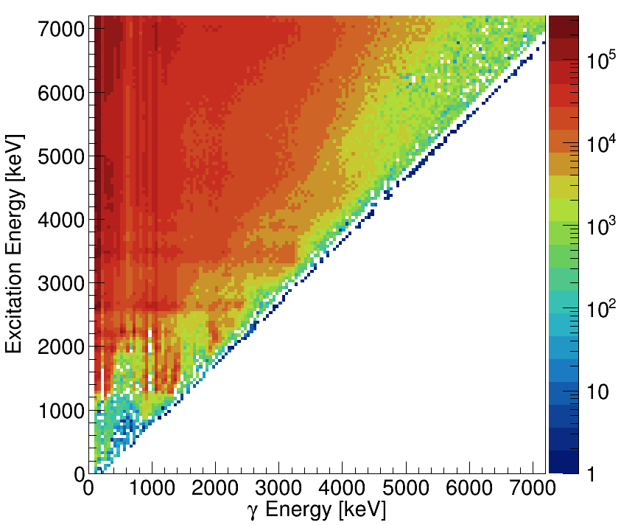
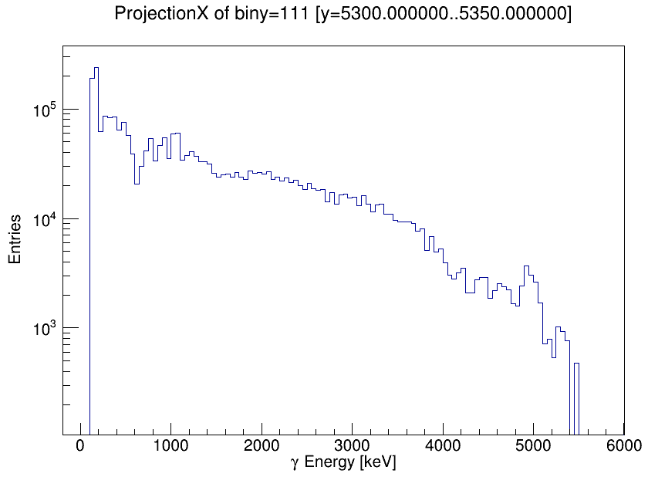
$γ$ spectra unfolding
For each excitation energy range, the measured $γ$ spectrum is unfolded to get the emitted spectrum (unfolding methods^{[1][2]}).
Measured ¹⁷⁷Lu
Unfolded ¹⁷⁷Lu
[1] R. Gold, ANL 6984 (1964).
[2] M. Guttormsen et al., Nucl. Instrum. Methods Phys. Res., Sect. A 374, 371 (1996).

Slide 10
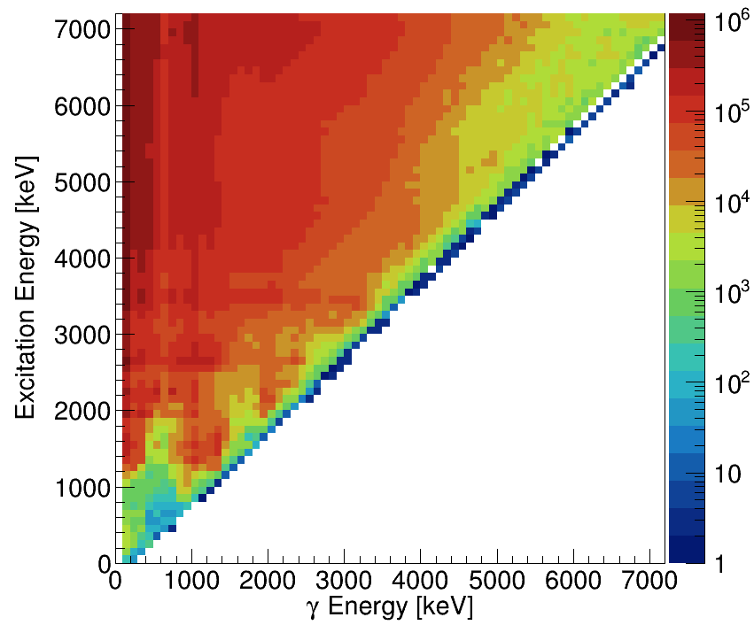
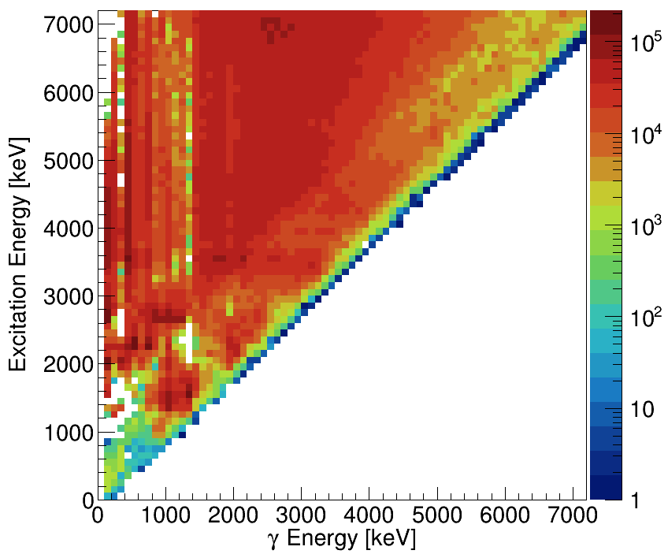
Primary $γ$ extraction
For each excitation energy range, primary $γ$ matrix is extracted from unfolded matrix^{[1]}.
n
primary $γ$ from level n
other $γ$ from level n
$γ$ cascade from excitation energy level n
Unfolded ¹⁷⁷Lu
Primary $γ$ ¹⁷⁷Lu
[1] M. Guttormsen et al., Nucl. Instrum. Methods Phys. Res., Sect. A 255, 518 (1987).

Slide 11
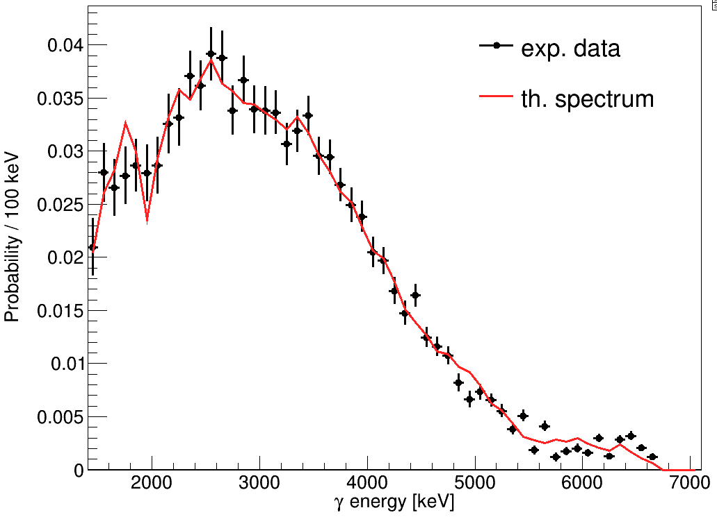
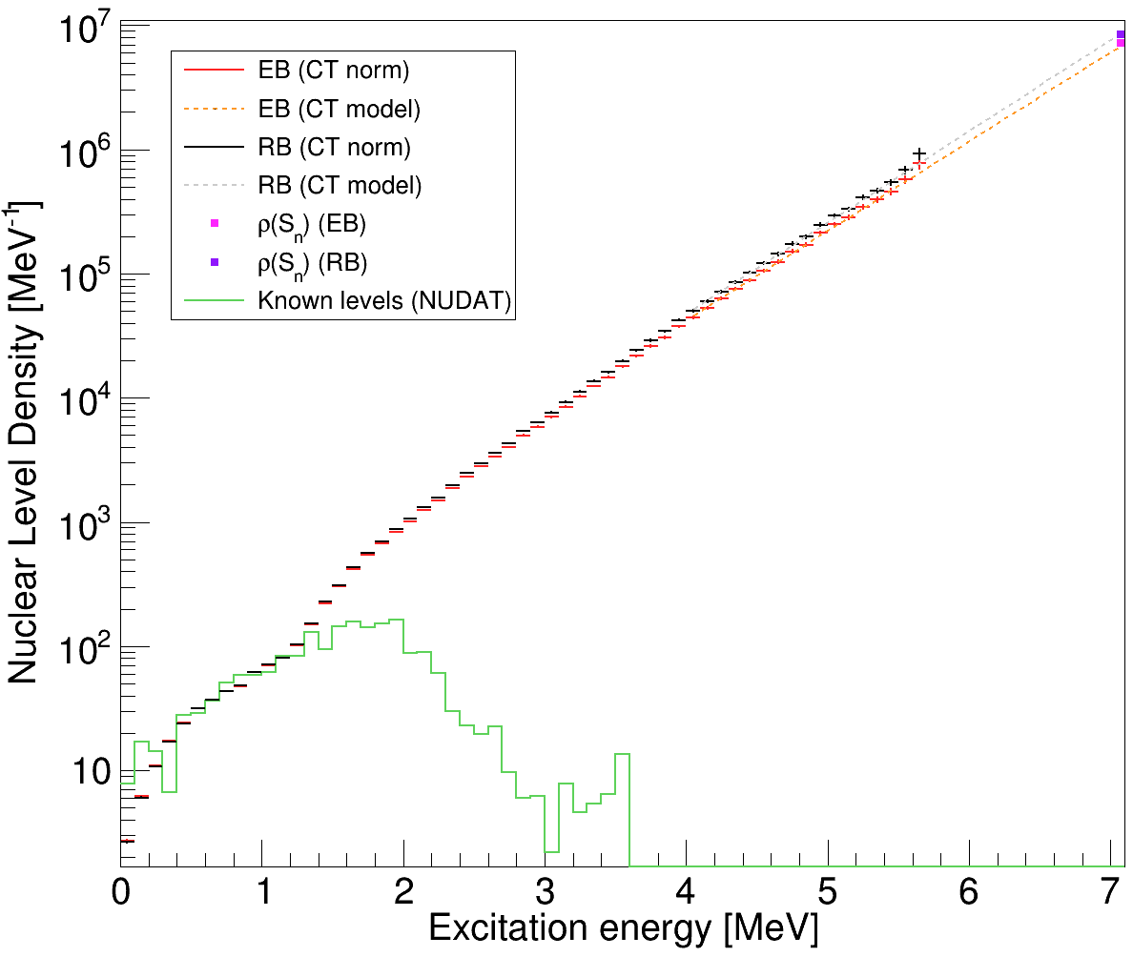
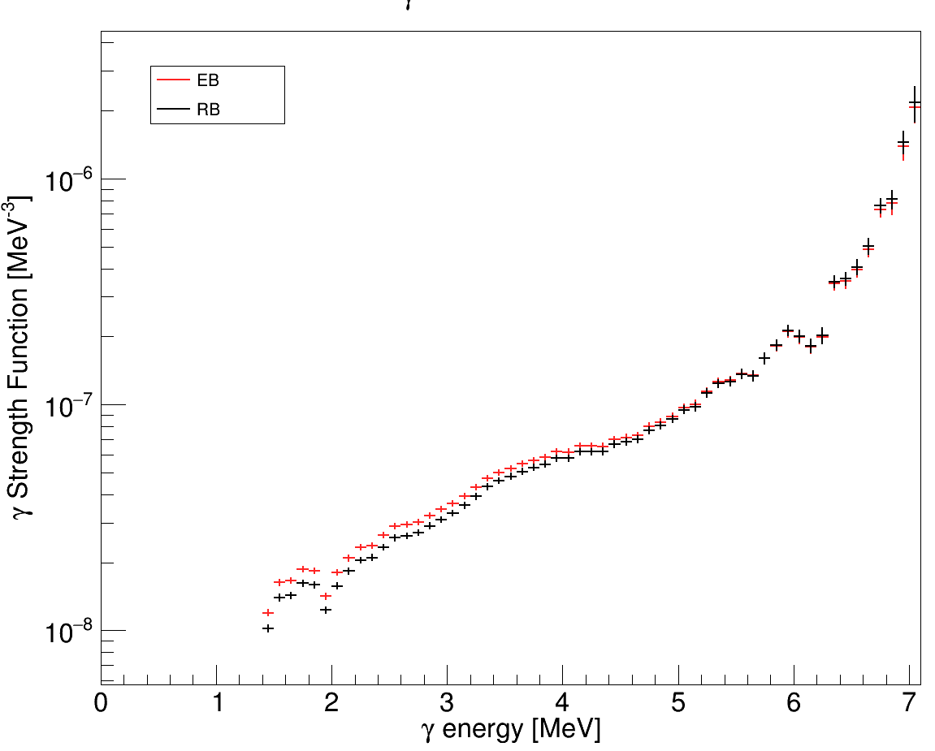
Nuclear level density and $γ$ strength function
Oslo method^{[1]}
Brink-Axel hypothesis: $γ$ strength function is independant of the energies, spins and parities of initial and final levels, it depends only on the $γ$ energy.
$$S_{th}\left(E_{γ},E_{ex}\right)∝F\left(E_{γ}\right)∗ρ(E_{ex}−E_{γ})$$
Normalization with known parameters at low and high energy.
$S_{exp}\left(E_{γ}\right)$
$S_{th}\left(E_{γ}\right)$
$$E_{ex}=6450 keV$$
preliminary
preliminary
Primary $γ$ spectra: theoritical and experimental
[1] A. Schiller et al., Nucl. Instrum. Methods Phys. Res., Sect. A 447, 498 (2000).
Notes:
Hypothèse de Brink-Axel : la fonction de force $γ$ est indépendant des énergies, des spins et des parités des niveaux initiaux et finaux, elle ne dépend que de l’énergie $γ$.

Slide 12
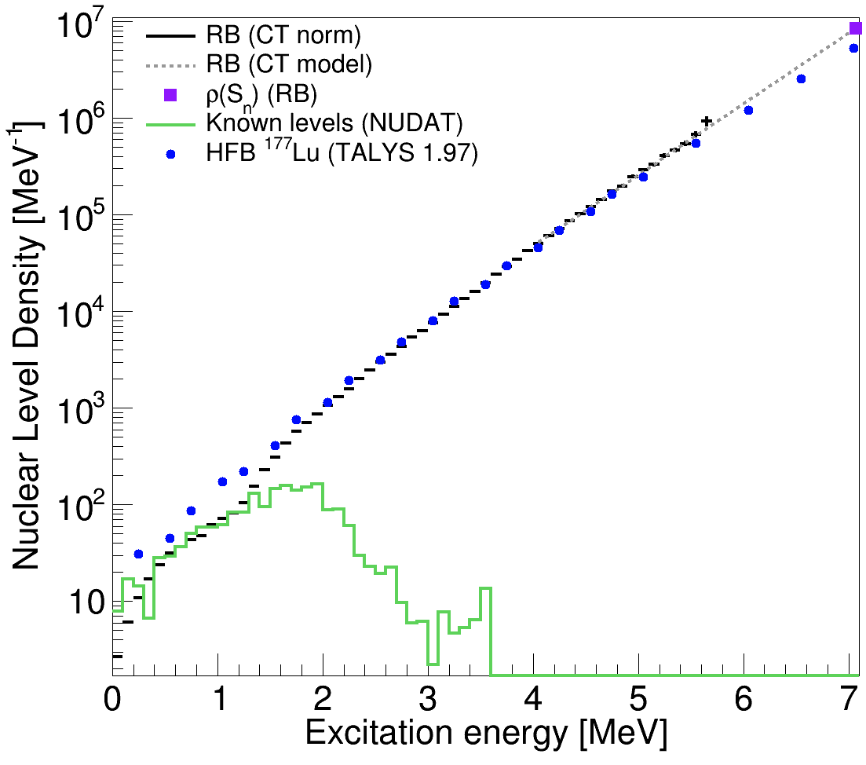
Nuclear level density
Experimental nuclear level density and calculation with TALYS 1.97 nuclear reaction code using the Hartree-Fock-Bogolyubov (HFB) approach.
preliminary
Quite good agreement, differences at low and high energy

Slide 13
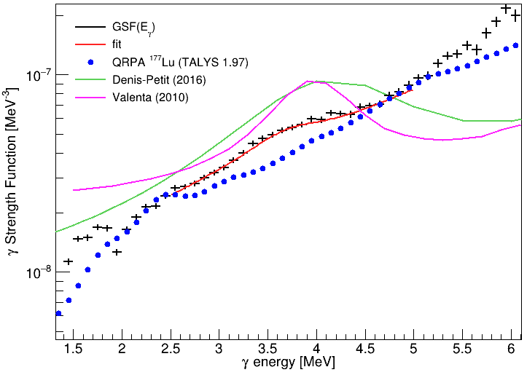
$γ$ strength function
Previous works, adjustement on experimental spectra of simulated $γ$ spectra with a $γ$-cascade code + GSF models for E1, M1 :
Denis-Petit: EVITA + EGLO + SLO
Valenta: DICEBOX + KMF + SF
 | $E$ (MeV) | $Γ$ (MeV) | $σ$ (mb)
This work | 3.71$±$0.04 | 1.01$±$0.08 | 0.61$±$0.04
D. Denis-Petit^{[1]} | 4.25 | 2.0 | 3.75
S. Valenta^{[2]} | 4 | 1.0 | 3.0
preliminary
QRPA does not show the resonance around 4 MeV
[1] D. Denis-Petit et al., Phys. Rev. C 94, 054612 (2016).
[2] S. Valenta, Dipl. thesis, Charles Univ., Prague (2010).
Notes:
New calculation with QRPA-FAM or matriciel QRPA

Slide 14
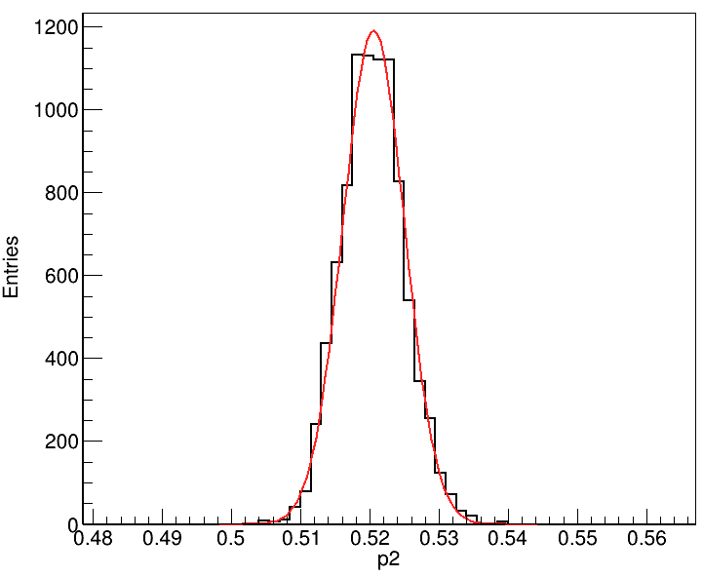
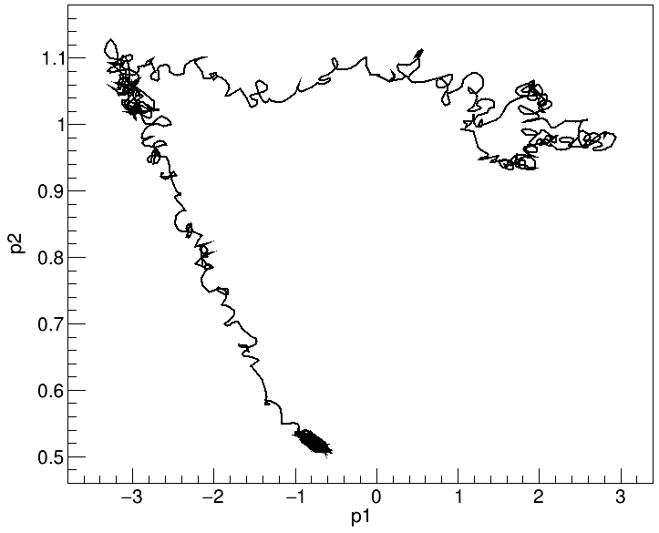
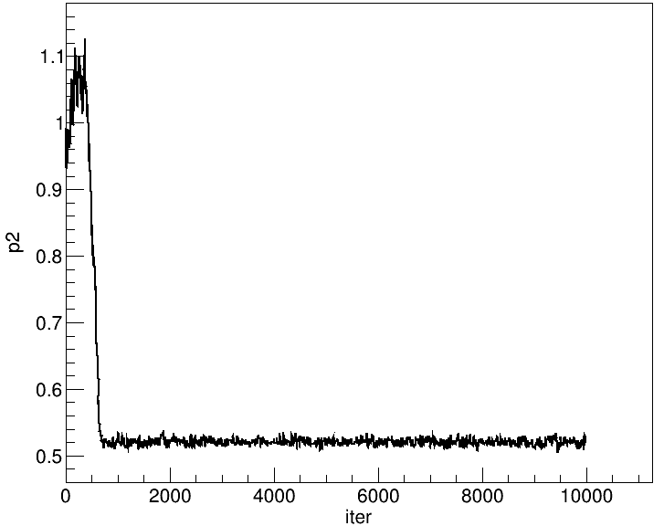
Perspectives
Extract nuclear level density and $γ$ strength function of ¹⁷⁷Lu with a different method: Monte-Carlo Markov chain
Confrontation with models (new calculation with QRPA…)
New evaluation of ¹⁷⁷Lu (cross sections determination)
Construction of probability distribution of nuclear level density and $γ$ strength function
comparison of theoritical spectra and experimental spectra at each iteration
random generation of parameters describing NLD and $γ$SF
after convergence: probability distribution of each parameter
Notes:
MCMC: NLD and GSF are described with several parameters, these parameters are randomly determined at each iteration following a probability distribution, theoritical spectra are calculated and compared to experimental spectra with chi2, new parameters are accepted or rejected following an acceptance law depending on previous and new chi2. the method give a probability distribution of each parameters

Slide 15
Thank you for your attention

