Slide 1












PERLE Status Report
Walid Kaabi, Achille Stocchi
IJCLab / Université Paris-Saclay, IN2P3/CNRS
PERLE-FRANCE
19 June 2024 – IJCLab-Orsay

Slide 2
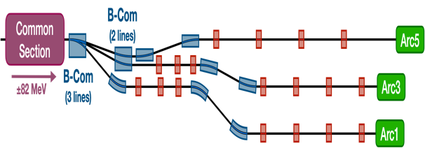
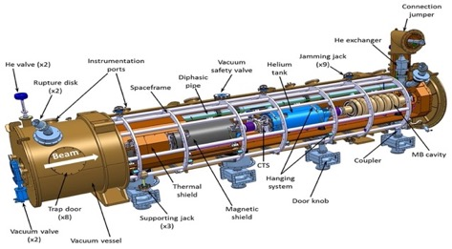
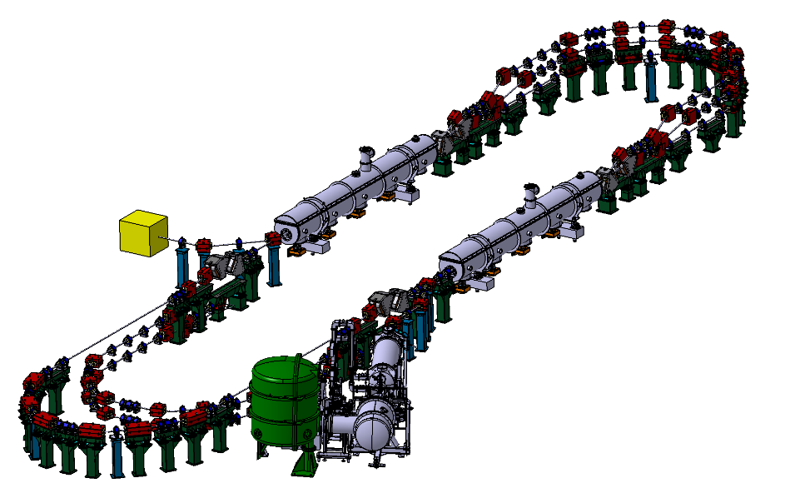
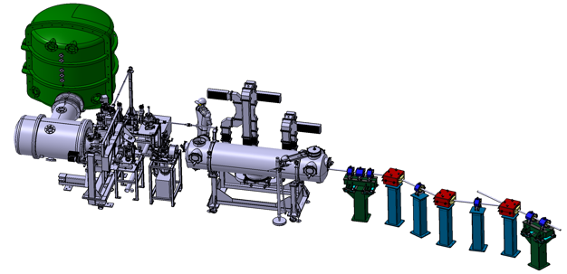

PERLE @ IJCLab-Orsay
PERLE: first multi-turn ERL, based on SRF technology, designed to operate at 10MW (20 mA, 500 MeV) power regime
→ A hub to explore a broad range of accelerator phenomena and to validate technical choices improving accelerators efficiency in an unexplored operational power regime on the pathway of the ERL technology development for future energy and intensity frontier machines.
Cryomodule with 4 five-Cell cavities
Total gradient 82 MeV
3 acc & 3 decc beams at different energies travelling in the CM.
Switchyard: vertical separation/recombination of beams at different energies
Target Parameter | Unit | Value
Injection energy | MeV | 7
Electron beam energy | MeV | 500
Normalised Emittance γε_{x,y} | mm mrad | 6
Average beam current | mA | 20
Bunch charge | pC | 500
Bunch length | mm | 3
Bunch spacing | ns | 25
RF frequency | MHz | 801.58
Duty factor |  | CW
Beam dump
3 staked isochronous recirculation arcs for beams at different energies (Arcs 1, 3, 5).
Interaction Points
HV tank
Photocathodes loading chamber (Sb-based photocathodes)
Buncher
350-500 kV
DC gun
Merger
3 staked (& inversed) isochronous recirculation arcs for beams at different energies (Arcs 2, 4, 6)
Light box
Green laser 40 MHz
Booster: 5 single-cell cavities (802MHz) individually powered
Injection line delivering 500pC bunches at 7 MeV.

Slide 3
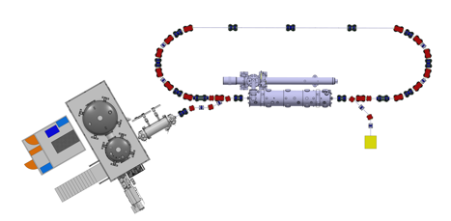
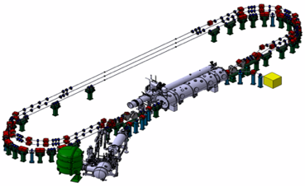
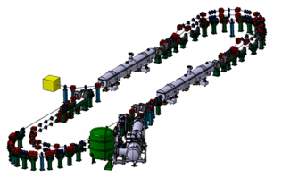
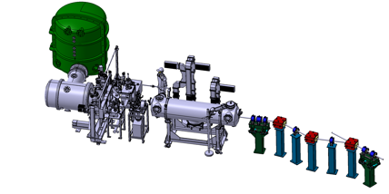
PERLE Timeline (macroscopic view)
Single turn ERL phase
→ Phase 1 to be extended to 2028
Prepare to Build phase (P2B): TDR and prototyping
Installation phases
Phase 1: Injection line Installation
Phase 2: PERLE 250 MeV version
Phase 3: PERLE 500 MeV version
2020
2021
2022
2023
2024
2025
2026
2027
2028
2029
2030
2031

Slide 4
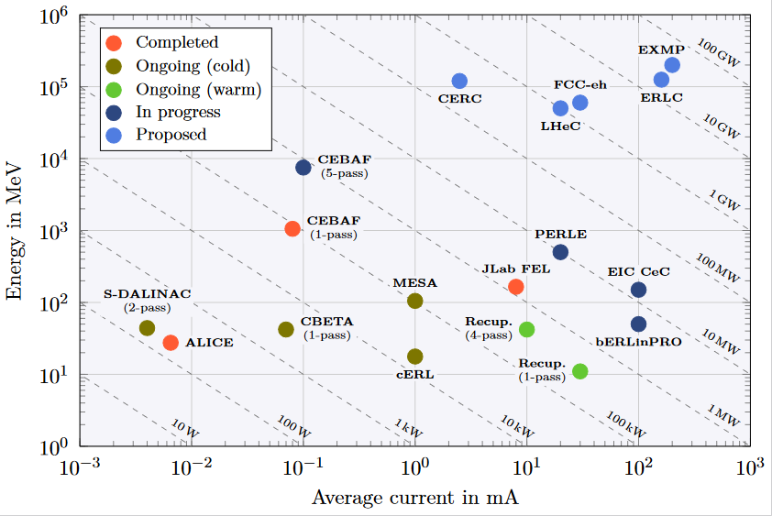
PERLE Timeline (macroscopic view)
PERLE
PERLE signle tour
PERLE 3 tours 250 MeV
PERLE 3 tours 500MeV
2020
2021
2022
2023
2024
2025
2026
2027
2028
2029
2030
2031

Slide 5
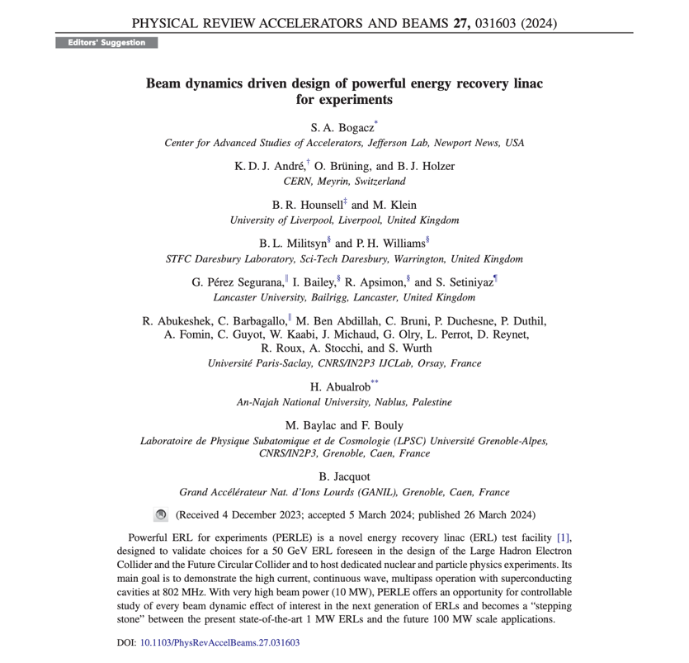
Recent paper of PERLE collaboration (centered on beam dynamics)
The first paper on Beam Dynamics and PERLE Design has been published in Physical Review Accelerators and Beams (PRAB) and was also selected as a « PRAB Editors Suggestion » on the journal homepage alongside other highlighted articles: https://journals.aps.org/prab
The following studies was reported in this paper for the 500 MeV version of PERLE:
  Lattice architecture and optics
  Staging construction
  Injector and merger, space charge study
  Longitudinal matching
  Filling pattern and bunch timing options
  Start to end simulations with CSR and Wakefield
  BBU study

Slide 6

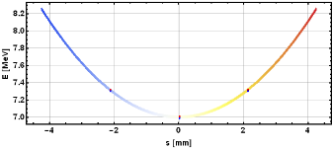
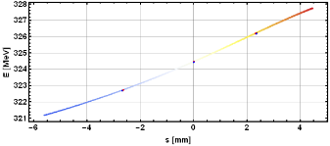
Further design and beam dynamics studies ongoing
Talks @ PERLE-France
Alex FOMIN « Lattices de PERLE et spécifications des éléments magnétiques »
Rasha ABUKESHEK « Etude de tolérance des optics de PERLE »
The effort is currently focused on the 250 MeV version of PERLE with a phase with a single tour.
The following beam dynamics studies are ongoing or done:
  Matching with collective effects
  Longitudinal phase space tuning and linearization
    Linacs phases
    Arc length correction
    Focal conditions at IRs
  Diagnostics
    Non destructive emittance measurement (DMD, MLA)
    Beam losses and halo formation
    6D beam qualification
IJCLab, LPSC, CERN, Jlab, Liverpool, STFC, Lancaster, An-Najah

Slide 7
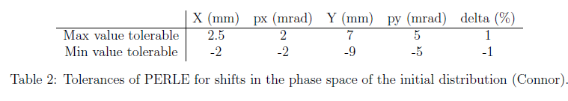

Further design and beam dynamics studies ongoing : 1 example
Beam Losses study: Vertical $5σ$ beam envelop through PERLE (with space charge and CSR)
Matched injector’s distribution
Unmatched injector’s distribution
Beam pipe of $φ40$ mm should be sufficient

Slide 8
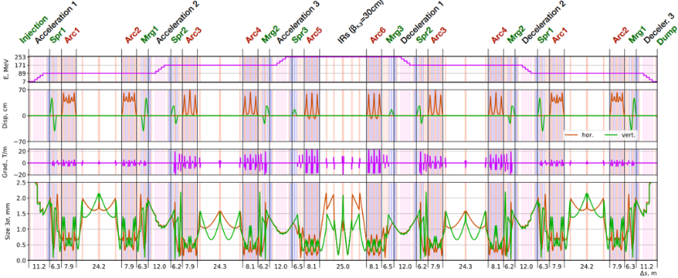
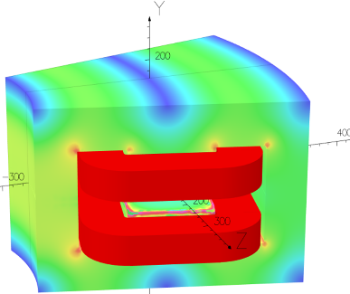
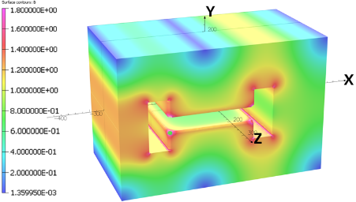
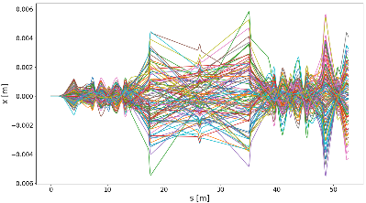
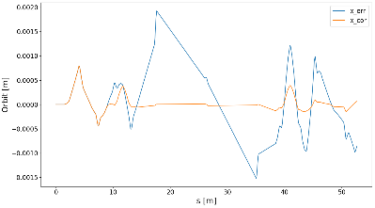
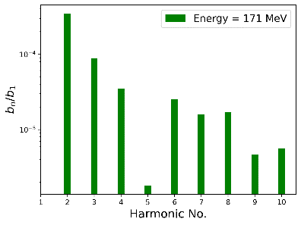
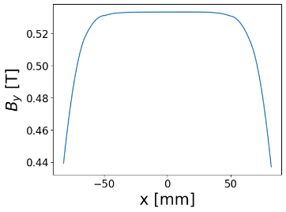
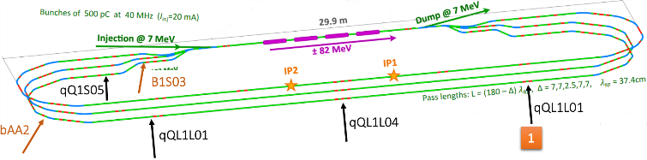
Magnet Design
Misalignments and Corrections
S-bend in Arcs
B-com in Spreader
163 mm
333 mm
Effect of quads misalignments on x-orbit
Before/after correction (with kickers)
500 mm
Positions of the diagnostic elements
BPM
BPM
BPM
BMP1
IJCLab, LPSC, Jlab, An-Najah
BMP3
BMP2

Slide 9
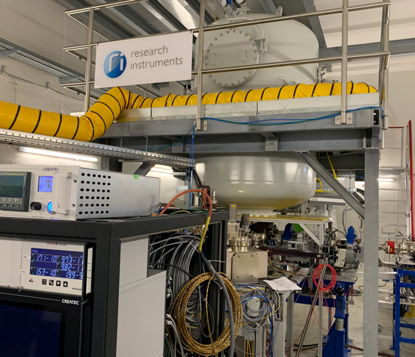
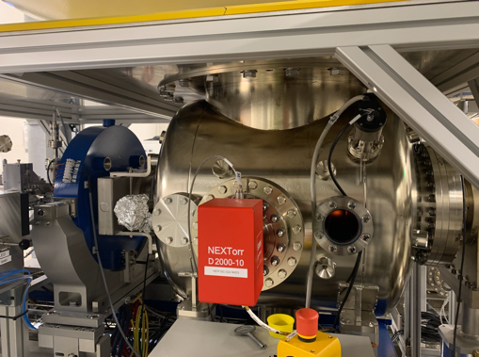
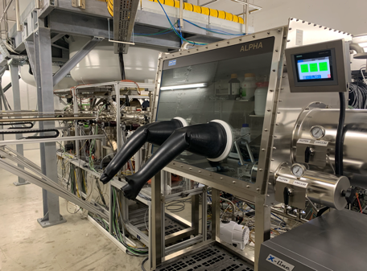
PERLE e- Source
Collaboration IJCLab-LPSC & RI GmbH
Within a Collaboration Agreement for photoinjector R&D between IJCLab (IN2P3) and Research Instruments GmbH (RI), Hardware of lighthouse project (terminated) transferred to IJCLab for PERLE. The gun was commissioned and tested at high rep rate, at a limited bunch charge. It includes:
A DC Gun, Cornell design (400 pC, 50 MHz demonstrated), fully equipped (all pumps) in load-lock version
A Photocathode Preparation Facility (PPF)
HV power supply suited for high bunch charge (designed for 40 mA, 450 kV)

Slide 10
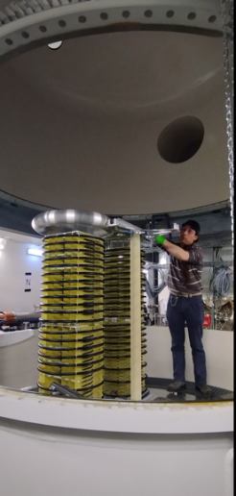
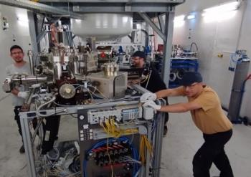
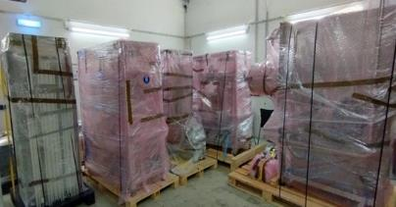
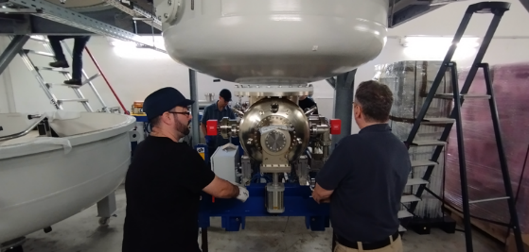
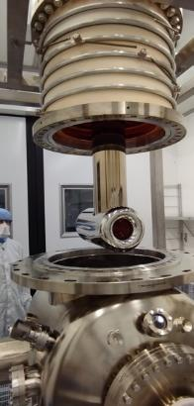
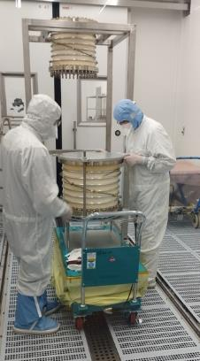
PERLE e- Source
Dismantling of the PPF (September 2023)
Dismantling of the PPF (September 2023)
Dismantling of the HV Columns tanks
Dismantling of the platform done by Baumann (November 2023)
Dismantling of the HV Columns tanks
Dismantling of the platform done by Baumann (November 2023)
Gun status : dismantling of the gun in clean room (January 2024)

Slide 11
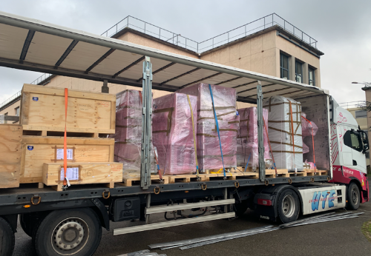
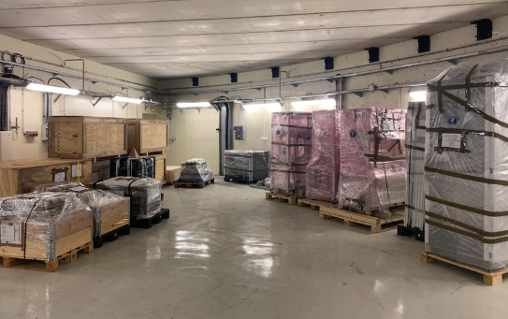
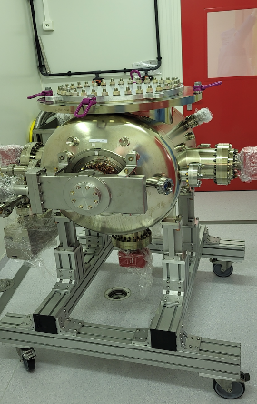
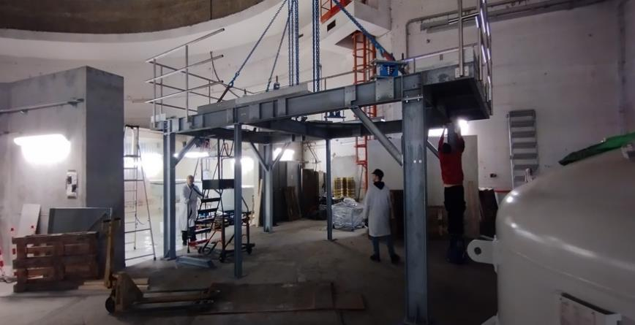
PERLE e- Source
The equipment were received at Orsay end of January
The installation at IJCLab well advanced in the IGLOO

Slide 12
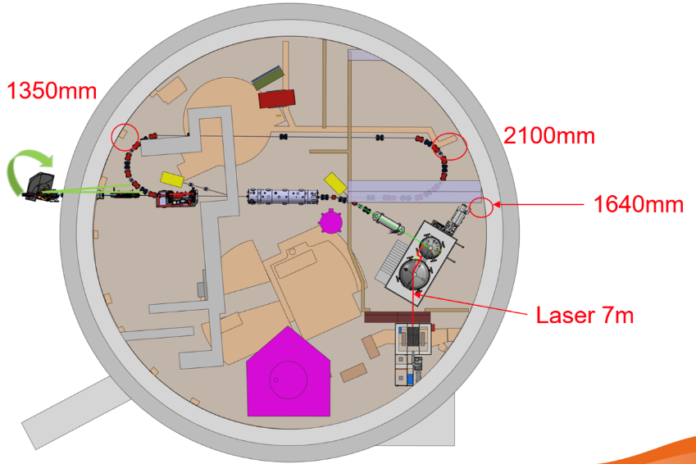
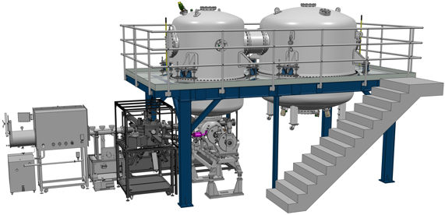
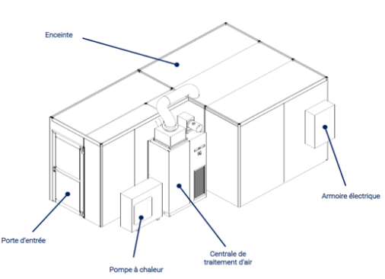
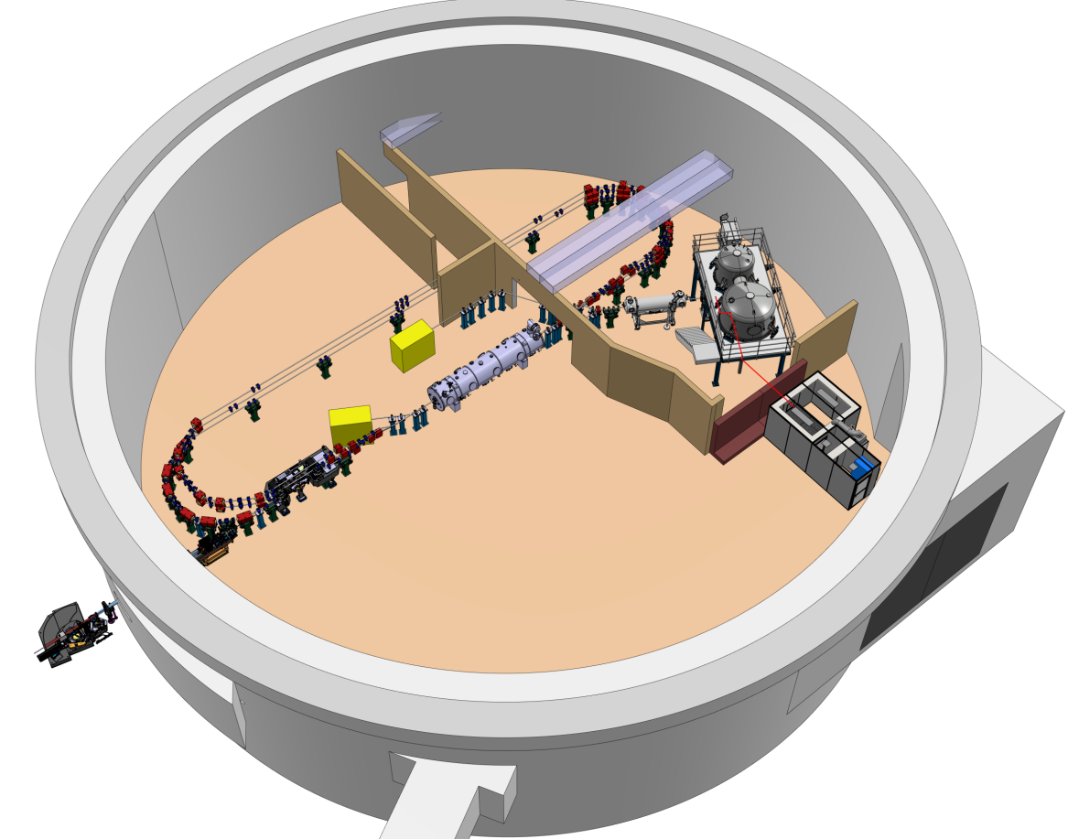

Site implementation
Talk @PERLE-France
Denis Reynet « DC Gun: Status et plan d'assemblage et implantation dans l’Igloo »
After site studies of the the two possible locations to host PERLE (Super ACO hall and Igloo):
The IGLOO was the preferred solution. Progress on Infrastructure and safety issues
Laser clean room: delivered in June 2024
Implantation in igloo being finalized

Slide 13
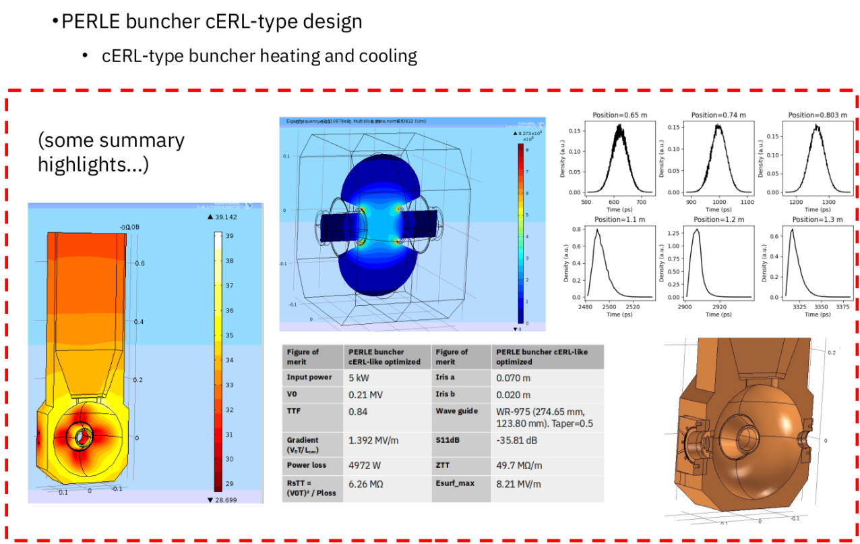
Buncher cavity design
Talk @PERLE-France
Frederic BOULY « Etude des besoins RF de PERLE »
Bruno MERCIER « Enjeux du vide pour PERLE »
Collaboration IJCLab-ESS Bilbao
Important progress in the RF design, thermal and beam dynamics simulations of a buncher cavity for PERLE by colleagues from ESS-Bilbao.

Slide 14
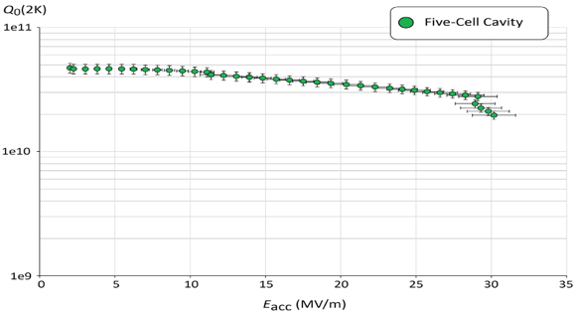
PERLE SRF cavity : reminder
Collaboration IJCLab-CERN and JLab
PERLE Requirements | Impacts | Challenges | Possible Solutions
CW operation (RF) | High dynamic losses | The highest cavity Q₀ | Cavity post-treatment (Doping, infusion…)
High current operation | High HOMs excitation | Efficient HOMs extraction & damping | Act on cavity design: low frequency cavity choice (< 1GHz), larger cavity aperture, fewer cells for the a given gradient, optimisation of end-cell design.
Muti-bunches operation | Increase beam instabilities | The highest BBU threshold | Regular spacing of bunches: optimisation of the bunch filling pattern during Lattice design + BBU study after HOM optimisation (including collective effects).
Q₀ (2k) = 3 e10 @ ~27 MV/m
Quench @ E_{acc} ~ 30 MV/m
PERLE requirements
First Nb 802 MHz 5-Cell cavity fabricated @ JLAB
F. Marhauser et al. “802 MHz ERL cavity design and development”- IPAC2018 (Vancouver, BC, Canada)- doi:10.18429/JACoW-IPAC2018-THPAL146

Slide 15

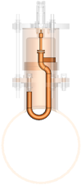
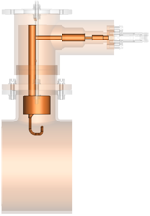
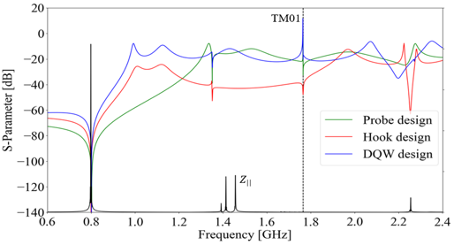
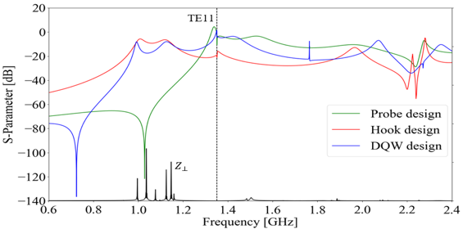
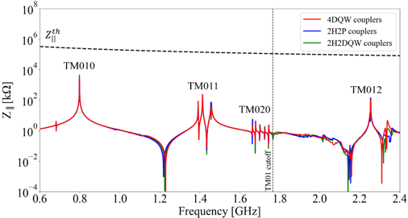
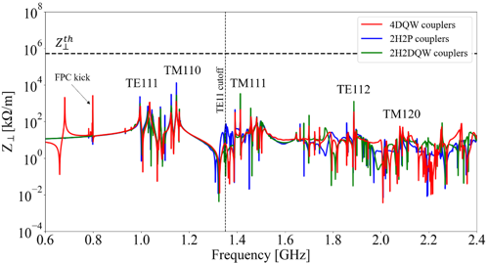
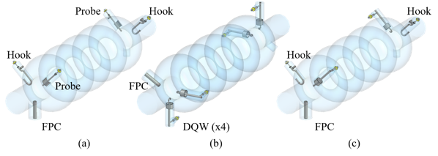
Status of HOM studies : news
HOM coupler optimization of 3 different designs
Collaboration IJCLab-Jlab and CERN
Monopole transmission
Dipole transmission
TM010
Optimized region
Probe Coupler
Hook Coupler
DQW Coupler
Optimized region
TM011
TM110
TM012
TE111
TM111
Couplers were geometrically optimized according to HOM spectrum ($Z_{||}$and $Z_{⊥}$) & S-parameters btw port 1 (beam pipe) & port 2 (coupler output) were studied.
The hook coupler provides higher damping of the first two dipole passbands (TE111 and TM110)
The DQW coupler exhibits a better monopole coupling for TM010 mode than the probe design.
Study of 2 damping schemes with 4 HOM couplers (Especially for dipole HOM extraction)
Longitudinal impedance spectra of the cavity
Transverse impedance spectra of the cavity
beam
beam
→ Promising results of the 4 DQW scheme: It allows damping both monopole and dipole HOMs below the analytically-computed beam-stability limits

Slide 16
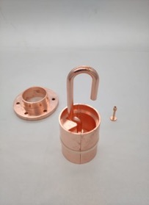
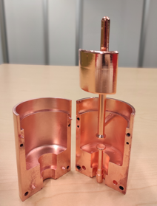
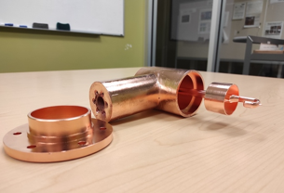



Status of HOM studies : news more details
From RF design to performance measurements: Successful collaborative effort between IJCLab, Jefferson Lab & CERN
Probe coupler
DQW coupler
Hook coupler
3D-printed prototype (Epoxy Accura 48) copper-coated @CERN
Ultimately, we aim to produce Nb HOM couplers with optimised design and to install them on a new Nb 5-cell PERLE cavity with optimised end groups. The Production of 4 cavity scheduled within the ISAS program (Starting from 2024).
C. Barbagallo et al. “First RF measurements of coaxial HOM coupler prototypes in a copper cavity for the PERLE project”- IPAC’23- MOPA025

Slide 17

SRF cavity : latest news
Current work:
Specifications of the 5-Cell 800 MHz cavity is under finalisation.
A review meeting on the cavity post-production processes recipes (EP, BCP, Mid-T baking…) was organised end of March with international experts.
Within iSAS program:
The Nb procurement procedure will be lunched before summer (for single and multi-cell cavities).
It is foreseen to lunch the procurement procedure of 4 cavities also before summer.
IJCLab, JLab, CERN and including now LASA-Milano

Slide 18


SRF cavity : latest news
Discussions/work with Jlab & CERN to pursue the R&D on 802 MHz cavities (Synergy with FCCee):
→ Optimisation surface treatment recipe (Mid-T baking, EP/PCB) and cold tests.
→ A CERN single-cell cavity fabricated by Jlab was received at IJLab end of May.
→ A common single-cell shape will be adopted for FCCee R&D and PERLE booster.

Slide 19



Cryomodule design
April 15-16, 2024: Kick-off of the European project ISAS (Innovate for Sustainable Accelerating Systems)
https://indico.ijclab.in2p3.fr/event/9521/
WP6: Integration of RF systems (SRF Cavities, HOM couplers & absorbers, Fundamental Power Couplers) optimized and developed within ISAS project into the 1st Cryomodule for PERLE- Foreseen for 2027
The cryomodule adapted from ESS design, will be optimised for efficient high current ERL operation.
ESS, CEA and INFN-LASA
involved in this work
The 2nd Cryomodule of PERLE: Foreseen after 2030
May include some/all the technologies studied within iSAS program to improve the efficiency of Cryomodules: Ferro-electric Fast Reactive Tuner (FE-FRT) for microphonics mitigation, LLRF managed by AI and 4.2 K Cavities operating.

Slide 20












Conclusions and remarks
PERLE@Orsay : International collaboration formed
Recently extended within iSAS for cryomodule work
PERLE@Orsay proceed by phases :
  Phase 1: Injection line Installation + Single turn (2028)
  Phase 2: PERLE 250 MeV version (2030)
  Phase 3: PERLE 500 MeV version (> 2030)
PERLE@Orsay : Recent achievements
  The site is chosen : IGLOO. Progresses on Infrastructure and Safety issues
  Installation of the DC gun started – will be finalised by end 2024, commissioning in 2025.
  Significant progresses in buncher design.
  A common single-cell shape cavity will be adopted for FCCee R&D and PERLE booster.
  Progresses on magnet design and orbit corrections / diagnostic
  Specifications of the 5-Cell 800 MHz cavity is under finalisation. Procurement of 4 cavities before summer 2024
  The cryomodule adapted from ESS design. Significant progress → in phase with the 2027 delivery (iSAS)
PERLE@Orsay
  Human resources significantly increased (permanent researchers, technical staff, Post-Doc & PhD)
  Financial support for Phase 1 (single tour) strongly depends on the succes of ERL4ALL
+ Contributions through iSAS of
Still opened to new comers

Slide 21
Important discussions / actions on going
We have proposed a project (ERL4ALL) to CNRS which should allow to finance the full injection line and a part of a first tour equipment. Money required 3,6M€. Led by Maud Baylac , Walid Kaabi, Eliane Bouquelrel We received a first green light and the project will be presented the 27 June for final decision/approval.
Discussions well advanced with HZB to recuperate part of the equipment of BESSY VSR - Cryogenic plant, valve box and transfer lines. Recuperation of all materiel by Summer 2026.
Discussion on going for receiving in-kind some material from CBETA (quadrupoles essentially to equip the first tour of PERLE)
Increasing collaborations with
  CERN (R&D on 800MHz SRF Cavities (FCC) : production and post-production processes. Discussion well advanced
  LASA-Milano (cavities LINAC Cryomodule, booster, DC-gun/photocathode). Discussion started
  Jlab (Hom/Absorbers/cavities). Discussion on going

Slide 22

New staging strategy –first 1-tour of a simplified PERLE by beginning 2028
Financed through
iSAS Program
+ ESS + in-Kind IN2P3
21m
Injector + First tour
ERL4ALL Project on going
+in-kind needed (as CBETA ) …
Delivered@IJCLab
Infrastructures and radioprotection
Financed by CPER funds
Cryogenic Plants.
In-kind from HZB + extra money requests

Slide 23

Backup

Slide 24
Challenges toward PERLE realisation
Development of high current electron sources:
DC gun: high charge production at high repetition rate, high cathode field & high vacuum
New photocathode materials with high quantum efficiency and long life time (CsKSb, GaAS…)
Beam dynamics & instrumentation:
Specific simulation tools for ERL adapted to high-power beams at different energies and currents
Development of high dynamic range instrumentation allowing high beam control at different functioning phases (commissioning, ramping-up and operation), and also to decern beams from “undesired” one (halo):
  Non-invasive diagnostics: optical system for beam imaging
  BPMs and BAMs adapted to multi-turn
  Sensitive BLMs for the monitoring of beam loss and beam halo
SRF Cavity and High Order Mode (HOM) damping:
For operation in CW mode with the minimum dynamic loss, cavity should have the highest Q₀: Thermal treatment (Doping, infusion, medium temperature annealing) or R&D on SRF material for 4,2K operation (Nb3Sn or others…)
Development of Fast Reactive Tuners (FRTs) adapted to cavity and cryomodule to mitigate cavity detuning by microphonics.
Efficient HOM extraction w/o increasing cryoload, to preserve beam quality & avoid its disruption by wakefields
  Cavity design choices should integrate the HOM extraction issue: frequency optimisation, large aperture, few cells, optimised end group)
  Design of specific HOM couplers & optimisation of the damping scheme
  Study the need of additional absorber in the beam line

Slide 25






PERLE e- Source
Dismantling of the PPF (September 2023)

Slide 26




PERLE e- Source
Dismantling of the HV Columns tanks
Dismantling of the platform done by Baumann (November 2023)

Slide 27




PERLE e- Source
Gun status : dismantling of the gun in clean room (January 2024)

Slide 28


PERLE e- Source
The equipment were received at Orsay in 2 lots, end of December and end of January. The installation at IJCLab already started

Slide 29




PERLE e- Source
The equipment were received at Orsay end of January
The installation at IJCLab already started

