Slide 1
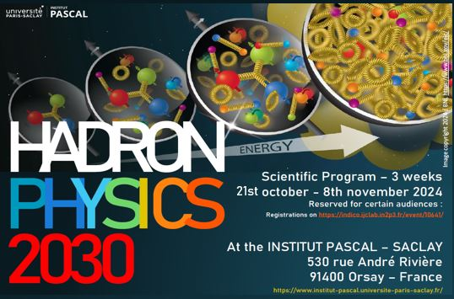
Target fragments in SIDIS and connection with exclusive processes
Harut Avakian (JLab)
HP2030, Nov 7, 2024
  Leptoproduction: processes of interest
  Beam SSAs as a tool to separate contributions
  Studies of hadronic correlations going from ep→e’πX to ep→e’ππX and ep→e’pπX
  New SIDIS observables
  Summary

Slide 2
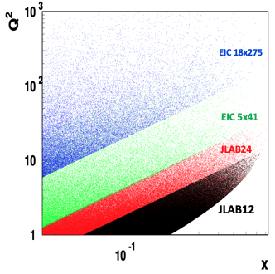
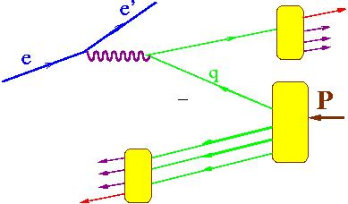

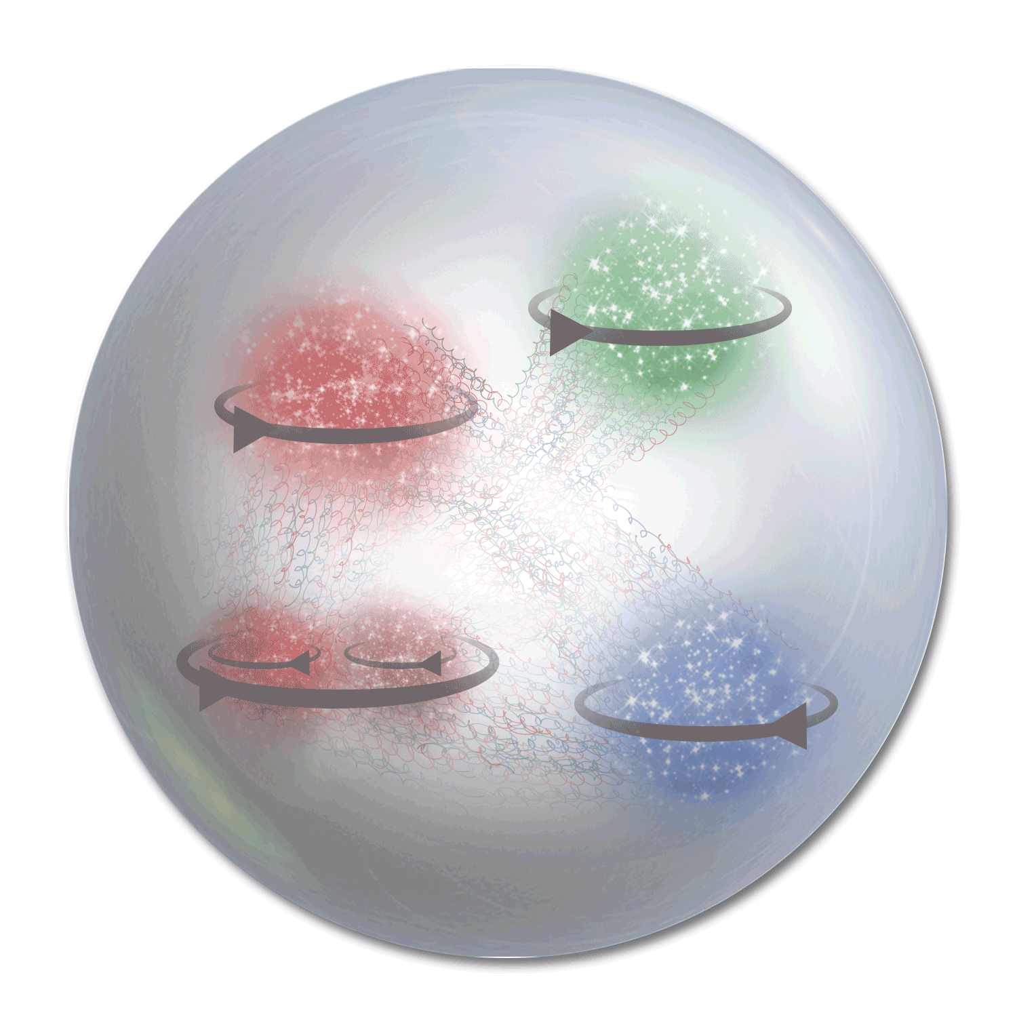



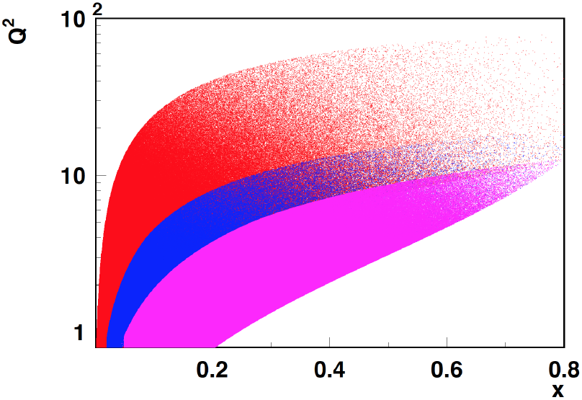
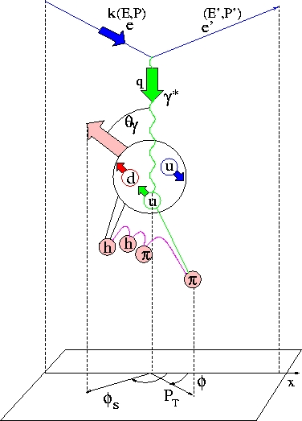

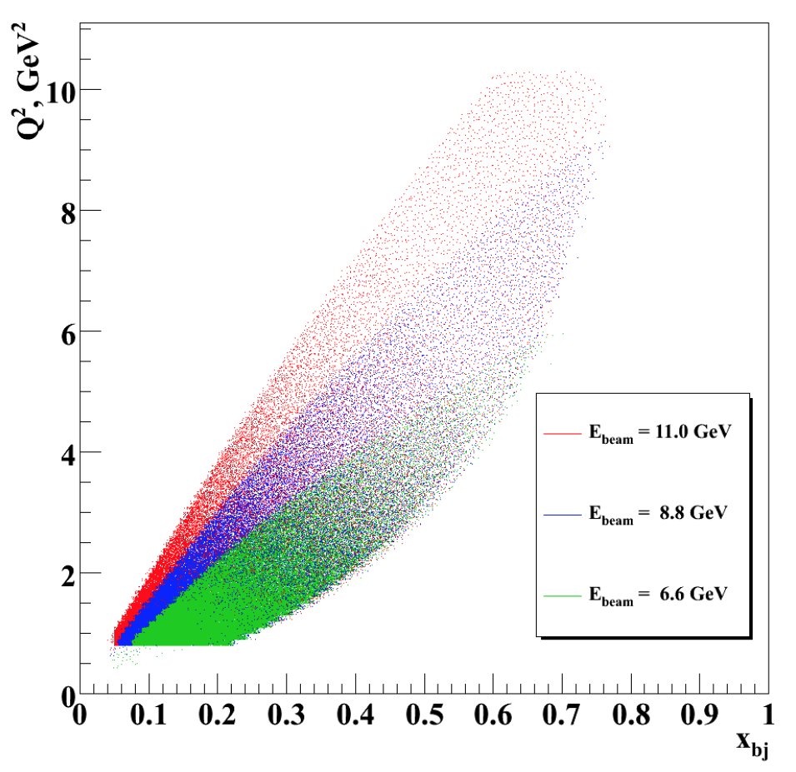
Polarized Leptoproduction
x_{F} – fractional momentum in the CM frame
x_{F}>0 (current fragmentation, CFR)
h
P
h
x_{F}<0 (target fragmentation,TFR)
COMPASS
HERMES/JLab24
y
JLab12
x
z
JLab7/9/11
in eN→e’hX
6D (x,Q²,z,P_{T},φ,φ_{S})
z

Slide 3
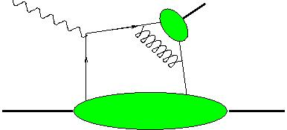
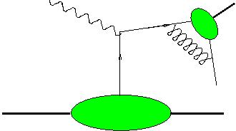


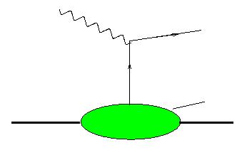
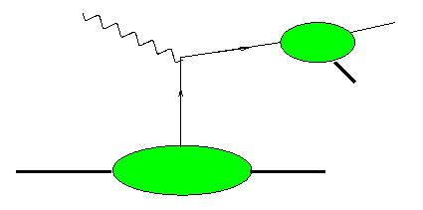
Hadron production in hard scattering in SIDIS
x_{F}
DA
π,ρ,Κ.
-1
+1
DA
N,Δ,Λ,..
Current Fragmentation Region (CFR)
N
N,Δ,Λ,..
N
π,Κ..
GPD
h
TDA
DA
h
h
X
X
PDF
N
h
Semi-exclusive production
(Brodsky-Berger)
Semi-exclusive production (Guo-Yuan)
arXiv:2312.01008
Target Fragmentation Region (TFR)
h
FF
h
q
h
X
N
0
X
M
x_{F}
TMD
Fracture Functions
Different non-perturbative objects may be involved in description, depending on kinematics
Semi-Exclusive processes allow mixed descriptions, allowing access to GPDs and GTMDs

Slide 4

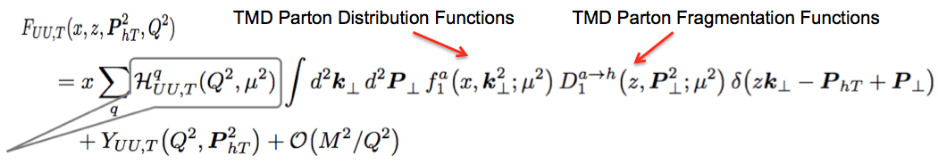
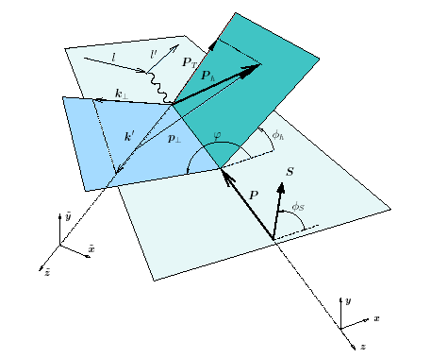
SIDIS as THE theory describes it
Probability to produce 1 or 2 hadrons in single photon exchange
can be measured from e+e-
h
can be measured from DY
X
+Radiative Corrections
hard part
Factorization allowing description using distribution functions (TMD-PDF) and fragmentation functions (TMD FF)
X→ multiplicity of unobserved hadrons LARGE, and x-section doesn’t depend on X (independent fragmentation)
Leading twist dominates,
p┴
P_{hT} = p┴ +z k┴
Conclusions in case of apparent disagreement:
factorization is broken?
unaccounted terms may contribute (assumptions are not good in certain kinematics,…)
“much bigger/smaller” defined in comparison with experiment
Data has it all!!! Dealing with unaccounted terms:
Theory accounts for them (ex. VMs)
Experiment measures and excludes them!!! (ex.VMs)

Slide 5

SIDIS in JLab: comments from theory
Statement:
“… SIDIS data has shown that there are basic open questions concerning the semi-inclusive pion/kaon production mechanisms at few-GeV energies, regarding e.g vector mesons and longitudinal photons....
Meaning:
JLab has problems specific for low energies, which should be solved, before THE theory of TMDs could be applied
Possible conclusion:
All problems are due to “few-GeV”, will magically vanish at higher energies, and TMDs can be studied in the valence region [in multidimensional space] at higher Q² using THE theory [no need to deal with higher twists/correlations of quarks/hadrons/…....]

Slide 6

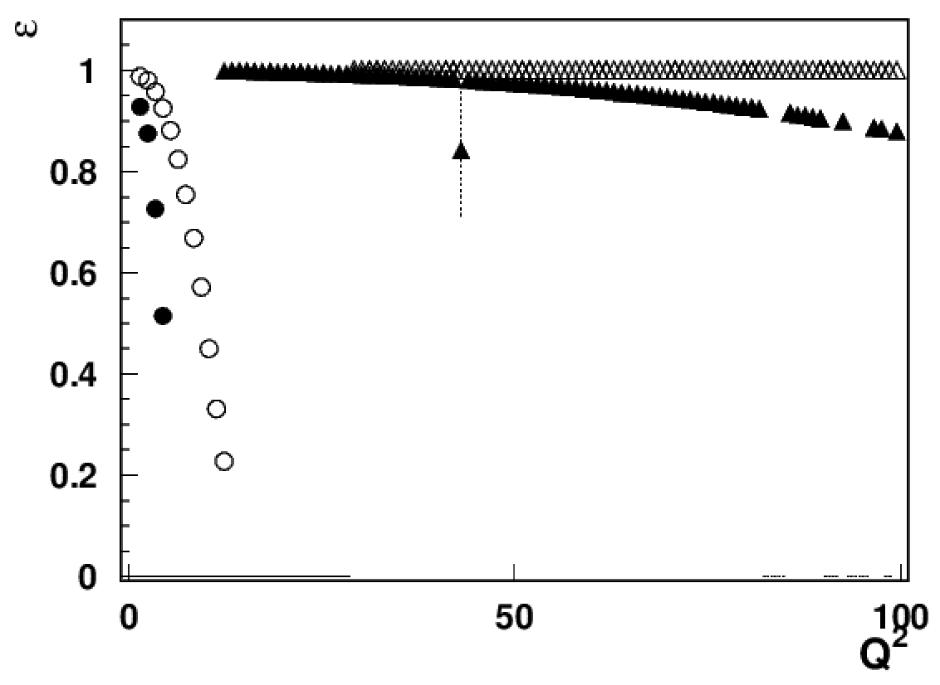
Addressing PAC/theory comments
What exactly are identified so far sources of “factorization breakdown” in SIDIS and where is the evidence that “few GeV” matters?
1) Longitudinal photon
EIC18x275
EIC5x41
For a given x&Q² the contribution from longitudinal photon increases at higher energies (ex. at EIC 5 times bigger at Q²~10, x~0.3 than at JLab )
JLab studies of impact of longitudinal photons critical for interpretation of polarized SIDIS, including EIC data
JLAB12
JLab24/HERMES
x=0.3

Slide 7
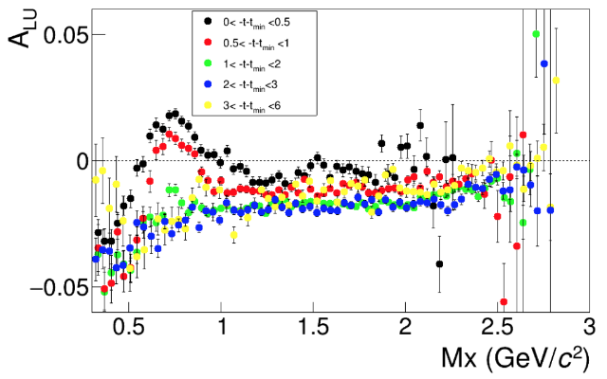
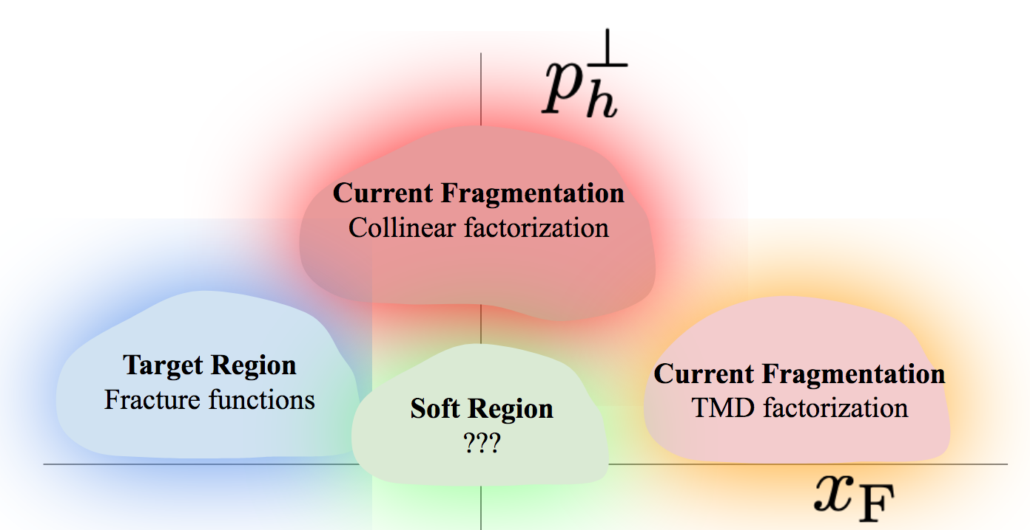
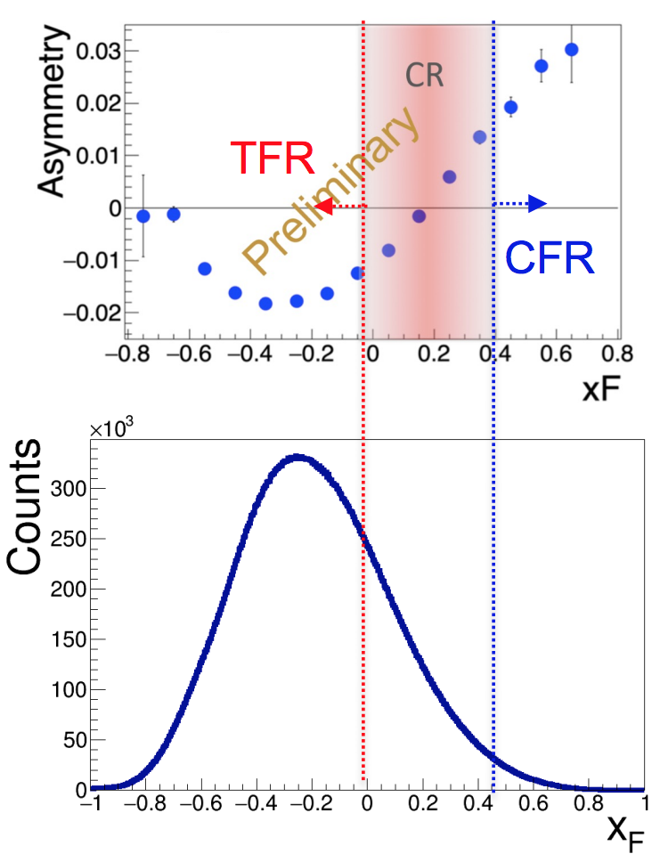
Beam SSAs as a tool to separate regions and contributions
3) Separating Target Fragmentation Region TFR from Current fragmentation region (CFR)
F. Benmokhtar & Duquesne U.
ep→e’pX
Major difference only for protons at small t!
With beams in polarized SIDIS typically always polarized, beam SSA can serve as a tool to separate
kinematical regions (CFR/TFR)
dynamical contributions
cut on M_{X} eliminate exclusive VMs
Negative sign of the SSA (plateau) defines the TFR dominance

Slide 8
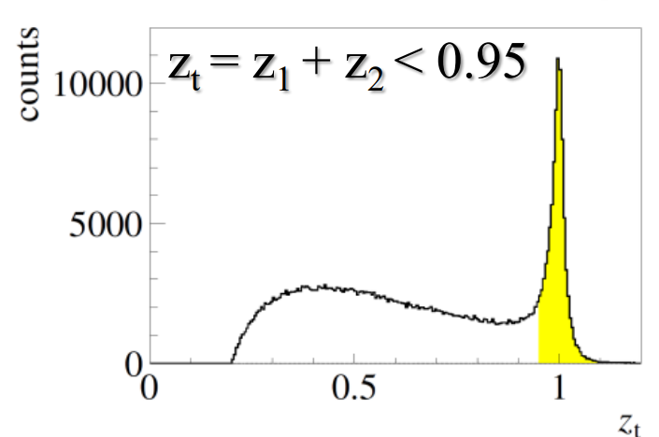
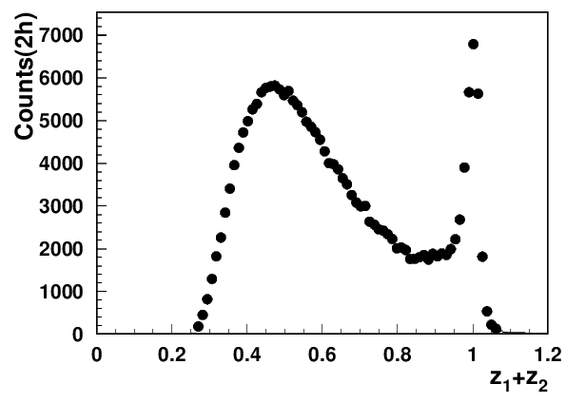
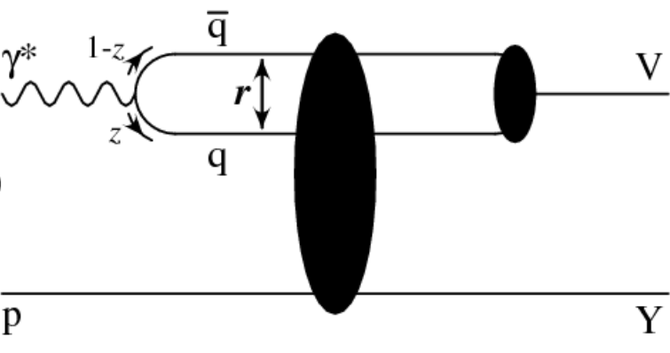
Addressing PAC/theory comments
What exactly are identified so far sources of “factorization breakdown” in SIDIS and where is the evidence that “few GeV” matters?
COMPASS 2h
CLAS12
Q²=2 GeV²
x=0.2
2) Diffractive VMs (ρ⁰)
CLAS12 measurements indicate the 2hadron exclusive sample is dominated by “diffractive rho0”produced at very small t
indication: most of the ρ⁰ are longitudinally polarized
note: higher the Q² lower is ε
Consistent with ~10% of diffractive DIS in inclusive DIS, exclusive rho contributes ~20% to charged pion SIDIS making studies of those rhos, crucial for interpretation in terms of TMDs of SIDIS data
Studies of exclusive processes require high resolution and multidimensional measurements !!!

Slide 9


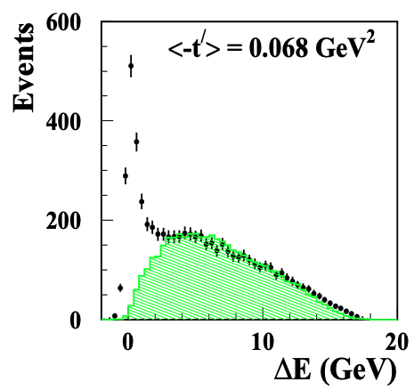
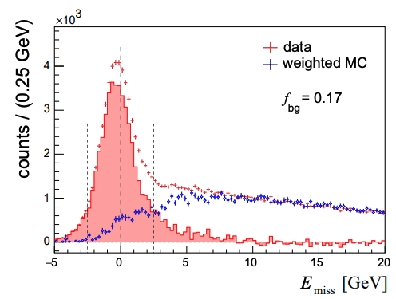
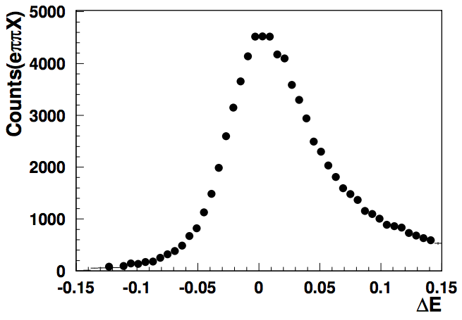
Understanding exclusive rhos and SDME validations
Exclusivity condition defined by the missing Energy:
CLAS12 (width <0.1GeV)
HERMES(width ~0.6GeV)
COMPASS(width ~2GeV)
~10% of data
Guarantying the “exclusivity” requires good resolutions (get worse at higher energies)
Subtraction procedure relays on normalization, based on exclusive limit of LUND-MC
All distributions have have tails, indicating the RC may not be negligible
Extraction of SDMEs, will require validation in the multi-D space (significant samples)

Slide 10
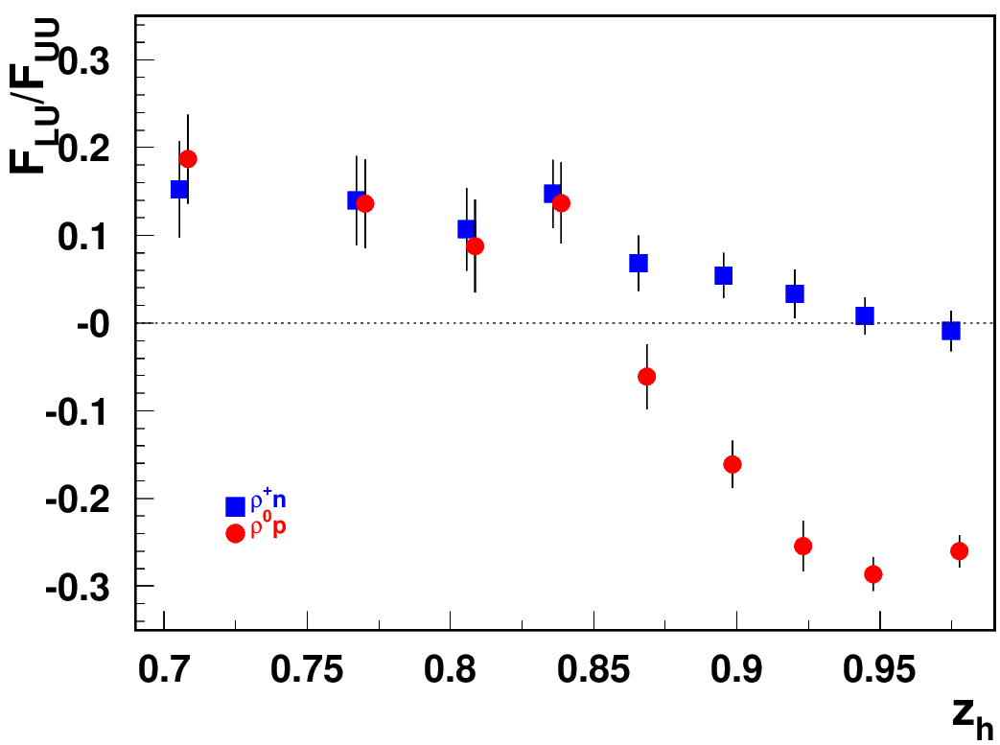
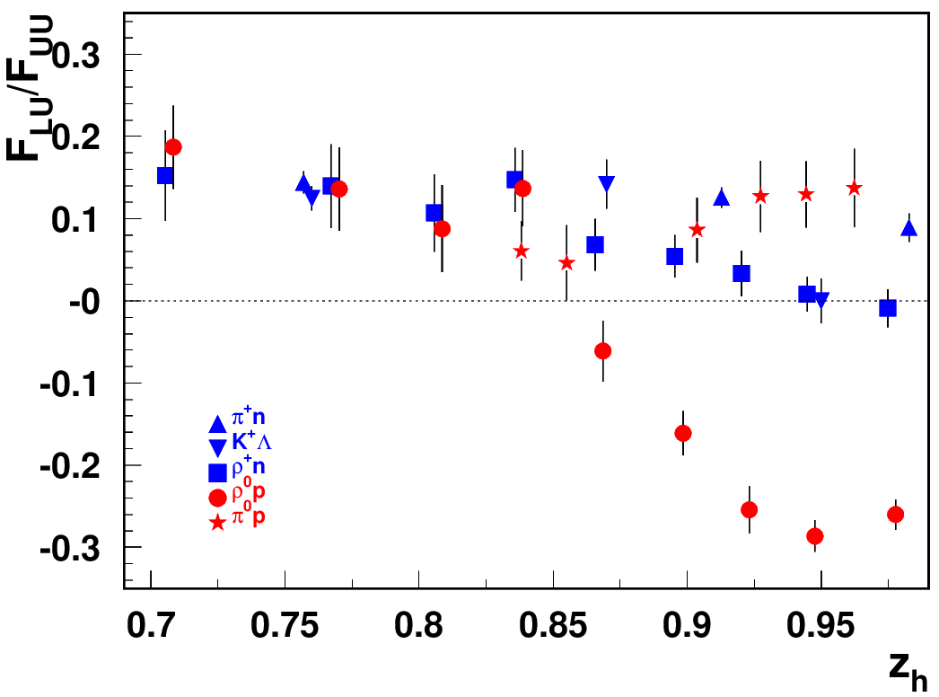
Separating the “diffractive” kinematics
Comparison with exclusive ρ+ and other non-diffractive channels clearly indicates the kinematics where the “diffractive rho0” shows up (increases at higher energies)
Comparison with other exclusive states, including the ρ⁰ at higher t, indicate the contributions from quark exchange mechanisms negligible in large z kinematics
Beam SSA for exclusive states
Diffractive VMs (ρ⁰)
+preliminary data on ep→e’pφ (A_{LU}=-0.084+/-0.038)
Beam SSA can be used to separate dynamical contributions
At higher energies (COMPASS/HERMES) no major effect were observed, as high resolution and multidimensional measurements are critical !!!

Slide 11
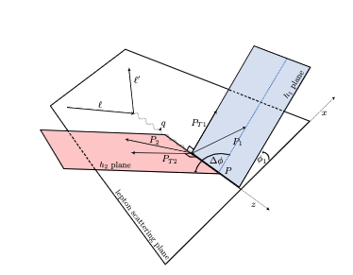
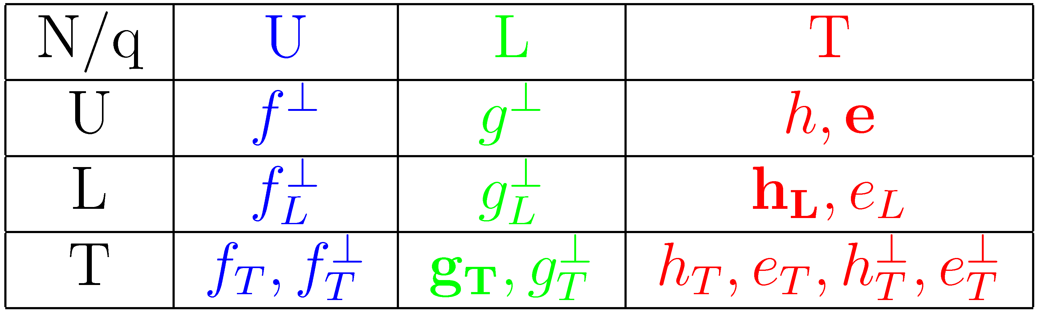
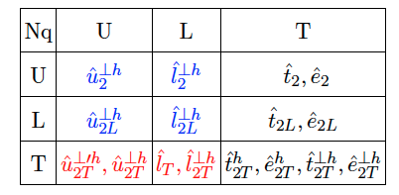
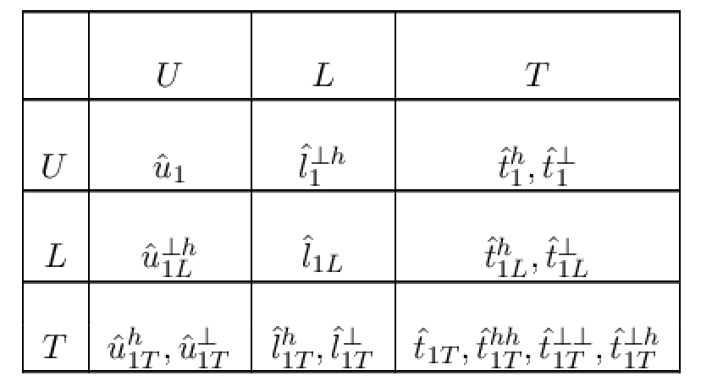
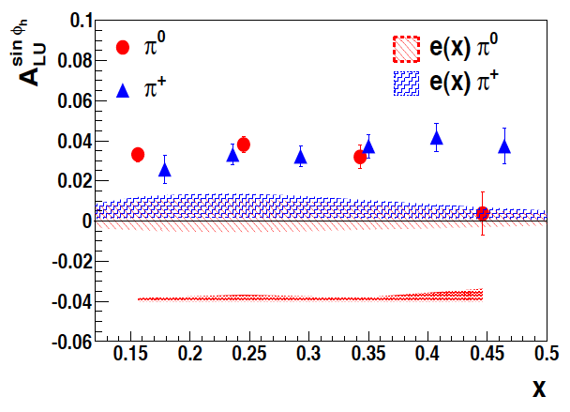
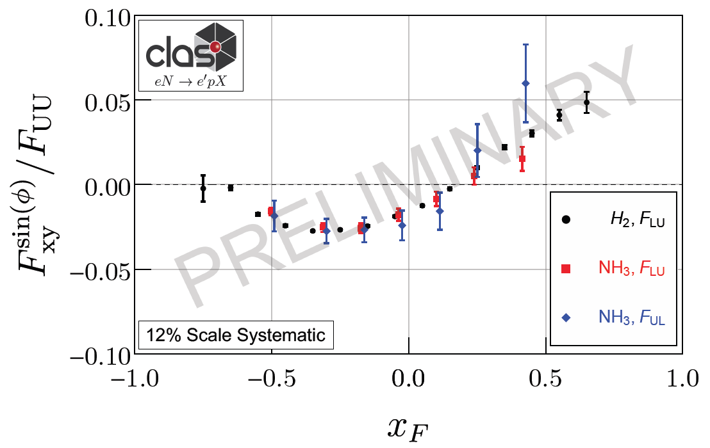
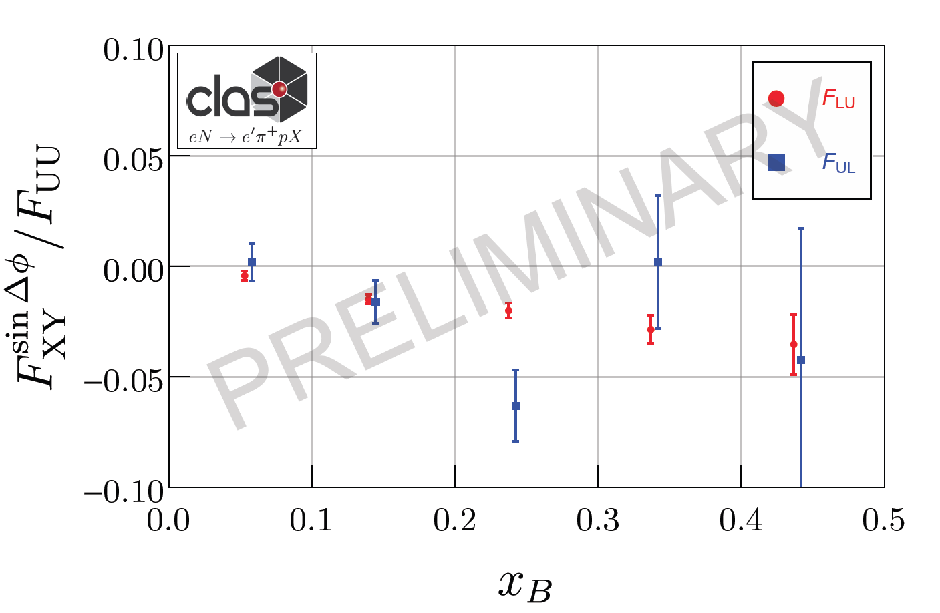
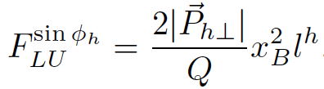

Longitudinal Beam SSA in CFR/TFR
CFR→Higher Twist TMDs
TFR→Higher Twist Fracture Functions
TFR/CFR→Leading Twist Fracture Functions
N/q
LT longitudinally pol. quarks in Unp. proton
Longitudinally polarized quarks most likely responsible for observed Single Beam Spin asymmetries

Slide 12
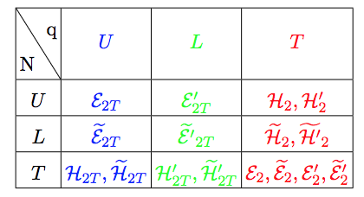

Exclusive hadron production in hard scattering
polarized quark
x_{F}>0 (current fragmentation)
x_{F} – fractional momentum in the CM frame
Twist3 GPDs
M.Constantinou
h
q’
FSI
x_{F}<0 (target fragmentation)
OAM
M.Engelhardt
L
Lorce&Pasquini, arXiv:1208.3065
Quark qluon correlations described by higher twist 3D PDFs
Correlations of the spin of the target or/and the momentum and the spin of quarks, combined with final state interactions define the azimuthal distributions of produced particles in exclusive limit

Slide 13
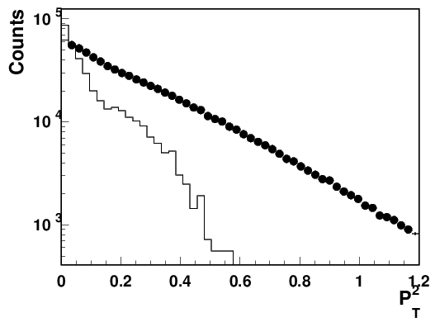

Contributions of “diffractive rho0s” in SIDIS
G.Matousek (Duke) & N.Trotta (UCONN)
0.18<x<0.22
0.5<z0.7
Q²=2 GeV²
total eπ+X
Estimated ~20% contributions from rho, mainly show up at low P_{T} in SIDIS
The “diffractive” rho will bias extractions of TMDs, unless properly subtracted in multidimensional space of SIDIS measurements.
Notes:
Lorenz invariant amplitudes

Slide 14
Excluding the “diffractive” rho from SIDIS
Depending on how we exclude the exclusive rho we can have several versions of experimental samples of inclusive hadrons, each with their own bias:
1) Standard SIDIS (eN→ehX, h=π,K,..) within the full accessible kinematics, corrected for acceptance and RC, measured in the multidimensional space
  →eπX biased with respect to theory by presence of contributions from diffractive rho, contributing to ~20% of counts, in low P_{T}, with contributions to SSA ~10 times higher
2) Standard SIDIS (eN→eπX) within the full accessible kinematics, corrected for acceptance and RC, measured in the multidimensional space, with subtracted in multi-D bins for rho0 contributions (“rho-subtracted SIDIS”)
  →requires measurements of pions from diffractive rho in multidimensional space, means detailed studies of SDMEs of rhos, requiring good precisions and huge statistics, also for all polarization observables, extensive validation needed, little known RC
SIDIS subsamples (eN→epπX, eN→eππX) within the full accessible kinematics, allowing clear eliminiation of rho0 contributions using cuts on missing masses of epX or eππX
(“rho-free SIDIS”)
  →biased by the presence of additional hadron in TFR (epX) or CFR (eppX), may need a new phenomenology
  requires measurements of dependence on M_{X} to understand the bias,
  Theory should be able to evaluate the bias from the presence of an additional hadron

Slide 15
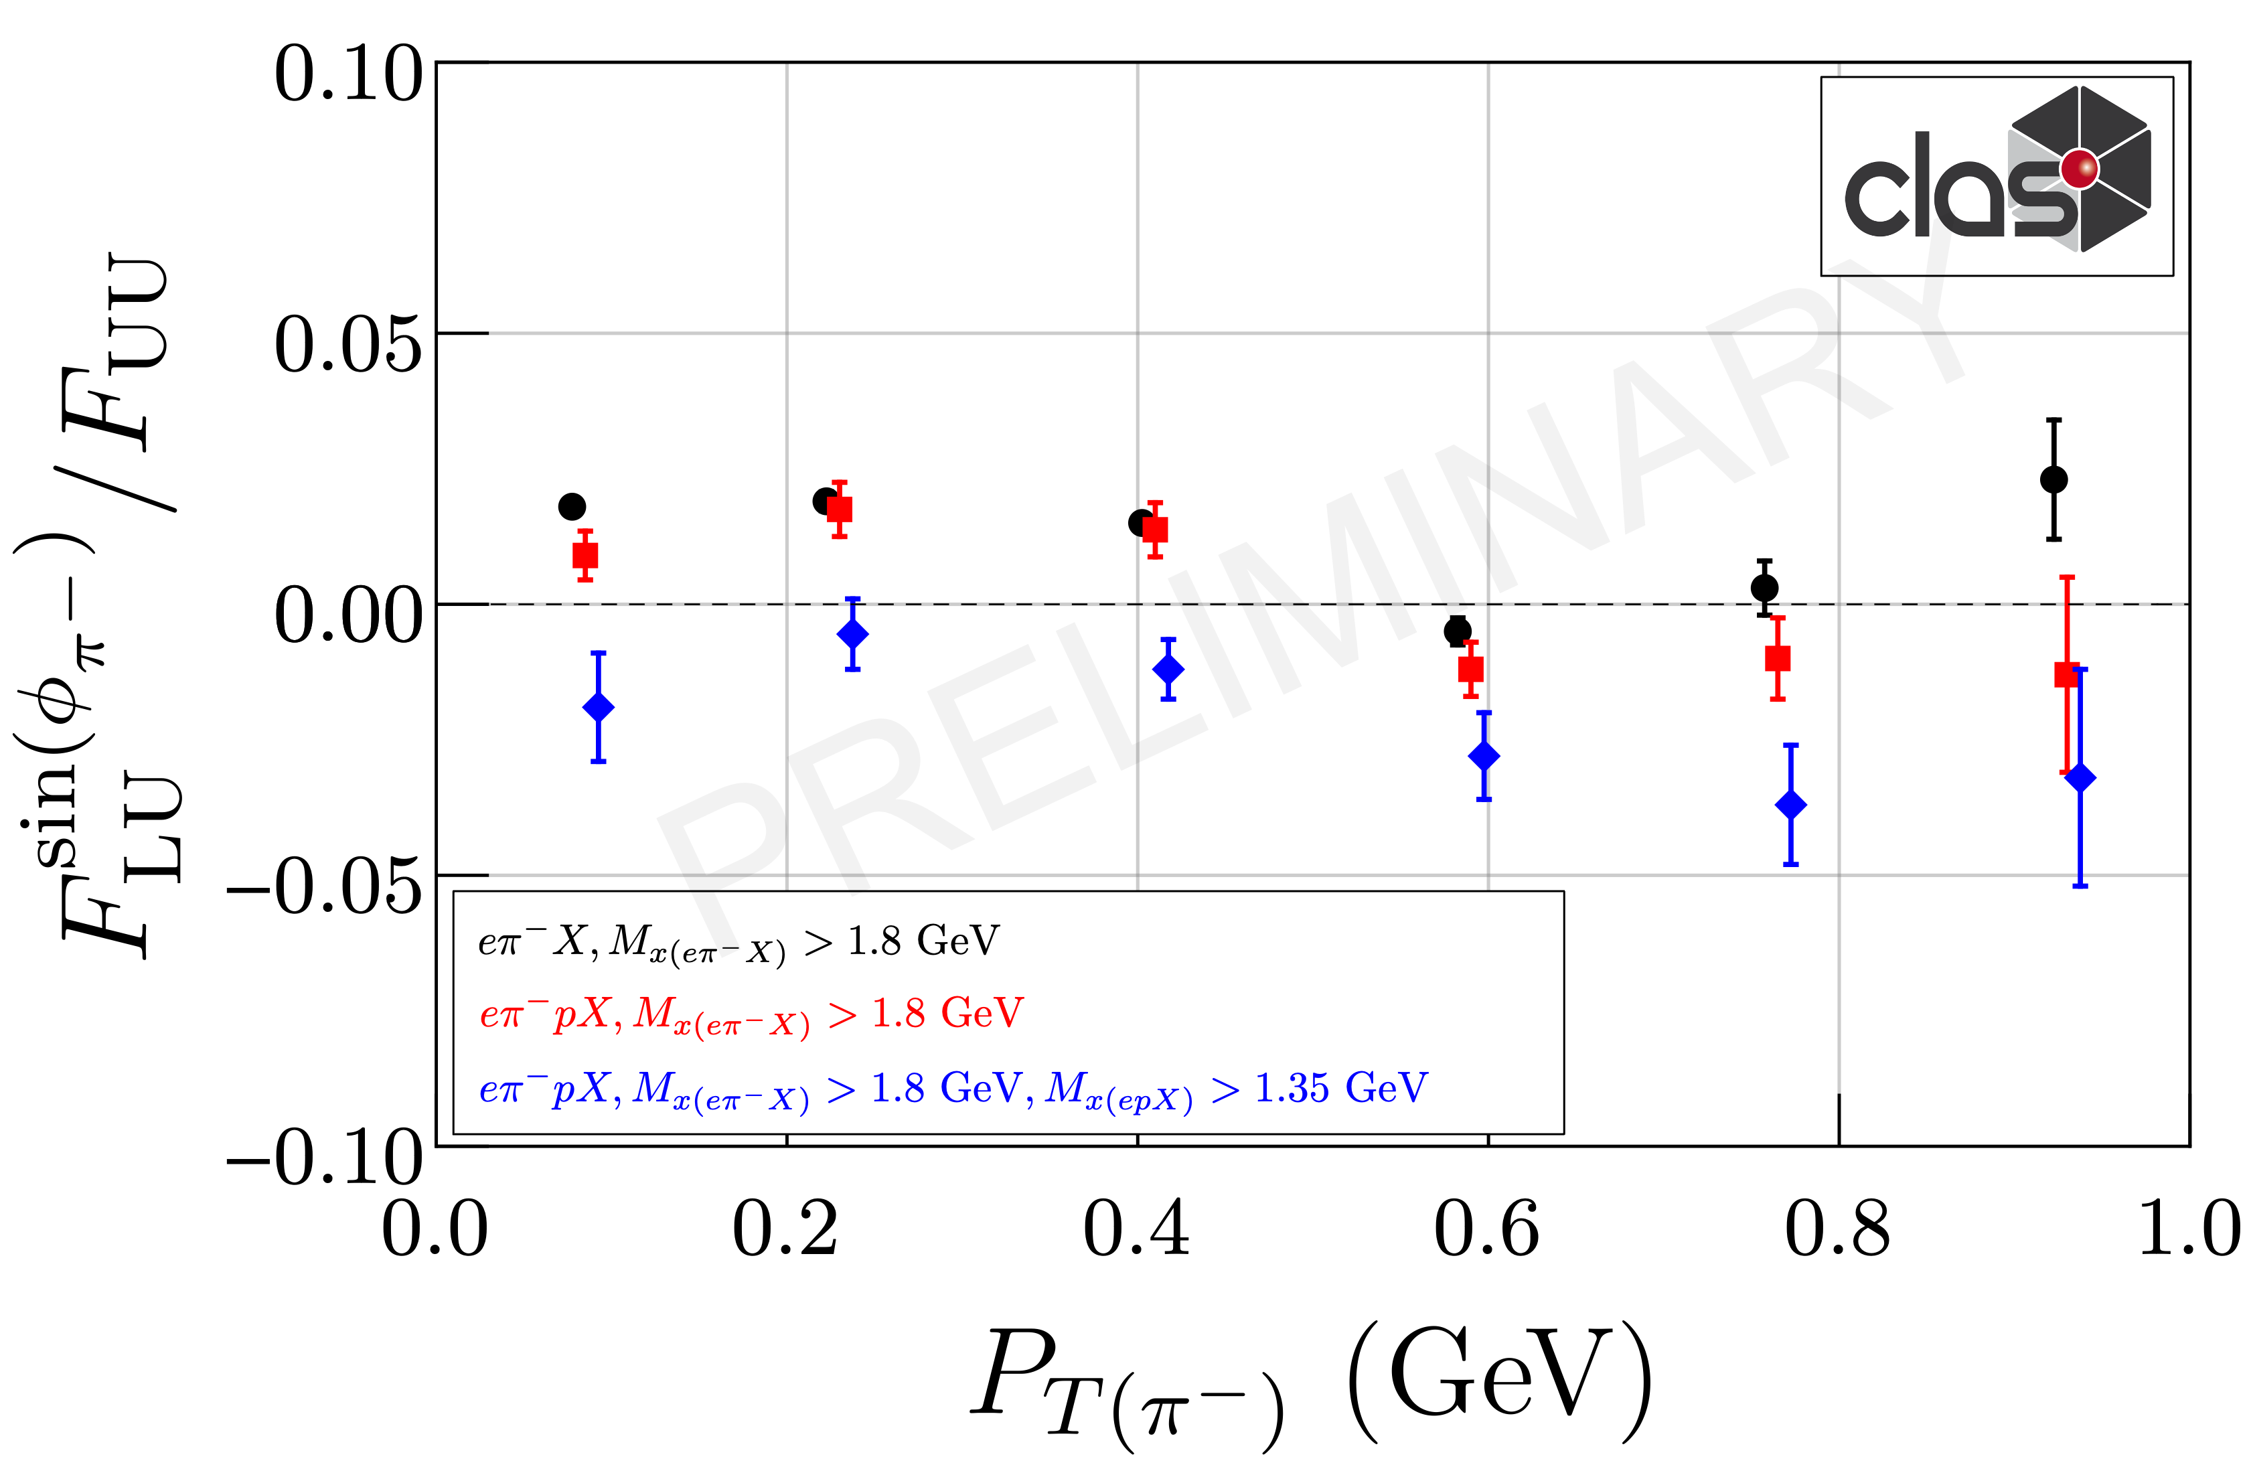
“rho-free” SIDIS and possible bias
Use sample of ep→e’p π- X and and make plots with and without M_{X} cut(epX) 1.35 GeV
All point include
M_{X}(e’π-X)>1.8 GeV
→out of resonance region
Blue squares
M_{X}(epX) >1.35 GeV (rho-free), significantly different and will impose much less challenge for phenomenology
COMPASS→“Positive trend”?
Exclusive rho-0s have very significant impact on kinematic dependences of SIDIS SSAs, in particular at low P_{T}
While VM contributions are ~20% in multiplicities in SSA they can be >100%
Detection of the target proton introduces much smaller bias on the inclusive charged pion SSA, than the exclusive rho contributions

Slide 16
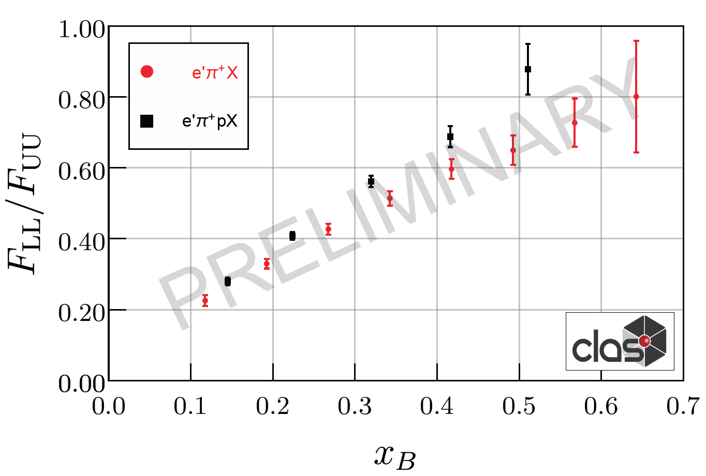
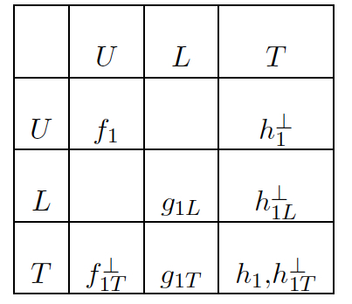
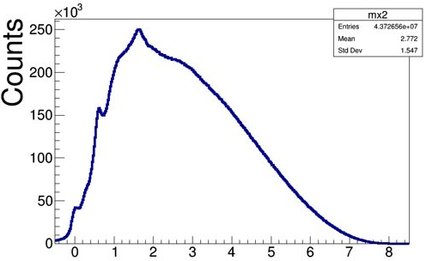
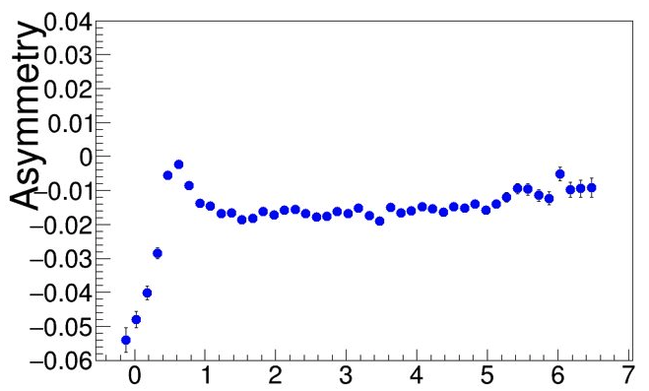
Longitudinally polarized quarks & protons in SIDIS
ep→e’πX
ep→e’pπX
N/q
standard SIDIS
b2b SIDIS
Detection of proton allows elimination of exclusive rho!
Possible theory formalisms:
φ
f₂
Formalism based on fracture functions (Anselmino, Barone, Kotzinian (back-to-back, b2b, hadron production, DSIDIS)
Semi-exclusive processes, involving GPDs/GTMDs on proton side (TFR) and FFs on pion side (CFR) Yuan and Guo
HEMP
SIDIS (“ρ free”)
Differences in A_{LL} , due to different weights on PDFs can provide additional info on impact of possible ingredients
Measurements of A_{LL} for ρ⁰ indicate very small values, and can be one of the reasons for higher A_{LL} with protons with a M_{X} cuts above 1.5 GeV (excluding exclusive ρ⁰ )
ep→e’pρ⁰ /ω
x_{F}<0
Beam SSA
M_{X}²(ep→e’pX)
ep→e’pπ⁰

Slide 17
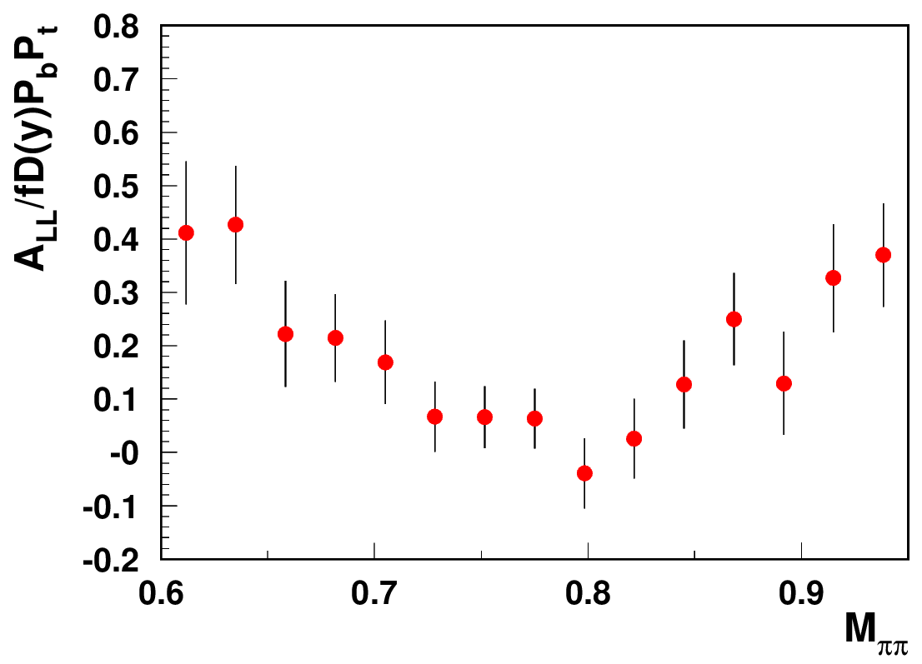
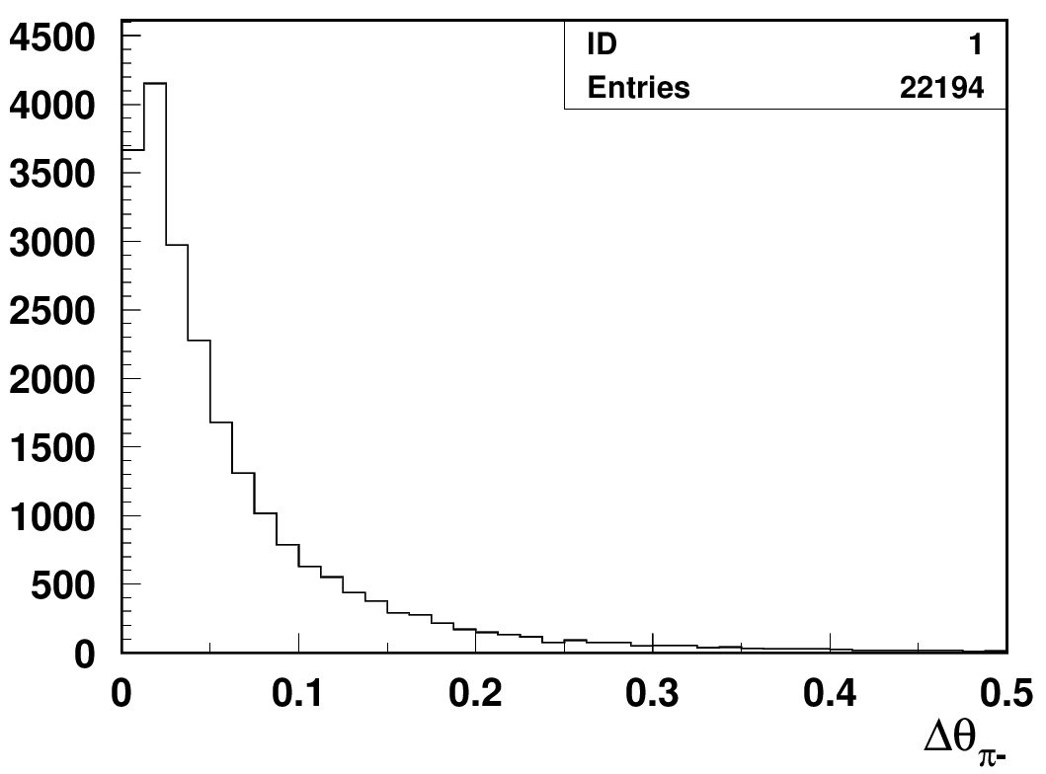
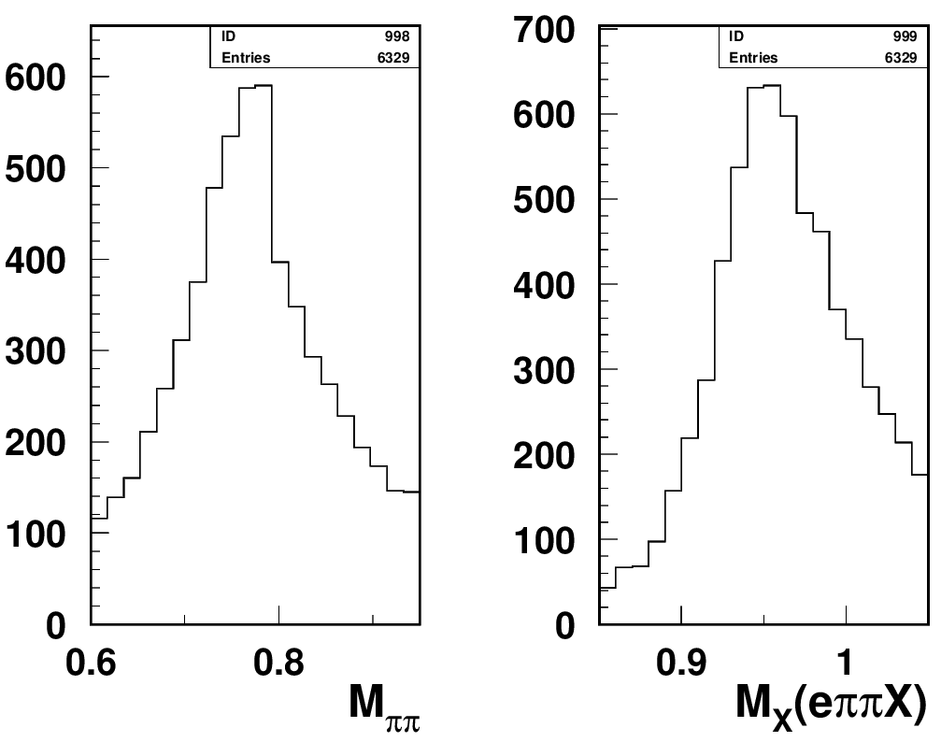
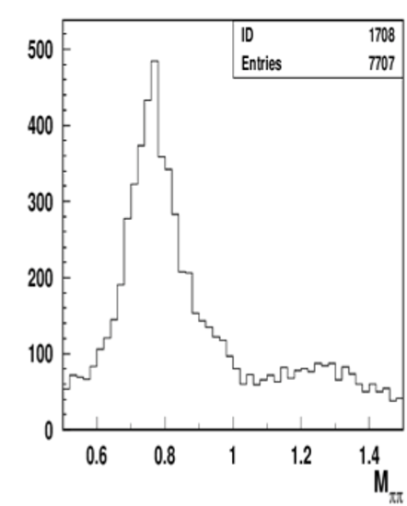
Studies of ρ⁰ impact with longitudinally polarized NH₃ target
Separating exclusive dihadrons
CLAS12 Preliminary
calculated
θ
measured
cut on Δθ <1º beetween measured and calculated π−
ep->e’p’π⁺π⁻
Require the angle of negative pions is within a degree from calculated from e’,p,π+ assuming exclusive e’,p,π+π- event.
Measurements of A_{LL} for ρ⁰ indicate very small values (with ~10-20% bck, likely negative ~ -2-10% ), and can be one of the reasons for higher A_{LL} with protons with a M_{X} cuts above 1.35 GeV (excluding exclusive ρ⁰ )
Need clear separation of hydrogen from NH₃
and diffractive exclusive ρ0s from exclusive π+π−

Slide 18
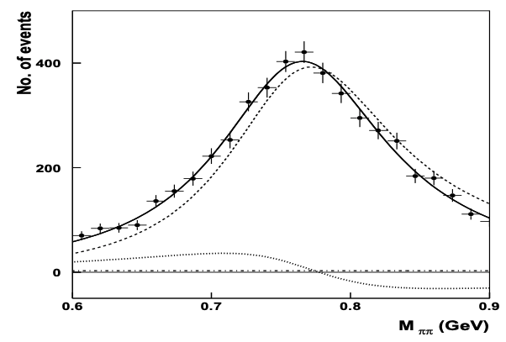
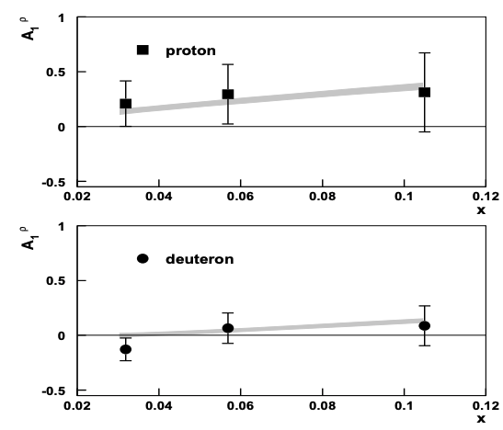
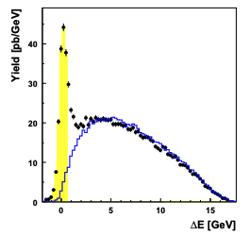
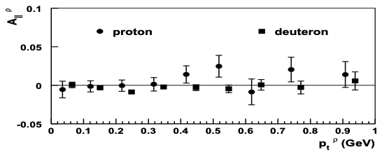
A_{LL} studies of exclusive ρ⁰ : HERMES
A_{1ρ}=0.23 ± 0.14±0.02
1D plots can be really misleading need multi-D
For a proper extraction of multiplicities and spin-azimuthal modulations of exclusive ρs, clean separation is needed for ρ⁰, and longitudinally polarized ρ⁰ signal, in particular
At low P_{T}, where the background is smaller, the asymmetry indeed tend to be negative
Accounting of ρ⁰ will change the phenomenology of helicity distributions

Slide 19
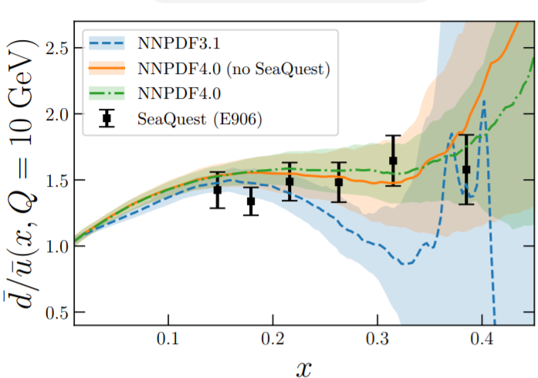
Understanding the QCD: from observables to QCD dynamics
Main goal to study the non-perturbative QCD dynamics in 3D space in details
JLAB uniqueness:
The superior luminosity of CEBAF, high resolutions of detectors, and ability for multidimensional and multiparticle detection, makes the JLab unique in disentangling the genuine intrinsic transverse structure of hadrons encoded in 3D partonic distributions (TMDs and GPDs) with controlled systematics in the kinematics dominated by valence quarks.
Understanding of hard scattering data at Q²<10 GeV² critical for multidimensional measurements, needed for understanding the QCD dynamics
The leptoproduction, with hadrons detected in the final state, from experimental point of view, in simplest case of a single hadron, is a measurement of observables in 5D space (x,Q²,z,P_{T},φ), 6D for transverse target, +φ_{S}
  Collinear SIDIS (last 50 years), is just the proper integration of observables, over P_{T},φ,φ_{S}

Slide 20
SUMMARY
Detection of additional particles in the Target Fragmentation Region provide access to partonic correlations and allows clear separation of exclusive and semi-inclusive events
Beam SSAs can be used as a tool to separate kineamtical regions in SIDIS and also separation of different dynamical contributions
Studies of QCD dynamics with controlled systematics involving Semi-Inclusive DIS, requires multidimensional measurements of cross sections/multiplicities/asymmetries as a function of all involved kinematical variables (including P_{T} and φ). Need reform in theory-phenomenology-experiment coordination
  For interpretation of the SIDIS data it is critical to separate contributions from different structure functions, as well as separation of different production mechanisms in a given structure function (including VMs)
  The diffractive VM contributions, violate the factorized picture of SIDIS based on the dominance of the leading twist contributions, and the “rho free SIDIS” may help to address the challenges of phenomenology

Slide 21
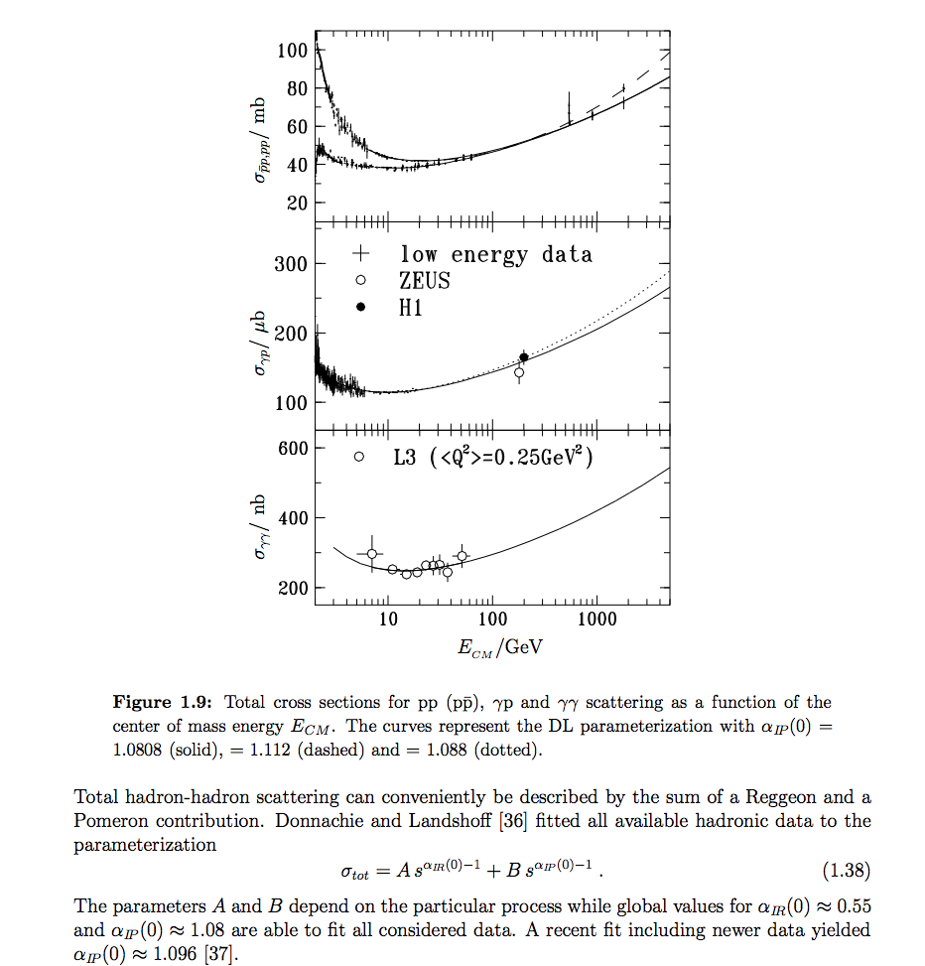

x-section

Slide 22
3D PDF Extraction and VAlidation (EVA) framework
EVA meetings at JLab to finalize goals and coordinate efforts
SIDIS,DY,e+/e-)
experiments
Hard Scattering MC (GEANT, FASTMC,…)
Generate/train in full parameter space
event selection
e’hX, e’hhX,..
Grid operations
QCD fundamentals
Library for Structure Function (SF) calculations
3D PDF and FF (models,
parametrizations)
Radiative
x-section
x-section calculations
SF calculations
Given Detector response (raw data)
Defined set of assumptions
Defined set of assumptions
Data Counts for all combinations of helicity states lepton/proton
N⁺⁺, N⁺⁻, N⁻⁺, N^{—(x,y,z,PT,phi)}
Extract 3D PDFs
extract
x-section
Extract SFs
Validation of extracted SFs or 3D PDFs (for a given set of assumptions)
Direct extraction of a given parameter sets from all steps (marked red) using AI tools techniques for the extraction of 3D PDFs and fragmentation functions from the multidimensional experimental observables with controlled systematics requires close collaboration of experiment, theory and computing

Slide 23




Exclusive ρ contributions to π: z-dependence
COMPASS (proton)
π− and π+ show similar behavior
Diffractive rho can change significantly observed pion SSAs
The same sign and size of π+ and π- SSA indicates the rho0 may not be properly subtracted(require detailed MC studies, which require proper SDMEs)

Slide 24




Unique ability to measure target fragments
Detection of the target nucleons (B2B SIDIS) provide a powerful tool to control the contributions in CFR
ep→e’pπX
3 processes:
ep→e’hX (regular SIDIS)
ep→e’NhX (SIDIS+ TFR nucleon, B2B SIDIS)
ep→e’NhX (SIDIS+ TFR Nucleon + cut on M_{X}(ep→e’NX)>1.35 GeV
“ρ-free” SIDIS
“ρ-free” SIDIS
0.1<P_{T}<0.3, 0.4<z<0.6
0.5<P_{T}<0.7, 0.4<z<0.6
ep→e’pX
Exclusive ρ (possibly f₂) have very significant contributions to all SIDIS observables (ex. beam SSA), which can be completely eliminated with detection of the TFR proton

Slide 25


Exclusive ρ⁰ (π+π−) contributions
Given detector resolutions and possible backgrounds the best option for studies of ep→e’p ρ⁰ will be detection of all 4 particles e’p,π+,π−
One can make invariant masses and missing masses of all combinations
ex. M_{X} (e’π+π−X) or M_{π+/π−} , M_{X}(e’p π+), M_{X}(e’p π−) also cuts calculated vs measured θs
θ
Plans: publish x-sections/multiplicities and SSAs of exclusive ρ(π+π−)
cut on Δθ <2º beetween measured and calculated π−
cuts on missing masses
cuts on invariant masses
10.5GeV
6.5GeV
at higher energies ρ more dominant
7.5GeV
6.5GeV
7.5GeV
10.5GeV

Slide 26










Exclusive dihadrons from CLAS12
Q²=2 GeV²
Q²=3 GeV²
Q²=4 GeV²
x=0.2
Fraction of rho decreases with Q²
Q²=2 GeV²
Q²=3 GeV²
Q²=4 GeV²
Q²=5 GeV²
x=0.3
Q²=2 GeV²
Q²=3 GeV²
Q²=4 GeV²
Q²=5 GeV²
x=0.4
Notes:
Lorenz invariant amplitudes

Slide 27

Understanding exclusive rhos and SDME validations

Slide 28

Understanding exclusive rhos and SDME validations

Slide 29

Understanding exclusive rhos and SDME validations

Slide 30



Radiative effects: impact on missing mass
Claim RC is negligible
solid→ reconstructed values
dashed→ e- generated
dotted/dash-dotted
→π generated
HERMES
LUND-MC description of the exclusive limit will be important in evaluation of the tail.
Energy loss of final state particles creates a shoulder (mainly e- for CLAS12)

Slide 31









“ρ-free SIDIS” free: target proton bias
ep→e’ππX
ep→e’pππX
+ x_{Fproton}<0
ep→e’pππX
+ x_{Fproton}<0
+ M_{X}(epX)>1.05 GeV
x=0.3(0.25<x<0.35)
Q²=2 GeV²
Q²=3 GeV²
Q²=4 GeV²
While the detected proton introduces slight difference in the kinematic distributions, the cut on the proton missing mass makes significant impact (clear at large z).
Notes:
Lorenz invariant amplitudes

Slide 32

Understanding exclusive rhos and SDME validations

Slide 33

Understanding exclusive rhos and SDME validations

Slide 34

Understanding exclusive rhos and SDME validations

Slide 35

Understanding exclusive rhos and SDME validations

Slide 36

Studies of rhos at COMPASS
tails may be significant, also because of RC

Slide 37
What we learned: missing parts of the mosaic
SIDIS, with hadrons detected in the final state, from experimental point of view, is a measurement of observables in 5D space (x,Q²,z,P_{T},φ), 6D for transverse target, +φ_{S}
Collinear SIDIS, is just the proper integration, over P_{T},φ,φ_{S}
SIDIS observations relevant for interpretations of experimental results:
  Understanding the kinematic domain where non-perturbative effects of interest are significant (ex. x,P_{T}-range)
  Understanding of P_{T}-dependences of observables in the full range of P_{T} dominated by non-perturbative physics is important
  Understanding of phase space effects is important (additional correlations)
  Understanding the role of vector mesons is important
  Understanding of evolution properties and longitudinal photon contributions
  Understanding of radiative effects may be important for interpretation
  Overlap of modulations (acceptance, RC,…) is important in separation of SFs
  Multidimensional measurements with high statistics, critical for separation of different ingredients
QCD calculations may be more applicable at lower energies when 1)-7) clarified

