Slide 1
The science case for low-energy intense positron beams
Benjamin Rienäcker | Research Associate | University of Liverpool / QUASAR Group

Slide 2
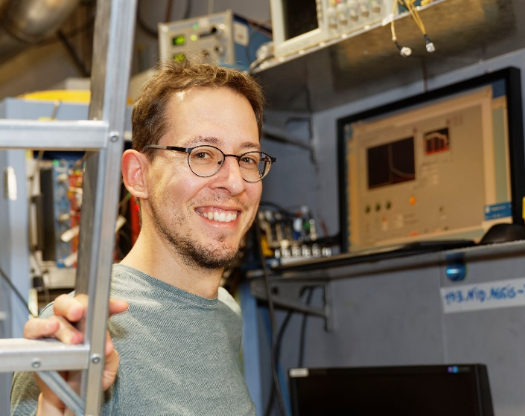
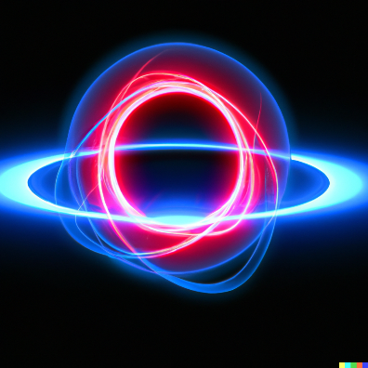
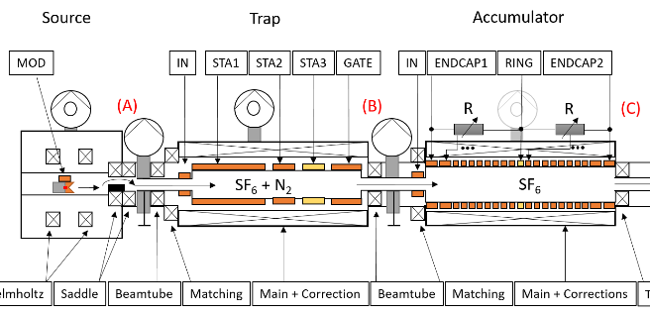
About me
I have worked at three facilities
using slow positrons:
NEPOMUC at FRM-II, Munich
AntiMatter Laboratory, Trento
AEgIS collaboration, CERN
Ps
PoSi
2024: “Experimental physicist”
< AEgIS Physics Coordinator >
AEgIS e⁺ system

Slide 3
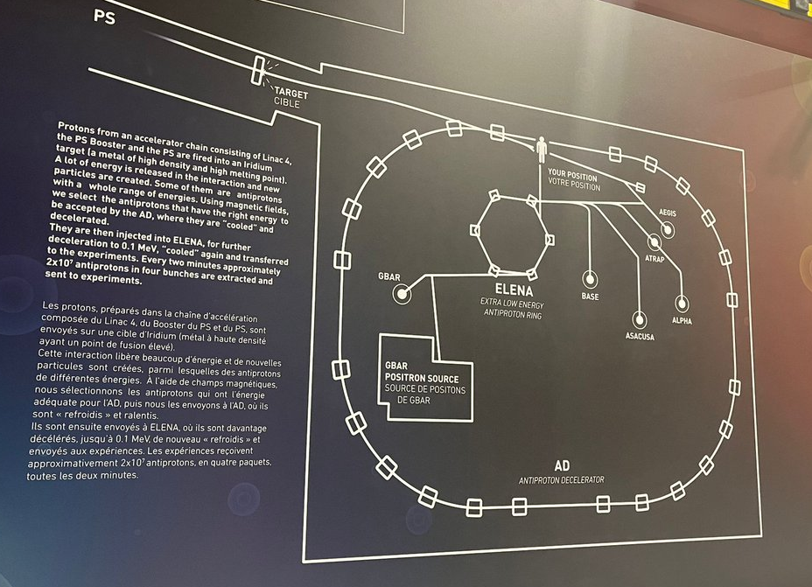
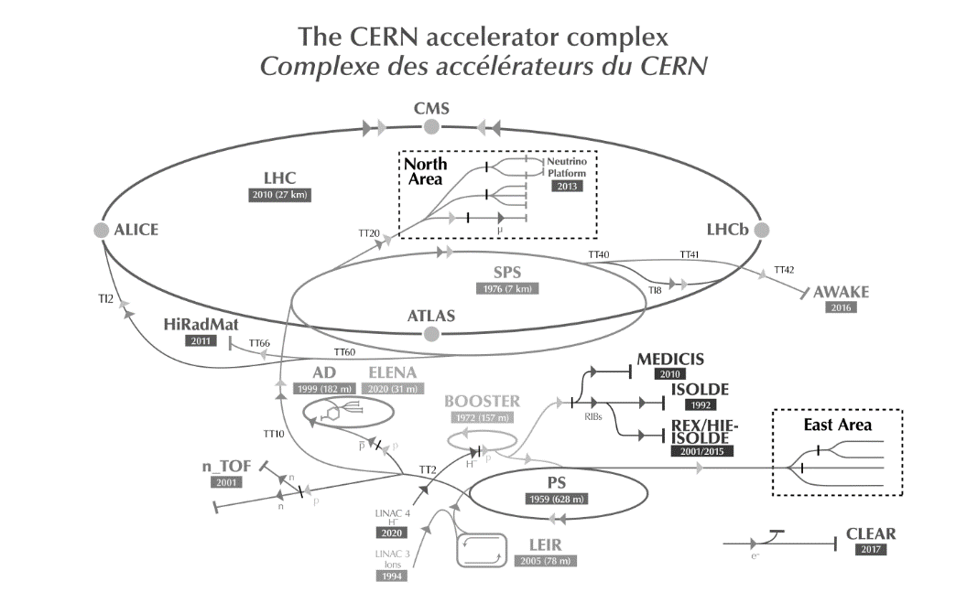
CERN: The Antimatter Factory (AD/ELENA)
„The only (?) place with cold antiprotons in larger numbers“
BASE
AEgIS
GBAR
PUMA
ASACUSA
ALPHA

Slide 4
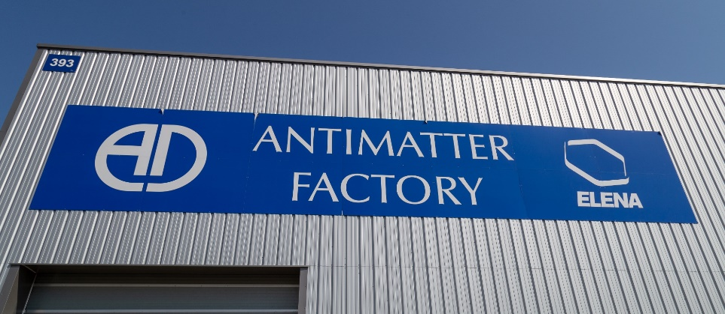
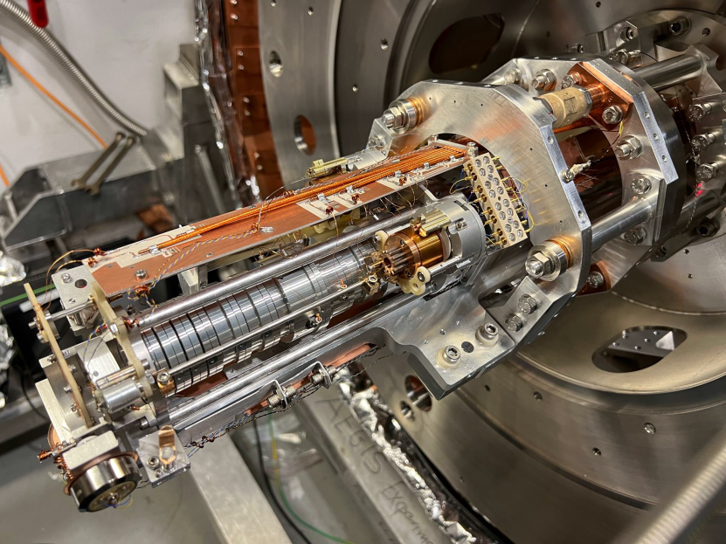
AEgIS: Production of anti-hydrogen
Charge exchange reaction:
$${Ps}^{∗}+ \overline{p}→ e^{−}+{\overline{H} }^{∗}$$
H*
laser excitation
Ps*
Ps converter
e⁺
antiprotons
H*
New trap 2022
Phys. Rev. A 94, 022714 (2016)
https://doi.org/10.1103/PhysRevA.94.022714

Slide 5
AEgIS: Production of anti-hydrogen
antiproton
positron
electron
positronium
antihydrogen

Slide 6
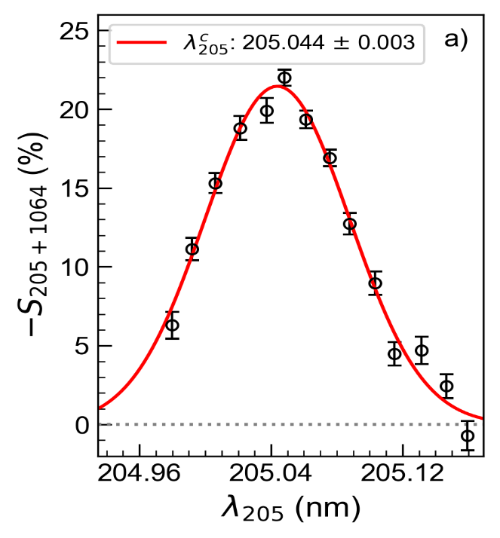
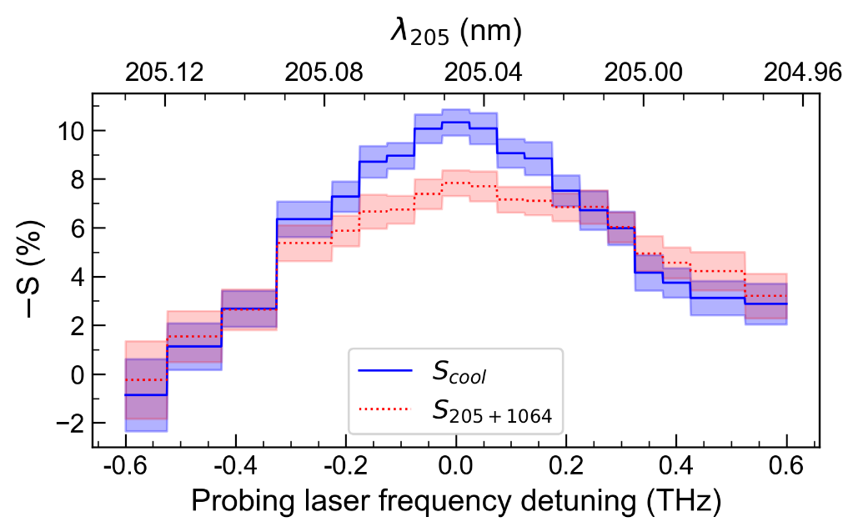
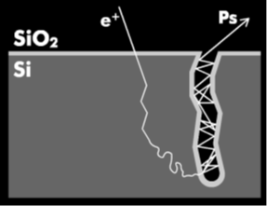
Physics with Ps at AEgIS
Nanoengineered positron to Ps conversion target
Laser Doppler-selection of the sample coldest atoms
Laser cooling of the coldest fraction
170K
380K
PRL 104 (2010) 243401, J. Phys. B 54 (2021) 085004
PRL 132 (2024) 083402
PRA 99, 033405 (2019), PRA 102, 013101 (2020)
Gained a lot of experience on the above three Ps pillars
Limited availability of positrons – currently only one experimental trial every few minutes.
Experiments greatly benefit from reliable and intense e⁺ sources.
Usually, groups do not have the resources to operate a LINAC source/reactor source.

Slide 7
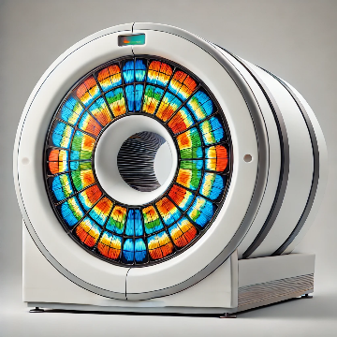
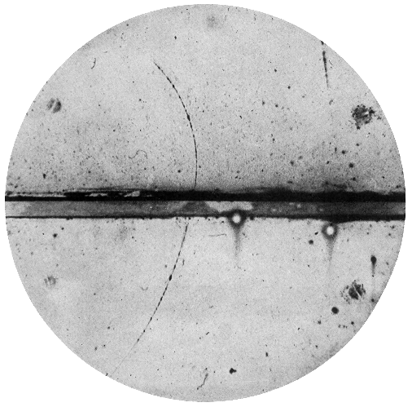
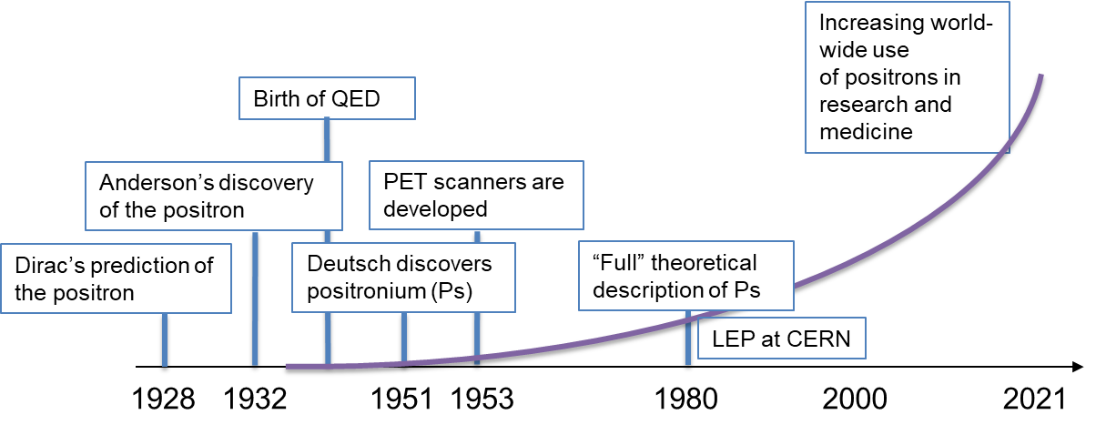
A century worth of positrons ...
2024

Slide 8
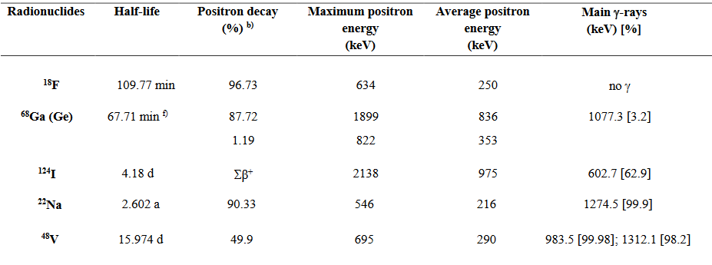
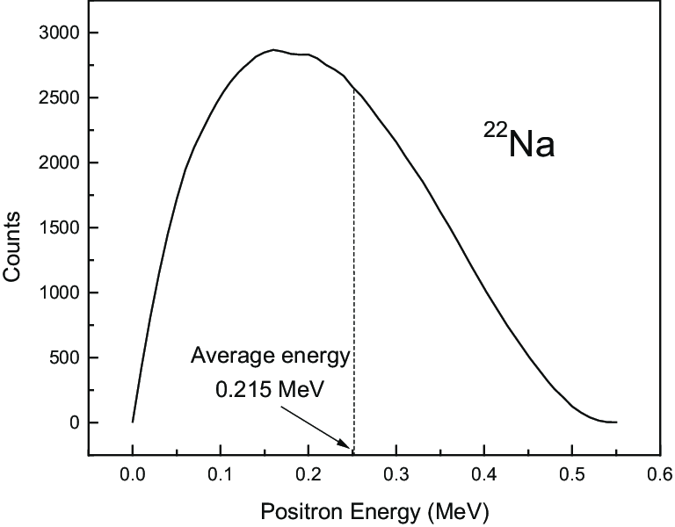
1/3 – Radionuclide sources
Positron Emission
Tomography (PET)
Tool in research
²²Na (halflife 2.6 years):
Most common laboratory positron source.
Single supplier world-wide for intense sources (50mCi)
4-pi source with
Moderated beam:
${2∙10}^{9}$ e⁺/s at @ 0-546keV
${3∙10}^{6}$ e⁺/s at @ 6eV

Slide 9
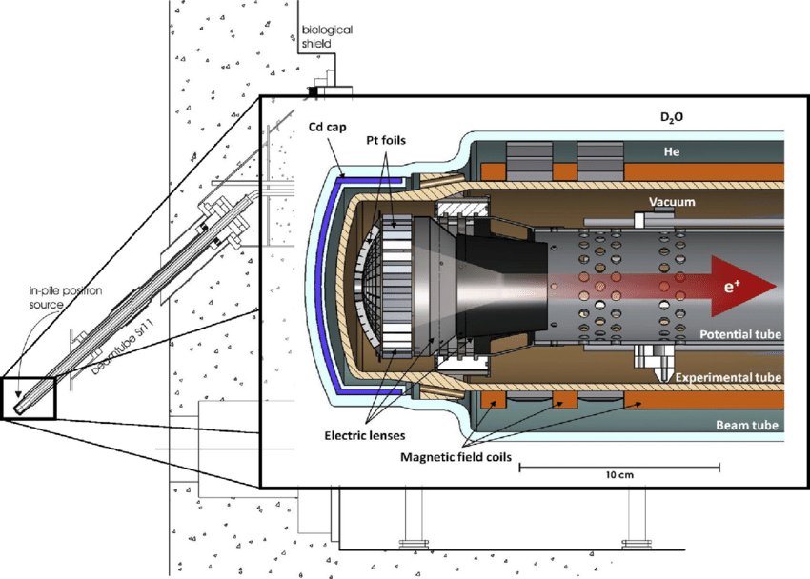
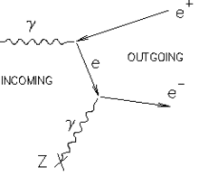
2/3 – Reactor sources
Example: Neutron induced positron source Munich (NEPOMUC), Germany
Research reactor
FRM-II, Garching
Other reactor-based positron sources:
ILL (Institut Laue-Langevin) in France
KUR (Kyoto University Research Reactor) in Japan
POSH (Delft University of Technology) in the Netherlands
PULSTAR (NC State University) in the USA
$${}_{}^{113}{\text{Cd}} +\text{n}→ {}_{}^{114}{\text{Cd}}+γ(\text{9 }\text{MeV})$$
${3∙10}^{9}$ e⁺/s at @ E_{L} = 1keV
${5∙10}^{7}$ e⁺/s at @ E_{L} = 20eV
Pt

Slide 10
3/3 – Accelerator sources
GBAR (CERN)
2-300 Hz
$$⋮$$
${5∙10}^{7}$ e⁺/s at @ E_{L} = 50eV
$$σ_{L}=4.2\text{eV}$$
Tungsten mesh: $ε= {<10}^{−3}$
https://cds.cern.ch/record/2722395/files/2006.05966.pdf

Slide 11
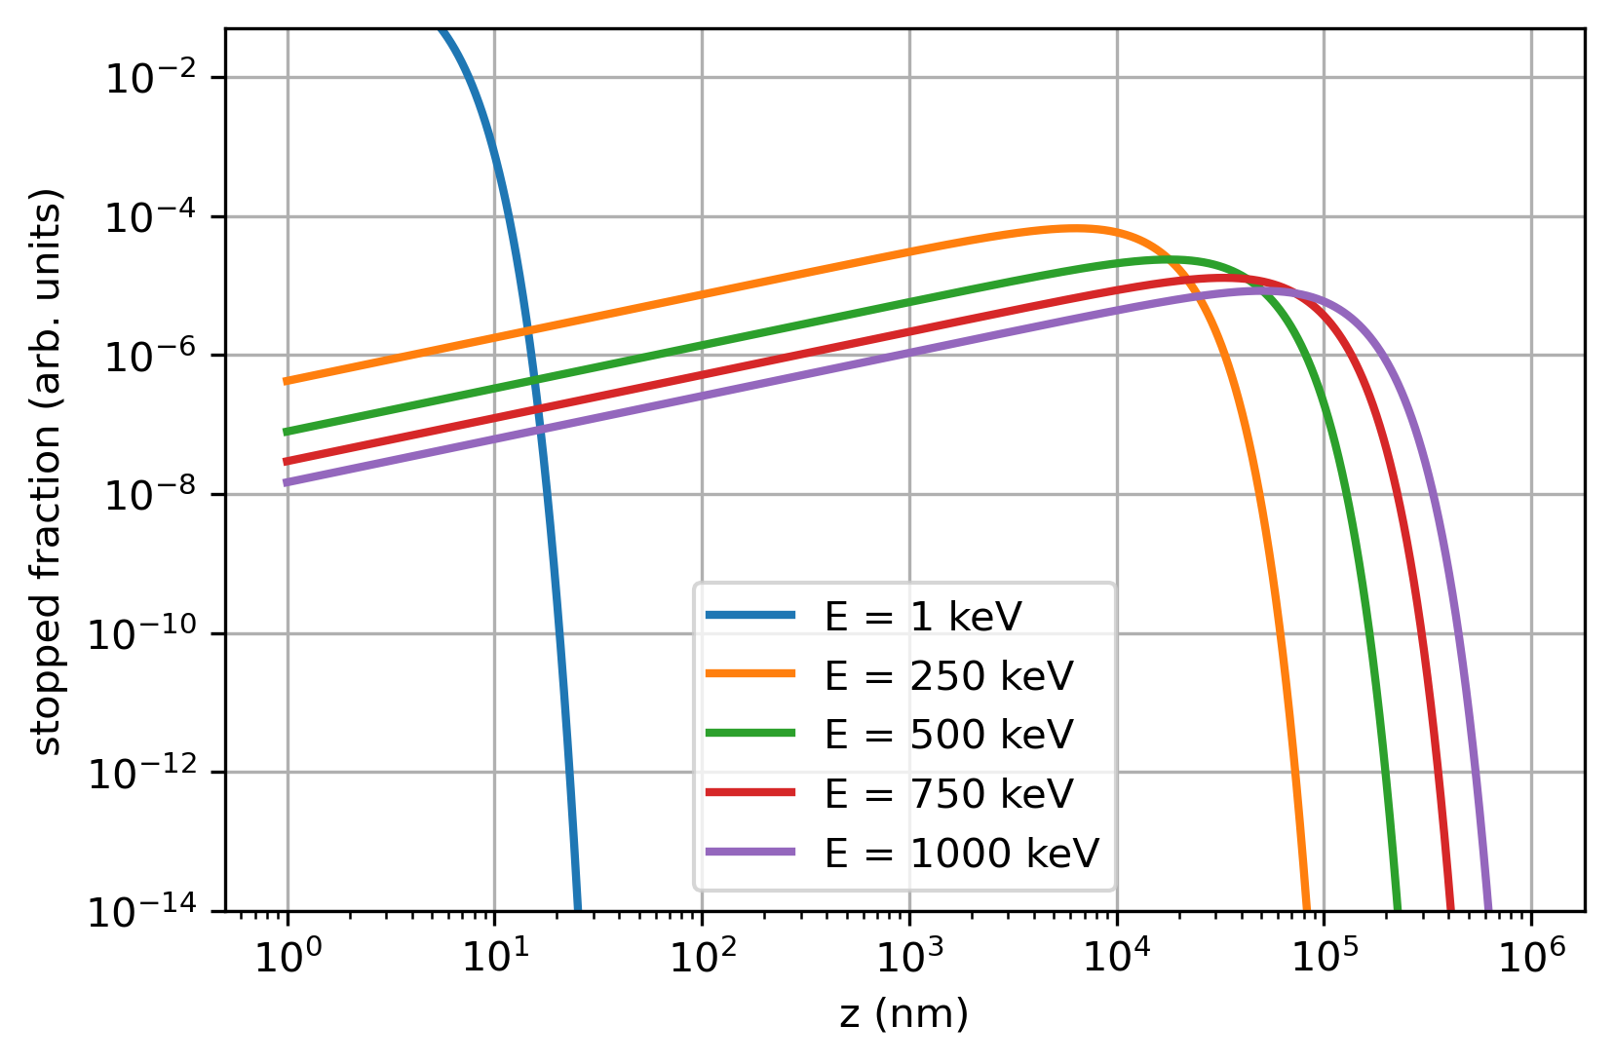
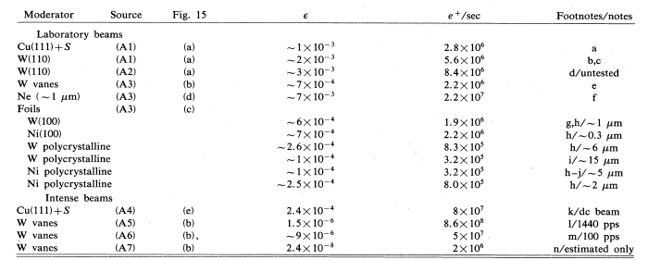
Positron moderators
Positron implantation profile on W
(Makhov profile)
1mm
+ some newer materials like 4H/6H-SiC ...
Schultz and Lynn, 1988

Slide 12
Combination positron sources
Proton Synchrotron (8-12 MeV)
$${}_{}^{48}{\text{Ti}} +\text{p}→ {}_{}^{48}{\text{V}}+n$$
W moderator + magnetic bottle
${4∙10}^{3}$ e⁺/s at @ E_{L} = 100eV
L. Gerchow et al., Instruments 2018, 2, 10 DOI: 10.3390/instruments2030010

Slide 13
Low energy positrons in experiments
e⁺ with MeV energy
e⁺ with eV energy
Isotope sources ($β^{+}$- decay)
Moderator
Continuous slow e⁺ beam
Pair production with:
Nuclear reactor-based sources
Accelerator-based sources
$$ε≈{10}^{−3}$$
Applications of slow positrons
Bulk defect studies
Surface and dislocation probing
Electronic structures
Trapping, cooling, remoderation, bunching
e⁺ beam
$$ε≈{ 10}^{−1}…{ 10}^{−?}$$
$$ε≈{ 10}^{−1}$$
Conversion into positronium (Ps)
Experiments with slow Ps
Precision tests of QED
Fundamental symm. (CPT, WEP)
BEC with Ps
Porosimetry
$$ε≈{ 10}^{−1}$$

Slide 14
Physics with slow positrons
Low energy positron/positronium physics at one glance:
Bose-Einstein condensates (BEC) with positronium
Fundamental symmetry tests (annihilation channels)
Precision QED studies (Ps spectroscopy)
Material studies (defect studies)

Slide 15
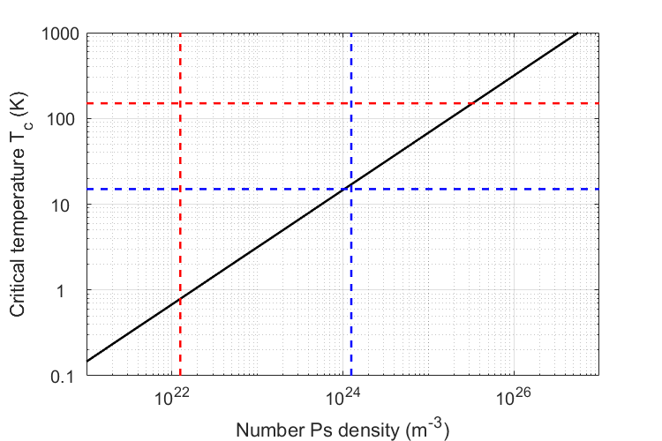
1/4 Towards Bose-Einstein condensates
Efforts towards the first Bose-Einstein condensation of Ps
Nanoporous silicon targets are able to produce Ps at temperatures of 150K and below.
PRL 104 (2010) 243401
Laser cooling precooled positronium atoms could reduce the temperature to 10K.
A positronium density of ${10}^{15}{\text{mm}}^{−3}$is necessary for forming a BEC. The currently available positron sources and Ps converters would require beam focussing better than 0.1 um².
When a Ps-BEC annihilates, a coherent burst of gamma rays is emitted. A proposed way to build a 511 keV gamma ray laser!

Slide 16
2/4 Fundamental symmetries
Tests of fundamental symmetries and BSM searches

Slide 17
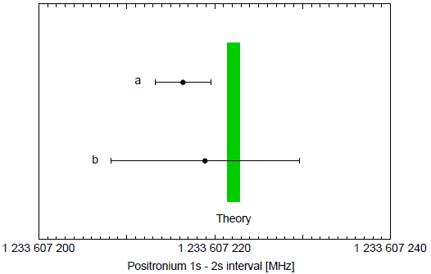
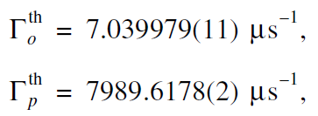
3/4 Precision QED tests
New precision QED measurements with colder Ps sources
Ps is an ideal system to test bound state
QED due to the absence of nuclear effects
Searches for BSM physics in:
energy intervals
decay rates
decay modes
1³S-2³S transition frequency
Decay times
Phys. Rep. 422 (2020) 1-63
?
Fifth fundamental force
Axion-like particles
Symmetry violations
Phys. Part. Nucl. 37 (2006) 321-346
Limited by second order Doppler effect, requires colder Ps sources

Slide 18
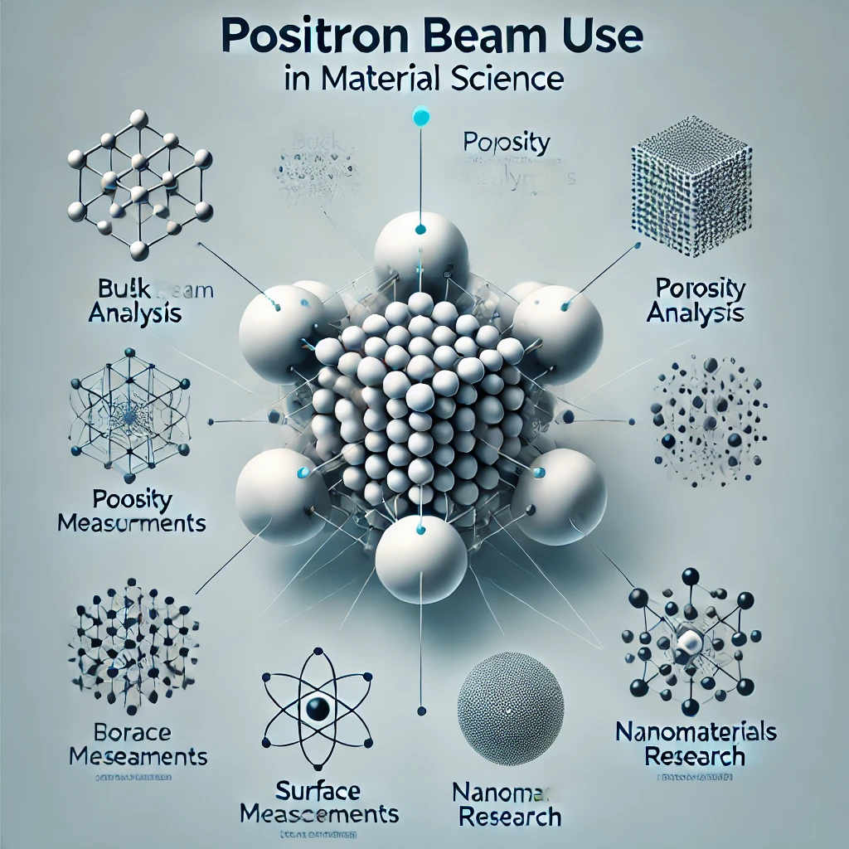
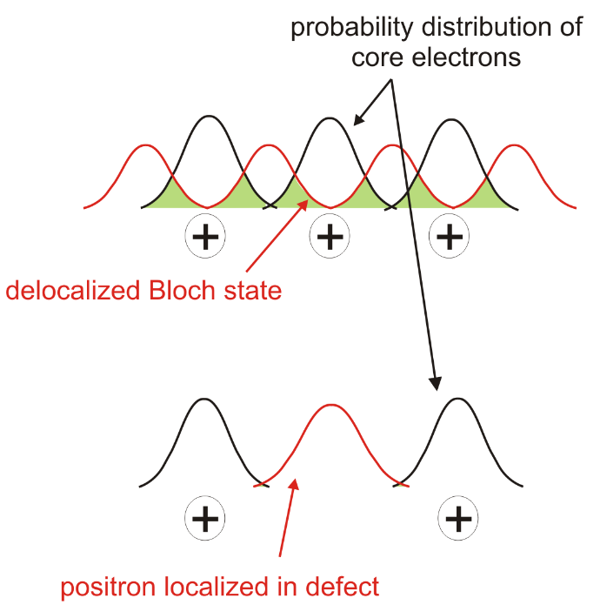
4/4 Material science studies
Positrons are non-destructive nanoprobes
Positronic signatures of material properties:
Positron annihilation lifetime
Doppler broadening of annihilation radiation
Positron annihilation-induced Auger- electrons
Angular correlation of annihilation radiation
Positronium (Ps) annihilation radiation
Total-Reflection High-Energy Positron Diffraction
Composition
Bulk
Porosimetry
Defects
Surface
SPM
Nanomaterials
Structure
T. Gigl et al 2017 New J. Phys. 19 123007, DOI 10.1088/1367-2630/aa915b

Slide 19
Take home message
Material Science: non-destructive nanoprobes
=> possibly beam time for global partners in industry and academia?
Positrons
Next generation Ps sources with
high intensity,
low energy and
higher density
Better measurement efficiency (results/time)
Higher data quality (less systematics)
A new intense low-energy e+ beam at
Unlocking exciting new possibilities (e.g. Ps-BEC, precision QED, BSM )
THANK YOU

