Slide 1

Undulator-based Positron Source for ILC
Khaled Alharbi (KAST, DESY), Gudrid Moortgat-Pick (Hamburg U., DESY), Sabine Riemann (DESY), Peter Sievers (CERN), Grigory Yakopov (DESY)

Slide 2
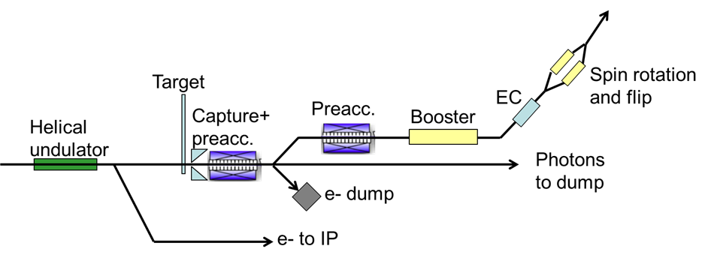
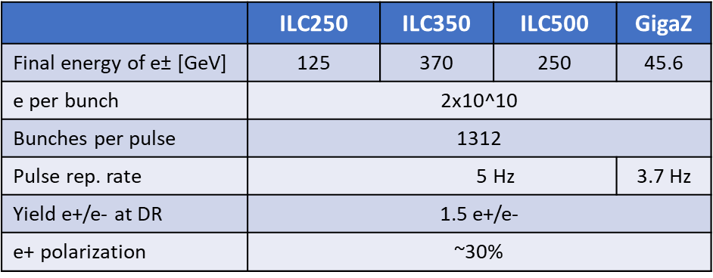
Overview
Supercond.
helical
undulator
ILC e+ source (TDR)
polarized photon beam → polarized e+ beam
production scheme must work for all ILC energies
Challenge: ~2x10¹⁴ e+/sec at DR
Key activities:
  Undulator
  Rotating target
  Magnetic focusing system
e-

Slide 3
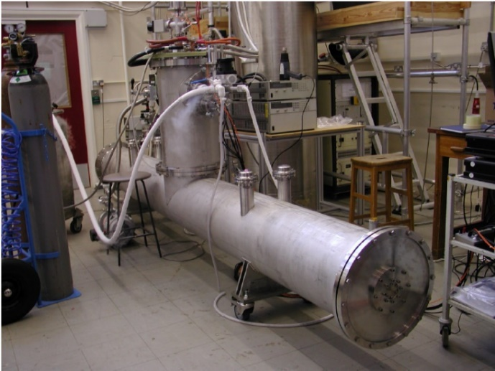
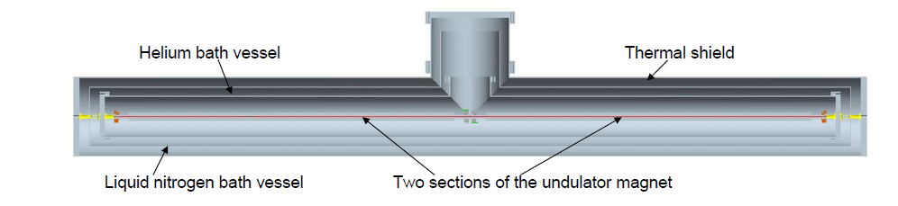
Superconducting helical undulator
D.Scott et al.,
Phys. Rev. Lett. 107, 174803
Prototype developed at RAL
  2 unduator modules of 1.75m in 4m cryomodule
→ ILC Undulator Parameters: Undulator period, λ_{U} =11.5mm
  Undulator strength K ≤ 0.92 (B_{max} ≤ 0.86T)
  Beam aperture (diam.) 5.85mm
Max 231m active undulator length: 132 undulator modules ⬄ 66 cryomodules
    Quadrupoles every 3 cryomodules
→ total length of undulator system is 320m

Slide 4
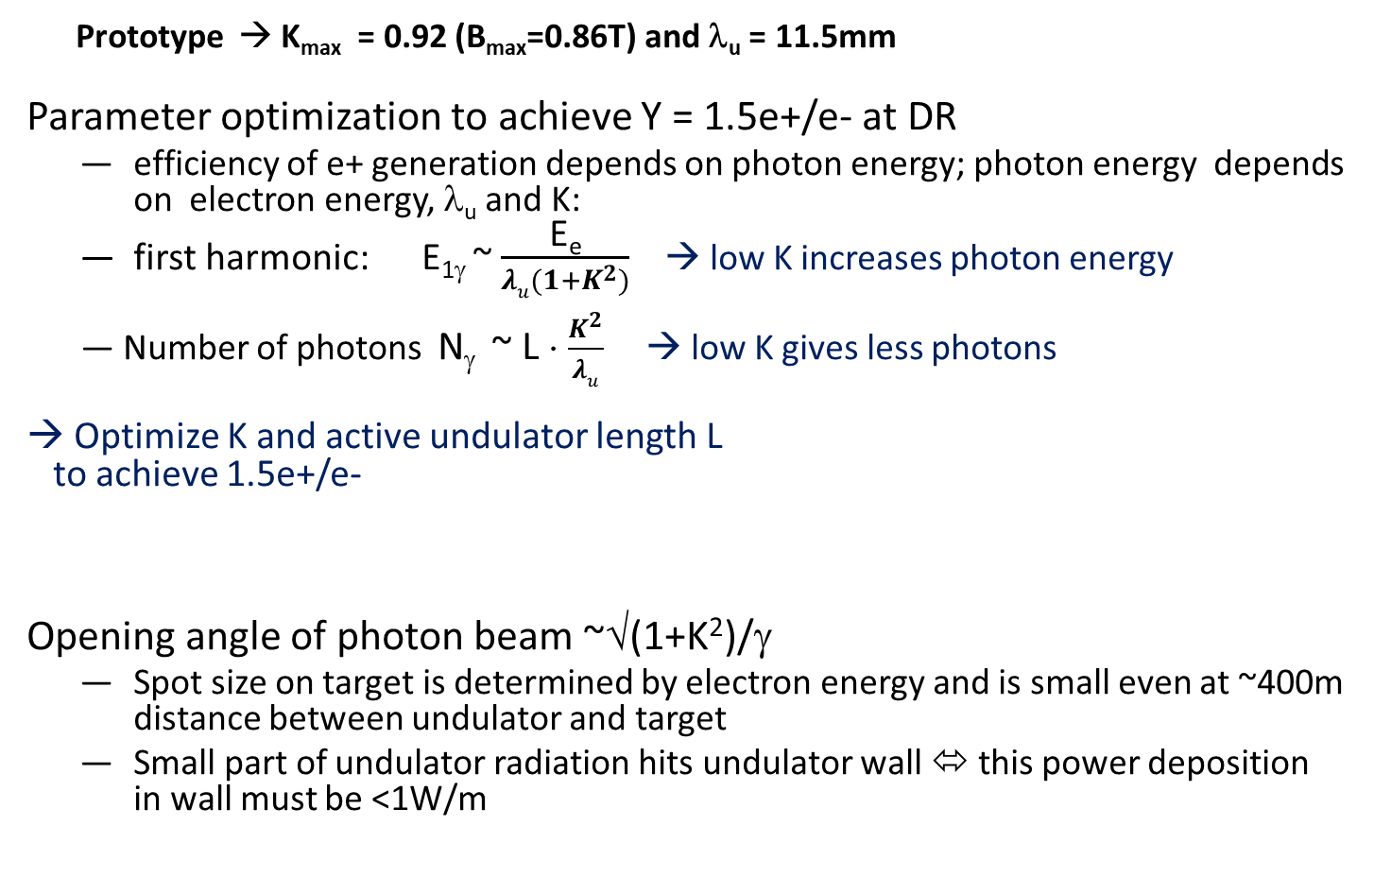
Helical undulator – parameter ‘choice’
Prototype → K_{max} = 0.92 (B_{max}=0.86T) and λ_{u} = 11.5mm
Parameter optimization to achieve Y = 1.5e+/e- at DR
  efficiency of e+ generation depends on photon energy; photon energy depends on electron energy, λ_{u} and K:
  first harmonic: E_{1γ} ~ $\frac{\text{E}\text{e}}{λu(1+K^{2})}$ → low K increases photon energy
Number of photons N_{γ} ~ L ⋅ $\frac{K^{2}}{λu}$ → low K gives less photons
Optimize K and active undulator length L to achieve 1.5e+/e-
Opening angle of photon beam ~√(1+K²)/γ
  Spot size on target is determined by electron energy and is small even at ~400m distance between undulator and target
  Small part of undulator radiation hits undulator wall ⬄ this power deposition in wall must be <1W/m
 | ILC250 | ILC350 | ILC500
K | 0.85 | 0.75 | 0.45
L [m] | 231 | 147

Slide 5
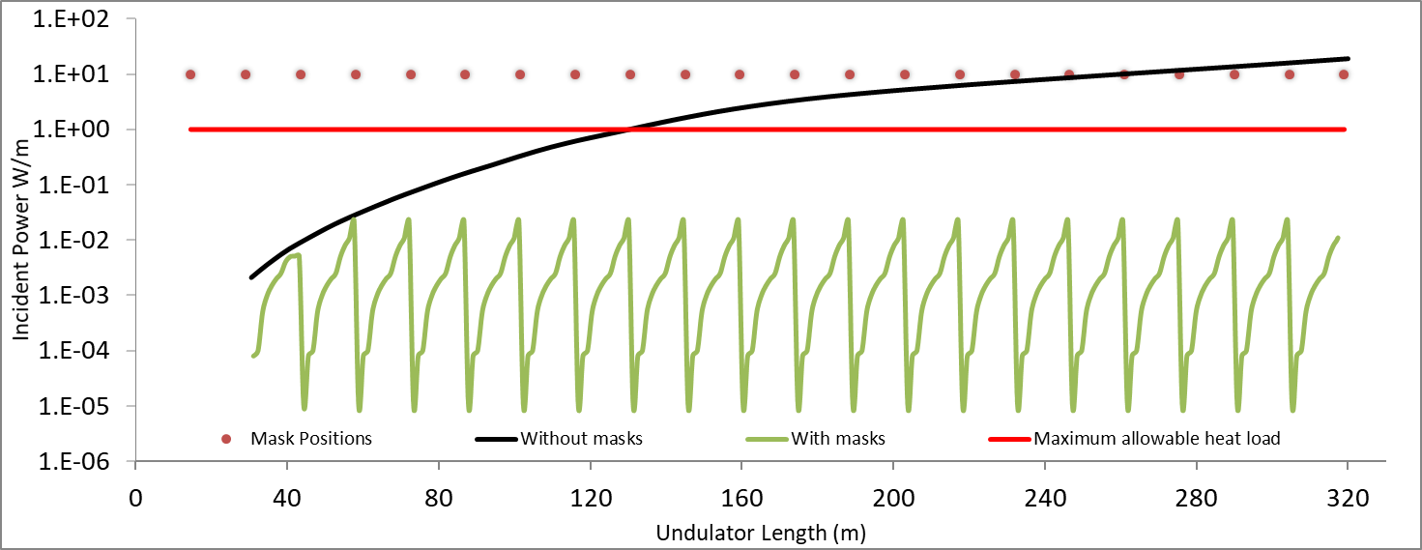
Energy deposition in undulator wall
Photon beam deposits power in undulator wall; limit of 1W/m
Consider ILC250 – largest photon beam opening angle
Assume ideal undulator – i.e. no fluctuation in K and lambda along the 320m long undulator section
no fluctuation in K and lambda along the 320m long undulator section (‘ideal’ undulator)
40 80 120 160 200 240 280 300
ideal masks
max acceptable limit
Undulator length [m]
Mask position
No masks

Slide 6
Energy deposition in undulator wall
Photon beam deposits power in undulator wall; limit of 1W/m
Consider ILC250 – largest photon beam opening angle
Need masks to absorb these photons;
mask are inserted after quadrupoles
Position of quadrupoles
Assume ideal undulator – i.e. no fluctuation in K and lambda along the 320m long undulator section
no fluctuation in K and lambda along the 320m long undulator section (‘ideal’ undulator)
40 80 120 160 200 240 280 300
ideal masks
max acceptable limit
Undulator length [m]
Mask position
No masks

Slide 7
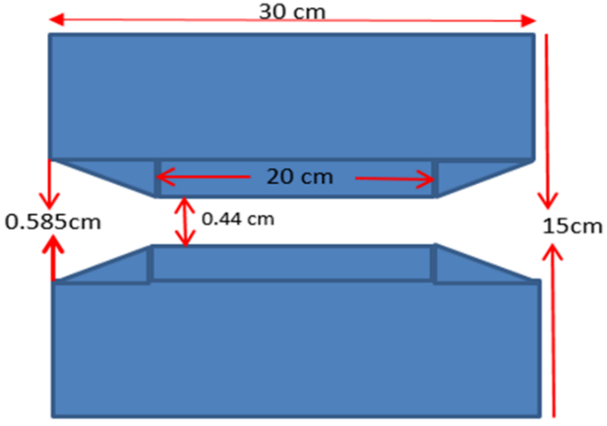
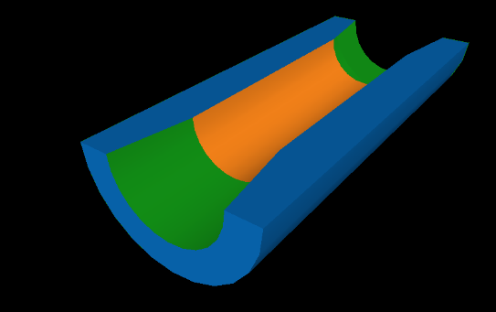
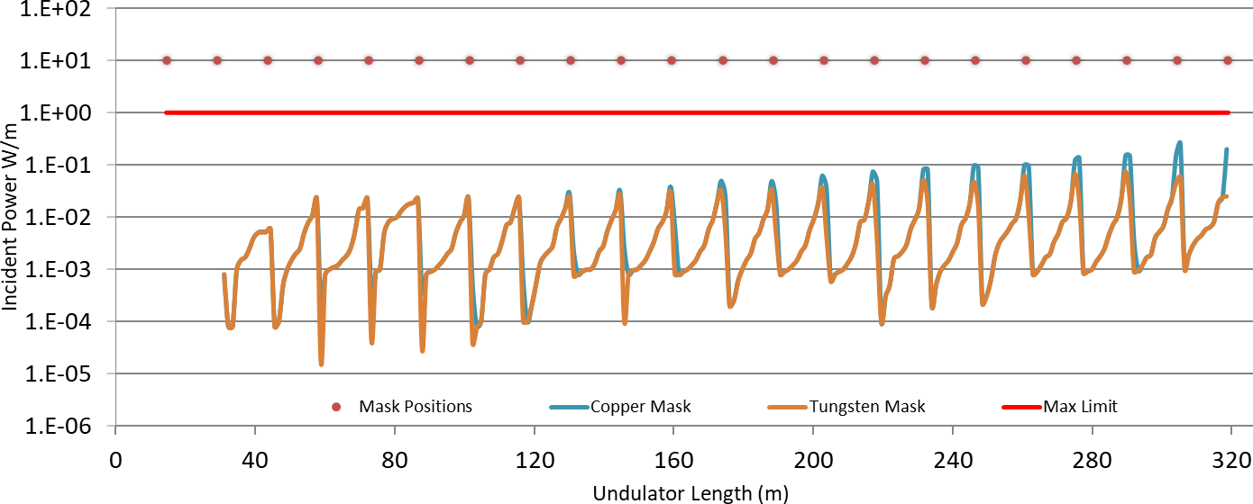
Masks to protect the undulator wall
Take into account fluctuation in K and period along the undulator (ILC250):
Mask material: Fe, Cu, W studied
Maximum power deposited at the undulator wall of the last three cryomodules
Mask position
Cu Mask
W Mask
max limit

Slide 8
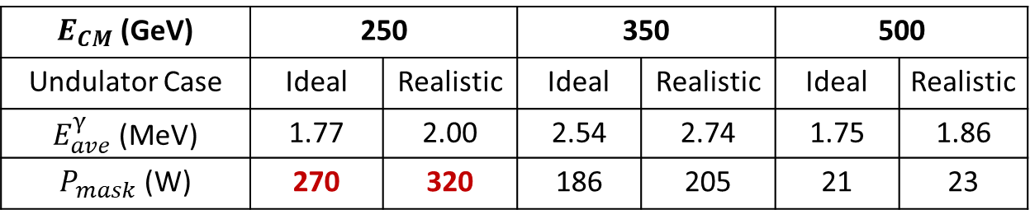

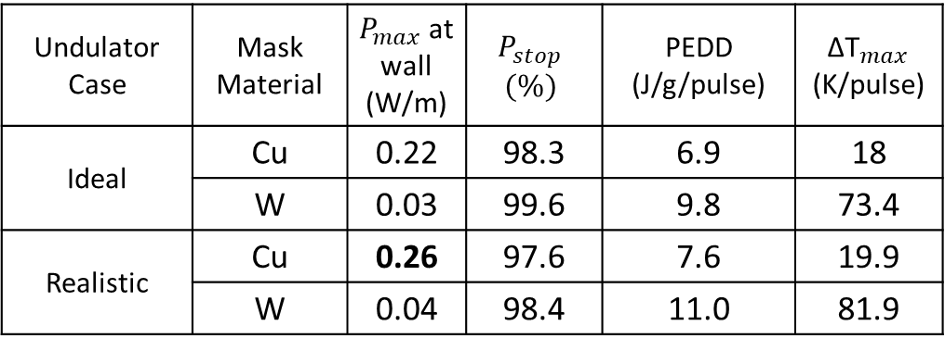
Average energy $E_{ave}^{γ}$of photons impinging on the last mask in the undulator, and power $P_{mask}$deposited in this mask
ILC250:
Masks keep the SR deposition in the undulator wall below 1W/m; this holds also for luminosity upgrade
‘realistic’ undulator increases slightly the energy deposition in the mask
$E_{CM}$ (GeV) | 250 |  | 350 |  | 500
Undulator Case | Ideal | Realistic | Ideal | Realistic | Ideal | Realistic
$E_{ave}^{γ}$ (MeV) | 1.77 | 2.00 | 2.54 | 2.74 | 1.75 | 1.86
$P_{mask}$ (W) | 270 | 320 | 186 | 205 | 21 | 23
Undulator Case | Mask Material | $P_{max}$at wall (W/m) | $$P_{stop}$$ $$(\%)$$ | PEDD (J/g/pulse) | ${\text{Δ}\text{T}}_{max}$ (K/pulse)
Ideal | Cu | 0.22 | 98.3 | 6.9 | 18
 | W | 0.03 | 99.6 | 9.8 | 73.4
Realistic | Cu | 0.26 | 97.6 | 7.6 | 19.9
 | W | 0.04 | 98.4 | 11.0 | 81.9

Slide 9
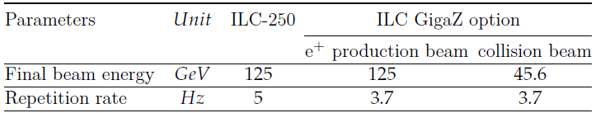
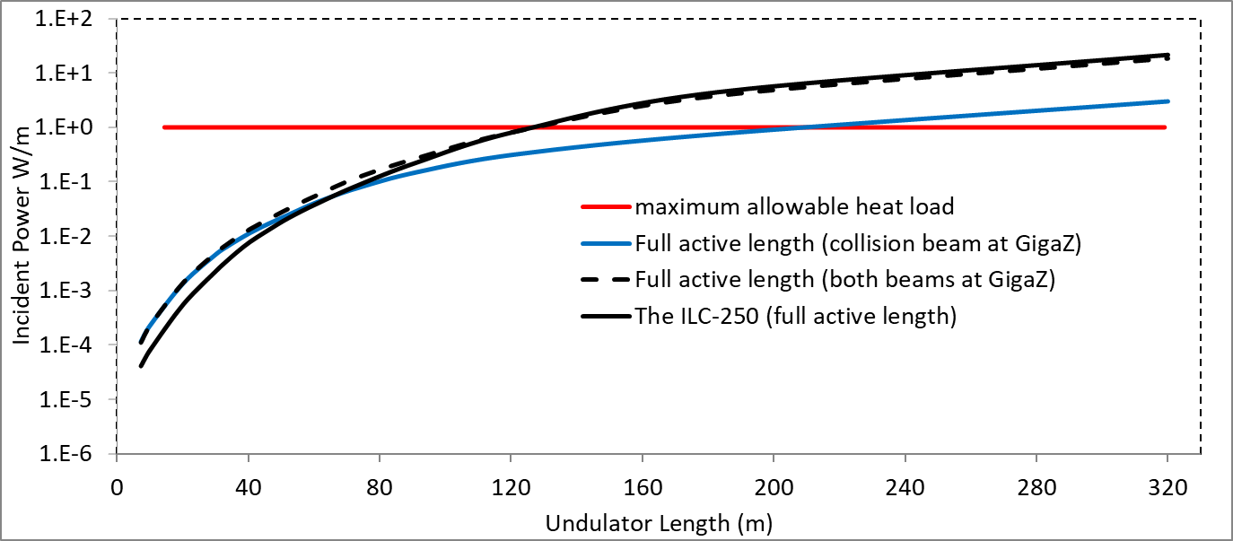
ILC GigaZ Option - Running at the Z boson pole
Using the ILC undulator, the 46GeV electron beam cannot generate the photons for positron production
Need 2 e- beams:
  46 GeV for physics collisions
  125 GeV for positron production
Question: can both beams, 46GeV and 125GeV pass the undulator without exceeding the 1W/m limit? Or do we need a bypass for the physics beam?
Without masks, both e- beams together deposit almost the same power in the undulator wall as the ILC250 e- beam does
→ Masks are sufficient for GigaZ; no bypass needed
1W/m limit
46 GeV beam passes undulator
Both beams pass undulator
ILC250

Slide 10
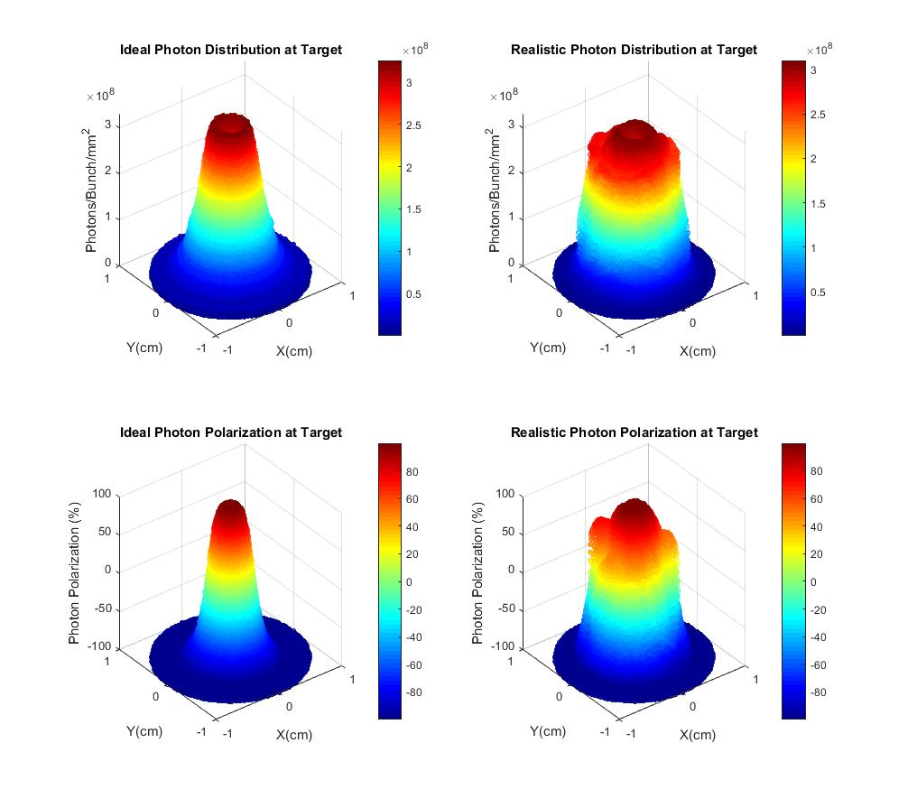
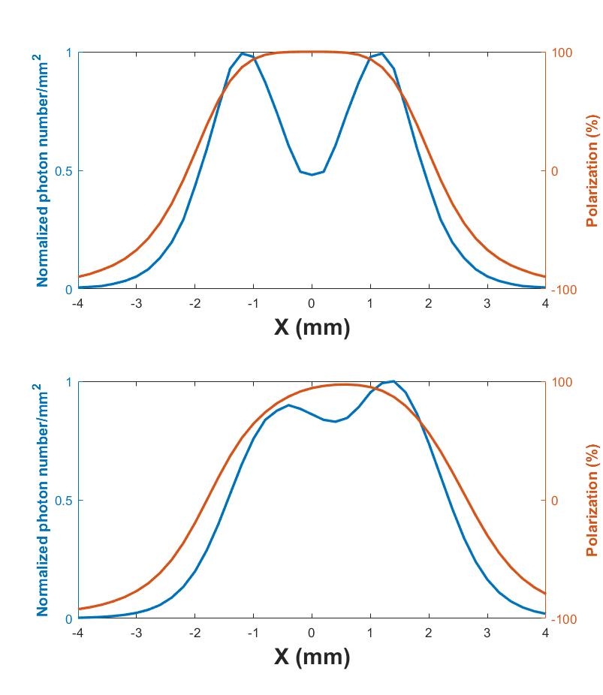
Polarisation of the photon beam
Ideal Photon Distribution
Realistic Photon Distribution
Consider photon beam profile in the target plane for ILC250
One undulator module only Full undulator length
Ideal undulator, Y=0
Realistic undulator, Y=0
Ideal Photon Distribution Realistic Photon Distribution
Ideal Polarization Distribution Realistic Polarization Distribution
10
In case of a realistic undulator, i.e. fluctuation in K and λ, polarisation of photon beam is slightly reduced - and hence also the polarization of the e+ beam

Slide 11
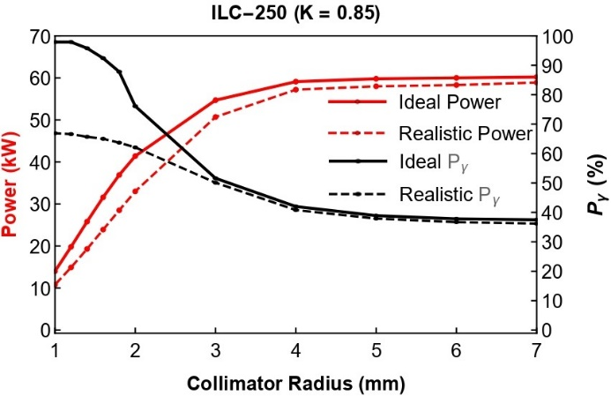
Photon beam polarization
Consider ‘artificial’ photon collimation to understand the difference of photon beam polarization for ideal and realistic undulator
Photon beam polarization decreases slightly for realistic undulator
ILC250, K=0.85
Ideal und.
Realistic und.
Ideal und.
Realistic und.
2σ beam size @ target

Slide 12
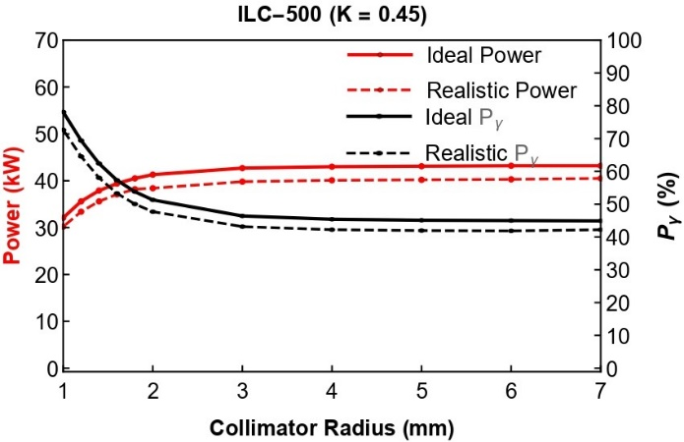
Photon beam polarization
ILC500, K=0.45
With smaller K value the photon polarization seems less sensitive to δK along undulator
Polarization upgrade so far (TDR):
  Insert photon collimator
  Increase K to compensate intensity loss
  ILC500: K= 0.92, active undulator length 70m
  → Study should be repeated for realistic undulator to optimize e+ polarization (to be done based on new pulsed solenoid/OMD performance)
Ideal undul.
Realistic und.
Ideal und.
Realistic und.
2σ beam size @ target

Slide 13
The positron target
narrow photon beam of ~60kW power
target wheel spinning in vacuum with ~2000rpm; photon beam impinges target at radius of 50cm
Power deposition in target ~2kW
material Ti6Al4V, thickness 0.2-0.4 X₀ (0.7-1.48cm) depending on E(e-)
Design and technical specification of target wheel must include capture system
Principle layout:
T⁴ radiative cooling from spinning hot target to stationary water cooled absorber.
  highest temperature along the beam path, hot area is concentrated in region ~15cm around it
  Max. target temperature should be below 600 C, must not exceed 700 C (T. Lengler)
  Irradiation tests using electrons at microtron in Mainz show that Ti6Al4V stands high load. Tests are ongoing to evaluate the effect of high cyclic load at high temperatures (see T. Lengler et al., IPAC2024 (2024) TUPC81, T. Lengler et al. arXiv:2308.15916)

Slide 14
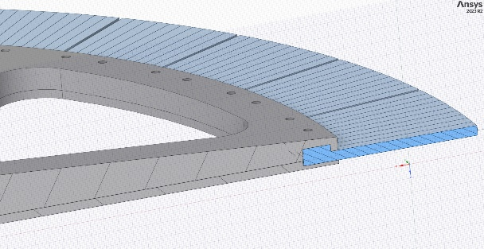
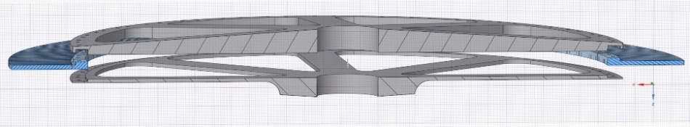
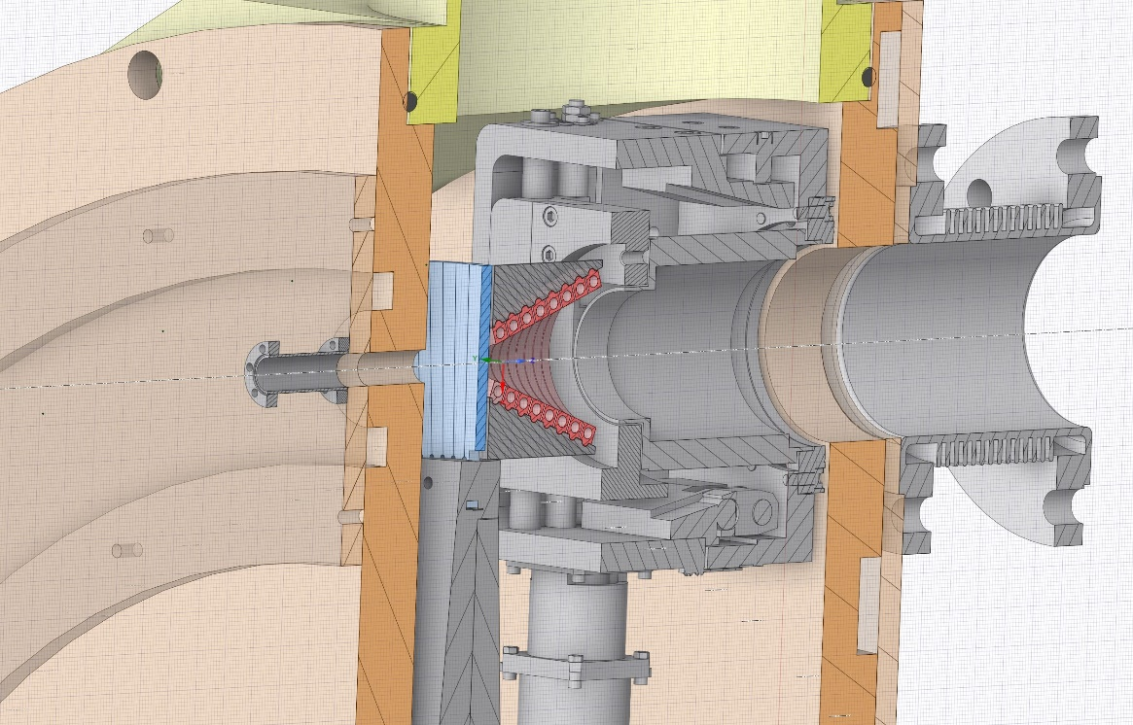
Vacuum chamber with target wheel, magnetic bearing system, and pulsed solenoid
Diameter of wheel: 120 cm
Weight of the wheel: 50kg
Radiative cooling ⬄ magnetic bearings for rotation in vacuum
Technical specification started, will be updated based on simulation studies
Feasibility studies: Contacts with SKF (Canada):
  There is no ready-technical technical solution that meets our requirements
  They think about design of magnetic suspension and seek government funding for R&D
Target material
Wheel: carrier of the target material
Vacuum chamber
Pulsed solenoid
Photon beam
Rotating target
Stationary cooler
Cooling
channels

Slide 15
Vacuum chamber with target wheel, magnetic bearing system, and pulsed solenoid
Radiative cooling ⬄ magnetic bearings for rotation in vacuum
Technical specification started, will be updated based on simulation studies
Feasibility studies: Contacts with SKF (Canada):
  There is no ready-technical solution that meets our requirements
  They think about design of the magnetic suspension and simultaneously they seek government funding for R&D

Slide 16
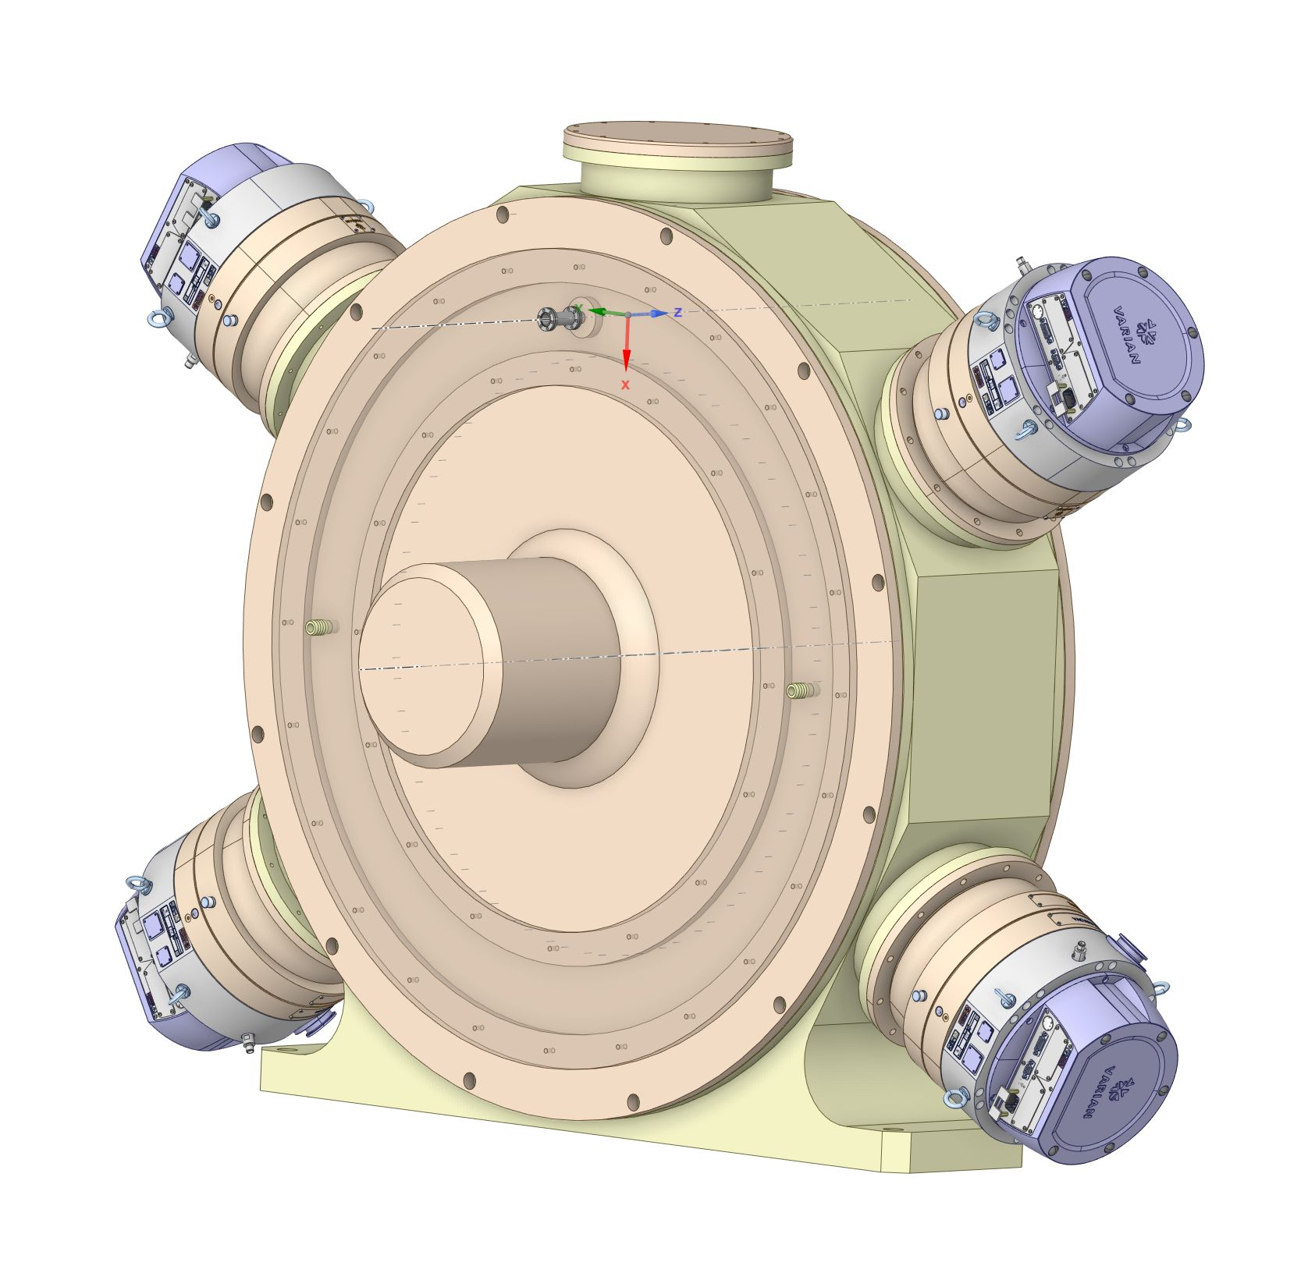
Target station (‘closed’)
Vacuum pump

Slide 17
Focusing system: pulsed solenoid
The focusing system right after the target is a critical item; decisive for the positron yield
ILC TDR: Flux concentrator (FC) or QWT
  QWT: required e+ yield not reached for ILC250
  FC: B field distribution is not constant during pulse (~1ms)
Pulsed solenoid
  Higher capture efficiency (B field on target)
  load by eddy currents is small, ~100W
  Pulsed breaking forces almost negligible
  → Strongest candidate for focusing system
R&D for the pulsed solenoid
  Detailed simulations are already on-going
  Principal design and engineering work for a prototype pulsed solenoid; tests
Details and status see talk on Thursday

Slide 18
Summary
Undulator based e+ source offers an efficient way to produce an intense polarized e+ beam for high energy e+e- colliders
Experience at FELs and XFEL: achieved extremely stable operation, and all the ILC studies since more than 30 years tell us that the helical undulator is not a problem. Better materials will provide even better performance
Work concentrates on the pulsed solenoid and the design of the spinning target
ITN initiative: we are very happy that we got support. This will allow design and engineering work for a prototype of the pulsed solenoid
Depending on the performance of the focusing system and target design a detailed simulation should optimize the final undulator K values to achieve high e+ yield and best e+ polarization

Slide 19
Thank you!

