Slide 1
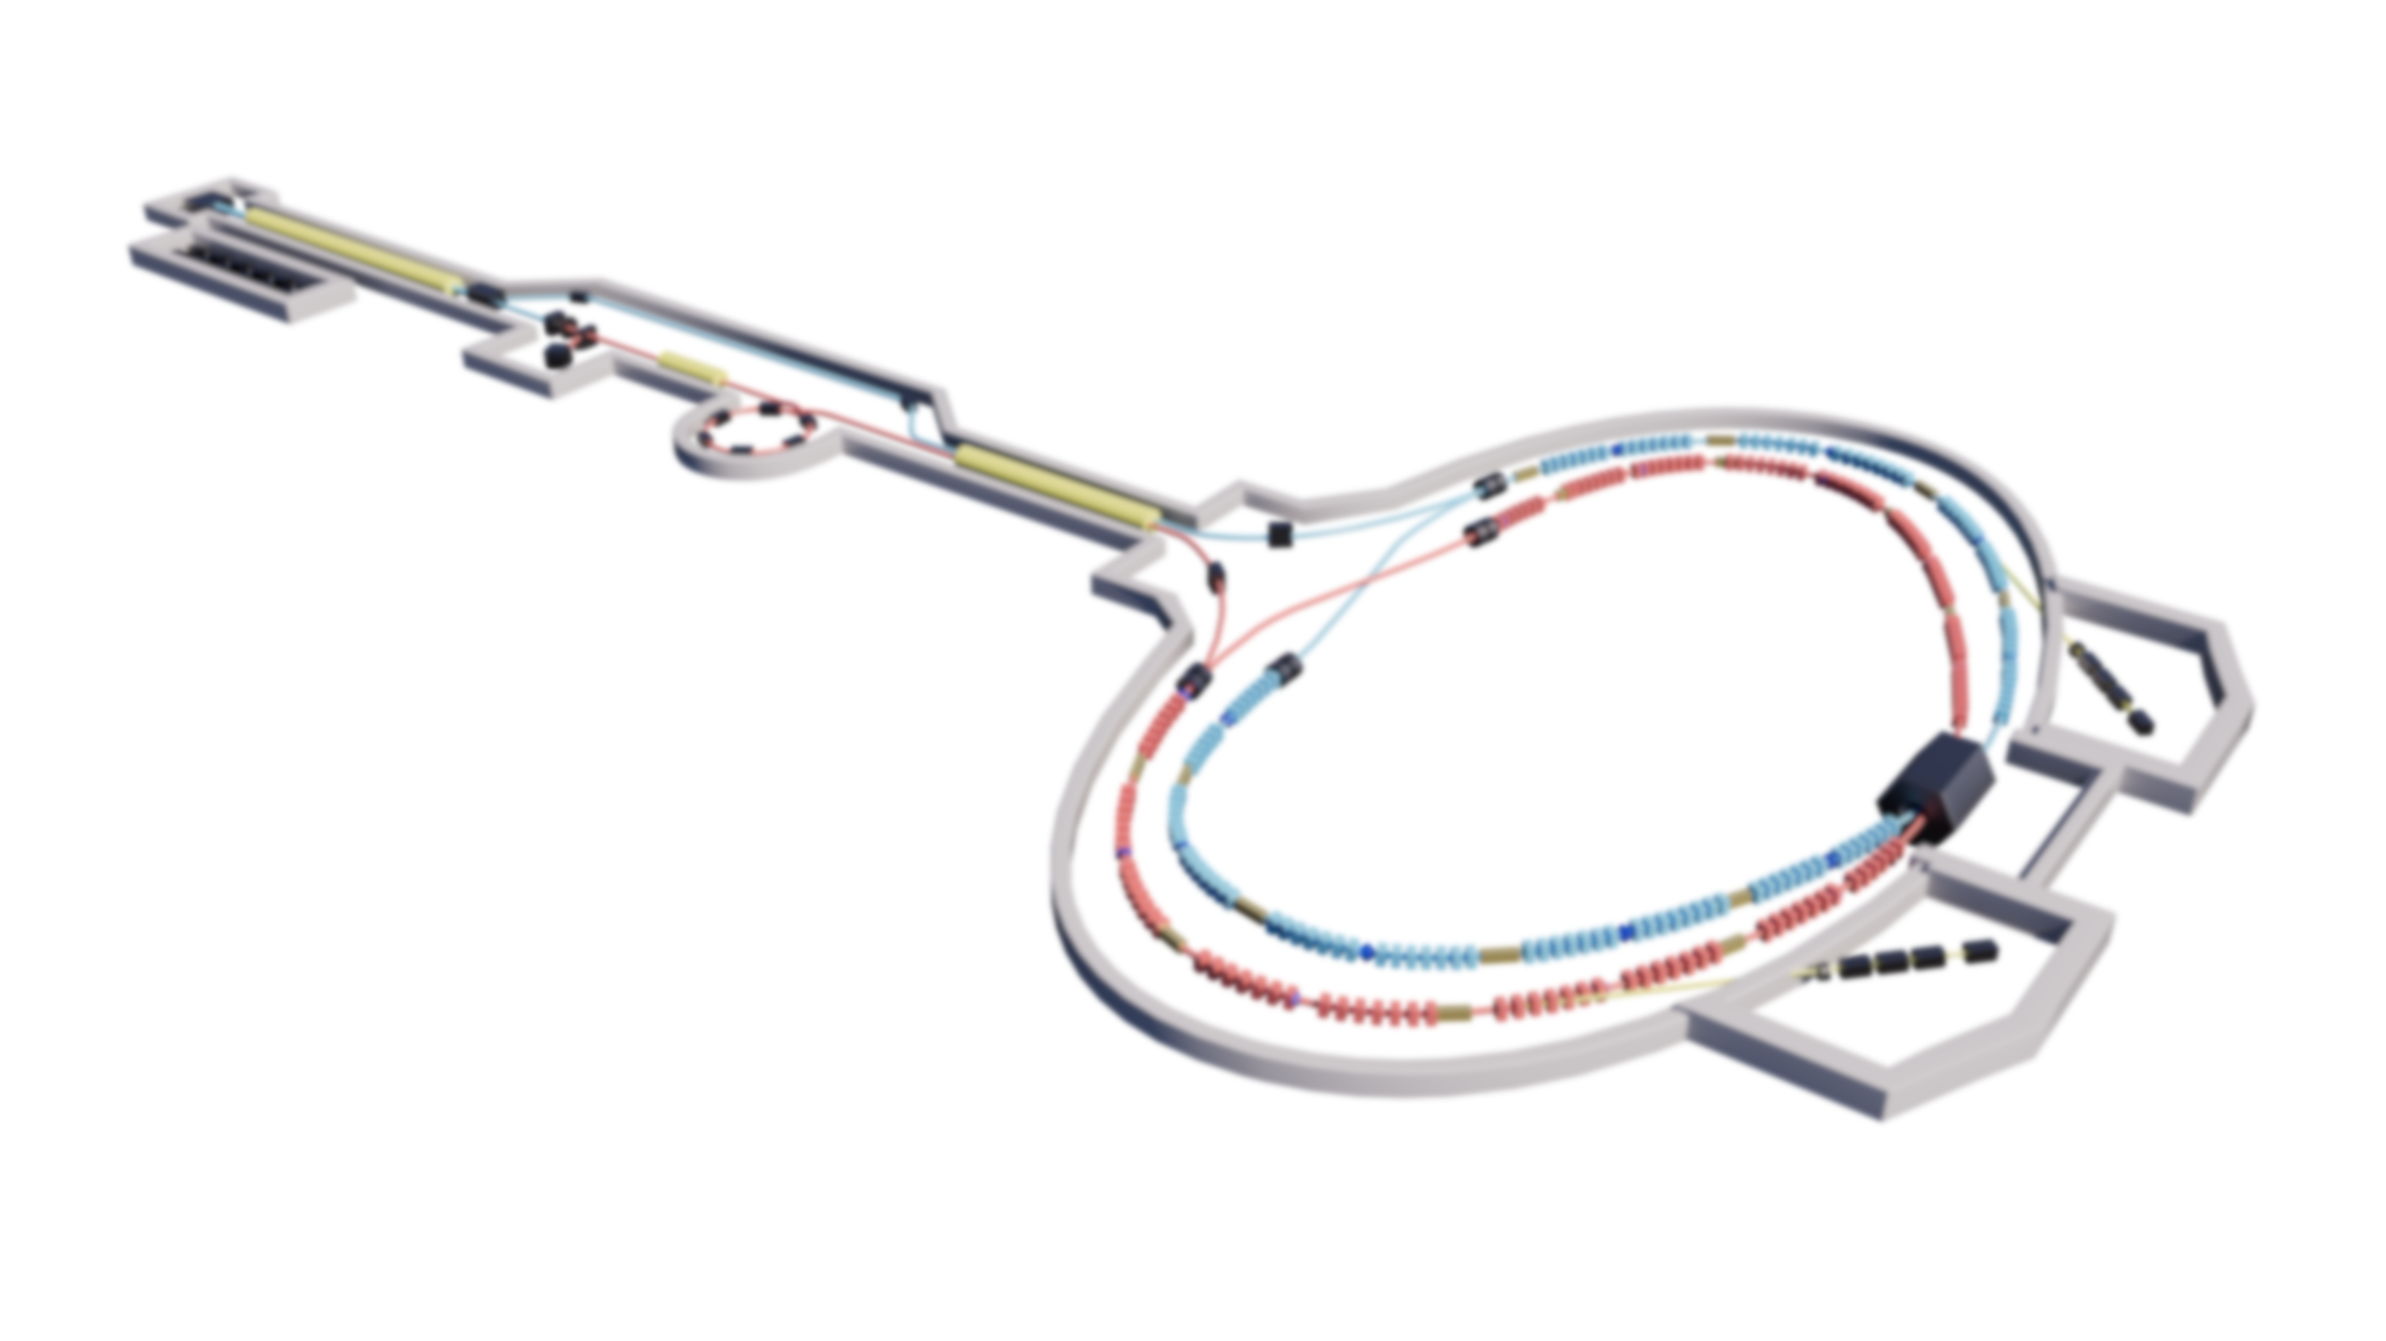
中国科学技术大学
STCF
University of Science and Technology of China
The positron source of STCF in China
Ailin Zhang, Xin Xu, Guoxi Pei,
Qing Luo，Haiping Peng
16th October
AHIPS-2024 Workshop
Notes:
Hello, esteemed experts!
I am Xu Xin from the STCF project team at the University of Science and Technology of China. I would like to express my gratitude to the IJCLAB for the invitation, which gives me the opportunity to engage in academic exchange with all of you. Today, I will report on the progress of the STCF positron source system.

Slide 2
Contents
STCF
The injectors of STCF
The positron source of STCF
Thermal research on target
Notes:
My presentation will cover the following three aspects:

Slide 3
The Super Tau-Charm Facility in China
STCF
Parameter | Value
Perimeter/m | ~800
Optimized beam energy/GeV | 2
Energy/GeV | 1-3.5
Current/A | 1.5
Emittance$\left(ε_{x}/ε_{y}\right)$/nm·rad | 5/0.05
β$\left({β_{x}^{∗}/β}_{y}^{∗}\right)$/mm | 90/0.9
Crossing Angle 2θ/mrad | 60
Frequency shift ξy | 0.06
Luminosity/×10³⁵cm⁻²s⁻¹ | ≥0.5
Notes:
First, the STCF is a new generation of electron-positron collider that China is about to build, with a total circumference of 800 meters and a luminosity of up to $0.5 ×{10}^{35}{cm}^{−2}s^{−1}$. To meet the luminosity requirements of the collider, we have designed two injection schemes.

Slide 4
The off-axis injection of STCF
STCF
Parameter | Off-axis injection
Bunch charge(e/e⁺) | 1.5nC/50 Hz
Beam energy(e/e⁺) | 1-3.5GeV
Geometric Emittance(@2GeV) | ≤6 nm·rad
e beam for e⁺(energy) | 1.5GeV
e beam for e⁺(charge) | 10 nC/50 Hz
Notes:
The first scheme is the off-axis injection scheme. This scheme mainly includes an electron gun, a positron production system, a positron and electron accelerator, a positron damping ring, and a transport line system. The required bunch charge for this scheme is 1.5 nC, with a frequency of 50 Hz, and the injected emittance must be less than 6 nm·rad. Positrons are produced by bombarding a tungsten target with 1.5 GeV electrons, with a frequency of 50 Hz.

Slide 5
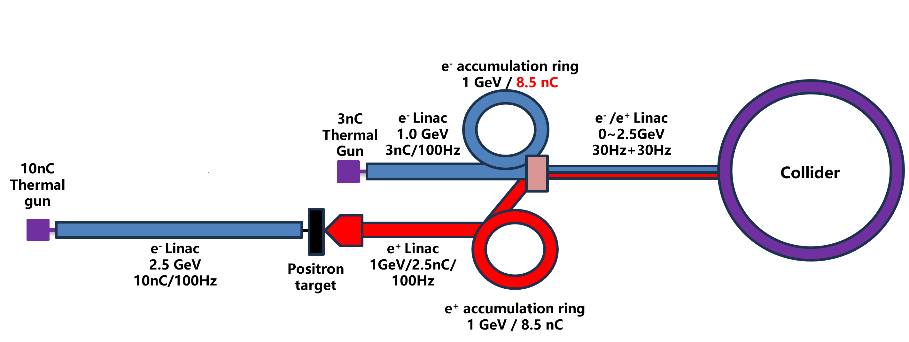
The Swap-out injection of STCF
STCF
Parameter | Swap-out injection
Bunch charge(e/e⁺) | 8.5nC/30 Hz
Beam energy(e/e⁺) | 1-3.5GeV
Geometric Emittance(@2GeV) | ≤30 nm·rad
e beam for e⁺(energy) | 2.5GeV
e beam for e⁺(charge) | 10 nC/100 Hz
Notes:
The second scheme is the swap-out injection scheme. The swap-out injection requires a larger charge, with both the electron and positron beams needing to inject no less than 240 nC/s. The thermionic cathode electron gun produces an electron beam with a charge of 10 nC at 100 Hz, which is accelerated to 2.5 GeV and directed to hit a tungsten target, producing positrons with a charge of 2.5 nC. These positrons are then accelerated to 1 GeV before being injected into the accumulation ring to reduce emittance and accumulate to 8.5 nC. The electron beam injection is produced by thermionic cathode electron gun, which produces a charge of 3 nC at 100 Hz. After being accelerated to 1 GeV and passing through the accumulation ring, the charge also reaches 8.5 nC. Finally, the electron and positron beams are jointly accelerated to a range of 1 to 3.5 GeV.

Slide 6
Contents
STCF
The injector of STCF
The positron source of STCF
Thermal research on target

Slide 7
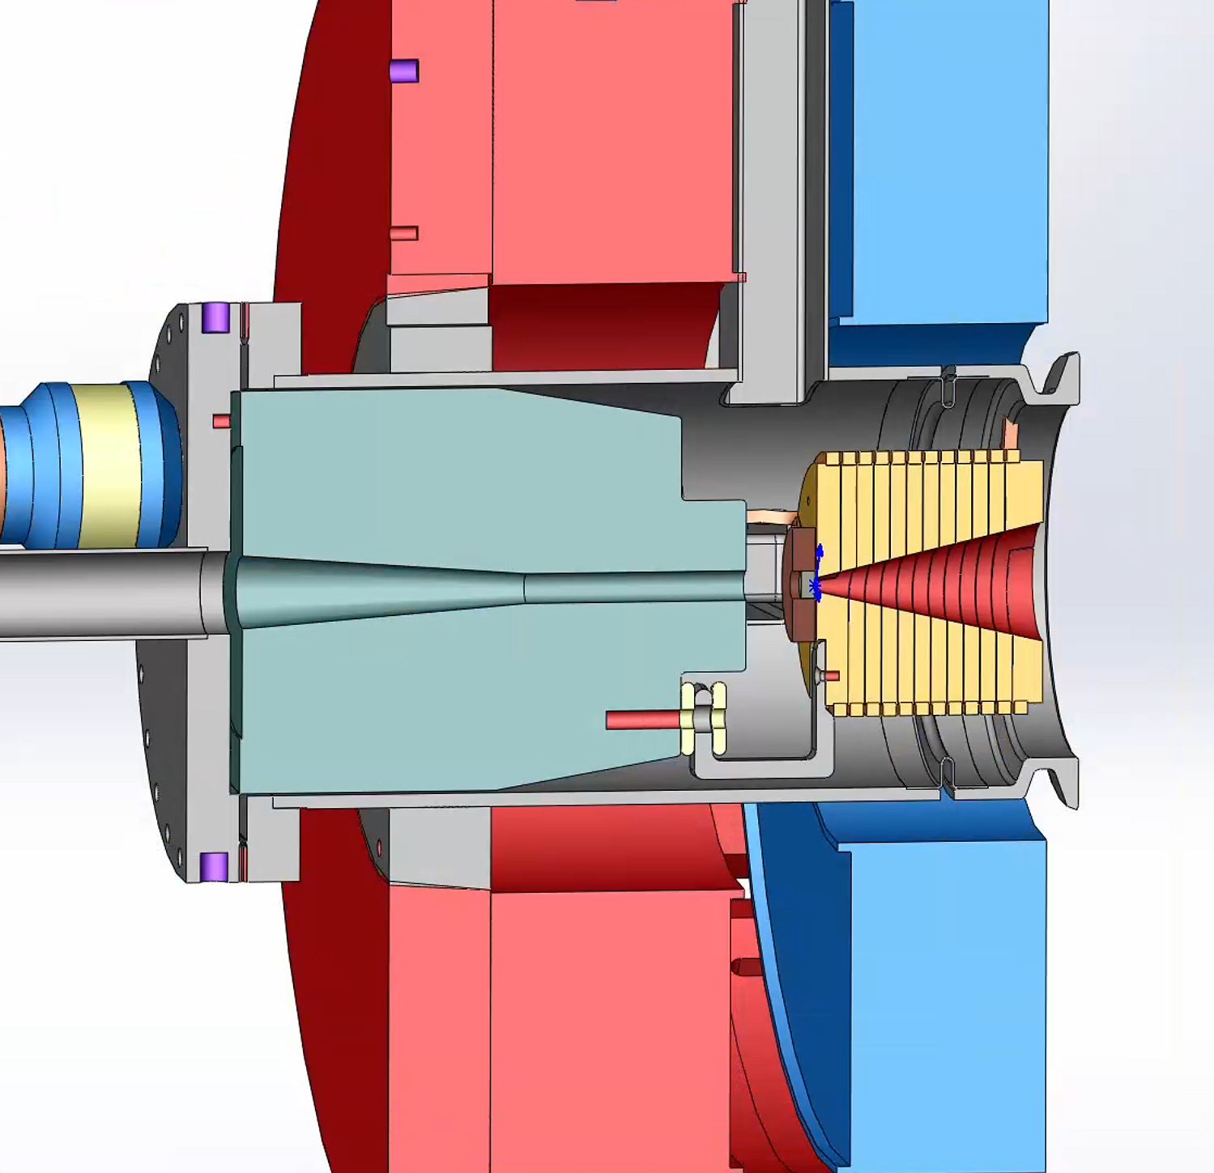
The positron production system
STCF
Parameter | Off-axis | Swap-out
Electron bunch | 10 nC | 10 nC
Electron energy | 1.5 GeV | 2.5 GeV
Rep. rate | 50 Hz | 100 Hz
Beam size（rms） | 0.5 mm | 0.5 mm
Magnetic field | 5↘0.5 | 5↘0.5
Target thickness | 13 mm | 15 mm
Target material | Tungsten | Tungsten
e+ yield | 0.15 | 0.25
PEDD | 6.3J/g | 11.5J/g
Deposit power(w) | 141w | 495w
Peak Deposit power density(kw/cm^3) | 6.09 | 22.34
1.Simulation tools ：Geant4、Fluka
2. tungsten, with thicknesses of 13mm and 15mm respectively, and PEDD less than 35J/g.
3.Calculate the peak deposition power, which may cause changes in the lattice state of the material and affect the yield.
Notes:
Based on the designs of the two injector systems, we have derived two positron production schemes. Both injection schemes require a target charge of 10 nC, with the electron bunch size being 0.5 mm. However, the target frequencies are 50 Hz and 100 Hz, with energies of 1.5 GeV and 2.5 GeV, respectively. The target thickness, determined by Geant4 simulations, is 13 mm and 15 mm, respectively, with calculated peak energy deposition densities both being less than 35 J/g. We also calculated the peak energy deposition power density, which can reach up to 22 kW/cm³. This may cause changes in the lattice structure of tungsten, thereby affecting the positron yield.

Slide 8
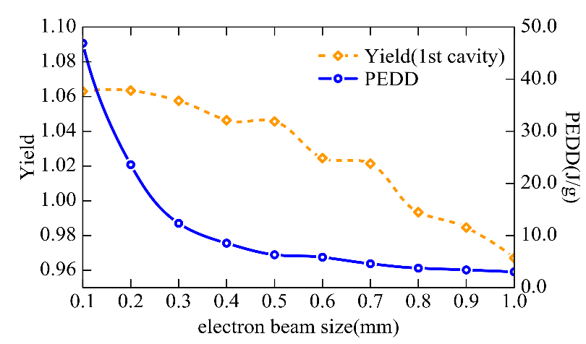
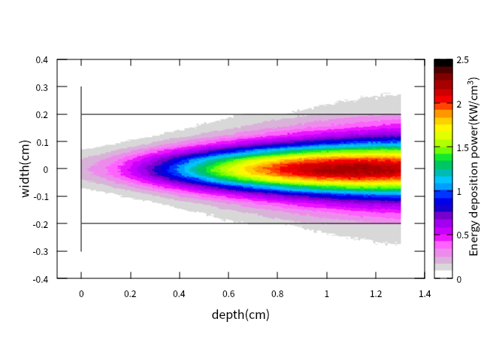
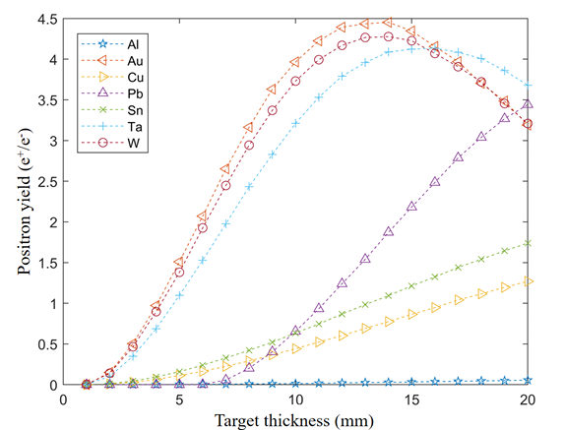
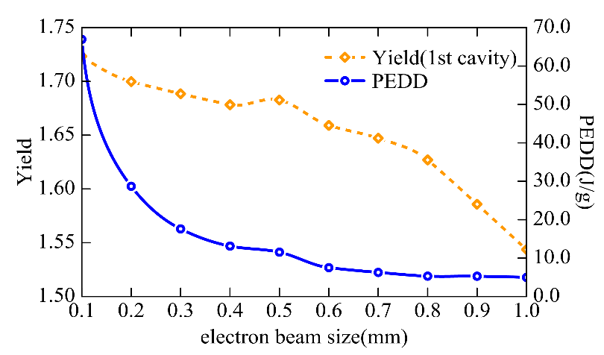
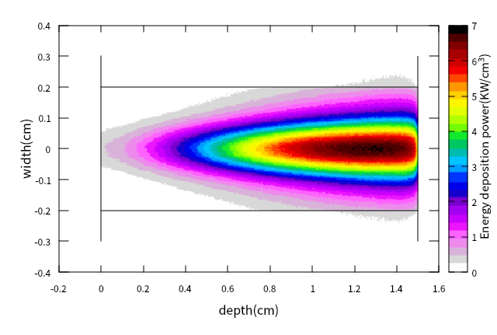
The positron production system
STCF
Positron yield and PEDD of different electron size(1.5Gev)
Positron yield under 1.5 GeV electron
Energy deposition of a 1.5 GeV electron beam in a 13 mm thick tungsten
Positron yield and PEDD of different electron size(2.5Gev)
Positron yield under 2.5 GeV electron
Energy deposition of a 2.5 GeV electron beam in a 15 mm thick tungsten
1.Beam size(0.5mm):Make the beam spot size as large as possible without affecting the yield, thereby reducing PEDD
2.The average deposition power of the two injection methods is 141w and 495w, respectively
Notes:
These two figures illustrate the selection of electron beam sizes. We aim to maximize the beam size without affecting the yield, thereby reducing the PEDD. These two figures show the energy deposition distribution of the electron beam within the tungsten target, with deposition powers of 141 W and 495 W, respectively.

Slide 9
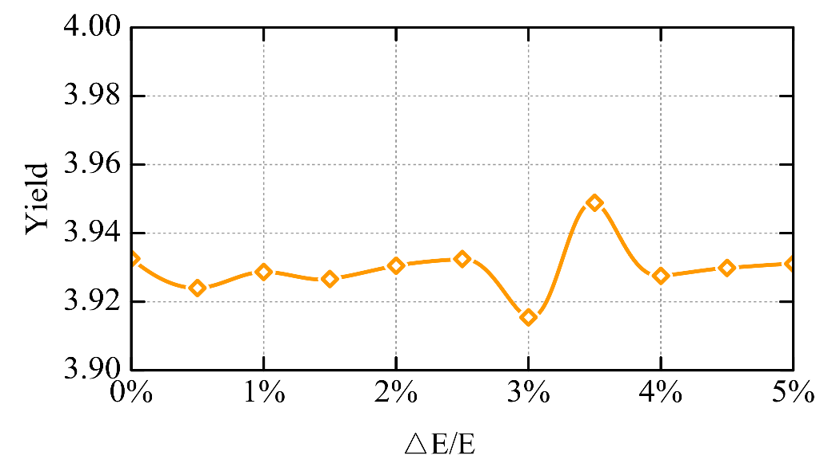
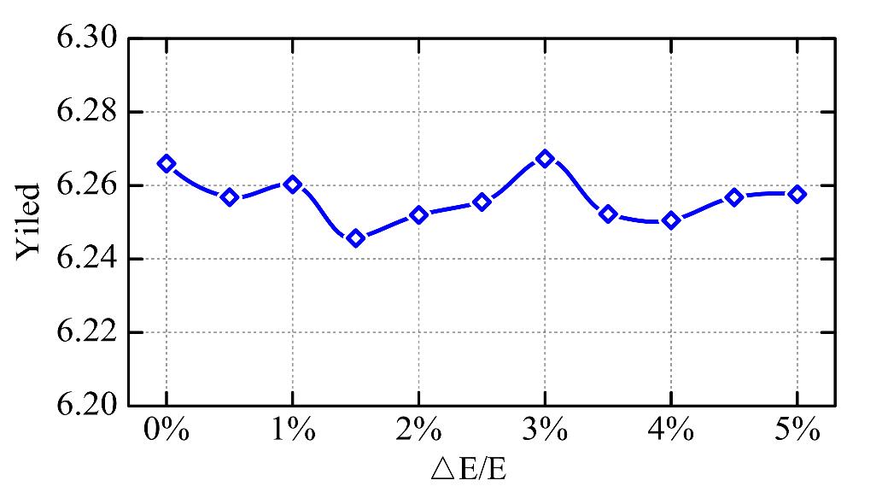
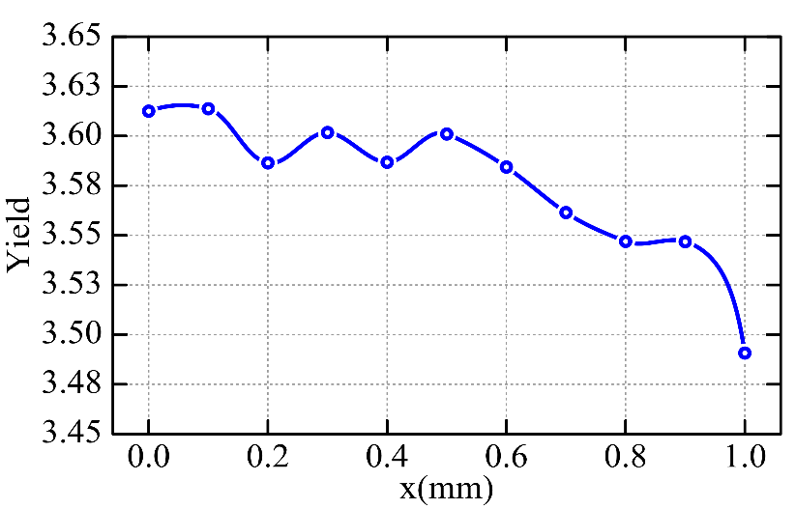
The positron production system
STCF
Positron yield of different electron energy spread(1.5Gev)
Positron yield of different electron energy spread(2.5Gev)
The energy spread of the electron beam has a relatively small impact on the positron yield .
Offset of electron beam targeting needs to be within 0.6 mm
The effect of electron beam target displacement on positron yield
Notes:
Regarding the requirements for the energy spread of the electron bunch, we found that the energy spread of the incident electron beam has a small impact on the positron yield. However, the offset of the electron bunch does affect the positron yield, and we may need to control the positron bunch offset to within 0.6 mm.

Slide 10
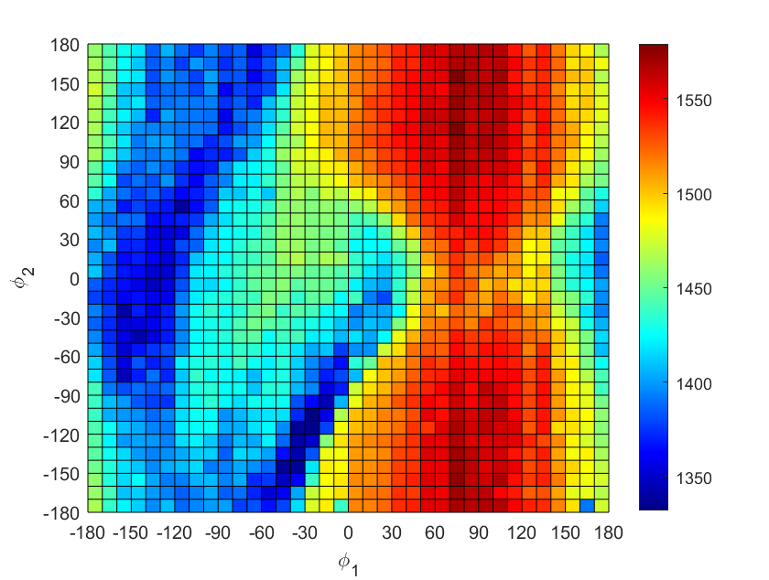
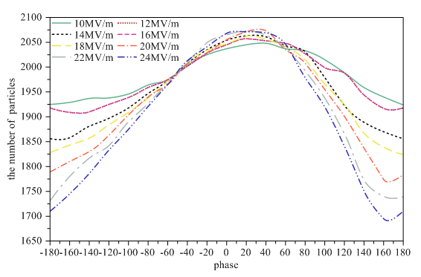
Positron pre-accelerating section
STCF
Phase optimization of Capture Section
Acceleration gradient of Capture Section
1.The capture section consists of two 1m acceleration cavities, and the acceleration section consists of four 3m acceleration cavities. The aperture of the acceleration tube is 30mm.
2. The peak magnetic field of Flux Concentrator is 5T, and the magnetic field of the solenoid is 0.5T
3. Acceleration gradient : 20MV/m
Notes:
Next, this is the design of our 200 MeV positron pre-acceleration section. The pre-acceleration section consists of 2 accelerating cavities of 1 meter each and 4 accelerating cavities of 3 meters each. The aperture of the accelerating cavity is 30 mm and an acceleration gradient of 20 MV/m. The peak magnetic field of the Flux Concentrator is 5 T, and the solenoid magnetic field is 0.5 T.

Slide 11
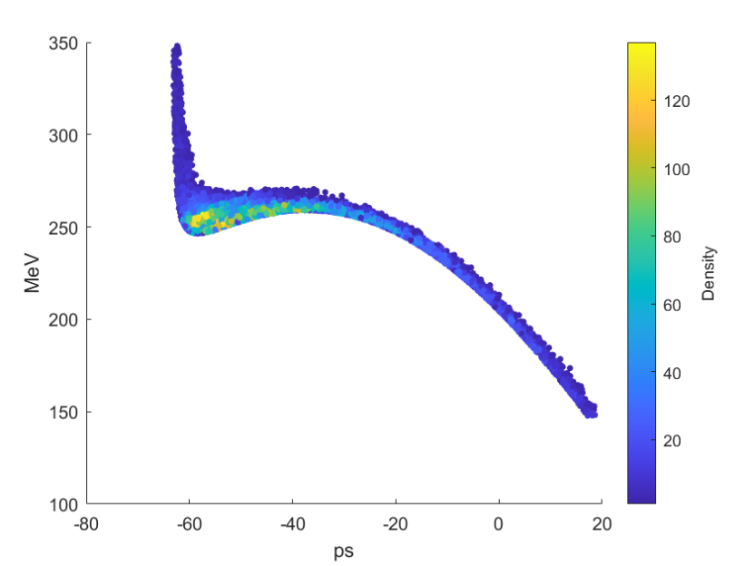
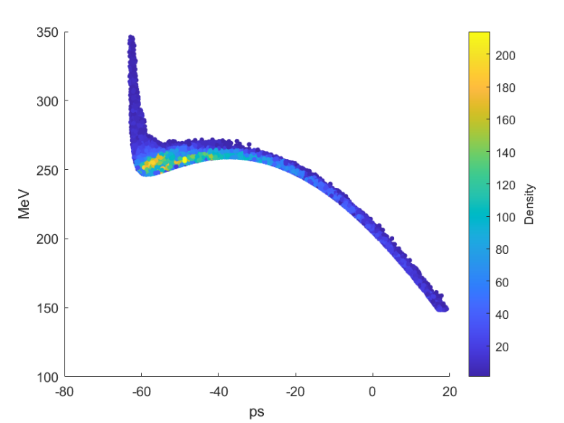
Positron pre-accelerating section
STCF
longitudinal phase space distribution of
the end of pre-accelerating section(Off-axis)
longitudinal phase space distribution of
the end of pre-accelerating section(Swap-out)
Parameter | Off-axis | Swap-out
yield | 0.570 | 0.883
Energy spread | 8.21% | 8.06%
Bunch length | 5.66mm | 5.63mm
Beam size | 4.63mm | 4.63mm
$$ε_{n}/mm·mrad$$ | ~3200 | ~3200
There is not much difference between the two injection methods except for production at the end of the pre acceleration stage
The energy divergence is relatively large, accounting for 8.21% and 8.06% respectively
Notes:
The longitudinal phase space distribution at the end of the 200 MeV acceleration is shown in the figure. The yields for the two injection methods are 0.570 and 0.883, with an energy spread of about 8% and a bunch size of approximately 5.6 mm.

Slide 12
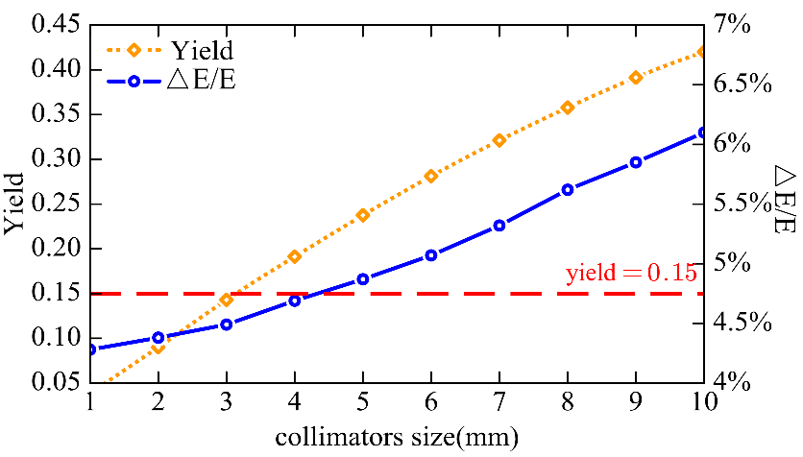
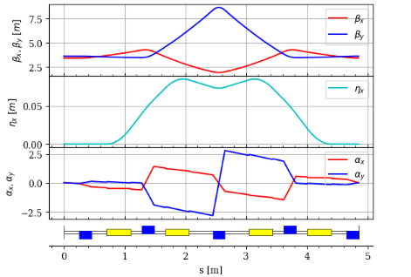
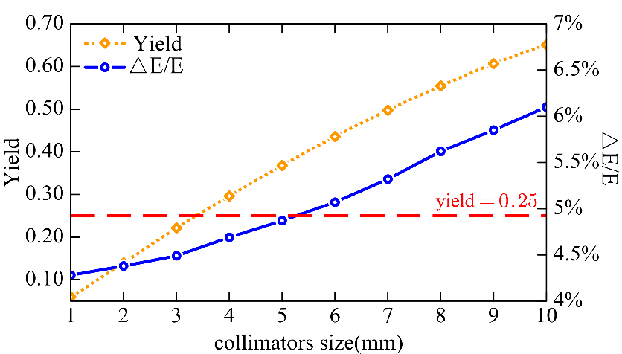
Positron pre-accelerating section
STCF
1.Add a collimator after the second group of Bend Magnet in the Chicane structure to reduce energy spread
2. The collimator radius :5mm, balance positron yield and energy spread.
Notes:
In the design of the positron and electron separation system, due to the larger energy spread of positrons, we added collimators in the x-direction of the vacuum pipe after the second bending magnet in the chicane structure to reduce the energy spread. Ultimately, the radius of the collimator was set to 5 mm to balance the positron yield and energy spread.

Slide 13
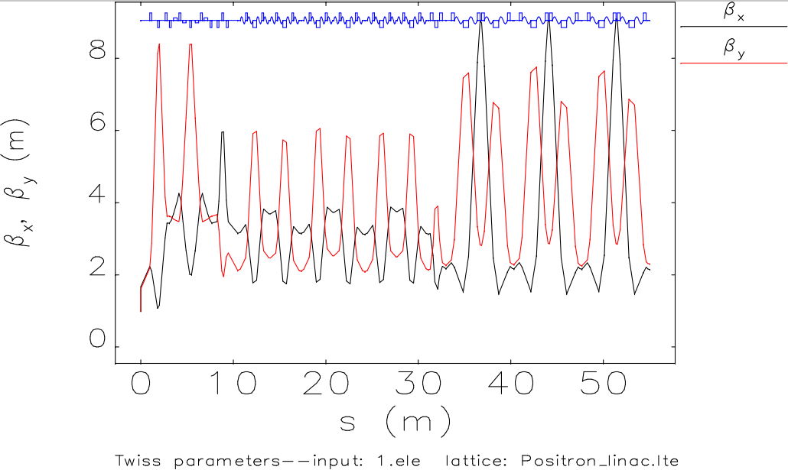
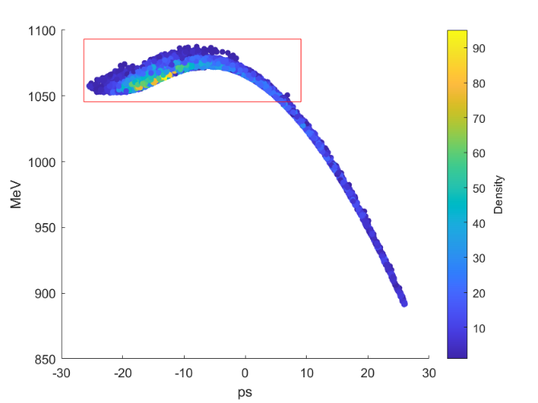
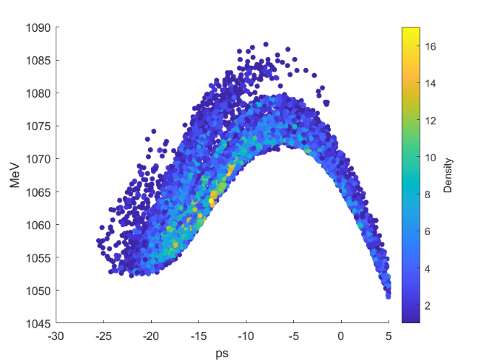
Design of 1 GeV positron beam-line
STCF
Beam distribution of 1 GeV positron beam
Parameter | Off-axis | Swap-out
yield | 0.16>0.15 | 0.252>0.25
Energy spread | 0.068% | 0.068%
Bunch length | 1.92mm | 1.95mm
Beam size | 1.2mm | 1.2mm
$$εx/nm·rad$$ | 795 | 769
$εy/nm·$rad | 1168 | 1185
1. The beam Emittance has met the requirements
2. Energy spread and beam length still need to be optimized
2. Gradient:22Mv/m , LAC for 600MeV
Notes:
The design of the 1 GeV positron injector proposes a gradient of 22 MV/m, utilizing a large-aperture accelerating cavity up to 600 MeV. Currently, the beam emittance meets the requirements, but the beam energy spread still needs further optimization.

Slide 14
Contents
STCF
The injector of STCF
The positron source of STCF
Thermal research on target

Slide 15
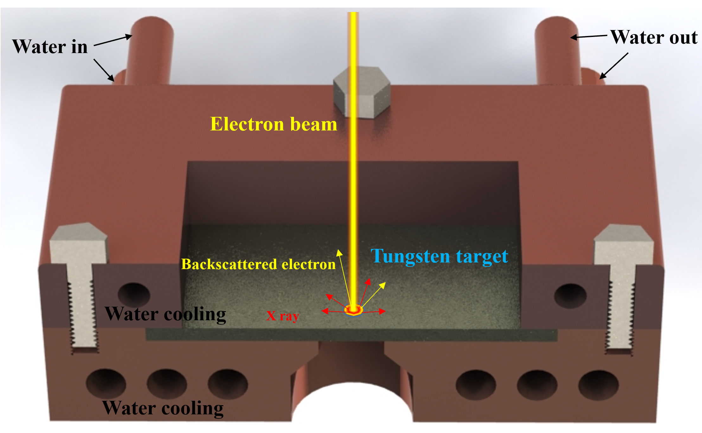
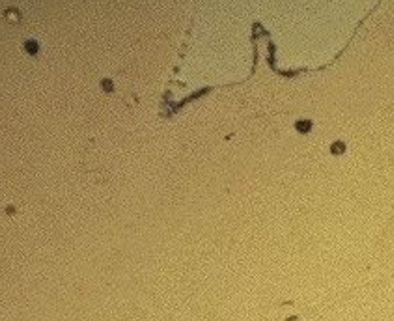
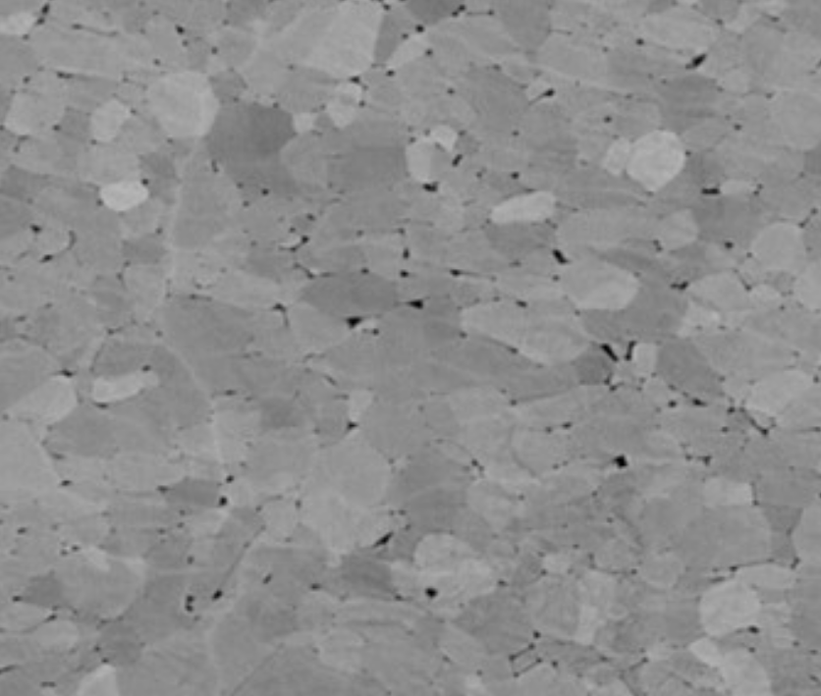
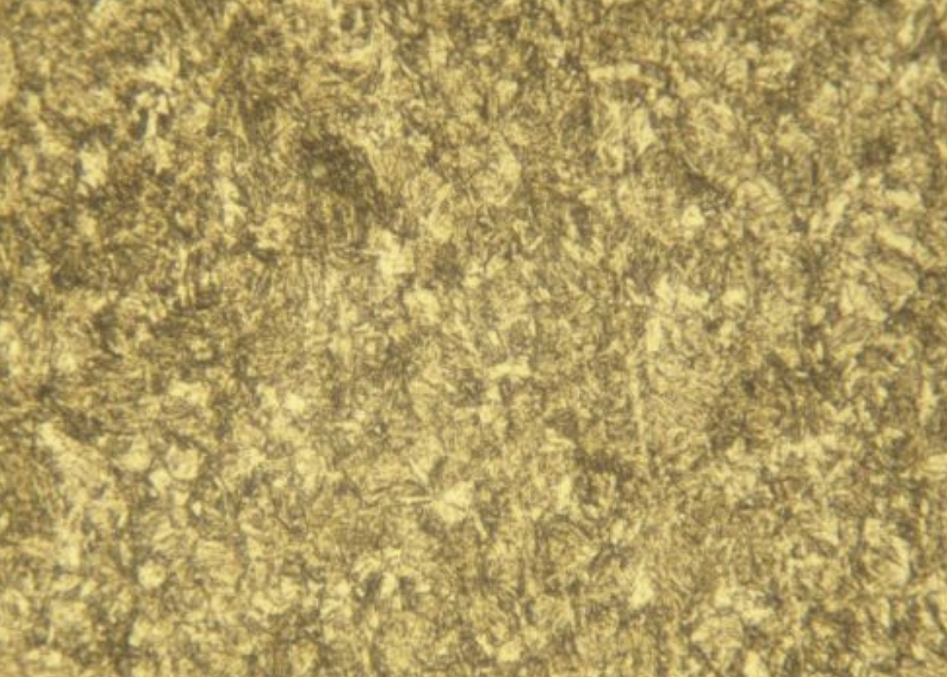
Recrystallization of tungsten target
STCF
Melting point of tungsten 3410℃.
Recrystallization of tungsten 900 ℃
900 ℃
900 ℃
Polycrystalline tungsten
Amorphous tungsten
Polycrystalline tungsten
Single crystal tungsten
Recrystallization of tungsten target
Notes:
Finally, I will discuss the recrystallization phenomenon of tungsten targets. Although tungsten has a melting point of 3410°C, recrystallization can occur at as low as 900°C. This leads to changes in the lattice structure of the tungsten target, which in turn affects the yield. As shown in the figure, we conducted an electron beam bombardment experiment to demonstrate that the lattice structure of both single-crystal tungsten and amorphous tungsten undergoes changes at 900°C. The four images below illustrate that within the temperature range of 900°C to 1400°C, the recrystallization phenomenon occurs: single-crystal tungsten transforms into polycrystalline tungsten, and amorphous tungsten recrystallizes into polycrystalline tungsten. This process can be completed in tens of microseconds and has a significant impact on the yield stability of the tungsten target. This is especially important for single-crystal targets, which require channeling-radiation, and must be carefully considered.

Slide 16
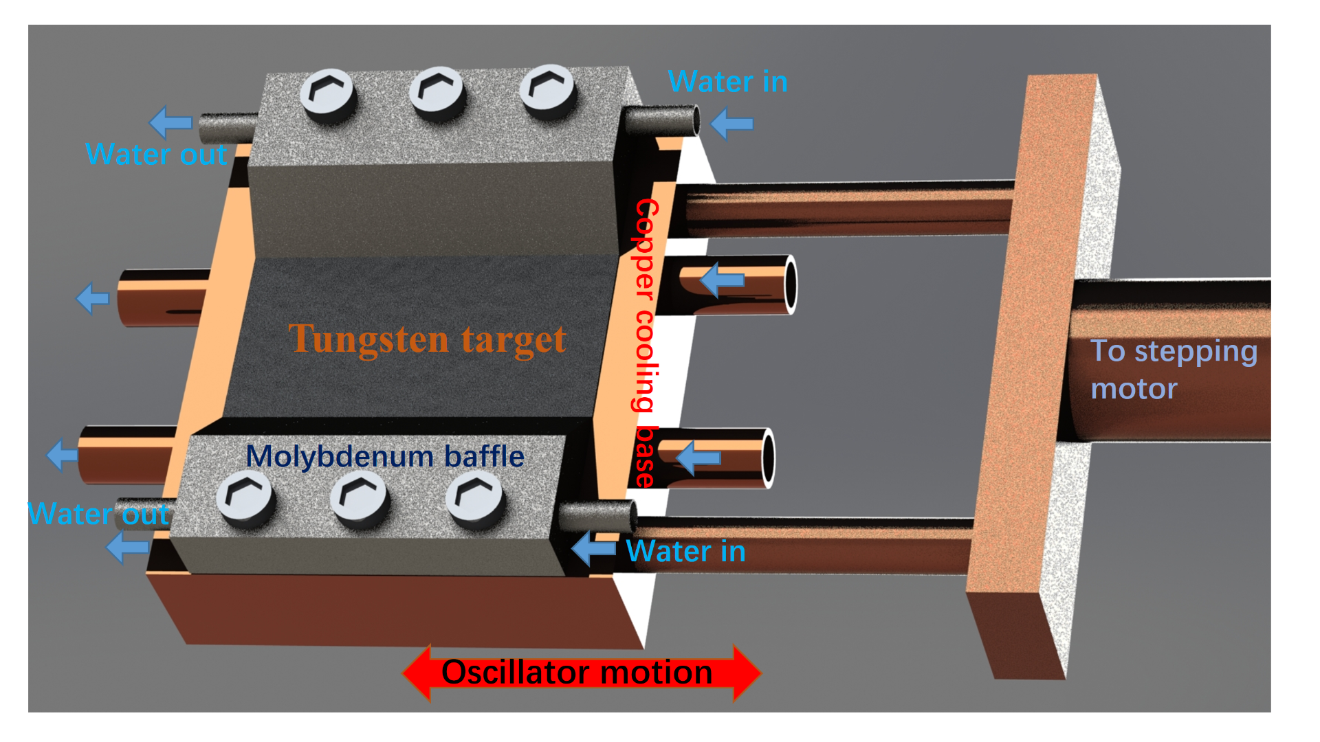
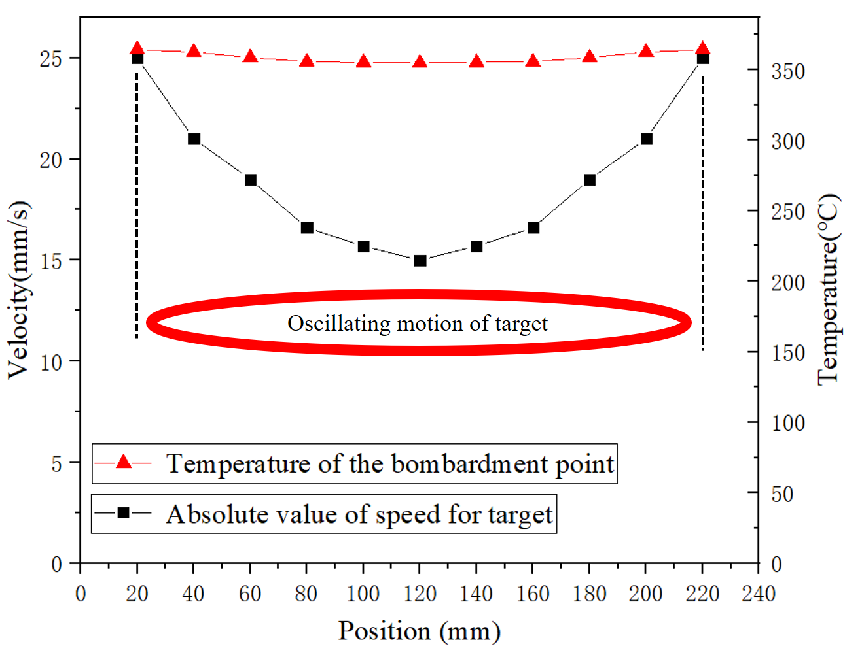
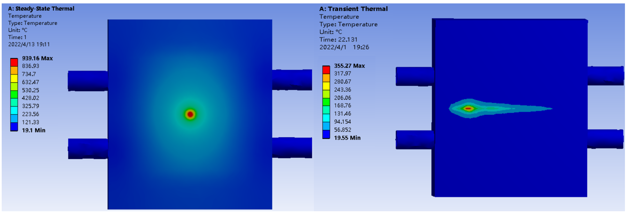
Design of oscillating moving targets
STCF
2.5 GeV/100Hz/10nC
Notes:
To address this issue, we designed a vibrating target system to reduce the temperature rise of the tungsten target. The moving target significantly lowers the instantaneous temperature on the target, preventing recrystallization. Additionally, by optimizing the movement speed, particularly at the turning points at both ends, the temperature uniformity of the target is ensured.

Slide 17
Conclusion
STCF
1.Two positrons were designed for off-axis injection and swap out injection, respectively.
2. Completed the design of the positron beam line in front of the damping ring.
3.The recrystallization phenomenon of tungsten positron conversion targets has been studied, and oscillating motion water-cooled targets have been designed.

Slide 18
STCF
Thanks for your attention！

