Slide 1
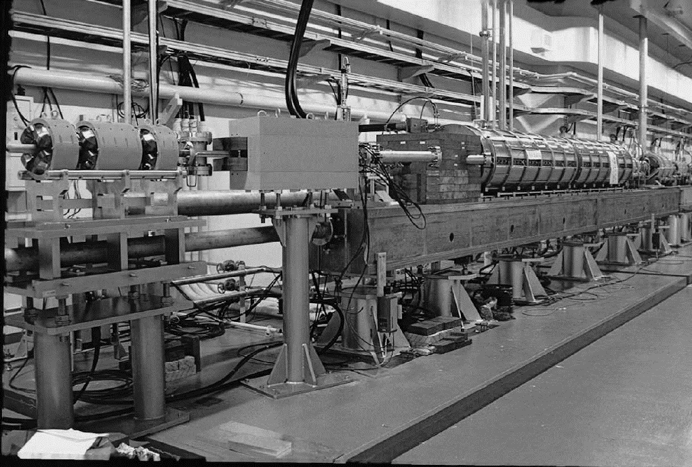
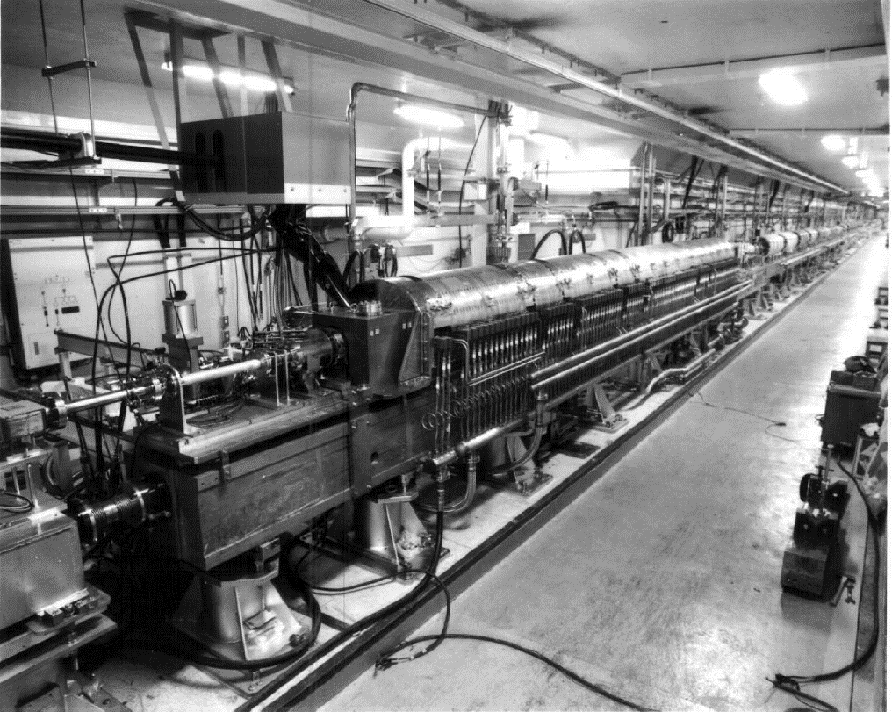
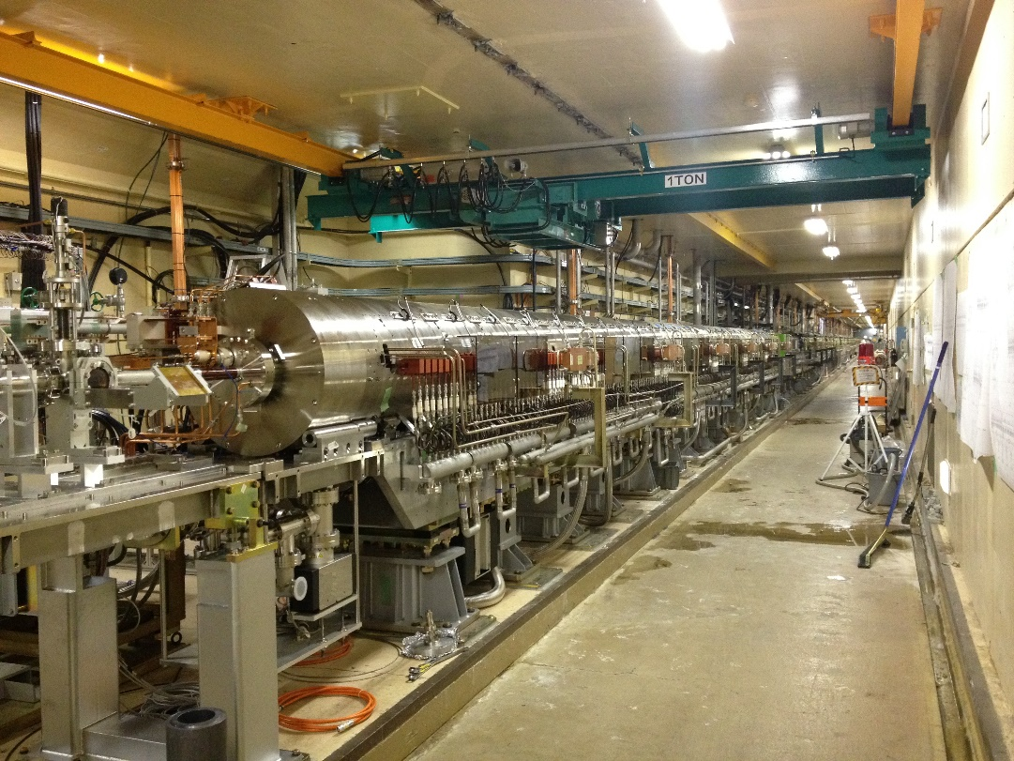
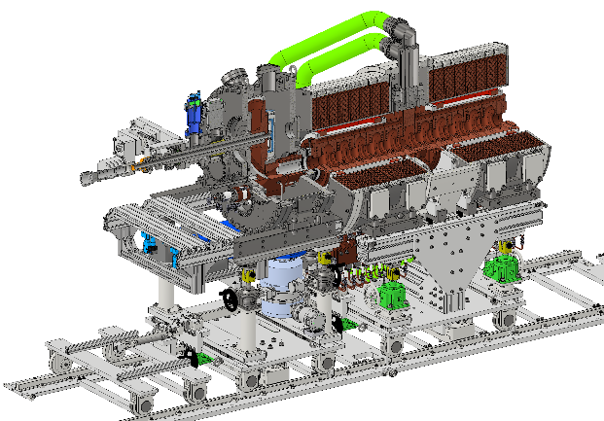
e-driven ILC positron source and prototyping at KEK
2024/10/16
Y. Enomoto
On behalf of positron group
M. Fukuda, Y. Morikawa, M. Sato, H. Hayano
TRISTAN
KEKB
SuperKEKB
ILC
This work was supported by 【MEXT Development of key element technologies to improve the performance of future accelerators Program】 Japan Grant Number JPMXP1423812204.

Slide 2
Comparison of positron sources
 | SKEKB | ILC | FCC
e- energy | 3.2 GeV | 3 GeV
e- charge/bunch | 10 nC | 3.7 nC
Repetition | 50 (25) Hz | 5 Hz
Num. bunches | 2 | 1320 = (33+33) x 20
Total charge / s | 1000 (500) nC | 24667 nC
Beam power on target | 3.2 | 74
yield | 0.4 | 1.3
●past
▲present
◆future
ILC e-driven
Many options
CLIC
High efficiency
SuperKEKB
FCCee
(many options)
BEPC
DAFNE
VEPP-5
CEPC
KEKB
SLC
ILC undulator
High power

Slide 3
Prototype to be built by JFY2027
target
Acc. structure
solenoid
Flux concentrator

Slide 4
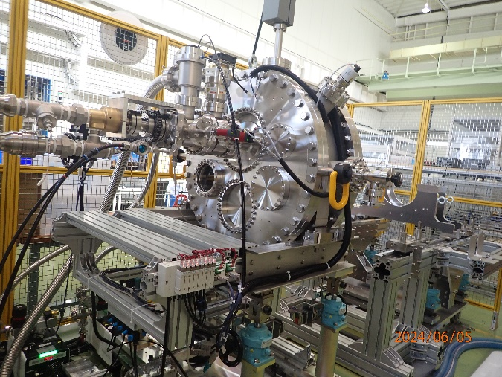
5 years-plan(as of 2024/3/28)
FY |  | 2022 |  | 2023 |  |  |  | 2024 |  |  |  | 2025 |  |  |  | 2026 |  |  |  | 2027
year |  |  | 2023 |  |  |  | 2024 |  |  |  | 2025 |  |  |  | 2026 |  |  |  | 2027
Quarter |  | Q4 | Q1 | Q2 | Q3 | Q4 | Q1 | Q2 | Q3 | Q4 | Q1 | Q2 | Q3 | Q4 | Q1 | Q2 | Q3 | Q4 | Q1 | Q2 | Q3 | Q4 | Q1
Test bench
High power test bench
W-Cu connection
Target unit | Rotation mechanism
 | Disk
FC base | 1st unit
magnet | Solenoid
 | Power supply
Chamber, vacuum, support
Acc. structure | 1st unit
FC power supply
Now!
Design
Manufacuring
test

Slide 5
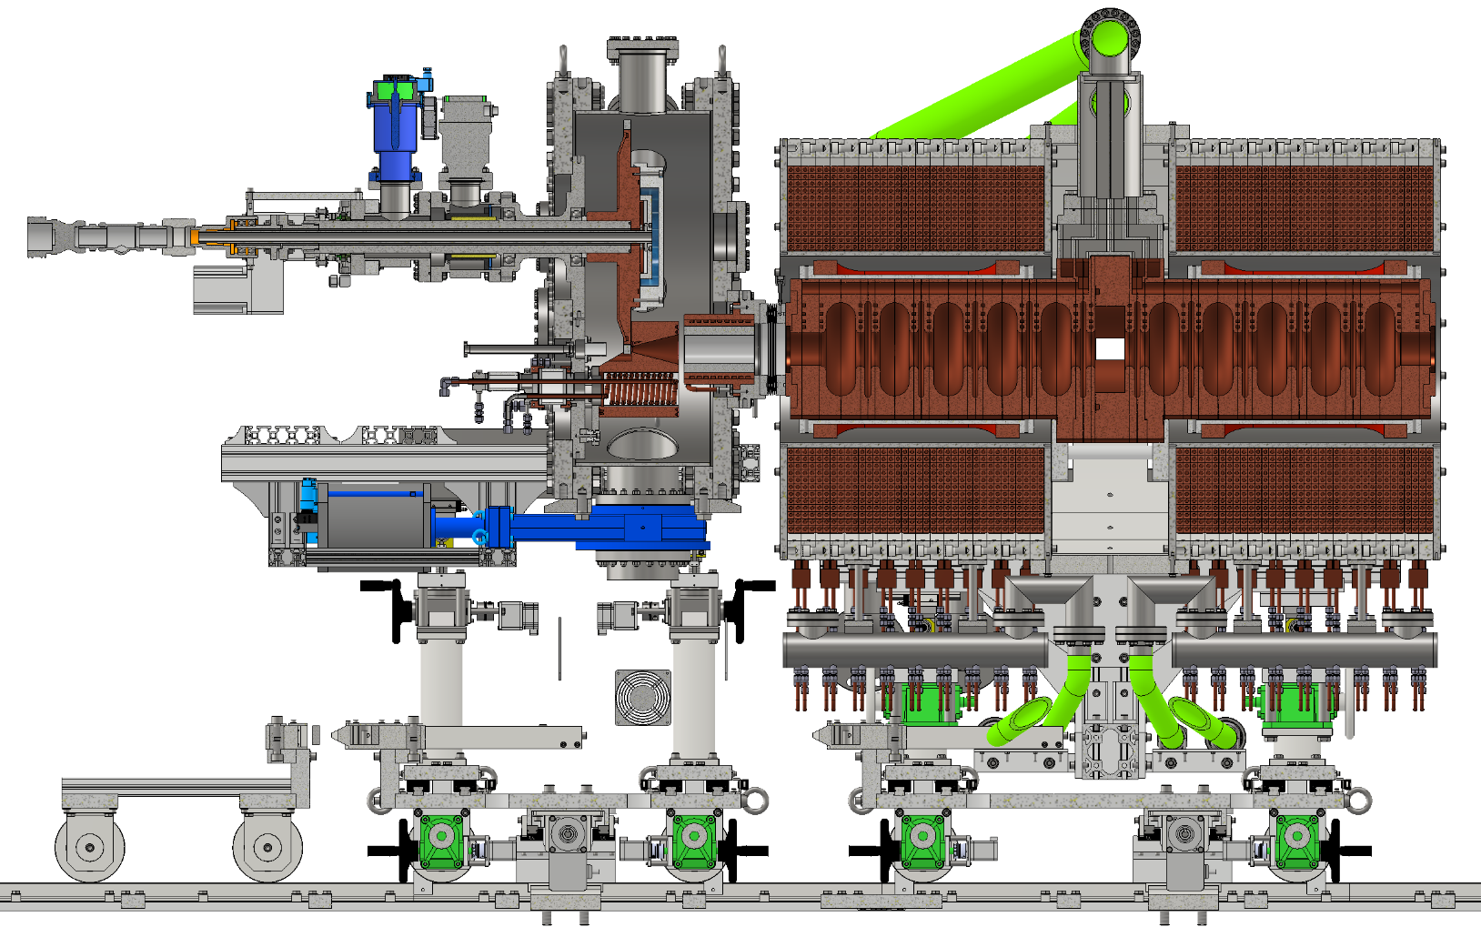
What we did in JFY2023
Target
rotation mechanism
Vacuum system
Solenoid
Design and procurement of material
ACC structure
RF design, 3D model
FC
Design and manufacture parts

Slide 6
What we plan to do in JFY2024
Target disk
Collimator with pillow seal
solenoid
ACC structure
Manufacturing test
FC
assemble

Slide 7
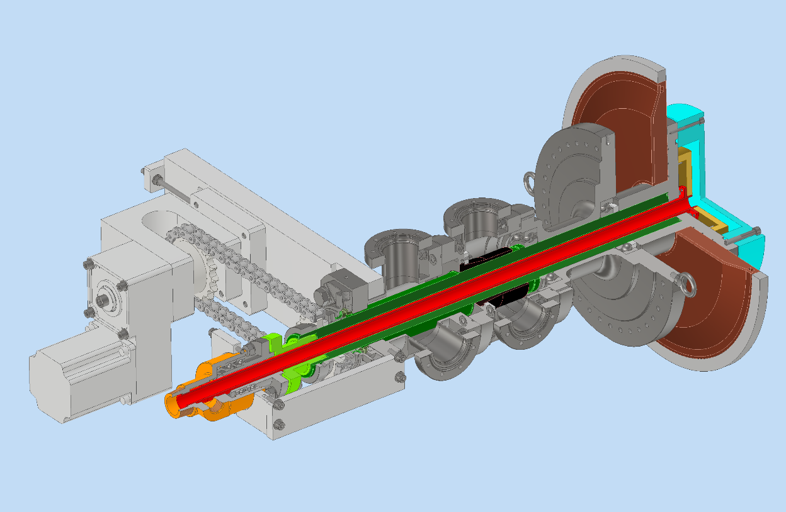
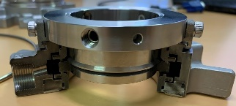
Target
 | Technical design | Engineering design | 3D model | Drawings | Manufacturing | Evaluation
Rotation mechanism | Done | Done | Done | Done | Done | Done
Target disk | Done | Done | Done | Done | Done | In progress
Design and manufacturing of rotation mechanism done in FY2023
Design and manufacturing of target disk finished
Assembled into the chamber
Vacuum test OK
Rotation test OK
run-out evaluation by laser displacement sensor is in progress
Thermal contact evaluation between W and Cu is planned
Narrow gap1 for differential pumping 30um
<10⁻⁵ Pa
Mechanical face seal
~10⁻² Pa
~10¹ Pa
Narrow gap2 for differential pumping 100um

Slide 8
【purchase】NC50, φ470×t20mm
【purchase】NC50, φ470×t132
【lathe?】finish all the part.
【lathe&mill】finish red line
【EBW】
【purchase】 φ500×t15.7
【lathe】finish red line part
【lathe】finish all the part.
【press fit】heat W ring, cool Cu disk

Slide 9
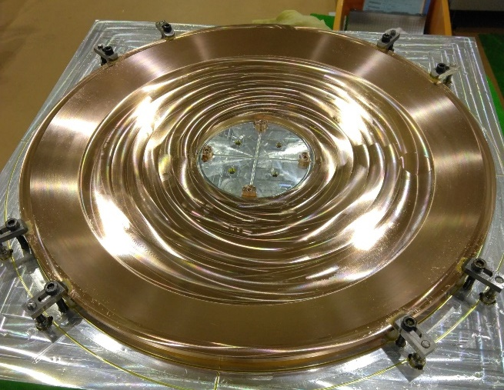
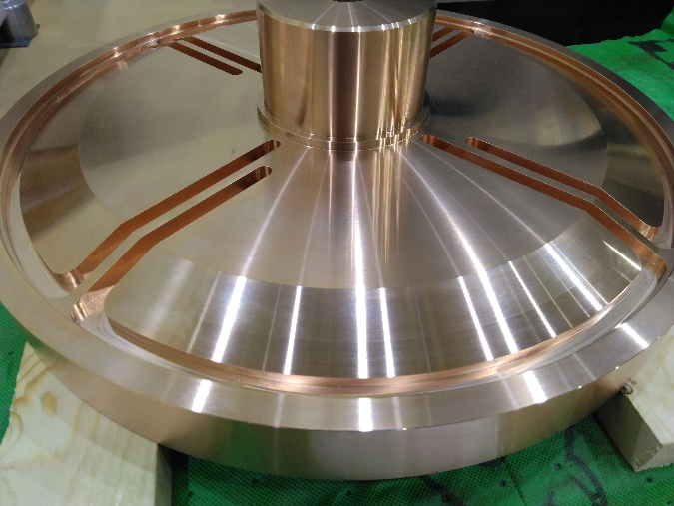
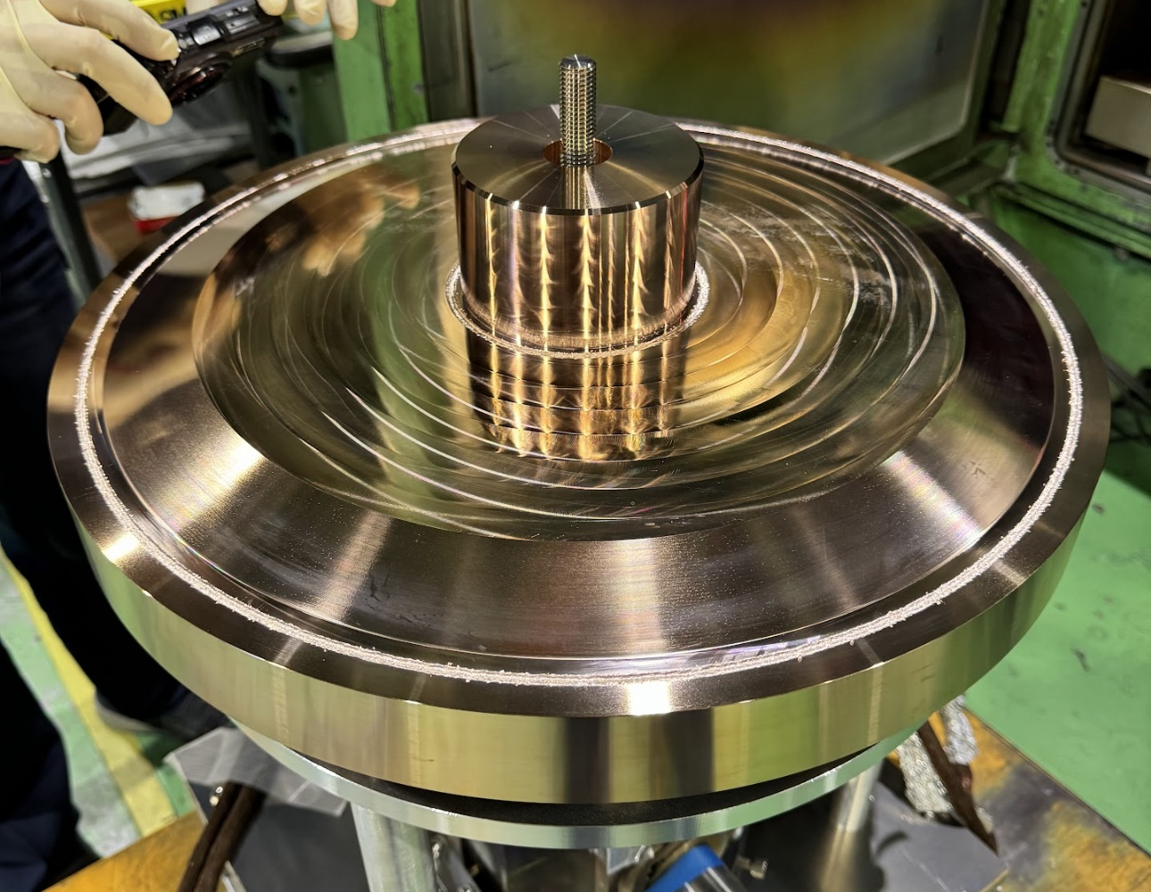
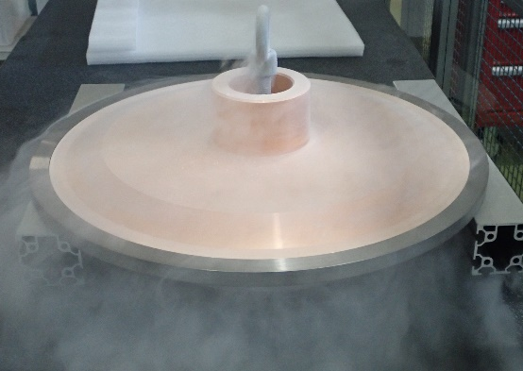
EBW
machining
Cold fit

Slide 10
Cold fit W ring

Slide 11
FC
FY2023
FY2024
Welding & assembly
Parts(delivered)
feedthrough
flange, support
piping
electrode
bolt, pin, bush
coil
Machining
done
EBW
done
Secondary working
Milling & EDM
done
Black plating
done

Slide 12
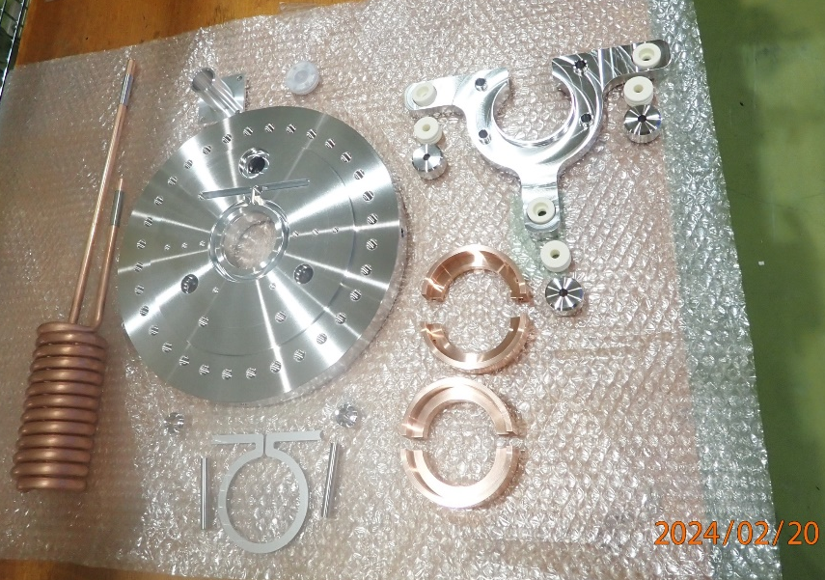
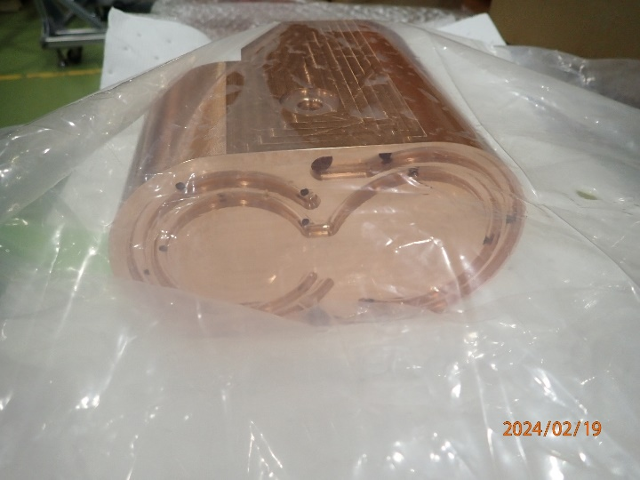
FC
FY2023
FY2024
Welding & assembly
Done
Parts(delivered)
feedthrough
flange, support
piping
electrode
bolt, pin, bush
coil
Machining
done
EBW
done
Secondary working
Milling & EDM
done
Black plating
done

Slide 13
Rotation test

Slide 14
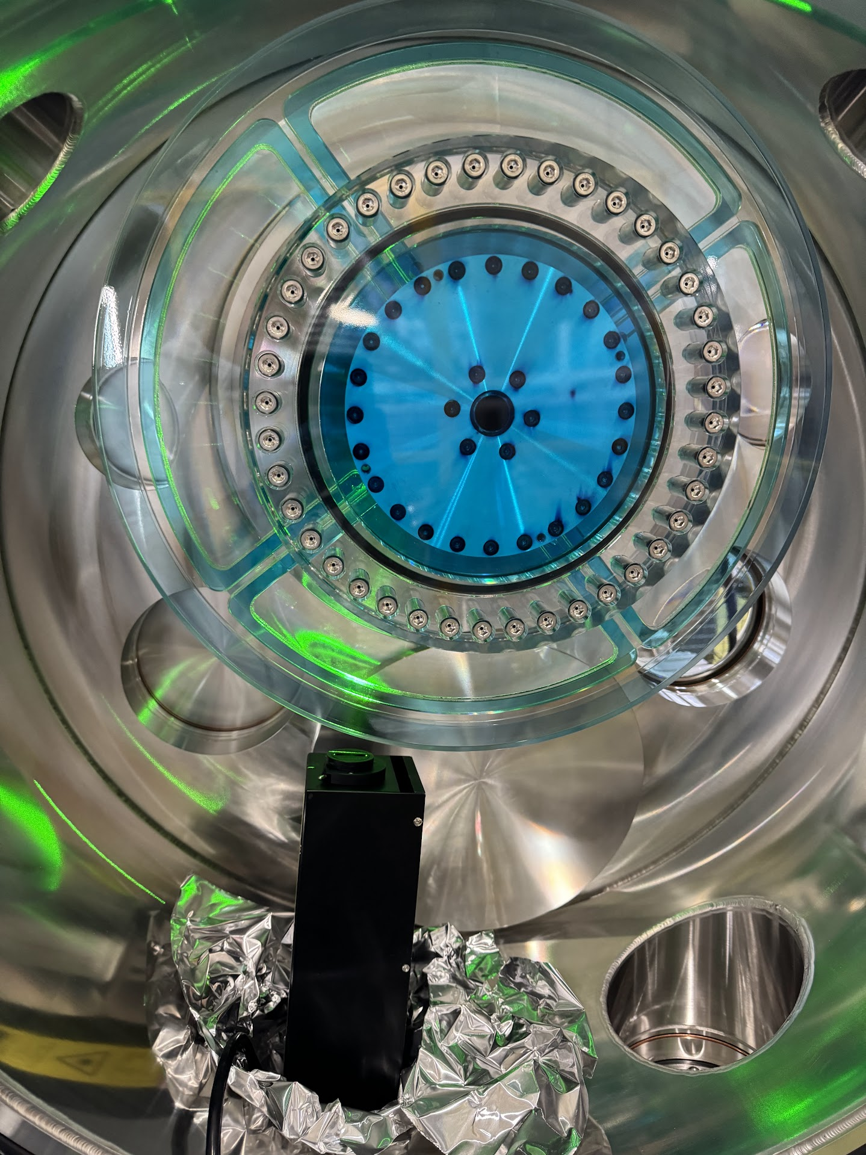
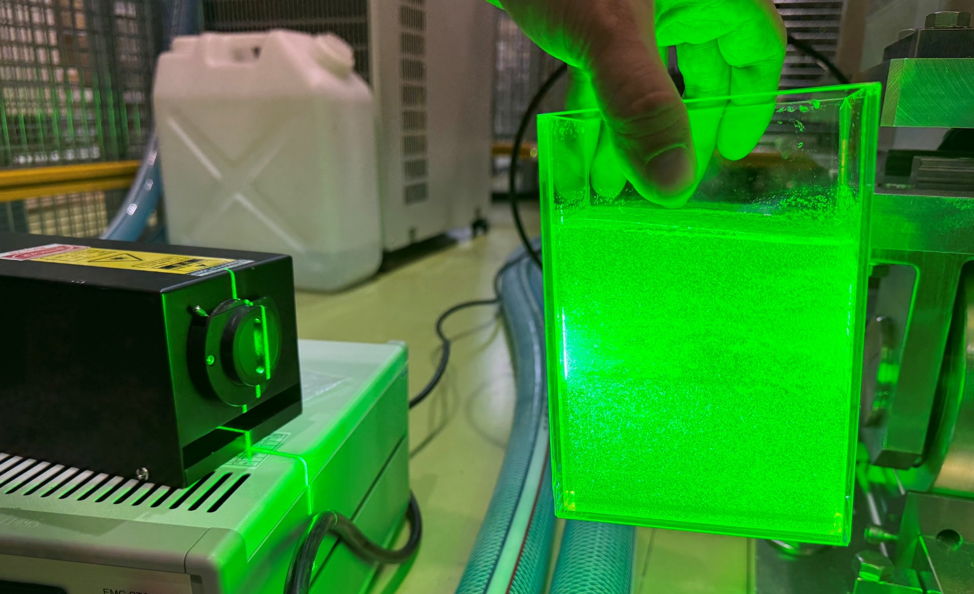
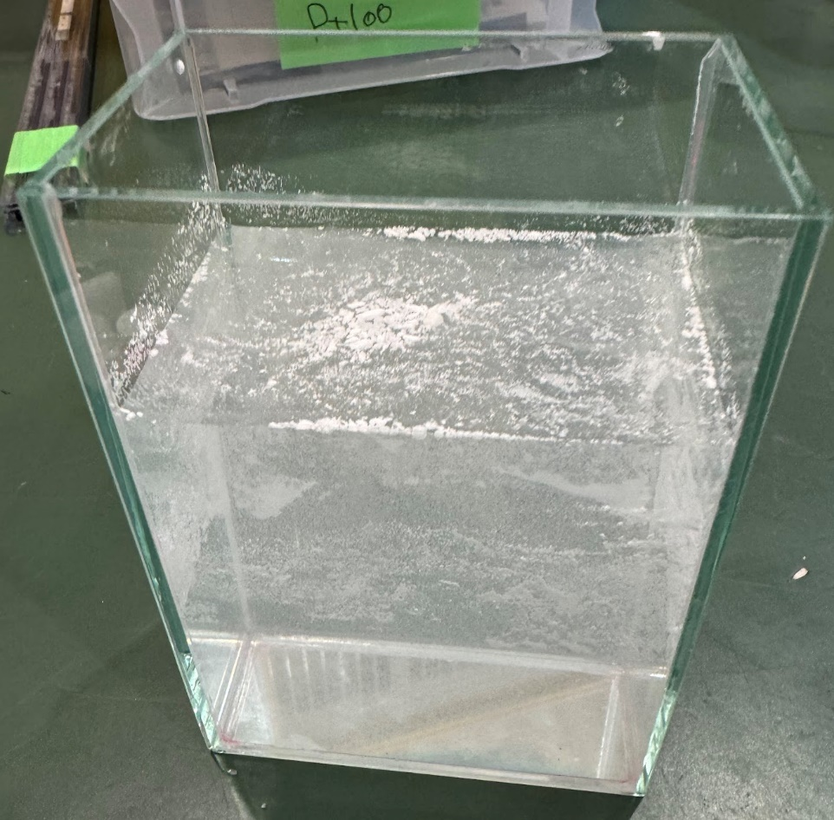
Water flow test and evaluation
tracer
・polyamide
・diameter 50 um
・1.03 g/cm³

Slide 16
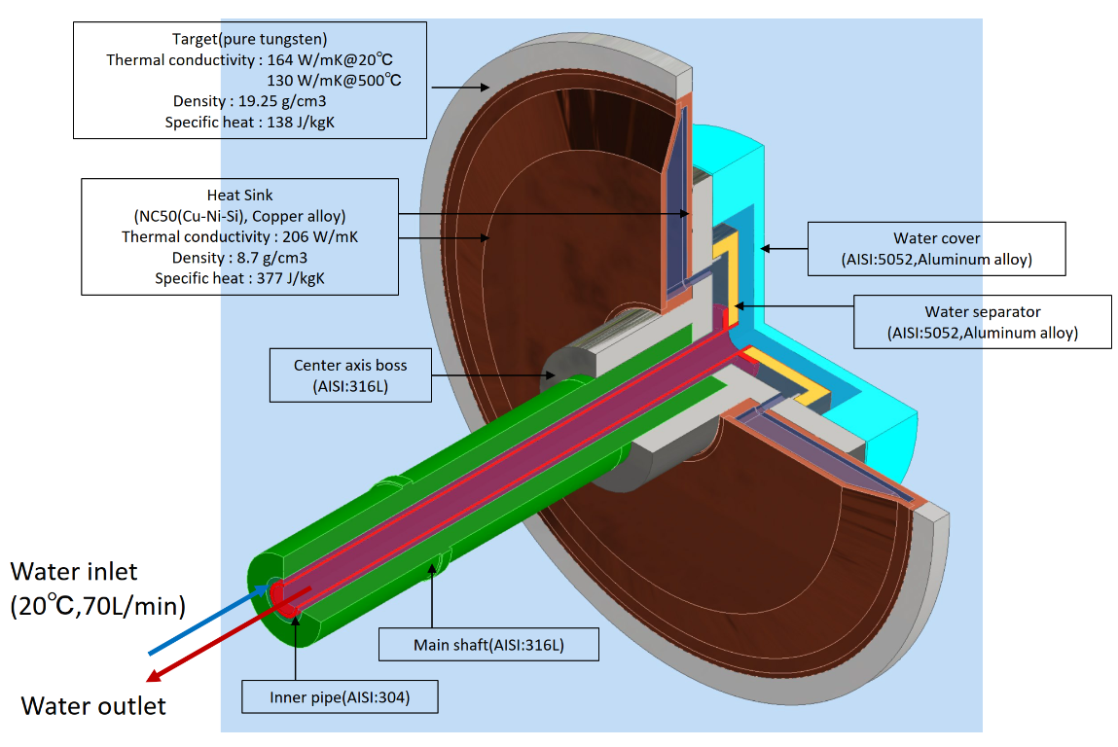
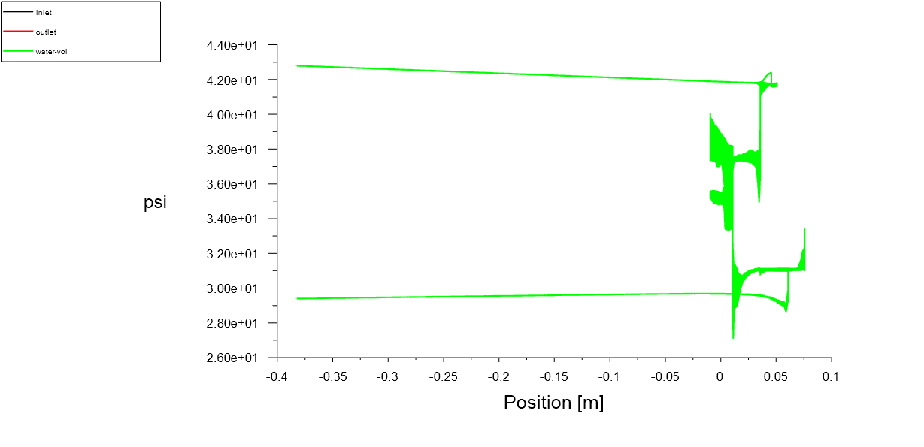
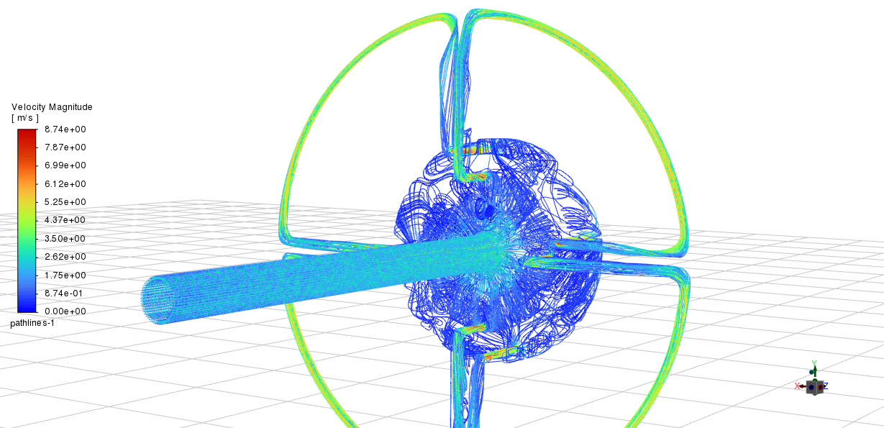
Target thermal and CFD simulation
Topic of US-Japan collaboration
Share 3D model and material information with JLab
First simulation result about velocity distribution and pressure drop from JLab

Slide 17
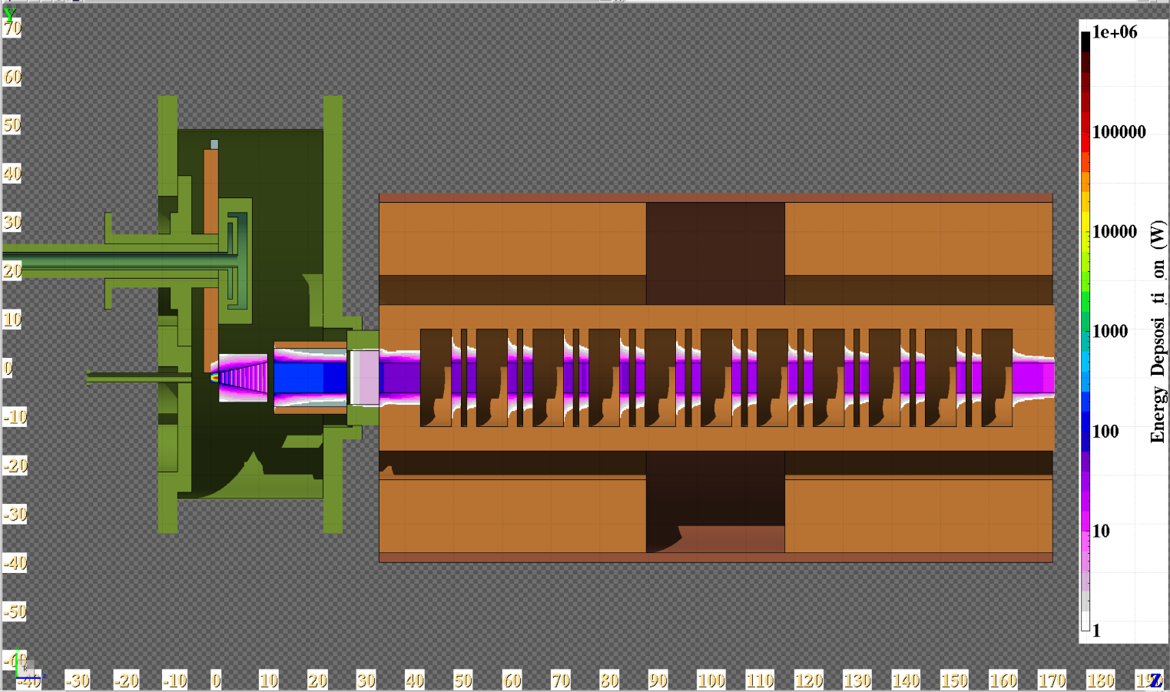
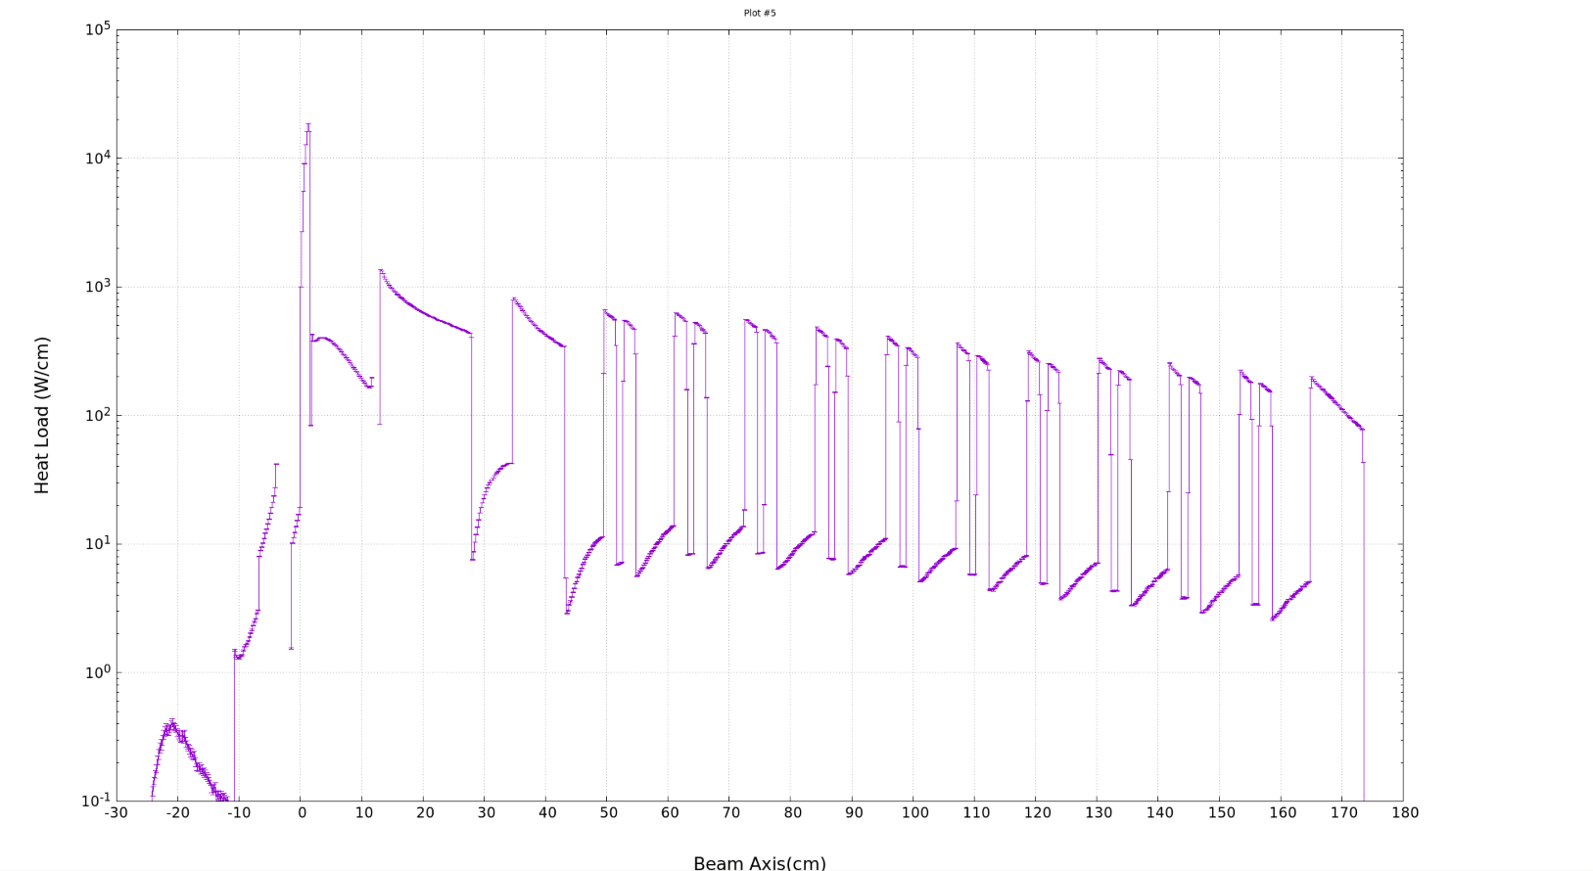
Acc. Structure - concept
Challenges
Beam loading compensation
High beam current : > 0.6A
Multi bunch operation
Powerful cooling system is required.
Very high heat load due to electromagnetic shower from the target
Remote beam flange connection
High activation by shower from the target and the connection point is surrounded by solenoid coils
Design Policy
High group velocity
Large coupling β
Water channel in the
APS cavity with a bi-periodic structure that operates in the π/2 mode, which maximizes the group velocity.
Target(26.1%, 16.4kW)
Cavity total (31.7%, 20.0kW)
Collimator(16.4%, 10.3kW)
CAV Entrance (7.0%, 4.4kW)
17
1st disk (3.5% ,2.2kW)

Slide 18
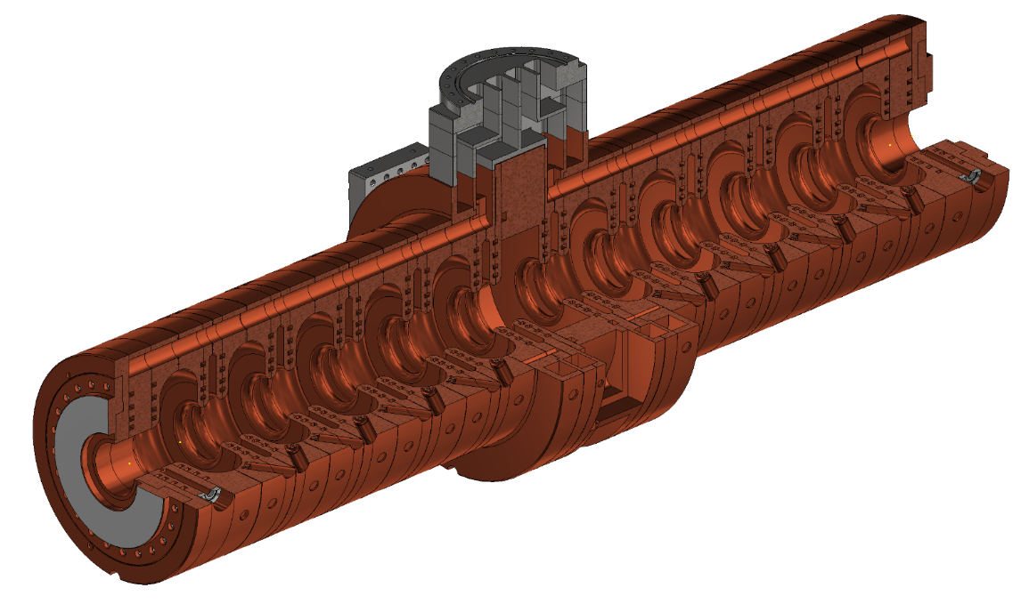
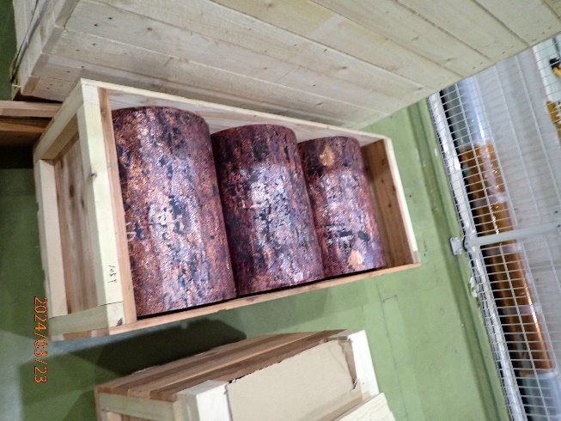
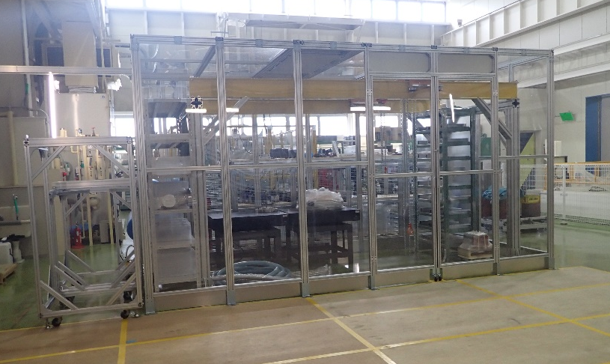
Acc. structure
 | Technical design | Mechanical design | 3D model | Drawings | Material | Manufacturing
Acc. Structure | Done（RF） | Done | Done | Ongoing | Delivered 2024/3 + additional 2025/3 | FY2024-FY2025
Test cell | Done（RF） | Done | Done | Done | Delivered 2024/3 | In progress
Machining and bonding of test cell is in progress
Drawing preparation is almost finished
Clean hut for RF test and assemble work was built
Precise cost estimation for all the prototype manufacturing process completed

Slide 19
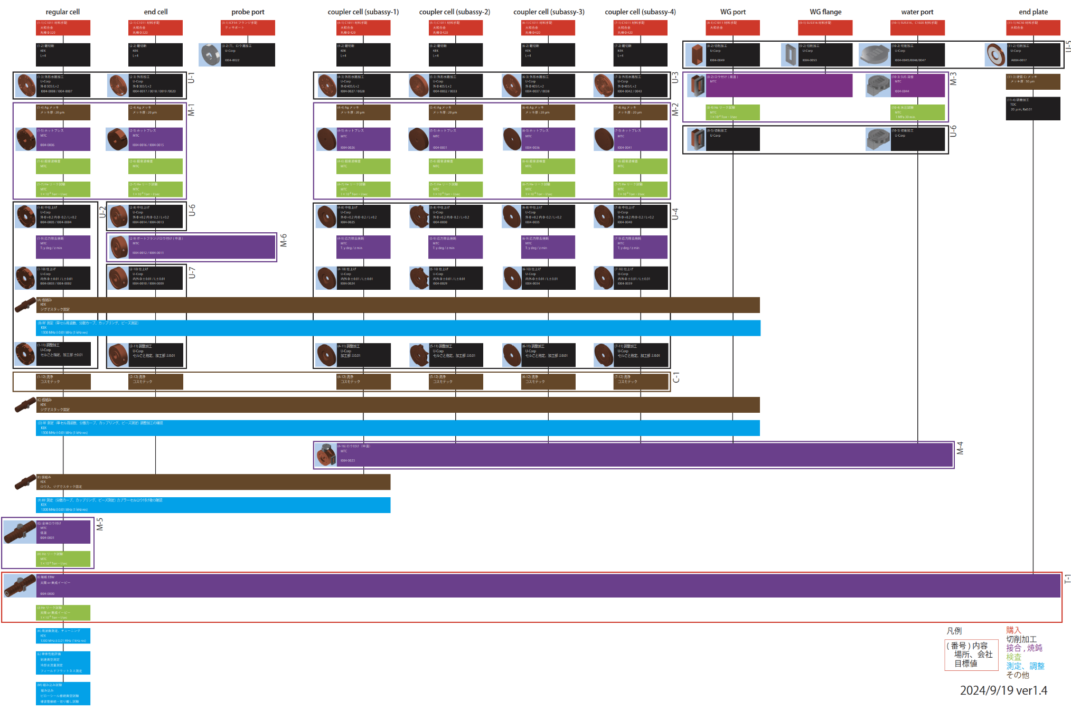
Acc. Structure manufacturing flow
Summary of manufacturing and evaluation flow from raw material to final assembly
Red: purchase
Black: machining
Purple: bonding
Brown: others
Light green: leak test
Sky blue: test and evaluation

Slide 20
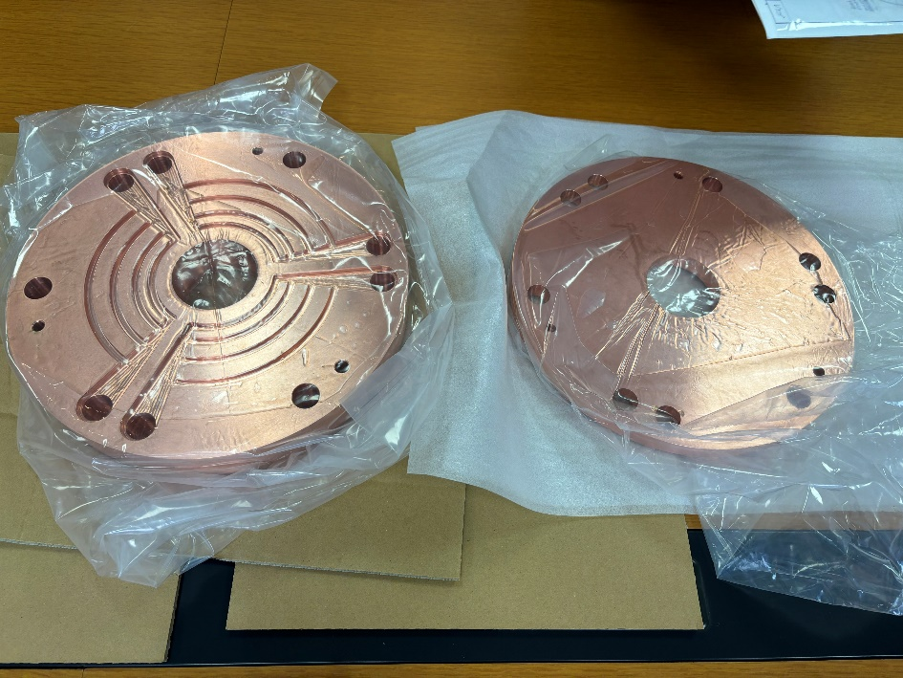
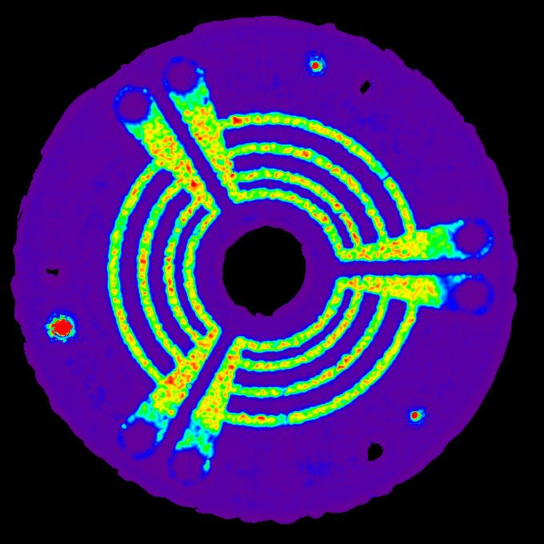
Hot pressing cells
C plate
□445×40t
294 kN@900℃
coupling-cell rp
C sheet 0.5t
accelerating-cell rp
C plate
□445×40t

Slide 21
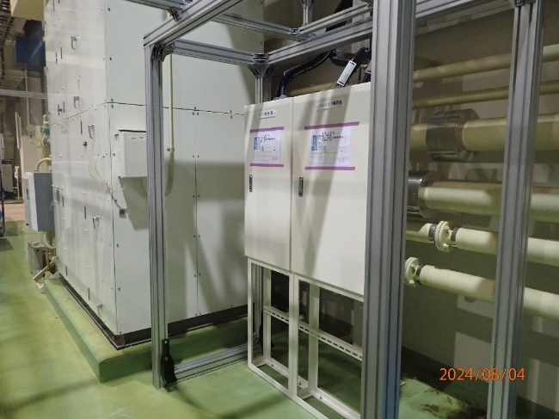
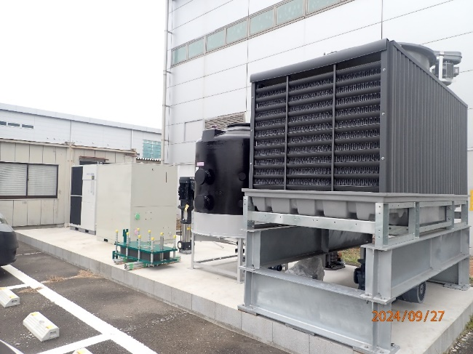
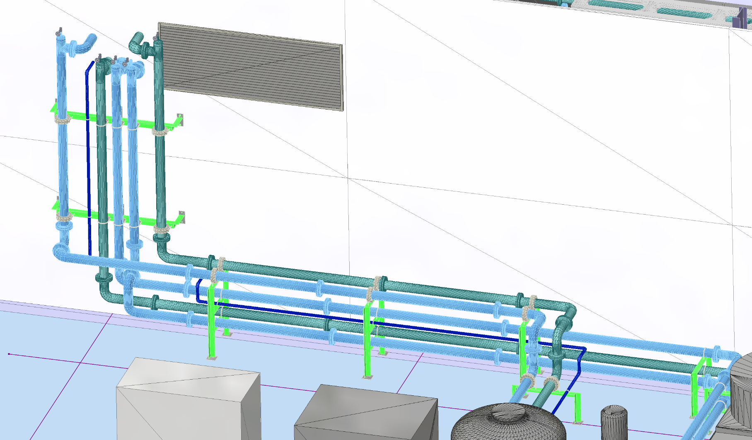
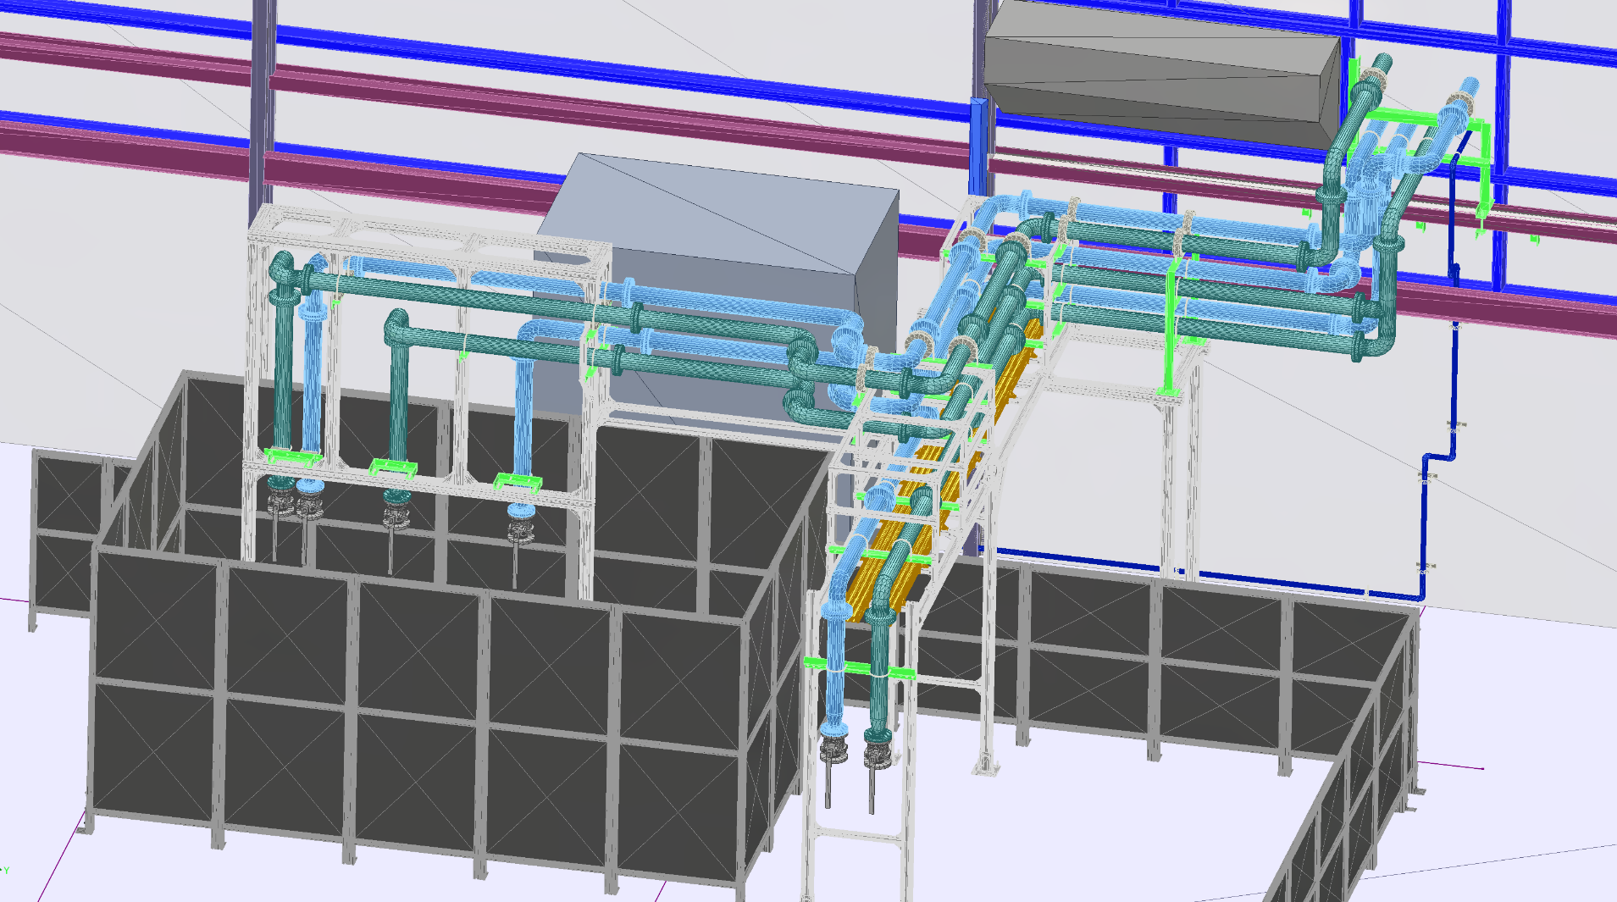
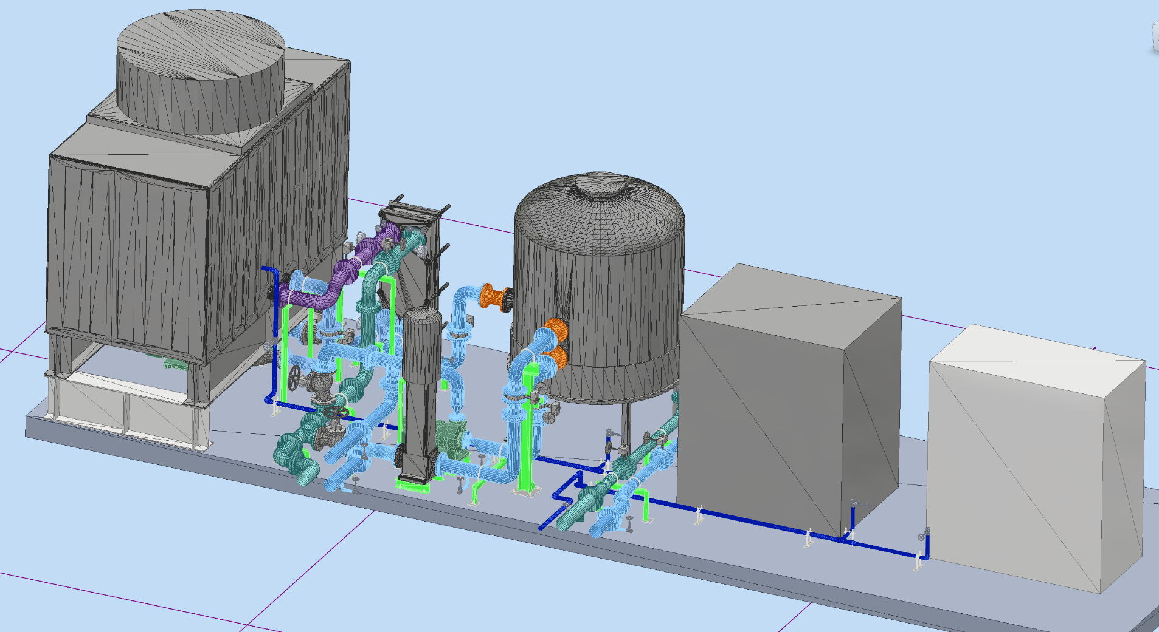
infrastructure
Cooling water
Chiller and cooling tower delivered in March 2023
Tank, pump and heat exchanger delivered in Aug. and Sept. 2024
Pipe and valve will be delivered Dec. 2024
Ordered 2024/9
Assembly work is planned in Jan. 2025
Electric power
For solenoid, FC power supply and cooling water system
Contract was made in Dec. 2023
Construction finished in Aug. 2024
Cooling water and electric power will be ready by the end of FY2024

Slide 22
Simulation flow of positron source

Slide 23
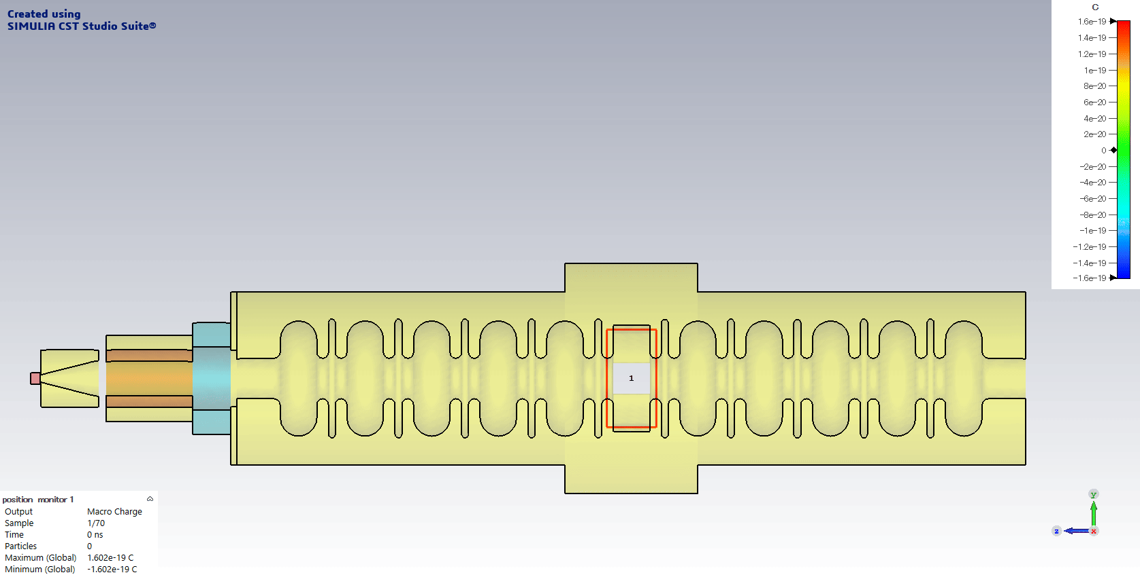
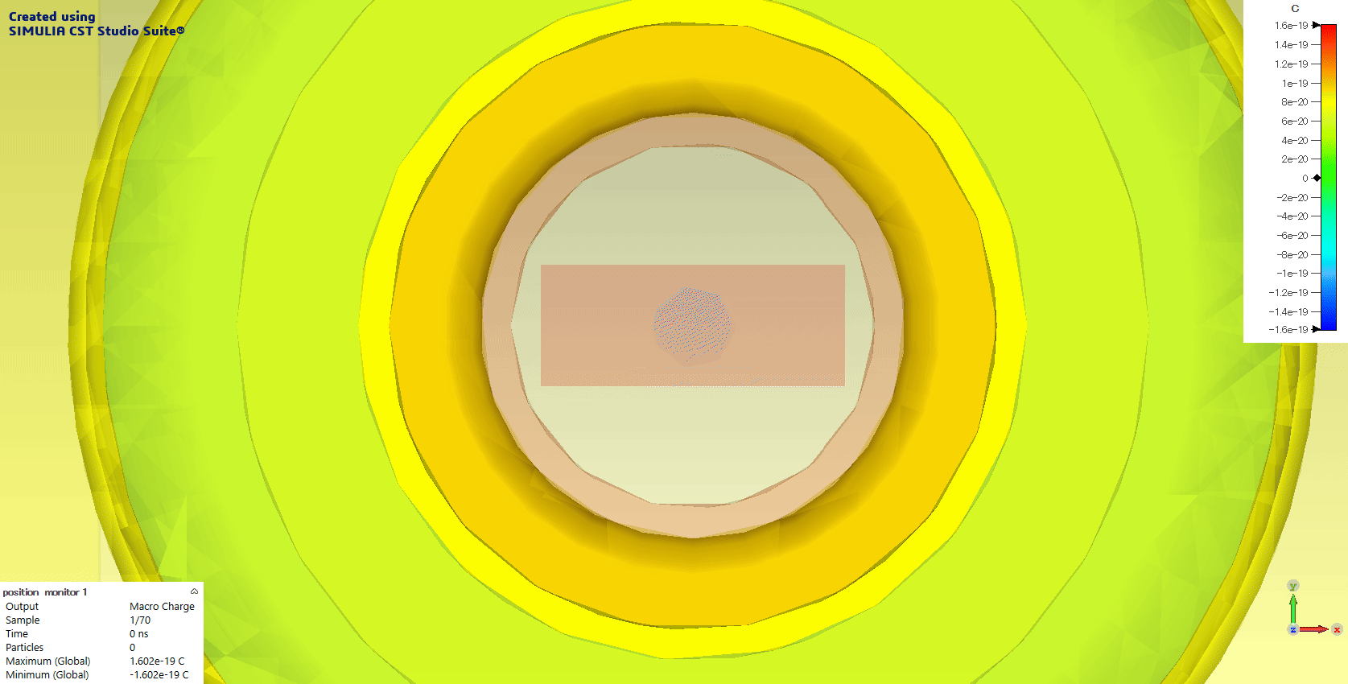
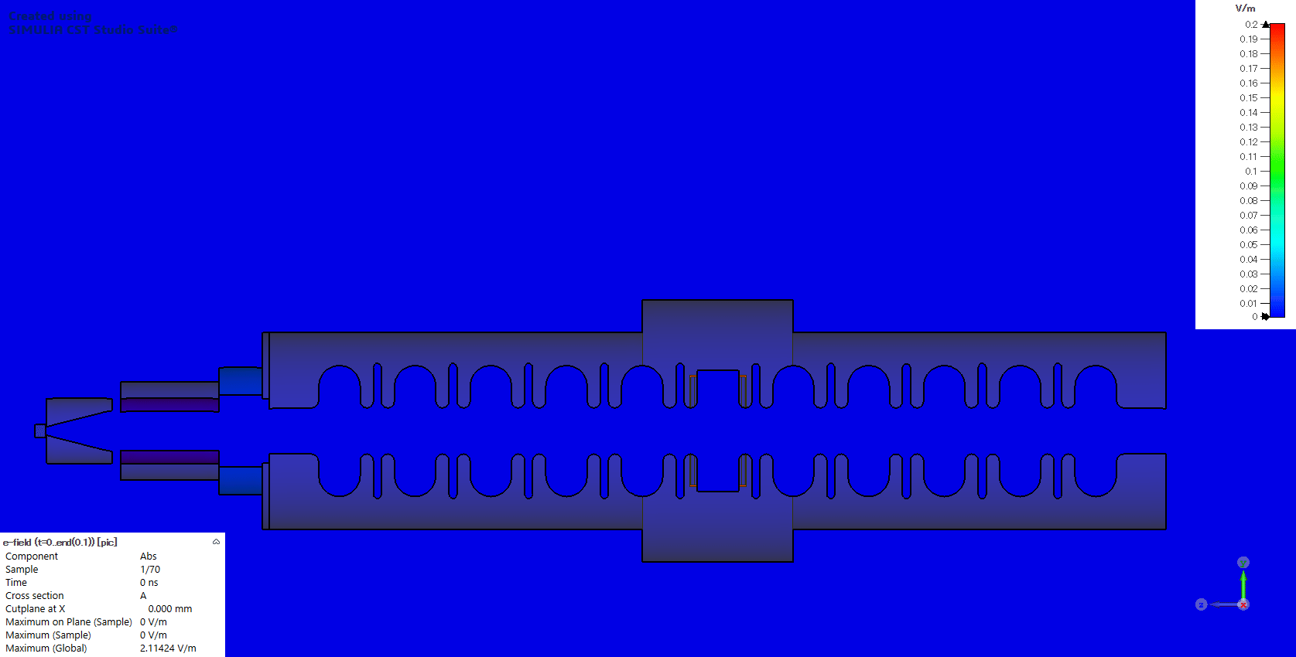
PIC simulation example
M. Fukuda
Blue:electron
Red:positron

Slide 24
3D model
Updated largely including many peripheral devices,
such as piping and cable connections
These peripheral devices will be manufactured and integrated by the end of FY2024

Slide 25
Summary
Prototyping of components are in progress
Cooling water and electric power will be ready by the end of FY2024
Everything but Acc. Structure, power supply (For FC and Solenoid) will be delivered by the end of FY2024

Slide 26
Outlook
FY2024
Finish prototyping of hardware
Except Acc. Structure and power supply
Infrastructure will be ready
Fully 3D simulation without beam loading effect
FY2025
DC power supply for solenoid (full module)
Prototype Acc. Structure
Pulsed power supply for FC
Fully 3D simulation with beam loading effect
FY2026
Assemble and evaluation of hardware
Improved design based on detailed simulation and the first prototype

