Slide 1
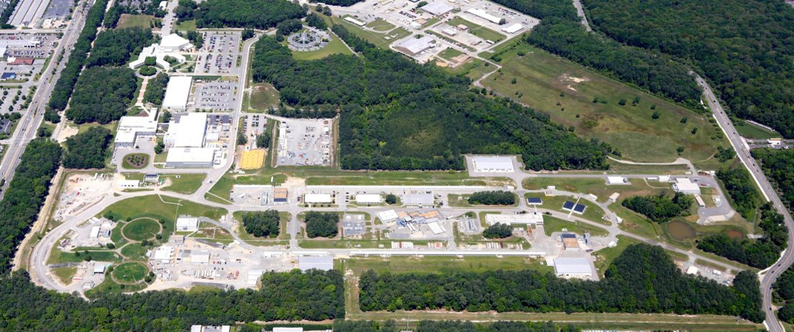
Injection Optics for 12 GeV High Polarization Positrons at Ce+BAF
Salim Ogur (Jefferson Lab)​
on behalf of the Ce+BAF Working Group
17 Oct 2024, AHIPS 2024, IJC-Lab

Slide 2












Ce⁺BAF Working Group
We would like to acknowledge members of the Ce⁺BAF Working Group, the Jefferson Lab Positron Working Group, the DOE industry partner Xelera, members of the DOE US-Japan HEP Collaboration, and collaborators at Universities and National Labs which contribute to the positron R&D effort.
T. Abe, J. Benesch, A. Bogacz, M.W. Bruker, L. Cardman, J. Conway, S. Covrig, P. Degtiarenko, Y. Enomoto,
S. Gessner, P. Ghoshal, S. Gopinath, J. Grames, J. Gubeli, C. Gulliford, S. Habet, G. Hays, C. Hernández-García,
D. Higinbotham, A. Hofler, R. Kazimi, M. Kostin, V.O. Kostroun, F. Lin, V. Lizarraga-Rubio, K. Malher,
Y. Morikawa, S. Nagaitsev, E. Nanni, S. Ogur, G. Palacios-Serrano, M. Poelker, N. Raut, B. Rimmer, Y. Roblin,
A. Seryi, K. Smolenski, M. Spata, M. Stutzman, R. Suleiman, A. Sy, N. Taylor, D. Turner, A. Ushakov,
C. Valerio-Lizarraga, E. Voutier, H. Wang, S. Wang, S. Zhang, Y. Zhang

Slide 3
Outline
  1. Layout of the LERF to North Linac(NL)
  2. South Transfer Line (STL)
  3. LERF Transfer Line to STL
  4. DBA Arc Cell
  5. LTL+STL+WTL
  6. LTL+STL+WTL to NL
  (Preliminary Spin Tracking)
  Conclusion and Outlook

Slide 4
Motivation
Injection Transfer Line optics design for 12 GeV Ce⁺BAF upgrade and 22 GeV Fixed Field Alternating Gradient CEBAF which fits the tunnel; which can transport high-emittance e+, which does not block existing CEBAF operation. Afterwards, e⁺ multiparticle tracking with spin-polarization to the physics experiments.
Machine Parameter​ | Electrons​ | Positrons​
Hall Multiplicity​ | 4​ | 1 or 2​
Energy (ABC/D)​ | 11/12 GeV​ | 11/12 GeV​
Beam Repetition​ | 249.5/499 MHz​ | 249.5/499 MHz​
Duty Factor​ | 100% cw​ | 100% cw​
Unpolarized Intensity​ | 170 µA​ | > 1 µA​
Polarized Intensity​ | 170 µA​ | > 50 nA​
Beam Polarization​ | > 85%​ | > 60%​
Fast/Slow Helicity Reversal​ | 1920 Hz/Yes​ | 1920 Hz/Yes​

Slide 5

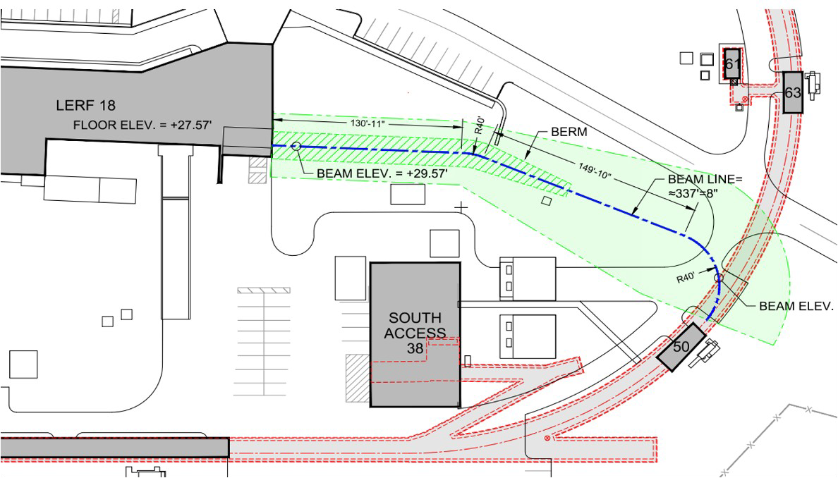
Positron Injector and Transport Line at CEBAF
Low Energy Recirculation Facility
West Arc
123 MeV e⁺ Beam
Injected to North Linac
New 123 MeV
e⁺ Injector at LERF
New Beamline
to CEBAF Tunnel
New Transport Line
along South Linac and West Arc

Slide 6
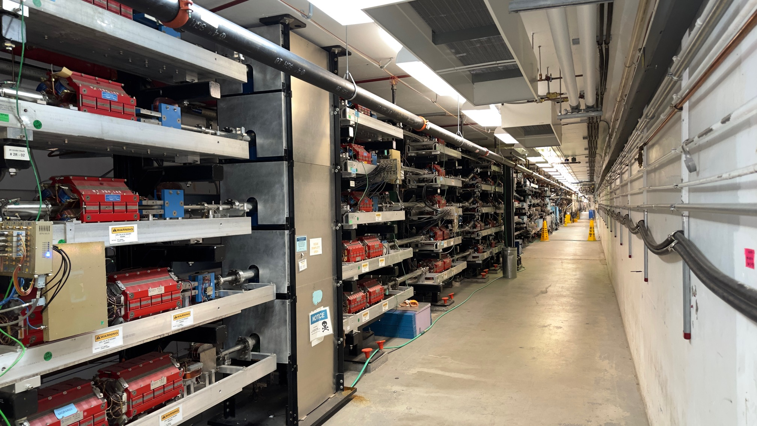
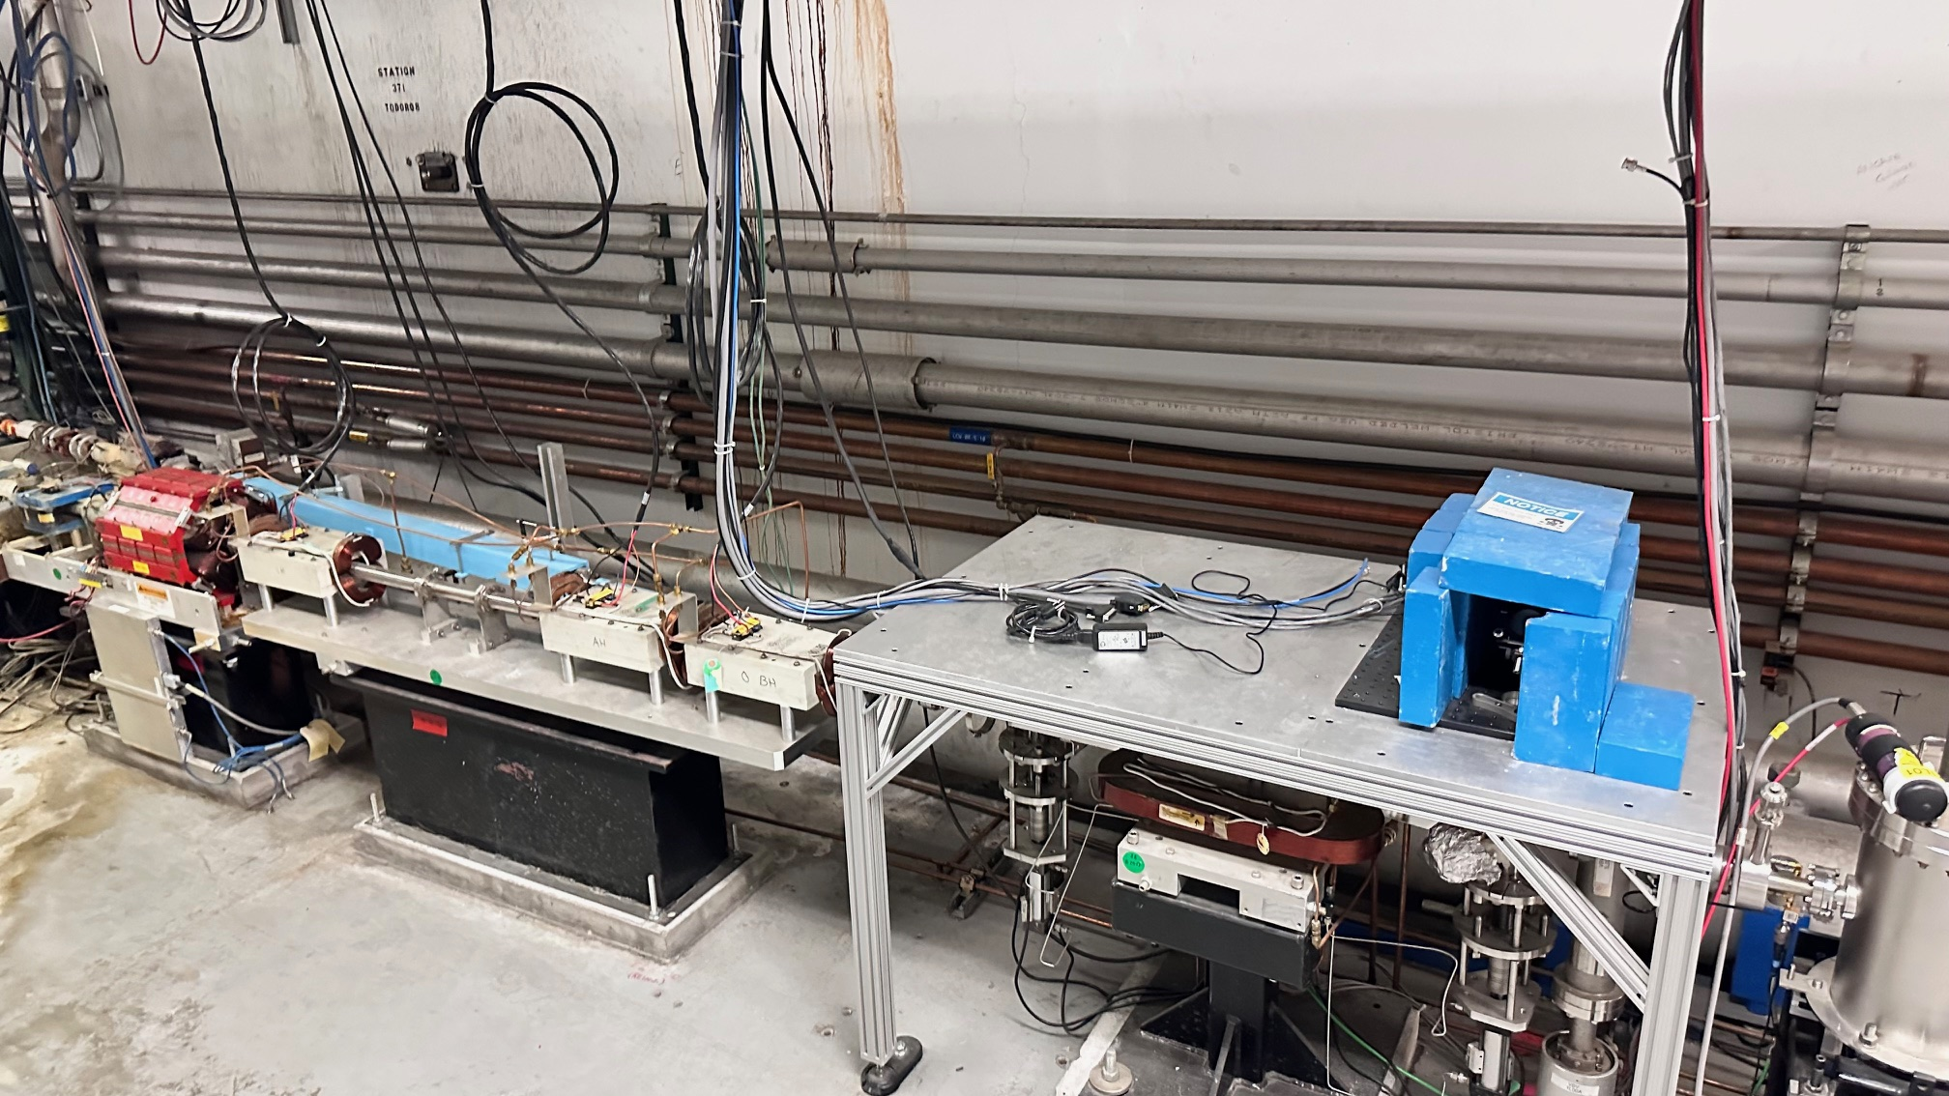
1- Layout of the New LERF to NL – MERGER
POSITRONS
ELECTRONS
ELECTRONS
POSITRONS

Slide 7
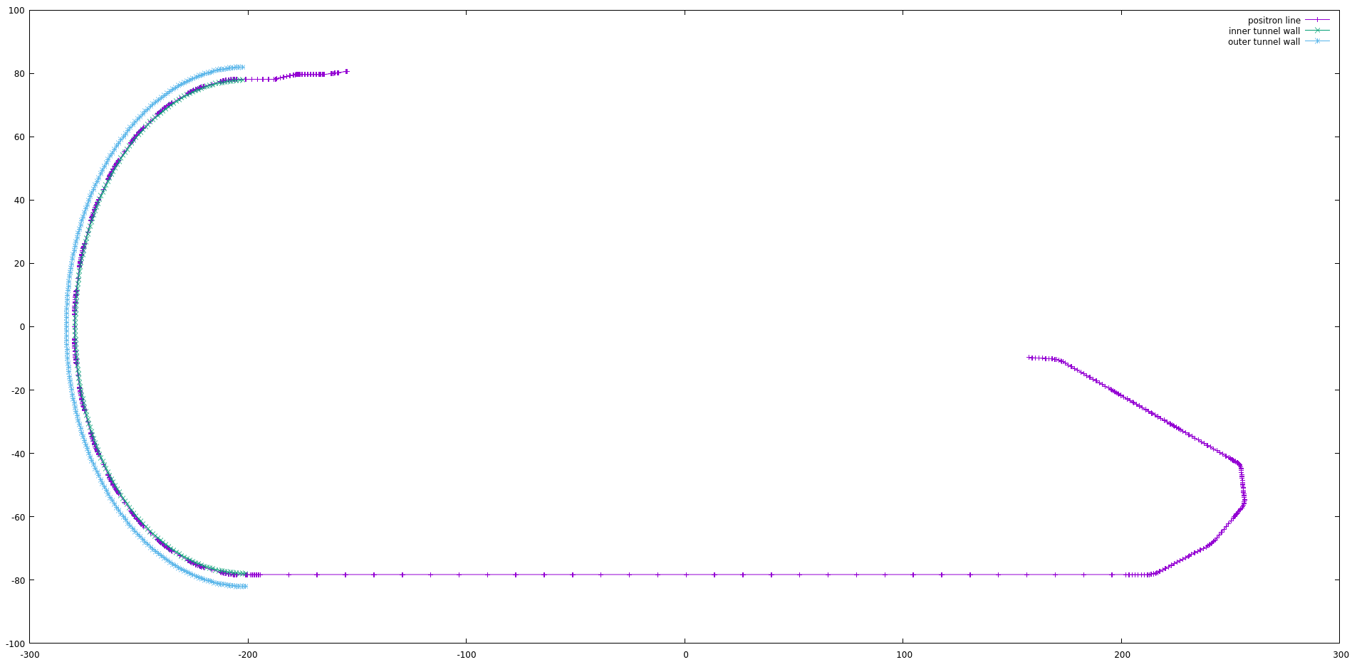
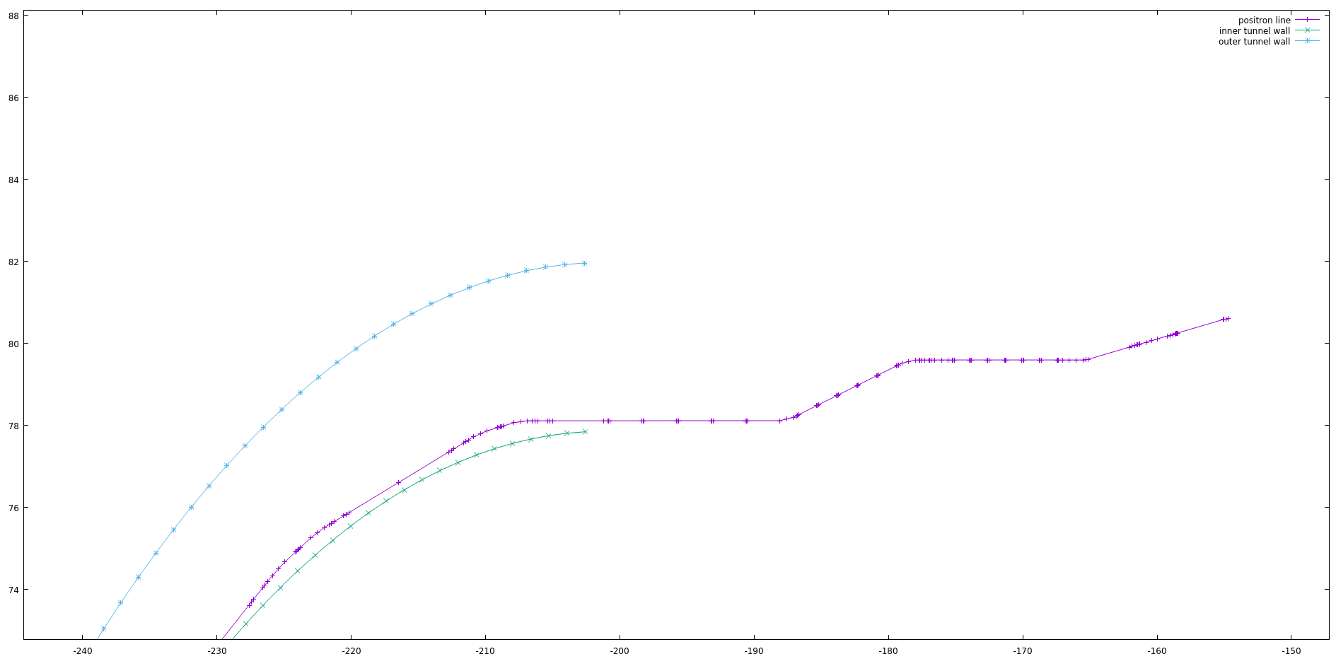
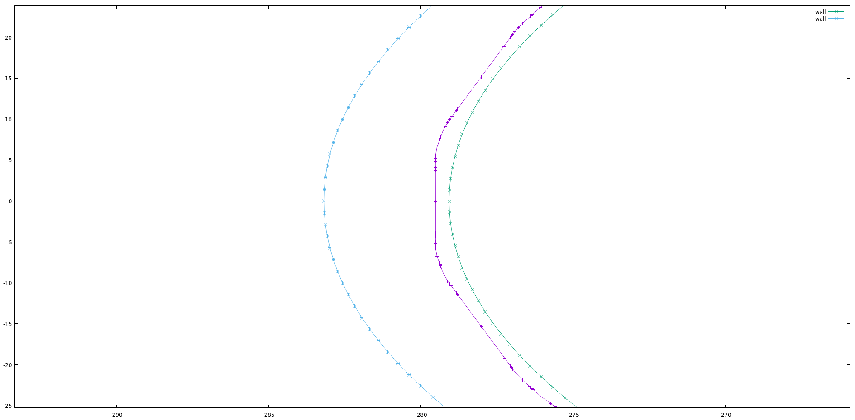
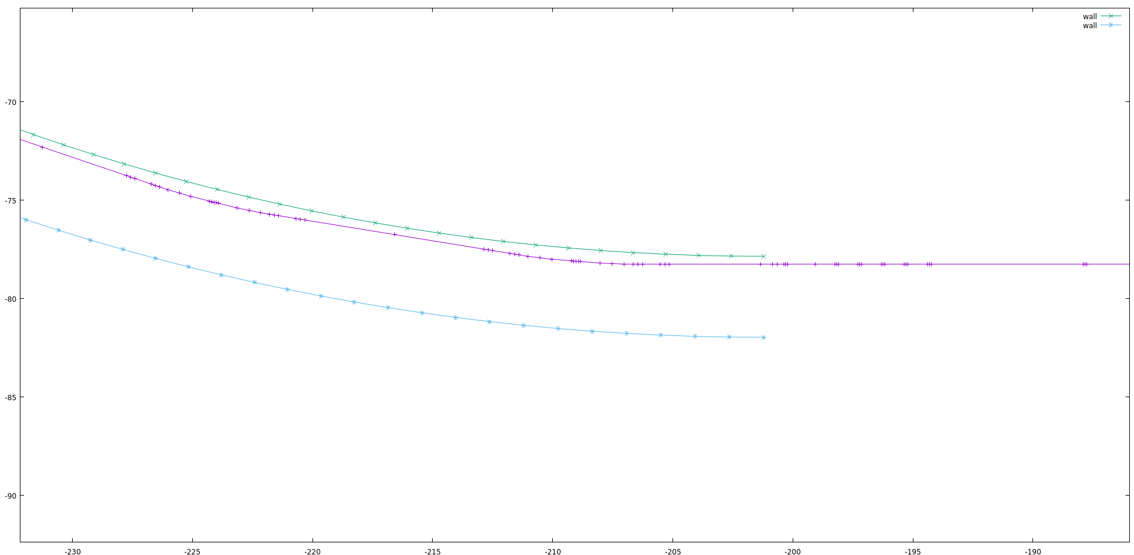
1- Layout of the New LERF to NL
X [m]
Z [m]

Slide 8
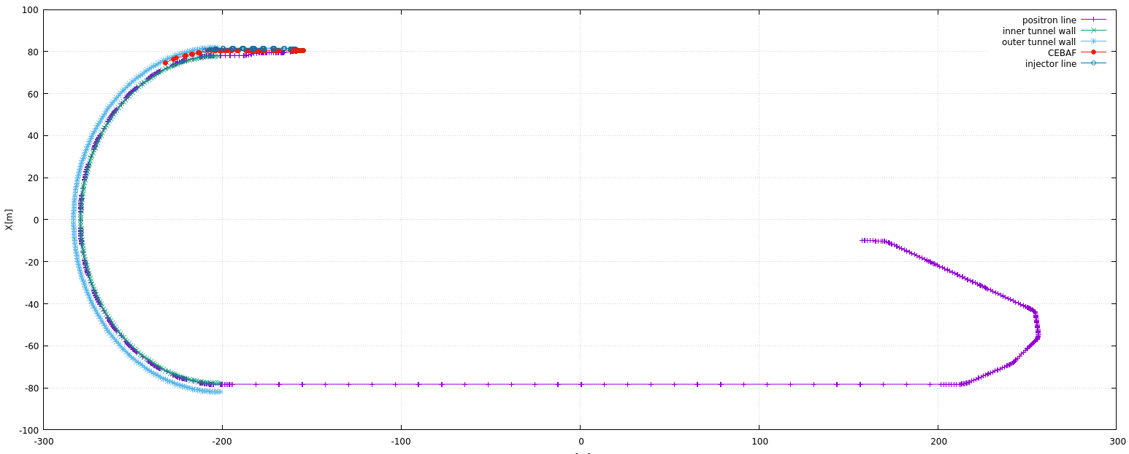
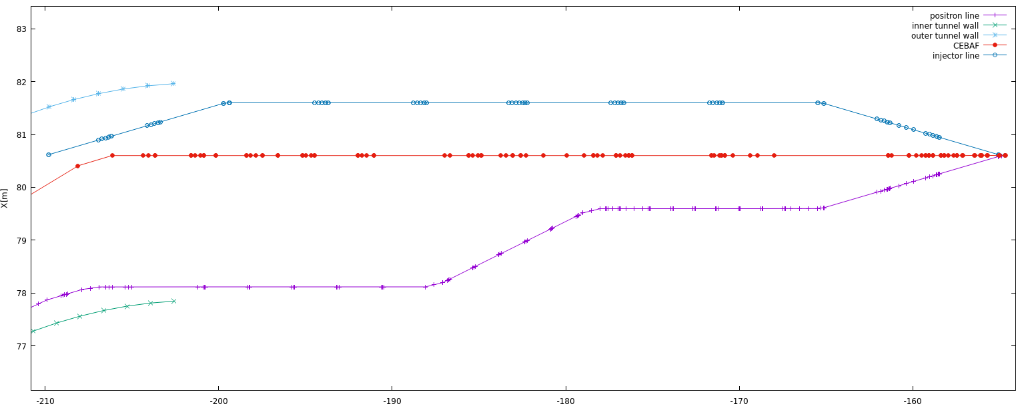
1- Layout of the New LERF to NL – MERGER
Vertical Descend from the tunnel ceiling to the Linac Level

Slide 9
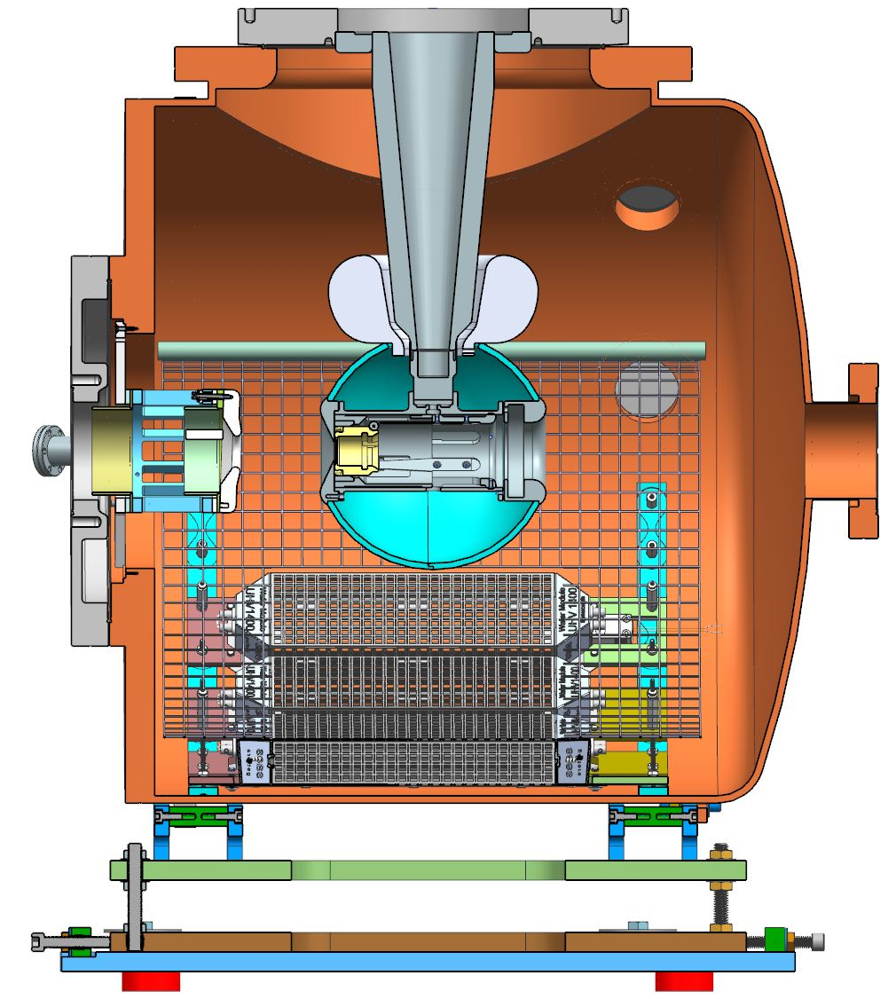
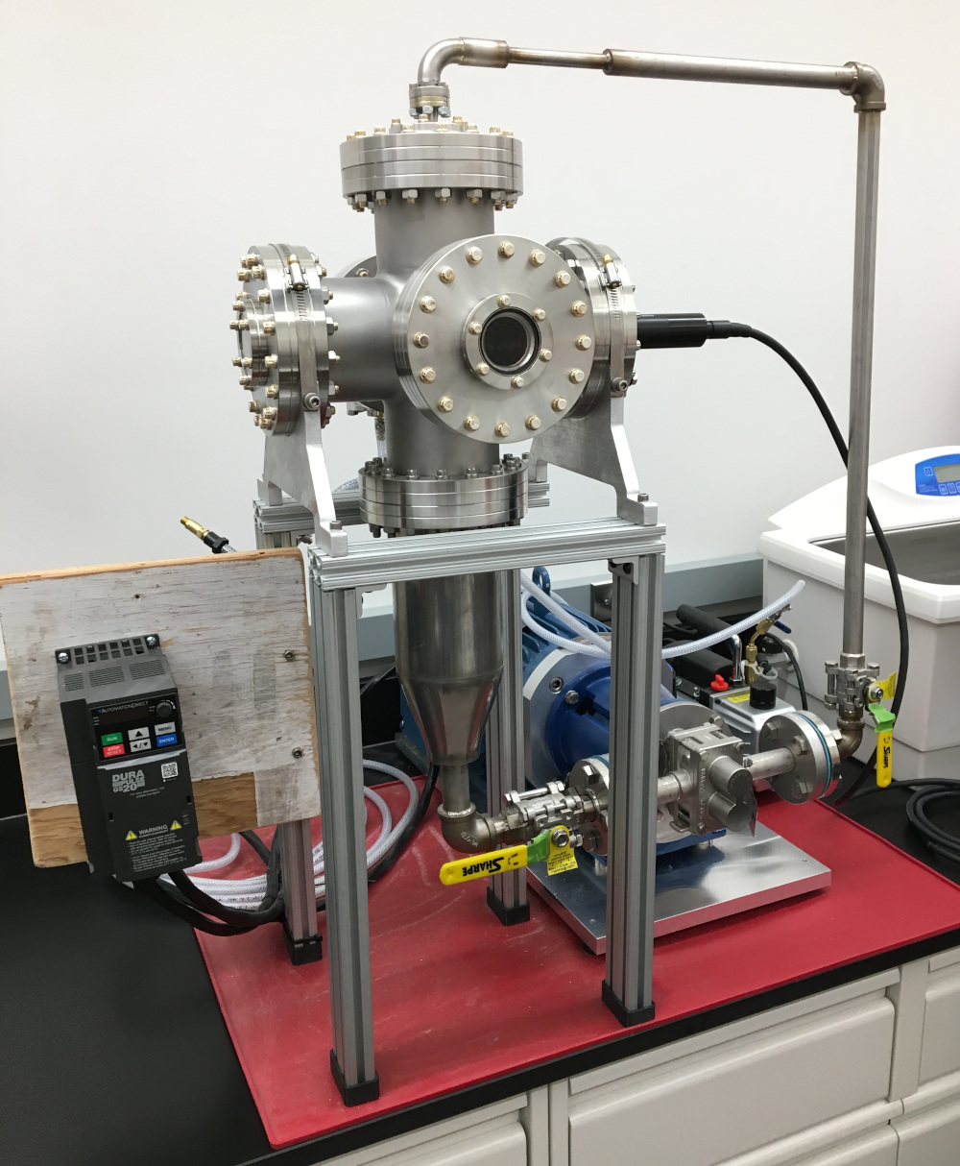
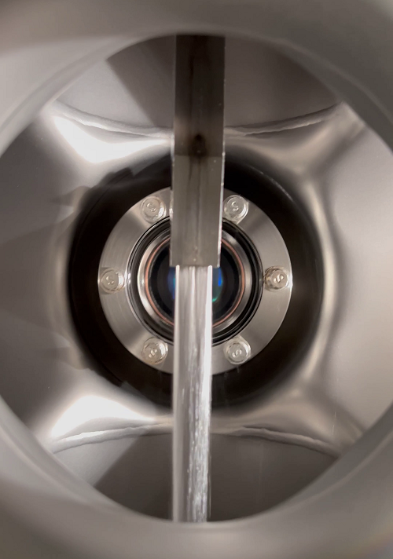
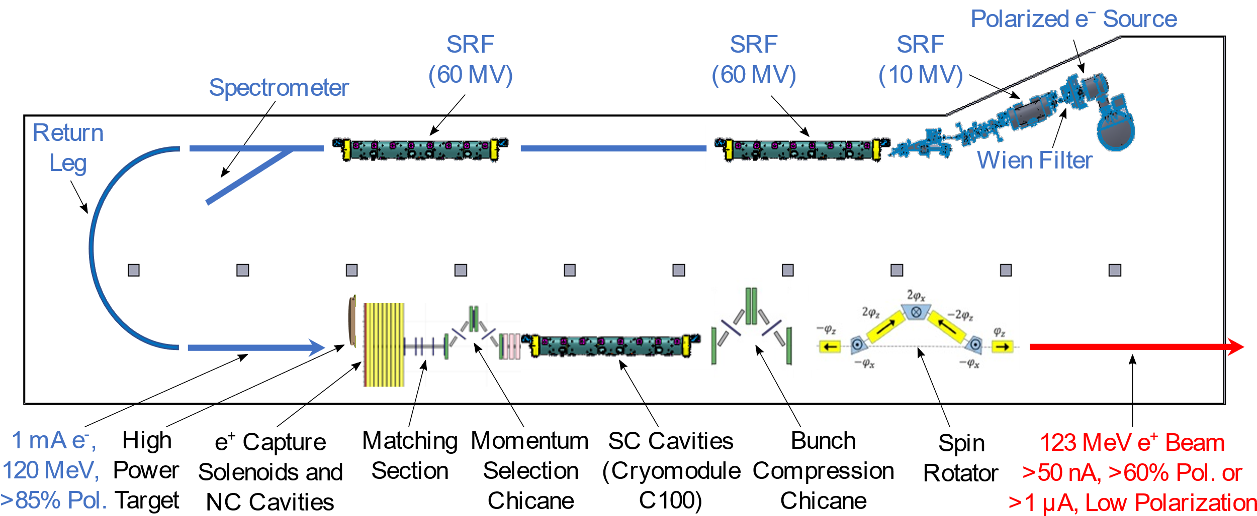
Pol. e⁺ Injector Ongoing works: mA e‒ Source, High Power Targets, Capture Cavity
Two target concepts are considered
1) Solid high-Z target (i.e. tungsten)
⇒ next slide
2) Liquid metal targets
Conceptual Development
Improve design of e⁺ injector
Develop pCDR
High current e‒ source
(<10 mA @ 10 MeV)
Up to 90% polarization
Long life time
Liquid Metal Targets are developed by
Xelera Research LLC
DOE SBIR Phase2, Oct 2024 – Sep 2026
GaInSn Jet
Liquid Metal Target
Test Area
Prototype of GaInSn
Test Stand
N. Taylor et al.,
IPAC’24, TUPC83
GaInSn target will be tested at JLab with up to 10 mA @ 10 MeV e‒ beam
Development of liquid PbBi target and test with 1mA @ 120 MeV e‒ is planned

Slide 10
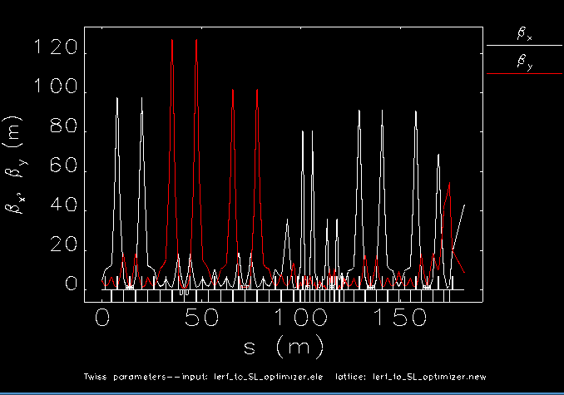
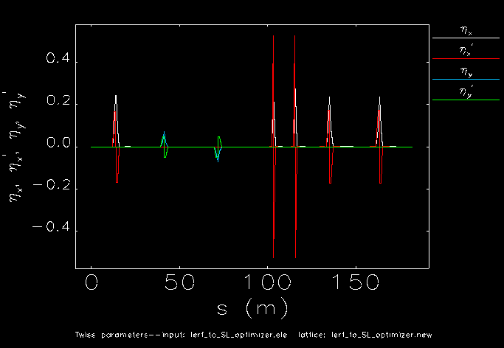
2- LERF Transfer Line (LTL) to STL - Matching
Positron generation and capture studies are ongoing, this presentation addresses the largest positron beam to be delivered without changing the existing CEBAF cryomodules. If the necessity emerges for larger cryomodule deployment as studies evolve, we may consider this option.
We use Elegant and Bmad for optics designs, yet Bmad would be used for the start-to-end tracking with spin components.

Slide 11
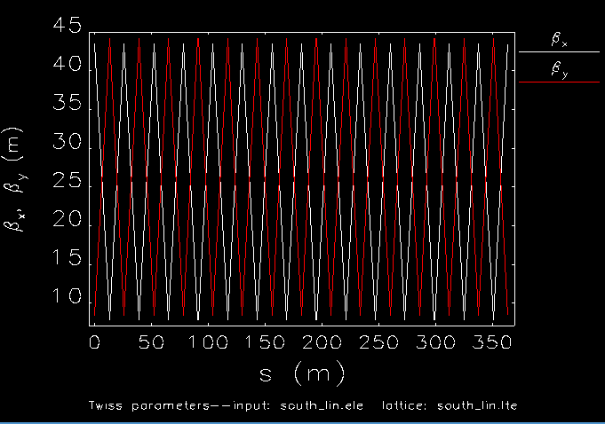
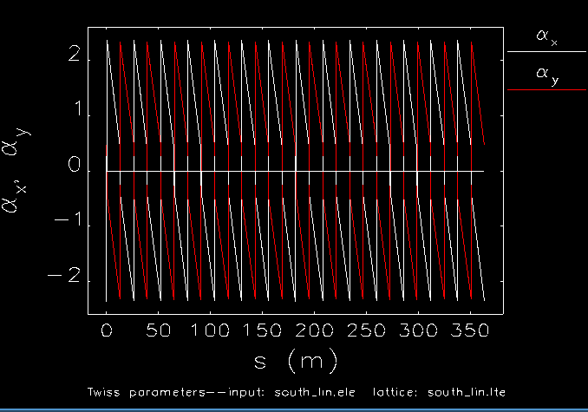


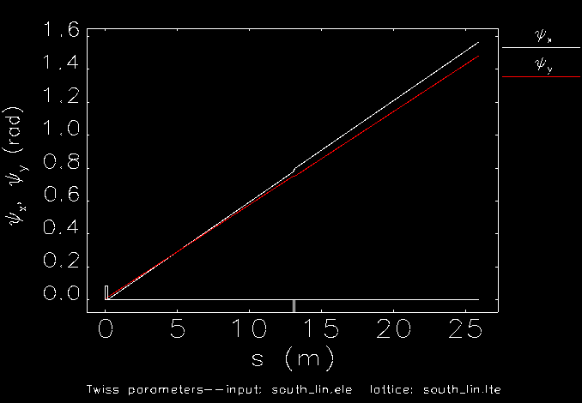
3 - South Transfer Line (STL)
Trace
< 2

Slide 12
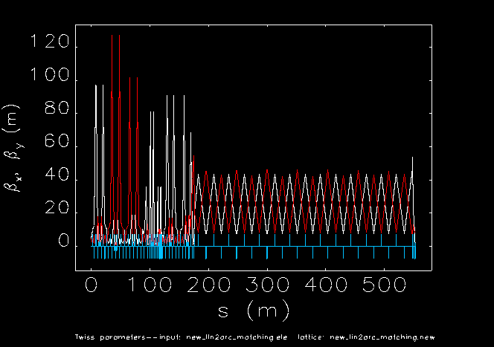
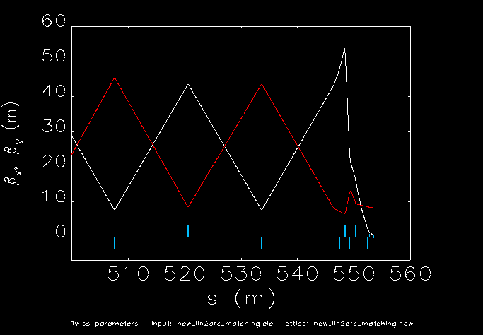
4 – LTL+STL Matching to New DBA Arc

Slide 13
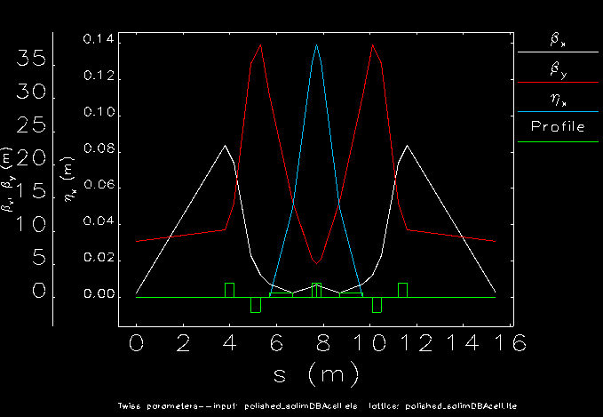
4 - The DBA Cell
Double bend achromat cell is designed for 180 degree turn from south to north straight sections. Below 40 m beta functions with 14 cm dispersion are achieved.

Slide 14
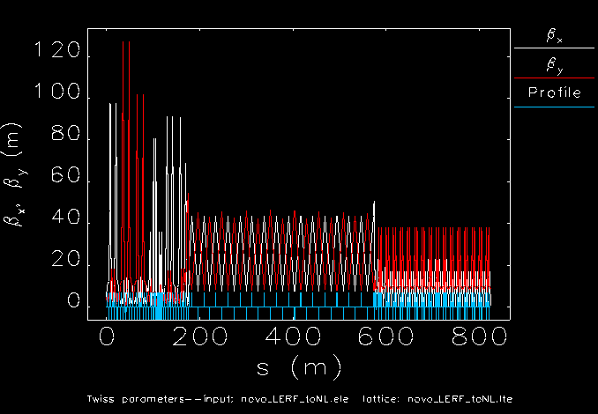
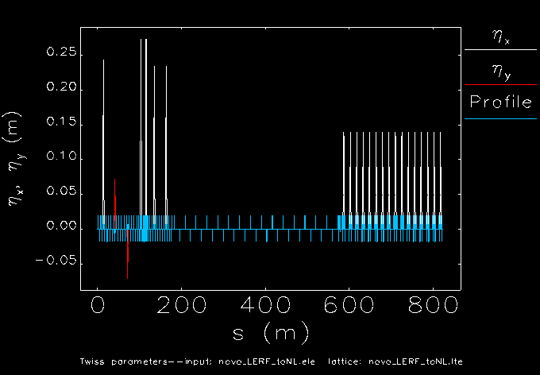
5- LTL+ STL + WTL
The last five quads MQL1-4 and MQB1A01 were used for fast-matching to the DBA arc. No drift length optimization.

Slide 15
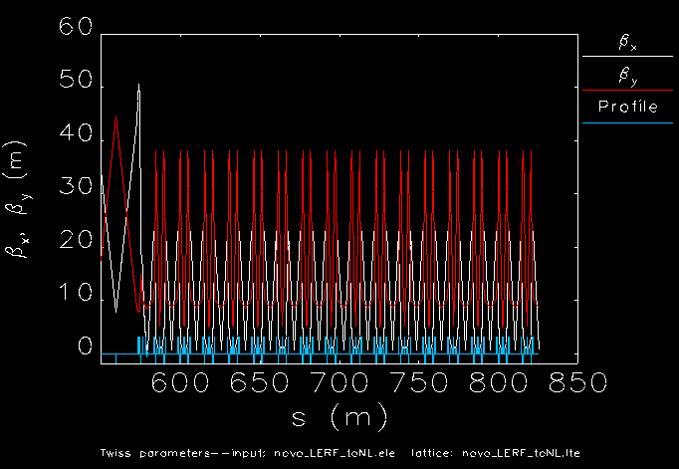
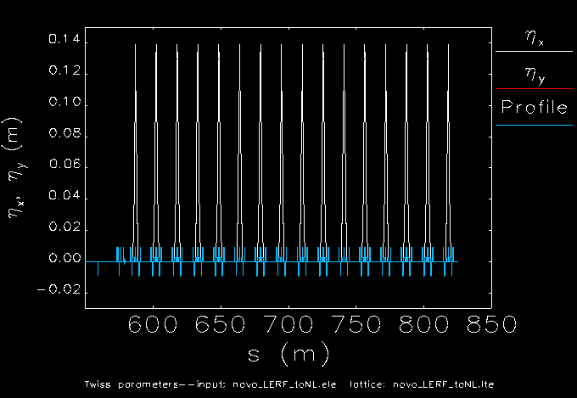
5- LTL+ STL + WTL (Zoomed)
DBA Arc zoomed into the stitched LERF and SL. They are all well matched resulting in NO betatron or dispersion oscillations.

Slide 16
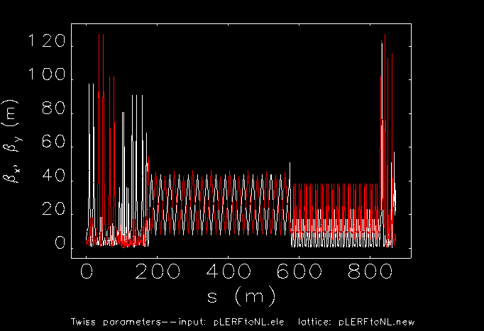
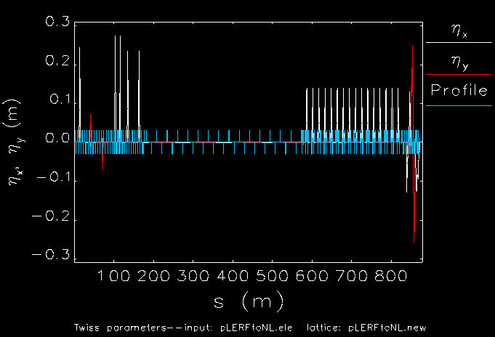
6 - Positron LERF to NL (ELEGANT)
Merger TL
Dennis’ LERF
(LTL)
South Transfer Line
(STL)
West Transfer Line
(WTL)
LERF TL is taken as reference for beta and dispersion function limits.

Slide 17
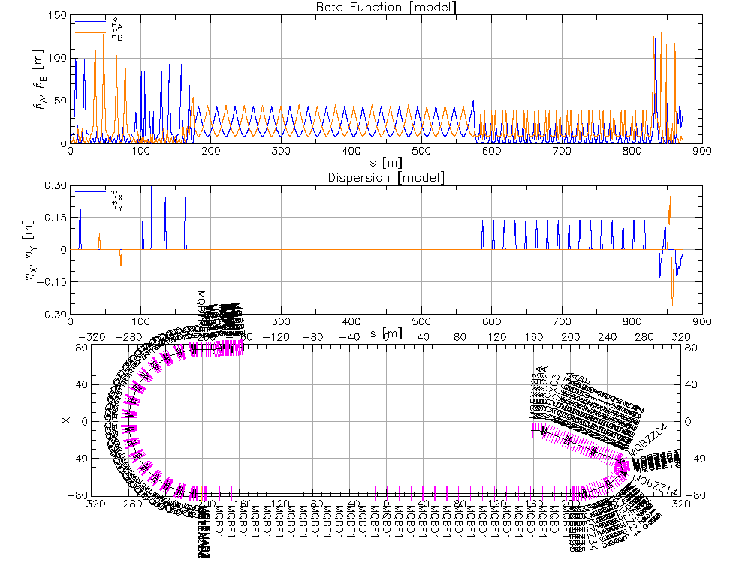
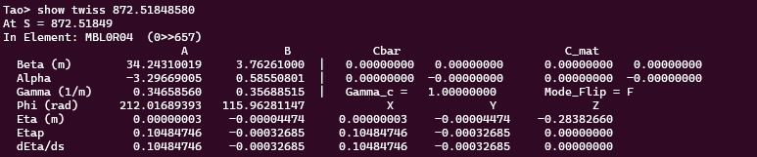
6 - Positron LERF to NL (Bmad)
Using the MQS01-07 and MQ01-02 quads reserved for the merger to NL are re-optimized (slightly different than the Elegant deck).
LERF to North Linac transfer line optics design are benchmarked with Elegant and Bmad, very small discrepancies are seen.

Slide 18
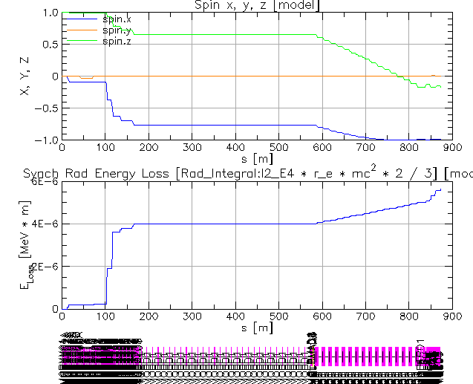
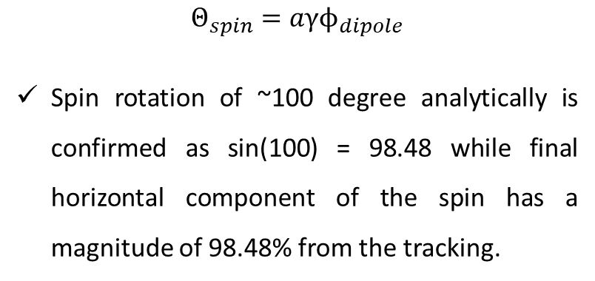
6 - Positron LERF to NL (Bmad)
Tracking with spin component giving a hypothetical spin_z=1. (PRELIMINARY)
$Θ_{spin}=aγϕ_{dipole}$
Spin rotation of ~100 degree analytically is confirmed as sin(100) = 98.48 while final horizontal component of the spin has a magnitude of 98.48% from the tracking.
Positron multi-particle beam (+spin) tracking from injector to the experiment halls (up to 11 GeV) is currently being prepared.

Slide 19
Conclusion & Outlook
  Injection optics from the positron injector to the existing CEBAF is designed.
  Minimum new tunnel digging is aimed and achieved. Meanwhile, the new transport line would not block existing CEBAF operation.
  Low dispersion and low beta optics are achieved, yet subject to change as upstream and downstream optimizations are ongoing.
  Beam tracking with spin from LERF to the physics experimental halls is soon to be performed.
  The CEBAF aperture mapping as well as acceptance measurement to be done. For the acceptance measurement, e- beam will be degraded for larger 6D emittance (installed).
  mA polarized electron source development project is ongoing.
  High power solid and liquid targets are both retained (Liquid target is to be tested.)
  CW capture cavities design is ongoing.

Slide 20
Back Up

Slide 21
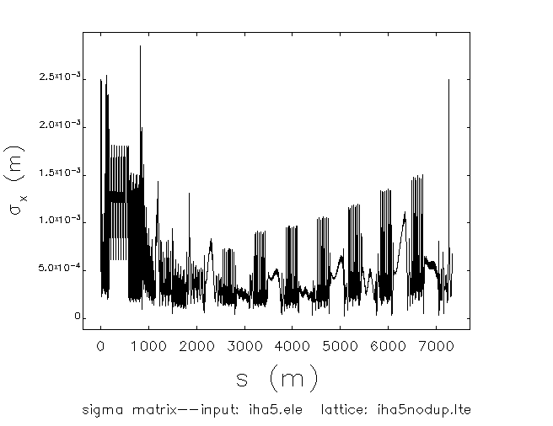
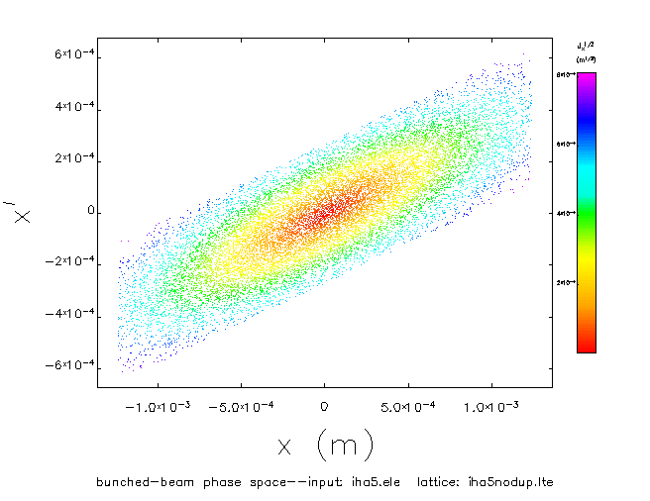
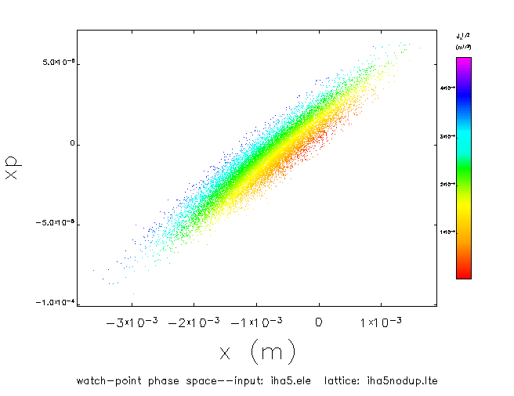
Tracking from Injector to Experiment Hall (PRELIMINARY)
Yves Roblin
20 mm.mrad normalized and up to 1e-3 dp/p sigma with a bunch length of 8e-4 m. (Existing CEBAF spreader causing the beam loss, see mid phase space figure). This might require re-optimization of CEBAF).

Slide 22
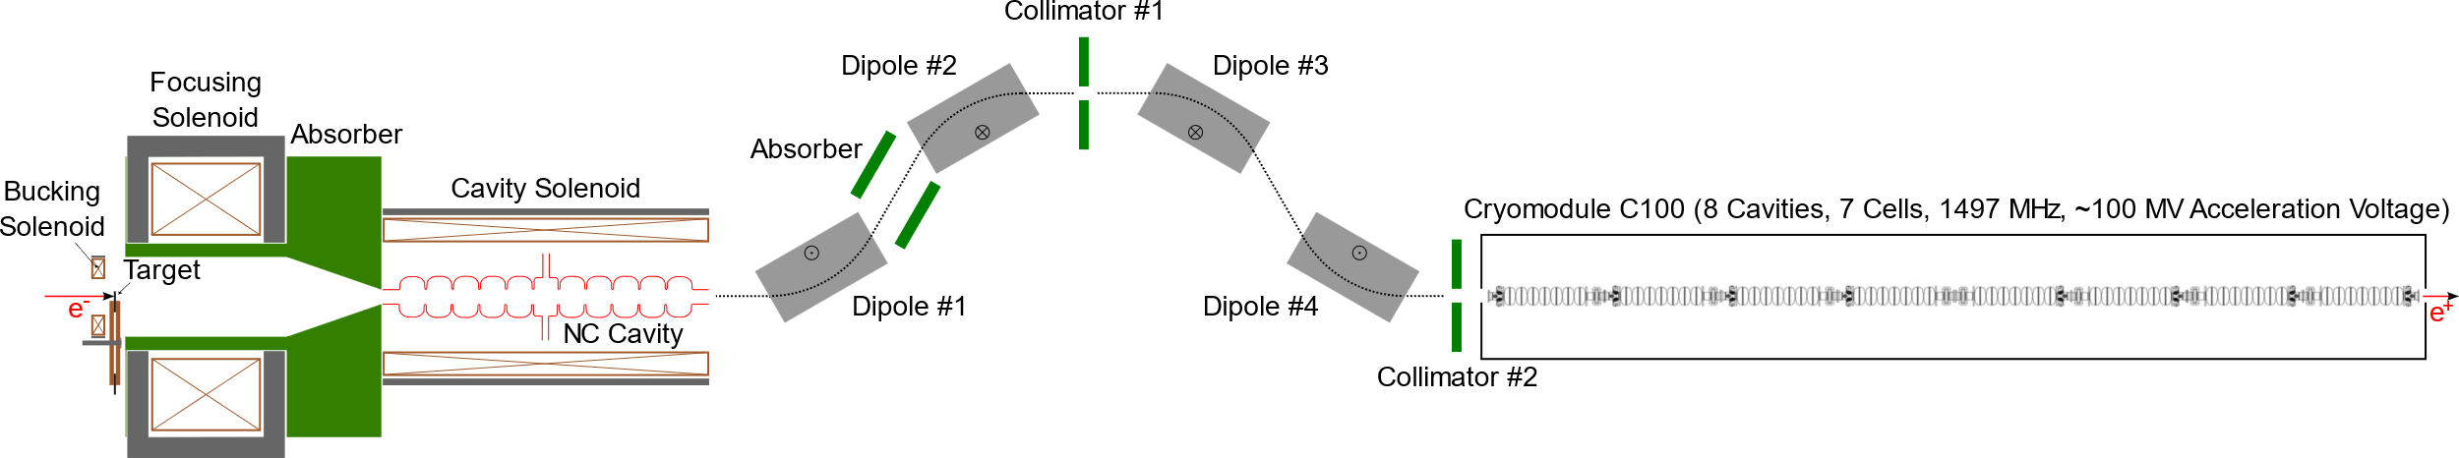
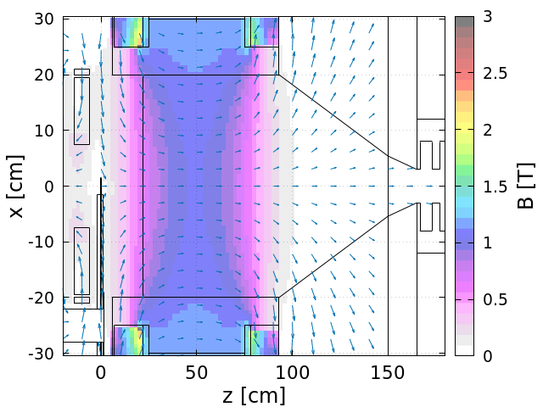
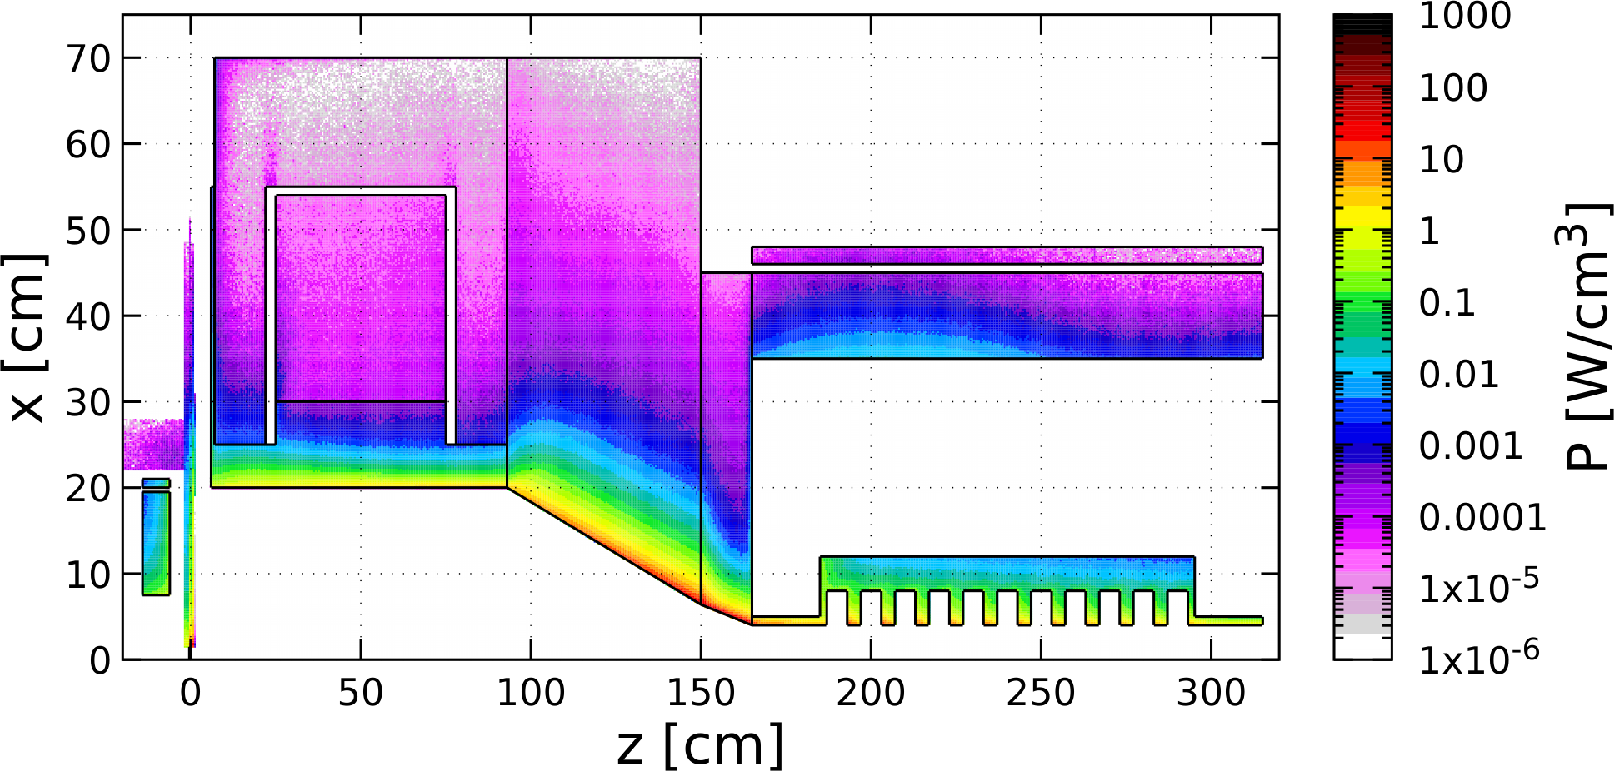
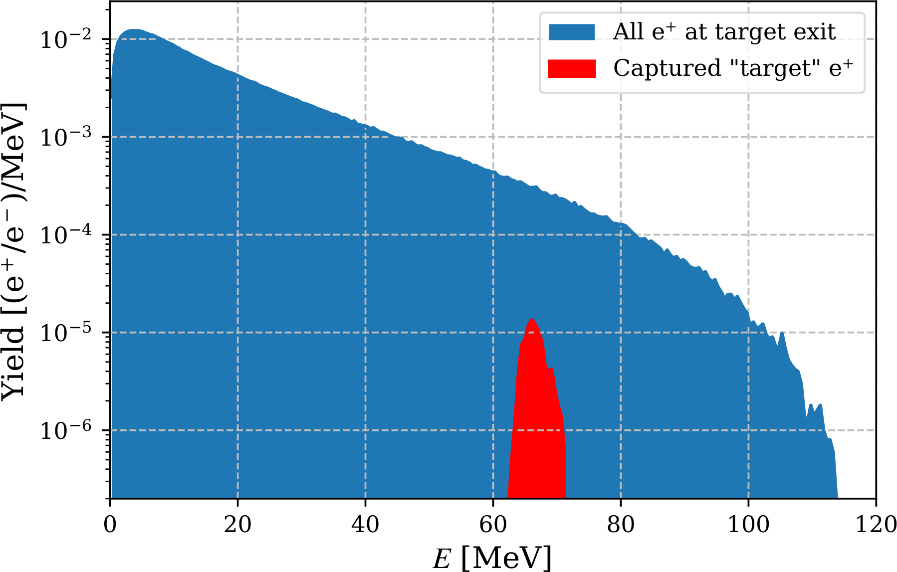
Ce⁺BAF: Simulations of CW Positron Beam Generation, Capture and Acceleration
New results in 2024
Scheme of e⁺ Generation, Capture, Energy Selection and Acceleration to 123 MeV
1 mA
120 MeV
Design of Capture Magnets
Simulation of Power Deposited by Beams
and Design of Shielding
Beam Tracking Simulations
Energy Spectrum of All and Captured e⁺
Bucking
Solenoid
Main Solenoid
Absorbers
Steel
1 mA e‒ Beam
@ 120 MeV
Target
TZM
Cu Coil
Cu Coil
W10Cu
W10Cu
Cavity
Cu Cavity*
Compensation
Solenoid
Target
A. Ushakov et al., IPAC’24, MOPC54
A. Ushakov “Positron Beams for 12 GeV CEBAF”, Hadron Physics 2030

Slide 23
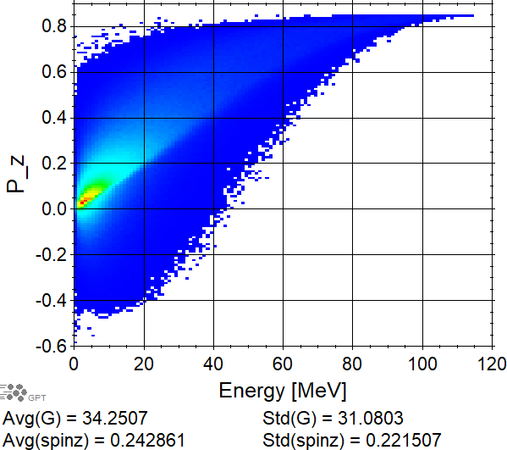
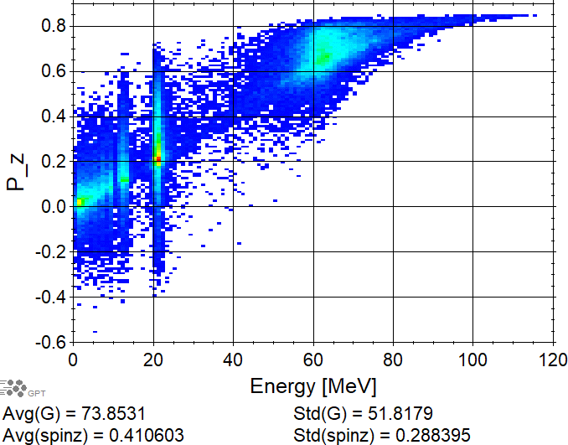
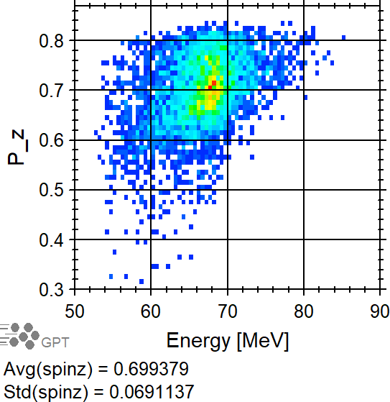
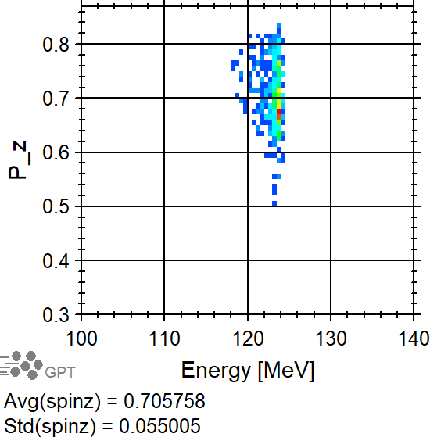




Spin Tracking in Geant4 and General Particle Tracer (GPT)
Target Exit
$$\left\langle P_{z}\right\rangle =24.3\%$$
Exit of Capture Cavity
$$\left\langle P_{z}\right\rangle =41.1\%$$
Exit of Col. #1
$$\left\langle P_{z}\right\rangle =69.9\%$$
Exit of C100
$$\left\langle P_{z}\right\rangle =70.6\%$$

Slide 24
Recirculating Injector Based on LERF (3-pass)
10 MeV + 3 × 3 × 71 MeV = 650 MeV
10 MeV
436 MeV
C-75
C-75
C-75
A. Bogacz

Slide 25
Recirculating Injector Based on LERF (3-pass)
10 MeV + 3 × 3 × 71 MeV = 650 MeV
10 MeV + 3 × 3 × 71 MeV = 650 MeV
10 MeV
650 MeV
436 MeV
C-75
C-75
C-75
C-75
C-75
C-75
New arc
New arc

Slide 26
