Slide 1
Flux Concentrator as the matching device for positron source
2024/10/17
Y. Enomoto (KEK)

Slide 2
Motivation
Size of positron beam is similar to the size of primary electron beam
Divergence is large
It’s important to collect and transport positron beam to the following section keeping loss minimum
Reducing the divergence at the expense of beam size
e⁻
target
e⁺
Electron hit small point of the target.
Positron comes from small spot.
Angle distribution is large.
target
e⁺
Adiabatically expand position distribution.
Angle distribution decrease.
Matched to the aperture of the following LAS.

Slide 3
Flux Concentrator
Originally develop by SLAC for SLC

Slide 4
Motion of charged particle in the uniform magnetic field
$$F=m\frac{dv}{dt}=qv×B$$
$$v_{x}=v_{⊥}cos⁡(ω_{c}t+δ)$$
$$ω_{c}=\frac{\left|q\right|B}{m}$$
$$v_{y}=−v_{⊥}sin⁡(ω_{c}t+δ)$$
$$x−x_{0}=r_{c}\sin\left(ω_{c}t+δ\right)$$
$$r_{c}=\frac{mv_{⊥}}{\left|q\right|B}$$
$$y−y_{0}=r_{c}\cos\left(ω_{c}t+δ\right)$$

Slide 5
Mirror magnetic field
Consider magnetic field
Direction of magnetic field : roughly z
Axially symmetric around z axis
Magnetic field decrease along positive direction of z axis
It is called magnetic mirror, well known in the plasm physics

Slide 6
Mirror magnetic field
First, consider relation between components of magnetic field
B_{θ} = 0 from symmetry
$$\frac{1}{r}\frac{∂}{∂r}\left(rB_{r}\right)+\frac{∂B_{z}}{∂z}=0$$
(1)
divB = 0

Slide 7
Mirror magnetic field
$$\frac{1}{r}\frac{∂}{∂r}\left(rB_{r}\right)+\frac{∂B_{z}}{∂z}=0$$
(1)
From (1), B_{r} is expressed using B_{z}
$$B_{r}=−\frac{1}{2}r{\left[\frac{∂B_{z}}{∂z}\right]}_{r=0}$$
(2)
Asuming B_{z} depends on r weekly (paraxial approximation)
B_{z} depends on r and ｚ, express B_{z}(r,z)
$$B=\left(\begin{matrix}B_{r} \\ B_{θ} \\ B_{z}\end{matrix}\right)=\left(\begin{matrix}−\frac{1}{2}r{\left[\frac{\left.∂B_{z}(r, z\right)}{∂z}\right]}_{r=0} \\ 0 \\ \left.B_{z}(r, z\right)\end{matrix}\right)$$
(3)

Slide 8
Motion of charged particle in the mirror magnetic field
$$B=\left(\begin{matrix}B_{r} \\ B_{θ} \\ B_{z}\end{matrix}\right)=\left(\begin{matrix}−\frac{1}{2}r{\left[\frac{\left.∂B_{z}(r, z\right)}{∂z}\right]}_{r=0} \\ 0 \\ \left.B_{z}(r, z\right)\end{matrix}\right)$$
(3)
$$F=\left(\begin{matrix}F_{r} \\ F_{θ} \\ F_{z}\end{matrix}\right)=\left(\begin{matrix}\left.q(v_{θ}B_{z}−v_{z}B_{θ}\right) \\ \left.q(−v_{r}B_{z}+v_{z}B_{r}\right) \\ \left.q(v_{r}B_{θ}−v_{θ}B_{r}\right)\end{matrix}\right)=\left(\begin{matrix}qv_{θ}B_{z} \\ q(−v_{r}B_{z}+v_{z}B_{r}) \\ −qv_{θ}B_{r}\end{matrix}\right)$$
(4)
In the following section, focus on F_{z}
$$F_{z}= qv_{θ}\frac{1}{2}r{\left[\frac{\left.∂B_{z}(r,z\right)}{∂z}\right]}_{r=0}$$
(5)
Consider particles near the z axis, r = r_{c},
Consider average during one cyclotron period,
v_{θ} = v⊥ = const (assumption)
$$ω_{c}=\frac{\left|q\right|B}{m}$$
$$r_{c}=\frac{mv_{⊥}}{\left|q\right|B}$$
$$〈F_{z}〉=−\frac{1}{2}qv_{⊥}r_{c}{\left[\frac{\left.∂B_{z}(r, z\right)}{∂z}\right]}_{r=0}$$
(6)

Slide 9
Motion of charged particle in the mirror magnetic field
$$〈F_{z}〉=−\frac{1}{2}qv_{⊥}r_{c}{\left[\frac{\left.∂B_{z}(r, z\right)}{∂z}\right]}_{r=0}$$
(6)
substitute
$$r_{c}=\frac{mv_{⊥}}{\left|q\right|B}$$
$$〈F_{z}〉=−\frac{1}{2}qv_{⊥}\frac{mv_{⊥}}{qB}{\left[\frac{\left.∂B_{z}(r, z\right)}{∂z}\right]}_{r=0}=−\frac{mv_{⊥}^{2}}{2B}{\left[\frac{\left.∂B_{z}(r, z\right)}{∂z}\right]}_{r=0}$$
(7)
$$μ=\frac{1}{2}\frac{mv_{⊥}^{2}}{B}$$
Introduce magnetic moment
(8)
$$〈F_{z}〉=−μ{\left[\frac{∂B_{z}(r, z)}{∂z}\right]}_{r=0}$$
(9)
To generalize direction of magnetic field,
express component parallel to the magnetic field by ||
$$F_{∥}=−μ\frac{∂B}{∂s}=−μ∇∥B$$
(10)
s is direction of magnetic field
Particle feels force to the direction of magnetic field line

Slide 10
Magnetic moment
$$μ=\frac{1}{2}\frac{mv_{⊥}^{2}}{B}$$
Why is
called magnetic moment
Charged particle in the magnetic field rotate
${ω_{c}}/{2π}$ times pre second.
Current I by this motion is
Magnetic moment : μ
$$I=\frac{ω_{c}}{2π}q$$
(11)
Area : A
Since radius of cyclotron motion is r_{c}, area A is
$$A=πr_{c}^{2}$$
(12)
Current : I
Then
$$μ=\frac{ω_{c}q}{2π}πr_{c}^{2}=\frac{q}{2}ω_{c}r_{c}^{2}$$
(13)
$$μ=IA$$
$$ω_{c}=\frac{\left|q\right|B}{m}$$
$$r_{c}=\frac{mv_{⊥}}{\left|q\right|B}$$
Substitute
General definition of
magnetic moment
$$μ=\frac{q}{2}\frac{qB}{m}{\left(\frac{mv_{⊥}}{qB}\right)}^{2}=\frac{1}{2}\frac{mv_{⊥}^{2}}{B}$$
(14)

Slide 11
Conservation of magnetic moment
μ is invariant
Consider parallel component
From conservation of energy
$$F_{∥}=−μ\frac{∂B}{∂s}$$
(10)
$$\frac{d}{dt}\left(\frac{1}{2}mv_{∥}^{2}+\frac{1}{2}mv_{⊥}^{2}\right)=0$$
(18)
$$m\frac{dv_{∥}}{dt}=−μ\frac{∂B}{∂s}$$
Equation of motion is
(15)
$$μ=\frac{1}{2}\frac{mv_{⊥}^{2}}{B}$$
Substitute
(8)
Multiply
$$v_{∥}=\frac{ds}{dt}$$
on both side
$$\frac{d}{dt}\left(\frac{1}{2}mv_{∥}^{2}+μB\right)=0$$
(19)
$${mv}_{∥}\frac{dv_{∥}}{dt}=−μ\frac{∂B}{∂s}\frac{ds}{dt}$$
(16)
$$\frac{d}{dt}\left(\frac{1}{2}mv_{∥}^{2}\right)+\frac{d}{dt}\left(μB\right)=0$$
(20)
$$\frac{d}{dt}\left(\frac{1}{2}mv_{∥}^{2}\right)=−μ\frac{dB}{dt}$$
(17)
$$−μ\frac{dB}{dt}+\frac{d}{dt}\left(μB\right)=0$$
(21)
$$\frac{dμ}{dt}=0$$
(22)
To satisfy (21)

Slide 12
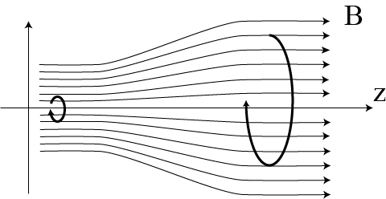
Motion of charged particle in the mirror magnetic field
Velocity : v₂
Position in r : r₂
Angle to z axis : φ₂
Velocity : v₁
Position in r : r₁
Angle to z axis : φ₁
B₁
B_{２}

Slide 13
Motion of charged particle in the mirror magnetic field
Velocity : v₂
Position in r : r₂
Angle to z axis : φ₂
Velocity : v₁
Position in r : r₁
Angle to z axis : φ₁
B₁
B_{２}
From conservation of energy
$$\frac{mv_{1}^{2}}{2}=\frac{mv_{2}^{2}}{2}$$
(23)
then
$$v_{1}=v_{2}$$
(24)

Slide 14
Motion of charged particle in the mirror magnetic field
Velocity : v₂
Position in r : r₂
Angle to z axis : φ₂
Velocity : v₁
Position in r : r₁
Angle to z axis : φ₁
From conservation of magnetic moment
$$\sin{φ_{2}}=\sin{φ_{1}}\sqrt{\frac{B_{2}}{B_{1}}}$$
$$\frac{mv_{1⊥}^{2}}{2B_{1}}=\frac{mv_{2⊥}^{2}}{2B_{2}}$$
Since
$$v_{1}=v_{2}$$
(24)
(28)
(25)
Assuming φ is small, approximate
sinφ = φ
Generally
$$v_{⊥}=v\sin{φ}$$
(26)
(29)
$$\frac{v_{1}^{2}\sin^{2}φ_{1}}{B_{1}}=\frac{v_{2}^{2}\sin^{2}φ_{2}}{B_{2}}$$
Then
(27)
$$φ_{2}=φ_{1}\sqrt{\frac{B_{2}}{B_{1}}}$$
(30)

Slide 15
Motion of charged particle in the mirror magnetic field
Velocity : v₂
Position in r : r₂
Angle to z axis : φ₂
Velocity : v₁
Position in r : r₁
Angle to z axis : φ₁
Cyclotron radius at B₂
$$r_{2}=\frac{mv_{2}\sin{θ_{1}}}{\left|q\right|B_{2}}\sqrt{\frac{B_{2}}{B_{1}}}=\frac{mv_{1}\sin{θ_{1}}}{\left|q\right|B_{1}}\frac{B_{1}}{B_{2}}\sqrt{\frac{B_{2}}{B_{1}}}$$
$$r_{2}=\frac{mv_{2⊥}}{\left|q\right|B_{2}}=\frac{mv_{2}\sin{θ_{2}}}{\left|q\right|B_{2}}$$
(31)
(32)
$$\sin{φ_{2}}=\sin{φ_{1}}\sqrt{\frac{B_{2}}{B_{1}}}$$
Substitute
(28)
$$r_{2}=r_{1}\sqrt{\frac{B_{1}}{B_{2}}}$$
then
(33)

Slide 16
Motion of charged particle in the mirror magnetic field
Velocity : v₂
Position in r : r₂
Angle to z axis : φ₂
Velocity : v₁
Position in r : r₁
Angle to z axis : φ₁
B₂ < B₁, Assume the particle move strong field region to weak field region,
$$v_{1}=v_{2}$$
Velocity conserves
$$r_{2}=r_{1}\sqrt{\frac{B_{1}}{B_{2}}}$$
Radius get larger
Convert radius and angle depending on the ratio of field strength
$$φ_{2}=φ_{1}\sqrt{\frac{B_{2}}{B_{1}}}$$
Angle get smaller

Slide 17
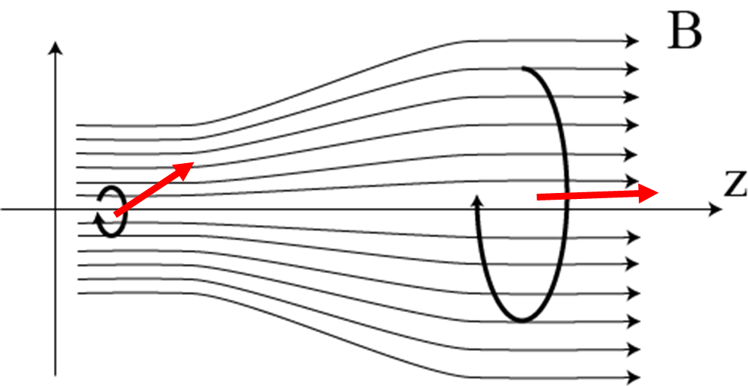
Adiabatic condition
Period of cyclotron motion
$${t_{c}=\frac{2π}{ω_{c}}}_{}=\frac{2πm}{\left|q\right|B}=\frac{35.7}{B[T]} [ps]$$
(34)
Particle moves in z direction during $t_{c}$
$${∆z}_{c}=c\sin{φ}t_{c}=\frac{3×{10}^{11}\sin{φ}×35.7}{B[T]}$$
$$=\frac{10.7\sin{φ}}{B[T]} [mm]$$
(35)
B₁
B_{２}

Slide 18
Adiabatic condition
v_{θ} = v⊥ depend on B
Period of cyclotron motion
$${t_{c}=\frac{2π}{ω_{c}}}_{}=\frac{2πm}{\left|q\right|B}=\frac{35.7}{B[T]} [ps]$$
(34)
$$R=\frac{B(t)}{B(t+t_{c})}=\frac{B(r_{1},z_{1})}{B(r_{2},z_{2})}$$
$$=\frac{B(r_{1},z_{1})}{B(r_{2},z_{1}+∆z_{c})}$$
Particle moves in z direction during $t_{c}$
(36)
$${∆z}_{c}=c\sin{φ}t_{c}=\frac{3×{10}^{11}\sin{φ}×35.7}{B[T]}$$
$$=\frac{10.7\sin{φ}}{B[T]} [mm]$$
If R～1, v_{θ} = v⊥ doesn’t change so much
during t_{c}
(35)
Adiabatic condition is satisfied
For example, B = 5 T, sinφ = 1, then Δz_{c} = 2 mm
B₁
Whether B (z±2) is not different from 5 T or not
is the criteria
B_{２}

Slide 19
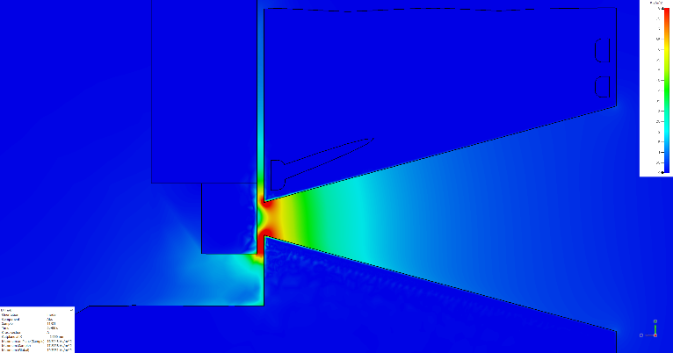
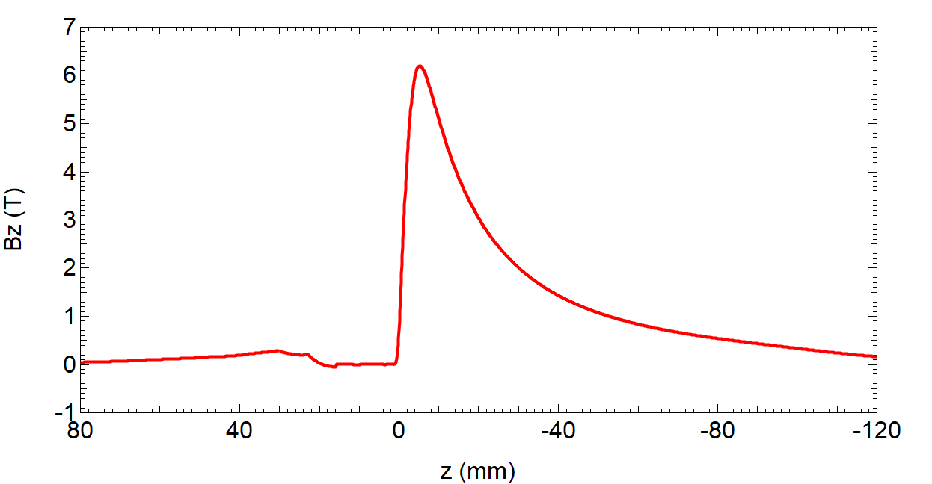
Real field
Eddy current cancel out the magnetic field on the surface of the target
Between target and FC entrance, magnetic field changes rapidly
→ non adiabatic region
Practical B₁ (initial magnetic field) is determined steepness of this region
→ steeper is better

Slide 20
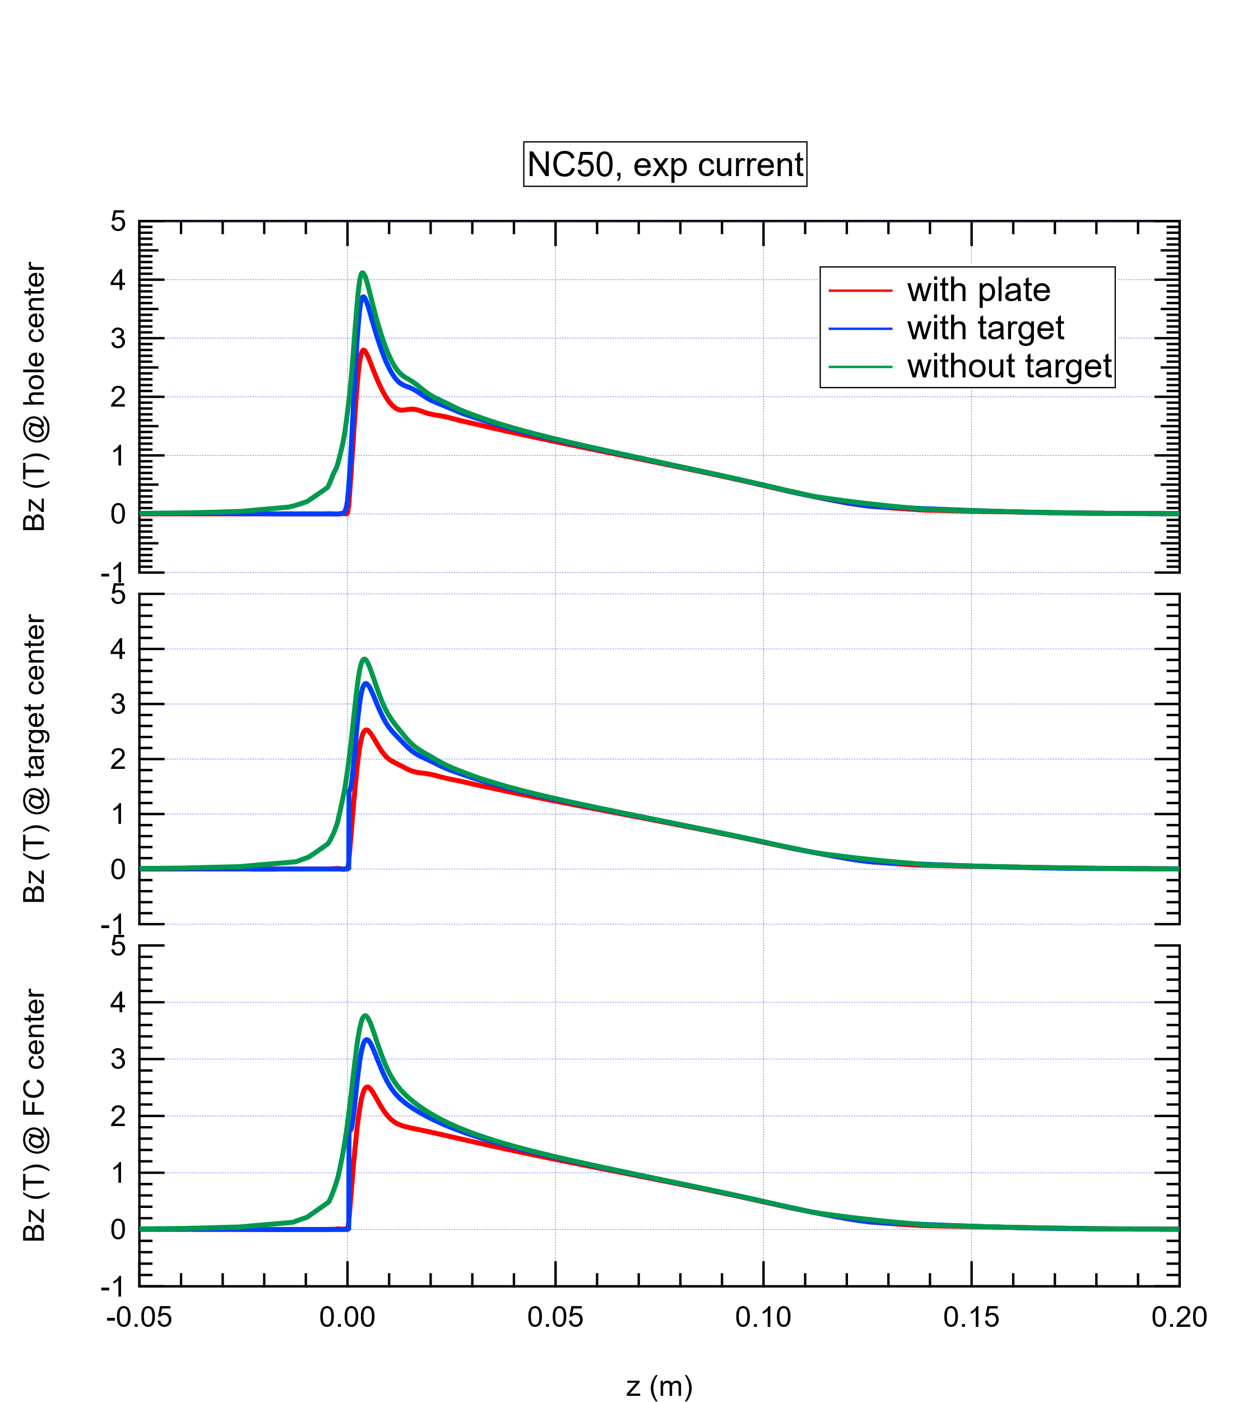
Simulation With target

Slide 21
Skin effect
$$δ=\sqrt{\frac{2ρ}{ωμ}}$$
$$δ_{Cu}\left(mm\right)={2.09}/{\sqrt{f\left(kHz\right)}}$$
$$ρ:electrical resistivity$$
$$ω:angular frequency$$
$$μ:permeability$$
Frequency (kHz) | Half sin Pulse width(us) | Skin depth(mm)
5 | 100 | 1.21
40 | 12.5 | 0.96
83 | 6 | 0.77
1000 | 0.5 | 0.43

Slide 22
Conduction current distribution in FC
Jx : conduction current density in x direction
Plot Jx as a function of y
y
z

Slide 23
Jx vs y - pulse width dependence
Half sine pulse width
Exp
500 us
100 us
12.5 us
6 us
0.5 us

Slide 24
Pulse width dependence of Bz
Half sine pulse width
Exp
500 us
100 us
12.5 us
6 us
0.5 us
Magnetic field shape is determined by skin depth

Slide 25
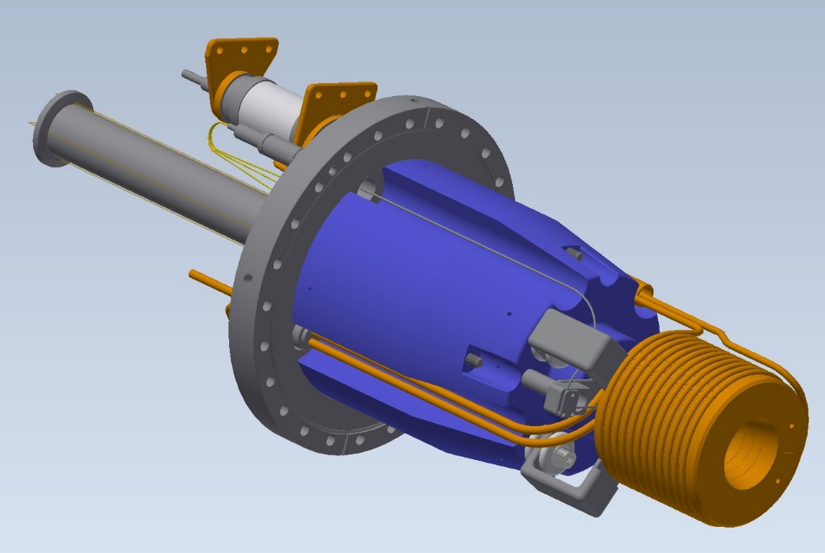
FC for SuperKEKB and ILC
 | SuperKEKB (SLAC type) | ILC (BINP type)
Peak Bz | 3.5 T | 5 T
Aperture | 7 mm | 12 mm
Peak current | 12 kA | 35 kA
Peak voltage | 20 kV | 20 kV
repetition | 50 Hz | 300 Hz (100 pps)
Pulse width | 5 us | 11 us
Peak power | 240 MW | 700 MW
Average power | 12 kW | 128 kW
Ohmic loss | 0.8 kW (measured) | 9 kW

Slide 26
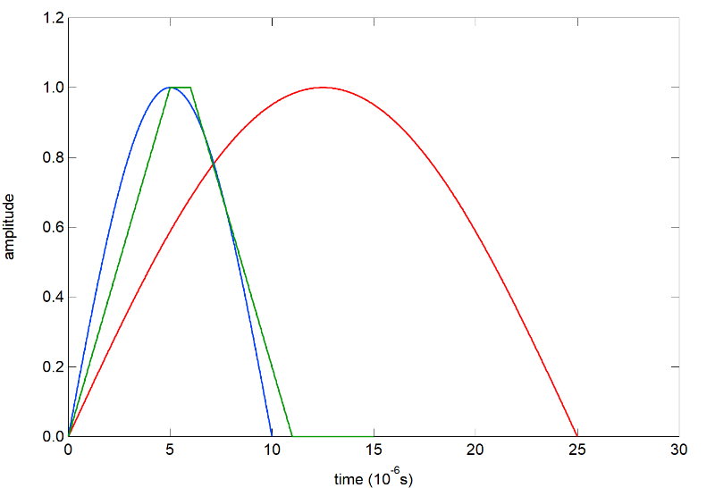
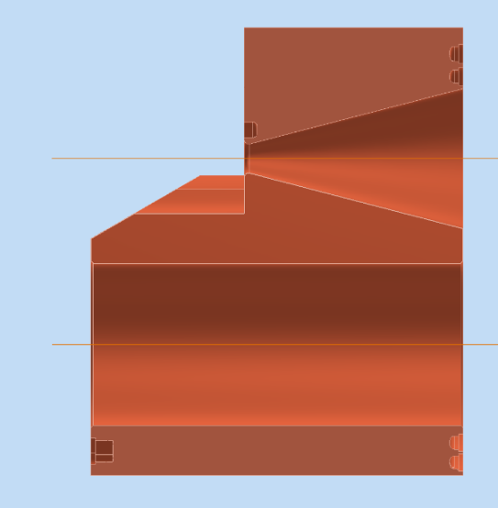
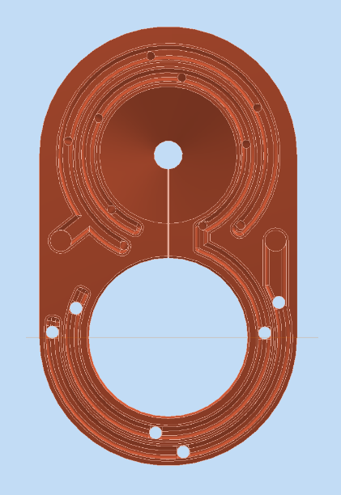
Challenges of FC design for ILC
Very high Ohmic loss
Optimize cooling water path
Near the inner surface of FC
Use BINP type for flexible design
Reconsider material
CuCr (for ILC)
NC50 (for SuperKEKB)
Trapezoidal excitation
Keep pulse width and peak voltage minimum
TP-5-1-5
Sin-20kHz
Shorter pulse width lead smaller ohmic loss but larger voltage

Slide 27
Temperature rise by current pulse
Current density distributionの図

Slide 28
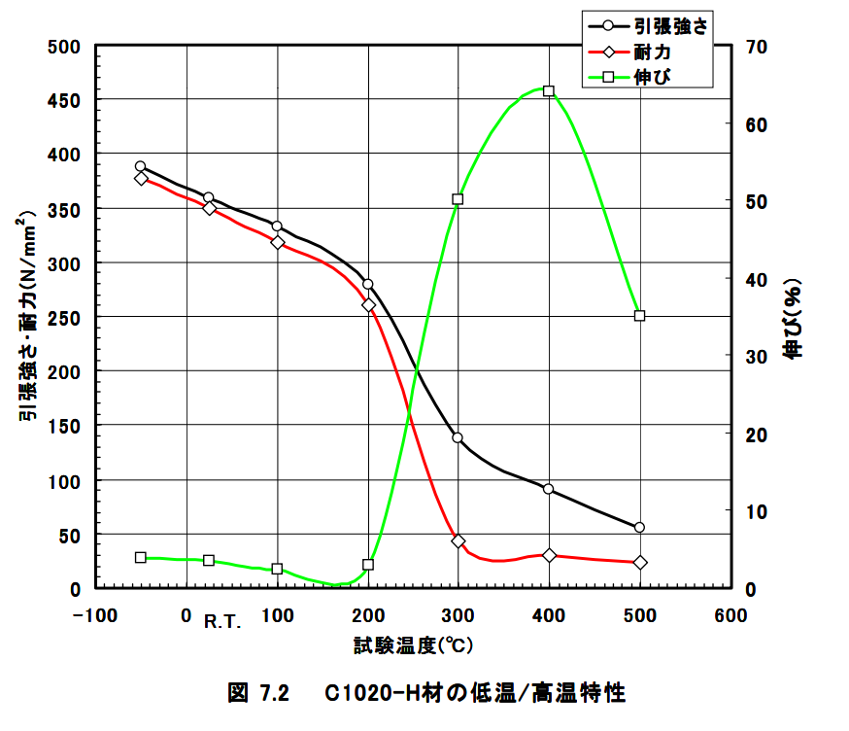
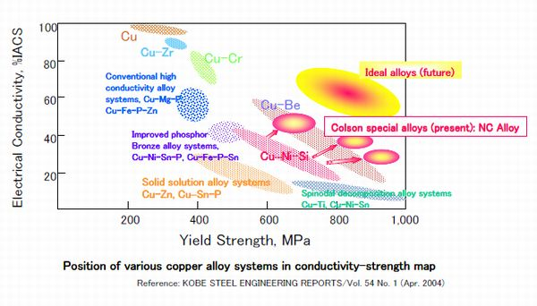
Material consideration for FC
Yield strength of C1020 (pure copper) decreases over 200℃
Simulation by copper alloys NC50, CrCu
Balance between mechanical properties and resistance is considered
CrCu is the best choice for our FC material
NC50 was chosen for SuperKEKB
Tensile strength and yield strength (Mpa)
Elongation (%)
Temp (deg)
Temperature dependence of mechanical properties
of Pure Cu

Slide 29
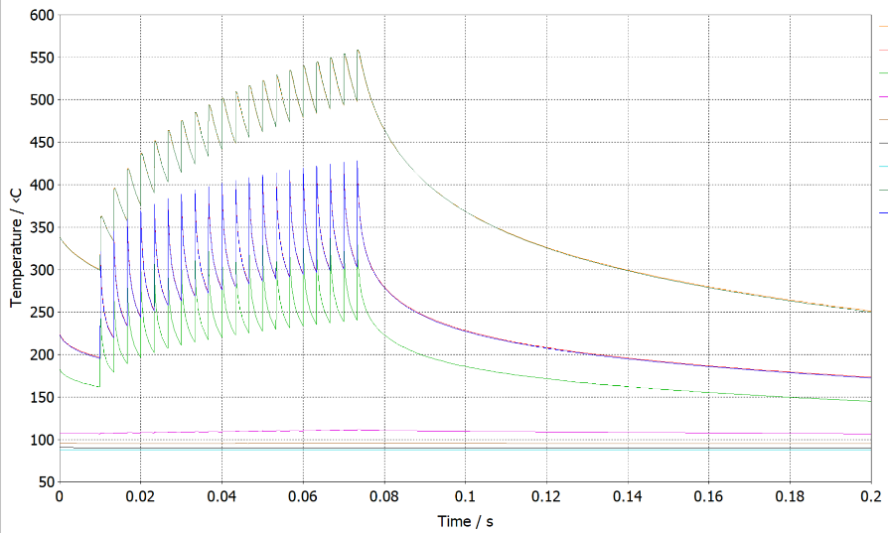
FC temperature result
Ambient 30℃
Max. temp
Temp. rise during 1 train
Temp. rise during 1 pulse
Temp. rise steady state
Temp rise (℃)
upstream aperture |  | D16 |  |  |  | D12
material |  | C1020 |  | NC50 |  | C1020 |  | NC50 |  | SH-1
excitation waveform | unit | Sin-20kHz | TP-5-1-5 | Sin-20kHz | TP-5-1-5 | Sin-20kHz | TP-5-1-5 | Sin-20kHz | TP-5-1-5 | TP-5-1-5
file |  | FC-5-01 | FC-5-02 | FC-5-01 | FC-5-02 | FC-5-03 | FC-5-04 | FC-5-03 | FC-5-04 | FC-5-04 | FC-8-04
others |  |  |  |  |  |  |  |  |  |  | R2, slit0.3
peak current | kA | 48 | 48 | 48 | 48 | 34.5 | 34.5 | 34.5 | 34.5 | 34.5 | 34.5

Slide 30
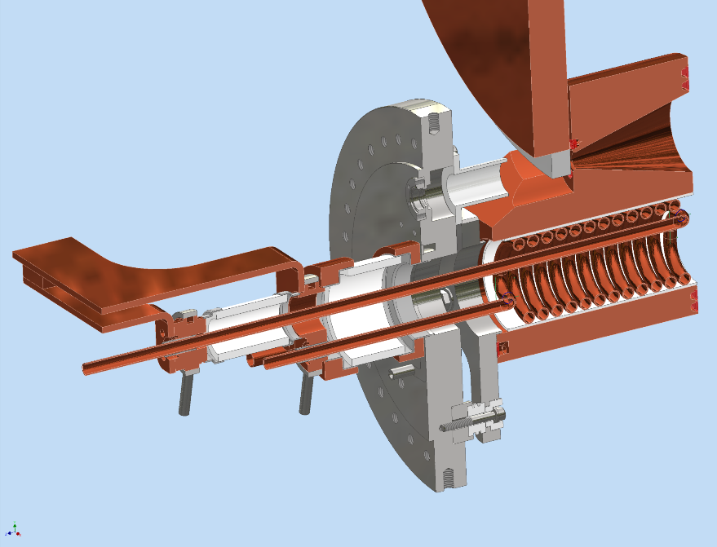
FC – thermal simulation
Total loss per pulse : 88.87 J
0.860
0.142
6.505
38.053
0.183
0
37.543
0
0.126
0.179
1.062
1.183
0.153
0.116

Slide 31
Courtesy of K. Wada

Slide 32
Summary
FC is an AMD (adiabatic matching device) to exchange position and angle of the particles using slowly changing magnetic field
Originally develop by SLAC for SLC
Eddy current and skin effect plays important role for design
Engineering design for cooling Ohmic loss getting more important for higher field and repetition requirement
Material selection
Cooling water path design

