Slide 1
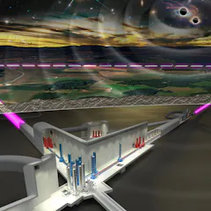
WP5 Project Office & Engineering Department
IJCLAB Participation
Introduction
29/05/2024
WP5 PO & EDpT - IJCLAB

Slide 2
IJCLAB WP5 Involvement
Project Office: Configuration Management
Project Office: Schedule Management
Eng DpT: Reference Clock Distribution
Eng DpT: Tower External Enveloppe & Associated Interfaces
Introduction with functions approach
29/05/2024
WP5 PO & EDpT - IJCLAB

Slide 3
IJCLAB WP5 Involvement
Project Office: Configuration Management (1)
Identification, Analysing
Deployement of any process
To ensure that all products
Are:
- Comply to intial design
- Comply to last version
validated
- Comply to real integrated
- Comply to any evolution
29/05/2024
WP5 PO & EDpT - IJCLAB

Slide 4
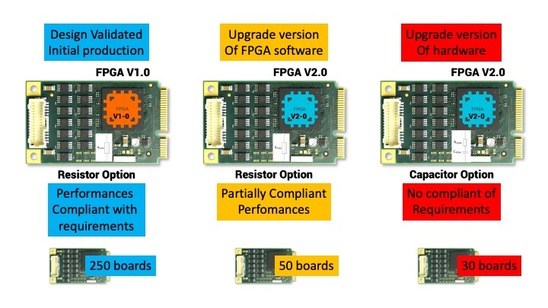
IJCLAB WP5 Involvement
Project Office: Configuration Management (2)
Bad Real Example
29/05/2024
WP5 PO & EDpT - IJCLAB

Slide 5
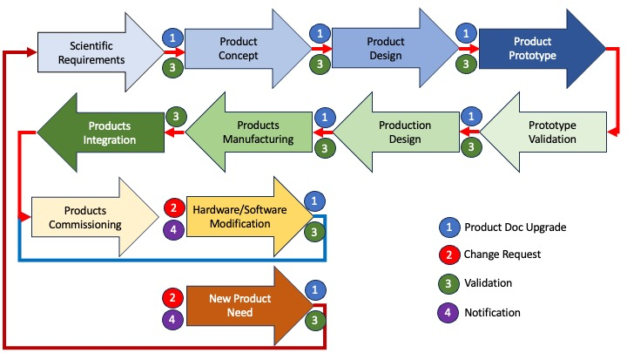
IJCLAB WP5 Involvement
Project Office: Configuration Management (3)
29/05/2024
WP5 PO & EDpT - IJCLAB

Slide 6
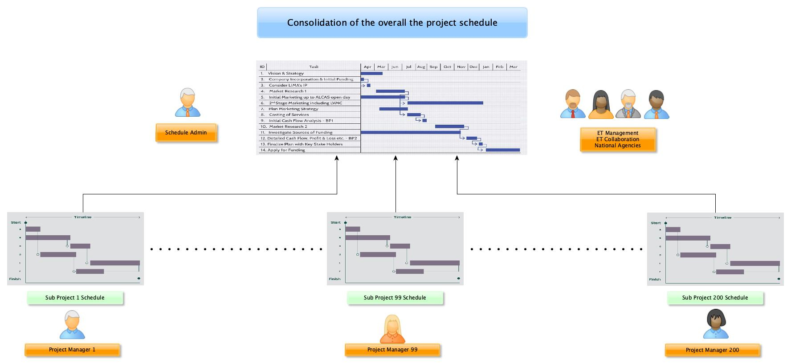
IJCLAB WP5 Involvement
Project Office: Schedule Management (1)
1300 Collaboration Viewers
National Institutions, EU
1 Administrator
200 Project Managers
29/05/2024
WP5 PO & EDpT - IJCLAB

Slide 7
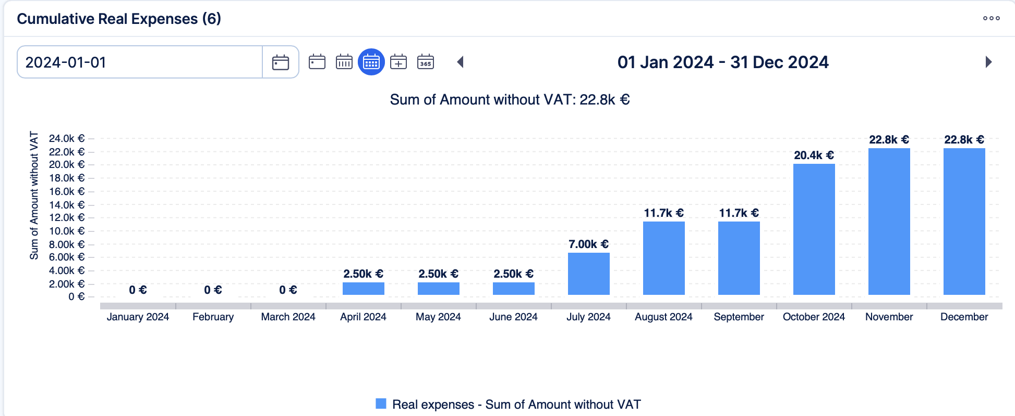
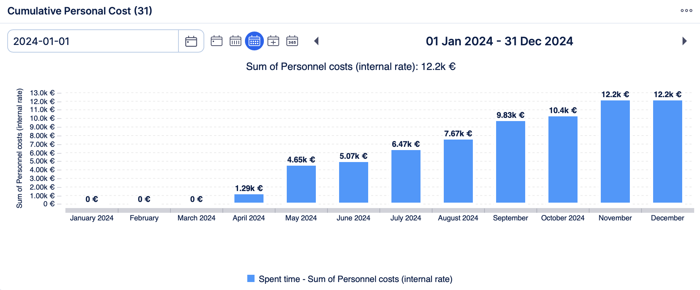
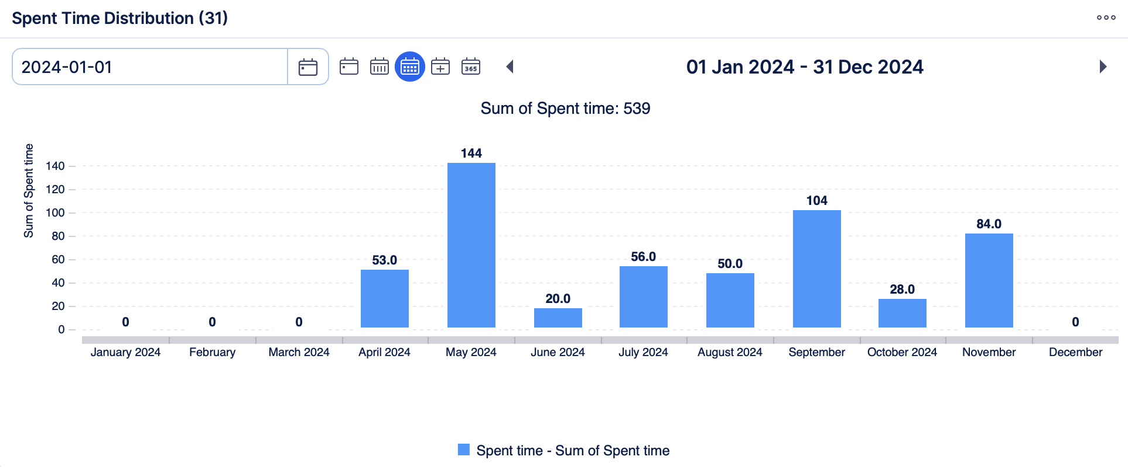
IJCLAB WP5 Involvement
Project Office: Schedule Management (2)
29/05/2024
WP5 PO & EDpT - IJCLAB

Slide 8
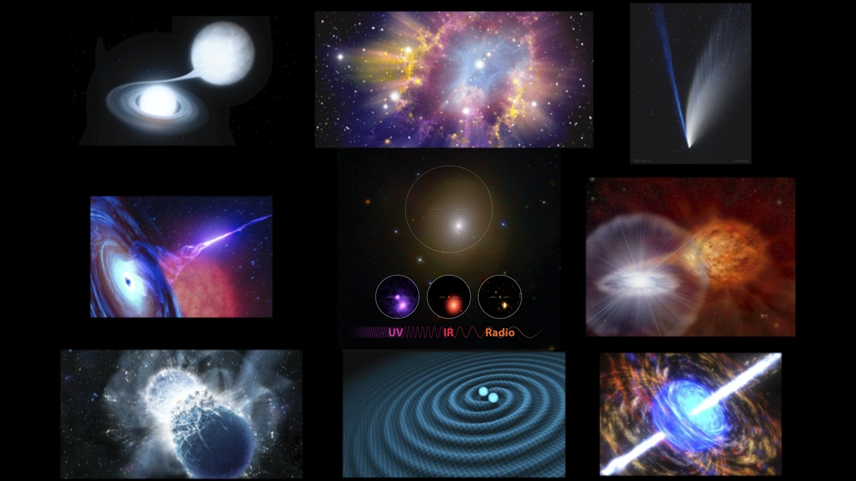
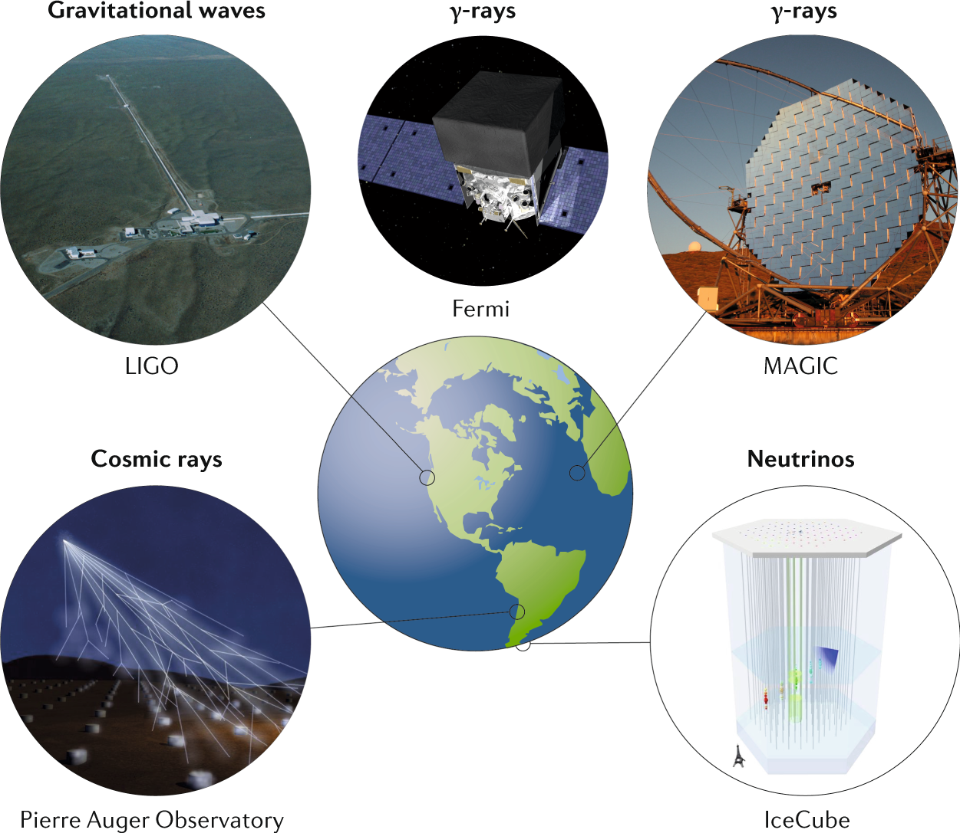
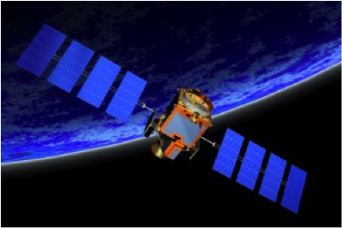
IJCLAB WP5 Involvement
Eng DpT: Reference Clock Distribution (1)
Synchronisation between all detectors
All around the world and space satellites
Very High Stability
Very Precision
Use European Network Atomic Clock
Define global network
29/05/2024
WP5 PO & EDpT - IJCLAB

Slide 9
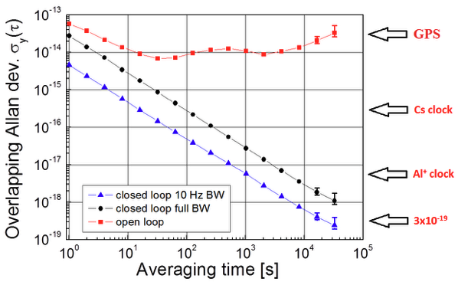
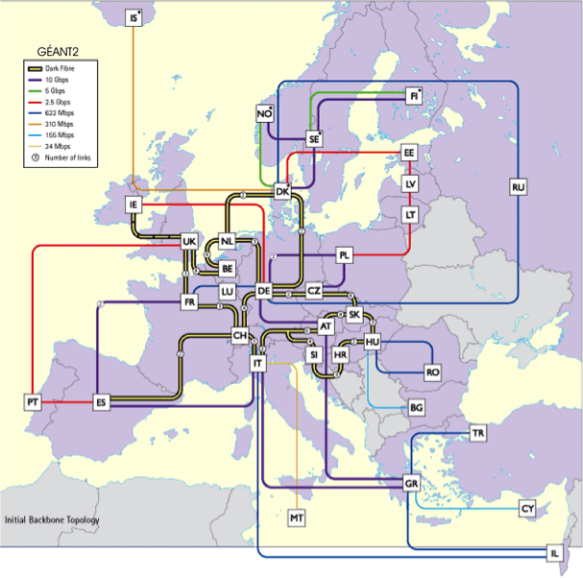
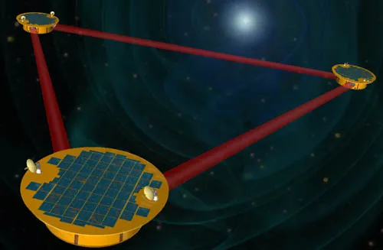
IJCLAB WP5 Involvement
Eng DpT: Reference Clock Distribution (2)
29/05/2024
WP5 PO & EDpT - IJCLAB

Slide 10
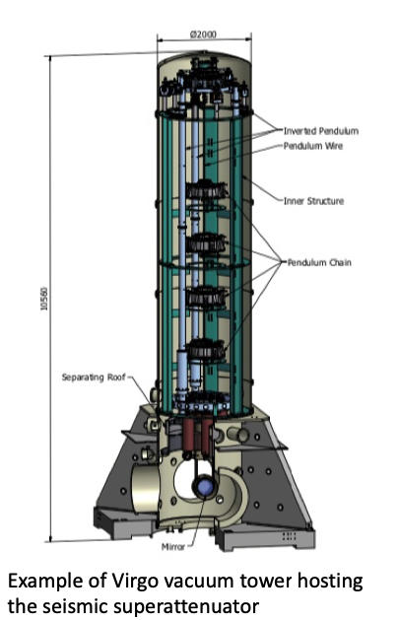
IJCLAB WP5 Involvement
Eng DpT: Tower External Enveloppe & Associated Interfaces (1)
Several dozen different towers
Cryogenics inside/outside function
WP 4 responsibility
Optics inside function
Collaboration responsibilities
Vaccum inside/outside function
WP 4 responsibility
29/05/2024
WP5 PO & EDpT - IJCLAB

Slide 11
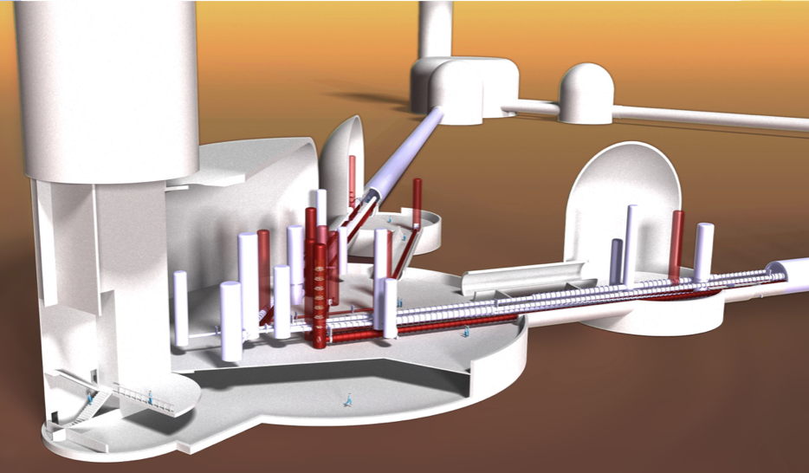
IJCLAB WP5 Involvement
Eng DpT: Tower External Enveloppe & Associated Interfaces (2)
We need to dissociate functions
- Inside/Cryo/Vaccum/Outside
For outer envelopes we need
to separate the functions
so that we can group all the
information together
from each design and
coordinate them to harmonise
interfaces and specifications
29/05/2024
WP5 PO & EDpT - IJCLAB

