Slide 1

ETO Engineering Department
Patrick Werneke
Meeting on ET Engineering Department and Project Office activities at IJCLab
May 29 – 30, 2024

Slide 2
Towards ET Dual Organizational Structure
1) project organization (towards legal entity) and 2) scientific collaboration
ETO (ET Organization)
ET Collaboration
Board of Governmental Representatives
Collaboration Board
Coordinators
Board of Scientific Representatives
Executive Board
ET Directorate
Specific Boards
INFRA-DEV
Project Office
EU project coordination
WP1:
WP2:
WP3:
WP4:
WP5: → ETO
WP6:
ISB
OSB
EIB
Local teams
Site characterisation with seismic and geological studies.
Deliver design and implementation plans that are unique to the region.
Develop economic case and deliver socio-economic impact plan.
Engineering
Department
SPB
…
...
...

Slide 3
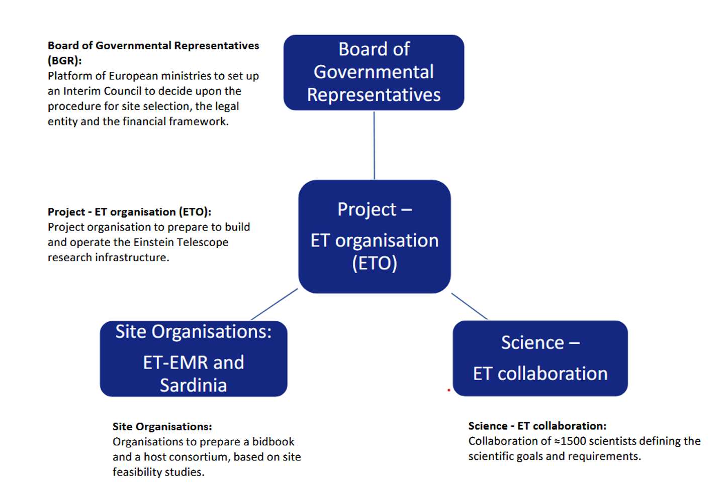
Governance in European context

Slide 4
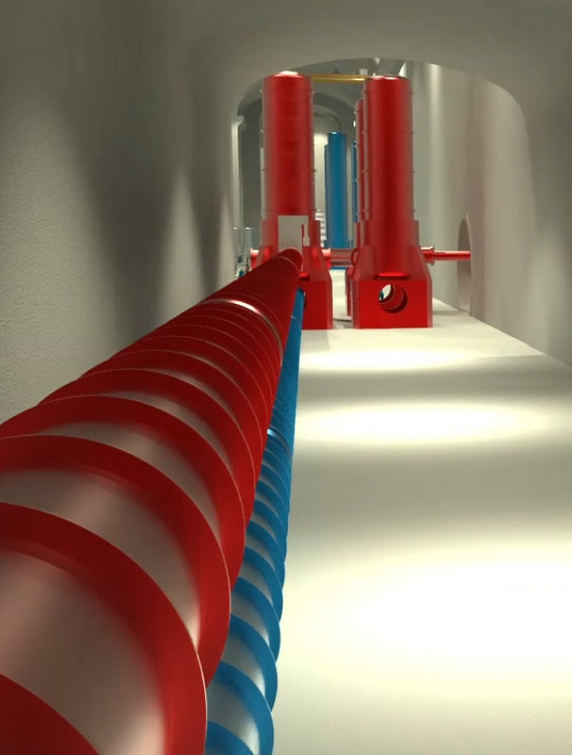
ETO Engineering Department - Mandate
Mandate: design, procure, install, commission, operate, maintain and eventually, dismantle:
The technical infrastructure systems needed to operate the interferometer
  Civil Engineering: shafts, caverns and tunnels, surface buildings and landscaping, …..
  Technical Infrastructures: Cooling and Ventilation, Access and Alarms, power distribution, …..
The special systems associated with the gravitational wave detector
  Vacuum beampipe
  Cryogenics infrastructure
  Survey
Tasks associated with on-site responsibilities
  Logistics and installation
  Engineering Integration
  Safety in the field

Slide 5
ETO Engineering Department – ET Phases
ET is currently in Phase I of a Design and Preparation Phase, which ends with the site decision and the principal approval for construction of ET.
Main ETO deliverables for Phase 1:
  Preliminary TDR
  Budget and risk report (Phase 2 + following phases)
  Planning report (Phase 2 + following phases )
  Organizational report (Phase 2 + following phases)
  Site evaluation report

Slide 6
Engineering Department: ET Phases
Phase 2 + following Phases:
Phase 2 of the Design and Preparation: this phase will end with the final TDR, costing overview, risk assessment and schedule for the construction;
Implementation Phase: this phase will end with the Einstein Telescope commissioned;
Operation Phase;
Termination Phase.

Slide 7
ETO Engineering Department – Organisational Chart
Engineering Department
Patrick Werneke (Nikhef)
External Contracts CERN
for ET Phase 1
Civil Engineering
Maria Marsella (INFN)
Technical Infrastructure
……
Mechanical Engineering
……
Logistics and Installation
….
Coordination and Integration
…..
Civil Engineering MoU with CERN
Responsibles:
CERN:
John Osborne (CERN SCE)
Coordinators:
Maria Marsella (INFN)
Patrick Werneke (Nikhef)
Mario Martinez (IFAE)
Civil Engineering:
Jonathan Bratanata (Nikhef)
Wissam Wahbeh (FHNW)
…..
Cooling and Ventilation
…..
Vacuum:
Marije Barel (Nikhef)
Alexandre Lacroix (CNRS)
Guillaume Deleglise (CNRS)
Romain Bonnand (CNRS)
Rafael Garcia (IFAE)
Logistics:
Max Majoor (Nikhef)
Integration:
…..
Access and Alarms
…..
Handling Engineering:
…..
Operational Safety:
Phase 2
Cryogenics:
…..
Vacuum Beampipe MoU with CERN
Responsibles:
CERN:
Paolo Chiggiato (CERN TE-VSC)
ETO Coordinators:
Fernando Ferroni (INFN)
Patrick Werneke (Nikhef)
Electrical Engineering
…..
Survey:
…..
Under dicussion MoU with CERN:
Occupational Health and Safety
Cooling and Ventilation
Access and Safety
Electricity Engineering
Coordination and Integration
Cryogenics
Survey

Slide 8
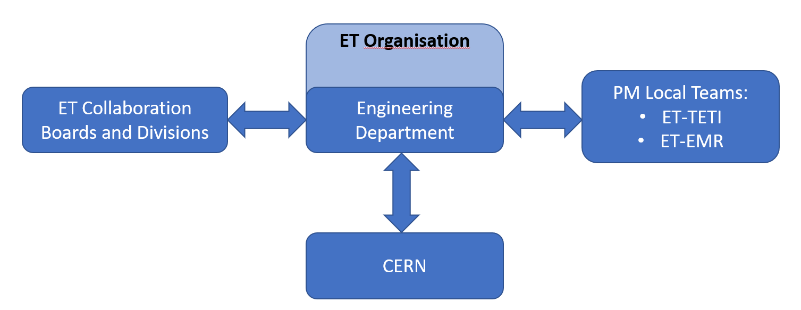
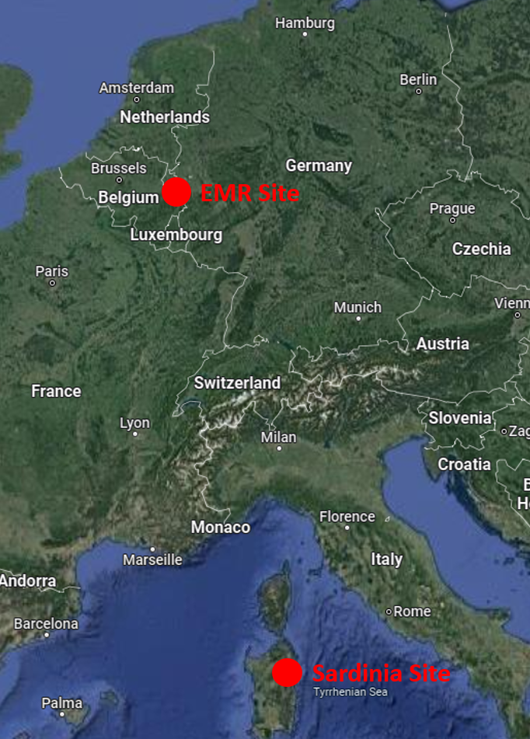
Engineering Department: meetings
ETO management: weekly and monthly f2f
ETO management - ETC-EB: bi weekly
Engineering Department: monthly
Civil Engineering: bi weekly
ETO (Nando and me) – CERN vacuum: f2f /3 months (monthly meeting @CERN)
ETO civil engineering – CERN civil engineering: monthly f2f
ETO civil engineering – Local teams (TETI & EMR) bi-weekly
ETO directors – Local team directors /3 months
Following the various ETC meetings

Slide 9
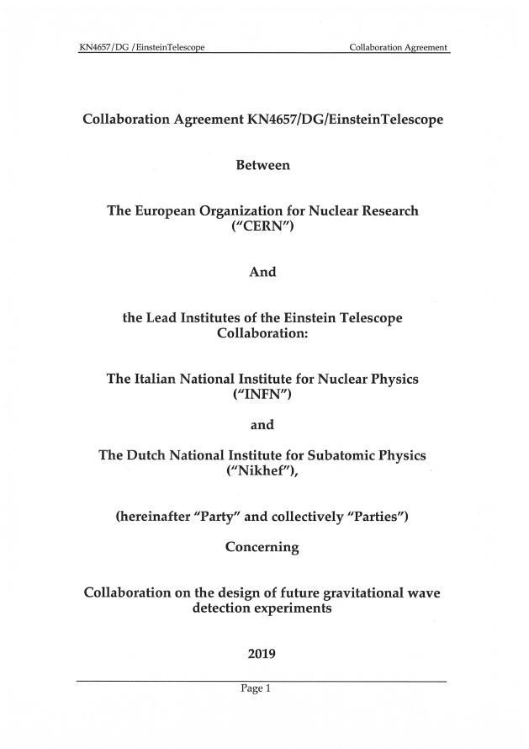
Collaboration Agreement with CERN
Vacuum beampipe: pilot sector and TDR
Civil Engineering: technical support
Under discussion:
Technical Infrastructure
Occupational Health and Safety
Costing, planning, integration, information management
Cryogenics and Survey

Slide 10
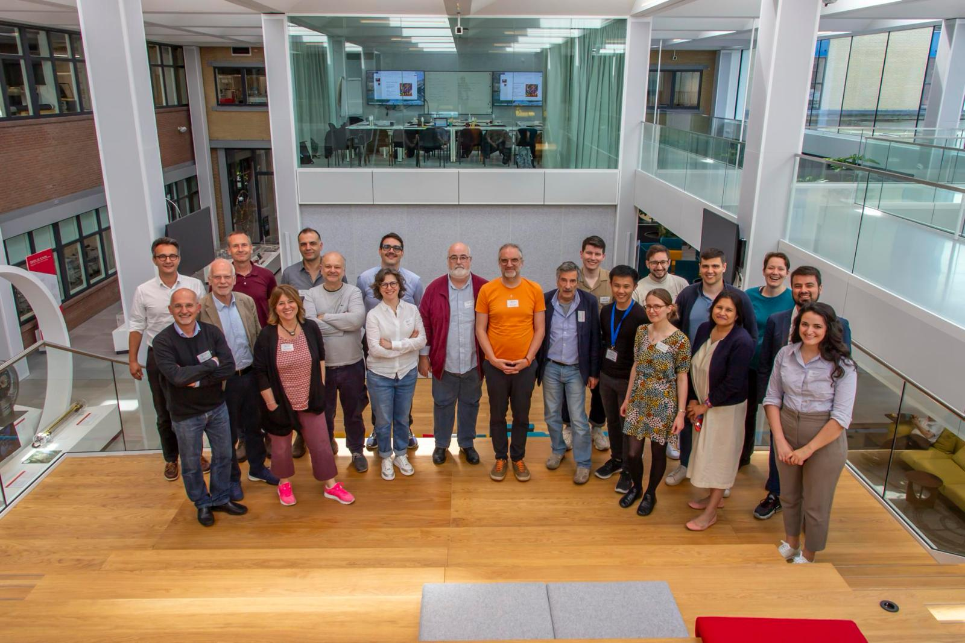
1st ETO General meeting – 27 & 28 May 2024 @Nikhef

Slide 11

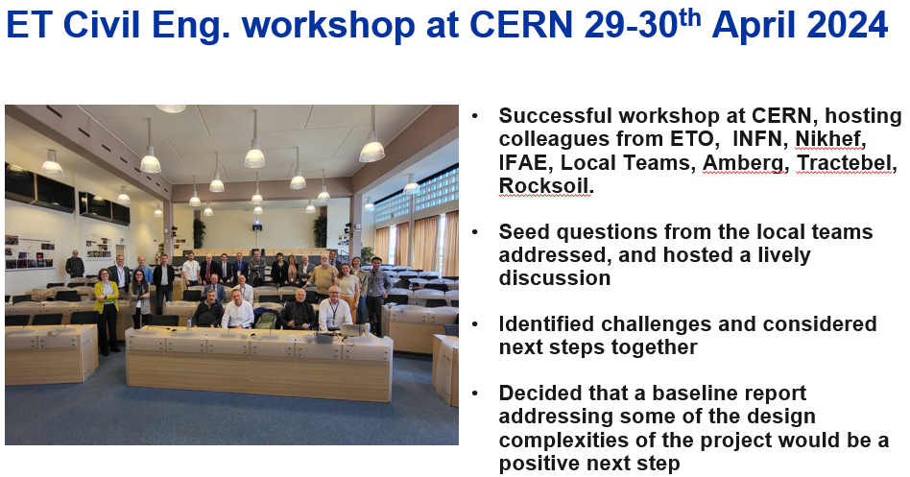
ETO activities with Local teams
11

Slide 12
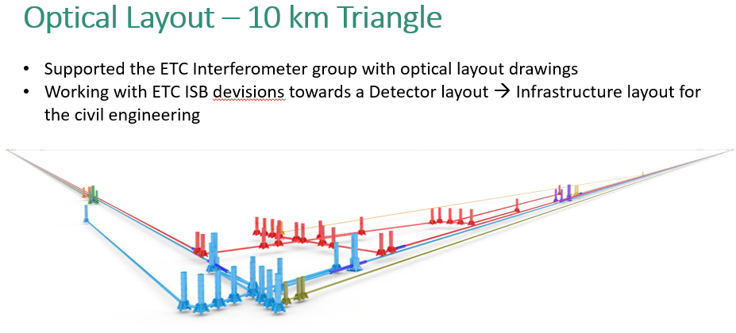
ETO activities with ET Collaboration
12

Slide 13
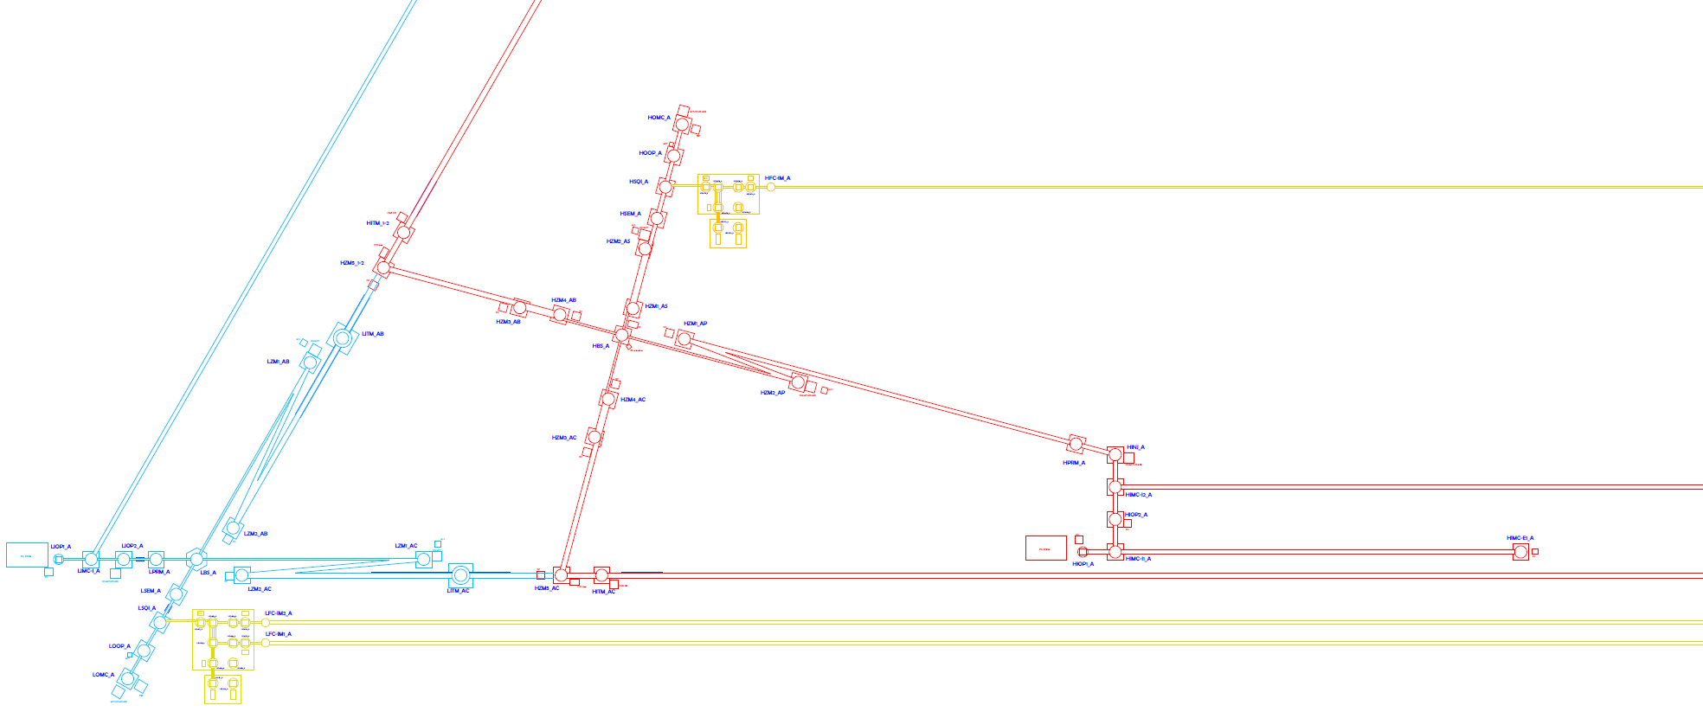
Optical Layout
13

Slide 14
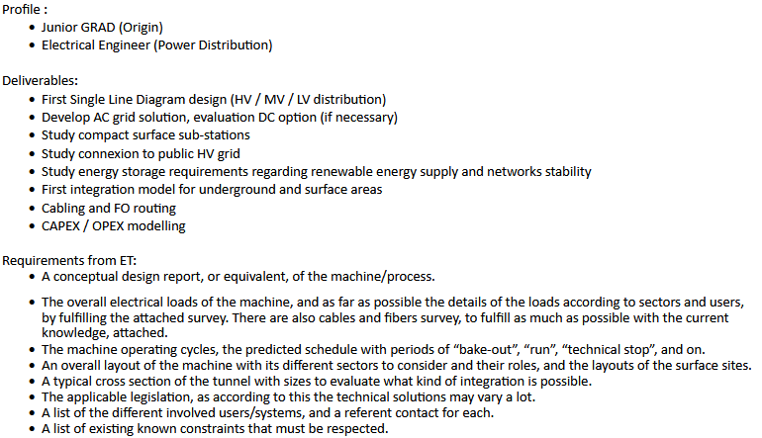
Collaboration Agreement with CERN
Electrical Engineer

Slide 15
Collaboration Agreement with CERN
Access and Alarms
Cooling and Ventilation
Senior Graduate (Quest) #1
  Profile: mechanical engineer, HVAC systems, underground installation (preferrable), CFD simulations on fluid flow analysis (preferable)
  Main task: perform the ventilation requirements analysis, define the technical solution for HVAC systems of surface and underground areas, participate in infrastructure design and integration meetings; writing technical reports.
Senior Graduate (Quest) #2
  Profile: mechanical engineer, building services and water systems, underground installation (preferrable), CFD simulations on fluid flow analysis (preferable)
  Main task: perform the water-cooling requirements analysis, define the technical solution for water cooling systems of surface and underground areas, participate in infrastructure design and integration meetings; writing technical reports.
Deliverables:
Evaluation of requirements
Participation in Infrastructure Working Groups and Integration Working Groups
Preliminary Technical Design Report
Preliminary planning

Slide 16
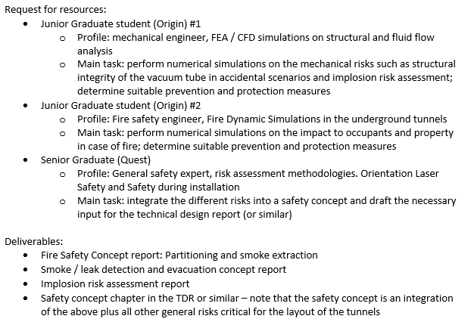
Collaboration Agreement with CERN
Occupational Health and Safety

Slide 17
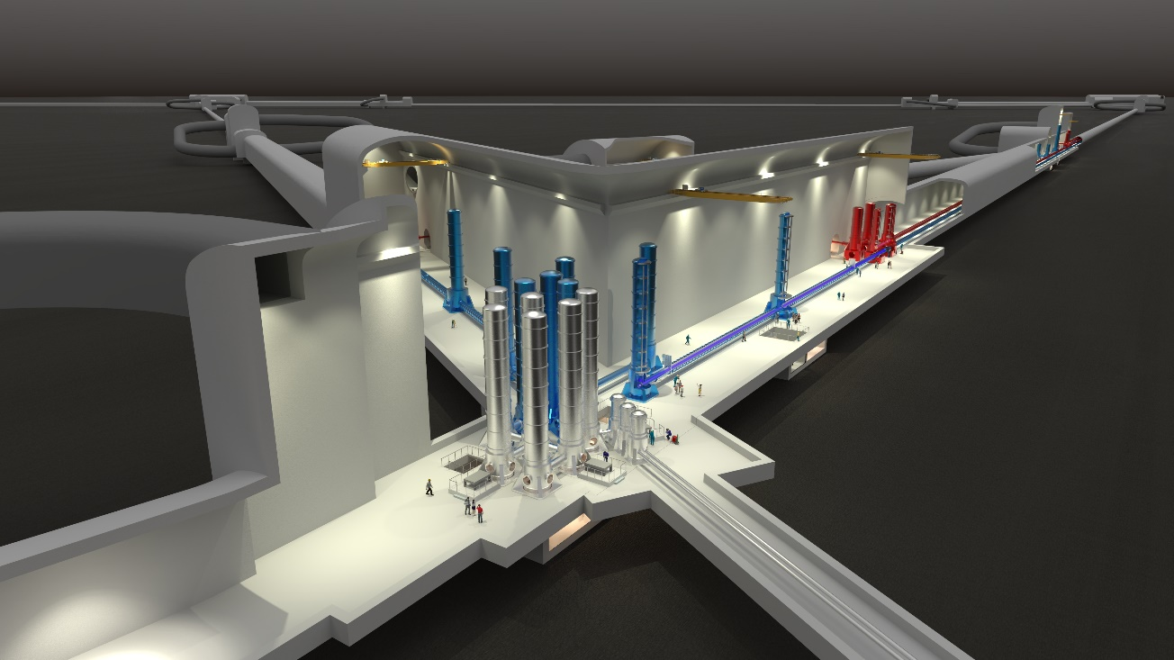
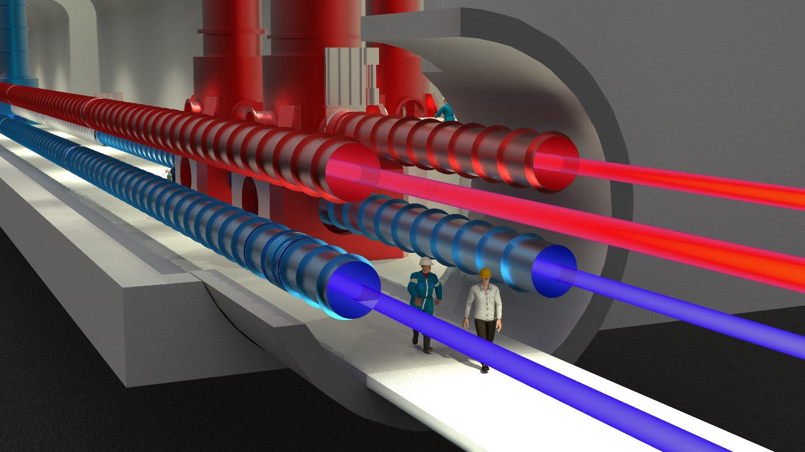
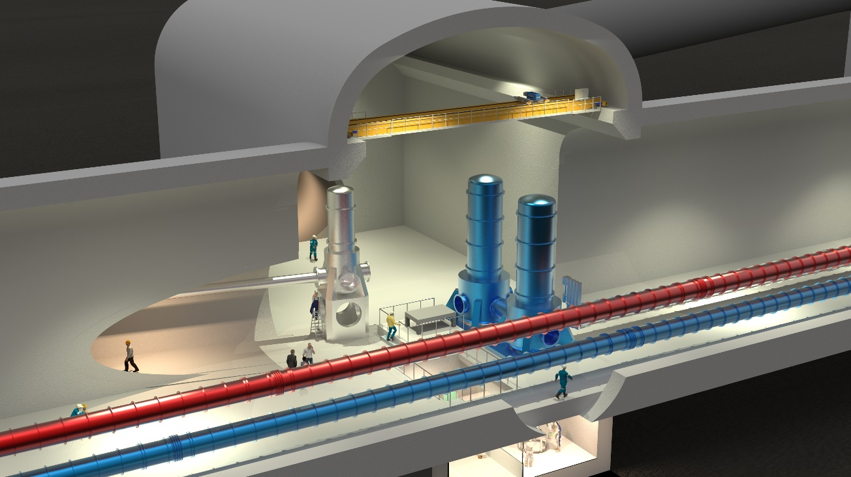
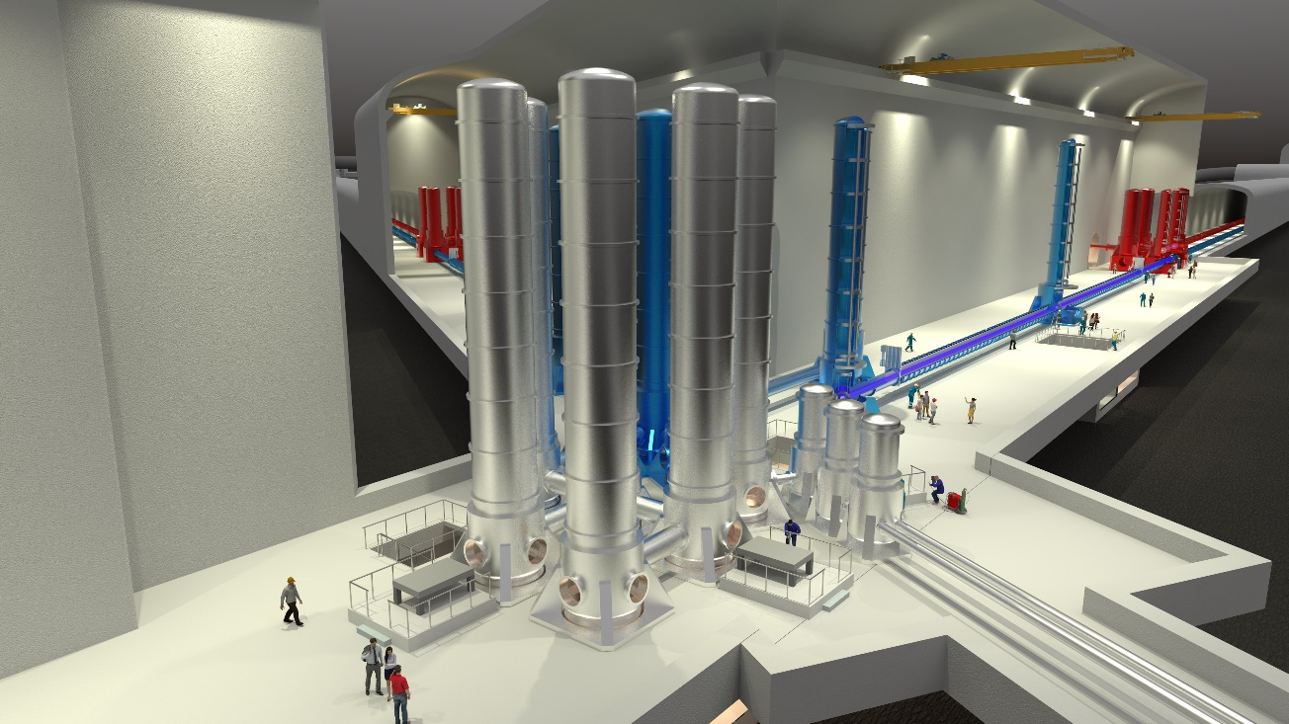
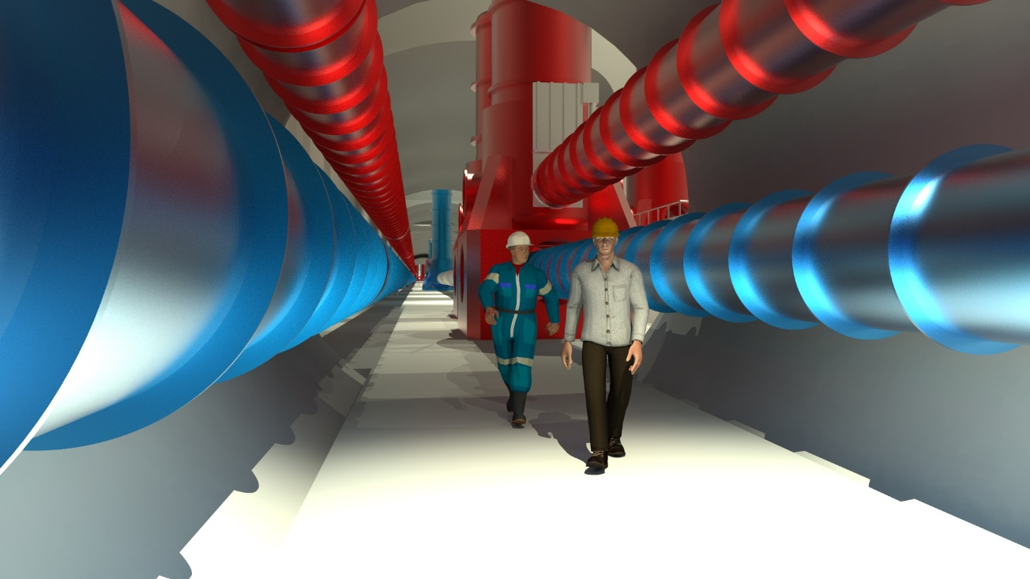
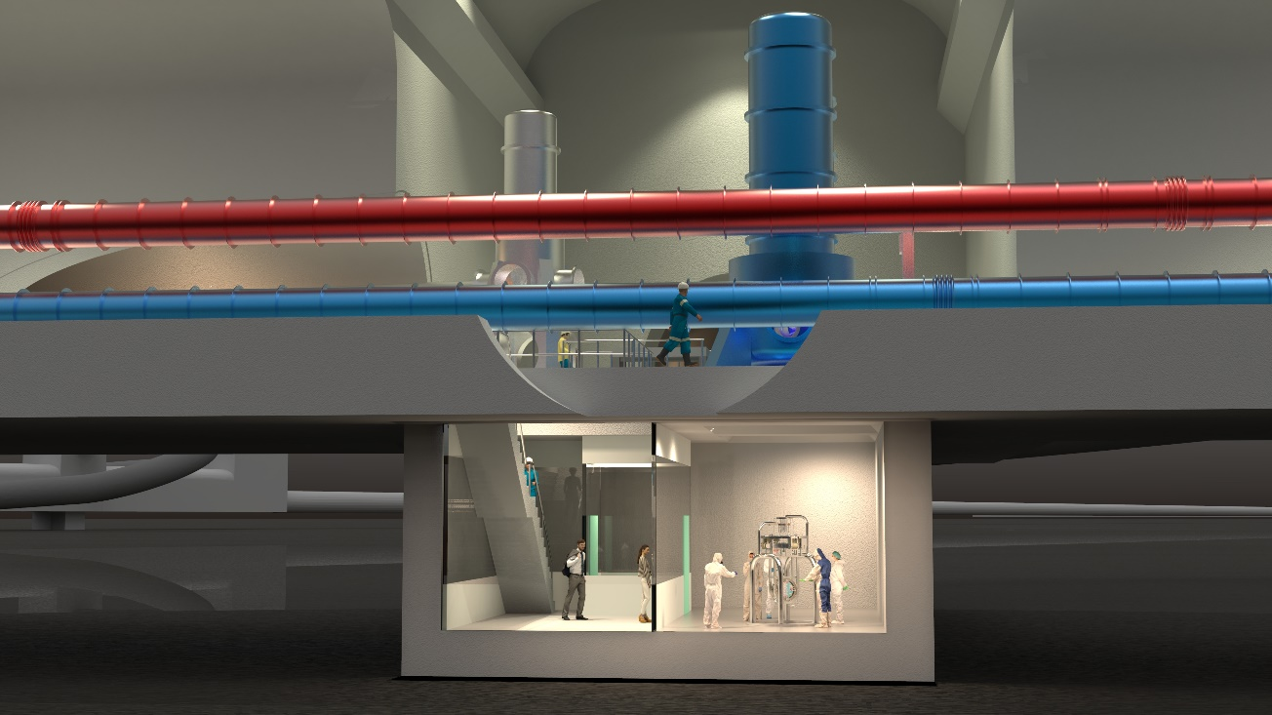
End

