Slide 1
Gravitational Wave in Non-Standard Cosmologies: From Inflaton to Primordial Black Holes
Mathieu Gross
Astroparticle symposium
27/11/2024
Based on : arXiv:2411.04189 [hep-ph]
In collaboration with: Essodjolo Kpatcha, Yann Mambrini, Maria Olalla Olea-Romacho, Rishav Roshan

Slide 2
Outline
Introduction
Reheating
Inflaton reheating
PBH evaporation
Primordial Black holes
Inflaton scattering
PBH reheating
Evaporation and scattering
Density fluctutations

Slide 3
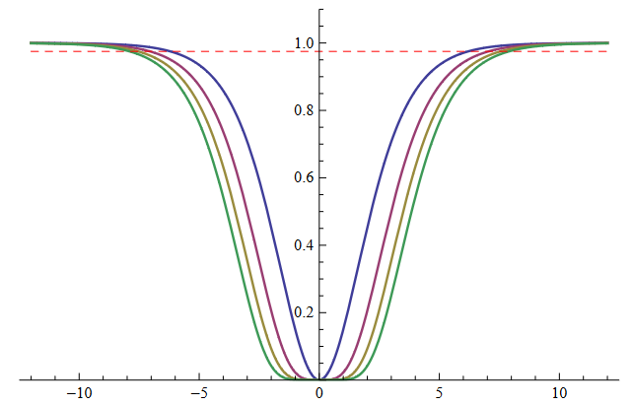
Reheating after inflation
arXiv:1806.01865v2 [hep-ph]
arXiv:1306.5220v3 [hep-th]

Slide 4
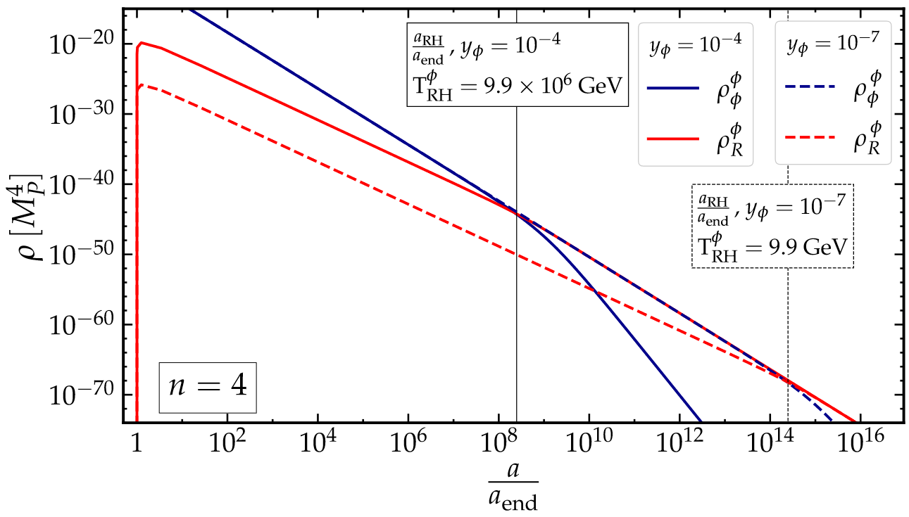
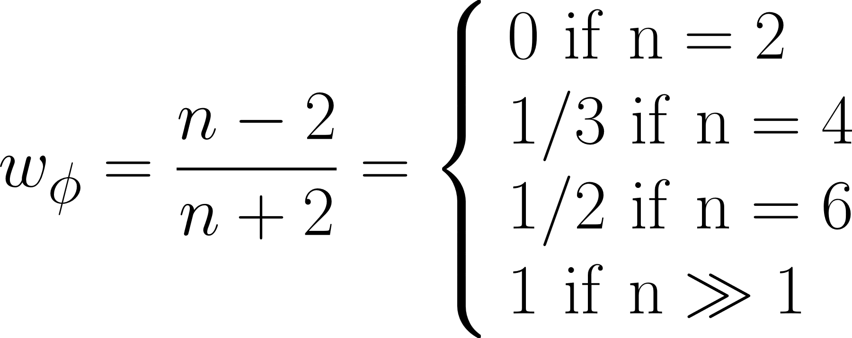
Reheating after inflation
T_{RH} is a free parameter in this talk
arXiv:2305.10518

Slide 5
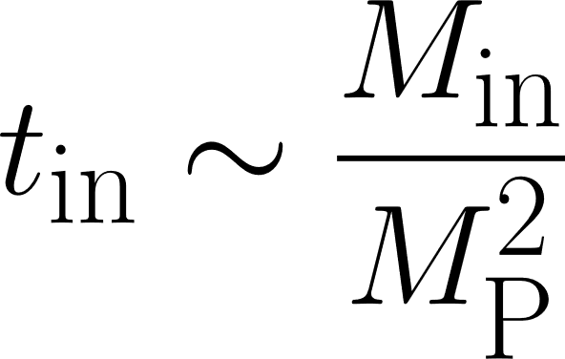
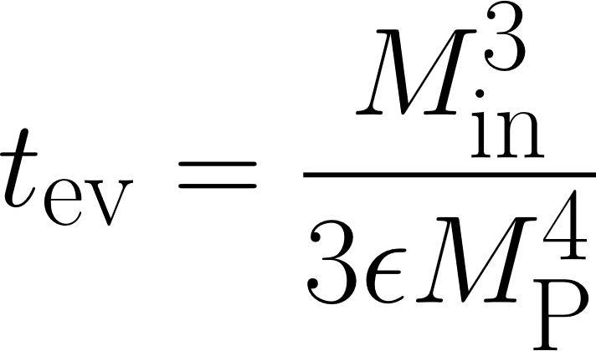
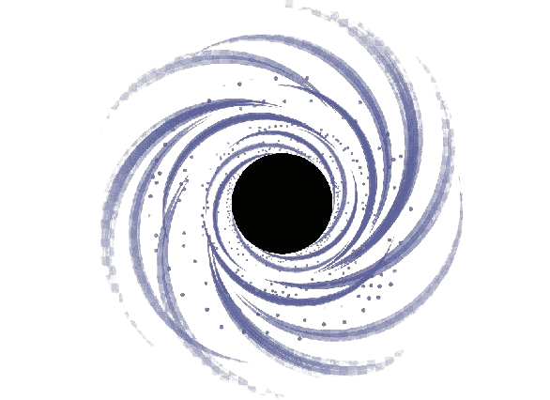
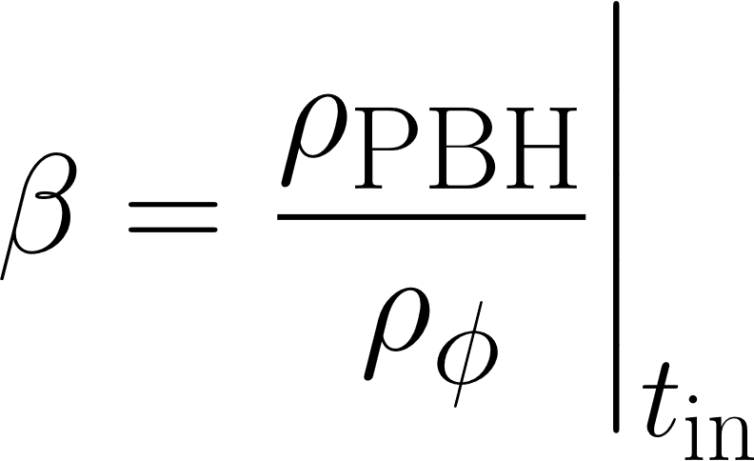
Primordial Black holes
-Hawking evaporation (Schwartzschild PBH)
- Formation and evaporation times
-Assume monochromatic distribution
-Initial abundance parameter

Slide 6
Inflaton reheating scenario
arXiv:2305.10518

Slide 7
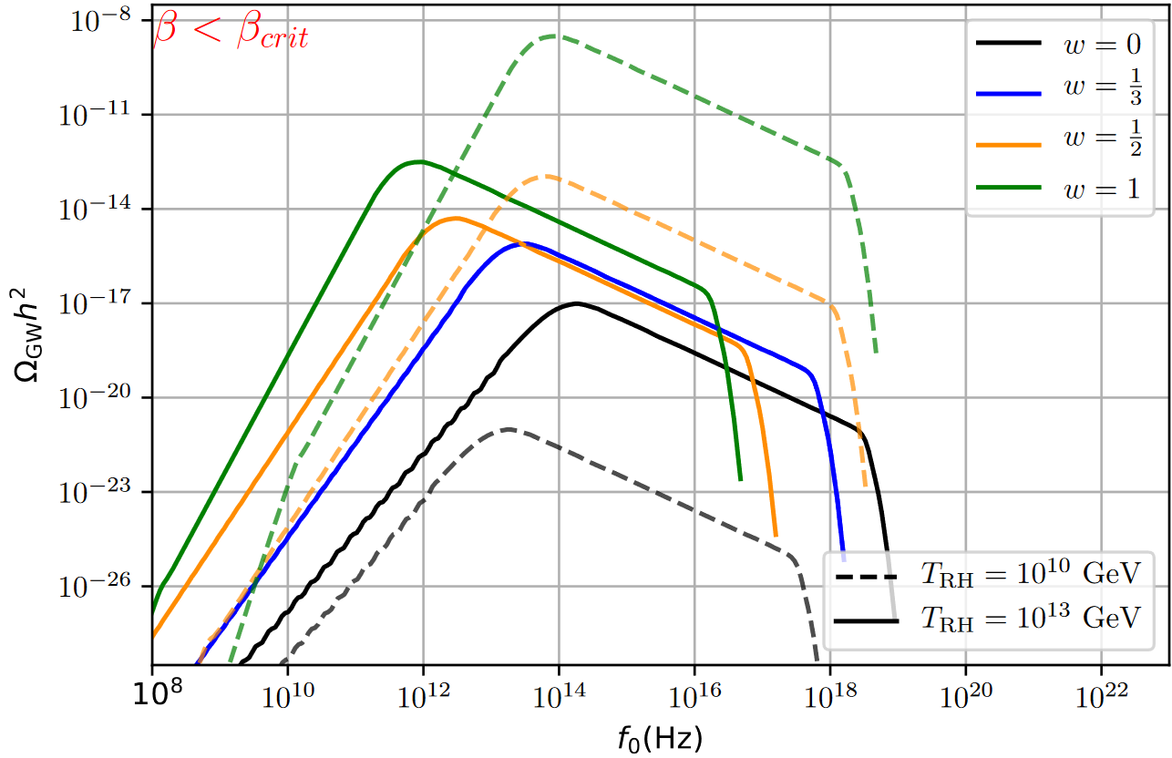
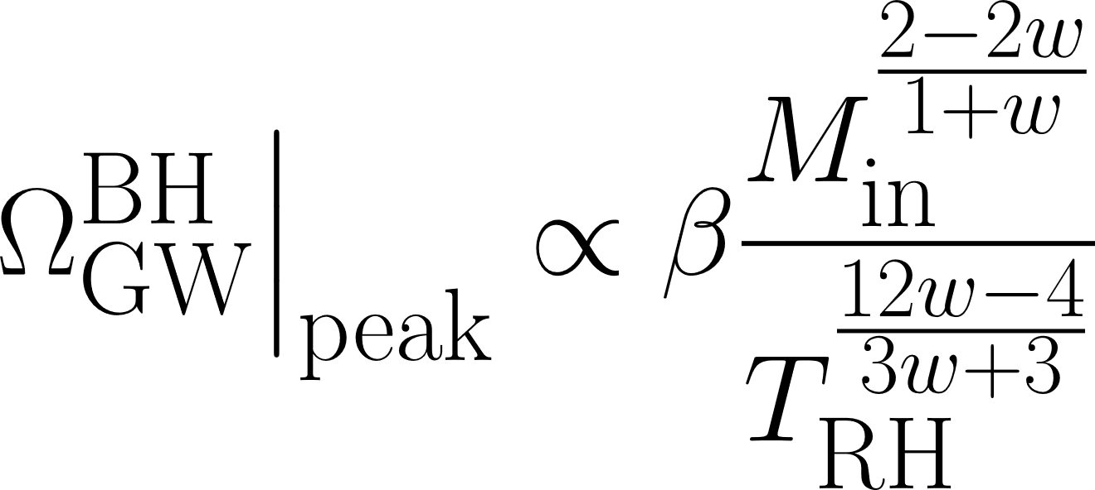
GW from Hawking evaporation
Greybody factor
Instantaneous emission
arXiv:1905.04268 [gr-qc] arXiv:2108.02737 [gr-qc]

Slide 8
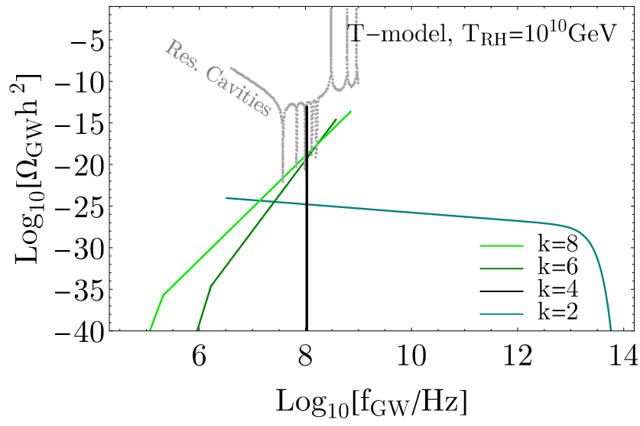
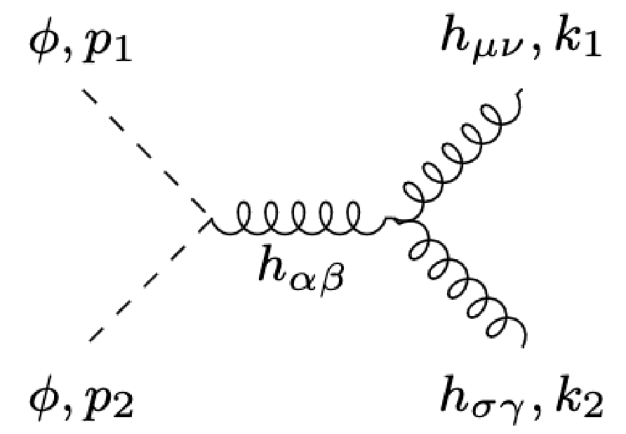
GW from inflaton scattering
arXiv:2402.04310 [hep-ph]

Slide 9
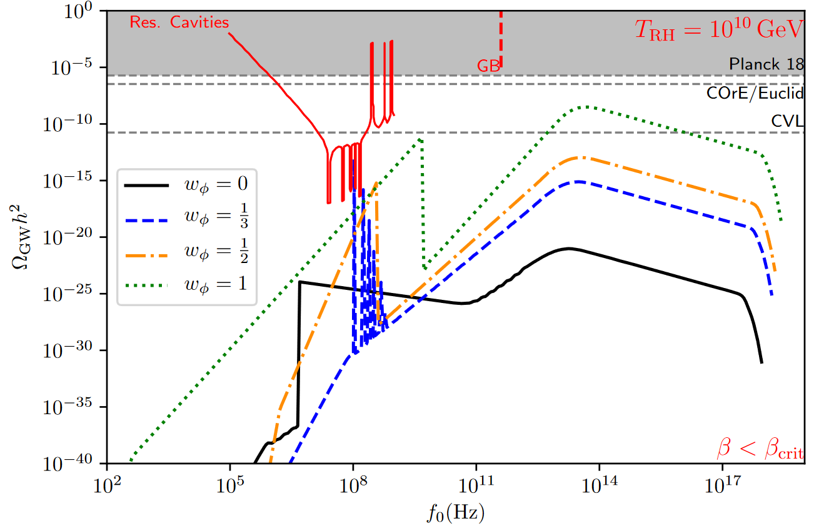
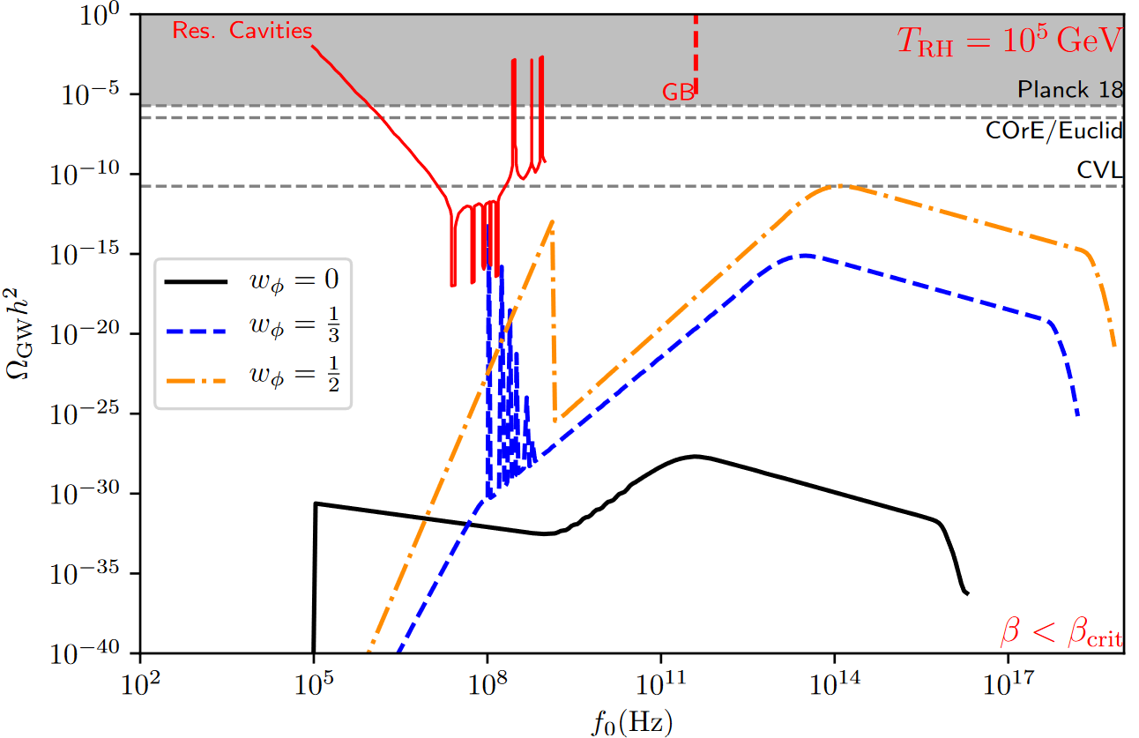
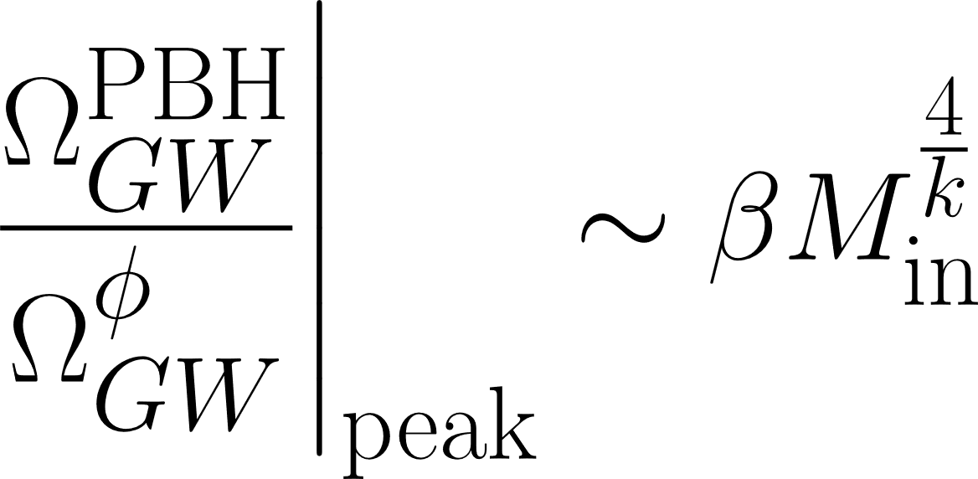
Result for usual reheating

Slide 10
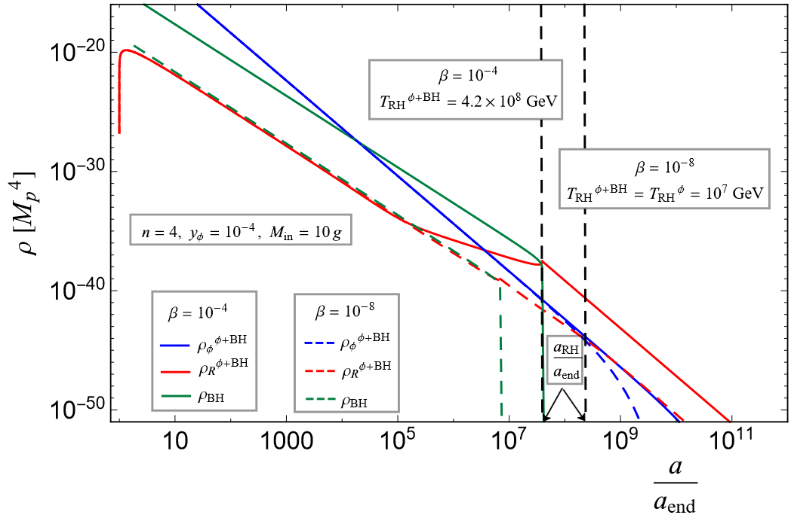
PBH domination/reheating
arXiv:2305.10518 [hep-ph]

Slide 11
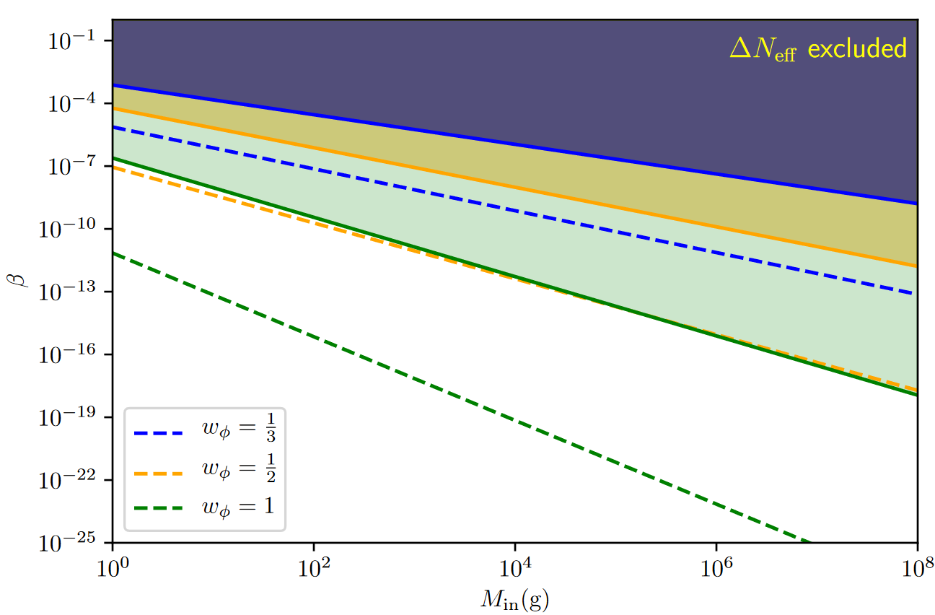
Parameter space
 | arXiv:2409.12125

Slide 12
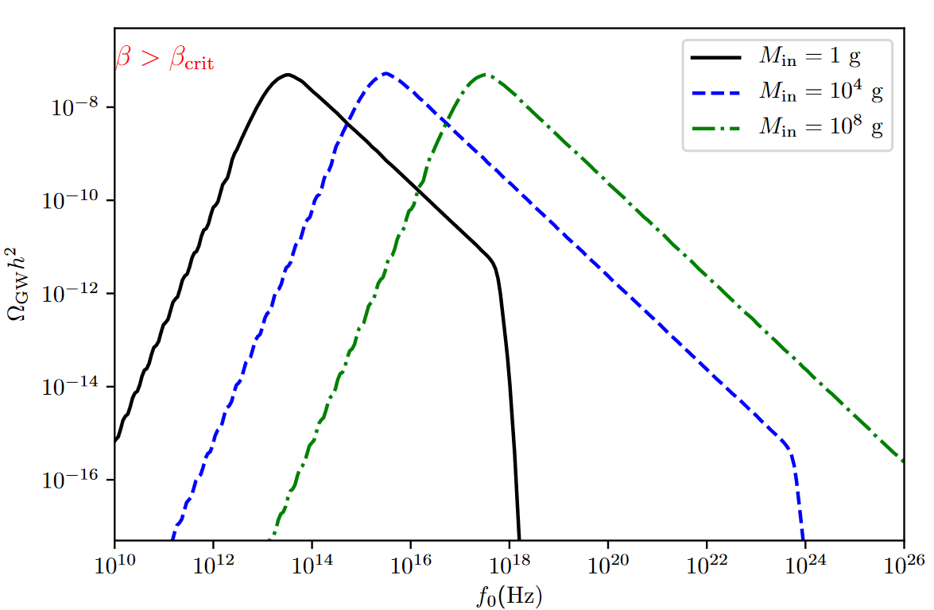
Hawking evaporation and inflaton scattering
The peak amplitude is independant on β

Slide 13
Scalar induced GW
Inhomogeneities are sourcing scalar fluctuation:
Analytical solution:
 | arXiv:2409.12125

Slide 14
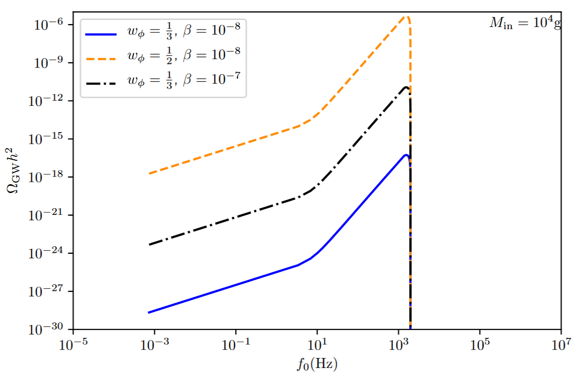
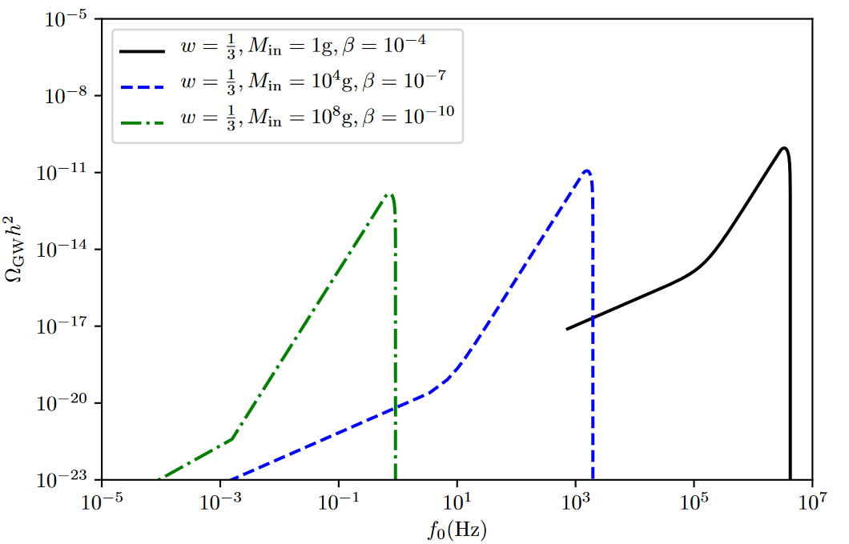
Scalar induced GW

Slide 15
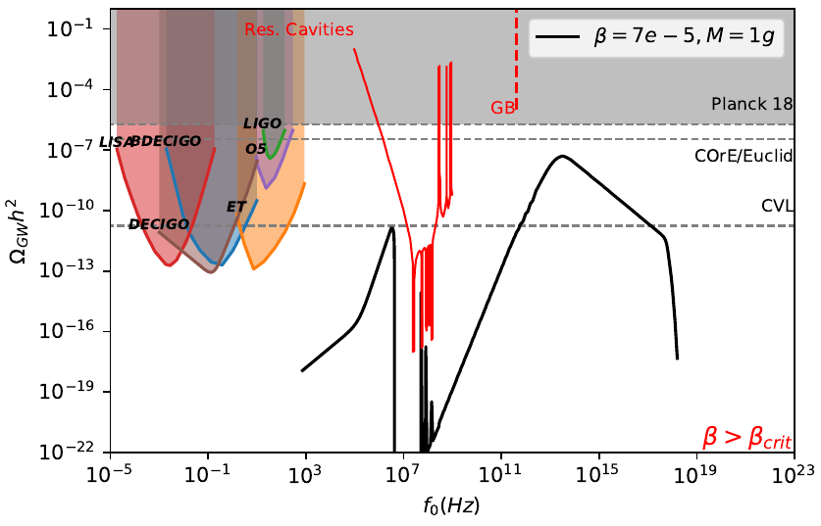
Result PBH domination

Slide 16
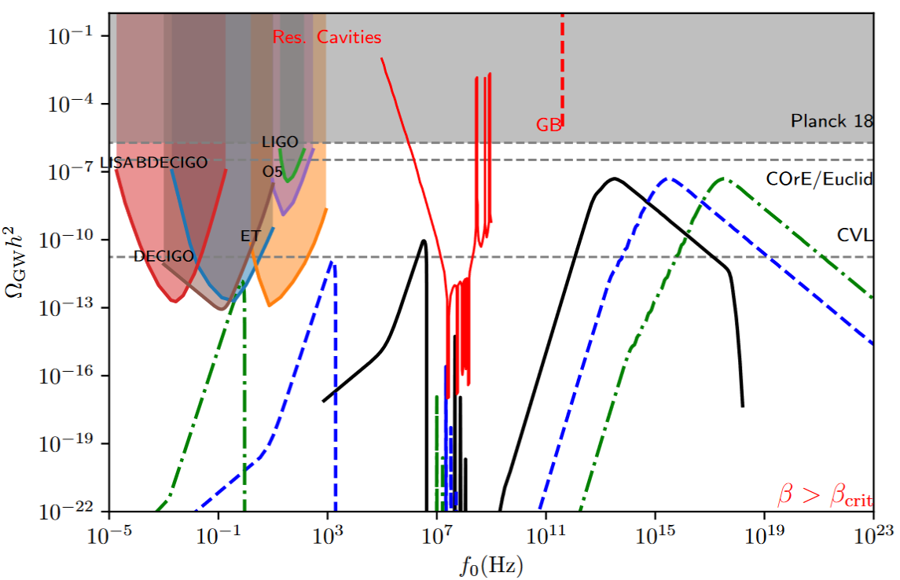
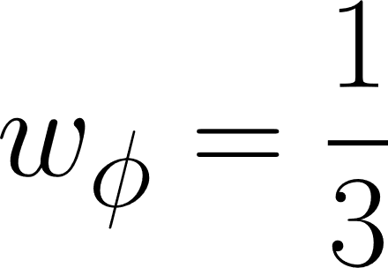
Result PBH domination

Slide 17
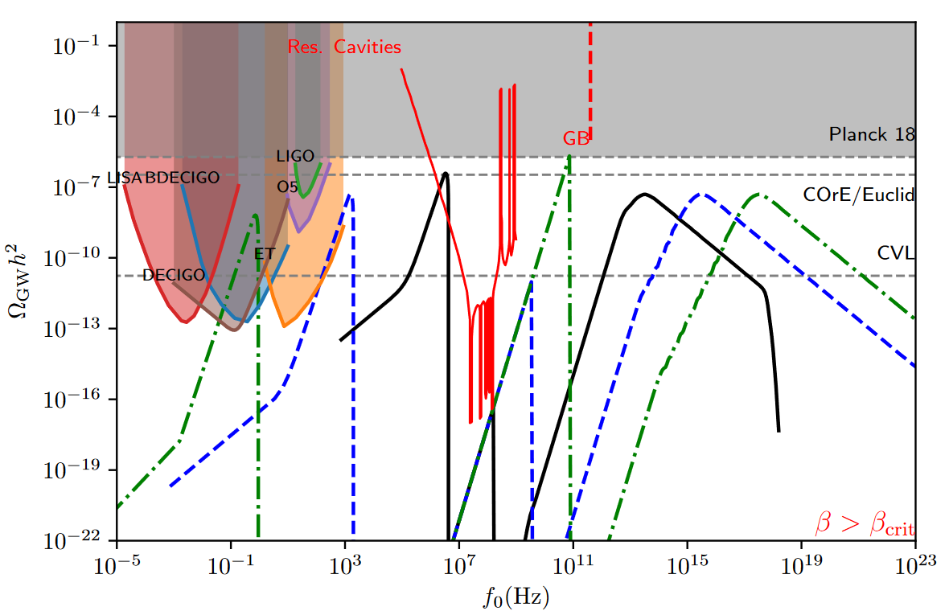
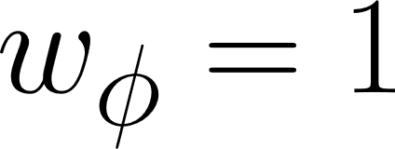
Result PBH domination

Slide 18
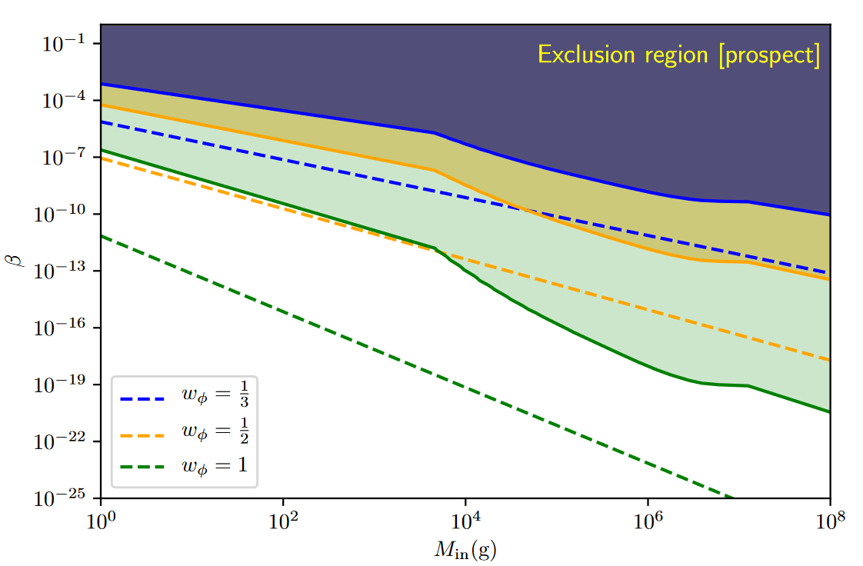
Probe of the parameter space

Slide 19
Conclusion
The GW signature from reheating after inflation should contain at least 2 peaks (3 for PBH reheating)
PBH domination scenario would be probed by future experiments
If PBH do not dominate, the amplitude ratio of the peaks do not depends on the reheating temperature

