Slide 1
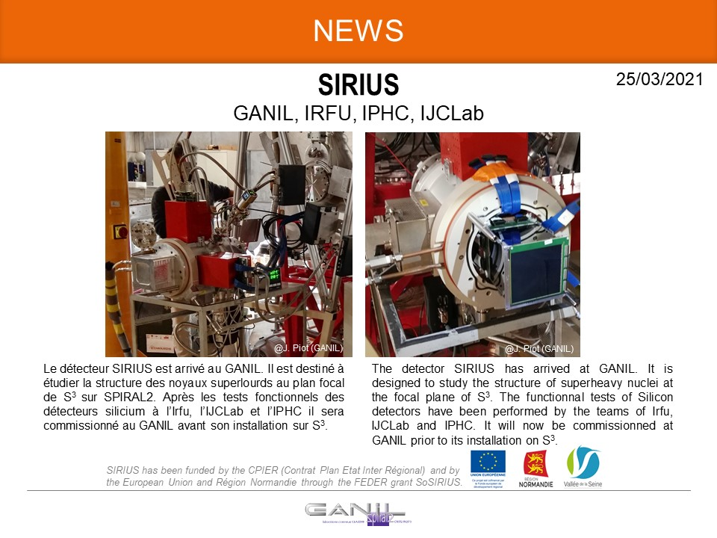
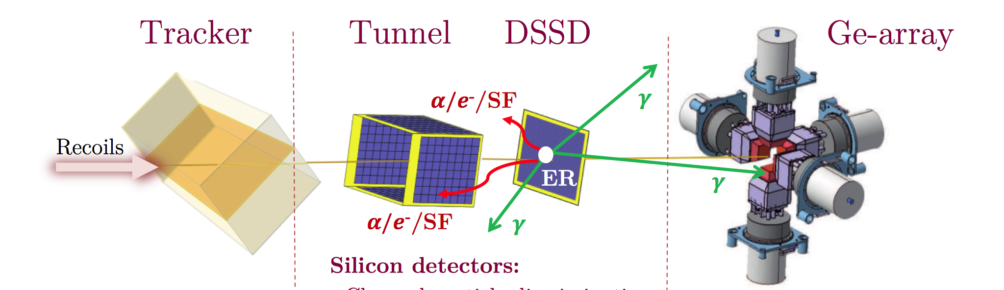
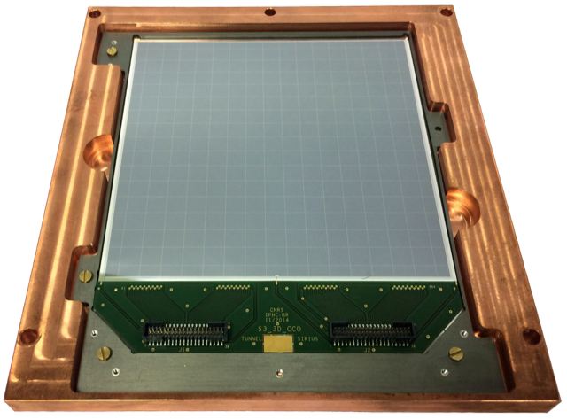
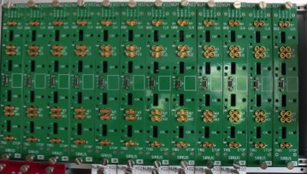
S3-SIRIUS (recap)
pôle nucléaire et pôle ingénierie
SIRIUS: the detection system to be installed at the focal plane of S³ @ GANIL
for heavy element spectroscopy
Our implication
→ upgraded NUMEXO2 mezzanine cards for the DSSD and the tunnel
→ front- and back-end electronics for the tunnel (digital feedback CSP)
NUMEXO2
+ FADC-DAC
P. Brionnet et al., Nucl. Instr. Meth. 1015 (2021) 165770
And experimental + Geant4 know-how

Slide 2
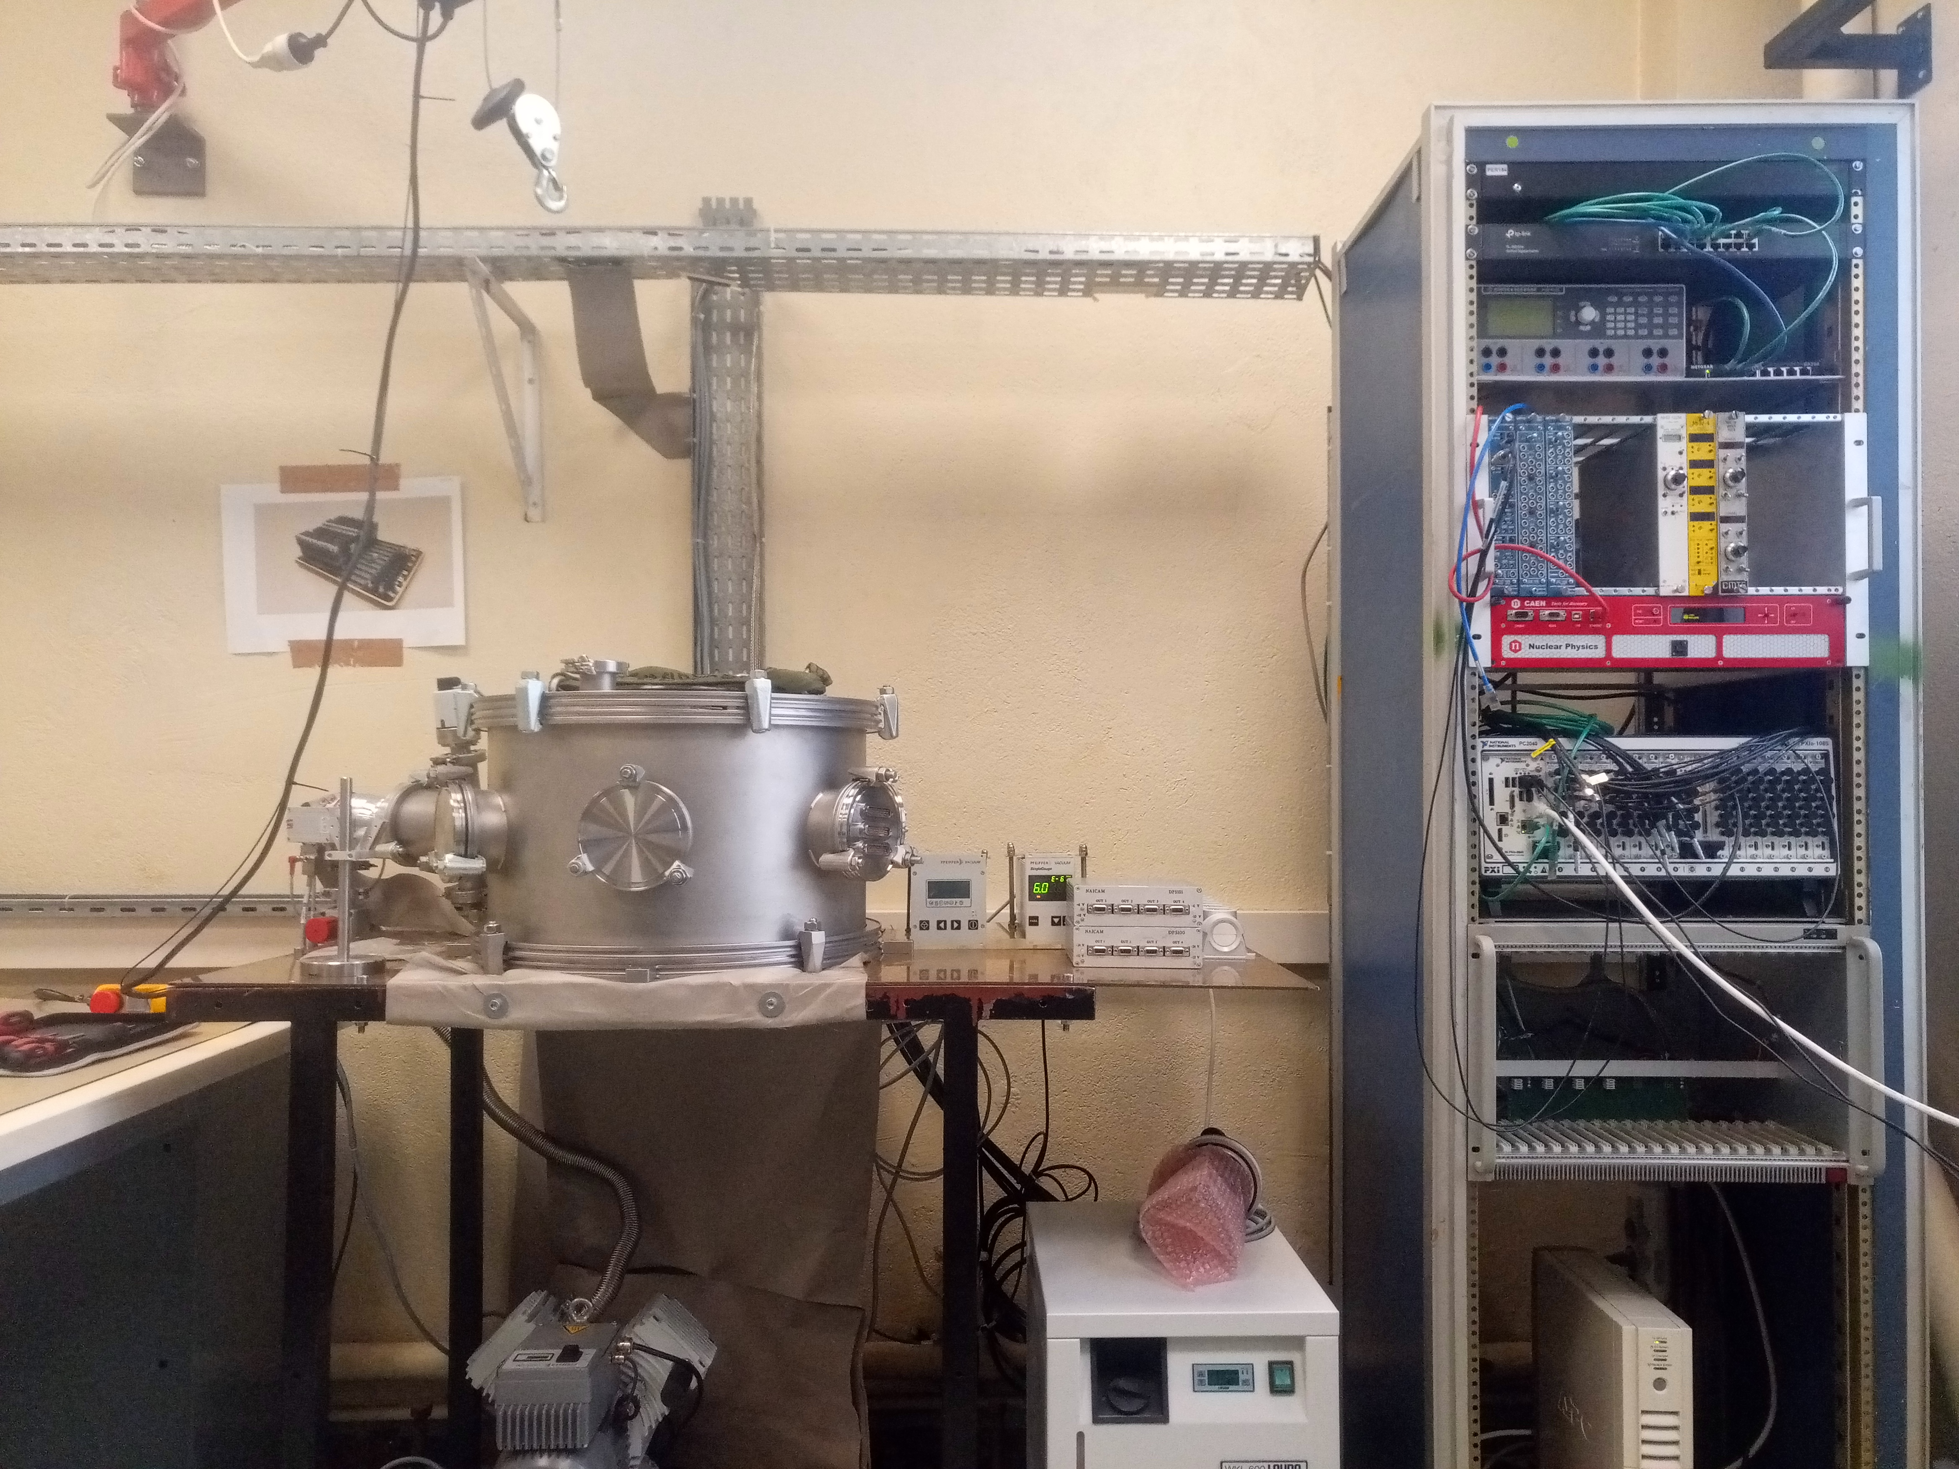
S3-SIRIUS: 2023 funding – where it went
Mission (GANIL): 4k
→ set-up SIRIUS
→ electronics and detector tests + updates + EMC
Mission (hors GANIL) : 1k
→ maintenance/upgrades of test benches used at sub-contractors
Equipment (local) : 4k
→ maintenance/upgrades of test benches used at the IJCLab
EMC upgrades
cable replacements
cooling support frame
PCB glue

Slide 3
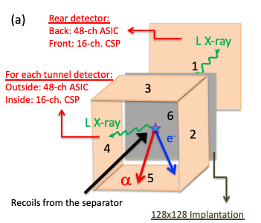
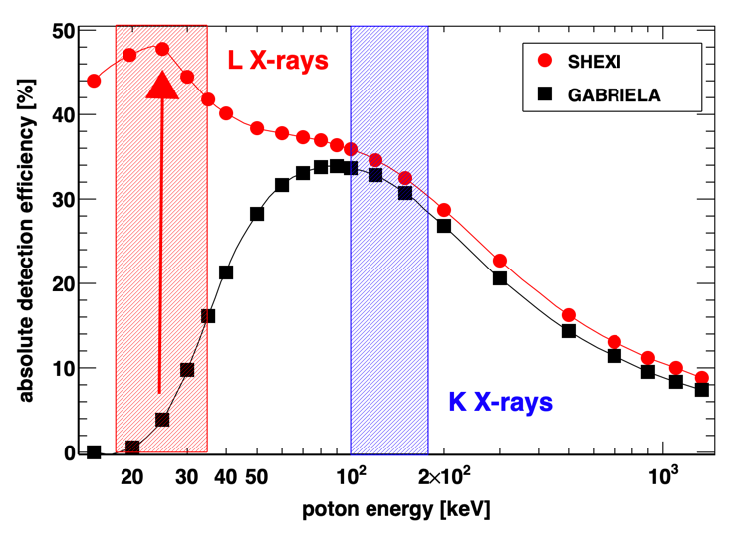
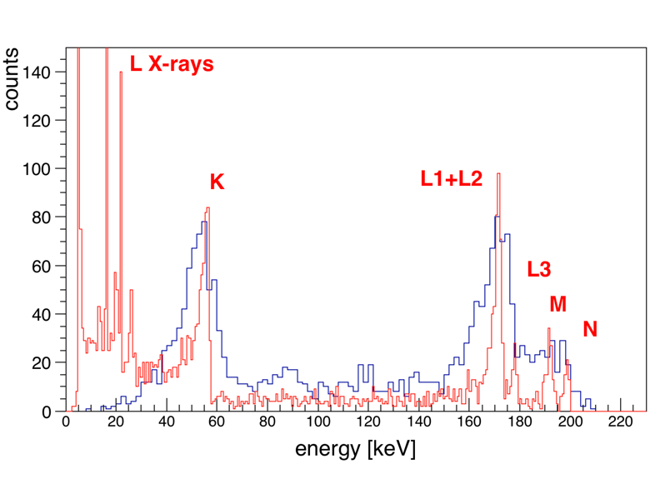
S3-SIRIUS upgrade →SHEXI (CODEC IJCLab & CS-GANIL)
Upgrade of the tunnel and veto detectors + associated electronics
→ L-Xray detection
Z identification of SHE
+ world leading ICE spectroscopy
²⁵¹Fm as an example:
GABRIELA data
vs
SHEXI simulation

Slide 4
SHEXI → SHEXI demonstrator (1)
(semi) Succesful P2I
Nature | Description brève / Brief description | Montant demandé / Grant request | Autres financements / Other source of funding
Équipement | 24 ASICs, 3x 8-ASIC carrier boards + 3 signal conditioning boards + bias boards + cables, connectors, vacuum feed-throughs | 25 600 €
 | Development of a 16-channel preamplifier board, implementation of PIONEER-v3 + cables, connectors, vacuum feed-throughs | 7 500 €
 | 3x 8-ASIC carrier boards + 3 signal conditioning boards |  | 20 880 €
 | PXIe chassis, 250 MHz digitizer, signal generator, monitor |  | 32 000 €
 | Si detector (+NRE for masks) |  | 18 000 €
 | High precision low-current high voltage |  | 7 000 €
 | Circulating liquid chiller (-25C) |  | 10 500 €
 | XY-theta positioner (for sources) in the vacuum |  | 16 000 €
Fonctionnement | Upgrade of data analysis workstation and NAS | 6 000 €
TOTAL |  | 39 100 € | 104 380 €
Can instrument 1/2 detector

Slide 5
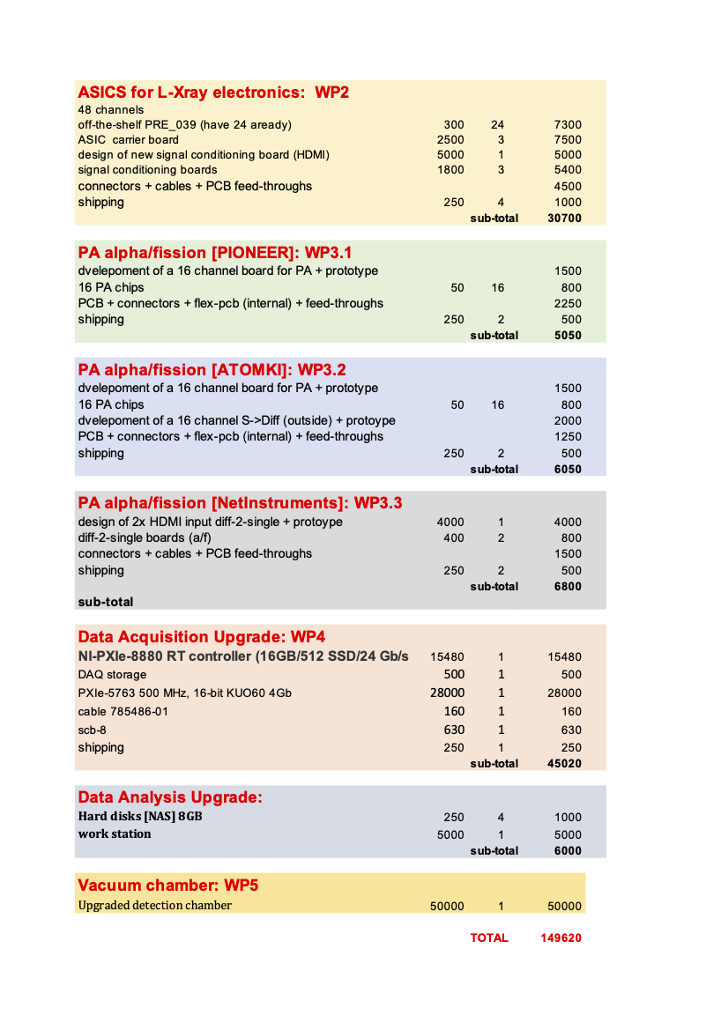
SHEXI → SHEXI demonstrator (2)
”Projets Émergent”: Normandie Recherche … GANIL are dragging their heals
→ Remainder of Demonstrator installation, which includes a new vacuum chamber: 150k

Slide 6
S3-SIRIUS-COMMISSIONING : 20245 funding request
Mission (GANIL) : 7k
→ firmware updates
→ set-up SIRIUS in area 51 + source commisioning: α-γ coinc. measurements)
→ commissioning of S3 ??
Mission (hors GANIL) : 1k
→ maintenance/upgrades of test benches used at sub-contractors
→ Consultation/repairs/upgrades/maintenance electronic cards + HV
Equipment (local) : 14k
→ maintenance/upgrades of test benches used at the IJCLab
(cables/connectors/collimators and source holder/stepper motor control/
UPS repair/vacuum feed-throughs/LAUDA mother board repair)
→ HD → SSD replacement for old PXIe controller

Slide 7
“AP-SHE”
2024: 5k → NN2024; ALM plenary session invited speaker
Zakopane; KH → Acta Physica Polonica B on the SHEXI concept
(re discussion of GANIL-UK)
Still extracting results from GABRIELA data pre 03/2022
R.S. Mukhin , …, KH, ALM, …, et al, “Prompt neutron emission in ²⁵⁰No spontaneous fission associated with ground and isomeric states decay”; Chinese Physics C 48 (2024) 1
A.V. Isaev , …, A. Lopez-Martens, … K. Hauschild, et al., “Structure of the prompt neutron multiplicity distribution in the spontaneous fission of ²⁵⁶Rf”, Phys. Lett. B (2023) 138008
A.V. Isaev, …, KH, ALM, …, et al, “Structure of the prompt neutron multiplicity distribution in the spontaneous fission of ²⁵⁶Rf”; Phys. Letts B843 (2023) 138008
B. Sailaubekov, …, KH, ALM, …, et al, “Prompt neutrons accompanying the spontaneous fission of ²⁵⁰No”; AIP Conference Proceedings 3020 (2024) 020007
R.S. Mukhin , …, KH, ALM, …, et al, “Analysis of the shape of multiplicity distributions of prompt neutrons emitted in spontaneous fission”; J. Radioanal. Nucl. Chem. 333 (2024) 1559
M. Forge , …, ALM, KH, …, “New results on the decay spectroscopy of ²⁵⁴No with GABRIELA@SHELS”; Journal of Physics Conference Series 2586 (2023) 012083
A. Lopez-Martens, KH, et al. “Fission hindrances in transfermium nuclei”; EPJ Web of Conferences 290 (2023) 02027
R. Chakma, A. Lopez-Martens, K. Hauschild et al., ‘’Investigation of isomeric states in ²⁵⁵Rf’’, Phys. Rev. C 107 (2023) 014326
A. Lopez-Martens, K. Hauschild and the GABRIELA collaboration, ‘’Spectroscopy of super heavy elements with GABRIELA’’, Eur. Phys. J. A 58 (2022) 134
K. Hauschild, A. Lopez-Martens et al., “Alpha-decay spectroscopy of ²⁵⁷Rf”, Eur. Phys. J. A 58 (2022) 6
A. Lopez-Martens, K. Hauschild, et al., “Fission properties of ²⁵³Rf and the stability of neutron-deficient Rf isotopes”, Phys. Rev. C 105 (2022) L021306
More papers already in the pipeline: ²⁵⁰No, ²⁵⁴No, ²⁵⁶Rf, ²⁵⁷Db
Further delays in S3 → digging deeper into the data
→(Hopefully) More invitations + another analysis workshop
request 5k€ for 2025

