Slide 1
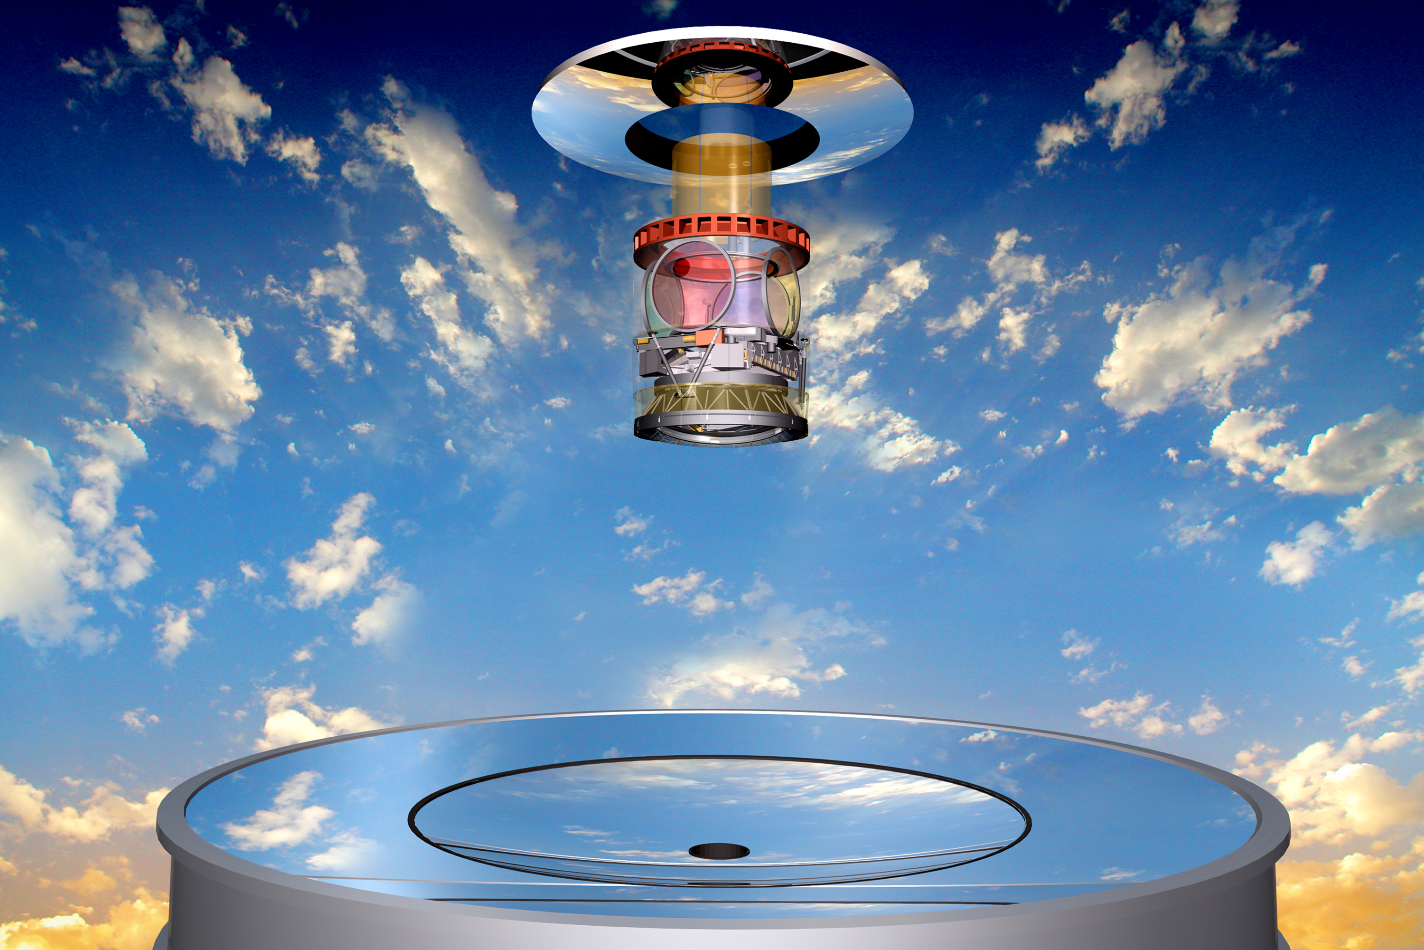
Flux de matière sur Terre avec LSST micrometeors@LSST
M. Moniez, 21/06/2024

Slide 2
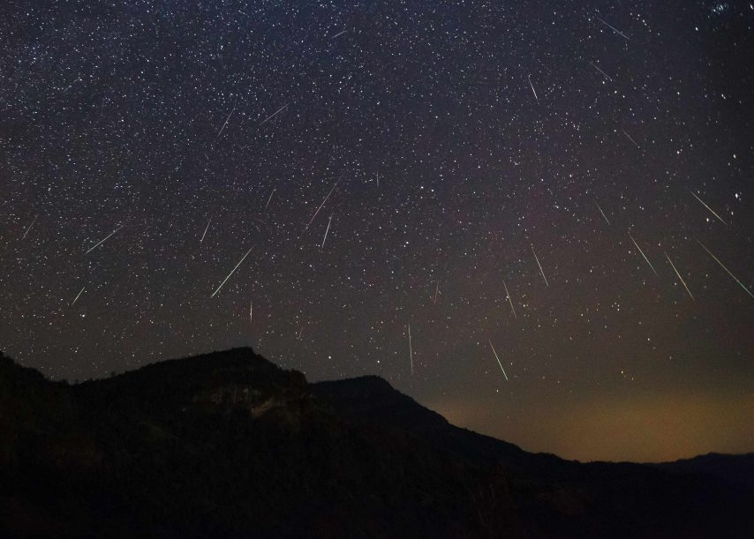
Scientific questions
Measure unbiased rate of particules entering atmosphere
the main source of matter income on Earth
  - Connect visual count of meteors with particle counts in the collections of micrometeorites
    - Mass distributions
    - Relation ablated mass / emitted light
  - Variation with time (seasonal and longer scale)
Directionality / velocity
  Dependence with the angle of the line of sight and the Earth orbital velocity
  Study of known radiants (showers from comet dust) and search for new ones
  Kinematical distributions (top of atmosphere velocities)
    Orbitology: asteroidal vs cometary origin?
Processus of atmospheric re-entry (light profile, chromaticity)

Slide 3
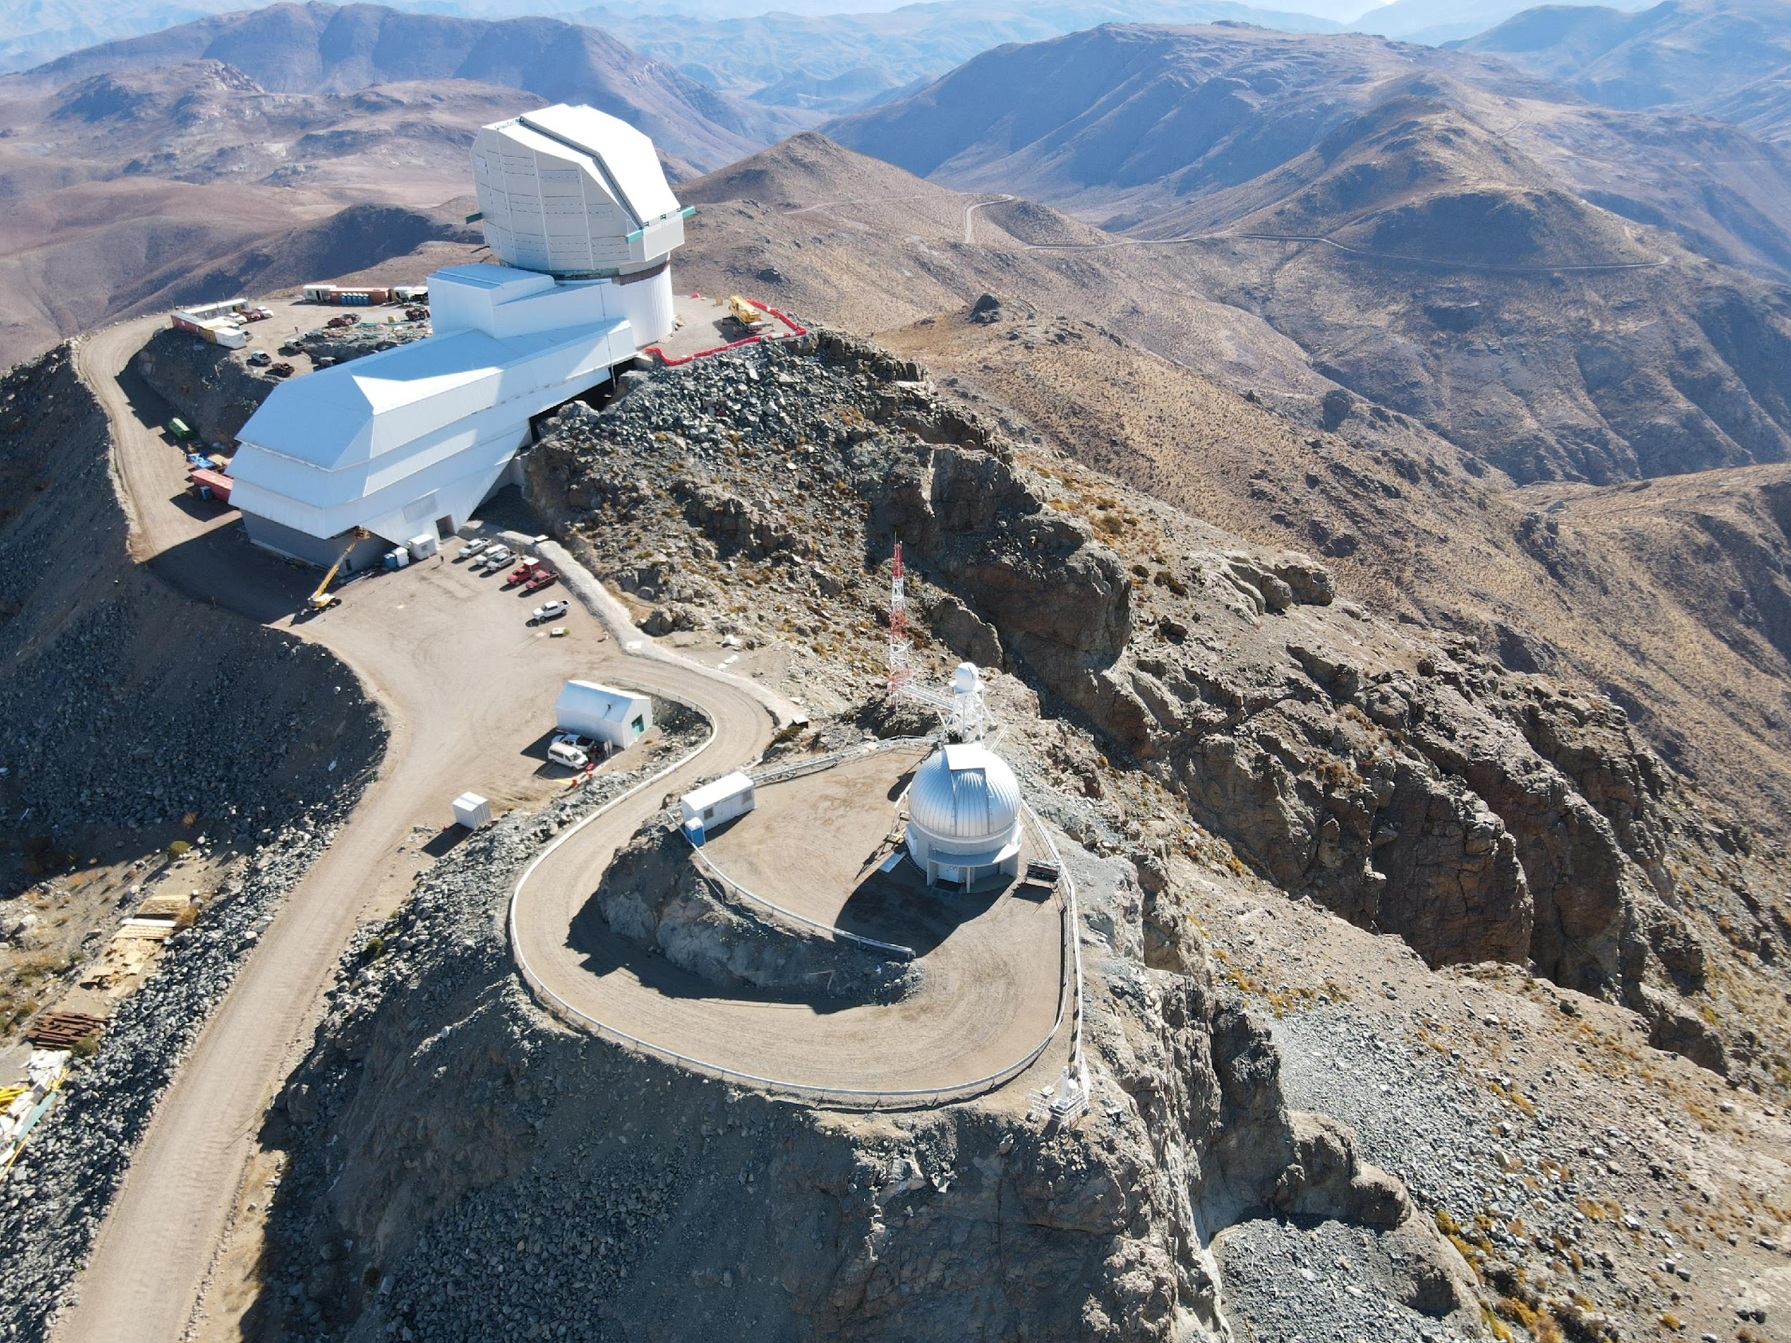

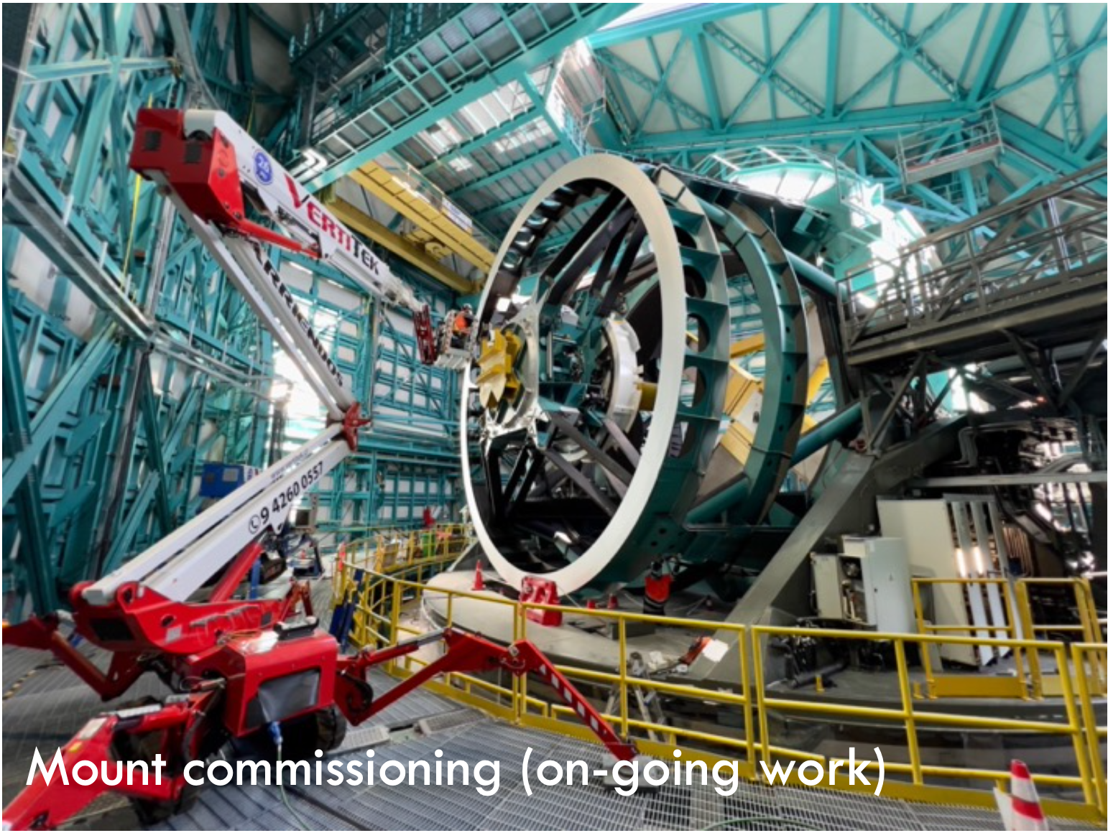
Rubin-LSST in a few figures
LSST = Large Survey of Space and Time
- Optical telescope 8.4 m diameter
- Wide-field camera : 3.5°, 3.2 Gpixels
- 6 wide-band filters u g r i z y
- Final catalogue: 10 years, 10¹⁰ galaxies, 10¹⁰ stars
- 1,000,000 SNIa up to z ~ 1
- Transients with alerts (10⁷/night)
~ 1000 scientists in the world (50% US)
- Only USA, Chile (site) & France-IN2P3 (builder since 2005) will have privileged access to all data
http://www.lsst.org/

Slide 4
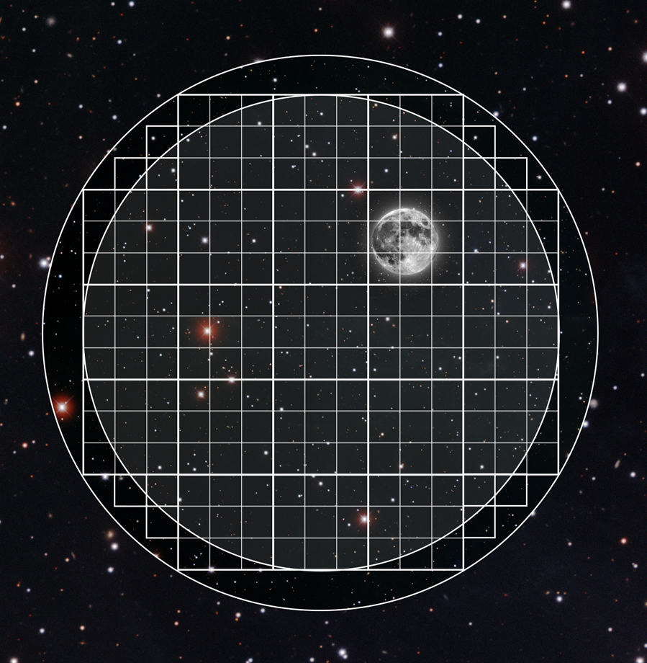
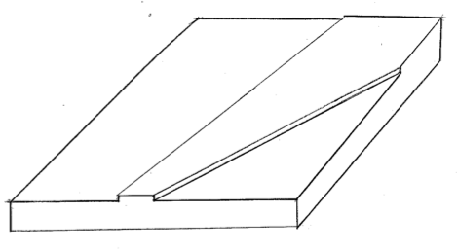
micrometeors@LSST
LSST image
Defocused light deposit
Scaling from rate of visible (V<6) shooting stars
s/b=5
s/b=30
3.5°
Conservative detection limit @LSST
Detection magnitude limit (30σ) of a meteoroid track of 2.75°x16’’
u = 9.6; g = 10.8; r = 10.3; I = 9.8; z = 9.1; y = 7.7
(airmass = 1.2, no moon)
Event rate / faisibility
- Detection rate of >25μg micrometeors:
[1/40 – 10] per LSST image -> depends on extrapolation: shooting stars, micrometeorites flux or observed falls
- Needs analysis of (10x10pixels) rebinned LSST images taken during dark nights in g (no moon) -> 40Gb/night
Science
Unbiased rate of particules entering atmosphere, Directionality, Processus of atmospheric re-entry
Sky background
Track of meteoroid V=10
(s/b=60)
Step 7γe⁻/(‘’)²
⬄ 0.3/pixel
1700γe⁻/(‘’)²
⬄ 70/pixel
Light trace crossing the LSST field
- <track length in LSST> = 2.75° (10000 pixels) (4.8km at 100km altitude)
- Light deposited in ~ 0.16s
- Out of focus: 16’’ (80 pixels) width@100km. Wider where object is closer
- Appears like apparent increase of sky background in a band

Slide 5
Artifacts
Planes: bright, dotted lines, stronger defocus
Satellites: bright, dotted / uniform lines
Detector defects: sensitivity to bright lines of the CCD -> x or y axis
Optics: egrets, ghosts? A priori curved structures or known directions

Slide 6
Going further
More detailed feasibility studies
  Simulate meteor tracks on a LSST-type image and study detection as a function of peak magnitude.
    Variable light profile
    Possibility to find the origin (defocus increases with time)
    Emission spectrum
  Estimate data management / computation costs
  Refine strategy: use only darkest nights, focus on g filter…
  Precursor studies on archived images (PanSTARRS, ZTF… Any wide field camera)
All these studies mainly need manpower with little money investment but a limited computing support

Slide 7
COMPLEMENTS

Slide 8
Challenges
Process LSST images (20 Tbytes/night)
  Because of defocusing, bin the data (10x10 pixels)
    1 rebinned image would be 32Mpix (like a smartphone)
    Limit to images with dark sky (and g/r filters?) -> divide data volume to process by ~5
  > 40 Gbytes/night. Sustainable
Detection of (weakly) overluminous bands extended on several CCDs
  Hough transform on a merged image; consider also differential imaging

Slide 9
Detection limit / event rate
Signal ⬄ light deposited by a star during 0.16s
(instead of 30s), spread over the track on a single image
Noise: fluctuation of the sky background light
under the track (~ 7 photoelectrons/(‘’)) -> integrate
Detection magnitude limit (5σ) of a meteoroid track of 2.75°x16’’:
u = 11.5; g = 12.7; r = 12.4; I = 11.7; z = 11.0; y = 9.8
(airmass median = 1.2, low moon)
Detection magnitude limit (30σ) of a meteoroid track of 2.75°x16’’:
u = 9.6; g = 10.8; r = 10.3; I = 9.8; z = 9.1; y = 7.7
(airmass median = 1.2, low moon)

Slide 10
Event rate (1): from shooting stars
s/b=5
s/b=30
Scaling from the rate of visible (V<6) shooting stars (0.075/hour in LSST)
(Jérémie Vaubaillon)
1 per 5 exposures of 15s with V<12 within the LSST field (1/2143 of the visible sky)
Above LSST detection limit for all filters
0.025/exposure
with mass > 25μg (V<10)

Slide 11
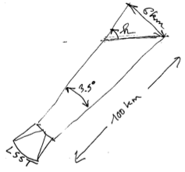
Event rate (2)
Link LSST <-> micrometeorites counting
From counting: deposition rate / time unit / surface unit (@100km altitude)
(pessimistic) hypothesis:
  # of tracks in LSST field =
  # of spherules in the surface covered at 100km altitude (30km²/sin h)
LSST 15s exposure > 14m².yr
Visible (V<6)
meteors

Slide 12
Event rate (2): from micrometeorite flux
Extrapolation from the estimated flux of micrometeorites
~ 0.3 spherule/m²/yr with mass> 3μg
15s LSST ⬄ exposure of 14/sin(h) m²yr
Expect 4 meteors with mass > 3μg (V<12) in each LSST 15s exposure
OR 0.05/exposure with mass > 25μg (V<10)
Reasonable excursion between the 2 extrapolations (<1 order)
s/b=5
s/b=30

Slide 13
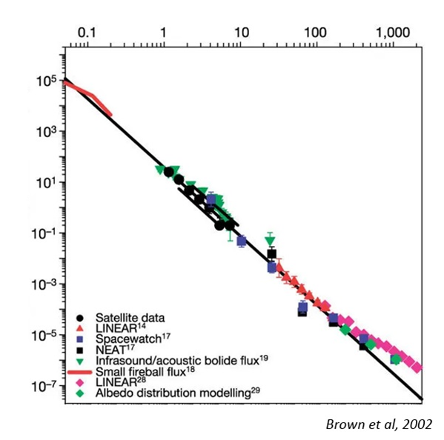
Event rate (3): from observed falls
Size: 250μm (25μg)
# falls: 10¹⁴/yr
Diameter (m)
# fall on Earth /yr

Slide 14
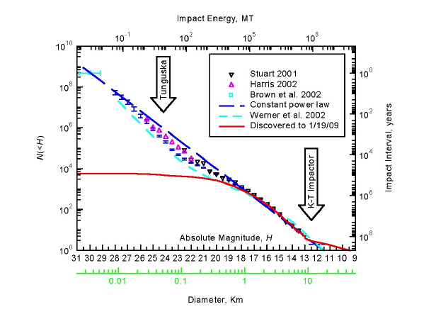
Event rate (3)
Size: 250μm (25μg)
# falls: 10¹⁴/yr
10¹²/yr
Diameter (m)
Scaling from the observed rate of individual falls
Extrapolation meteors with V<10
  High: 60 per LSST exposure
  Low: 0.6 /LSST exposure with mass > 25μg
# fall on Earth /yr
Completeness of LSST for objects brighter than H
NASA goal
Absolute magnitude H

