Slide 1


The DESIR facility at GANIL/SPIRAL2
Bertram Blank
L2Pi Bordeaux
Séminaire IJCLab, 13/12/2024
27-29 November 2024

Slide 2


• • • DESIR at GANIL
« Decay , Excitation and Storage of Radioactive Ions »
Exotic decay modes Shape, size, structure of the nucleus Mass, correlations
A new GANIL users facility
Study of the fundamental properties of atomic nuclei and underlying forces
With a high precision using ultra-pure samples of radioactive ions manipulated at very low energy
Taking advantage of the various RIBs production methods
In complementarity to S³(-LEB) and other GANIL installations

Slide 3
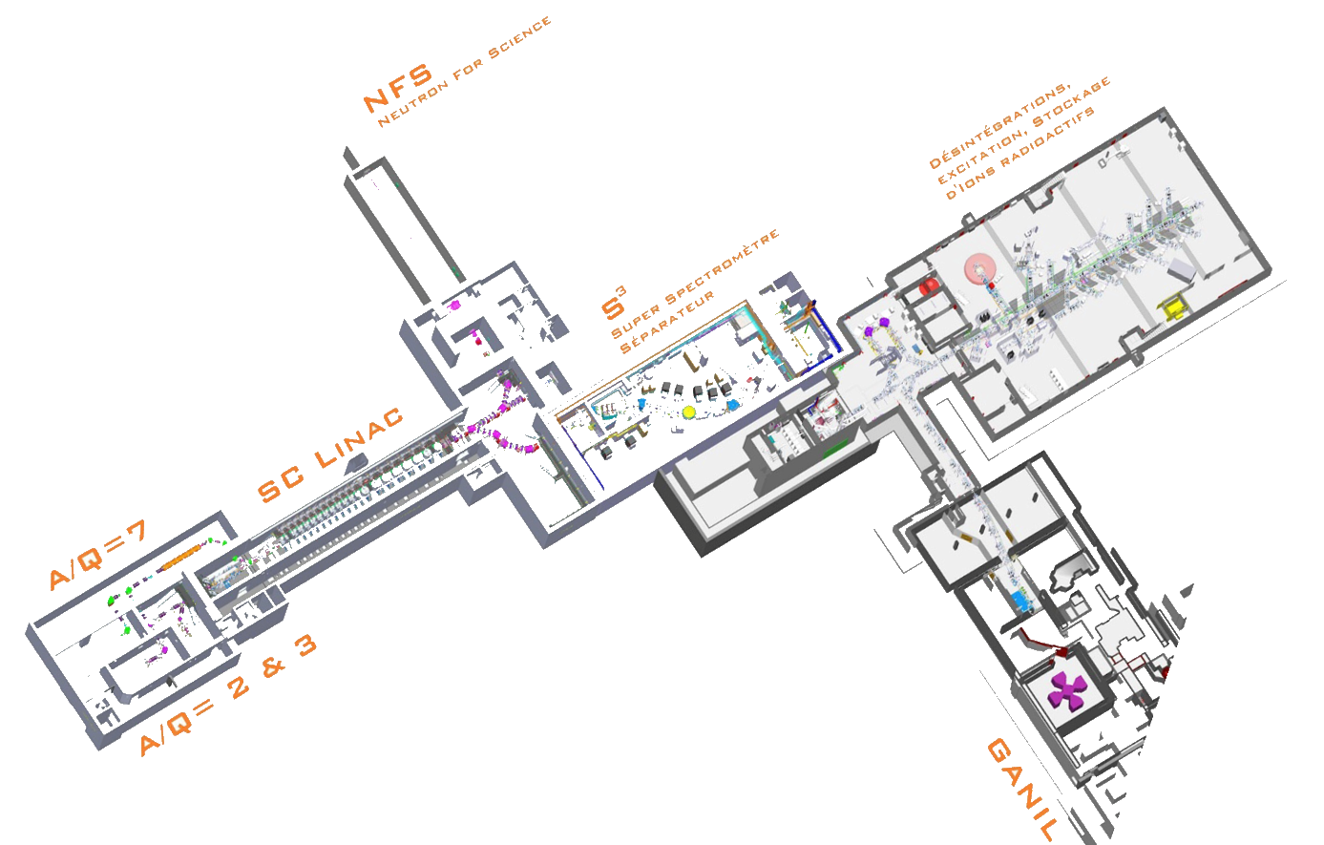
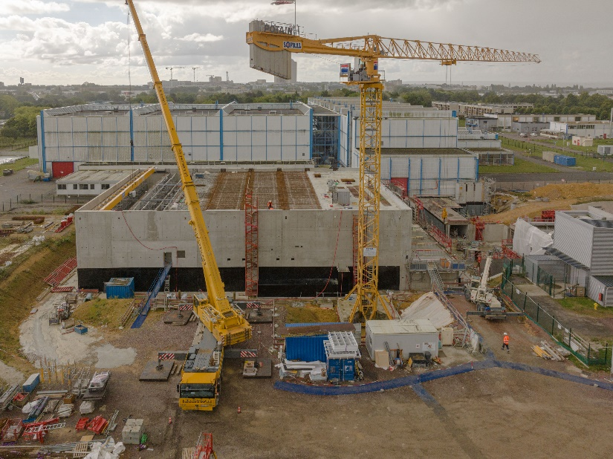



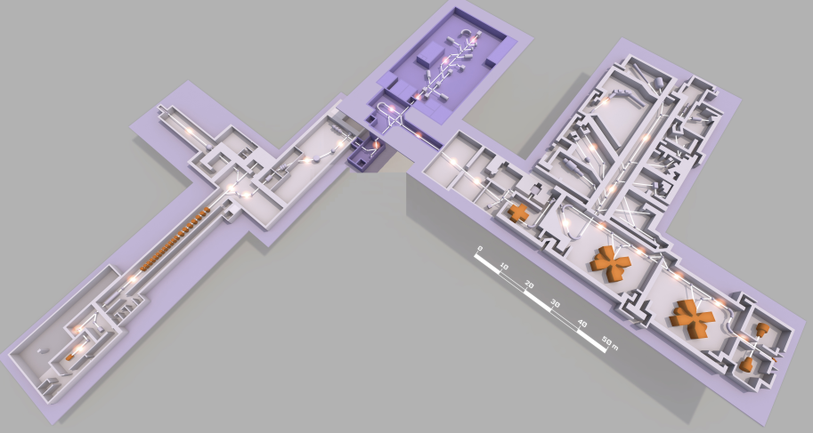
• • • DESIR at GANIL
2028
Building delivery: mid-2025
Commissioning (stable beams): 2027
Day 1 experiments (RIBs): 2028
DESIR
S³ (2026)
Fusion-évaporation
SPIRAL1 (2001)
Fragmentation
SPIRAL2
GANIL

Slide 4
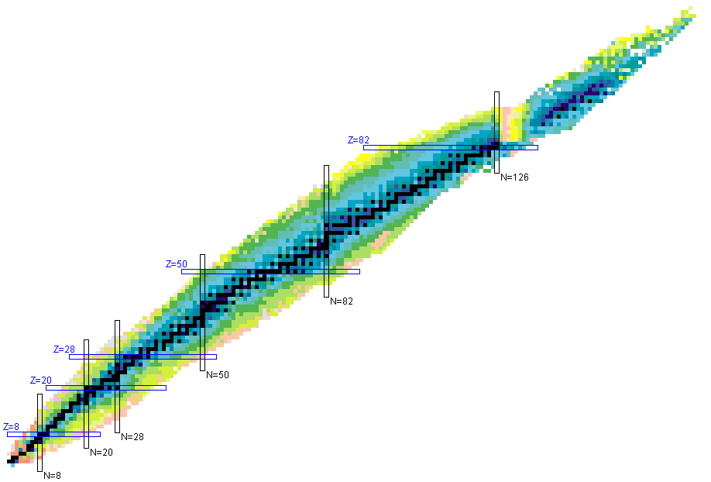
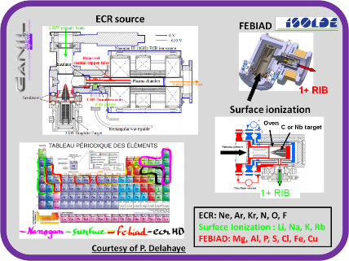
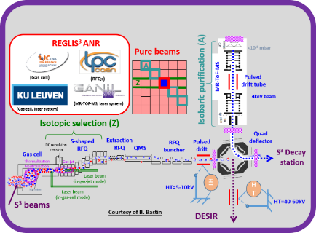
• • • DESIR physics programme
Collinear laser-spectroscopy
Correlations in β decay (MORA)
Mass meas. (PIPERADE, MLLTrap)
(Trap-assisted) decay spectroscopy
(Super) Heavy nuclei
LUMIERE
DETRAP
Size & Shape
Deformation
BESTIOL
Exotic decay modes
SPIRAL 1
S³-LEB
N~Z
  Fragmentation
Nuclear structure
  Fusion-evaporation
Fundamental interactions

Slide 5
• • •
Beam production

Slide 6
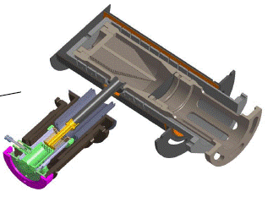
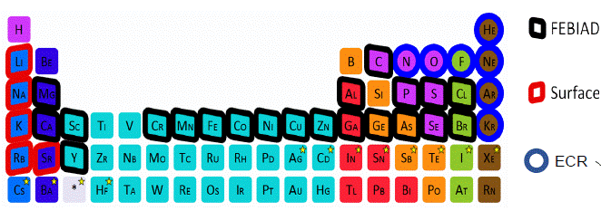
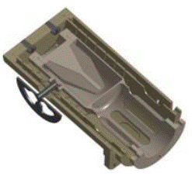
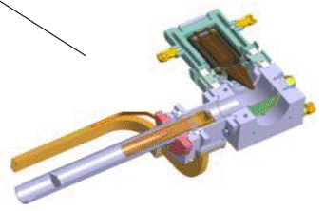
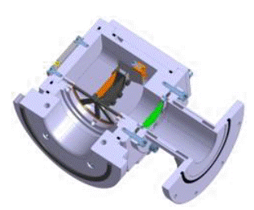
• • • SPIRAL1 beams
FEBIAD
for condensables
MonoNaKe
for alkalines
Nanogan
for gases
TULIP
for proton-rich
isotopes
Fragmentation (and fus-eva) of heavy primary beams
Limitations:
primary beam power
fragmentation cross sections
diffusion/effusions times (refractory elements, short half-lives)
ionisation efficiency
operational issues (stability, resilience etc.)
Courtesy P. Chauveau

Slide 7
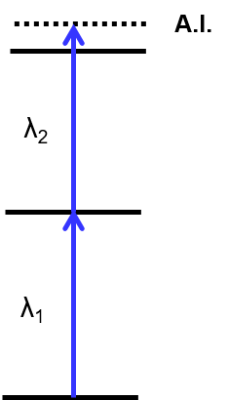
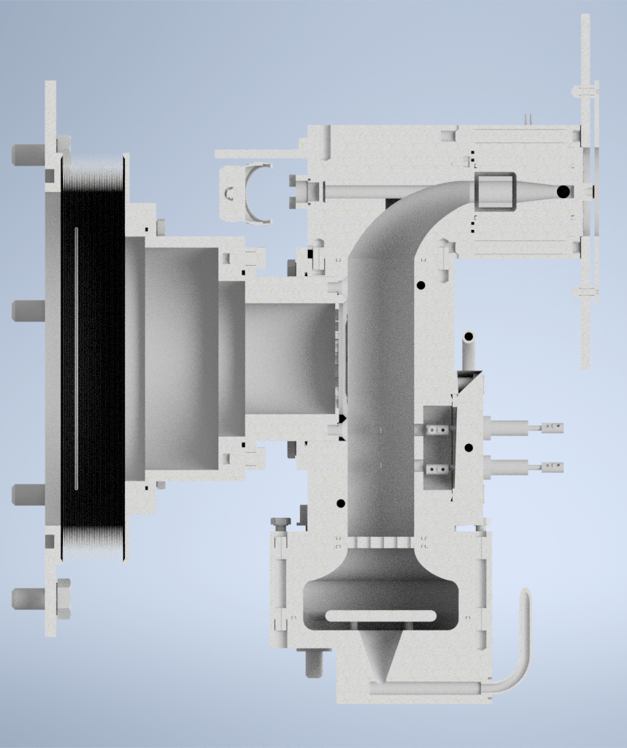
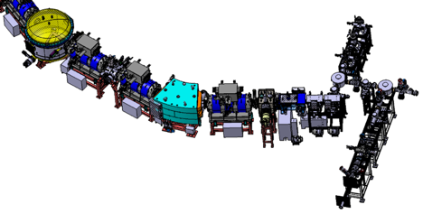
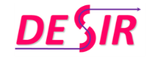


• • • S3-LEB beams
Gas jet laser probing
Gas cell laser probing
Critical performance criteria :
  Stopping efficiency
  Extraction efficiency and time
  Chemical survival/neutralization efficiency
Decoupling of laser axis from spectrometer axis
Supersonic jet
S³-LEB
(Low Energy Branch)
S³ nuclei
Extraction by gas flow only
E< 1 MeV/u
Stopping, thermalization
and neutralization
Buffer gas at 100-500 mbar
Thin window
R. Ferrer, Nature Comm. 8 14520 (2017)
Courtesy V. Manea

Slide 8

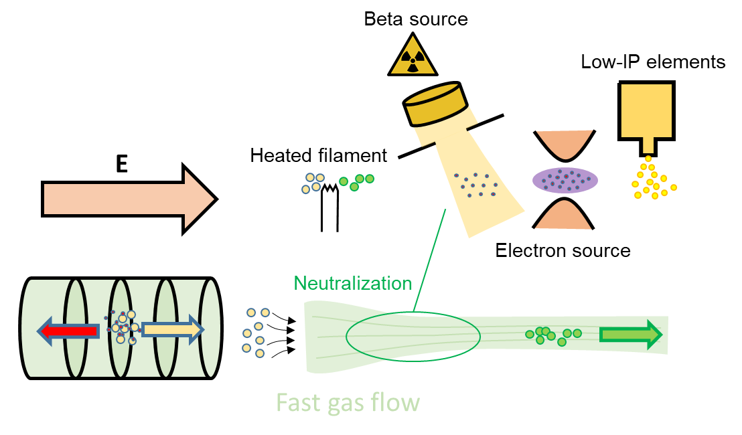
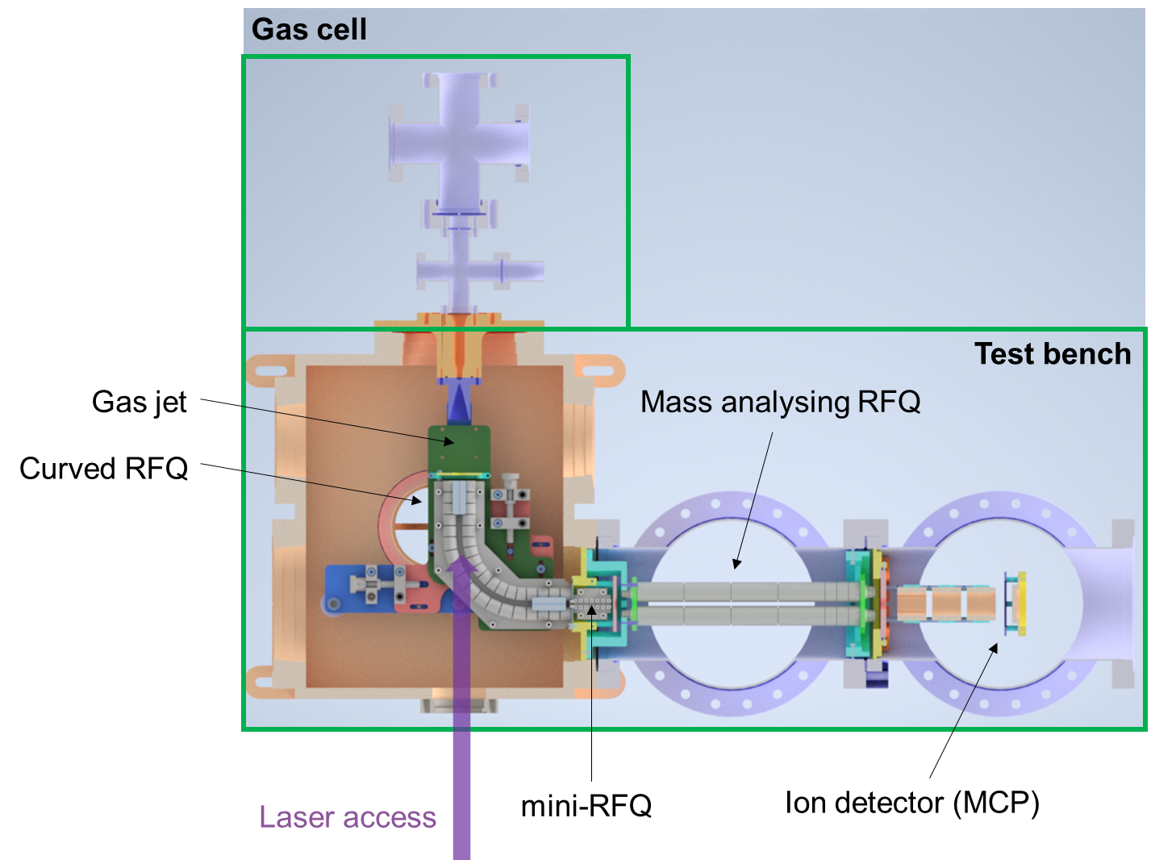
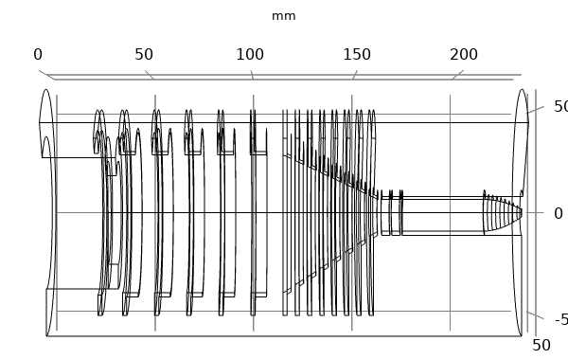
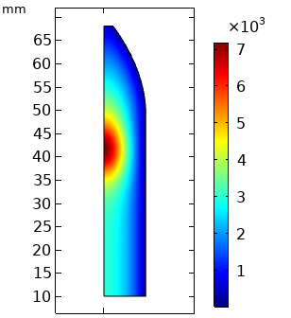
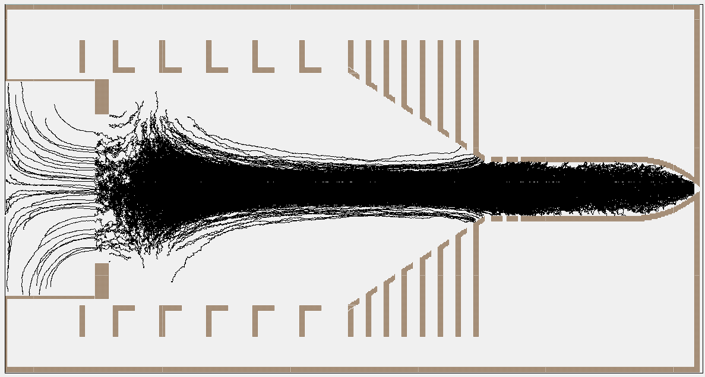
• • • S3-LEB beams: FRIENDS³
ANR JCJC project FRIENDS³ aimed at improving the S³-LEB gas cell:
  Reduce extraction time
  Improve neutralization efficiency
  Ideally both at the same time
Construction of test bench
Simulations
Test-bench design study finalized, constructed in 2024
Will be installed at GANIL for laser access
Exploration of direct ion extraction by electrical field
Courtesy V. Manea

Slide 9
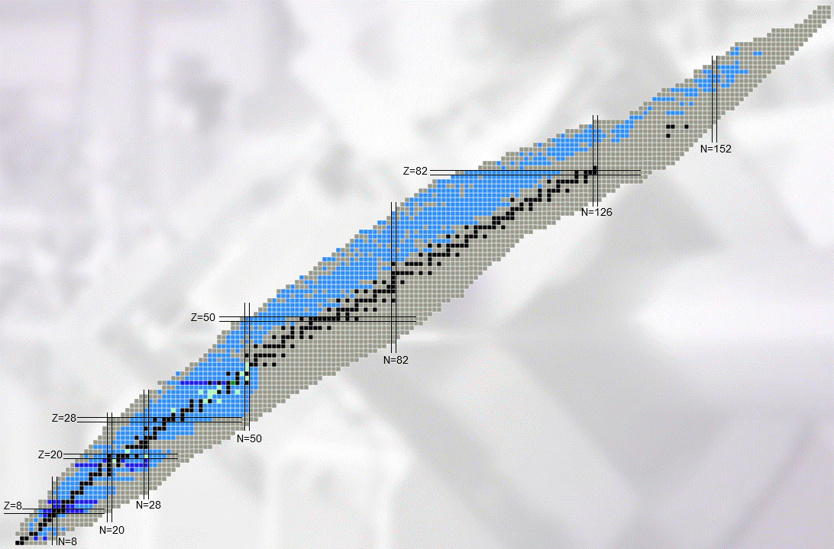
• • • DESIR beams: S1 & S3 (& S2)
DESIR beams:
S1: fragmentation
S3: fusion-
evaporation
S2: fission
Multi-nucleon
transfer reactions
DESIR beams:
S1: fragmentation
S3: fusion-
evaporation

Slide 10
• • •
Beam transport

Slide 11
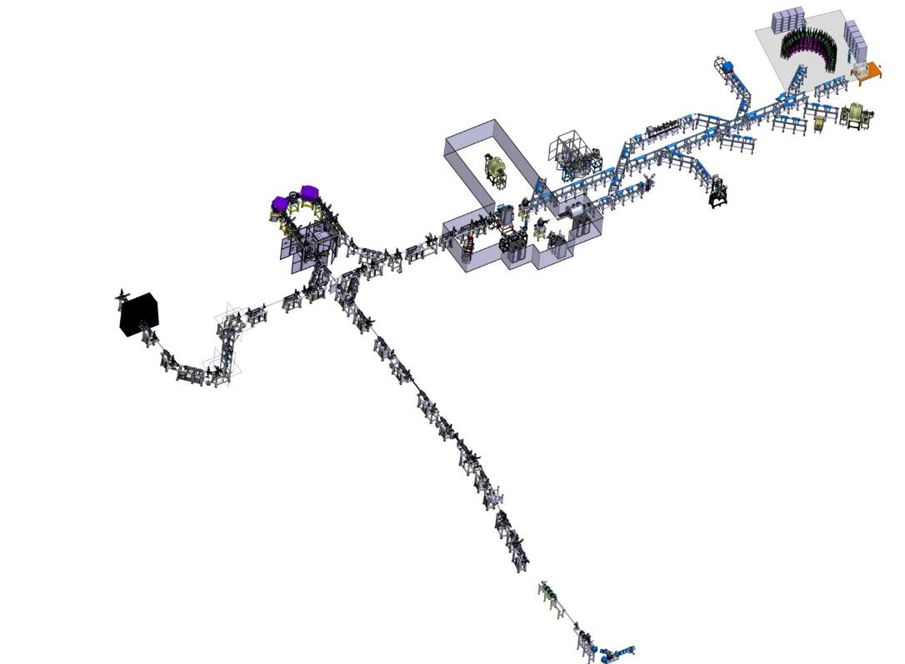
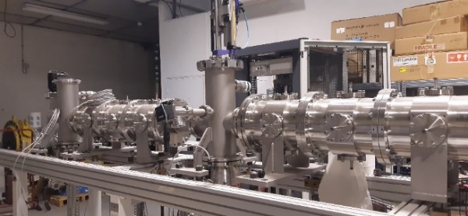

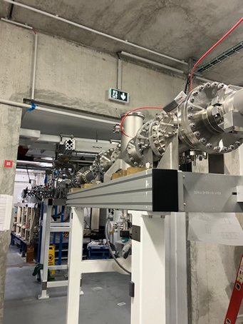
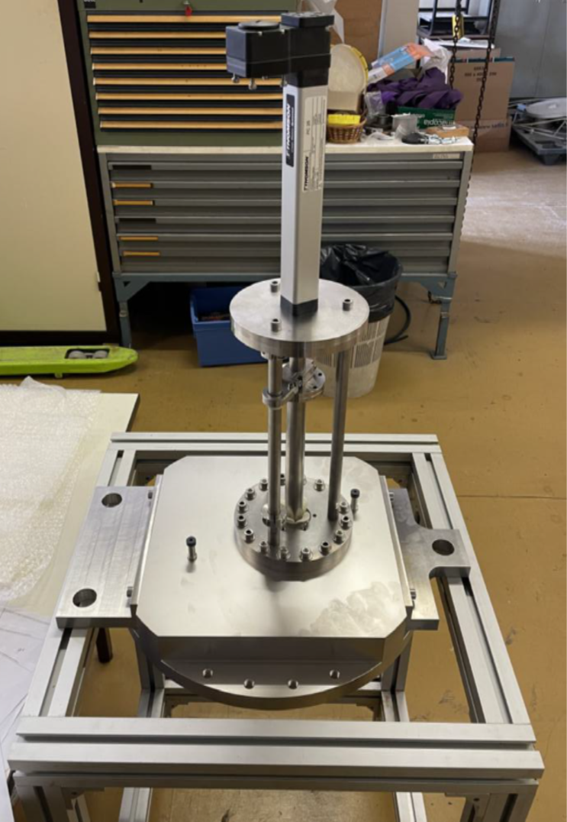
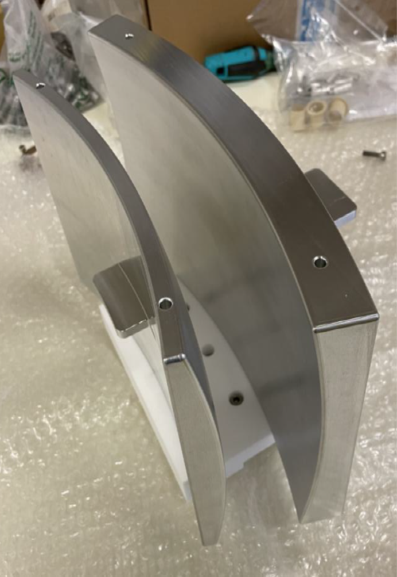
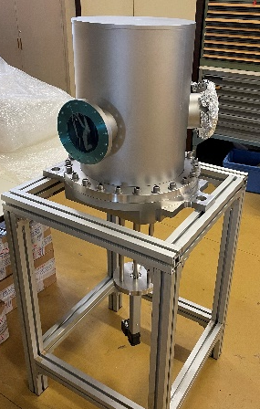

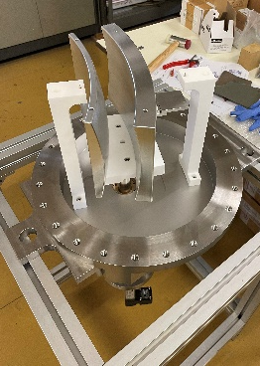

• • • Transport beam lines
1+ ions, < 60 keV, < 80 π.mm.mrad – fully electrostatic
Test bench
DESIR Hall
Ph. Alfaurt, LP2iB
SP1 -> DESIR beam line
Junction beam lines from SPIRAL1 and S3-LEB to the DESIR Hall: ~100 m
Installation starting by the end of 2025
Example: 45° deflector assembly
Upper part
Insertion
Pole assembly
Internal part
Base assembly
V. Watt-Morel, GANIL
SPIRAL1
L. Perrot et al., IJCLab

Slide 12
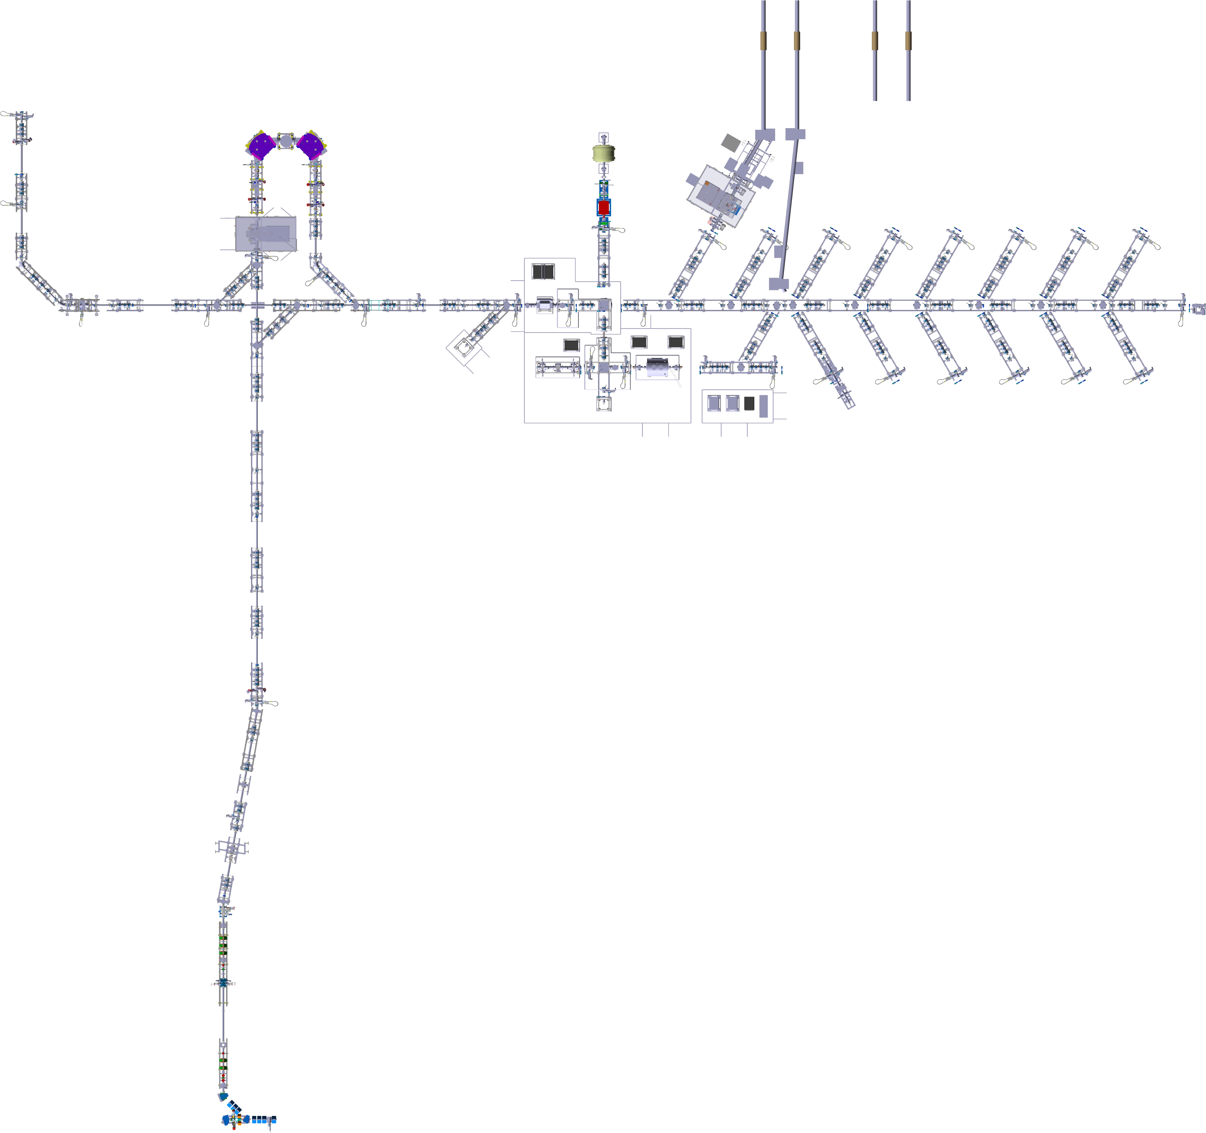
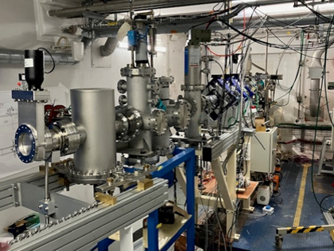
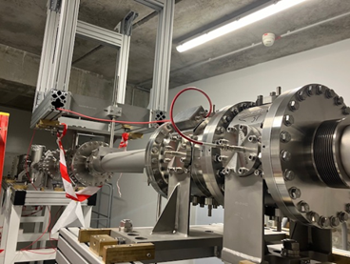
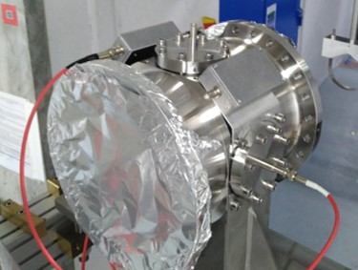
• • • Transport beam lines
SPIRAL -> DESIR section
- Ongoing installation (mechanical assembly, supply integration tests, …)
- Operation tests scheduled middle of 2025
- LP2IB/GANIL: process supplies, remote control systems…
RFQ1P (LPCC)
HRS (LP2IB)
MLLTRAP (IJCLab)
MORA (LPC)
Laser
Distribution lines
Junction S3-LEB / DESIR
GPIB
(LP2IB)
First DESIR (electrostatic) section
Stable source
PIPERADE (LP2IB)
Integration tests
SPIRAL1
(magnetic section)
Courtesy V. Watt-Morel, GANIL

Slide 13
• • •
Beam preparation and purification

Slide 14
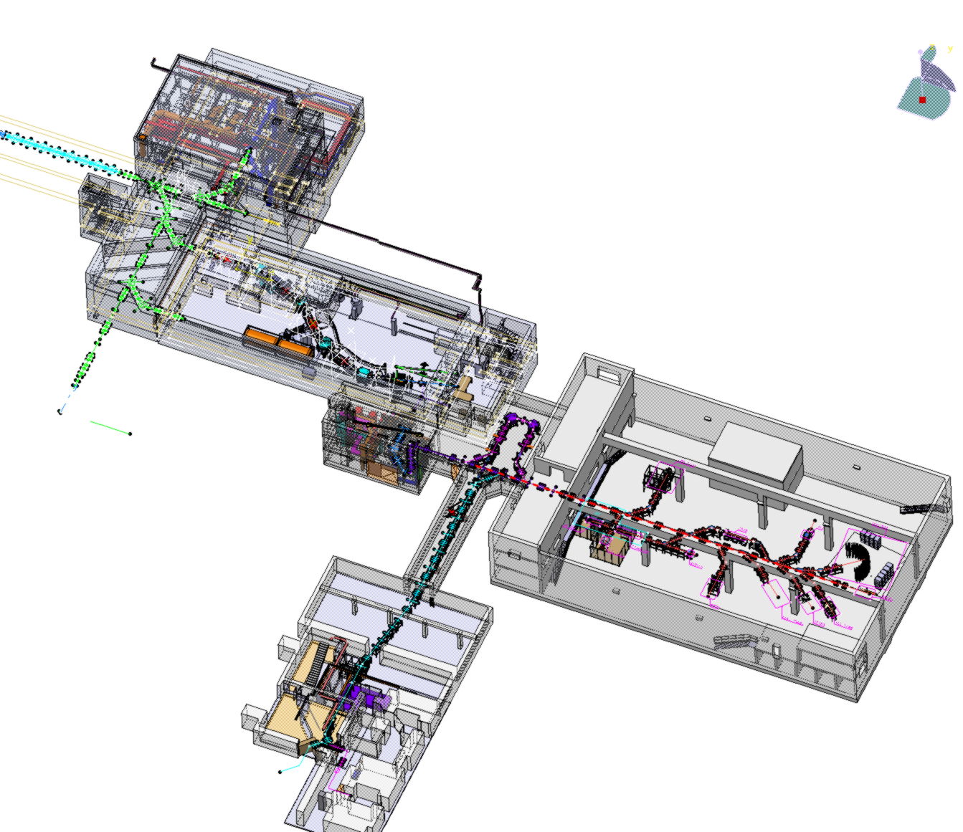


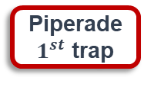
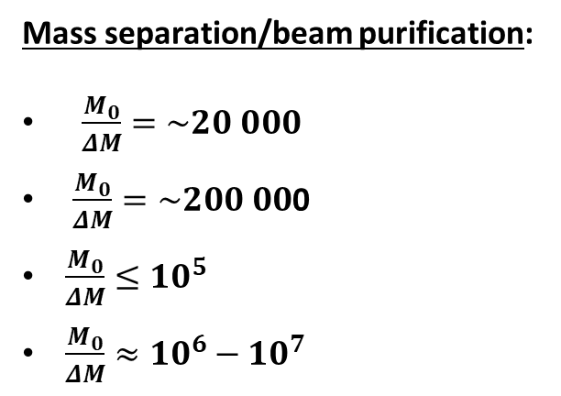
• • • Beam preparation and purification
RFQ Cooler
High Resolution Separator HRS
RFQ-Cooler Buncher
GPIB
Mass separation/beam purification:
$\frac{M_{0}}{ΔM}=\sim 20 000$
$\frac{M_{0}}{ΔM}=\sim 200 00$0
$\frac{M_{0}}{ΔM}≤{10}^{5}$
$\frac{M_{0}}{ΔM}≈{10}^{6}−{10}^{7}$
RFQ+HRS
Double Penning Trap
MR-ToF
Piperade
$1^{st}$ trap
Piperade
2nd trap
Beam preparation:
Cooling and bunching
Accumulation trap
Mass measurements:
Mass precision: 10⁻⁸ – 10⁻⁹
GPIB
Piperade
2nd trap
MR-ToF
Piperade
2nd trap

Slide 15
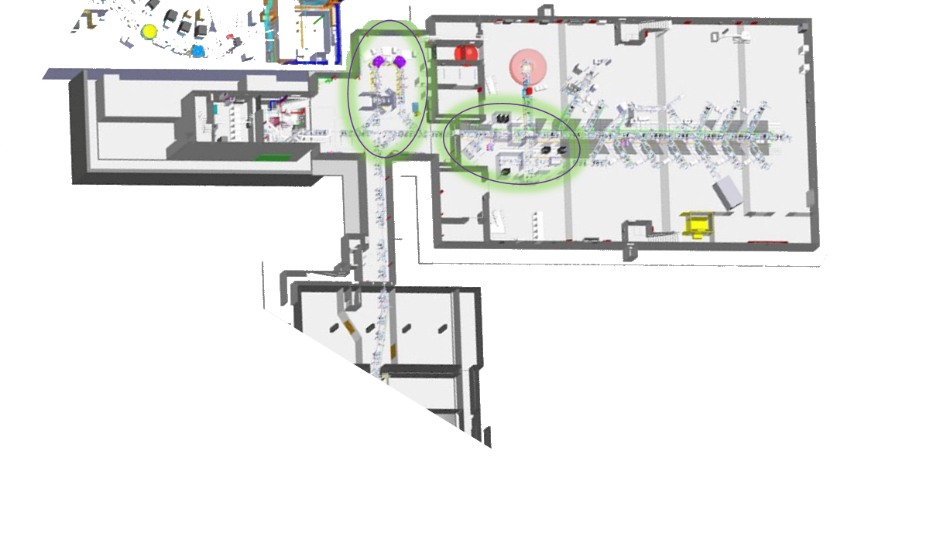

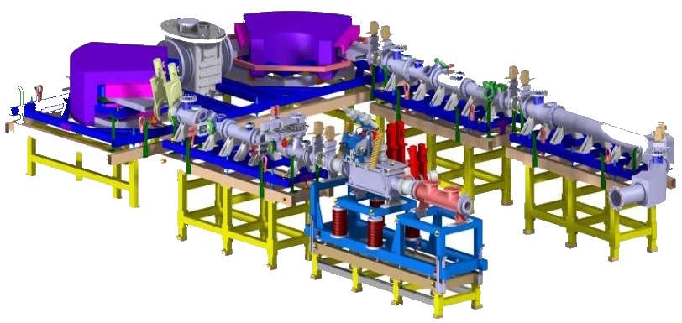

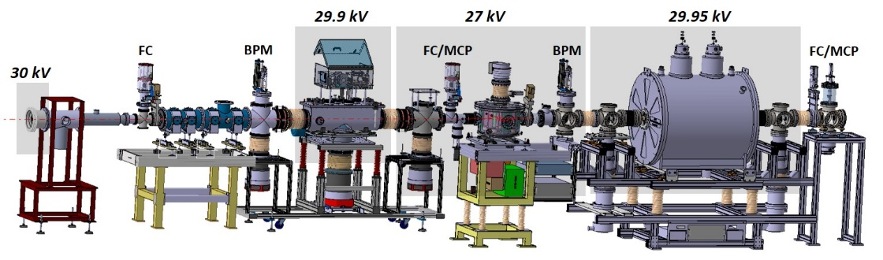
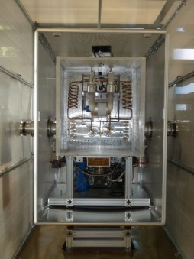
• • • Beam purification
RFQ + HRS
M/ΔM =20,000 @
3π mm.mrad / 30keV
GPIB + PIPERADE
  10⁵ ions/bunch, 2-20 Hz M/ΔM = 10⁵
Commissioning at LP2iB
Commissioning at LP2iB
Installation and commissioning: 2026-2027
MR-ToF-MS for mass measurements and beam purification: 2026-2028
Refurbishment
at LPC Caen

Slide 16
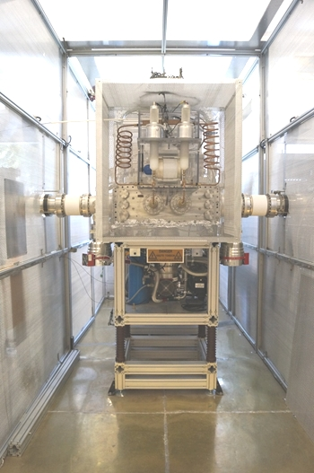
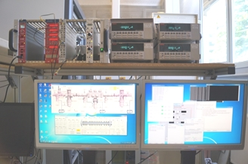
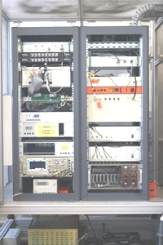
• • • Beam purification: RFQ SHIRaC
SHIRaC : Construction and test @ LPC Caen
6 m
Beam
5m
Beam
1,5 m
SHIRaC
RF: 2.1-4.9 MHz; V_{pp}: 8kV
Emittence: ~3π mm.mrad
ΔE ~eV
Transmission ~70 % for 1eµA beam
HT platform 60 kV
RF Electrical Field: 500V/m
…presently refurbished at LPC
(according to RFQ cooler of SPES)
R. Boussaid et al., PRCST 18 (2015) 072802

Slide 17
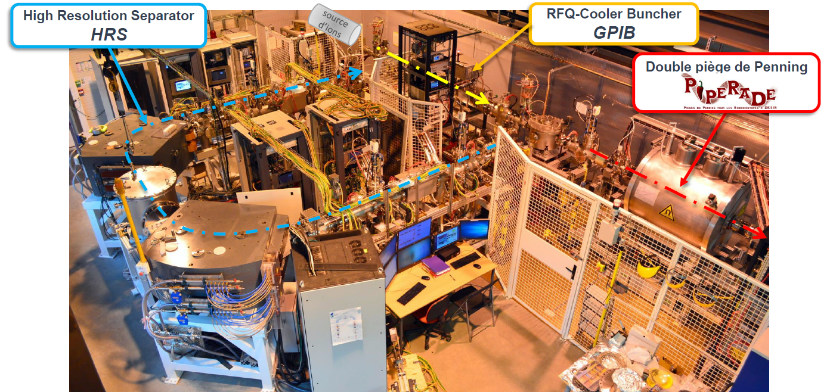
• • • Beam purification: Ion source, GPIB, PIPERADE and HRS at LP2i Bordeaux
Ion source

Slide 18
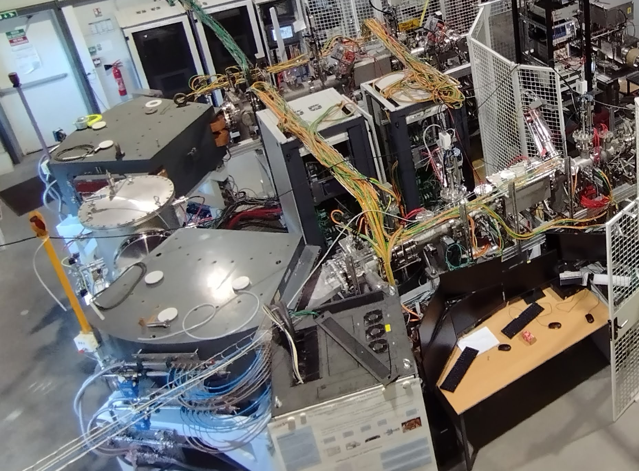
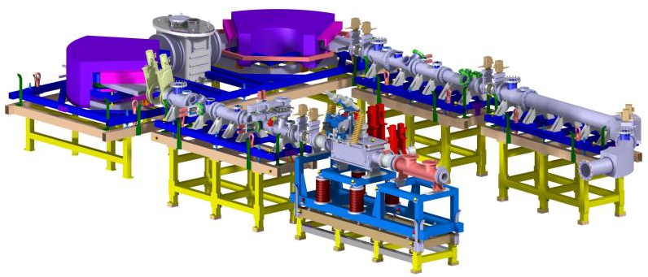
• • • Beam purification: High-resolution separator HRS
Configuration: MQ-MQ-FS-FQ-D-M-D-FQ-FS-MQ-MQ
M/ΔM =20 000 @ 3π mm.mrad / 30keV
T. Kurtukian Nieto et al., NIMB 317 (2013) 284
J. Michaud et al., LP2iB & IJCLab

Slide 19
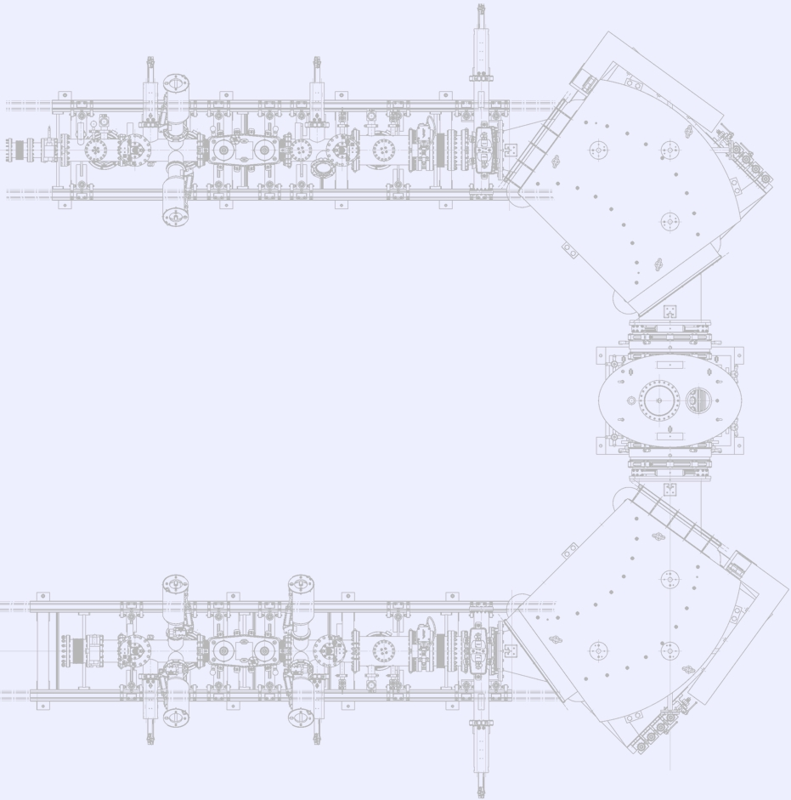



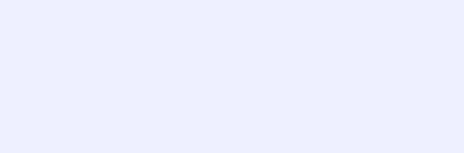




• • • Beam purification: High-resolution separator HRS
${{}_{}^{133}{Cs}}^{1+}$ ions source
DC11-HO
Q11
Q13
F21
Q22
DC21-HO
F22
PR22
Q23
F31
DC11-VE
Q12
PR21
CF21
Q21
DC21-VE
CF22
H21
D31
PR31
Magnetic
dipole
Electrostatic
deflector
Electrostatic
quadrupole
Electrostatic
sextupole
Electrostatic multipole
Beam profiler
Faraday cup
Adjustable slits
Vaccum valve
PR32
D32
CF42
PR42
Q42
CF41
PR41
DC41-VE
Q41
Pepperpot-type
emittance-meter
F42
Q43
F41
DC41-HO
H41
F32
J. Michaud et al., LP2iB & IJCLab

Slide 20
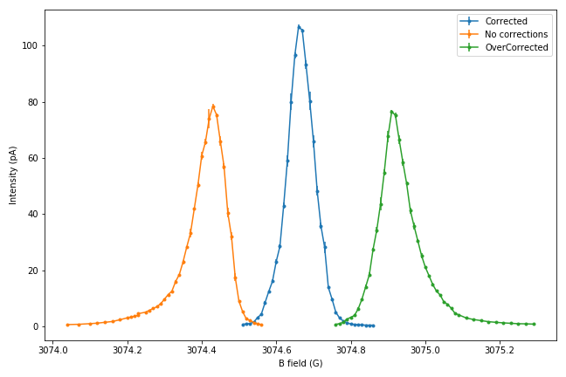
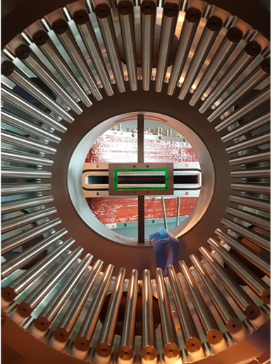
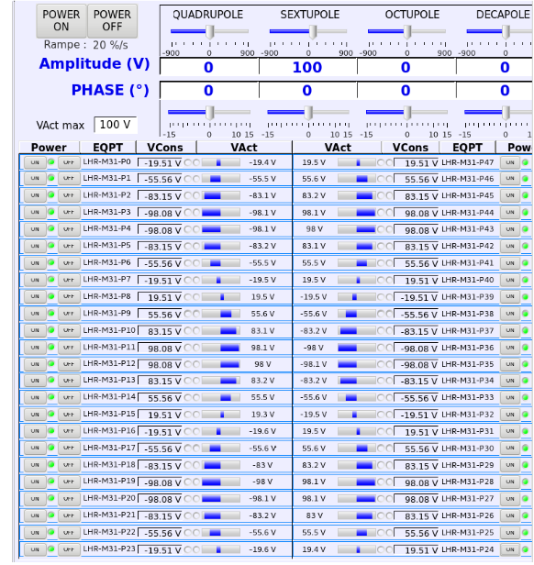
• • • High-resolution separator 2nd order correction measurements
¹³³Cs: 1mm x 1mm
-> Shifted left -0,2G
-> Shifted right +0,2G
Beam can be scanned with the dipoles through end slits to obtain a precise beam profile
Corrected
Not corrected
Overcorrected
48-rod
multipole
J. Michaud et al., NIMB 541 (2023) 161
J. Michaud et al., LP2iB & IJCLab

Slide 21


• • • High-resolution separator HRS: emittance meter
Front view: tantal mask
Side view:
Phosphore screen + MCP
Front view:
CCD camera
Pepperpot
emittance-meter
14/12/2024
J. Michaud et al., LP2iB & IJCLab

Slide 22


• • • High-resolution separator HRS: emittance figures
Experimental measurements correspond to simulations
2nd order aberrations can be observed with the emittance-meter
Order 3: Not by eye, but a computer could
Image analysis software under development
(A. Balana)
J. Michaud et al., NIMB 541 (2023) 161
J. Michaud et al., LP2iB & IJCLab

Slide 23

• • • High-resolution separator 2nd order correction measurements
¹³³Cs: 1mm x 1mm
-> Shifted left -0,2G
-> Shifted right +0,2G
Corrected
Beam (1mm x 1mm) can be scanned with the dipoles through exit slits to obtain a precise beam profile
Not corrected
Overcorrected
Pepperpot emittance figures
J. Michaud et al., LP2iB & IJCLab

Slide 24




• • • High-resolution separator 3rd order correction measurements
¹³³Cs: 1mm x 1mm
Beam (1mm x 1mm) can be scanned with the dipoles through exit slits to obtain a precise beam profile
Hard to see a change, but a computer should
J. Michaud et al., LP2iB & IJCLab

Slide 25







• • • High-resolution separator HRS: arbitrary waveform generator
COSY Infinity
$$∆V=2.5V$$
Period = 5
$∆V=2.5V$
Period = 5
Create custom beam contaminants
$∆V=0V$
Period = 1
$∆V=−5V$
Period = 0.2
The HRS can be commissioned in almost real operating conditions, with no radioactive beam and (relatively) high intensities
J. Michaud et al., NIMB 541 (2023) 243
J. Michaud et al., LP2iB & IJCLab

Slide 26


• • • High-resolution separator HRS: arbitrary waveform generator
COSY Infinity
COSY
¹⁰⁰Sn/¹⁰⁰In separation:
simulation and measurement
J. Michaud et al., NIMB 541 (2023) 243
J. Michaud et al., LP2iB & IJCLab

Slide 27
• • • High-resolution separator HRS: arbitrary waveform generator
COSY Infinity
To-do list:
shaping of exit (1st dipole) and entrance (2nd dipole) poles
➔ fixed hexapole corrections
optimising of 3rd and higher orders
implementation of automatic higher-order corrections
NMR measurement reliability improvement
¹⁰⁰Sn/¹⁰⁰In separation:
simulation and measurement
J. Michaud et al., NIMB 541 (2023) 243
J. Michaud et al., LP2iB & IJCLab

Slide 28





• • • Beam preparation: General purpose ion buncher GPIB
To-do list:
- Magnetof for energy dispersion (avoid efficiency issues)
- Transverse emittance measurements in bunching mode
- RF phase dependence for the bunches
- Bunching mode to be investigated in detail (energy vs time dispersion)
- Space charge effects
- coupling to HRS ?
Emittance:
$3 π$.mm.mrad at 30 keV
Continuous mode:
Transmission for K⁺ ions is routinely over 75 %
Careful optical tuning yields transmission >90 %
Bunching mode:
100 % transmission up to 10⁶ ions/bunch
$∼$ 50 % transmission with 10⁸ ions/bunch
Energy and time dispersion:
Energy dispersion measurement currently limited by detection
system (< 6 eV) ➔ Magnetof
Minimum time dispersion currently down to $≈$ 250 ns (FWHM) at 3 keV
M. Gerbaux, C. Roumegou et al., LP2iB
M. Gerbaux et al., NIMA 1046 (2023) 167631

Slide 29





• • • Beam purification: PIPERADE, 1st trap
First trap:
7T
³⁹K
Resolving power:
$$\frac{ν_{c}}{Δν_{c}} ∝ \frac{m}{Δm} ≈ 2×{10}^{5}$$
purification trap accumulation & measurement trap
P. Ascher et al., NIMA1019 (2021) 165857
P. Ascher, M. Flayol, D. Atanasov,
E. Rey-herme, G. Guignard et al., LP2iB

Slide 30





• • • Beam purification: PIPERADE, 2nd trap
accuracy: $\frac{Δm}{m}≈{9.5×10}^{−10}$
precision: $\frac{δm}{m}≈{3×10}^{−9}$
7T
$$ν_{c}=\frac{φ_{c}+ 2πn}{2πt}=\frac{qB}{2πm}$$
PI-ICR
accuracy: $\frac{Δm}{m} ∗5$
precision: $\frac{δm}{m} ∗40$
purification trap accumulation & measurement trap
P. Ascher et al., NIMA1019 (2021) 165857
P. Ascher, M. Flayol, D. Atanasov,
E. Rey-herme, G. Guignard et al., LP2iB

Slide 31








• • • PIPERADE: Mass measurement of ⁴¹K with ToF-ICR
$${}_{}^{39}{K^{+}}$$
$${}_{}^{41}{K^{+}}$$
$${}_{}^{39}{K^{+}}$$
$$ν_{c}= \frac{qB}{2πm}$$
measured with ³⁹K as reference
ToF-ICR of 1 s
P. Ascher, M. Flayol, D. Atanasov,
E. Rey-herme, G. Guignard et al., LP2iB

Slide 32








• • • PIPERADE: PI-ICR
position-
sensitive
MCP
$ν_{c}=\frac{φ_{c}+ 2πn}{2πt}$ = $\frac{qB}{2πm}$
${δν}_{c}=\frac{δφ_{c}}{2πt}$ $=\frac{δr}{2πrt\sqrt{N}}$
y_{d}
Cyclotron réduit
r
$$φ_{c}$$
x_{d}
Précision $\frac{δm}{m}≈{10}^{−8}$ à ${10}^{−10}$
Centre
Magnétron

Slide 33
• • • PIPERADE: PI-ICR
To-do list:
January 2025: diaphragm change for a smaller diameter hole
(reduction of gas leaking from PT to MT)
before moving to DESIR:
  systematic studies of ToF-ICR, impact of field imperfections
  (anharmonicities of E-field and fluctuations of B-field) on mass precision,
  mass-dependent errors, ion-ion interaction
  PI-ICR mass measurement and systematic studies
  (imperfections E/B fields + image distortion + extraction optimisation)
  PI-ICR cleaning: installation of an iris to select the ion of interest
  Buffer gas cooling technique: limits in terms of trapping times and
  investigation vs number of ions
if AC not OK at DESIR: pressure/temp stabilisation system to implement
commissioning at DESIR: all systematics to study again

Slide 34
• • •
Installation of experimental equipment

Slide 35




• • • Experimental equipment: time line
S2 - 2026: GPIB + PIPERADE + fluorescence laser line (LINO)
LINO
Beams
Id. Station
GPIB
Diag. box
PIPERADE

Slide 36


• • • Experimental equipment: time line
S1 - 2027: MORA cooler-buncher (RFQ)
RFQ (MORA)
LINO
Beams
Id. Station
GPIB
Diag. box
PIPERADE

Slide 37


• • • Experimental equipment: time line
2028: MORA completed, MR-ToF-MS, decay stations
End of 2028: RIBs available
MORA
LINO
Beams
Id. Station
GPIB
Decay station
MR-ToF-MS
PIPERADE
Decay station

Slide 38







• • • Experimental equipment: time line
2029: collinear laser spectroscopy (LASAGN) completed, MLLTrap
MORA
LASAGN
Id. /Decay
Station
Beams
GPIB
Decay station
MR-ToF-MS
PIPERADE
Decay station
MLLTRAP

Slide 39







• • • The DE_{sir}TRAP_{ping} facility
MORA
MLLTrap
P. Delahaye, GANIL, L. Hayen, X. Fléchard, LPC Caen
P. Thirolf, LMU Munich – E. Minaya Ramirez, IJClab
RFQ-CB associated with a Paul trap
-> β-ν angular correlation coefficient
-> D correlation with laser polarized beams
Double Penning trap
-> high precision mass measurements
-> in-trap decay
e⁻ pixel
detector
E. Minaya-Ramires et al., NIM B 463 (2020) 315
P. Chauveau et al., NIMB 463 (2020) 371
P. Delahaye et al., Hyperfine Interaction 240 (2019) 63
Nuclear structure & Decay properties
  shell evolution, deformation
  (super-) heavy nuclei decay spectroscopy
Commissioning at ALTO (IJCLab)
Fundamental interaction physics
  exotic currents, CVC, V_{ud}, CP-violation
Commissioning at JYFL

Slide 40



• • • The LUMIERE facility
Laser Utilization for Measurement and Ionization of Exotic Radioactive Elements
LASAGN (L. Lalanne, IPHC)
Collinear laser spectroscopy (CRIS like)
  -> hyperfine structure (magnetic and quadrupole moments, mean square charge radii)
LINO commissioned at ALTO, IJCLab, D. Yordanov et al.
LINO
MT, FC
IR
DP
IU
CRIS

Slide 41











• • • The BESTIOL facility
BEta decay STudies at the SPIRAL2 IsOL facilty
Beam cooling and purification using PIPERADE for (trap-assisted) decay spectroscopy
-> High-precision measurements with ultra-pure samples for
fundamental interaction, nuclear structure, nuclear astrophysics etc
β-γ decay stations (BEDO, …)
total absorption spectrometers (DTAS)
neutron detection arrays (BELEN, MONSTER, …)
electron and proton detection (COeCO, SiCube, b-STILED
recoil detection (ASGARD)
for
CVC, V_{ud}
beta shapes
lifetimes, P_{(2)n}
exotic decays (β-2p, cluster emission)
Gamow-Teller strength
BELEN
ASGARD
SiCube
COeCO
BEDO
b-STILED
MONSTER
DTAS

Slide 42

• • • DESIR C/C
L. Daudin et al.

Slide 43




• • • The DESIR building
Building delivery: September 2025
October 2025 to September 2026: Beam line & experiment installation
June 2026 to January 2027: Cabling
October 2026 to June 2027: Technical commissioning
March to October 2027: Stable beam commissioning
November 2027: Facility ready for radioactive beams

Slide 44




• • • DESIR construction
HRS room
DESIR hall
Thermal isolation of roof
Soil refilling

Slide 45
• • • DESIR time line
… 2018 2019 2020 2021 2022 2023 2024 2025 2026 2027 ...
DECRET
Autorisations administratives
MSNR (ASN et AE)
Décret
Autorisation de modification INB 113
DAM
Enquête Publique
Autorisation de mise en service
DMES
Décision ASN
Dépôt DMES
Décision ASN
Bâtiment et infrastructures
Etudes et consultation des entreprises
Construction
Non-conformité Bâtiment
PC
Réception
Procédés (PRO-F,
-E, -SE,
-SYS, -SNC)
Conception, fabrication et qualification technique
Décision ASN
Installation / mise en service
Moyens communs

Slide 46

• • •
Thanks for your attention

