Slide 1


Coordination panel meeting
iSAS project
4th September, 2024

Slide 2
iSAS Coordination panel meeting
Agenda
Agenda items:
Advisory Board mandate starting
Consortium agreement in progress
Padova meeting in March
Amendment to include Nikhef (and maybe Polish & Latvian partners as well)
Preparation of the Governing board meeting
ADMIRE Linac
AOB
Notes will be found in the Indico page
iSAS project Indico page

Slide 3
iSAS Coordination panel meeting
Advisory Board mandate starting
Welcome meeting
20th September at 10 am CET
Mandated: Roberto Losito
Eugenio Nappi
Maxim Titov
To propose: A new Advisory Board member for the Governing Board to endorse?

Slide 4
iSAS Coordination panel meeting
Consortium agreement in progress
Comments & questions phase until Governing Board meeting
9th September to validate signatures phase
CA: Beneficiaries
Associate partners
Industrial partners?
NDA: Industrial partners to be integrated later in the project?

Slide 5
iSAS Coordination panel meeting
Padova meeting in March
Context:
LNL, INFN, Padova, 3 days in-person meeting in March 2025 (including travel)
Which week? (1st week to be avoided if possible) from Wednesday to Friday 3 options
Which objectives?
Advisory Board & Governing Board organised at the same time? Industry Board?
Visit of LNL to anticipate?

Slide 6
iSAS Coordination panel meeting
Amendment to include Nikhef…
The iSAS Scientific Coordinator Jorgen D'Hondt has been promoted as Nikhef Director
Transition from VUB in Brussels to Nikhef in Amsterdam to be handled
Including Nikhef means an amendment to the Grant Agreement
To be confirmed with all partners

Slide 7
iSAS Coordination panel meeting
… and Polish & Latvian partners as well
IFJ PAN (Kraków, Poland) & RTU (Riga, Latvia)
Context
Amendment to the project expected around November 2024 to integrate Nikhef, the Polish & Latvian partners have been interested for a long time, and the amendment is an opportunity to integrate them as well
Which roles/tasks to allocate ?
Andris Ratkus from RTU & Dariusz Bocian from IFJ PAN will present their proposal to the Governing Board 9th Sept after discussions with WP Leaders involved
To be discussed & hopefully endorsed by Governing Board

Slide 8
iSAS Coordination panel meeting
Preparation of the Governing board meeting
Objectives proposed
To guide iSAS choices as a collective, to arbitrate on legal & strategic pending matters such as questions around the CA & new partners joining the project
Agenda items (tbc)
  Project brief status report: based on 1 slide per WP from M5 updates & global work plan
  Advisory Board members welcome into the project
  Consortium Agreement (CA)
    From comments phase to signature phase
    Integration of industrial partners into the project via the CA, the Governing Board & the Industry Board
  Decision on the integration of 3 new partners: Nikhef (The Netherlands), IFJ PAN (Poland), RTU (Latvia)
  Have been invited to participate as guests: Dariusz Bocian (IFJ PAN), Andris Ratkus (RTU) & Toms Torims (CERN)
  Which roles/tasks to allocate?

Slide 9
iSAS Coordination panel meeting
ADMIRE Linac
Jorgen D’Hondt
Presents

Slide 10
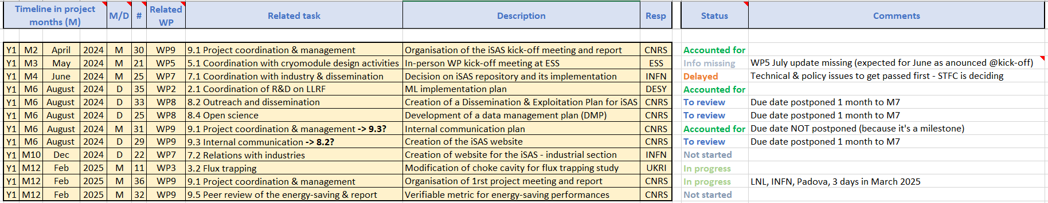
iSAS Coordination panel meeting
Work plan
Up to date with Milestones & Deliverables status by timeline for the 1st project year:

Slide 11
Thank you!

