Slide 1
iSAS Governing Board meeting
9th September, 2024

Slide 2
iSAS Governing Board meeting
Agenda
Objectives
To guide iSAS choices as a collective, to arbitrate on legal & strategic pending matters such as questions around the CA & new partners joining the project
Agenda items
Project brief status report
Advisory Board members welcome into the project
Consortium Agreement (CA)
From comments phase to signature phase
Integration of industrial partners into the project via the CA, the Governing Board & the Industry Board
Decision on the integration of 3 new partners: Nikhef (The Netherlands), IFJ PAN (Poland), RTU (Latvia)
Which roles/tasks to allocate?
Padova meeting in March 2025
Notes will be found in the Indico page
iSAS project Indico page

Slide 3
iSAS Governing Board meeting
The iSAS project
With the ambition to maintain the attractiveness and competitiveness of European RIs, and enable Europe’s Green Deal, the Innovate for Sustainable Accelerating Systems (iSAS) project has been approved by Horizon Europe. Its aim is to establish an enhanced collaboration in the field to broaden, expedite and amplify the development and impact of novel energy-saving technologies to accelerate particles. (…)
To save energy from RF power systems, novel fast-reacting tuners are being developed to compensate rapidly for detuning of the cavity’s frequency caused by mechanical vibrations, and methods are being invented to integrate them into smart digital control systems.
To save energy from the cryogenics, and based on the ongoing Horizon Europe I.FAST project, superconducting cavities with thin films of Nb3Sn are being further developed to operate with high performance at 4.2 K instead of 2 K, thereby reducing the grid-power to operate the cryogenic system. The cryogenic system requires three times less cooling power to maintain a 4.2 K bath at 4.2 K when heat is dissipated in the bath compared to maintaining a 2 K bath at 2 K.
Finally, to save energy from the accelerated particle beam itself, the technology of energy recovery linacs (ERLs) is being improved to operate efficiently with high-current beams by developing novel higher-order mode dampers that significantly avoid heat loads in the cavities.
Implementation of technologies in the design of a new energy-saving cryomodule (parametric design)
Implementation of technologies in current and future research infrastructures accelerator
Implementation of technologies into industrial solutions
Source: CERN Courier, July/August 2024

Slide 4
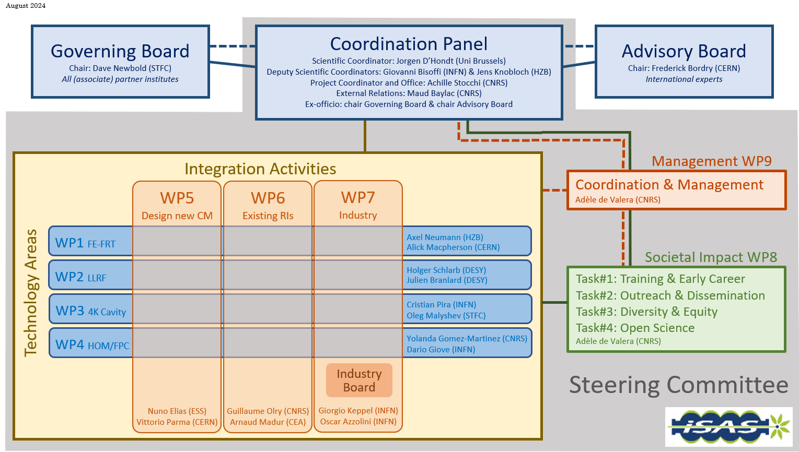
iSAS Governing Board meeting

Slide 5
iSAS Governing Board meeting
iSAS organisation
The Coordination panel, who leads the scientific coordination of the project, meets every 6 weeks
Every other meeting becomes a Steering committee to review WP progress in cross-coordination with WP Leaders & Deputies, every trimester
The following slides sum up in 1 slide per WP (so very briefly) the last WP feedback updates received since the kick-off meeting, with particular focus on milestones, deliverables & status report:

Slide 6
iSAS Governing Board meeting
WP1 - Ferro-electric fast reactive tuners
Since the kick-off meeting at IJCLab, WP1 has worked on the following:
Exchange of personal is going to start latest after the summer vacation period with an engineer from HZB visiting CERN
High voltage break-down measurements with ferro-electric samples using the setup of Walter Wuensch’s group at CERN are pushed forward by fabricating holding cathode/anodes for the teststand
Exchange on the RF design of FE-FRTs so far mainly between CERN and HZB started
An integrated and combined project plan between mainly HZB and CERN will be put together soon
The commissioning and first characterizations of the FE ceramics with the new teststand for 1.3 GHz has been started at HZB in June/July this year

Slide 7
iSAS Governing Board meeting
WP2 - Low level RF controls
Coordination of R&D on LLRF
Machine learning implementation plan
Providing the roadmap to achieve D2.2. "ML-based MC": Machine Learning based Microphonics Compensation
Deliverable: ML implementation plan (WP2 D#35) Accounted for

Slide 8
iSAS Governing Board meeting
WP3 - Nb3Sn-on-Cu films for 4.2-K cavity operation
Flux Trapping
A design of a new sample holder that will accommodate Hall probes is ongoing
Tunability
Design of adapter for blade tuner
Adaptive Layers
Coating systems ready for first planar sample deposition. Substrate polishing in progress
Working Cavity
1.3 GHz Coating systems in the commissioning phase (part of the I.FAST program)
Milestones: Modification of choke cavity for flux trapping study (WP3 M#11) due month 12

Slide 9
iSAS Governing Board meeting
WP4 - Higher-order mode dampers & fundamental power couplers
Task 4.2: HOM coupler design
Design of 800 MHz HOM coupler to be used in the WP6 are on going (CNRS – IJCLab). At the meeting on 25 June, Patricia Duchesne (IJCLab) gave a presentation of the work carried out (EM simulation, RF designs,..). Some optimization and studies are going to be improved
Task 4.5: 800 MHz FP coupler design
All the partners agrees about who is in charge for each component.
To note: No partner is in charge of the double walls tubes (cuffs) for the RF coupler. CERN and IJCLab are working together to find a solution. Technical solution and cost estimate under progress by CERN. Funding has to be found
The definition of the final RF coupler specification is on going

Slide 10
iSAS Governing Board meeting
WP5 - Integration into a new LINAC cryomodule
Milestone reporting delay
No feedback update received recently (since kick-off)
Expected for June as announced at the kick-off meeting:
“Preparations of M 5.1: In-person meeting at ESS; 2-day Meeting ~first week of June (3-4 June)”
Milestones: In-person WP kick-off meeting at ESS (WP5 M#21) Info missing

Slide 11
iSAS Governing Board meeting
WP6 - Integration into accelerator (PERLE) & collider RIs
Cavities
Technical specifications for the Niobium material:
Sent to the CNRS procurement department and validated. Published: July 17th. Tender submission deadline: Sept 17th
Technical specifications for the cavities:
On going iterations between our procurement department and CNRS. Publication not before October 1st

Slide 12
iSAS Governing Board meeting
WP7 - Integration into industrial solutions
iSAS Repository host at STFC?
It has been difficult for policy and technical reasons:
The SharePoint host would have to be willing and able to provide access to external, including non-academic users (specifically industrial associate partners)
iSAS website - industrial section
A iSAS website task force will be created soon to:
Phase 1: create a finalized skeleton (layout design) until around mid-October
Phase 2: create the added contents
Industry Board
1st Industry Board to be held end September/early October
Milestones: Decision on iSAS repository and its implementation (WP7 M#25) Delayed
Deliverables: Creation of website for the iSAS - industrial section (WP7 D#22) due month 10

Slide 13
iSAS Governing Board meeting
WP8 – Societal impact
Postponed for participation reasons:
Postponed until M7 to facilitate wide participation, that summer months do not allow
Deliverables: Development of a data management plan (DMP) (WP8 D#25) due month 7
Creation of a Dissemination & Exploitation Plan (WP8 D#33) due month 7

Slide 14
iSAS Governing Board meeting
WP9 – Management & Coordination
Task 9.1: Project Coordination and Management
Consortium agreement questions asked, ready for signature process
Task 9.2: Scientific Coordination
Coordination panel every 6 weeks, and every other meeting becomes a Steering committee with WP Leaders & Deputies
3 Advisory Board members mandated (Roberto Losito, Eugenio Nappi, Maxim Titov), 1 proposed for endorsement (tbd)
Welcome meeting 20th September
Task 9.3: Internal communication
Internal communication plan accounted for
Deliverable postponed until M7 to facilitate wide participation, that summer months do not allow
Deliverables: Creation of the iSAS website (WP9 D#29) due month 7
Milestones: Internal communication plan (WP9 M#31) accounted for

Slide 15
iSAS Governing Board meeting
Work plan
Up to date with Milestones & Deliverables status by timeline for the 1st project year:

Slide 16
iSAS Governing Board meeting
Advisory Board members welcome into the project
Welcome meeting
20th September at 10 am CET confirmed
Mandated: Roberto Losito
Eugenio Nappi
Maxim Titov
Declined: Caterina Biscari
To discuss: A new Advisory Board member for the Governing Board to endorse?

Slide 17
iSAS Governing Board meeting
Consortium agreement (CA) in progress
Comments & questions phase
Until 9th September
Guest participant
Julie Gendron (CNRS)
To validate signatures phase?
To clarify: integration of industrial partners into the project via the CA, the Governing Board & the Industry Board

Slide 18
iSAS Governing Board meeting
Decision on the integration of 3 new partners
Nikhef (The Netherlands)
Riga Technical University (RTU) (Latvia)
Institute of Nuclear Physics (IFJ PAN) (Poland)
Have been invited to participate as guests
Andris Ratkus (RTU) & Toms Torims (CERN), Dariusz Bocian (IFJ PAN)
Which roles/tasks to allocate?
Amendment to integrate them (if validation from Governing Board) finalised around November

Slide 19
iSAS Governing Board meeting
Padova meeting in March 2025
Context
Hosted at LNL, INFN, Padova
2 options:
From Wednesday 12th to Friday 14th (including travel)
From Wednesday 19th to Friday 21st (including travel)
Proposal: Advisory Board, Industry Board & Governing Board organised at the same time
Visit of LNL to anticipate

Slide 20
Thank you!

